Slide 1
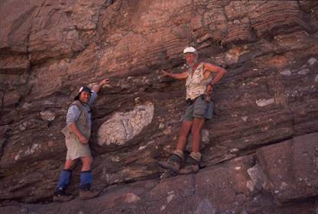
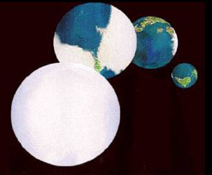
Past Glaciations and a Snowball Earth?
GEO101
Spring 2023

Slide 2
Contents
Recent climate indicators
Paleoclimate Indicators
The Long-term Glacial Record
Snowball Earth?

Slide 3
Recent climate Indicators
“Paleoclimates” = past climates
To reconstruct them, we need indicators
Today, we focus on glaciations.
Recent cold glacial climates:
#1 tills: unconsolidated, unsorted deposits,
deposited on land at edges and under glaciers
#2 striations: scratches/grooves
glaciers are heavy!

Slide 4
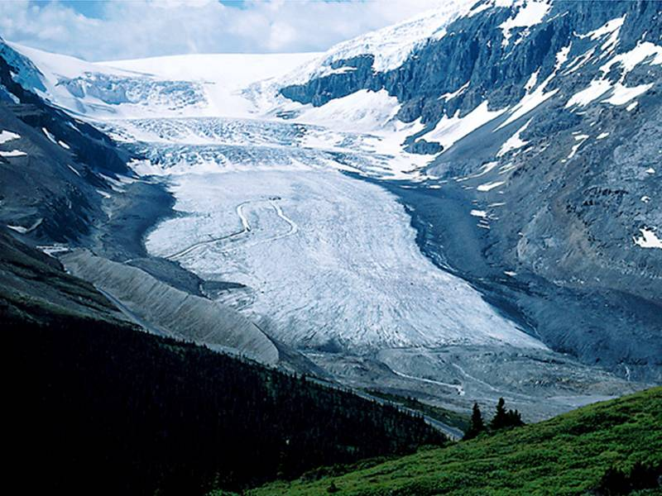

Slide 5
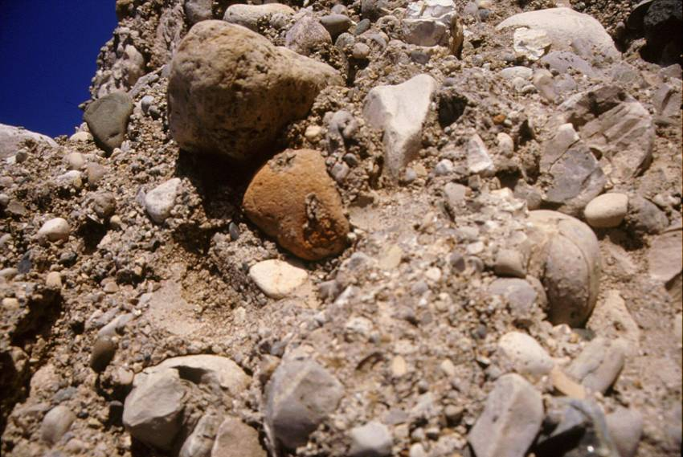
Tills

Slide 6
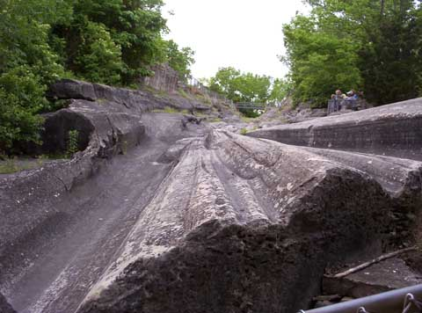
Striations
Ohio

Slide 7
Recent climate Indicators
#3 dropstones:
stones in unconsolidated, sorted sediment
stones fall onto glacier,
glacier reaches water,
an iceberg “raft” breaks off,
stone dropped into fine-grained
sediment of the lake.

Slide 8
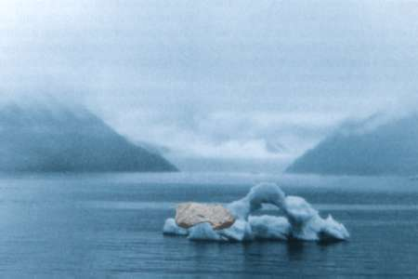
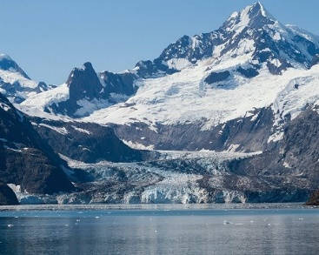
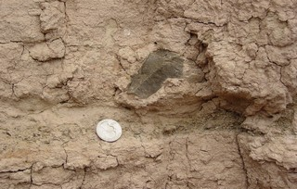

Slide 10
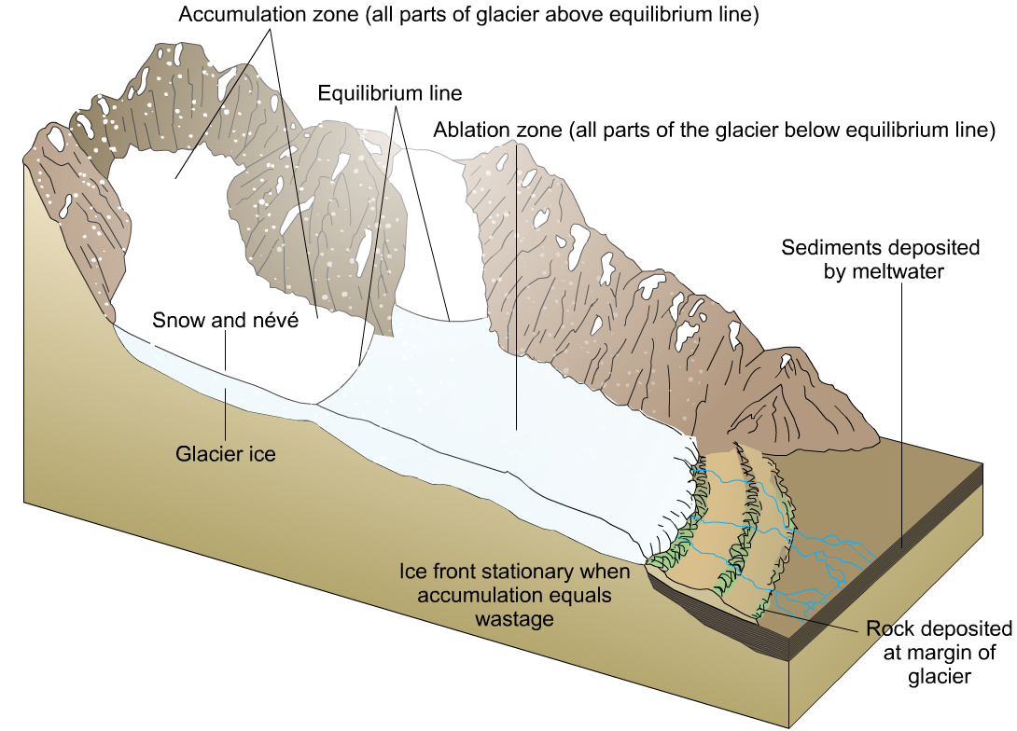
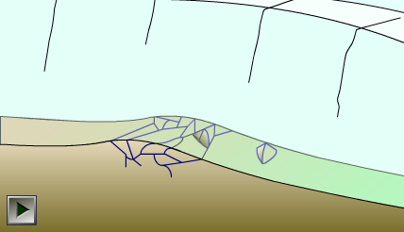
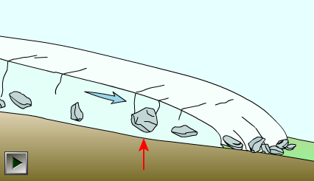
The process of plucking
The formation of the terminal moraine

Slide 11
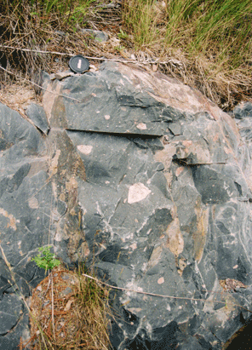
Paleoclimate Indicators
Ancient cold glacial climates:
similar evidence, but consolidated.
tillite: unsorted till gets compressed;

Slide 12
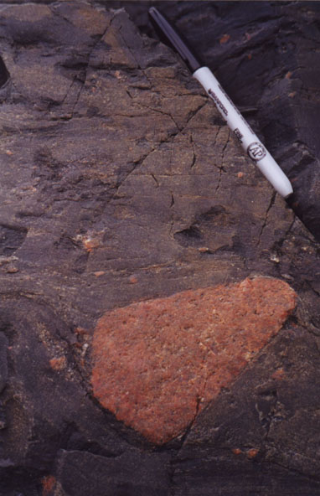
Ancient cold glacial climates:
dropstones in fine-grained sediment

Slide 13
Paleoclimate Indicators
Fossils reflect climate.
Macrofossils (multi-cellular)
e.g. elephant (warm) vs. mammoth (cold)
Microfossils (single-celled)
e.g. different diatom species

Slide 14
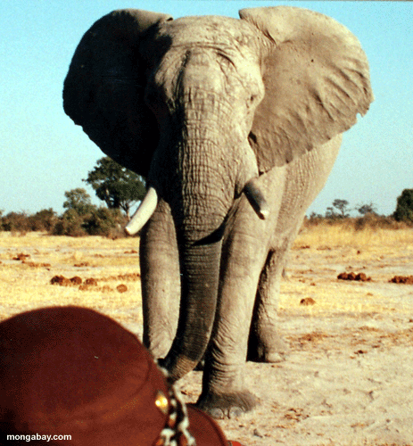
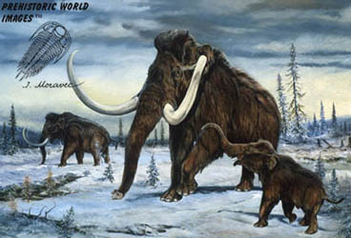

Slide 15
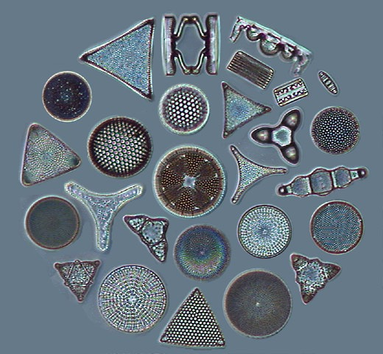
Diatom species: triangle or circle shapes

Slide 16
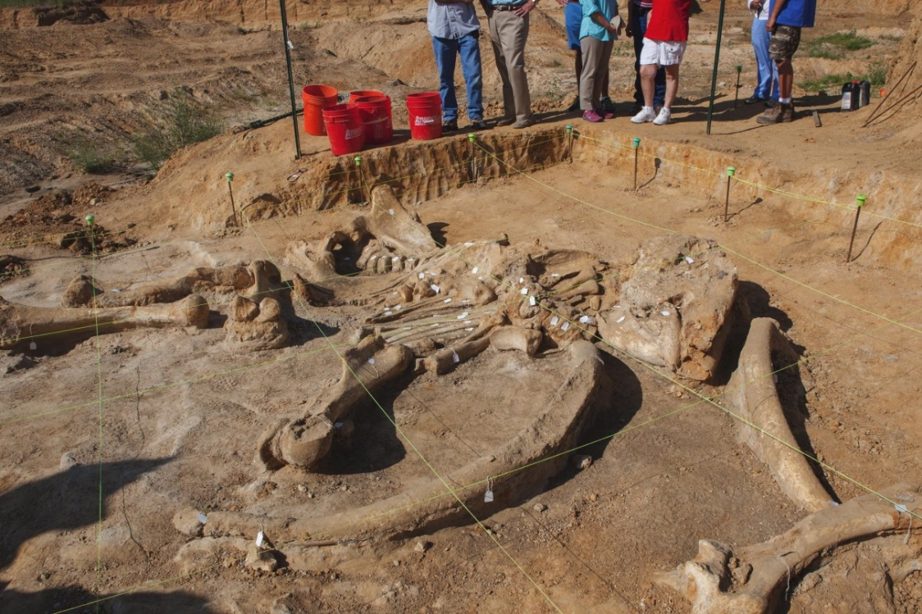
Fossils found in recent unconsolidated sediments or ancient consolidated sedimentary rocks.
[Mammoth skeleton in unconsolidated deposits in Ellis County, Texas]

Slide 17
Paleoclimate indicators
Stable isotopes: relative abundances
Recall that ¹²C vs. ¹³C indicates rates of photosynthesis
¹⁶O and ¹⁸O can indicate temperature changes.

Slide 18
The Long-Term Glacial Record
Five major “glaciations”
(permanent ice sheet on Earth)
1st – oxygen
2nd – continental arrangement
3rd – South Pole
4th – coal
5th – Himalayas and currents
The third one is obvious.

Slide 19
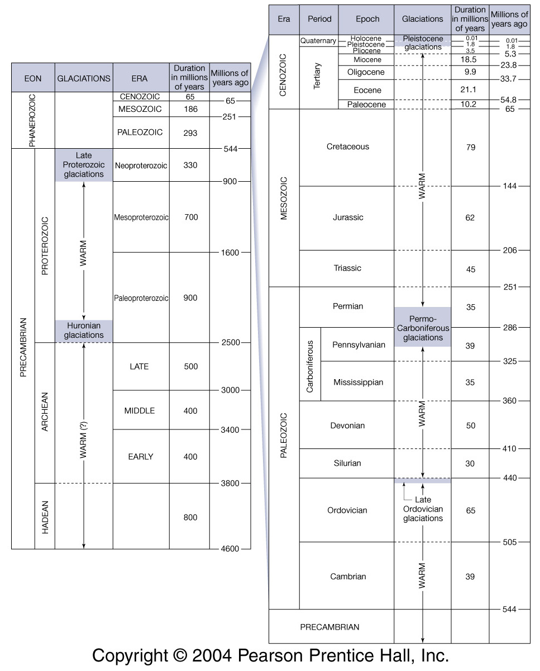

Slide 21
The Long-Term Glacial Record
2.4 billion years ago = 1st glaciation [Huronian]
evidence: tillites and dropstones in sedimentary rocks
Oxygen scarce beforehand.
BIFs below glacial deposits, redbeds above deposits.
cause? Rise of O₂, oxidation of CH₄, and creation of CO₂
CH₄ is ~30x stronger GHG.
Glaciation ends: feedbacks!
Silicate weathering slowed as rocks were covered in ice, less CO₂ removal from atmosphere.
volcanic GHGs still added GHGs.

Slide 23
Snowball Earth? (glaciation #2)
700 million years ago [late Proterozoic, at the end of Precambrian Eon], before multi-cellular Eukarya (600 million years ago)
Two super-continents arranged along Equator prior to the glaciation.
Evidence:
Ancient glacial deposits (tillites, striations, and dropstones) on all continents
e.g. tillite in Australia.

Slide 25
Snowball Earth
What caused the snowball Earth?
rapid silicate weathering (tropical) removed CO₂ from the atmosphere ↓
Carbonate reefs in shallow water around continents removed even more CO₂ from atmosphere.
Short coastline at the beginning, as super-continents split up, more coastline means more C removal from atmosphere.
Polar ice-caps formed.
Ice–albedo positive feedback resulted in snowball Earth.

Slide 26
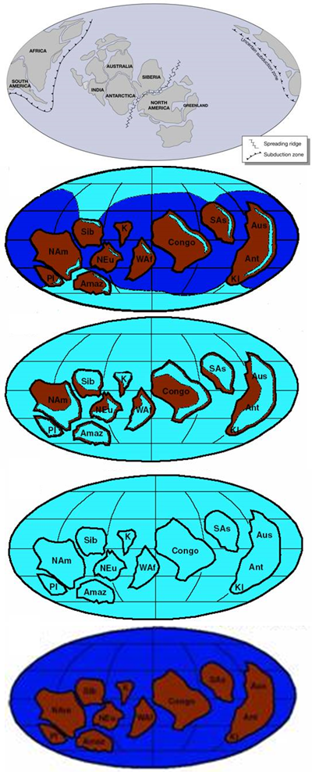

Slide 27
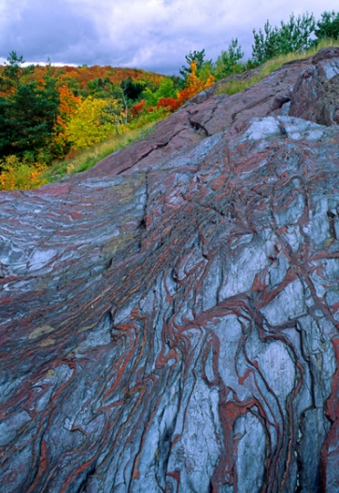
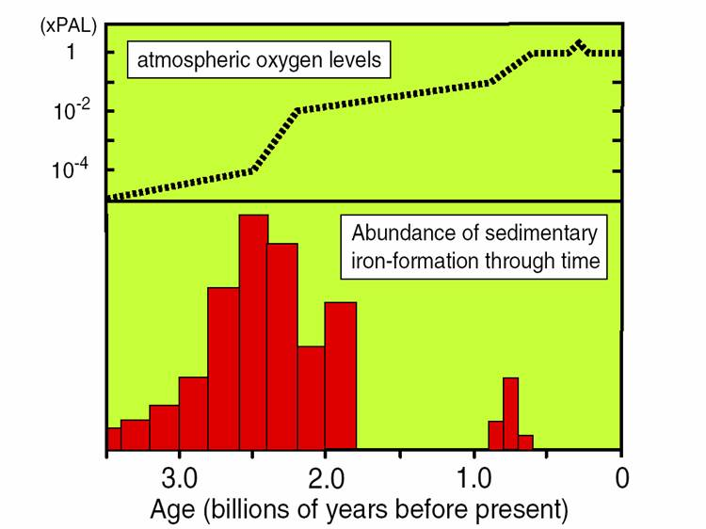
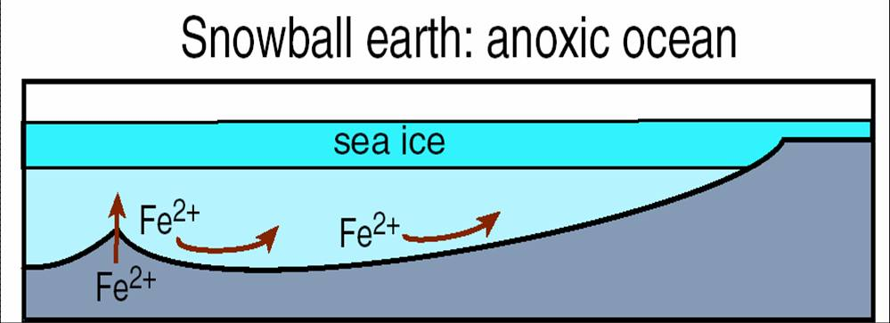
Evidence for Snowball Earth? More BIFs!
Recall: if low O₂ , Fe²⁺ remain dissolved.
During that period, lots of O₂ in atmosphere,
but ice stopped O₂ from getting into ocean.
Fe²⁺ from undersea volcanoes,
+ light through ice at Equator for photosynthesis
= oxidation of Fe²⁺
Ishpheming MI

Slide 28
Snowball “melted”, because of the same reasons as Huronian glaciation.
Post-Snowball: rapid warming and reef carbonates formed again. Thick layer of carbonates on top of deposits. They only form in tropical areas.
However, continents shifted, less coastlines in tropics.

Slide 29
How did life survive the Snowball?
All are single-celled ocean life.
How can they survive global ice cover?
Option #1 – by volcanic vents?
okay for chemosynthetic organisms.
but, DNA shows that photosynthetic life survived.
Option #2 – Thin Equatorial ice?
would allow light for photosynthesis,
and O₂ for BIFs!

Slide 30
