Slide 1
Recent warming
GEO101
Spring 2023

Slide 2
Contents
Review of past temperature record
Types of temperature records
Calibration of indirect records
Has it really been warming?
Causes of warming
Temporal variations in warming
Completing the picture

Slide 3
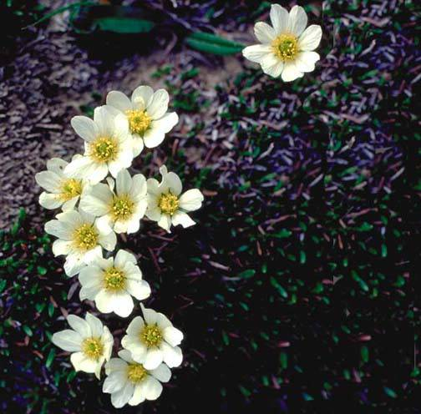
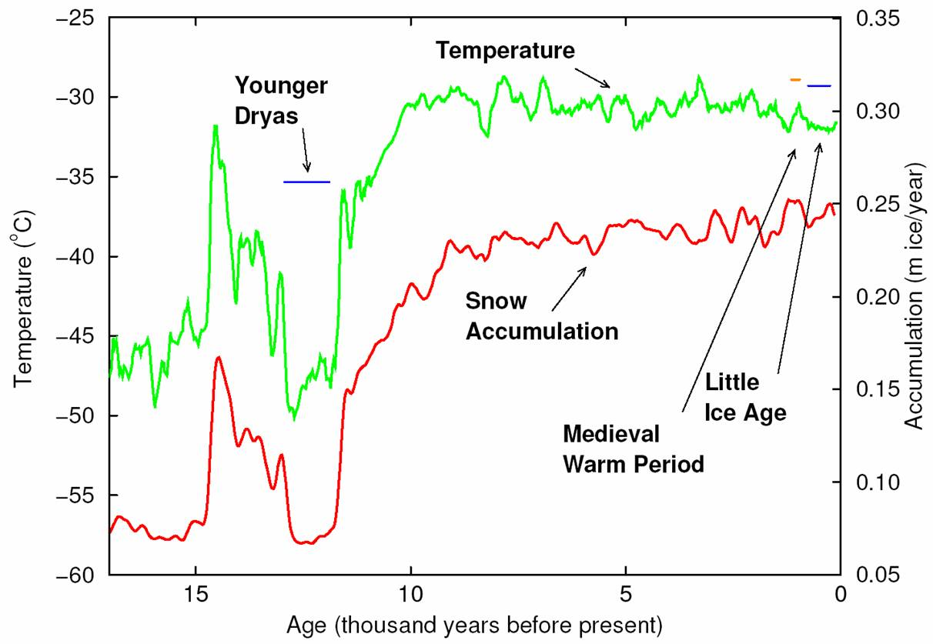

Slide 4
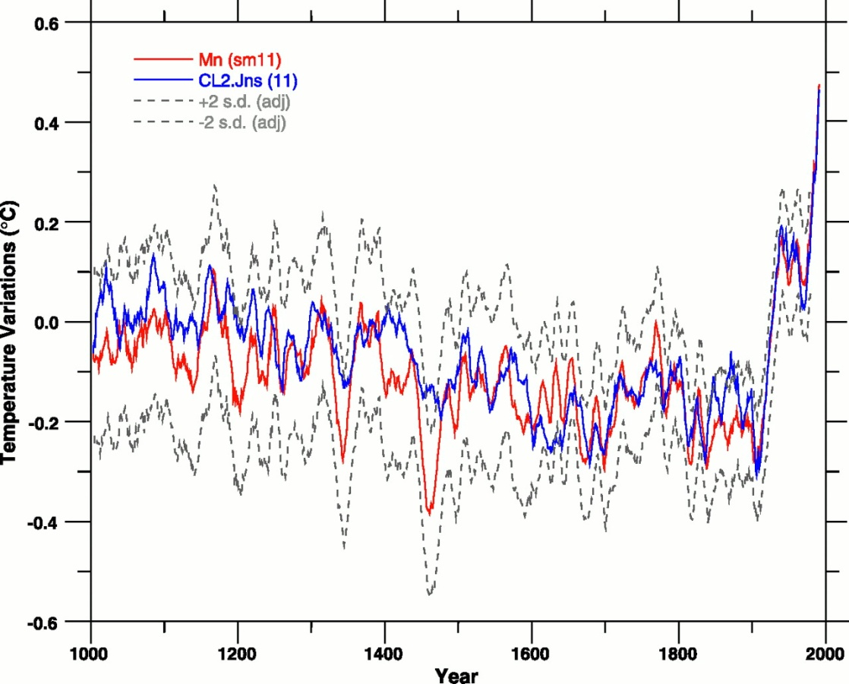
last millennium (1000-2000 CE):
#1 “Medieval Warm” 1000-1400 CE
(similar to 1960s and 1970s)
#2 “Little Ice Age” 1400-1850 CE
Glaciers ran over towns.
#3 warming since 1850 CE
#4 1940s, 1980s, 1990s warmest

Slide 5
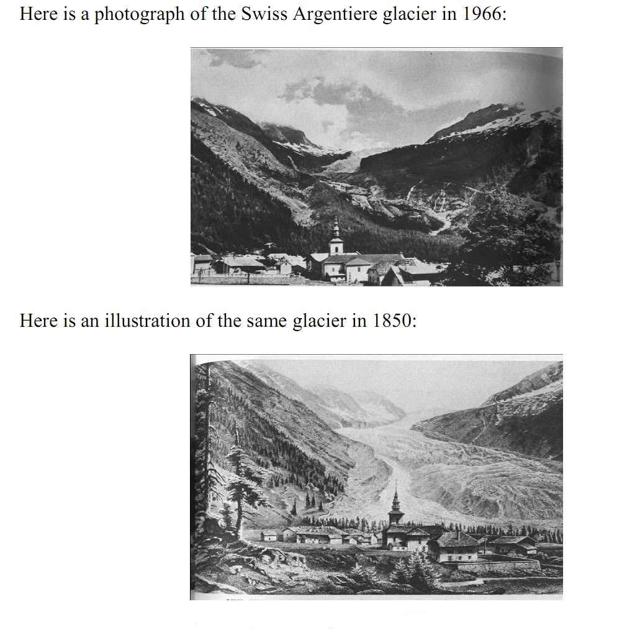

Slide 6
Types of Temperature Records
two types: Instrumental (direct) and indirect records
Galileo in 1593; glass spheres w/ weighted tags
  Colder, denser surrounding liquid. Balls rise.
  Warmer, less dense. Balls sink.
  Provides relative changes
Fahrenheit in 1714
  Mercury expands and contracts
Mercury thermometers widespread by mid-1800s

Slide 7
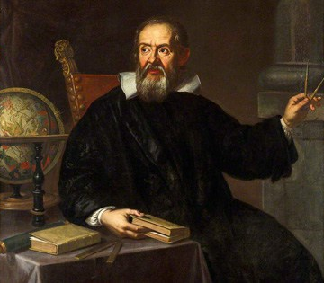
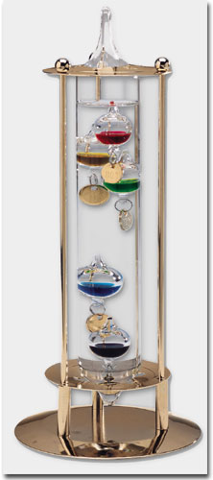
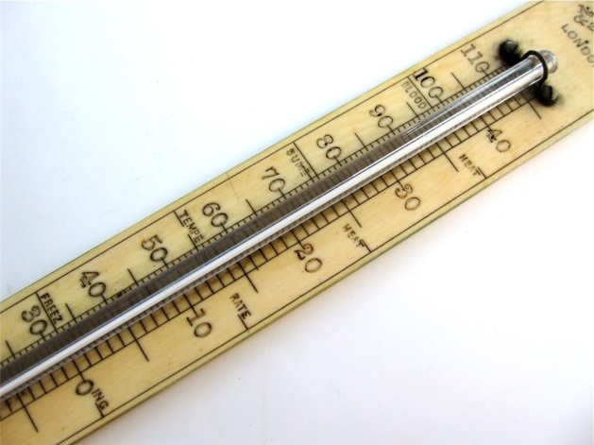

Slide 8
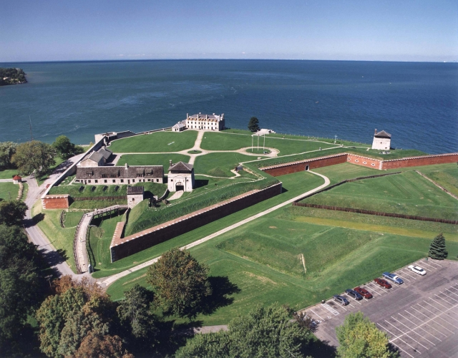
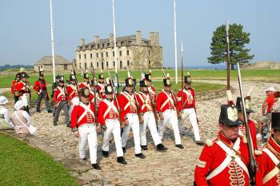
Temperature record starting in Fort Niagara in 1820

Slide 9
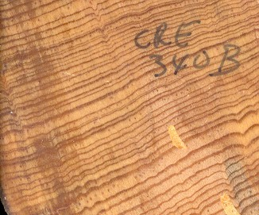
Types of Temperature Records
Indirect temperature records from something natural
  best: annual resolution
Trees have annual growth-rings
  best: temperature-stressed environment

Slide 10
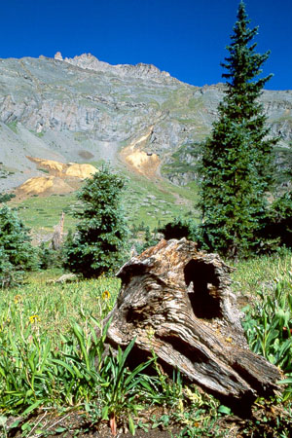
treeline

Slide 11
Types of Temperature Records
Glacial ice has annual layers.
  resolution: oxygen isotopes (decadal or more)
Corals have annual layers.
  x-rays for annual layers and oxygen isotopes in calcium carbonate (CaCO₃) skeleton.

Slide 12
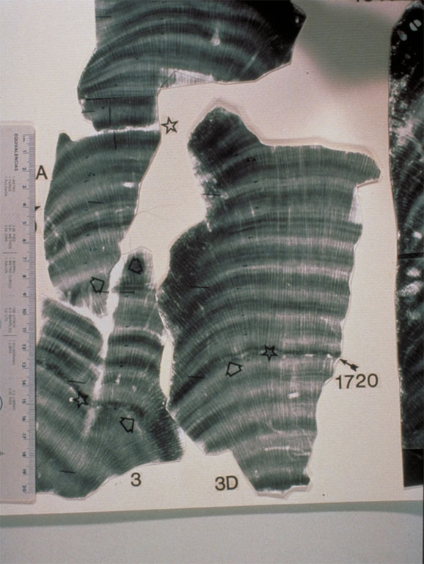
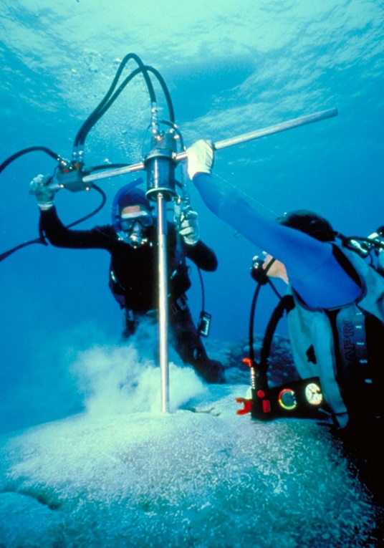

Slide 13
Types of Temperature Records
annual, indirect records worldwide
locations: mostly in N. hemisphere
  goal: as many areas of the world as possible
Records related to temperature:
  120 record going back to 1800 CE
  12 going back to 1000 CE (less geographic detail, all continents except Antarctica)
A more recent study obtained more records for further back.

Slide 14
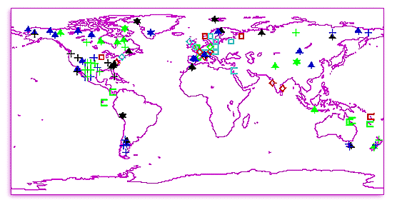
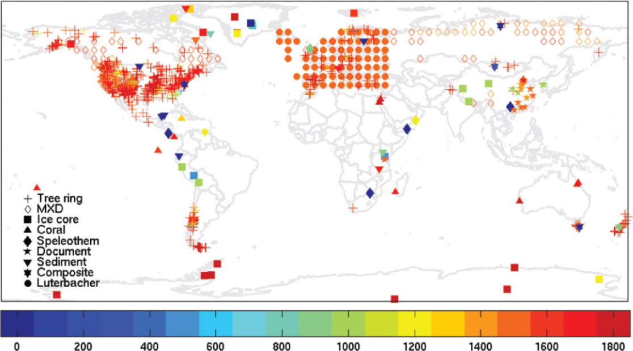

Slide 15
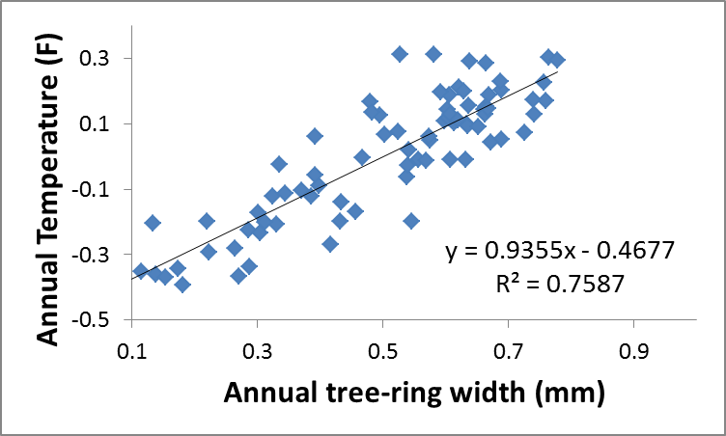
Calibration of Indirect Records
“Calibration”: statistical relationship between instrumental records and the indirect records.
e.g., annual tree-ring widths
  Buffalo trees vs. trees near “tree-line”

Slide 16
relationship between X and Y
  X (tree rings) vs. Y (temperature)
  (opposite of the causal relationship)
Calibration done for overlapping period
[useful relationship by R²]
“inference”: apply equation to older, indirect data

Slide 17
Calibrate the indirect record to see its usefulness
Instrumental records grouped into grids (prevent spatial bias)
Instrumental records back to 1902 or 1850 CE
instrumental vs. inferred records
  Given a value for indirect record, use equation to infer past temperature.
  Small annual variations match.
  well-calibrated, which supports using indirect data to infer past temperature.

Slide 18
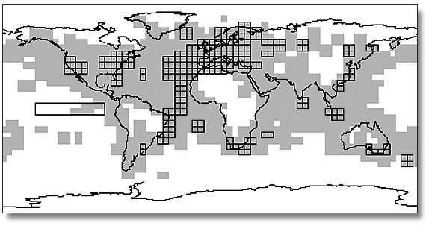
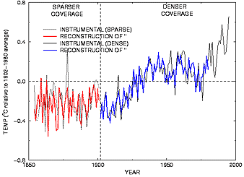

Slide 19
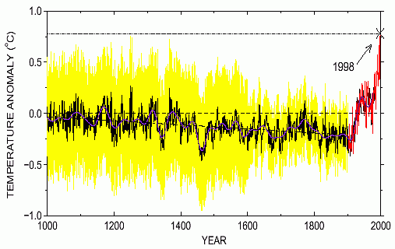
Has it Really Been Warming?
1,000-year climate record
non-scientists critique:
  “hockey-stick” curve;
  of course not natural…!
Indirect records exhibit cooling
Thermometer records warming
  Are they biased?
annual temperatures since 1880
  fairly steady warming
rate: 0.067°C (0.12°F) / decade since 1880
0.16°C (0.28°F) / decade since 1975
2016 ranked #1 hottest

Slide 20
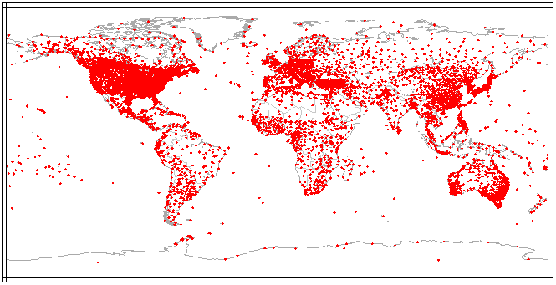
How to create a global record?
  thousands of point-locations.
  A Stevenson screen shields the thermometer, standardizes measurements.
  daily average = (high + low) / 2
  annual average = all dailies / 365

Slide 21
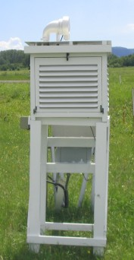
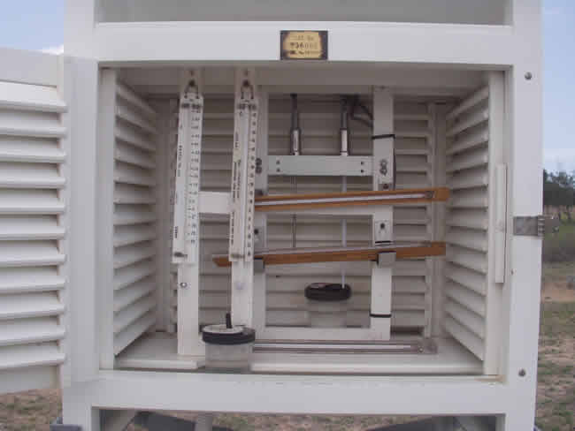

Slide 22
global average:
  not simple average
  average of average T in grid-cells [grid: 5° latitude x 5° longitude]
  # of records in a cell varies.
  Grids eliminate spatial bias that would occur from over-representing areas with many thermometers.

Slide 23
Urban Heat Island
urban areas warmer than surroundings
causes: many machines, dark dry surfaces.
urbanization since pre-1880,
  Most thermometers in the urban area
  UHI effect biasing global record?

Slide 24
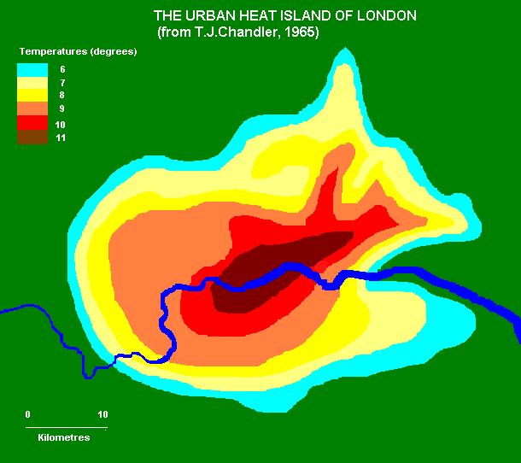

Slide 25
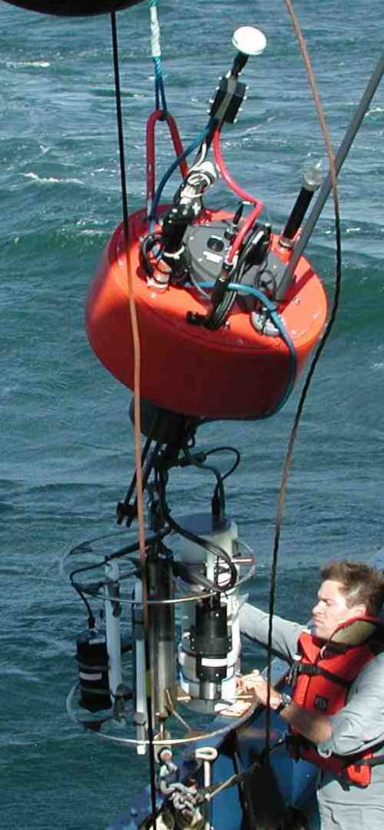
Has it Really Been Warming?
Ocean surface record.
  Earth’s surface: 70% water
records since 1800s:
  surface water temperature
  by commercial and military boats
  mostly along trade routes
  now: automated buoys

Slide 26
Has it Really Been Warming?
Ocean vs. land warming rate: ocean slower [1/2].
Reasons:
  light penetrates deeply
  mixing of water
  “specific heat”
Thus: warming is global, not artifact of UHI

Slide 27
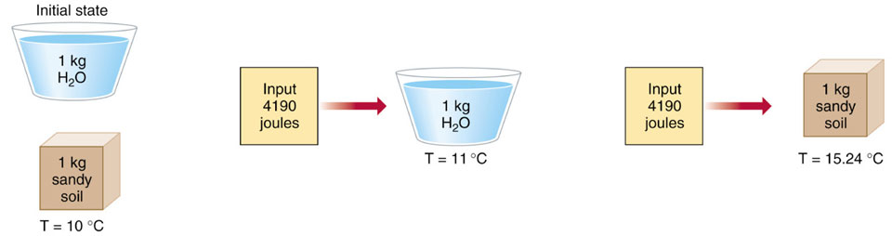

Slide 28
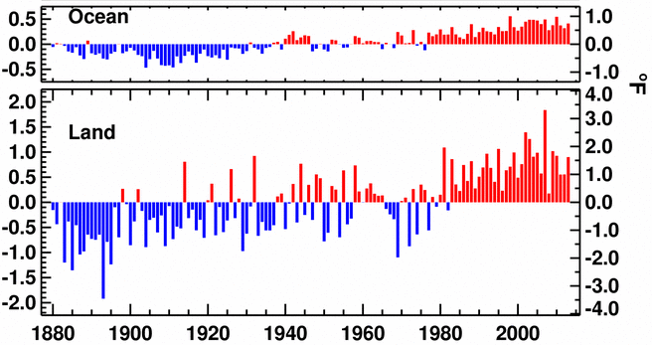

Slide 29
Has it Really Been Warming?
Satellite record since 1979
troposphere: the lowest 16 km (10 miles), mixed by convection and where GHGs collect heat
(exactly mid-troposphere: 3-10 km (2-6 miles)
no spatial bias: throughout troposphere across the globe.
Improvement over just surface points.

Slide 30
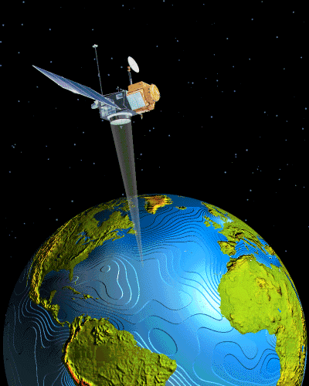
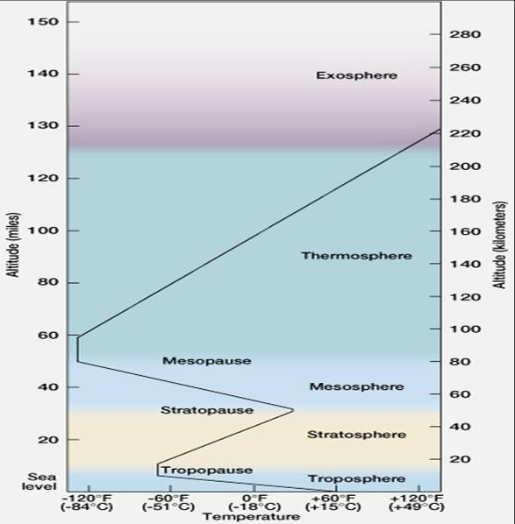

Slide 31
Has it Really Been Warming?
satellite records first showed no warming.
thermometer record biased?
However, two errors:
  satellites slowing down
  included some stratosphere temperature
corrected satellite data:
  0.12°C (0.21°F) per decade;
  close to 0.16°C (0.28°F) from thermometers.

Slide 32
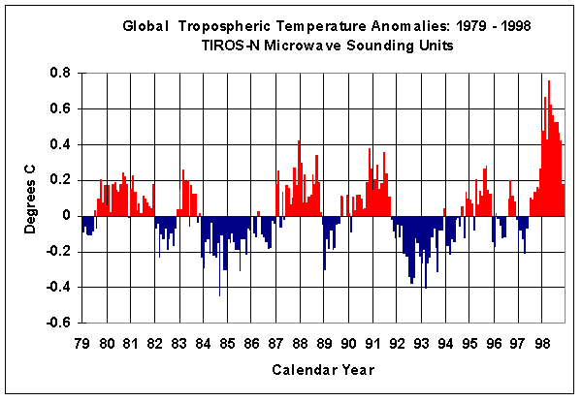
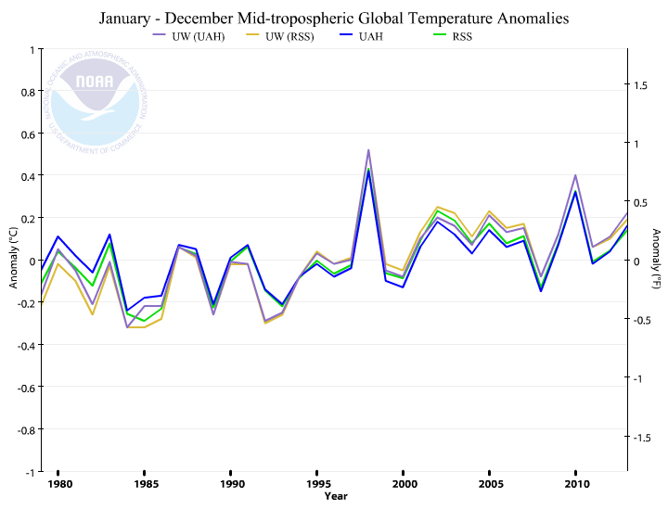
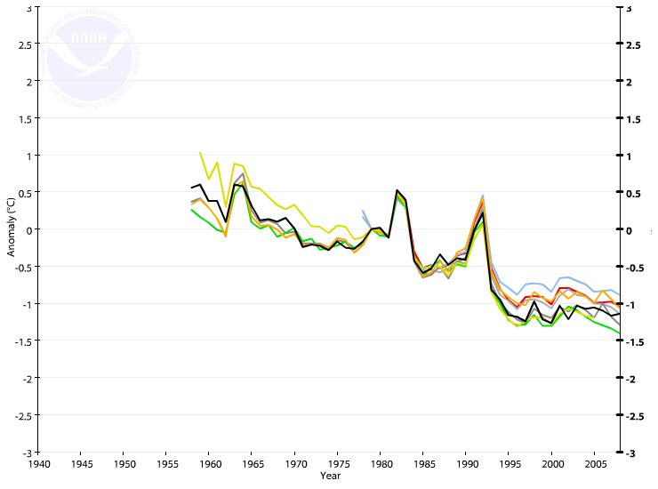
stratosphere

Slide 33
Conclusion: all evidences show warming.
Urban heat islands or spatial bias are not the reasons for the warming trend.

Slide 34
Causes of Warming
Global temperature variations
Warming factors:
  GHGs caused 90%
  solar radiation, 10%
Cooling factors:
  higher albedo
  land-use change (forest to cropland)
  aerosols

Slide 35
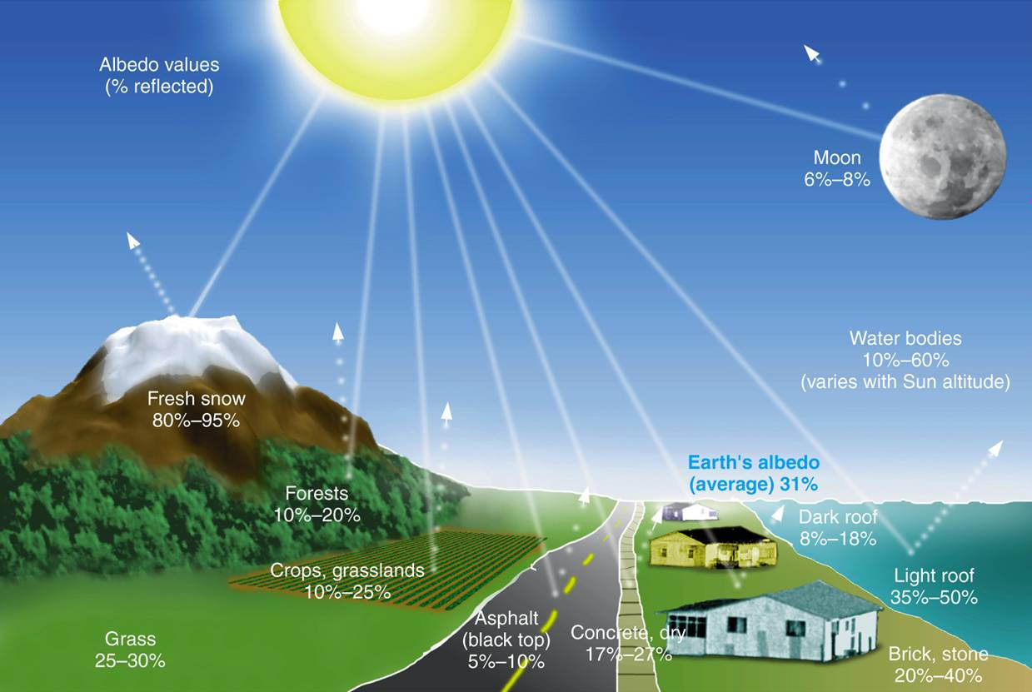
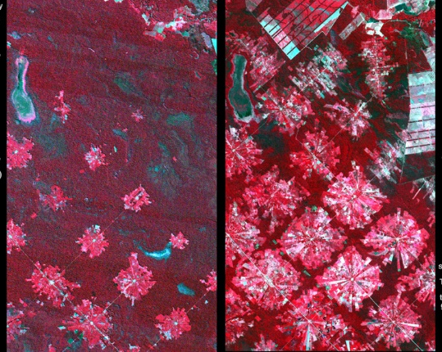

Slide 36
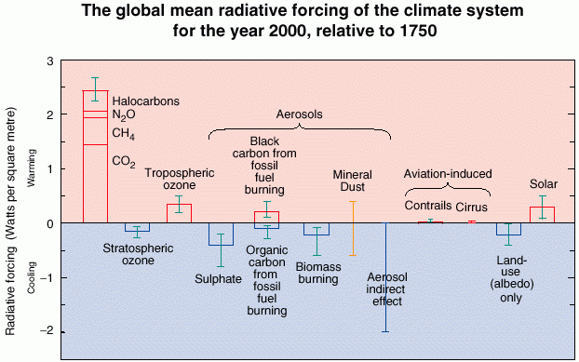
Comparison of forcing since 1750

Slide 37
Extend the end year to 2011. Bars show radiative forcing from well-mixed GHG (WMGHG), other anthropogenic, total anthropogenic, and natural forcing. The error bars indicate the 5 to 95% uncertainty.
Other anthropogenic forcing include aerosol, land surface reflectance, and ozone changes. Natural forcing include solar and volcanic effects. The total anthropogenic radiative forcing for 2011 relative to 1750 is 2.3 W/m², corresponding to a CO₂-equivalent concentration of 430 ppm.

Slide 38
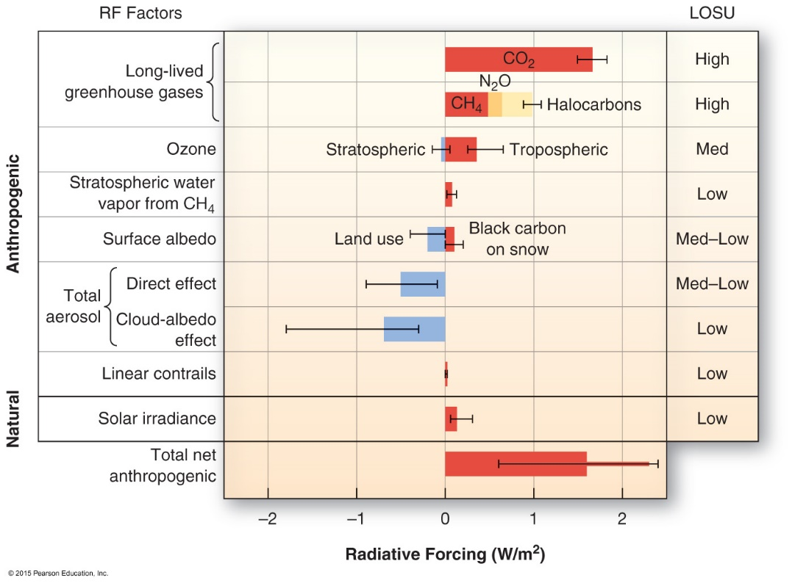

Slide 39
Temporal Variations in Warming
Annual record since 1880 CE:
  1880 - 1945: slow warming
  1945 - 1975: no trend
  1975 - now: rapid warming
Why no trend during 1945 - 1975?
  Solar radiation decreased.
  However, only 10% forcing from solar.

Slide 40
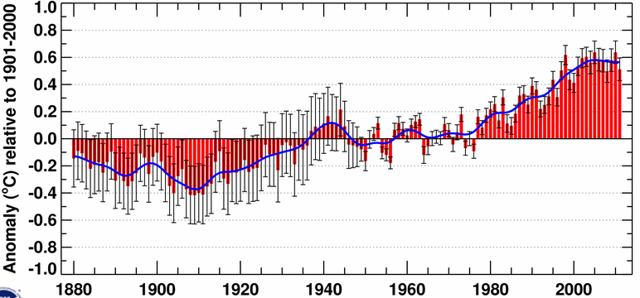
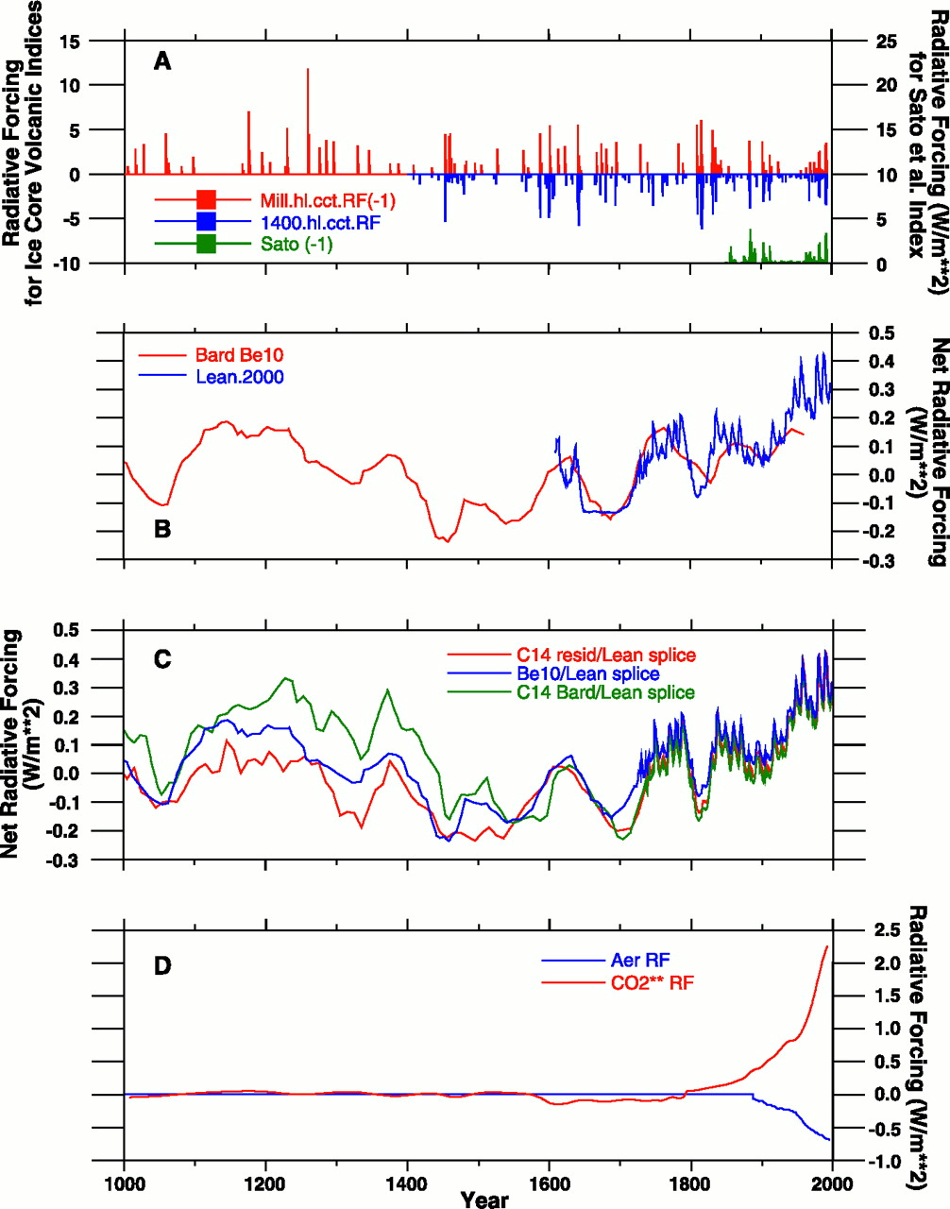

Slide 41
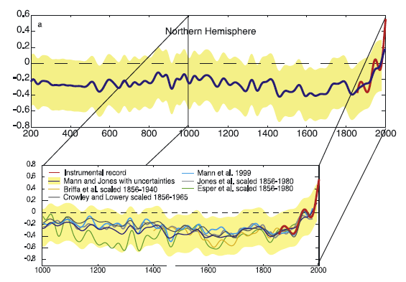
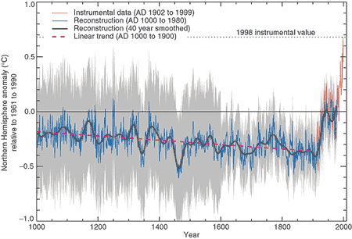
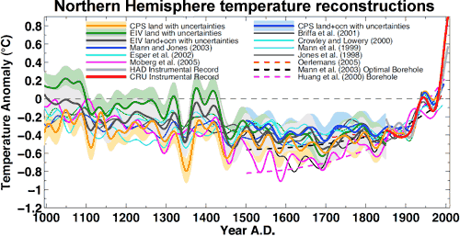

Slide 42
Completing the Picture
Hockey-stick curve
  indirect (cooling) vs. instrumental (warming)
We have verified the warming, but was cooling real?
  Longer indirect records show warming from 200 – 1000 CE

Slide 43
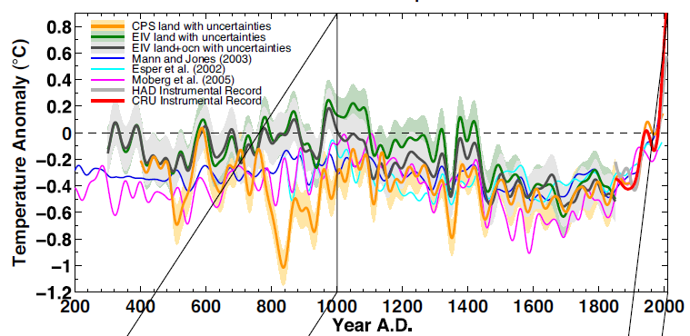
Thus, indirect records are not biased toward cooling.

Slide 44
Completing the Picture
A longer instrumental record: back to 1750 using spatial stats
warming, w/ variation
matches the indirect record on the “hockey stick”

Slide 46
Completing the Picture
Atmosphere warmed little since 2000, which is strange, as GHGs ↑
Ocean absorbs 90% of imbalance
  ocean temperature history since 1959
surface ocean warming since 2000
deep ocean warming even faster (NOAA graphs)
  especially in tropics (wind speed increase ocean currents)
Heat transfer to deep ocean.

Slide 47
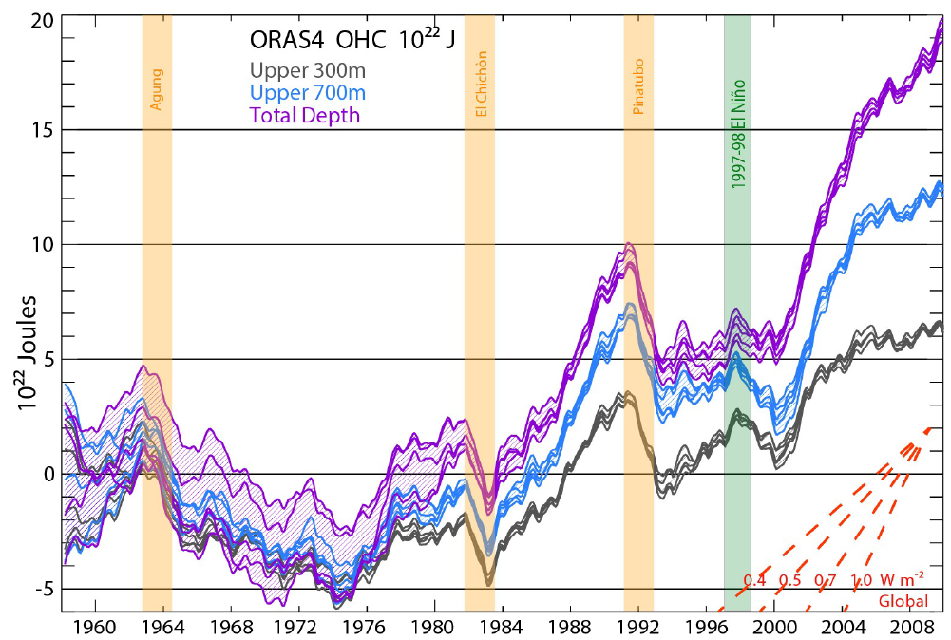

Slide 48
El Niño/Southern Oscillation (ENSO)
Every year warming occurs off the coast of Peru (~2˚/C)
Suppresses upwelling
But every 4 or 5 years it is much more pronounced = El Niño
Because there is no upwelling fish die.
The 2015-2016 El Nino event greatly reduced the amount of heat transferred to the deep ocean, contributing to record global temperatures in 2015 and 2016.

Slide 49
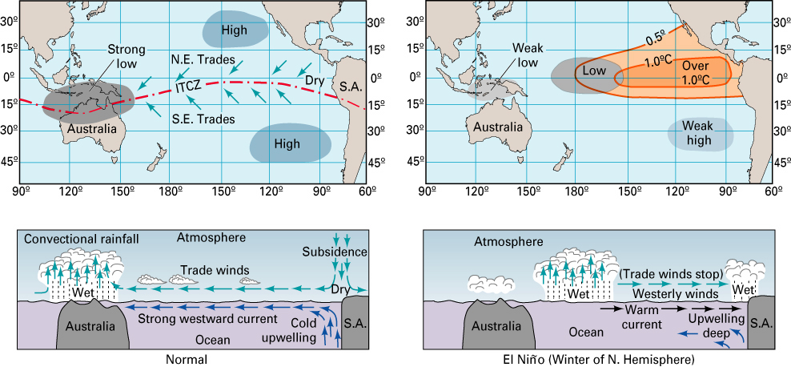
In normal year, low pressure dominates in Malaysia and northern Australia.
In an El Niño year, low pressure moves east to the central part of the western Pacific.

Slide 50
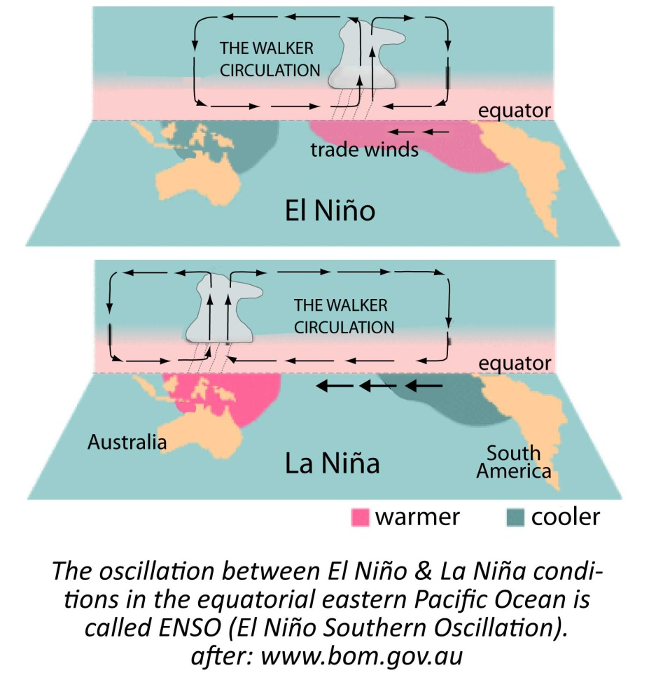
El Niño warm
weak trades
La Niña cool
strong trades

Slide 52
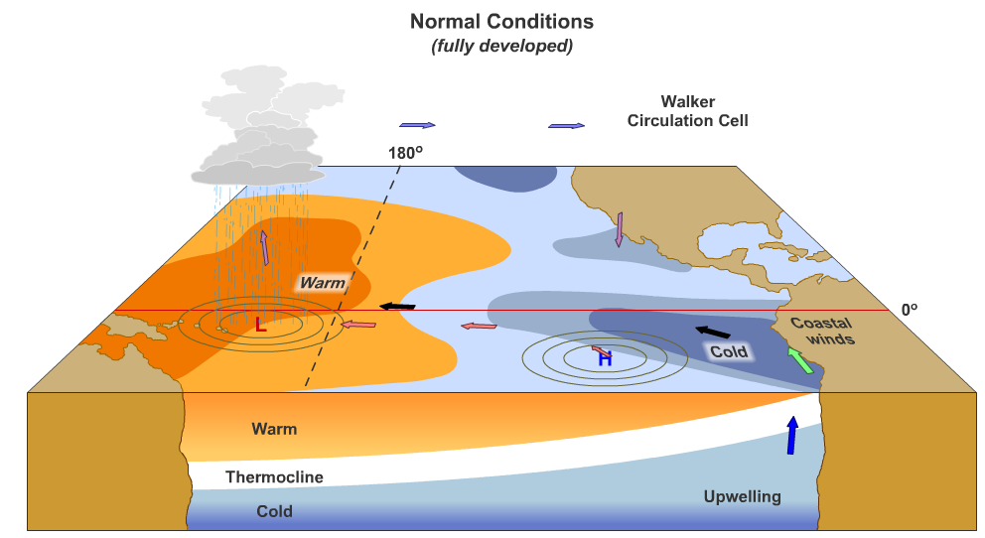
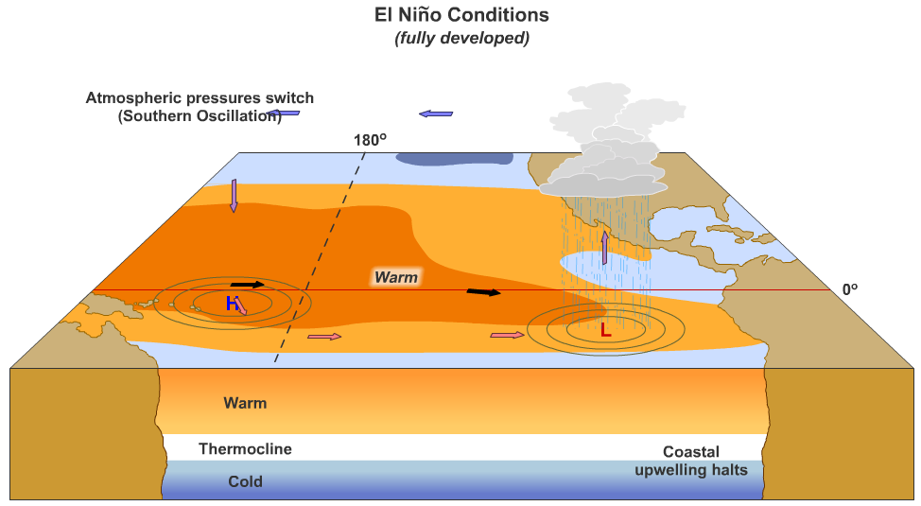

Slide 53
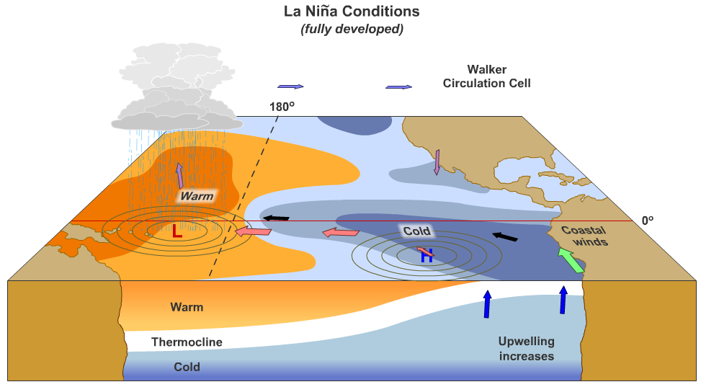

Slide 54
Thank you for your attention!

