Slide 1
The Rise of Atmospheric Oxygen
GEO101
Spring 2023

Slide 2
Contents
Energy Sources for Early Life
Cyanobacteria and the Rise of Atmospheric Oxygen
Iron Sedimentary Evidence of Atmospheric Oxygen
What Delayed the Rise of Atmospheric Oxygen?
Carbon Isotopes
Phanerozoic Oxygen
Fire and Atmospheric Oxygen
The Rise of Ozone

Slide 3
Energy Sources for Early Life
Hyper-thermophilic and chemosynthetic
in deep sea vents (mid-ocean ridge)
Photosynthesis is not possible in deep sea.
Chemosynthesis for carbohydrate (CH₂O)
CO₂ + 4 H₂S + O₂ → CH₂O + 4 S + 3 H₂O
uses oxygen.

Slide 4
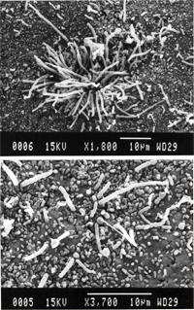
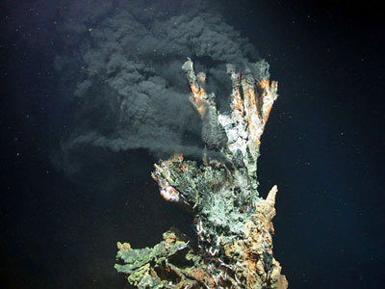
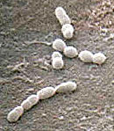

Slide 5
Energy Sources for Early Life
Second form of life is methanogenic bacteria, also a chemosynthetic type.
slightly further along the tree in the Archaea domain.
Some are hyper-thermophiles, probably evolved from hyper-thermophilic bacteria.
obtain chemical energy via:
CO₂ + 4 H₂ → CH₄ + 2H₂O + chemical energy
[recall methanogenesis: C₆H₁₂O₆ → 3CO₂ + 3CH₄ + chemical energy]
Deep-sea vents provide carbon dioxide (CO₂) and hydrogen (H₂).
Methane is a by-product (hence: methanogenic).
indirect chemical evidence 2.8 billion years ago
CH₄ + CH₄ from volcanoes = thick haze 2.7 billion years ago.

Slide 6
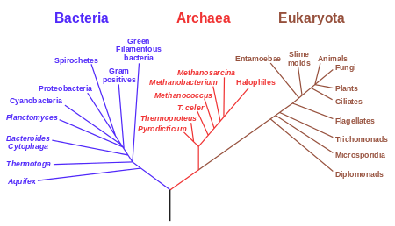
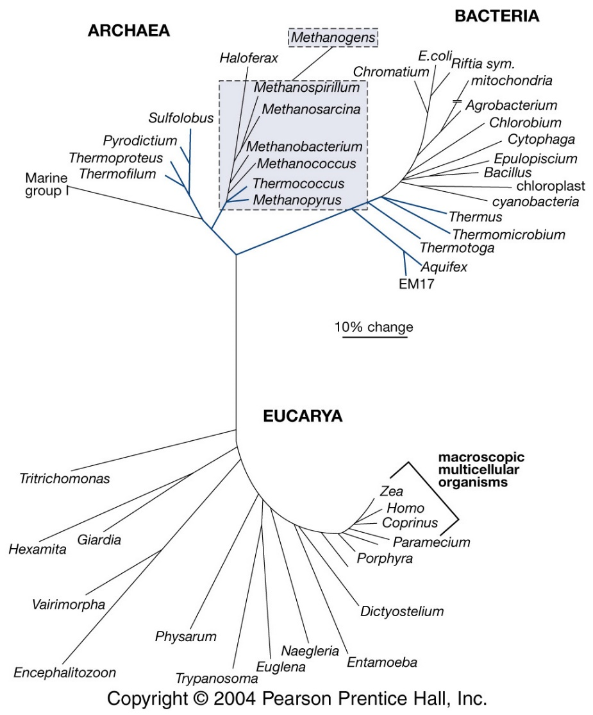
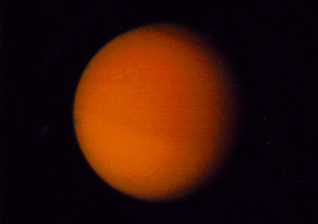

Slide 7
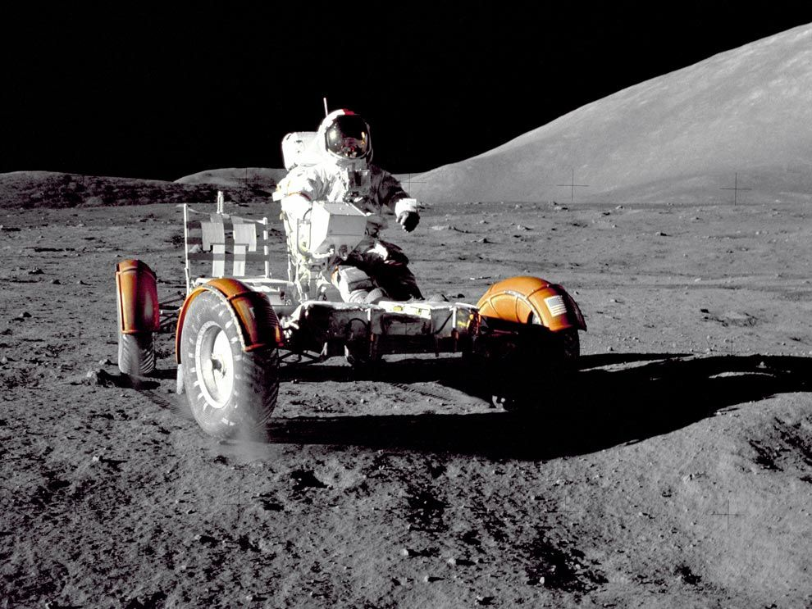
Why won’t your car rust on Luna?
Apollo 17, December 1972

Slide 8
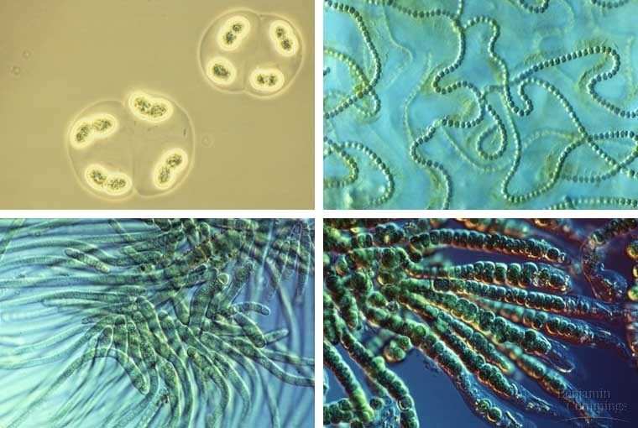
Cyanobacteria and the Rise of Atmospheric Oxygen
cyanobacteria (CB)
domain: Bacteria
first photosynthetic life
likely evolved from hyper-thermophilic bacteria

Slide 9
Cyanobacteria and the Rise of Atmospheric Oxygen
cyan (blue-green) algae
Example: Grand Prismatic Spring in USA
center: hyper-thermophilic bacteria in Archaea domain
edges: cyanobacteria
Different colors from chlorophyll and carotenoids.
Cyanobacteria are photosynthetic, so replace CO₂ with O₂.

Slide 10
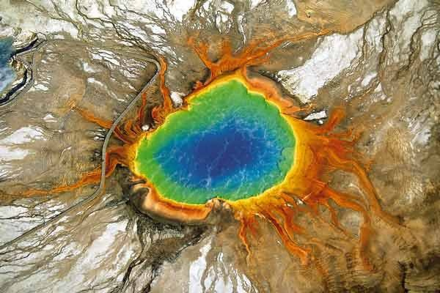
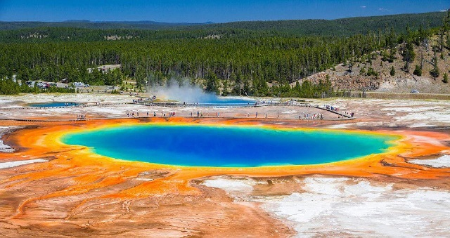

Slide 11
Cyanobacteria and the Rise of Atmospheric Oxygen
When did bacteria become photosynthetic?
Hyper-thermophilic bacteria did not but used O₂ and CO₂ and generated carbohydrate and water.
Methanogenic bacteria used CO₂ and generated water.
Cyanobacteria (third) added oxygen.
They live many places, so add lots of oxygen.

Slide 12
Cyanobacteria and the Rise of Atmospheric Oxygen
oldest evidence of photosynthesis:
unique chemicals decayed from fat
in 2.7 billion years old rocks.
fluorescence of decayed fat
rocks with decayed fat

Slide 13
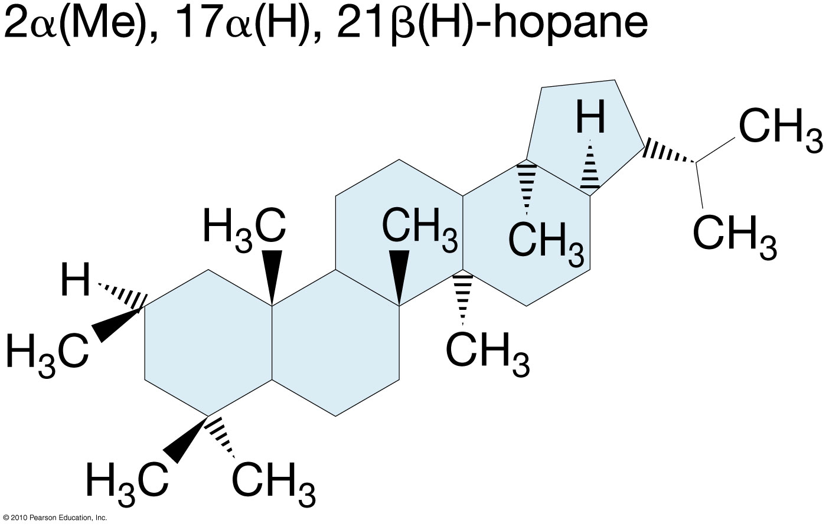
2.7-billion-year-old oil with 2α-methylhopanes, thought to be an indicator for cyanobacteria.

Slide 14
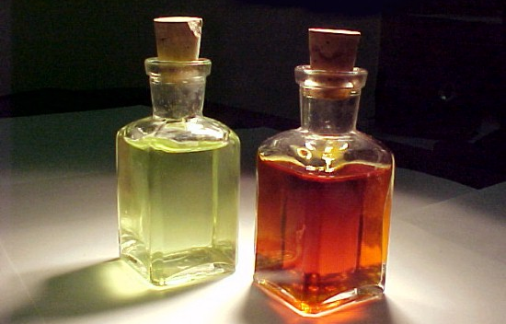
Iron Sedimentary Evidence of Atmospheric Oxygen
2.7 billion years ago, cyanobacteria was adding O₂.
When did atmospheric O₂ significantly increase?
Iron sediments give evidence…
States of iron: elemental (Fe), ferrous (Fe²⁺) and ferric (Fe³⁺), ²⁺ indicates two electrons lost.
Fe²⁺ → Fe³⁺ if exposed to O₂
Fe³⁺ more “oxidized”
Fe²⁺ dissolves into H₂O
Fe³⁺ suspended particles.
Crystals of iron form and sink.

Slide 15
Banded-iron formations (BIFs)
BIFs are ocean deposits: alternating iron and silicate layers, formed between 2.7 billion years ago and 1.9 billion years ago.
Dissolved Fe²⁺ into ocean, and stays dissolved unless much oxygen
If there is oxygen, it oxidized into Fe³⁺.
There is oxygen at surface because of photosynthesis.
Ferrous (Fe²⁺) turned into crystals then formed the BIFs.
2.7 billion years ago, a little oxygen. otherwise, iron would be oxidized and stay on land.
1.9 billion years ago, too much oxygen.
Most steel are made from BIFs.

Slide 16
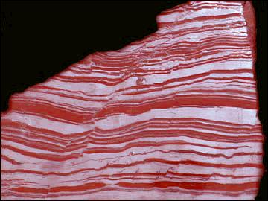
Fe²⁺: dissolved from rocks
Fe₃O₄ =
FeO.Fe₂O₃
BIF: 1:2 mixture of ferrous iron and ferric iron.

Slide 17
Iron Sedimentary Evidence of Atmospheric Oxygen
Redbeds: water- or wind-borne sediments in arid regions
red color: Fe³⁺ coating
formed since 2.2 billion years ago.
From 2.2 billion years ago to now, atmosphere got enough oxygen.
The oxidation stopped the export of Fe²⁺ to oceans.
BIF evidence: enough O₂ 1.9 billion years ago
redbeds evidence: enough O₂ 2.2 billion years ago.

Slide 18
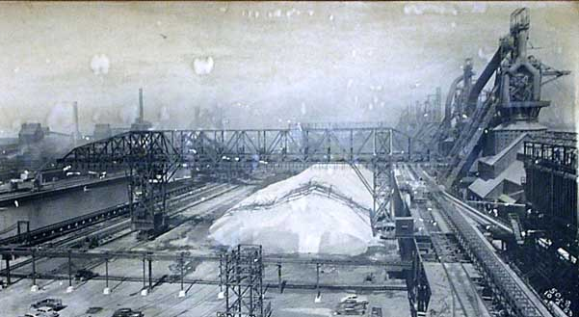
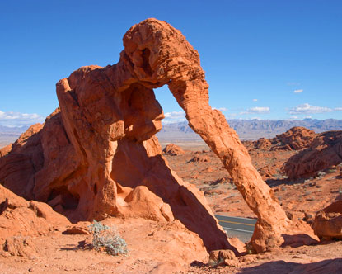
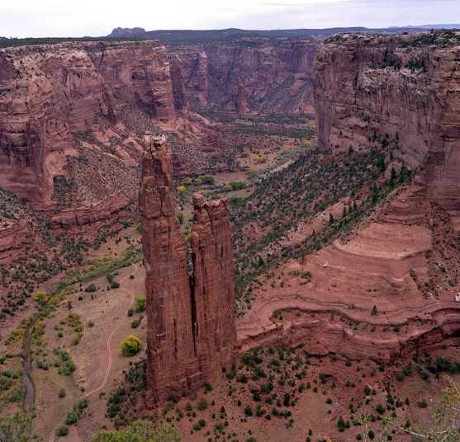
Bethlehem Steel, Lackawanna, USA

Slide 19
What Delayed the Rise of Atmospheric Oxygen?
Cyanobacteria 2.7 billion years ago, but oxygen remained low until 2.2 billion years ago. There was 500 million years lag. Why?
O₂ + 2 H₂ → 2 H₂O
Early rocks and volcanic gas had H
Hydrogen gradually lost due to photolysis
Later rocks and volcanic gas had less H₂.
Therefore, later less O₂ was used for oxidizing H₂.
More O₂ accumulates in the atmosphere.
The 500-million-year delay of O₂ in the atmosphere caused by hydrogen.
As atmospheric hydrogen decreased, oxygen built up.

Slide 20
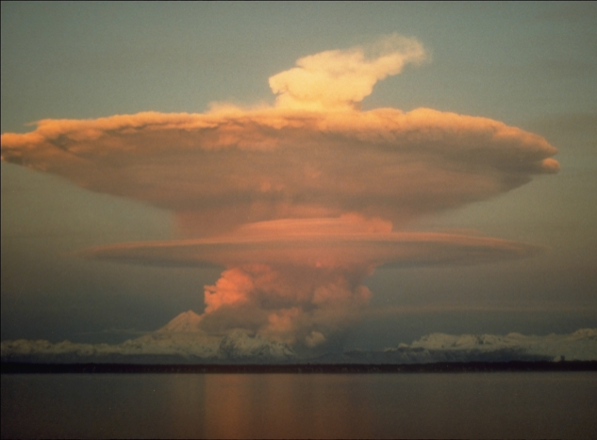
oxygen
Early: H₂ vs. O₂
Later: H₂ vs. O₂

Slide 21
Carbon Isotopes
Carbon isotopes help us track atmospheric carbon and oxygen.
Atomic structure: nucleus (protons and neutrons), masses = 1.0
Electrons in “orbitals”, mass is negligible.
Atomic charge: Proton⁺ Neutron⁰ electro⁻
Atom has no charge if # proton = # electron
Atomic weight = # proton + # neutron
# proton = # of element in periodic table
isotopes: variations of neutrons, e.g., ¹²C, ¹³C, ¹⁴C
¹²C and ¹³C is stable. ¹⁴C is radioactive.

Slide 22
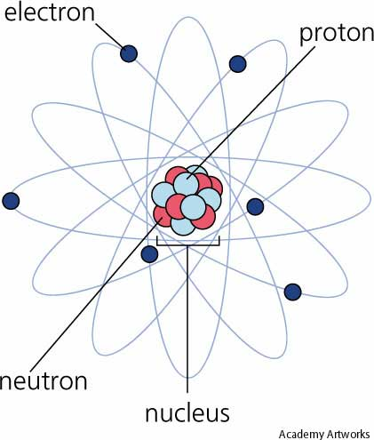
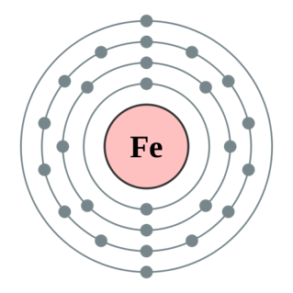
¹²C
Fe²⁺

Slide 23
Carbon isotope uptake patterns
Photosynthesis uses CO₂.
Of the CO₂ in the air, 99% is ¹²C, 1% is ¹³C, and a very tiny amount is radioactive ¹⁴C.
Photosynthesis likes ¹²C; thus, more ¹²C in plant tissue.
Cyanobacteria in the ocean likes ¹²C.
land burial of ¹²C-enriched biomass

Slide 24
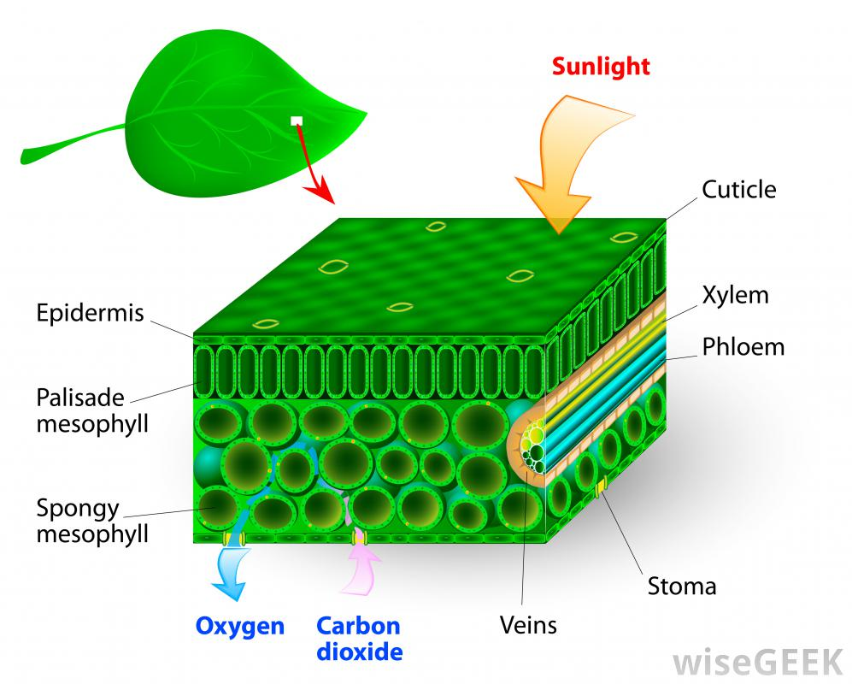
¹²CO₂

Slide 25
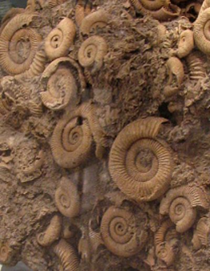
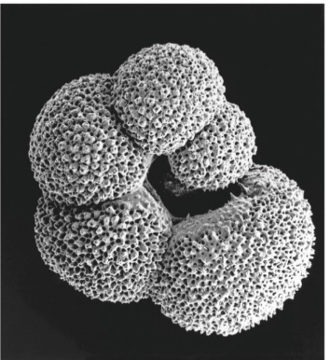
Carbon isotope uptake patterns
Atmosphere and ocean are more enriched in ¹³C than plants.
Carbonate shells and rocks (CaCO₃) are more enriched in ¹³C than cyanobacteria.
More photosynthesis on land, more ¹²C in organic sediments, more ¹³C in ocean carbonates.
foraminifera

Slide 26
Carbon isotope uptake patterns
The carbon isotope record in carbonates formed in oceans in last 540 million years:
¹³C-enriched during Carboniferous Period: 360 – 290 million years ago
suggests land-plant growth very high.

Slide 27
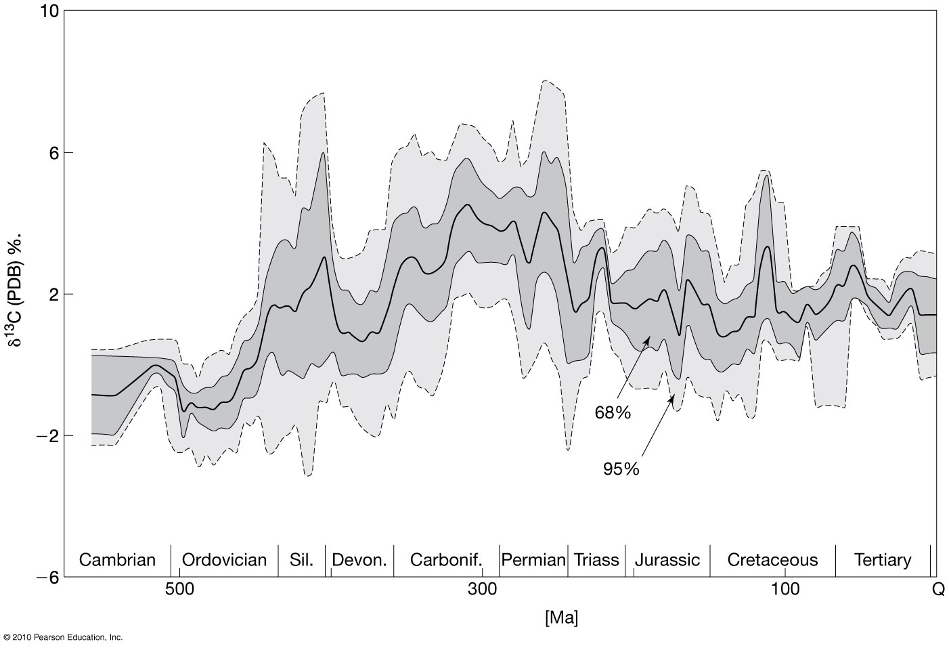
360, 290 million years ago

Slide 28
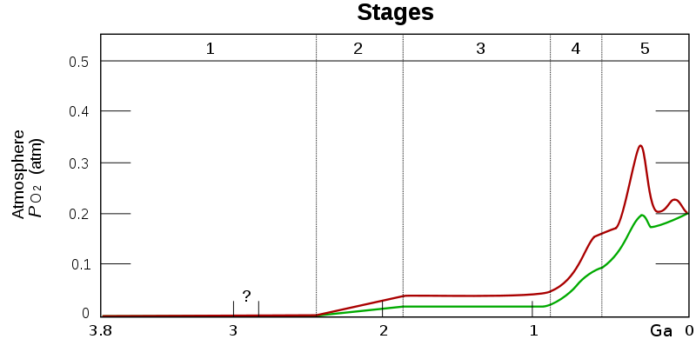
Phanerozoic Oxygen
Atmospheric O₂ has steadily risen:
CO₂ + H₂O + sun energy → CH₂O + O₂

Slide 30
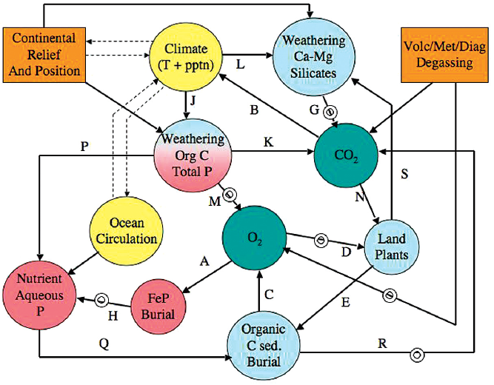
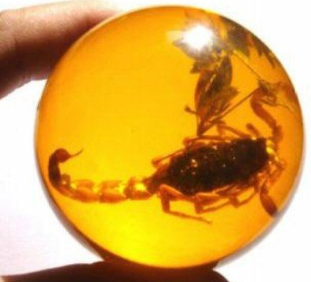
a systems model to predict oxygen

Slide 31
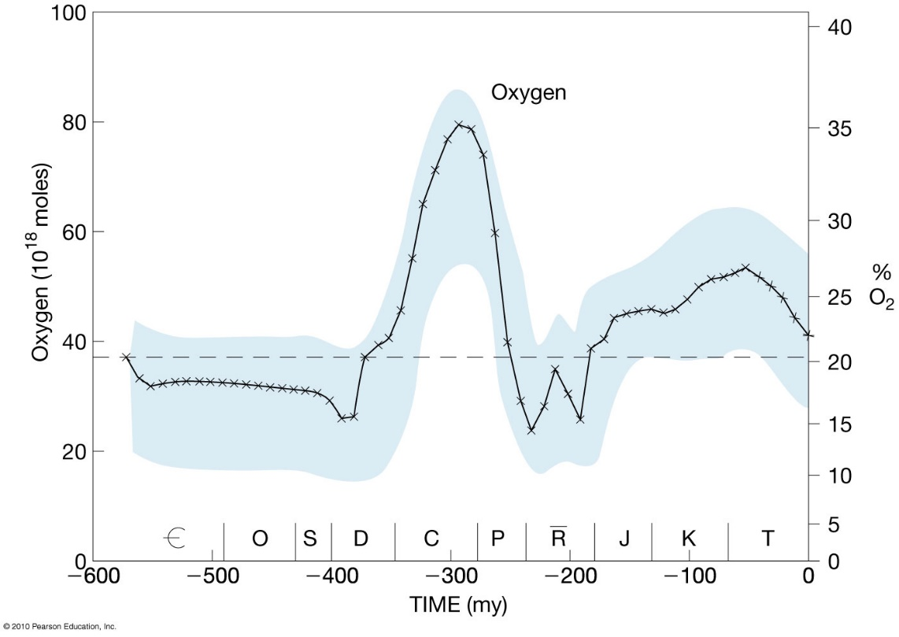
Phanerozoic Oxygen
range: 13 to 35%
modern level is 21%
What caused the variation?
Carboniferous: 360 to 290 million years ago
high levels of oxygen
3 key reasons:

Slide 32
Phanerozoic oxygen
#1 land plant evolution:
evolved from aquatic Photosynthetic Eucarya
500 million years ago: moss, horsetails
350 million years ago (Carboniferous): conifers, ferns
150 million years ago: flowering plants
photosynthesis in the ocean and on the land
large oxygen input.

Slide 33
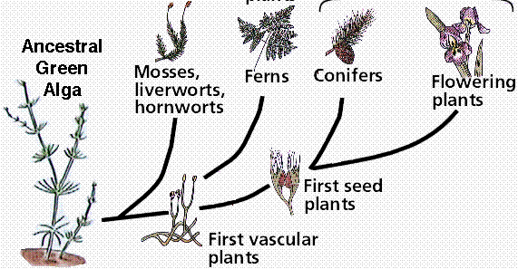

Slide 34
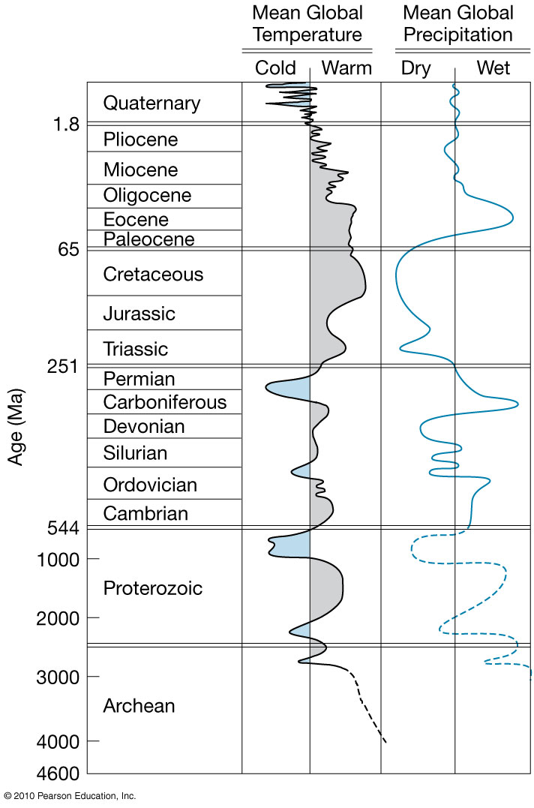
#2 warm and moist climate
rapid growth of plants.
high NPP with precipitation.

Slide 35
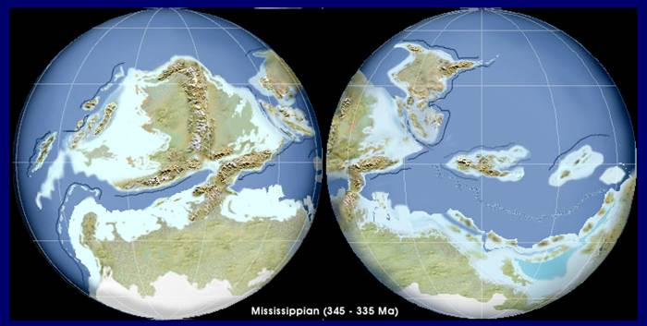
Phanerozoic Oxygen
#3 continental arrangement:
Shallow seas in the Equator and subtropics
The seas alternate between open sea and shallow swamps.
Plant matter was rapidly buried.

Slide 36
Fire and Atmospheric Oxygen
Fire keeps atmospheric oxygen stable.
Fire causes very rapid carbohydrates oxidation:
CH₂O + O₂ + heat → CO₂ + H₂O + energy
Forest fire could occur when oxygen is more than 13%. < 13% too little heat, > 35% causes spontaneous combustion.
Negative feedback system:
increased O₂, increased fire, decreased forest, decreased O₂
negative feedback system = stability
Carboniferous: oxygen up to 35% for spontaneous combustion
increase in fires, decrease forest, decrease oxygen
The end: shift in continents and climate, fewer swamps, oxygen decreased.

Slide 37
Forest
Fires
Atmospheric
Oxygen
Forest
Cover

Slide 38
The Rise of Ozone
Di-atomic oxygen: O₂
Tri-atomic oxygen: O₃
Ozone production:
UV radiation splits O₂ into monoatomic oxygen (O), which reacts with another O₂ to create O₃.
occurs in the stratosphere, because of intense UV radiation there for the reaction
Ozone absorbs UV radiation:
O₃ + UV → O₂ + O
O₂ + UV → O + O
O₂ + O → O₃

Slide 39
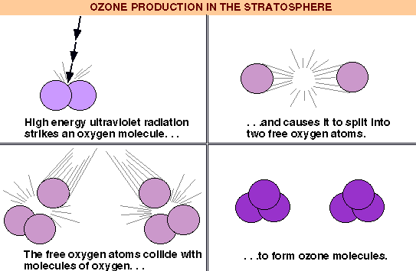
The ozone layer thus absorbs UV
Thank You, Ozone layer!

Slide 40
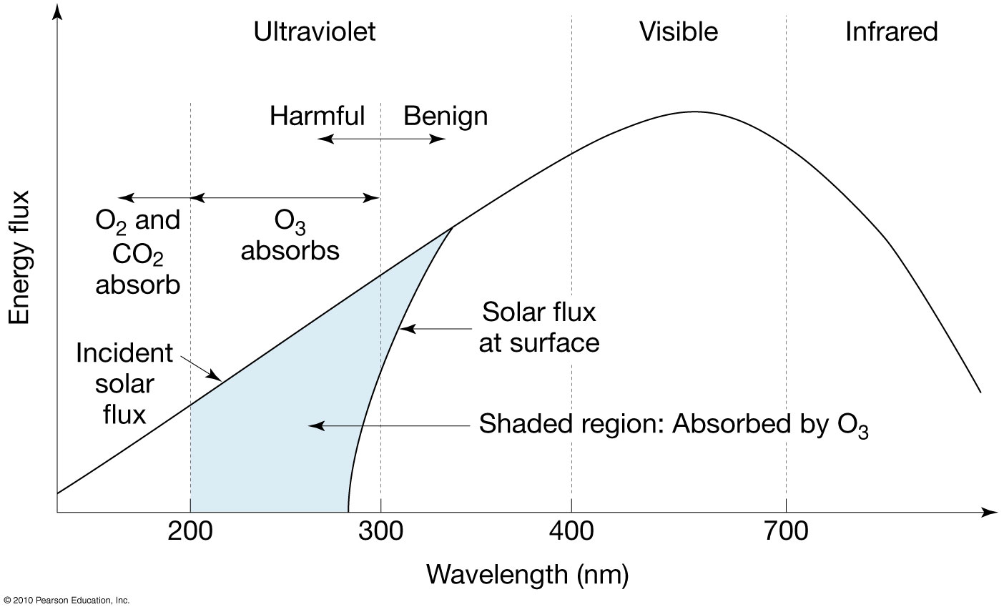

Slide 41
The Rise of Ozone
When did ozone layer appear?
Since ozone is created from O₂ , the Earth must have oxygen first.
A logarithmic relationship between O₂ and O₃
only need 0.2%
0.2% oxygen by 2.2 billion years ago
Life prior to 2.2 billion years ago was “naked”.
refuge below water surface.

Slide 42
