Slide 1
The Origin of the Earth
GEO101
Spring 2023

Slide 2
Contents
Geological time
Formation of Earth’s solar system
Formation of Earth
Formation of Earth’s atmosphere

Slide 3
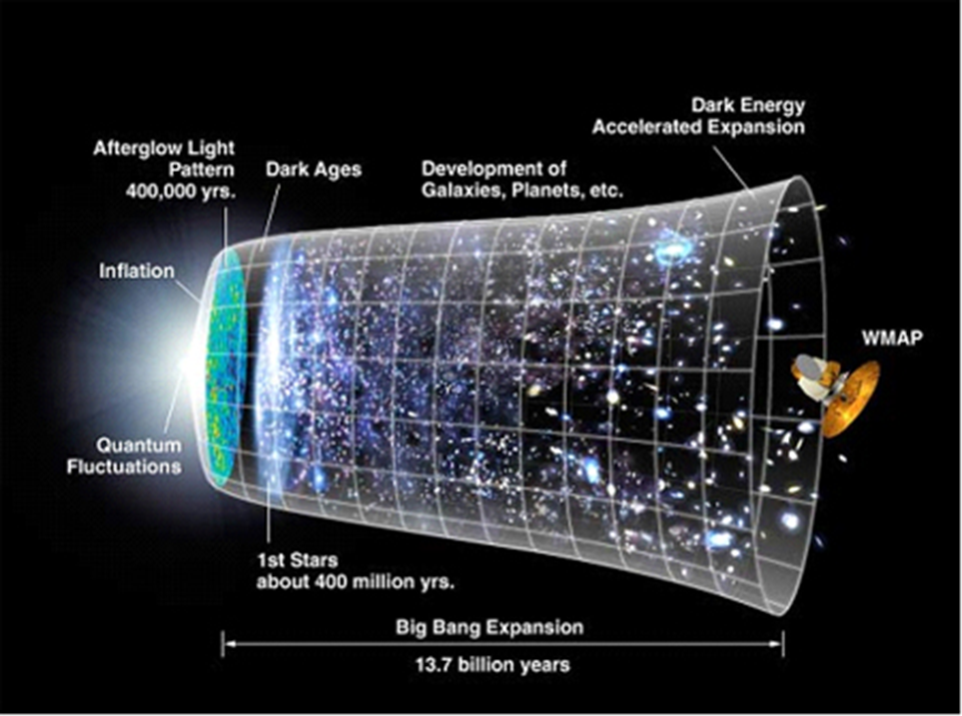
Geological Time
The universe is 14 billion years old and has been expanding and developing its structure.

Slide 4
Geological Time
Earth is 4.55 billion years old.
Two eons:
Precambrian: first 4 billion years.
Phanerozoic: multi-cellular life
Geological time periods named according to environmental conditions or evolutionary events.

Slide 5
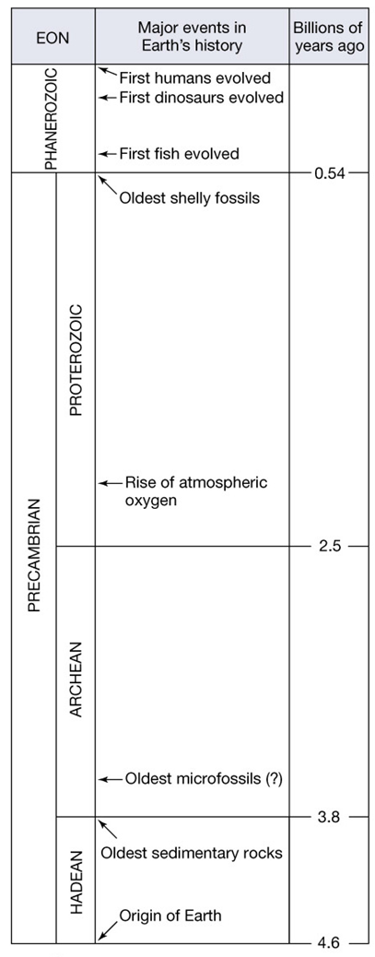

Slide 6
Geological Time
Geological dating for ages of rocks and events
(a) relative dating: sedimentary rocks
(b) absolute dating based on natural radioactivity
parent elements decay → daughter elements
Ratio of parent to daughter elements told the age.
Rate of decay determined via observation in lab
“half-life”: time for half of the parent element to decay into the daughter element.

Slide 7
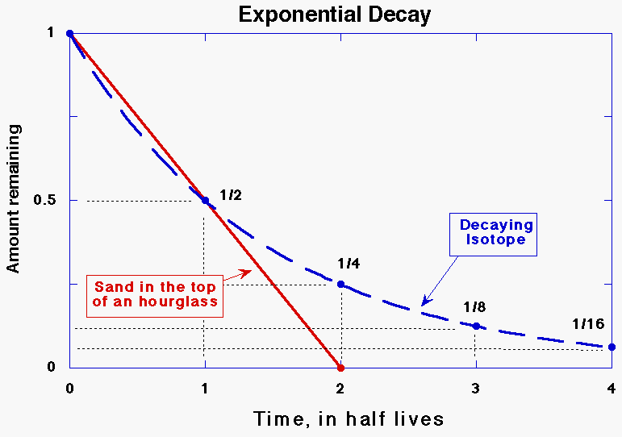
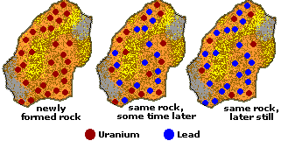

Slide 8
Geological Time
Radiative elements have half-lives ranging from billions years to millions years to thousands years to decades.
Elements with short half-lives are used to date young rocks [e.g. Carbon-14 has a half-life of 5,715 years]
Elements with long half-lives are used to date very old rocks [e.g. Uranium-238 has a half-life of 4.5 billion years].

Slide 9
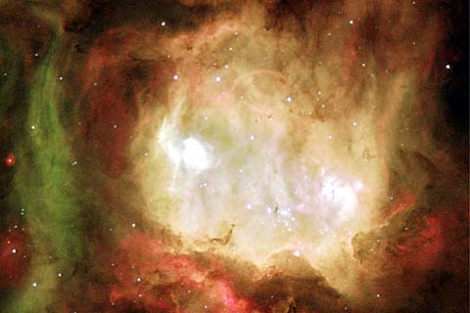
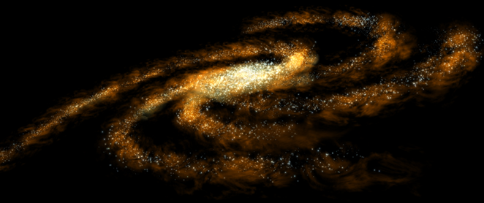
Formation of Earth’s Solar System
Our Solar Nebula:
Solar System began as a nebula (cloud of dust and gas).
Nebula occur throughout the spiral arms of the Milky Way galaxy.

Slide 10
Our nebula collapsed due to explosion of a nearby star.
The pressure on the nebula → nuclear fusion → heat
…a star is born.
[video…]

Slide 11
Planets also formed due to the condensing nebula.
Elements condense into solid particles close to the Sun.
further: methane and hydrogen (H₂) condense.
The transition area is called “frost line”
Gravity attracted material to one plane around Sun.
Particles collided and accreted into planetesimals.
Planets formed after tens of millions of years.
Small, warm inner-planets vs. large, cold outer-planets

Slide 12
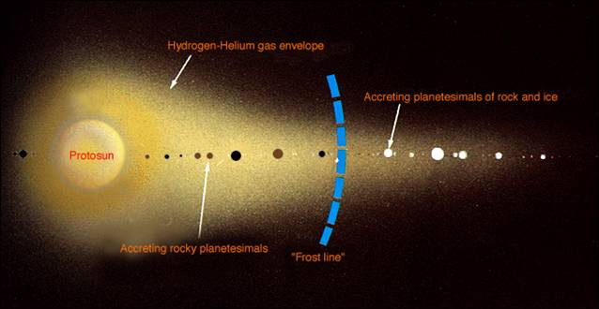
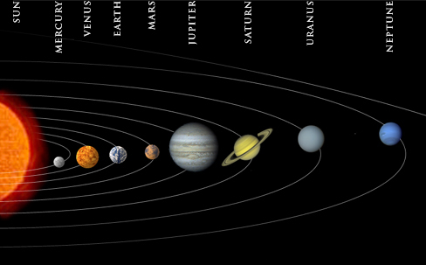

Slide 13
Formation of Earth
Early Earth had no core from accretion of planetesimals.
Core formed in two related ways:
Small planetesimals collided with Earth, resulting heavy elements sinking and light elements floating up.
About 4.45 billion years ago, a planet the size of Mars collided with Earth, adding its iron core to that of Earth.

Slide 14
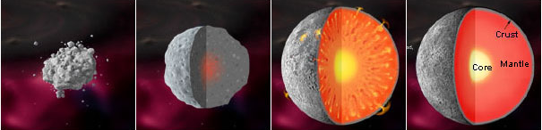
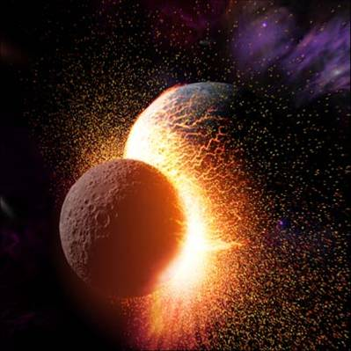
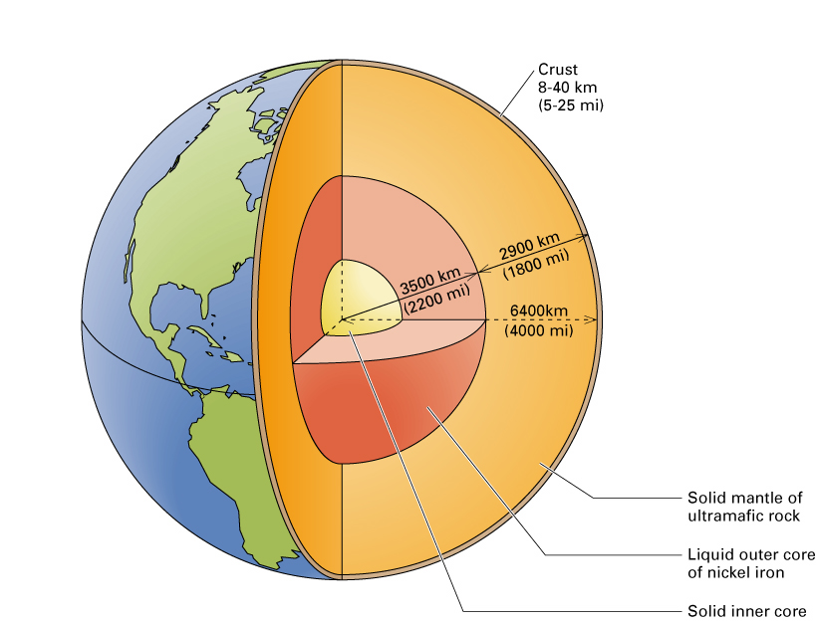

Slide 15
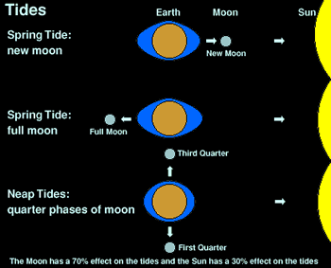
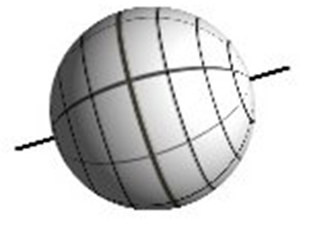
Earth’s moon
Earth’s moon (Luna):
Gravitational pull creates ocean tides.
stabilizes Earth’s axial tilt (22.5° ~ 24.5°). Without moon, axial tilt would be 85°.

Slide 16
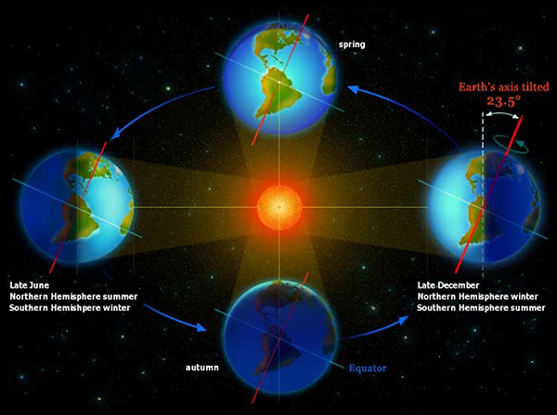

Slide 17
Earth’s moon
Luna’s rocks:
few volatile elements, such as hydrogen or carbon
oxygen isotopes in its rocks like Earth’s surface rock
Moon age (4.45 billion years old) = Earth age (4.55 billion years old) – 100 million years
[Potassium-40 to Argon-40. half-life: 1.26 billion years]

Slide 18
Earth’s moon
Giant impact hypothesis:
4.45 billion years ago, a Mars-sized planet collides, adding its iron core to Earth’s.
The debris that was created by this impact orbited around the Earth and accreted to form the Moon.
Luna’s rocks have similar oxygen isotopes as do Earth’s rocks because it is formed from Earth’s surface rocks, have fewer volatile elements than Earth’s rocks because they would have been turned to gasses by the friction of the impact.

Slide 19
A Mars-sized body, 0.1 to 0.2 Earth masses, approaches the proto-Earth at an oblique angle.
The two bodies collide. The ejecta from the impact fly off at an angle and the proto-Earth starts spinning rapidly.
The ejecta from the impact form a disk around the proto-Earth. The debris in the disk collide with each other and accrete to form the Moon.

Slide 20
The Moon is initially only a few Earth radii (~20,000 km) away from the Earth. Earth spins rapidly as a result of the collision. The day length is 5-6 hours. Because they are so close together, the Moon and the Earth generate huge tides in each other that dissipate energy and transfer angular momentum from the Earth to the Moon.
Overtime, Earth’s rotation slows, while the Moon retreats to its present orbital distance of ~60 Earth radii (384,400 km).

Slide 21
Formation of Earth’s atmosphere
First 100 million years: heavy bombardment, Luna at the end.
Planetesimal collision decreased over time.
Next 600 million years: sporadic bombardment by planetesimals.
The friction caused surface rocks to heat up.
Heating caused “impact degassing”.
The gasses, such as CO₂, created and rise up.
CO₂ reacted with hydrogen, and turned into H₂O and CO.
CO₂ + H₂ → H₂O + CO (carbon monoxide)
Sometimes, all oceans temporarily evaporated.
[asteroid-meteor-meteorite…] [Feb. 15, 2013, Urals video]

Slide 22
Formation of Earth’s Atmosphere
Earth’s early atmosphere:
Collision with the Mars-size planet made Earth hot (3000 K). It took 10 million years to cool down to 300 K.
Hot early atmosphere: H₂O > H₂ > CO > CO₂
Cool down: N₂ is the only abundant gas.

Slide 23
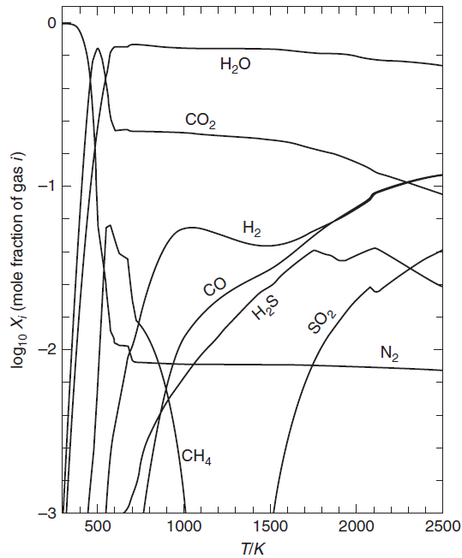
Cool down
hot

Slide 24
Formation of Earth’s Atmosphere
loss of hydrogen:
hydrogen most abundant element (H₂O and H₂)
water photolysis into H and OH
Hydrogen is light and would be lost to space.
This irreversible reaction of losing the light hydrogen made atmosphere denser over time.

Slide 25
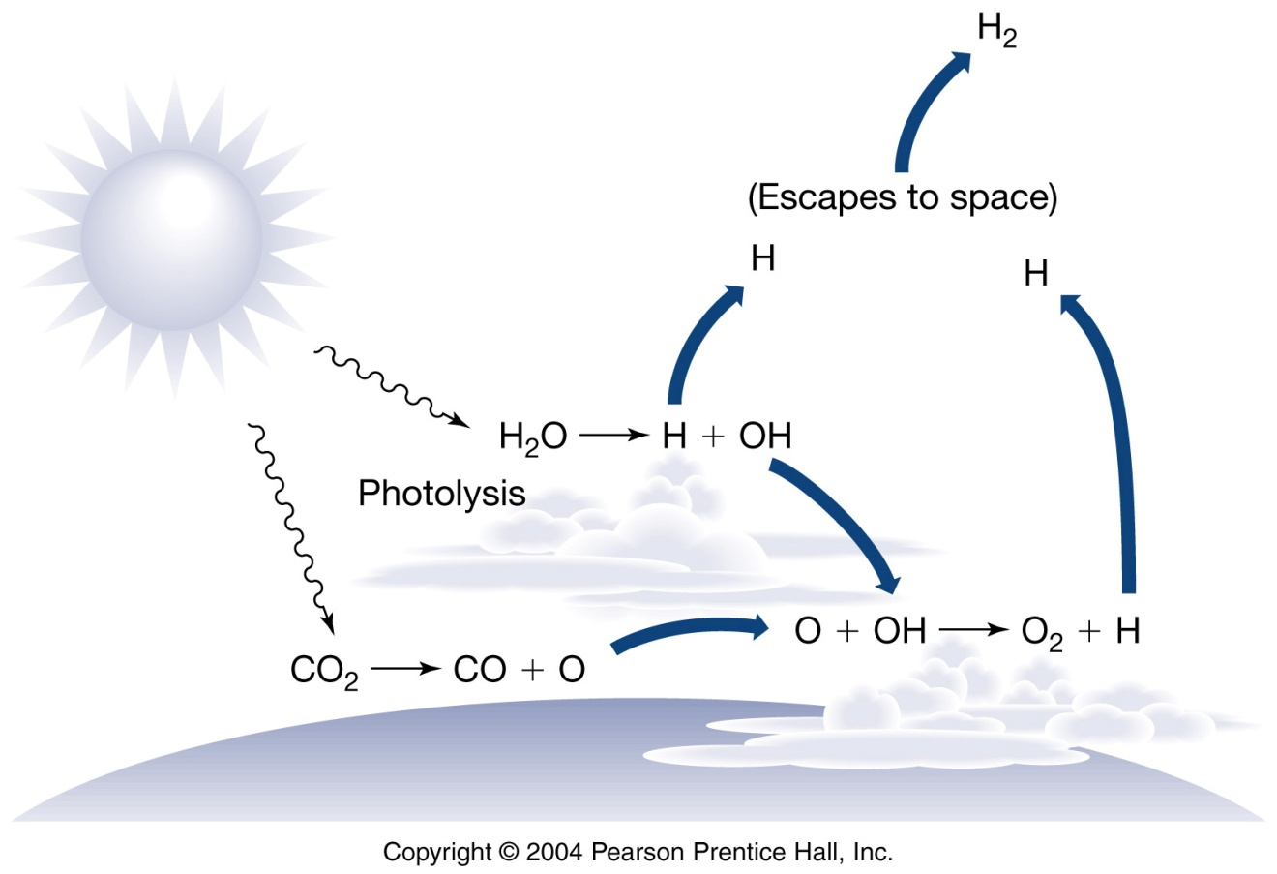

Slide 26
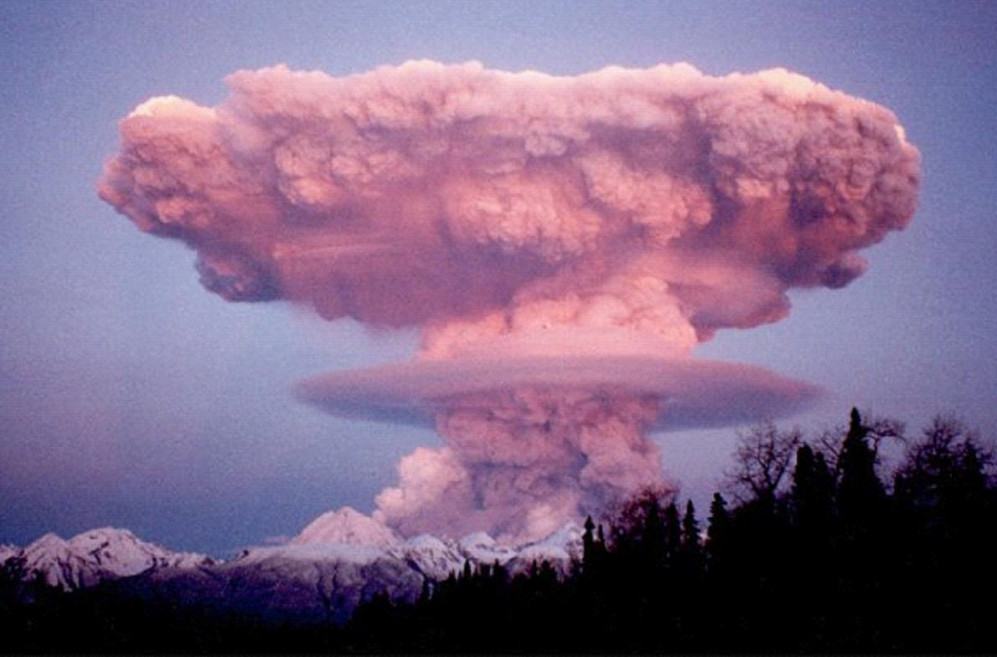
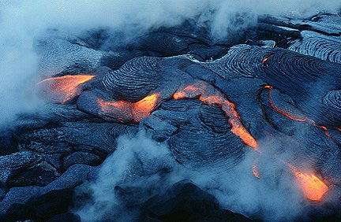
Formation of Earth’s Atmosphere
the accumulation of Nitrogen:
nitrogen is released from magma and volcanoes in the form of NH₃, NO₂, N₂.
Nitrogen gas (N₂) is non-reactive.
N₂ is so heavy that gravity kept it in the atmosphere.

Slide 27
Thank you for your attention!

