Slide 1
Dynamic Modeling of the Atmosphere–Ocean System
GEO101
Spring 2023

Slide 2
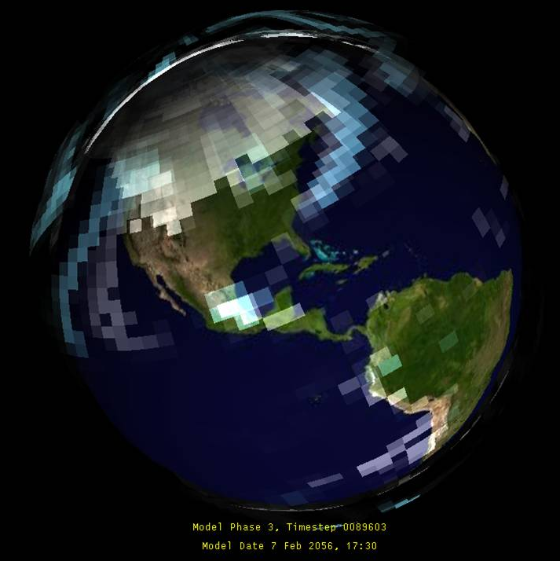
Contents
Need for dynamic models
General circulation model
GCM predictions
Validation

Slide 3
The need for dynamic models
So far, only simple, static models:
System diagram: couplings
Soil
Water
Plant
Growth

Slide 4
The need for dynamic models
So far, only simple, static models:
System diagram: couplings
Build graphs to show size and direction
Soil
Water
Plant
Growth
Soil
Water
Plant Growth

Slide 5
The need for dynamic models
So far, only simple, static models:
System diagram: couplings
Build graphs to show size and direction
Mathematical predictions:
F = σεT⁴
rearranged:
$$T=\sqrt[4]{F/σε}$$
Soil
Water
Plant
Growth
Soil
Water
Plant Growth

Slide 6
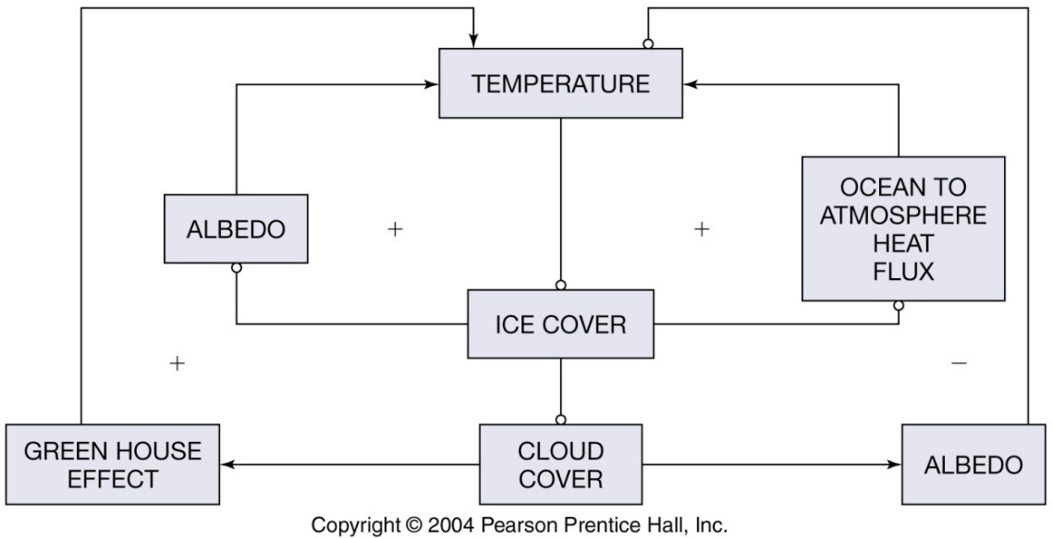
The need for dynamic models
Earth is complex and dynamic:
e.g., the influence of greenhouse effect on ocean ice-cover.

Slide 7
The need for dynamic models
We could add complexity by graphing, but it would be hard to graph that many variables together.
We could use simple equation to predict the changed states of the components.
To make it applicable to other places we would need to include parameters considering spatial or temporal variations, as well as lag time in the responses.
Generally, we need spatially-differentiated, temporally-dynamic models of the Earth System.

Slide 8
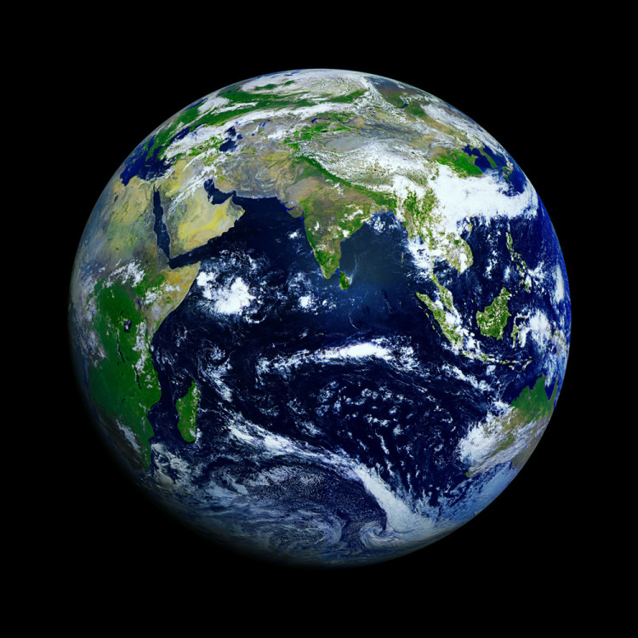
General Circulation Model
Dynamic models of climate as influenced by components of atmosphere, biosphere, hydrosphere, and lithosphere.
General Circulation Models
= circulation of ocean,
atmosphere, energy

Slide 9
General Circulation Model
3D grid cells
Divide spatially varied Earth into homogenous units

Slide 10
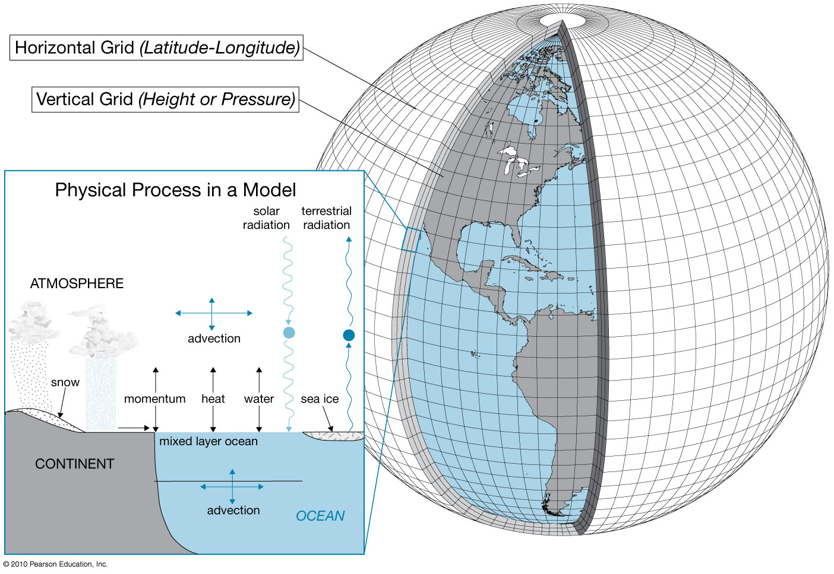

Slide 12
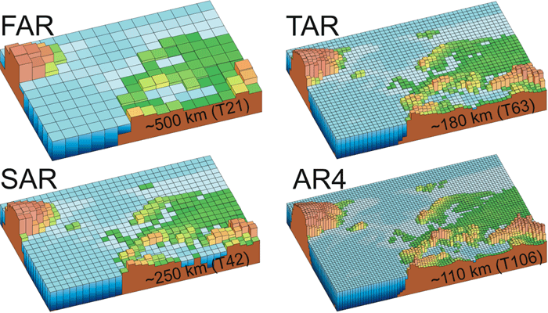
General Circulation Model
Grid size decreases.
more realistic geography = more homogenous units

Slide 13
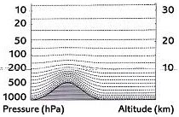
General Circulation Model
vertical layers:
But,
unequal thickness…
Allows more realistic vertical
motion of air and water
 | Ocean | Atmosphere
FAR | 1 | 10
AR4 | 30 | 30

Slide 14
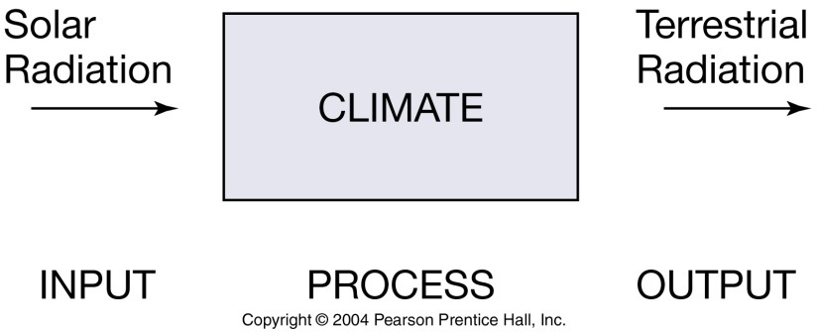
General Circulation Model
GCMs require cell homogeneity.
Real world is generalized into grid-cells.
What if multiple “land cover types”?
Each 3D cell has inputs, outputs, and stored properties (states).

Slide 15
General Circulation Model
Equations are used to predict changes due to processes: wind, runoff, ocean heat exchange, etc.

Slide 16
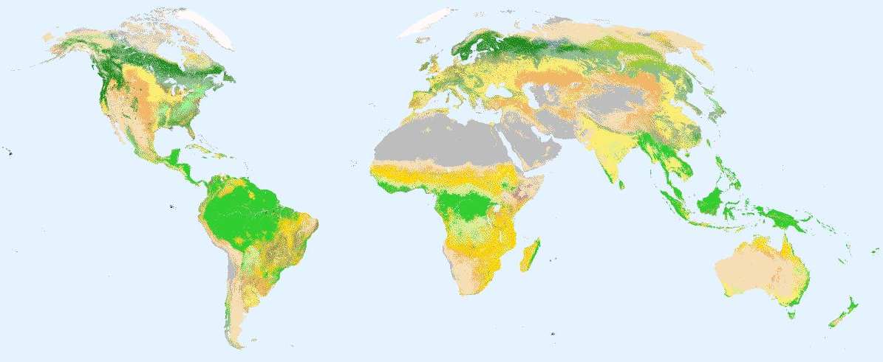
e.g., thermohaline conveyor belt
Cool deep water Warm surface water
A simple horizontal flow of one state (temperature)
In reality, many fluxes of various states (temperature, salinity, carbon content of the water…)

Slide 17
Quiz
Which statement about GCMs is INCORRECT?
They are dynamic models.
They are “general circulation models”.
They model Earth as continuous field rather than grids.
They predict the amount of warming due to Earth system feedbacks.

Slide 18
The climate predictions in AR4 (2007) GCMs were made using GCMs whose grids were ____ km wide
2100
1100
110
11

Slide 19
Polling question
GCM predictions can be validated by using them to predict temperatures of the past.
TRUE
FALSE
Sounds like bogus science

Slide 22
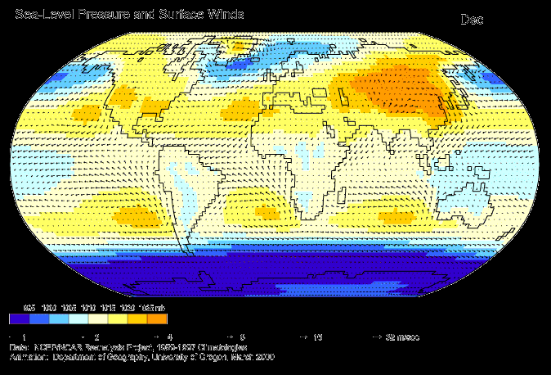
GCM predictions
Annual predictions: sea level pressure and wind

Slide 23
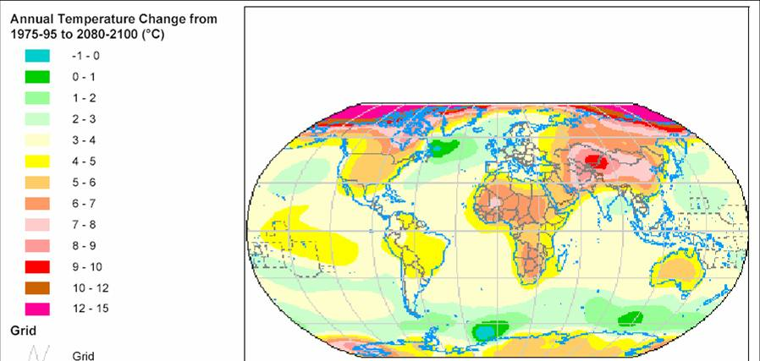
GCM predictions
Centennial prediction: temperature

Slide 24
cloud simulation using a GCM
high resolution GCM of surface ocean currents

Slide 25
GCM predictions
transient models:
- annual changes in GHGs for annual results
A2: CO2 increases to 840 ppm at 2100

Slide 26
GCM predictions
equilibrium models:
- a single change made to inputs (perturbation)
model run until new stable state (equilibrium)
- e.g., 2xCO2:
equilibrium takes about 50 years
prediction includes feedbacks (2 * 1.2°C)
- limitation: only one prediction…

Slide 27
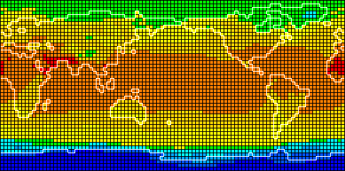
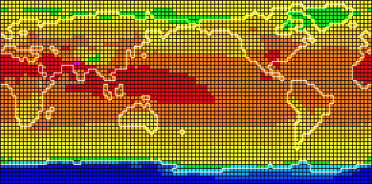
1xCO₂
2xCO₂

Slide 28
Validation
Predicting the past
use known levels of solar activity, volcanic activity, dust, and GHGs.
compare to observations

Slide 29
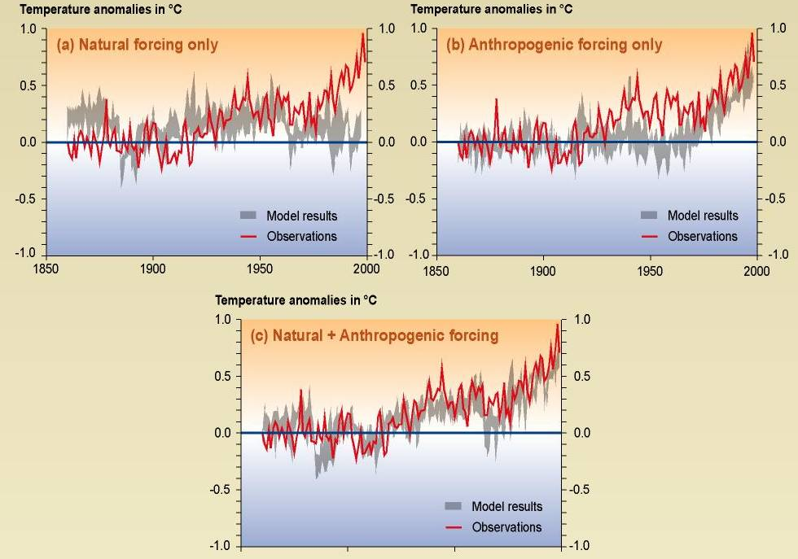
Comparison between modeled and observed temperature rise since year 1860.

Slide 30
Thank you for your attention!

