Slide 1
The Holocene
GEO101
Spring 2023

Slide 2
Contents
The Holocene Epoch
Case studies
How did Humans Reach North America?

Slide 3
The Holocene
Current interglacial “Holocene”
Its peak temperature in 9,000 years ago
was 0.8°C (1.5°F) warmer than 1850 CE
[173 fossil/chemical records]

Slide 4
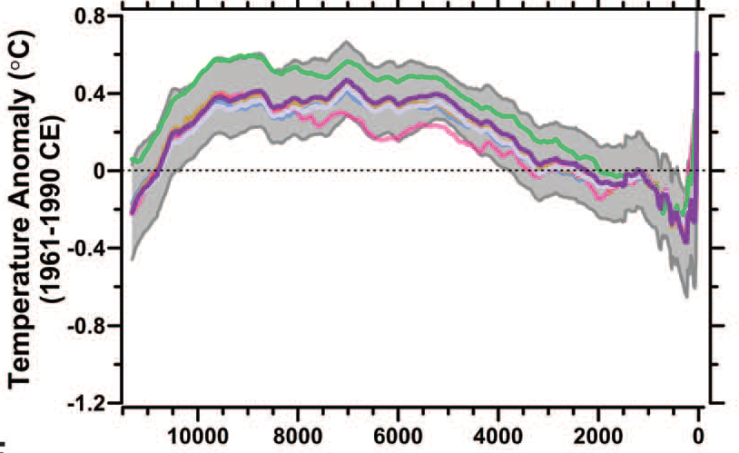
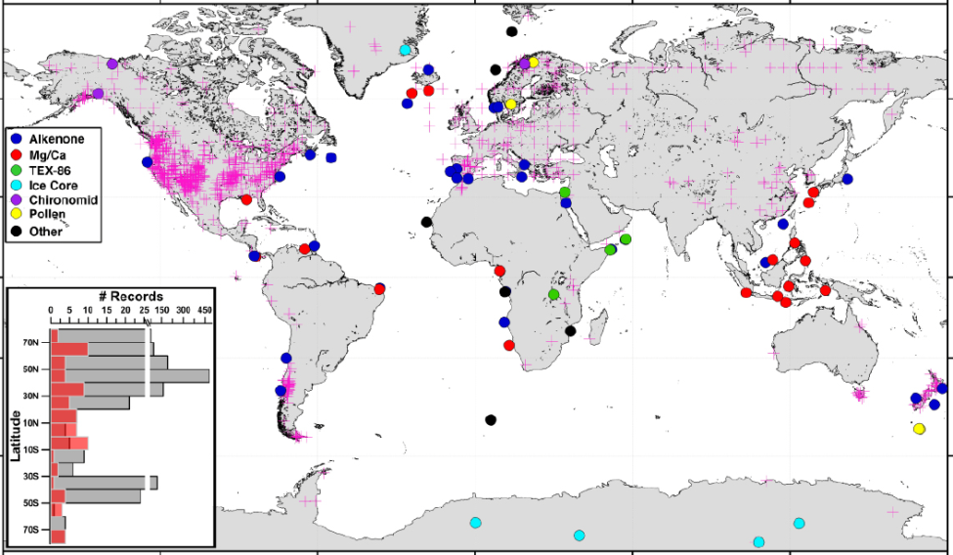

Slide 5
The Holocene
Fossil records for vegetation and climate conditions in the past
fossils in lake sediments
lake sediments above water
combine to recreate past climate

Slide 6
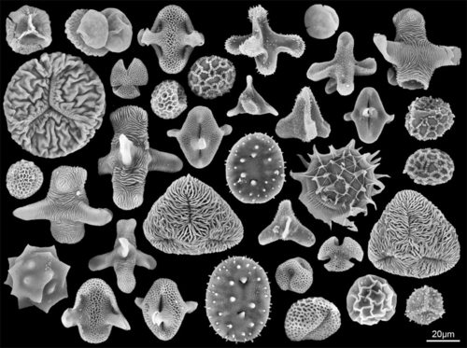
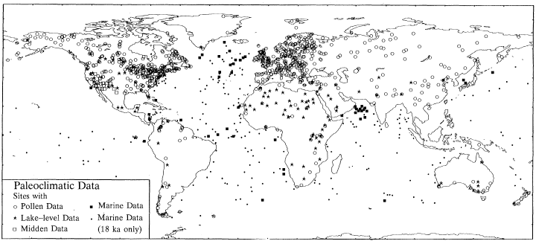
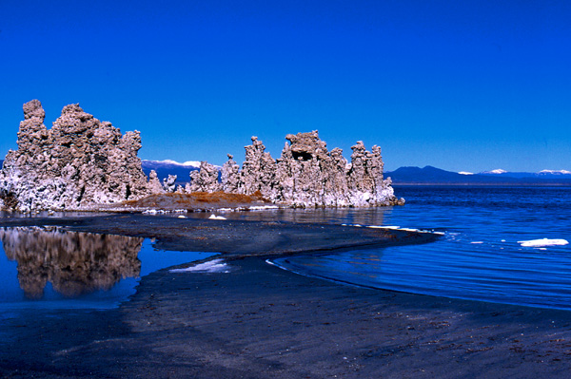

Slide 7
The Holocene
Models used to explore causes of Earth system change.
(computer model of ocean–atmosphere)
Earth in 3-D grid
Inputs: environmental conditions
Outputs: temperature, precipitation, wind.

Slide 8
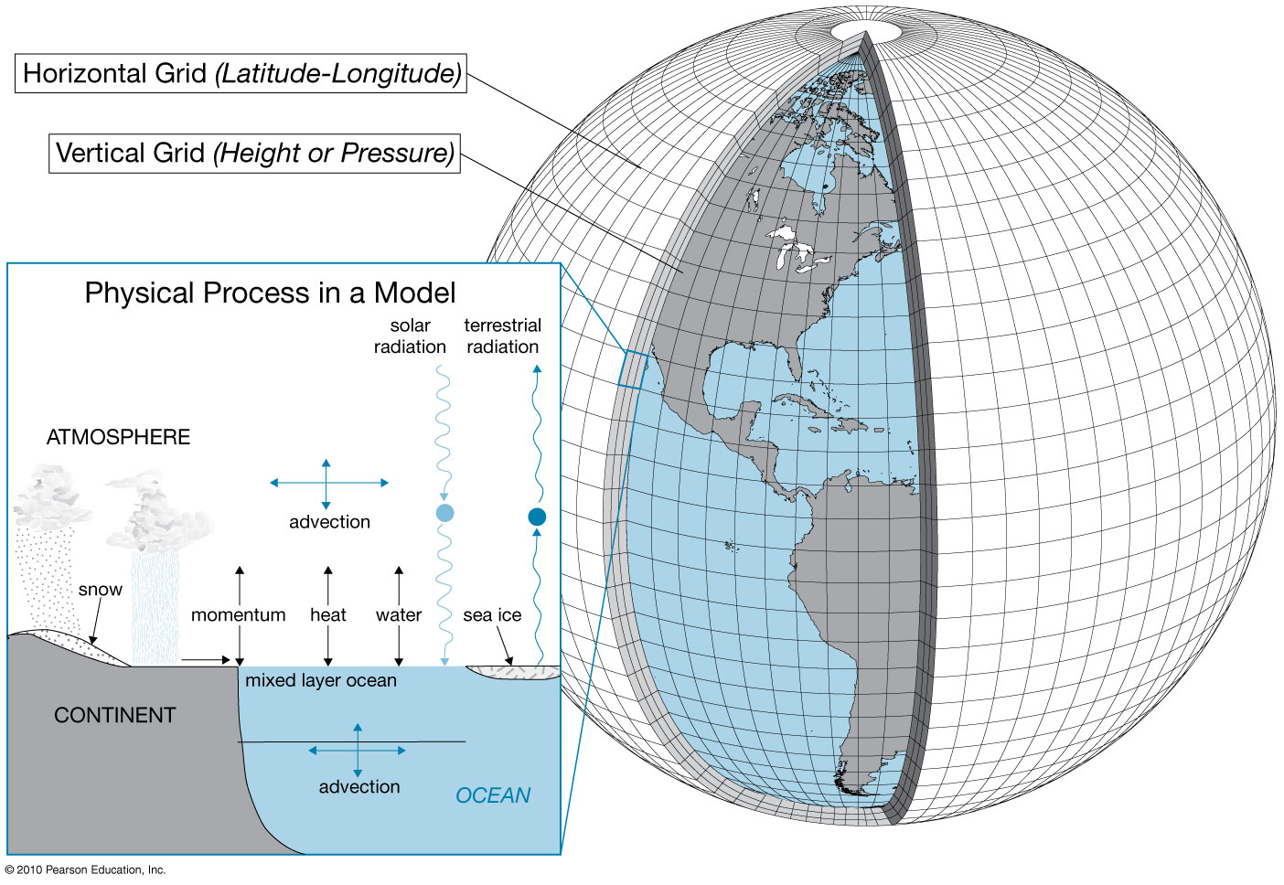

Slide 10
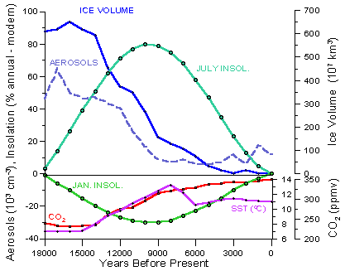
Inputs for the last 18,000 years:
insolation from the astronomical factors. N. hemisphere summer insolation peaked 9,000 years ago. (winter insolation is opposite)
Glacial ice cover ↓
Aerosol dusts declined as glacial till gets vegetated.

Slide 11
Inputs for the last 18,000 years:
CO₂ steadily ↑. As ocean warmed, it releases CO₂.
fed into model for geographic patterns

Slide 12
The Holocene
Sahara is now very dry.
wetter conditions suggested by:
cave paintings
lake sediments with fossils like crocodile teeth and hippo’s bones

Slide 13
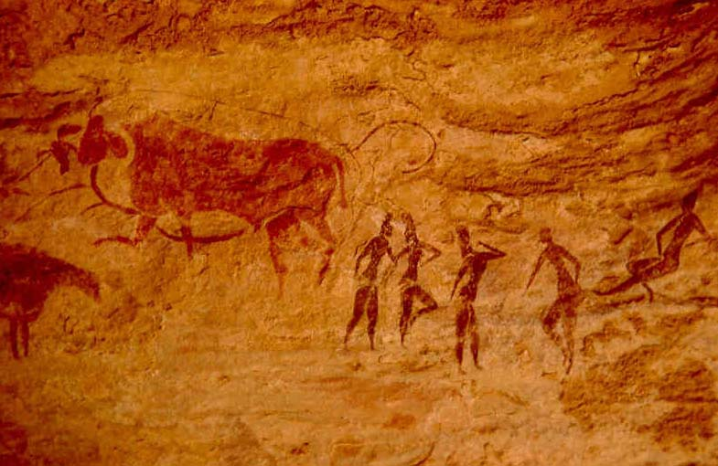
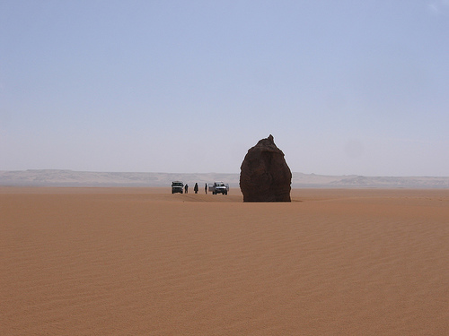

Slide 14
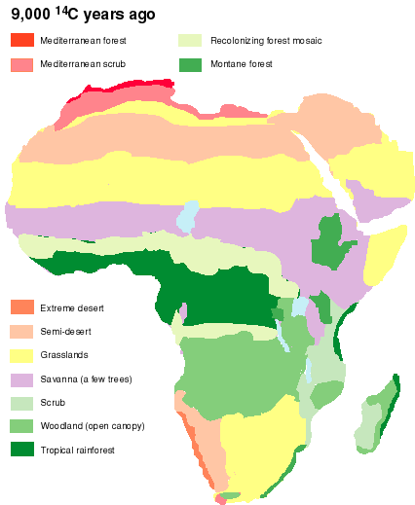
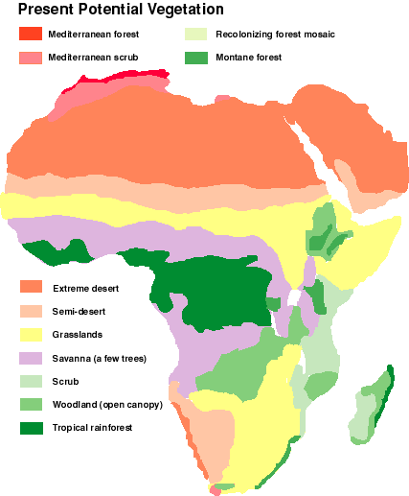
9,000 years ago, no extreme desert.
wetter and warmer?

Slide 15
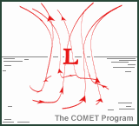
Saharan summer monsoon:
- Warming creates low pressure in desert,
pulling moist air from Atlantic Ocean.
- 9,000 years ago, summer insolation at peak,
created stronger low pressure;
pulled moist air further inland.
allowed Sahara to have lakes etc.

Slide 16
Holocene
Western USA lakes sediments above current water level, so lakes used to be deeper.
12,000 years ago: All western USA was wetter.
6,000 years ago: SW USA was still wetter than now, but PNW USA became even drier than today.
Why? Model on wind and precipitation.

Slide 17
Mono Lake CA

Slide 18
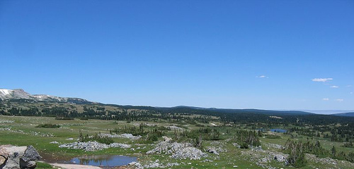
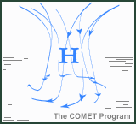
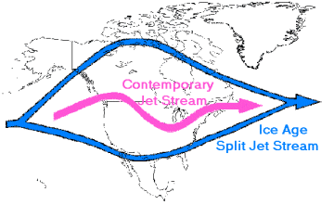
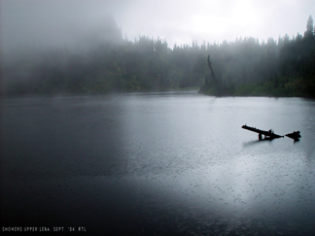
Wind predictions:
Present: summer high pressure
winds from land to ocean, so clear and dry.
12,000 years ago, ice sheet pushed jet-stream south.
Jet-stream means arctic and tropical air meet: frontal precipitation.
Winds went from ocean to land.

Slide 19
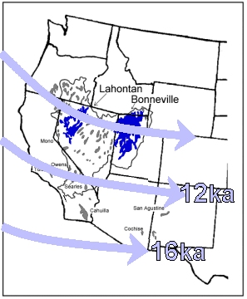
By 6,000 years ago, ice sheet retreated north.
PNW USA dried out as dominated by high-pressure system rather than jet stream; summer insolation was great.
SW USA has enhanced summer monsoon, so the lake level was still higher there than now.

Slide 20
How Did Humans Reach North America?
Humans left Africa ~150,000 years ago [fossils and mitochondrial DNA]
Arrival and dispersal hypotheses:
#1 Bering land-bridge (LB) formed, then ~40,000 years ago, temporary ice-free corridor
#2 LB, then ~14,000 years ago, permanent ice-free corridor
#3 LB, then along coastline by foot and boat
#4 by boat from Asia/Australia
Possibly all, but evidence suggests #2.

Slide 21
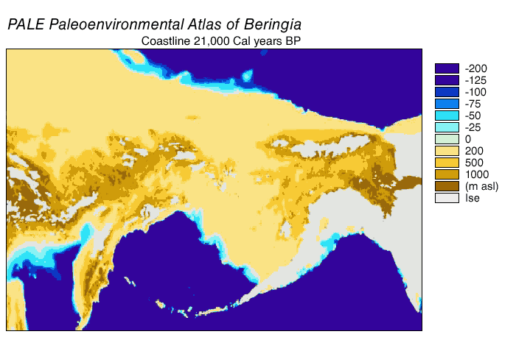
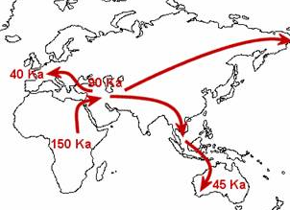

Slide 23
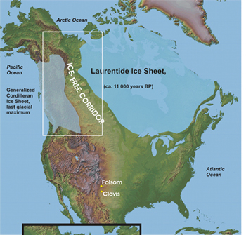
How Did Humans Reach North America?
Ice-free corridor east of Rocky Mountains
open tundra environment w/ large mammals;
hunters followed them.

Slide 24
How Did Humans Reach North America?
Migration evidence:
#1 Clovis points spread north to south
#2 Megafauna extinctions follow
75% of megafauna extinct
also, from north to south
Megafauna had survived interglacial, so human arrival is most likely.

Slide 25
