Slide 1
Energy balance and the greenhouse effect
GEO101
Spring 2023

Slide 2
Contents
Temperature
The urban heat island
Atmospheric structure
Physical Causes of the Greenhouse Effect
Effects of Clouds
Climate Feedbacks

Slide 3
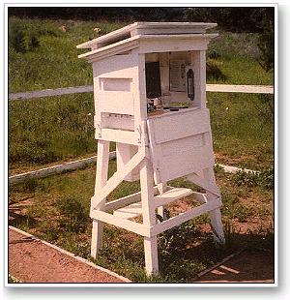
Temperature
Thermometers describe energy (temperature is not the same as heat)
Temperature declines with height in the troposphere.
Warm air is less dense than cold air.
Warm air rises.
Cold air sinks.

Slide 4
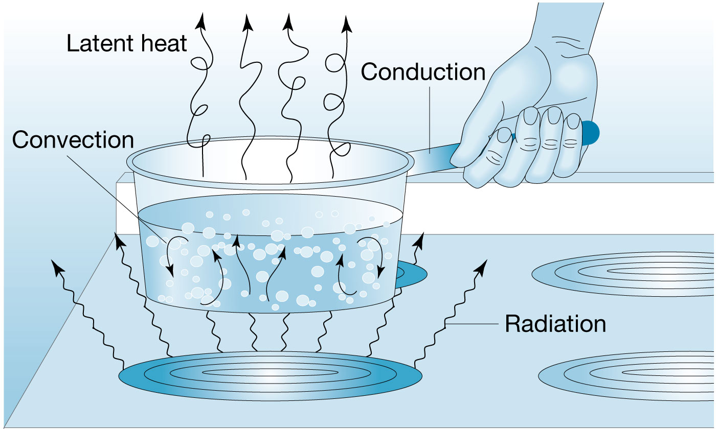
Movement of Heat (Energy Transfer)
Radiation (e.g. from the Sun)
Conduction (by contact of one object with another)
Convection (by transferring energy in liquid or gas)
Latent Heat (re appears if water vapor condenses)

Slide 5
Factors affecting air temperature
Insolation - daily and seasonal variations
Latitude - also daily and seasonal variations, and energy deficit
Surface type - albedo of surface as well as surface moisture
Coastal vs. interior location - temperature range is lower at coasts
Elevation - thinner atmosphere means less greenhouse effect

Slide 6
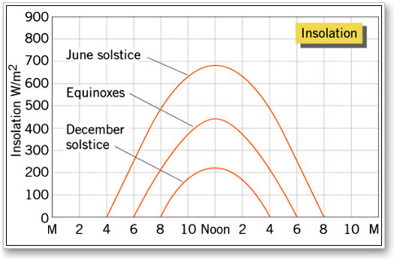
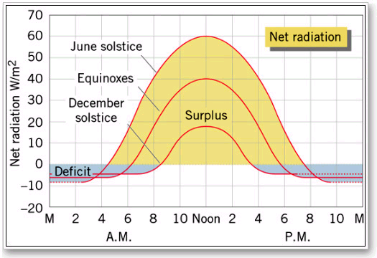
Daily Insolation - Mid-latitude
varies with time of day and season
Early or late in the day there is a deficit.
The length of time for a surplus also changes seasonally.

Slide 7
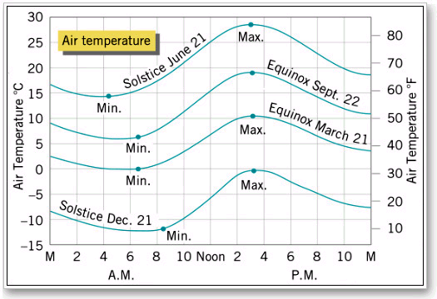
Daily Insolation and temperature - Mid-latitude
daily maxima and minima
Positive net radiation leads to an increase in temperature, but there is a time lag.

Slide 8
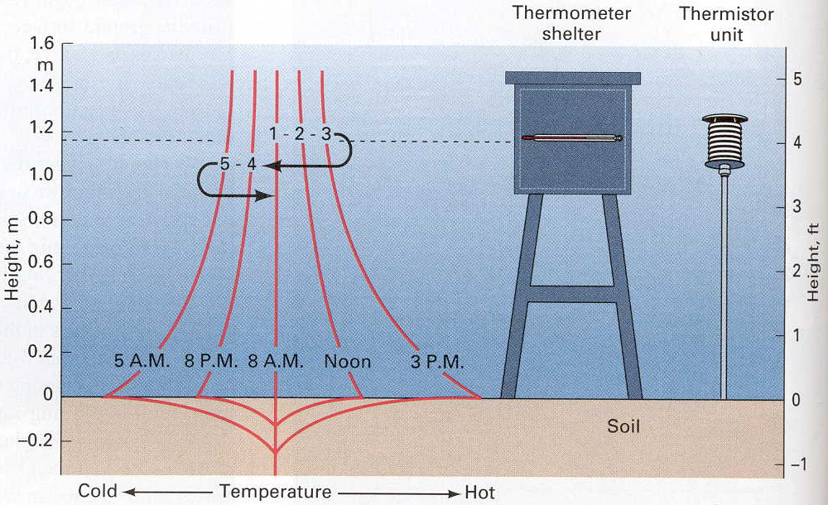
Time (Cycle) and 1-D Space (Profile)
Daily temperature profiles close to the ground at five times of a day. The soil surface becomes very hot by midafternoon but cools greatly at night.

Slide 9
Time (Cycle) and 2-D Space (Pattern)
Thermal infrared images show the urban heat island effect over downtown Atlanta, Georgia in May 1997. Left is a daytime image, and right is a nighttime image.

Slide 10
Temperatures - rural areas
Transpiration from leaves cools the air.
Evaporation from moist soils cools the ground.
Temperatures - urban areas
Water is channeled so surfaces tend to be dry.
Surfaces, like asphalt, are often dark.
Heat could be generated inside the building and then released.

Slide 11
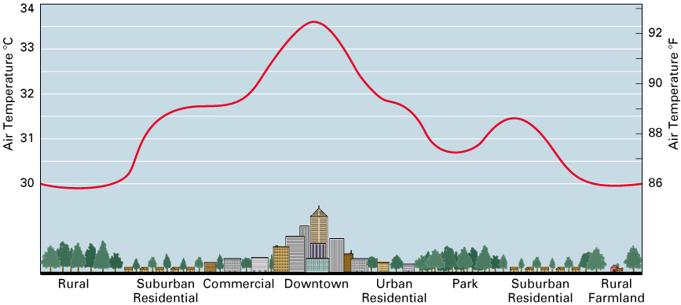
The Urban Heat Island
The heat island tends to persist overnight.
Parks can reduce the heating.
Desert urban areas often do not exhibit heat islands, where irrigated vegetation may make the city cooler.

Slide 12
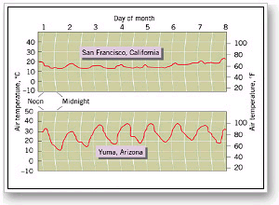
Maritime and continental climates
Land heats and cools quickly while water heats and cools slowly.
During a year an ocean surface has a smaller annual range of temperature (maritime climates).

Slide 13
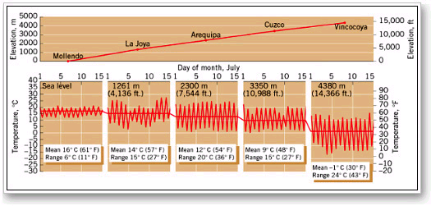
Elevation and Temperature
Generally temperatures drop with altitude.
Daily temperature range increases due to decreased greenhouse.

Slide 14
Normally temperature decreases with height
but sometimes upper air is warmer than lower air = temperature inversion
occurs if the ground cools overnight
Cold air may flow into an area.

Slide 15
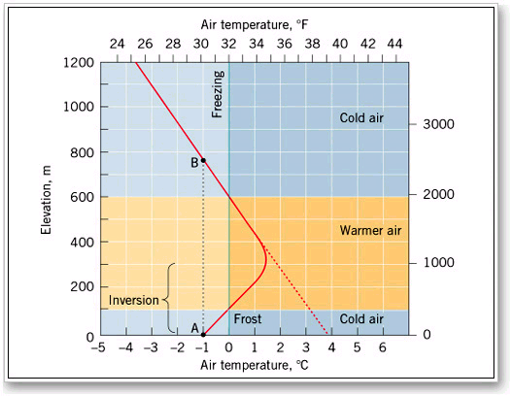

Slide 16
The Earth’s Atmosphere
atmosphere = gaseous envelope surrounding the Earth
made up of a series of concentric layers
Atmosphere is held down by gravity.
Most of the atmosphere’s mass is near the surface.

Slide 17
The structure of the atmosphere
The troposphere is the lowest atmospheric layer (nearest to the ground)
Temperature decreases on average by 6.4˚C per 1000 meters in the troposphere (environmental lapse rate).

Slide 18
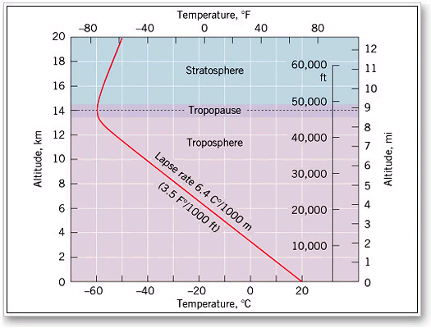

Slide 19
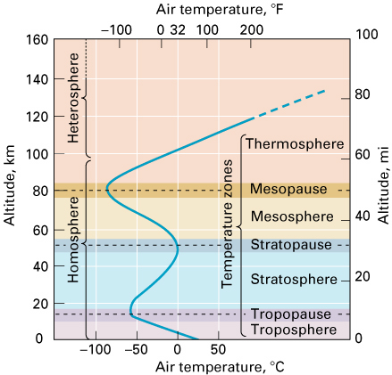
Troposphere bounded by the tropopause (~12km)
Above this is the stratosphere.
In the stratosphere temperature increases with altitude.
Ozone layer absorbs ultraviolet (UV) radiation.

Slide 20
Stratosphere is bounded by the stratopause.
Above is the mesosphere where temperatures fall with altitude.
Mesosphere is bounded by the mesopause. Above is the thermosphere.

Slide 21
Greenhouse Effect
How greenhouse effect works:
SW radiation from sun…
some absorbed by Earth
LW radiation from Earth…
some absorbed by GHGs
LW radiation is re-emitted by GHGs,
some absorbed by Earth, etc.
This is the GHE.
how do the GHGs have this effect?

Slide 22
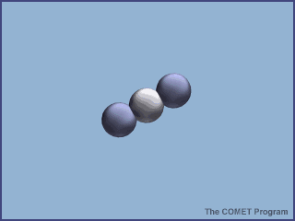
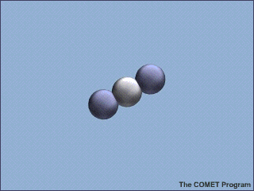
Physical Causes of the Greenhouse Effect
Molecules and LW radiation:
GHGs absorb LW by rotating/vibration.
Each GHG responds to specific λ.
diff. peaks correspond diff. motions
if “wrong” λ, then no effect.

Slide 23
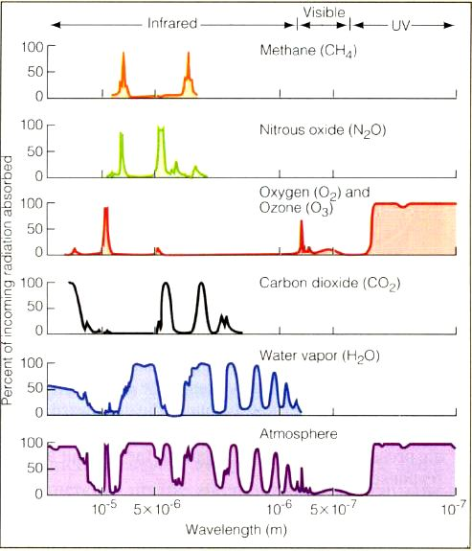

Slide 24
Physical Causes of the Greenhouse Effect
LW radiation is stored by molecule.
LW then emitted again.
GHGs have this unique ability. Other gases do not.

Slide 25
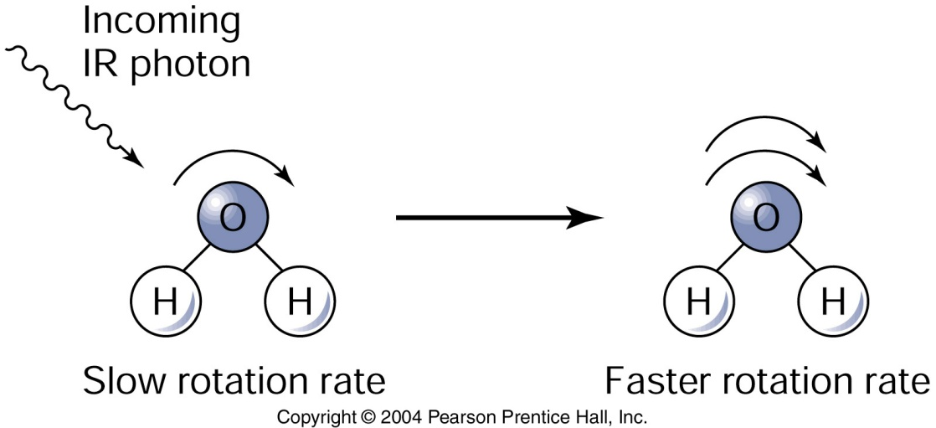
Physical Causes of the Greenhouse Effect
H₂O molecular motions:
Molecules can only rotate at specific rates (r sec⁻¹).
To change their rotation rate, they need to be impacted by a photon with the right energy.

Slide 26
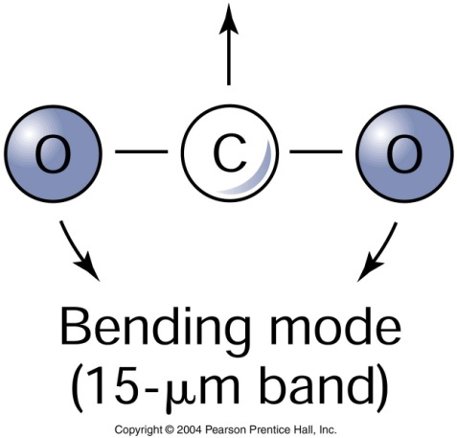
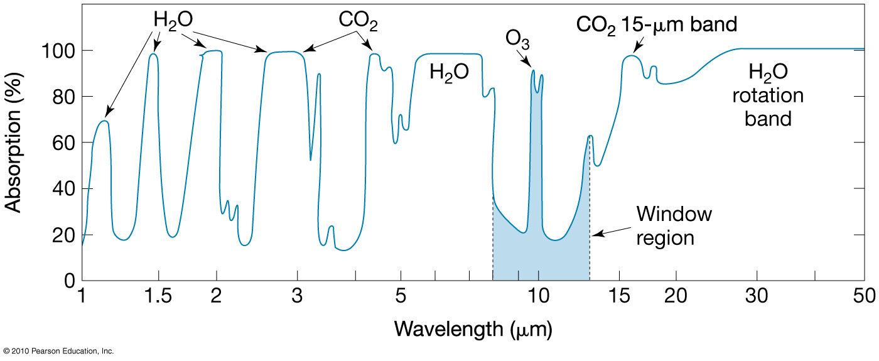
Physical Causes of the Greenhouse Effect
CO₂ molecule can vibrate in three ways.
bending mode of vibration:

Slide 27
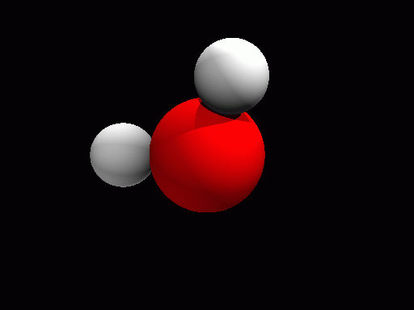
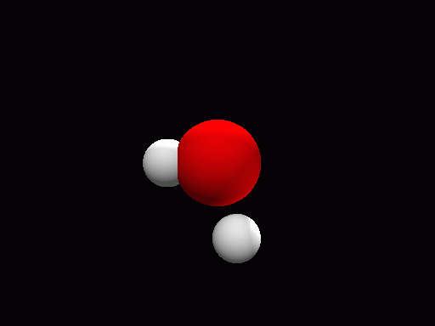
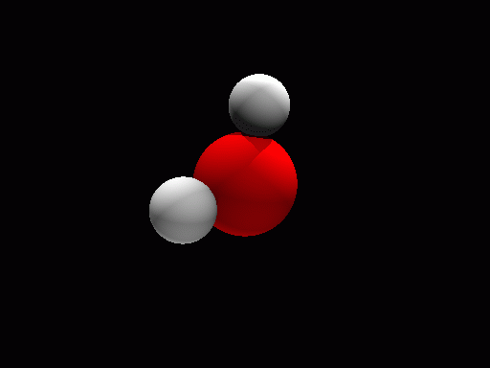
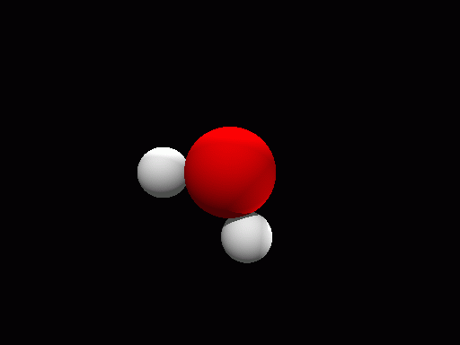
molecular motions
rotating
Vibrating:
asymmetrical stretching
Vibrating:
symmetrical stretching
Bending mode of vibration

Slide 28
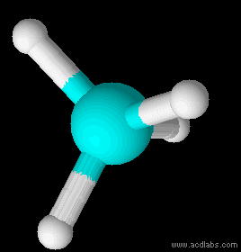
molecular motions
Larger molecules
= greater GHE per molecule
e.g., CH₄ vs. CO₂
Vibrating: bending

Slide 29
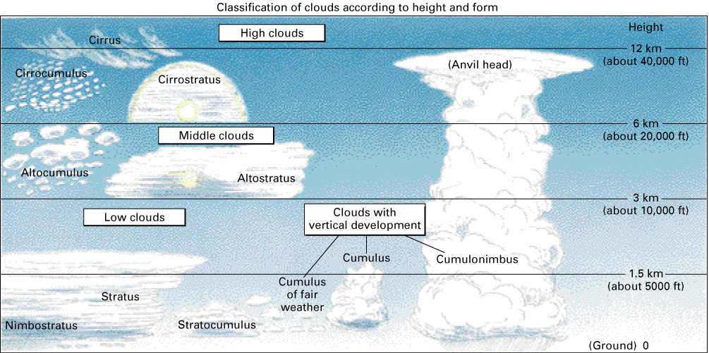
Classification of clouds according to height and form

Slide 30
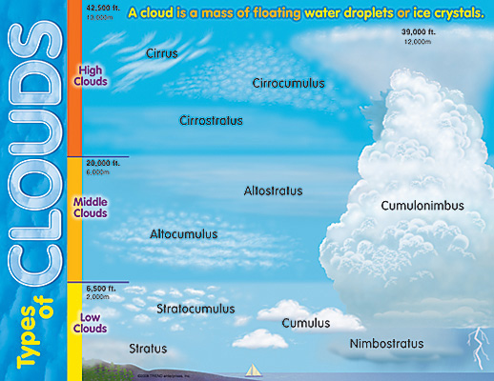
Effects of clouds
classify by height, thickness…
GHE and clouds: high v. low
high clouds: cold, thin
low clouds: warm, thick
dual role:
reflect SW, cloudy days therefore cooler.
absorb LW, cloudy nights therefore warmer.

Slide 31
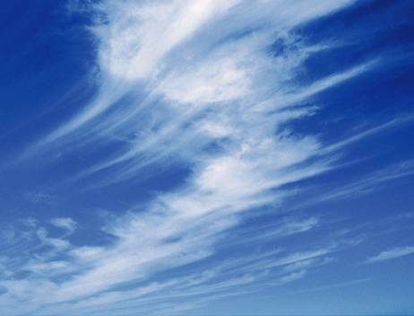
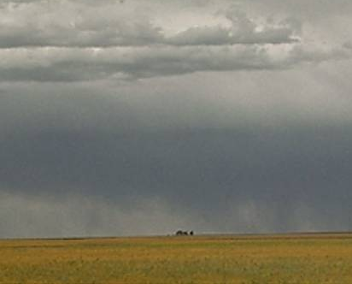
High cirrus clouds vs. low stratus clouds
The elongated ice crystals in cirrus clouds allow much of the incident solar radiation to pass through.
Stratus clouds reflect much of the incoming visible radiation.
Low clouds are warmer than high clouds, so the warm low clouds emit more LW radiation back to space.
Overall, high clouds = net warming, low clouds = net cooling

Slide 32
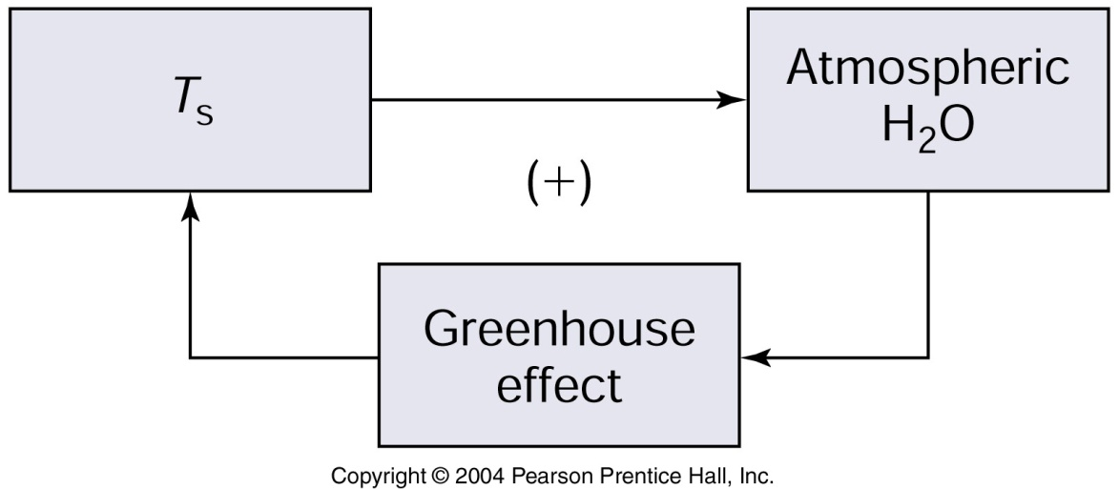
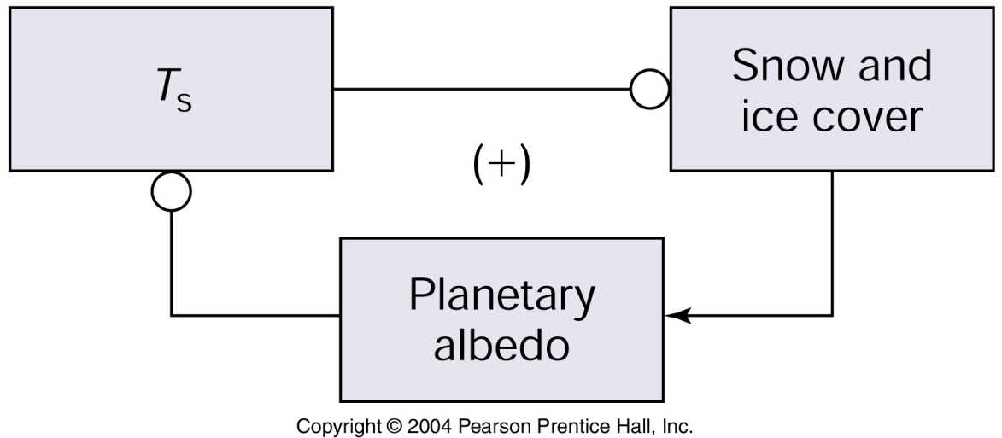
Climate Feedbacks
water vapor:
warming causes more evaporation.
PFB for more warming.
snow/ice and albedo:
warming reduces albedo…
PFB for more warming.

Slide 33
Climate Feedbacks
LW flux and temperature FB
= NFB response to warming = stability

