Slide 1
Global Energy Balance
GEO101
Spring 2023

Slide 2
Contents
Electromagnetic radiation
Solar and Earth’s radiation
Incoming solar radiation
Composition of the atmosphere
Energy balance

Slide 3
Energy
Systems have inputs or outputs of both matter and energy.
Energy occurs in different forms.
Energy transforms from one type to another.
Energy occurs in some form everywhere, is essential for life and all processes.
Energy cannot be created or destroyed (first law of thermodynamics).

Slide 4
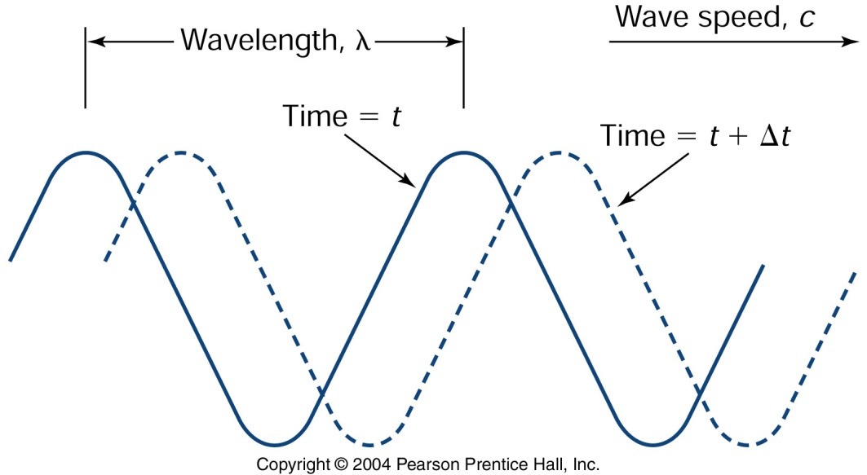
Electromagnetic radiation
Fundamental properties…
wave-particle duality:
As a wave, it’s a cycle.
λ = wavelength in μm (micrometers)
ν = frequency (peaks sec⁻¹)
c = speed of light (constant)…
λν = c
inverse relation between λ and ν
as particle:
photon: the smallest amount of energy carried by given wavelength
E = hν
h = Planck’s constant [6.63 * 10⁻³⁴ joule seconds]
E increases with ν, so what does that mean for wavelength?

Slide 5
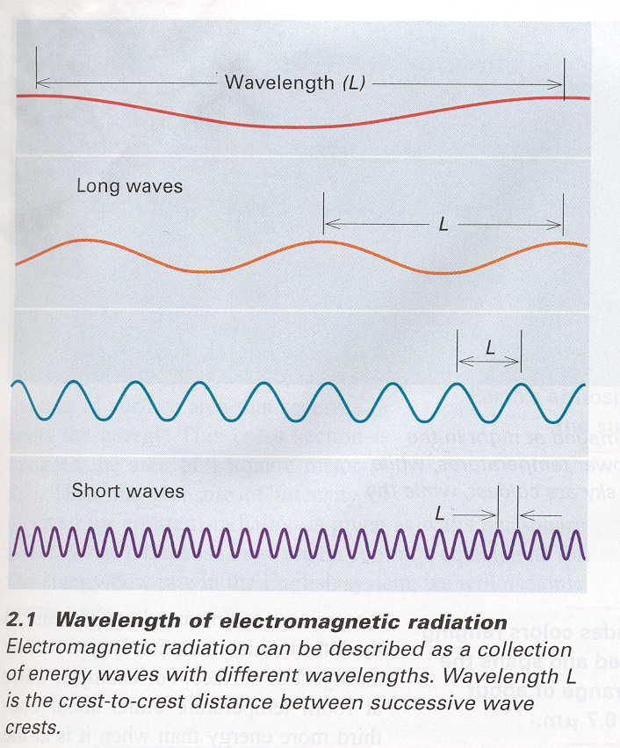

Slide 6
Remote Sensing
allows us to obtain information about the surface of a planet by using instruments that are not in direct physical contact with the surface
Sensors detect radiation from different parts of the spectrum, e.g. infra-red, visible.

Slide 7
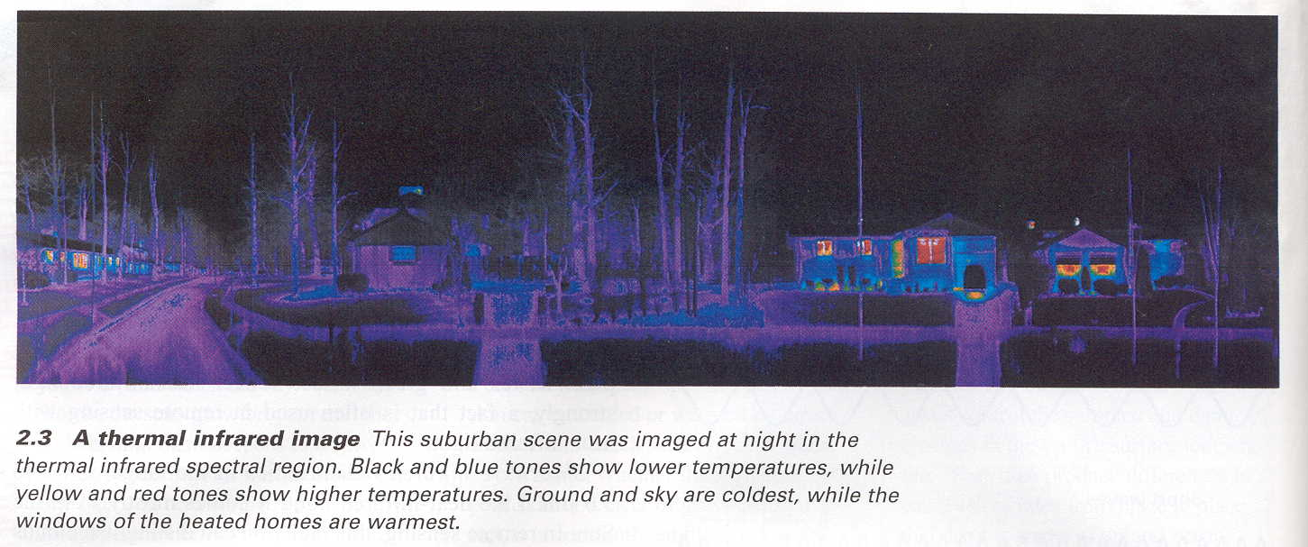

Slide 8
Electromagnetic spectrum
Divided into different wavelengths
Different objects produce different wavelengths.
Unit measure is micrometer (1m / 1million)

Slide 9
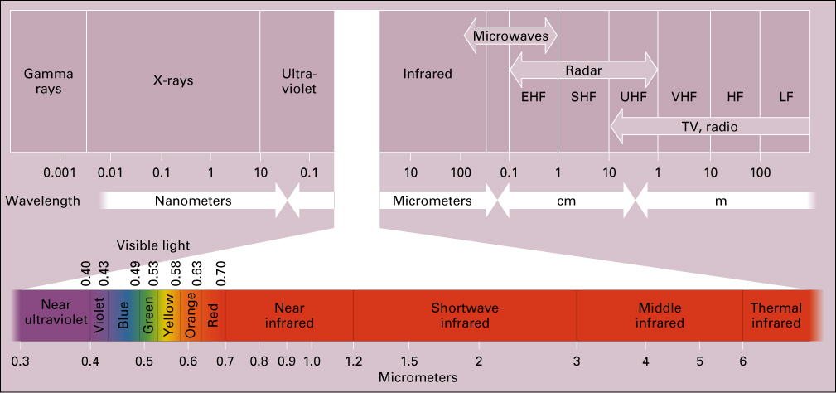

Slide 10
Blackbody Radiation
a blackbody: 100% efficient
It has the following physical laws:
Planck function:
shows flux (emission) across λ
rises very sharply at short wavelength
reaches a peak at some wavelength
then falls gradually at longer wavelengths
serves as a model for other, non-blackbody objects.

Slide 11
Radiation
Everything above -273˚C (or 0˚ K) emits radiation.
The warmer the object, the shorter the wavelength.
Sun emits mostly in shortwave
Earth emits mostly in longwave

Slide 12
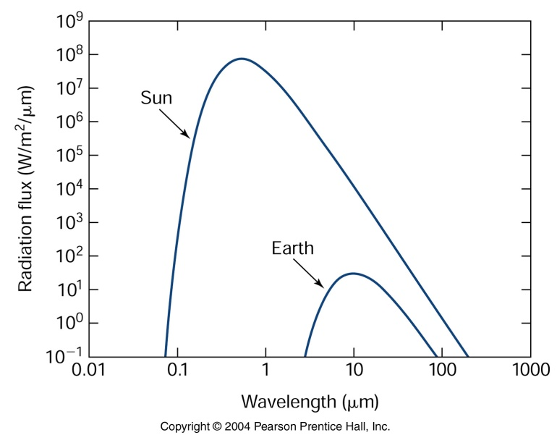
Black body radiation of the Sun and the Earth
Wien’s Law

Slide 13
Characteristics of Solar Energy
Solar radiation emitted at short wavelengths close to that of a blackbody.
Some absorbed by the Earth’s atmosphere before it arrives at the surface e.g. by ozone.

Slide 14
Characteristics of Earth’s Energy
Earth’s radiation emitted at long wavelengths
Much is absorbed by the Earth’s atmosphere before it leaves e.g. by carbon dioxide.

Slide 15
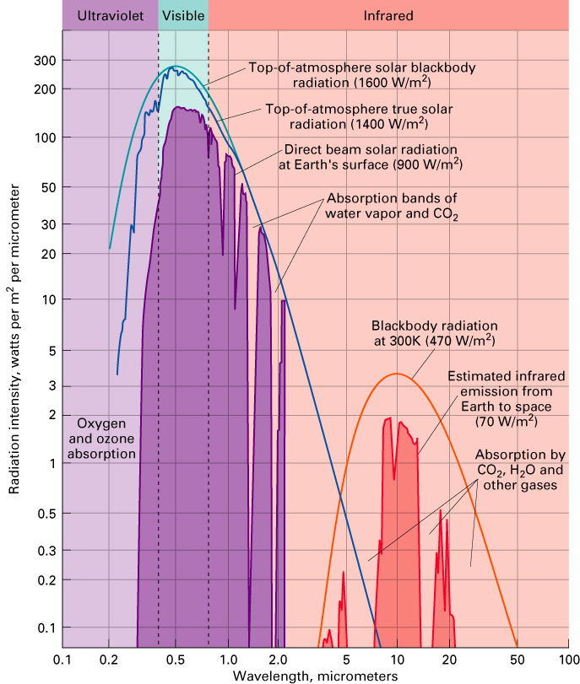

Slide 16
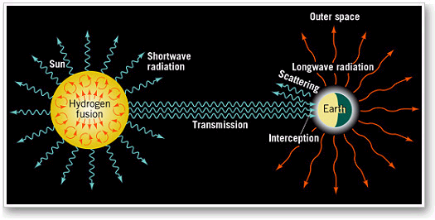
Incoming solar radiation
measured in units of watts per square meter
therefore varies by latitude and by season

Slide 17
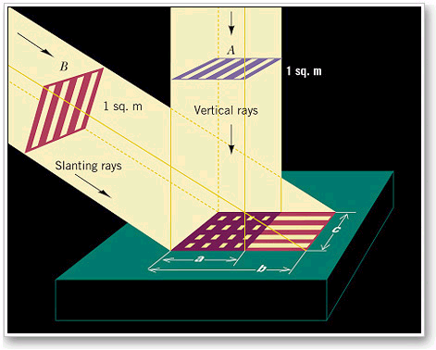
A = as if overhead - insolation at its greatest
B = slanted - same energy spread of larger area

Slide 18
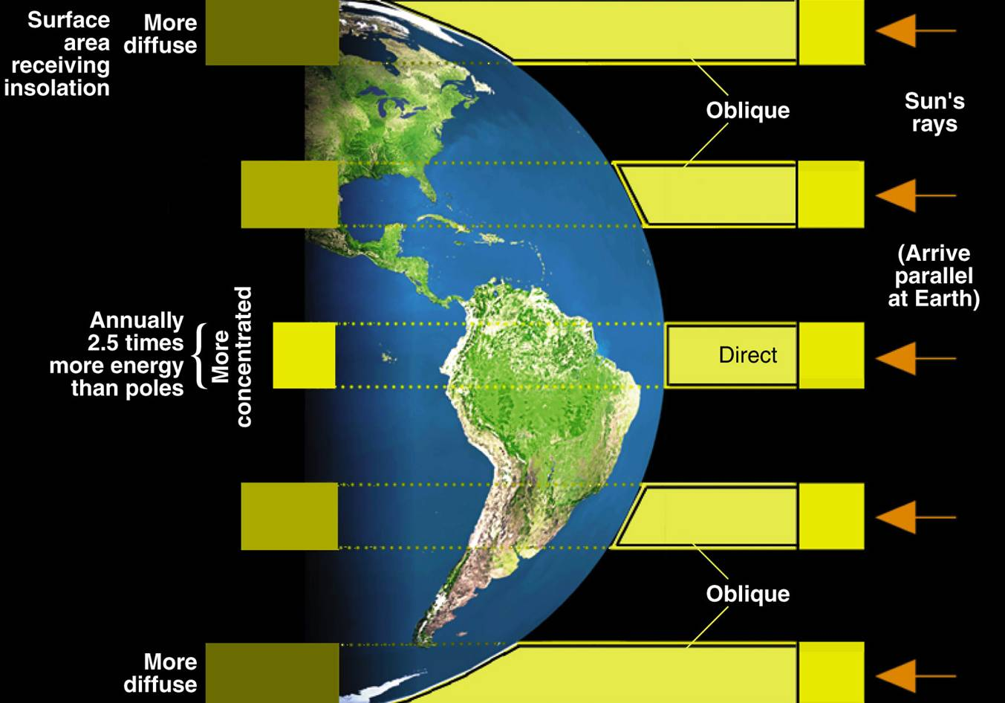

Slide 19
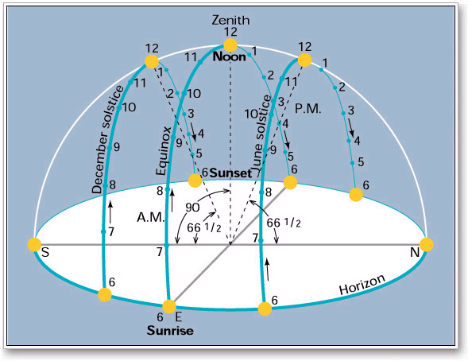
Insolation varies with the Sun’s passage in the sky e.g. passage of the Sun at the equator.

Slide 20
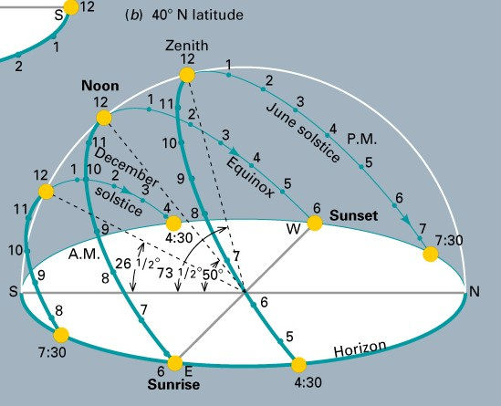
Insolation varies with the Sun’s passage in the sky e.g. passage of the Sun at mid latitudes.

Slide 21
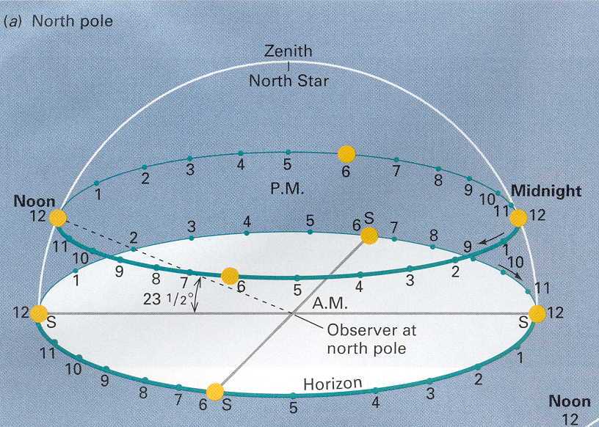
Insolation varies with the Sun’s passage in the sky e.g. passage of the Sun at the north pole.

Slide 22
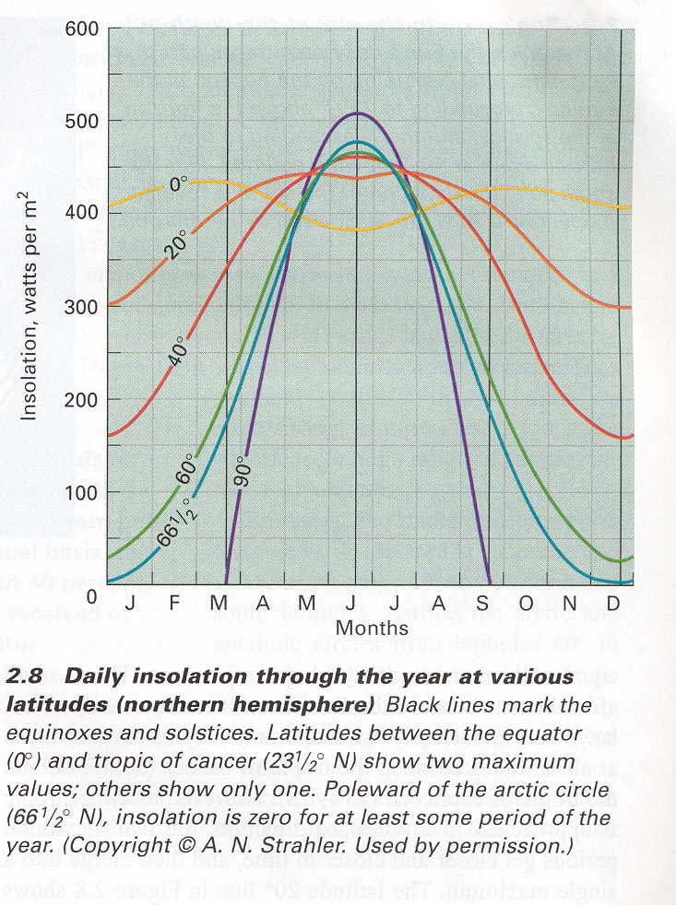

Slide 23
World Latitude Zones

Slide 24
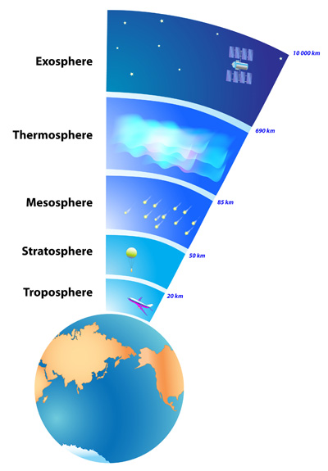
Atmospheric Thermal Structure
(a) The atmosphere extends 6,000 mi
[vs. Earth’s radius, 4,000 mi]
But, 75% of mass is in bottom 10 mi.
(b) troposphere – 10 mi up
As altitude temperature
Why? density,
and GHGs
(c) In stratosphere, temp with altitude.
Why? Ozone absorbs SW and LW…

Slide 25
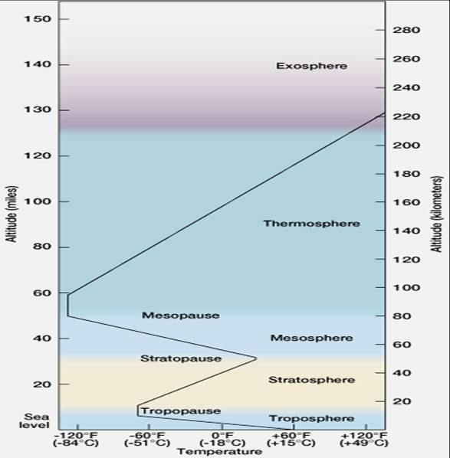

Slide 26
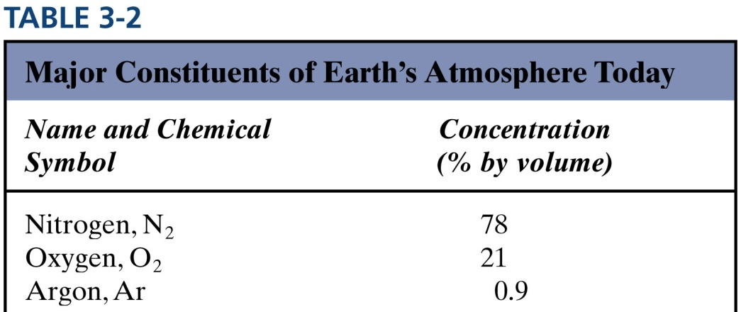
Composition of the Atmosphere
3 common gasses = 99.9%
#1 N₂ – usually inert
#2 O₂ – very reactive
#3 Ar – inert

Slide 27
Composition of the atmosphere
Greenhouse Gasses (GHGs):
6 key players
H₂O – up to 4% [40,000 ppm]
CO₂ – 408 ppm in 2016
CH₄ – methane (natural gas)
N₂O – nitrous oxide
O₃ – surface (not stratospheric)
Freons – [CFCs]

Slide 28
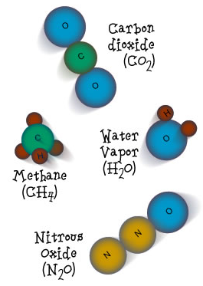
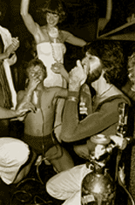
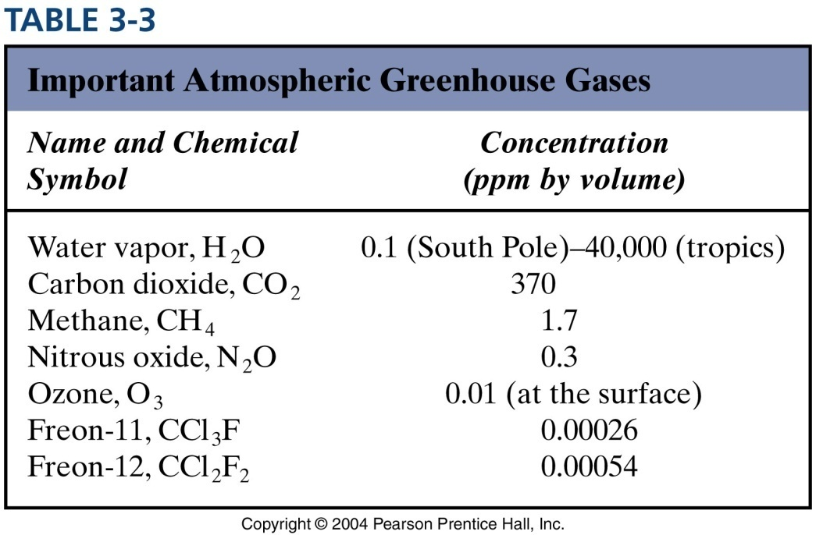
O₃

Slide 29
Earth’s energy balance
Albedo = % radiation
not absorbed
surfaces vary:
snow: 90%
water bodies: 35%
forests: 15%
Earth: ~30% (or 0.30)

Slide 30
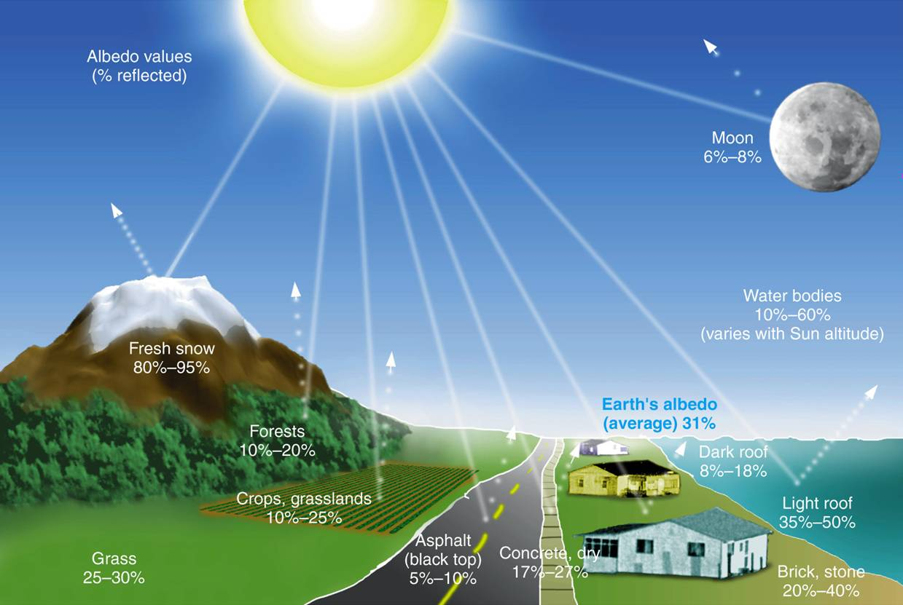

Slide 31
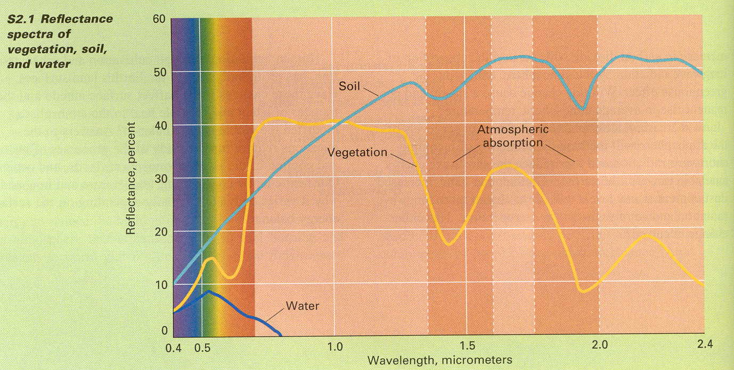

Slide 32
Heat
Sensible heat = heat you can sense e.g. warmed air
Latent heat = heat used in the evaporation of water or liberated in condensation
Latent heat transfer = transfers heat from an evaporating surface to the atmosphere

Slide 33
Earth’s energy balance
Earth’s surface temperature…
#1 incoming Solar energy
#2 Earth reflecting away (albedo)…
#3 Energy emitted by Earth…
#4 Earth’s greenhouse effect

Slide 34
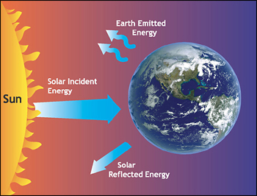
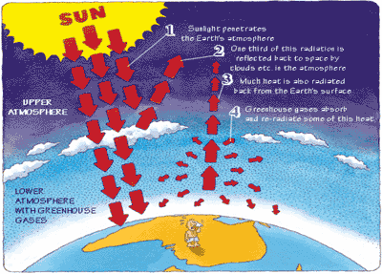

Slide 35
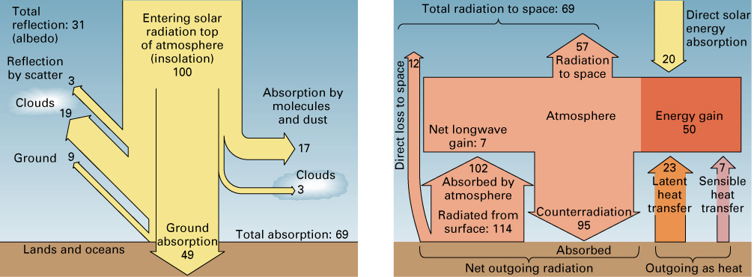
Earth’s Energy Balance

Slide 36
Diffuse radiation
Under clear skies, 80% of insolation may reach the ground.
Under cloudy skies, this is much less (45 to 10%).
When scattering, sends this radiation back to space - diffuse reflection

Slide 37
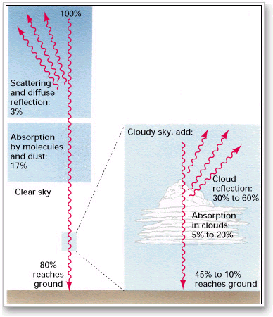

Slide 38
Net radiation
difference between incoming and outgoing radiation
At high latitudes there is an energy deficit.
Poleward heat transfer moves surplus energy from low to high latitudes.

Slide 39
