Slide 1
Introduction to the Carbon Cycle
GEO101
Spring 2023

Slide 2
Contents
A Brief Overview
Carbon Reservoirs and their Dynamics
Types of Carbon
Organic Carbon Cycling
Short-Term Terrestrial Organic Carbon Cycle
Short-Term Marine Organic Carbon Cycle

Slide 3
A brief overview
Earth is only planet w/ life.
“just-right” distance from sun
Water is essential.
Venus: H₂O vapor = no life = no C cycle
Mars: ice
Mercury: small, atmosphere no GHG
Temperature: Venus > Mercury > Earth > Mars

Slide 4
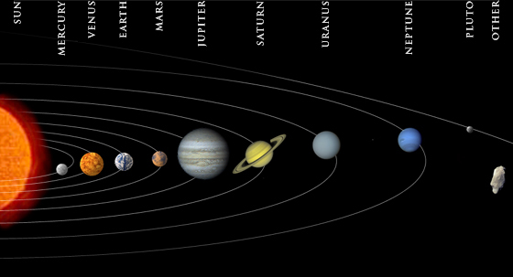
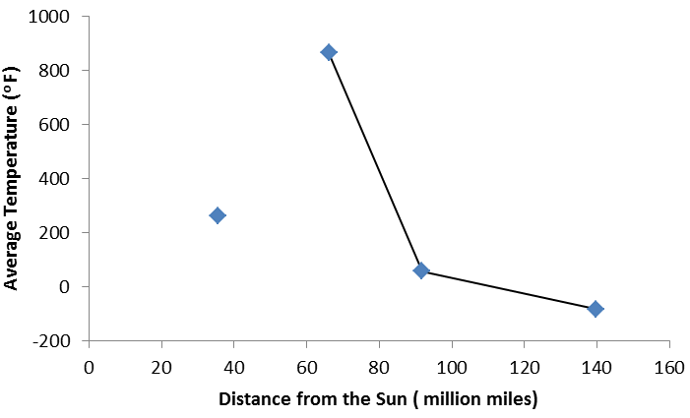

Slide 5
A brief overview
Earth is only planet w/ life.
Recycling of essential nutrients occurs on Earth.
Recycling is the movements of water, life, soil, atmosphere, etc.
Without these processes, nutrients get “locked up”

Slide 6
Carbon cycle
Carbon is one of the most important nutrients for life.
part of living organism and it is greenhouse gas.
Three carbon-cycles:
short-term terrestrial: photosynthesis and respiration
short-term marine: phytoplankton
long-term cycles: through volcanic activity, rock weathering, and burial of sediments

Slide 8
Carbon Reservoir Dynamics
Where is the carbon?
Carbon reservoirs are components that hold carbon.
rock, ocean water, fossil fuels, sediments, atmosphere, and living organism.

Slide 9
Living organisms
Atmosphere
Sediments
Fossil fuels
Ocean water
rock

Slide 10
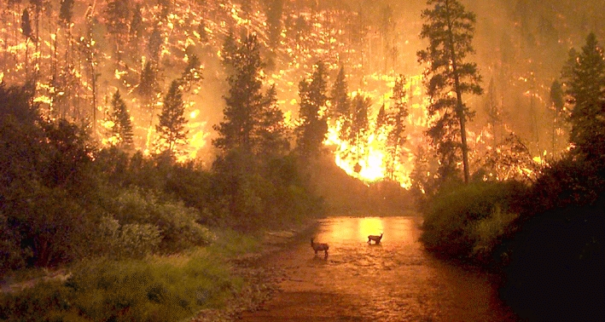
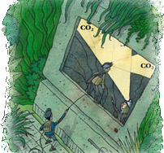
Carbon Reservoir Dynamics
Reservoirs only temporarily hold carbon. For example,
burning forests release carbon into atmosphere.
Even rocks are losing carbon into the atmosphere.

Slide 11
Carbon Reservoir Dynamics
Reservoirs have inflows and outflows.
- atmosphere
- forests have the opposite
- bank account analogy

Slide 12
Carbon Reservoir Dynamics
equilibrium: inflow = outflow
Annually, atmosphere carbon is approximately in equilibrium.
Globally, atmospheric carbon is highest in May and lowest in September.

Slide 13
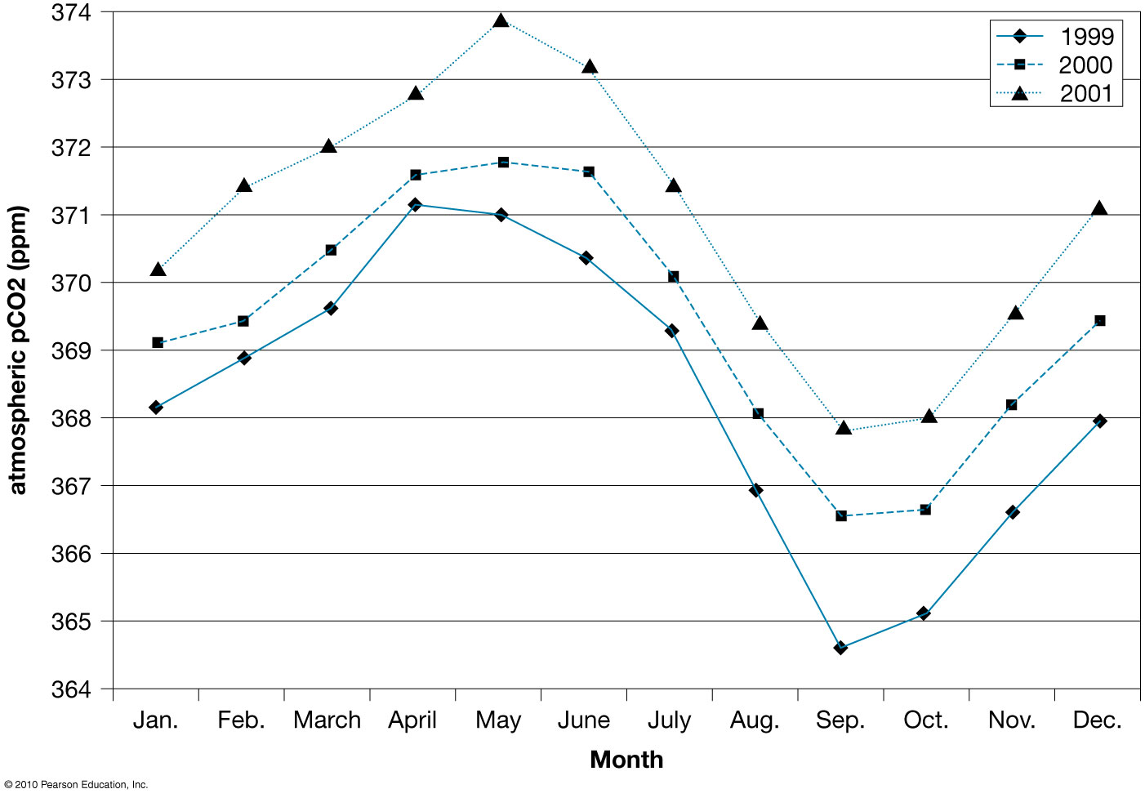

Slide 14
Carbon Reservoir Dynamics
Relation between CO₂ and photosynthesis:
As CO₂ increases, photosynthetic rate increases.
As photosynthetic rate increases, CO₂ decreases.
This negative coupling slows down the change of CO₂ in the atmosphere.

Slide 16
Types of carbon
chemical definitions:
organic C molecules: C w/ C or H
inorganic C molecules: C w/o
problem: organisms create both…
Earth-systems definitions:
organic: stored/moved by biotic processes.
inorganic: abiotic processes
CO₂ could thus be either organic or inorganic.

Slide 17
Types of carbon
oxidized vs. reduced:
Oxidized C is bonded to O, such as CO₂.
Reduced C is not bonded to oxygen, such as CH₄.
Oxygen is highly reactive; thus, reduced carbon is easily converted to the oxidized form.
Evolution of life changed atmosphere, more O₂, resulting more oxidized elements.

Slide 18
Organic Carbon Cycling
photosynthesis involves reduction of CO₂:
CO₂ + H₂O + sun energy → CH₂O (carbohydrate) + O₂
Plants/algae have pigments or chlorophyll that allows them to photosynthesize.
6CO₂ + 6H₂O + sun energy → C₆H₁₂O₆ (glucose) + 6O₂

Slide 19
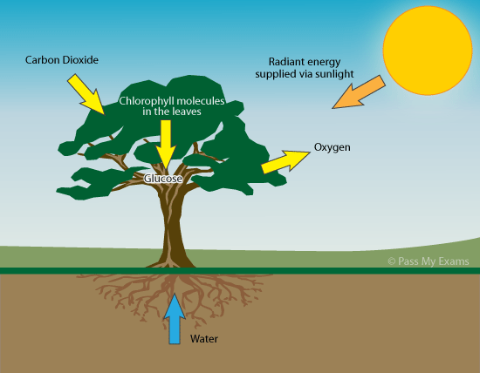
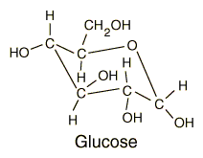
C₆H₁₂O₆

Slide 20
Organic Carbon Cycling
Respiration involves oxidation:
CH₂O + O₂ → CO₂ + H₂O + chemical energy
C₆H₁₂O₆ + 6O₂ → 6CO₂ + 6H₂O + chemical energy
Plants respire all the time…
Animals & bacteria also respire.

Slide 21
Organic Carbon Cycling
methanogenesis: anaerobic decomposition
2CH₂O → CO₂ + CH₄ + chemical energy
C₆H₁₂O₆ → 3CO₂ + 3CH₄ + chemical energy
Occurs when organic matter is wet and little oxygen.

Slide 22
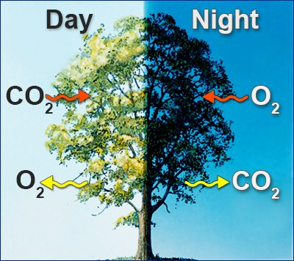
Organic Carbon Cycling

Slide 23
Short-term Terrestrial Organic Carbon Cycle
terrestrial carbon reservoirs:
2.5x more C in soil sediments than in living organisms.
Soils have two types of dead organic carbon:
litter – dead materials
humus – tiny clay particles
coats the mineral matter in the topsoil and make it dark
Reservoir residence time vary from years to centuries.
Carbon in living organisms change more rapidly.
A Year in the Life of Earth’s CO₂

Slide 24
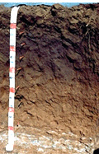
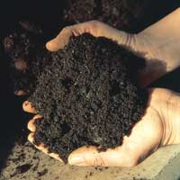
Litter
humus

Slide 25
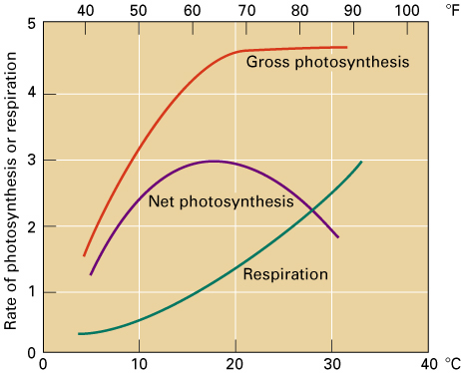
Photosynthesis
Gross Photosynthesis – total amount of carbohydrate produced
Net Photosynthesis – amount of carbohydrate remaining after respiration

Slide 26
Net Primary Productivity
NPP = photosynthesis – respiration
photosynthesis only during growing season
respiration all year
January spatial pattern:
positive: S. Hem
negative: N. Hem
e.g., Buffalo NY…
NPP in July would be opposite.

Slide 27
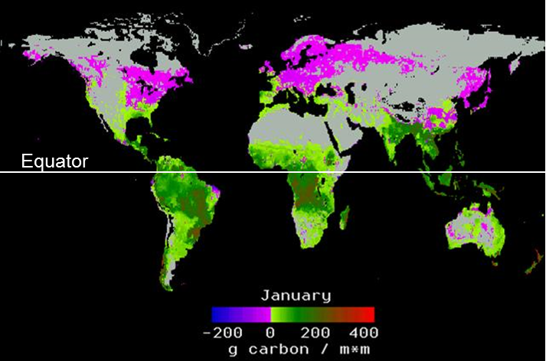
Net Primary Productivity

Slide 28
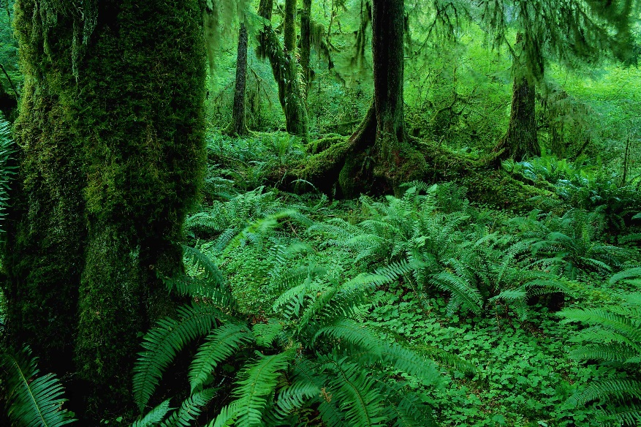
Net Primary Production
Accumulated net production by photosynthesis = biomass (dry weight of organic matter)
Rainforest of equatorial zone – 2000 grams/sq. metre per year

Slide 29
Net Primary Production
Freshwater swamps and marshes – 2500
Mid-latitude forest – 1300
Mid-latitude grassland – 500

Slide 30
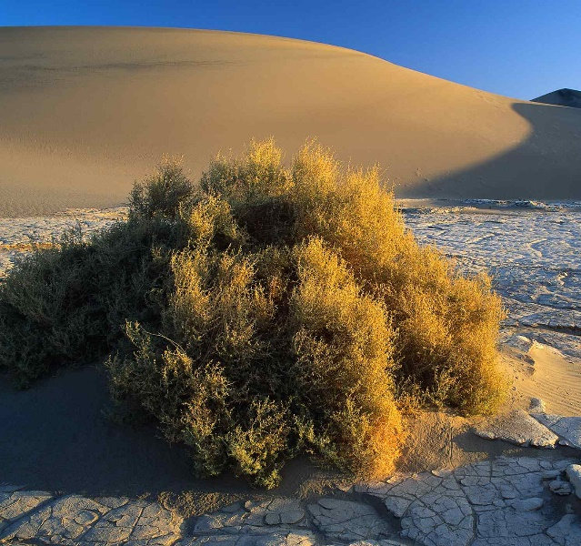
Net Primary Production
Deserts – 3
Algal beds and reefs – 2000
Open oceans – 125

Slide 31
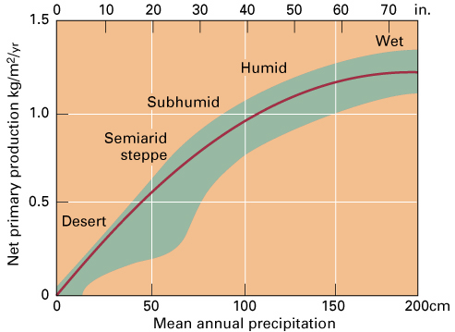
Net Production and Precipitation
Net production increases rapidly with increasing precipitation, but level off at higher values.

Slide 32
Biomass as an Energy Source
Burning of wood, vegetation and other organic materials such as crop residues
Or generate fuels – methane gas, charcoal and alcohol
Useful to reduce emissions of carbon dioxide from the burning of fossil fuels

Slide 33
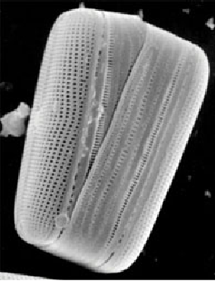
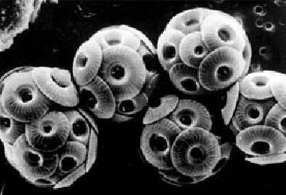
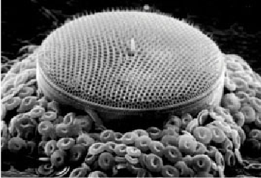
Short-term Marine Organic Carbon Cycle
Phytoplankton: (shown many hundred times their actual size)
Coccolithophores
Diatom
Dinoflagellate
Diatom and coccoliths

Slide 34
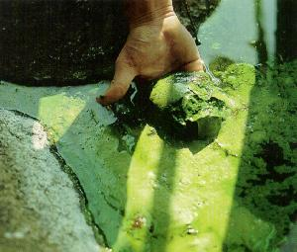
Short-term Marine Organic Carbon Cycle
70% of Earth covered by ocean.
producers: organisms producing food through photosynthesis
Phytoplankton are marine producers.
(most are algae)

Slide 35
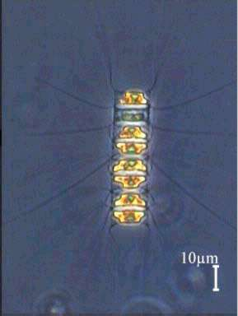
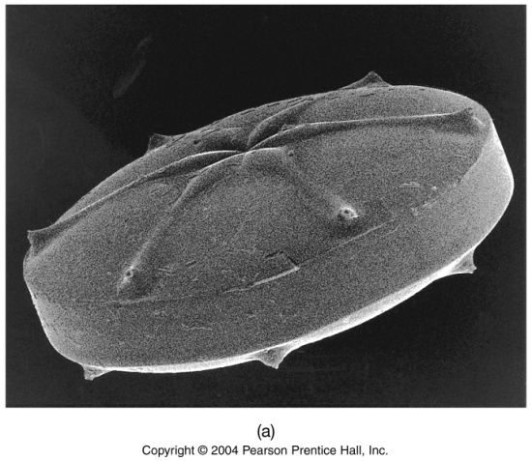
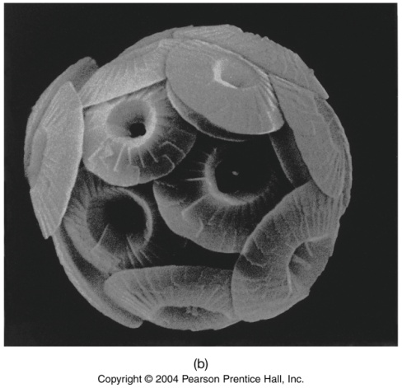
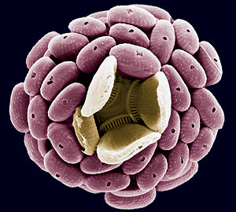
Diatom: SiO₂ (silicon dioxide) shell
coccolithophorids: CaCO₃ (calcium carbonate) shell
Diatom
Coccolithophores

Slide 36
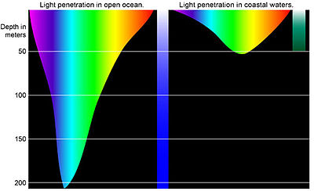
Short-term Marine Organic Carbon Cycle
Phytoplankton photosynthesize, so consume CO₂, and produce O₂ and carbohydrates.
top 100 meters

Slide 37
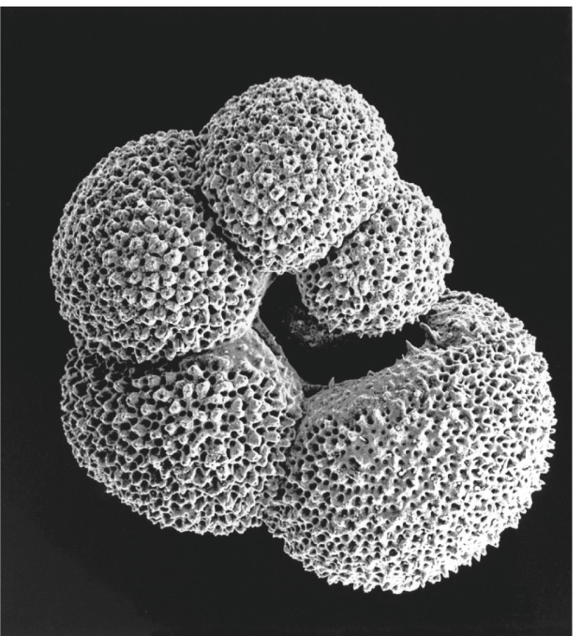
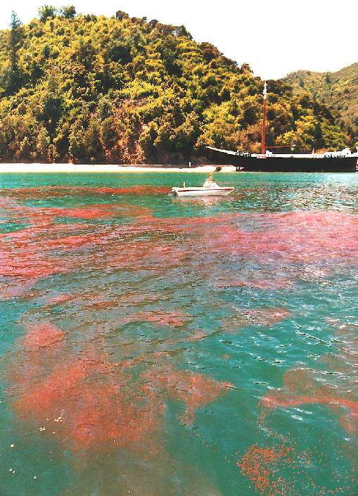
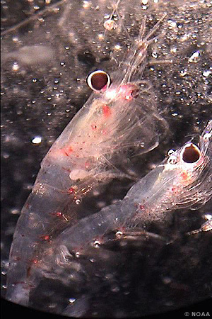
Short-term Marine Organic Carbon Cycle
foraminifera
Consumers are organisms feeding on producers.
Most are zooplankton…
free-floating, CaCO₃/SiO₂ shell
Other organisms swim;
size range from tiny krill to whales
total biomass < plankton
krill

Slide 38
Biological pump
Photosynthesis of phytoplankton reduces CO₂ at surface.
Zooplankton consume phytoplankton.
Waste from zooplankton and dead plankton sink.
Decomposers eat the waste (99.9%).
0.1% of C is not decomposed and buried in ocean sediment.
Net decrease in CO₂ in the ocean water makes atmospheric CO₂ easier to dissolve into the water.
Summarize: more plankton = more waste = more C in sediment = more CO₂ taken out of atmosphere

Slide 39
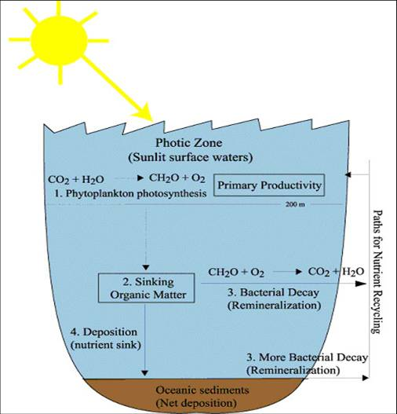

Slide 40
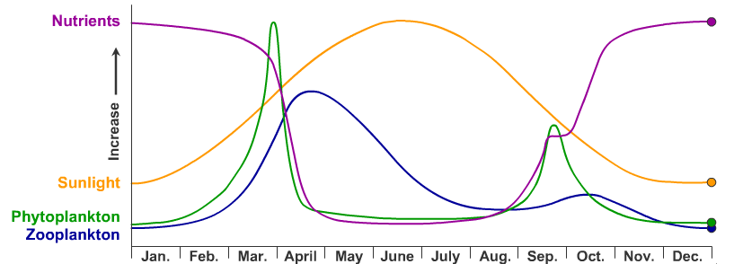
Annual change in sunlight and productivity
Oceanic midlatitude

Slide 41
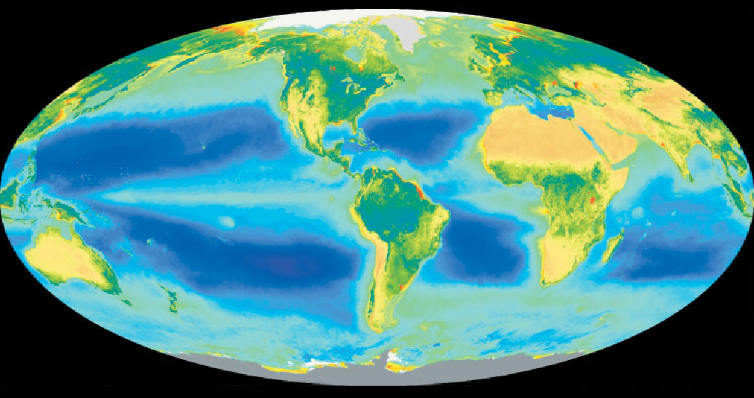
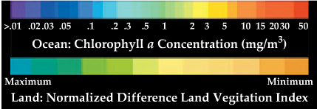

Slide 42
Spatial patterns
Satellites detect pigments of phytoplankton.
July pattern:
only high in high northern latitudes.
On the other hand, terrestrial productivity is high in many latitudes, where it is warm and moist.

Slide 43
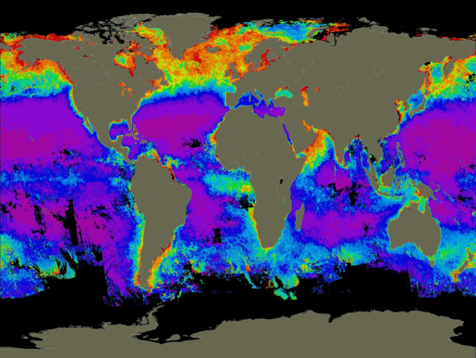

Slide 44
Marine pattern differs from the terrestrial one because:
One of the limitation for plankton growth is nutrient.
Water layer mixing and upwelling of nutrients help plankton.
In high latitudes, dense water sink, mixing the layers.
In other latitudes, mixing is prevented.

Slide 45
Thank you for your attention!

