Slide 1
The Carbon Cycles
GEO101
Spring 2023

Slide 2
Contents
The Short-term Anthropogenic Carbon Budget
The Long-term Organic Carbon Cycle
The Long-term Inorganic Carbon Cycle

Slide 3
Short-term anthropogenic carbon budget
since 1750, human-released CO₂ changed.
anthropogenic C budget for 2000-10:
Anthropogenic C Sources: Gt C yr⁻¹
fossil fuel combustion: 7.9
land-use change: 1.0
Anthropogenic C Sinks:
atmosphere: 4.1
oceans: 2.3
land vegetation: 1.4
soil and sediment (inferred): 1.1

Slide 4
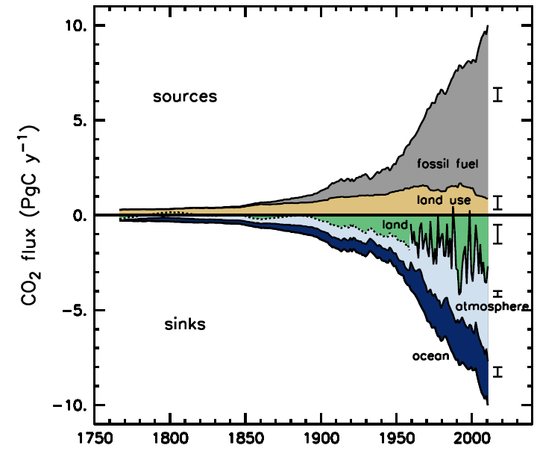

Slide 5
Short-term anthropogenic carbon budget
Sources must equal sinks.
non-atmosphere absorption of human carbon emission (4.8) > atmosphere absorption (4.1 Gt C yr⁻¹)
Carbon emission due to deforestation (1.0) < carbon removal by land vegetation (1.4 Gt C yr⁻¹)

Slide 6
Living organisms
Atmosphere
Sediments
Fossil fuels
Ocean water
rock

Slide 7
Long-term organic carbon cycle
Organic carbon: stored, moved by living organisms
sedimentary rocks = largest carbon reservoir
Limestone (CaCO₃) contains most carbon.
Shells created by phytoplankton and zooplankton via:
Ca²⁺ + 2HCO₃⁻ → CaCO₃ + H₂CO₃
Calcium ion + bicarbonate → calcium carbonate + carbonic acid

Slide 8
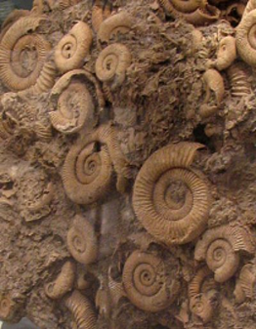
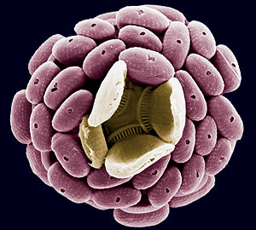
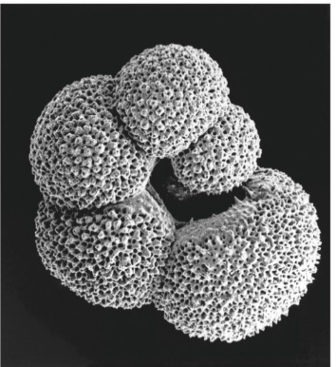
limestone
foraminifera
coccolithophorids

Slide 9
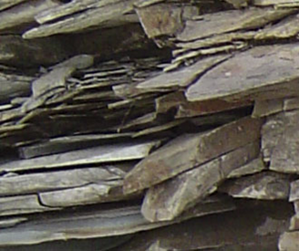
Long-term organic carbon cycle
Although shale is most common sedimentary rock (75%) and contains fossil fuels and organic debris, it not made of CaCO₃ and thus does not contain as much carbon as limestone.

Slide 10
Long-term organic carbon cycle
Fossil fuels are 3rd largest carbon reservoir.
They form over million of years from organic matter in sedimentary rock.
coal: compaction of plant matter in wetlands
oil and gas: pressure from overlying rocks and heat
light so they rise and pool up

Slide 11
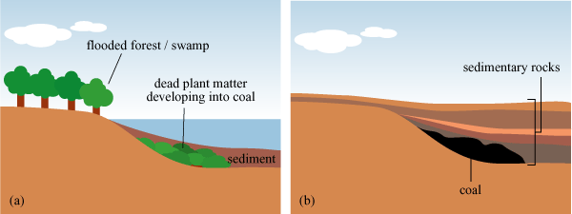
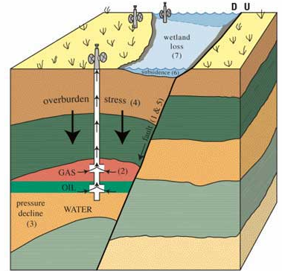

Slide 12
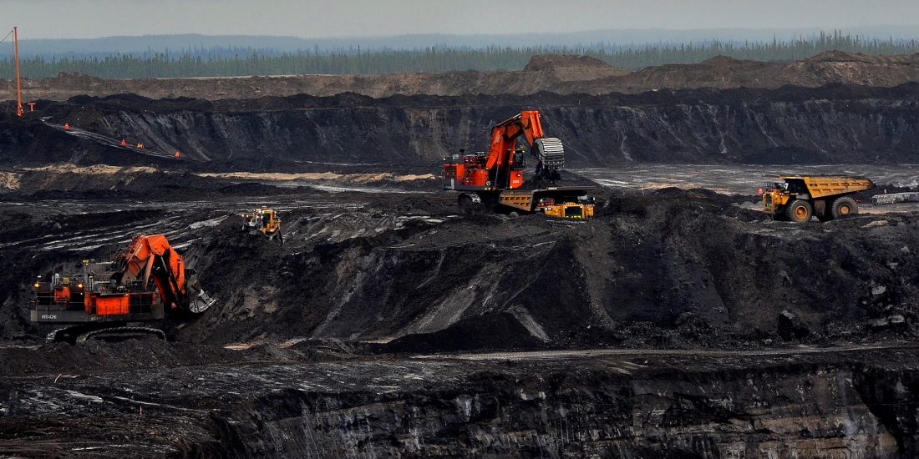
Long-term organic carbon cycle
economic reserves:
oil: 40 – 100 yrs.
natural gas: 100 yrs. (USA)
coal: 200 yrs. (global)
but hard to refine for low quality oil

Slide 13
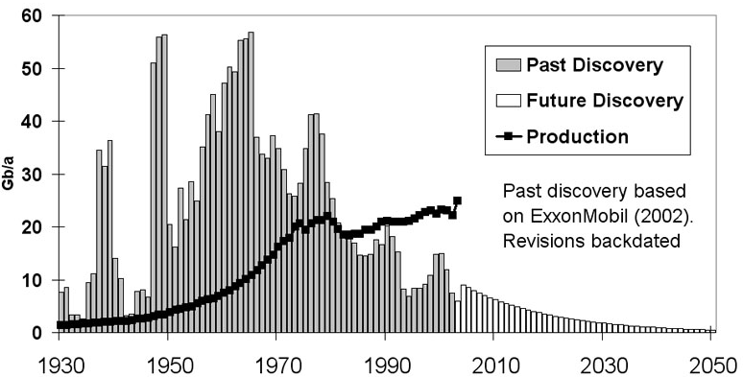
Long-term organic carbon cycle
“peak oil”: peak production, 2020 to 2060…
“peak discovery” in 1960s

Slide 14
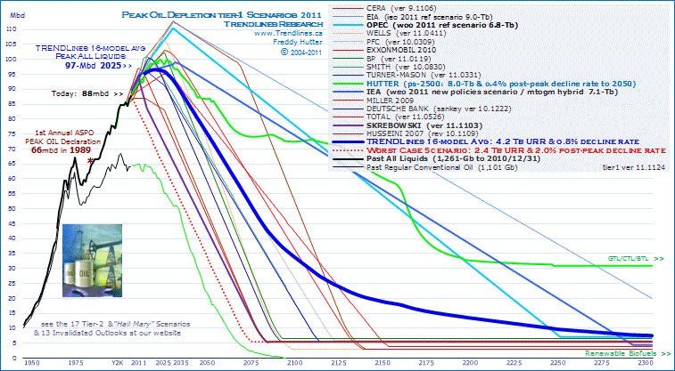

Slide 15
Long-term Inorganic Carbon Cycle
inorganic C: stored/moved abiotic
between ocean and atmosphere first
latitudinal variations in ocean carbon sources/sinks
3 reasons:
#1 temperature and dissolution: CO₂ dissolves into cold water easily.
#2 bio pump: high productivity = high CO₂ removal
#3 upwelling brings up organic matter.

Slide 16
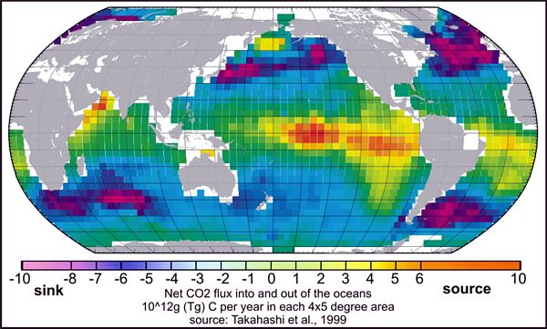

Slide 17
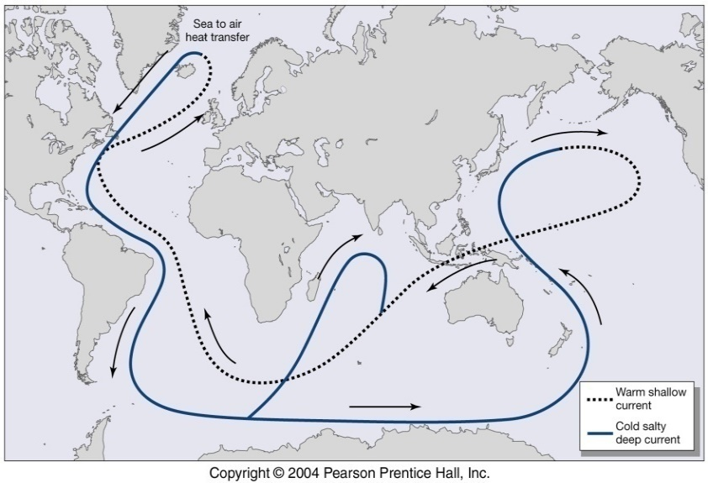

Slide 18
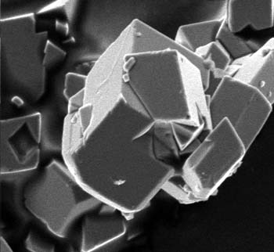
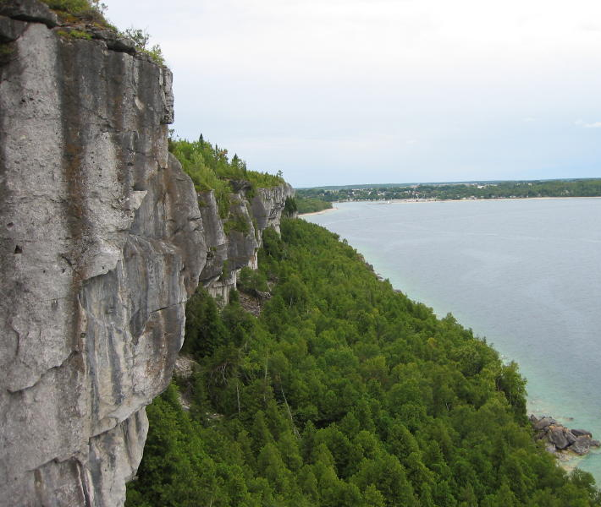
Long-term inorganic carbon cycle
Carbonate minerals are deposited in the ocean via:
Ca²⁺ + 2HCO₃⁻ → CaCO₃ + H₂CO₃
Calcium ion + bicarbonate → calcium carbonate + carbonic acid
The reaction occurs for shell formation (organic) and open ocean (inorganic).

Slide 19
Long-term inorganic carbon cycle
chemical weathering of calcium carbonate:
CaCO₃ + H₂CO₃ → Ca²⁺ + 2HCO₃⁻
The reaction between calcium carbonate and carbonic acid results in the release of calcium and bicarbonate.
It dissolves limestone rock—whether it occurs in mountains or in statues and gravestones made of limestone.

Slide 20
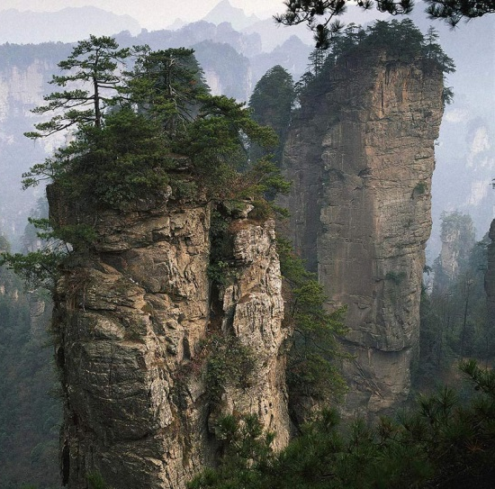
Limestone weathering

Slide 21
Long-term Inorganic Carbon Cycle
silicate rocks:
composition: Si + O₂ + …
formation:
Igneous rocks created via cooling of magma.
Rock cycle can then metamorphose the igneous rocks, or break them down physically and “repackage” them as sedimentary rocks (e.g. shale).

Slide 22
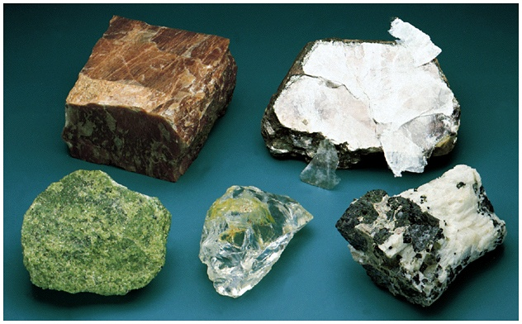
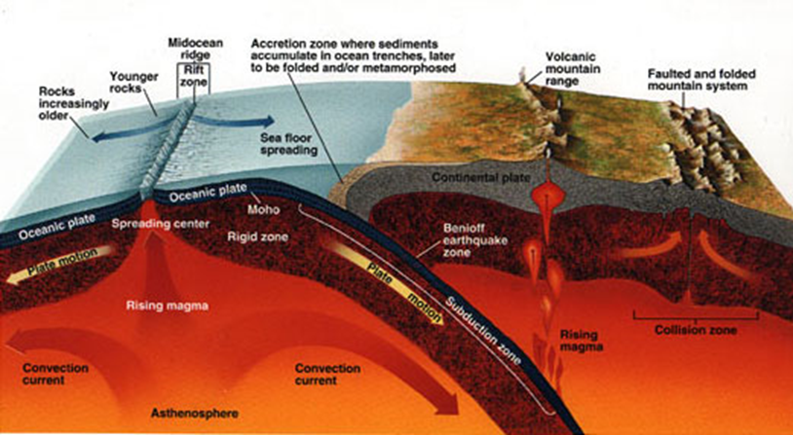

Slide 23
Long-term Inorganic Carbon Cycle
e.g., Wollastonite (CaSiO₃):
- Formed by metamorphism of carbonates and silicates:
CaCO₃ + SiO₂ + heat → CaSiO₃ + CO₂
- chemical weathering dissolves silicate rock
[CaSiO₃ + 2H₂CO₃ → Ca²⁺ + 2HCO₃⁻ + SiO₂ + H₂O]

Slide 24
Feedbacks
perturbation of increasing GHE,
temperature and rainfall increase, more silicate weathering, reduce CO₂ in the atmosphere.
negative feedback loop
enhances stability of climate
over millions of years!

Slide 25
