Slide 1
Atmospheric Circulation
GEO101
Spring 2023

Slide 2
Contents
The three states of water
The global water balance
Humidity
Precipitation
Atmospheric pressure
Winds
Global wind and pressure patterns

Slide 3
The three states of water

Slide 4
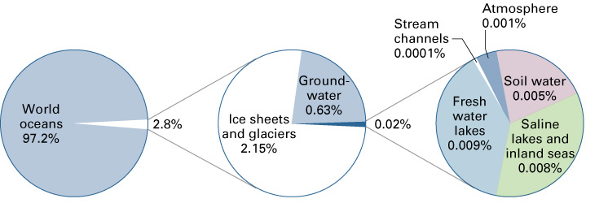
Majority of water occurs as ocean saltwater.
Of the remaining water (only 2.8%), the majority is accounted for by glaciers and ice sheets, and groundwater.
Only 0.001% occurs in the atmosphere.

Slide 5
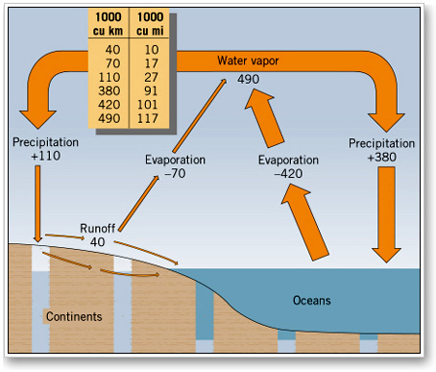
The global water balance constantly cycles between these reservoirs.
Note that even though the atmosphere contain relatively little water, it is responsible for the largest flow.

Slide 6
How water is stored and moved throughout the Earth system

Slide 7
Humidity
Humidity is the amount of water vapor in the atmosphere.
Warm air can hold much more than cold air.
Cold dry air can have close to 0%
Warm tropical air may have 4-5%
two ways to describe humidity (specific humidity and relative humidity).

Slide 8
Specific humidity
is the actual quantity of water vapor in the air
expressed as grams of water per kilogram of air (g/kg)
Used to describe the water content of large air masses, and how it varies by latitude

Slide 9
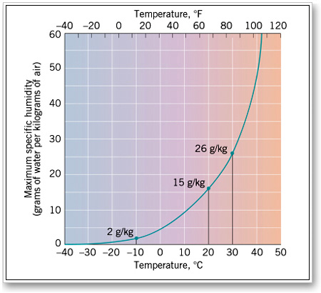
Specific humidity and temperature

Slide 10
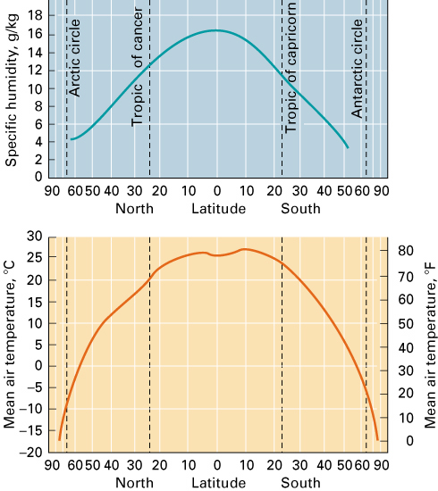
Pole-to-pole specific humidity

Slide 11
Relative Humidity
compares amount of water vapor present to the maximum amount that the air can hold at that temperature (%)
E.g. if relative humidity is 50%, it contains half the amount it could have given the temperature.
Relative humidity therefore changes as temperature changes.

Slide 12
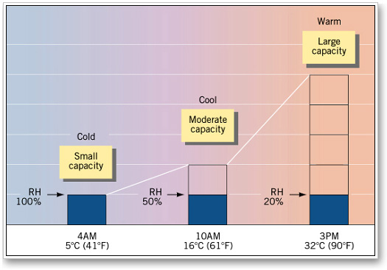
Relative humidity and temperature

Slide 13
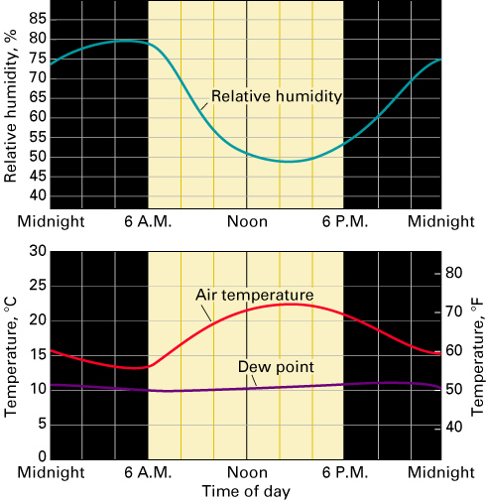
Relative Humidity and temperature
e.g. if temperature increases, if the amount of water vapor stays the same, then relative humidity decreases

Slide 14
Dew Point Temperature
If air is cooled eventually it will be said to be saturated (100% relative humidity) = (dew point temperature)
If cooling continues, condensation begins and dew forms

Slide 15
Clouds
Made up of water droplets and/or ice particles
Form when air is saturated and contains particles (condensation nuclei) e.g. dust, salts.
Water can remain in liquid state below freezing (super cooled) to as low as -12 degrees.

Slide 16
Precipitation
For precipitation to occur, it requires:
growth of droplets in clouds
ice - crystal process - ice particles act as freezing nuclei
coalescence process - large droplets collide with smaller ones
All precipitation begins as frozen water.

Slide 17
Types of Precipitation:
freezing rain (ice crystals freeze onto a frozen surface)
snow (ice crystals have not melted)
sleet (ice crystals melt as they fall)
hail (melting and refreezing crystals that form in thunder clouds)

Slide 18
Orographic precipitation
Air rising over a mountain
Intercepting slope = Windward slope (wetter)
Leeward slope (drier) (rain shadow)

Slide 19
Convectional Precipitation
Warm air rises and cools to dew point and clouds form.
Latent heat release.
adds energy and increases updraft
produces thunderstorms

Slide 20
Frontal (cyclonic) precipitation
where air masses with different temperatures come together
warm air lifted by cold dense air along a weather front
leads to frontal precipitation

Slide 21
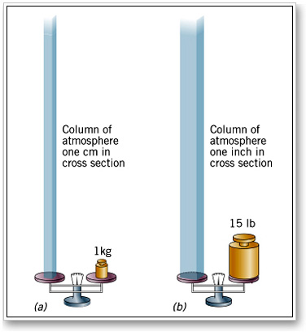
Atmospheric Pressure
As the atmosphere is held down by gravity, it exerts a force upon every surface (pressure = force per unit area).
At sea level the force is the weight of 1 kg of air that lies above each square centimeter of the surface (around 15 lbs. per inch)

Slide 22
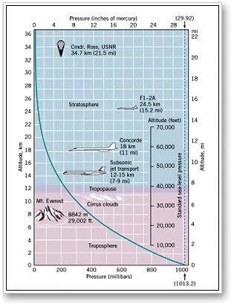
Atmospheric pressure decreases rapidly with altitude near the surface.
Therefore, a small change in elevation will often produce a significant change in air pressure.

Slide 23
Differences in air pressure = a pressure gradient
The pressure gradient forces act at right angles to the isobars (90 degrees).
820
830
840
850
860
820
830
840
850
860
870
880
890
weak pressure gradient
strong pressure gradient

Slide 24
Land and Sea breezes
During the day, air over land heats up and the sea is relatively cool (sea breeze).
land = low pressure and sea = high pressure
At night air over land cools and the sea is relatively warm (land breeze).
land = high pressure and sea = low pressure

Slide 25
High pressure (anticyclone)
Side View
From above
H
H
L
L
L
Air descends.
Surrounding air is relatively low.

Slide 26
Low pressure (depressions, cyclone)
Side View
From above
L
L
H
H
H
Air ascends.
Surrounding air is relatively high.

Slide 27
low pressure
pressure geostrophic
gradient force winds
992
996
1000
1004
1008
1012
1016
1020
high pressure

Slide 28
The planet Earth rotates.
In the northern hemisphere air appears to be deflected to the right.
In the southern hemisphere, it deflected to the left.
this deflective force = Coriolis force
because the wind is deflected it now flows parallel to the isobars = geostrophic wind

Slide 29
Imagine a turntable
When not turning, a ball traces straight line.
When moving, ball traces a curved line.
Friction forces
As wind flows over the surface friction reduces the speed.
Friction also changes the direction of the geostrophic wind.
The pressure gradient force overpowers the Coriolis effect.
As a result, wind flow across the isobars.

Slide 30
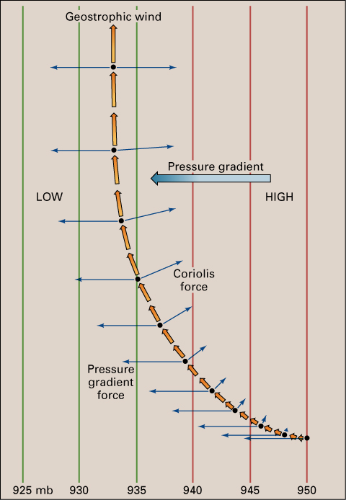
Upper atmosphere
at 5-7 km above the surface
influenced only by pressure gradient force and Coriolis force
geostrophic winds that flow parallel to isobars

Slide 31
General Circulation of the Earth’s Atmosphere
Deflection is least at the equator and greatest at the poles
Deflection
No Deflection
Deflection

Slide 32
L
H
Northern Hemisphere
H
L
Southern Hemisphere

Slide 33
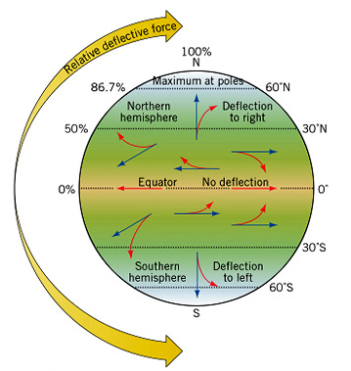
General Circulation of the Earth’s Atmosphere
Deflection is least at the equator and greatest at the poles.

Slide 34
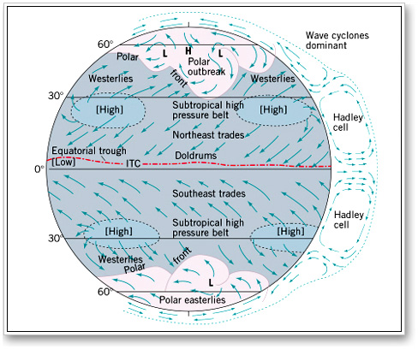
l
H
h
L
l
H
SUN
L
H

Slide 35
Warm air rises and flows poleward.
LOW
PRESSURE
L
So, around the equator = ITCZ (Inter-Tropical Convergence) Zone
Variable center is calm known as the “Doldrums”.

Slide 36
Warmer air rises
HIGH
PRESSURE
Cold air sinks
At around 30 degrees North and South is the Subtropical High because cool air sinks here.
Subpolar low pressure because the warmer air of the mid-latitudes rises as it meets cold polar air

Slide 37
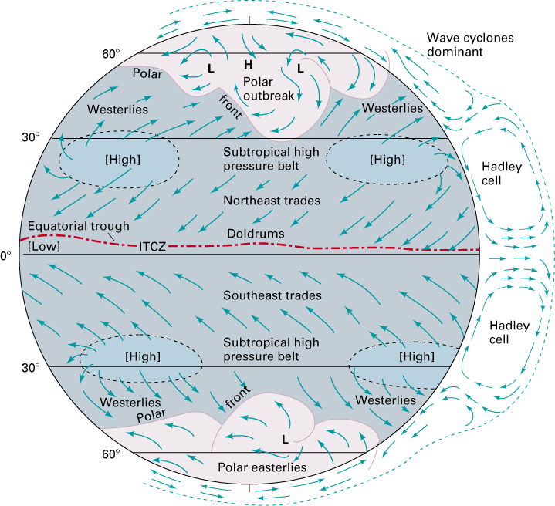
Trade winds are predictable.
Northeast in Northern hemisphere
Southeast in Southern hemisphere
At subtropical high conditions are calm.
known as the “horse latitudes”

Slide 38
From the subtropical high to the subpolar low = “westerlies”
Includes variable low and high pressure systems
At the Polar Front cold and warm air meet - storms form.
From the Polar High to the subpolar low are the Polar easterlies - variable

Slide 39
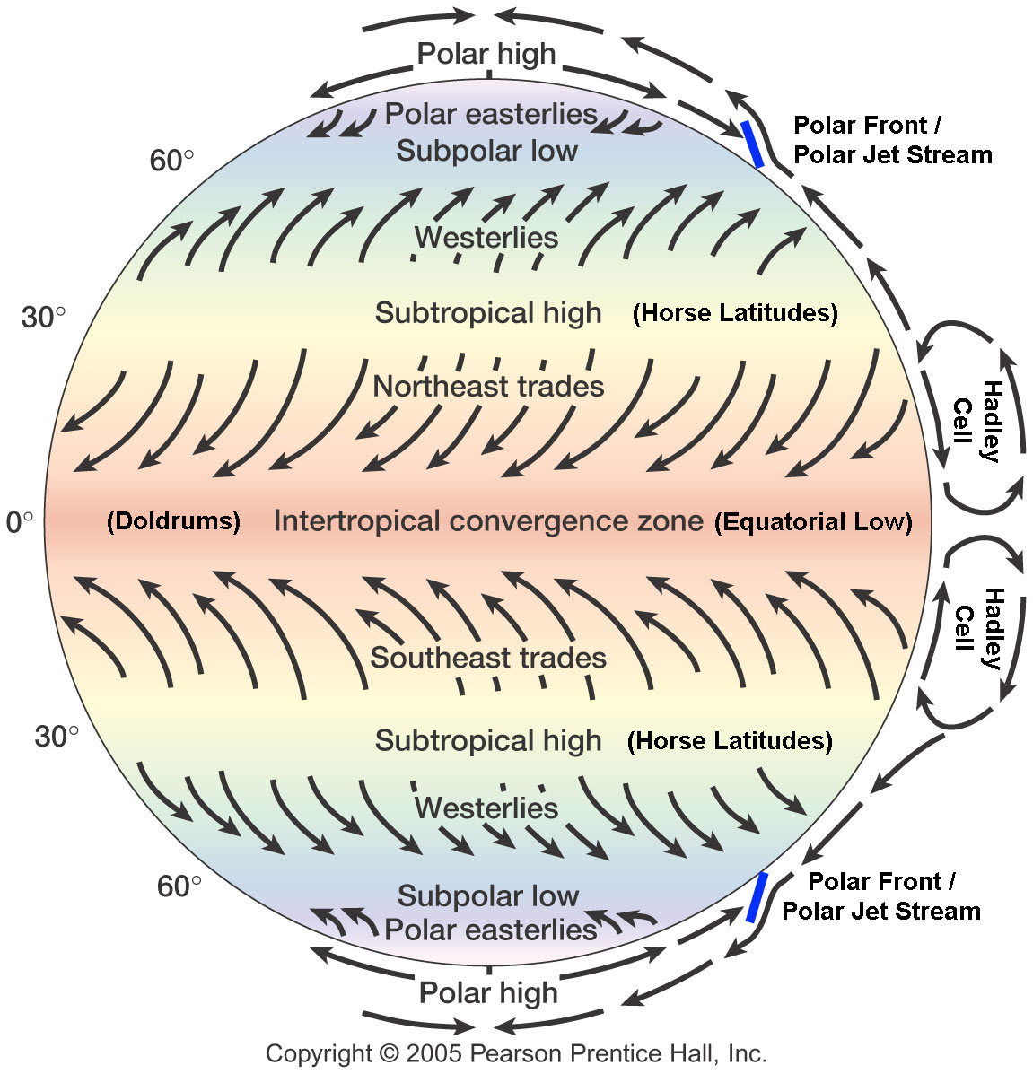

Slide 40
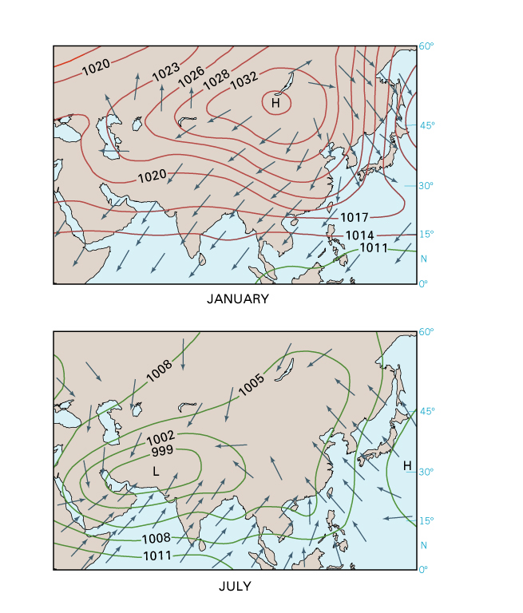
Monsoons
In January high pressure over the land produces dry winds.
Air is flowing towards the ITCZ.
In July the position of the ITCZ moves North.
Low pressure over the land causes winds to flow off the ocean.
This brings heavy rainfall.

Slide 41
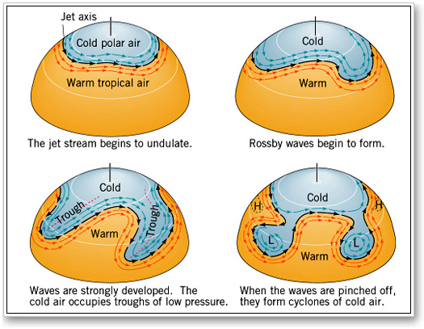
Rossby Waves
Smooth westward flow of upper air westerlies
Develop at the polar front, and form convoluted waves eventually pinch off
Primary mechanism for poleward heat transfer
Pools of cool air create areas of low pressure

Slide 42
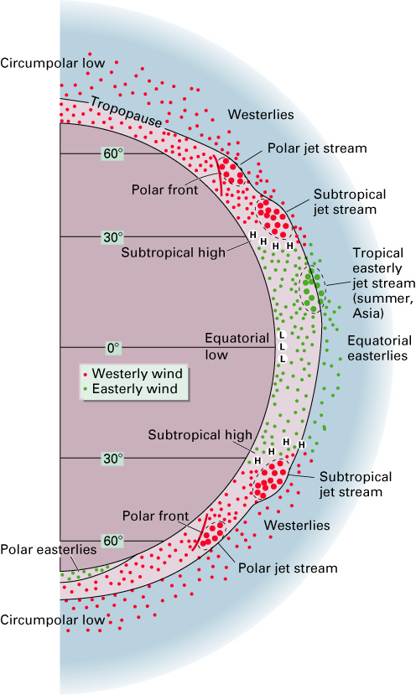
Jet Streams
Narrow bands of high velocity
Form along the polar front and above the Hadley cell in the subtropics

