Slide 1
The Earth’s Oceans
GEO101
Spring 2023

Slide 2
Contents
Oceanic circulation
Ocean currents
Gyres
Deep-sea currents
El Niño/Southern Oscillation (ENSO)

Slide 3
Oceanic circulation
circulation patterns (CURRENTS) produced by:
winds
density differences in sea water
Coriolis force
shape of ocean basins
astronomical factors (TIDES)

Slide 4
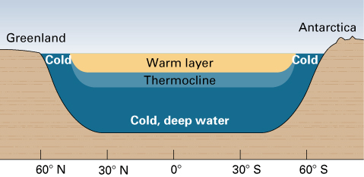
Ocean Temperatures
Surface warms – especially in the summer
Layer of rapid temperature drop - thermocline

Slide 5
Ocean Currents
Driven mostly by wind blowing over the surface
However, currents move slowly
Lag behind wind speed so often called drifts
wind

Slide 6
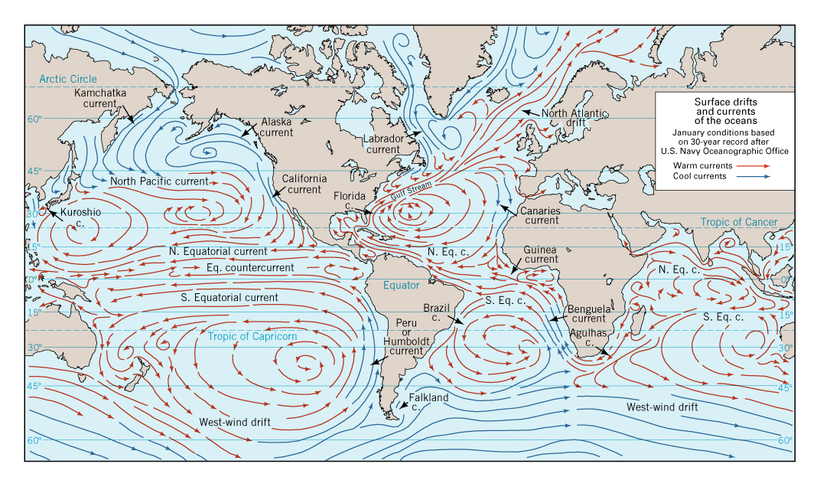
Ocean currents
Large continuously moving loops (gyres)
Produced by winds, Coriolis force and land masses

Slide 7
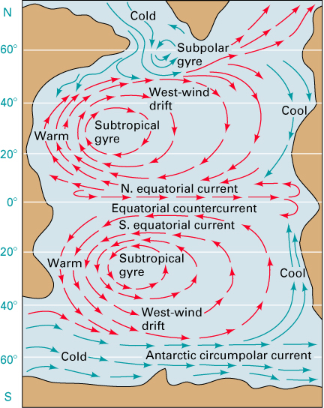
Gyres
Large circular currents
Subtropical gyre corresponds to the subtropical high pressure.

Slide 8
N. and S. Equatorial currents corresponds to the trade winds.
Equatorial countercurrent corresponds to the ITCZ.

Slide 9
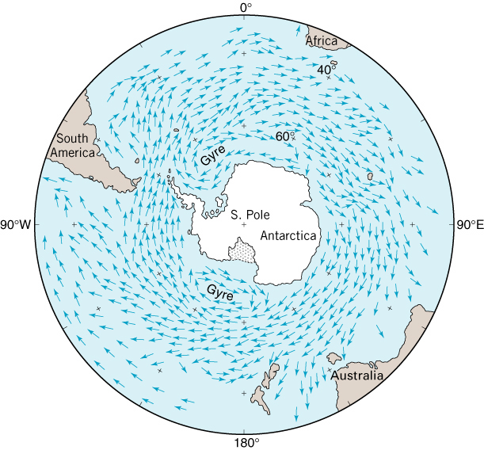
West winds around Antarctica create circumpolar gyre.
Portions branch off toward the equator

Slide 10
Deep-sea currents
Driven by differences in temperature and salinity
Much slower than surface currents
Thermohaline circulation
Depends on conditions in the North Atlantic

Slide 12
El Niño/Southern Oscillation (ENSO)
Every year warming occurs off the coast of Peru (~2˚/C)
Suppresses upwelling
But every 4 or 5 years it is much more pronounced = El Niño
Because there is no upwelling fish die.
May have far wider effects

Slide 13
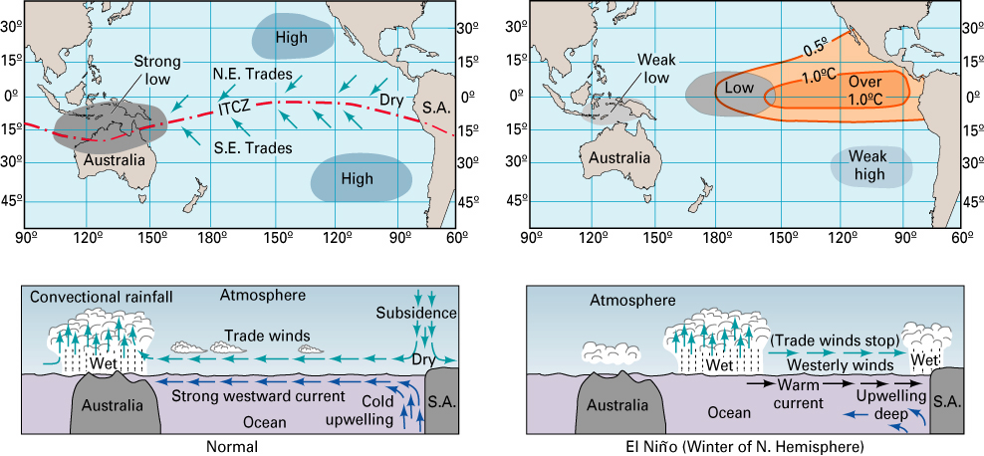
In normal year, low pressure dominates in Malaysia and northern Australia.
In an El Niño year, low pressure moves east to the central part of the western Pacific.

Slide 14
El Niño warm
weak trades
La Niña cool
strong trades

