Slide 1
Deep Ocean Circulation
GEO101
Spring 2023

Slide 2
Contents
Ocean Salinity
The Vertical Structure of Oceans
Deep-water Formation
The Thermohaline Conveyor Belt
Deep Ocean Currents and Climate

Slide 3
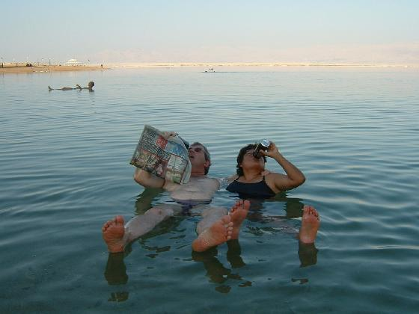
Ocean salinity
salinity = salt
Ocean is 3.5% salt.
extra density
concentrated in oceans:
Precipitation dissolves salts.
Rivers transport.
Evaporation leaves the salt.
[31.5%]

Slide 4
Ocean salinity
oceans ever-saltier?
early oceans less salty, but stable for last 1.5 billion years
input = outputs

Slide 5
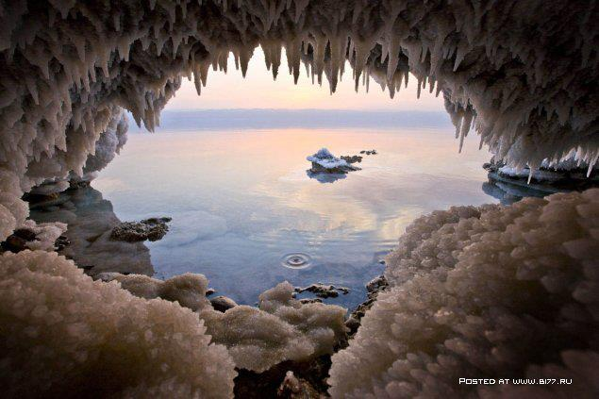
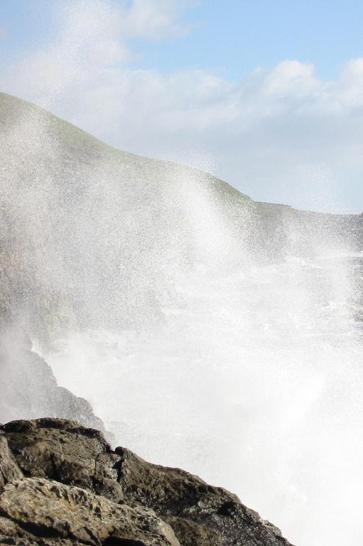
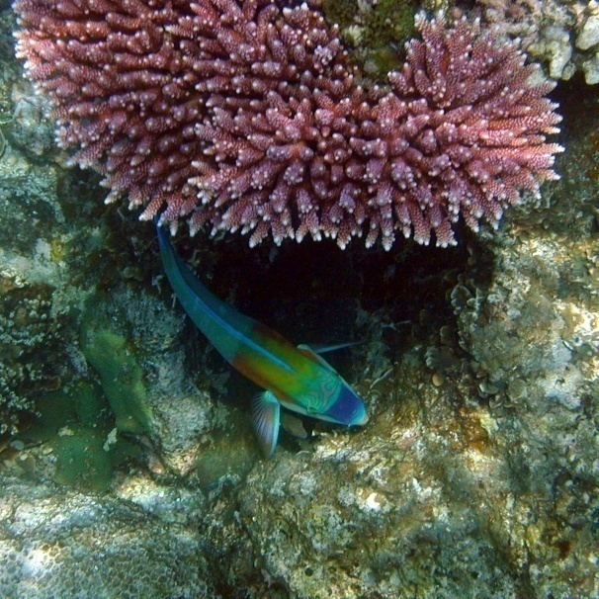
Salt deposits
Biological uptake (e.g., coral)
Salt spray

Slide 6
Ocean salinity
spatial variation
salt inputs:
rivers (e.g., Mediterranean & Nile)
salt outputs:
sediments or spray
water loss minus gain:
sea ice: ice crystals exclude salt
evaporation – precipitation

Slide 8
Ocean Salinity
evaporation - precipitation

Slide 9
Ocean Salinity
Brinicle video

Slide 10
The Vertical Structure of Oceans
Ocean water varies vertically in terms of:
temperature:
As you go deeper, temperature drops.
Sun and atmosphere warmth
salinity:
As you go deeper, salinity increases.
salt inputs from river and rainfall
deep ocean receives salt no freshwater

Slide 11
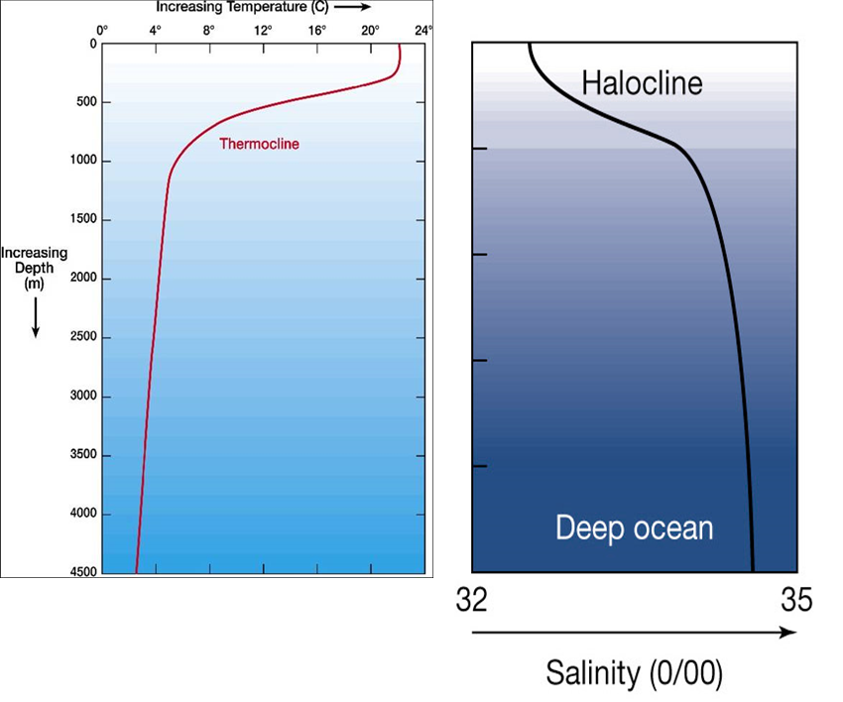

Slide 12
Vertical Structure of Oceans
water density:
As you go deeper, density increases.
Why?
higher salinity
pressure from overlying water
lower temperature (note: freshwater density peaks at 4°C)

Slide 13
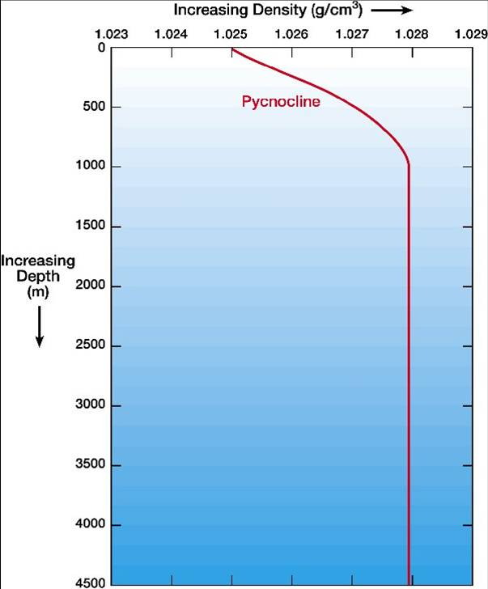
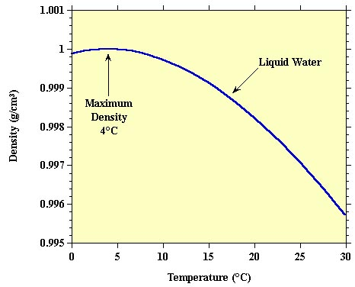

Slide 14
Vertical Structure of Oceans
three general layers:
surface layer: warm, mixed by wind
transition zone: rapid changes
deep water: cold, salty, dense.
How do the three layers mix?

Slide 15
Deep-water Formation
surface water moved by wind
Density and salinity change with latitudes.
Evaporation increases salinity.
Ice formation increases salinity.
Cooling increases density.
Cold, dense water sinks.
Deep-water formed as:
North Atlantic Deep Water (NADW), off the coast of Greenland
Antarctic Bottom Water (AABW), off Antarctica

Slide 16
The Thermohaline Conveyor Belt
Sinking water creates a “conveyor belt”.
“thermohaline” (temperature and salinity)
After sinking, NADW travels south and joins AABW.
Water upward in Indian Ocean and North Pacific Ocean
deep water:
17 ft hr⁻¹, residence time = 500 years
conveyor belt moves:
nutrients
water

Slide 17
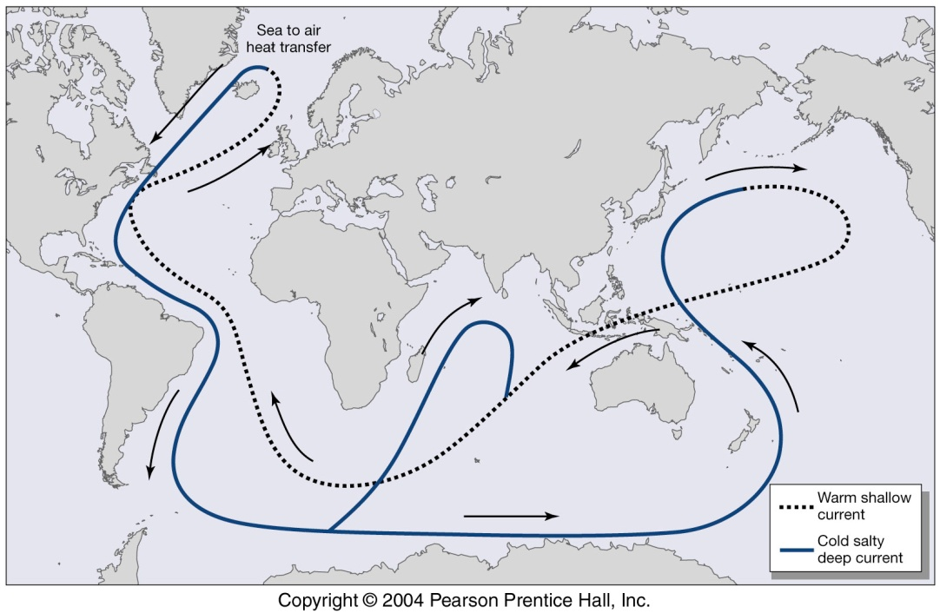
the thermohaline “conveyor belt” circulation connecting the surface currents (dotted lines) with deep-ocean currents (solid line).

Slide 19
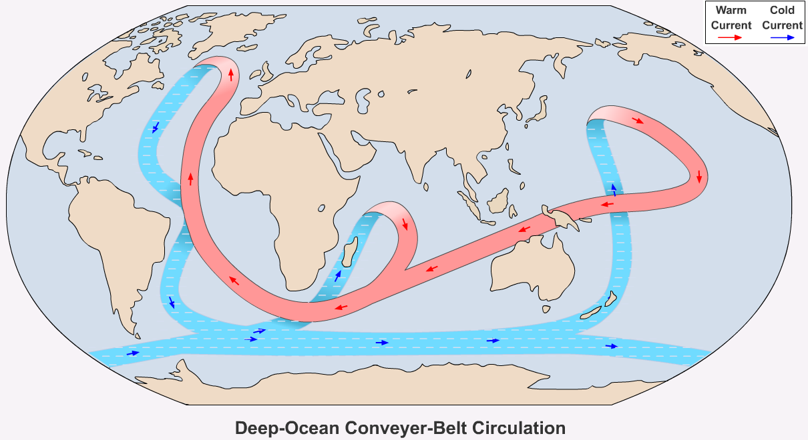

Slide 20
Deep Ocean Currents and Climate
Deep ocean delivers cold water, thus cools atmosphere.
Thermohaline circulation plays an important role in the carbon cycle by moving CO₂-rich surface waters into the ocean depths.
It could be slowed or stopped by inputs of fresh water into the North Atlantic.

Slide 21
Deep Ocean Currents and Climate
Fresh water inputs could come from the sudden drainage of large lakes formed by melting ice at the close of the last Ice Age.
The fresh water would decrease the density of the ocean water, keeping the water from sinking.
Without sinking, circulation would stop.
This would interrupt the transfer of heat from equatorial regions to the northern midlatitudes.
This mechanism could result in relatively rapid climatic change and is one explanation for periodic cycles of warm and cold temperatures since the melting of continental ice sheets about 12,000 years ago.

