Slide 1
Earth Systems Science
GEO 101
Spring 2023

Slide 2
Contents
1. Earth Systems Science
2. What are the goals of science?
3. What do scientists do?
4. What are the steps in a scientific study?

Slide 3
Introducing Geography
Geography
  the study of the changing patterns and processes taking place at the Earth’s surface.
  the study of human activities that take place on the earth
  the study of the relationships between human activities and the natural world.

Slide 4
Tools in Geography
Geographers use specialized tools to help them portray information that varies spatially on the earth’s surface.
These tools include
  maps
  geographical information systems (GIS)
  remote sensing
  Earth systems models (space and time)

Slide 5
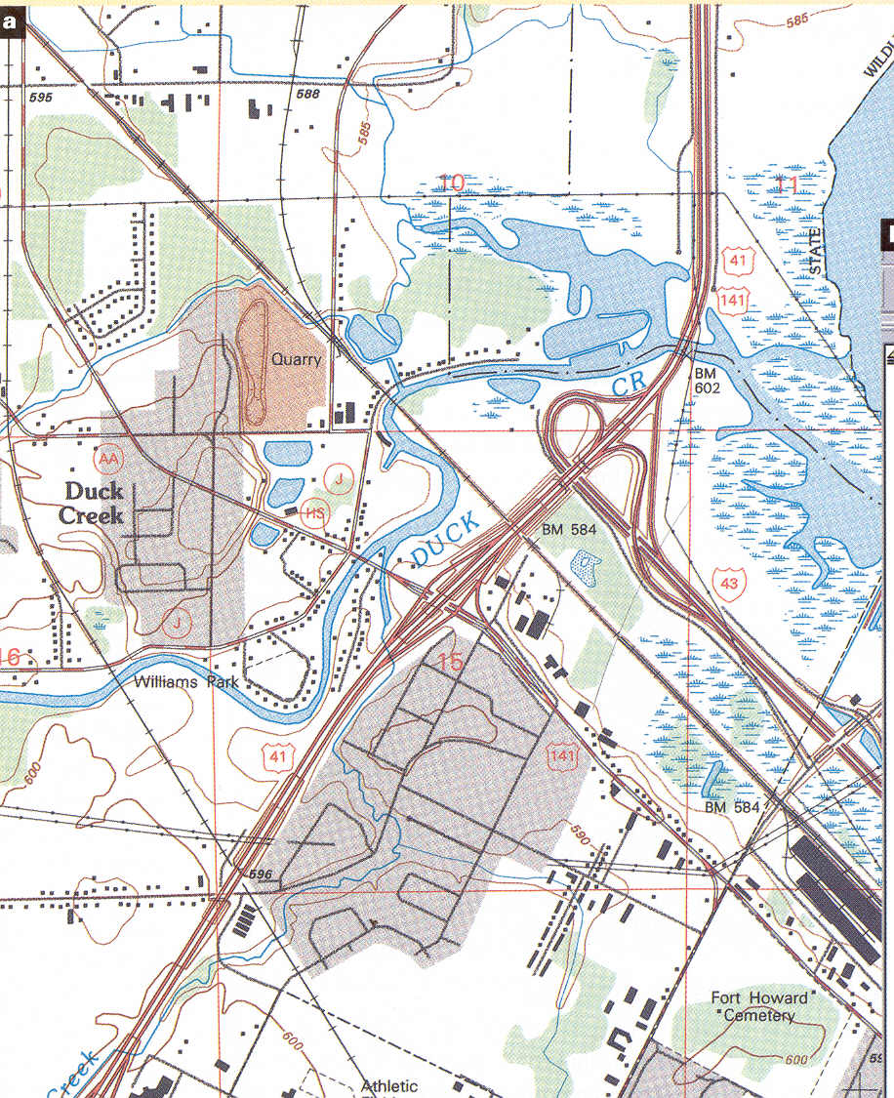
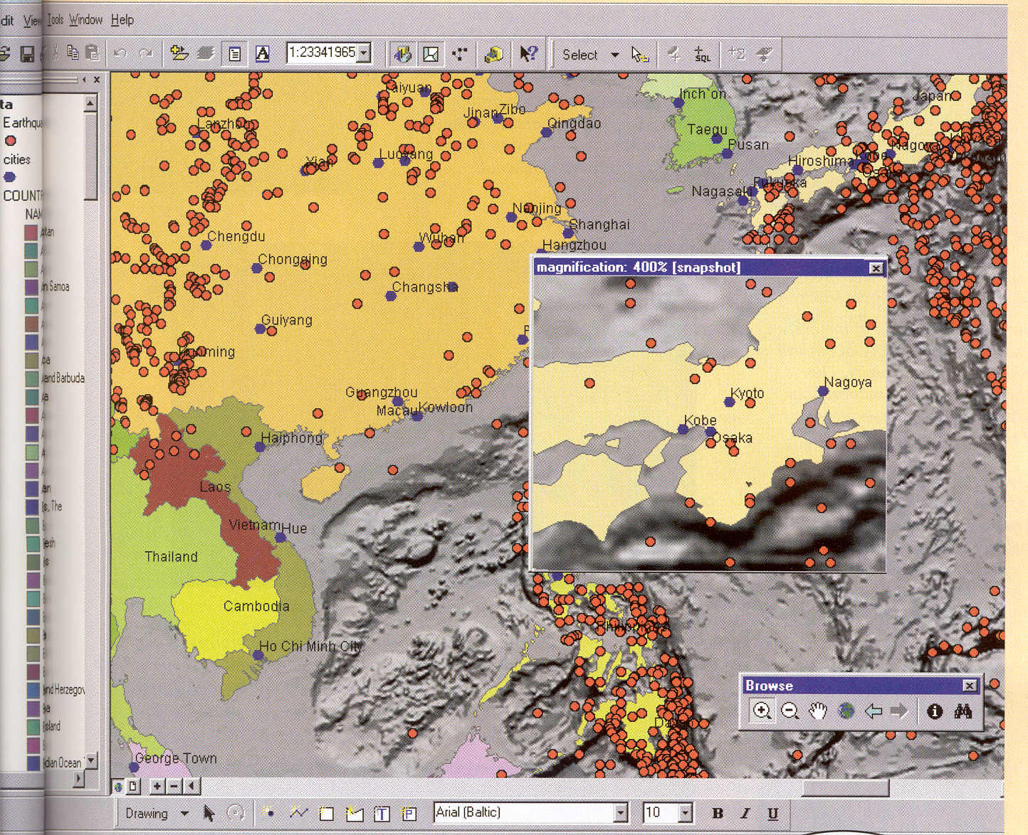
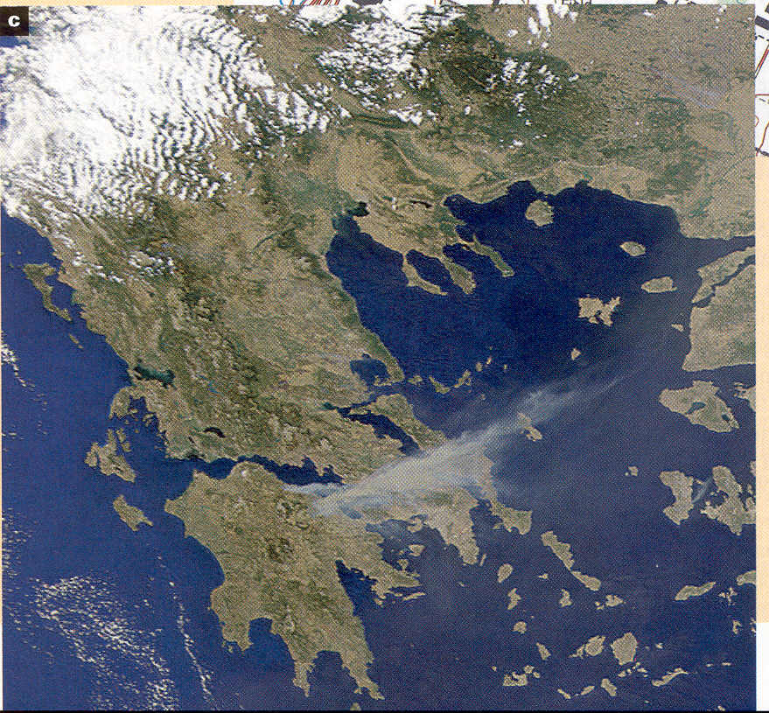
Cartography, Remote Sensing and GIS

Slide 6
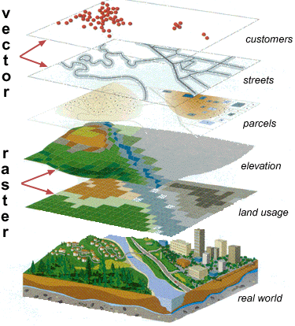

Slide 7
Earth, Environment, and Climate
Environmental change is caused by both natural and human processes.
Important topics of global change that physical geographers are studying are:
  global climate change
  the carbon cycle
  biodiversity
  pollution
  extreme events.

Slide 8
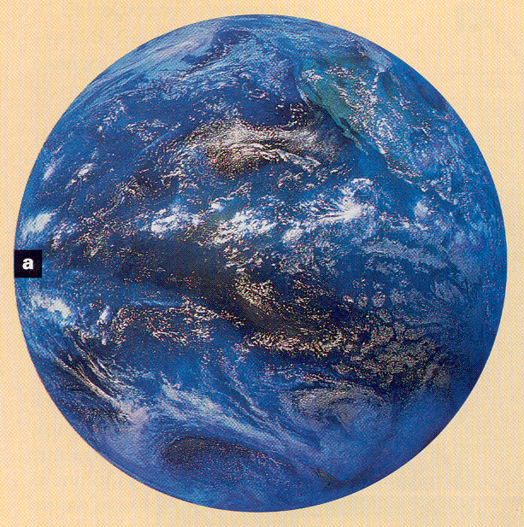
Global Climate Change

Slide 9
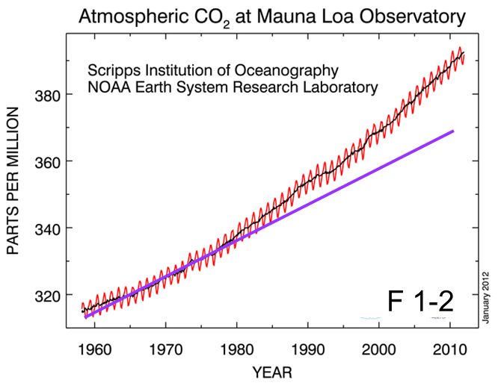
Global change on short time scales
- evidence of global warming
‘Keeling Curve’: CO₂ concentrations, Mauna Loa, Hawaii

Slide 10
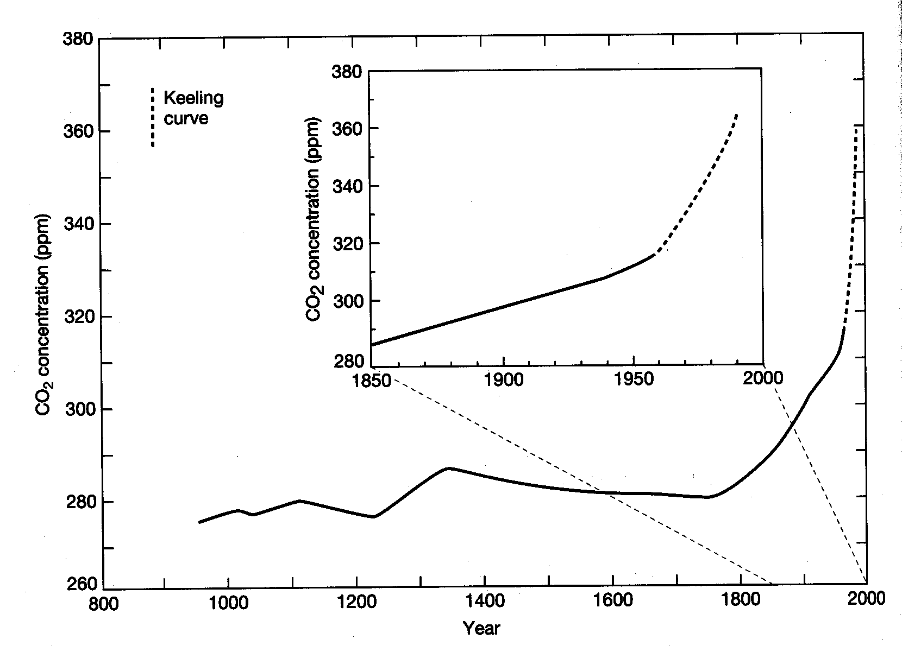
Atmospheric CO₂ concentrations over the past 1000 years, determined from ice cores and atmospheric measurements

Slide 11
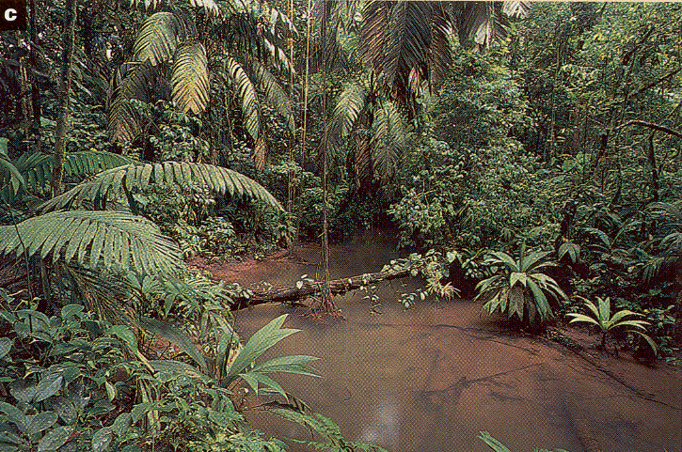
Biodiversity

Slide 12
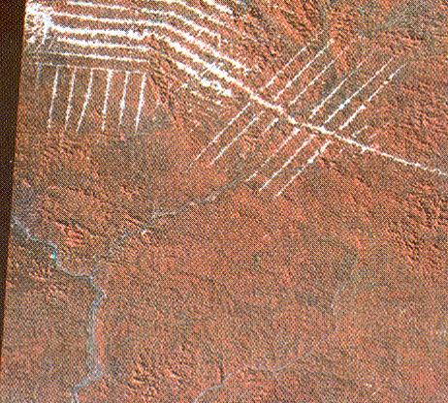
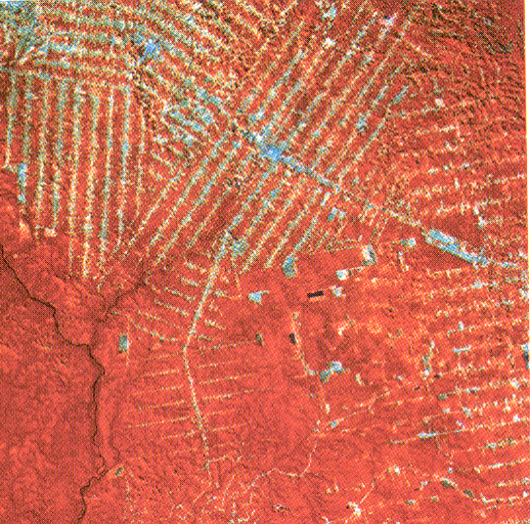
Deforestation & loss of biodiversity
Satellite photos of area in Amazonia in 1972 and 1992; if rate continues, half of rainforest left and 5-10% loss of species by 2025.

Slide 13
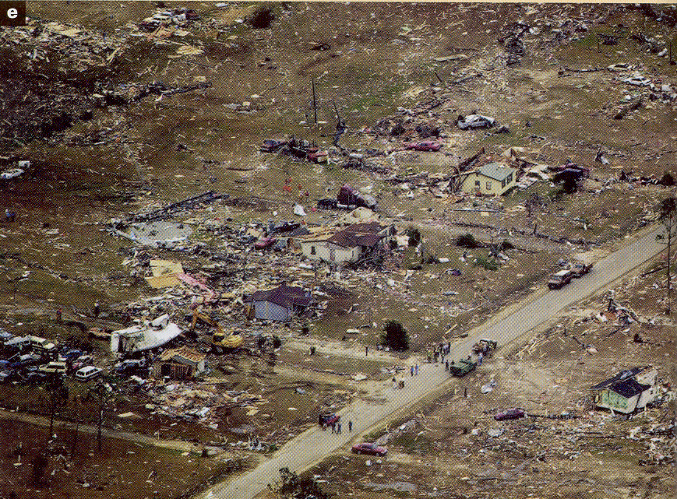
Extreme events
Hurricanes
Storms
Droughts
Floods
Fires
Volcanoes
Earthquakes
Tsunamis
…

Slide 15
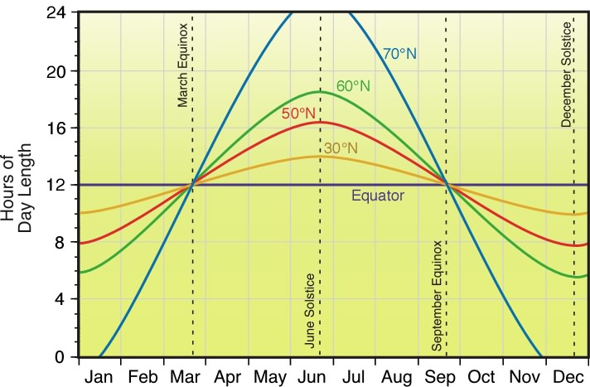
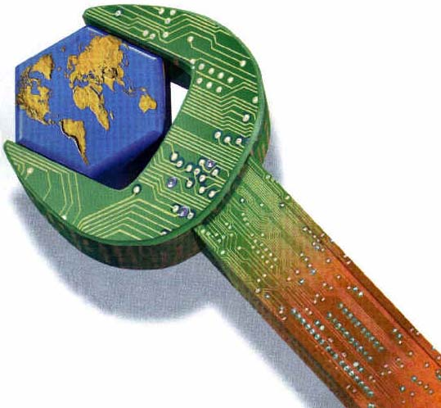
2. What are the goals of science?
(a) Goals:
understand and predict.
in Earth systems science…
(b) science is an intellectual tool.
it creates and tests models…
it is not technology, although…

Slide 16
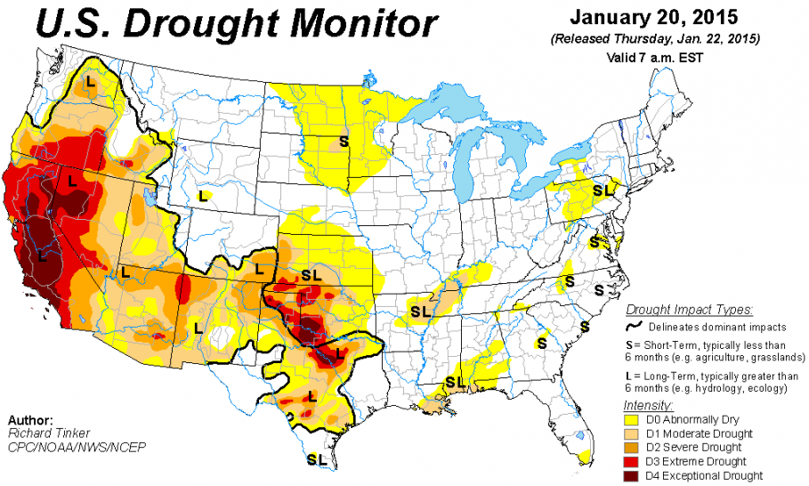
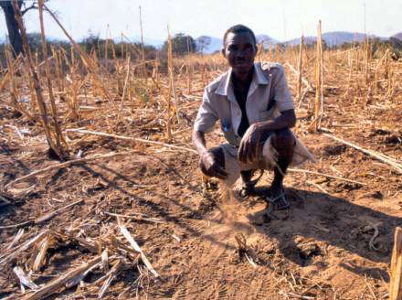
2. What are the goals of science?
(c) deals with observable & measurable…
it can’t say what’s good/bad
(d) social values assign value.
morality, aesthetics, desires…
e.g. if climate change causes…

Slide 17
All scientific models are incomplete.
(polling question)
True
False

Slide 18
3. What do scientists do?
Scientists create models.
usually mathematical…
What is a Model?
A simplified representation of a system.
All models are “wrong,” but good ones can still be quite useful.

Slide 19
4. The steps in a scientific study
1) Informal question: something…
2) Hypothesis: independent.+ dep. vars.
3) Observations
4) Model using…
5) Predict state of dependent var. using independent var.
6) New observations
7) Verification: obs. vs. pred.
8) Revision
9) Predictions (new)
10) Observations (to test again)
11) Action (use predictions!)

Slide 20
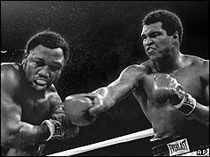
4. The steps in a scientific study
1) Informal question: something…
2) Hypothesis: independent.+ dep. vars.
3) Observations
4) Model using…
5) Predict state of dependent var. using independent var.
6) New observations
7) Verification: obs. vs. pred.
8) Revision
9) Predictions (new)
10) Observations (to test again)
11) Action (use predictions!)
repetition of steps 7-10
repetition is like training…
when you have trained enough…

Slide 21

4. The steps in a scientific study
repetition of steps ends…
Note that models are never perfected, but become useful when errors in prediction is small enough.
Example:
Q: I wonder if egg…

Slide 22
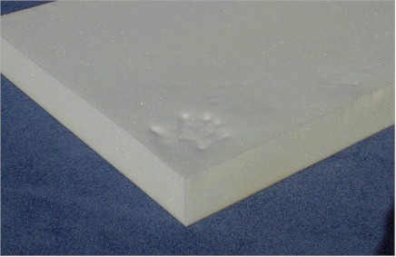
4. The steps in a scientific study
repetition of steps ends…
Note that models are never perfected, but become useful when errors in prediction is small enough.
Example:
Q: I wonder if egg…
H: If I put foam…?

Slide 23
4. The steps in a scientific study
repetition of steps ends…
Note that models are never perfected, but become useful when errors in prediction is small enough.
Example:
Q: I wonder if egg…
H: If I put foam…?
O: observe foam thickness & height
M: relate thickness & height…
Ht. of egg drop
Foam thickness

Slide 24
4. The steps in a scientific study
Example:
Q: I wonder if egg…
H: If I put foam…?
O: observe foam thickness & height
M: relate thickness & height…
P: predict if egg…
O: observe what happens…
V: verify if correct…
Ht. of egg drop
Foam thickness

Slide 25
4. The steps in a scientific study
Example:
Q: I wonder if egg…
H: If I put foam…?
O: observe foam thickness & height
M: relate thickness & height…
P: predict if egg…
O: observe what happens…
V: verify if correct…
R: revise relation between…
etc.
Ht. of egg drop
Foam thickness

Slide 26
A scientific model is considered useful when:
It is published in a scientific journal
Its prediction error is lower than the needed accuracy
Its prediction error is higher than the needed accuracy

