Slide 1
Introductions to systems
GEO101
Spring 2023

Slide 2
Contents
Systems
Earth systems
Feedback systems
Equilibrium states
Example

Slide 3
What is a system?
Earth is big and complex!
make it simpler…
first components, then linkages →
“systems models”
Earth as a system.

Slide 4
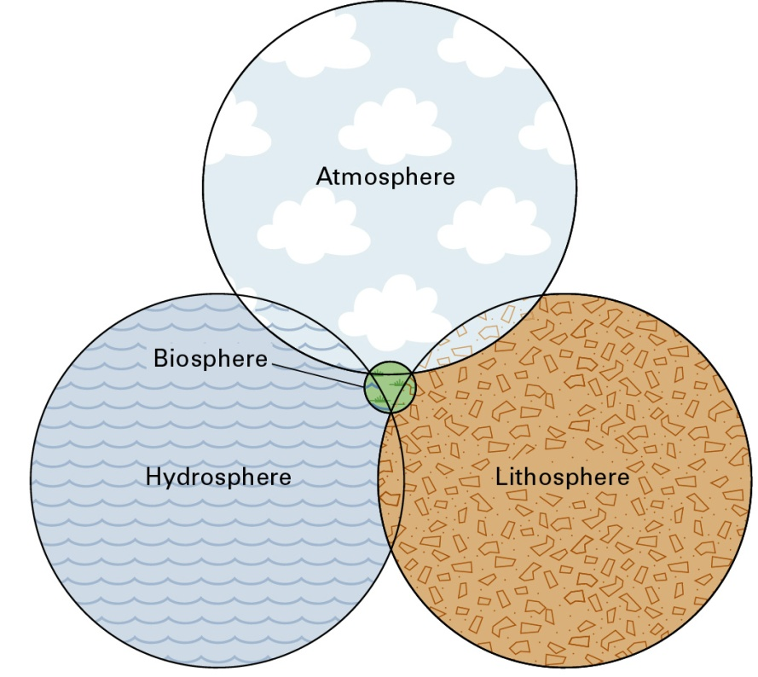
The Four Great Realms
The natural systems studied in physical geography operate within the four great realms:
Atmosphere
Lithosphere
Hydrosphere
Biosphere

Slide 5
Atmosphere
The gaseous layer that surrounds the earth.
Receives heat and moisture from the surface and redistributes them, returning some heat and all of the moisture to the surface.
Supplies vital elements to support all life forms.

Slide 6
Lithosphere
The solid portion of the earth.
Is sculpted into landforms, such as mountains, hills, and valleys
Has a thin layer of soil covering solid rock (see also Biosphere).

Slide 7
Hydrosphere
Liquid water.
Most water is in the oceans.
Water is also found in the atmosphere in all phases (liquid, solid, gas), and on the lithosphere as lakes, streams, groundwater and ice.

Slide 8
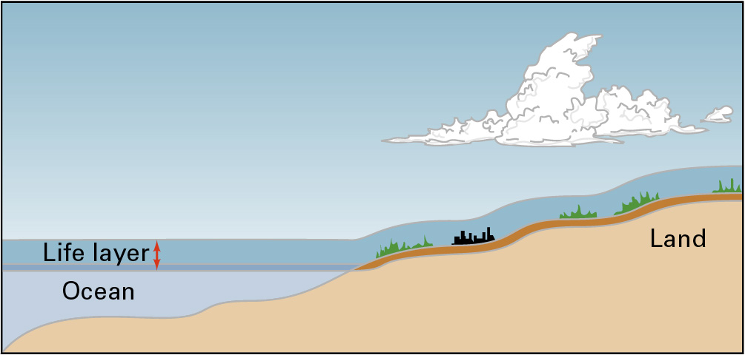
Biosphere
Includes all living organisms of the Earth
Is dependent upon the other three layers to support life.
These layers interact with each other in the ‘life layer’ at the surface of the earth.

Slide 9
Components
components are distinct objects
(this definition differs from the Text’s)
e.g. a nose

Slide 10
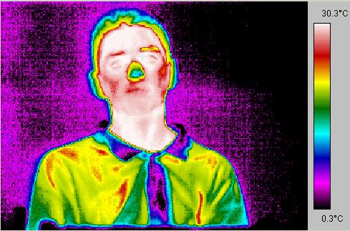
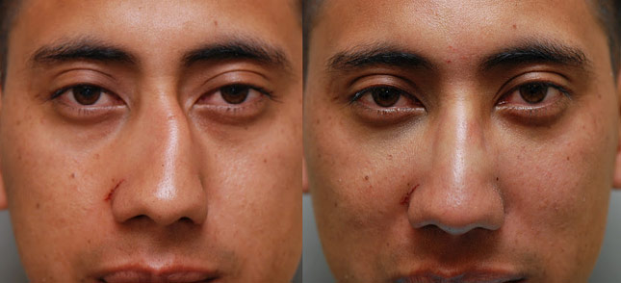
States: component’s have varying states
e.g. nose can be warm or cold
Linkages: systems require them.
linkage occurs because a component state respond to another.
e.g. if nose is cold, then body pumps more blood to warm it.
Perturbations disturb the state.
e.g. pressure on a nose…
if small and temporary...
Bit if large or sustained…

Slide 11
Which one of these is a component?
Atmosphere
Elasticity
Reflectivity

Slide 12
Coupled systems
A system’s response to a perturbation depends on linkages.
“Systems diagrams” display couplings.
A coupling occurs when state changes
affect other states.
e.g. air temp & nose
Positive coupling:
Negative coupling:

Slide 13
Exercise
When a decrease in a state of one component causes a decrease in a state of a second component, the components are ______ coupled.
Not
Negatively
Positively
Reverse

Slide 14
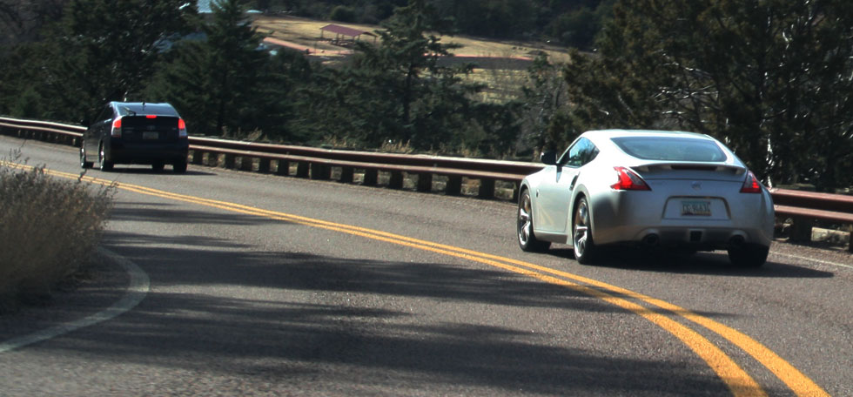
Coupled systems
Driving:
single-lane; no passing zone
front vehicle linked to back vehicle…
if front vehicle speed up?
back vehicle speed up…
if front vehicle slow down?
back vehicle slow down…
= coupled components
systems diagram:
components
states of interest
linkage
front
back
Front car’s
speed
Back car’s
speed

Slide 15
Coupled systems
if the two cars are close to each other,
the front vehicle speeds up.
= positive coupling
Vehicle
proximity
Front
speed

Slide 16
Coupled systems
if the two cars are close to each other,
the front vehicle slows down.
= negative coupling
cause (IV) is at the beginning of the line.
The open circle symbol touches the affected (DV).
Vehicle
proximity
Front
speed

Slide 17
Exercise
Which statement about a system diagram is FALSE?
A negative coupling is shown with an open circle symbol.
A positive coupling is shown with an arrow symbol.
The symbol touches the component, which is the cause (independent variable).

Slide 18
Feedback systems
feedback system: components linked circularly
- each component is both IV and DV
First example:
Back
speed
Vehicle
proximity
Front
speed

Slide 19
Feedback systems
feedback system: components linked circularly
- each component is both IV and DV
First example: add implicit coupling…
Back
speed
Vehicle
proximity
Front
speed
(+)

Slide 20
Feedback systems
Second driving example:
1 negative, 1 positive coupling
Back
speed
Vehicle
proximity
Front
speed
(-)

Slide 21
Feedback systems
To be a feedback system:
> two components coupled in a loop;
# couplings > # components
count the negative couplings…
none (all positive) = positive feedback
even # of negatives = positive feedback
odd # of negatives = negative feedback

Slide 22
Earth’s
heat
Cloud
cover
Global
warming
Ice cover

Slide 23
Equilibrium
A steady state where the flow rates in the various pathways of a system stay about the same.
Systems in equilibrium are usually regulated by negative feedback.

Slide 24
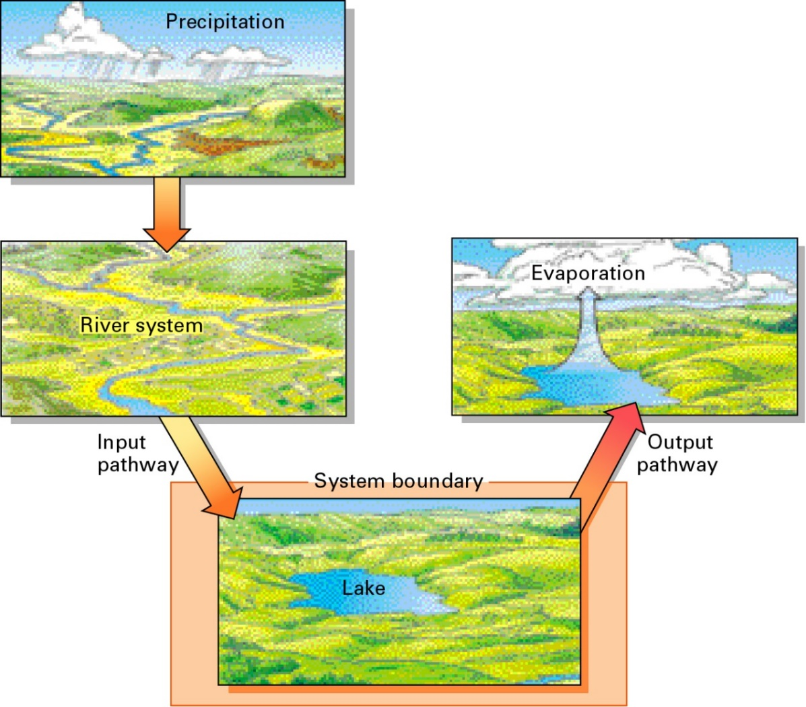
A Lake in Equilibrium (1)
This lake is in a closed basin.
The lake is in equilibrium and inflows and outflows of water are balanced.

Slide 25
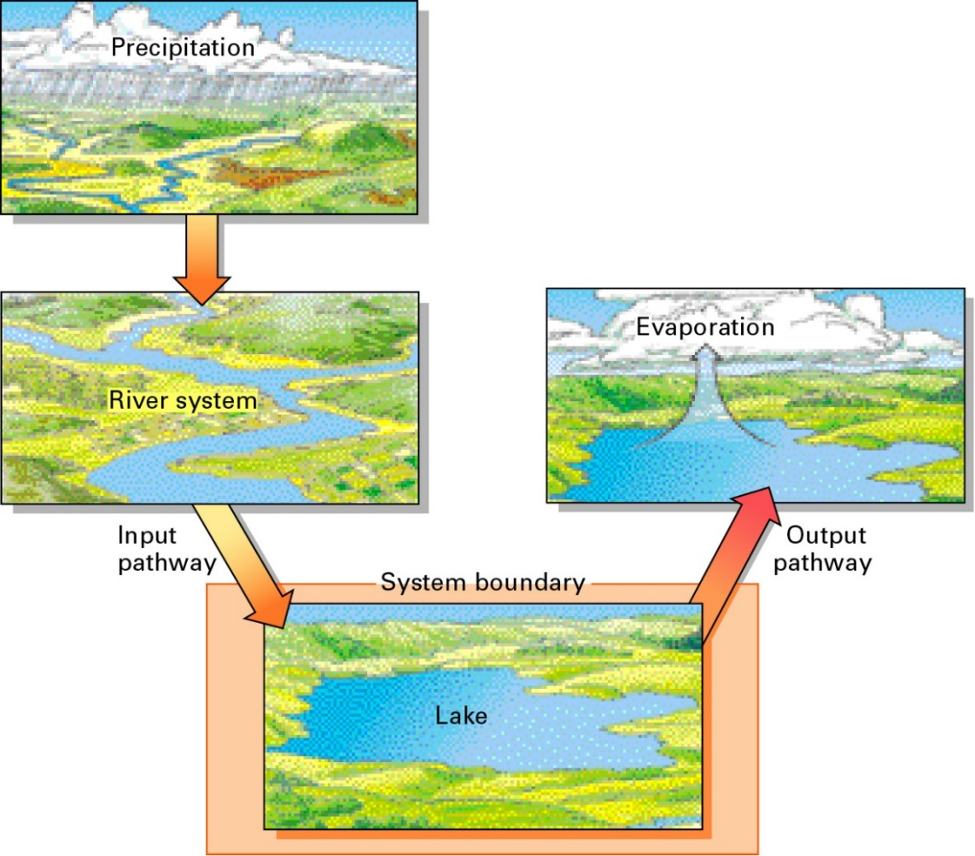
A Lake in Equilibrium (2)
Increased precipitation leads to rising lake levels.
Lake surface area increases, increasing evaporation, which balances the increased precipitation.
Thus the system remains in equilibrium.

Slide 26
Equilibrium states
Stable equilibrium state (SES)
NF “dampens” the perturbation…
Unstable equilibrium state (UES)
either: passes a threshold,
or PF amplifies the perturbation…

Slide 27
Equilibrium states
Examples of stable equilibrium states:
a ball in a valley…
if a small perturbation raises…
gravity = NF
returns to SES

Slide 28
Stable equilibrium states
Driving negative feedback system:
It was stable equilibrium system
because of the dampening of the
negative coupling.
Back
speed
Vehicle
proximity
Front
speed
(-)

Slide 29
Equilibrium states
Examples of UES:
a ball on a hilltop:
unstable: a small push…
gravity = positive feedback
a ball in a valley:
stable equilibrium state?
if large perturbation…
hilltop is threshold.

Slide 30
Unstable equilibrium system
driving positive feedback system:
it was unstable equilibrium system because of the amplifying effect of the positive feedback.
Back
speed
Vehicle
proximity
Front
speed
(+)

