Slide 1
The role of oceans in glacial cycles
GEO101
Spring 2023

Slide 2
Contents
Review on last topic
Glacial Cycles
The Role of Oceans
D-O Cycles
The Role of Oceans in D-O cycles

Slide 3
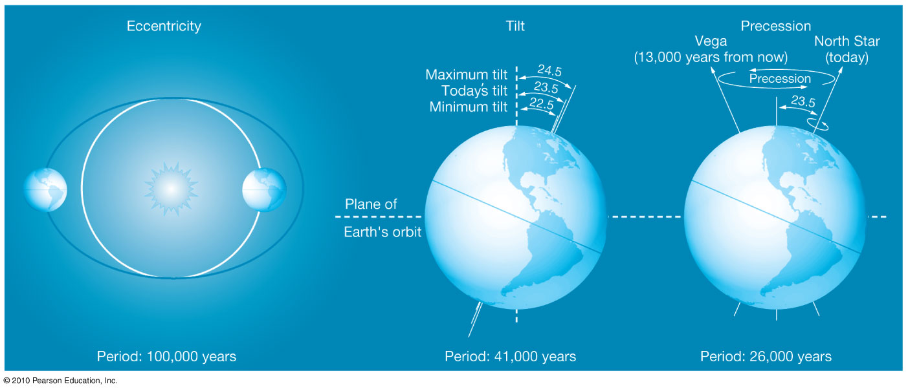
Last Topic: Pleistocene Glaciation – and cycles
Astronomical cycles
~20 cycles
Isotope record

Slide 4
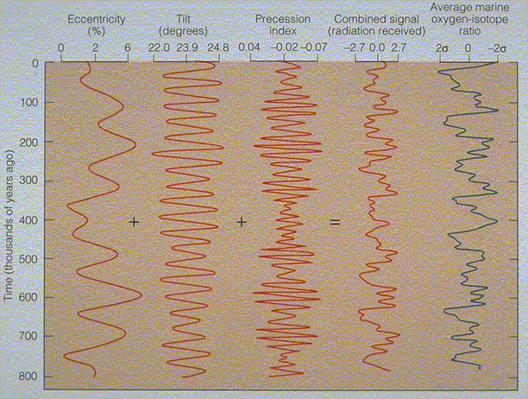

Slide 5
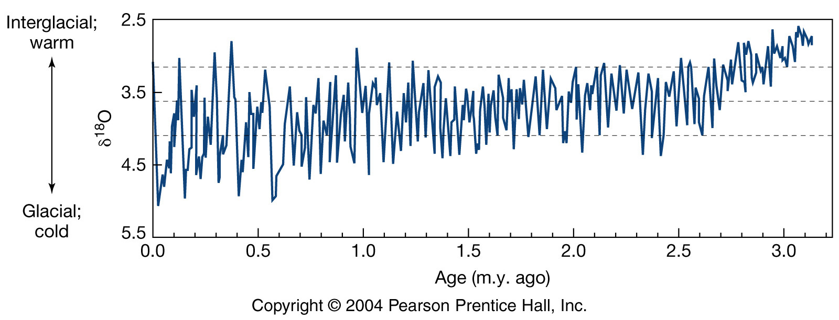
Glacial Cycles
Glacial cycle: glacial and interglacial events
within a glaciation
~20 cycles in the last 2.6 million years (Pleistocene)

Slide 6
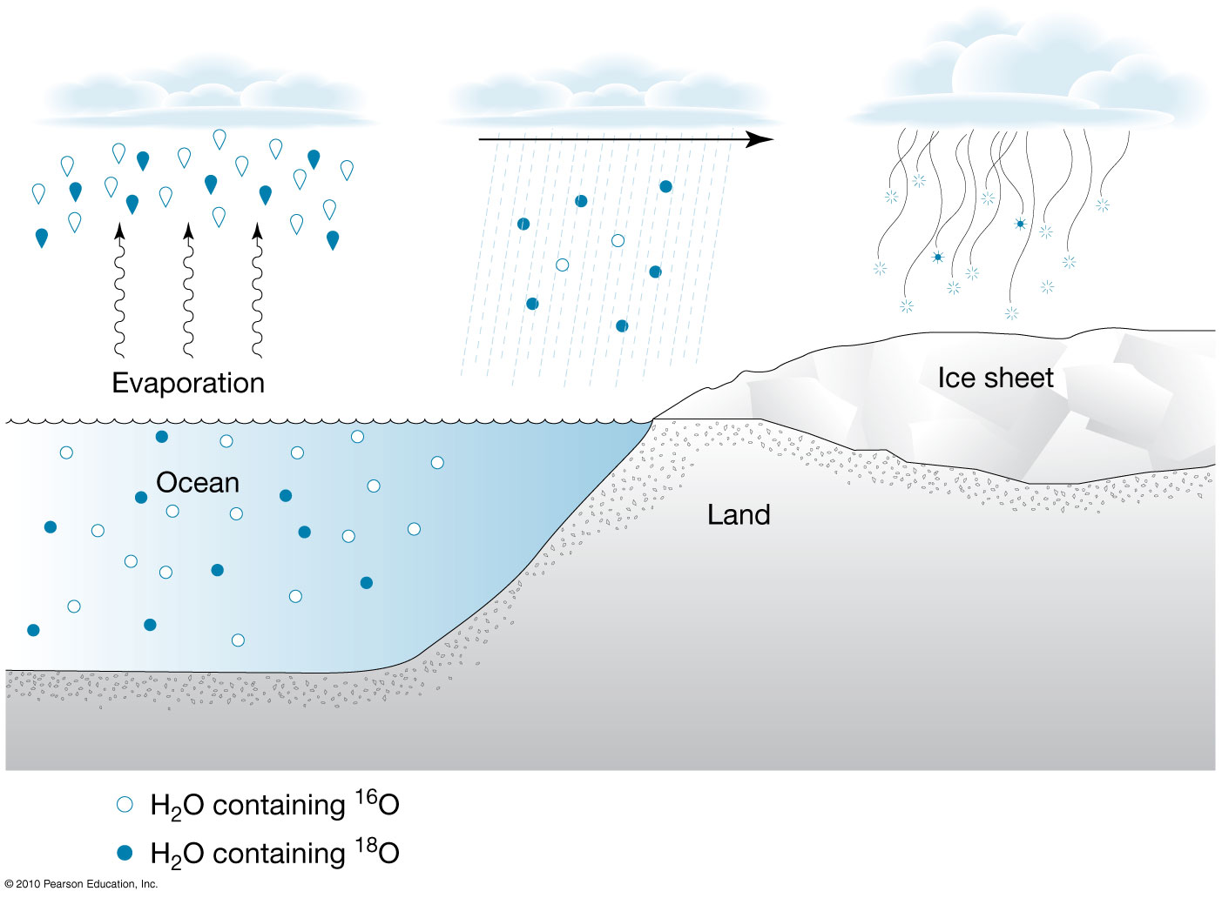
Glacial events: more ¹⁸O in marine fossils

Slide 7
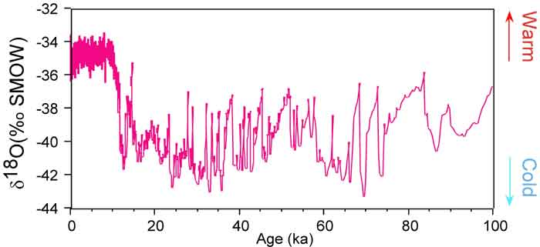
¹⁸O in glacial ice decreases during glacial events.
Ice cores have more detail than ocean sediments.

Slide 8
¹⁸O in ice have better details. Why?
Reason #1: ocean sediments accumulate slowly:
1,000 yrs. in⁻¹, ice: 2 yrs. in⁻¹
Ice allows for detection of short-term changes.
Reason #2: annual layers: in summer, more moisture to the glaciers
light color (lots of snowfall relative to dustfall)

Slide 9
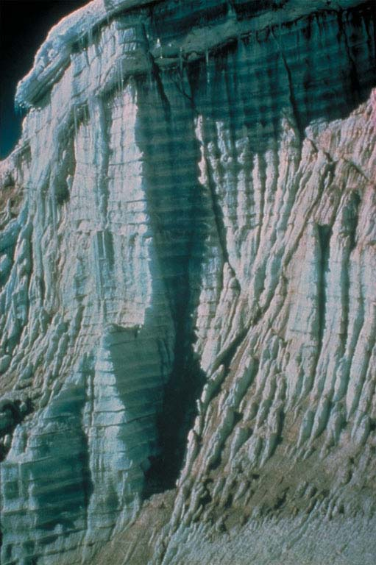

Slide 10
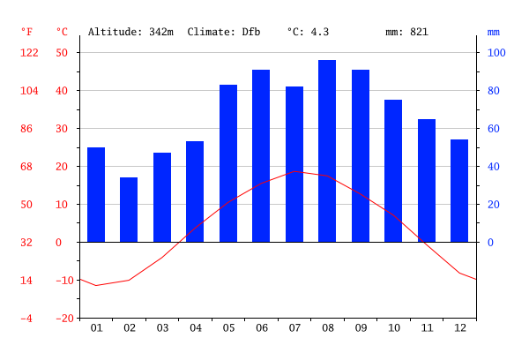

Slide 11
Glacial cycles
Antarctica glaciated 34 million years ago and Greenland 2 million years ago.
ice thickest in center
Weight pushes old ice outward and melt.
Oldest ice:
800,000 yrs. on Antarctica
150,000 yrs. on Greenland

Slide 12
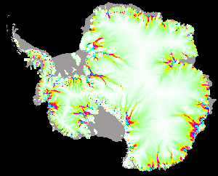
AA GL
800,000 150,000
4.5 km thick in the center

Slide 13
Glacial cycles
Temperatures reconstructed from oxygen isotopes in ice: Relative to 1850 CE
interglacial peak temperatures: 3°C (6°F) warmer
glacial events: 8°C (15°F) cooler than in 1850
Rates of warming and cooling during cycles:
ice–albedo feedback, slowly cool.
Rapidly warm because low-albedo rock replacing high-albedo ice.
Easier to break than to make (entropy).

Slide 14
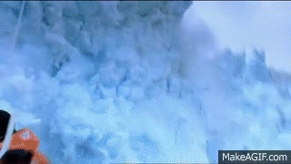
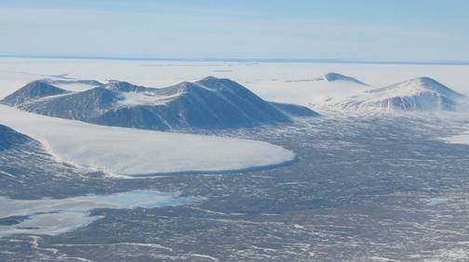

Slide 15
The Role of Oceans in Glacial Cycles
Temperature and GHGs:
Isotopes in ice show the temperature record.
GHGs trapped in ice show same trend.
CO₂ and CH₄ follow temperature pattern.
glacial events = ½ GHGs in interglacial events
Astronomical cycles trigger the change in N. hemisphere summer insolation, GHGs cause additional change. Why the same pattern?
NH summer insolation
Global
temperature
GHG
concentration
+

Slide 16
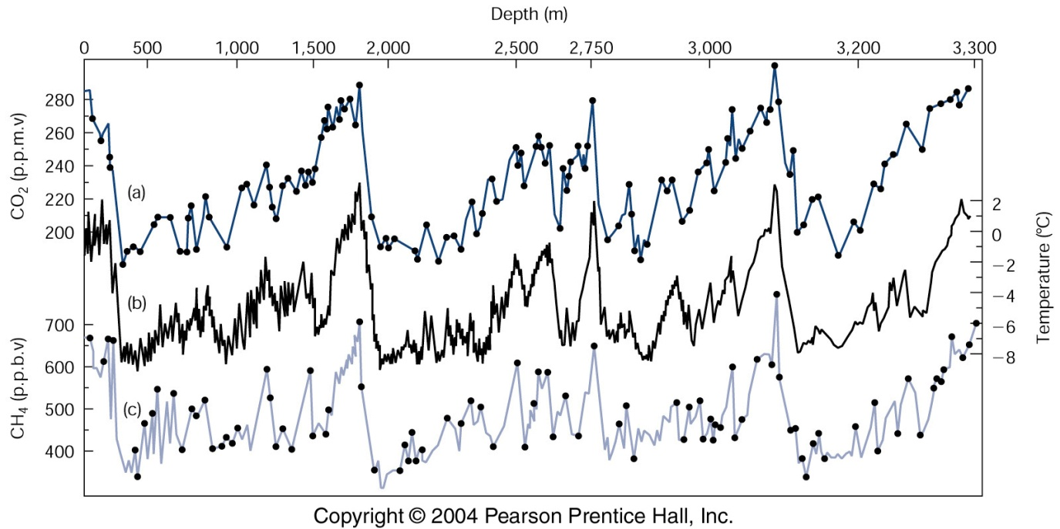
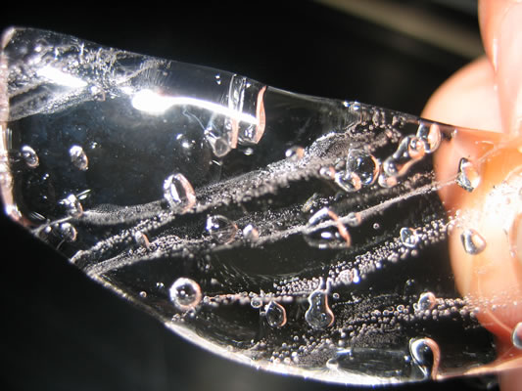
45 KY AA

Slide 17
Role of Oceans in Glacial Cycles
GHGs vary due to 2 factors: Marine Productivity (#1)
clue: methane sulfonic acid (MSA) gas [CH₃SO₃], produced when plankton die and decay.
large, healthy population = MSA ↑
(more living = more dying)
MSA [since 1840 CE] in Antarctic ice:
satellite images [since 1975] show in colder year, more sea ice extent and more MSA.

Slide 18
MSA ↑ during glacial events: ocean productivity also ↑ Why?
Increased nutrient supply.
Continental shelves (nutrient-rich);
lower sea-level exposes nutrients;
erosion washes them into ocean;
fertilize phytoplankton growth
Plankton productivity pulls in CO₂
biological pump!
positive feedback
(after the trigger)
reason #1 why GHGs decrease during glacial events.

Slide 19
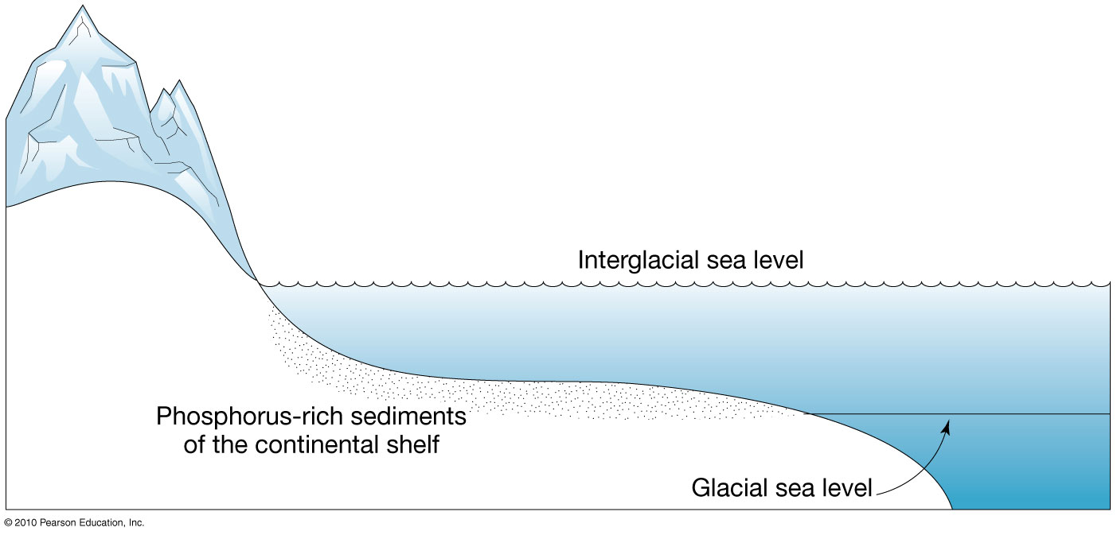

Slide 20
Role of Oceans in Glacial Cycles
Ocean Temperature (#2)
CO₂ dissolves more easily into cold water.
Colder water: more upwelling of nutrients, more positive feedbacks by biological pump
These 2 factors explain why GHGs decrease by ~50%, because positive feedbacks amplify the changes.
When astronomical factors change, warmer temperature, ocean productivity ↓, weaker biological pump, atmospheric CO₂ ↑, positive feedback “flipped” and more warming

Slide 21
D-O Cycles [Dansgaard and Oeschger]
Greenland ¹⁸O record show rapid changes.
only during glacial events (not interglacial).
variations of 20°C in Greenland (largest temperature swings in Polar region due to changes in albedo)
Younger Dryas: most recent changes

Slide 22
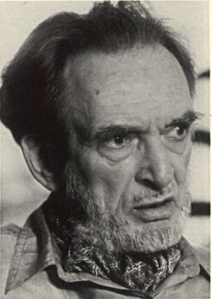
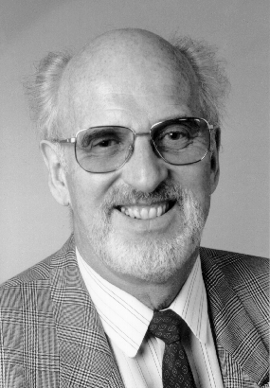
Willi Dansgaard
Hans Oeschger

Slide 23
D-O cycles
Younger Dryas:
1,300 year cold snap beginning 12,900 years ago.
Temperature and snowfall in GL decreased, suggesting warm currents slowed down.
end: GL warmed 10°C in 50 years, faster than anthropogenic GHE.
Cause?

Slide 24
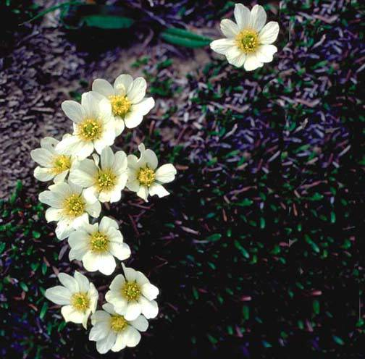
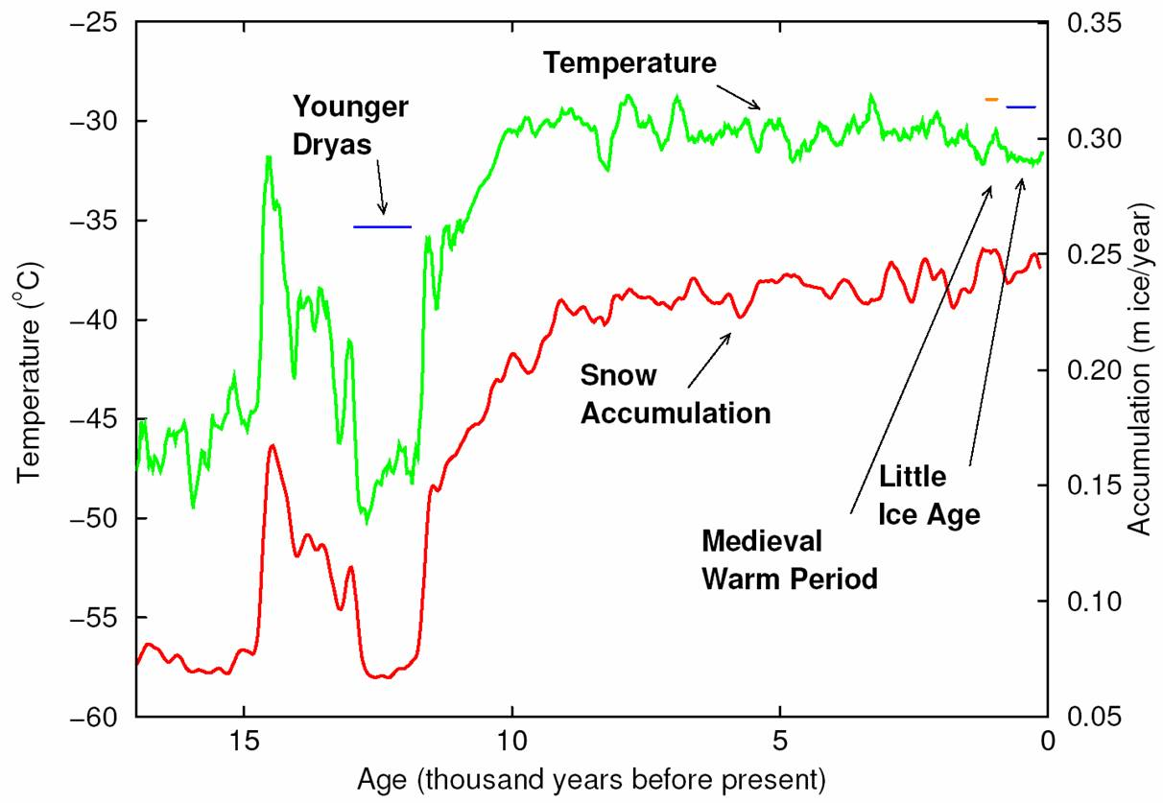

Slide 26
Role of Oceans in D-O Cycles
Freshwater input location changes.
14,000 years ago, ice at maximum extent; meltwater flowed south.
12,900 years ago, ice retreated; meltwater flows NE into North Atlantic Ocean. (St. Lawrence River)
like when a dam breaks and water rushes out through the path of least resistance.

Slide 27
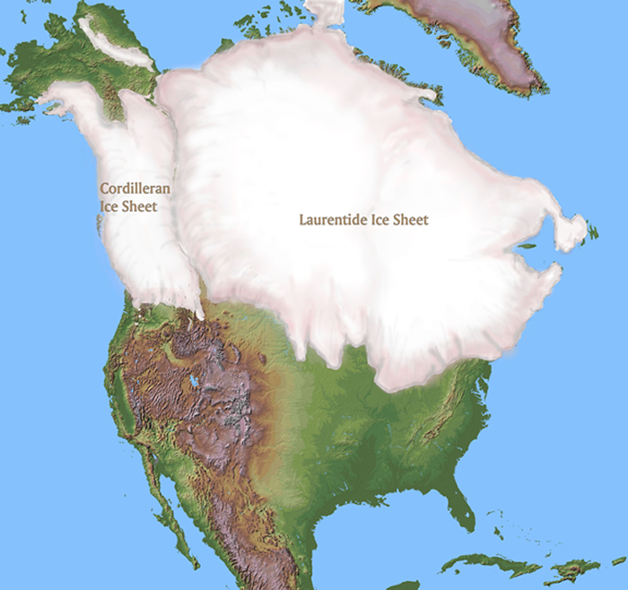

Slide 28
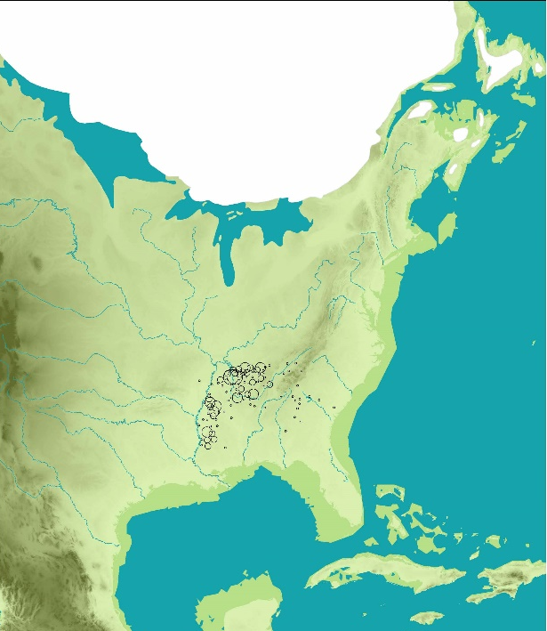

Slide 29
Role of Oceans in D-O cycles
Thermohaline conveyor belt:
Warm surface currents to North Atlantic Ocean
Water gets colder/saltier: dense and sinks
Sinking drives the conveyor, redistributes heat globally.

Slide 30
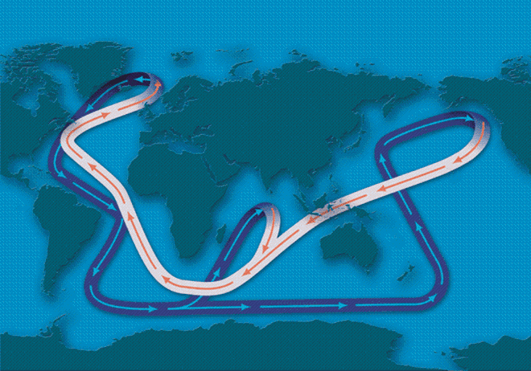

Slide 31
Role of Oceans in D-O cycles
Freshwater flowing down St. Lawrence river: surface salinity ↓
less dense water, less sinking, conveyor slows.
High latitudes became colder during Younger Dryas, but low latitudes warmer.
Younger Dryas ended when meltwater stopped.
Younger Dryas is one of several D-O events.

Slide 32
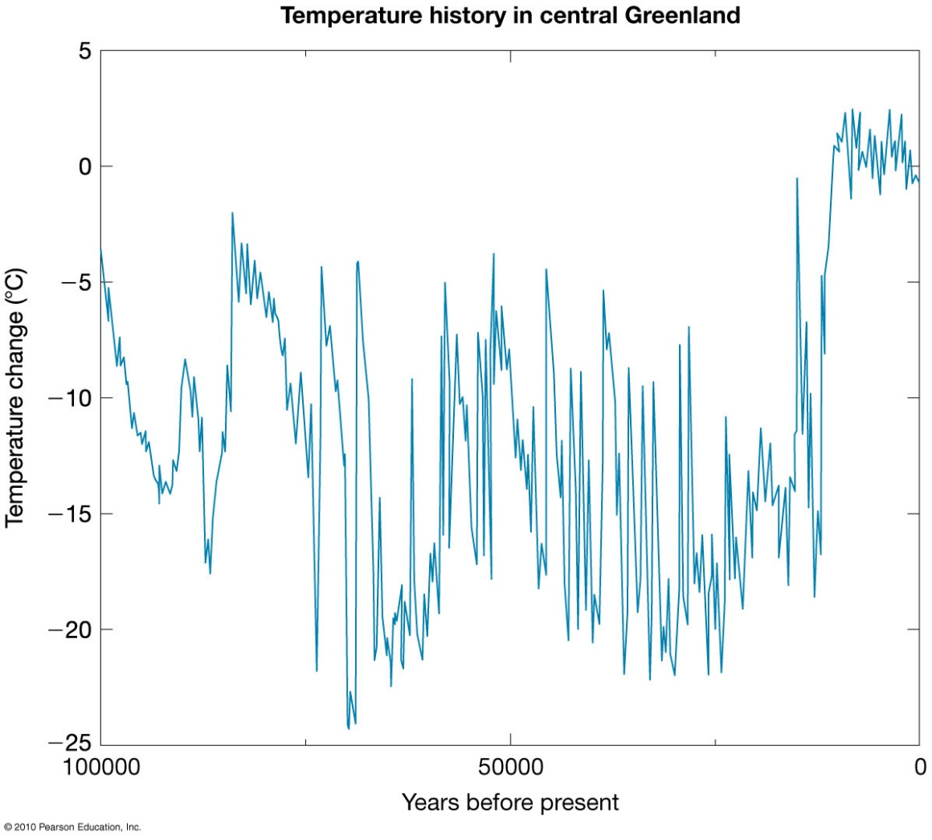

Slide 33
simulation

