Slide 1
The Faint Young Sun Paradox
GEO101
Spring 2023

Slide 2
Contents
A Faint Young Sun?
Possible Solutions to the Paradox

Slide 3
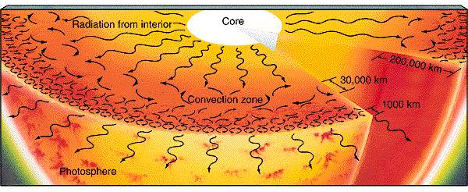
A Faint Young Sun?
How has the Sun changed?
Produces energy via nuclear fusion
Currently, the Sun’s mass is 71% H and 27% He;
Originally, it contained 74% H and 24% He.
Extreme heat fuses atoms.
4 hydrogen atoms → 1 Helium atom

Slide 4
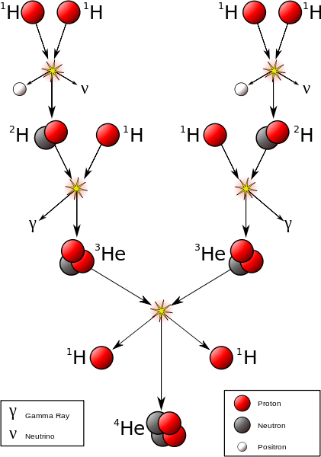
Extreme heat fuses atoms.
Fusion releases energy, which causes positive feedback.
Fusion
Heat

Slide 5
the dynamic Sun!

Slide 6
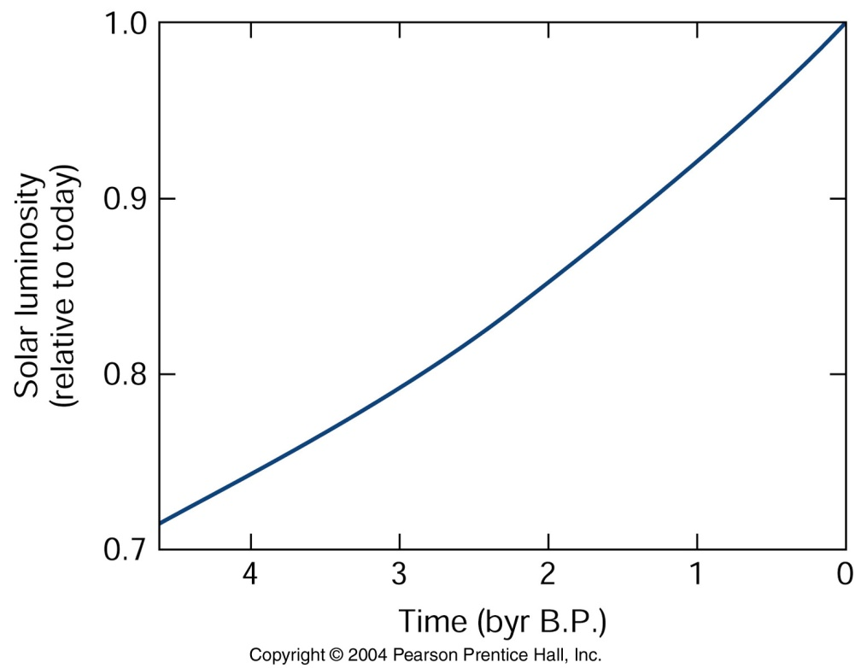
A faint young Sun
luminosity (brightness)
4.55 billion years ago, the Sun was 30% less luminous.

Slide 7
A faint young Sun
“Fainter” sun = cooler Earth?
(i) Stefan-Boltzmann law
F = σεT⁴
rearranged:
$$T=\sqrt[4]{F/σε}$$

Slide 8
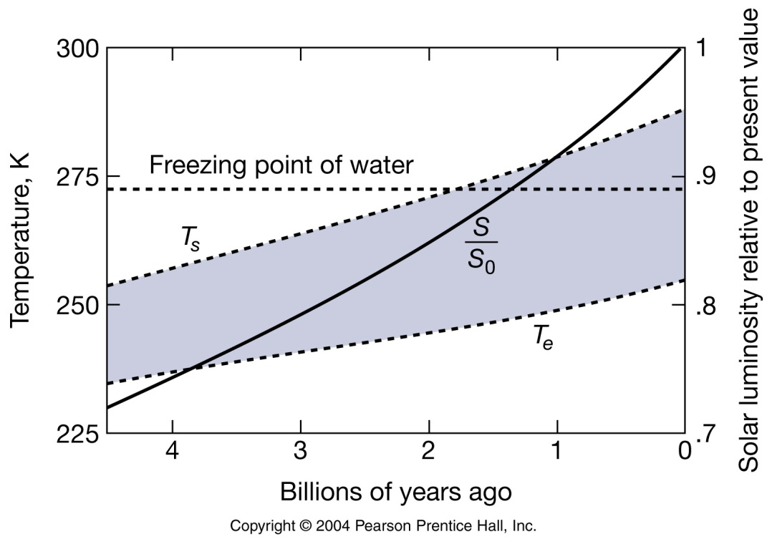
add the greenhouse effect (22K)
T_{s}= 255K (-18 °C) = still much cooler than today [equatorial areas below freezing too]
as luminosity ↑ , temperature ↑
Paradox: Earth not above freezing until 1.9 billion years ago?
However, 3.8 billion years old sedimentary rocks, and 2.7 billion year ago, photosynthesis in ocean

Slide 9
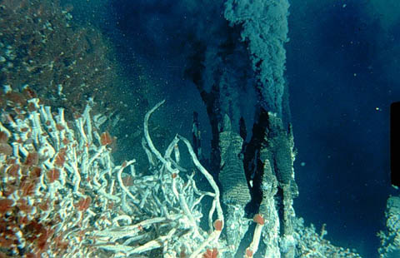
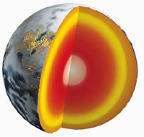
Possible Solutions to the Paradox
Geothermal heat?
produced in Earth’s core
released via vents and conduction through crust
but it’s weak…[0.09 W m⁻² does not make up for 411 W m⁻²]

Slide 10
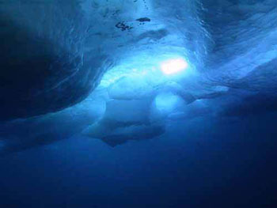
enough to warm bottom ocean, but still thick ice above
preventing the formation of ocean sediments and blocking sunlight for photosynthesis.
Therefore, it can’t resolve the paradox.

Slide 11
Albedo?
assumed to be 0.30 (30%)
if 0%, temperature would be like now.
However, Earth’s albedo can’t change too much.
if below freezing, then snow/ice’s albedo is high.
if above freezing, then clouds make albedo increase.
Therefore, albedo is not the solution.
Stronger greenhouse effect?
assumed to be 22 °K.
maybe it was stronger?

Slide 12
Stronger greenhouse effect
volcanic eruptions added GHGs
methanogenic bacteria 3.5 billion years ago
silicate rocks: formation = adds CO₂, weathering = removes CO₂ from the atmosphere.
Lower temperature reduces weathering, so CO₂ increases in the atmosphere.
An early cool Earth: less carbon in rock, more carbon in the atmosphere.

Slide 13
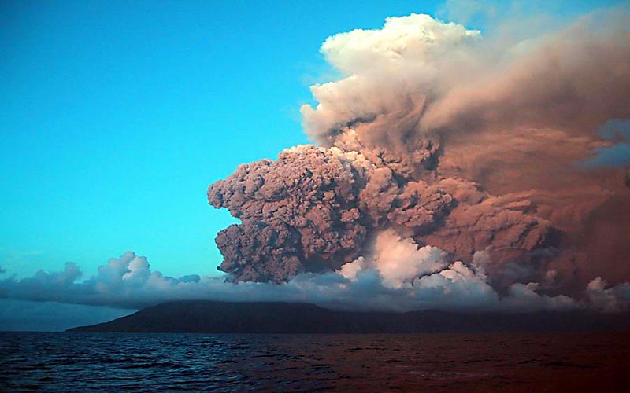
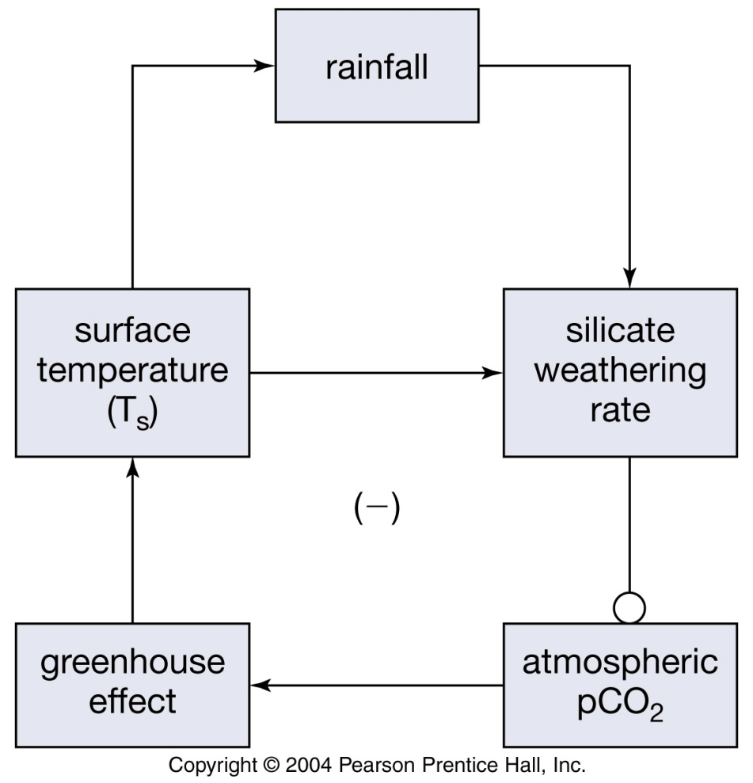
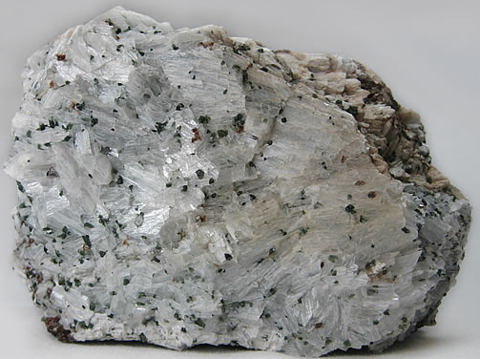

Slide 14
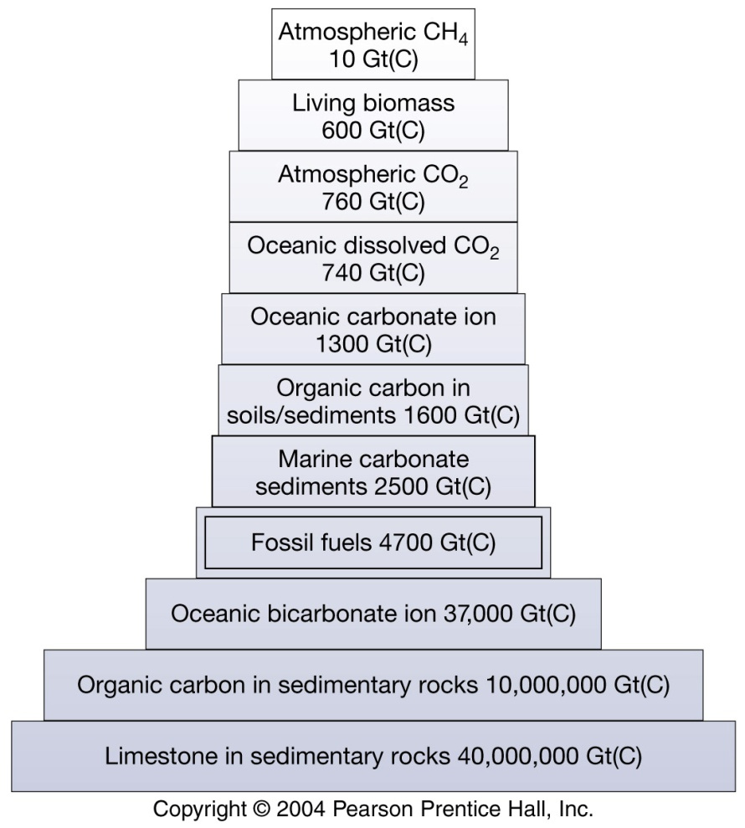
If 1000 x CO₂, global temperature could have been 15 °C 4.55 billion years ago.
1000 x 280 ppm pre-industrial = 0.28 CO₂ (28%)
Requires adding < 0.5% of C from rocks, from
volcanoes,
methanogenic bacteria,
silicate formation.

Slide 15
As solar luminosity increases, temperature increases?
This heating would cause more silicate weathering, and reduce CO₂ (negative feedback system)

Slide 16
