Slide 1
The Eukarya
GEO101
Spring 2023

Slide 2
Contents
Recap of Key Dates
Eukarya
The “Cambrian Explosion”

Slide 3
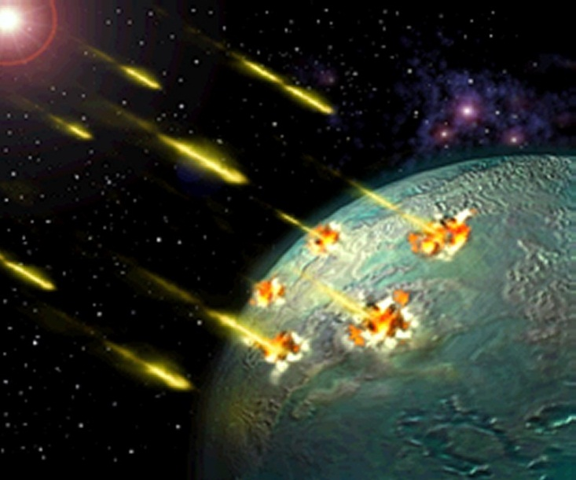
Recap
4.55 billion years ago: Earth
4.3 billion years ago: oldest rocks
Sporadic bombardment for 600 million years until 3.85 billion years ago
Oldest sedimentary rocks: 3.8 billion years
First fossil: 3.7 billion years ago
Photosynthetic cyanobacteria: 2.7 billion years

Slide 4
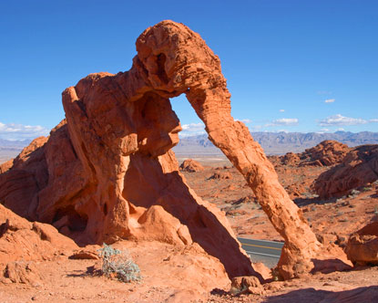
Evidence for oxygen (redbeds): 2.2 billion years
540 million years ago – present: Phanerozoic eon (O₂ and multi-cellular life)

Slide 5
The Eukarya
Prokaryote (Bacteria and Archaea domain) vs. Eukaryote (Eukarya domain)
Prokaryotes: small, single-celled, no nucleus
Eukaryotes: larger, nucleus, most are single-celled
All multi-celled are Eukaryotes. Some are photosynthetic, most need oxygen.

Slide 6
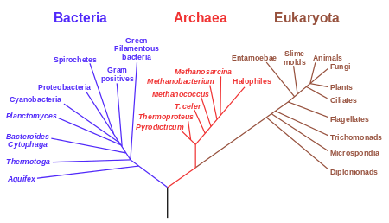
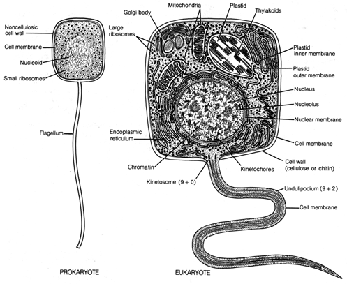
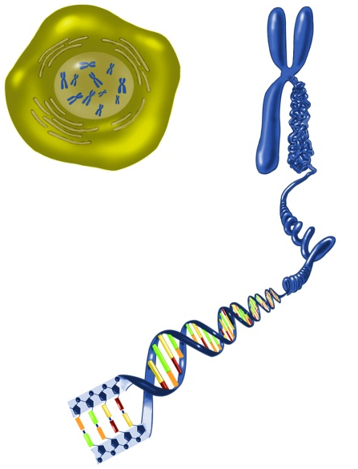

Slide 7
The Eukarya
First Eukaryote?
fossils: 2.1 billion years ago. Cholesterol produced by Eukarya: 2.7 billion years old rocks
So, by 2.7 billion years ago, cyanobacteria and Eukarya coexisted.
Eukarya would be only underwater then, as no O₂ in atmosphere yet.

Slide 8
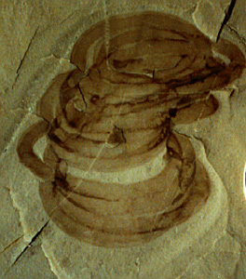
Grypania

Slide 9
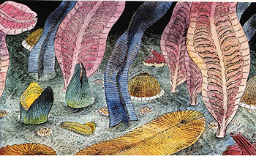
The Eukarya
First multi-cellular life: Ediacaran fauna: 600 million years ago, so 2.1 billion years after first Eukarya (2.7 billion years ago).
Multi-cellular organism: cellular differentiation

Slide 10
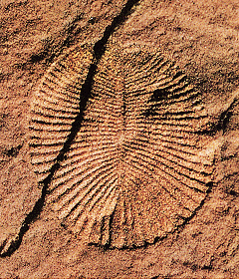
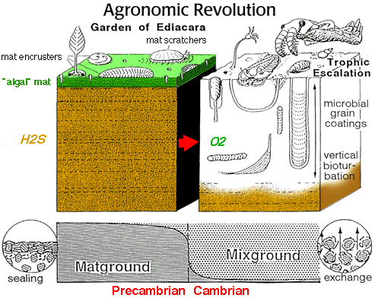
First multi-cellular life
Ediacaran fauna live in shallow water:
  long, thin, flat bodies.
  [Dickinsonia: 12” long x 0.5” thick]
  absorb O₂ through skin (like insects)
  Flattened shape helps.
Grazed on undersea mats of bacteria

Slide 11
Cambrian “Explosion”
Precambrian eon: until 540 million years ago
540 million years ago: rapid evolution
Species with hard-shells (calcium carbonate, CaCO₃)
Some could dig below mats
= increased nutrient recycling
Precambrian Cambrian

Slide 12
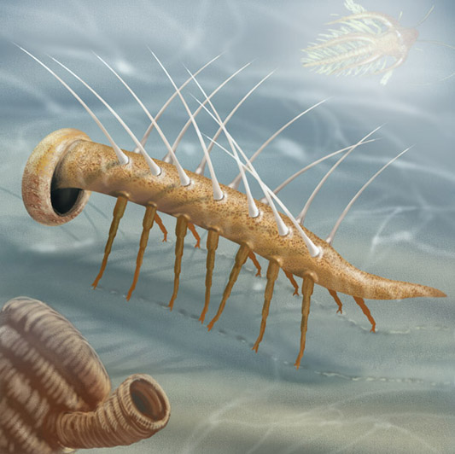
Hallucinogenia
[375 million years ago: first land vertebrate]

Slide 13
3 to 5 “mass extinctions” since Cambrian Explosion
mass extinction = over 50% of existing genera lost. But new species can show up so the remaining number of genera could be more than 50%.
causes: meteorites, volcanic activity, rapid climate changes.

Slide 14
“Global biodiversity” = # species
old species
+ new species (“origination”)
– extinction
= biodiversity
(iii) Stable or unstable state?

Slide 15
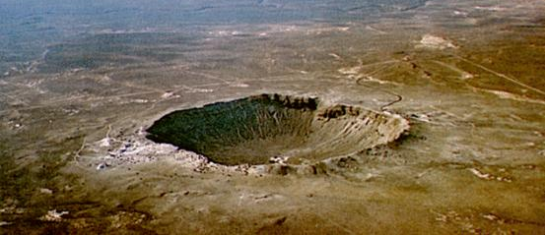
(External forcing)
Evolution
Biodiversity
Extinction

