Slide 1
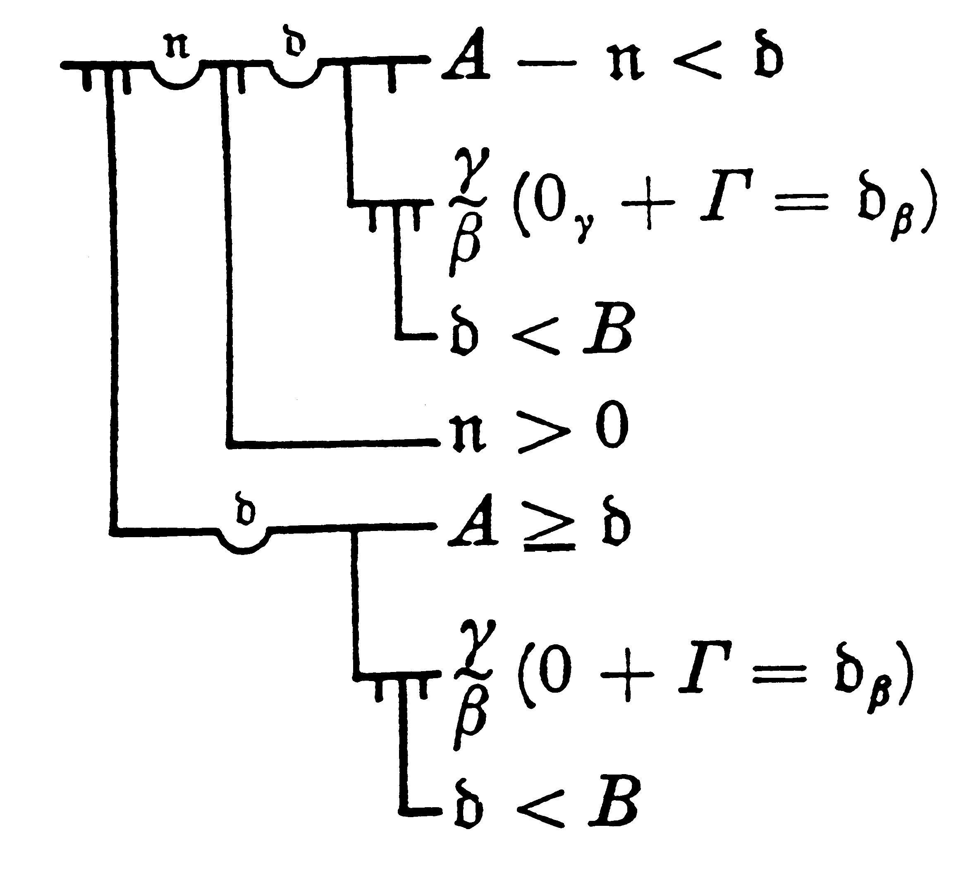

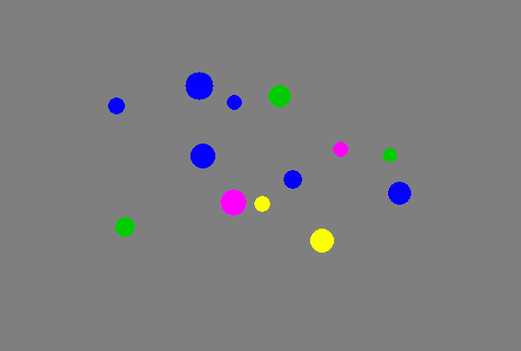
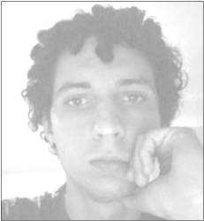

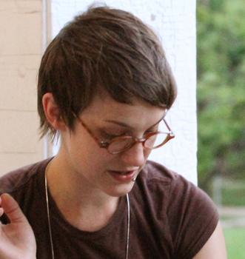

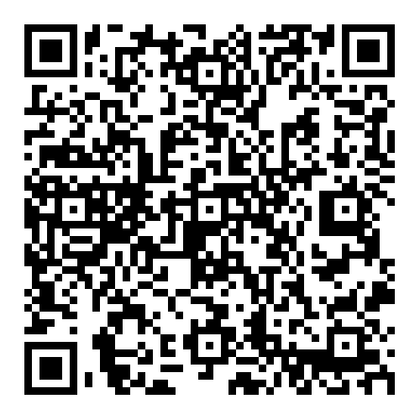
Quantifier Meanings in Human Minds
Paul M. Pietroski, Rutgers University
http://www.tinyurl.com/pietroski
slides (.pptx) available here…

Slide 2
Start by describing a couple of experiments…
Tyler Knowlton
Knowlton et. al. (2023):
Individuals and Ensembles
and each versus every
(Glossa Psycholinguistics)
Knowlton et. al. (2021):
The Mental Representation
of Universal Quantifiers
(Linguistics & Philosophy)
Jeff Lidz
Justin Halberda
…and then give you a roadmap for the talk

Slide 3
Performance is better
on ‘each’-trials.
Task: Given a scene with three circles that differ in hue, say whether or not each/every circle is green.
(The circles will disappear; after 300ms, they will reappear in the same positions.)
Then say whether or not one circle changed its color.

Slide 4
Performance is better
on ‘each’-trials.
Block 1
Block 2
EXPERIMENT 1: Uniform Range of Difficulty
Better accuracy for color-change with ‘each’ (p < .05)
Note: participants knew the color-change question was coming; and on ‘every’-trials, they were free to use whatever resources they used on ‘each’-trials.
EXPERIMENT 2: Staircased Difficulty
For a fixed accuracy level (≈67%),
with difficulty dependent on performance,
smaller changes noticed on ‘each’-trials (p < .001)
Again, on ‘every’-trials, participants could have
(but did not) use their ‘each’-strategy.

Slide 5
EXPERIMENT 1: Uniform Range of Difficulty
Better accuracy for color-change with ‘each’ (p < .05)
Note: participants knew the color-change question was coming; and on ‘every’-trials, they were free to use whatever resources they used on ‘each’-trials.
EXPERIMENT 2: Staircased Difficulty
For a fixed accuracy level (≈67%),
with difficulty dependent on performance,
smaller changes noticed on ‘each’-trials (p < .001)
Again, on ‘every’-trials, participants could have
(but did not) use their ‘each’-strategy.

Slide 6
3 possible sizes:
big, medium, small
Performance is better
on ‘every’-trials.
Each big dot is blue
Every big dot is blue
3 possible colors:
blue, red, yellow
DET NP VP
Each/Every big dot is blue
(Image remains until
the sentence is evaluated.)
Task: Evaluate a sentence of the form ‘Each/Every [size] dot is [color]’, once you see the image.
(Then the screen will go blank.) Then answer a “how many”-question about the image just seen.
Questions about colors were fillers. This experiment was not about the external (VP) arguments of ‘each/every’.
The questions of interest (for us, here) concerned sizes, which corresponded to internal (NP) arguments.
(We have other experiments, for another talk, about the contrast between internal/VP and external VP/arguments.)

Slide 7
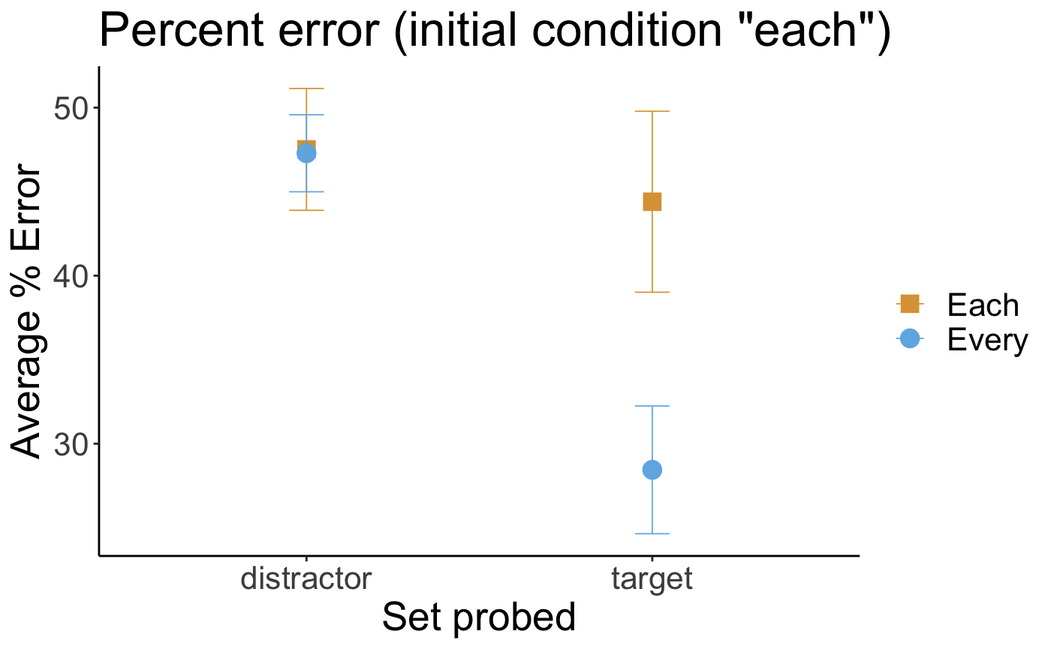
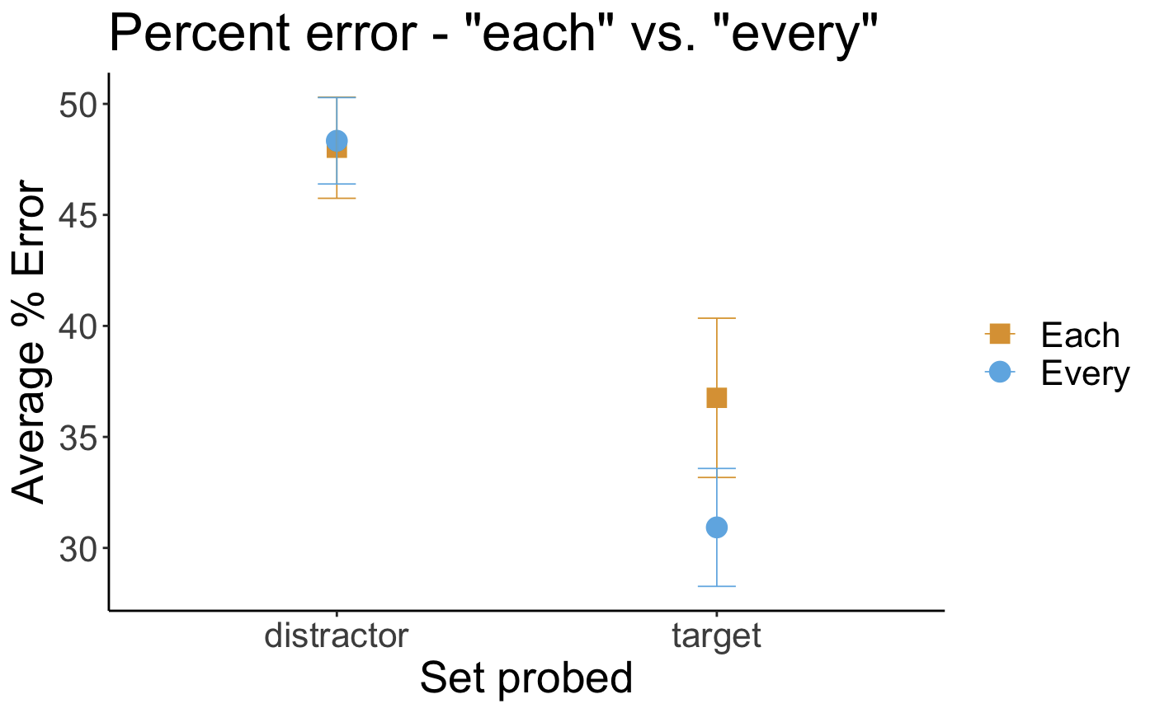
Seeing the block of ‘every’-trials first
improves performance on the ‘each’-trials.
(That’s already interesting.)
But even given this boost for ‘each’ in half of the trials,
when comparing models of all the trials,
the model that does best is the one that predicts
better performance with ‘every’ for the target set.
(all data)
Performance (across all trials) can also be compared to a standard model of number estimation along two important dimensions: accuracy and precision.
On number estimation tasks, better performance manifests as a higher “accuracy” (less underestimation) and smaller errors (on average). On both dimensions, participants did better on ‘every’-trials for target sets.
Accuracy: p < .001 Precision: p = .025

Slide 8
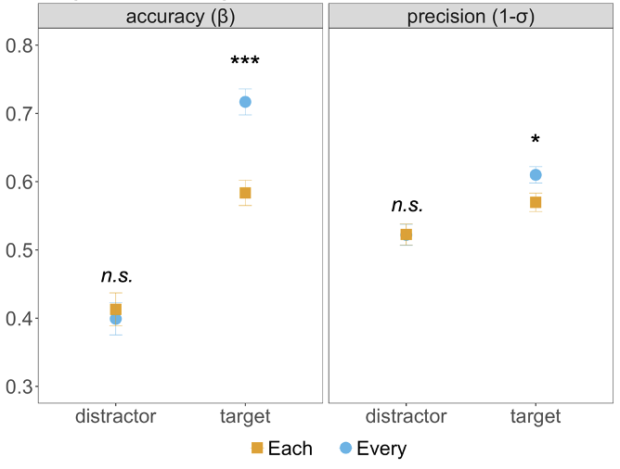
Participants knew
that a “how many” question was coming.
And on ‘each’-trials, they were free to use whatever mental resources they used on ‘every’-trials.
Yet by multiple measures, performance was significantly better
on ‘every’-trials.

Slide 9
Better performance on ‘each’-trials.
Better performance on ‘every’-trials.
Each big dot is blue
Every big dot is blue
I’ll come back to a proposed explanation for the constrasts.

Slide 10
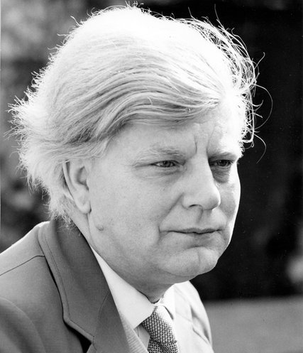
What is a Theory of Meaning a theory of?
It’s not a theory of anything.
It’s a “Holistic Regimenter” for Object Language expressions.
It’s about how speakers of the OL understand the expressions.
Positing concepts (and even meanings) is OK.
OL-expressions may be understood as instructions for how to build concepts. And instructions can differ, even if executing them (provably) leads equivalent results.
Each dog barked
and
every cat purred.
It’s a recursive specification of some (alleged) semantic properties of OL-expressions.
But the theorist isn’t saying how (or whether) speakers represent these properties.
→
HR
→
∀x:Dx(Bx) & ∀x:Cx(Px)
OL-sentences have…
truth
conditions
assertability
conditions
…
context-change-
potentials

Slide 11
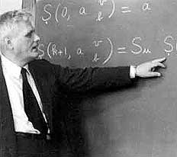
function in intension function in extension
(computational procedure) ( (set of input-output pairs)
|x – 1| ⁺√(x² – 2x + 1)
{…(-2, 3), (-1, 2), (0, 1), (1, 0), (2, 1), …}
λx . |x – 1| ≠ λx . ⁺√(x² – 2x + 1)
λx . |x – 1| = λx . ⁺√(x² – 2x + 1)
Extension[λx . |x – 1|] = Extension[λx . ⁺√(x² – 2x + 1)]
____________________________________________________________
Are meanings more like functions in intension or functions in extension?
Do meanings reflect details of certain representational formats?
Or are meanings neutral contents that abstract from such details?

Slide 12
ROADMAP
Each circle is green
Every circle is green
Most of the circles are blue
#(the blue circles) > #(the circles that aren’t blue)
#(the circles) > [#(the circles) − #(the blue circles)]
Most of the circles are blue
More of the circles are blue
Understood differently
(as Vendler suggested)
Understood differently
in contexts where
all non-blue circles are red

Slide 13
Better performance on ‘each’-trials.
Better performance on ‘every’-trials.
Each big dot is blue
Every big dot is blue

Slide 14
Two Kinds of Mental Representations
Object File
• indexed to a particular object
• individuated by spatial location
• anchors a list of properties exhibited by individuals (e.g., size and color)
Kahneman & Treisman (1984);
Kahneman, Treisman & Gibbs (1992)
Ensemble Representation
• abstracts from properties exhibited by individuals
• encodes “summary statistics”
--average size
--centroid
--envelope
--cardinality
--average hue, but not individual hues
Ariely (2001); Whitney & Yamanashi Leib (2018)
Helpful reviews: Feigenson, Dehaene & Spelke (2004); Carey (2009)

Slide 15
Better performance on ‘each’-trials.
And using Object Files
would yield better performance
than using Ensemble Representations.
Better performance on ‘every’-trials.
And using Ensemble Representations
would yield better performance
than using Object Files.
Each big dot is blue
Every big dot is blue

Slide 16
Better performance on ‘each’-trials.
as if ‘each’ is understood in a way that encourages Object Files, while ‘every’ is understood in a way that
encourages Ensemble Representations.
Better performance on ‘every’-trials.
And using Ensemble Representations
would yield better performance
than using Object Files.
Each big dot is blue
Every big dot is blue

Slide 17
So here’s a hypothesis…
‘Each’ links its pronunciation with a meaning
that is apt for accessing Object-Concepts of universal quantification,
but less apt for accessing Ensemble-Concepts of universal quantification.
Better performance on ‘each’-trials.
as if ‘each’ is understood in a way that encourages Object Files, while ‘every’ is understood in a way that
encourages Ensemble Representations.
‘Every’ links its pronunciation with a meaning that is apt for accessing Ensemble-Concepts
of universal quantification,
Better performance on ‘every’-trials.
as if ‘every’ is understood in a way that encourages Ensemble Representations, while ‘each’ is understood in a way that
encourages Object Files.
Each big dot is blue
Every big dot is blue
but less apt for accessing
Object-Concepts of universal quantification.
EACH ∀x:Circle(x)[Green(x)] EVERY 𝝸X:TheCircles(X)[Green(X)]
𝝸X:TheCircles{∀x:X(x)[Green(x)]} 𝝸X:TheCircles(X)[AllGreen(X)]

Slide 18

‘Most of the dots are yellow’
MOST[D, Y]
OneToOnePlus[{D & Y}, {D & ∼Y}]
#{D & Y} > #{D & ∼Y}
#{D & Y} > #{D}/2
#{D & Y} > #{D} – #{D & Y}
Number Representations
Pietroski et.al. 2009
Hackl 2009

Slide 19
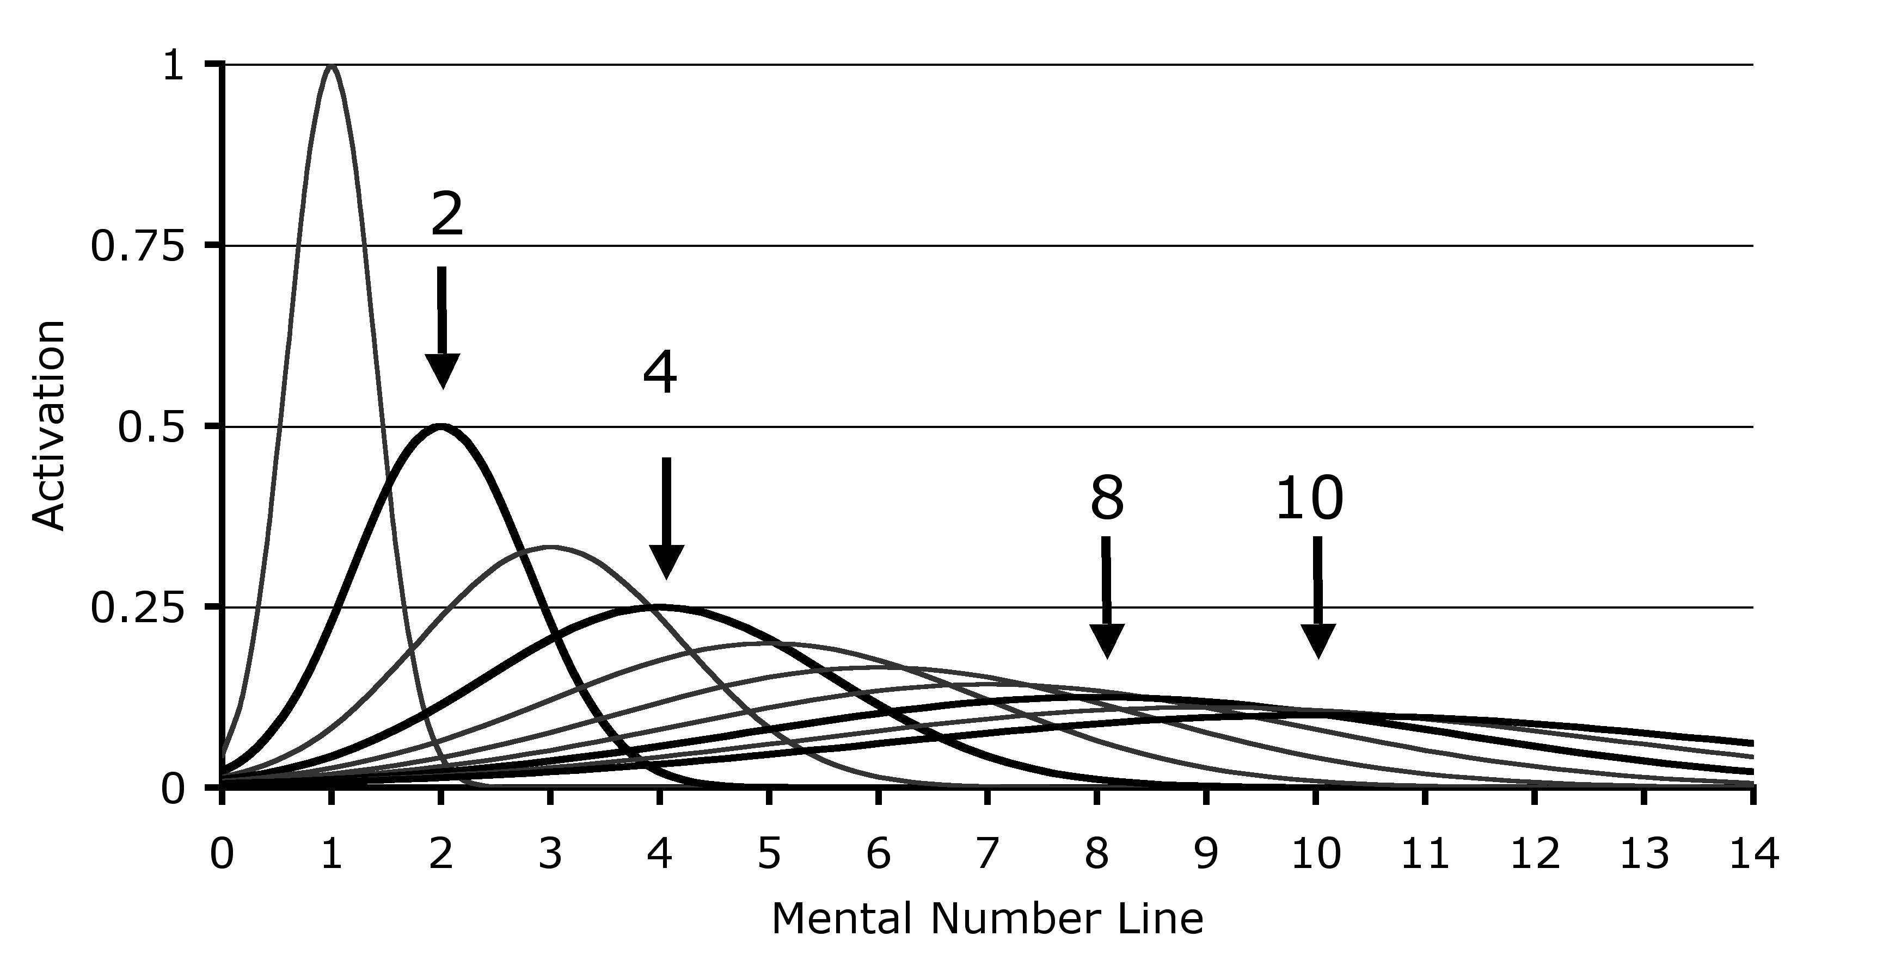
a model of the “Approximate Number System”
(key feature: ratio-dependence of discriminability)
distinguishing 8 dots from 4 (or 16 from 8)
is easier than
distinguishing 10 dots from 8 (or 20 from 10)

Slide 20
a model of the “Approximate Number System”
(key feature: ratio-dependence of discriminability)
correlatively, as the number of dots rises, “acuity” for estimating of cardinality decreases--but still in a ratio-dependent way, with wider “normal spreads” centered on right answers

Slide 21
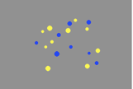
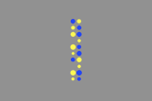
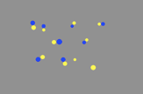
scattered random
scattered pairs
Are most of the dots yellow? (Dots presented for 200 ms)
Key findings (multiple replications):
Participants estimate cardinalities across the trial types. Performance is as expected (R² > .9) by models of the ANS.
Follow-up experiment:
performance on Scattered Pairs trials is
better (at 150ms) if the task is to identify the “outliers” and their color
column pairs mixed

Slide 22
‘Most of the dots are yellow’
MOST[D, Y]
OneToOnePlus[{D & Y}, {D & ∼Y}]
#{D & Y} > #{D & ∼Y}
#{D & Y} > #{D}/2
#{D & Y} > #{D} – #{D & Y}
Number Representations
Can the “predicate negation” hypothesis be empirically distinguished from the “cardinality substraction” hypothesis?

Slide 23
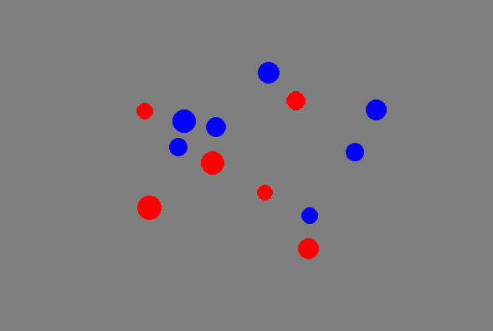
Tim Hunter
Darko Odic
Jeff Lidz
Justin Halberda
Lidz et. al. (2011).
Interface Transparency and the Psychosemantics of ‘Most’.
Natural Language Semantics 19: 227-56.

Slide 24
Most of the dots are blue.
What conditions
make it
easy/hard
to evaluate
the sentence?
That might
provide
clues
about
how the
sentence is understood
(given independent accounts of the information used
by the evaluators in those conditions).

Slide 25
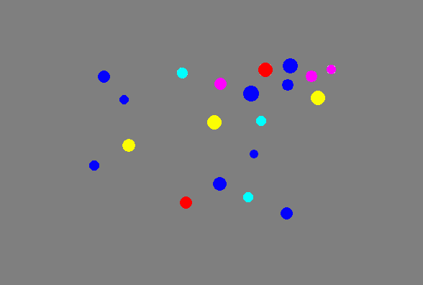
Most of the dots are blue?
What conditions
make it
easy/hard
to evaluate
the sentence?
That might
provide
clues
about
how the
sentence is understood
(given independent accounts of the information used
by the evaluators in those conditions).

Slide 26
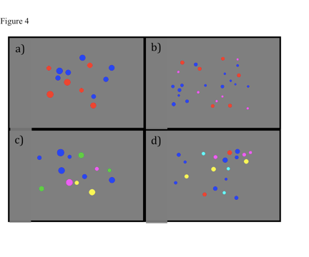
Four Trial Types (2-5 colors)

Slide 27
‘Most of the dots are blue’
#{Dot & Blue} > #{Dot & ~Blue}
in scenes with two colors, blue and red,
the non-blues can be identified with the reds
#{Dot & ~Blue} = #{Dot & Red}
the visual system will “select” the dots, the blue dots, and
the red dots; these 3 sets will be estimated for cardinality
but adding colors will make it harder (and with 5 colors,
impossible) to estimate the cardinality of the non-blues
#{Dot & Blue} > #{Dot} − #{Dot & Blue}

Slide 28
‘Most of the dots are blue’
#{Dot & Blue} > #{Dot & ~Blue}
verification should get harder
as the number of colors increases
but in the two-color case,
“acuity” should be relatively good (w ≈ .15) since
no estimate of the total figures in the computation
#{Dot & Blue} > #{Dot} − #{Dot & Blue}
predicts indifference to the number of colors
but in the two-color case,
“acuity” should be less good (w ≈ .3) since
an estimate of the total will figure in the computation
15 dots, 9 blue
9 > 6
15 dots, 9 blue
9 > (15 − 9)

Slide 29
#{Dot & Blue} >
#{Dot & ~Blue}
#{Dot & Blue} >
#{Dot} − #{Dot & Blue}
6
9
15
lower
acuity

Slide 30
‘Most of the dots are blue’
#{Dot & Blue} > #{Dot & ~Blue}
verification should get harder
as the number of colors increases
but in the two-color case,
“acuity” should be relatively good (w ≈ .15) since
no estimate of the total figures in the computation
#{Dot & Blue} > #{Dot} − #{Dot & Blue}
predicts indifference to the number of colors
but in the two-color case,
“acuity” should be less good (w ≈ .3) since
an estimate of the total will figure in the computation
15 dots, 9 blue
9 > 6
15 dots, 9 blue
9 > (15 − 9)

Slide 31
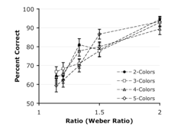
better performance on easier ratios: p < .001

Slide 32
no effect of number of colors

Slide 33
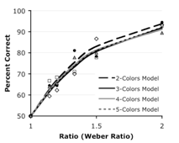
fit to psychophysical model of ANS-driven performance

Slide 34
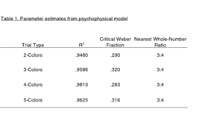
But can we find independent evidence that ‘most’ is understood in a way that leads speakers of English to hear ‘Most of the dots are blue’ as inviting them
to estimate the cardinality of the dots, and do a subtraction:
#{Dot & Blue} > #{Dot} − #{Dot & Blue}

Slide 35
Tim Hunter
Tyler Knowlton
Alexis Wellwood
Darko Odic
Justin Halberda
Jeff Lidz
Linguistic Meanings as Cognitive Instructions.
Annals of the New York Academy of Sciences 1500:134–144 (2021).

Slide 36
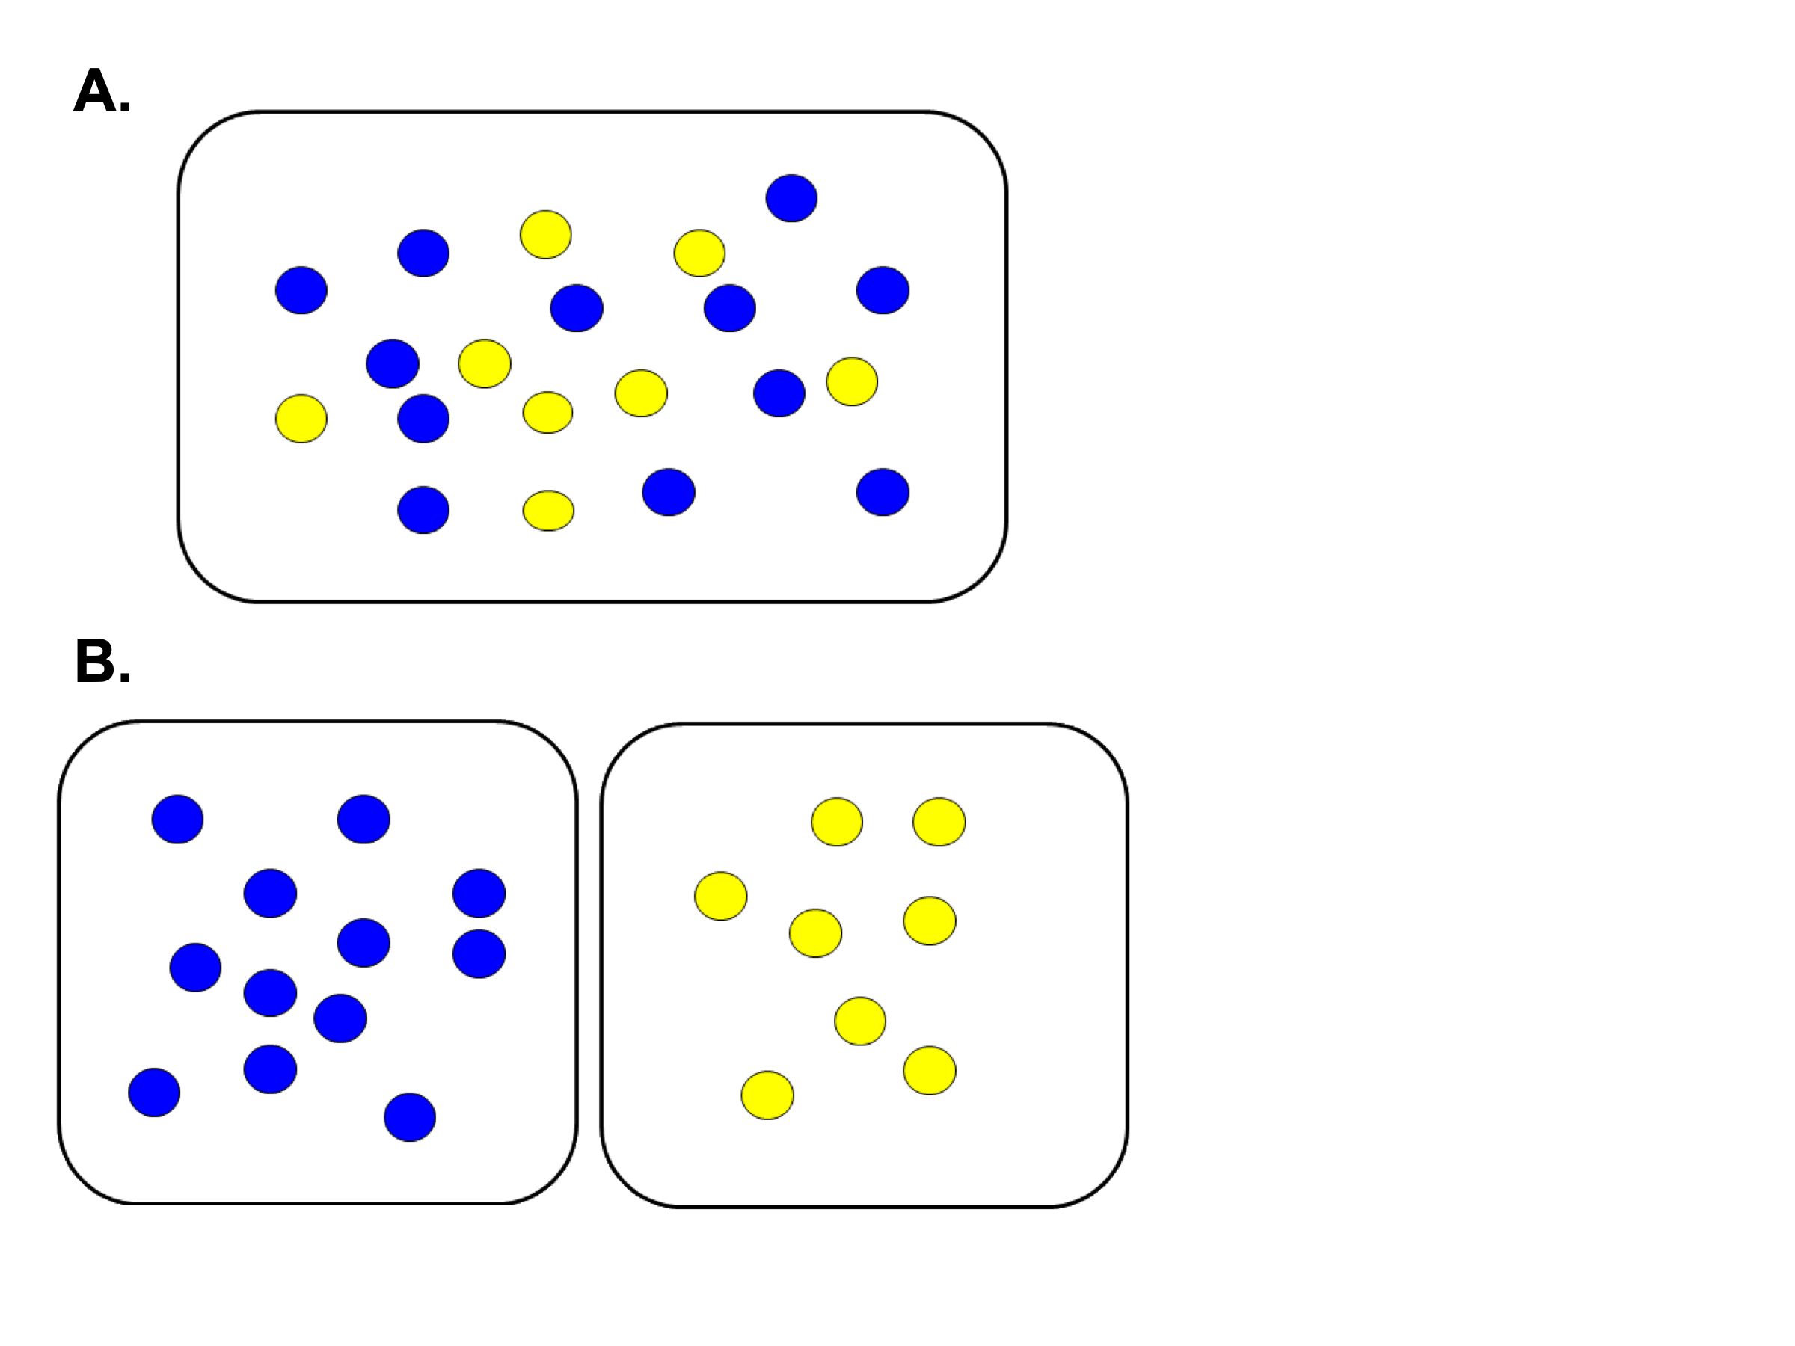
Which picture is the
better example of…
‘Most of the dots are blue’
‘More of the dots are blue’
‘Most of the dots are blue’
‘There are more blue dots
than yellow dots’
✓
EXP-1, Knowlton et. al.
(Annals NY Acad of Sci)

Slide 37
Choose a sentence…
‘Most of the dots are blue’
‘More of the dots are blue’
‘Most of the dots are blue’
‘There are more blue dots
than yellow dots’
EXP-2, Knowlton et. al.
(Annals NY Acad of Sci)

Slide 38
Choose a sentence…
‘Most of the dots are blue’
‘More of the dots are blue’
‘Most of the dots are blue’
‘There are more blue dots
than yellow dots’
✓
EXP-2, Knowlton et. al.
(Annals NY Acad of Sci)

Slide 39
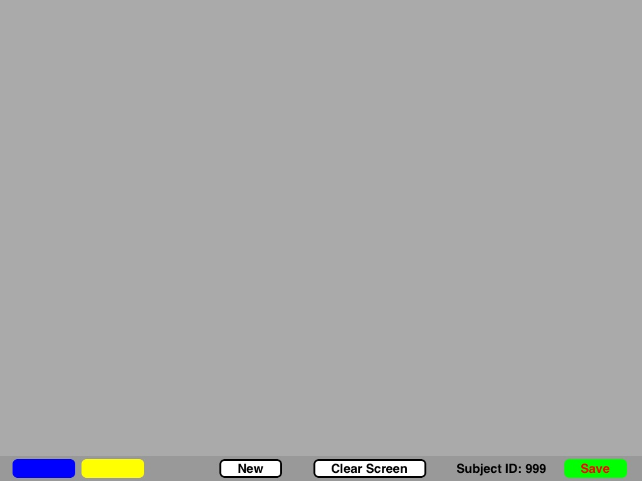
Not just about recognition
80 participants asked to “draw” on an iPad More/Most of the dots are blue

Slide 40
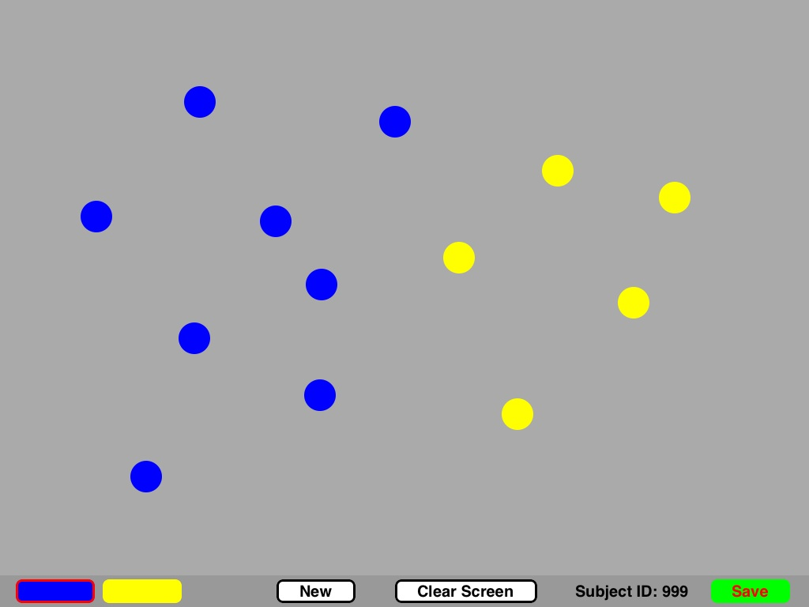
Not just about recognition
Typical for “More of the dots are blue”

Slide 41
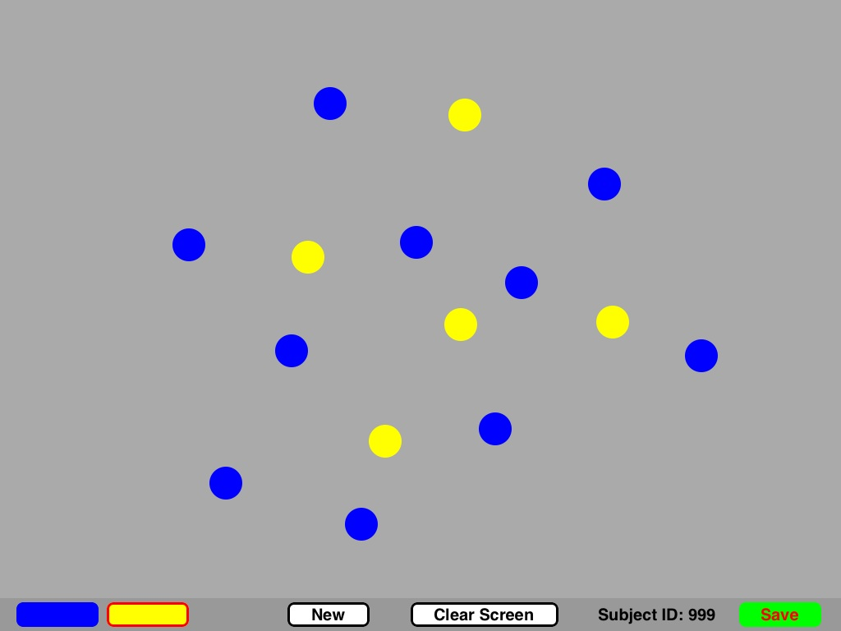
Not just about recognition
Typical for “Most of the dots are blue”

Slide 42
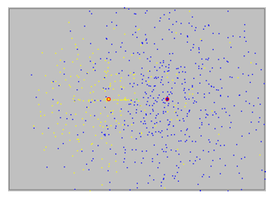
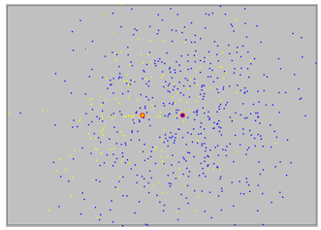
Centroid distance (adults)
More Most
  Halberda, Pietroski, Hunter, Odic, Wellwood, & Lidz. (2012). More & most: spatial vision affects word understanding on an iPad. Vision Science Society annual meeting.
EXP-3, Knowlton et. al.
(Annals NY Acad of Sci)

Slide 43
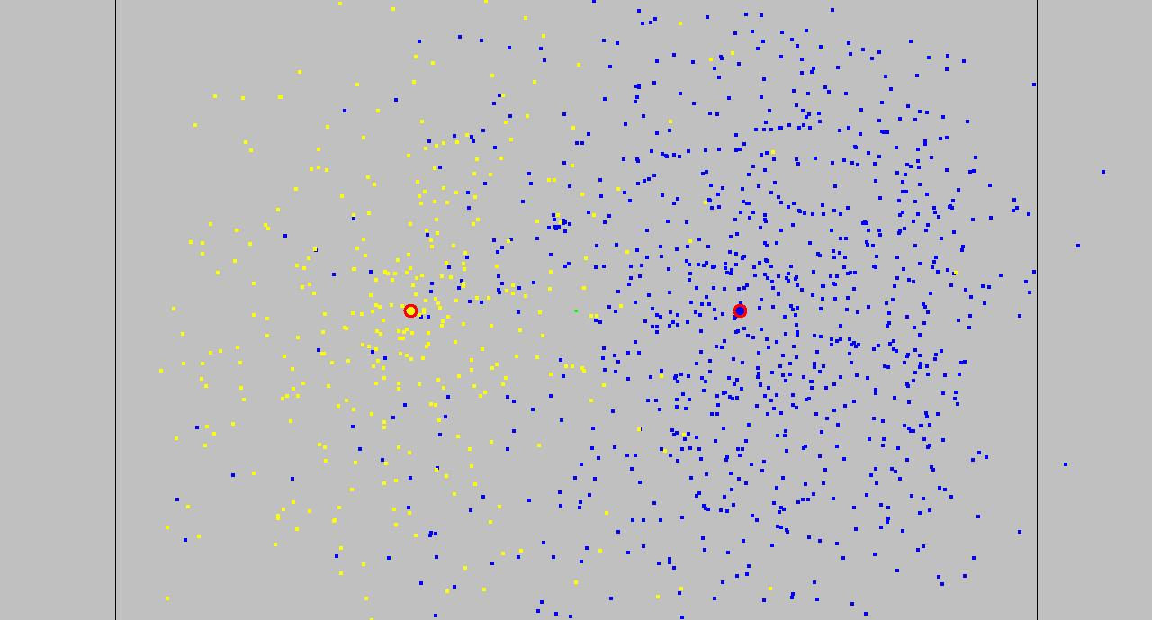
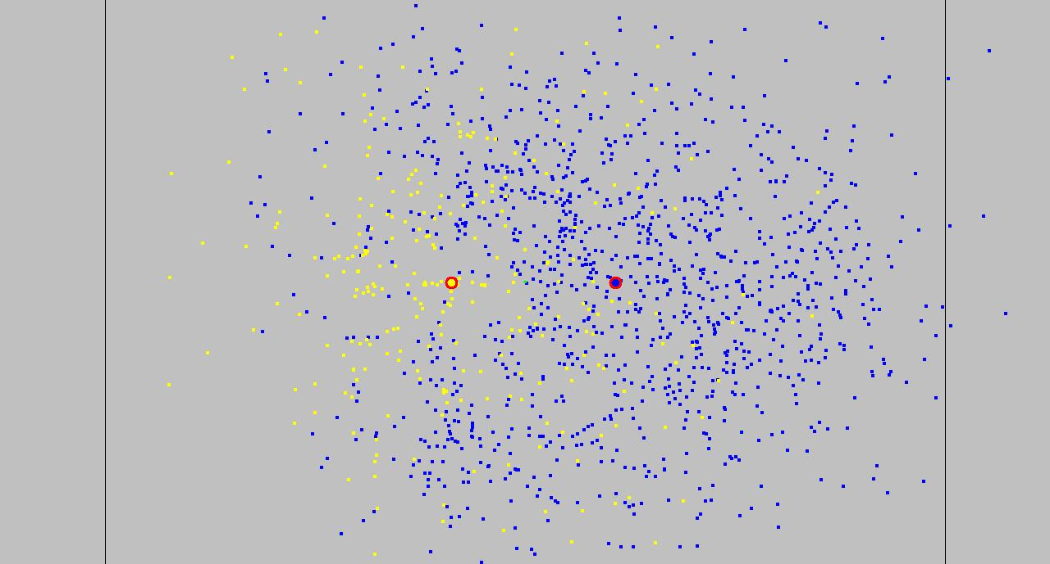
4-8 yr olds (n=92)
More
Most
EXP-4, Knowlton et. al.
(Annals NY Acad of Sci)

Slide 44
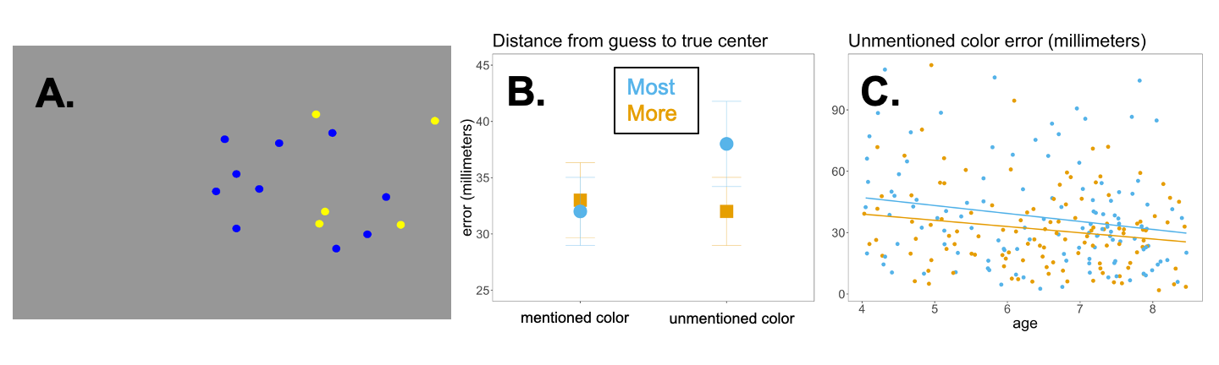
Most/More of the dots are blue
Tasks (for 4-8 year olds) after picture disappears:
-- point to center of the blues
-- point to center of the yellows
EXP-5, Knowlton et. al.
(Annals NY Acad of Sci)

Slide 45
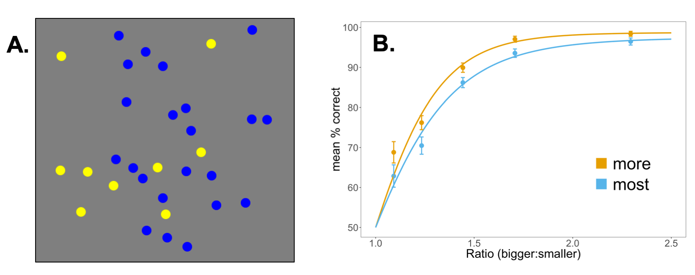
Most/More of the dots are blue
Task (for adults) after picture disappears:
-- YES or NO
EXP-6, Knowlton et. al.
(Annals NY Acad of Sci)

Slide 46
Each circle is green
Every circle is green
Most of the circles are blue
#(the blue circles) > #(the circles that aren’t blue)
#(the circles) > [#(the circles) − #(the blue circles)]
OneToOnePlus(the blue circles, the circles that aren’t blue)
Most of the circles are blue
More of the circles are blue
Understood differently
(as Vendler suggested)
Understood differently
in contexts where
all non-blue circles are red

Slide 47
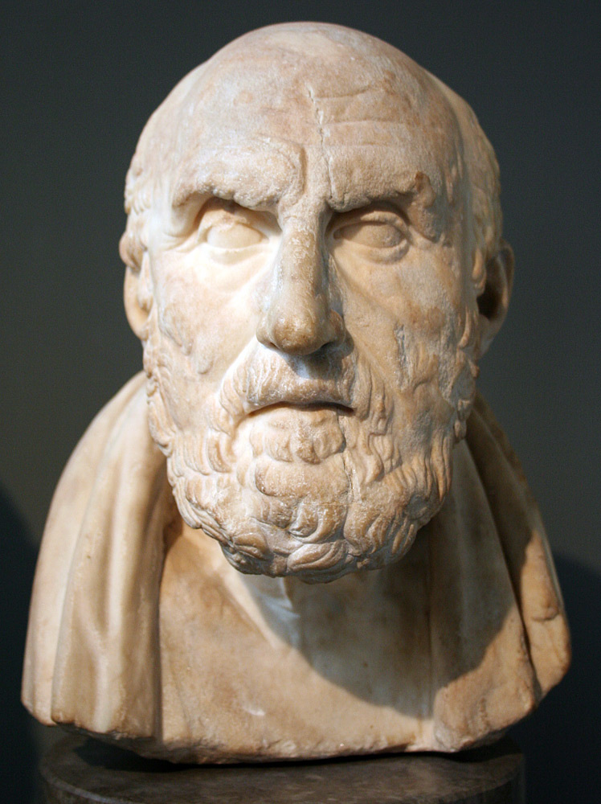
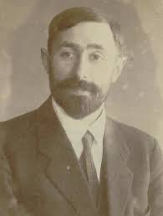
A dog barked and a cat purred.
Is the conjunction really propositional?
Fido barked and then Felix purred
∃e{PastBarkBy(e, Fido) &
∃f[AndThen(e, f) PastPurrBy(f, Felix)]}
Fido barked and Felix purred
∃e{PastBarkBy(e, Fido) &
∃f[And(e, f) & PastPurrBy(f, Felix)]}
P = A dog barked.
Q = A cat purred.
P & Q
P & Q ≡ (P † P) † (Q † Q)
≡ (P | Q) | (P | Q)
≡ ∀y[∀z(P | Q) | ∀z(P | Q)]
≡ (P |^{z} Q) |^{y} (P |^{z} Q)
≡ U((Upq)(Upq))
P & Q U((Upq)(Upq))
P U((Upp)(Upp))
∃x[Fx & (Gx & Hz)] U{fU[U(Ugh)(Ugh)]}{fU[U(Ugh)(Ugh)]}
∃x(Fx) Uff

Slide 48
function in intension function in extension
(computational procedure) ( (set of input-output pairs)
|x – 1| ⁺√(x² – 2x + 1)
{…(-2, 3), (-1, 2), (0, 1), (1, 0), (2, 1), …}
λx . |x – 1| ≠ λx . ⁺√(x² – 2x + 1)
λx . |x – 1| = λx . ⁺√(x² – 2x + 1)
Extension[λx . |x – 1|] = Extension[λx . ⁺√(x² – 2x + 1)]
____________________________________________________________
Are meanings more like functions in intension or functions in extension?
Do meanings reflect details of certain representational formats?
Or are meanings neutral contents that abstract from such details?

Slide 49
Tim
Hunter
A W
l e
e l
x l
i w
s o
o
d
Darko
Odic
J
e
f
f
L
i
d
z
Justin Halberda

