Slide 1
Negation without Negating, Description without Variables
Paul M. Pietroski
Rutgers University
With apologies to Lewis Carroll and Bertrand Russell...
The Queen of Hearts was not happy.
Indeed, she was well past unhappy and positively in a rage.
The garden party would begin at noon, and she saw some things missing.
“There are no square circles! I said that I wanted square circles!”
But your majesty, remarked The Hatter, “There are no square circles.”
The Queen found this repetition of her remark impertinent.
So she screamed, “Off with his head!”

Slide 2
• Revisit two Classics of Analytic Philosophy that revel in variables and sentential negation
-- Russell’s “On Denoting” (1905) and Quine’s “On What There Is” (1948)
-- Logical form of ‘Pegasus does not exist’: ~∃x[P(x)]
• Make a few remarks about negation, grammar, and scope
• A simple LoT with no variables or sentential negation (Pietroski 2018, Icard & Moss 2023, Pietroski & Icard 202?)
-- a very simple core recursive system and small supplements that dramatically extend expressive power
-- I’ll focus on the core system, which can reconstruct Russell/Quine on descriptions and negative existentials
-- if you’ve heard me talk about this LoT before, don’t worry: I’ll keep this part short, and you can check your email
• Compare the LoT to the variable-free language that Schönfinkel (1924) used to reconstruct Frege’s logic
-- in both cases, analogs of ‘~∃x(Fx & Gx)’ figure centrally in the characterizations of truth and valid inference
-- in the LoT, analogs of inferences like ‘∃x(Fx & (Gx & Hx)), so ∃x(Fx & Gx)’ are trivial
-- but in Schönfinkel’s more powerful system, the analogs of these inferences turn out to be pretty complicated
-- moral regarding psycho-logical forms: maybe we should eschew variables and be very careful with negation
-- moral regarding logical forms: maybe we should figure out what we’re talking about before we revel in variables

Slide 3
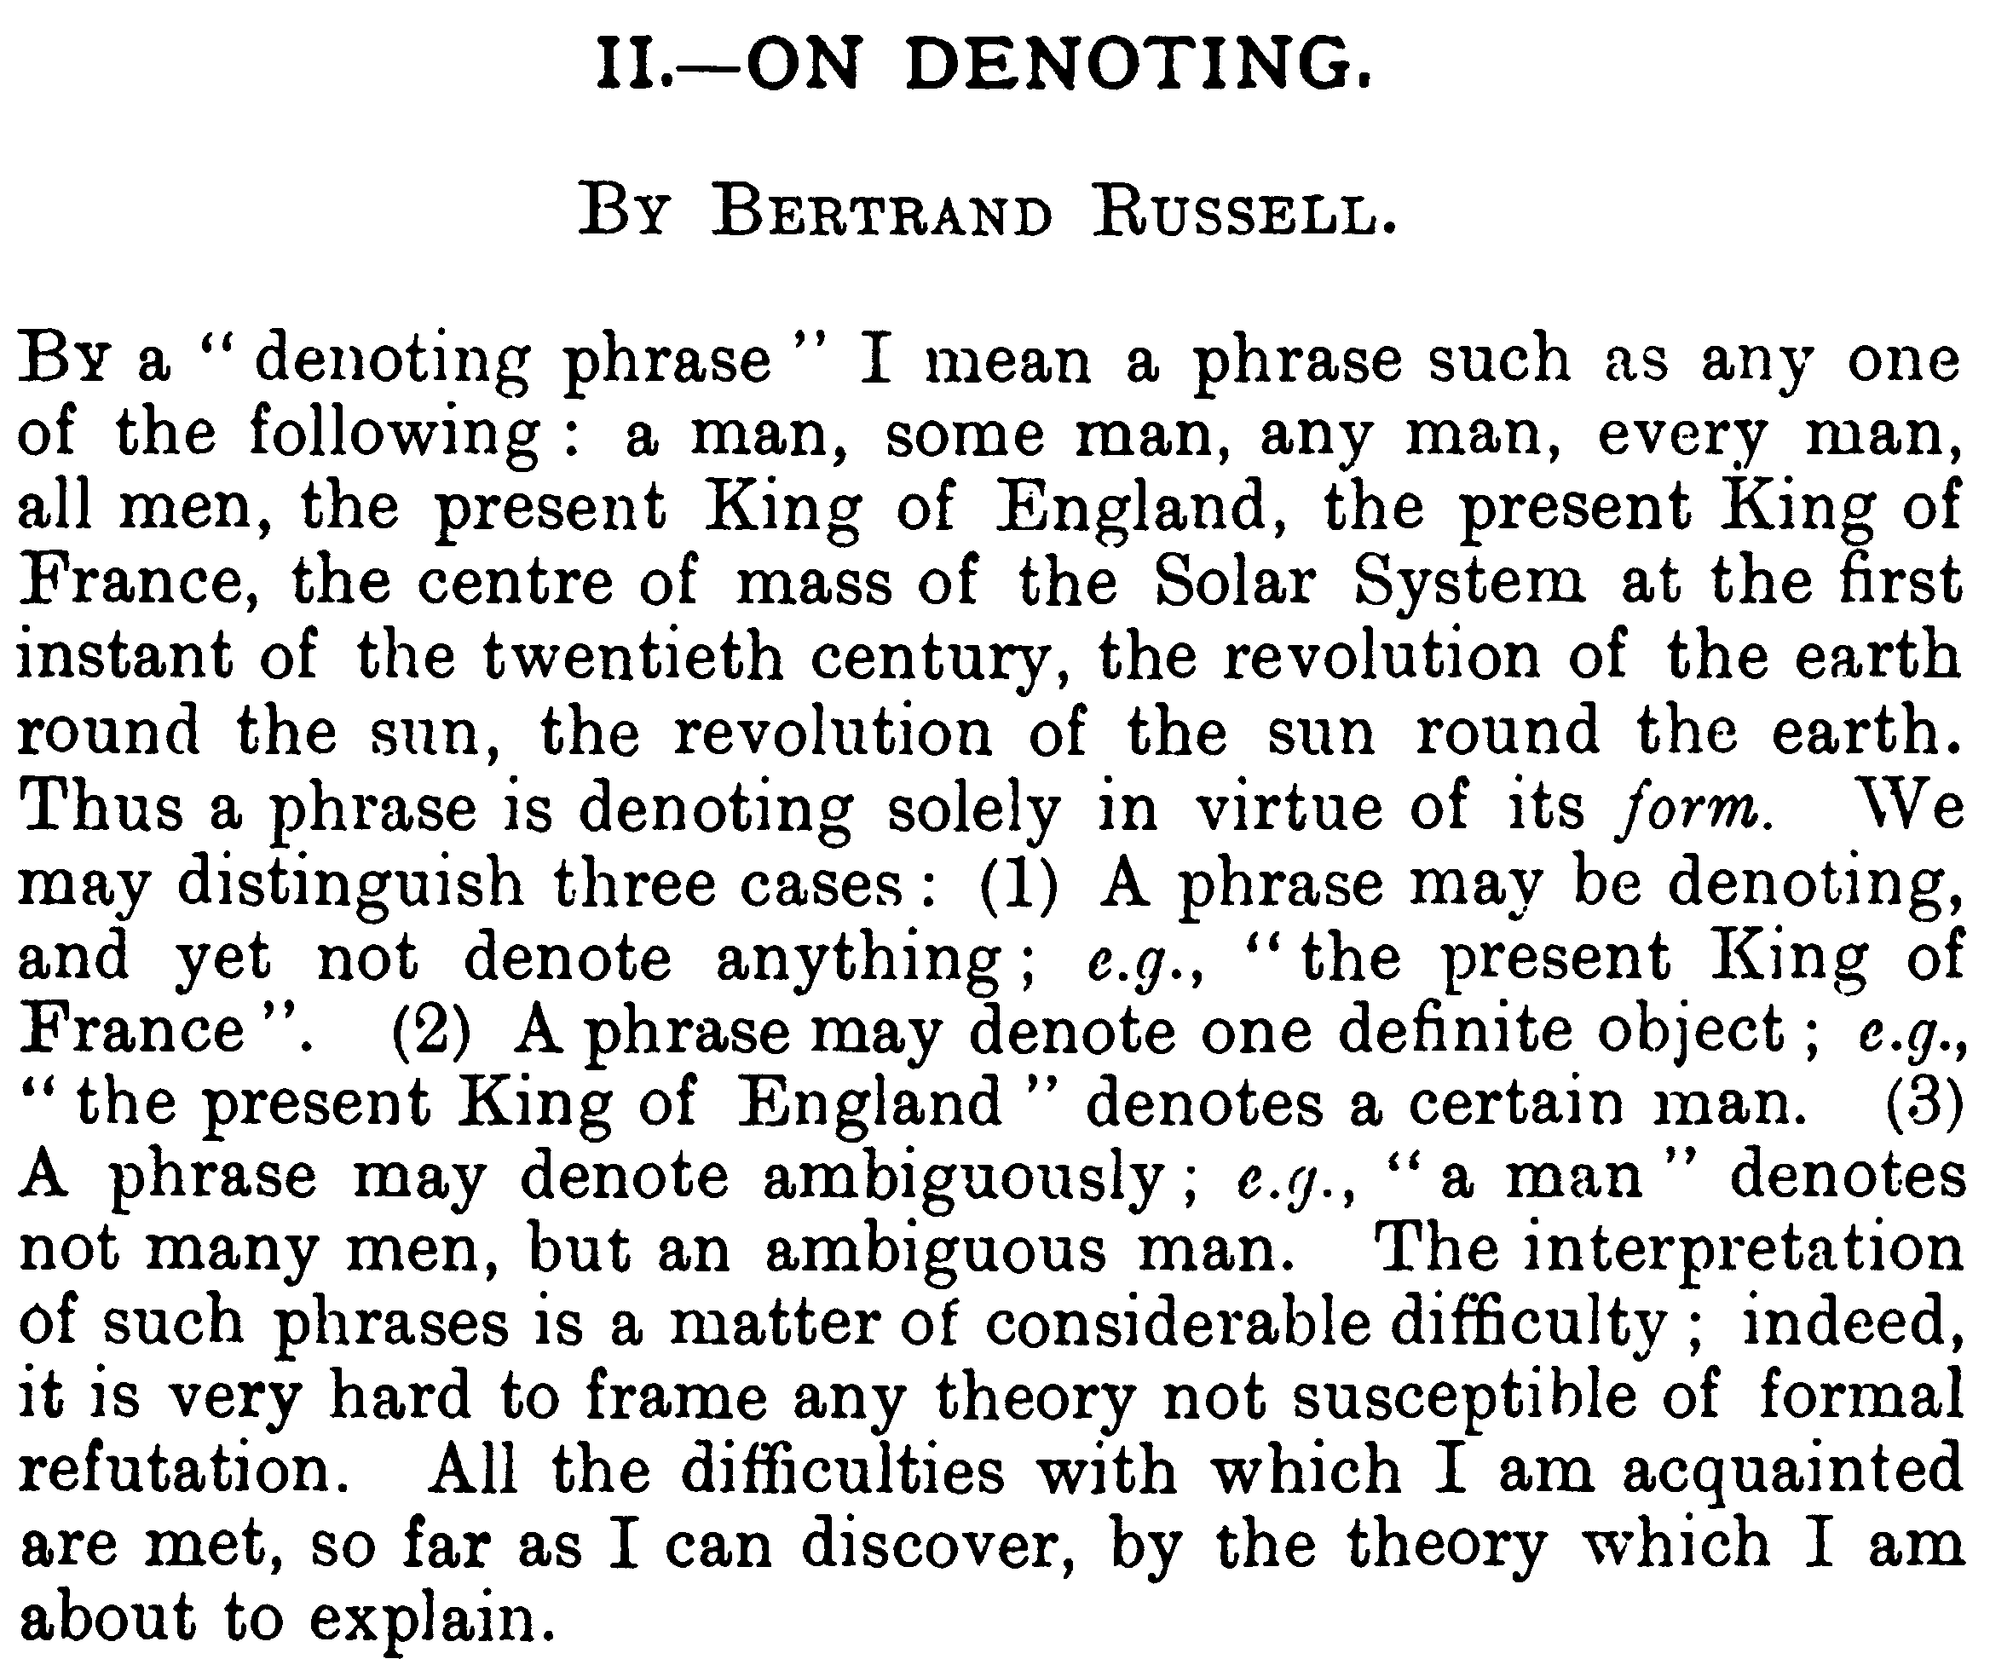
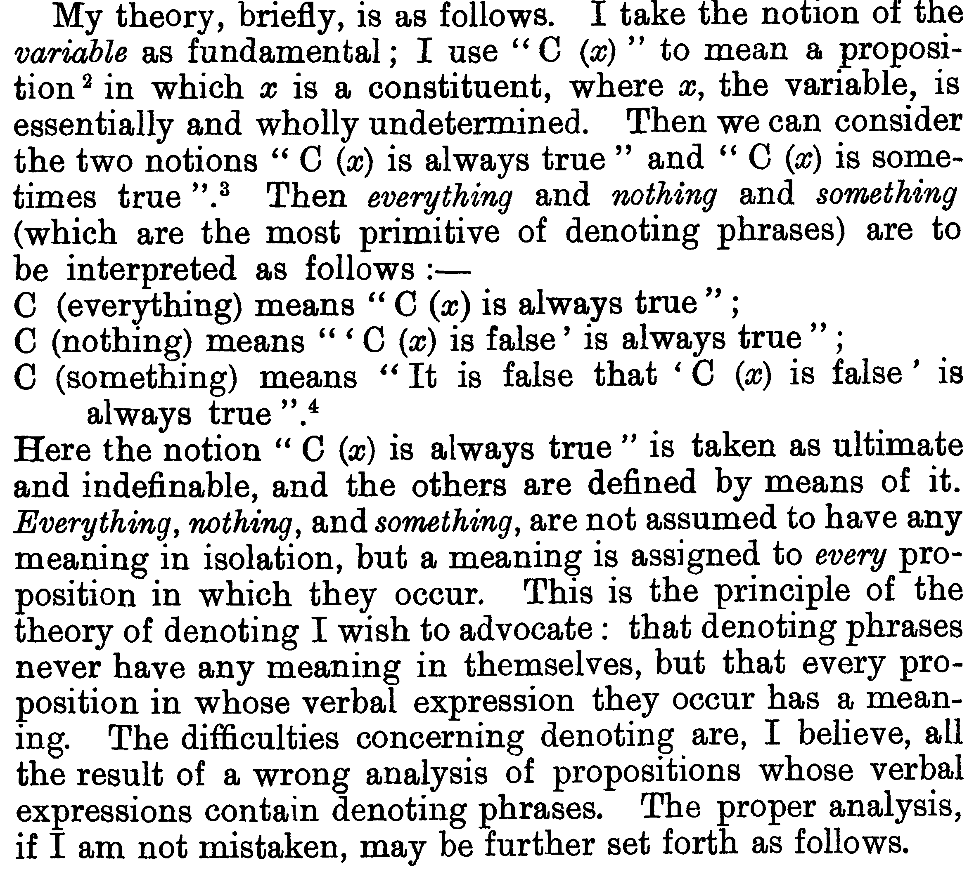
(1905)
footnote 2: “More exactly, a propositional function.”
…
…

Slide 4
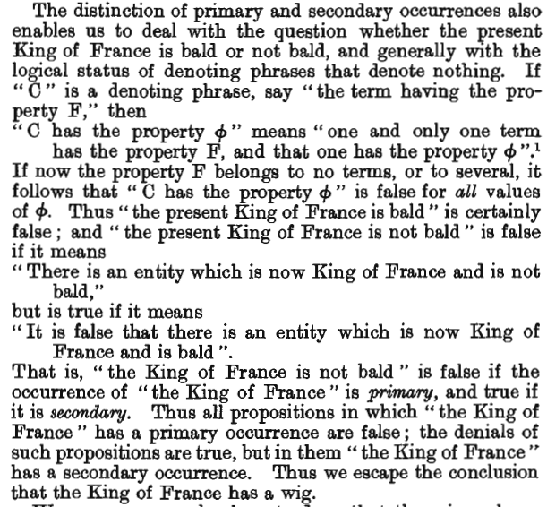
‘
Let’s avert our eyes from the use-mention issues, and recode Russell’s proposal in a familiar way…
The present King of France is bald.
∃x{K(x) & ∀y[K(y) ⊃ (y = x)] & B(x)}
∃x{K(x) & #K = 1 & B(x)}
∃x{K!(x) & B(x)}
The present King of France isn’t bald.
∃x{K!(x) & ~B(x)}
~∃x{K!(x) & B(x)}
?
Some king is not happy
(a) ∃x{King(x) & ~Happy(x)}
# (b) ~∃x{King(x) & Happy(x)}

Slide 5
‘
And note that if ‘~’ can attach to an open sentence like ‘Bald(x)’ or ‘Raven(x)’, then ‘~’ doesn’t seem cognitively natural.
Given the concept RAVEN, one can think about things as ravens, and one isn’t far from being able to have thoughts of the form THAT IS/ISN’T A RAVEN.
But this doesn’t ensure that one can think about things (e.g., stars or colors) as non-ravens. And thinking about things as things that aren’t ravens may require relative clause abstraction.
The present King of France isn’t bald.
∃x{K!(x) & ~B(x)}
~∃x{K!(x) & B(x)}
?

Slide 6
Contortions we could do without…
treating the English indefinite article as if it is (or signifies) an existential quantifier
-- lots of existential closures without ‘a’: ‘I saw horses/water’, ‘I saw horses drink water’, …, Japanese, …
--‘a’ seems to mark a count-noun in ‘I saw a horse’, with existential closure triggered by something else
--see Kamp, Heim
saying that indefinite descriptions are “wholly destitute of meaning” (cp. Montague, Neale)
--the meaning of ’a horse’ can be the meaning of the count noun ‘horse’
--the correct point is that ‘∃x’ may not correspond to any constituent of the sentence…ditto for ‘&’
treating count nouns like homophonic adjectives
--I met a Martian: ‘I met x, and x is Martian’ is not always false
--Russell can’t go for: ‘I met x, and x is a Martian’ is not always false
--Socrates is human: ∃x[S!(x) & H(x)]
--Socrates is a human: ∃x{S!(x) & ∃y[H(y) & (x = y)]} (Socrates is identical with something human)
Russell’s example was ‘I met a man’, which he took to be equivalent to : ‘I met x, and x is human’ is not always false. But this seems to imply that ‘I met a man’ can be used to report meeting a young girl or a human skull.

Slide 7
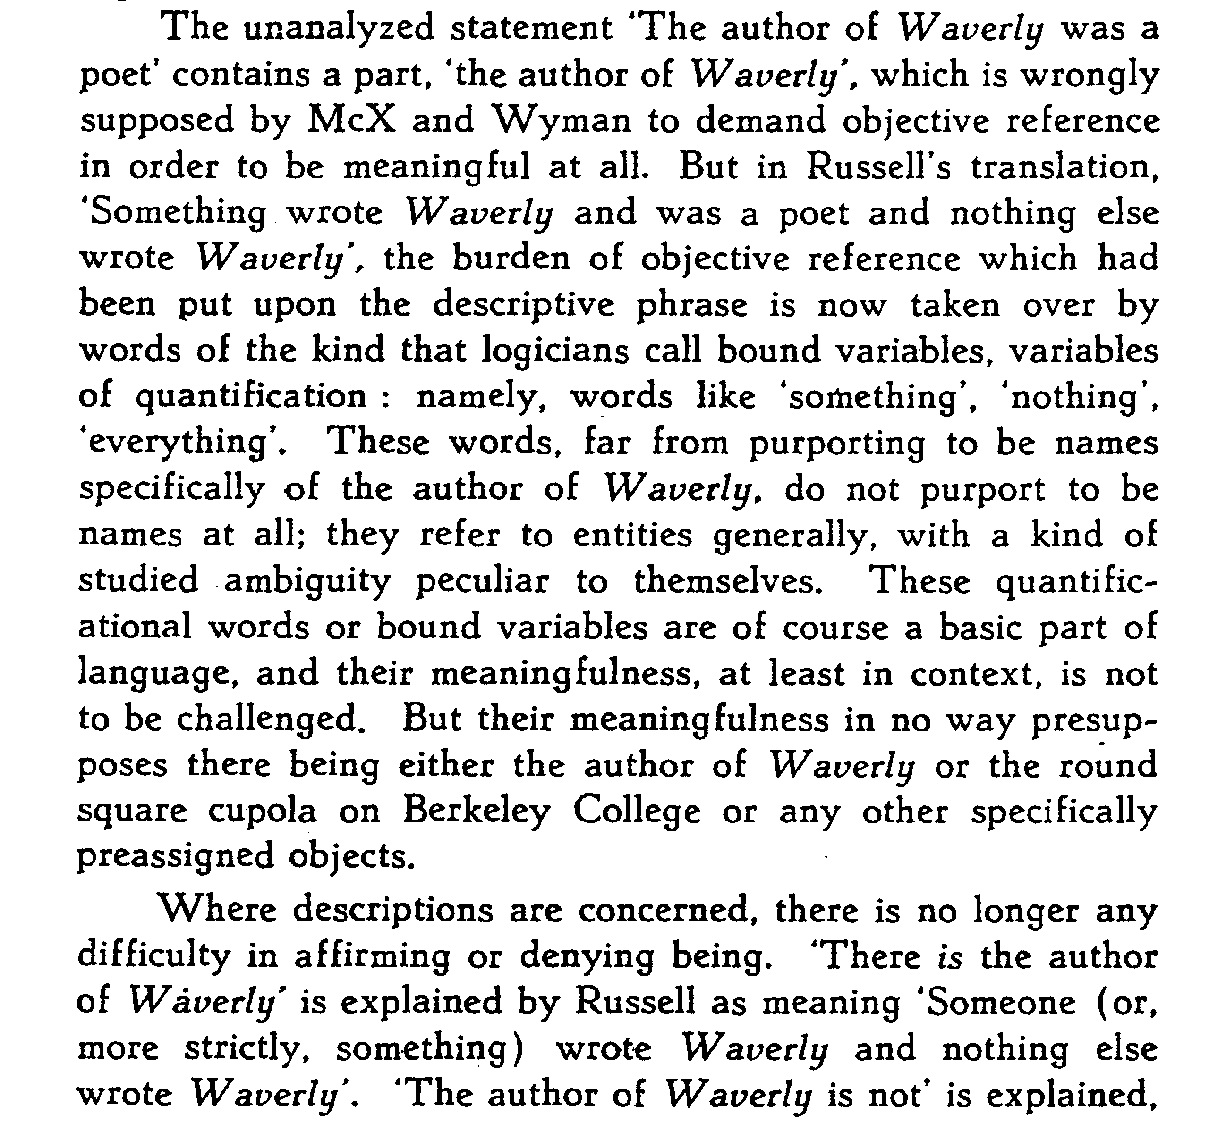
Quine, “On What There Is” (1948/1953)
The author of Waverly was a poet.
∃x{W(x) & P(x) & ∀y[W(y) ⊃ (y = x)]}

Slide 8
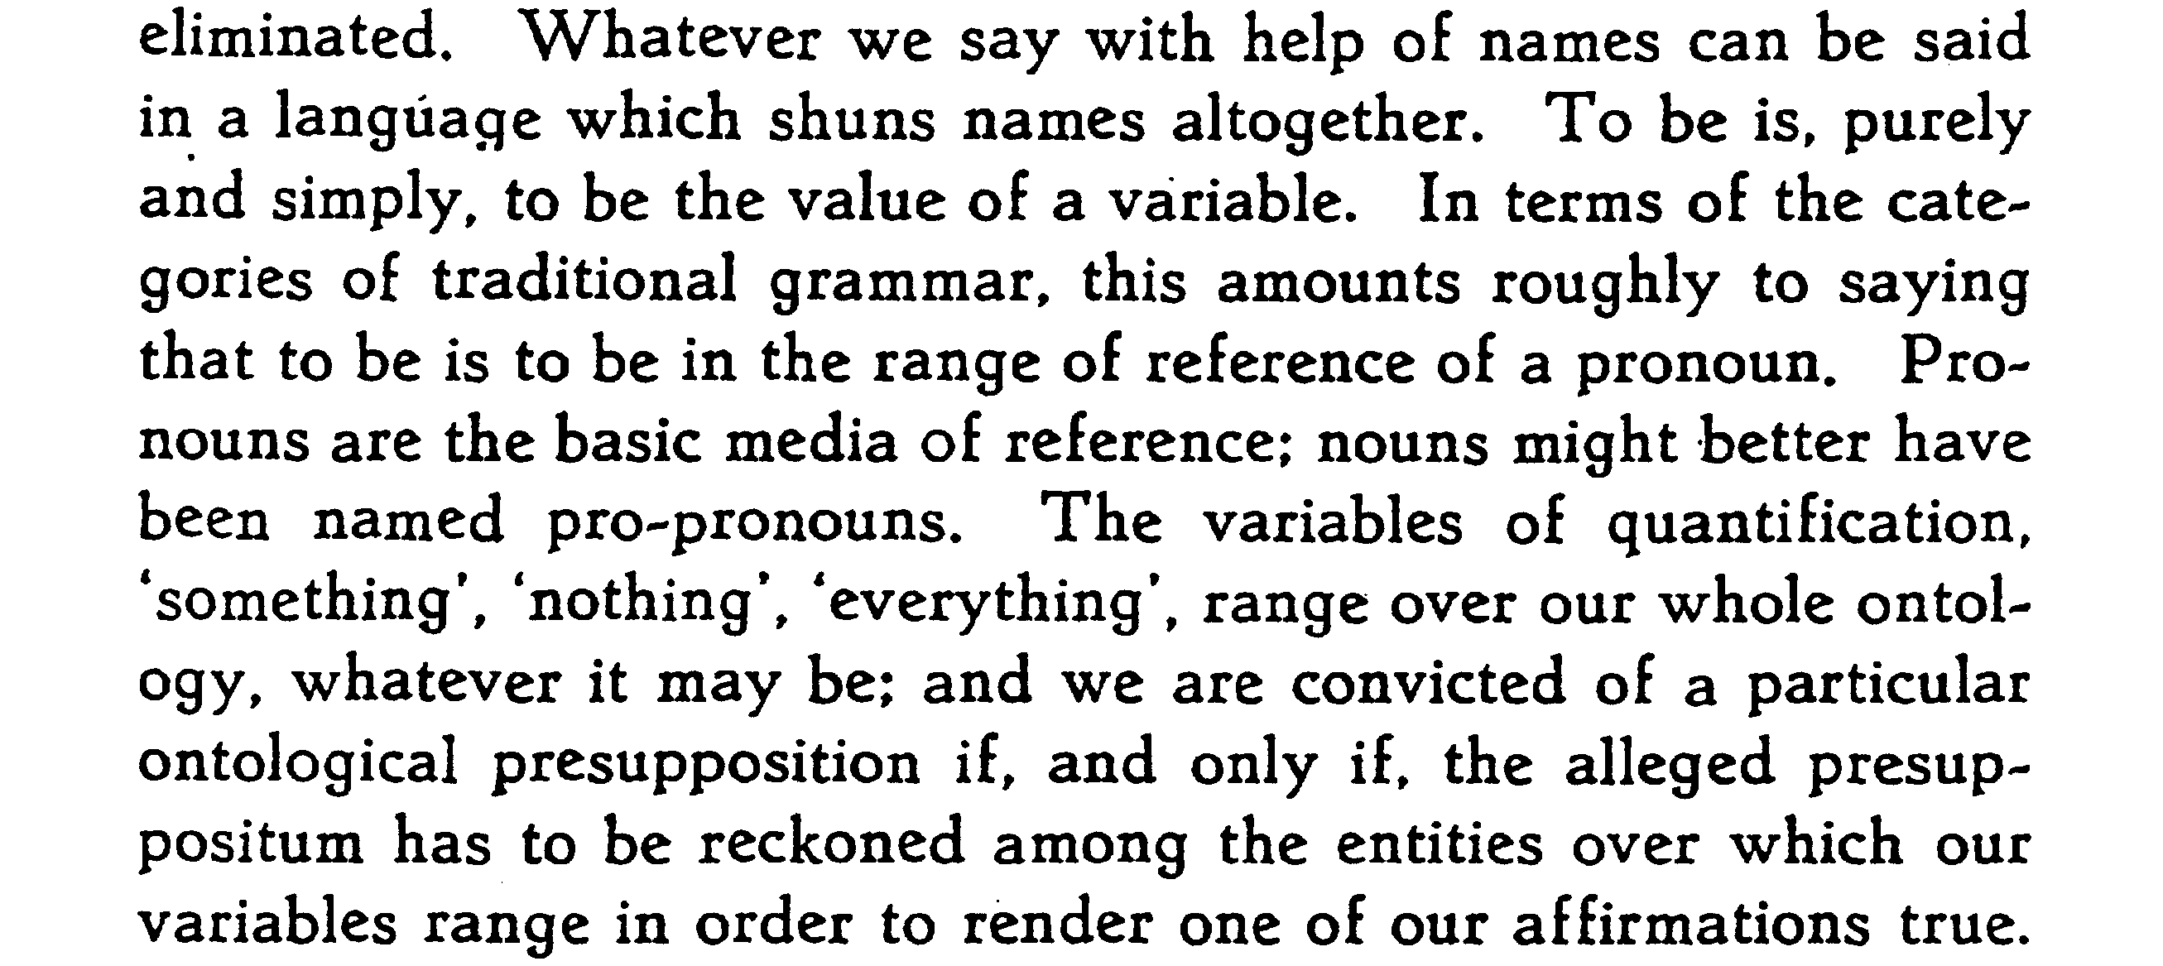
Quine, “On What There Is” (1948/1953)
Historical notes:
Quine (1960)…“Variables Explained Away”
Quine (1967)…his introduction to Schönfinkel’s paper (about eliminating variables) for the van Heijenoort volume
Good luck finding places where Quine explicitly discusses the apparent tension.
For a rare discussion of the issue, see Collins (2023)…
“Quine on Ontological Commitment
in Light of Predicate-Functor Logic”

Slide 9
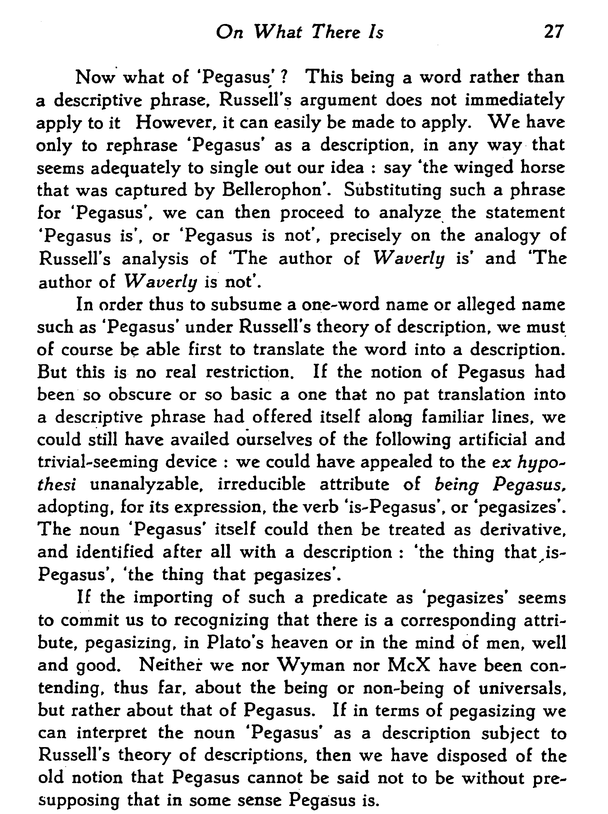
Pegasus flew.
∃x{P(x) & F(x) & ∀y[P(y) ⊃ (y = x)]}
∃x{P!(x) & F(x)}
The thing that pegasizes flew.
‘
Pegasus exists.
∃x{P(x) & ∀y[P(y) ⊃ (y = x)]}
∃x{P!(x)}
There exists/is the thing that pegasizes.
Pegasus doesn’t exist.
~∃x{P(x) & ∀y[P(y) ⊃ (y = x)]}
~∃x{P!(x)}
Nothing pegasizes.

Slide 10
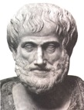
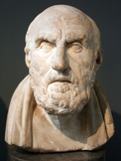
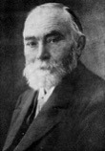
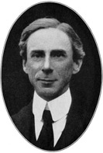
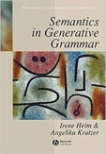
S
S
OLD QUESTION:
Is this kind of negation part of our subsentential logical vocabulary?
Can atomic sentences be negative?
SUBJECT
PREDICATE
SUBJECT
PREDICATE
Aristotle
arrived
has arrived
will arrive
will have arrived
…
was dumb
Aristotle
didn’t arrive
hasn’t arrived
won’t arrive
won’t have arrived
…
wasn’t dumb
Or is this kind of negation suprasentential?
Does it combine with a sentence,
at least semantically…
or maybe in the relevant LoT…
or maybe in the relevant proposition?
S
S
not
SUBJECT
PREDICATE
Aristotle
was dumb
What’s the alternative?

Slide 11
S
S
SUBJECT
PREDICATE
SUBJECT
PREDICATE
Aristotle
arrived
Aristotle
didn’t arrive
S
S
∃[PAST^ARRIVAL-OF-ARISTOTLE]
∃[𝚽]: 𝚽 applies to something
AUX
VP
do+past+not
AUX
VP
+past
NP
V
Aristotle
arrive
NP
V
Aristotle
arrive
~∃[PAST^ARRIVAL-OF-ARISTOTLE]
∄[PAST^ARRIVAL-OF-ARISTOTLE]
∄[𝚽]: 𝚽 applies to nothing

Slide 12
S
S
∃[PAST^ARRIVAL-OF-ARISTOTLE]
AUX
VP
do+past+not
∃[𝚽]: 𝚽 applies to something
AUX
VP
NP
V
+past
Aristotle
arrive
NP
V
Aristotle
arrive
~∃[PAST^ARRIVAL-OF-ARISTOTLE]
Three Operations: ~, ∃, ^
∄[PAST^ARRIVAL-OF-ARISTOTLE]
Three Operations: ∄, ∃, ^
∄[𝚽]: 𝚽 applies to nothing

Slide 13
S
S
∃[PAST^ARRIVAL-OF-ARISTOTLE]
AUX
VP
do+past+not
∃[𝚽]: 𝚽 applies to something
AUX
VP
NP
V
+past
Aristotle
arrive
NP
V
Aristotle
arrive
~∃[PAST^ARRIVAL-OF-ARISTOTLE]
Three Operations: ~, ∃, ^
⇓⇓[𝚽] applies to e iff:
⇓[𝚽] applies to nothing; i.e.,
𝚽 applies to something
⇓[PAST^ARRIVAL-OF-ARISTOTLE]
Two Operations: ⇓, ^
for any entity e:
⇓[𝚽] applies to e iff
𝚽 applies to nothing

Slide 14
S
S
∃[PAST^ARRIVAL-OF-ARISTOTLE]
AUX
VP
do+past+not
⇓⇓[𝚽]: 𝚽 applies to something
AUX
VP
NP
V
+past
Aristotle
arrive
NP
V
Aristotle
arrive
~∃[PAST^ARRIVAL-OF-ARISTOTLE]
Three Operations: ~, ∃, ^
⇓⇓[𝚽] applies to e iff:
⇓[𝚽] applies to nothing; i.e.,
𝚽 applies to something
⇓[PAST^ARRIVAL-OF-ARISTOTLE]
Two Operations: ⇓, ^
for any entity e:
⇓[𝚽] applies to e iff
𝚽 applies to nothing

Slide 15
A Very Little Logic
Every expression, atomic or complex, is a monadic predicate.
There are some atomic expressions like cow and brown.
If 𝚽 and 𝚿 are expressions, so is (𝚽^𝚿).
If 𝚽 is an expression, so is ⇓𝚽.
For each thing:
(𝚽^𝚿) applies to it iff 𝚽 applies to it and 𝚿 applies to it
⇓𝚽 applies to it iff 𝚽 applies to nothing
⇑𝚽—a.k.a., ⇓⇓𝚽—applies to it iff 𝚽 applies to something
For each thing:
⇓cow applies to it iff cow applies to nothing
⇓(cow^brown) applies to it iff cow^brown applies to nothing
brown^⇓cow applies to it iff it is brown and (it is such that) nothing a cow
⇓⇓cow applies to it iff ⇓cow applies to nothing
⇓⇓cow applies to it iff cow applies to something
Let ⇑ abbreviate ⇓⇓.
⇓𝚽 applies to
everything
or nothing
(cp. ~∃x𝚽x)
(cp. ∃x𝚽x)

Slide 16
A Very Little Logic
Every expression, atomic or complex, is a monadic predicate.
There are some atomic expressions like cow and brown.
If 𝚽 and 𝚿 are expressions, so is (𝚽^𝚿).
If 𝚽 is an expression, so is ⇓𝚽.
For each thing:
(𝚽^𝚿) applies to it iff 𝚽 applies to it and 𝚿 applies to it
⇓𝚽 applies to it iff 𝚽 applies to nothing
⇑𝚽—a.k.a., ⇓⇓𝚽—applies to it iff 𝚽 applies to something
Let ⇑ abbreviate ⇓⇓.
(cp. ~∃x𝚽x)
(cp. ∃x𝚽x)
This is enough to reconstruct propositional logic.
⇑⇓𝚽 is equivalent to ⇓⇓⇓𝚽, to ⇓⇑𝚽 and ⇓𝚽
⇑⇑𝚽 is equivalent to ⇓⇓⇓⇓𝚽, ⇓⇓𝚽, and ⇑𝚽.
𝚽^⇓𝚽, which can be abbreviated as ⊥, applies to nothing
⇓(𝚽^⇓𝚽), which can be abbreviated as ⊤, applies to everything.
(See Icard & Moss…and Tarski)
It’s also enough to capture “Quined Russell”.
⇑𝚽 ⇓𝚽 ⇑𝚿 ⇓𝚽 ⇑𝚽^⇑𝚿 ⇓𝚽^⇓𝚿
E N E N E N
E N N E N N
N E E N N N
N E N E N E

Slide 17
A Very Little Logic
Every expression, atomic or complex, is a monadic predicate.
There are some atomic expressions like cow and brown.
If 𝚽 and 𝚿 are expressions, so is (𝚽^𝚿).
If 𝚽 is an expression, so is ⇓𝚽.
For each thing:
(𝚽^𝚿) applies to it iff 𝚽 applies to it and 𝚿 applies to it
⇓𝚽 applies to it iff 𝚽 applies to nothing
⇑𝚽—a.k.a., ⇓⇓𝚽—applies to it iff 𝚽 applies to something
Let ⇑ abbreviate ⇓⇓.
(cp. ~∃x𝚽x)
(cp. ∃x𝚽x)
For any concepts 𝚽 and 𝚿, we can distinguish ⇓(𝚽^𝚿) from ⇑(𝚽^⇓(𝚽^𝚿))
⇓(cow^brown) applies to each thing iff:
(cow^brown) applies to nothing; i.e., there is no brown cow
⇑(cow^⇓(cow^brown)) applies to each thing iff:
cow applies to something, and (cow^brown) applies to nothing; i.e., there is a cow but no brown cow

Slide 18
A Very Little Logic
Every expression, atomic or complex, is a monadic predicate.
There are some atomic expressions like cow and brown.
If 𝚽 and 𝚿 are expressions, so is (𝚽^𝚿).
If 𝚽 is an expression, so is ⇓𝚽.
For each thing:
(𝚽^𝚿) applies to it iff 𝚽 applies to it and 𝚿 applies to it
⇓𝚽 applies to it iff 𝚽 applies to nothing
⇑𝚽—a.k.a., ⇓⇓𝚽—applies to it iff 𝚽 applies to something
Let ⇑ abbreviate ⇓⇓.
(cp. ~∃x𝚽x)
(cp. ∃x𝚽x)
For any concepts 𝚽 and 𝚿, we can distinguish ⇓(𝚽^𝚿) from ⇑(𝚽^⇓(𝚽^𝚿))
⇓(Socratizes^dumb) applies to each thing iff there is no dumb Socratizer
⇑(Socratizes^⇓(Socratizes^dumb)) applies to each thing iff: there is a Socratizer but no dumb Socratizer
⇓(Pegasizes^exists) applies to each thing iff there is no existing Pegasizer
⇑(Pegasizes^⇓(Pegasizes^exists)) applies to each thing iff: there is a Pegasizer but no existing Pegasizer

Slide 19
A Very Little Logic
Every expression, atomic or complex, is a monadic predicate.
There are some atomic expressions like cow and brown.
If 𝚽 and 𝚿 are expressions, so is (𝚽^𝚿).
If 𝚽 is an expression, so is ⇓𝚽.
For each thing:
(𝚽^𝚿) applies to it iff 𝚽 applies to it and 𝚿 applies to it
⇓𝚽 applies to it iff 𝚽 applies to nothing
⇑𝚽—a.k.a., ⇓⇓𝚽—applies to it iff 𝚽 applies to something
Let ⇑ abbreviate ⇓⇓.
(cp. ~∃x𝚽x)
(cp. ∃x𝚽x)
For any concepts 𝚽 and 𝚿, we can distinguish ⇓(𝚽^𝚿) from ⇑(𝚽^⇓(𝚽^𝚿))
We can allow for a concept exists that is guaranteed to apply to each thing; cp. ⇓(cow^⇓cow).
⇓(Pegasizes^exists) applies to each thing iff there is no existing Pegasizer
⇑(Pegasizes^⇓(Pegasizes^exists)) applies to each thing iff: there is a Pegasizer but no existing Pegasizer

Slide 20
A Very Little Logic
Every expression, atomic or complex, is a monadic predicate.
There are some atomic expressions like cow and brown.
If 𝚽 and 𝚿 are expressions, so is (𝚽^𝚿).
If 𝚽 is an expression, so is ⇓𝚽.
For each thing:
(𝚽^𝚿) applies to it iff 𝚽 applies to it and 𝚿 applies to it
⇓𝚽 applies to it iff 𝚽 applies to nothing
⇑𝚽—a.k.a., ⇓⇓𝚽—applies to it iff 𝚽 applies to something
Let ⇑ abbreviate ⇓⇓.
(cp. ~∃x𝚽x)
(cp. ∃x𝚽x)
This is enough to reconstruct propositional logic.
It’s also enough to capture “Quined Russell.”
⇓(Socratizes^dumb) applies to each thing iff
there is no dumb Socratizer
⇓(Pegasizes^exists) applies to each thing iff
there is no existing Pegasizer.
It’s also enough to capture “Davidsonian Diamonds.”
⇑𝚽 ⇓𝚽 ⇑𝚿 ⇓𝚽 ⇑𝚽^⇑𝚿 ⇓𝚽^⇓𝚿
E N E N E N
E N N E N N
N E E N N N
N E N E N E

Slide 21
(1) A spy poked a soldier in a library with a pencil.
(2) A spy poked a soldier with a pencil.
(3) A spy poked a soldier in a library.
(4) A spy poked a soldier.
(5) A spy poked a soldier in a kitchen.
(6) A spy poked a soldier with a spoon.
(7) A spy poked a soldier in a kitchen with a spoon.
(8) A spy poked a soldier in a kitchen with a pencil.
(9) A spy poked a soldier in a library with a spoon.
(1') There was an incident in a library involving a pencil. ∃x(Ix & Lx & Px) ⇑(𝚽^(𝚿^𝚷)
(2') There was an incident involving a pencil. ∃x(Ix & Px) ⇑(𝚽^𝝮)
(3') There was an incident in a library. ∃x(Ix & Lx) ⇑(𝚽^𝚿)
(4') There was an incident. ∃x(Ix) ⇑𝚽
(5') There was an incident in a kitchen. ∃x(Ix & Kx) ⇑(𝚽^𝚱)
(6') There was an incident involving a spoon. ∃x(Ix & Sx) ⇑(𝚽^𝚺)
(7') There was an incident in a kitchen involving a spoon. ∃x(Ix & Kx & Sx) ⇑(𝚽^(𝚱^𝚺))
(8') There was an incident in a kitchen involving a pencil. ∃x(Ix & Kx & Px) ⇑(𝚽^(𝚱^𝚷))
(9') There was an incident in a library involving a spoon. ∃x(Ix & Lx & Sx) ⇑(𝚽^(𝚿^𝚺))
(1)
 
(2) (3)
 
(4)
 
(5) (6)
 
(7)
 
(8) (9)
 
Scenario: Ms. Scarlet (a spy) poked Col. Mustard (a soldier) in the main library with a pencil.
Later, she poked him again in the main kitchen with a spoon.

Slide 22
(1) A spy poked a soldier in a library with a pencil.
(2) A spy poked a soldier with a pencil.
(3) A spy poked a soldier in a library.
(4) A spy poked a soldier.
(5) A spy poked a soldier in a kitchen.
(6) A spy poked a soldier with a spoon.
(7) A spy poked a soldier in a kitchen with a spoon.
(8) A spy poked a soldier in a kitchen with a pencil.
(9) A spy poked a soldier in a library with a spoon.
(1e) ∃e[Past(e) & PokeByOf(e, a spy, a soldier) & With-a-Pencil(e) & In-a-Library(e)]
(2e) ∃e[Past(e) & PokeByOf(e, a spy, a soldier) & With-a-Pencil(e)]
(3e) ∃e[Past(e) & PokeByOf(e, a spy, a soldier) & In-a-Library(e)]
(4e) ∃e[Past(e) & PokeByOf(e, a spy, a soldier)]
(5e) ∃e[Past(e) & PokeByOf(e, a spy, a soldier) & In-a-Kitchen(e)]
(6e) ∃e[Past(e) & PokeByOf(e, a spy, a soldier) & With-a-Spoon(e)]
(7e) ∃e[Past(e) & PokeByOf(e, a spy, a soldier) & In-the-Kitchen(e) & With-a-Spoon(e)]
(8e) ∃e[Past(e) & PokeByOf(e, a spy, a soldier) & With-a-Pencil(e) & In-a-Kitchen(e)]
(9e) ∃e[Past(e) & PokeByOf(e, a spy, a soldier) & In-a-Library(e) & With-a-Spoon(e)]
(1)
 
(2) (3)
 
(4)
 
(5) (6)
 
(7)
 
(8) (9)
 
Lots of relationality here.
So let’s allow for some relational concepts.

Slide 23
M: a Minimal Concept Generator
Every concept of M, atomic or complex, is monadic.
There are some atomic concepts like cow and brown.
If 𝚽 and 𝚿 are concepts, so is (𝚽^𝚿).
If 𝚽 is a concept, so is ⇓𝚽. Let ⇑ abbreviate ⇓⇓.
For each thing:
(𝚽^𝚿) applies to it if and only if 𝚽 applies to it and 𝚿 applies to it;
⇓𝚽 applies to it if and only if 𝚽 applies to nothing.
Atomic concepts can be monadic or dyadic.
There are atomic concepts like In, Above, DoneBy, PokeOf, and DoneWith.
If 𝚽 is monadic and Δ is dyadic, then Δ:𝚽 is a monadic concept.
For each thing: Δ:𝚽 applies to it if and only if
it bears the dyadic relation indicated with Δ to something that 𝚽 applies to.
Above:cow applies to e iff e is above a cow
DoneBy:spy applies to e iff e is an event done by a spy
PokeOf:soldier applies to e iff e is an event of a soldier getting poked
DoneWith:pencil applies to e iff e is an event done with a pencil
M: a Minimal Extension of M
Permits a
smidgeon of
polyadicity

Slide 24
(1) A spy poked a soldier in a library with a pencil.
(2) A spy poked a soldier with a pencil.
(3) A spy poked a soldier in a library.
(4) A spy poked a soldier.
(5) A spy poked a soldier in a kitchen.
(6) A spy poked a soldier with a spoon.
(7) A spy poked a soldier in a kitchen with a spoon.
(8) A spy poked a soldier in a kitchen with a pencil.
(9) A spy poked a soldier in a library with a spoon.
(1e) ⇑(past^(((DoneBy:spy^PokeOf:soldier)^In:library)^DoneWith:pencil))
(2e) ⇑(past^((DoneBy:spy^PokeOf:soldier)^DoneWith:pencil))
(3e) ⇑(past^((DoneBy:spy^PokeOf:soldier)^In:library))
(4e) ⇑(past^(DoneBy:spy^PokeOf:soldier))
(5e) ⇑(past^((DoneBy:spy^PokeOf:soldier)^In:kitchen))
(6e) ⇑(past^((DoneBy:spy^PokeOf:soldier)^DoneWith:spoon))
(7e) ⇑(past^(((DoneBy:spy^PokeOf:soldier)^In:kitchen)^DoneWith:spoon))
(8e) ⇑(past^(((DoneBy:spy^PokeOf:soldier)^In:kitchen)^DoneWith:pencil))
(9e) ⇑(past^(((DoneBy:spy^PokeOf:soldier)^In:library)^DoneWith:spoon))
(1)
 
(2) (3)
 
(4)
 
(5) (6)
 
(7)
 
(8) (9)
 

Slide 25
M: a Minimal Concept Generator
Add a notion of
concept equivalence:
Every concept of M, atomic or complex, is monadic.
There are some atomic concepts like cow and brown.
If 𝚽 and 𝚿 are concepts, so is (𝚽^𝚿).
If 𝚽 is a concept, so is ⇓𝚽. Let ⇑ abbreviate ⇓⇓.
For each thing:
(𝚽^𝚿) applies to it if and only if 𝚽 applies to it and 𝚿 applies to it;
⇓𝚽 applies to it if and only if 𝚽 applies to nothing.
Atomic concepts can be monadic or dyadic.
There are atomic concepts like In, Above, DoneBy, PokeOf, and DoneWith.
If 𝚽 is monadic and Δ is dyadic, then Δ:𝚽 is a monadic concept.
For each thing: Δ:𝚽 applies to it if and only if
it bears the dyadic relation indicated with Δ to something that 𝚽 applies to.
Above:cow applies to e iff e is above a cow
DoneBy:spy applies to e iff e is an event done by a spy
PokeOf:soldier applies to e iff e is an event of a soldier getting poked
DoneWith:pencil applies to e iff e is an event done with a pencil
for each entity e,
𝚽 ≈ 𝚿 applies to e iff
𝚽 and 𝚿 are equivalent
every 𝚽 is 𝚿 iff 𝚽 ≈ (𝚽^𝚿)
This permits Aristotelian
logic (and more).
The result is sound,
complete, and decidable
with the computational
complexity of a prop calc.
(Icard & Moss 2023)
M: a Minimal Extension of M
Permits a
smidgeon of
polyadicity
If you want to know about
mental analogs of
‘things that are not ravens’,
ask in the Q&A

Slide 26
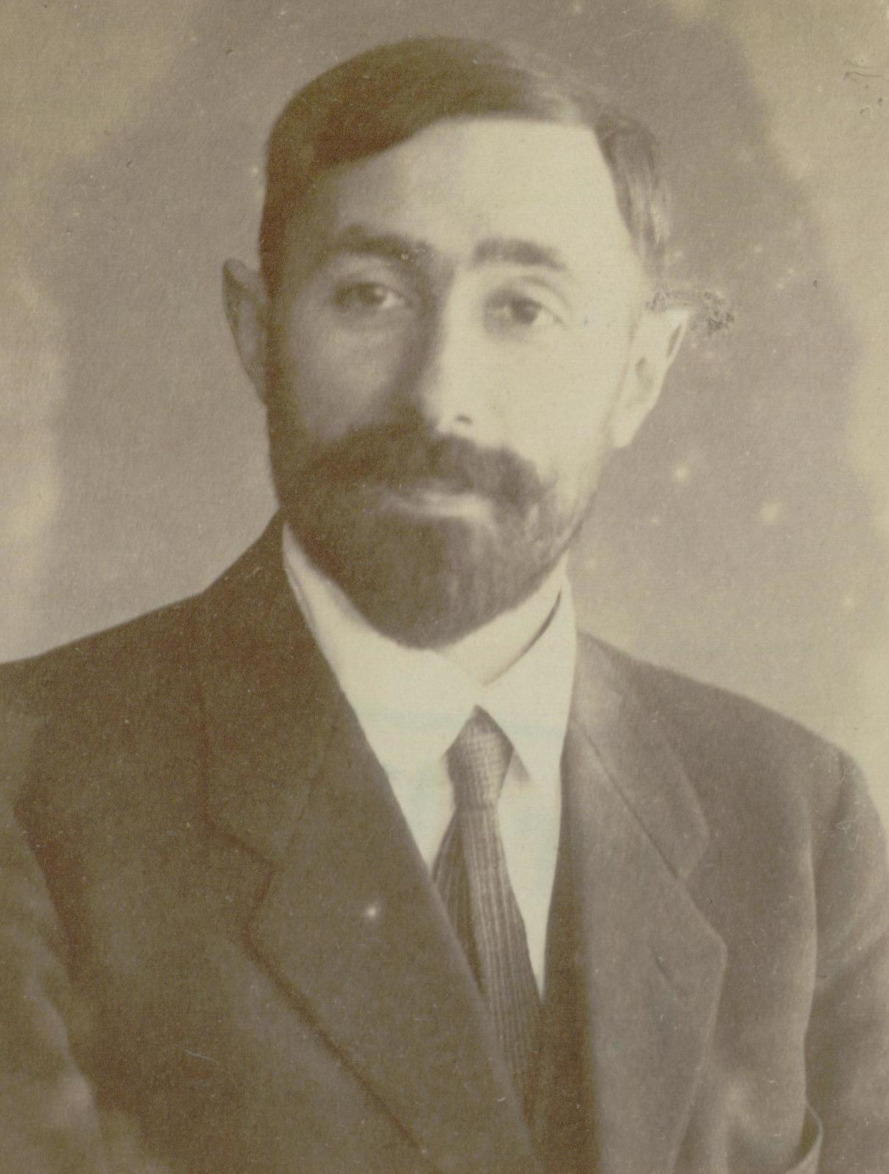
…We are led to the idea, which at first glance certainly appears extremely bold, of attempting to eliminate by suitable reduction the remain­ing fundamental notions, those of proposition, propositional function, and variable…
To examine this possibility more closely and to pursue it would be valuable not only from the methodological point of view that enjoins us to strive for the greatest possible con­ceptual uniformity but also from a certain philosophic, or, if you wish, aesthetic point of view.
For a variable in a proposition of logic is, after all, nothing but a token [Abzeichen] that characterizes certain argument places and operators as belonging together; thus it has the status of a mere auxiliary notion that is really inappropriate to the constant, "eternal" essence of the propositions of logic.
It seems to me remarkable in the extreme that the goal we have just set can be realized also; as it happens, it can be done by a reduction to three fundamental signs.
So let’s not assume that even the Logically Ideal Thoughts in the ballpark of
‘There is a/no unicorn in the garden’ are of the forms ∃x… and ~∃x…

Slide 27
Bottom Line:
Frege’s logic apparatus (∀, ~, ⊃, variables) can reduced to USB.
Ditto for the Russell/Whitehead apparatus
(∀, ~, v, variables)
Ditto for Davidson’s (∃, ~, &, variables)
(P | Q) ≡ ~(P & Q)
(fx | gx) ≡ ~(fx & gx) (fx |^{x} gx) ≡ ∀x(fx | gx)
≡ ~∃x(fx & gx)
(fx |^{x} gx) |^{y} (fx |^{x} gx) ≡ ∀y[(fx |^{x} gx)y | (fx |^{x} gx)y]
≡ (fx |^{x} gx) | (fx |^{x} gx)
≡ ~[(fx |^{x} gx) & (fx |^{x} gx)]
≡ ~(fx |^{x} gx)
Ufg ⇔ (fv |^{v} gv), for any fresh variable ‘v’
K12 ⇔ 1
B123 ⇔ 1(23)
C123 ⇔ 132
W1⇔ 11
I1⇔ 1
S123 ⇔ (13)(23)
(fx |^{x} gx) |^{y} hy
Ufg |^{y} hy
K(Ufg)y |^{y} hy
U[K(Ufg)]h
fy |^{y} (gx |^{x} rxy)
fy |^{y} (gx |^{x} Cryx)
fy |^{y} Ug [Cry]
fy |^{y} (Ug)[(Cr)y]
fy |^{y} B(Ug)(Cr)y
Uf [B(Ug)(Cr)]
K and S can deliver the others

Slide 28
Bimbó (2010):
there are 4 Schönfinkelish primitives:
α |^{x} β) ≡ ¬∃x(α & β)
(α |^{x} β) ≡ ¬∀x(α & β)
(α †^{x} β) ≡ ¬∃x(α v β)
(α †^{x} β) ≡ ¬∀x(α v β)
Each yields negation, substituting α for β
(P | Q) ≡ ~(P & Q)
(fx | gx) ≡ ~(fx & gx) (fx |^{x} gx) ≡ ∀x(fx | gx)
≡ ~∃x(fx & gx)
(fx |^{x} gx) |^{y} (fx |^{x} gx) ≡ ∀y[(fx |^{x} gx)y | (fx |^{x} gx)y]
≡ (fx |^{x} gx) | (fx |^{x} gx)
≡ ~[(fx |^{x} gx) & (fx |^{x} gx)]
≡ ~(fx |^{x} gx)
Ufg ⇔ (fv |^{v} gv), for any fresh variable ‘v’
K12 ⇔ 1
B123 ⇔ 1(23)
C123 ⇔ 132
W1⇔ 11
I1⇔ 1
S123 ⇔ (13)(23)
(fx |^{x} gx) |^{y} hy
Ufg |^{y} hy
K(Ufg)y |^{y} hy
U[K(Ufg)]h
fy |^{y} (gx |^{x} rxy)
fy |^{y} (gx |^{x} Cryx)
fy |^{y} Ug [Cry]
fy |^{y} (Ug)[(Cr)y]
fy |^{y} B(Ug)(Cr)y
Uf [B(Ug)(Cr)]
K and S can deliver the others

Slide 29
∃x(fx & gx) can be rewritten as follows:
U(Ufg)(Ufg)
U((Uf)g)((Uf)g)
BU(Uf)g((Uf)g)
S(BU(Uf))(Uf)g
S(BBBUUf)(Uf)g
BS(BBBUU)f(Uf)g
S(BS(BBBUU))Ufg
(P | Q) ≡ ~(P & Q)
(fx | gx) ≡ ~(fx & gx) (fx |^{x} gx) ≡ ∀x(fx | gx)
≡ ~∃x(fx & gx)
(fx |^{x} gx) |^{y} (fx |^{x} gx) ≡ ∀y[(fx |^{x} gx)y | (fx |^{x} gx)y]
≡ (fx |^{x} gx) | (fx |^{x} gx)
≡ ~[(fx |^{x} gx) & (fx |^{x} gx)]
≡ ~(fx |^{x} gx)
Ufg ⇔ (fv |^{v} gv), for any fresh variable ‘v’
K12 ⇔ 1
B123 ⇔ 1(23)
C123 ⇔ 132
W1⇔ 11
I1⇔ 1
S123 ⇔ (13)(23)
In this sense,
S(BS(BBBUU))U
captures the logical role
of the sentence-frame
obtained by abstracting
f and g from ∃x(fx & gx).
That’s pretty perspicuous.
(fx |^{x} gx) |^{y} hy
Ufg |^{y} hy
K(Ufg)y |^{y} hy
U[K(Ufg)]h
fy |^{y} (gx |^{x} rxy)
fy |^{y} (gx |^{x} Cryx)
fy |^{y} Ug [Cry]
fy |^{y} (Ug)[(Cr)y]
fy |^{y} B(Ug)(Cr)y
Uf [B(Ug)(Cr)]
K and S can deliver the others

Slide 30
⇓(𝚽^𝚿) is like Ufg, which is like ~∃x(Fx & Gx).
But instead of taking U as logically basic, I’m positing ^ and ⇓ as psychologically basic.
First Order Logic
Variable-Free: Schönfinkel
Variable-Free: IMP
1. ~∃xFx Uff ⇓𝚽
~∃x(Fx & Gx) Ufg ⇓(𝚽^𝚿)
2. ∃x(Fx & Gx) U(Ufg)(Ufg) ⇑(𝚽^𝚿)
∃x(Fx) U(Uff)(Uff) ⇑(𝚽)
3. ∃x((Fx & Gx) & Hx) ⇑((𝚽^𝚿)^𝝮)
∃x(Fx & Gx) ⇑(𝚽^𝚿)
???

Slide 31
⇓(𝚽^𝚿) is like Ufg, which is like ~∃x(Fx & Gx).
But instead of taking U as logically basic, I’m positing ^ and ⇓ as psychologically basic.
First Order Logic
Variable-Free: Schönfinkel
Variable-Free: IMP
1. ~∃xFx Uff ⇓𝚽
~∃x(Fx & Gx) Ufg ⇓(𝚽^𝚿)
2. ∃x(Fx & Gx) U(Ufg)(Ufg) ⇑(𝚽^𝚿)
∃x(Fx) U(Uff)(Uff) ⇑(𝚽)
3. ∃x((Fx & Gx) & Hx) ⇑((𝚽^𝚿)^𝝮)
∃x(Fx & Gx) ⇑(𝚽^𝚿)
Eliminating variables a la Schönfinkel is logically pretty; but conjuncts become
psychologically nightmarish.
* = S(BU(S(BUf)g))(S(BUf)g)
! = S(BU(S(BU*)h))(S(BU*)h)
But variables can be avoided in a way that makes dealing with conjuncts super-easy.
U(U*h)(U*h) U(U!!)(U!!)
U(Ufg)(Ufg) or U(U**)(U**)
U(U*h)(U*h) = U(U(S(BU(S(BUf)g))(S(BUf)g))h)(U(S(BU(S(BUf)g))(S(BUf)g))h).
And * is a kind of “shortcut” for S(BU(BK(S(BU(BKf))(BKg))))(BK(S(BU(BKf))(BKg))).

Slide 32
⇓(𝚽^𝚿) is like Ufg, which is like ~∃x(Fx & Gx).
But instead of taking U as logically basic, I’m positing ^ and ⇓ as psychologically basic.
First Order Logic
Variable-Free: Schönfinkel
Variable-Free: IMP
1. ~∃xFx Uff ⇓𝚽
~∃x(Fx & Gx) Ufg ⇓(𝚽^𝚿)
2. ∃x(Fx & Gx) U(Ufg)(Ufg) ⇑(𝚽^𝚿)
∃x(Fx) U(Uff)(Uff) ⇑(𝚽)
3. ∃x((Fx & Gx) & Hx) ⇑((𝚽^𝚿)^𝝮)
∃x(Fx & Gx) ⇑(𝚽^𝚿)
Eliminating variables a la Schönfinkel is logically pretty; but conjuncts become
psychologically nightmarish.
* = S(BU(S(BUf)g))(S(BUf)g)
! = S(BU(S(BU*)h))(S(BU*)h)
But variables can be avoided in a way that makes dealing with conjuncts super-easy.
U(U*h)(U*h) U(U!!)(U!!)
U(Ufg)(Ufg) or U(U**)(U**)
This point ramifies for ∃x(Fx & ((Gx & Hx) & Ix)); so ∃x(Fx & Gx), etc.

Slide 33
Maybe it would be better to not “take the notion of the variable as fundamental” for purposes of logic or psychology. Maybe the thoughts we express with ordinary sentences—and even their ideal regimentations—are variable-free.
(1905)
Maybe we should be positing variable-free mental languages that diverge a little from logically ideal regimentations that are also be variable-free. Issues about how “logical form” is related to grammatical form remain very much alive.
…

Slide 34
Thanks!

Slide 35
We saw no unicorn. There are no unicorns. There aren’t any unicorns. Unicorns don’t exist.
There is a unicorn that doesn’t exist.
∃x[Unicorn(x) & ~Exists(x)]
~∃x[Unicorn(x) & Exists(x)]
Some dog saw no cat.
∃x{Dog(x) & ~∃y[Cat(y) & Saw(x, y)]} ∃x:Dog(x){~∃y:Cat(y)[Saw(x, y)]}
~∃y{Cat(y) & ∃x[Dog(x) & Saw(x, y)] ~∃y:Cat(y){∃x:Dog(x)[Saw(x, y)]}
What thoughts are naturally expressed? How are these thoughts structured? What are their parts?
Is the expressed thought of the form ~∃x…Unicorn(x)… in each case?
Don’t rush on to a less psychologistic question: what Logically Ideal Sentences are in this ballpark?
The “scope of negation” is grammatically constrained.
(At a minimum, no getting out of a relative clause.)
The direct object ‘no cat’ cannot take wide scope.

Slide 36
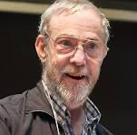
There are usually (often/regularly/typically frequently/rarely) unicorns in the garden.
There are usually no unicorns in the garden.
There is usually a unicorn in the garden.
There is usually no unicorn in the garden.
There usually isn’t a unicorn in the garden.
#There isn’t usually a unicorn in the garden.
# NOT: there usually is a unicorn in the garden.
#No unicorn is usually in the garden.
There is usually no/a unicorn in the garden.
There [tense [usually [be no/a unicorn in the garden]]]
⇡__________|
It isn’t obvious that ‘no/a’ is understood as a quantifier, much less one that can raise and take wide scope
Maybe the negation in ‘isn’t’ is not sentential.
Getting ‘no/a unicorn’ to scope over the tense) requires syntactic magic.
If you try to use any such (dark) magic, you’ll have to deal with Howard.
So let’s not assume that the thoughts naturally expressed with
‘There is no/a unicorn in the garden’ are of the forms ~∃x/∃x…Unicorn(x)…

Slide 37
There was no incident in a library involving a pencil. ~∃x(Ix & Lx & Px) ⇓(𝚽^(𝚿^𝚷)
There was no incident involving a pencil. ~∃x(Ix & Px) ⇓(𝚽^𝝮)
There was no incident in a library. ~∃x(Ix & Lx) ⇓(𝚽^𝚿)
There was no incident. ~∃x(Ix) ⇓ 𝚽
There was no incident in a kitchen. ~∃x(Ix & Kx) ⇓(𝚽^𝚱)
There was no incident involving a spoon. ~∃x(Ix & Sx) ⇓(𝚽^𝚺)
There was no incident in a kitchen involving a spoon. ~∃x(Ix & Kx & Sx) ⇓(𝚽^(𝚱^𝚺))
There was no incident in a kitchen involving a pencil. ~∃x(Ix & Kx & Px) ⇓(𝚽^(𝚱^𝚷))
There was no incident in a library involving a spoon. ~∃x(Ix & Lx & Sx) ⇓(𝚽^(𝚿^𝚺))

