Slide 1


Meanings without Extensions: One Word, Multiple Concepts
Paul M. Pietroski
Rutgers University
Slides available via tinyurl.com/pietroski

Slide 2


Roadmap
A typical word corresponds to a family of concepts that are not extensionally equivalent
  ‘book’ ➔ BOOK:CONTENT (downloadable), BOOK:CONTAINER (droppable), …
  ‘window’ ➔ WINDOW:HOLE, WINDOW:FILLER, …
  ‘circle’ ➔ … PERIMETER vs. AREA, PERCEPTIBLE vs. ABSTRACT…
A more familiar starting point—the idea that meanings determine extensions—is a Trojan Horse.
Word meanings are neither concepts nor extensions. Human language/thought is more interesting.
Polysemy suggests a more internalistic conception of linguistic meanings, as mental instructions for how to build concepts of a special sort. This proposal is developed in more detail elsewhere:
, a new book manuscript, and two recent papers with Thomas Icard
Distinctively human cognition often involves using “concept assembly instructions” to think in ways that don’t require us to resolve polysemy by assembling specific concepts.
POLYSEMY
The Vocabulary of Meanings

Slide 3
The circle is green.
A circle is a set of points.
More specifically, a circle is a set of
of all the points in a plane that are
a fixed distance from a fixed point.
(Geometric points are not visible, much less green.)

Slide 4
from the O.E.D.
circle, n.
I.1.a. (c1305)
A perfectly round plane figure. In Geometry defined as a plane figure bounded by a single curved line, called the circumference, which is everywhere equally distant from a point within, called the centre. But often applied to the circumference alone, without the included space.
to square the circle: to find a square of the same area as a given circle
(a famous problem, incapable of geometrical solution).
Perimeter
Area
Perceptible Abstract
The square is blue. The circle is green.

Slide 5
from the O.E.D.
circle, n.
I.1.a. (c1305)
A perfectly round plane figure. In Geometry defined as a plane figure bounded by a single curved line, called the circumference, which is everywhere equally distant from a point within, called the centre. But often applied to the circumference alone, without the included space.
to square the circle: to find a square of the same area as a given circle
(a famous problem, incapable of geometrical solution).
Thinking about something as a circular perimeter/circumference
differs from thinking about something as a circular area.
(Imperfect) (Perfect)
Perimeter
Area
Perceptible Abstract
The square is blue. The circle is green.
C1
C3
The noun ‘circle’ seems to be linked to a family of concepts.
C2
C4
composable mental representations
that can be used to think about
things in systematically related ways
I.1.b. (c1380)
In a vaguer and more general sense.
traffic circles, circles of friends,
great circles, crop circles…
circular reasoning, circling wagons

Slide 6
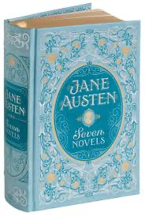


one tome, seven novels
--one book, but hard to carry
--seven books by Austen (Pride and Prejudice, Sense and Sensibility, … , Emma)
  ‘book’ ➔ BOOK:CONTENT (downloadable), BOOK:CONTAINER (droppable)
  ‘window’ ➔ WINDOW:HOLE, WINDOW:FILLER
, WINDOW:DISPLAY-SPACE, WINDOW:TELLER’S, …
He cut a window in the wall. Then he bought a window to fill it.
The window from the store differed from the window it filled.
The original window was nicer than the one he installed.
The window he bought didn’t fit. He couldn’t cut it smaller.
And he couldn’t cut the original window bigger.
So he bought another window, and that one fit the hole in the wall.

Slide 7
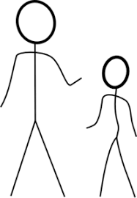
A typical word is linked to distinct concepts
that are not concepts of the same thing or things.
A typical word is linked to two (or more) concepts
that are not extensionally equivalent.
The circle is green.
A circle is a set of points.
He put the window that he bought into
the window that he cut in the wall.
A word can get linked to distinct concepts
that are concepts of the same thing or things.
‘Lo, Hesperus…
In fact, it is the planet Venus’
N
W E
S
‘Lo, Phosphorus…
In fact, it is the planet Venus’
'Hesperus’ ➔ HESPERUS
‘Phosphorus’ ➔ PHOSPHORUS
‘Venus’ ➔ VENUS
↕︎
↕︎
But this is a special case of conceptual equivocality.

Slide 8
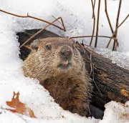


A typical word is linked to distinct concepts
that are not concepts of the same thing or things.
A typical word is linked to two (or more) concepts
that are not extensionally equivalent.
The circle is green.
A circle is a set of points.
He put the window that he bought into
the window that he cut in the wall.
A word can get linked to distinct concepts
that are concepts of the same thing or things.
‘Lo, a groundhog…
also called a whistlepig’
N
W E
S
‘Lo, a woodchuck,
also called a whistlepig’
‘groundhog’ ‘woodchuck’ ‘whistlepig’
CONCEPT-1 CONCEPT-2 CONCEPT-3
But this is a special case of conceptual equivocality.
‘The groundhog (Marmota monax) is a rodent.

Slide 9
A typical word is linked to distinct concepts
that are not concepts of the same thing or things.
A typical word is linked to two (or more) concepts
that are not extensionally equivalent.
The circle is green.
A circle is a set of points.
He put the window that he bought into
the window that he cut in the wall.
Kingdom: Animalia
…
Order: Rodentia
Family: Sciuridae
Genus: Marmota
Species: Monax
‘Lo, a groundhog…
also called a whistlepig’
‘groundhog’
CONCEPT-1 CONCEPT-1A
(individual) (kind)
‘The groundhog (Marmota monax) is a rodent.

Slide 10
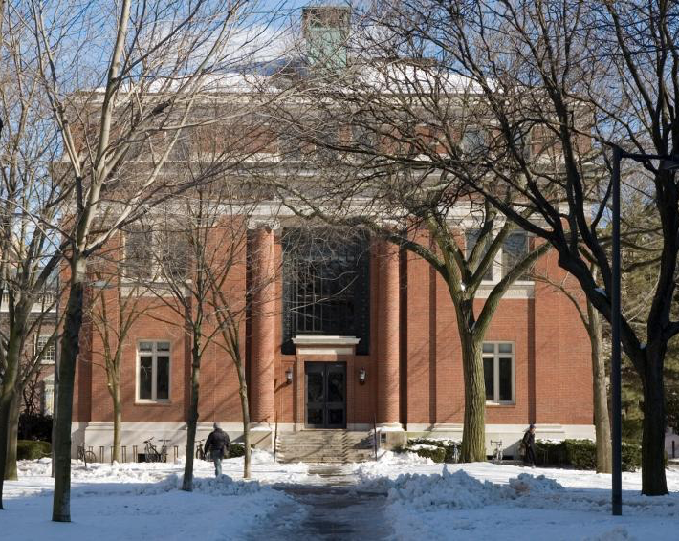
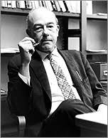
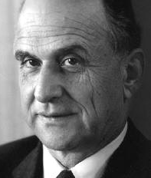
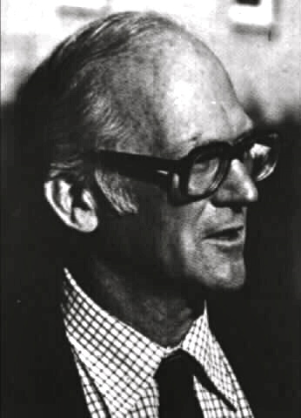
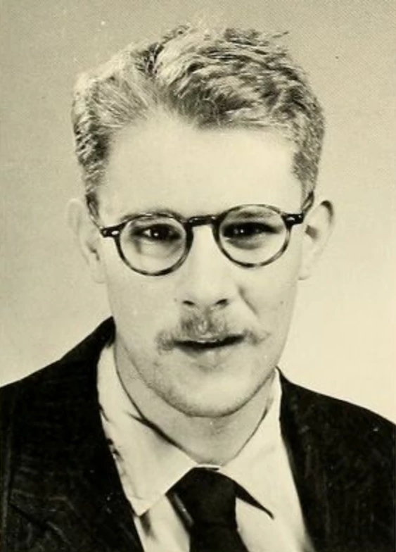
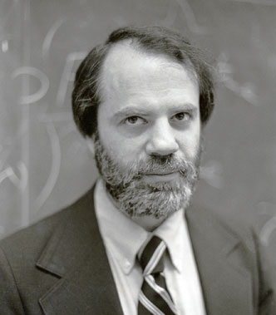

So why did anyone ever think that ordinary words
(as opposed to expressions of “ideal” languages)
have meanings that determine extensions?
One can boldly conjecture that despite appearances, ordinary words have extensions.
But then one owes some account of the (many) contrary appearances.
Even if we set aside Liar Paradoxes,
along with Vagueness and the Context Sensitivity of words like ‘big’,
what about Polysemy?

Slide 11
A Bad Idea: Polysemy is Homophony
The circle is green.
1
He put the window that he bought into
the window that he cut in the wall.
1
2
The circle is green.
2
word-sound
A word can be linked to two or more concepts that are not extensionally equivalent.
____
____
A circle is a set of points.
3

Slide 12
Homophony
bæŋk bare_{A} ←bεr→ bear_{V}
↙ ︎ ↘︎ ↓
bank_{N$} bank_{N▼} ︎ bear_{N}
one pronunciation,
two or more expressions,
each with its own meaning
--typically arbitrary: you/ewe, die/dye, no/know, so/sew
--linguistically accidental
cp. French seau/sceau/saut
Doesn’t Support Anaphora:
*The banks of the river were nicer than the ones we robbed.
Polysemy
bare_{A}, bear_{V}, bank_{N$}, triangle_{N}, window_{N}, ...
$BANK:INST ⤶ ⤷ $BANK:BLDG
one expression, whose meaning supports a
family of concepts/subsenses
--not arbitrary
--often common across languages
hold_{V}
Supports Anaphora in many cases:
The windows that we cut in the walls were nicer than the ones we installed.
book_{N}
BOOK:CONTENT ⤶ ⤷ BOOK:CONTAINER
my hand, the door, a title, your temper, my calls, so much weight, an opinion,
a seminar, a ridge, a course (of due east)

Slide 13
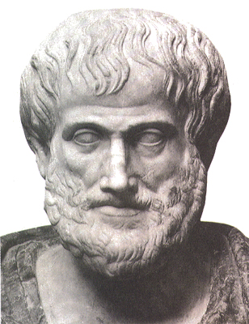
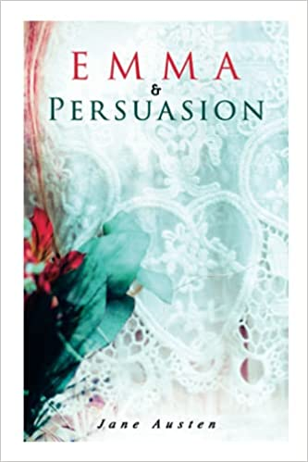
Polysemy is not Homophony
(pace Fodor, Devitt, King…) see Collins for more details
He dropped the book he defaced, and he plagiarized the book you wrote.
He dropped the book he defaced, and he plagiarized the one you wrote.
The red book was hard to carry, and the one you reviewed was boring.
Being is said in many ways. Ditto for book, window, line,...
The book I was carrying contained two books by Austen.
You could say I brought one book, or I was brought two books.
But I didn’t bring three books.
⤷ BOOK:CONTAINER ⤷BOOK:CONTENT
Lingua 2015 issue on polysemy
--intro to work since 1972
--many interesting papers
Mind & Language 2021
--paper by Quilty-Dunn
Dissertation and a series of papers
by Elliot Murphy
The shuttered window was nicer than the window that got installed.
The shuttered window was nicer than the one that got installed..
window, n.
I.1.a. (c1230)
An opening in the wall or roof of a building, for admitting light or air and allowing people to see out;
esp. such an opening fitted with a frame containing a pane or panes of glass (or a similar transparent substance); the glazed frame intended to fit such an opening, sometimes with hinges, a sliding mechanism, etc., so that it may be opened or closed. Also: a similar opening in the side of a ship, train, car, or other vehicle.

Slide 14
Homophony
bæŋk bare_{A} ←bεr→ bear_{V}
↙ ︎ ↘︎ ↓
bank_{N$} bank_{N▼} ︎ bear_{N}
one pronunciation,
two or more expressions,
each with its own meaning
Polysemy
bare_{A}, bear_{V}, bank_{N$}, triangle_{N}, window_{N}, ...
$BANK:INST ⤶ ⤷ $BANK:BLDG
one expression, whose meaning supports a
family of concepts/subsenses
book_{N}
BOOK:CONTENT ⤶ ⤷ BOOK:CONTAINER
Think about lexical acquisition.
Luckily, kids are pretty good at (i) guessing which concepts speakers are expressing and
(ii) confirming/revising their initial guesses; see Gleitman and Trueswell.
But if kids adopted a “One Word, One Concept” policy (or somehow enforced “One Word, One Extension”) then homophony would be way more rampant than it is.
Polysemy looks like a by-product of kids treating homophony as a last resort strategy, with paradigm cases of polysemy (‘book’, ‘window’, ‘circle’) involving concepts that somehow “dovetail.”
And if kids allow for polysemy to limit homophony, conceptual equivocality will become normal.

Slide 15
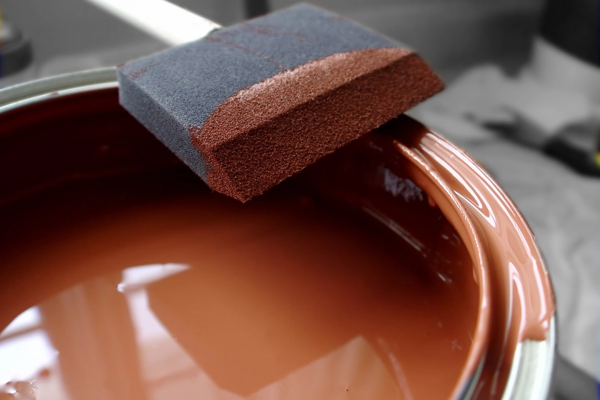

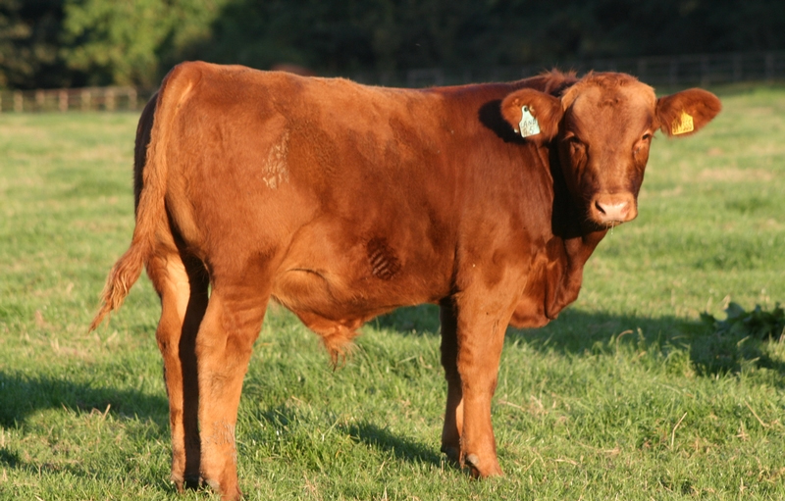
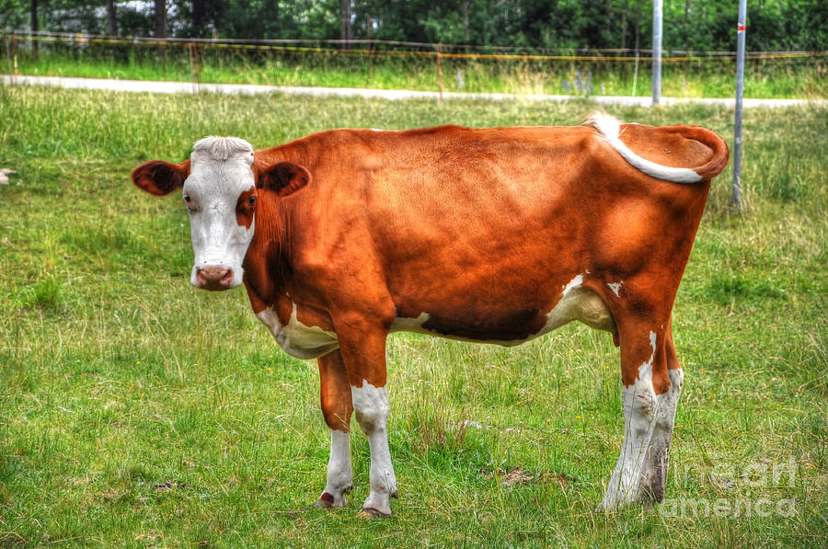


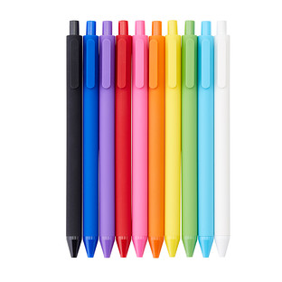
The paint is brown
The house is brown
The cow is brown
I used my
red pen to
mark the exam
red pen: a pen that...
--is red on the outside
--contains red ink

Slide 16
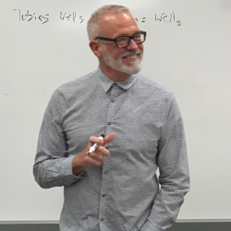
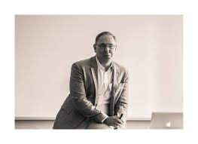
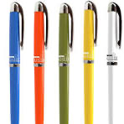
Jeff utters, fully sincerely,
‘I want the blue pen’.
Michael utters, fully sincerely,
‘I want the red pen’.
They each know the facts about the pens.
But it turns out that they want the same pen.
You know this, though you don’t know which pen they both want.
You know that
either Jeff wants to write in blue and Michael wants the red exterior,
or Jeff wants the blue exterior and Michael wants to write in red.
The one on the left has red ink.
The one on the right has blue ink.
Do ‘red pen’
and ‘blue pen’
have extensions?
Do ‘red’ and ‘blue have extensions?
(1) Jeff said ‘I want the blue pen’, and Michael said ‘I want the red pen’. 👍
(2) Jeff wants the blue pen and Michael wants the red one. 👎
(3) Michael wants the red pen and Jeff wants the blue one. 👎
(4) Either they both want the blue pen, or they both want the red one. 👍
(But note: a speaker can endorse this last description of the situation,
regardless of which pen the speaker takes to be the blue one.)

Slide 17
Jeff utters, fully sincerely,
‘I want the blue pen’.
Michael utters, fully sincerely,
‘I want the red pen’.
They each know the facts about the pens.
But it turns out that they want the same pen.
You know this, though you don’t know which pen they both want.
You know that
either Jeff wants to write in blue and Michael wants the red exterior,
or Jeff wants the blue exterior and Michael wants to write in red.
The one on the left has red ink.
The one on the right has blue ink.
The window he cut in the wall was nicer than the one he installed.
The window he installed was nicer than the one he cut in the wall.
The window that Click liked was nicer than the one that Clack liked.
Note: a speaker can endorse this description of the situation without
knowing whether Click preferred the hole or the filler.
The speaker might trust Click on such matters; see Pietroski (forthcoming).

Slide 18
Why did anyone ever think that ordinary words
(as opposed to expressions of “ideal” languages)
have meanings that determine extensions?
How did it become standard for naturalistically-minded philosophers of language
to assume that ordinary word meanings determine extensions?

Slide 19
The Extension Dogma: a Trojan Horse
There are endlessly many meaningful expressions, even for a single language like spoken English. But it’s not obvious that there are meanings that these expressions have. Symbols can have extensions without having meanings (or “intensions” or “senses”) that determine the extensions.
So when offering theories of meaning, we should grant that linguistic expressions have extensions,
but we should not assume that these expressions have meanings in any further sense.
Whatever expression meanings are—if there are any—they determine what, if anything, expressions are true of. So modulo worries about gathering what expressions are true of into sets: if an expression E has a meaning 𝛍, then E has an extension that is determined by 𝛍.
Usual caveats: allow for contexts, functions, and possibilities; the extension of an expression can be a function from contexts to (functions from possibilities to) sets of entities.
Corollary: psychological studies of understanding are, at best, optional additions to “core” semantics.
AN OLD SUSPICION...
There may be nothing else for semanticists to do apart from specifying extensions
speakers of “the same language” may have very different (and perhaps alien) psychologies
the “semantic commonalities” across speakers of a language may be exhausted by (i) a shared environment, and (ii) general constraints of rationality, as applied to communication
cp. Pietroski et. al. (2009), Lidz et. al. (2011), Odic et. al. (2018),
Knowlton et. al. (2021, 2022, 2023a, 2023b), Pietroski (2005, 2011, 2018)

Slide 20
The Extension Dogma: a Trojan Horse
There are endlessly many meaningful expressions, even for a single language like spoken English. But it’s not obvious that there are meanings that these expressions have. Symbols can have extensions without having meanings (or “intensions” or “senses”) that determine the extensions.
So when offering theories of meaning, we should grant that linguistic expressions have extensions,
but we should not assume that these expressions have meanings in any further sense.
Whatever expression meanings are—if there are any—they determine what, if anything, expressions are true of. So modulo worries about gathering what expressions are true of into sets: if an expression E has a meaning 𝛍, then E has an extension that is determined by 𝛍.
Usual caveats: allow for contexts, functions, and possibilities; the extension of an expression can be a function from contexts to (functions from possibilities to) sets of entities.
Corollary: psychological studies of understanding are, at best, optional additions to “core” semantics.
SHORT FORM: meanings—if such there be—determine extensions;
theories of meaning should specify extensions for linguistic expressions;
but we shouldn’t assume that there are any further semantic properties to specify
But it’s not concessive (or agnostic) to assume that words have extensions,
and then ask for evidence that words also have meanings/intensions that determine extensions

Slide 21
Origins of The Extension Dogma: very fast and biased history
Initially, the issues were about ideal languages designed for science; see Frege. But attempts to cash out talk of senses as empiricist “verification procedures” did not work out; see Logical Positivism.
This fed old concerns that semantic notions are too “hermeneutic” for use in science. But as Tarski showed, talk of truth is scientifically legit given his semantic conception of truth. (This was a new use of ‘semantic’.)
That fed Quine’s worry that construing scientific notation via intensions will improperly saddle theories with analyticities that count as theorems because of “how things are presented” by a choice of notation.
Quine was also a behaviorist who thought there were no real facts about what natural expressions mean: on his view, linguists were—at best—regimenting ordinary human modes of speech in convenient ways.
Others followed Quine in trying to make natural language fit an extensionalist mold, greasing a slide from “ideal meanings determine extensions” to “if there are meanings, they determine extensions”.
The Dogma became an increasingly standard practitioner’s framework after Montague and Partee. (But there was a lot of instrumentalism, behaviorism, and confusion about the targets of inquiry.)
Skeptics (including Chomsky, Harman, Fodor, and Jackendoff…often echoing Wittgenstein/Strawson/Austin) . were largely ignored. And in the 1980s, many cognitivists accepted The Dogma while arguing that psychology also mattered for semantics; see Evans, Peacocke, Davies, Kamp, Heim, Higginbotham, Larson & Segal.
The Dogma became interwoven with various claims about Proper Nouns and “Kind Terms”.
Notes:
ONLY GAME IN TOWN

Slide 22
Proper Nouns are also Conceptually Equivocal
Textbooks (and classes) in semantics often start by assuming that Proper Nouns (e.g., ‘Aristotle’ and ‘Napoleon’) are atomic terms that designate individuals.
But initial assumptions can be false. Theorists don’t get to stipulate that certain nouns are “singular denoters.” Claims about nouns have to be justified.
And prima facie, Proper Nouns are a lot like Common Nouns.
  Napoleon lost at Waterloo. (But cp. Greek, which disallows bare PN subjects.)
  There were three Napoleons at the party.
  Two of them were wearing hats. The third one sang.
  The Napoleon who sang is a good cook.
  Our Napoleon would never do such a thing.
  But the Napoleon on the soccer team would.
  The little Napoleon on the committee must be stopped.
DP
/ \
D N
the / \
N RC
Napoleon who
sang
DP
/ \
D N
our Napoleon
that
the
∅
No need to posit homophony instead of polysemy.

Slide 23
James Atlas on Global Warming (NY Times: Nov 25, 2012), cp. Chomsky (1995)
…a good chance that New York City will sink beneath the sea…
but the city could move to another island, the way Torcello was moved to Venice, stone by stone,
after the lagoon turned into a swamp and its citizens succumbed to a plague of malaria.
The city managed to survive, if not where it had begun.”
Venice_{N}
VENICE:POLIS ⤶ ⤷ VENICE:PLACE
Torcello was moved to Venice.
Venice was a better place.
Venice will soon be underwater.
Torcello was moved to a place that will soon be underwater.
inference
seems valid
Torcello was moved to Venice.
Venice was a better place.
Venice will have to be moved.
Torcello was moved to a place that will have to be moved.
inference
seems invalid
Notes:
FIRST SLIDE

Slide 24
Alleged “Kind Terms” do not have Kinds as Extensions
It is often suggested that words like ‘rabbit’ and ‘dog’ and ‘water’ are somehow “drawn to” natural properties—e.g., being a member of certain biological kind, or being a sample of H₂O modulo trace impurities—and that these properties determine extensions for the words.
NOTE: advocates of The Extension Dogma often stress that
speakers can have very different concepts of the same thing(s)
One can have various “kind-concepts”
--a concept of the Leporids
--a concept of the Lagomorphs
--a concept of the European Rabbits
--a concept of the Cottontail Rabbits
--a concept of the local
sub-genus of Cottontail Rabbits
Find the alleged
extension of ’rabbit’
A child can have a concept of the sort
psychologists (e.g., Keil and Gelman) describe when talking about innate tendencies to “essentialize”
Theorists can have other concepts of rabbits—e.g., the Lagomorphs minus the pikas, jackrabbits, and any hares.
↑
↑

Slide 25
Alleged “Kind Terms” do not have Kinds as Extensions
It is often suggested that words like ‘rabbit’ and ‘dog’ and ‘water’ are somehow “drawn to” natural properties—e.g., being a member of certain biological kind, or being a sample of H₂O modulo trace impurities—and that these properties determine extensions for the words.
But given the biological facts, why think the nouns in ‘a dog chased a rabbit’ have extensions? extensions?
Find the alleged
extension of ’rabbit’
Taxonomical distinctions need not correspond to clean genetic distinctions.
CANIS
...
latrans
coyotes lupus familiaris
grey domestic
wolves dogs
↑
↑

Slide 26
Alleged “Kind Terms” do not have Kinds as Extensions
It is often suggested that words like ‘rabbit’ and ‘dog’ and ‘water’ are somehow “drawn to” natural properties—e.g., being a member of certain biological kind, or being a sample of H₂O modulo trace impurities—and that these properties determine extensions for the words.
But given the biological facts, why think the nouns in ‘a dog chased a rabbit’ have extensions?
And ‘water’ is an even worse example.
many examples of
--very high H₂O content
--but not water
many examples of
--lower H₂O content
--and yet water
So why insist that Putnam’s imagined substance, XYZ, couldn’t be described as water?
Percentage of H₂O
Club Soda: 99.9 Coffee: 99.39
Diet soda, not cola: 99.8 Espresso: 97.8
Tea: 99.7 Ocean Water: 96.5
Diet Cola: 99.54 Bud Light: 95.0
stuff from my well < 99.4 Distilled vinegar: 94.78
in New Mexico

Slide 27
Accommodating Conceptual Equivocality isn’t Hard
Think of meanings as instructions (recipes) for how to access and assemble concepts
Meaning[Venice] = fetch@address:Venice
➔ Venice-place
` ➔ Venice-polis
Meaning[water] = fetch@address:water
➔ water-kind(_)
➔ water-functional(_)
Meaning[window] = fetch@address:window
➔ window-hole(_)
➔ window-filler(_)
Meaning[book] = fetch@address:book
➔ book-container(_)
➔ book-content(_)
Meaning[wet] = fetch@address:wet
➔ wet(_)
Meaning[wet] = fetch@address:boring
➔ boring(_)
Meaning[wet book] =
Combine(Meaning[wet], Meaning[book])
➔ wet(_)^book-container(_)
➔ wet(_)^book-content(_)
Meaning[boring book] =
Combine(Meaning[wet], Meaning[book])
➔ boring(_)^book-container(_)
➔ boring(_)^book-content(_)

Slide 28
Accommodating Conceptual Equivocality isn’t Hard
Think of meanings as instructions (recipes) for how to access and assemble concepts
Meaning[Venice] = fetch@address:Venice
➔ Venice-place
` ➔ Venice-polis
Meaning[water] = fetch@address:water
➔ water-kind(_)
➔ water-functional(_)
Meaning[window] = fetch@address:window
➔ window-hole(_)
➔ window-filler(_)
Meaning[book] = fetch@address:book
➔ book-container(_)
➔ book-content(_)
Meaning[wet] = fetch@address:wet
➔ wet(_)
Meaning[republic] = fetch@address:republic
➔ republic(_)
Meaning[Venice is wet] =
Combine(Meaning[Venice], Meaning[wet])
➔ Venice-place(_)^wet(_)
➔ Venice-polis(_)^wet(_)
Meaning[Venice is a republic] =
Combine(Meaning[Venice], Meaning[republic])
➔ Venice-place(_)^republic(_)
➔ Venice-polis(_)^republic(_)

Slide 29
Accommodating Conceptual Equivocality isn’t Hard
Working out the compositional details, for lots of concepts and specific constructions, is harder
, a new book manuscript, and two recent papers with Thomas Icard
But adopting The Extension Dogma doesn’t help with the hard work. It just frames the hard work in terms of implausible assumptions
The Vocabulary of Meanings
Extension(Venice) = {Venice}
Extension(window) = {x: x is a window}
Extension(book) = {x: x is a book}
Extension(wet) = {x: x is wet}
Extension(boring) = {x: x is boring}
Extension(blue) = {x: x is blue}
Extension(pen) = {x: x is a pen}
Extension(wet book) =
Combine[Extension(wet), Extension(book)] =
{x: x is wet} ∩ {x: x is a pen}
Extension(boring book) =
Combine[Extension(boring), Extension(book)] =
{x: x is boring} ∩ {x: x is a book}
Extension(blue pen) =
Combine[Extension(blue), Extension(pen)] =
{x: x is blue} ∩ {x: x is a pen}

Slide 30
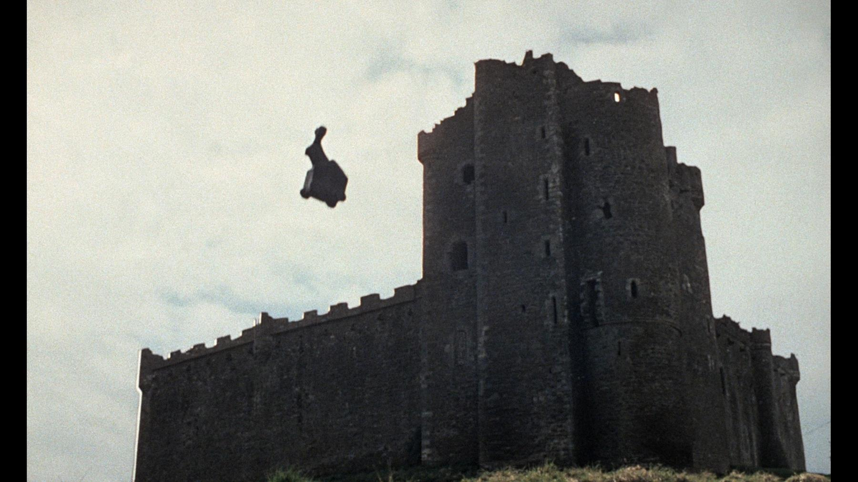
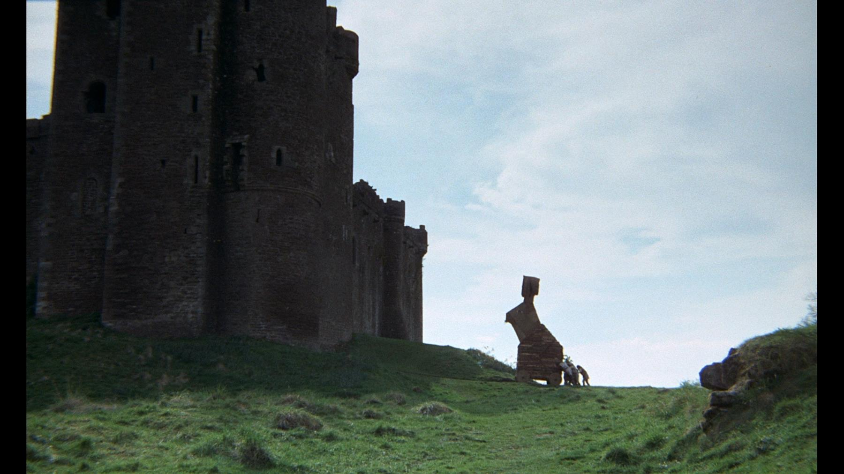
Accommodating Conceptual Equivocality isn’t Hard
Working out the compositional details, for lots of concepts and specific constructions, is harder
, a new book manuscript, and two recent papers with Thomas Icard
But adopting The Extension Dogma doesn’t help with the hard work. It just frames the hard work in terms of implausible assumptions
Reject the Trojan Horse!
The Vocabulary of Meanings
Extension(wet book) =
Combine[Extension(wet), Extension(book)] =
{x: x is wet} ∩ {x: x is a pen}
Extension(book) = {x: x is a book}
Extension(wet) = {x: x is wet}
Extension(boring) = {x: x is boring}
Extension(boring book) =
Combine[Extension(boring), Extension(book)] =
{x: x is boring} ∩ {x: x is a book}

Slide 31
Meanings without Extensions: One Word, Multiple Concepts
(Thanks for your time)
Slides available via tinyurl.com/pietroski

