Slide 1
Linguistically Expressible Concepts:
a simple mentalese for human grammars
Paul M. Pietroski
(with help from friends)
Rutgers University
tinyurl.com/pietroski
slides available there…scroll down

Slide 2
Describe a possible Language of Thought (LoT) that is very simple
Every concept of this LoT is monadic, and there is no concept-negation
But propositional logic is easily reconstructed
The LoT also validates A big dog barked and No dog barked
A dog barked No big dog barked
Make a few modest additions
Allow for some atomic dyadic concepts…
Enough to validate: A cat on a mat saw a dog at dusk; so a cat saw a dog
Add a notion of concept equivalence…
Enough for Aristotelian Logic with Every/Some/No, but not Some_not
As time permits, show how to add analogs of wh_{person} Abelard loved
and wh_{person} loved Heloise, but not wh_{relation} Abelard Heloise
Goal: start to explain how humans can express so many concepts,
and formulate so many inferences that are intuitively impeccable,
yet also form concepts that resist natural linguistic expression.
First, locate the project in a larger context
Notes:
<10 minutes for the intro and the next 8 slides….MOVE

Slide 3
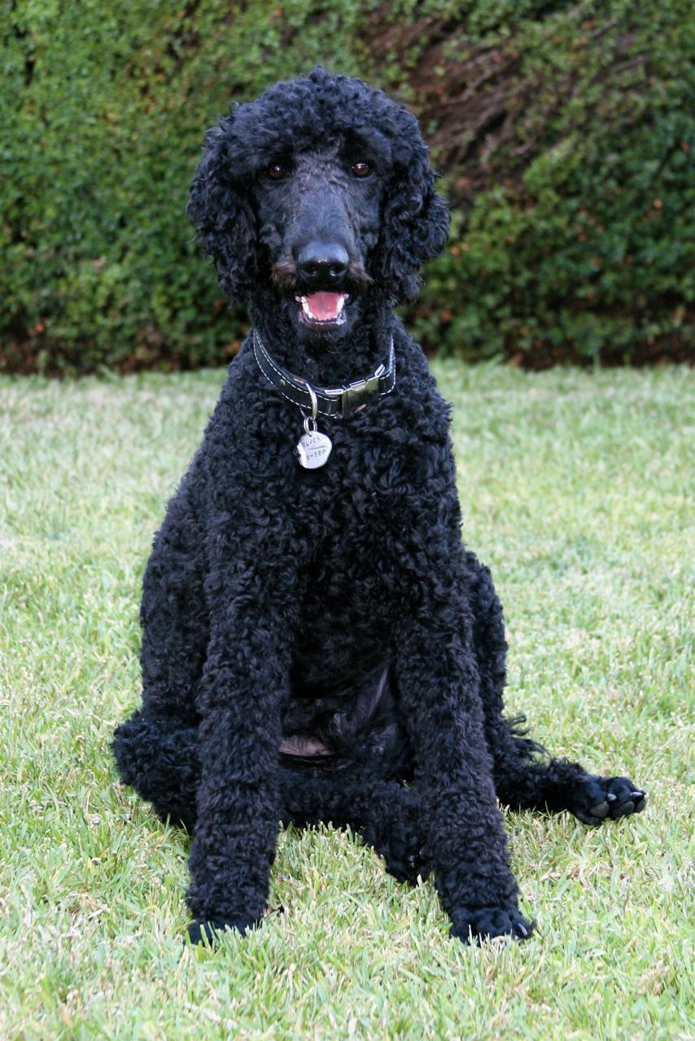
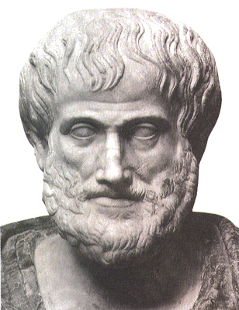
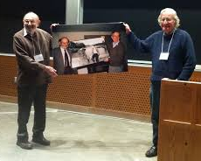
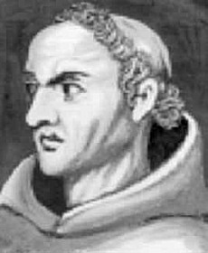
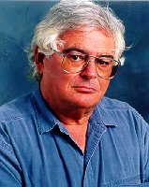
That dog is a poodle That dog is a father
That dog is mine That dog is mine
That dog is my poodle That dog is my father
👉D is P
👉D is M
👉D is MP
👉D is F
👉D is M
👉D is MF
✓
X
Grammars generate expressions that are pronounceable
(and meaningful).
Languages of Thought generate concepts that exhibit logical relations
(and have contents).
pronounceable expressions
Grammar
concepts
LoT

Slide 4
That dog is a poodle That dog is a father
That dog is mine That dog is mine
That dog is my poodle That dog is my father
??
✓
???
X
Grammars generate expressions that are
pronounceable
(and meaningful).
Languages of Thought generate concepts that exhibit logical relations
(and have contents).
pronounceable expressions
Grammar
concepts
LoT

Slide 5
That dog is a poodle That dog is a father
That dog is mine That dog is mine
That dog is my poodle That dog is my father
??
✓
???
X
Is the LoT like…
--Aristotle’s Syllogistic?
--First Order Logic?
--Some other fragment
of Frege’s Begriffsschrift?
--Some other extension
of First Order Logic?
If there is a Grammar+LoT in there…
--what types of atomic concepts
(and lexical items) are permitted?
--what modes of composition does
the LoT (and the Grammar) permit?
--what inferences are licensed?

Slide 6
That dog is a poodle That dog is a father
That dog is mine That dog is mine
That dog is my poodle That dog is my father
??
✓
???
X
Whatever the answers,
don’t confuse these
questions about
Human Psychology
with other venerable questions about Logic, Truth, and Reason.
If there is a Grammar+LoT in there…
--what types of atomic concepts
(and lexical items) are permitted?
--what modes of composition does
the LoT (and the Grammar) permit?
--what inferences are licensed?

Slide 7
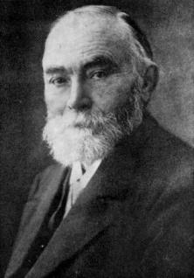
That dog is a poodle That dog is a father
That dog is mine That dog is mine
That dog is my poodle That dog is my father
✓
X

Slide 8
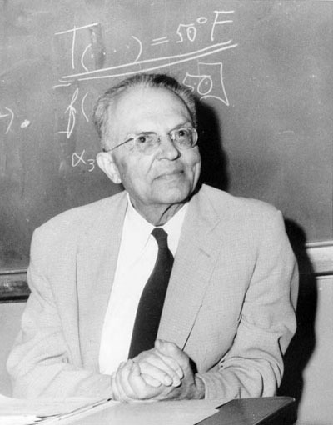
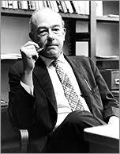
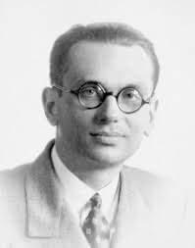
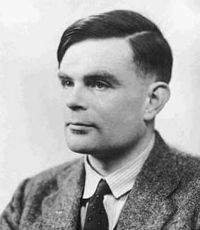
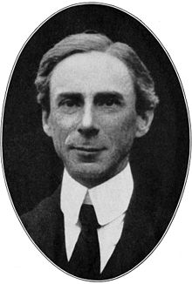
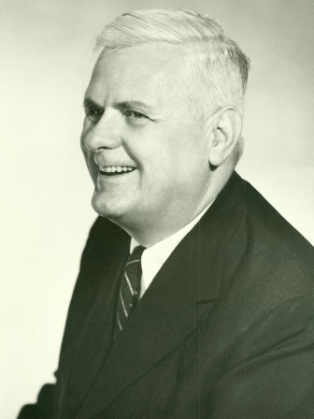
Some 𝚽 is 𝚿 Axioms for Arithmetic Logical Truths
Every 𝚿 is 𝝮 Definitions Definitions
Some 𝚽 is 𝝮 Arithmetic Theorems Arithmetic
✓
✓?
??
How far beyond Aristotelian systems does Logic go?
Some consistent (but large) fragment of Frege’s Begriffsschrift?
Some other extension of First Order Logic?
What is Logic? Is it the most general science?
How is Logic related to Math, Truth, Modality, and Rationality?
Great questions that I am NOT trying to answer.

Slide 9
That dog is a poodle That dog is a father
That dog is mine That dog is mine
That dog is my poodle That dog is my father
??
✓
???
X
If there is a Grammar+LoT in there…
--what types of atomic concepts
(and lexical items) are permitted?
--what modes of composition does
the LoT (and the Grammar) permit?
--what inferences are licensed?
What’s the
format
of the LoT
that interfaces
with the Grammar?

Slide 10
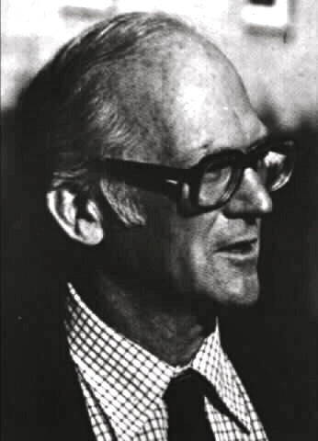
Ms. Scarlet poked Col. Mustard in a library with a pencil
Ms. Scarlet poked Col. Mustard in a library
??
✓
???
If there is a Grammar+LoT in there…
--what types of atomic concepts
(and lexical items) are permitted?
--what modes of composition does
the LoT (and the grammar) permit?
--what kind of inferences are licensed?
What’s the
format
of the LoT
that interfaces
with the Grammar?

Slide 11
(1) A spy poked a soldier in a library with a pencil.
(2) A spy poked a soldier with a pencil.
(3) A spy poked a soldier in a library.
(4) A spy poked a soldier.
(5) A spy poked a soldier in a kitchen.
(6) A spy poked a soldier with a spoon.
(7) A spy poked a soldier in a kitchen with a spoon.
(8) A spy poked a soldier in a kitchen with a pencil.
(9) A spy poked a soldier in a library with a spoon.
(1') There was an incident in a library involving a pencil. ∃x(Ix & Lx & Px)
(2') There was an incident involving a pencil. ∃x(Ix & Px)
(3') There was an incident in a library. ∃x(Ix & Lx)
(4') There was an incident. ∃x(Ix)
(5') There was an incident in a kitchen. ∃x(Ix & Kx)
(6') There was an incident involving a spoon. ∃x(Ix & Sx)
(7') There was an incident in a kitchen involving a spoon. ∃x(Ix & Kx & Sx)
(8') There was an incident in a kitchen involving a pencil. ∃x(Ix & Kx & Px)
(9') There was an incident in a library involving a spoon. ∃x(Ix & Lx & Sx)
(1)
 
(2) (3)
 
(4)
 
(5) (6)
 
(7)
 
(8) (9)
 
Scenario: Ms. Scarlet (a spy) poked Col. Mustard (a soldier) in the main library with a pencil.
Later, she poked him again in the main kitchen with a spoon.
Notes:
<10 minutes to here…5 minutes for next 4 slides

Slide 12
(1) A spy poked a soldier in a library with a pencil.
(2) A spy poked a soldier with a pencil.
(3) A spy poked a soldier in a library.
(4) A spy poked a soldier.
(5) A spy poked a soldier in a kitchen.
(6) A spy poked a soldier with a spoon.
(7) A spy poked a soldier in a kitchen with a spoon.
(8) A spy poked a soldier in a kitchen with a pencil.
(9) A spy poked a soldier in a library with a spoon.
(1e) ∃e[Past(e) & PokeByOf(e, a spy, a soldier) & With-a-Pencil(e) & In-the-library(e)]
(2e) ∃e[Past(e) & PokeByOf(e, a spy, a soldier) & With-a-Pencil(e)]
(3e) ∃e[Past(e) & PokeByOf(e, a spy, a soldier) & In-the-library(e)]
(4e) ∃e[Past(e) & PokeByOf(e, a spy, a soldier)]
(5e) ∃e[Past(e) & PokeByOf(e, a spy, a soldier) & In-the-kitchen(e)]
(6e) ∃e[Past(e) & PokeByOf(e, a spy, a soldier) & With-a-spoon(e)]
(7e) ∃e[Past(e) & PokeByOf(e, a spy, a soldier) & In-the-kitchen(e) & With-a-spoon(e)]
(8e) ∃e[Past(e) & PokeByOf(e, a spy, a soldier) & With-a-Pencil(e) & In-the-kitchen(e)]
(9e) ∃e[Past(e) & PokeByOf(e, a spy, a soldier) & In-the-library(e) & With-a-spoon(e)]
(1)
 
(2) (3)
 
(4)
 
(5) (6)
 
(7)
 
(8) (9)
 
Regimentation is great for Logic.
But mere regimentation doesn’t explain the phenomenon of Intuitively Impeccable Inference.
∃ and & and variables are powerful devices. Think about ∃x(Fx & Gy).
It’s not obvious how these inventions are related to Linguistic Comprehension.

Slide 13
(10) A brown cow that dallied ruminated.
∃e[Brown(x) & Cow(x) & Dallied(x) & Ruminated(x)]
(11) A cow that dallied ruminated.
∃e[Cow(x) & Dallied(x) & Ruminated(x)]
(12) A brown cow ruminated.
∃e[Brown(x) & Cow(x) & Ruminated(x)]
(13) A cow ruminated.
∃e[Cow(x) & Ruminated(x)]
(14) No cow ruminated.
~∃e[Cow(x) & Ruminated(x)]
(15) No brown cow ruminated.
~∃e[Brown(x) & Cow(x) & Ruminated(x)]
(16) No cow that dallied ruminated.
~∃e[Cow(x) & Dallied(x) & Ruminated(x)]
(17) No brown cow that dallied ruminated.
~∃e[Brown(x) & Cow(x) & Dallied(x) & Ruminated(x)]
(10)
 
(11) (12)
 
(13)
(14)
 
(15) (16)
 
(17)
Regimentation is great for Logic.
But mere regimentation doesn’t explain the phenomenon of Intuitively Impeccable Inference.
∃ and & and variables are powerful devices. Think about ∃x(Fx & ~Gy).
It’s not obvious how these inventions are related to Linguistic Comprehension.

Slide 14
(10) A brown cow that dallied ruminated.
∃e[Brown(x) & Cow(x) & Dallied(x) & Ruminated(x)]
(11) A cow that dallied ruminated.
∃e[Cow(x) & Dallied(x) & Ruminated(x)]
(12) A brown cow ruminated.
∃e[Brown(x) & Cow(x) & Ruminated(x)]
(13) A cow ruminated.
∃e[Cow(x) & Ruminated(x)]
(14) No cow ruminated.
~∃e[Cow(x) & Ruminated(x)]
(15) No brown cow ruminated.
~∃e[Brown(x) & Cow(x) & Ruminated(x)]
(16) No cow that dallied ruminated.
~∃e[Cow(x) & Dallied(x) & Ruminated(x)]
(17) No brown cow that dallied ruminated.
~∃e[Brown(x) & Cow(x) & Dallied(x) & Ruminated(x)]
(10)
 
(11) (12)
 
(13)
(14)
 
(15) (16)
 
(17)
PLAN: Describe a simpler LoT that captures the basic diamond patterns (10-17).
Then add a simple tweak that accommodates the Davidsonian variants (1-9).
Then add a simple tweak to allow for a mental analog of ‘every’.

Slide 15
M: a Minimal Concept Generator
Every concept of M, atomic or complex, is monadic.
There are some atomic concepts like cow and brown.
If 𝚽 and 𝚿 are concepts, so is (𝚽^𝚿).
If 𝚽 is a concept, so is ⇓𝚽.
For each thing:
(𝚽^𝚿) applies to it if and only if 𝚽 applies to it and 𝚿 applies to it;
⇓𝚽 applies to it if and only if 𝚽 applies to nothing.
⇑𝚽 applies to it if and only if 𝚽 applies to something
For every concept 𝚽 of M, ⇓𝚽 applies to nothing or everything.
If 𝚽 applies to anything, ⇓𝚽 applies to nothing.
If 𝚽 applies to nothing, ⇓𝚽 applies to each thing.
For each thing: ⇓𝚽 applies to it if and only if 𝚽 applies to nothing
⇓⇓𝚽 applies to it if and only if ⇓𝚽 applies to nothing
⇓⇓𝚽 applies to it if and only if 𝚽 applies to something
Let ⇑ abbreviate ⇓⇓.
(cp. ~∃x𝚽x)
(cp. ∃x𝚽x)
Notes:
<15 minutes to here…<15 minutes for the next EIGHT slides

Slide 16
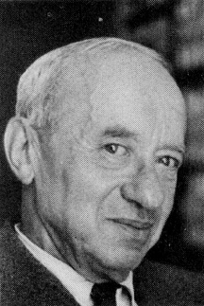
M: a Minimal Concept Generator
Every concept of M, atomic or complex, is monadic.
There are some atomic concepts like cow and brown.
If 𝚽 and 𝚿 are concepts, so is (𝚽^𝚿).
If 𝚽 is a concept, so is ⇓𝚽.
For each thing:
(𝚽^𝚿) applies to it if and only if 𝚽 applies to it and 𝚿 applies to it;
⇓𝚽 applies to it if and only if 𝚽 applies to nothing.
⇑𝚽 applies to it if and only if 𝚽 applies to something
For each entity e: ⇓cow applies to e iff cow applies to nothing;
⇑cow—a.k.a., ⇓⇓cow—applies to e iff cow applies to something;
⇓(cow^brown) applies to e iff cow^brown applies to nothing
⇑(cow^brown) applies to e iff cow^brown applies to something
(i.e., iff something is such that both cow and brown apply to it)
cow^⇓brown applies to e iff e is a cow and (such that) nothing is brown
Let ⇑ abbreviate ⇓⇓.
(cp. ~∃x𝚽x)
(cp. ∃x𝚽x)

Slide 17
(10) A brown cow that dallied ruminated.
∃e[Brown(x) & Cow(x) & Dallied(x) & Ruminated(x)]
(11) A cow that dallied ruminated.
∃e[Cow(x) & Dallied(x) & Ruminated(x)]
(12) A brown cow ruminated.
∃e[Brown(x) & Cow(x) & Ruminated(x)]
(13) A cow ruminated.
∃e[Cow(x) & Ruminated(x)]
(14) No cow ruminated.
~∃e[Cow(x) & Ruminated(x)]
(15) No brown cow ruminated.
~∃e[Brown(x) & Cow(x) & Ruminated(x)]
(16) No cow that dallied ruminated.
~∃e[Cow(x) & Dallied(x) & Ruminated(x)]
(17) No brown cow that dallied ruminated.
~∃e[Brown(x) & Cow(x) & Dallied(x) & Ruminated(x)]
(10)
 
(11) (12)
 
(13)
(14)
 
(15) (16)
 
(17)

Slide 18
(10) A brown cow that dallied ruminated.
⇑((brown^(cow^dallied))^ruminated)
(11) A cow that dallied ruminated.
⇑((cow^dallied)^ruminated)
(12) A brown cow ruminated.
⇑((brown^cow)^ruminated)
(13) A cow ruminated.
⇑(cow^ruminated)
(14) No cow ruminated.
⇓(cow^ruminated)
(15) No brown cow ruminated.
⇓((brown^cow)^ruminated)
(16) No cow that dallied ruminated.
⇓((cow^dallied)^ruminated)
(17) No brown cow that dallied ruminated.
⇓((brown^(cow^dallied))^ruminated)
(10)
 
(11) (12)
 
(13)
(14)
 
(15) (16)
 
(17)
⇑(𝚽^𝚿) ⇓𝚽
⇑(𝚽) ⇓(𝚽^𝚿)

Slide 19
(1) A spy poked a soldier in a library with a pencil.
(2) A spy poked a soldier with a pencil.
(3) A spy poked a soldier in a library.
(4) A spy poked a soldier.
(5) A spy poked a soldier in a kitchen.
(6) A spy poked a soldier with a spoon.
(7) A spy poked a soldier in a kitchen with a spoon.
(8) A spy poked a soldier in a kitchen with a pencil.
(9) A spy poked a soldier in a library with a spoon.
(1e) ∃e[Past(e) & PokeByOf(e, a spy, a soldier) & With-a-Pencil(e) & In-the-library(e)]
(2e) ∃e[Past(e) & PokeByOf(e, a spy, a soldier) & With-a-Pencil(e)]
(3e) ∃e[Past(e) & PokeByOf(e, a spy, a soldier) & In-the-library(e)]
(4e) ∃e[Past(e) & PokeByOf(e, a spy, a soldier)]
(5e) ∃e[Past(e) & PokeByOf(e, a spy, a soldier) & In-the-kitchen(e)]
(6e) ∃e[Past(e) & PokeByOf(e, a spy, a soldier) & With-a-spoon(e)]
(7e) ∃e[Past(e) & PokeByOf(e, a spy, a soldier) & In-the-kitchen(e) & With-a-spoon(e)]
(8e) ∃e[Past(e) & PokeByOf(e, a spy, a soldier) & With-a-Pencil(e) & In-the-kitchen(e)]
(9e) ∃e[Past(e) & PokeByOf(e, a spy, a soldier) & In-the-library(e) & With-a-spoon(e)]
(1)
 
(2) (3)
 
(4)
 
(5) (6)
 
(7)
 
(8) (9)
 
Lots of relationality here.
So let’s allow for some relational concepts.

Slide 20
M: a Minimal Concept Generator
Every concept of M, atomic or complex, is monadic.
There are some atomic concepts like cow and brown.
If 𝚽 and 𝚿 are concepts, so is (𝚽^𝚿).
If 𝚽 is a concept, so is ⇓𝚽. Let ⇑ abbreviate ⇓⇓.
For each thing:
(𝚽^𝚿) applies to it if and only if 𝚽 applies to it and 𝚿 applies to it;
⇓𝚽 applies to it if and only if 𝚽 applies to nothing.
Atomic concepts can be monadic or dyadic.
There are atomic concepts like In, Above, DoneBy, PokeOf, and DoneWith.
If 𝚽 is monadic and Δ is dyadic, then Δ:𝚽 is a monadic concept.
For each thing: Δ:𝚽 applies to it if and only if
it bears the dyadic relation indicated with Δ to something that 𝚽 applies to.
Above:cow applies to e iff e is above a cow
DoneBy:spy applies to e iff e is an event done by a spy
PokeOf:soldier applies to e iff e is an event of a soldier getting poked
DoneWith:pencil applies to e iff e is an event done with a pencil
M: a Minimal Extension of M
Permits a
smidgeon of
polyadicity

Slide 21
(1) A spy poked a soldier in a library with a pencil.
(2) A spy poked a soldier with a pencil.
(3) A spy poked a soldier in a library.
(4) A spy poked a soldier.
(5) A spy poked a soldier in a kitchen.
(6) A spy poked a soldier with a spoon.
(7) A spy poked a soldier in a kitchen with a spoon.
(8) A spy poked a soldier in a kitchen with a pencil.
(9) A spy poked a soldier in a library with a spoon.
(1e) ⇑(past^(((DoneBy:spy^PokeOf:soldier)^In:library)^DoneWith:pencil))
(2e) ⇑(past^((DoneBy:spy^PokeOf:soldier)^DoneWith:pencil))
(3e) ⇑(past^((DoneBy:spy^PokeOf:soldier)^In:library))
(4e) ⇑(past^(DoneBy:spy^PokeOf:soldier))
(5e) ⇑(past^((DoneBy:spy^PokeOf:soldier)^In:kitchen))
(6e) ⇑(past^((DoneBy:spy^PokeOf:soldier)^DoneWith:spoon))
(7e) ⇑(past^(((DoneBy:spy^PokeOf:soldier)^In:kitchen)^DoneWith:spoon))
(8e) ⇑(past^(((DoneBy:spy^PokeOf:soldier)^In:kitchen)^DoneWith:pencil))
(9e) ⇑(past^(((DoneBy:spy^PokeOf:soldier)^In:library)^DoneWith:spoon))
(1)
 
(2) (3)
 
(4)
 
(5) (6)
 
(7)
 
(8) (9)
 

Slide 22
M
if 𝚽 and 𝚿 are monadic concepts, then so are ⇓𝚽 and 𝚽^𝚿
(enough for basic Diamond Patterns)
M
When extending M,
think about small modular additions.
(There are others coming.)
Add a smidgeon
of dyadicity
(enough for
Davidsonian Diamond Patterns)
But as we’re about to see,
M was already enough for propositional logic.

Slide 23
M: a Minimal Concept Generator
For each thing:
(𝚽^𝚿) applies to it iff 𝚽 applies to it and 𝚿 applies to it;
⇓𝚽 applies to it iff 𝚽 applies to nothing;
⇓⇓𝚽 (a.k.a. ⇑𝚽) applies to it iff 𝚽 applies to something.
Longer is stronger,
but that’s reversible,
and so is that.
This is enough to reconstruct propositional logic. (See Icard & Moss…and Tarski)
⇑⇓𝚽 is equivalent to ⇓⇑𝚽 and ⇓𝚽 (i.e., ⇓⇓⇓𝚽 is equivalent to ⇓⇓⇓𝚽 and ⇓𝚽)
⇑⇑𝚽 is equivalent to ⇑𝚽 (i.e., ⇓⇓⇓⇓𝚽 is equivalent to ⇓⇓𝚽).
𝚽^⇓𝚽, which can be abbreviated as ⊥, applies to nothing
⇓(𝚽^⇓𝚽), which can be abbreviated as ⊤, applies to everything.
P ~P Q P & Q
1 0 1 1
1 0 0 0
0 1 1 0
0 1 0 0
⇑𝚽 ⇓𝚽 ⇑𝚿 ⇑𝚽^⇑𝚿
E N E E
E N N N
N E E N
N E N N
⇓𝚽 ⇑𝚽 ⇓𝚿 ⇓𝚽^⇓𝚿
E N E E
E N N N
N E E N
N E N N
Notes:
<<30 minutes to here…10 minutes for the next 8 slides

Slide 24
M: a Minimal Concept Generator
For each thing:
(𝚽^𝚿) applies to it iff 𝚽 applies to it and 𝚿 applies to it;
⇓𝚽 applies to it iff 𝚽 applies to nothing;
⇓⇓𝚽 (a.k.a. ⇑𝚽) applies to it iff 𝚽 applies to something.
This is enough to reconstruct propositional logic. (See Icard & Moss…and Tarski)
⇑⇓𝚽 is equivalent to ⇓⇑𝚽 and ⇓𝚽 (i.e., ⇓⇓⇓𝚽 is equivalent to ⇓⇓⇓𝚽 and ⇓𝚽)
⇑⇑𝚽 is equivalent to ⇑𝚽 (i.e., ⇓⇓⇓⇓𝚽 is equivalent to ⇓⇓𝚽).
𝚽^⇓𝚽, which can be abbreviated as ⊥, applies to nothing
⇓(𝚽^⇓𝚽), which can be abbreviated as ⊤, applies to everything
S
P ~P
1 0
0 1
⇑𝚽 ⇓𝚽
E N
N E
SUBJECT
PREDICATE
Aristotle
COPULA
ADJECTIVE
|
dumb
was/wasn’t

Slide 25
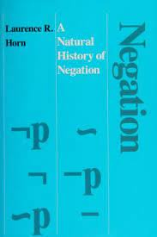
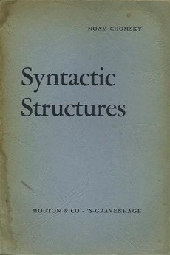
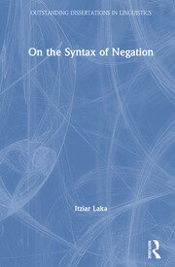
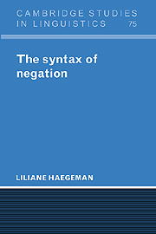
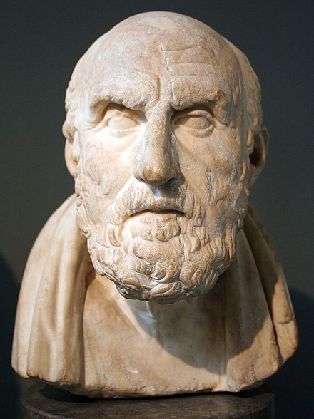
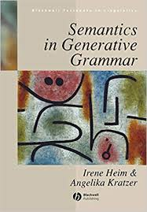
S
OLD QUESTION:
Is the negation in ‘Aristotle was not dumb’ part of our subsentential logical vocabulary?
Can sentences with no sentential constituents be negative in this way?
SUBJECT
PREDICATE
Aristotle
COPULA
ADJECTIVE
|
dumb
wasn’t
S
Or does this kind of negation combine with a sentence, at least semantically…
or maybe in the relevant LoT…
or maybe in the relevant proposition?
not
S
SUBJECT
PREDICATE
Aristotle
COPULA ADJECTIVE
| |
was dumb

Slide 26
S
S
SUBJECT
PREDICATE
SUBJECT
PREDICATE
Aristotle
Pegasus
COPULA
ADJECTIVE
COPULA
VERB
|
dumb
|
exist
wasn’t
doesn’t
Don’t assume that an LoT must fit
a Stoic/Fregean model that starts with a Propositional Calculus.
We can follow The Philosopher,
and say that concepts can be
affirmed or denied in thought.
Then borrowing from Tarski,
we can describe mental sentences as special (“polarized”) concepts.
⇓(ThatAristotle^dumb)

Slide 27
S
SUBJECT
PREDICATE
a b
𝚽
Aristotle
COPULA
ADJECTIVE
Suppose that 𝚽 applies to b,
and that 𝚽 doesn’t apply to a.
|
dumb
wasn’t
There’s no way of using 𝚽
to build a concept that
applies to a but not to b.
⇓(ThatAristotle^dumb)
⇑𝚽 applies to both a and b. ⇓𝚽 applies to neither a nor b.
And for any concept 𝚿:
(𝚽^𝚿) applies to b, or
(𝚽^𝚿) applies to nothing.
This is a good place to stress that our minimal LoT can’t be used to turn each concept 𝚽 into a concept that applies to whatever 𝚽 doesn’t apply to; see Icard & Moss.
⇓(ThatAristotle^dumb)
applies to everything, but
ThatAristotle^⇓dumb
applies to nothing

Slide 28
⇓(𝚽^𝚿)
Every 𝚽 is 𝚿
No 𝚽 is 𝚿
What kind of mind acquires Every, Some, and No,
but not Sumaint?
contradicts
The “4th corner”
of the traditional
Square of Opposition
does not correspond to
a natural quantifier.
Why not?
Some 𝚽 is 𝚿
Sumaint 𝚽 is 𝚿
Some 𝚽 isn’t 𝚿
Nall 𝚽 is 𝚿
Nevry 𝚽 is 𝚿
⇑(𝚽^𝚿)

Slide 29
∀x:𝚽x[𝚿x]
∀x:𝚽x[~𝚿x]
~∃x[𝚽x & ~𝚿x]
~∃x[𝚽x & 𝚿x]
Every 𝚽 is 𝚿
No 𝚽 is 𝚿
What kind of mind acquires Every, Some, and No,
but not Sumaint?
Sumaint seems all too
possible given ~.
contradicts
So maybe we should posit an
LoT that doesn’t have ~.
Some 𝚽 is 𝚿
Sumaint 𝚽 is 𝚿
∃x[𝚽x & ~𝚿x]
∃x[𝚽x & 𝚿x]
~∀x:𝚽x[𝚿x]

Slide 30
Strategy: add a (motivated) notion of
concept equivalence to the basic LoT.
𝚽 ≈ (𝚽^𝚿)
⇓(𝚽^𝚿)
Every 𝚽 is 𝚿
No 𝚽 is 𝚿
contradicts
Maybe
Some/No reflect
a basic cognitive pair,
and Every gets introduced
in a way that Sumaint
can’t be introduced
Some 𝚽 is 𝚿
Sumaint 𝚽 is 𝚿
∃x[𝚽x & ~𝚿x]
⇑(𝚽^𝚿)

Slide 31
M
if 𝚽 and 𝚿 are monadic concepts, then so are ⇓𝚽 and 𝚽^𝚿
(enough for basic Diamond patterns and Propositional Logic)
M
M≈
Add a smidgeon
of dyadicity
(enough for Davidsonian diamond patterns)
Add a notion of concept equivalence
When extending M,
think about small modular additions.
Notes:
<<40 minutes to here…10 minutes for the next 5 slides

Slide 32
M
if 𝚽 and 𝚿 are monadic concepts, then so are ⇓𝚽 and 𝚽^𝚿
(enough for basic Diamond patterns and Propositional Logic)
M≈
Add a notion of concept equivalence
Assume that if a mind with M has two monadic concepts, it can suppose that they are interchangeable (materially equivalent) for purposes of simple reasoning.
⇑𝚽 ⇓𝚽
𝚽 ≈ 𝚿 𝚽 ≈ 𝚿
⇑𝚿 ⇓𝚿
For any concepts 𝚽 and 𝚿:
𝚽 ≈ 𝚿 iff each entity is such that
𝚽 applies to it iff 𝚿 applies to it

Slide 33
M
if 𝚽 and 𝚿 are monadic concepts, then so are ⇓𝚽 and 𝚽^𝚿
(enough for basic Diamond patterns and Propositional Logic)
M≈
Add a notion of concept equivalence
Assume that if a mind with M has two monadic concepts, it can suppose that they are interchangeable (materially equivalent) for purposes of simple reasoning.
⇑𝚽 ⇓𝚽
𝚽 ≈ 𝚿 𝚽 ≈ 𝚿
⇑𝚿 ⇓𝚿
For any concepts 𝚽 and 𝚿:
𝚽 ≈ 𝚿 iff each entity is such that
𝚽 applies to it iff 𝚿 applies to it.
According to a supposition of the form 𝚽^𝚿 ≈ 𝚽 , every 𝚽 is 𝚿.
And if every 𝚽 is 𝚿, then 𝚽^𝚿 ≈ 𝚽 .
Dictum de Omni:
Whatever holds for cows holds for brown cows.
And if every cow is brown, whatever holds for brown cows holds for cows.
So if every cow is brown, whatever holds for cows holds for brown cows and vice versa.

Slide 34
M
if 𝚽 and 𝚿 are monadic concepts, then so are ⇓𝚽 and 𝚽^𝚿
(enough for basic Diamond patterns and Propositional Logic)
M≈
Add a notion of concept equivalence
(a) 𝚽 ≈ (𝚽^𝚿) EVERY:𝚽(𝚿)
(b) (𝚽^𝚿) ≈ (𝚽^⇓𝚽) NO:𝚽(𝚿)
NO:𝚽(𝚿)
conjoining 𝚿 to 𝚽 is like conjoining ⇓𝚽 to 𝚽…
the result applies to nada
𝚽^⇓𝚽, which can be abbreviated as ⊥, applies to nothing

Slide 35
M
if 𝚽 and 𝚿 are monadic concepts, then so are ⇓𝚽 and 𝚽^𝚿
(enough for basic Diamond patterns and Propositional Logic)
M≈
enough for
Aristotelian logic;
still doesn’t support
concept-negation
or SUMAINT
(see Icard & Moss)
Add a notion of concept equivalence
(a) 𝚽 ≈ (𝚽^𝚿) EVERY:𝚽(𝚿)
(b) (𝚽^𝚿) ≈ (𝚽^⇓𝚽) NO:𝚽(𝚿)
(c) ⇑(𝚽^𝚿) ≈ ⇓(𝚽^⇓𝚽) SOME:𝚽(𝚿)
(d) SUMAINT:𝚽(𝚿)
𝚽^⇓𝚽, which can be abbreviated as ⊥, applies to nothing
⇓(𝚽^⇓𝚽), which can be abbreviated as ⊤, applies to everything
SOME:𝚽(𝚿)
⇑(𝚽^𝚿) applies to everything;
𝚽^𝚿 doesn’t apply to nothing;
something is such that both 𝚽 and 𝚿 apply to it

Slide 36
M
if 𝚽 and 𝚿 are monadic concepts, then so are ⇓𝚽 and 𝚽^𝚿
(enough for basic Diamond patterns and Propositional Logic)
M
M≈
Add a smidgeon
of dyadicity
(enough for Davidsonian diamond patterns)
Add a notion of concept equivalence
(enough for Aristotelian logic)
𝚽 ≈ (𝚽^𝚿) EVERY:𝚽(𝚿)
(𝚽^𝚿) ≈ (𝚽^⇓𝚽) NO:𝚽(𝚿)
(𝚽^𝚿) ≈ ⇓(𝚽^⇓𝚽) SOME:𝚽(𝚿)
sound/complete/decidable;
still like a propositional calculus in terms of
computational complexity (see Icard & Moss);
but not enough for analogs of relative clauses
Add a modest form of abstraction to allow for analogs of
‘who a spy poked’ and ‘who poked a soldier’
Notes:
<<50 minutes to here…10 minutes to finish

Slide 37
M
if 𝚽 and 𝚿 are monadic concepts, then so are ⇓𝚽 and 𝚽^𝚿
(enough for basic Diamond patterns and Propositional Logic)
There are MANY conceiveable abstractions that this doesn’t permit.
3⇑(past^(DoneBy:spy^3:soldier)) applies to <e, x> iff
e was an event of a spy doing something to x, and x is a soldier
Allow for limited abstraction on monadic concepts within polarized concepts:
⇑(past^(DoneBy:spy^PokeOf:soldier))
⇑(past^(DoneBy:1^PokeOf:soldier))
1⇑(past^(DoneBy:1^PokeOf:soldier))
1⇑(past^(DoneBy:1^PokeOf:soldier))
applies to e iff
⇑(past^(DoneBy:1^PokeOf:soldier))
applies to e given e as the value of 1
1⇑(past^(DoneBy:1^PokeOf:soldier))
applies to e iff e poked a soldier
⇑(past^(DoneBy:spy^PokeOf:soldier))
⇑(past^(DoneBy:spy^PokeOf:2))
2⇑(past^(DoneBy:spy^PokeOf:2))
2⇑(past^(DoneBy:spy^PokeOf:2))
applies to e iff
⇑(past^(DoneBy:spy^PokeOf:2))
applies to e given e as the value of 2
2⇑(past^(DoneBy:spy^PokeOf:2))
applies to e iff a spy poked e

Slide 38
M
if 𝚽 and 𝚿 are monadic concepts, then so are ⇓𝚽 and 𝚽^𝚿
(enough for basic Diamond patterns and Propositional Logic)
There are MANY conceiveable abstractions that this doesn’t permit.
3⇑(past^(3:spy^PokeOf:soldier)) applies to <e, x> iff
e bears some relation to a spy, and e was a poking of a soldier
Allow for limited abstraction on monadic concepts within polarized concepts:
⇑(past^(DoneBy:spy^PokeOf:soldier))
⇑(past^(DoneBy:1^PokeOf:soldier))
1⇑(past^(DoneBy:1^PokeOf:soldier))
1⇑(past^(DoneBy:1^PokeOf:soldier))
applies to e iff
⇑(past^(DoneBy:1^PokeOf:soldier))
applies to e given e as the value of 1
1⇑(past^(DoneBy:1^PokeOf:soldier))
applies to e iff e poked a soldier
⇑(past^(DoneBy:spy^PokeOf:soldier))
⇑(past^(DoneBy:spy^PokeOf:2))
2⇑(past^(DoneBy:spy^PokeOf:2))
2⇑(past^(DoneBy:spy^PokeOf:2))
applies to e iff
⇑(past^(DoneBy:spy^PokeOf:2))
applies to e given e as the value of 2
2⇑(past^(DoneBy:spy^PokeOf:2))
applies to e iff a spy poked e

Slide 39
M
if 𝚽 and 𝚿 are monadic concepts, then so are ⇓𝚽 and 𝚽^𝚿
(enough for basic Diamond patterns and Propositional Logic)
M
M≈
Add a smidgeon
of dyadicity
(enough for Davidsonian diamond patterns)
Add a notion of concept equivalence
(enough for Aristotelian logic)
𝚽 ≈ (𝚽^𝚿) EVERY:𝚽(𝚿)
(𝚽^𝚿) ≈ (𝚽^⇓𝚽) NO:𝚽(𝚿)
(𝚽^𝚿) ≈ ⇓(𝚽^⇓𝚽) SOME:𝚽(𝚿)
sound/complete/decidable…
like Prop Calc in terms of computational complexity
Add a modest form of abstraction to allow for analogs of
‘who a spy poked’ and ‘who poked a soldier’
undecidable, but tame
expressively equivalent to First Order Logic
(generates equivalent monadic concepts);
but still easily specifiable with context-free rules
Notes:
WRAP UP

Slide 40
??
???
If there is a Grammar+LoT in there…
--what computational resources are getting used?
--how expressive is the basic (pre-abstraction) LoT?
--what kind(s) of abstraction does the LoT permit?
--in what way(s) is the LoT recursive?
Notes:
WRAP UP

Slide 41
Describe a simple Language of Thought (LoT)
Every concept is monadic, and there is no concept-negation
But propositional logic is easily reconstructed
The LoT also validates A big dog barked and No dog barked
A dog barked No big dog barked
Show how modest tweaks can increase expressive power dramatically
Allow for some atomic dyadic concepts…
Enough to validate: She wrote a note with a pen; so she wrote a note
Add a notion of concept equivalence…
Enough for Aristotelian Logic with Every/Some/No, but not Some_not
If time, show how to add mental analogs of wh_{person} Abelard loved and
wh_{person} loved Heloise without permitting wh_{relation} Abelard Heloise
Notes:
FINISH

Slide 42
Thanks for part of your day!
Thanks to Thomas Icard & Larry Moss for their paper, “A Simple Logic of Concepts”
(forthcoming in the Journal of Philosophical Logic)
https://philpapers.org/archive/ICAASL.pdf
And thanks to Thomas for many conversations.

