Slide 1


Externalist Contents, Internalist Meanings GeorgesFest Feb 27, 2026 UMD
Paul M. Pietroski Rutgers University
tinyurl.com/pietroski
Slides available at

Slide 2
Cut the pie any way you like, ‘meanings’ just ain't in the head!
--Hilary Putnam, “The Meaning of ‘Meaning’ ”
Like many slogans, this one is rubbish. There was never a good argument for it.
But underneath the rhetoric was an important point.
Putnam highlighted a good line of thought that tells against conjoining two theses.
(1) That knowing the meaning of a term is just a matter of being in a certain
psychological state (in the sense of ‘psychological state’ in which states of
memory and psychological dispositions are ‘psychological states’ … )
(2) That the meaning of a term (in the sense of ‘intensions’ ) determines its extension
(in the sense that sameness of intension entails sameness of extension).
I shall argue that these two assumptions are not jointly satisfied by any notion, let alone any notion of meaning. The traditional concept of meaning is a concept which rests on a false theory.
But as Putnam himself noted, thesis (2) is at best a “severe idealization;” it ignores polysemy.
Given independent observations, the good line of thought tells against (2) and favors (1).
Externalism about conceptual contents leads to internalism about linguistic meanings.

Slide 3
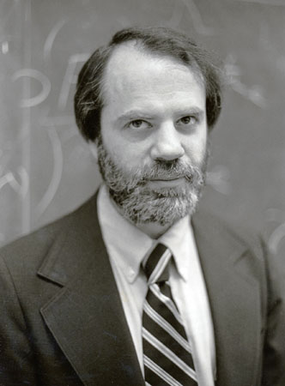
The Good Externalist Line of Thought
Big Mistakes Have Been Made: stars, planets, nebulae, quasars, whales, …
Even when we’re right, error remains conceivable: cats are animals, gold has atomic number 79
Often, definitions don’t stay put: melting point of ice (–0.001 ºC); boiling point of water (99.9839 ºC)
Typical names like ‘Aristotle’, ‘Shakespeare’, and ‘Russell’ do not abbreviate independent descriptions
Neither do (so-called) kind terms like ‘gold’ and ‘water’
Most lexical items resist analysis, even if a few like ‘bachelor’ and ‘mare’ can be decomposed (somehow)
There’s much to be said for causal conceptions of reference, action, perception, memory, knowledge, …
There are singular concepts (e.g., ¹Aristotle) and kind concepts (e.g., ^{K}water)
There’s much to be said for idea that ¹Hesperus and ¹Phosphorus have the same content (viz., Venus), and that ^{K}woodchuck has the same content as ^{K}groundhog
Aristotle isn’t in your head! Cats are mind-external things!

Slide 4
The Good Externalist Line of Thought
Big Mistakes Have Been Made: stars, planets, nebulae, quasars, whales, …
Even when we’re right, error remains conceivable: cats are animals, gold has atomic number 79
Often, definitions don’t stay put: melting point of ice (–0.001 ºC); boiling point of water (99.9839 ºC)
Typical names like ‘Aristotle’, ‘Shakespeare’, and ‘Russell’ do not abbreviate independent descriptions
Neither do (so-called) kind terms like ‘gold’ and ‘water’
Most lexical items resist analysis, even if a few like ‘bachelor’ and ‘mare’ can be decomposed (somehow)
There’s much to be said for causal conceptions of reference, action, perception, memory, knowledge, …
There are singular concepts (e.g., ¹Aristotle) and kind concepts (e.g., ^{K}water)
There’s much to be said for idea that ¹Hesperus and ¹Phosphorus have the same content (viz., Venus), and that ^{K}woodchuck has the same content as ^{K}groundhog
Aristotle isn’t in your head. Cats are mind-external things.

Slide 5
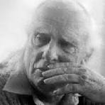
Don’t Spoil a Good Thing with Bad Philosophy of Language
Don’t assume that
each word expresses exactly one concept
each word has an extension…not even if you assume that each concept has an extension
‘Hesperus’ and ‘Phosphorous’ are synonyms if ¹Hesperus and ¹Phosphorus have the same content
‘woodchuck’ and ‘groundhog’ are synonyms if ^{K}woodchuck and ^{K}groundhog have the same content
Maybe
words are polysemous in a way that tells against the idea that each word expresses one concept
‘meaning’ is very polysemous, but sometimes, it gets used to express a kind-concept
^{K}meaning applies to human linguistic meanings, which differ importantly from conceptual contents
these meanings turn out to internalistic aspects of linguistic expressions
Human linguistic expressions have theoretically interesting semantic properties, but
theorists can be badly mistaken about what meanings/languages/stars/nebulae are

Slide 6
The Meaning of ‘Circle’
The circle is green.
A circle is a set of points.
More specifically, a circle is a set of
of all the points in a plane that are
a fixed distance from a fixed point.
(Geometric points are not visible, much less green.)

Slide 7
from the O.E.D.
circle, n.
I.1.a. (c1305)
A perfectly round plane figure. In Geometry defined as a plane figure bounded by a single curved line, called the circumference, which is everywhere equally distant from a point within, called the centre. But often applied to the circumference alone, without the included space.
to square the circle: to find a square of the same area as a given circle
(a famous problem, incapable of geometrical solution).
Perimeter
Area
Perceptible Abstract
The square is blue. The circle is green.

Slide 8
from the O.E.D.
circle, n.
I.1.a. (c1305)
A perfectly round plane figure. In Geometry defined as a plane figure bounded by a single curved line, called the circumference, which is everywhere equally distant from a point within, called the centre. But often applied to the circumference alone, without the included space.
to square the circle: to find a square of the same area as a given circle
(a famous problem, incapable of geometrical solution).
Thinking about something as a circular perimeter/circumference
differs from thinking about something as a circular area.
(Imperfect) (Perfect)
Perimeter
Area
Perceptible Abstract
The square is blue. The circle is green.
C1
C3
The noun ‘circle’ seems to be linked to a family of concepts.
C2
C4
composable mental representations
that can be used to think about
things in systematically related ways
I.1.b. (c1380)
In a vaguer and more general sense.
traffic circles, circles of friends,
great circles, crop circles…
circular reasoning, circling wagons

Slide 9
The meanings of (so-called) kind terms
It is often suggested that words like ‘rabbit’ and ‘dog’ and ‘water’ somehow lock onto natural properties—e.g., being a member of certain biological kind, or being a sample of H₂O modulo trace impurities—and that these properties determine extensions for the words.
But given the biological facts, why think the nouns in ‘a dog chased a rabbit’ have extensions?
One can have various “kind-concepts”
--the Leporids
--the European Rabbits
--the Cottontails
--17 species of Cottontails, 3 sub-genuses
A child can have a concept of the sort
psychologists (e.g., Keil and Gelman) describe when talking about innate tendencies to “essentialize”
Adults can have other concepts of rabbits—e.g., the Lagomorphs minus the pikas, jackrabbits, and any hares.

Slide 10
The meanings of (so-called) kind terms
It is often suggested that words like ‘rabbit’ and ‘dog’ and ‘water’ somehow lock onto natural properties—e.g., being a member of certain biological kind, or being a sample of H₂O modulo trace impurities—and that these properties determine extensions for the words.
But given the biological facts, why think the nouns in ‘a dog chased a rabbit’ have extensions?
Taxonomical distinctions need not correspond to clean genetic distinctions.
CANIS
...
latrans
coyotes lupus familiaris
grey domestic
wolves dogs

Slide 11
The meanings of (so-called) kind terms
It is often suggested that words like ‘rabbit’ and ‘dog’ and ‘water’ are somehow “drawn to” natural properties—e.g., being a member of certain biological kind, or being a sample of H₂O modulo trace impurities—and that these properties determine extensions for the words.
But given the biological facts, why think the nouns in ‘a dog chased a rabbit’ have extensions?
And ‘water’ is an even worse example.
many examples of
--very high H₂O content
--but not water
many examples of
--lower H₂O content
--and yet water
So why insist that Putnam’s imagined substance, XYZ, couldn’t be described as water?
Percentage of H₂O
Club Soda: 99.9 Coffee: 99.4
Diet soda, not cola: 99.8 Espresso: 97.8
Tea: 99.7 Ocean Water: 96.5
Diet Cola: 99.54 Bud Light: 95.0
stuff from my well < 99.4 Distilled vinegar: 94.8
in New Mexico

Slide 12
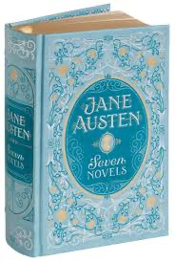


one tome, seven novels
--one book, but hard to carry
--seven books by Austen (Pride and Prejudice, Sense and Sensibility, … , Emma)
‘book’ ➔ BOOK:CONTENT (downloadable), BOOK:CONTAINER (droppable)
‘window’ ➔ WINDOW:HOLE, WINDOW:FILLER
, WINDOW:DISPLAY-SPACE, WINDOW:TELLER’S, …
He cut a window in the wall. Then he bought a window to fill it.
The window from the store differed from the window it filled.
The original window was nicer than the one he installed.

Slide 13
In a longer version of the talk…
Polysemy is ubiquitous
conceptual equivocality is the normal case for naturally acquired lexical items
special cases of the far more general phenomenon include
(i) Travis cases (e.g., pens with blue ink and red exteriors, or red ink and blue exteriors) and
(ii) cases of linking a word to two or more extensionally equivalent concepts (‘Venus’ to both Hesperus and Phosphorus…‘whistlepig’ to both groundhog and woodchuck)
Polysemy is not homophony
distinguishing ‘bank_{money}’ from ‘bank_{river}’ is one thing
distinguishing ‘bank_{money:building}’ from ‘bank_{money:institution}’ is another thing
For today, I’m taking these as premises.
(Happy to return to this in the Q&A or later.)

Slide 14
(1) That knowing the meaning of a term is just a matter of being in a certain
psychological state (in the sense of ‘psychological state' in which states of memory
and psychological dispositions are ‘psychological states’ …)
(2) That the meaning of a term (in the sense of ‘intensions’ ) determines its extension
(in the sense that sameness of intension entails sameness of extension).
I shall argue that these two assumptions are not jointly satisfied by any notion, let alone any notion of meaning. The traditional concept of meaning is a concept which rests on a false theory.
In the early pages of the paper, Putnam granted that words are typically polysemous, and that (2) is at best a “severe idealization”. But later, he assumed (2) in his argument against (1).
He used the Twin-Earth thought experiment to argue against the conjunction of (1) and (2).
But he ignored the possibility that ‘water’ is conceptually equivocal, making (2) the culprit.
Suppose that (a) ‘water’ can be used to express a kind concept ^{K}water—which applies only to
samples of H₂O, modulo trace impurities, and wouldn’t apply to samples of XYZ—and
(b) ‘water’ can be used to express a functional concept ^{F}water that doesn’t apply to Diet Coke, does apply to the stuff from my well, and would apply to samples of XYZ.
Putnam ignored this possibility even though the early pages of his paper open a door to it.

Slide 15
content externalism leaves room for the idea that
‘water’ can be used to express various concepts, one of which is a kind-concept tied to H₂O
‘meaning’ can be used to express various concepts, one of which is a kind-concept
discovering the nature of whatever ^{K}water applies to is a matter for empirical inquiry
discovering the nature of whatever ^{K}meaning applies to is a matter for empirical inquiry
in trying to figure out "what water is,” scientists gradually noted and tried to explain a cluster of phenomena concerning water that seemed important
its freezing/boiling points
how it acts as a solvent, its high heat capacity, its polarity properties, …
low density as a solid (ice floats)
ditto for stars, nebulae, quasars, whales, etc.
for linguistic meaning(s), the relevant list of phenomena includes
composition, but also homophony and polysemy
the paucity of analytic biconditionals (lawyer/attorney, mare/mature female horse, but not lots)
the ubiquity of intuitively compelling one-way inferences
Miss Scarlet drew a green circle with a red pen in the main library; so she drew a circle
Miss Scarlet melted some chocolate; so some chocolate melted

Slide 16
content externalism leaves room for the idea that
‘water’ can be used to express various concepts, one of which is a kind-concept tied to H₂O
‘meaning’ can be used to express various concepts, one of which is a kind-concept
discovering the nature whatever ^{K}water applies to is a matter for empirical inquiry
discovering the nature whatever ^{K}meaning applies to is a matter for empirical inquiry
in trying to figure out "what water is,” scientists gradually noted and \
its freezing/boiling points
how it acts as a solvent, its high heat capacity, its polarity properties, …
low density as a solid (ice floats)
ditto for stars, nebulae, quasars, whales, etc.
for linguistic meaning(s), the relevant list of phenomena includes
composition, but also homophony and polysemy
the paucity of analytic biconditionals (lawyer/attorney, mare/mature female horse, but not lots)
but the ubiquity of intuitively compelling one-way inferences
Miss Scarlet drew a green circle with a red pen in the main library; so she drew a circle
Miss Scarlet melted some chocolate; so some chocolate melted
In a longer talk (and the book).
--each phenomenon on the list favors meaning internalism
--taken together, they strongly favor meaning internalism,
even when it comes to explaining linguistic communication
Here, I’ll stress one important point about homophony and conclude.
Communicative uses of expressions are important. But why think they require externalistic meanings, as opposed to some concepts with externalist contents?

Slide 17
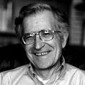
Homophony and Polysemy are Distinct Phenomena, and “Structural Homophony” is limited in theoretically interesting ways
the duck is ready to eat
the duck is ready/prepared to eat something (that is suitable for a duck)
the duck is ready/suitable to be eaten (by relevant parties)
the duck is eager to eat
the duck is eager to eat something
the duck is eager to be eaten
the duck is easy to eat
it is easy for the duck to eat something
it is easy for the duck to be eaten
the duck is ready [A to eat P]
the duck is eager [A to eat P]
the duck is easy [A to eat P]

Slide 18
Homophony and Polysemy are Distinct Phenomena, and “Structural Homophony” is limited in theoretically interesting ways
Mary saw the boy walking towards the railway station
Mary saw the boy while she was walking towards the railway station
Mary saw the boy who was walking towards the railway station
Mary saw the boy walk towards the railway station
this is the railway station that Mary saw the boy walking towards
this is the railway station such that Mary saw the boy while she was walking towards it
this is the railway station such that Mary saw the boy who was walking towards it
this is the railway station such that Mary saw the boy walk towards it
[[saw the boy] [while she was walking towards it]]
[saw [the [boy [who was walking towards it]]]]
[saw [the boy walk towards it]]
One meaning per syntactic structure!!!

Slide 19
in trying to figure out "what water is,” scientists gradually noted and tried to explain a cluster of phenomena concerning water that seemed important
its freezing/boiling points
how it acts as a solvent, its high heat capacity, its polarity properties, …
low density as a solid (ice floats)
for linguistic meaning(s), the relevant list of phenomena presumably includes
composition: tightly constrained, with one meaning per syntactic structure
homophony: expressions with distinct meanings can share a pronunciation
polysemy: the meaning of a single expression can allow for distinct but related subsenses
the paucity of analytic biconditionals (lawyer/attorney, mare/mature female horse, but not lots)
but endlessly many compelling one-way inferences
Miss Scarlet drew a green circle with a red pen in the main library; so she drew a circle
Miss Scarlet melted some chocolate; so some chocolate melted
Putnam-style externalists should keep this in mind, since the list doesn’t obviously favor the idea that ^{K}meaning applies to externalistic properties of linguistic expressions.

Slide 20
Like most words, ‘language’ is polysemous
I-languages (procedures that generate expressions)
E-languages (sets of generable expressions)
for Chomsky: E-languages include any “things” we count as languages, apart from I-languages
F(x) = |x – 1| G(x) = ^{nonneg}√(x² – 2x + 1)
same extension, different procedures
Empirical claims that externalists can’t deny on ”philosophical” grounds (cp. deference to experts)
humans naturally acquire I-languages that are individuated internalistically
these I-languages generate expressions that have pronunciations and meanings
these pronunciations and meanings are also individuated internalistically
theorists can have corresponding kind concepts: ^{K}language, ^{K}meaning, and ^{K}pronunciation
{ … , (-2, 3), (-1, 2), (0, 1), (1, 0), (2, 1), … }
#[Dx & Bx] > #[Dx]/2 Imagine 15 dots, 9 > 15/2
#[Dx & Bx] > #[Dx & ∼Bx] 9 of which 9 > 6
#[Dx & Bx] > #[Dx] – #[Dx & Bx] are blue 9 > 15 – 9

Slide 21
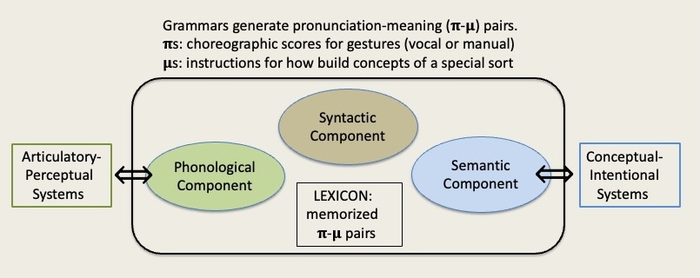
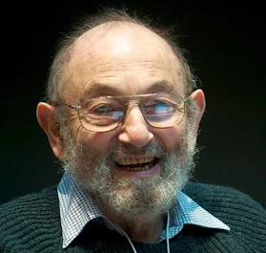

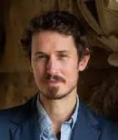
circle_{N}
𝛑: ˈsɜːkᵊl (a Phono-plan)
𝛍: fetch@A123 (a Begriff-plan)
A123:
circle_{Area:Percept}
circle_{Area:Abstract}
circle_{Curve:Percept}
circle_{Curve:Abstract}
It isn’t obvious what pronunciations are. But here’s an attractive internalist idea
pronunciations are like instructions that a choreographer can give to some dancers
the phonological properties of expressions are (biologically implementable) “choreographic scores” that can be executed via vocal tracts and produced in related ways
Maybe the meanings of human linguistic expressions are instructions of another kind
like recipes for making cakes/cocktails given a stock of available ingredients
maybe the semantic properties of expressions are (biologically implementable) instructions for how to access and assemble concepts in certain limited ways

Slide 22
window_{N}
𝛑: ˈwɪndəʊ (a Phono-plan)
𝛍: fetch@A2017 (a Begriff-plan)
A2017:
window_{Hole}
window_{Filler}
It isn’t obvious what pronunciations are. But here’s an attractive internalist idea
pronunciations are like instructions that a choreographer can give to some dancers
the phonological properties of expressions are (biologically implementable) “choreographic scores” that can be executed via vocal tracts and produced in related ways
Maybe the meanings of human linguistic expressions are instructions of another kind
like recipes for making cakes/cocktails given a stock of available ingredients
maybe the semantic properties of expressions are (biologically implementable) instructions for how to access and assemble concepts in certain limited ways

Slide 23
Cut the pie any way you like, ‘meanings’ just ain't in the head!
FALSE! Cutting the pie in a way that content externalists should cut it leads to internalism about the meanings that human languages connect with pronunciations. Putnam rightly noted that we shouldn’t combine two familiar theses.
(1) That knowing the meaning of a term is just a matter of being in a certain
psychological state (in the sense of ‘psychological state’ in which states of
memory and psychological dispositions are ‘psychological states’ … )
(2) That the meaning of a term (in the sense of ‘intensions’ ) determines its extension
(in the sense that sameness of intension entails sameness of extension).
I shall argue that these two assumptions are not jointly satisfied by any notion, let alone any notion of meaning. The traditional concept of meaning is a concept which rests on a false theory.
But thesis (2) is FALSE: it ignores polysemy. So don’t blame the internalist thesis (1).
We can and should be externalists about the content of any kind-concept, ^{K}meaning, that we employ in theorizing about linguistic meanings.
But as externalists, we should be prepared to find out that Mistakes Have Been Made about stars, planets, nebulae, quasars, whales, languages, and meanings.

Slide 24
Externalist Contents, Internalist Meanings
Paul M. Pietroski Rutgers University
tinyurl.com/pietroski
Slides available at

Slide 25
Homophony
bæŋk bare_{A} ←bεr→ bear_{V}
↙ ︎ ↘︎ ↓
bank_{N$} bank_{N▼} ︎ bear_{N}
one pronunciation,
two or more expressions,
each with its own meaning
--typically arbitrary: you/ewe, die/dye, no/know, so/sew
--linguistically accidental
cp. French seau/sceau/saut
Doesn’t Support Anaphora:
*The banks of the river were nicer than the ones we robbed.
Polysemy
bare_{A}, bear_{V}, bank_{N$}, triangle_{N}, window_{N}, ...
$BANK:INST ⤶ ⤷ $BANK:BLDG
one expression, whose meaning supports a
family of concepts/subsenses
--not arbitrary
--often common across languages
hold_{V}
Supports Anaphora in many cases:
The windows that we cut in the walls were nicer than the ones we installed.
book_{N}
BOOK:CONTENT ⤶ ⤷ BOOK:CONTAINER
my hand, the door, a title, your temper, my calls, so much weight, an opinion,
a seminar, a ridge, a course (of due east)

Slide 26
Homophony
bæŋk bare_{A} ←bεr→ bear_{V}
↙ ︎ ↘︎ ↓
bank_{N$} bank_{N▼} ︎ bear_{N}
one pronunciation,
two or more expressions,
each with its own meaning
Polysemy
bare_{A}, bear_{V}, bank_{N$}, triangle_{N}, window_{N}, ...
$BANK:INST ⤶ ⤷ $BANK:BLDG
one expression, whose meaning supports a
family of concepts/subsenses
book_{N}
BOOK:CONTENT ⤶ ⤷ BOOK:CONTAINER
If you wonder how words could be(come) polysemous, think about lexical acquisition.
Kids are pretty good at connecting words with concepts in ways that support communication;
see, e.g., Gleitman and Trueswell.
But if kids adopted a “One Word, One Concept” policy,
homophony would be way more rampant than it is.
Polysemy looks like a by-product of treating homophony as a last resort strategy, with paradigm cases of polysemy (‘book’, ‘window’, ‘circle’) involving concepts that “dovetail.”
And if kids allow for polysemy to limit homophony, conceptual equivocality will become normal.

Slide 27
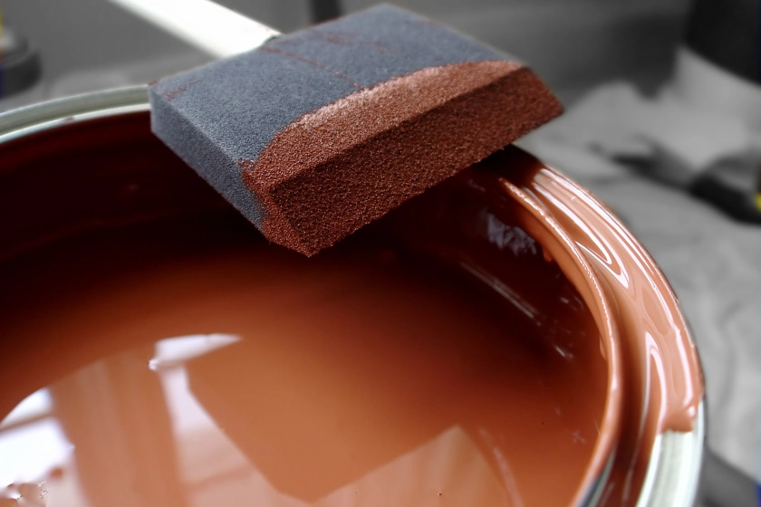

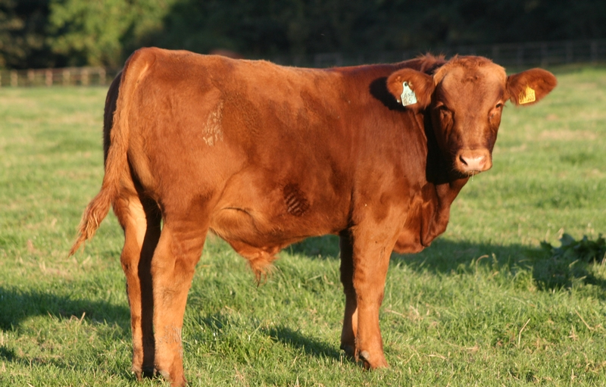
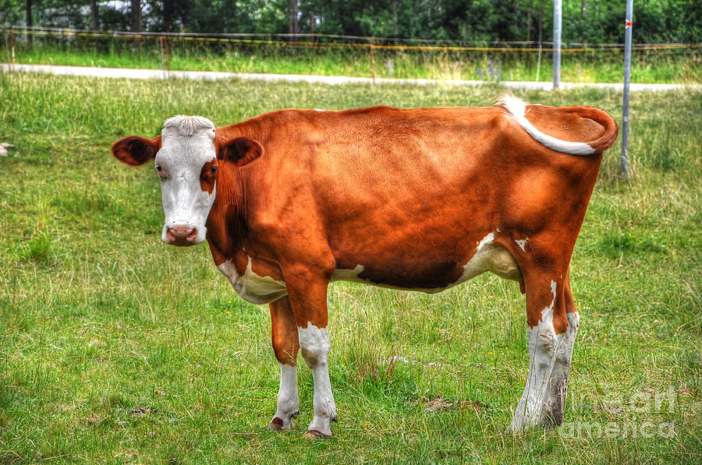



The paint is brown
The house is brown
The cow is brown
I used my
red pen to
mark the exam
red pen: a pen that...
--is red on the outside
--contains red ink

Slide 28
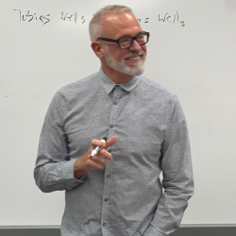
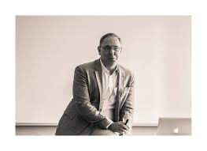

Jeff utters, fully sincerely,
‘I want the blue pen’.
Michael utters, fully sincerely,
‘I want the red pen’.
They each know the facts about the pens.
But it turns out that they want the same pen.
You know this, though you don’t know which pen they both want.
You know that
either Jeff wants to write in blue and Michael wants the red exterior,
or Jeff wants the blue exterior and Michael wants to write in red.
The one on the left has red ink.
The one on the right has blue ink.
Do ‘red pen’
and ‘blue pen’
have extensions?
Do ‘red’ and ‘blue have extensions?
(1) Jeff said ‘I want the blue pen’, and Michael said ‘I want the red pen’. 👍
(2) Jeff wants the blue pen and Michael wants the red one. 👎
(3) Michael wants the red pen and Jeff wants the blue one. 👎
(4) Either they both want the blue pen, or they both want the red one. 👍
(But note: a speaker can endorse this last description of the situation,
regardless of which pen the speaker takes to be the blue one.)

Slide 29
Jeff utters, fully sincerely,
‘I want the blue pen’.
Michael utters, fully sincerely,
‘I want the red pen’.
They each know the facts about the pens.
But it turns out that they want the same pen.
You know this, though you don’t know which pen they both want.
You know that
either Jeff wants to write in blue and Michael wants the red exterior,
or Jeff wants the blue exterior and Michael wants to write in red.
The one on the left has red ink.
The one on the right has blue ink.
The window he cut in the wall was nicer than the one he installed.
The window he installed was nicer than the one he cut in the wall.
The window that Click liked was nicer than the one that Clack liked.
Note: a speaker can endorse this description of the situation without
knowing whether Click preferred the hole or the filler.
The speaker might trust Click on such matters; see Pietroski (forthcoming).

Slide 30
James Atlas on Global Warming (NY Times: Nov 25, 2012), cp. Chomsky (1995)
…a good chance that New York City will sink beneath the sea…
but the city could move to another island, the way Torcello was moved to Venice, stone by stone,
after the lagoon turned into a swamp and its citizens succumbed to a plague of malaria.
The city managed to survive, if not where it had begun.”
Venice_{N}
VENICE:POLIS ⤶ ⤷ VENICE:PLACE
Torcello was moved to Venice.
Venice was a better place.
Venice will soon be underwater.
Torcello was moved to a place that will soon be underwater.
inference
seems valid
Torcello was moved to Venice.
Venice was a better place.
Venice will have to be moved.
Torcello was moved to a place that will have to be moved.
inference
seems invalid
Notes:
FIRST SLIDE

Slide 31
Propositions get asked to do a lot of work
values of the variables in a propositional calculus
truth-evaluable things that exhibit logical relations
"objects" of propositional attitudes like believing (endorsing, holding-true)
"contents" of corresponding attitude states, at least relative to contexts
such that the meanings of sentences determine mappings from contexts to them
and maybe still more jobs related to modality (metaphysical and/or epistemic)
But whatever we think about propositions, we can be externalists about the contents of kind concepts—including ^{K}brain and ^{K}pain—while still thinking that (as it turns out) brains and pains are located in heads, even if ^{K}water doesn’t apply to any stuff on Twin Earth.
Likewise, one can say that ^{K}meaning applies to the meanings of ‘water’ and ‘water from a well’, and that these linguistic expressions could be used to talk about stuff on Twin Earth.
There are no good reasons for thinking that ^{K}water is the only concept we can express with ‘water’, or that ‘meaning’ cannot be used to express a kind concept. Words are polysemous.
Externalists can’t just assume that ^{K}meaning applies to meanings that determine extensions.
___________________________________________________________________________________ ___________________________________________________________________________________

Slide 32
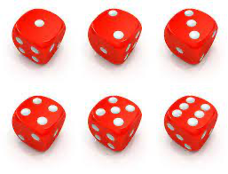

One die came up two. Call it ‘Deuce’.
One die came up one. Call it ‘Ace’.
One die landed on the left.
One die landed on the right.
Call it ‘Louie’.
Call it ‘Ralph’.
⇑
One Possibility
: Louie is Ace
Another Possibility
: Louie is Deuce
Louie
Ralph
Louie
Ralph
Ace
Deuce
A simple universe
Deuce
Ace

