Slide 1
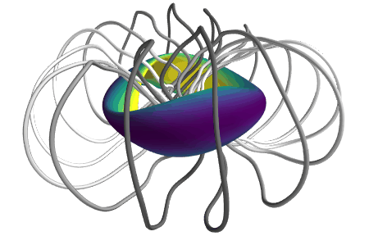
Inverse magnetostatics
& its application to stellarator optimization
Matt Landreman¹, Alan Kaptanoglu², John Kappel¹, Gabriel Langlois², Dhairya Malhotra³
1. University of Maryland 2. NYU Courant 3. Flatiron Institute
Notes:
https://www.youtube.com/watch?v=CJ_OBoEs3uU

Slide 2
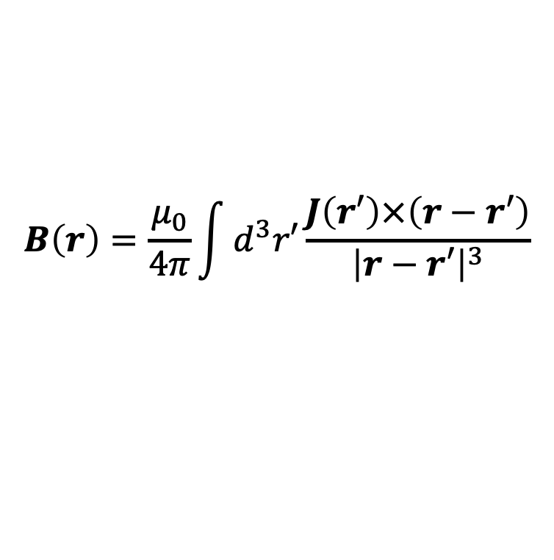
Inverse magnetostatics:
We want a certain magnetic field B in a region Ω.
Find an arrangement of electric currents outside Ω that produce B.
$$B\left(r\right)=\frac{μ_{0}}{4π}\int{d^{3}r′}\frac{J\left(r′\right)×\left(r−r′\right)}{{\left|r−r′\right|}^{3}}$$
I.e., invert the Biot-Savart Law
Notes:
https://media.cnn.com/api/v1/images/stellar/prod/220705075914-01-large-hadron-collider-file.jpg?c=original
https://www.lhc-closer.es/webapp/files/1435504063_7a5913ddba2ffceaacc3026f44c4b624.jpg

Slide 3
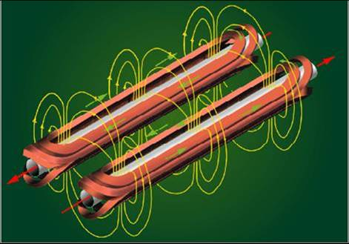
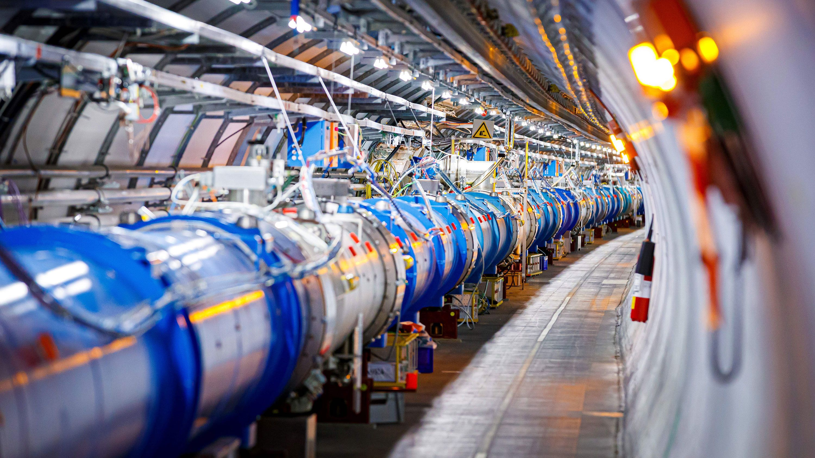
Inverse magnetostatics:
We want a certain magnetic field B in a region Ω.
Find an arrangement of electric currents outside Ω that produce B.
Example: Particle accelerators
Notes:
https://media.cnn.com/api/v1/images/stellar/prod/220705075914-01-large-hadron-collider-file.jpg?c=original
https://www.lhc-closer.es/webapp/files/1435504063_7a5913ddba2ffceaacc3026f44c4b624.jpg

Slide 4
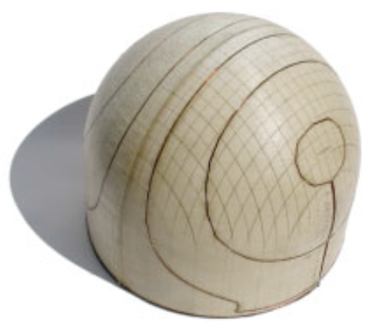
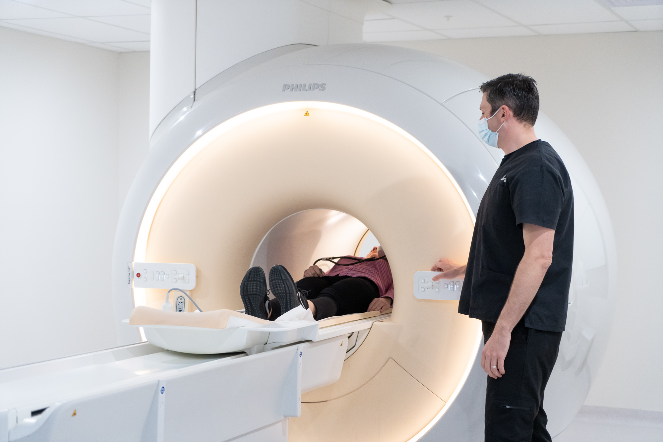
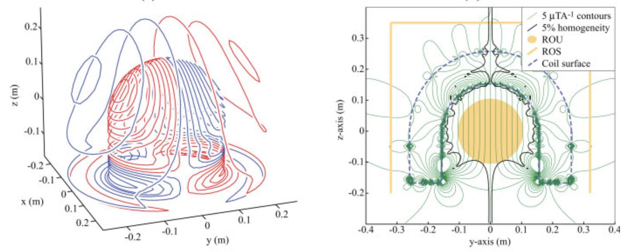
Inverse magnetostatics:
We want a certain magnetic field B in a region Ω.
Find an arrangement of electric currents outside Ω that produce B.
Example: Magnetic resonance imaging
Poole & Bowtell (2007)
Notes:
https://www.directradiology.com.au/media/jl3df5fy/capitol-radiology-76.jpg

Slide 5
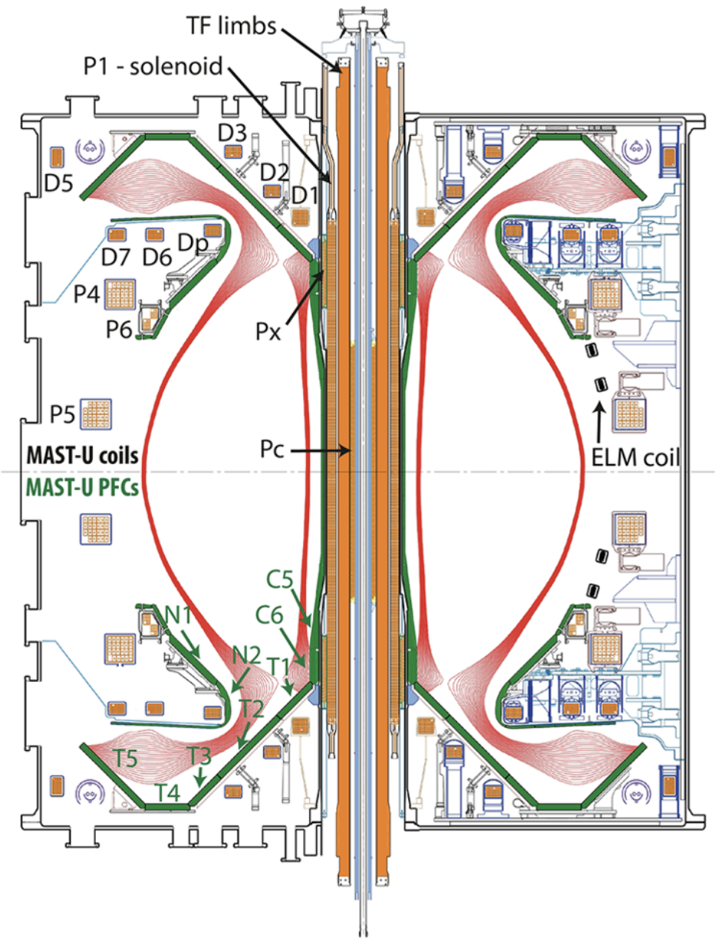
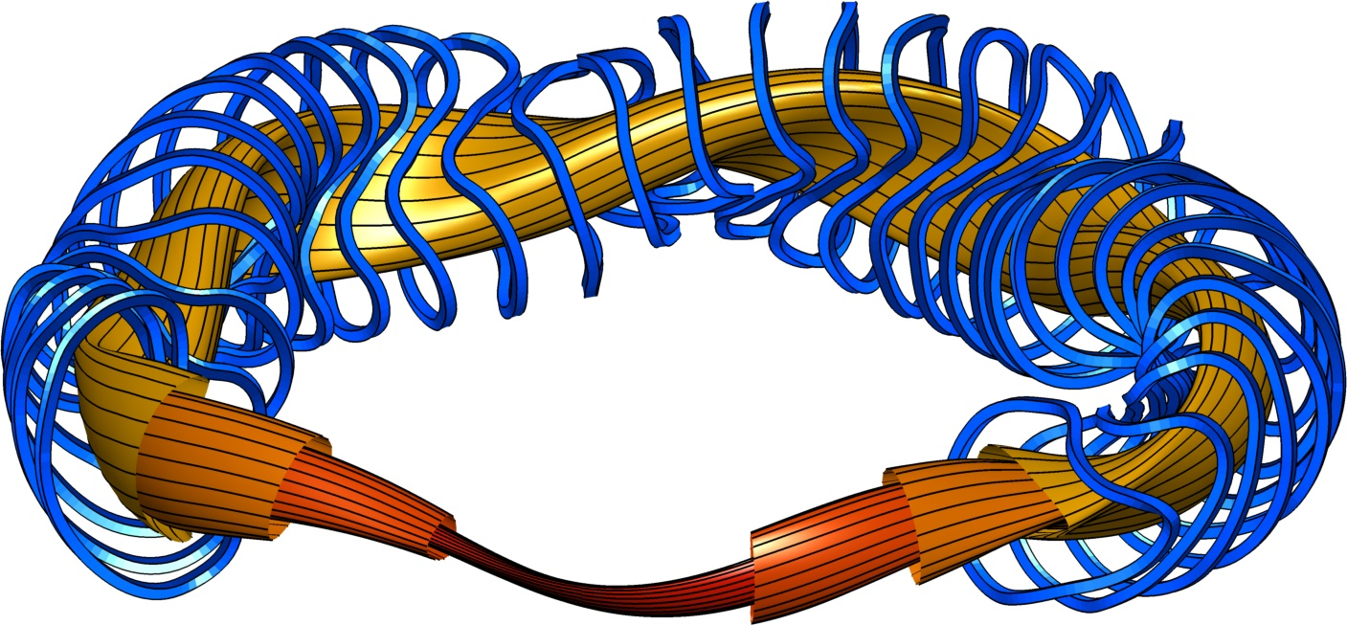
Inverse magnetostatics:
We want a certain magnetic field B in a region Ω.
Find an arrangement of electric currents outside Ω that produce B.
Example: Magnetic confinement fusion
Electromagnetic coils
Tokamak→
Stellarator
Plasma
Magnetic field lines
Notes:
https://www.epj-conferences.org/articles/epjconf/pdf/2020/22/epjconf_lnes2020_00013.pdf
https://www.researchgate.net/profile/Gary-Taylor-4/publication/280601072/figure/fig4/AS:284555547299848@1444854737441/Free-boundary-vacuum-calculations-of-some-of-the-achievable-plasma-configurations-in-MAST.png

Slide 6
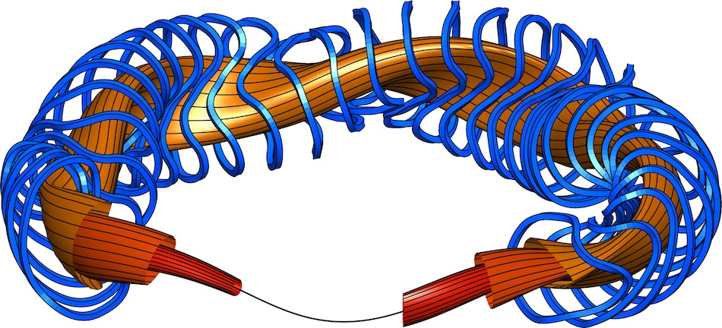
Outline
Background & previous approaches
Current voxels: topology optimization for electromagnets
A A Kaptanoglu, G P Langlois, & ML, Comp Meth Appl Mech Engr (2023)
Bounding the distance to the coils
J Kappel, ML, & D Malhotra, arXiv:2309.11342 (2023)

Slide 7
Outline
Background & previous approaches
Current voxels: topology optimization for electromagnets
A A Kaptanoglu, G P Langlois, & ML, Comp Meth Appl Mech Engr (2023)
Bounding the distance to the coils
J Kappel, ML, & D Malhotra, arXiv:2309.11342 (2023)

Slide 8
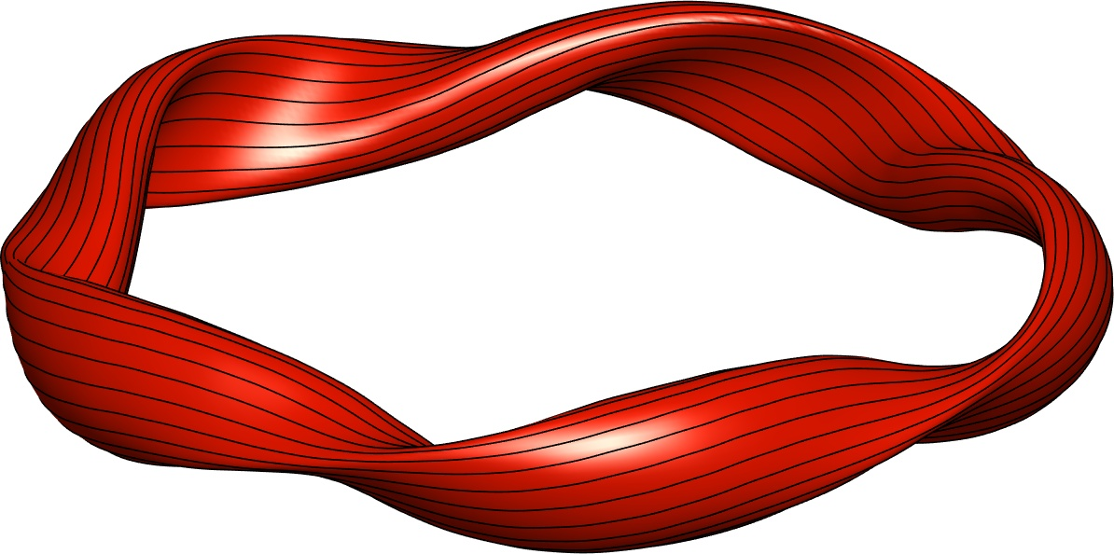
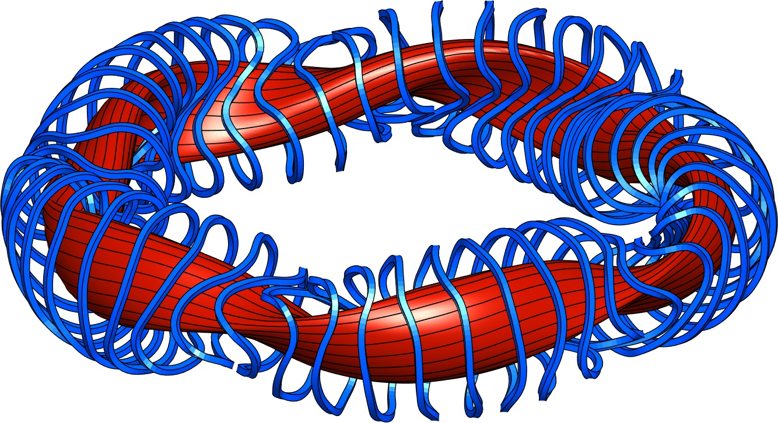
Most transport-optimized stellarators have used 2 sequential optimization stages
Parameters = shape of boundary toroidal surface. Objective = physics (confinement, stability, etc.)
Parameters = coil shapes. Objective = error in B on boundary shape from stage 1.
Shape of a toroidal boundary surface (+ pressure & current vs r inside, & total B flux) determines B everywhere inside:
Notes:
m20200814_01_W7XIllustrationWithCoils

Slide 9
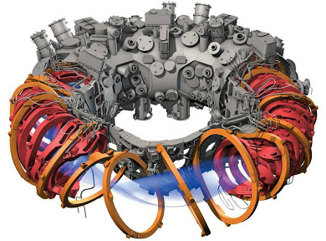
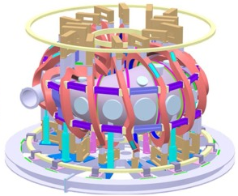
Most transport-optimized stellarators have used 2 sequential optimization stages
Parameters = shape of boundary toroidal surface. Objective = physics (confinement, stability, etc.)
Parameters = coil shapes. Objective = error in B on boundary shape from stage 1.
W7-X (Germany)
CFQS (China), under construction
Notes:
m20200814_01_W7XIllustrationWithCoils

Slide 10
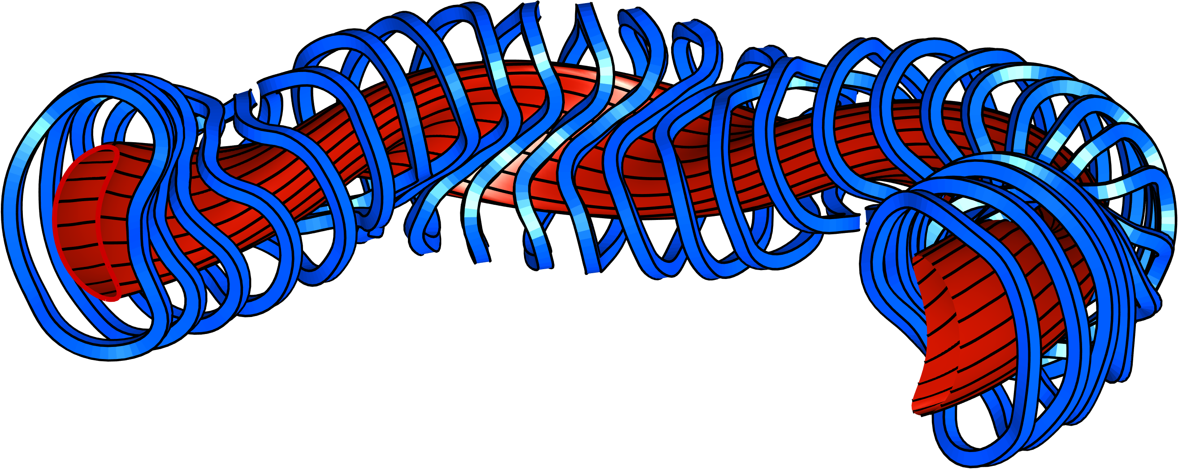
Calculating the currents that produce a given B is an ill-posed inverse problem: solution is not unique.
Actually a good thing:
There is a lot of freedom in coil design
Some kind of regularization is needed to exclude solutions like this:
Notes:
Figure created using m20160506_01_W7X_illustrationForBDISTRIBTalk.m

Slide 11
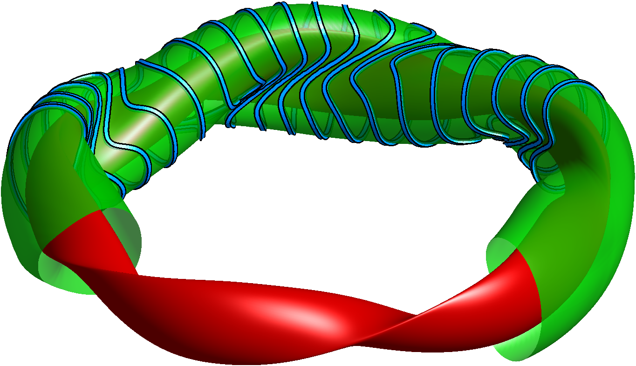



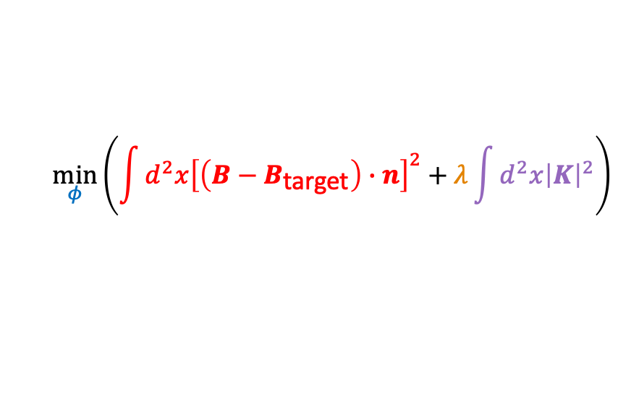
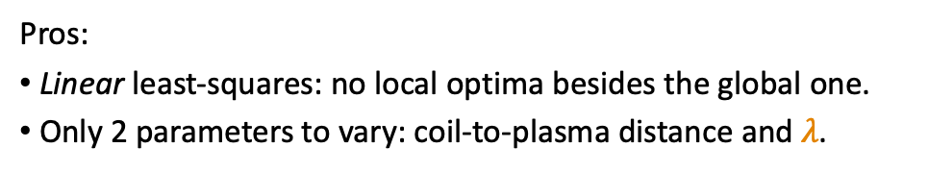
Current potential methods: REGCOIL
Regcoil: Consider sheet current on a “coil winding surface”
ML, Nuclear Fusion (2017).
$$K=n×∇φ$$
Surface current
“current potential”
Normal to winding surface
$$\min_{φ}\left(\int{{d^{2}x\left[\left(B−B_{\text{target}}\right)∙n\right]}^{2}}+λ\int{d^{2}x{\left|K\right|}^{2}}\right)$$
Plasma
surface
Coil
surface
B field error
Coil complexity
Regularization parameter
$φ$ contours = coils
$K=\left|K\right|∝1/$distance between coils
Pros:
Linear least-squares: no local optima besides the global one.
Only 2 parameters to vary: coil-to-plasma distance and $λ$.
Cons:
Neglects ripple from discrete coils.
Limited flexibility in 3rd dimension.
Notes:
m20221031_01_plot_regcoil_coils_and_surfaces.png

Slide 12
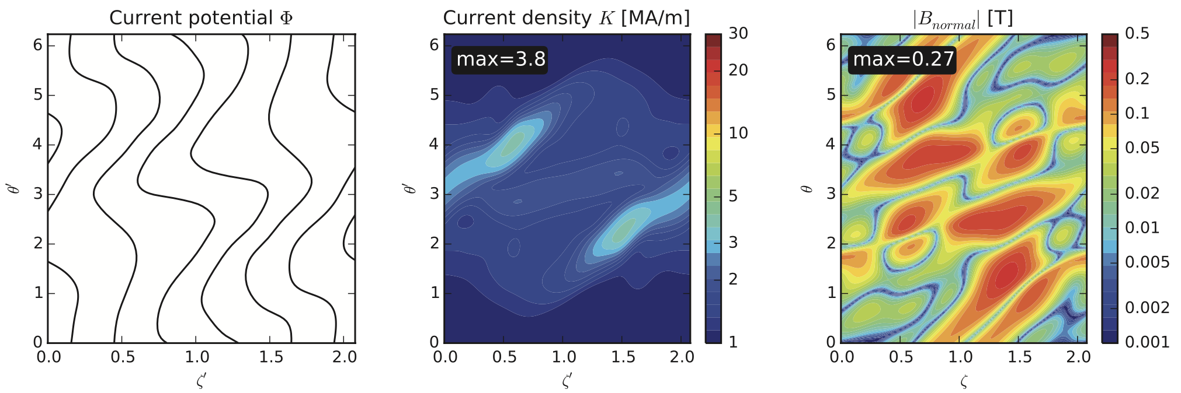
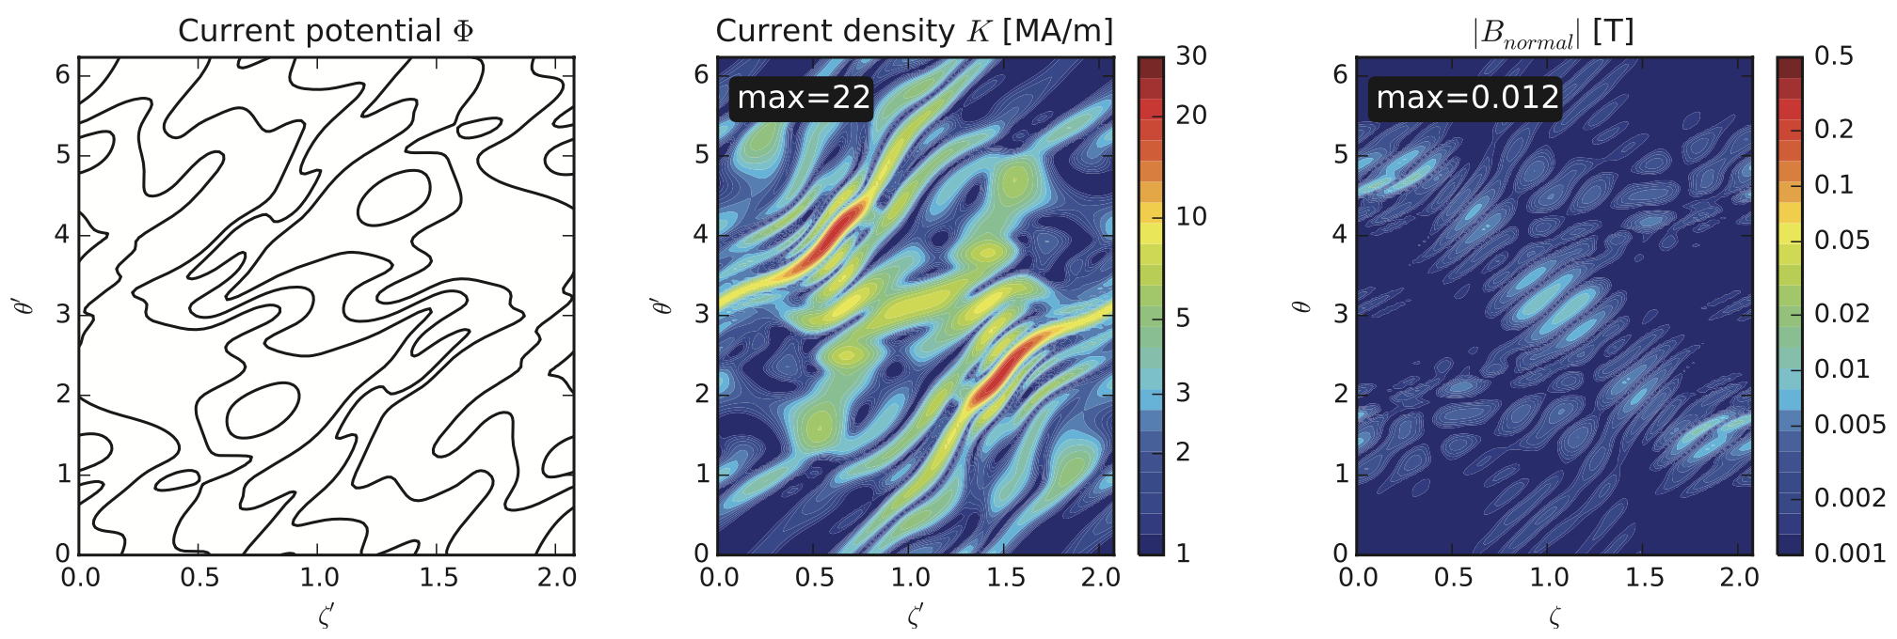
In stage-2 coil optimization, there is a trade-off between field accuracy and coil simplicity
High regularization λ:
Simpler coils
but large field error
Low regularization λ:
Complicated coils
but small field error

Slide 13
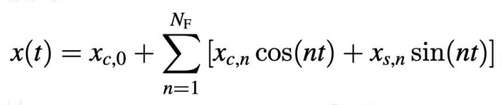
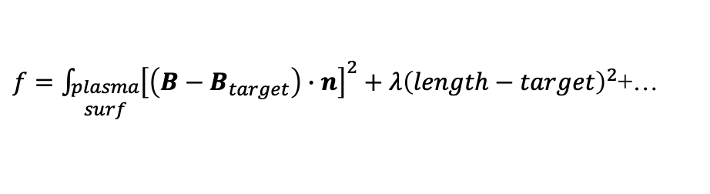
Filament coil optimization
Zhu, Hudson, et al, Nuclear Fusion (2018).
Coils represented as space curves.
Design variables: Fourier modes of Cartesian components.
Objective:
$f=\int_{\begin{aligned}plasma \\ surf\end{aligned}}{{\left[\left(B−B_{target}\right)∙n\right]}^{2}}+λ{\left(length−target\right)}^{2}$+…
Match target B
Regularization
Does account for B ripple from discreteness of coils.
Non-convex, so there are multiple local minima. May need good initial guess.

Slide 14
Outline
Background & previous approaches
Current voxels: topology optimization for electromagnets
A A Kaptanoglu, G P Langlois, & ML, Comp Meth Appl Mech Engr (2023)
Bounding the distance to the coils
J Kappel, ML, & D Malhotra, arXiv:2309.11342 (2023)

Slide 15
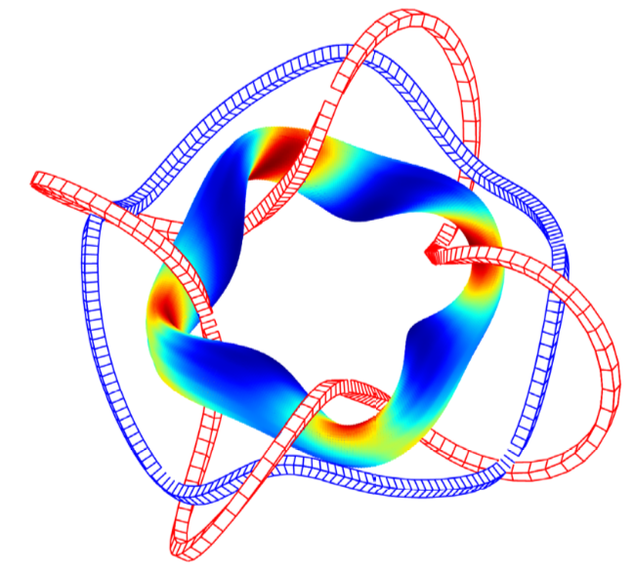
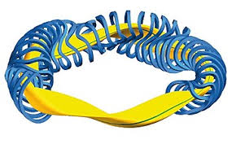
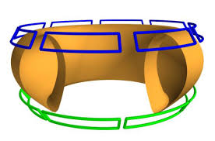
Current voxels: topology optimization for inverse magnetostatics
Kaptanoglu, Langlois, & ML, arXiv:2306.12555 (2023)
Coil topology is an output rather than input.
Generalize REGCOIL to lift restriction that currents lie on specified surface.
Preserve REGCOIL advantages of linearity/convexity as far as possible.
Yamaguchi (2019)

Slide 16
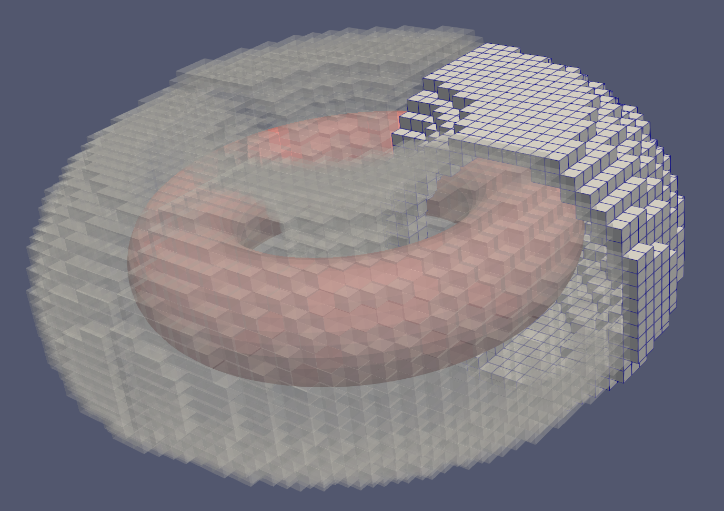
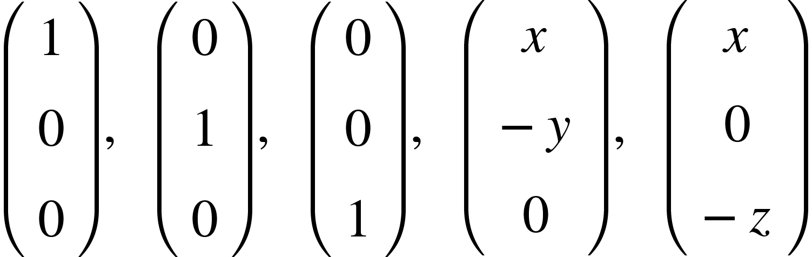
New topology optimization method for electromagnetic coils
Pre-define grid of voxels where current might flow.
Current density J in each voxel represented by basis of 5 divergence-free functions. Amplitudes are the design variables.
Charge conservation at each cell face gives linear equality constraints.
Alternative:
Design variables are the fluxes through faces. Linear constraints enforce 0 net flux in each volume.

Slide 17
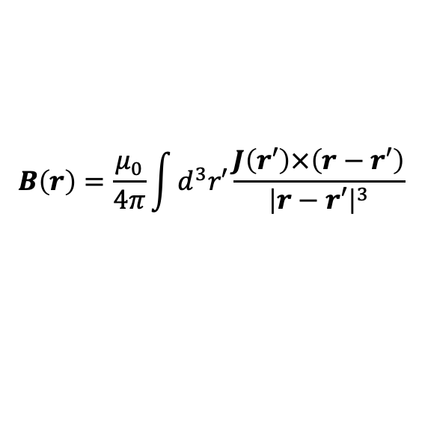
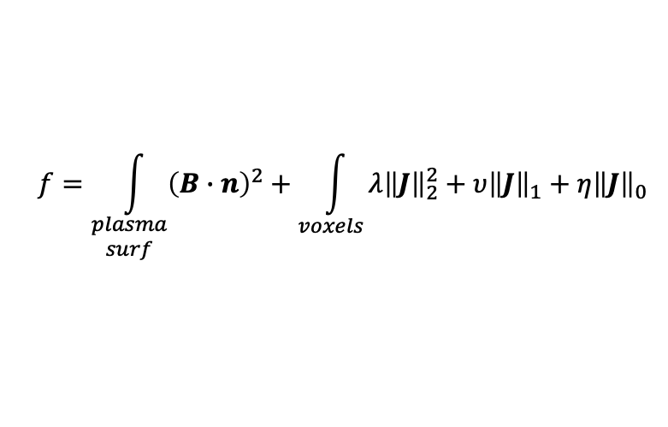
New topology optimization method for electromagnetic coils
Given basis functions, B can be computed by Biot-Savart Law:
$$B\left(r\right)=\frac{μ_{0}}{4π}\int{d^{3}r′}\frac{J\left(r′\right)×\left(r−r′\right)}{{\left|r−r′\right|}^{3}}$$
Minimize objective:
$$f=\int_{\begin{aligned}plasma \\ surf\end{aligned}}{{\left(B∙n\right)}^{2}}+\int_{voxels}{λ{\left\|J\right\|}_{2}^{2}}+υ{\left\|J\right\|}_{1}+η{\left\|J\right\|}_{0}$$
Match target B
Regularization
Without sparsity-promoting terms, problem is linear.
With ℓ₁ sparsity, problem remains convex.
With ℓ₀ sparsity, good algorithms exist.

Slide 18
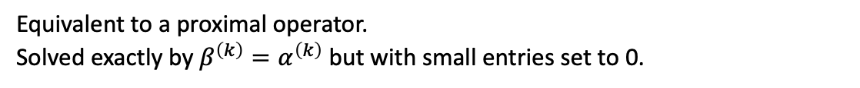
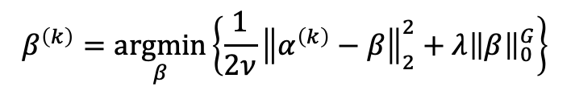
The ℓ₀-regularized problem is solved using the “relax & split” method
Original problem:
$\min_{α}\left[\frac{1}{2}{\left\|Aα−b\right\|}_{2}^{2}+λ{\left\|α\right\|}_{0}^{G}\right]$ s.t. $Cα=0$.
Relaxed problem:
$\min_{β}\left\{\min_{α}\left[\frac{1}{2}{\left\|Aα−b\right\|}_{2}^{2}+\frac{1}{2ν}{\left\|α−β\right\|}_{2}^{2}\right]+λ{\left\|β\right\|}_{0}^{G}\right\}$ s.t. $Cα=0$.
$α^{\left(k\right)}=\underset{α}{argmin}\left[\frac{1}{2}{\left\|Aα−b\right\|}_{2}^{2}+\frac{1}{2ν}{\left\|α−β^{\left(k−1\right)}\right\|}_{2}^{2}\right]$ s.t. $Cα=0$.
Iterate:
Linear least-squares with linear constraints.
Solved with MINRES + approximate Schur complement preconditioner.
$$β^{\left(k\right)}=\underset{β}{argmin}\left\{\frac{1}{2ν}{\left\|α^{\left(k\right)}−β\right\|}_{2}^{2}+λ{\left\|β\right\|}_{0}^{G}\right\}$$
Equivalent to a proximal operator.
Solved exactly by $β^{\left(k\right)}=α^{\left(k\right)}$ but with small entries set to 0.
Zheng, Askham, Brunton, Kutz, Aravkin, IEEE Access (2019), Champion, Zheng, Aravkin, Brunton, Kutz, IEEE Access (2020)

Slide 19
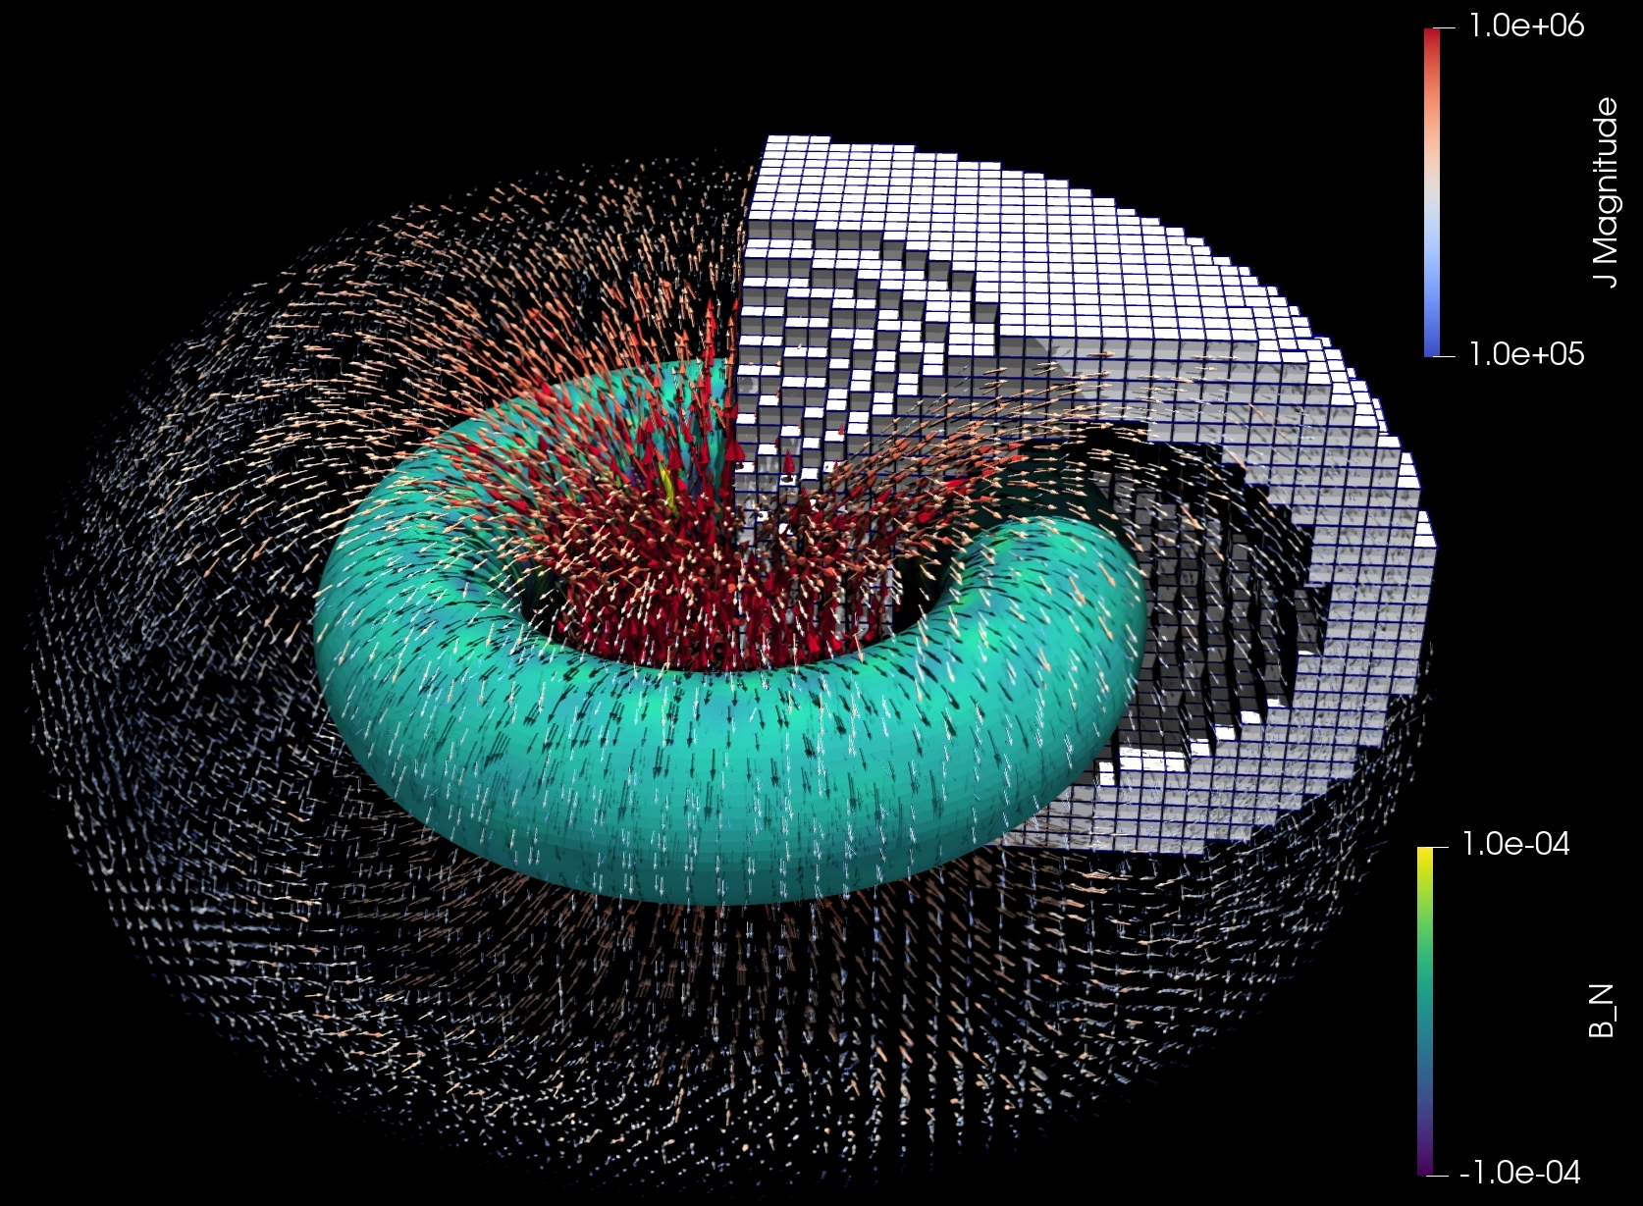
In axisymmetry, without sparsity terms, expected currents are recovered
Notes:
Image in an email from Alan on Sept 23, 2023, titled “current voxels picture”

Slide 20
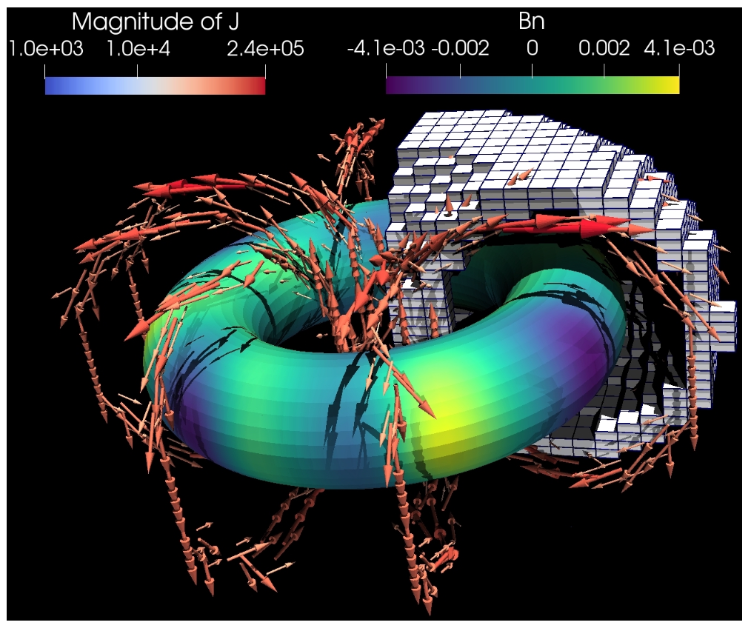
With sparsity objective included, currents coalesce into discrete coils

Slide 21
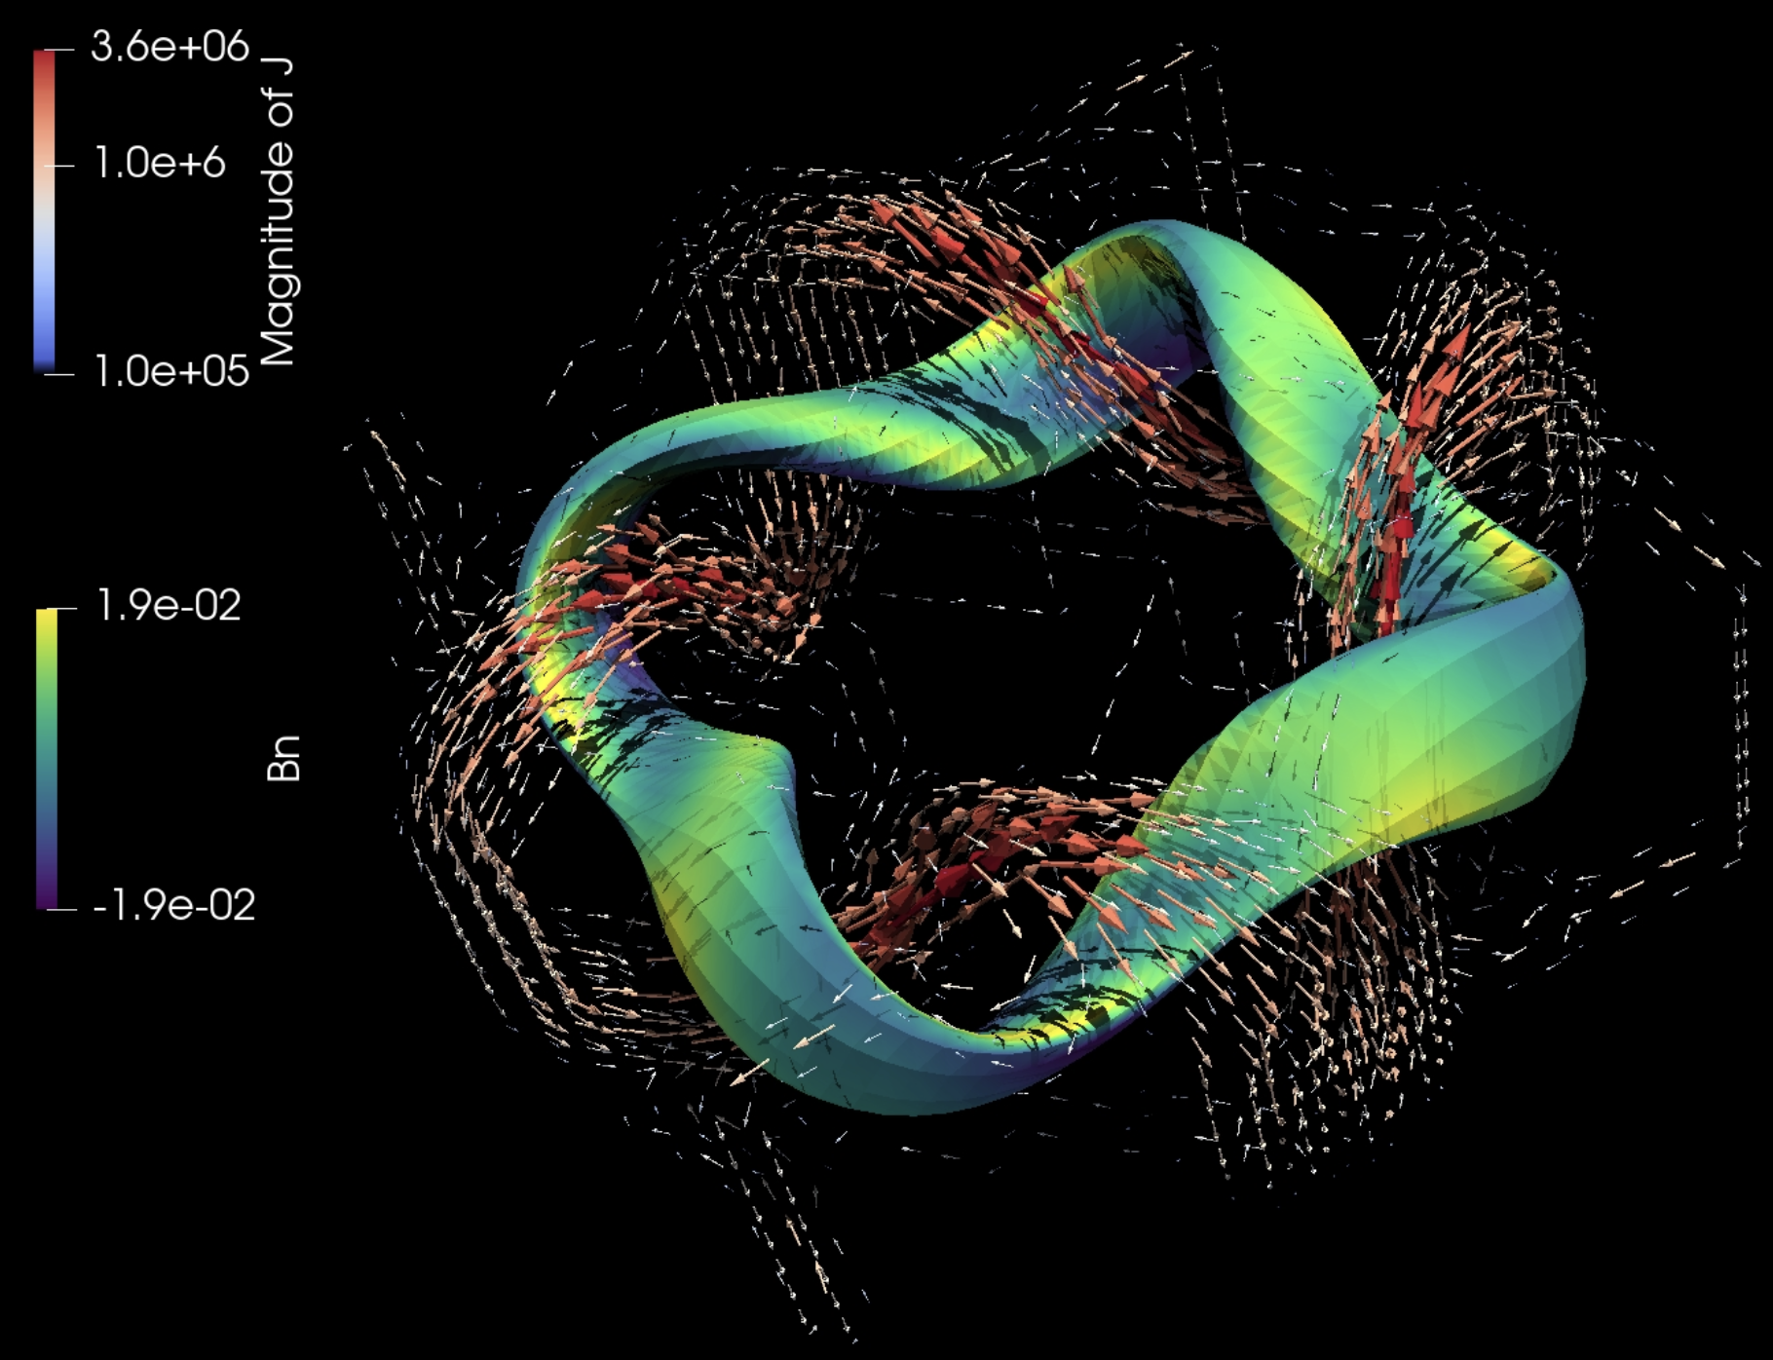
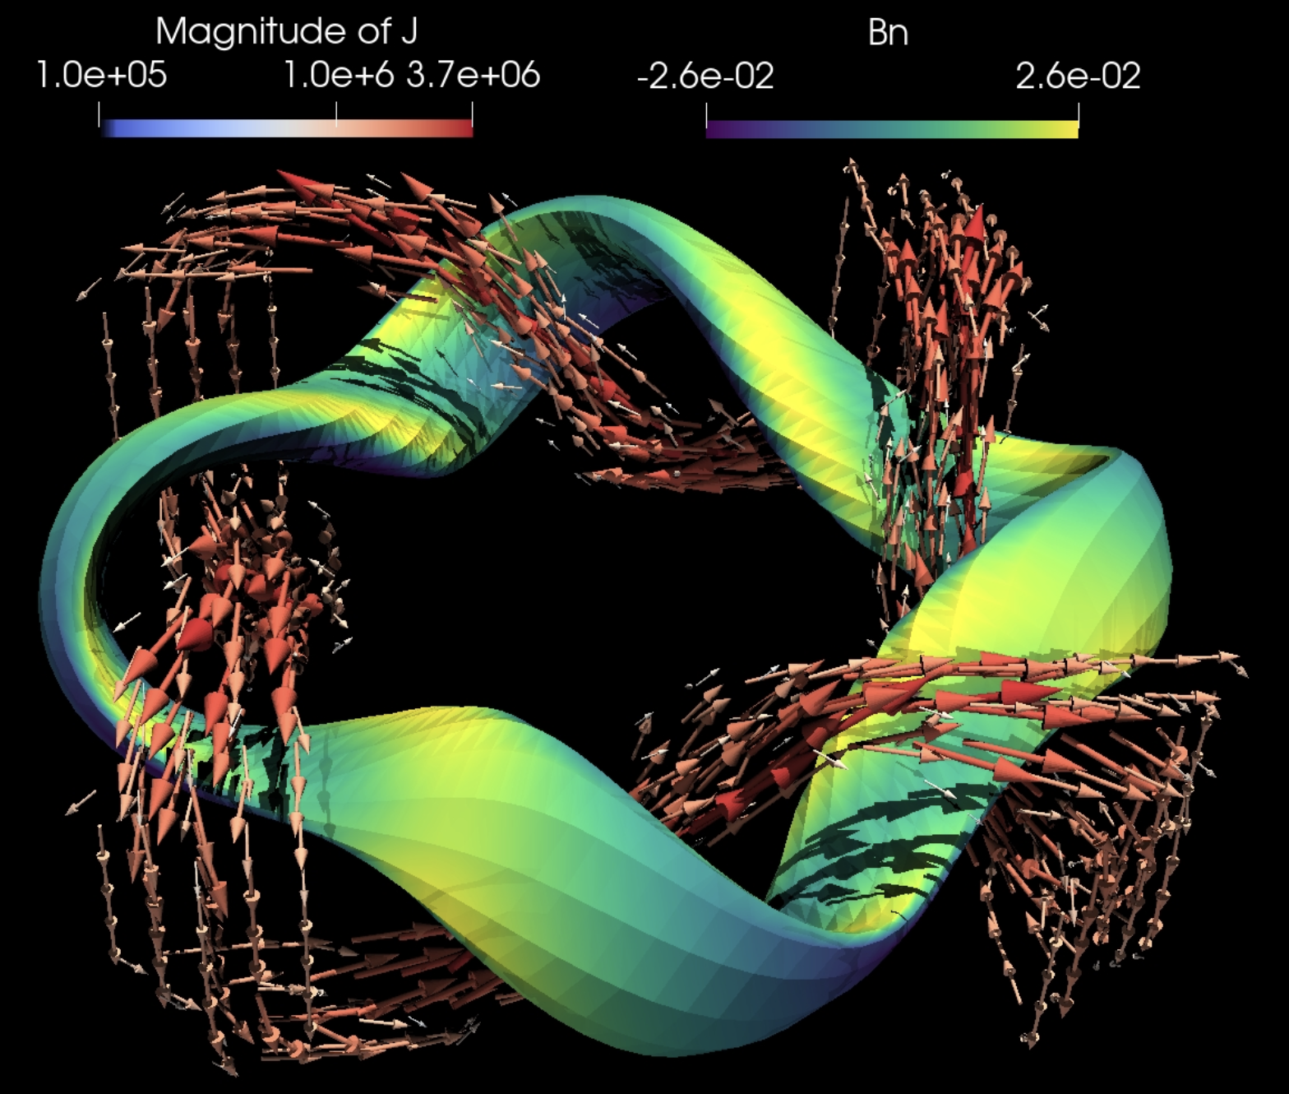
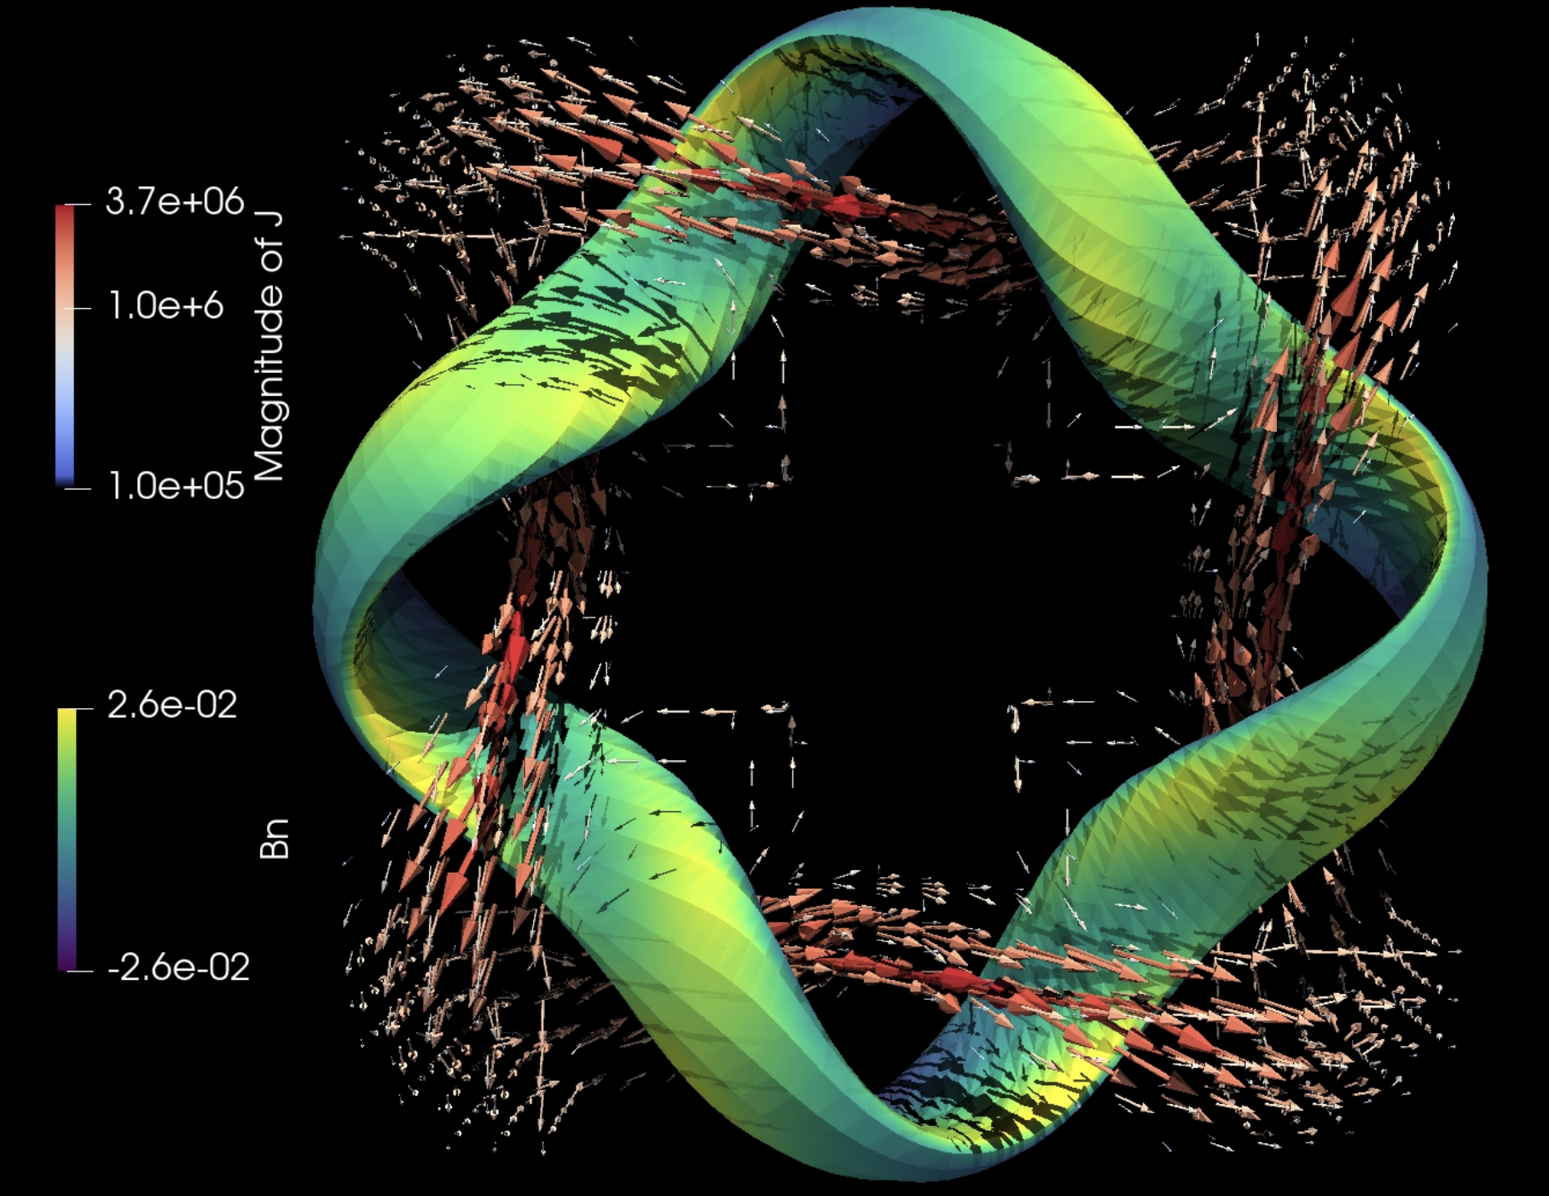
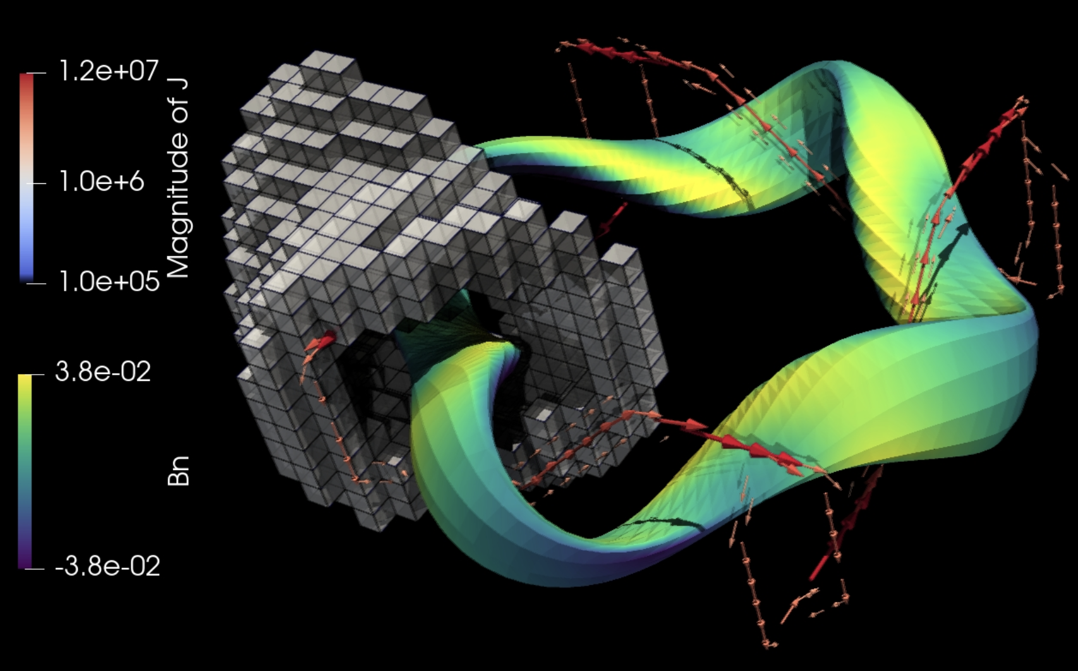
Larger l0 coefficient

Slide 22
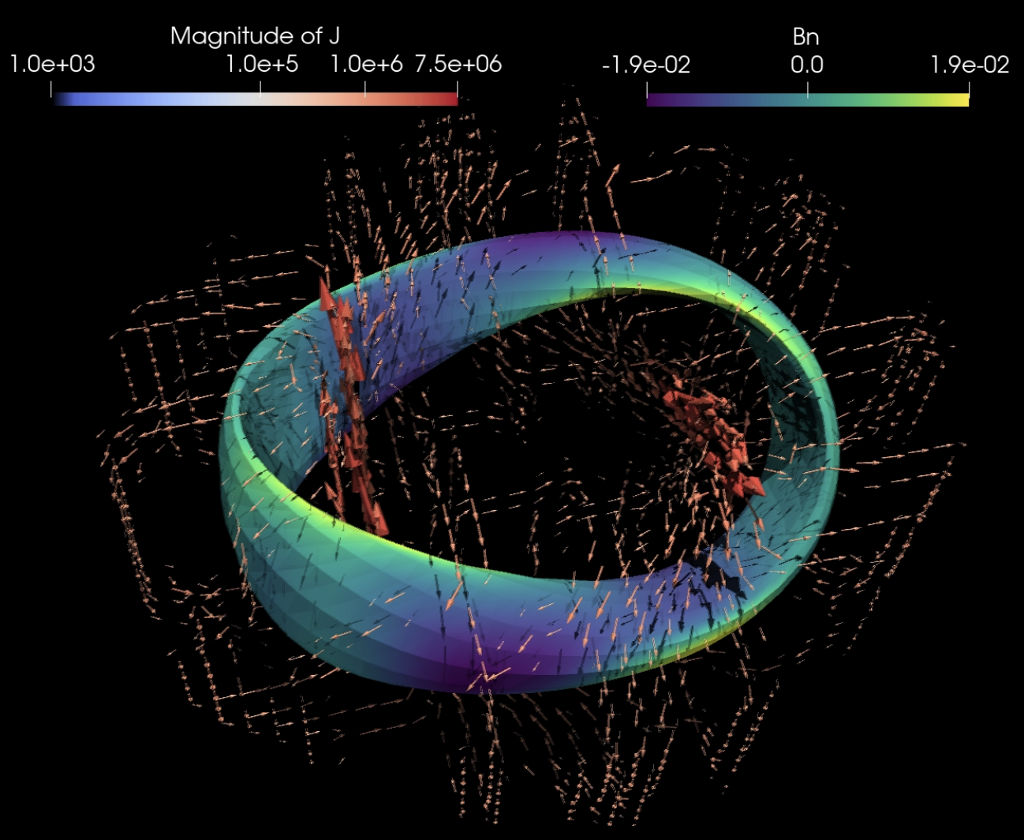
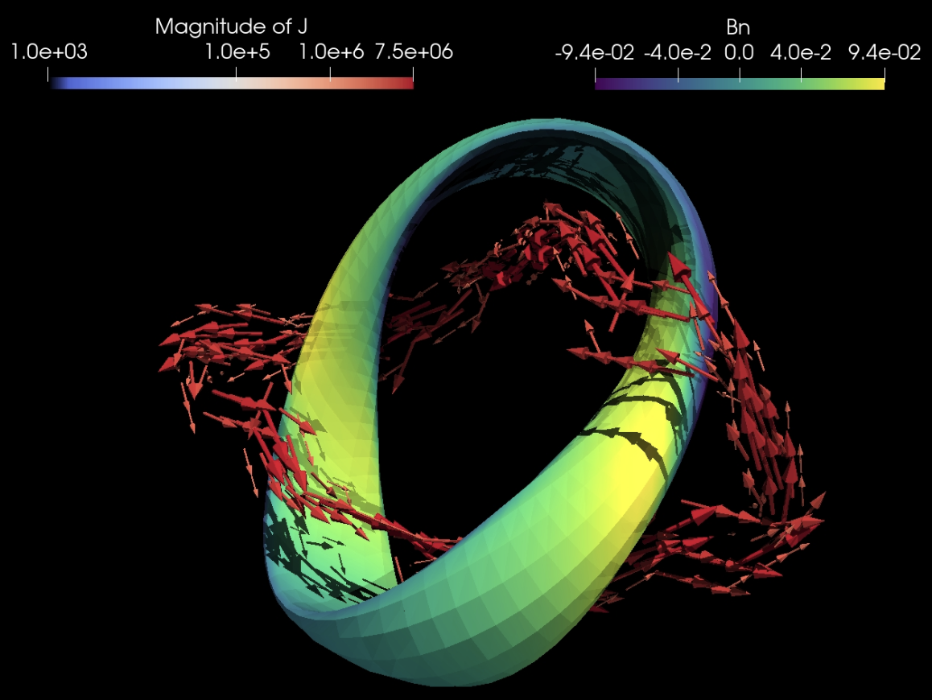
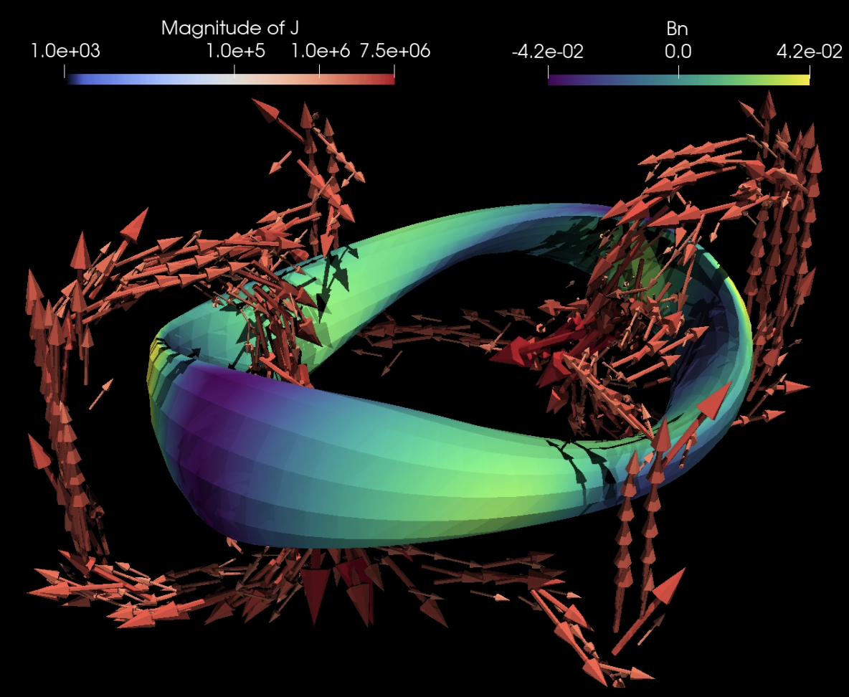
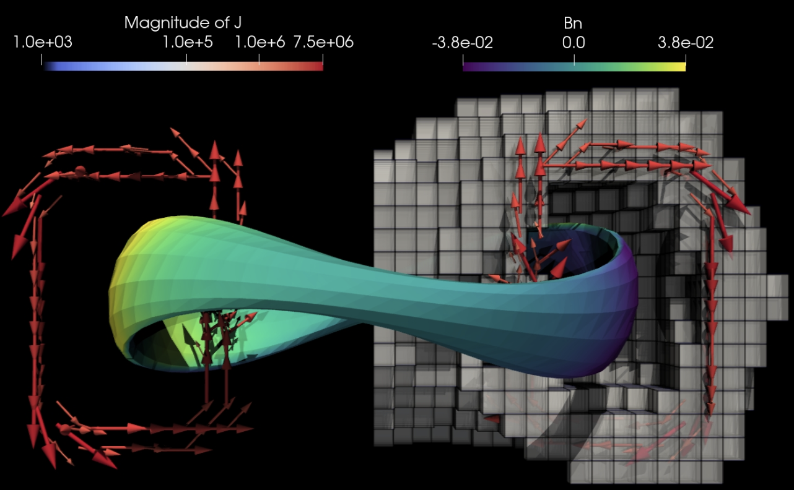
Larger l0 coefficient
The new current voxel for inverse magnetostatics enables topologically unconstrained 3D solutions with quadratic, convex, or structured objectives.

Slide 23
Outline
Background & previous approaches
Current voxels: topology optimization for electromagnets
A A Kaptanoglu, G P Langlois, & ML, Comp Meth Appl Mech Engr (2023)
Bounding the distance to the coils
J Kappel, ML, & D Malhotra, arXiv:2309.11342 (2023)

Slide 24
How far away can the magnets be?
Notes:
Figure created using m20160506_01_W7X_illustrationForBDISTRIBTalk.m

Slide 25
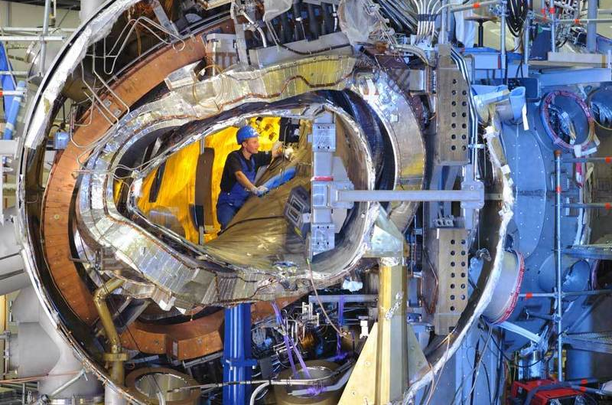
The small coil-to-plasma separation in stellarators is a headache for engineering
W7-X
“Lesson 1: A lack of generous margins, clearances and reasonable tolerance levels implies an unnecessary increase of the complexity and leads to late design changes. This has a strong impact on schedule, budget, man-power and potentially sours the relationship to funding bodies.”
Klinger et al, Fusion Engineering & Design (2013)

Slide 26
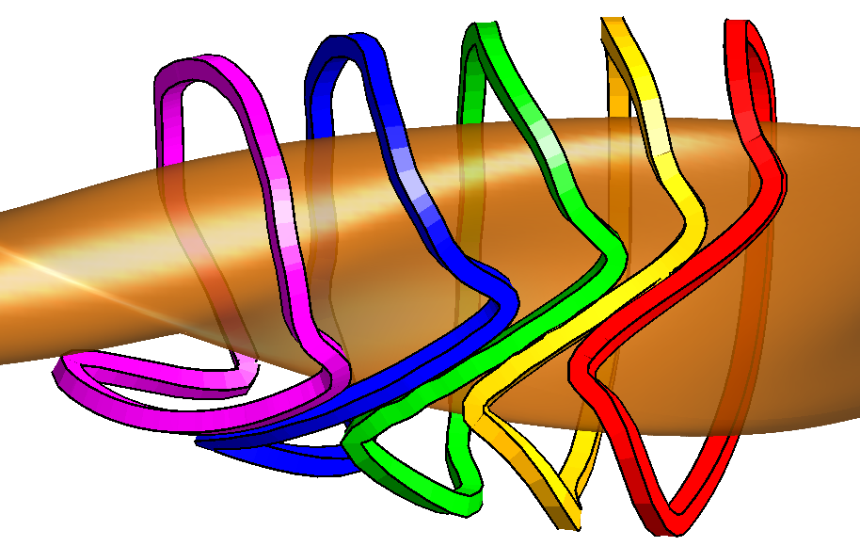
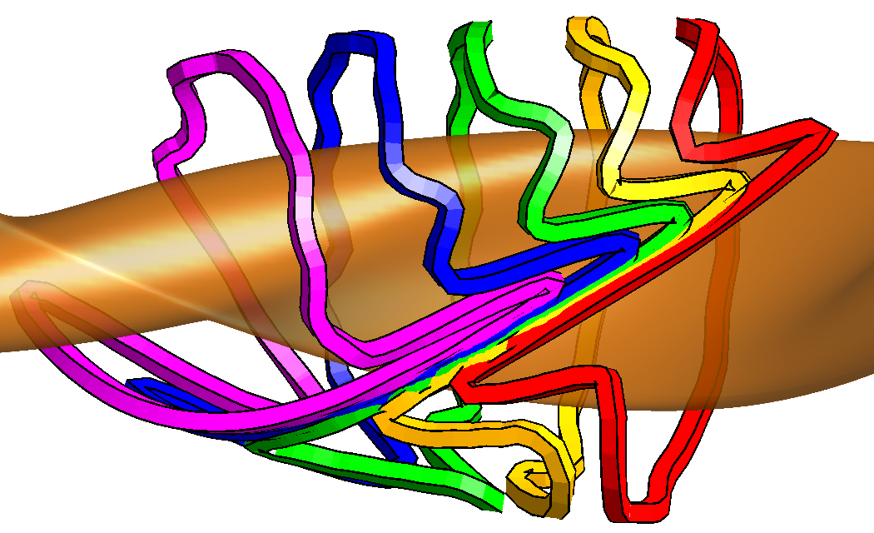
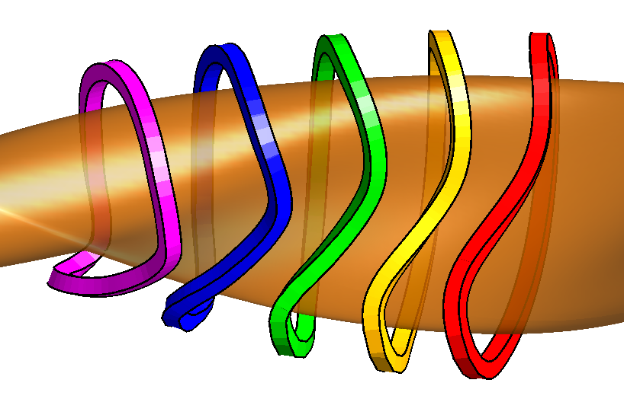
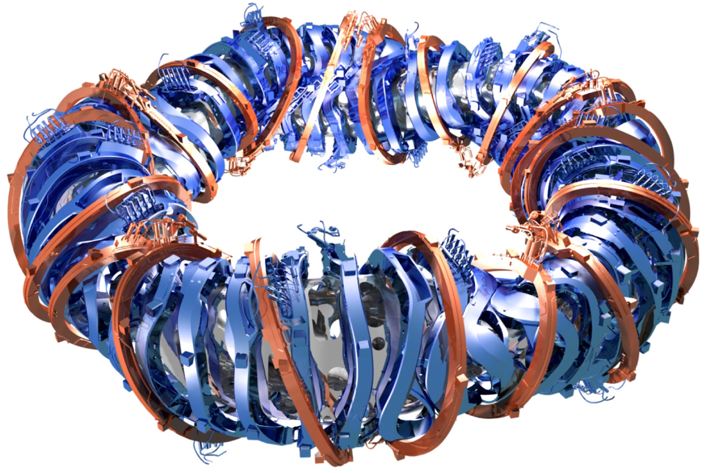
In a reactor, must fit ~ 1.5m “blanket” between plasma and coils to absorb neutrons
But at fixed plasma shape & size, coils shapes become impractical if they are too far away:
Coils offset a uniform distance from W7-X plasma:
25cm separation
50cm separation
65cm separation
So we must scale everything up:
$$$
$$$
Najmabadi et al (2008),
Lion et al (2021)
Notes:
m20160512_01_nescoutTo3DCoil.m
NESCOIL runs on nersc in 20160512-01-IllustrationOfCoilComplexityIncreasingWithSeparation

Slide 27
In a reactor, must fit ~ 1.5m “blanket” between plasma and coils to absorb neutrons
But at fixed plasma shape & size, coils shapes become impractical if they are too far away:
Coils offset a uniform distance from W7-X plasma:
25cm separation
50cm separation
65cm separation
Hypothesis:
The coil-to-plasma distance scale for which coils are feasible is ~ the 𝛁B scale length
Notes:
m20160512_01_nescoutTo3DCoils.m
NESCOIL runs on nersc in 20160512-01-IllustrationOfCoilComplexityIncreasingWithSeparation

Slide 28
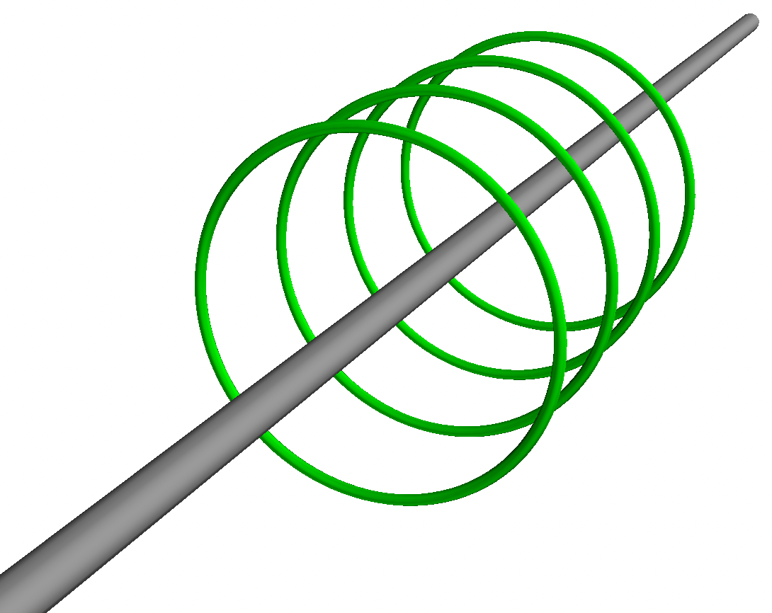
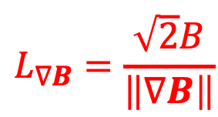


At any point, a magnetic field has multiple gradient length scales
$∇B$, $∇_{||}B$, $∇_{⊥}B$, $b∙∇b$, $\left\|∇B\right\|=\sqrt{∇B:∇B}$, eigenvalues of $∇B$, $\left\|∇∇B\right\|$…
($B=\left|B\right|$, $b=B/B$)
Frobenius norm
$\left\|∇B\right\|$ smoothly captures largest gradient ⟹ shortest length scale
B
Normalize so scale length gives the distance to an infinite straight wire:
$$L_{∇B}=\frac{\sqrt{2}B}{\left\|∇B\right\|}$$
$$L_{∇B}=R$$
I
Notes:
E.g. pick the z direction along B, and pick the x direction along grad_perp |B|. Then Phi_{yz} = 0.

Slide 29
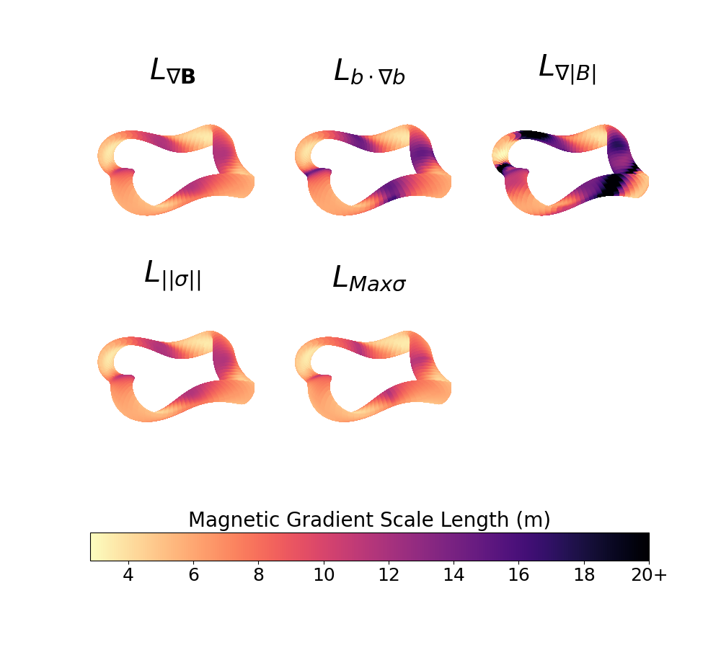
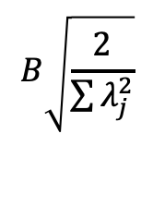





The different B scale lengths are not identical, but have similarities, e.g. all are small on the inside of concave regions
$$\frac{\sqrt{2}B}{\left\|∇B\right\|}$$
$$\frac{1}{\left|b∙∇b\right|}$$
$$\frac{B}{\left|∇B\right|}$$
$$B\sqrt{\frac{2}{\sum{λ_{j}^{2}}}}$$
$$\frac{B}{\max_{}\left|λ_{j}\right|}$$
$λ_{j}=$ eigenvalues of $∇B$
Notes:
Scale_lengths.png from John’s paper

Slide 30








To test hypothesis that 𝛁B is related to coil-plasma distance, scale length will be compared to “real” coil designs for a diverse set of ~45 configurations
NCSX (li383 & c09r00)
ARIES-CS
HSX
W7-X (std, high-mirror, …)
LHD, R=3.5, 3.6, 3.75
CFQS
ML+Paul QA, QH
ML, Buller, Drevlak QA, QH
Near-axis QH
Jorge et al QI
Goodman et al QIs
ESTELL
ITER
CNT
CTH
TJ-II
QPS
ATF
CIEMAT-QI
Garabedian QA
Henneberg et al QA
Wistell-A, B
Wechsung et al QA
Giuliani et al QA
Ku & Boozer nfp=4 QH
Nuhrenberg & Zille QH
Drevlak QH
…
All scaled to same minor radius (1.7 m) and ⟨B⟩ = 5.9 T.
Notes:
m20210604_01_plotVMECWout_withFieldlineSeamAtBottom.m

Slide 31




Methodology: Apply REGCOIL, adjust regularization λ and coil-to-plasma separation to match B error and coil current density between configurations
At fixed coil-to-plasma separation, $λ$trades off between B field error and coil complexity.
At the target B field error, coil complexity increases with coil-to-plasma separation
$$λ→∞$$
Max K
[A/m]
(Coil complexity)
target
target
$$λ→0$$
(Coil complexity)
Coil-to-plasma distance [m]

Slide 32

Main result: 𝛁B length is well correlated with real coil designs
$$\min_{}{\frac{\sqrt{2}B}{\left\|∇B\right\|}}$$
${=L}_{∇B}$ [m]
Coil-to-plasma distance from REGCOIL [m]
Notes:
20221103-01-plot_Kappel_results_grad_B_tensor.pdf

Slide 33


Main result: 𝛁B length is well correlated with real coil designs
Jorge nfp1 QI
$$\min_{}{\frac{\sqrt{2}B}{\left\|∇B\right\|}}$$
${=L}_{∇B}$ [m]
Goodman nfp1 QI
Precise QAs
HSX with ripple
HSX without ripple
W7-X with ripple
ITER
NCSX
ROSE nfp5 QH
W7-X
CTH
Wistell-B
Ku QH
Coil-to-plasma distance from REGCOIL [m]
Notes:
20221103-01-plot_Kappel_results_grad_B_tensor.pdf

Slide 34
Other scale lengths can be reasonably well correlated as well
Field line radius of curvature
Gradient of scalar B
Largest eigenvalue
Notes:
20221103-01-plot_Kappel_results_grad_B_tensor.pdf

Slide 35



The location of limiting 𝛁B length and coil complexity are also correlated spatially
$L_{∇B}=\frac{\sqrt{2}B}{\left\|∇B\right\|}$ [m]
Current density K [MA/m]
Limiting coil-to-coil distance occurs where scale length is smallest
Plasma surface
Coil winding surface
Notes:
m20221101_01_plot_regcoil_coils_and_current_density.m
m20221031_02_plotRegcoilCurrentDensity3D.m

Slide 36


Conclusions:
The new current voxel for inverse magnetostatics enables topologically unconstrained 3D solutions with quadratic, convex, or structured objectives.
The maximum coil separation can be understood from the scale length $L_{∇B}$.
Questions:
Is there a more efficient solver for the current voxel system?
Can the current voxel method be generalized for more flexible geometry (tetrahedra?)
Is $L_{∇B}$ a useful objective function to enable larger coil separation?
Besides $L_{∇B}$, are there other metrics to predict coil separation?
Improvements in algorithms for inverse magnetostatics can translate to significant benefits for fusion, accelerators, MRI, etc.

Slide 37
Extra slides

Slide 38

2D example
3 basis functions per cell, 12 degrees of freedom, 11 unique constraints

Slide 39



At any point, a magnetic field has multiple gradient length scales
$∇B$, $∇_{||}B$, $∇_{⊥}B$, $b∙∇b$, $\left\|∇B\right\|=\sqrt{∇B:∇B}$, eigenvalues of $∇B$, $\left\|∇∇B\right\|$…
Frobenius norm
($B=\left|B\right|$, $b=B/B$)
$\left\|∇B\right\|$ captures largest gradient ⟹ shortest length scale
We can get some insights by considering vacuum fields:
$B=∇Φ$ so $∇B=∇∇Φ$ is a symmetric 3×3 matrix ⟹ 6 degrees of freedom.
$$∇B=\left(\begin{matrix}∂_{xx}Φ & ∂_{xy}Φ & ∂_{xz}Φ \\ ∂_{yx}Φ & ∂_{yy}Φ & ∂_{yz}Φ \\ ∂_{zx}Φ & ∂_{zy}Φ & ∂_{zz}Φ\end{matrix}\right)$$
-1 degree of freedom since $∇∙B=0$.
Some entries can be made to vanish by rotating the coordinate system.
Notes:
E.g. pick the z direction along B, and pick the x direction along grad_perp |B|. Then Phi_{yz} = 0.

Slide 40


The 𝛁B scale lengths can be normalized so that in the case of an infinite straight wire, they give the distance to the wire
B
$$L_{∇B}=\frac{\sqrt{2}B}{\left\|∇B\right\|}$$
$$L_{∇B}=R$$
I
Notes:
20221030-01-mayavi_wire_for_grad_B_talk

Slide 41








The different B scale lengths are not identical, but have similarities, e.g. all are small on the inside of concave regions
$$\frac{\sqrt{2}B}{\left\|∇B\right\|}$$
$$\frac{B}{\left|∇B\right|}$$
$$\frac{B}{\max_{}\left(n∙∇B, 0\right)}$$
$$\frac{B}{\max_{}\left|λ_{j}\right|}$$
$$B\sqrt{\frac{2}{\sum{λ_{j}^{2}}}}$$
$$\frac{1}{\left|b∙∇b\right|}$$
$λ_{j}=$ eigenvalues of $∇B$
Notes:
“scale.png” in an email from John Kappel on 2022-11-05

Slide 42

Main result: 𝛁B length is well correlated with real coil designs
$$\min_{}{\frac{\sqrt{2}B}{\left\|∇B\right\|}}$$
${=L}_{∇B}$ [m]
All configurations scaled to same minor radius
Notes:
20221103-01-plot_Kappel_results_grad_B_tensor.pdf

Slide 43
Main result: 𝛁B length is well correlated with real coil designs
$$\min_{}{\frac{\sqrt{2}B}{\left\|∇B\right\|}}$$
${=L}_{∇B}$ [m]
Jorge nfp1 QI
Precise QA
Goodman nfp1 QI
HSX with ripple
HSX without ripple
W7-X
ESTELL
Wistell-A
ITER
ROSE nfp5 QH
NCSX
All configurations scaled to same minor radius
Wistell-B
Notes:
20221103-01-plot_Kappel_results_grad_B_tensor.pdf

Slide 44

Regcoil coil-to-plasma distance is actually well correlated with other definitions of B length scale too
$\min_{}{\frac{B}{\left|∇B\right|}}$
[m]
All configurations scaled to same minor radius
Notes:
20221105-01-plot_Kappel_results_grad_mod_B.pdf

Slide 45

Regcoil coil-to-plasma distance is actually well correlated with other definitions of B length scale too
$\min_{}{\frac{1}{\left|b∙∇b\right|}}$ [m]
All configurations scaled to same minor radius
Notes:
20221105-01-plot_Kappel_results_grad_mod_B.pdf

