Slide 1
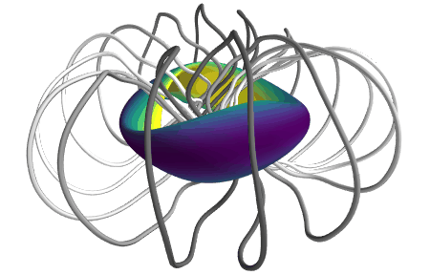
Stellarator optimization
Where do these shapes come from?
Matt Landreman – mattland@umd.edu, University of Maryland
Notes:
https://www.youtube.com/watch?v=CJ_OBoEs3uU

Slide 2
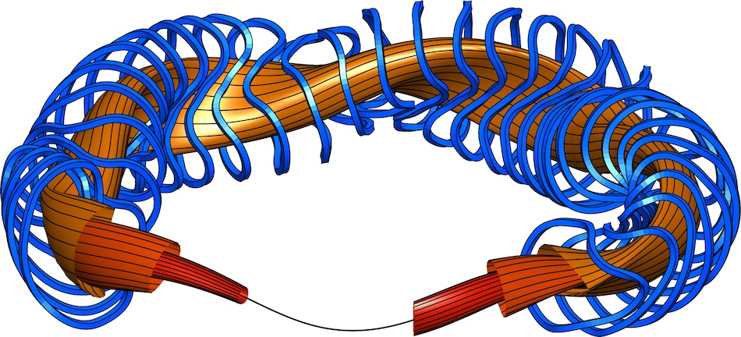
There is lots of freedom in the shape of a stellarator plasma and coils, which can be used to achieve many objectives
Large volume of good magnetic surfaces (not islands & chaos)
Enough rotational transform
Plasma pressure & current doesn’t modify B too much, i.e. maximum plasma pressure is not too low.
Buildable coil shapes: low curvature, large clearances
Magnetohydrodynamic (MHD) stability
Good confinement of particle trajectories
Low neoclassical transport
Low turbulent transport

Slide 3
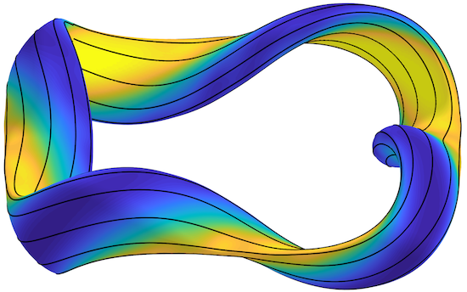
Outline
Optimization in general
Optimization for good flux surfaces
Quasi-axisymmetry, quasi-helical symmetry, and quasi-isodynamic
Optimization for stability & turbulence
Coil optimization: current potential and filament methods

Slide 4
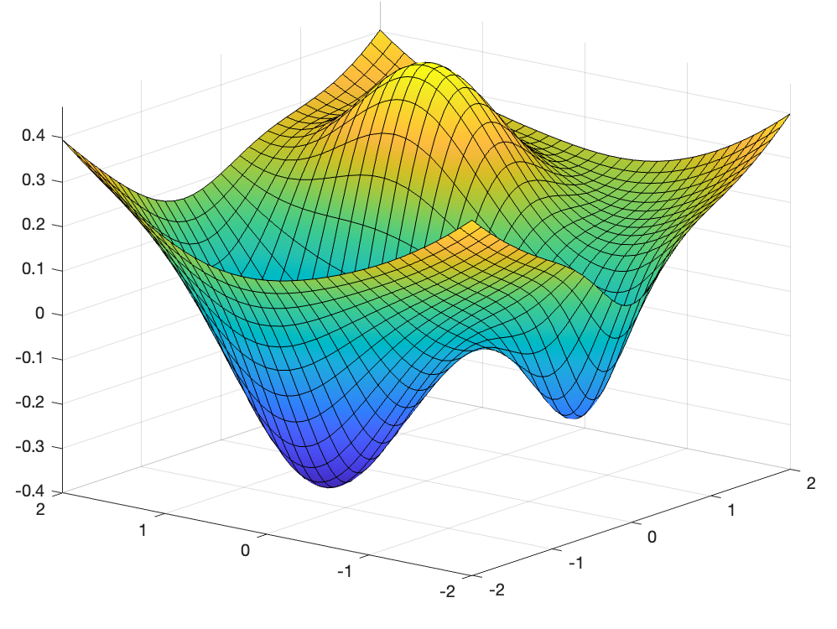



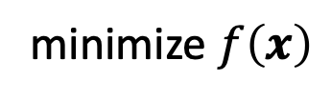
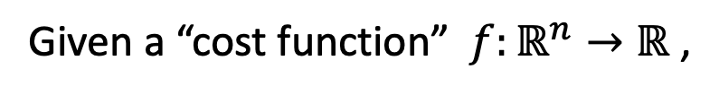
Optimization is a general technique with many applications
Given a “cost function” $f:ℝ^{n}→ℝ$ ,
minimize $f\left(x\right)$
(a.k.a. “objective function”, “loss function”)
$$f\left(x\right)$$
Local minimum
$$x_{1}$$
$$x_{2}$$
Global minimum
Notes:
f = @(x,y) x.*exp(-x.^2-y.^2)+(x.^2+y.^2)/20;
f = @(x,y) x.*exp(-x.^2-(y-0.5).^2)+(x.^2+y.^2)/20-0.3*exp(-4*((y+1.5).^2+x.^2));
fsurf(f,[-2,2])
set(gcf,'color','w')

Slide 5
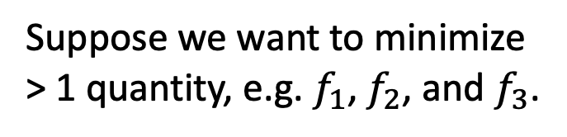

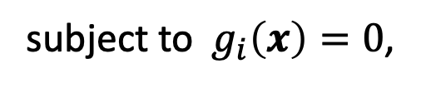
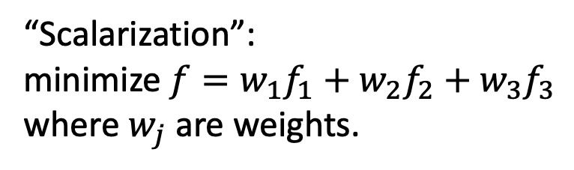
Optimization is a general technique with many applications
Given a “cost function” $f:ℝ^{n}→ℝ$ ,
minimize $f\left(x\right)$
(a.k.a. “objective function”, “loss function”)
subject to $g_{i}\left(x\right)=0$,
(Optional) Can add constraints:
$$h_{j}\left(x\right)<0$$
$$f\left(x\right)$$
Suppose we want to minimize > 1 quantity, e.g. $f_{1}$, $f_{2}$, and $f_{3}$.
“Scalarization”:
minimize ${f=w_{1}f}_{1}+w_{2}f_{2}+w_{3}f_{3}$ where $w_{j}$ are weights.
$$x_{1}$$
$$x_{2}$$
Notes:
f = @(x,y) x.*exp(-x.^2-y.^2)+(x.^2+y.^2)/20;
f = @(x,y) x.*exp(-x.^2-(y-0.5).^2)+(x.^2+y.^2)/20-0.3*exp(-4*((y+1.5).^2+x.^2));
fsurf(f,[-2,2])
set(gcf,'color','w')

Slide 6
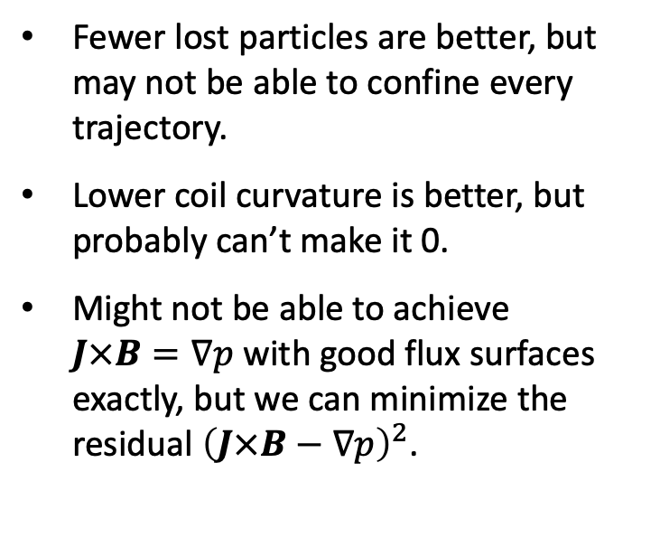
Optimization is natural to apply to stellarators
Given a “cost function” $f:ℝ^{n}→ℝ$ ,
minimize $f\left(x\right)$
(a.k.a. “objective function”, “loss function”)
Fewer lost particles are better, but may not be able to confine every trajectory.
Lower coil curvature is better, but probably can’t make it 0.
Might not be able to achieve $J×B=∇p$ with good flux surfaces exactly, but we can minimize the residual ${\left(J×B−∇p\right)}^{2}$.
$$f\left(x\right)$$
$$x_{1}$$
$$x_{2}$$
Notes:
f = @(x,y) x.*exp(-x.^2-y.^2)+(x.^2+y.^2)/20;
fsurf(f,[-2,2])
set(gcf,'color','w')

Slide 7
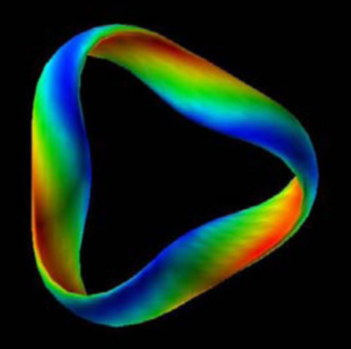
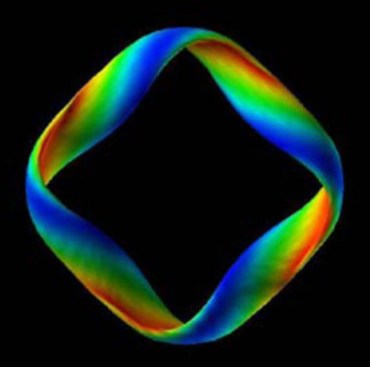
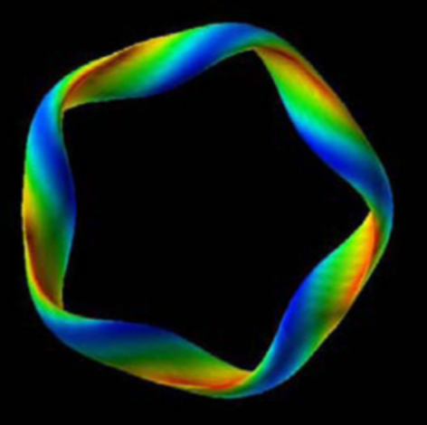
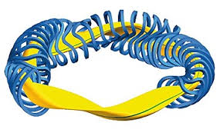
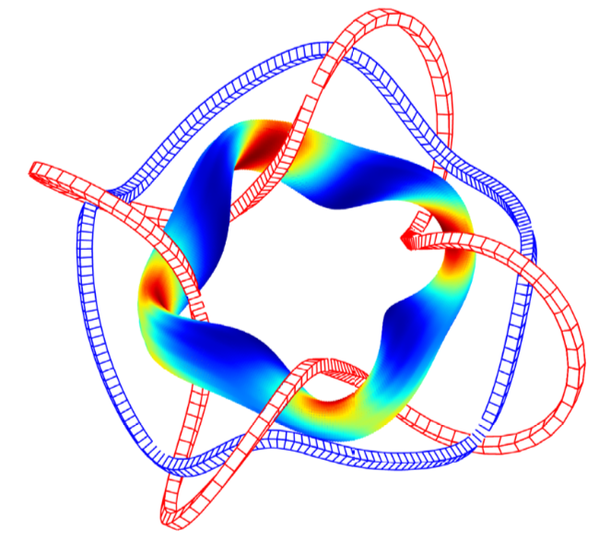
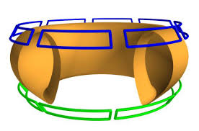

Some stellarator parameters are integers. These are mostly optimized by hand.
Number of “field periods”.
Number of coils.
NFP=3
NFP=4
NFP=5
Do coils link the plasma poloidally, helically, or not at all?
Do B contours link the torus toroidally (QA), helically (QH), or poloidally (QI)?
Notes:
KuBoozer_2011_NF_v51_p013004 New classes of quasi-helically-symmetric stellarators.pdf
Yamaguchi_2019_NF_59_104002 QI vacuum field with helical coils.pdf

Slide 8
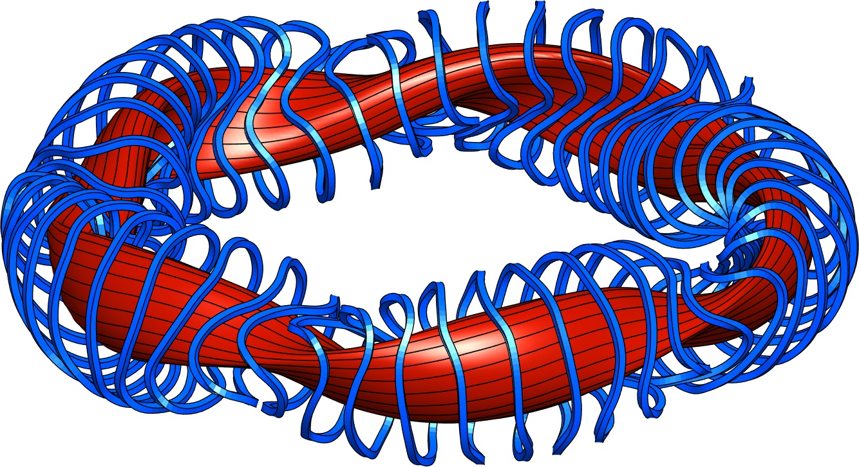
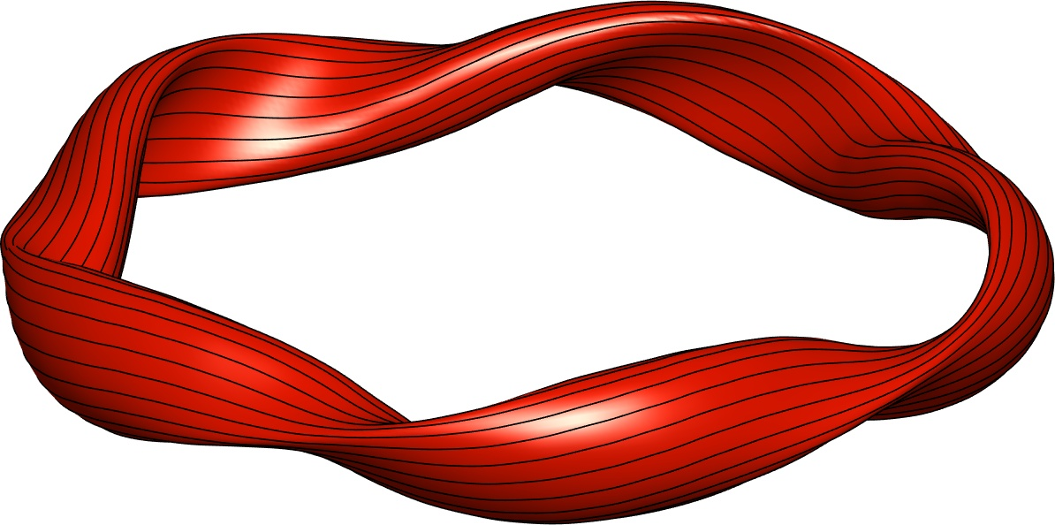
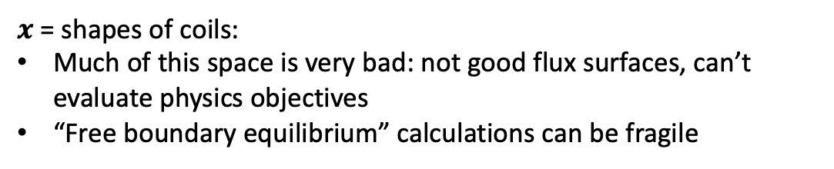

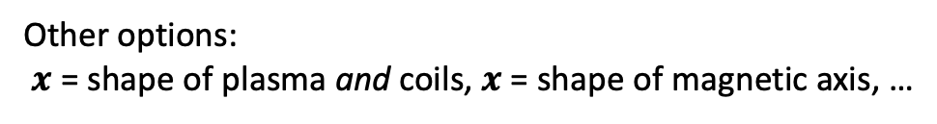
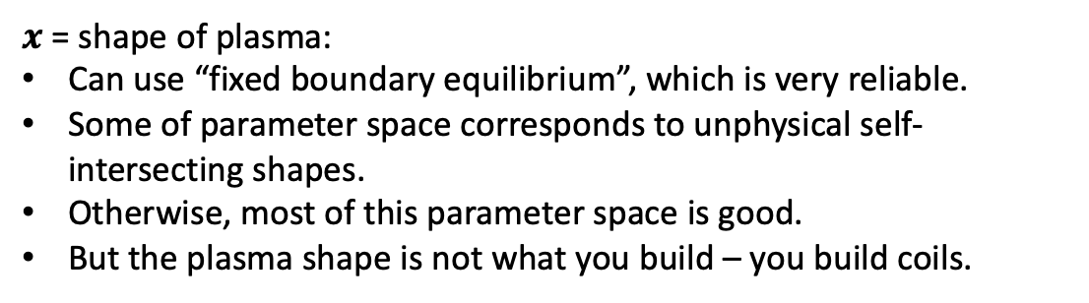
There are several possible choices of parameter space to optimize in
Minimize $f\left(x\right)$ where $x∈ℝ^{n}$. What is $x$?
$x$ = shapes of coils:
Much of this space is very bad: not good flux surfaces, can’t evaluate physics objectives
“Free boundary equilibrium” calculations can be fragile
$x$ = shape of plasma:
Can use “fixed boundary equilibrium”, which is very reliable.
Some of parameter space corresponds to unphysical self-intersecting shapes.
Otherwise, most of this parameter space is good.
But the plasma shape is not what you build – you build coils.
Other options:
$x$ = shape of plasma and coils, $x$ = shape of magnetic axis, …

Slide 9
Most transport-optimized stellarators have used 2 sequential optimization stages
Parameters = shape of boundary toroidal surface. Objective = physics (confinement, stability, etc.)
Parameters = coil shapes. Objective = error in B on boundary shape from stage 1.
Shape of a toroidal boundary surface (+ pressure & current vs r inside, & total B flux) determines B everywhere inside:
Notes:
m20200814_01_W7XIllustrationWithCoils

Slide 10
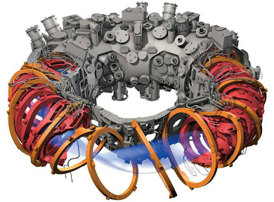
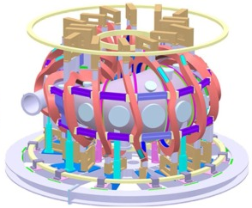
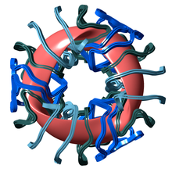
Most transport-optimized stellarators have used 2 sequential optimization stages
Parameters = shape of boundary toroidal surface. Objective = physics (confinement, stability, etc.)
Parameters = coil shapes. Objective = error in B on boundary shape from stage 1.
W7-X (Germany)
CFQS (China), under construction
NCSX (Princeton)
Notes:
m20200814_01_W7XIllustrationWithCoils

Slide 11
Outline
Optimization in general
Optimization for good flux surfaces
Quasi-axisymmetry, quasi-helical symmetry, and quasi-isodynamic
Optimization for stability & turbulence
Coil optimization: current potential and filament methods

Slide 12
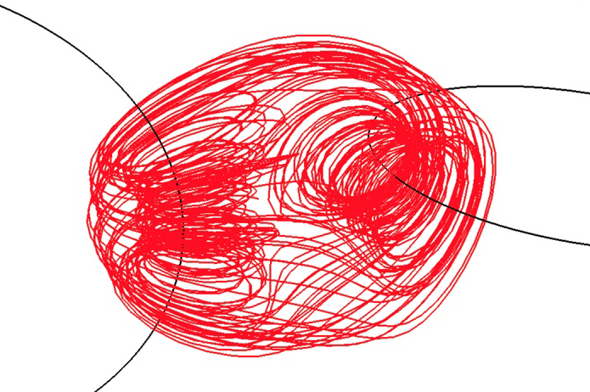
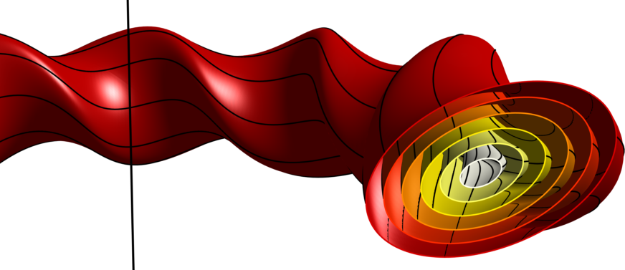
One goal of stellarator optimization is having field lines lie on surfaces.
Chaotic (volume-filling) B field lines would allow inside & outside to mix even without cross-B drift.
BAD
Magnetic field lines
Hosoda, PRE (2009)
GOOD
Magnetic surfaces
Notes:
m20160131_DartmouthTorusFigure.m

Slide 13
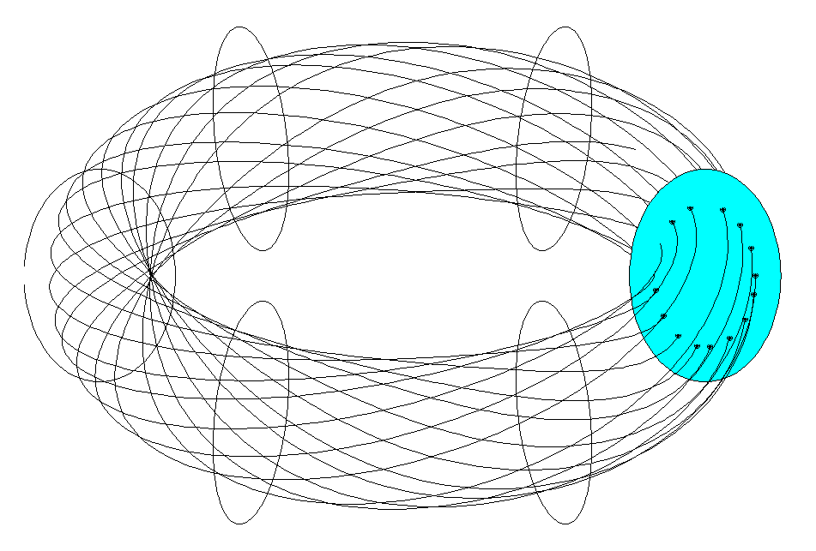
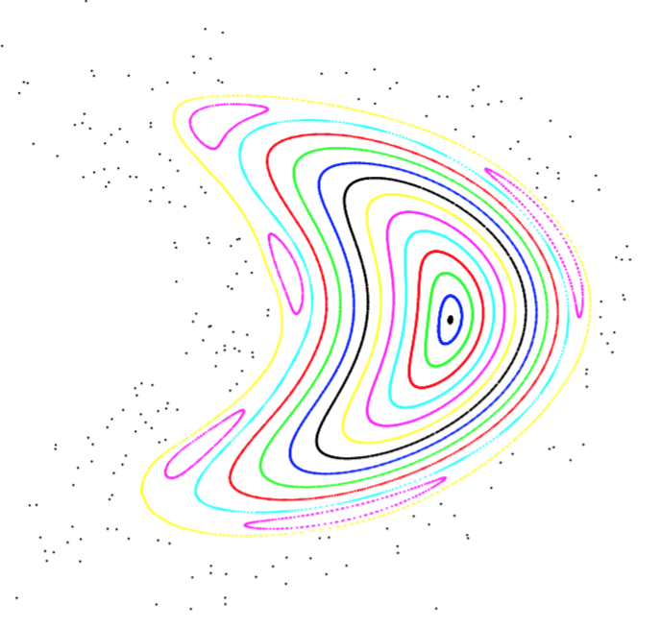
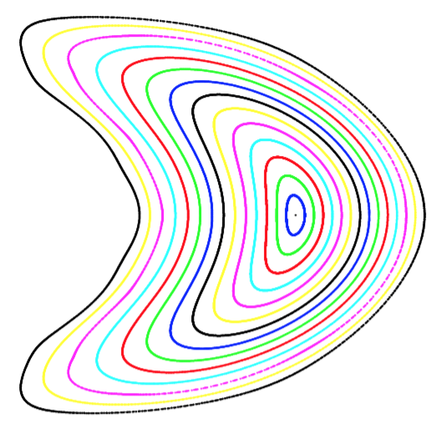
One goal of stellarator optimization is having field lines lie on surfaces.
Magnetic surfaces (a.k.a flux surfaces) can be visualized with a “Poincare plot”:
Good
Not so good
Islands, where ι is rational
Chaos
J P Kremer,
PhD thesis, Columbia

Slide 14
How much rotational transform do you want?
Avoid rationals like ι = 1 or ½: islands form there.
So, maybe want low “magnetic shear” = |∇ι|.
Or, maybe want high magnetic shear since it makes islands thin. (width ∝ |∇ι|^{-1/2})
Islands
Larger ι means:
Thinner orbits, so better confinement.
B changes less due to plasma current. (Higher “equilibrium β limit”.)
But, more complicated coils.
Notes:
20200812-01-plotIotaProfiles.pdf

Slide 15
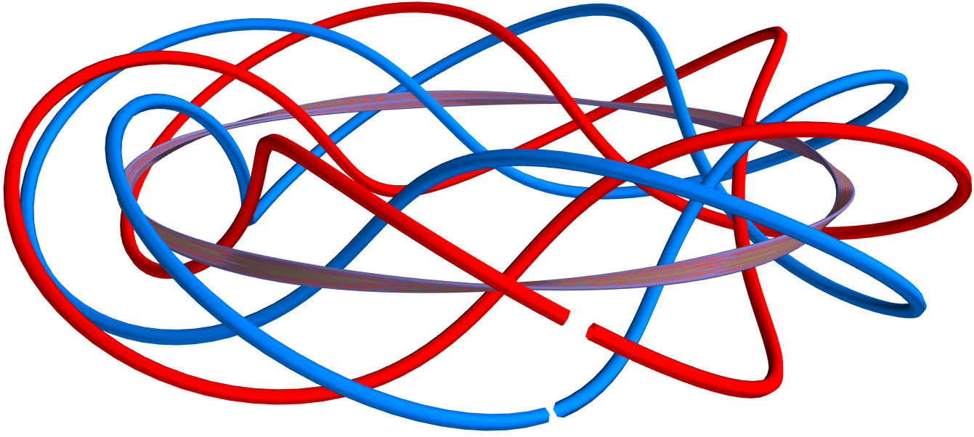
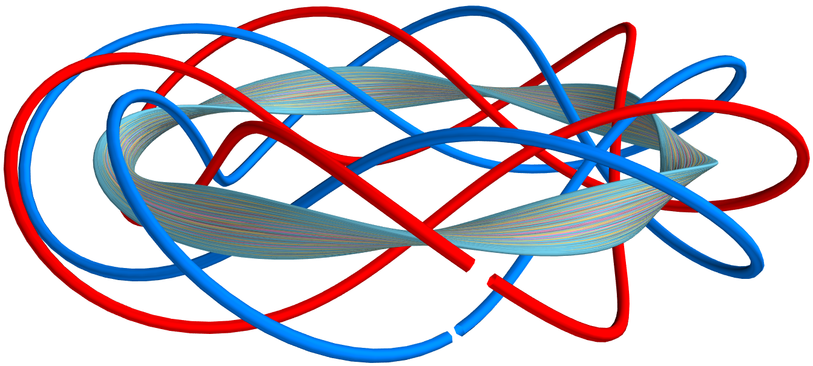
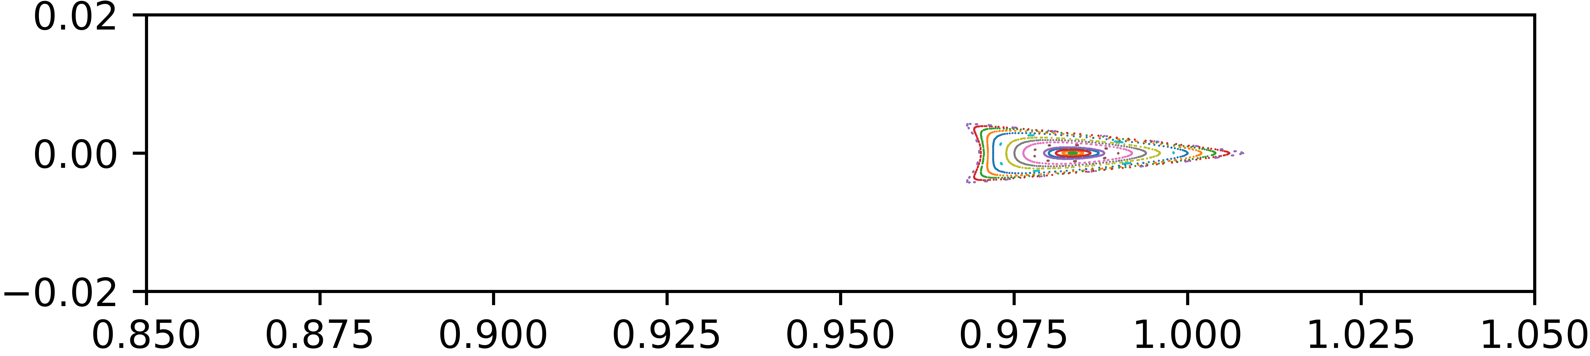
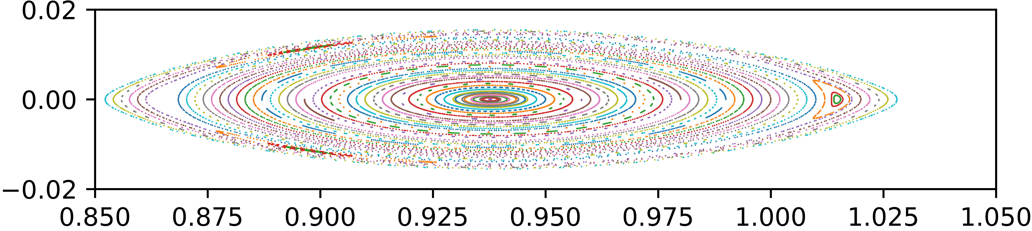
Perhaps the first type of stellarator optimization was to achieve good flux surfaces
Reproduction of Cary & Hanson (1986) by Rogerio Jorge
Unoptimized
Optimized
Z [m]
Z [m]
R [m]
R [m]
Parameter space x = Fourier modes of coil shapes. Cost function f = square of “Greene’s residue”

Slide 16
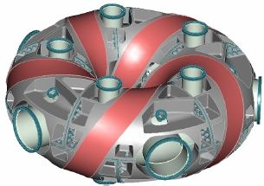
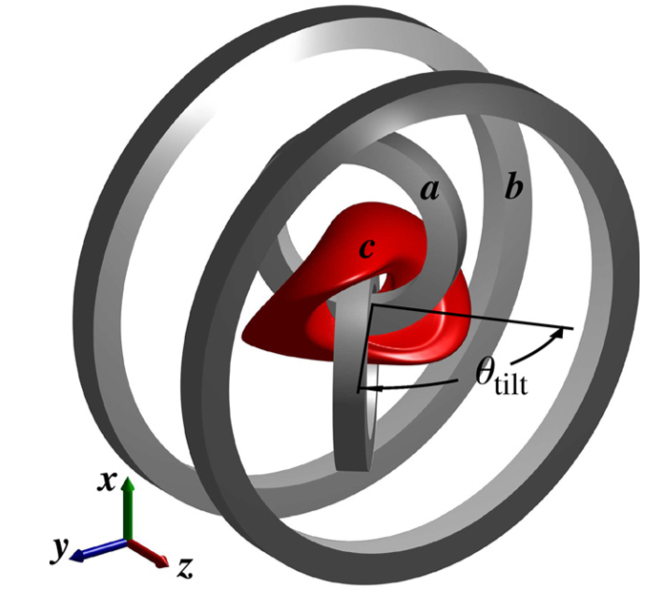
Optimization for good flux surfaces continues to be a principle behind recent stellarators
CTH:
(Compact Toroidal Hybrid, at Auburn)
CNT (Columbia Non-neutral Torus):
Optimize expected volume over possible coil position errors
Pedersen (2004), Hammond (2016)

Slide 17
Outline
Optimization in general
Optimization for good flux surfaces
Quasi-axisymmetry, quasi-helical symmetry, and quasi-isodynamic
Optimization for stability & turbulence
Coil optimization: current potential and filament methods

Slide 18
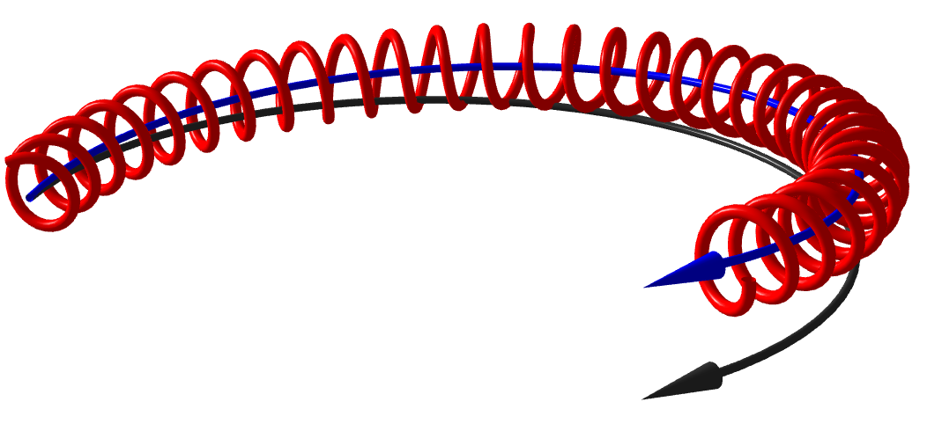
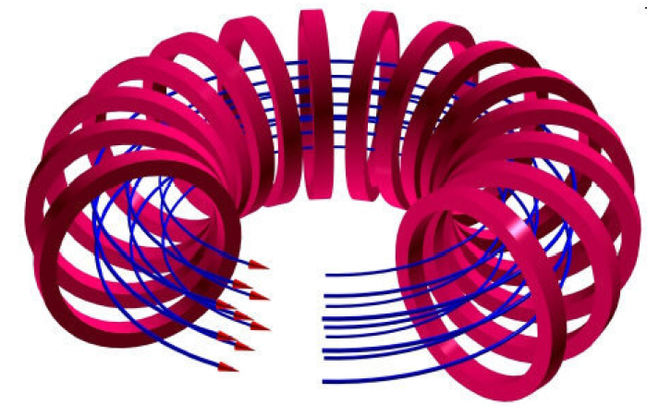
Reminder: the ∇B and curvature drifts make confinement challenging
Particle trajectory
Guiding center trajectory
Magnetic field line
Ions drift up: they are not confined!
Notes:
m20230807_01_illustrationOfGuidingCenterDrift.m – flip horizontally

Slide 19
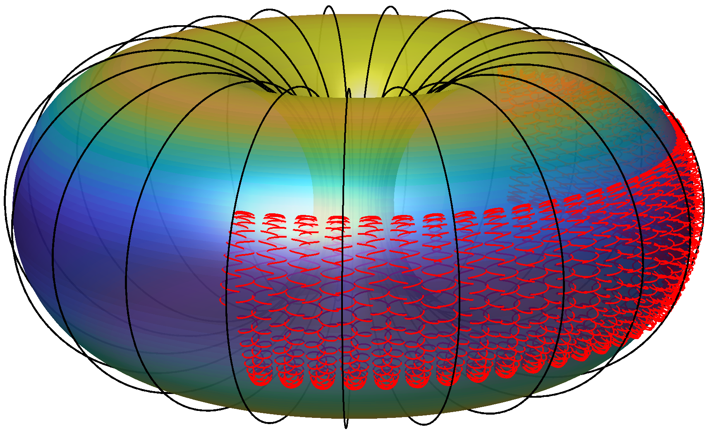
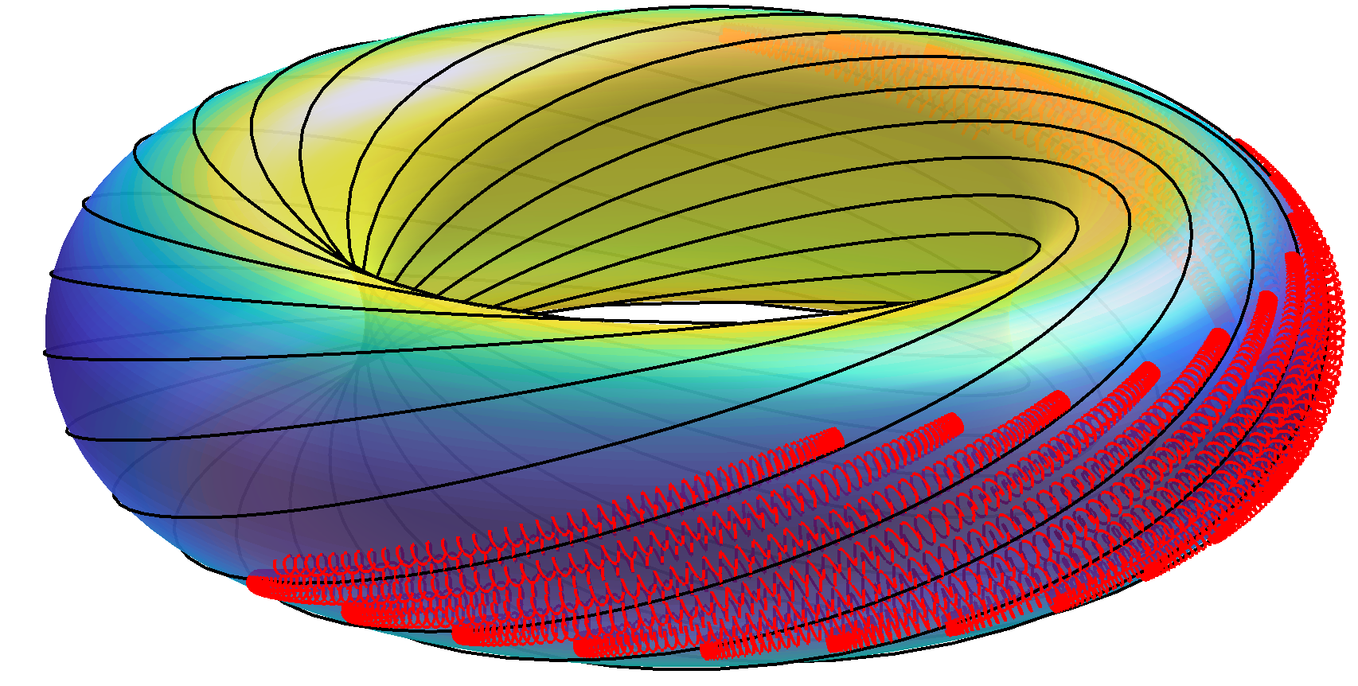

Mirror force: particles are pushed away from regions of high |B|
Ion trajectory
B field lines
v×B force has slight ➔ component
A few particles with very small v|| = v⋅B “bounce” and are “trapped” in low-|B| regions.
|B|
Notes:
m20200812_02_orbitsInATokamak.m

Slide 20
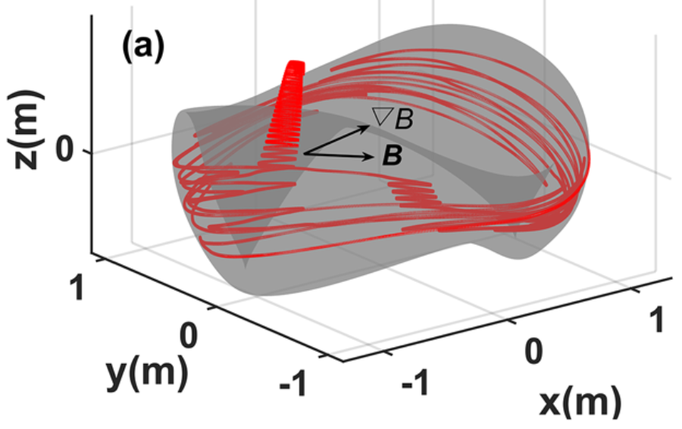
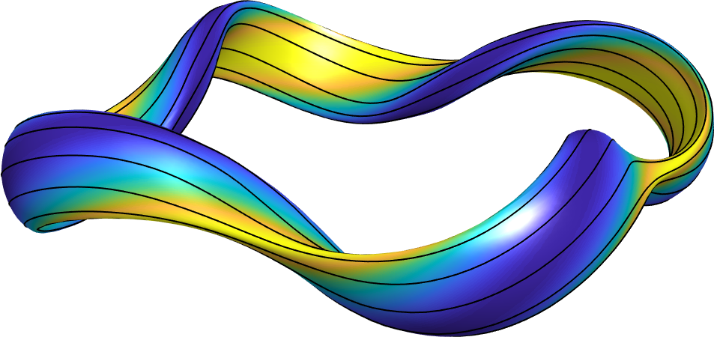
Flux surfaces are not enough: Trapped particles are not confined without a further condition like “quasisymmetry” or “omnigenity”
In general: trapped particles do not sample the whole surface, so cross-field drift does not average to 0.
⟹ Large neoclassical transport.
Su et al (2020)
One solution is quasisymmetry: make B(r, 𝜃, 𝜑) = B(r, M𝜃−N𝜑) for special angles 𝜃, 𝜑.
B
Symmetry direction
⟹ Conserved quantity.
⟹ Drift averages to 0.

Slide 21
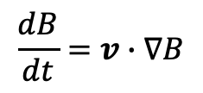

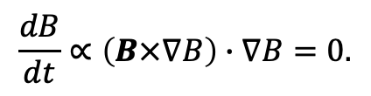

Lemma: deeply trapped particles move so |B| is constant
$$B$$
Deeply trapped particles
Distance along a field line
$$\frac{dB}{dt}=v∙∇B$$
$v_{||}≈0$ so $v≈$ the $∇B$ drift $⟹$ $v || B×∇B$
$$\frac{dB}{dt}∝\left(B×∇B\right)∙∇B=0.$$

Slide 22
For low neoclassical transport, recent stellarators have come in 3 flavors
Trapped particles should drift toroidally, helically, or poloidally on a surface.
B contours on a surface have the same topology as these drifts.
Toroidal:
E.g., particles with v||=0
move along a constant-B contour:
Helical:
Poloidal:
Notes:
https://commons.wikimedia.org/wiki/File:Torus_illustration.png

Slide 23
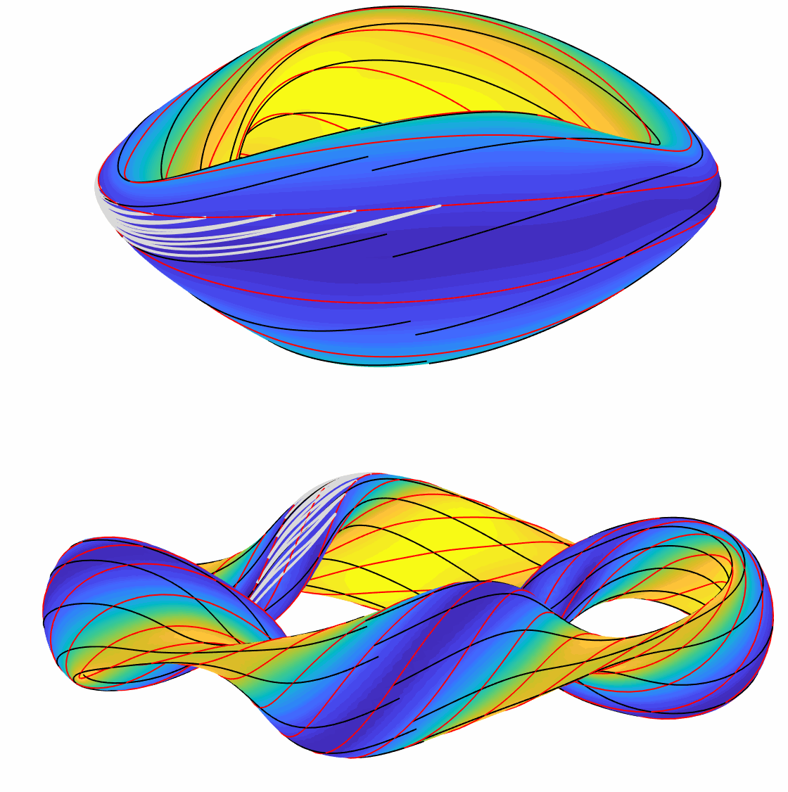
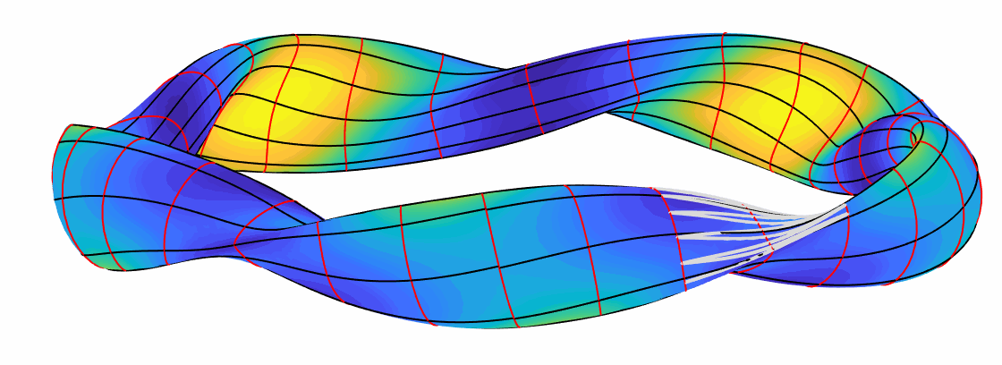
For low neoclassical transport, recent stellarators have come in 3 flavors
Trapped particles should drift toroidally, helically, or poloidally on a surface.
B contours on a surface have the same topology as these drifts.
Toroidal: “QA” = Quasi-axisymmetric
Field lines
|B| contours (slightly idealized)
Trapped particle
Helical: “QH”= Quasi-helically symmetric
Poloidal: “QI”= Quasi-isodynamic
Notes:
m20200812_02_3TypesOfOptimizedStellarator_gif.m

Slide 24
Pros and cons of the 3 classes
QA:
+ Lowest aspect ratio
+ Fewest coils, largest clearances
+ Large bootstrap current increases iota
- Wider orbits mean worse confinement
- Large current may contribute to MHD instability
QH:
+ Extremely good confinement
+ Can build on experience with HSX
- Seems to require high aspect ratio and many coils
? Intermediate bootstrap current between QA and QI
QI:
+ Low bootstrap current means high robustness to different pressure profiles
+ Can use island divertor
+ Can build on experience from W7-X
- Seems to require high aspect ratio and many coils
- Optimization is generally trickier

Slide 25
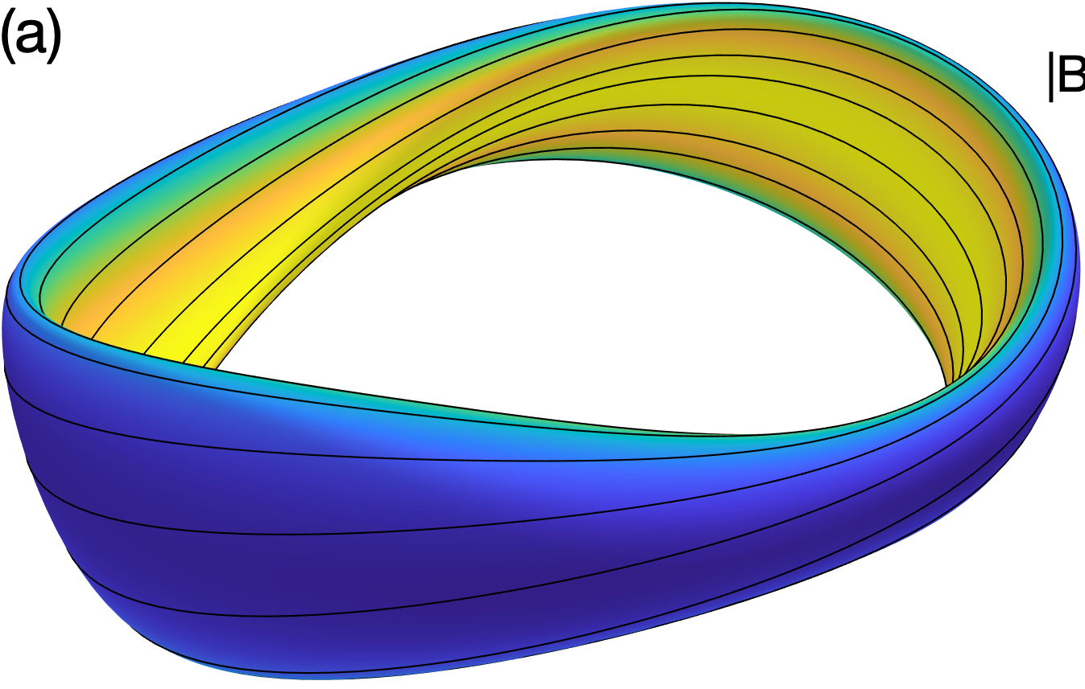
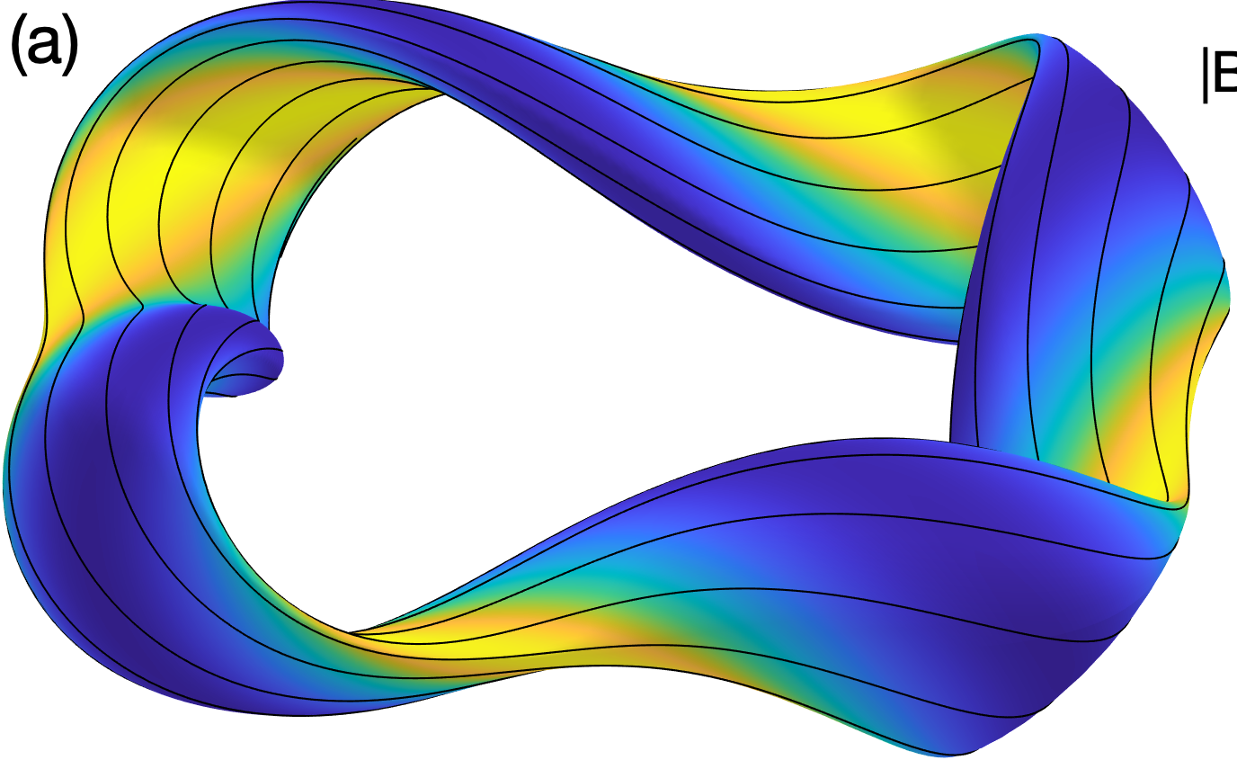
There has been great progress recently in optimizing stellarator neoclassical confinement
Trajectories of fusion-produced distribution of alpha particles followed in many magnetic configurations, all scaled to reactor size and |B|:
Since 2021
Fraction of alpha-particle energy lost before thermalization
Landreman et al, Phys Plasmas (2022).

Slide 26
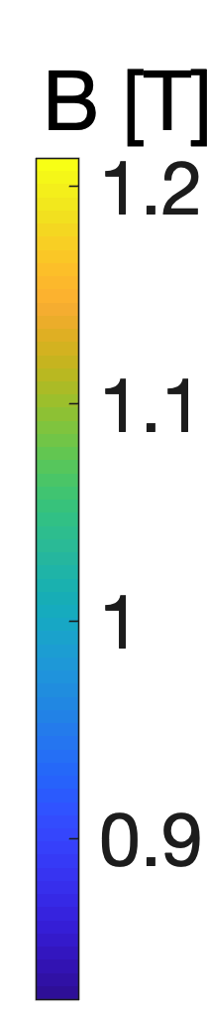
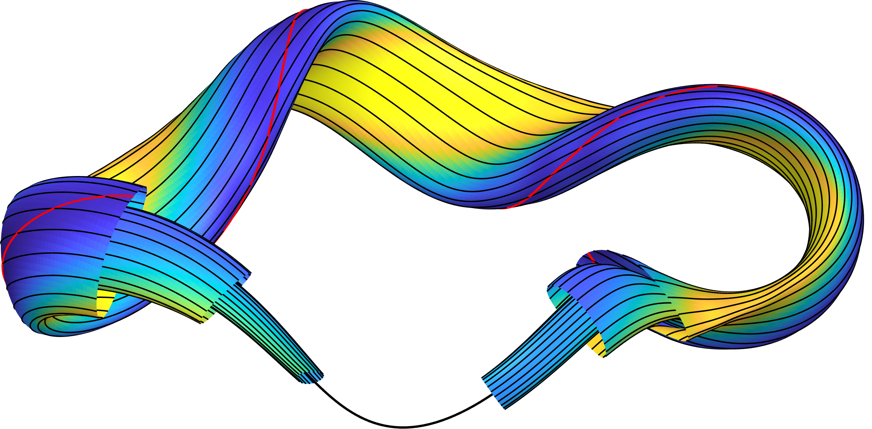
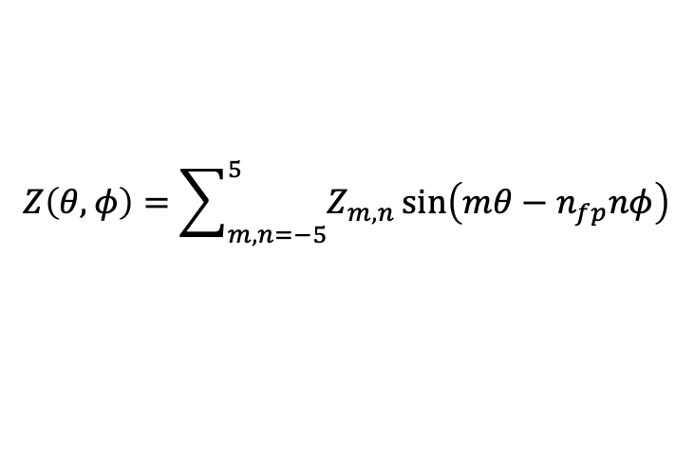


The parameter space for stage-1 optimization is typically a set of Fourier amplitudes for the boundary surface in cylindrical coordinates
𝜃
Magnetic field lines
$$φ$$
Parameterization of boundary surface:
$$R\left(θ,φ\right)=\sum_{m,n=−5}^{5}{R_{m,n}\cos\left(mθ−n_{fp}nφ\right)}$$
$$Z\left(θ,φ\right)=\sum_{m,n=−5}^{5}{Z_{m,n}}\sin\left(mθ−n_{fp}nφ\right)$$
$φ$ = standard cylindrical angle, $n_{fp}$ = number of field periods
Parameter space for optimization: $x=\left[R_{m,n},Z_{m,n}\right]$

Slide 27



Quasisymmetry is a sufficient (though not necessary) condition for confinement, & a useful surrogate
𝜃
Magnetic field lines
B = B(s, 𝜃 − N 𝜑)
𝜑
“Boozer angles”
Constant s = normalized toroidal flux
$$f_{QS}=\int{d^{3}x}{\left(\frac{1}{B^{3}}\left[\left(N−ι\right)B×∇B∙∇ψ−GB∙∇B\right]\right)}^{2}$$
Objective:
e.g.
N = 4
here
For quasi-axisymmetry,
N = 0.
For quasi-helical symmetry,
N is the number of field periods,
Boundary aspect ratio

Slide 28

Example of quasi-axisymmetry optimization
ML & Paul, Phys Rev Lett (2022)

Slide 29

Example of quasi-helical symmetry optimization
ML & Paul, Phys Rev Lett (2022)

Slide 30





There has been similar recent progress in finding quasi-isodynamic configurations
Jorge et al (2022)
Mata et al (2022)
Goodman et al (2023)
Dudt et al (2023)
Sanchez et al (2023)

Slide 31
Outline
Optimization in general
Which parameter space to optimize in?
Quasi-axisymmetry, quasi-helical symmetry, and quasi-isodynamic
Optimization for stability & turbulence
Coil optimization: current potential and filament methods

Slide 32



Stellarator geometry can be optimized for MHD stability
Types of MHD stability calculations, in increasing complexity:
Magnetic well & Mercier’s criterion (interchange)
Ballooning modes (short wavelength ⟂ to B)
Finite wavelength (everything)
Cote et al, (2019)
Growth rate of ballooning modes
(minor radius)
Sanchez et al, Plasma Phys. Control. Fusion (2000)

Slide 33


Optimization for reduced turbulence has mostly used simplified proxies in the cost function
Turbulent heat flux can be simulated, but it is computationally expensive and noisy
$⇒$ not good for an objective function
Turbulent heat flux (code units)
Time (normalized)
Nunami 2017

Slide 34









Optimization for reduced turbulence has mostly used simplified proxies in the cost function
NCSX (unoptimized)
NCSX (unoptimized)
Turbulent heat flux (code units)
optimized
optimized
optimized
Time (normalized)
Mynick et al, Physical Review Letters (2010)

Slide 35


The first optimizations with nonlinear turbulence calculations in the objective are becoming possible
By Patrick Kim (Maryland undergraduate!)
time

Slide 36
Outline
Optimization in general
Optimization for good flux surfaces
Quasi-axisymmetry, quasi-helical symmetry, and quasi-isodynamic
Optimization for stability & turbulence
Coil optimization: current potential and filament methods

Slide 37

Calculating the currents that produce a given B is an “ill-posed inverse problem”: solution is not unique.
Actually a good thing:
There is a lot of freedom in coil design
Some kind of ‘regularization’ is needed to exclude solutions like this:
Notes:
Figure created using m20160506_01_W7X_illustrationForBDISTRIBTalk.m

Slide 38
Finding coils that produce a given B is analogous to fitting data with a polynomial
As polynomial degree increases, fit is closer to data but less ‘regular’.
Polynomial degree is the ‘regularization parameter’.

Slide 39






Current potential methods: NESCOIL & REGCOIL
Regcoil: Consider sheet current on a “coil winding surface”
ML, Nuclear Fusion (2017).
$$K=n×∇φ$$
Surface current
“current potential”
Normal to winding surface
$$\min_{φ}\left(\int{{d^{2}x\left[\left(B−B_{\text{target}}\right)∙n\right]}^{2}}+λ\int{d^{2}x{\left|K\right|}^{2}}\right)$$
Plasma
surface
Coil
surface
B field error
Coil complexity
Regularization parameter
$φ$ contours = coils
$K=\left|K\right|∝1/$distance between coils
Pros:
Linear least-squares: no local optima besides the global one.
Only 2 parameters to vary: coil-to-plasma distance and $λ$.
Cons:
Neglects ripple from discrete coils.
Coils can’t move in 3rd dimension.
Notes:
m20221031_01_plot_regcoil_coils_and_surfaces.png

Slide 40


In stage-2 coil optimization, there is a trade-off between field accuracy and coil simplicity
High regularization λ:
Simpler coils
but large field error
Low regularization λ:
Complicated coils
but small field error

Slide 41


Filament coil optimization
Zhu, Hudson, et al, Nuclear Fusion (2018).
Assume plasma shape has already been optimized, so target B field is known.
Coils represented as space curves.
Design variables: Fourier modes of Cartesian components.
Objective:
$f=\int_{\begin{aligned}plasma \\ surf\end{aligned}}{{\left[\left(B−B_{target}\right)∙n\right]}^{2}}+λ{\left(length−target\right)}^{2}$+…
Match target B
Regularization
Does account for B ripple from discreteness of coils.
Non-convex, so there are multiple local minima. Need good initial guess.

Slide 42
Open questions for stellarator optimization
How best to combine coil and plasma design?
How to find designs that tolerate errors in coil shape/position?
How to avoid getting stuck in little local minima? How to find global optima?
How to optimize for expensive & noisy objectives (turbulence & fast-particle confinement)?
How to balance multiple competing objectives?
How to optimize coil topology?
How to find configurations that are flexible?
  Good confinement for different plasma pressures.
  Ability to tune physics properties by changing coil currents.

Slide 43
More resources
Introductory papers:
Imbert-Gerard, Paul, & Wright, https://arxiv.org/abs/1908.05360
Helander, http://dx.doi.org/10.1088/0034-4885/77/8/087001
Summer schools:
https://hiddensymmetries.princeton.edu/summer-school/summer-school-2020/schedule
https://hiddensymmetries.princeton.edu/summer-school/summer-school-2019/schedule
https://gss.pppl.gov/2021/
https://suli.pppl.gov/2022/course/index.html
https://suli.pppl.gov/2021/course/index.html
https://suli.pppl.gov/2020/course/index.html
https://suli.pppl.gov/2019/course/index.html
Open-source software:
https://github.com/PrincetonUniversity/STELLOPT
https://desc-docs.readthedocs.io/
https://simsopt.readthedocs.io/
https://github.com/landreman/regcoil
https://gitlab.com/wistell/StellaratorOptimization.jl

