Slide 1

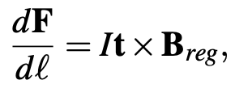
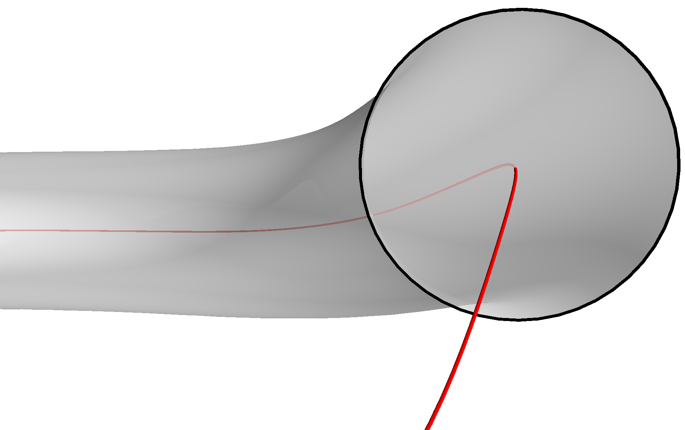
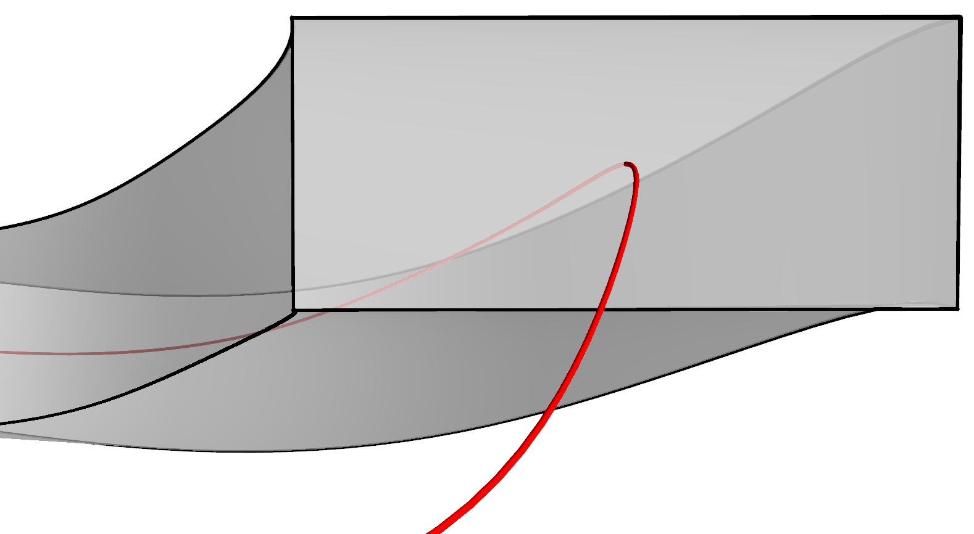
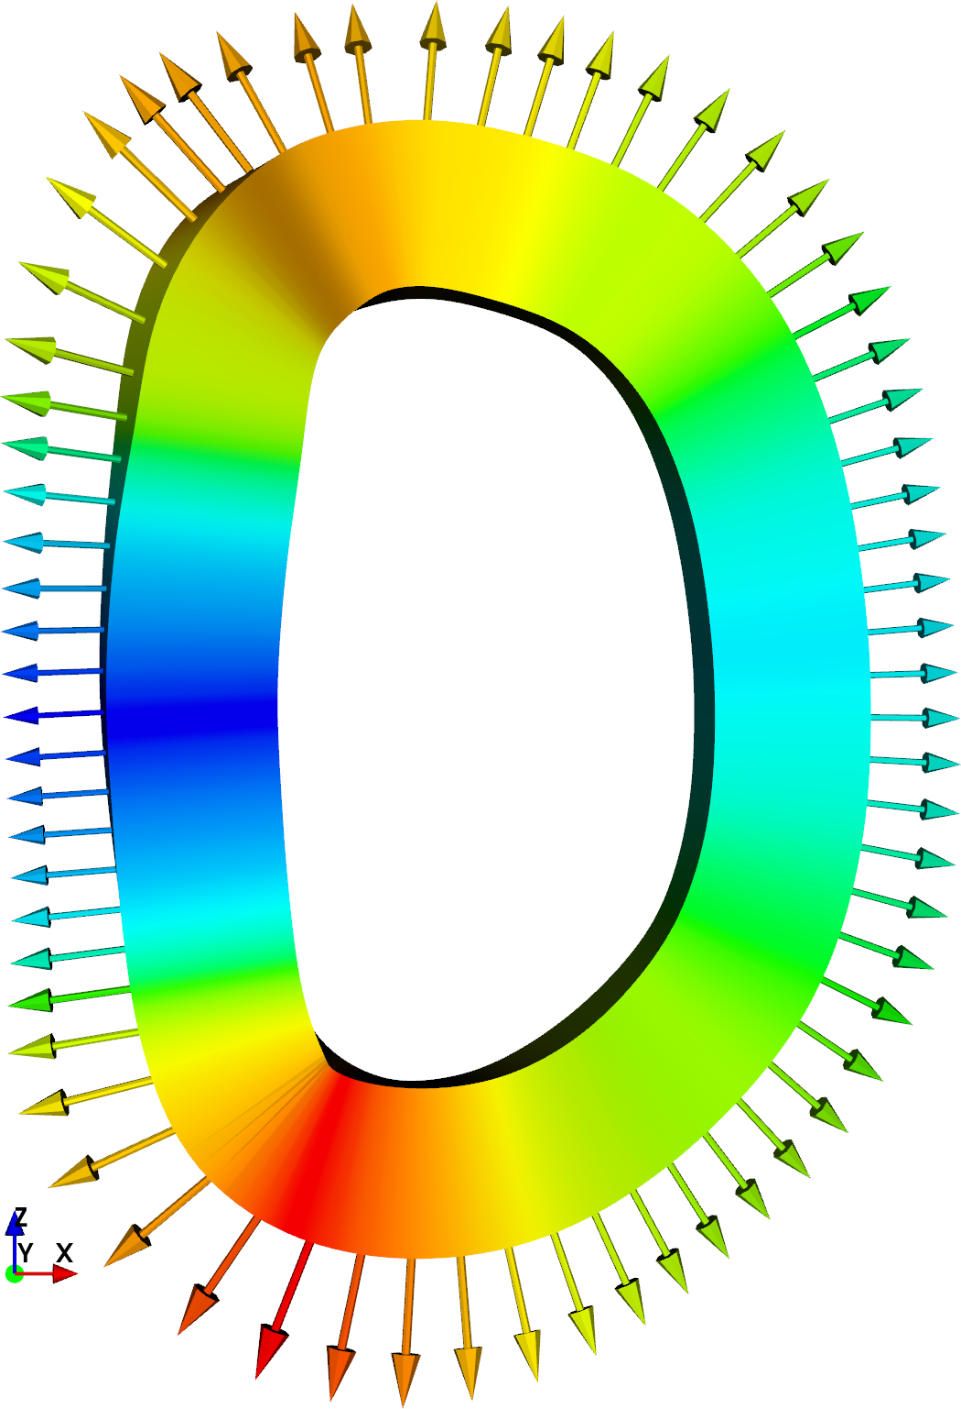
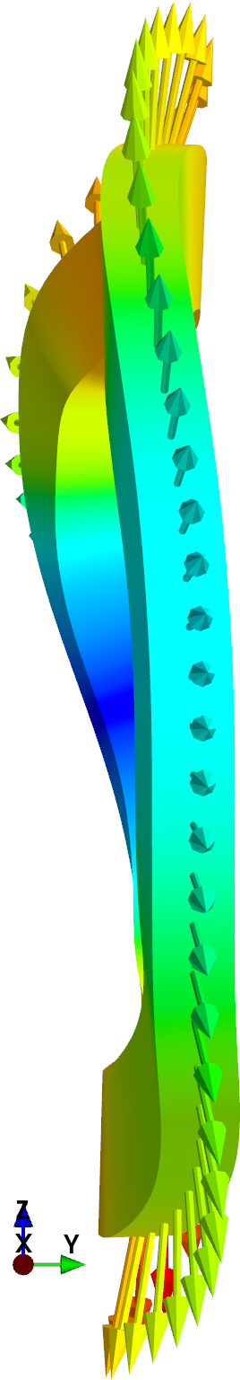
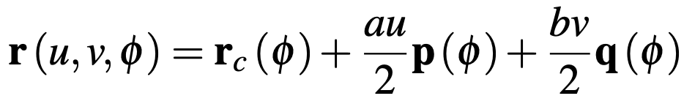
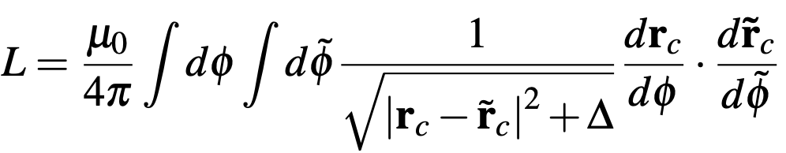
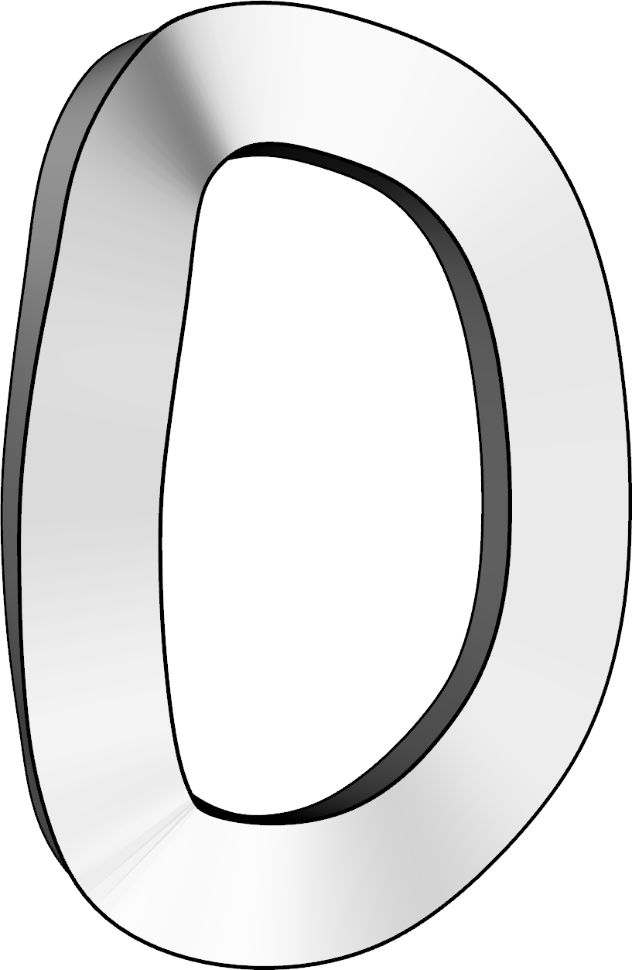
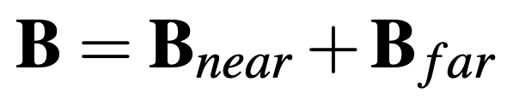

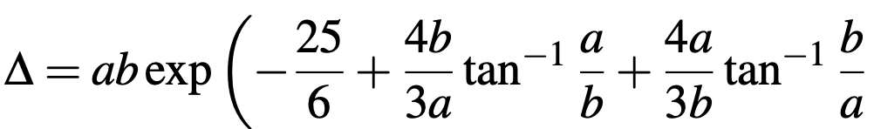

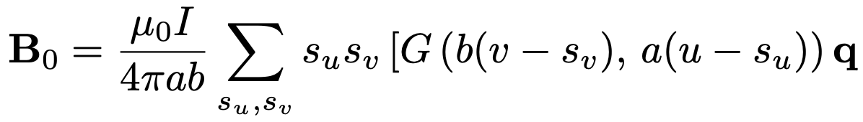
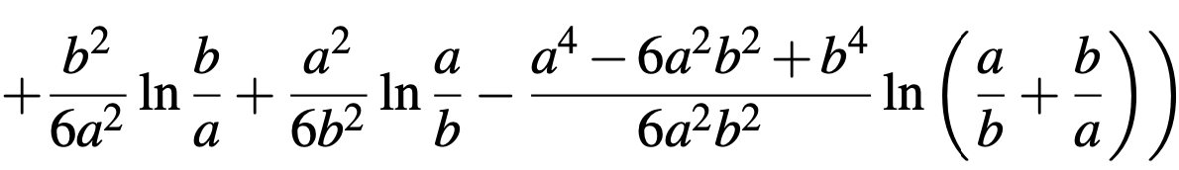
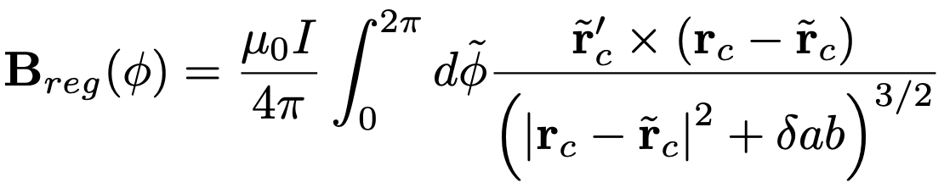
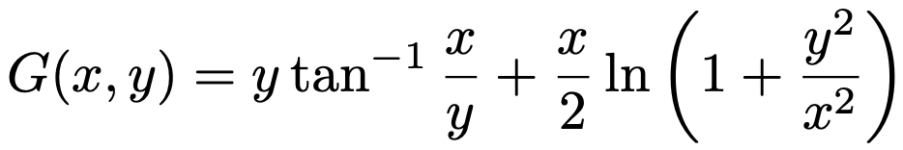

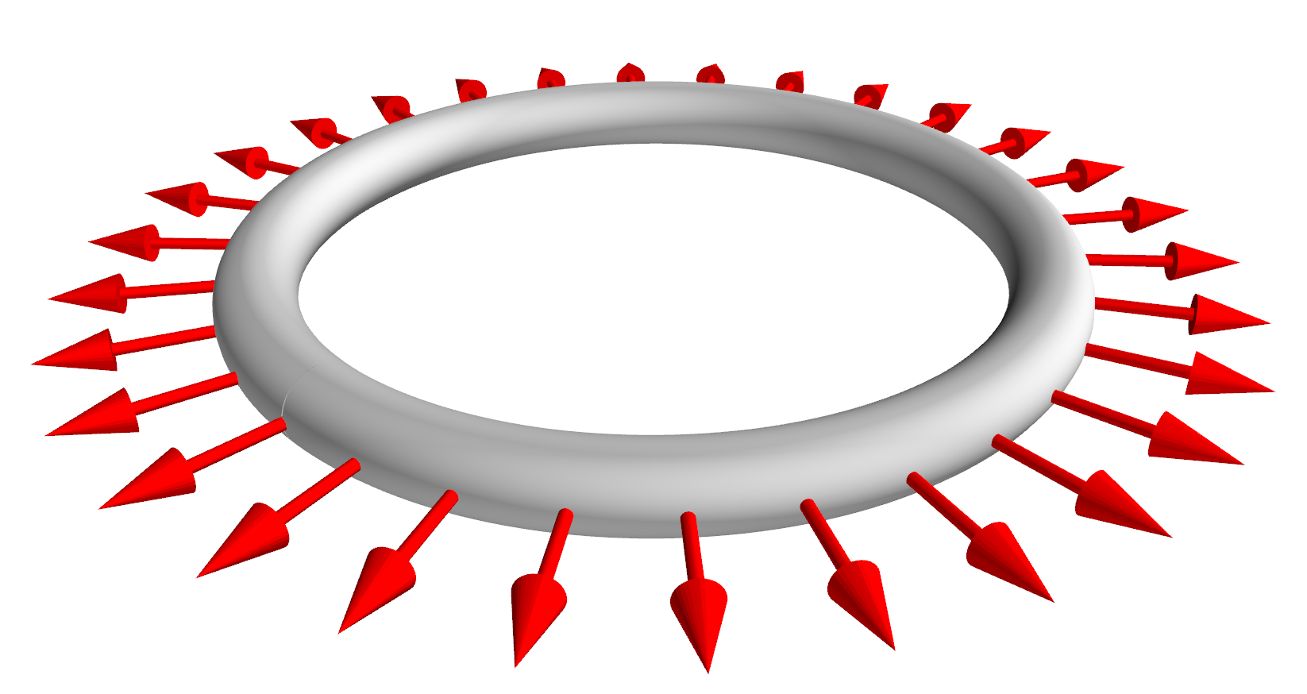
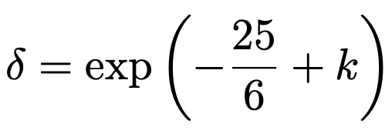
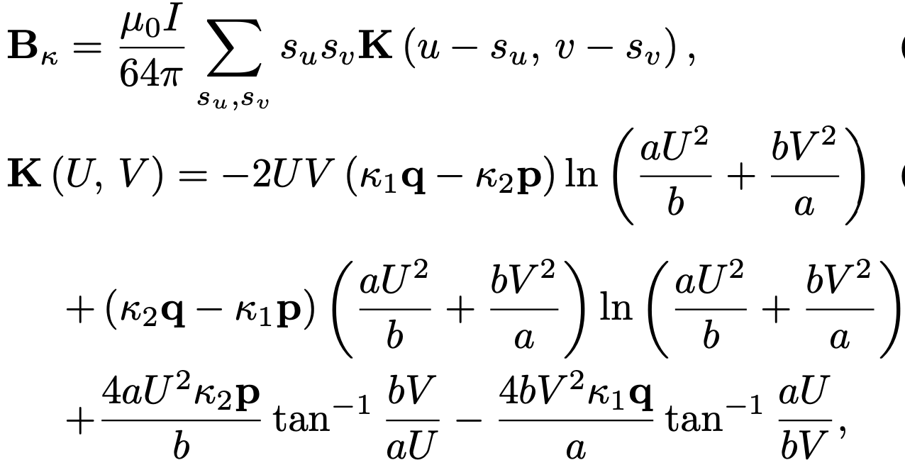
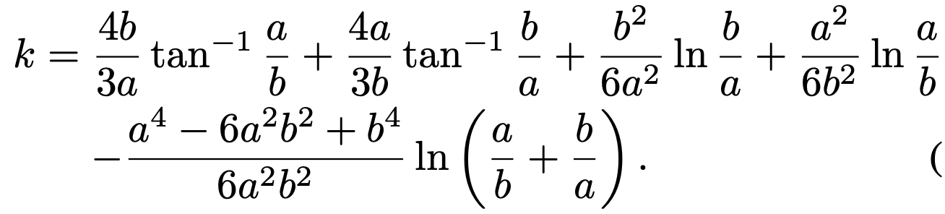
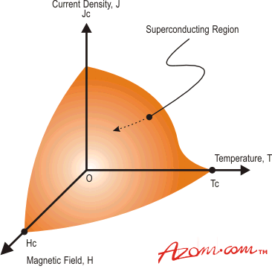
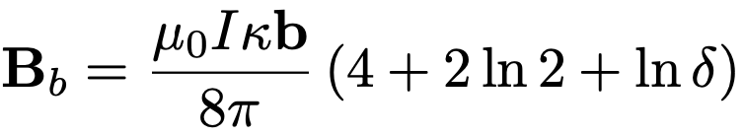
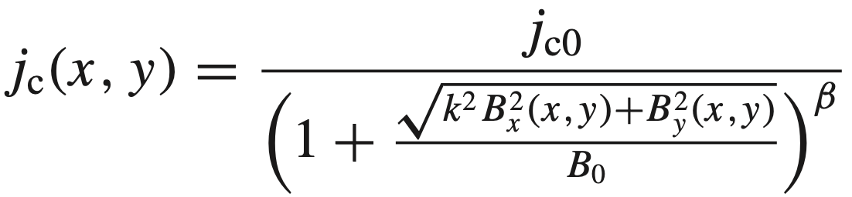
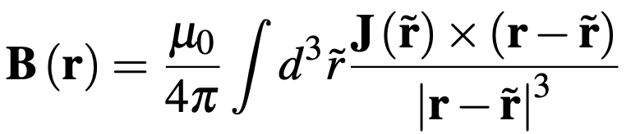
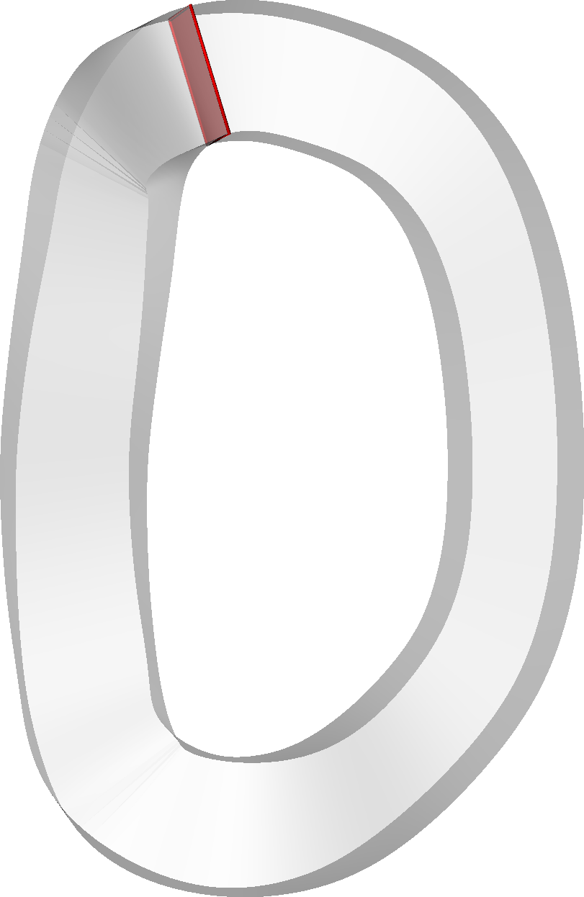
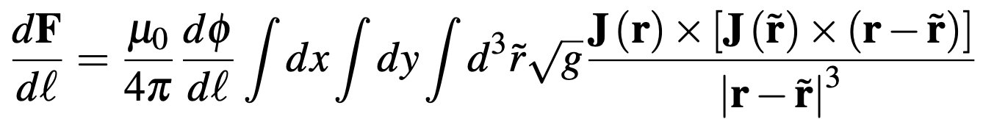
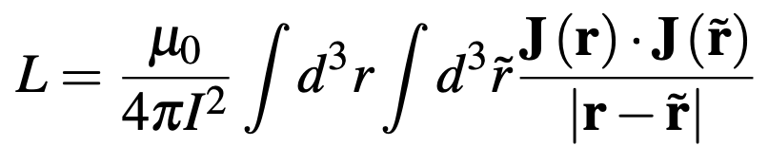
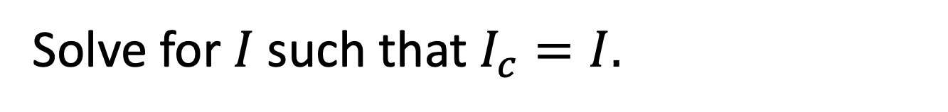
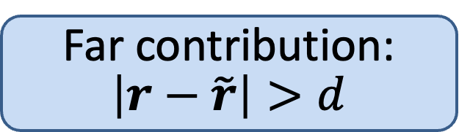
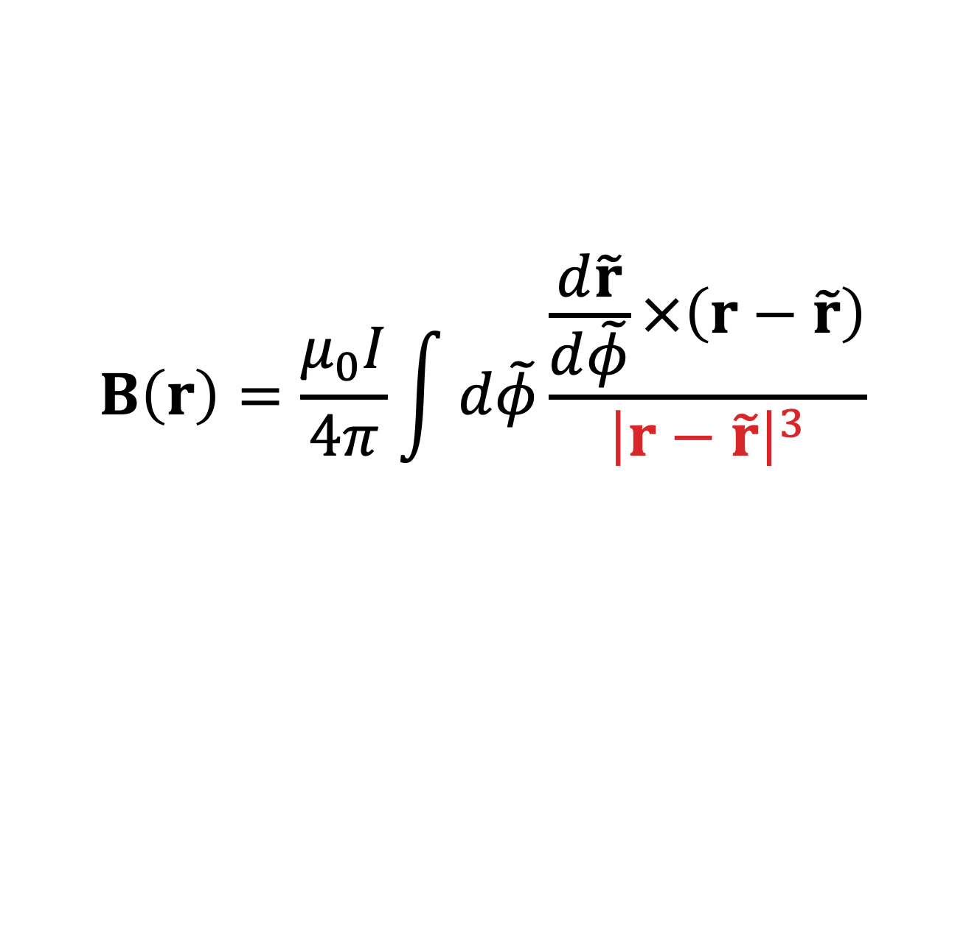
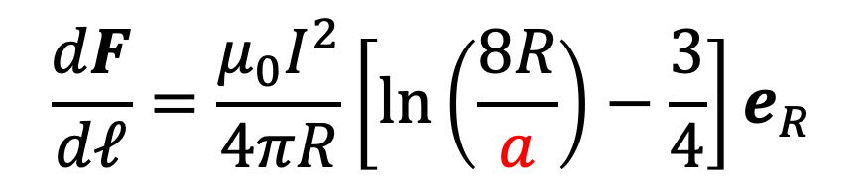
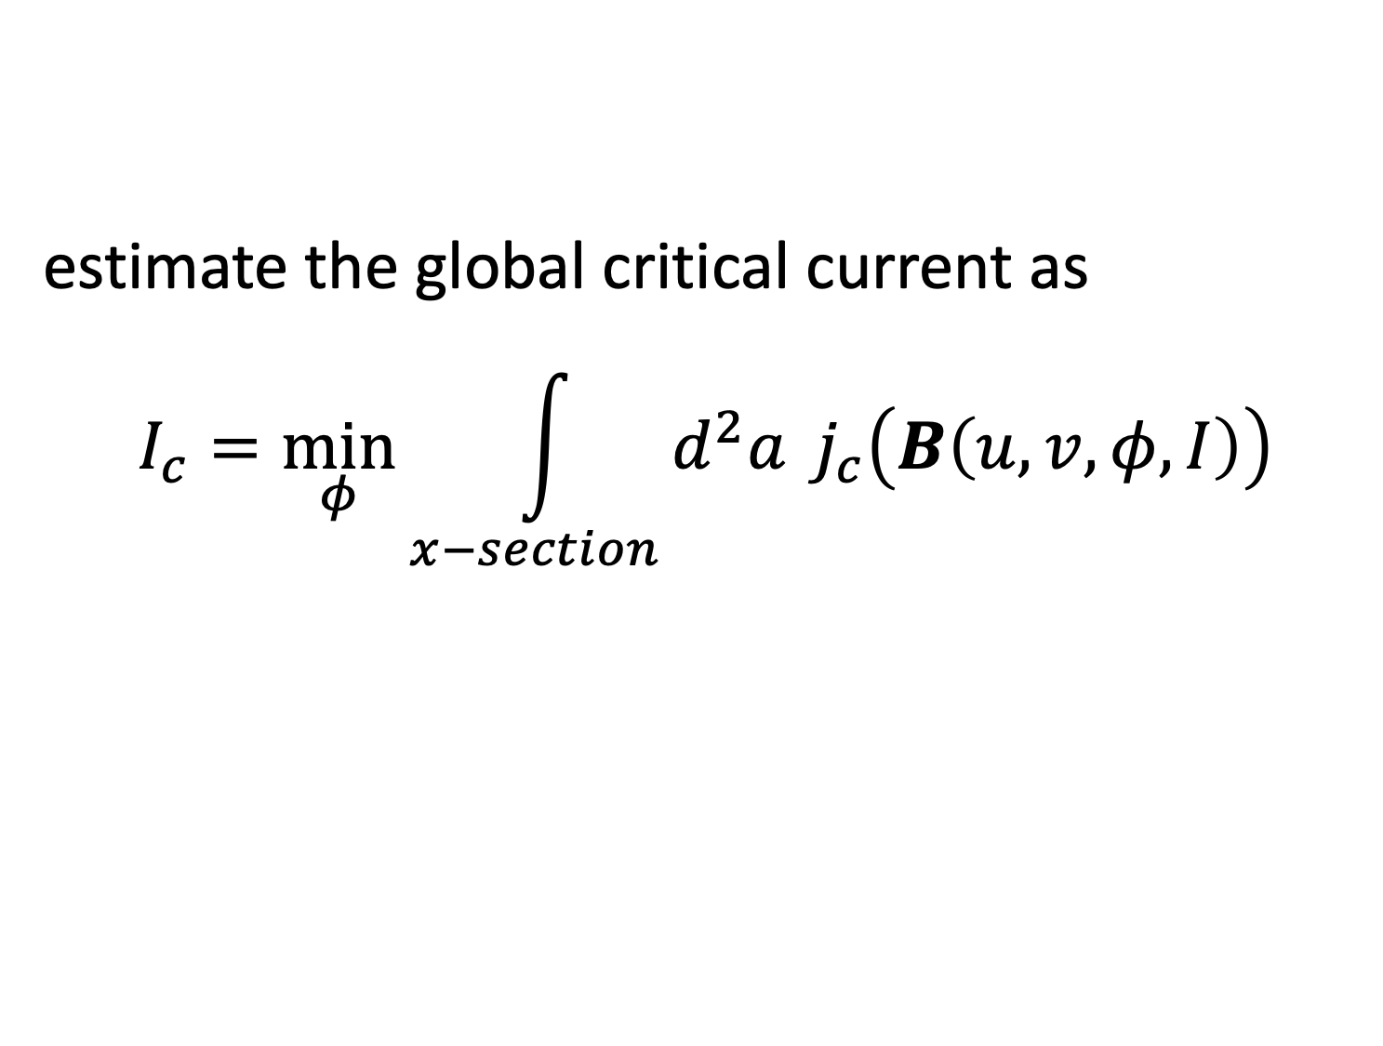

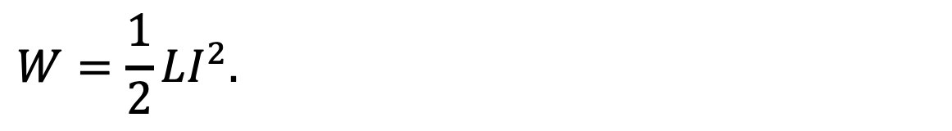

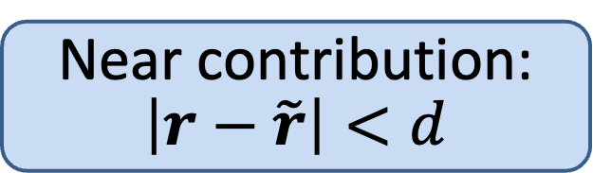
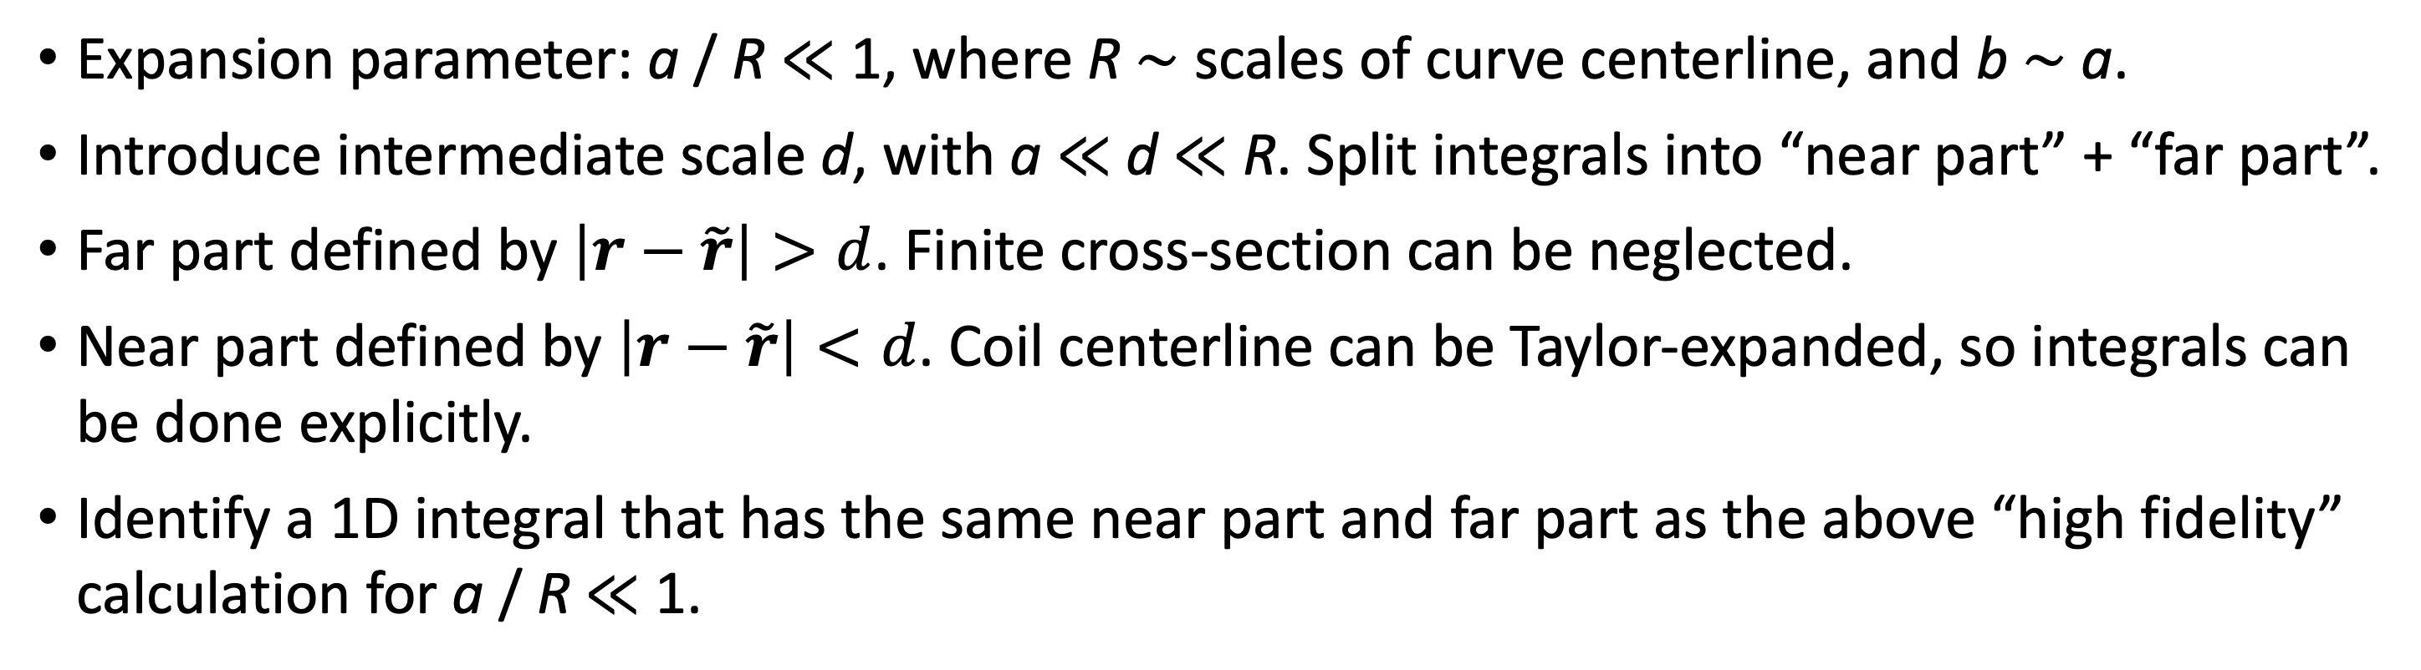
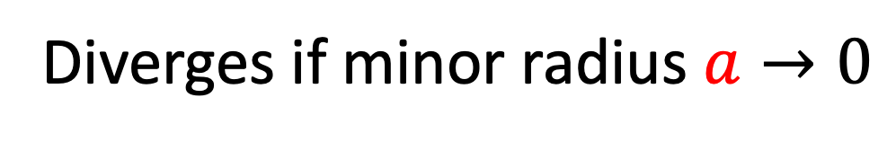
Reduced models of self-force, stored energy, & critical current for design optimization of electromagnets
Matt Landreman, Siena Hurwitz, Tom Antonsen
Motivation
Derivation of reduced models
Self-force
Forces ∝ B². High B limited by support structure.
Superconductor quench limits depend on local B.
Need to be able to dissipate stored energy W = ½LI².
Coil shapes can probably be optimized for these quantities.
Parameterize the conductor volume:
a
a
v = 1
q
b
HSX coil 1
ρ
n
u = -1
r_{c}
p
u = 1
θ
b
v = -1
Field and force on coil 2 due to current in coil 1 can be computed quickly: 1D filament models are ok.
r_{c}
1
2
Expansion parameter: a / R ≪ 1, where R ∼ scales of curve centerline, and b ∼ a.
Introduce intermediate scale d, with a ≪ d ≪ R. Split integrals into “near part” + “far part”.
Far part defined by $\left|r−\tilde{r}\right|>d$. Finite cross-section can be neglected.
Near part defined by $\left|r−\tilde{r}\right|<d$. Coil centerline can be Taylor-expanded, so integrals can be done explicitly.
Identify a 1D integral that has the same near part and far part as the above “high fidelity” calculation for a / R ≪ 1.
Tricky part is the self-field: singularity in
Biot-Savart Law:
$$B\left(r\right)=\frac{μ_{0}I}{4π}\int{d\tilde{φ}\frac{\frac{d\tilde{r}}{d\tilde{φ}}×\left(r−\tilde{r}\right)}{{\left|r−\tilde{r}\right|}^{3}}}$$
~ 18,000x speed-up for same precision
Simply skipping the singular point in a 1D filament calculation gives a non-converging result with significant error:
Self-inductance & stored energy
Maximum |B| in the conductor [Tesla]
Force per unit length [N / m]
a / R ≪ 1
High fidelity 3D model
Far contribution:
$$\left|r−\tilde{r}\right|>d$$
New 1D filament model
Near contribution:
$$\left|r−\tilde{r}\right|<d$$
for circular x-section,
Self-field
for rectangular x-section,
Also apparent from analytic formulas for a circular coil:
$$W=\frac{1}{2}LI^{2}.$$
$$R$$
$$\frac{dF}{dℓ}=\frac{μ_{0}I^{2}}{4πR}\left[ln\left(\frac{8R}{a}\right)−\frac{3}{4}\right]e_{R}$$
Critical current
$$2a$$
Diverges if minor radius $a→0$
Given a model for how the local critical current density depends on B, e.g.
Can we avoid high-dimensional integrals or PDE solve?
Field: 3D integral
Gömöry and Klinčok (2006)
HSX coil 1
estimate the global critical current as
$$I_{c}=\min_{φ}{\int_{x−section}{d^{2}a} j_{c}\left(B\left(u,v,φ,I\right)\right)}$$
azom.com
Force per unit length: 5D integral
High fidelity model
Solve for $I$ such that $I_{c}=I.$
Not self-consistent, but maybe good enough for optimization/estimates?
Self-inductance & stored energy: 6D integral
References
S Hurwitz, Poster GP11.00098 (Tuesday morning)
S Hurwitz, M Landreman , & T Antonsen, arXiv:2310.09313
M Landreman, S Hurwitz, & T Antonsen, arXiv:2310.12087
Supported by DE-FG02-93ER54197 & the Simons Foundation (560651, T. A.).

