Slide 1
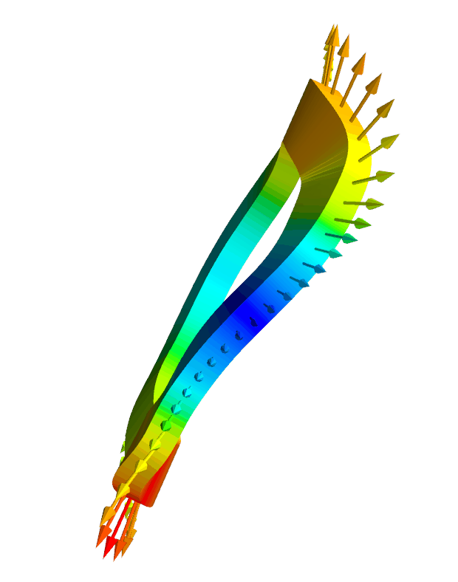
Some theoretical advances for easing stellarator power plant engineering challenges
Matt Landreman¹, John Kappel¹, Siena Hurwitz¹, Tom Antonsen¹, Dhairya Malhotra²,
1. Maryland 2. Flatiron Institute
1. Reduced model for coil self-field, self-force, & critical current
arXiv:2310.09313, arXiv:2310.12087
2. Room for a blanket, & understanding coil-plasma distance
arXiv:2309.11342
Supported by DOE DE-FG02-93ER54197 & the Simons Foundation 560651
Notes:
11 min + 2 for questions
~/Box/work23/20230623-01-HSX_rectangular_xsection_force_animation/20230623-01-mayavi_plot_HSX_rectangular_coil_and_force.py.gif
~/Box/work23/20230430-02-HSX_coil_force_mayavi_animation for circular-xsection version

Slide 2
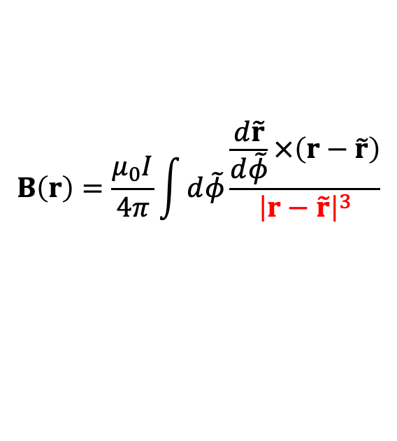

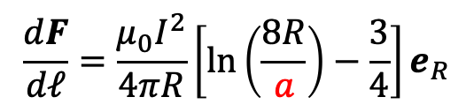
Motivation: We’d like to quickly evaluate & optimize I x B forces, internal field, and stored energy
Forces ∝ B². High B limited by support structure.
Superconductor quench limits depend on local B.
Need to be able to dissipate stored energy W = ½LI².
Tricky part is the self-field: singularity in Biot-Savart Law
$$B\left(r\right)=\frac{μ_{0}I}{4π}\int{d\tilde{φ}\frac{\frac{d\tilde{r}}{d\tilde{φ}}×\left(r−\tilde{r}\right)}{{\left|r−\tilde{r}\right|}^{3}}}$$
Circular coil
$$\frac{dF}{dℓ}=\frac{μ_{0}I^{2}}{4πR}\left[ln\left(\frac{8R}{a}\right)−\frac{3}{4}\right]e_{R}$$
Diverges if minor radius $a→0$

Slide 3
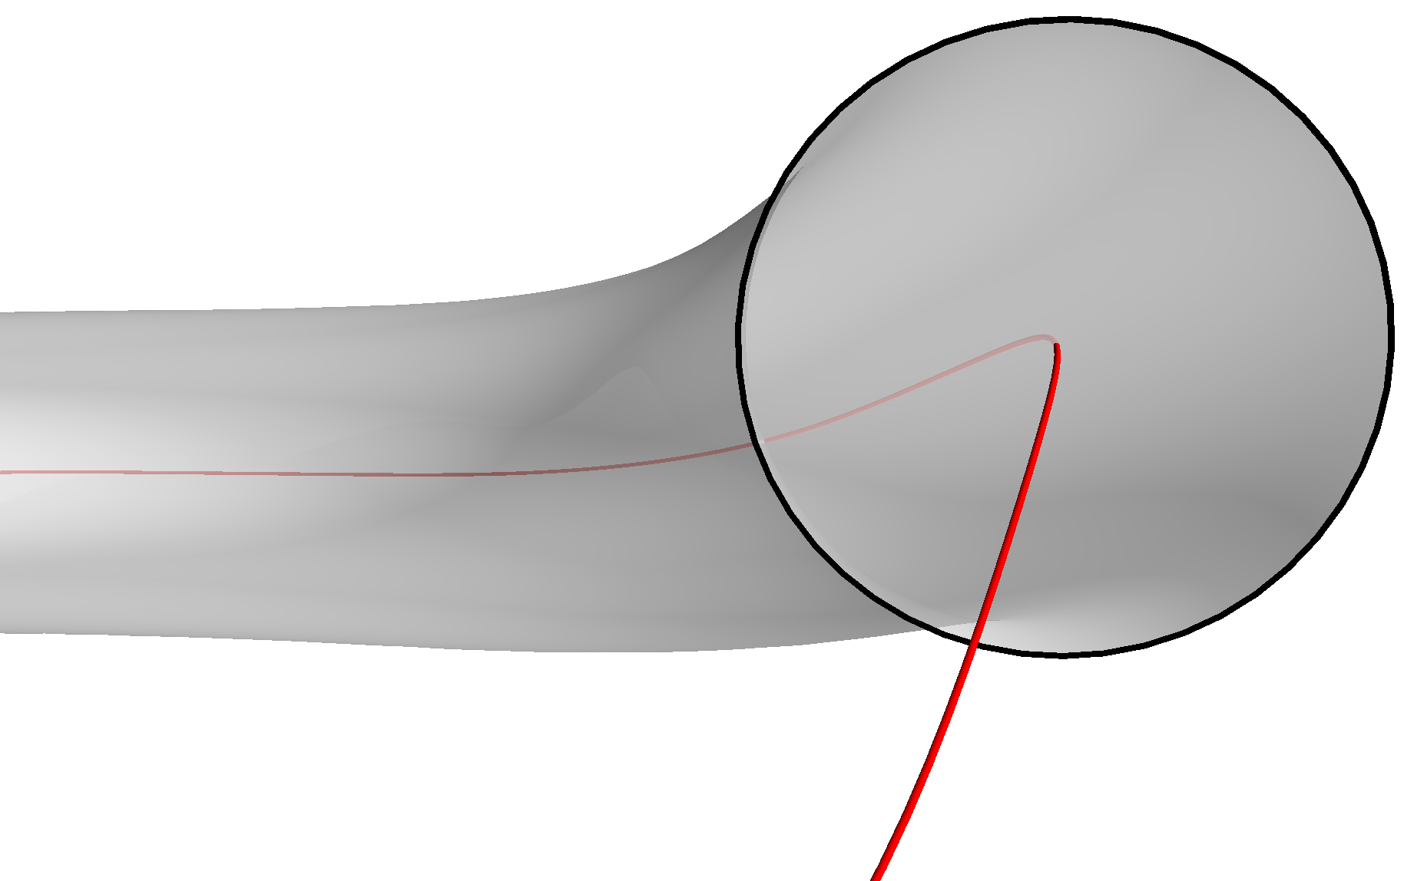
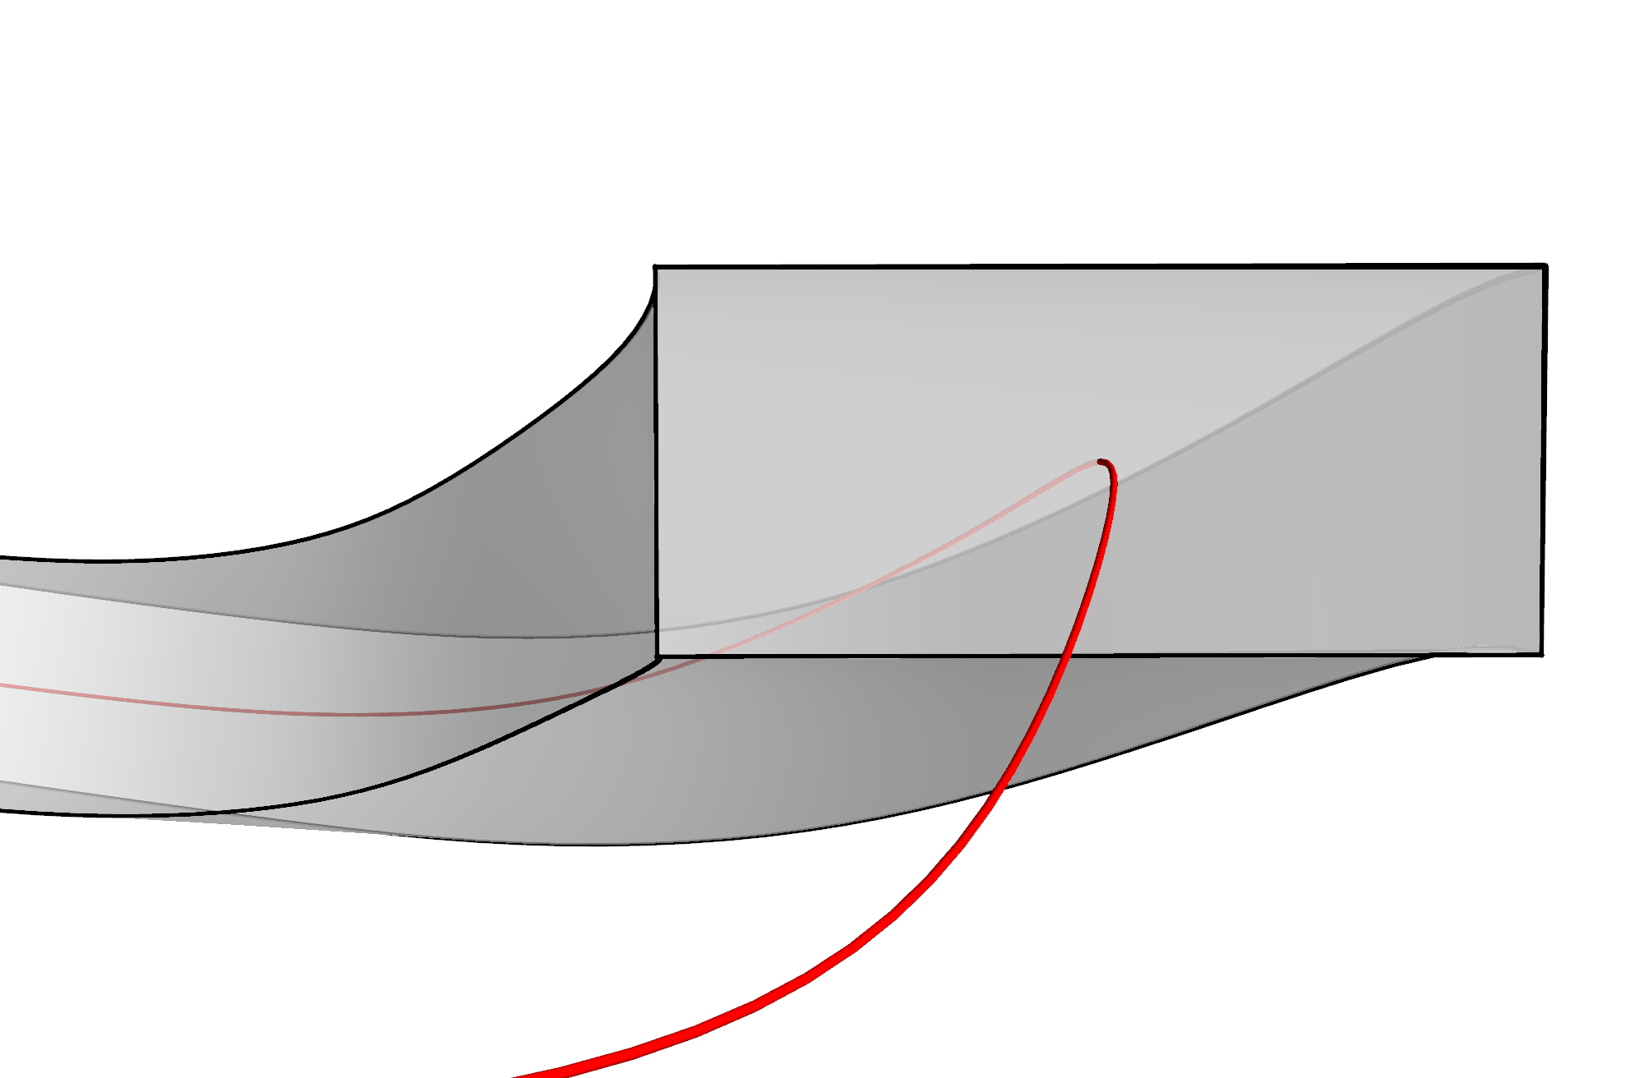
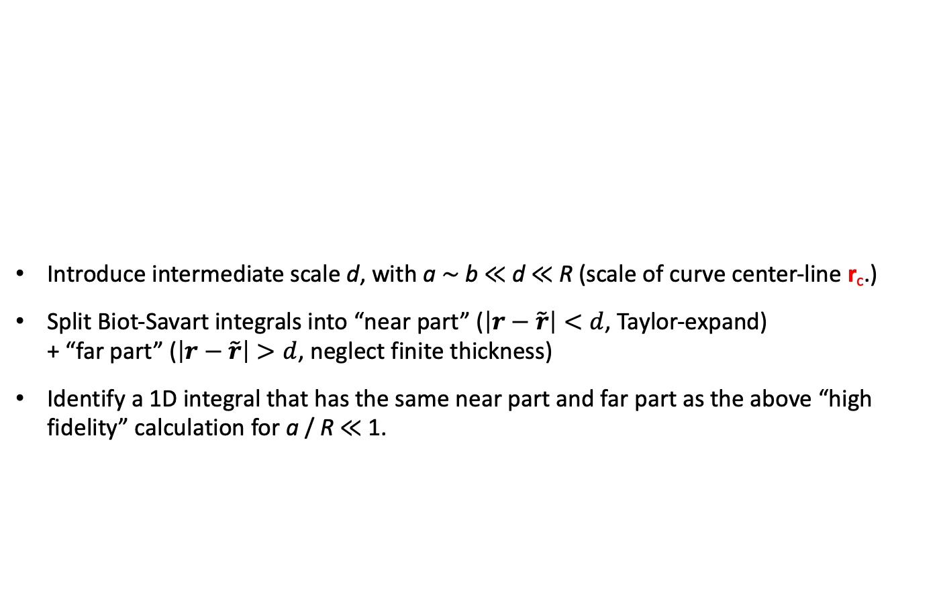
Methodology for finding an accurate reduced model
a
Introduce intermediate scale d, with a ∼ b ≪ d ≪ R (scale of curve center-line r_{c}.)
Split Biot-Savart integrals into “near part” ($\left|r−\tilde{r}\right|<d$, Taylor-expand) + “far part” ($\left|r−\tilde{r}\right|>d$, neglect finite thickness)
Identify a 1D integral that has the same near part and far part as the above “high fidelity” calculation for a / R ≪ 1.
a
b
r_{c}
r_{c}

Slide 4
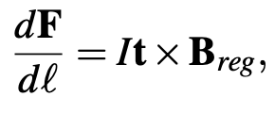
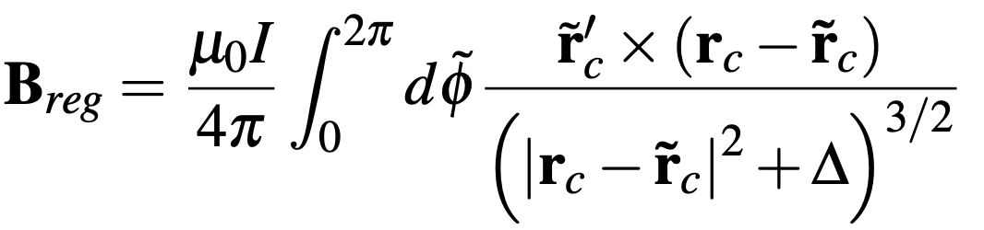
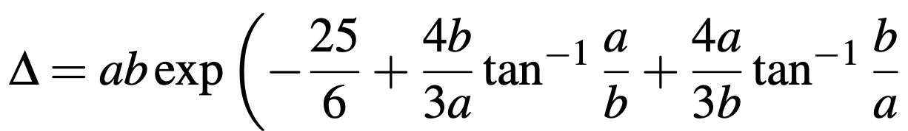
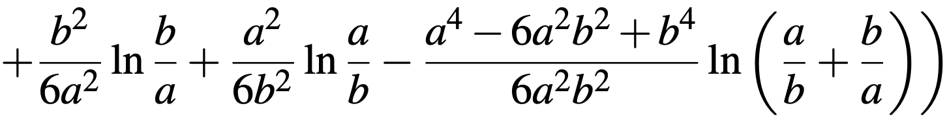
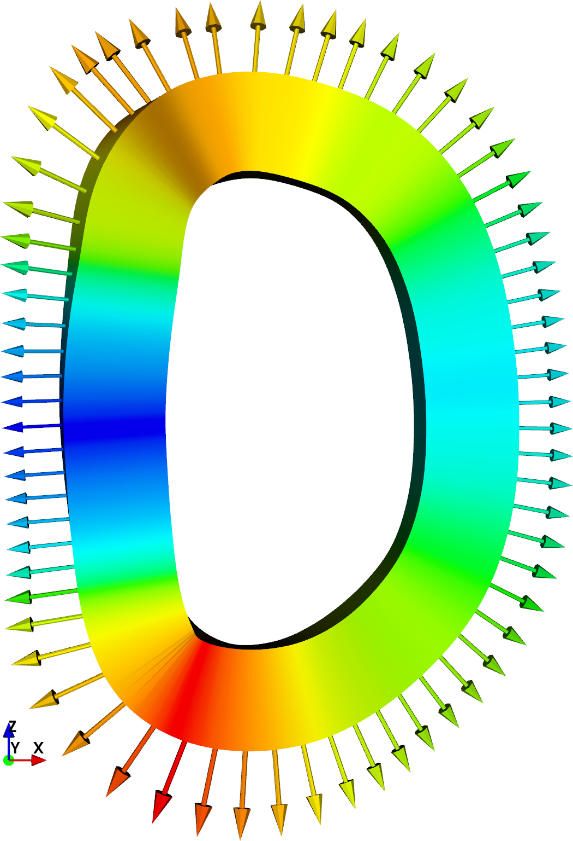
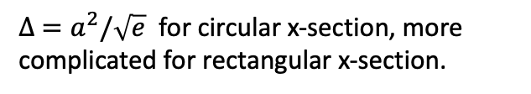
New 1D integral accurately approximates high-fidelity calculations for the self-force in stellarator coils
$∆ =a^{2}/\sqrt{e}$ for circular x-section, more complicated for rectangular x-section.
HSX coil 1
~ 18,000x speed-up for given precision
Model also reproduces high-fidelity calculations for self-inductance & stored energy.
Notes:
20230717-01 Equations for coil force talk.lyx
20230508-01-HSX_coil_force_hifi_vs_filament.pdf
Created using CoilForces.plot_hifi_force_and_1D_for_HSX_for_talk()
3D figures created using 20230508-02-plot_HSX_coil_mayavi_a1cm
And 20230508-01-plot_HSX_coil_mayavi_a10cm
The resulting png files were opened in Preview to turn the background white into transparency.

Slide 5
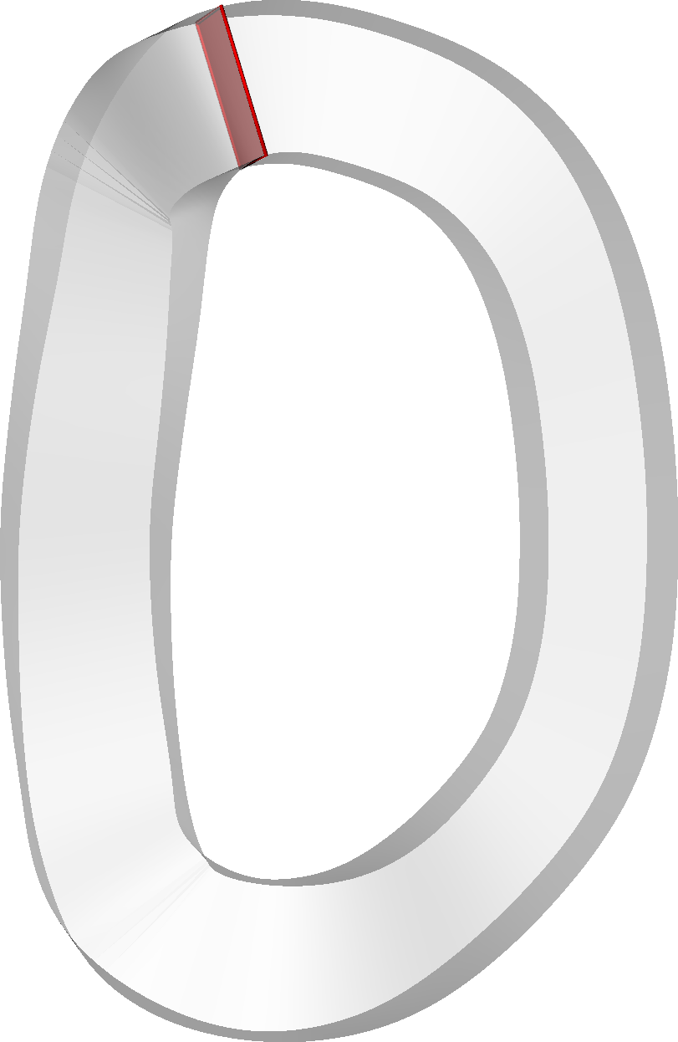
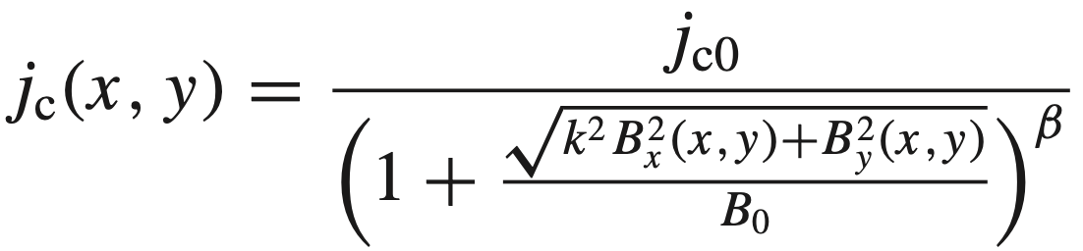
Similar 1D integral for B agrees with the high-fidelity 3D integral for B in stellarator coils
The individual B components also agree:
HSX coil 1
Estimate critical current by iterating with
?
Gömöry and Klinčok (2006)
Notes:
20230624-01-mayavi_plot_HSX_rectangular_coil_phi0_highlight.py.png
20230621-01-HSX_rectangular_xsection_B_for_paper_hifi_modB.pdf
20230621-01-HSX_rectangular_xsection_B_for_paper_hifi_Bz.pdf
20230621-01-HSX_rectangular_xsection_B_for_paper_analytic_modB.pdf
20230621-01-HSX_rectangular_xsection_B_for_paper_analytic_Bz.pdf
CoilForces.plot_high_fidelity_B_vector_for_HSX_coil_for_talk("HSX_B_a0.01_rtol0.001_atol0.001_nphi1_nn64_nb65_2023-05-11T10.06.03.780.dat")
CoilForces.plot_high_fidelity_B_vector_for_HSX_coil_for_talk("HSX_B_a0.01_rtol0.001_atol0.001_nphi2_nn30_nb31_2023-04-27T09.40.25.165.dat")
20230511-02-plot_HSX_coil_with_dot_mayavi_a1cm

Slide 6
Some theoretical advances for easing stellarator power plant engineering challenges
Matt Landreman¹, John Kappel¹, Siena Hurwitz¹, Tom Antonsen¹, Dhairya Malhotra²,
1. Maryland 2. Flatiron Institute
1. Reduced model for coil self-field, self-force, & critical current
arXiv:2310.09313, arXiv:2310.12087
2. Room for a blanket, & understanding coil-plasma distance
arXiv:2309.11342
Supported by DOE DE-FG02-93ER54197 & the Simons Foundation 560651
Notes:
11 min + 2 for questions
~/Box/work23/20230623-01-HSX_rectangular_xsection_force_animation/20230623-01-mayavi_plot_HSX_rectangular_coil_and_force.py.gif
~/Box/work23/20230430-02-HSX_coil_force_mayavi_animation for circular-xsection version

Slide 7
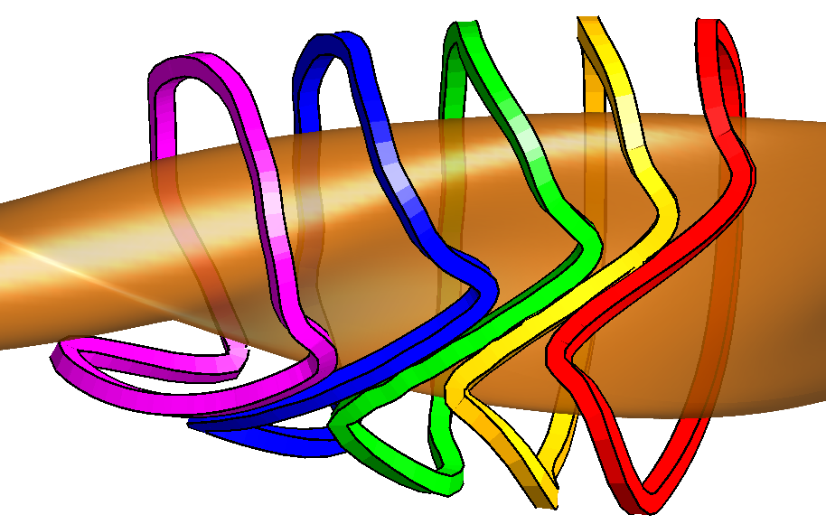
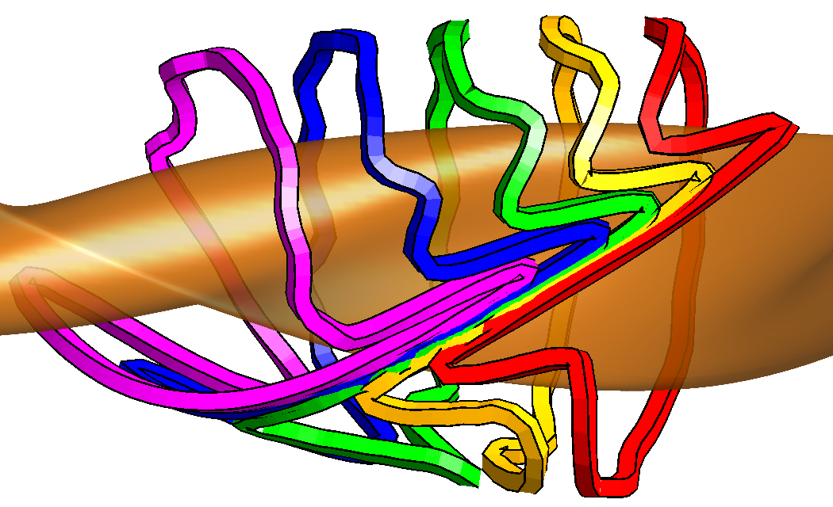
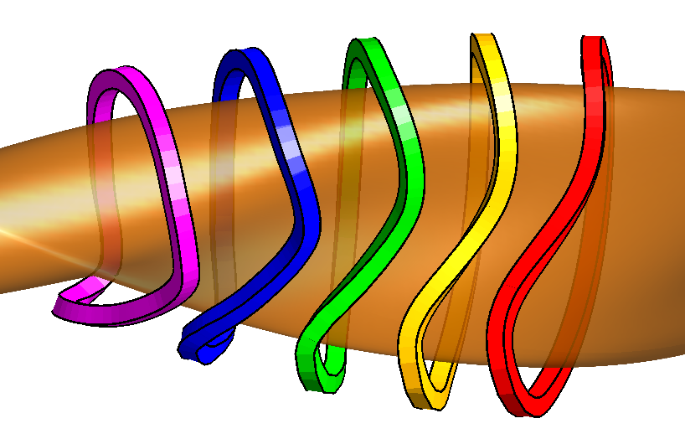
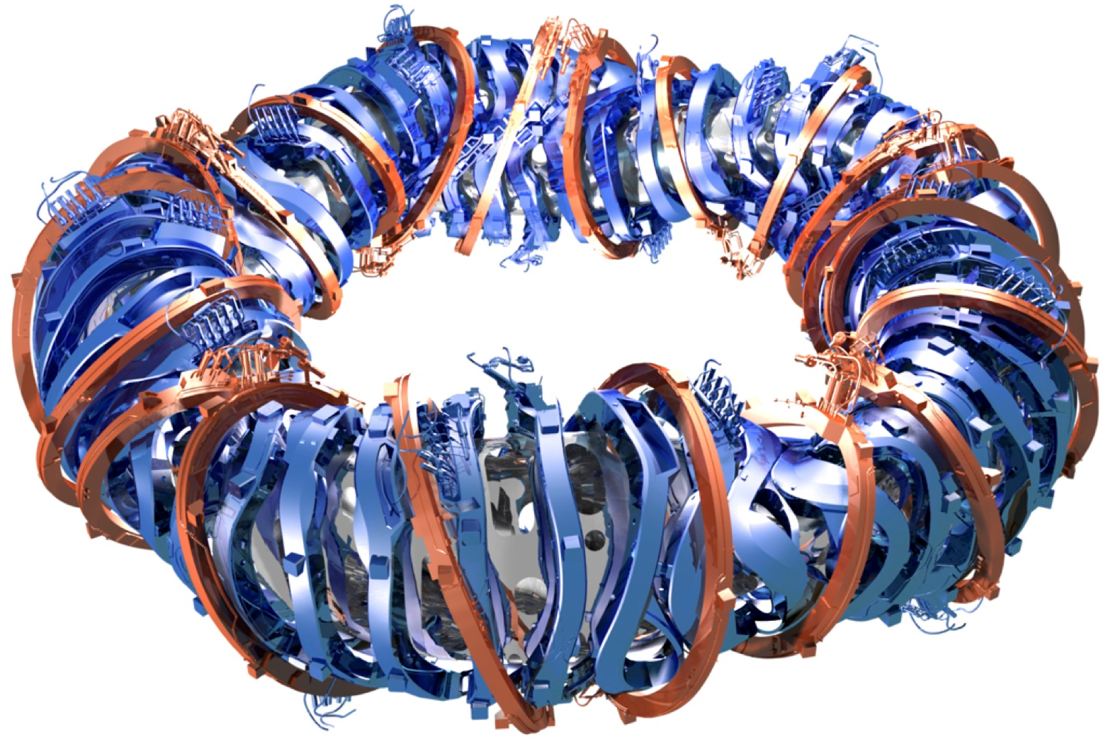
In a reactor, must fit ~ 1.5m “blanket” between plasma and coils to absorb neutrons
But at fixed plasma shape & size, coils shapes become impractical if they are too far away:
Coils offset a uniform distance from W7-X plasma:
25cm separation
50cm separation
65cm separation
So we must scale everything up:
$$$
$$$
Najmabadi et al (2008),
Lion et al (2021)
Notes:
m20160512_01_nescoutTo3DCoil.m
NESCOIL runs on nersc in 20160512-01-IllustrationOfCoilComplexityIncreasingWithSeparation

Slide 8
In a reactor, must fit ~ 1.5m “blanket” between plasma and coils to absorb neutrons
But at fixed plasma shape & size, coils shapes become impractical if they are too far away:
Coils offset a uniform distance from W7-X plasma:
25cm separation
50cm separation
65cm separation
Hypothesis:
The coil-to-plasma distance scale for which coils are feasible is ~ the 𝛁B scale length
Notes:
m20160512_01_nescoutTo3DCoils.m
NESCOIL runs on nersc in 20160512-01-IllustrationOfCoilComplexityIncreasingWithSeparation

Slide 9
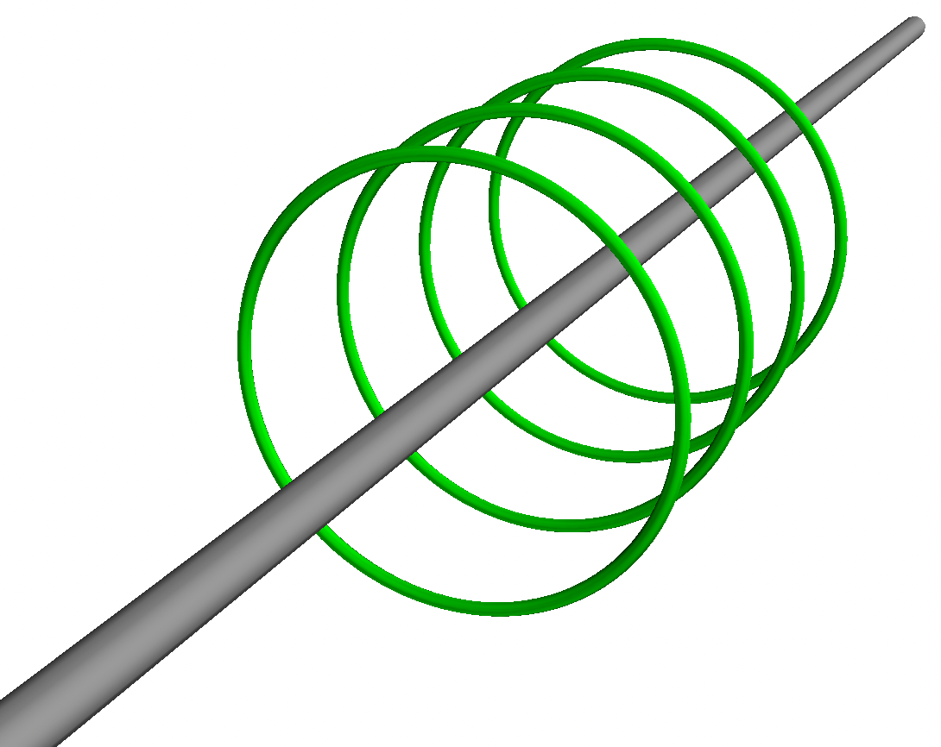
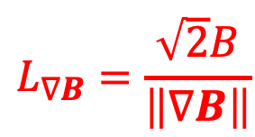


At any point, a magnetic field has multiple gradient length scales
$∇B$, $∇_{||}B$, $∇_{⊥}B$, $b∙∇b$, $\left\|∇B\right\|=\sqrt{∇B:∇B}$, eigenvalues of $∇B$, $\left\|∇∇B\right\|$…
($B=\left|B\right|$, $b=B/B$)
Frobenius norm
$\left\|∇B\right\|$ smoothly captures largest gradient ⟹ shortest length scale
B
Normalize so scale length gives the distance to an infinite straight wire:
$$L_{∇B}=\frac{\sqrt{2}B}{\left\|∇B\right\|}$$
$$L_{∇B}=R$$
I
Notes:
E.g. pick the z direction along B, and pick the x direction along grad_perp |B|. Then Phi_{yz} = 0.

Slide 10
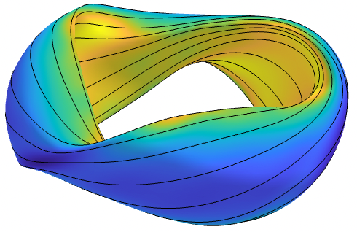
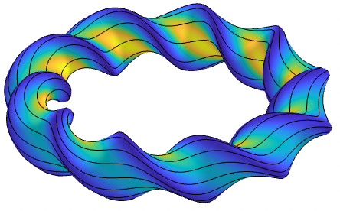
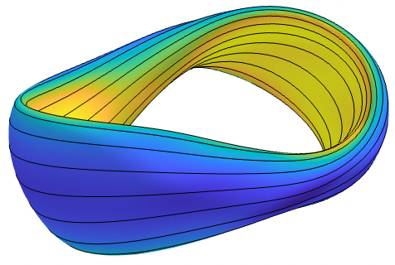
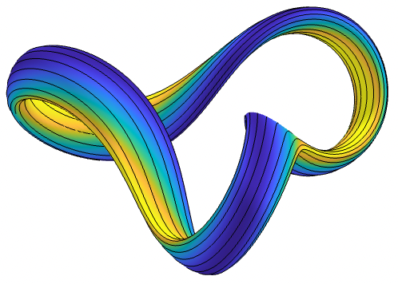
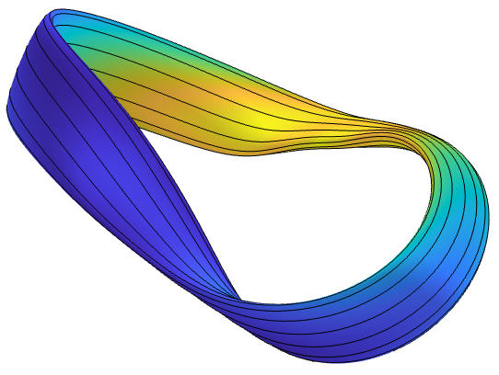
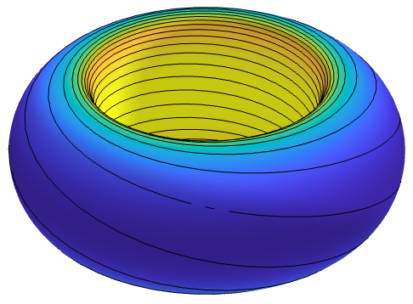
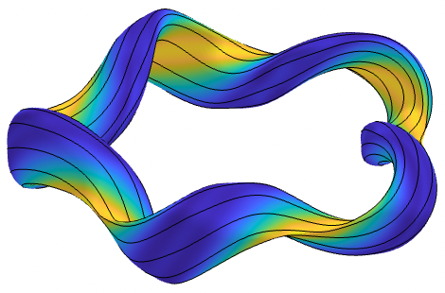
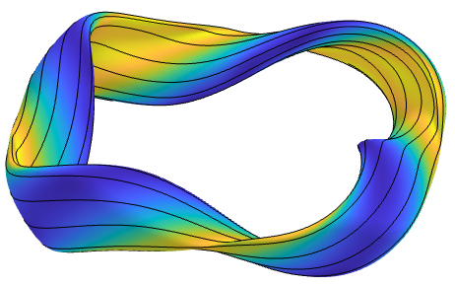
To test hypothesis that 𝛁B is related to coil-plasma distance, scale length will be compared to “real” coil designs for a diverse set of 45 configurations
W7-X, LHD, HSX, CFQS, CTH, CNT, NCSX, TJ-II, QPS, ATF, Precise QA/QH, CIEMAT-QI, ITER, …
All scaled to same minor radius (1.7 m) and ⟨B⟩ = 5.9 T of ARIES-CS.
Coils computed with REGCOIL for a uniform-offset winding surface.
Coil-to-plasma distance & regularization computed so that B_{normal} error and “coil complexity” (sheet current density) are same for all configuration.
Notes:
m20210604_01_plotVMECWout_withFieldlineSeamAtBottom.m

Slide 11
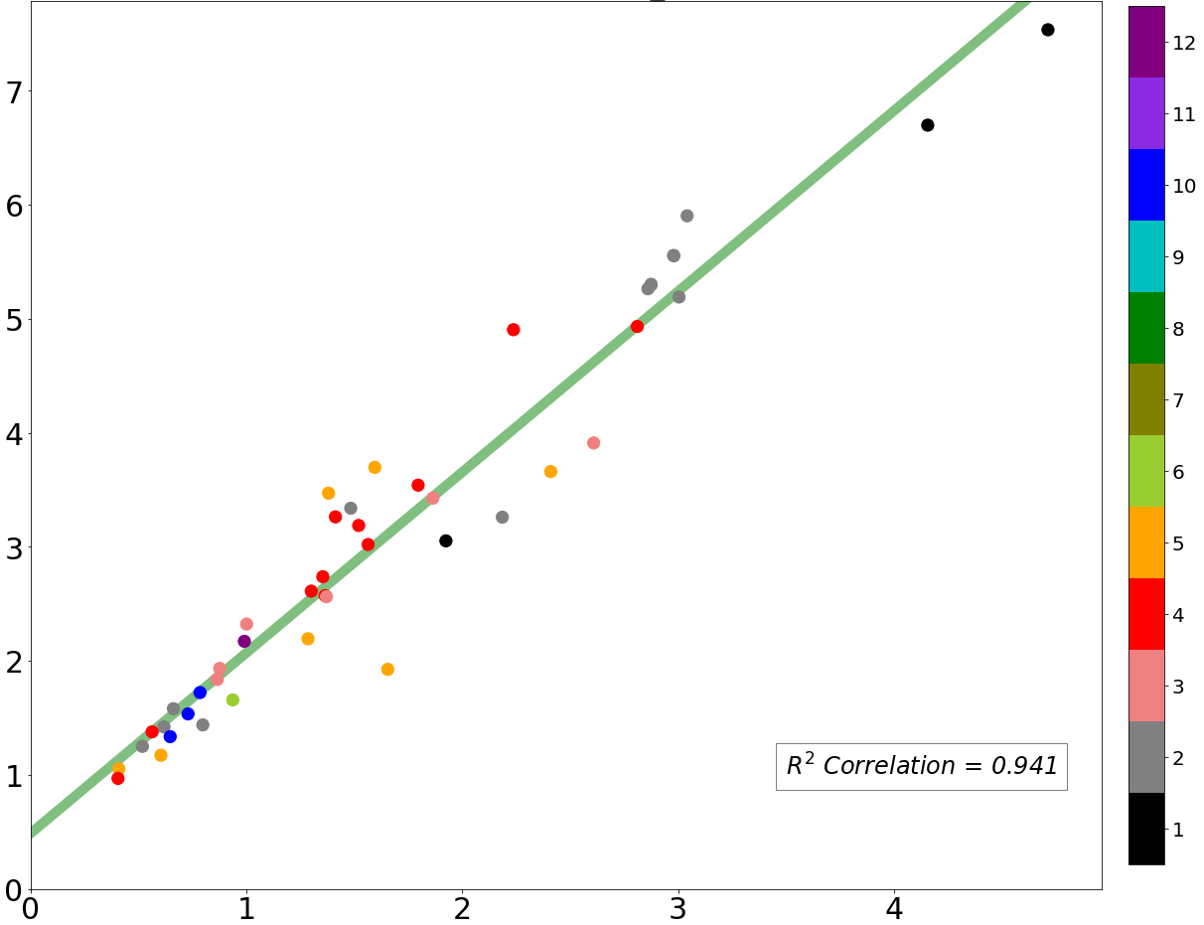
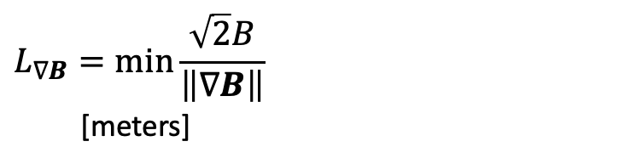
Main result: 𝛁B length is well correlated with real coil designs
$$L_{∇B}=\min_{}{\frac{\sqrt{2}B}{\left\|∇B\right\|}}$$
[meters]
nfp (number of field periods)
Stellarators do exist with sufficient space for a blanket,
particularly if nfp = 1 or 2.
All configs scaled to a_{minor} = 1.7 m
Coil-to-plasma distance from REGCOIL [meters]
Notes:
coloredMoneyPlot.png, in email from John on 1012-Oct 12

Slide 12
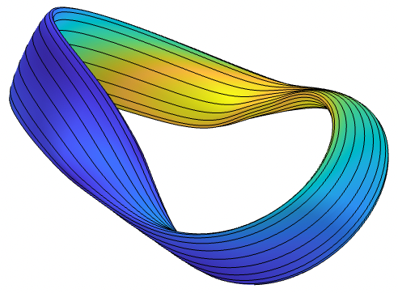
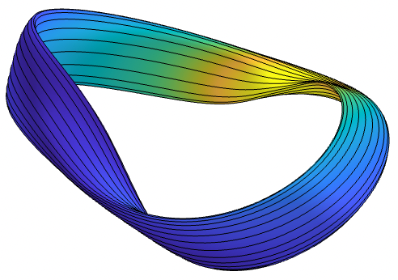
Main result: 𝛁B length is well correlated with real coil designs
Jorge nfp1 QI
$$L_{∇B}=\min_{}{\frac{\sqrt{2}B}{\left\|∇B\right\|}}$$
[meters]
Goodman nfp1 QI
Precise QAs
HSX with ripple
HSX without ripple
W7-X with ripple
ITER
NCSX
ROSE nfp5 QH
W7-X
Stellarators do exist with sufficient space for a blanket,
particularly if nfp = 1 or 2.
CTH
Wistell-B
Ku QH
All configs scaled to a_{minor} = 1.7 m
Coil-to-plasma distance from REGCOIL [meters]
Notes:
20221103-01-plot_Kappel_results_grad_B_tensor.pdf

Slide 13
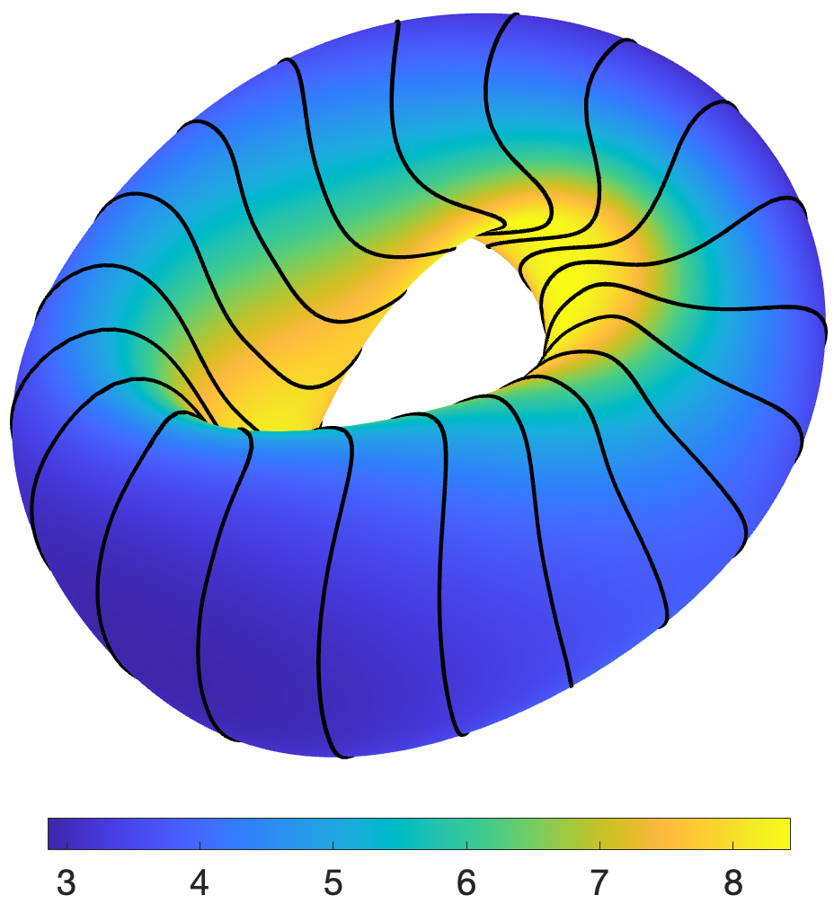
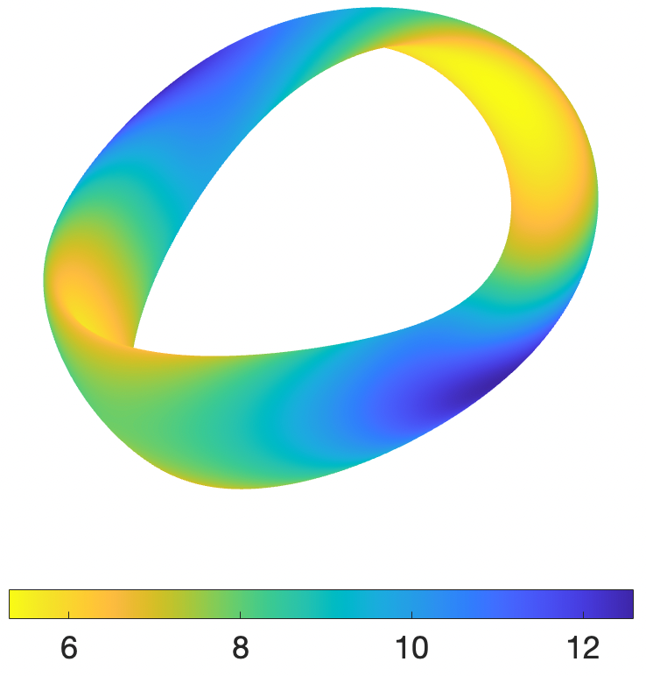
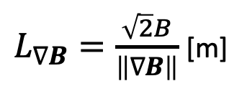
The location of limiting 𝛁B length and coil complexity are also correlated spatially
$L_{∇B}=\frac{\sqrt{2}B}{\left\|∇B\right\|}$ [m]
Current density K [MA/m]
Limiting coil-to-coil distance occurs where scale length is smallest
Plasma surface
Coil winding surface
Notes:
m20221101_01_plot_regcoil_coils_and_current_density.m
m20221031_02_plotRegcoilCurrentDensity3D.m

Slide 14
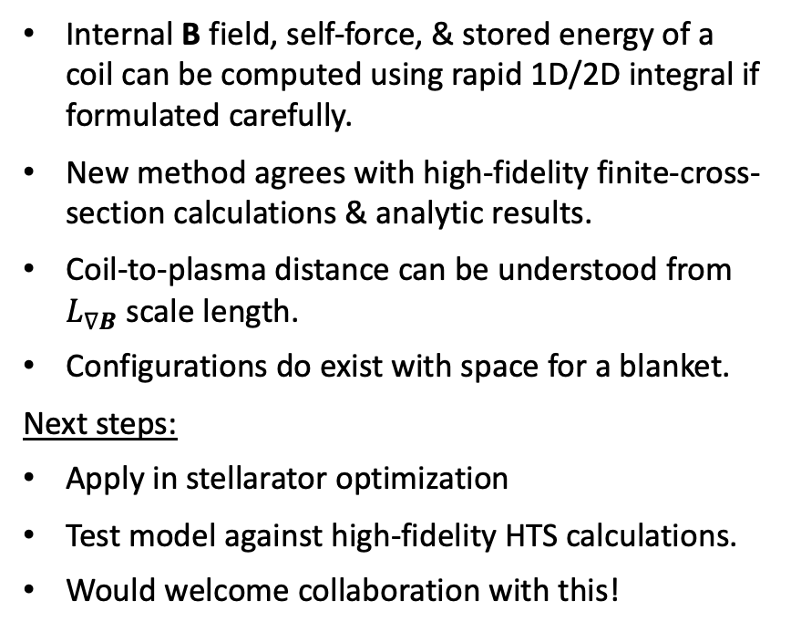
Conclusions & future work
Internal B field, self-force, & stored energy of a coil can be computed using rapid 1D/2D integral if formulated carefully.
New method agrees with high-fidelity finite-cross-section calculations & analytic results.
Coil-to-plasma distance can be understood from $L_{∇B}$ scale length.
Configurations do exist with space for a blanket.
Next steps:
Apply in stellarator optimization
Test model against high-fidelity HTS calculations.
Would welcome collaboration with this!
arXiv:2310.09313, arXiv:2310.12087, arXiv:2309.11342

Slide 15
Extra slides

Slide 16
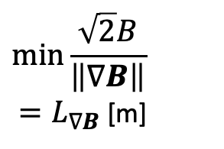
Main result: 𝛁B length is well correlated with real coil designs
$$\min_{}{\frac{\sqrt{2}B}{\left\|∇B\right\|}}$$
${=L}_{∇B}$ [m]
Stellarators do exist with sufficient space for a blanket,
Particularly if nfp = 1 or 2.
Coil-to-plasma distance from REGCOIL [m]
Notes:
20221103-01-plot_Kappel_results_grad_B_tensor.pdf

Slide 17
Main result: 𝛁B length is well correlated with real coil designs
Jorge nfp1 QI
$$\min_{}{\frac{\sqrt{2}B}{\left\|∇B\right\|}}$$
${=L}_{∇B}$ [m]
Goodman nfp1 QI
Precise QAs
HSX with ripple
HSX without ripple
W7-X with ripple
ITER
NCSX
ROSE nfp5 QH
W7-X
Stellarators do exist with sufficient space for a blanket,
Particularly if nfp = 1 or 2.
CTH
Wistell-B
Ku QH
Coil-to-plasma distance from REGCOIL [m]
Notes:
20221103-01-plot_Kappel_results_grad_B_tensor.pdf

Slide 18
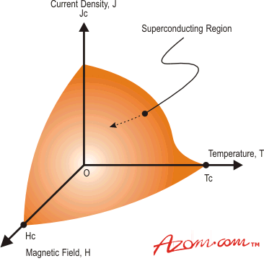
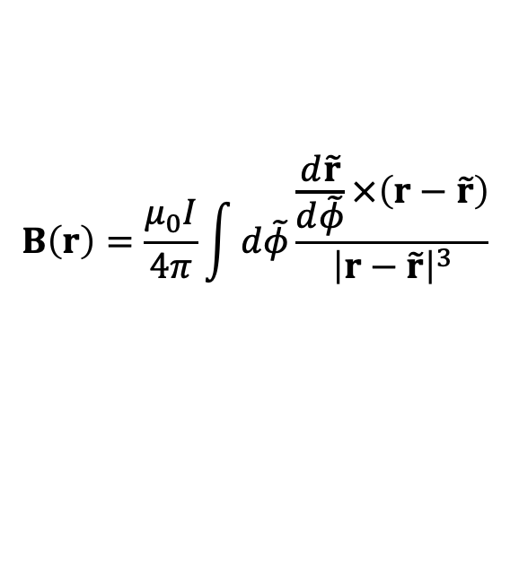
Tokamak & stellarator design requires calculations for the
I x B force, internal field, and stored energy
Forces ∝ B². High B limited by support structure.
Superconductor quench limits depend on local B.
Need to be able to dissipate stored energy W = ½LI².
Coil shapes can probably be optimized for these quantities.
Field and force on coil 2 due to current in coil 1 can be computed quickly: 1D filament models are ok.
azom.com
1
$$B\left(r\right)=\frac{μ_{0}I}{4π}\int{d\tilde{φ}\frac{\frac{d\tilde{r}}{d\tilde{φ}}×\left(r−\tilde{r}\right)}{{\left|r−\tilde{r}\right|}^{3}}}$$
2
Tricky part is the self-field: singularity in Biot-Savart Law

Slide 19

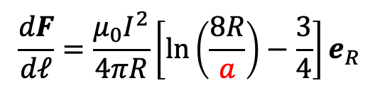
Simply skipping the singular point in a 1D filament calculation gives a non-converging result with significant error
Circular coil
Maximum |B| in the conductor [Tesla]
$$\frac{dF}{dℓ}=\frac{μ_{0}I^{2}}{4πR}\left[ln\left(\frac{8R}{a}\right)−\frac{3}{4}\right]e_{R}$$
Diverges if minor radius $a→0$

Slide 20
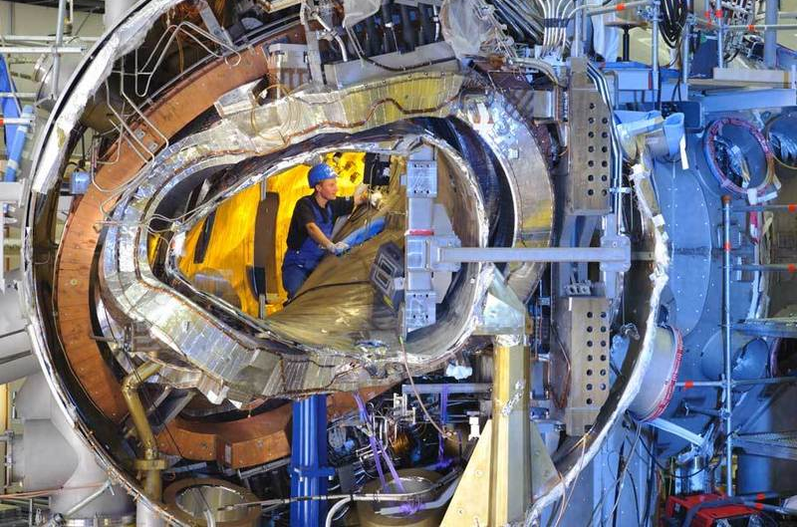
The small coil-to-plasma separation in stellarators is a headache for engineering
W7-X
“Lesson 1: A lack of generous margins, clearances and reasonable tolerance levels implies an unnecessary increase of the complexity and leads to late design changes. This has a strong impact on schedule, budget, man-power and potentially sours the relationship to funding bodies.”
Klinger et al, Fusion Engineering & Design (2013)

Slide 21
To test hypothesis that 𝛁B is related to coil-plasma distance, scale length will be compared to “real” coil designs for a diverse set of ~45 configurations
NCSX (li383 & c09r00)
ARIES-CS
HSX
W7-X (std, high-mirror, …)
LHD, R=3.5, 3.6, 3.75
CFQS
ML+Paul QA, QH
ML, Buller, Drevlak QA, QH
Near-axis QH
Jorge et al QI
Goodman et al QIs
ESTELL
ITER
CNT
CTH
TJ-II
QPS
ATF
CIEMAT-QI
Garabedian QA
Henneberg et al QA
Wistell-A, B
Wechsung et al QA
Giuliani et al QA
Ku & Boozer nfp=4 QH
Nuhrenberg & Zille QH
Drevlak QH
…
All scaled to same minor radius (1.7 m) and ⟨B⟩ = 5.9 T.
Notes:
m20210604_01_plotVMECWout_withFieldlineSeamAtBottom.m

Slide 22
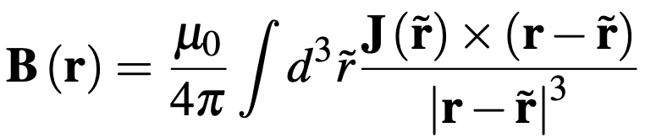
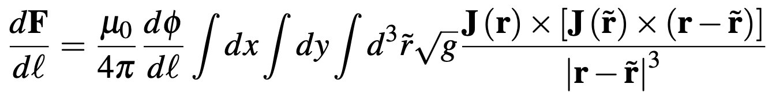
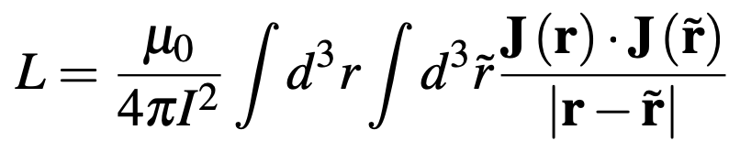
Accurate calculation of the internal field and self-force appear to require high-dimensional integrals
Field: 3D integral
Force per unit length: 5D integral
Self-inductance & stored energy: 6D integral
Can we simplify/approximate these integrals for fast evaluation inside an optimization loop?
Notes:
20230501-01 Equations for coil force talk.lyx
20230717-01 Equations for coil force talk.lyx

Slide 23
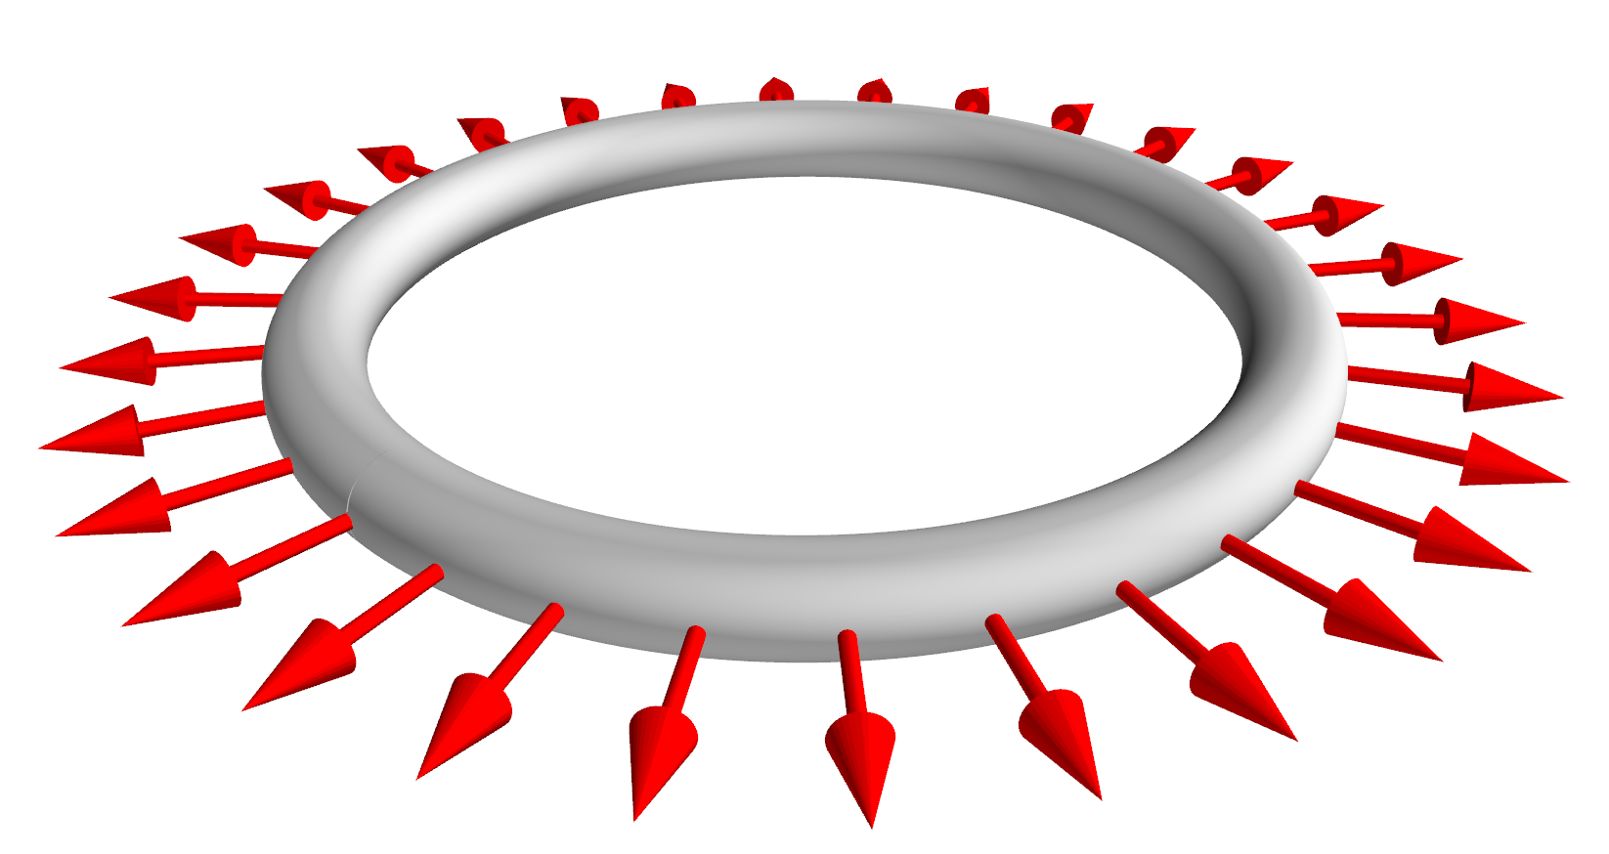




Analytic formulas for a circular coil show that the finite cross-section cannot be ignored
$$\frac{dF}{dℓ}=\frac{μ_{0}I^{2}}{4πR}\left[ln\left(\frac{8R}{a}\right)−\frac{3}{4}\right]e_{R}$$
$$R$$
$$2a$$
Diverges if minor radius $a→0$
Could a modified 1D filament model work if we supplement it with a value for a?
Notes:
20230510-01-plot_circular_coil_mayavi
20230511-05-plot_circular_coil_mayavi_with_force_arrows

Slide 24
Simply skipping the singular point in a 1D filament calculation gives a non-converging result with significant error
Circular coil
Maximum |B| in the conductor [Tesla]
Force per unit length [N / m]

Slide 25
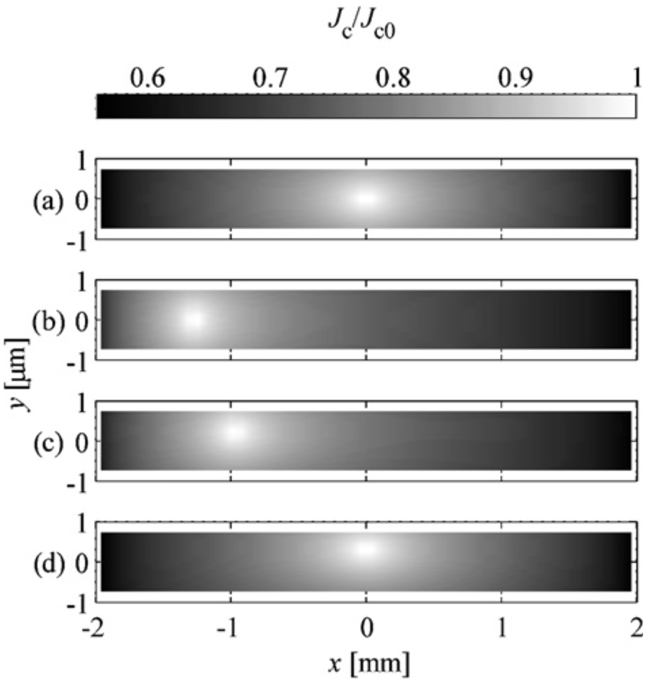
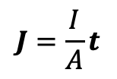
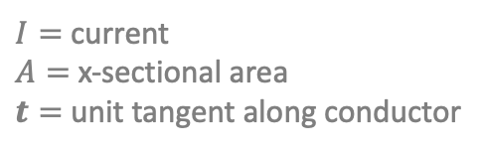
Assumption: current density J is uniform
$$J=\frac{I}{A}t$$
$I=$ current
$A=$ x-sectional area
$t=$ unit tangent along conductor
J in YBCO
Ok if multiple turns in both dimensions of the x-section.
Not necessarily accurate for superconductors, particularly HTS tapes.
Good enough for optimization?
Rostila et al, (2007)

Slide 26
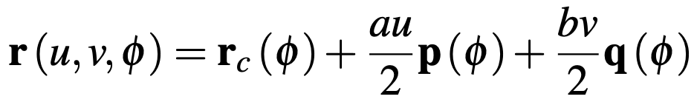
We can do the calculations for cross-sections that are either circular or rectangular
a
a
v = 1
q
b
u = -1
r_{c}
p
u = 1
ρ
n
b
v = -1
θ
r_{c}
Notes:
20230717-04-mayavi_plot_HSX_circular_xsection_coil_for_coordinate_definitions
20230707-01-mayavi_plot_HSX_rectangular_coil_for_coordinate_definitions
20230511-03-plot_HSX_coil_mayavi_a1cm_incomplete.png

Slide 27
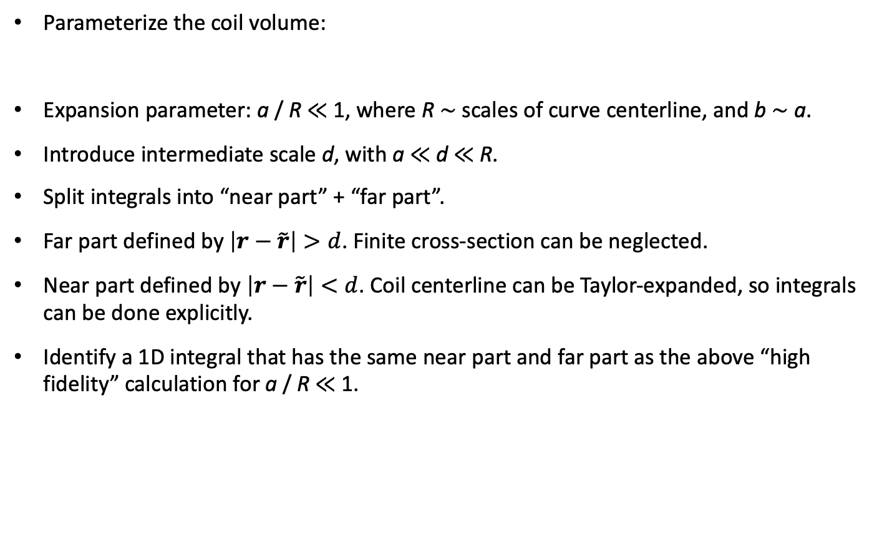
Methodology for finding an accurate reduced model
Parameterize the coil volume:
Expansion parameter: a / R ≪ 1, where R ∼ scales of curve centerline, and b ∼ a.
Introduce intermediate scale d, with a ≪ d ≪ R.
Split integrals into “near part” + “far part”.
Far part defined by $\left|r−\tilde{r}\right|>d$. Finite cross-section can be neglected.
Near part defined by $\left|r−\tilde{r}\right|<d$. Coil centerline can be Taylor-expanded, so integrals can be done explicitly.
Identify a 1D integral that has the same near part and far part as the above “high fidelity” calculation for a / R ≪ 1.
centerline

Slide 28

Methodology for finding an accurate reduced model
a
Parameterize the coil volume:
Expansion parameter: a / R ≪ 1, where R ∼ scales of curve centerline r_{c}, and b ∼ a.
Introduce intermediate scale d, with a ≪ d ≪ R.
Split integrals into “near part” ($\left|r−\tilde{r}\right|<d$, Taylor-expand) + “far part” ($\left|r−\tilde{r}\right|>d$, neglect finite thickness)
Identify a 1D integral that has the same near part and far part as the above “high fidelity” calculation for a / R ≪ 1.
a
v = 1
q
b
ρ
u = -1
r_{c}
p
u = 1
n
b
v = -1
θ
r_{c}

Slide 29



Methodology for finding an accurate reduced model
a / R ≪ 1
High fidelity 3D model
Far contribution:
$$\left|r−\tilde{r}\right|>d$$
New 1D filament model
Near contribution:
$$\left|r−\tilde{r}\right|<d$$

Slide 30



Limit of the 3D integral for the internal field for a / R ≪ 1
Intuition:
Leading order near-field is same as a straight wire. But corrections contribute to the force.

Slide 31


Our new 1D filament model reproduces the same limit as the original 3D integral
Intuition:
Regularization added to Biot-Savart. Makes a difference when source and evaluation points are as close as the coil radius.
Notes:
Equations from 20230501-01_Equations_for_coil_force_talk.pdf

Slide 32


If curve centerline is a circle, the new filament model matches analytic formula for B

Slide 33


Integrating the J x B force over the conductor cross-section, our method reduces the 5D integral for the self-force to a 1D integral
If r_{c} is a circle
$$\frac{dF}{dℓ}=\frac{μ_{0}I^{2}}{4πR}\left[ln\left(\frac{8R}{a}\right)−\frac{3}{4}\right]e_{R}$$
Same as analytic result

Slide 34

A possible reduced model for the critical current?
Given a model for how the local critical current density depends on B, e.g.
Gömöry and Klinčok (2006)
estimate the global critical current as
$$I_{c}=\min_{φ}{\int_{x−section}{d^{2}a} j_{c}\left(B\left(u,v,φ\right)\right)}$$
azom.com
Not self-consistent, but is it good enough to be useful?

Slide 35






Similarly, the inductance & stored energy can be computed accurately with only a 2D integral
6D:
2D:
for circular x-section,
for rectangular x-section.
For circular centerline, matches analytic result by
Weinstein, Annalen der Physik (1884)
Notes:
20230717-01-mayavi_plot_HSX_rectangular_coil_plain_transparent.png

Slide 36



Calculations of internal field and self-force are also of interest for many other subjects, e.g. solar flares
NASA/SDO/Goddard

Slide 37
Some related work
Garren & Chen, Phys. Plasmas (1994). Looked at force but not internal field. Solution is to do a 1D integral over an incomplete loop, with a specific segment removed.
Dengler, Advanced Electromagnetics (2016). Computed self-inductance using 2D integral.
Lion, Warmer, et al Nuclear Fusion (2021). Computed B in conductor by summing analytical result for rectangular prism of J.
Robin & Volpe, Nuclear Fusion (2022). Computed force for sheet current on a winding surface.
Our contribution:
Compute self-force, stored energy / inductance, and spatially-resolved internal field using only 1D/2D integrals.
Integration is over a periodic domain, so quadrature can be spectrally accurate, & can re-use points/data from other coil optimization objectives.

Slide 38


Remaining 1D integral is still tricky since integrand has fine structure
With singularity subtraction
Original
A solution: subtract and add a function to the integrand with the same near-singular behavior that can be integrated analytically.
Notes:
plot_integrand_rectangular_xsection_for_talk()
20230717-03-mayavi_plot_HSX_rectangular_coil_phi0_highlight_ab0p02.png

Slide 39


To make integrand smooth, we subtract and add a function with the same singular behavior that can be integrated analytically.
Compute Q by Taylor expansion of integrand about $\tilde{φ}=φ$.
Result:

Slide 40
The singularity-subtraction method allows B and the force to be evaluated with very few quadrature points.
HSX coil 1
Notes:
20230717-03-mayavi_plot_HSX_rectangular_coil_phi0_highlight_ab0p02
CoilForces.plot_force_convergence_single_for_talk()
20230511-01-HSX_force_convergence_vs_nquadpoints.pdf
20230511-02-plot_HSX_coil_with_dot_mayavi_a1cm

Slide 41

The new filament model agrees with the high-fidelity 3D integral for B in stellarator coils
HSX coil 1
|B| [T], High fidelity
|B| [T], Filament
The individual B components also agree:
B_{z} [T], High fidelity
B_{z} [T], Filament
Notes:
CoilForces.plot_high_fidelity_B_vector_for_HSX_coil_for_talk("HSX_B_a0.01_rtol0.001_atol0.001_nphi1_nn64_nb65_2023-05-11T10.06.03.780.dat")
CoilForces.plot_high_fidelity_B_vector_for_HSX_coil_for_talk("HSX_B_a0.01_rtol0.001_atol0.001_nphi2_nn30_nb31_2023-04-27T09.40.25.165.dat")
20230511-02-plot_HSX_coil_with_dot_mayavi_a1cm

Slide 42





The 1D integral accurately approximates high-fidelity calculations for the self-force in stellarator coils
$dF_{x}/dℓ$ [kN / m] for HSX coil 1, @ 150 kA
High fidelity (5D integral)
1D integral
High fidelity (5D integral)
1D integral
Parameter along curve ($φ$)
Parameter along curve ($φ$)
Notes:
20230508-01-HSX_coil_force_hifi_vs_filament.pdf
Created using CoilForces.plot_hifi_force_and_1D_for_HSX_for_talk()
3D figures created using 20230508-02-plot_HSX_coil_mayavi_a1cm
And 20230508-01-plot_HSX_coil_mayavi_a10cm
The resulting png files were opened in Preview to turn the background white into transparency.

Slide 43


Summary of main results
Internal field:
Self-force:
Notes:
20230501-01_Equations_for_coil_force_talk.pdf

Slide 44




Methodology: Apply REGCOIL, adjust regularization λ and coil-to-plasma separation to match B error and coil current density between configurations
At fixed coil-to-plasma separation, $λ$trades off between B field error and coil complexity.
At the target B field error, coil complexity increases with coil-to-plasma separation
$$λ→∞$$
Max K
[A/m]
(Coil complexity)
target
target
$$λ→0$$
(Coil complexity)
Coil-to-plasma distance [m]

Slide 45







The different B scale lengths are not identical, but have similarities, e.g. all are small on the inside of concave regions
$$\frac{\sqrt{2}B}{\left\|∇B\right\|}$$
$$\frac{1}{\left|b∙∇b\right|}$$
$$\frac{B}{\left|∇B\right|}$$
$$B\sqrt{\frac{2}{\sum{λ_{j}^{2}}}}$$
$$\frac{B}{\max_{}\left|λ_{j}\right|}$$
$λ_{j}=$ eigenvalues of $∇B$
Notes:
Scale_lengths.png from John’s paper

Slide 46
Other scale lengths can be reasonably well correlated as well
Field line radius of curvature
Gradient of scalar B
Largest eigenvalue
Notes:
20221103-01-plot_Kappel_results_grad_B_tensor.pdf

