Slide 1
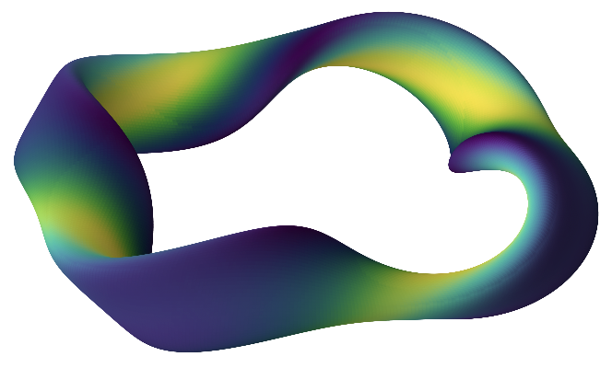
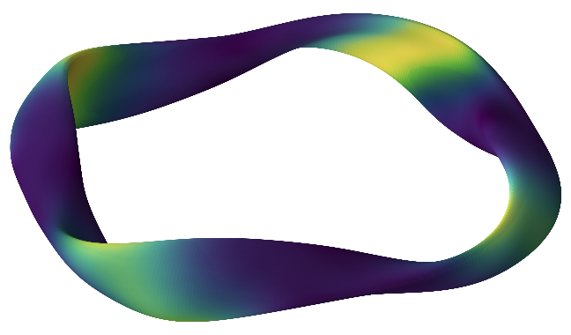
Bayesian optimization of stellarator α-particle confinement using data-informed parameter spaces
& dimensionality reduction
Matt Landreman¹, Michael Czekanski², Andrew Giuliani³, Byoungchan Jang¹, Rory Conlin¹
1. University of Maryland 2. Cornell University 3. Flatiron Institute

Slide 2
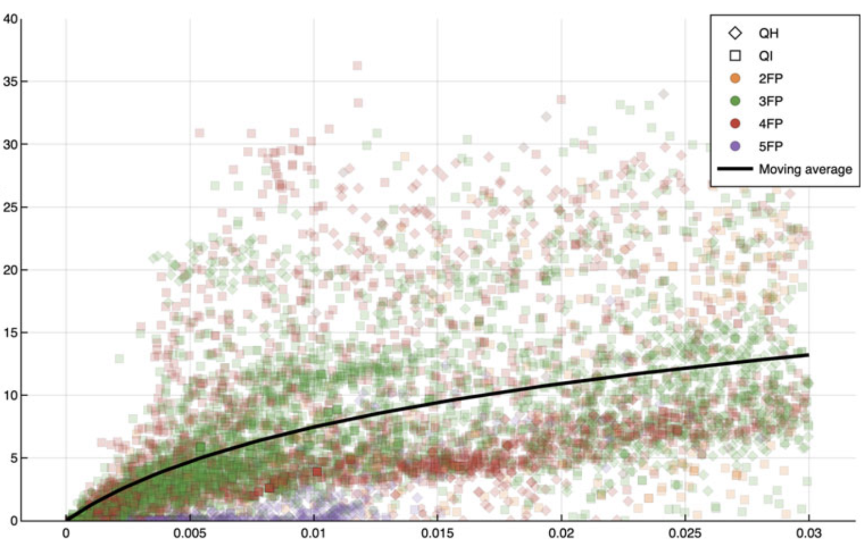
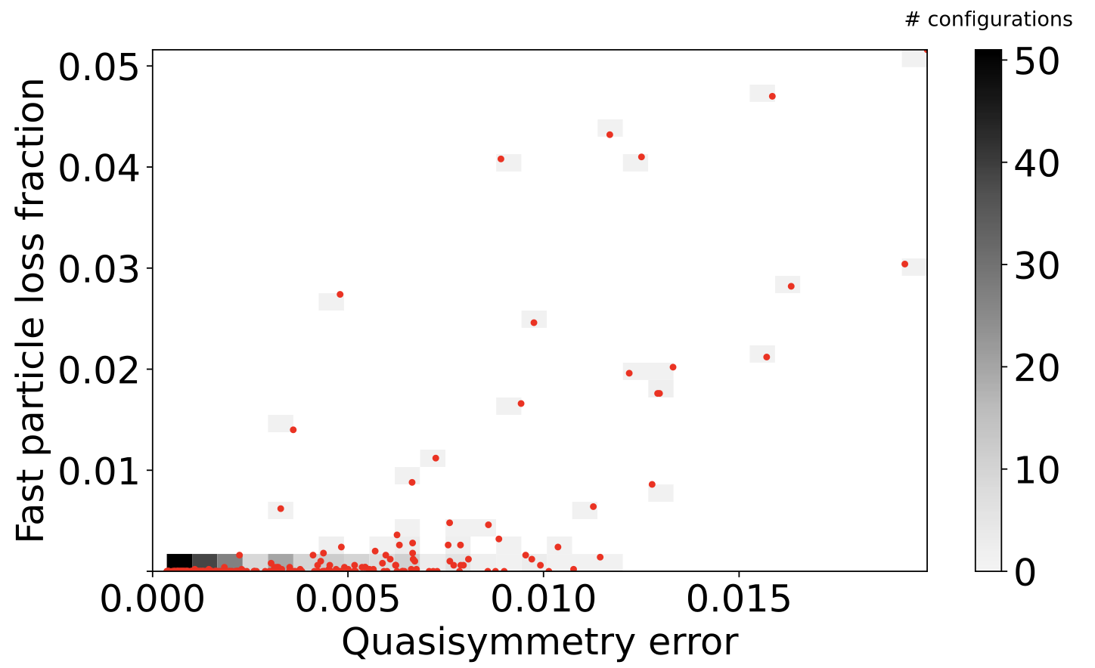
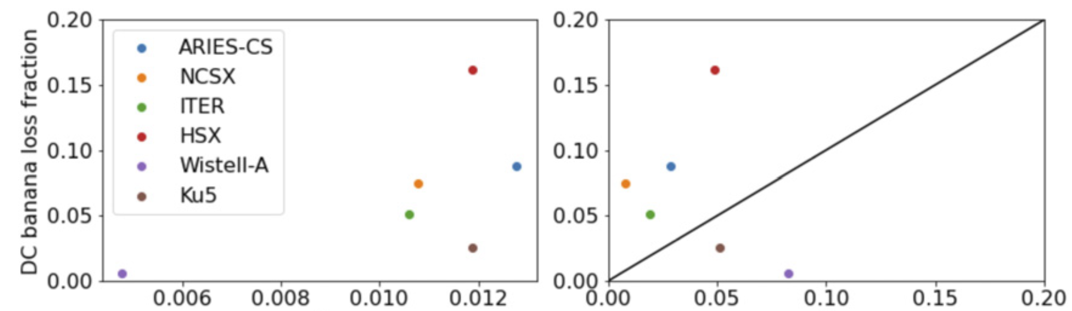
Physics-based surrogates like quasisymmetry & Γ_{c} aren’t that well correlated with α confinement
Hegna JPP (2025)
α loss fraction (%)
Γc
Wiedman JPP (2024)
Paul NF (2022)
Γc
Γα

Slide 3
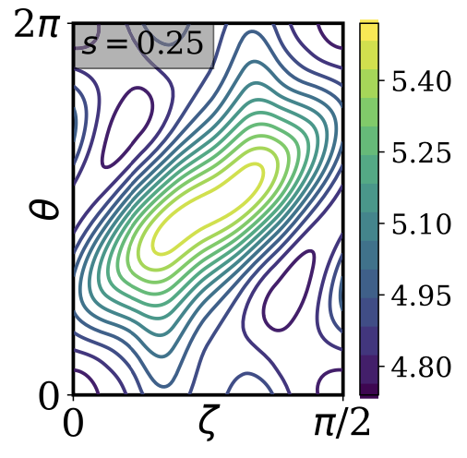
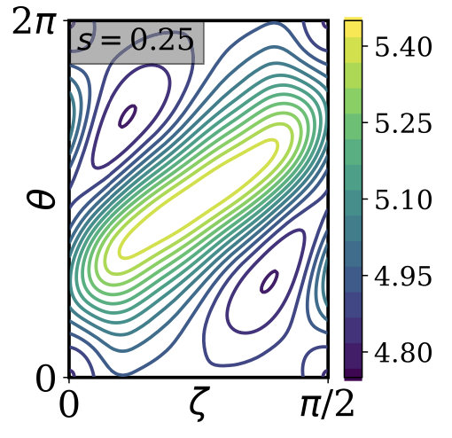
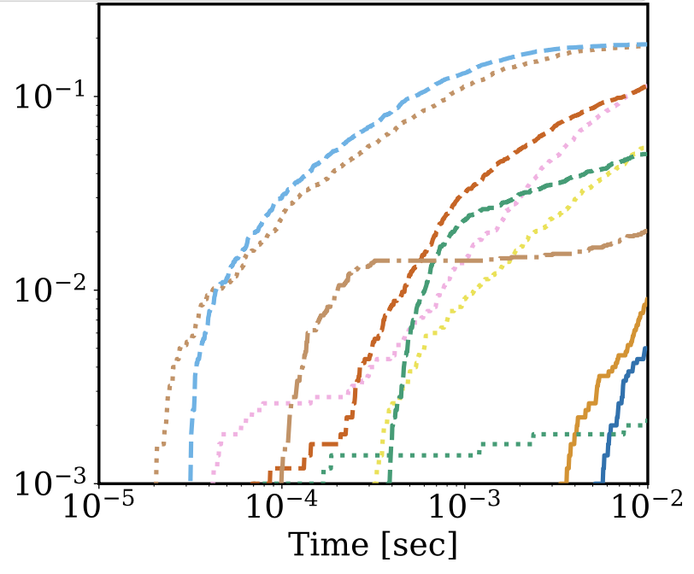
We should try harder at directly tracing alpha particles inside optimization
Bindel, Landreman, & Padidar (2023) traced alphas in the optimization loop, found promising new configurations with significant departures from QS/QI in the loop.
α loss fraction
Related work on piecewise omnigenity (Velasco, Zhu, Fernández-Pacheco, Liu, …)
GPUs now allow tracing 25,000 particles for 0.1 s (physical time) in only ~4 minutes wallclock. Affordable in the loop.

Slide 4
Outline
New parameter spaces to optimize in
Bayesian optimization of α-particle confinement
Resulting new configurations

Slide 5
Outline
New parameter spaces to optimize in
Bayesian optimization of α-particle confinement
Resulting new configurations

Slide 6
For alphas in the loop, need a well-scaled parameter space
Due to Monte-Carlo noise & chaos, focus on derivative-free optimization algorithms.
Many algorithms (e.g. Bayesian) need bound constraints. Hard to pick these with the usual Fourier representation.
Need d.o.f.s to be scaled comparably.
Derivative-free methods don’t scale well with # of dimensions. Try dimensionality reduction.
Here: 2 new parameter spaces, both based on dataset of boundary shapes.

Slide 7
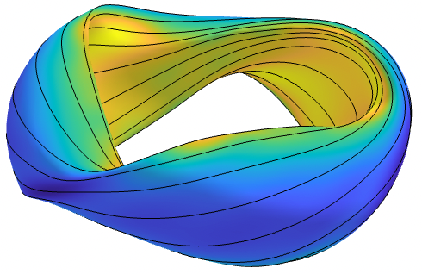
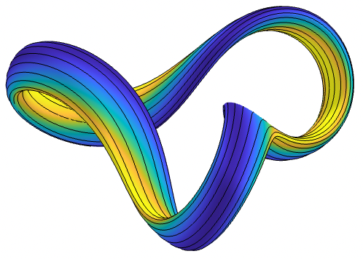
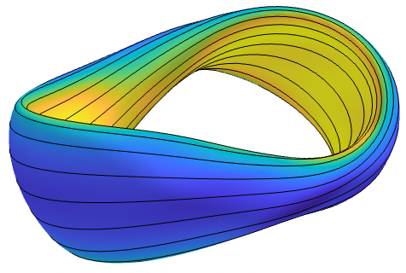
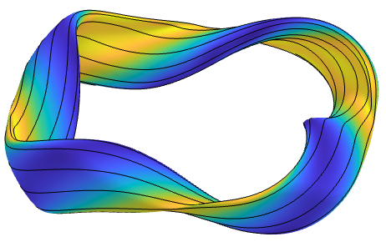
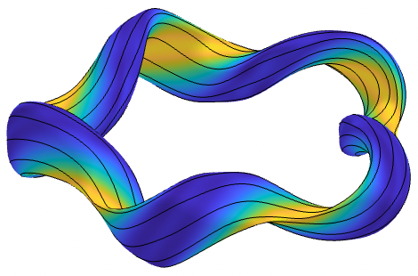
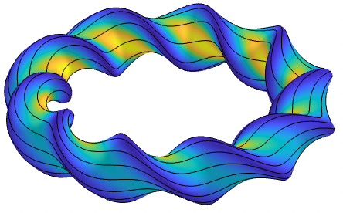
Diverse dataset of known stellarator boundaries
Combine 3 groups:
Famous devices (W7-X, LHD, HSX, NCSX, TJ-II, CTH, CNT, …)
QUASR (QA & QH). Pick configs with lowest QS error at each aspect ≤ 10, iota, nfp. Filter: vmec++ converges at β=2%
ConStellaration (QI). Filter for aspect ≤ 10, vmec++ converges at β=2%, Mercier-stable or nearly so.
Systematize orientation (θ=0 at outboard, bean at ϕ=0, etc.)
Apply spectral condensation to all, to systematize θ.

Slide 8
Use quantile transformation to map between distribution & [0,1]
Inverse map
d.o.f.s for optimization
Notes:
20260503-01_illustration_of_quantile_transform.pdf

Slide 9
New space 1: Apply QuantileTransform to Garabedian Δ_{mn}’s
Notes:
20260508-02_grid_of_xsections_GarabedianQuantiles_for_paper_allNfp_seed0_xmin0.10_dotsFalse.pdf

Slide 10
MHD equilibrium converges for a reasonable fraction of the space
Vmec++, each d.o.f. sampled uniformly on [u_{min}, 1 – u_{min}]
Notes:
20260509-01_plot_success_fraction_vs_garabedian_2plots_allNfp_extra_series_vs_mpol_for_xmin0_and_xmin0p1_allNfp.pdf
20260509-01_plot_success_fraction_vs_garabedian_2plots_allNfp_extra_series_vs_xmin_for_mpol1_and_mpol4_allNfp.pdf

Slide 11
New space 2: principal components
Apply PCA to boundary (R,Z) values, then apply quantile transform to PC amplitudes.
Same advantages as space 1, & also dimensionality reduction.
Notes:
20260512-01_weighted_PCA_explained_variance_both_datasets.pdf

Slide 12
New space 2: principal components
Apply PCA to boundary (R,Z) values, then apply QuantileTransform to PC amplitudes.
Notes:
20260505-02_weightedPCA_grid_xsections_varying_components_allNfp_nrows5_mpol6_ntor6_xmin0.00_seed3_dotsFalse.pdf

Slide 13
MHD equilibrium converges for a reasonable fraction of the space
Vmec++, each d.o.f. sampled uniformly on [0, 1]
Notes:
20260509-01_plot_success_fraction_vs_pca_components.pdf

Slide 14
Outline
New parameter spaces to optimize in
Bayesian optimization of α-particle confinement
Resulting new configurations

Slide 15
Plausible profiles & scaling for alpha tracing
Size scaling: $a=(0.31 m)/{(aspect)}^{0.38}$
Fits Stellaris (a=1.3m), Infinity Two (a=1.3m), Helios (a=1.8m), ARIES-CS (a=1.7m)
Scale B so B_{max} = 12 T. Comparable to Stellaris & Infinity Two.
B_{max} more meaningful constraint than ⟨B⟩. Gives ⟨β⟩ = 1.5% - 3%.
Notes:
% Code for this figure is in alpha_opt.profiles.plot_profiles()
% To generate this figure:
% python -c "from alpha_opt.profiles import plot_profiles; plot_profiles()"
profiles_for_alpha_opt.pdf

Slide 16
The objective function saves computation for the best configurations
Case 1, for high losses:
f = -log(time)
at which
loss = M
Tracing aborted
M
Case 2, for low losses:
f = constant + log(loss) at t_{max}
High-loss configuration
Low-loss configuration
t_{max}
Notes:
20260517-01_alpha_opt_objective_illustration.py

Slide 17
Asynchronous Bayesian optimization
GPU guiding center tracing using FIRM3D/CATAPULT: Czekanski arXiv:2604.07617, github.com/ColumbiaStellaratorTheory/firm3d
Trace 25,000 particles for 0.1 sec physical time, source ∝ fusion rate.
Use all 4 GPUs on 1 node of Perlmutter (Nvidia A100s) for 2 hrs.
Manager
(CPU)
Worker 1
Worker 2
Worker 3
Worker 4
Time (minutes)

Slide 18
Outline
New parameter spaces to optimize in
Bayesian optimization of α-particle confinement
Resulting new configurations

Slide 19
New configuration 1
Garabedian space, m,n ≤ 1. # dofs = 7
α loss for optimum: 0.01%
Notes:
20260402-01-178_TURBO_Garabedian_mpol1_xmin0p1_allNfp_aspect6/evals/eval000155

Slide 20
New configuration 1
QH-ish but far from ideal QH.
Aspect ratio = 6
⟨β⟩ = 1.5%
Notes:
20260402-01-178_TURBO_Garabedian_mpol1_xmin0p1_allNfp_aspect6/evals/eval000155

Slide 21
New configuration 2
Garabedian space, m,n ≤ 2. # dofs = 23
α loss for optimum: 0.009%
Notes:
20260402-01-136_Ax_Garabedian_mpol2_xmin0p1_allNfp_aspect6/evals/eval000206

Slide 22
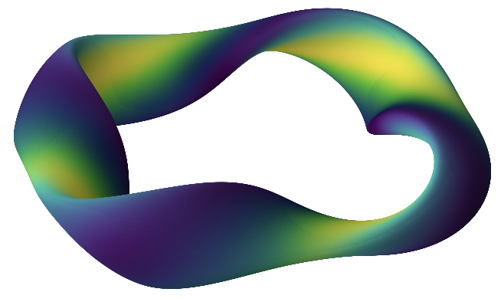
New configuration 2
QH-ish but far from ideal QH.
Aspect ratio = 6
⟨β⟩ = 1.4%
Notes:
20260402-01-136_Ax_Garabedian_mpol2_xmin0p1_allNfp_aspect6/evals/eval000206

Slide 23
New configuration 3
PCA space, 20 components.
α loss for optimum: 0.06%
Notes:
20260402-01-038_Ax_PCA_20dofs_allNfp_aspect6/evals/eval000290

Slide 24
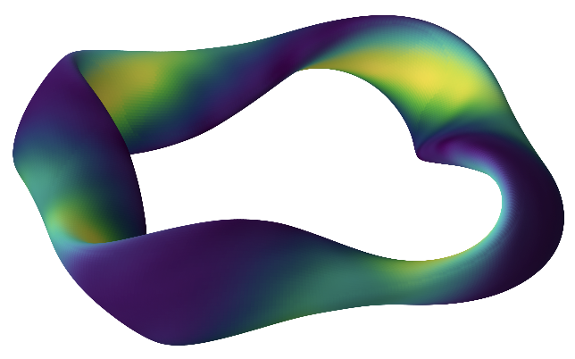
New configuration 3
Reminiscent of piecewise omnigenity
Aspect ratio = 6
⟨β⟩ = 1.5%
Notes:
20260402-01-038_Ax_PCA_20dofs_allNfp_aspect6/evals/eval000290

Slide 25
New configuration 4
Garabedian space, m,n ≤ 2. # dofs = 23. Include Mercier stability constraint.
α loss for optimum: 0.6%
Notes:
20260406-01-alpha_optimization_constrained_parameter_scans/best_configs
20260406-01-262-Ax_nfp4_Garabedian_mpol2_ntor2_minx0_allNfp_aspect10_DMercFail_m0p3_eval000323

Slide 26
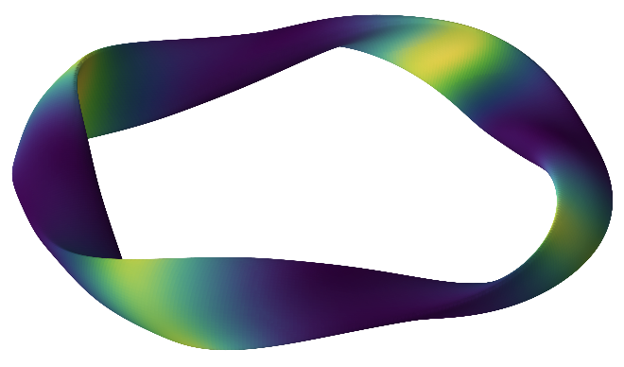
New configuration 4
α loss ~ 0.6%
ConStellaration configurations in dataset: >15% loss
Aspect ratio = 10
⟨β⟩ = 2.9%
Notes:
20260406-01-alpha_optimization_constrained_parameter_scans/best_configs
20260406-01-262-Ax_nfp4_Garabedian_mpol2_ntor2_minx0_allNfp_aspect10_DMercFail_m0p3_eval000323

Slide 27
New configuration 5
PCA space, 25 components. Include Mercier stability constraint.
α loss for optimum: 1%
Notes:
20260406-01-alpha_optimization_constrained_parameter_scans/best_configs
20260406-01-051-Ax_nfp4_PCA_dimx25_noNfp2_aspect10_DMercFail_m0p1_eval000130/

Slide 28
New configuration 5
Reminiscent of QI, but with no QI objective.
Aspect ratio = 10
⟨β⟩ = 1.9%
Notes:
20260406-01-alpha_optimization_constrained_parameter_scans/best_configs
20260406-01-051-Ax_nfp4_PCA_dimx25_noNfp2_aspect10_DMercFail_m0p1_eval000130/

Slide 29
New configs also perform well on other benchmarks
As in Landreman & Paul PRL (2022) & later publications.
All configs scaled to ARIES-CS: a = 1.7 m, ⟨B⟩ = 5.9 T
Initialize particles at s = 0.25.
< 2%
loss
ϵ_{eff} < W7-X in the core – good enough
Notes:
20260410-01-plot_SIMPLE_loss_for_new_BO_configs.py

Slide 30
Conclusions
These 2 new parameter spaces are nice for stage-1 optimization: few equilibrium failures despite strong shaping, & natural bound constraints.
It’s feasible to directly trace alphas inside the optimization loop.
Configurations exist with excellent confinement that are far from ideal QA/QH/QI!
Future work
Add constraints/objectives for iota, bootstrap current, L_{∇B}, ballooning, nonlinear gyrokinetics, etc.
Fine-tune configurations using local optimization.
Understand α trajectories in these fields – why aren’t they lost?

Slide 31
Extra slides

Slide 32
New space 1: Apply QuantileTransform to Garabedian Δ_{mn}’s
Effective prior probability: uniform on unit hypercube.
Natural bound constraints: extremes of the data.
Robust to outliers in the data.
Major & minor radius (hence aspect ratio) are matched exactly. No need for aspect penalty or constraint, 1 fewer d.o.f.
Could apply method to VMEC or DESC Fourier amplitudes instead.
Gives highly shaped boundaries (“expressive”), with few self-intersections or equilibrium failures.

Slide 33
New space 1: Apply QuantileTransform to Garabedian Δ_{mn}’s
m_{max} = n_{max}=2
m_{max} = n_{max}=3
Notes:
20260402-02_grid_of_xsections_SurfaceGarabedianQuantiles_mpol2_xmin0.10_dotsFalse.pdf
20260402-02_grid_of_xsections_SurfaceGarabedianQuantiles_mpol3_xmin0.10_dotsFalse.pdf

Slide 34
New space 2: principal components
Apply PCA to boundary (R,Z) values, then apply QuantileTransform to PC amplitudes.
Same advantages as space 1, & also dimensionality reduction. 10 PCs shown here:
Notes:
20260303-01_weightedPCA_on_hdf5_grid_of_xsections_without_dots.py

Slide 35
Optimization problem setup
Alpha tracing using FIRM3D GPU “CATAPULT” method: github.com/ColumbiaStellaratorTheory/firm3d.
Trace 25,000 particles for 0.1 sec physical time, source ∝ fusion rate, no collisions.
Objective allows early termination if confinement is bad. Natural multi-fidelity method.
Time to reach loss of M = 2%
If loss < 2% at t_{max}, penalize loss at t_{max}
keep f continuous

