Slide 1
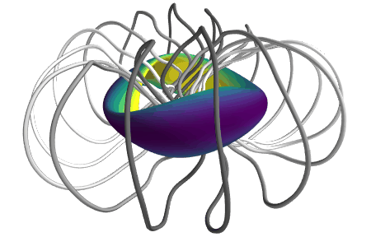
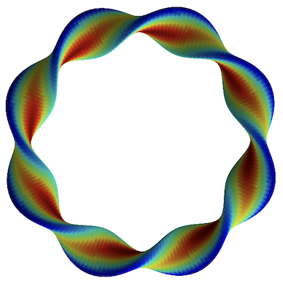
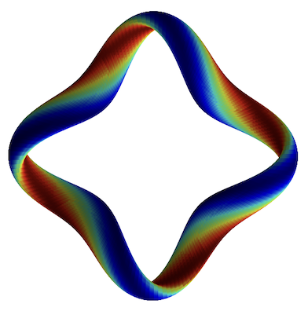
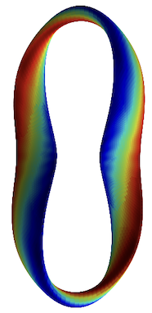
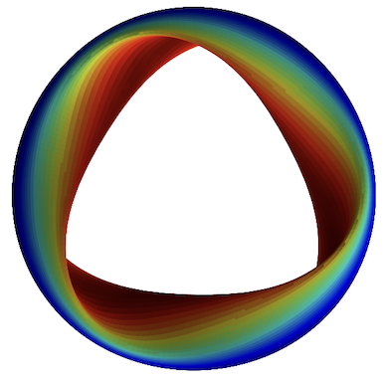
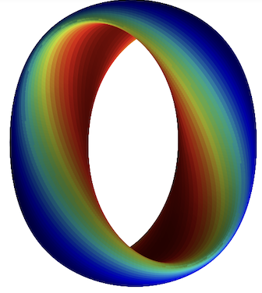
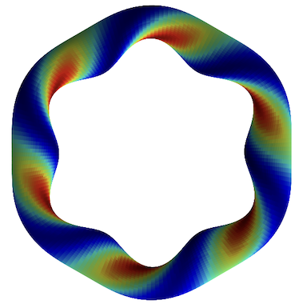
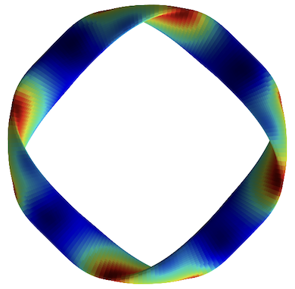
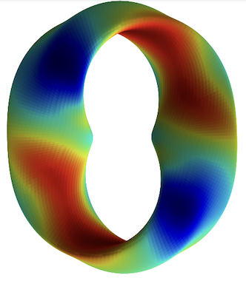
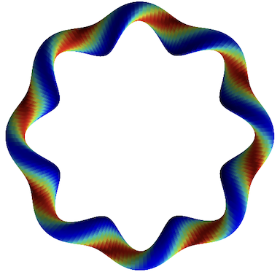
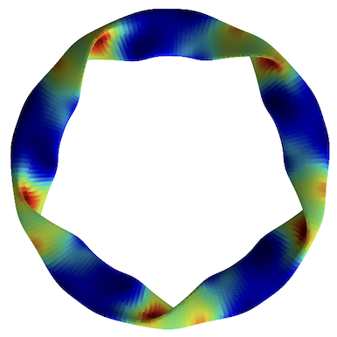
Plasma turbulence in stellarators: physics insights from machine learning
Turbulence simulations
Journal of Plasma Physics 91, E120 (2025)
M Landreman¹, J Y Choi², C Alves², P Balaprakash², R M Churchill³, R Conlin¹, W Dorland¹, G Roberg-Clark⁴
1 Maryland, 2 Oak Ridge National Laboratory, 3 Princeton Plasma Physics Laboratory, 4 Max Planck Institute
Notes:
20250102-10_plot_Q_vs_time_for_several_simulations.pdf
~/Box Sync/work22/20220304-01-animated_gifs_for_simons_talk/20220304-01-001_simsopt_QH_beta0p05_animated_gif
~/Box Sync/work22/20220304-01-animated_gifs_for_simons_talk/20220304-01-002-preciseQAWithWellFromSimsopt_animated_gif
~/Box Sync/work21/20211103-01-simsopt_coils_from_Florian/20211103-01-precise_QA_coil_animation
https://www.youtube.com/watch?v=NVTAPZ6BrW4

Slide 2
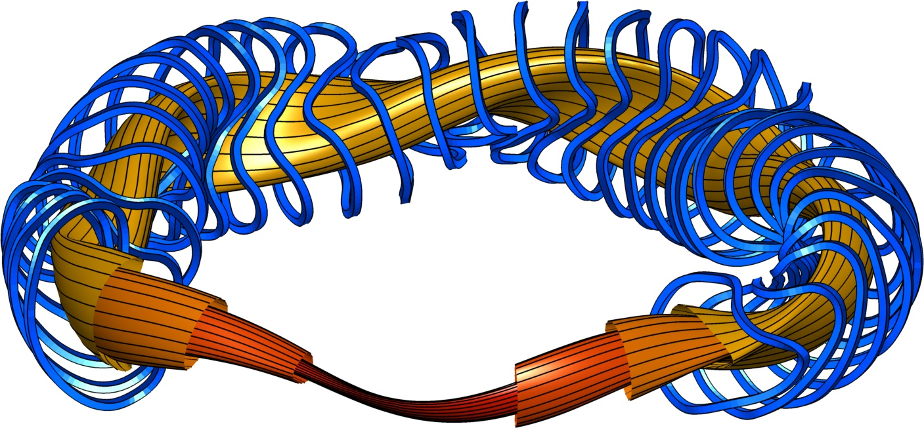
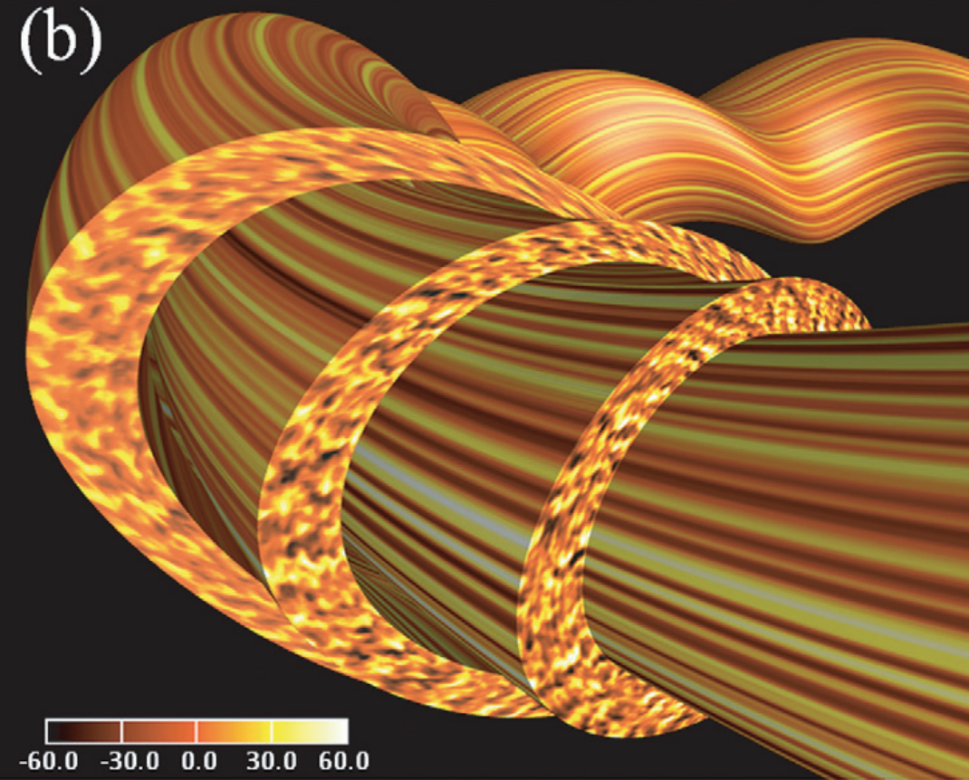
Stellarators: confining plasma with optimized magnetic fields
Stellarator plasma turbulence: insights from interpretable machine learning
Nunami 2012

Slide 3
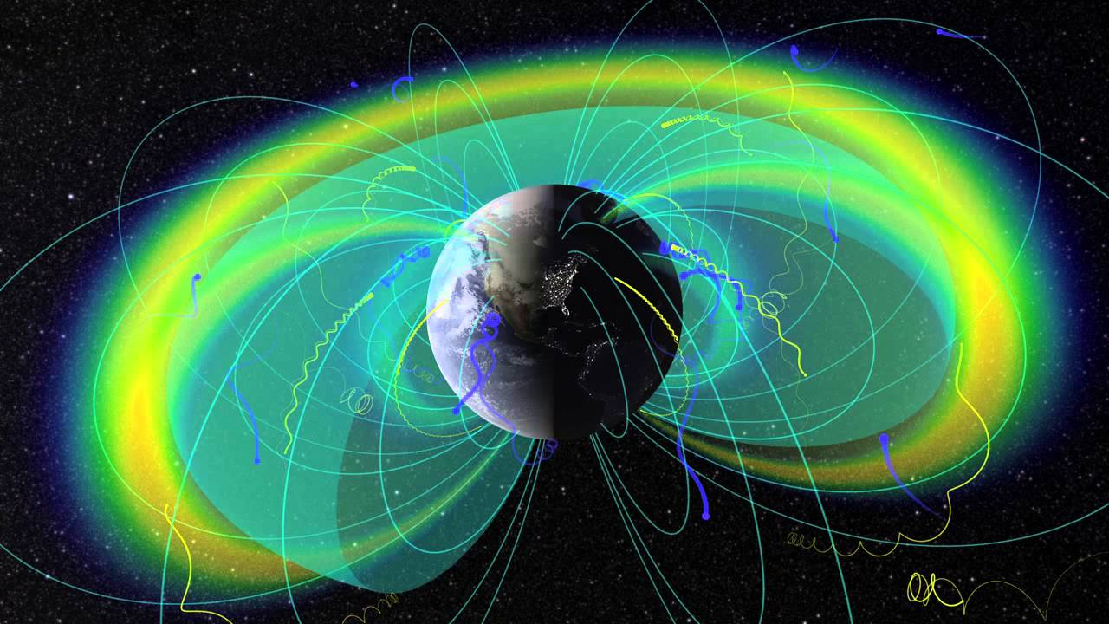
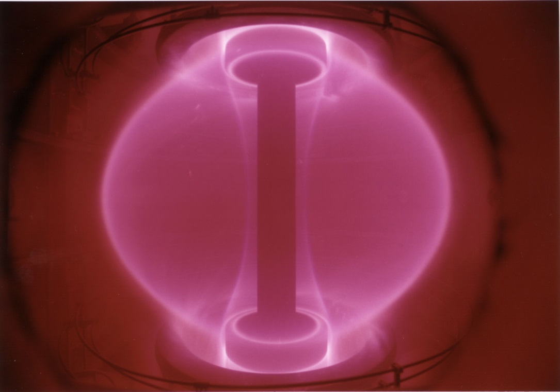
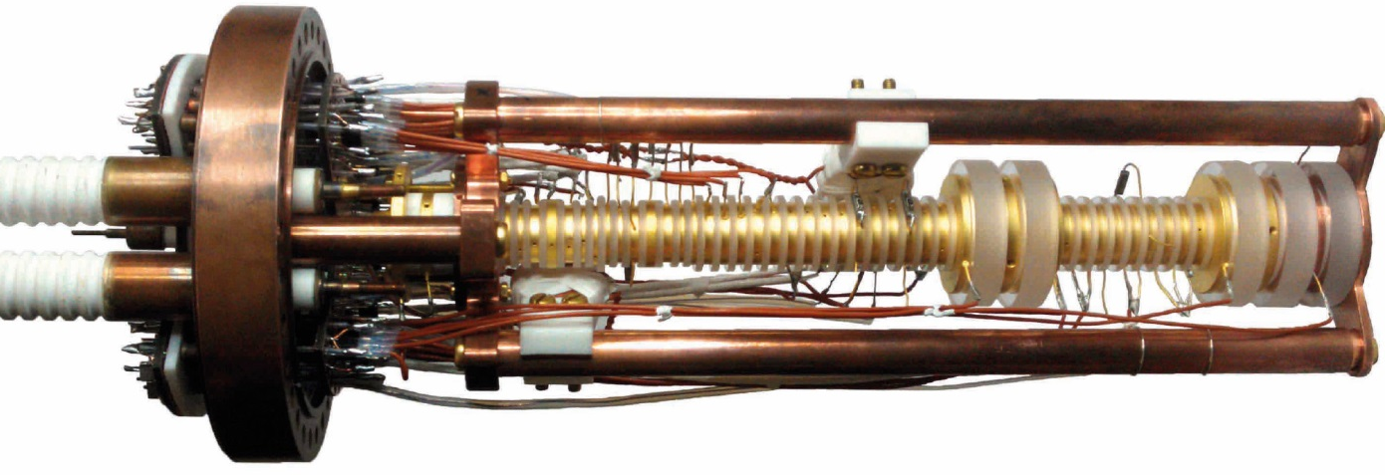
Charged particles can be confined by magnetic fields.
Planetary dipole fields
Hot laboratory
plasmas, fusion
Laboratory particle traps
Notes:
Website with Penning trap picture: https://www.mpg.de/9367572/comparing-matter-antimatter
https://www.google.com/url?sa=i&rct=j&q=&esrc=s&source=imgres&cd=&cad=rja&uact=8&ved=0ahUKEwj4kIGgweXKAhXCbj4KHerqAS8QjhwIBQ&url=https%3A%2F%2Fwww.youtube.com%2Fwatch%3Fv%3DN8Yecb-WA0A&psig=AFQjCNGKN59EbzBQLnfdYWG4PoGfnM77fQ&ust=1454929596721019

Slide 4
But, confining charged particles with a magnetic field is tricky.
Uniform straight B: confinement ⊥ to B, but end losses.
Magnetic field line
Charged particle
Notes:
m20150414_02_illustrationOfToroidalSolenoid.m
m20150414_01_illustrationOfGradBDrift.m

Slide 5
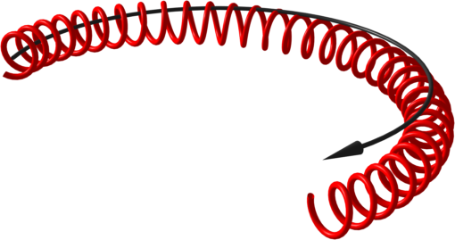
But, confining charged particles with a magnetic field is tricky.
Uniform straight B: confinement ⊥ to B, but end losses.
Magnetic field line
Charged particle
If field is not uniform,
particles drift across field lines.
Notes:
m20150414_02_illustrationOfToroidalSolenoid.m
m20150414_01_illustrationOfGradBDrift.m

Slide 6
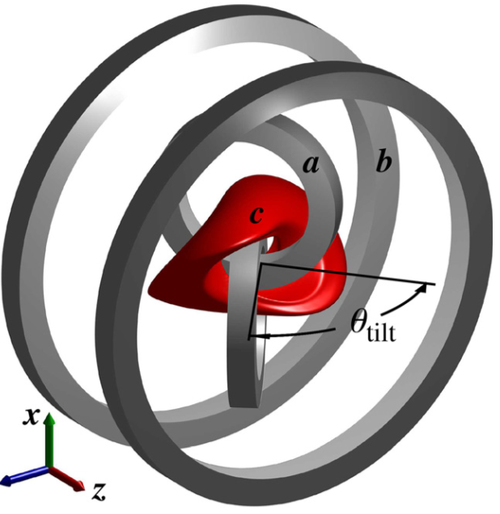
“Stellarator”: A device for nonaxisymmetric magnetic confinement
Electromagnetic coils
Also can use planar coils
Magnetic field lines
Magnetic surfaces, plasma
W7-X, Max Planck Institute
CNT, Columbia University
Notes:
On Dec 15, Novi measured Te = 3 keV, Ti = 0.5 keV – 1st available measurement
From January,
one slide shows Te=6 keV, Ti = 1.2 keV
Another slide I see Te=4keV

Slide 7
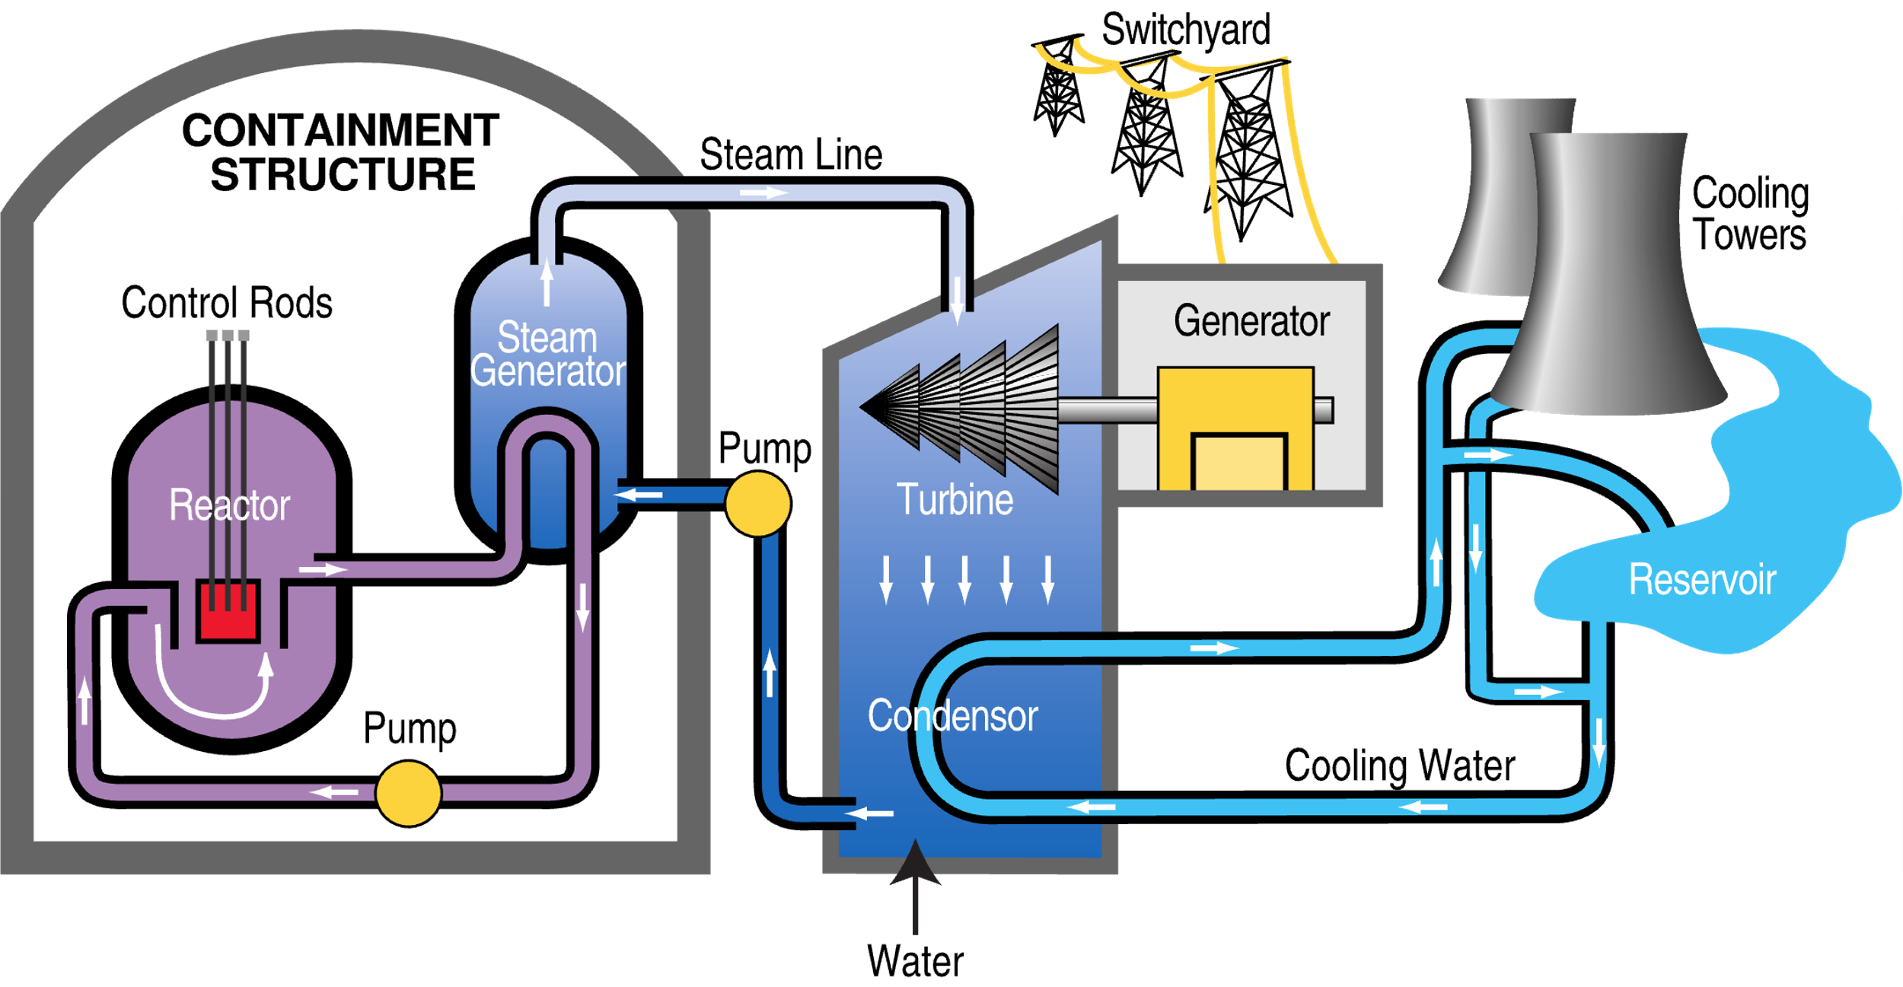
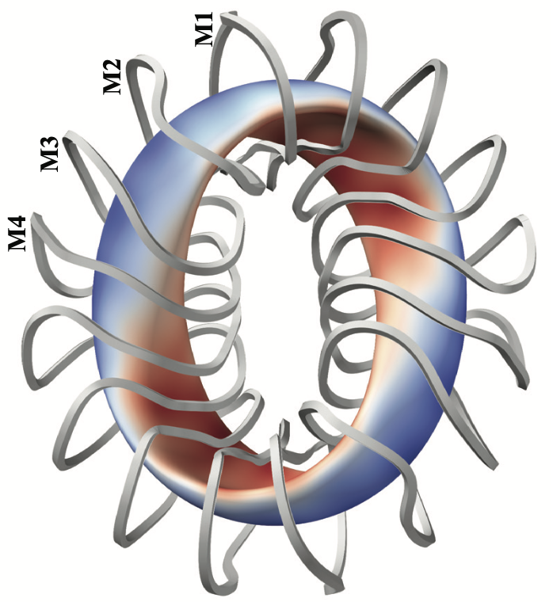


One application of stellarators is fusion energy
Advantages:
Carbon-free
Not intermittent
Minimal land use
Site near customers
Plentiful fuel
No proliferation risk
No meltdown risk
No long-lived waste
Notes:
https://upload.wikimedia.org/wikipedia/commons/c/c3/PWR_nuclear_power_plant_diagram.svg
CFQS picture from Zhu_2019_NF_59_126007 Identification of important error fields in stellarators using the Hessian matrix method.pdf

Slide 8

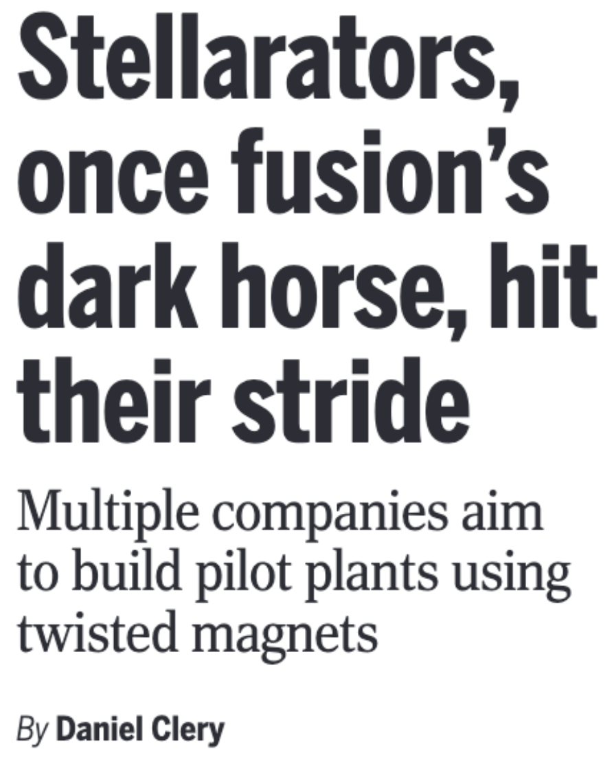

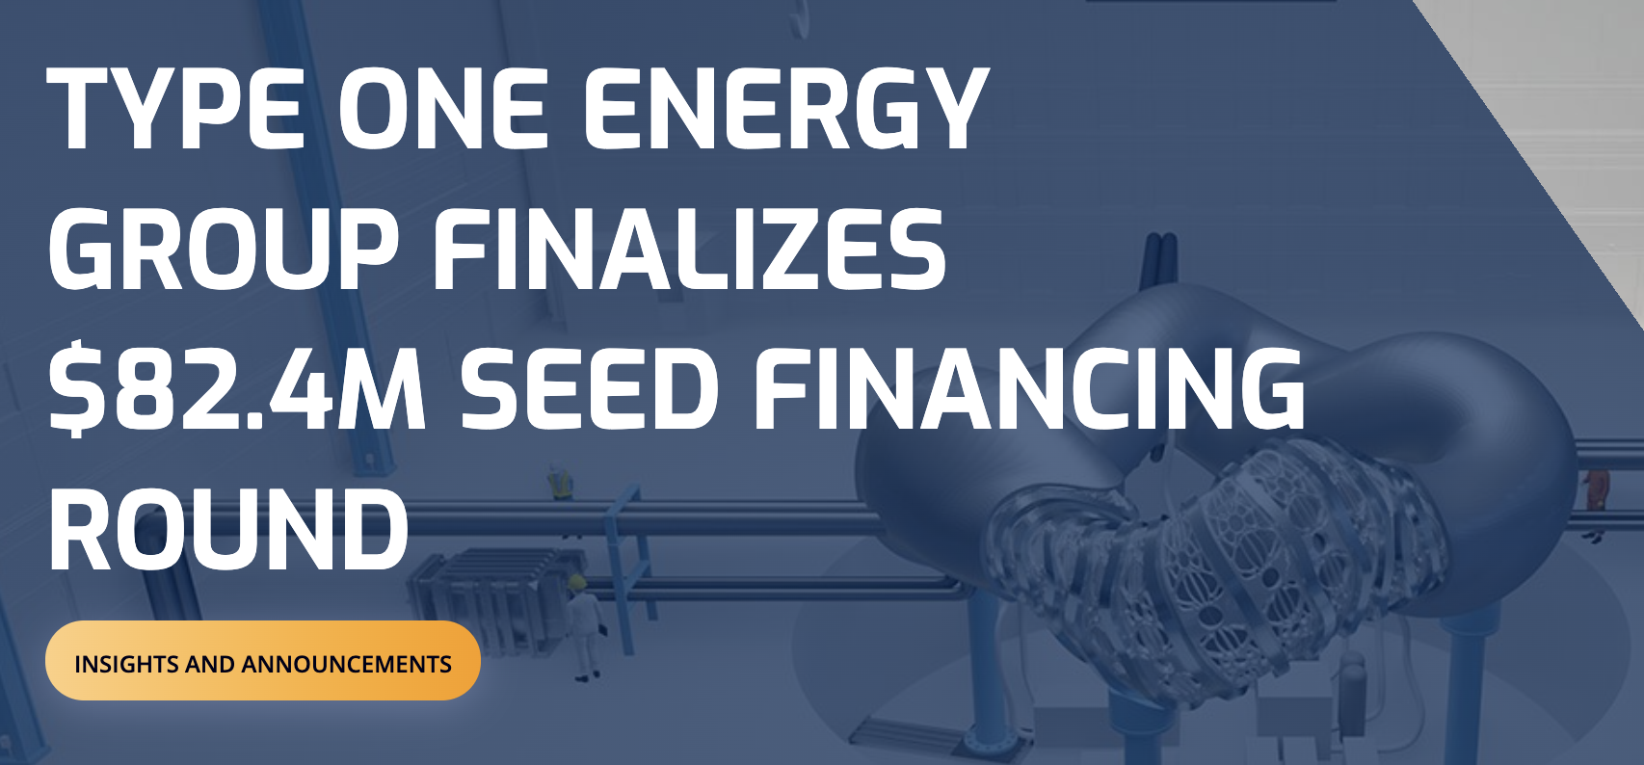




Companies for fusion energy, including stellarators, have raised $billions
Fusion Industry Association
Notes:
2025-Global-Fusion-Industry-Report.pdf
20260106-01_plot_fusion_funding_for_talk.py
8 stellarator companies: Thea Energy, Type One Energy, Proxima Fusion, Gauss Fusion, Helical Fusion, Renaissance Fusion, Stellarex, and nT-tao
https://www.nature.com/articles/d41586-026-00188-6

Slide 9
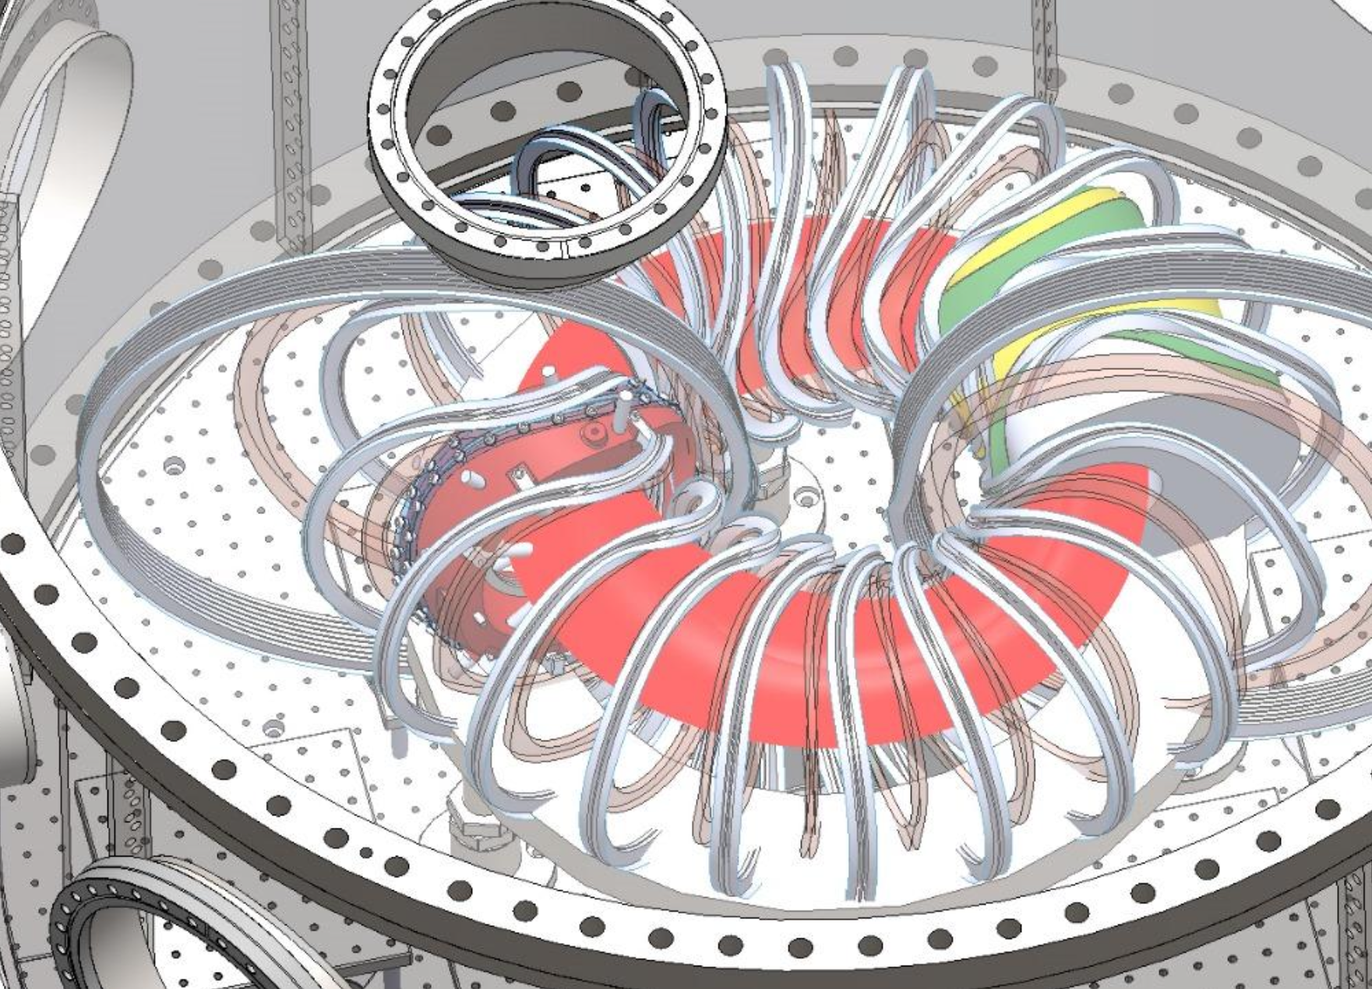
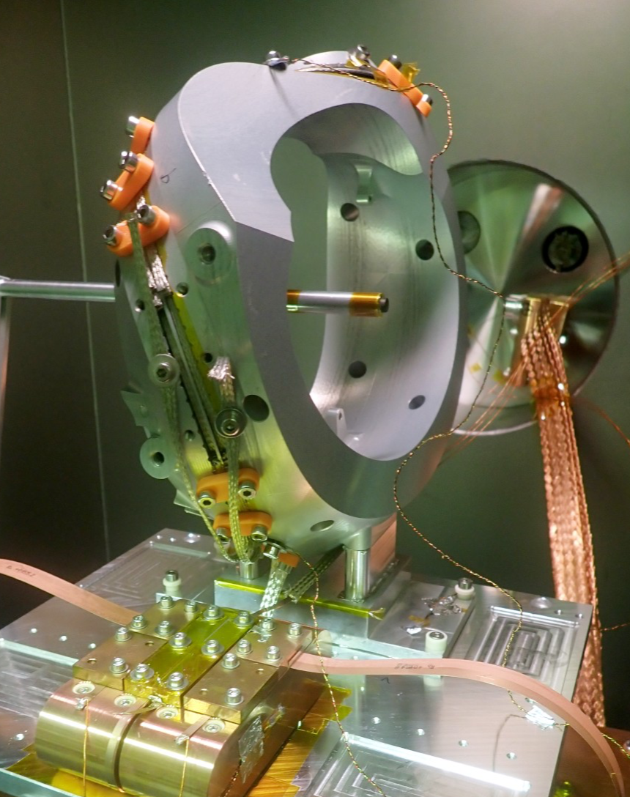
Stellarators can also confine electron-positron plasmas
EPOS project, Max Planck Institute

Slide 10
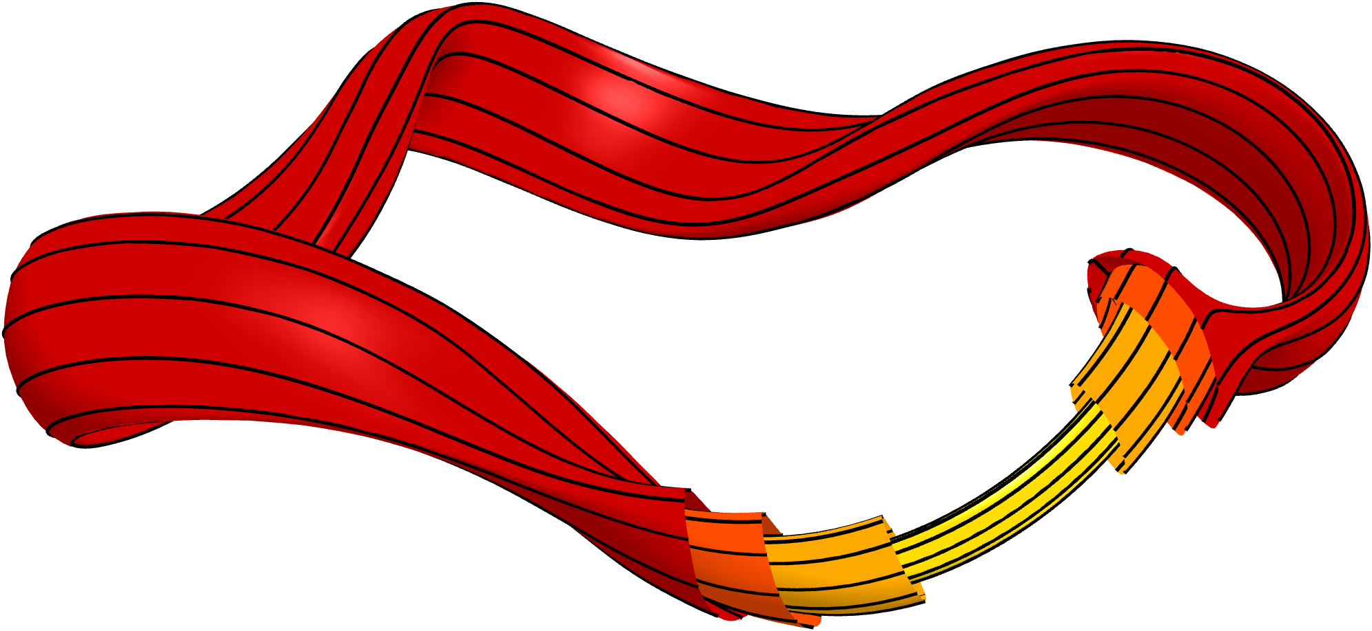
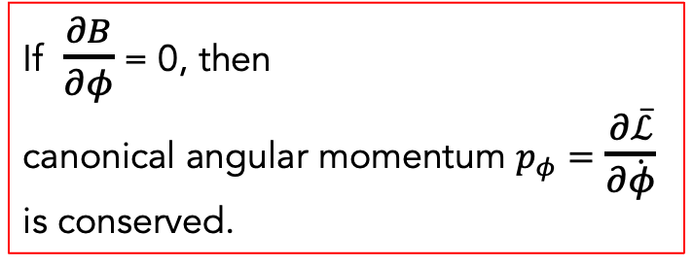
How to confine particles? Quasisymmetry
Lagrangian for particle in magnetic field:
Average over fast gyration to get
“Guiding center Lagrangian”.
Use coordinates (r,𝛳,𝜙):
Only depends on (𝛳,𝜙) through B=|B|!
If $\frac{∂B}{∂φ}$ = 0, then
canonical angular momentum $p_{φ}=$ $\frac{∂\overline{ℒ}}{∂\dot{φ}}$ is conserved.
Boozer (1983),
r : which magnetic surface
T Jacobson, J. Plasma Physics (2025)
Notes:
m20260207_01_plotHSXWithFieldlinesAndMultipleSurfaces

Slide 11
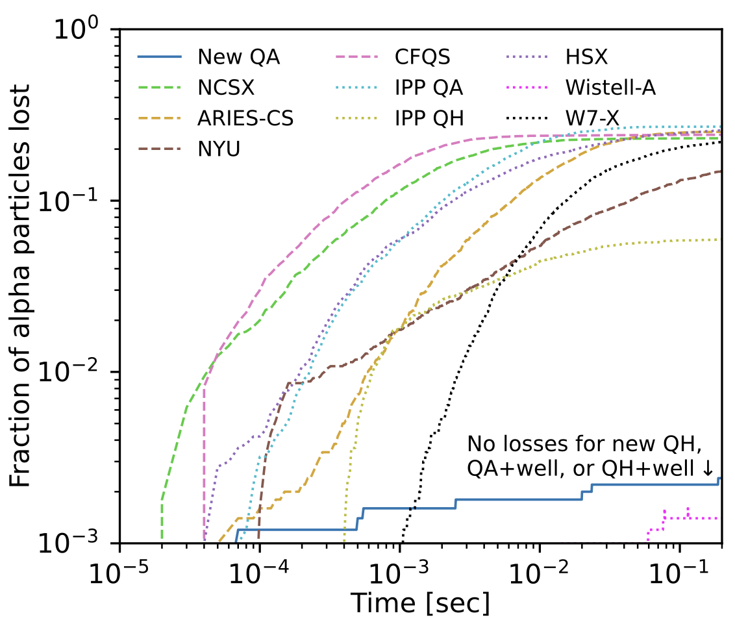

How to confine particles? Quasisymmetry
Older stellarators
Fraction of particles lost
New quasisymmetric stellarators ↓
|B| [T]
θ
ϕ
M.L. & Elizabeth Paul, Phys Rev Lett (2022)
Notes:
~/Box Sync/work21/20211103-01-simsopt_coils_from_Florian/20211103-01-precise_QA_coil_animation
~/Box Sync/work26/20260102-02_plot_B_contours_QA_for_talk.py

Slide 12
Open physics questions in stellarator research

Slide 13
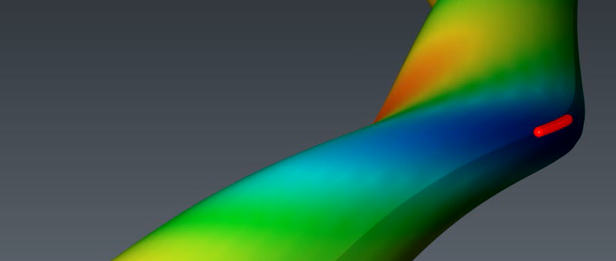
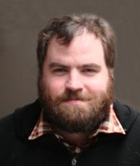
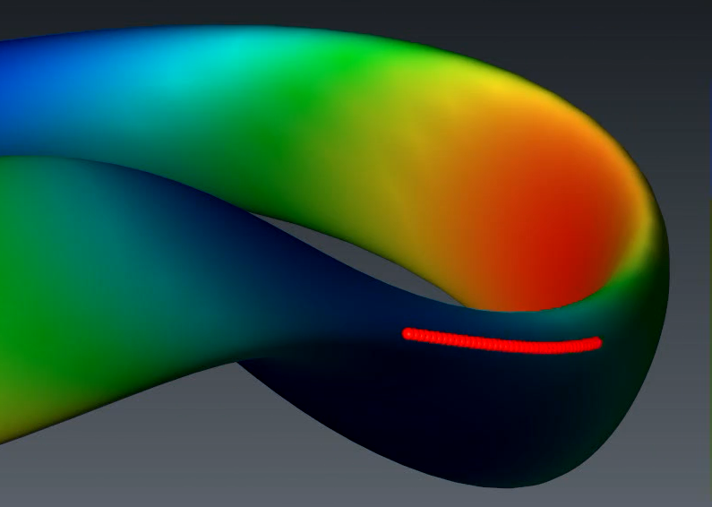
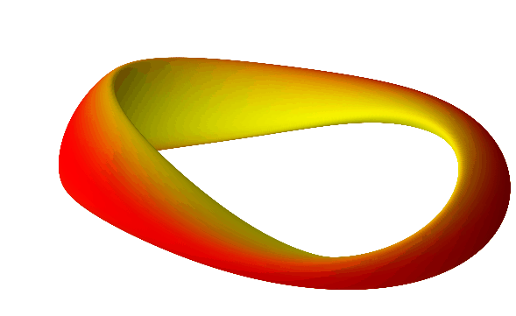
Open physics questions in stellarator research
How can we exploit & explore the high-dimensional space of plasma shapes to best confine the plasma?
Rory Conlin,
Byoungchan Jang
Notes:
20260127-02_stellarator_morphing_animation.py
20260127-02_stellarator_morphing_animation_2_cropped.gif

Slide 14
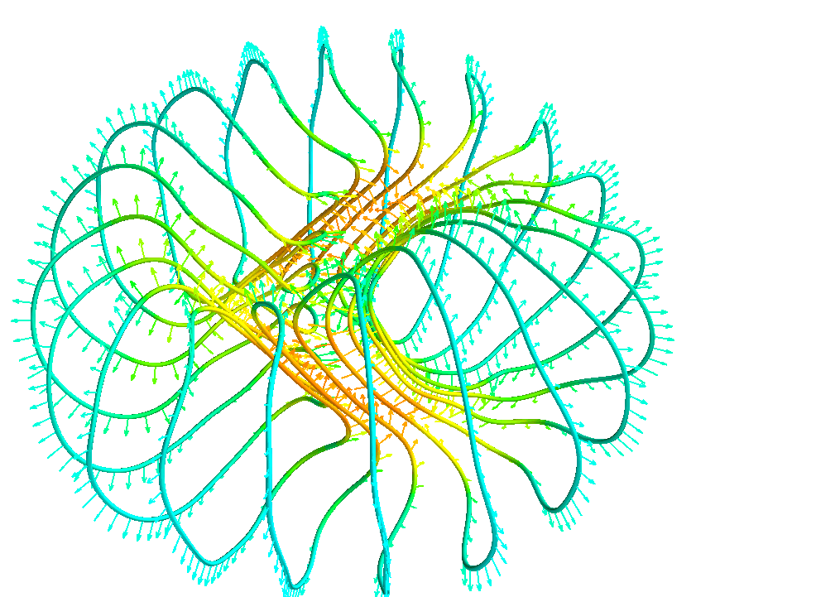
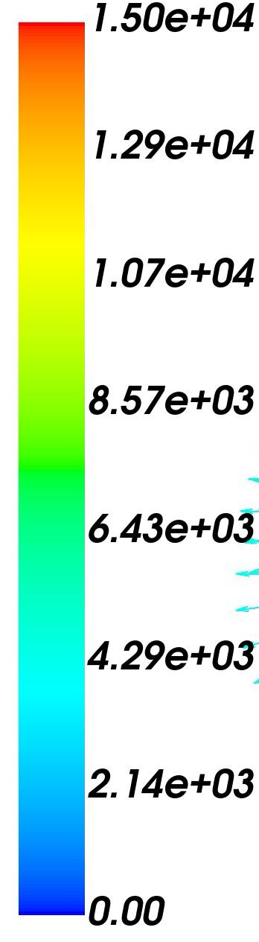


Open physics questions in stellarator research
To confine these plasmas, how can we design magnets that are easier to build?
John Kappel, Siena Hurwitz
Force per length (N/m)

Slide 15
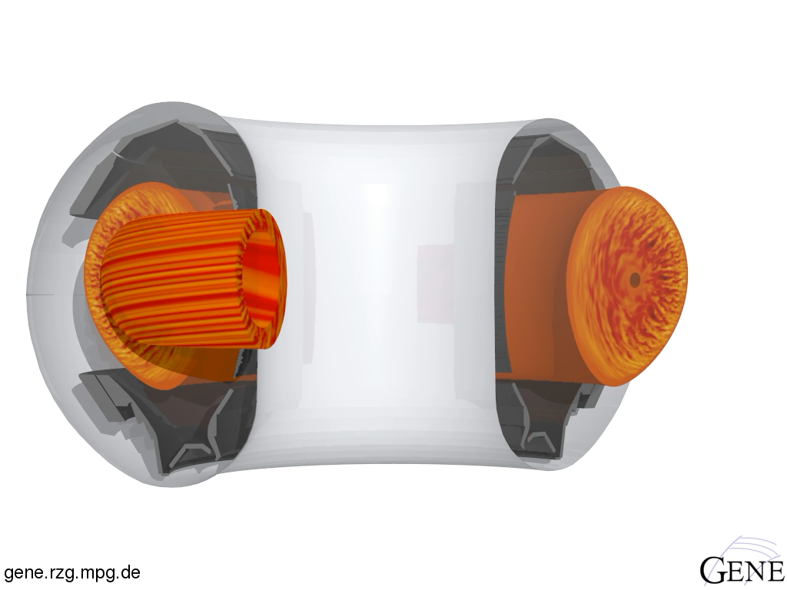
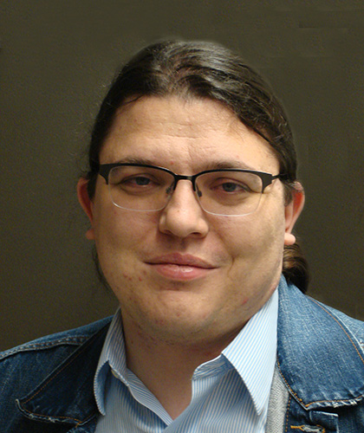
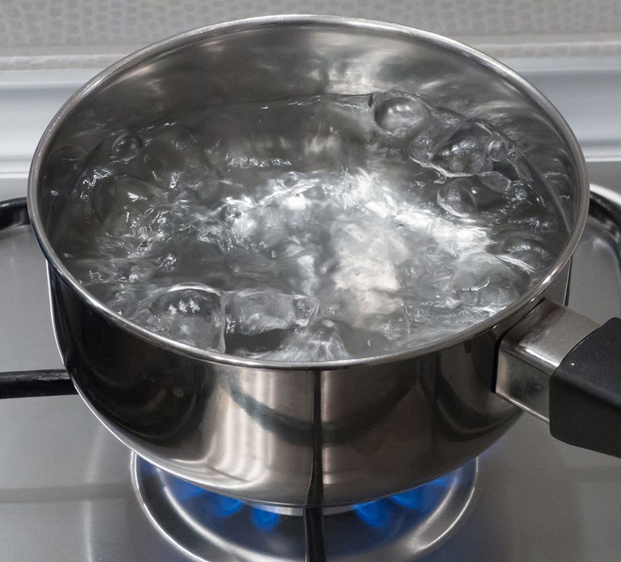


Open physics questions in stellarator research
How can we efficiently simulate and minimize the turbulence in these plasmas?
Ian Abel, Nathaniel Barbour, Zheng Yang Tan

Slide 16
Stellarators: confining plasma with optimized magnetic fields
Stellarator plasma turbulence: insights from interpretable machine learning
Nunami 2012

Slide 17
Turbulence in fusion plasmas: we want to understand & optimize
Turbulence depends on plasma shape, but how exactly?
Geometry could be optimized to reduce turbulence
Turbulence simulations: ~10 GPU-min to 10⁶s of CPU-hours.
5D + time
Nunami 2012
Electrostatic potential
Notes:
Turbulence image from http://fusionsites.ciemat.es/gyrokineticsmadrid2014/files/2014/06/Nunami.pdf
From https://aip.scitation.org/doi/pdf/10.1063/1.4704568 Nunami et al., PoP 19, 042504 (2012)

Slide 18
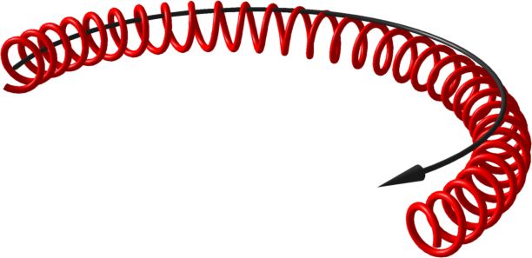
Turbulence in fusion plasmas is highly anisotropic due to magnetic field
Nunami 2012
Magnetic field line
Particle trajectory
Electrostatic potential
Notes:
Turbulence image from http://fusionsites.ciemat.es/gyrokineticsmadrid2014/files/2014/06/Nunami.pdf
From https://aip.scitation.org/doi/pdf/10.1063/1.4704568 Nunami et al., PoP 19, 042504 (2012)

Slide 19
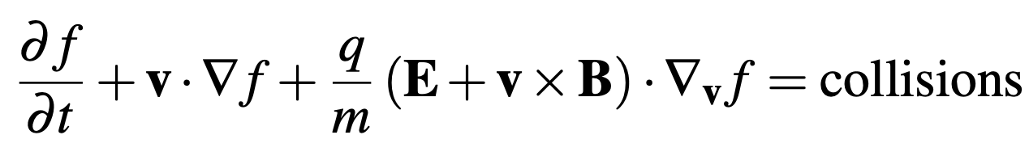
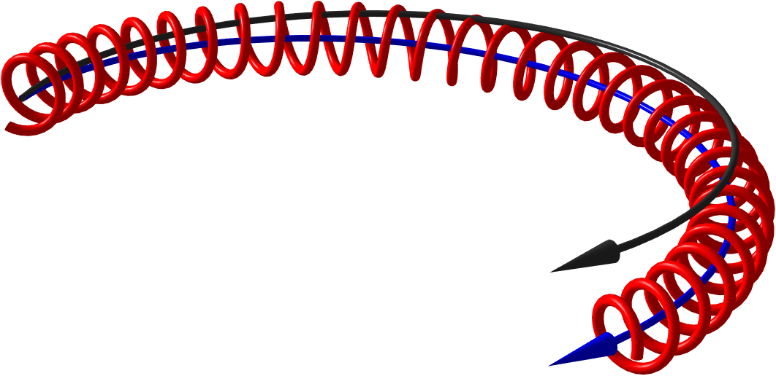
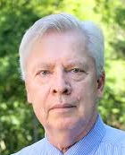
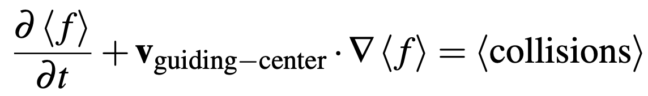

Turbulence is simulated using the “gyrokinetic” model
Kinetic equation:
Particle trajectory
Average over fast gyration
B
Antonsen & Lane (1980)
Guiding center
Gyrokinetic equation:
Nonlinear since v_{guiding-center} depends on (E, B) which depend on f ⇒ turbulence
Bill Dorland
Notes:
20260106-01 Equations for UMD physics talk.lyx
m20160712_01_illustrationOfGuidingCenterDrift.png

Slide 20
Turbulence simulations
R² = 0.989
Predicted heat flux
Regression
Feature importance
True heat flux
Notes:
20250102-10_plot_Q_vs_time_for_several_simulations.pdf

Slide 21
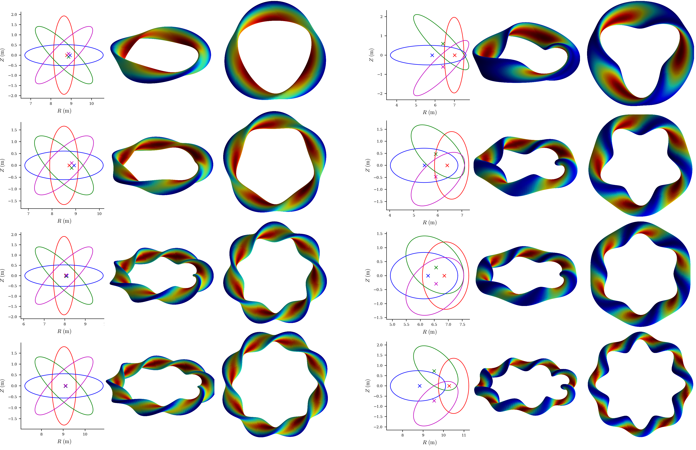
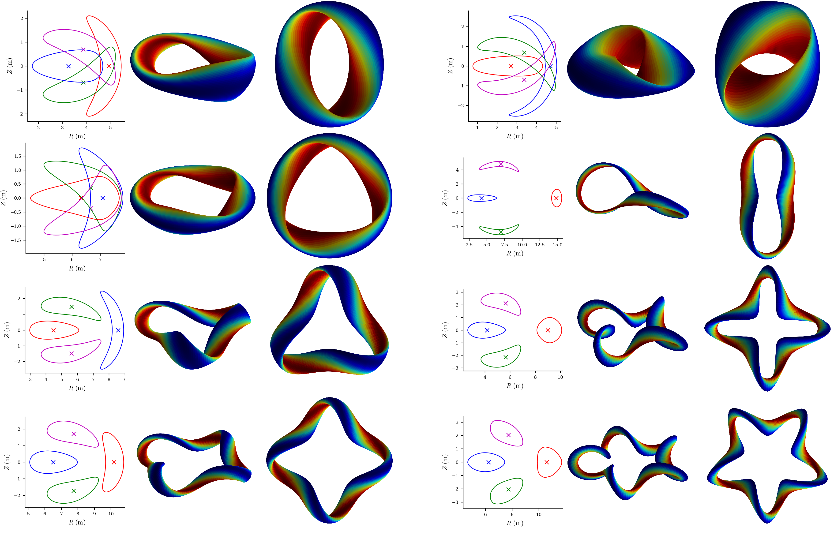
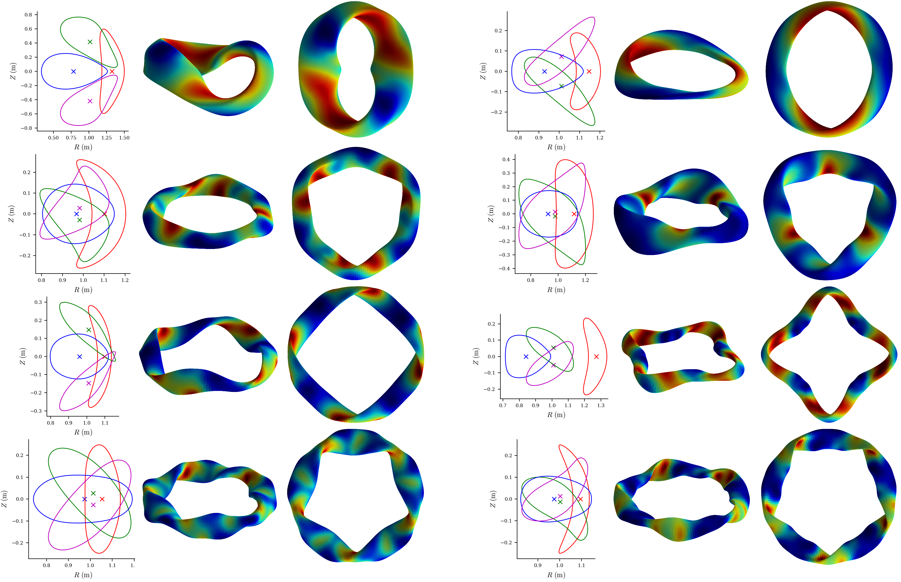
Equilibria include rotating ellipses, quasi-symmetric, and random shapes
Varied aspect ratio,
elongation,
plasma pressure, rotation symmetry, etc.
Notes:
~/Box/work24/20241220-02-figure_of_heliiotron_equilibria$ ./20241220-02-plot_heliotron_equilibria_for_paper.py

Slide 22

Nonlinear turbulence simulations were run in every equilibrium
GX code by Bill Dorland & Noah Mandell
8 minutes to get heat flux on 1 GPU
2×10⁵ nonlinear simulations took < 7000 node-hours
0⁴
Notes:
This was about 1/8 of our SciDAC GPU allocation was 53,738 node hrs, UMD GPU allocation was 40,978 node hrs.
/pscratch/sd/l/landrema/20240601-01-random_stellarator_equilibria/20240601-01-075_ntheta_scan> ./plot_gx_scan_over_1_parameter_and_configuration.py
20240902-03_plot_distribution_of_Q_from_GX_database_for_poster.py
20241218-01-plot_distribution_of_heat_fluxes_for_paper.py
20260113-01-plot_distribution_of_heat_fluxes_for_UMD_talk.py
20250102-10_plot_Q_vs_time_for_several_simulations.pdf

Slide 23
Turbulence simulations
R² = 0.989
Predicted heat flux
Regression
Feature importance
True heat flux
Notes:
20250102-10_plot_Q_vs_time_for_several_simulations.pdf

Slide 24
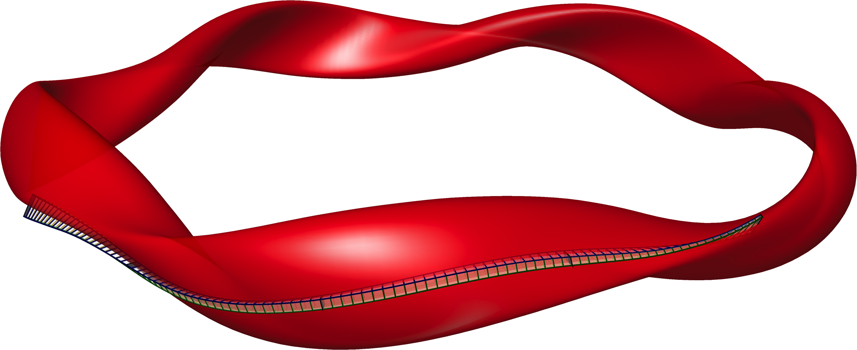
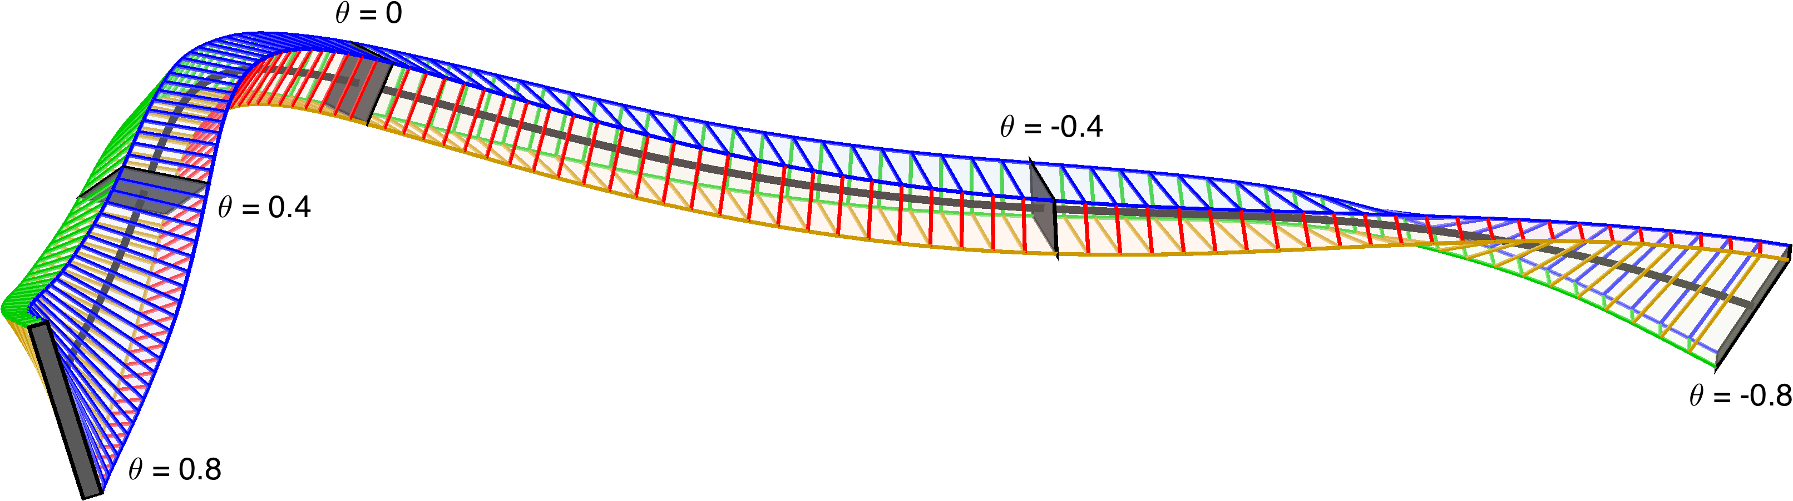






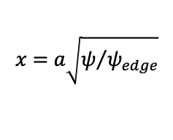


Raw feature space: 7x 1D functions that enter the turbulence simulations
$$B=B_{ref}∇x×∇y$$
$$x=a\sqrt{ψ/{ψ_{edge}}}$$
Flux tube simulation domain
$$\left|B\right|$$
$${\left|B\right|}^{−3}B×∇\left|B\right|∙∇y$$
$${\left|B\right|}^{−2}B×κ∙∇y$$
$${\left|B\right|}^{−3}B×∇\left|B\right|∙∇x$$
$$∇y∙∇y$$
$$∇x∙∇y$$
$$∇x∙∇x$$
Notes:
20250127-01-plot_random_flux_tube.py

Slide 25
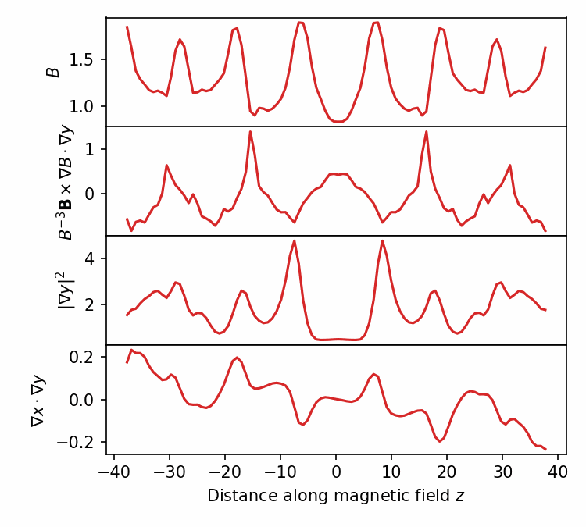
Raw features should not be directly fed to classical regression or fully-connected neural network, since model should be translation-invariant
GK equation, hence heat flux, is invariant under periodic translation of the raw features in z.
Similar to computer vision, where convolutional neural networks give approximate translation-invariance.
Notes:
20250102-01-plot_geometry_for_GX_circshift_figure.py
20250102-01-plot_geometry_for_GX_circshift_animation.py
See 20240609-01 Regressions for database of GX runs.docx
/pscratch/sd/l/landrema/20240609-01-gx_convergence/20240609-01-012_circshift
plot_gx_scan_over_1_parameter_and_configuration.py
plot_Q_vs_z_vs_circshift.py
python \
/global/homes/l/landrema/gx/gx/post_processing/plot-Q-z.py \
000001_circshift_0/gx.out.nc \
000001_circshift_12/gx.out.nc \
000001_circshift_24/gx.out.nc \
000001_circshift_36/gx.out.nc \
000001_circshift_48/gx.out.nc \
000001_circshift_61/gx.out.nc \
000001_circshift_73/gx.out.nc \
000001_circshift_85/gx.out.nc

Slide 26
Convolutional neural networks give accurate prediction of the turbulence
dT/dr
dn/dr
z-dependent geometric features
R² = 0.989
Convolutional layers x5
Predicted heat flux Q / Q_{GB}
Fully connected layers x2
Actual heat flux Q / Q_{GB} from gyrokinetic simulation
Heat flux Q
Prediction in 0.001 sec for single network, 0.1 sec for ensemble
Notes:
pred_vs_actual_plot_pre2_20250211-01-002.pdf

Slide 27
Turbulence simulations
R² = 0.989
Predicted heat flux
Regression
Feature importance
True heat flux
Spearman correlation
Sequential feature selection
Shapley values
Notes:
20250102-10_plot_Q_vs_time_for_several_simulations.pdf

Slide 28
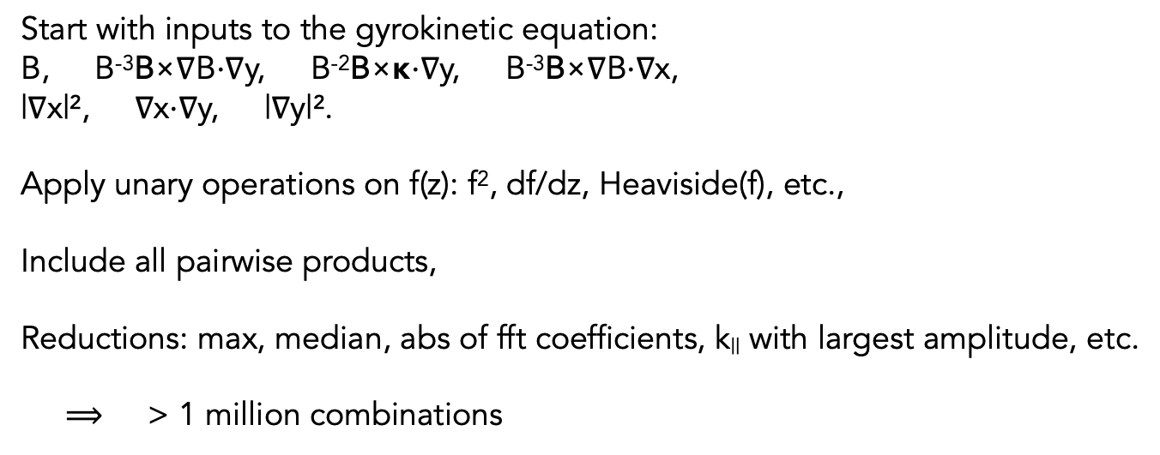
Our interpretable models use a large library of candidate features, all translation-invariant
Start with inputs to the gyrokinetic equation:
B, B⁻³B×∇B⋅∇y, B⁻²B×κ⋅∇y, B⁻³B×∇B⋅∇x,
|∇x|², ∇x⋅∇y, |∇y|².
Apply unary operations on f(z): f², df/dz, Heaviside(f), etc.,
Include all pairwise products,
Reductions: max, median, abs of fft coefficients, k|| with largest amplitude, etc.
$⟹$ > 1 million combinations

Slide 29
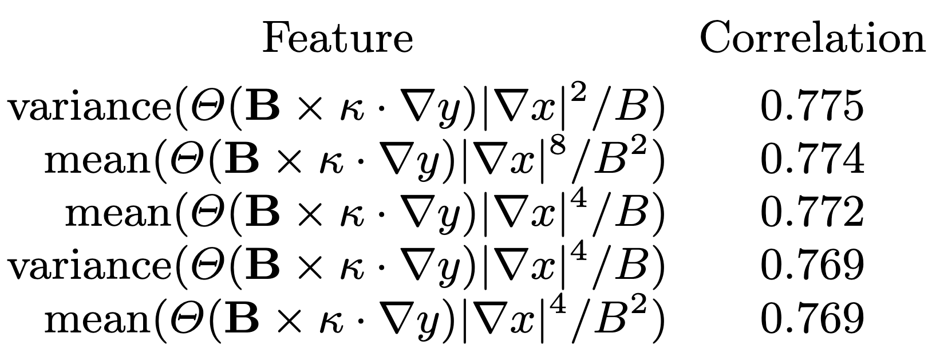
Spearman correlation is a quick tool to find the most important feature
Unlike Pearson, Spearman is invariant to any monotonic function.
Features with highest correlation to heat flux Q at fixed ∇T & ∇n:
Heaviside function: Where there is bad curvature,
Jacobian (maybe squared)
local temperature gradient in real space (to various powers)
|∇T| = (dT/dx) |∇x|
?!?! |∇x| does not appear in gyrokinetic equation for fastest-growing linear modes!
Notes:
20250114-06-plot_W7-X_xsection_and_surface.py

Slide 30
Another method to identify most important features: forward sequential feature selection
Using decision trees (XGBoost)
Notes:
20241229-07-plot_sfs_results_for_talk_simplified.py

Slide 31

Most important features from sequential feature selection
Temperature gradient
Density gradient
The 2nd most important geometric feature involves flux surface compression and radial ∇B drift
The most important geometric feature is flux surface compression where curvature is bad
The gradients are more important than any geometric feature
Xanthopoulos et al (2011), Nakata & Matsuoka (2022):
Larger geodesic curvature (= radial drift) ⇒ Stronger damping of zonal flows ⇒ higher heat flux

Slide 32
Shapley values show the sign and magnitude of each feature’s effect
Temperature gradient
|dT/dr| increases Q
Density gradient
|dn/dr| decreases Q
Most important geometric features:
|∇x| increases Q,
especially near bad curvature
Next geometric features:
Radial drift (geodesic curvature)
increases Q
Decreasing importance
Shapley value: contribution to predicted ln(Q) (Q=Heat flux)
Notes:
20240902-01-plot_shapley_values_for_GX_regression.py

Slide 33
Summary
Stellarators for energy & basic science are a rich source of physics questions, with significant activity.
We’re uncovering how turbulence in these plasmas can be manipulated via geometry.
Large datasets & interpretable machine learning can reveal trends and stimulate theory.

Slide 34
Open questions
How does geometry specifically affect linear instability vs nonlinear saturation?
Can we look inside the neural networks to understand the features they extract?
Can we better understand analytically the trends that are revealed by the interpretable ML?

