Slide 1
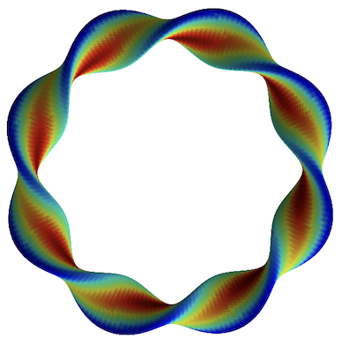
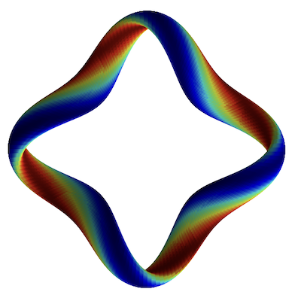
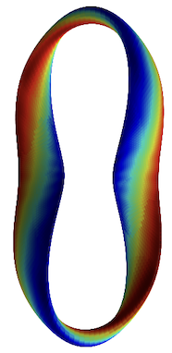
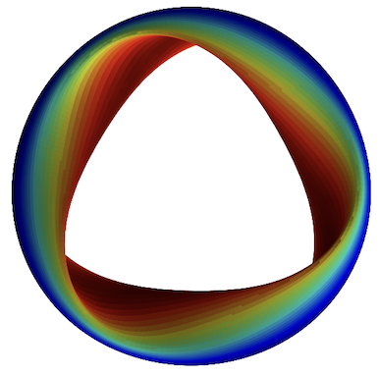
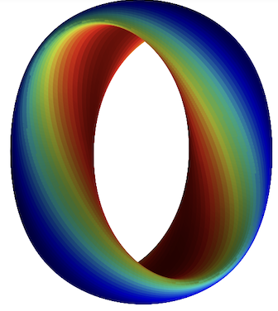
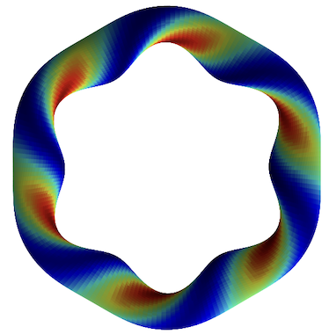
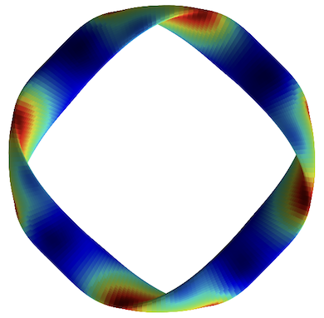
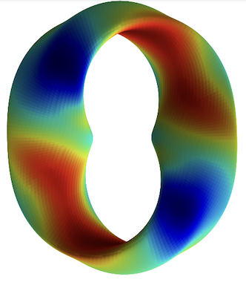
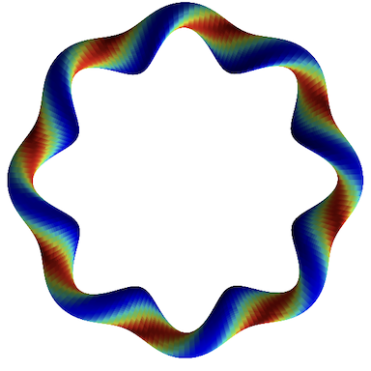
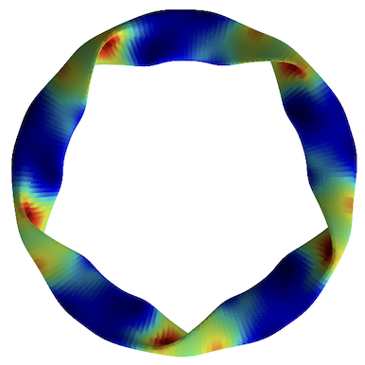
Efficient interpretable regression and classification with translation-invariance
Turbulence simulations
R² = 0.989
Predicted heat flux
Regression,
classification
Feature importance
True heat flux
M Landreman, J Y Choi, C Alves, P Balaprakash, R M Churchill , R Conlin, G Roberg-Clark
Journal of Plasma Physics 91, E120 (2025), arXiv:2502.11657
Notes:
20250102-10_plot_Q_vs_time_for_several_simulations.pdf

Slide 2
Efficient interpretable regression and classification with translation-invariance
Motivating application: turbulence in fusion plasmas
Regression/classification method
Results

Slide 3
Efficient interpretable regression and classification with translation-invariance
Motivating application: turbulence in fusion plasmas
Regression/classification method
Results

Slide 4

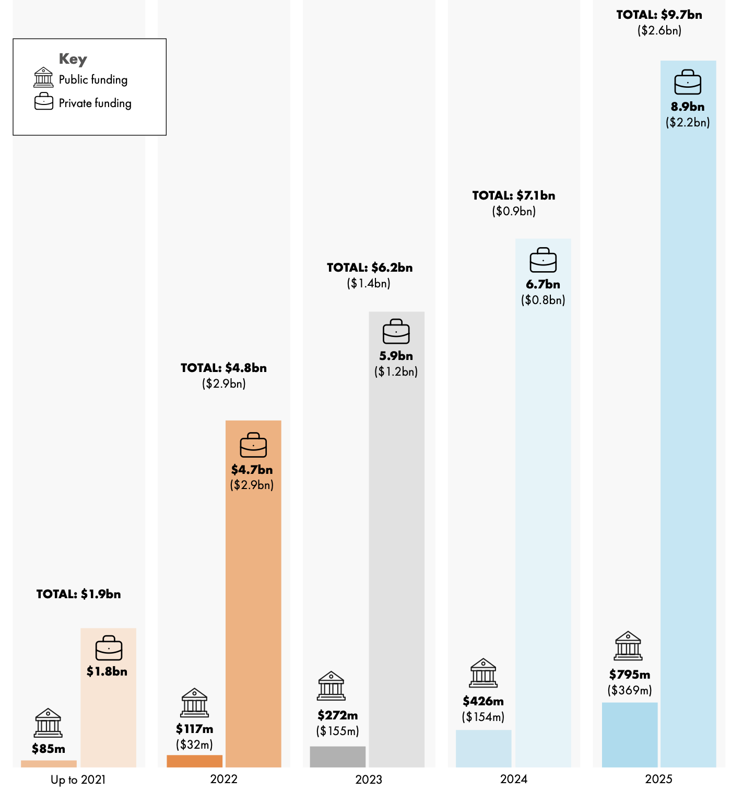



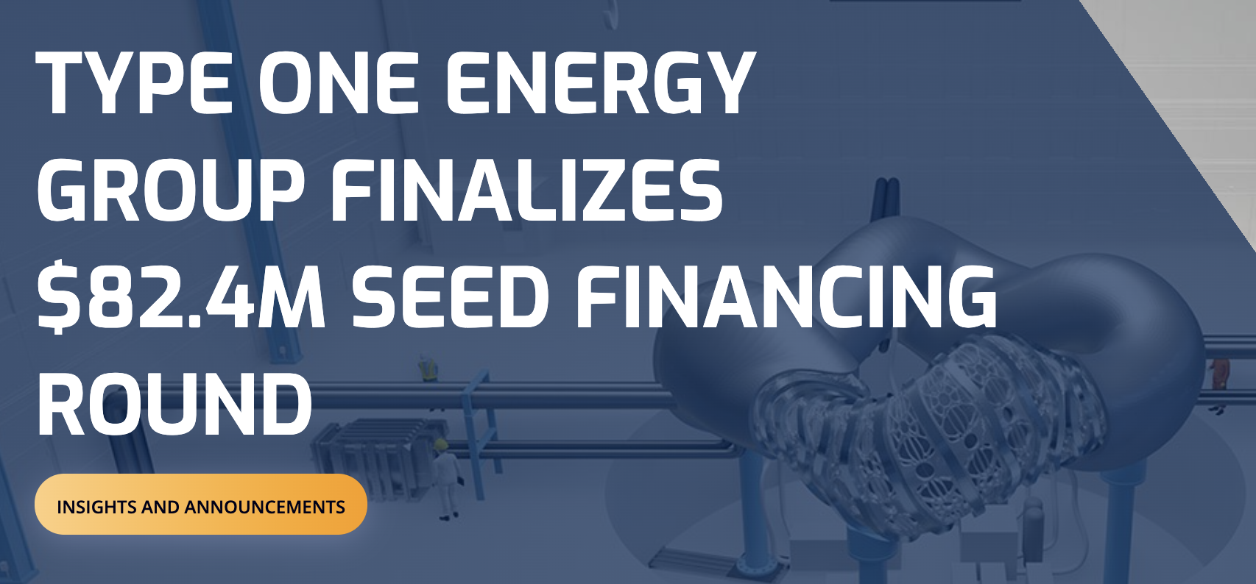
Chart from Fusion Industry Association

Slide 5
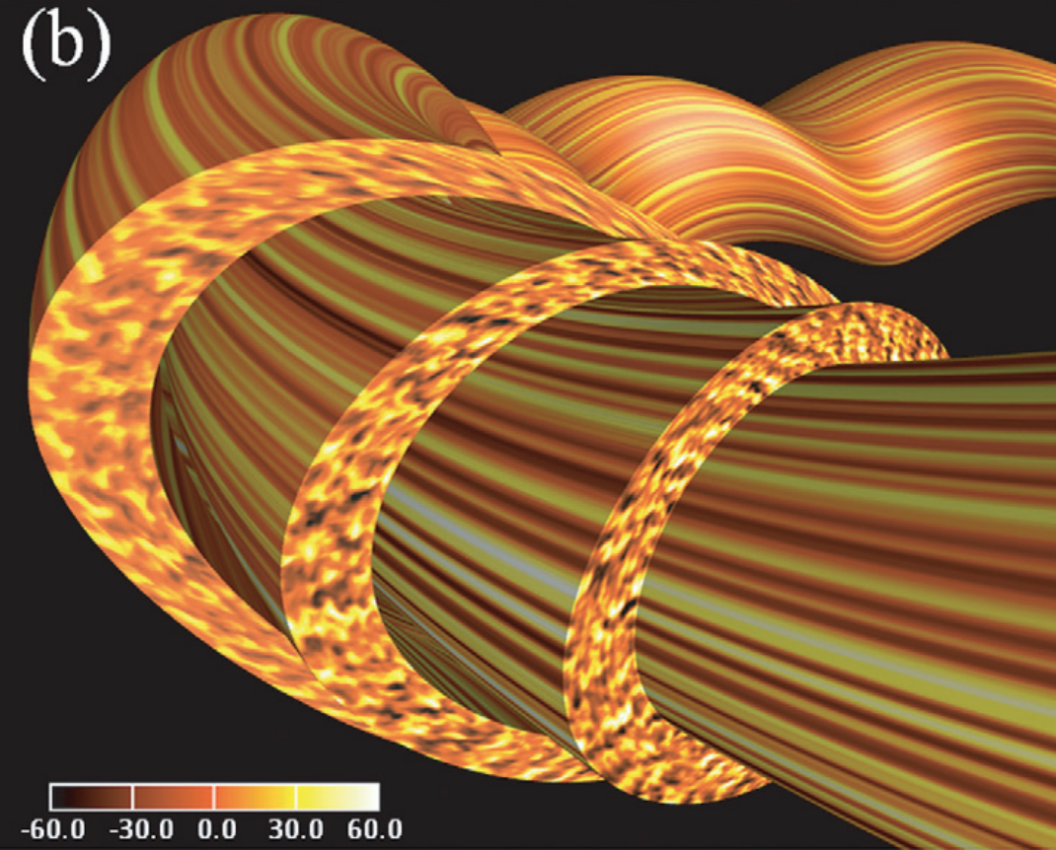
Turbulence in fusion plasmas: we want to understand & optimize
Gradients of plasma density & temperature cause instabilities & turbulence.
Causes heat to leak out.
Known to depend on plasma shape, but how exactly?
Geometry could be optimized to reduce turbulence
Turbulence simulations: ~10 GPU-min to 10⁶s of CPU-hours.
5D + time
Nunami 2012
Electrostatic potential
Notes:
Turbulence image from http://fusionsites.ciemat.es/gyrokineticsmadrid2014/files/2014/06/Nunami.pdf
From https://aip.scitation.org/doi/pdf/10.1063/1.4704568 Nunami et al., PoP 19, 042504 (2012)

Slide 6
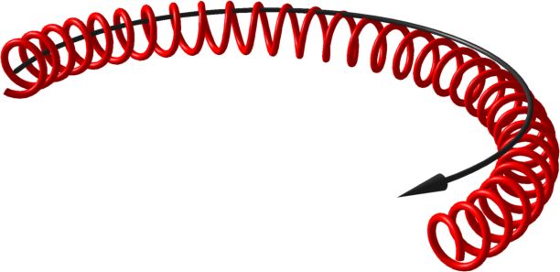
Turbulence in fusion plasmas is highly anisotropic due to magnetic field
Nunami 2012
Magnetic field line
Particle trajectory
Electrostatic potential
Notes:
Turbulence image from http://fusionsites.ciemat.es/gyrokineticsmadrid2014/files/2014/06/Nunami.pdf
From https://aip.scitation.org/doi/pdf/10.1063/1.4704568 Nunami et al., PoP 19, 042504 (2012)

Slide 7
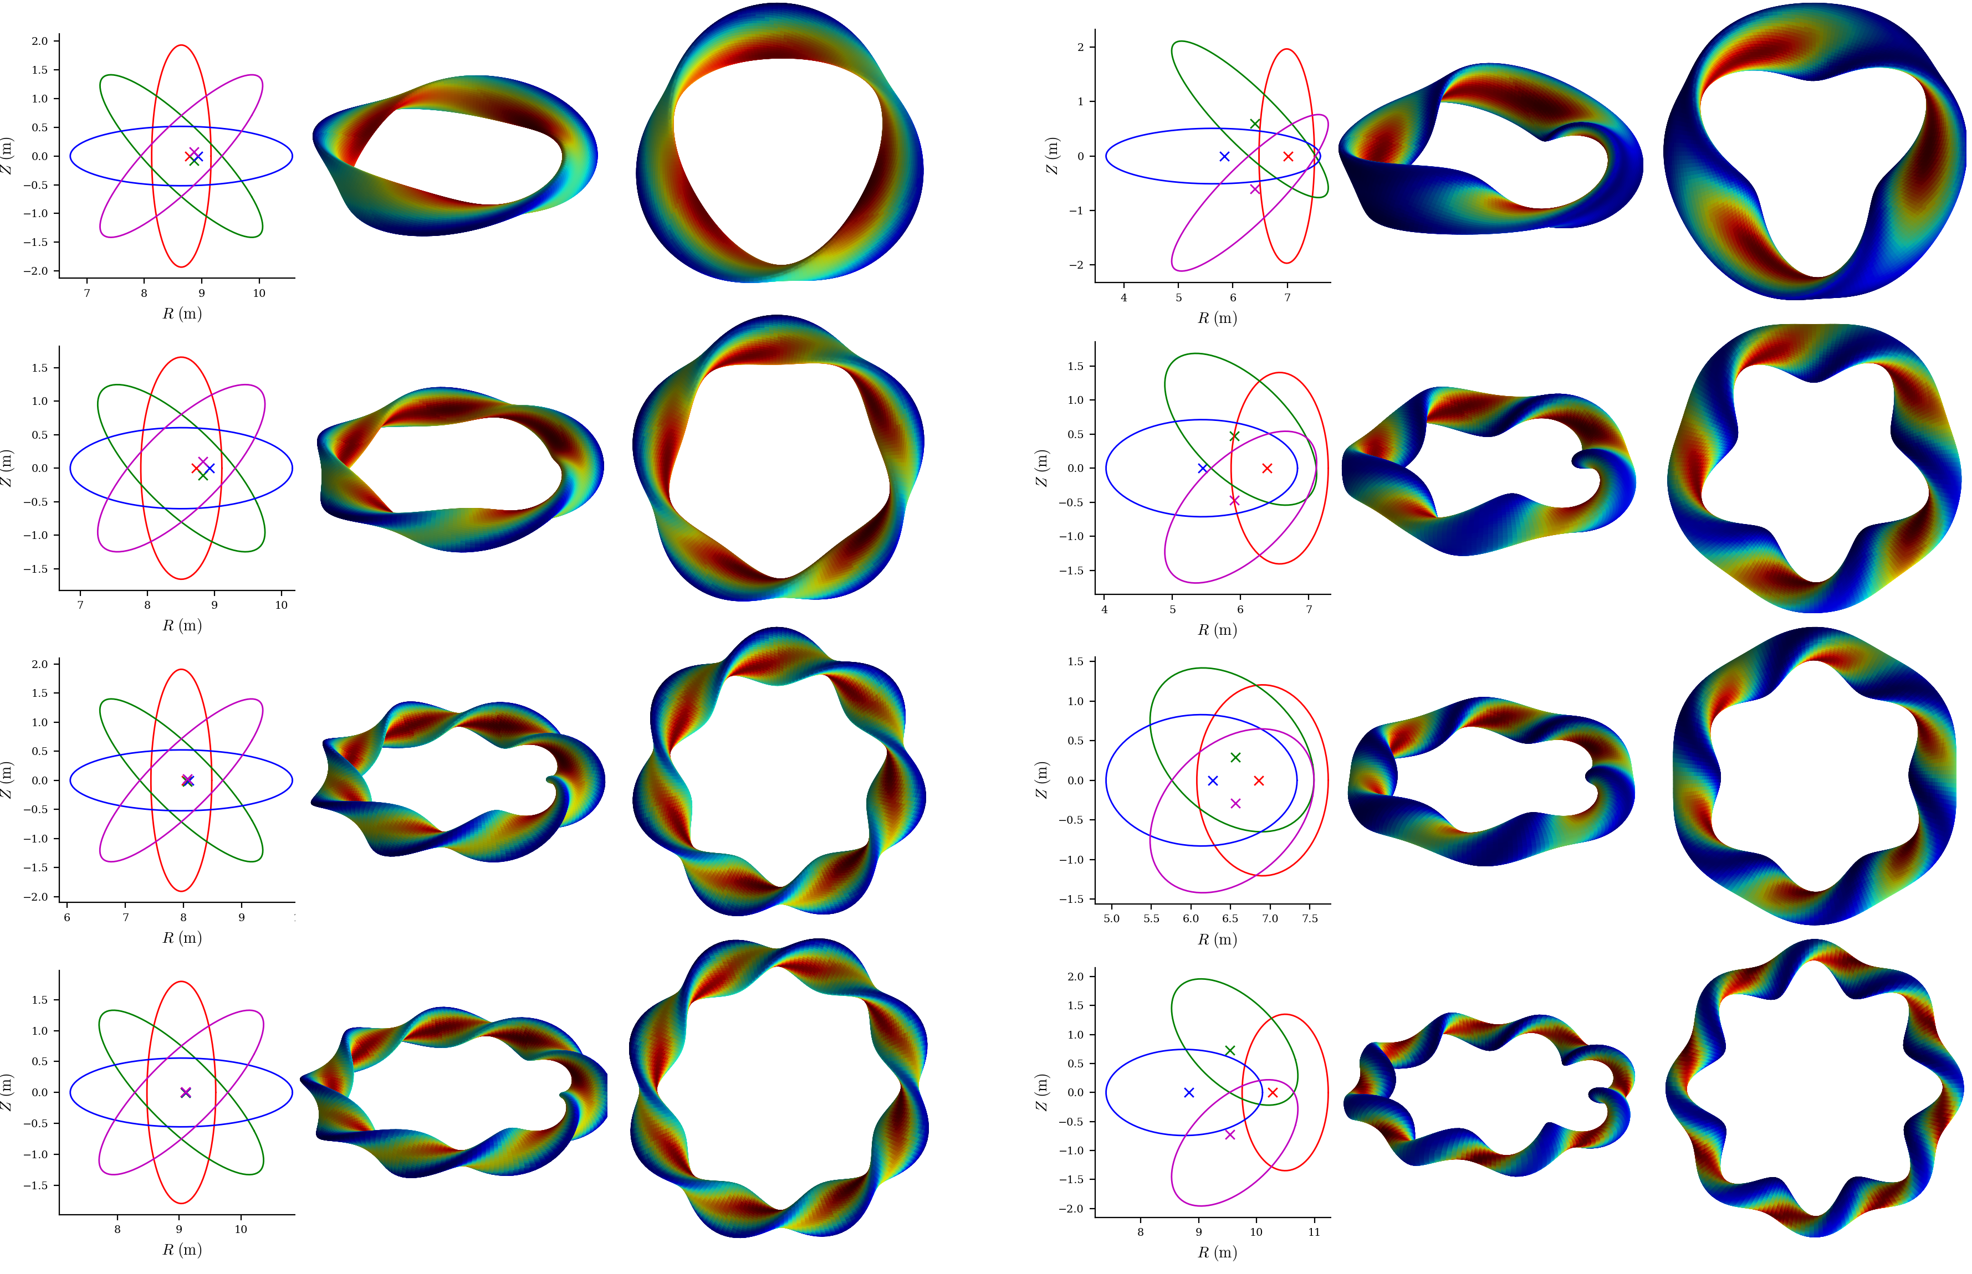
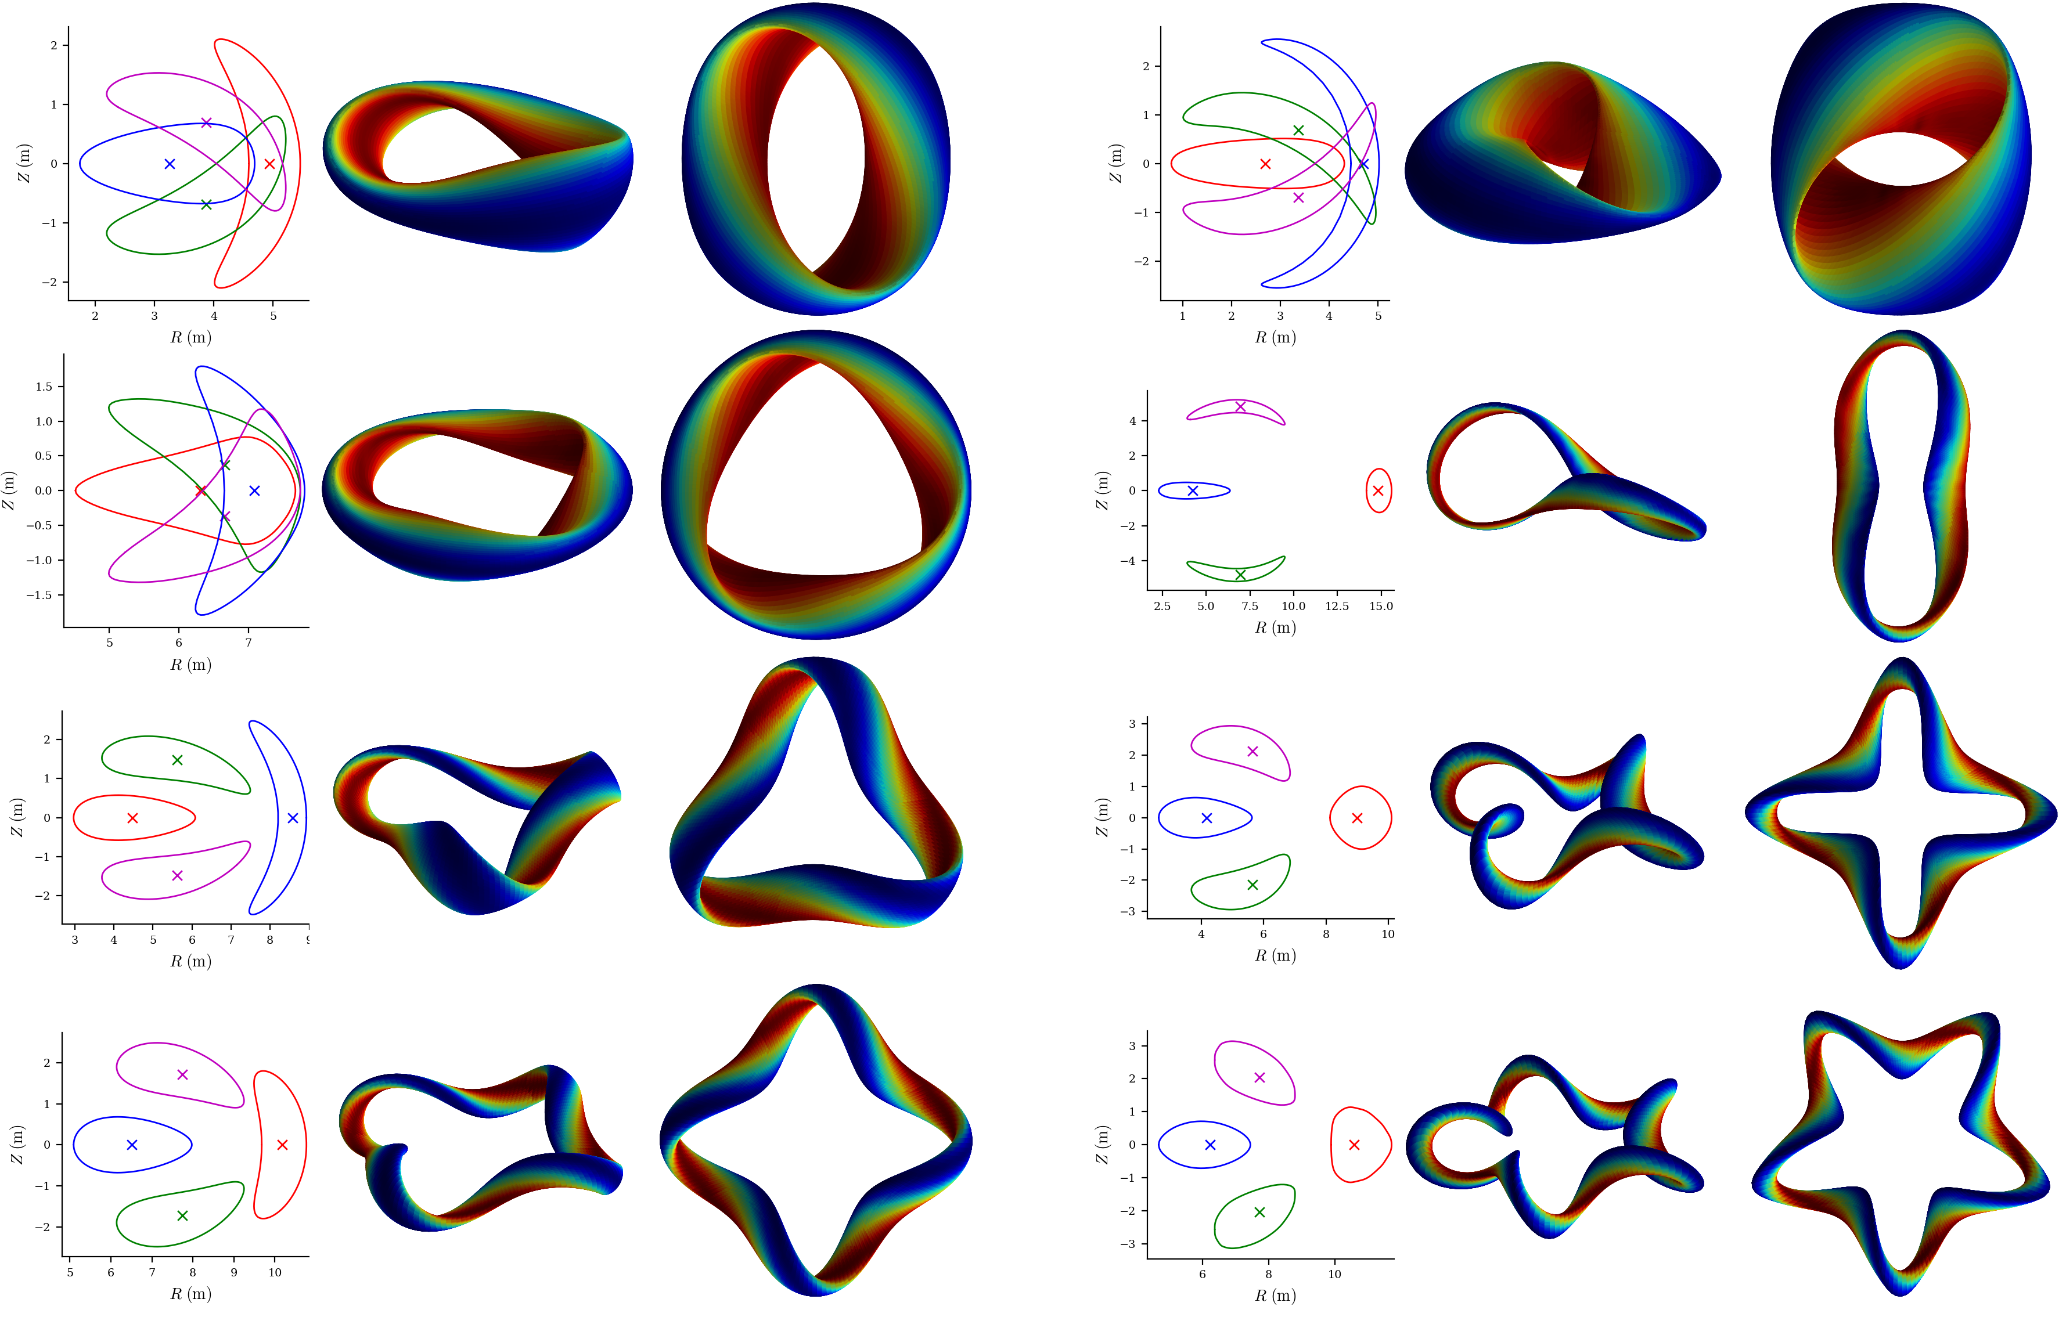
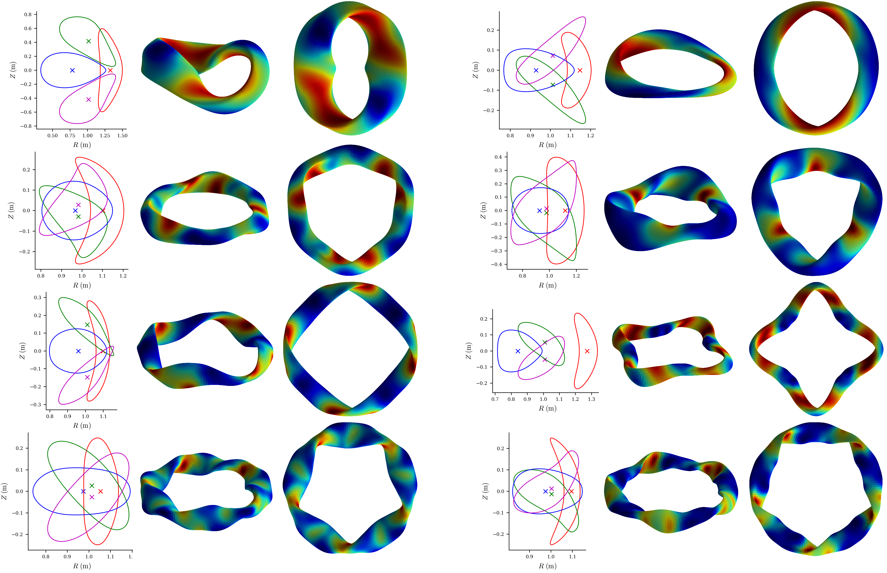
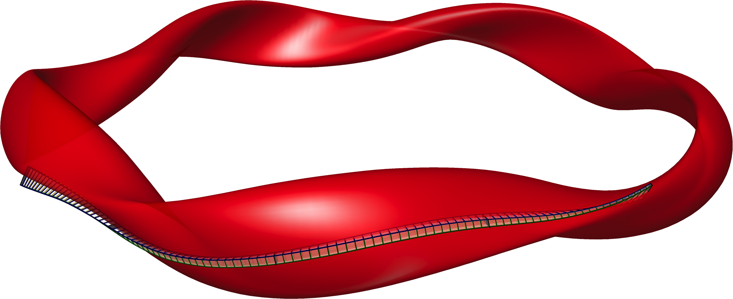
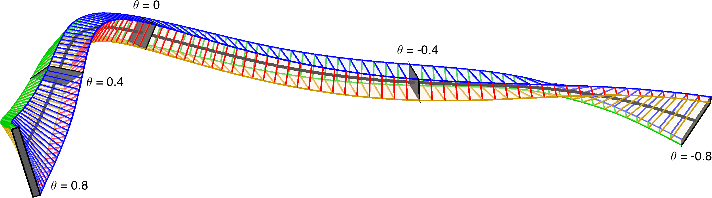
Approach here: learn how turbulence depends on geometry using data
Start with direct numerical simulations of turbulence in 10⁵ geometries
“Flux tube” simulation domain
z
x
y
Notes:
~/Box/work24/20241220-02-figure_of_heliiotron_equilibria$ ./20241220-02-plot_heliotron_equilibria_for_paper.py

Slide 8
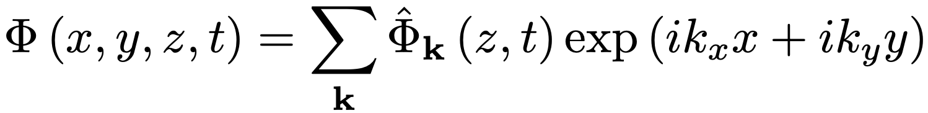
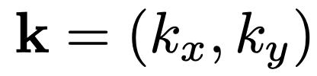
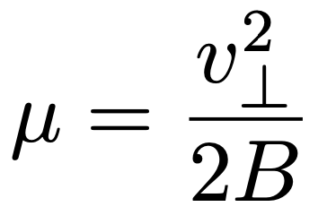
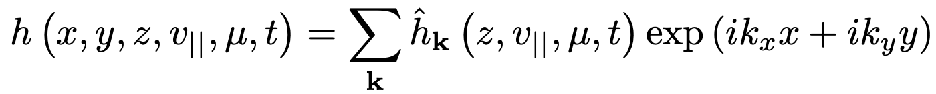
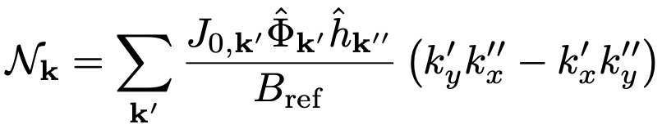
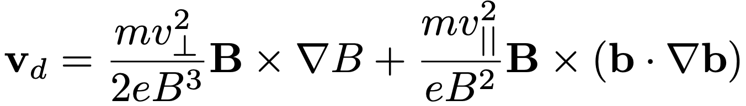
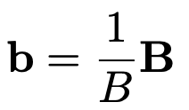

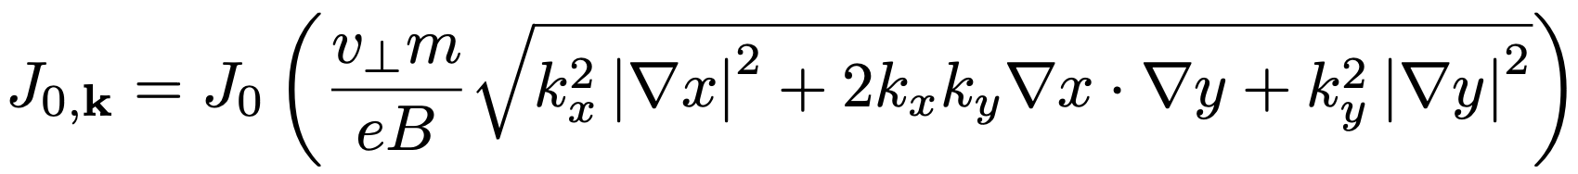
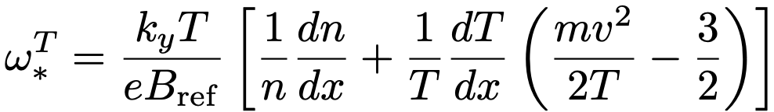
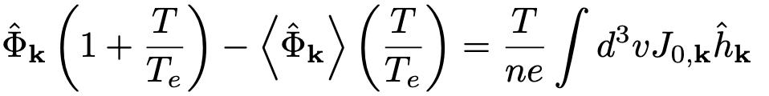
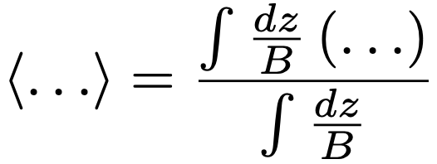
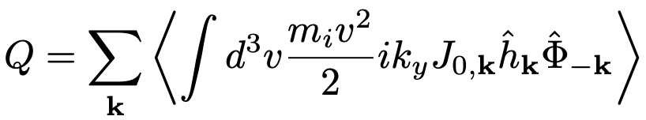
Equations describing the turbulence
Electrostatic potential:
Ion distribution function:
Gyrokinetic equation:
Quasineutrality:
Heat flux:
Notes:
20250821-01_Equations_for_numerical_analysis_seminar_on_gyrokinetic_equation.lyx

Slide 9
Nonlinear turbulence simulations were run in 10⁵ geometries
1 simulation in each tube with random dT/dx and dn/dx.
1 simulation in each tube with (a/T) dT/dx = 3, (a/n) dn/dx=0.9
8 minutes to get heat flux on 1 GPU
2×10⁵ nonlinear simulations took < 7000 node-hours
10⁴
Notes:
This was about 1/8 of our SciDAC GPU allocation was 53,738 node hrs, UMD GPU allocation was 40,978 node hrs.
/pscratch/sd/l/landrema/20240601-01-random_stellarator_equilibria/20240601-01-075_ntheta_scan> ./plot_gx_scan_over_1_parameter_and_configuration.py
20240902-03_plot_distribution_of_Q_from_GX_database_for_poster.py
20241218-01-plot_distribution_of_heat_fluxes_for_paper.py
20250102-10_plot_Q_vs_time_for_several_simulations.pdf

Slide 10






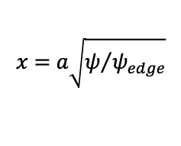


Raw feature space: 7x 1D functions that enter the turbulence simulations
$$B=B_{ref}∇x×∇y$$
x
$$x=a\sqrt{ψ/{ψ_{edge}}}$$
z
y
Flux tube simulation domain
$$\left|B\right|$$
$${\left|B\right|}^{−3}B×∇\left|B\right|∙∇y$$
$${\left|B\right|}^{−2}B×κ∙∇y$$
$${\left|B\right|}^{−3}B×∇\left|B\right|∙∇x$$
$$∇y∙∇y$$
$$∇x∙∇y$$
$$∇x∙∇x$$
Notes:
20250127-01-plot_random_flux_tube.py

Slide 11
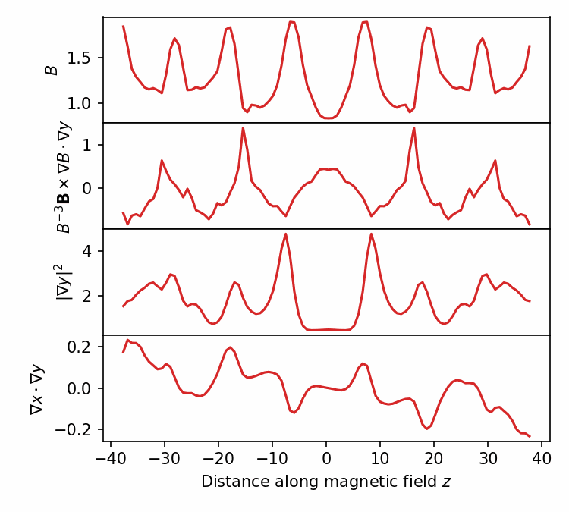
Raw features should not be directly fed to classical regression or fully-connected neural network, since model should be translation-invariant
Gyrokinetic equation, hence heat flux, is invariant under periodic translation of the raw features in z.
Similar to computer vision, where convolutional neural networks give approximate translation-invariance.
Notes:
20250102-01-plot_geometry_for_GX_circshift_figure.py
20250102-01-plot_geometry_for_GX_circshift_animation.py
See 20240609-01 Regressions for database of GX runs.docx
/pscratch/sd/l/landrema/20240609-01-gx_convergence/20240609-01-012_circshift
plot_gx_scan_over_1_parameter_and_configuration.py
plot_Q_vs_z_vs_circshift.py
python \
/global/homes/l/landrema/gx/gx/post_processing/plot-Q-z.py \
000001_circshift_0/gx.out.nc \
000001_circshift_12/gx.out.nc \
000001_circshift_24/gx.out.nc \
000001_circshift_36/gx.out.nc \
000001_circshift_48/gx.out.nc \
000001_circshift_61/gx.out.nc \
000001_circshift_73/gx.out.nc \
000001_circshift_85/gx.out.nc

Slide 12
Efficient interpretable regression and classification with translation-invariance
Motivating application: turbulence in fusion plasmas
Regression/classification method
Results

Slide 13
Convolutional neural networks give accurate prediction of the turbulence, but lack interpretability
a/L_{T}
a/L_{n}
z-dependent geometric features
R² = 0.989
Convolutional layers x5
Predicted heat flux Q / Q_{GB}
Fully connected layers x2
Actual heat flux Q / Q_{GB} from gyrokinetic simulation
Heat flux Q
Notes:
pred_vs_actual_plot_pre2_20250211-01-002.pdf

Slide 14
Regression/classification method to achieve invariance & interpretability
Define library of candidate features which are all translation-invariant. (Akin to SINDy).
Apply a fast regression/classification method like decision trees to these features.
Use forward sequential feature selection to pick out only the most important features.
Guarantees that model will respect the invariance.
Each feature is an analytic expression ⇒ partially interpretable.
Step 2 allows extra nonlinearity beyond functions in the library.
Method in step 2 must be fast to fit because we will fit millions of models.

Slide 15
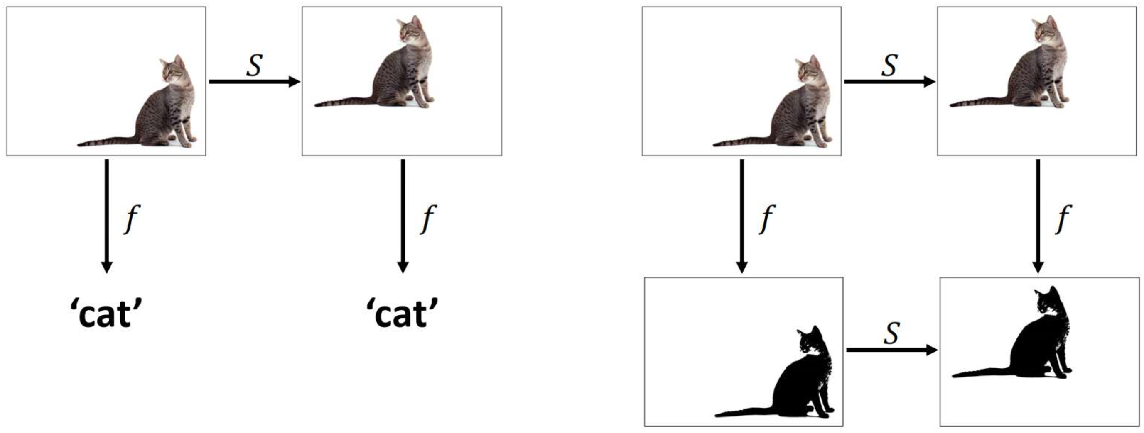
To create library of candidate features, apply any translation-invariant reduction to translation-equivariant operations
Invariance
Equivariance
Figure by Bernhard Kainz
Notes:
https://www.doc.ic.ac.uk/~bkainz/teaching/DL/notes/equivariance.pdf

Slide 16
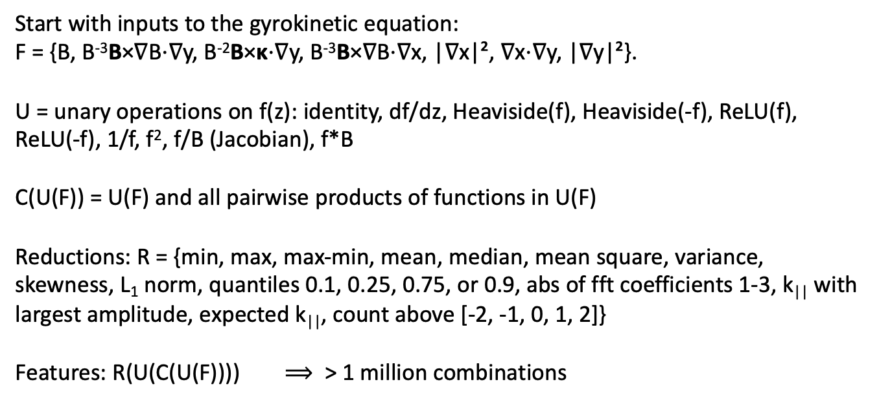
To create library of candidate features, apply any translation-invariant reduction to translation-equivariant operations
Start with inputs to the gyrokinetic equation:
F = {B, B⁻³B×∇B⋅∇y, B⁻²B×κ⋅∇y, B⁻³B×∇B⋅∇x, |∇x|², ∇x⋅∇y, |∇y|²}.
U = unary operations on f(z): identity, df/dz, Heaviside(f), Heaviside(-f), ReLU(f), ReLU(-f), 1/f, f², f/B (Jacobian), f*B
C(U(F)) = U(F) and all pairwise products of functions in U(F)
Reductions: R = {min, max, max-min, mean, median, mean square, variance, skewness, L₁ norm, quantiles 0.1, 0.25, 0.75, or 0.9, abs of fft coefficients 1-3, k|| with largest amplitude, expected k||, count above [-2, -1, 0, 1, 2]}
Features: R(U(C(U(F)))) $⟹$ > 1 million combinations

Slide 17
Efficient interpretable regression and classification with translation-invariance
Motivating application: turbulence in fusion plasmas
Regression/classification method
Results

Slide 18
Forward sequential feature selection
Using decision trees (XGBoost library), varied-gradient dataset
Notes:
20241229-07-plot_sfs_results_for_talk_simplified.py

Slide 19
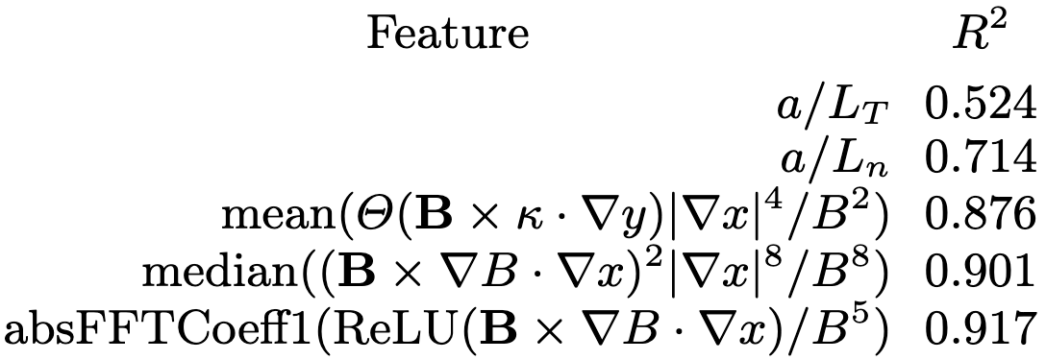
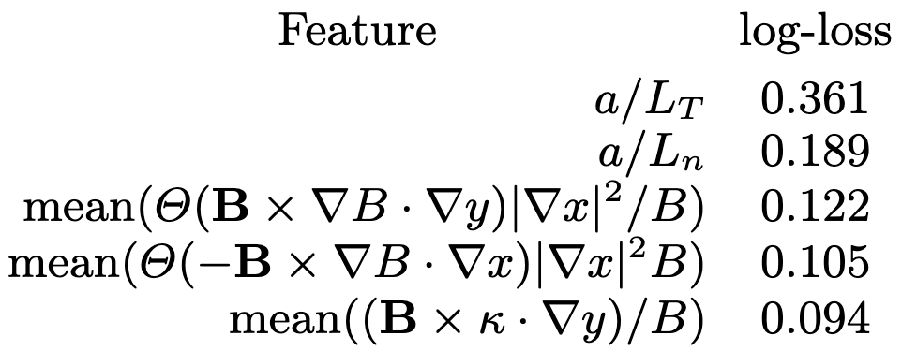
Most important features from sequential feature selection
Regression on heat flux
Classification (stability vs instability)
Most important geometric feature:
Local temperature gradient in real space |∇T| = (dT/dx) |∇x|, where there is bad curvature.
Similar to proposed physics-inspired surrogates
[Mynick (2010), Xanthopoulos (2014), Stroteich (2022), Goodman (2024)].
The gradients are more important than any geometric feature
Xanthopoulos et al (2011), Nakata & Matsuoka (2022):
Larger geodesic curvature (= radial drift) ⇒ Stronger damping of zonal flows ⇒ higher heat flux

Slide 20
Sequential feature selection allows closer fit to the data as more geometric features are included
Performance shown on 20% held-out test data
Notes:
20241224-01-plot_Q_vs_predicted_for_ML_paper.py

Slide 21
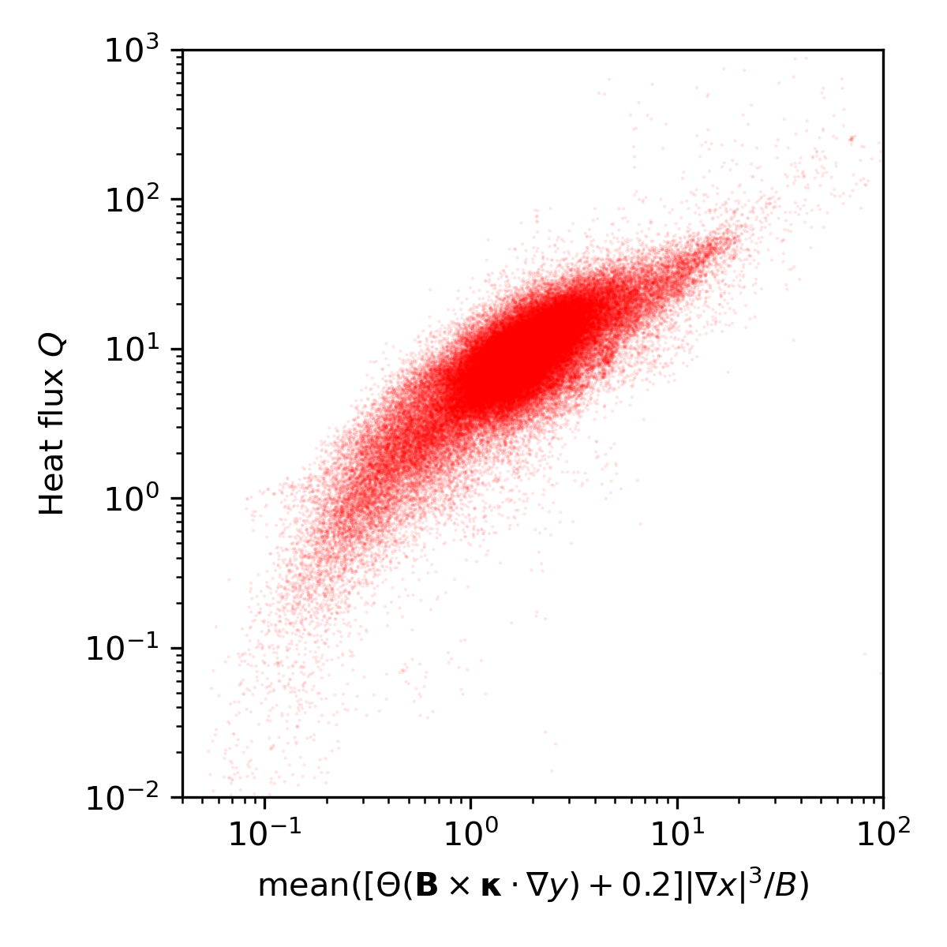
The first geometric feature can be fine-tuned for even better fit
Notes:
20241229-04_plot_Q_vs_optimized_single_feature_for_paper.png

Slide 22

Summary
Interpretable regression/classification guaranteeing translation-invariance.
Library of candidate invariant features + decision trees + feature selection.
Most important features align with recent physics-motivated surrogates.
Future work
Use model for optimizing geometry & predicting temperature.
Compare to saliency maps for the neural networks.
Include physics-motivated features (e.g. linear growth rates).
Generate data with higher physics fidelity, repeat analysis.
Other suggestions for methods to try?
Journal of Plasma Physics 91, E120 (2025)
arXiv:2502.11657

Slide 23
Extra slides

Slide 24
How does magnetic geometry affect ITG turbulence?
Insights from data & machine learning
Turbulence simulations
R² = 0.989
Predicted heat flux
Regression
Feature importance
True heat flux
M Landreman, J Y Choi, C Alves, P Balaprakash, R M Churchill , R Conlin, G Roberg-Clark arXiv:2502.11657
Thanks to many others who gave suggestions Supported by the US DOE StellFoundry SciDAC
Notes:
20250102-10_plot_Q_vs_time_for_several_simulations.pdf

Slide 25
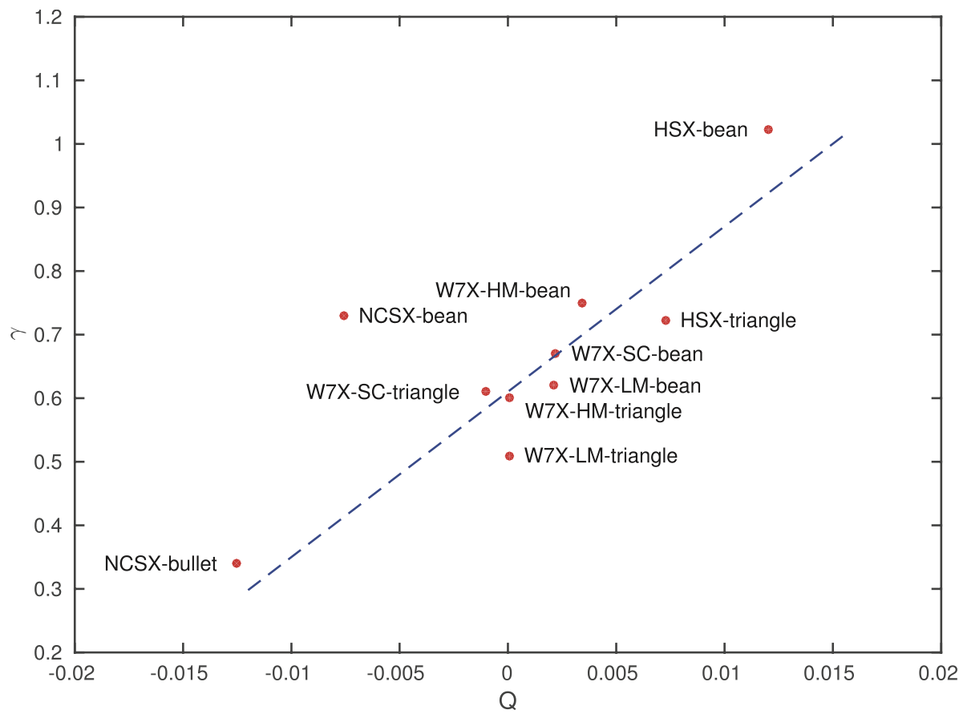
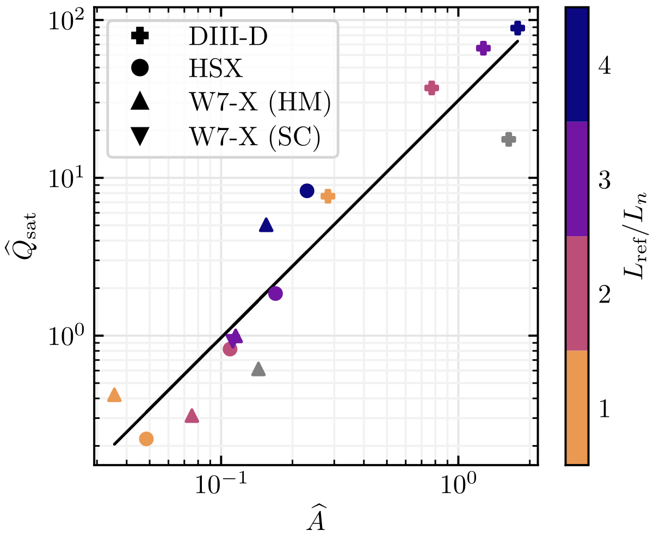
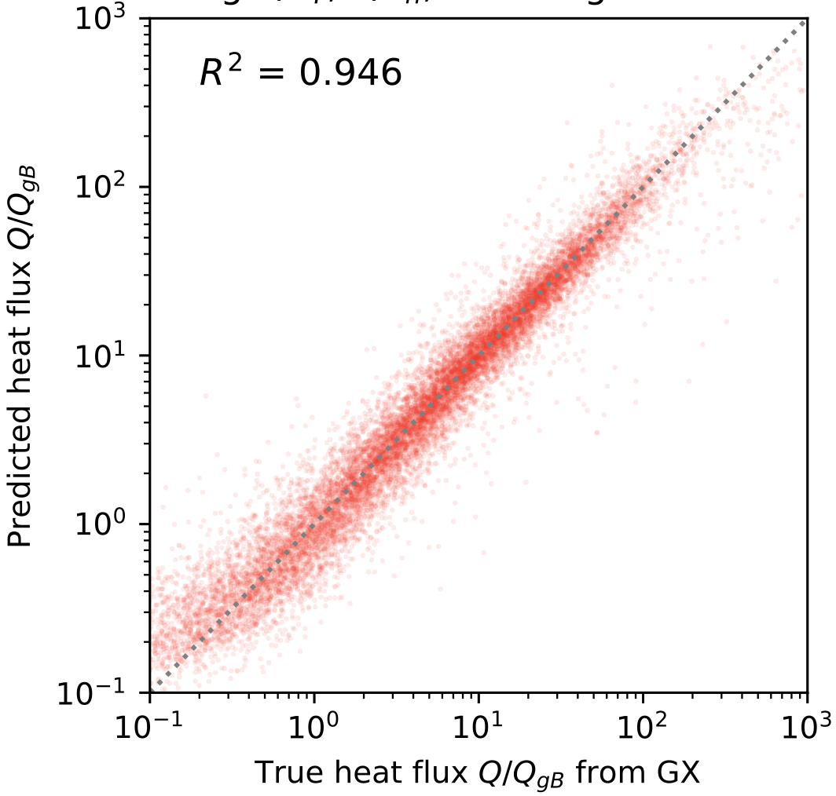
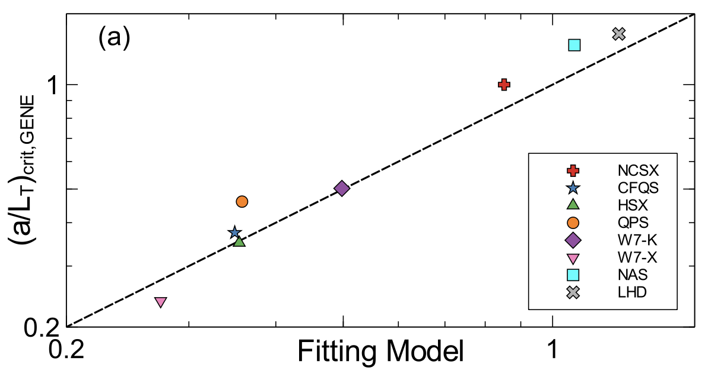
Proll (2016)
N = 10
Mackenbach (2022)
N = 15
TEM proxy
This work:
N = 100,705
Roberg-Clark (2022)
N = 8

Slide 26
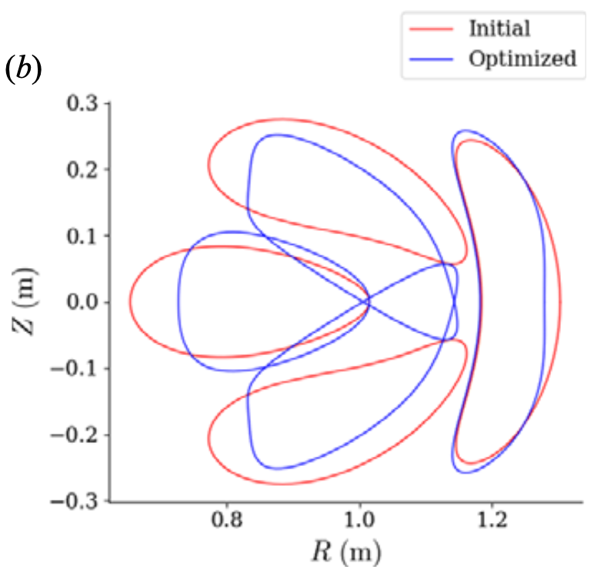

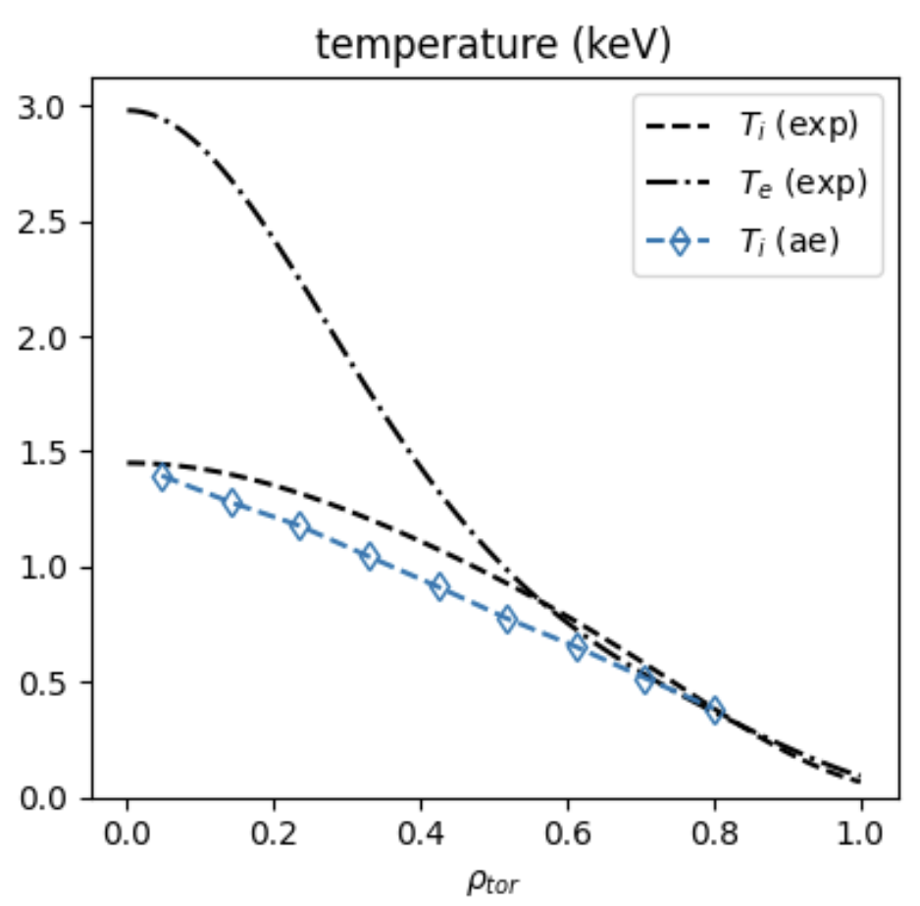
Motivations
Understanding
Optimization
Profile prediction
Kim (2024)
Mandell (2024)
Optimize geometry for maximum fusion power
Notes:
https://www.google.com/imgres?q=eureka%20understanding%20light%20bulb%20brain&imgurl=https%3A%2F%2Fpreview.redd.it%2Fhow-do-light-bulb-moments-come-about-v0-0mgno4a97tva1.jpg%3Fwidth%3D777%26format%3Dpjpg%26auto%3Dwebp%26s%3D541d28c2f1009471ab52add4a282ee4916a311fa&imgrefurl=https%3A%2F%2Fwww.reddit.com%2Fr%2Fmbti%2Fcomments%2F12xc0ef%2Fhow_do_light_bulb_moments_come_about%2F&docid=G-9kXBNk27S2YM&tbnid=9jUFrhBW814RkM&vet=12ahUKEwjdq_HN6OOKAxW7MVkFHflMNswQM3oECHAQAA..i&w=777&h=625&hcb=2&ved=2ahUKEwjdq_HN6OOKAxW7MVkFHflMNswQM3oECHAQAA

Slide 27
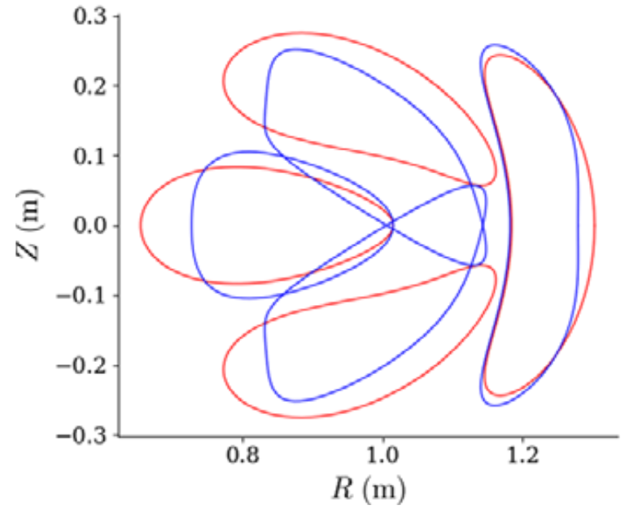
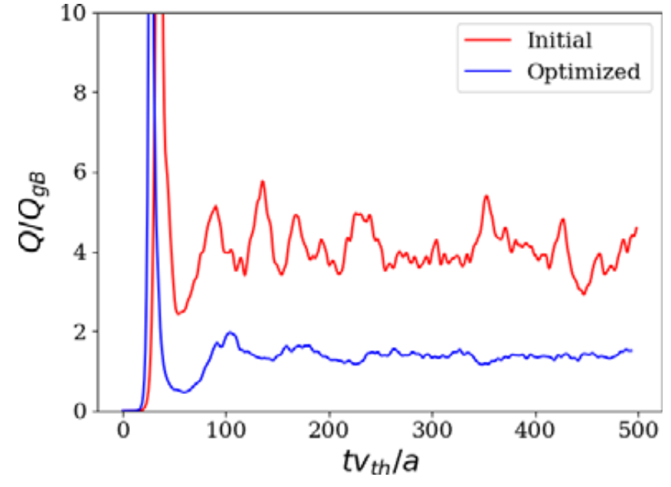
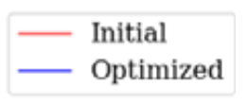
Motivations
Understanding
Optimization
Profile prediction
Kim (2024)
Mandell (2024)
Notes:
https://www.google.com/imgres?q=eureka%20understanding%20light%20bulb%20brain&imgurl=https%3A%2F%2Fpreview.redd.it%2Fhow-do-light-bulb-moments-come-about-v0-0mgno4a97tva1.jpg%3Fwidth%3D777%26format%3Dpjpg%26auto%3Dwebp%26s%3D541d28c2f1009471ab52add4a282ee4916a311fa&imgrefurl=https%3A%2F%2Fwww.reddit.com%2Fr%2Fmbti%2Fcomments%2F12xc0ef%2Fhow_do_light_bulb_moments_come_about%2F&docid=G-9kXBNk27S2YM&tbnid=9jUFrhBW814RkM&vet=12ahUKEwjdq_HN6OOKAxW7MVkFHflMNswQM3oECHAQAA..i&w=777&h=625&hcb=2&ved=2ahUKEwjdq_HN6OOKAxW7MVkFHflMNswQM3oECHAQAA

Slide 28
Turbulence simulations
R² = 0.989
Predicted heat flux
Regression
Feature importance
True heat flux
Notes:
20250102-10_plot_Q_vs_time_for_several_simulations.pdf

Slide 29
Equilibria include rotating ellipses, quasi-symmetric, and random shapes
Aspect ratio,
elongation, q = 1 / ι, β, and number of field periods are all varied.
All configurations scaled to have same gyroBohm normalizations
(Tokamak generation underway by Ralf Mackenbach)
Notes:
~/Box/work24/20241220-02-figure_of_heliiotron_equilibria$ ./20241220-02-plot_heliotron_equilibria_for_paper.py

Slide 30
Turbulence simulations
R² = 0.989
Predicted heat flux
Regression
Feature importance
True heat flux
Notes:
20250102-10_plot_Q_vs_time_for_several_simulations.pdf

Slide 31
Equilibria group 1: random rotating ellipses
Nfp,
aspect ratio,
elongation,
axis torsion,
and beta are all random.
All configurations have same minor radius & toroidal flux, so same gyroBohm normalization
Notes:
~/Box/work24/20241220-02-figure_of_heliiotron_equilibria$ ./20241220-02-plot_heliotron_equilibria_for_paper.py

Slide 32
Equilibria group 2: QUASR QA & QH (Giuliani 2024)
Random pressure added for even more diversity
Notes:
~/Box/work24/20241220-01-figure_of_QUASR_equilibria$ ./20241220-01-plot_QUASR_equilibria_for_paper.py

Slide 33
Equilibria group 3: random boundary modes
RBC and ZBS boundary Fourier modes sampled from normal distributions, fit to 44 “real” stellarators
Notes:
~/Box/work24/20241117-01-figure_of_random_equilibria$ ./20241117-02-plot_random_equilibria_for_paper.py

Slide 35
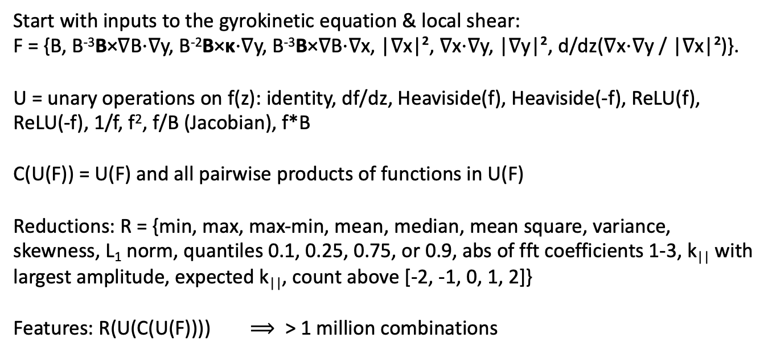
Our interpretable models use a large library of candidate features, all translation-invariant
Start with inputs to the gyrokinetic equation & local shear:
F = {B, B⁻³B×∇B⋅∇y, B⁻²B×κ⋅∇y, B⁻³B×∇B⋅∇x, |∇x|², ∇x⋅∇y, |∇y|², d/dz(∇x⋅∇y / |∇x|²)}.
U = unary operations on f(z): identity, df/dz, Heaviside(f), Heaviside(-f), ReLU(f), ReLU(-f), 1/f, f², f/B (Jacobian), f*B
C(U(F)) = U(F) and all pairwise products of functions in U(F)
Reductions: R = {min, max, max-min, mean, median, mean square, variance, skewness, L₁ norm, quantiles 0.1, 0.25, 0.75, or 0.9, abs of fft coefficients 1-3, k|| with largest amplitude, expected k||, count above [-2, -1, 0, 1, 2]}
Features: R(U(C(U(F)))) $⟹$ > 1 million combinations

Slide 36
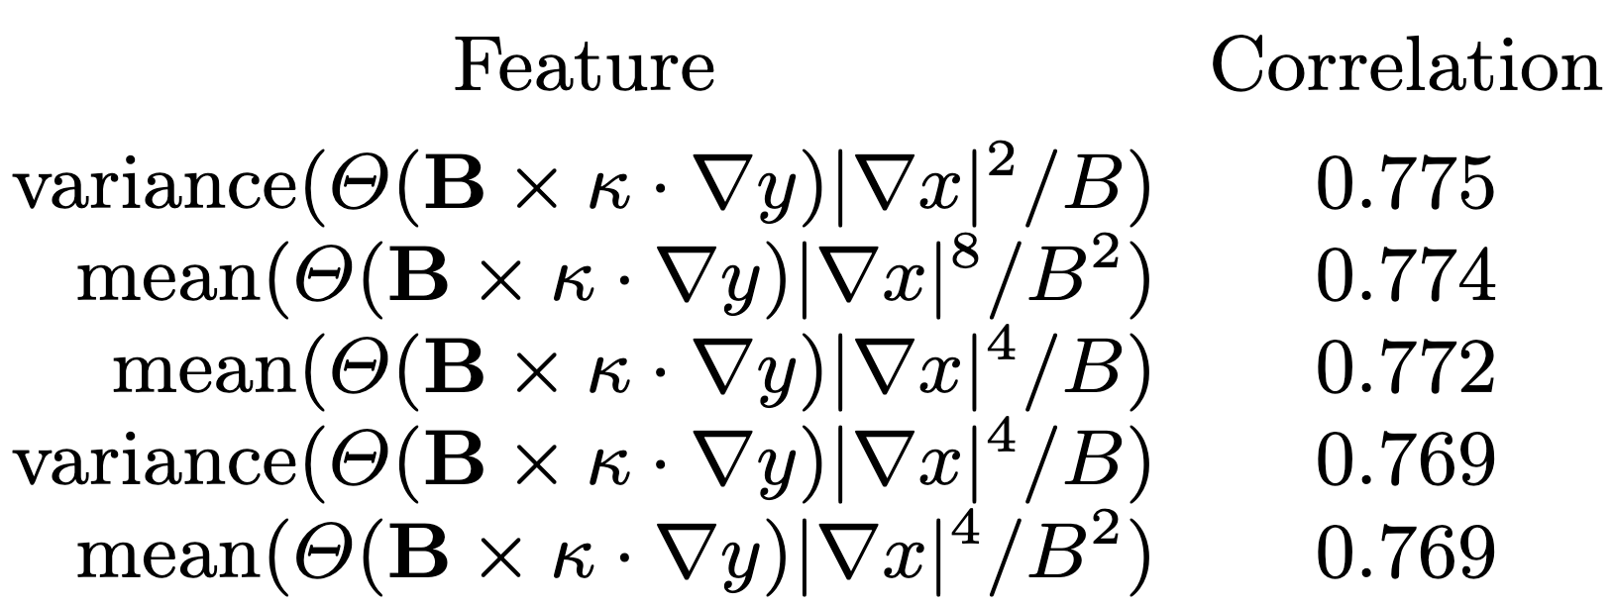
Spearman correlation is a quick tool to find the most important feature
Spearman correlation is the regular Pearson correlation of the the sorted rank of the target with the sorted rank of the feature.
Its magnitude is invariant to any monotonic nonlinear function, e.g. corr(x, exp(x)) = 1
No regression model required.
Features with highest correlation to heat flux Q at fixed dT/dx & dn/dx:
Heaviside function: Where there is bad curvature,
Jacobian (maybe squared)
local temperature gradient in real space (to various powers)
|∇T| = (dT/dx) |∇x|
Extremely similar to Mynick (2010), Xanthopoulos (2014), Stroteich (2022), Goodman (2024)!

Slide 37
Forward sequential feature selection: ∼3 features can be almost as predictive as all features
Stiffness
Critical gradient
Notes:
20241229-02-plot_sfs_results_for_talk.py

Slide 38
Sequential feature selection allows closer fit to the data as more geometric features are included
Performance shown on 20% held-out test data
Notes:
20241224-01-plot_Q_vs_predicted_for_ML_paper.py

Slide 39
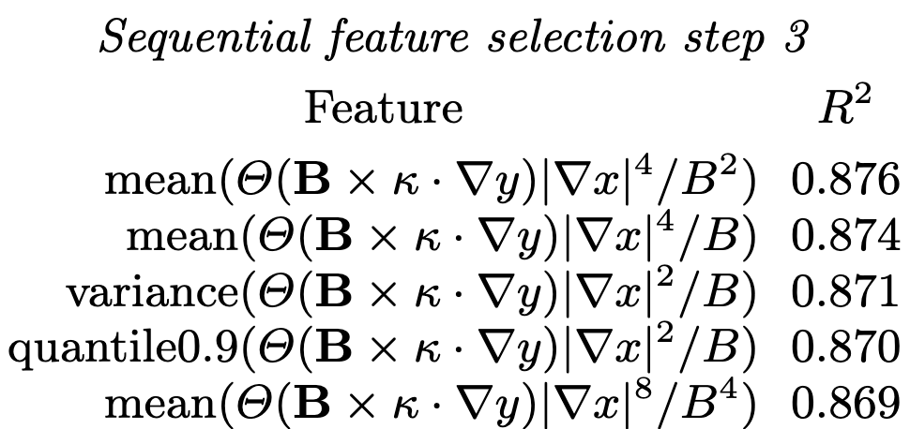

At each step, the top features are variations on a theme
Regression for the random-gradient dataset
Notes:
20241210-01-085_allConfigs_randomGradients_onlyUnstable_YlnQ_Qmin0p1_features20241227_XGB_20nodes

Slide 40
Spearman correlation is a quick tool to find the most important feature
Unlike Pearson, Spearman is invariant to any monotonic function.
Features with highest correlation to heat flux Q at fixed dT/dx & dn/dx:
Heaviside function: Where there is bad curvature,
Jacobian (maybe squared)
local temperature gradient in real space (to various powers)
|∇T| = (dT/dx) |∇x|
Extremely similar to Mynick (2010), Xanthopoulos (2014), Stroteich (2022), Goodman (2024)!
Notes:
20250114-06-plot_W7-X_xsection_and_surface.py

Slide 41
Previously proposed proxies can be tested
Notes:
20250206-02_compare_previously_published_ITG_proxies_singleline.py

Slide 42
Other machine learning regression methods work also
All using a/L_{T}, a/L_{n}, and the top 10 geometric features selected via XGBoost
Notes:
20241228-01-plot_comparison_of_regression_methods.py

Slide 43

XGBoost regression model with 1 feature
XGBoost fit
Fixed-gradient dataset
Notes:
20250128-02-plot_Q_vs_optimized_single_feature_including_xgboost.py

Slide 44


XGBoost regression model using only a/LT and a/Ln
Same plot, showing data as dots
Notes:
20241231-03_2_feature_tprim_fprim_XGB_model_visualization.ipynb

Slide 45


XGBoost regression model for fixed gradients using 2 features
Same plot, showing data as dots
Notes:
20241231-02_2_feature_XGB_model_visualization.ipynb

Slide 46
Turbulence simulations
R² = 0.989
Predicted heat flux
Regression
Feature importance
True heat flux
Notes:
20250102-10_plot_Q_vs_time_for_several_simulations.pdf

Slide 47
Multiple lines of evidence agree that the most important geometric feature is |∇ψ| in regions of bad curvature
Highest Spearman correlation at fixed gradients.
Consistently the first geometric feature chosen in sequential feature selection:
  In regression on the heat flux above the critical gradient
  And in the classifier for stability vs instability (i.e. determines critical gradient)
  Chosen by XGBoost, nearest-neighbors, & other algorithms.
Also the largest Shapley values
Notes:
20250114-06-plot_W7-X_xsection_and_surface.py

Slide 48
There are many extensions possible
Try larger sets of possible features
From the gyrokinetic equation, understand how these features affect turbulence.
Kinetic electrons, magnetic fluctuations.
Saliency maps to understand the features learned by the neural networks.
Symbolic regression.
Kolmogorov-Arnold Networks.
Optimization, profile prediction.
Include & test other physics-motivated features.
Data is online at doi:10.5281/zenodo.14867776, so have a go at it!

Slide 49

Paper: arXiv:2502.11657 Dataset doi:10.5281/zenodo.14867776
Turbulence simulations
R² = 0.989
Predicted heat flux
Regression
Feature importance
True heat flux
Notes:
20250102-10_plot_Q_vs_time_for_several_simulations.pdf

Slide 50
Turbulence simulations
R² = 0.989
Predicted heat flux
Regression
Feature importance
True heat flux
Notes:
20250102-10_plot_Q_vs_time_for_several_simulations.pdf

Slide 51

To create library of candidate features, apply any translation-invariant reduction to translation-equivariant operations
Start with inputs to the gyrokinetic equation & local shear:
B, B⁻³B×∇B⋅∇y, B⁻²B×κ⋅∇y, B⁻³B×∇B⋅∇x,
|∇x|², ∇x⋅∇y, |∇y|², d/dz(∇x⋅∇y / |∇x|²).
Apply unary operations on f(z): f², df/dz, Heaviside(f), etc.,
Include all pairwise products,
Reductions: max, median, abs of fft coefficients, k|| with largest amplitude, etc.
$⟹$ > 1 million combinations

Slide 52
Most important features from sequential feature selection
Regression on heat flux
Classification (stability vs instability)
The 2nd most important geometric feature involves flux surface compression and radial ∇B drift
The most important geometric feature is flux surface compression where curvature is bad
The gradients are more important than any geometric feature
Xanthopoulos et al (2011), Nakata & Matsuoka (2022):
Larger geodesic curvature (= radial drift) ⇒ Stronger damping of zonal flows ⇒ higher heat flux

Slide 53
Shapley values show the sign and magnitude of each feature’s effect
a/L_{T} increases Q
a/L_{n} decreases Q
Most important geometric features:
|∇x| increases Q,
especially near bad curvature
Next geometric features:
Radial drift (geodesic curvature)
increases Q
Decreasing importance
Shapley value: contribution to predicted ln(Q)
Notes:
20240902-01-plot_shapley_values_for_GX_regression.py

Slide 54
Summary
Interpretable ML can reveal trends and stimulate theory.
Most important feature for ITG seems to be |∇ψ| in regions of bad curvature.
Future work
From the gyrokinetic equation, understand how top features affect turbulence.
Saliency maps to understand the features learned by the neural networks.
Other interpretable methods (symbolic regression, Kolmogorov-Arnold Networks)
Kinetic electrons, magnetic fluctuations.
Optimization & profile prediction.
Paper:
arXiv:2502.11657
Dataset
doi:10.5281/zenodo.14867776

Slide 55
Notes:
20250321-01_compare_variants_of_ITG_proxy_grad_x_vs_grad_y.pdf

