Slide 1
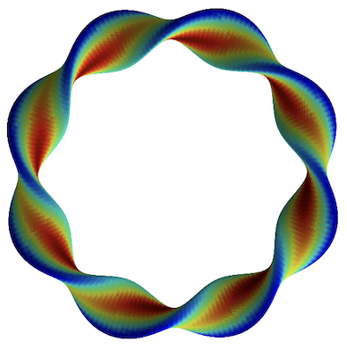
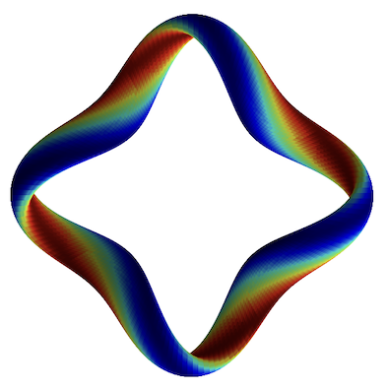
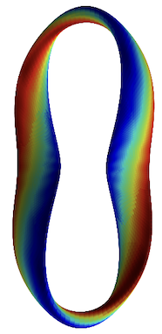
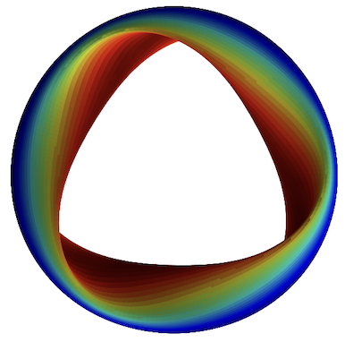
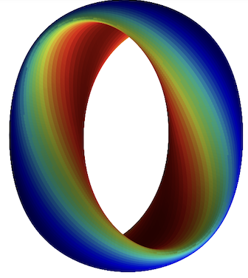
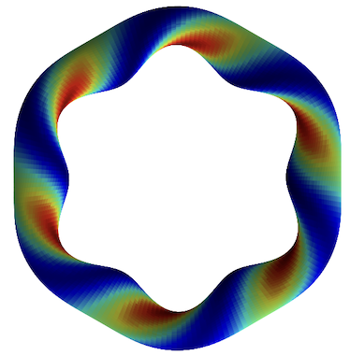
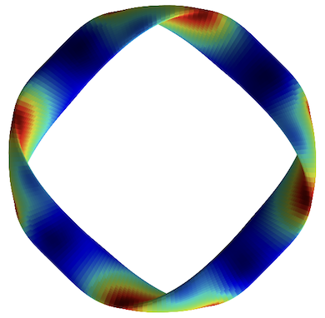
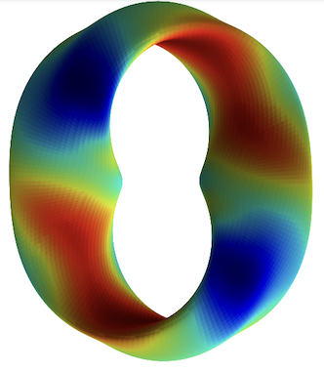
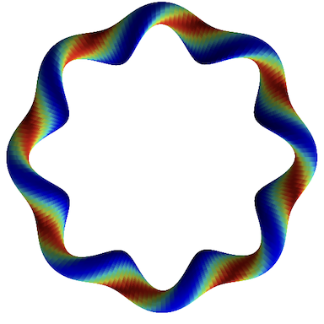
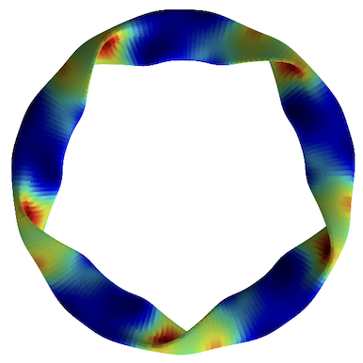
How does magnetic geometry affect ITG turbulence?
Insights from data & machine learning
Turbulence simulations
R² = 0.989
Predicted heat flux
Regression
Feature importance
True heat flux
M Landreman, J Y Choi, C Alves, P Balaprakash, R M Churchill , R Conlin, G Roberg-Clark arXiv:2502.11657
Thanks to many others who gave suggestions Supported by the US DOE StellFoundry SciDAC
Notes:
20250102-10_plot_Q_vs_time_for_several_simulations.pdf

Slide 2
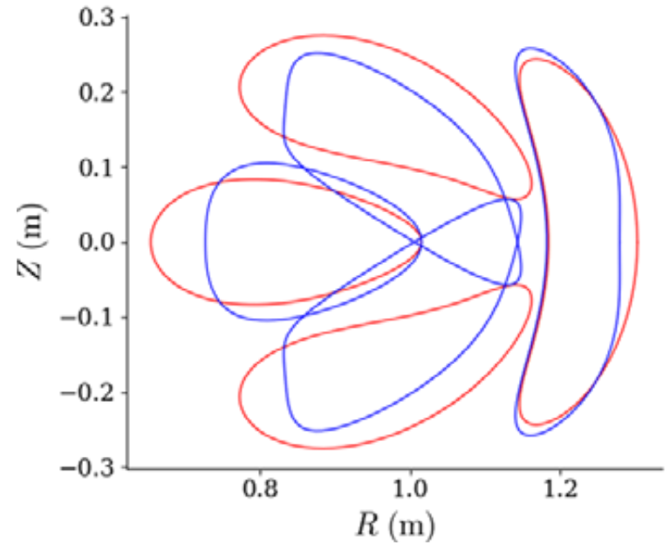

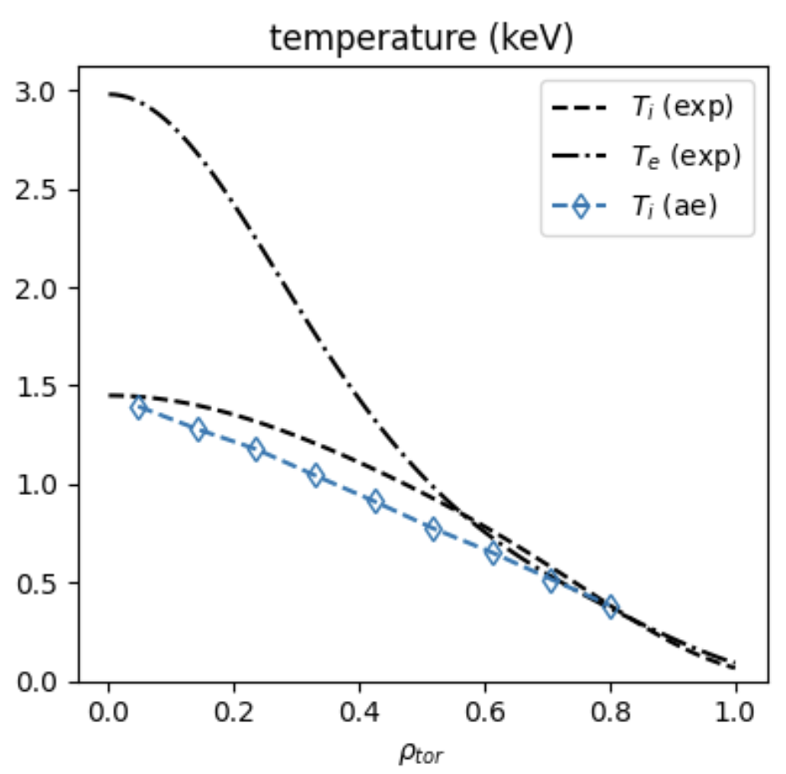
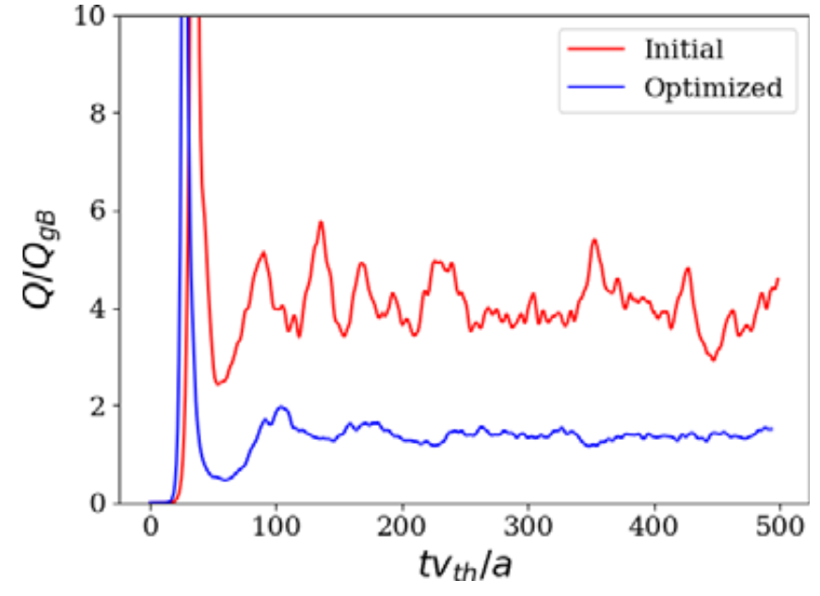
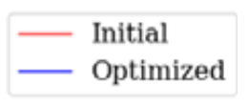
Motivations
Understanding
Optimization
Profile prediction
Kim (2024)
Mandell (2024)
Notes:
https://www.google.com/imgres?q=eureka%20understanding%20light%20bulb%20brain&imgurl=https%3A%2F%2Fpreview.redd.it%2Fhow-do-light-bulb-moments-come-about-v0-0mgno4a97tva1.jpg%3Fwidth%3D777%26format%3Dpjpg%26auto%3Dwebp%26s%3D541d28c2f1009471ab52add4a282ee4916a311fa&imgrefurl=https%3A%2F%2Fwww.reddit.com%2Fr%2Fmbti%2Fcomments%2F12xc0ef%2Fhow_do_light_bulb_moments_come_about%2F&docid=G-9kXBNk27S2YM&tbnid=9jUFrhBW814RkM&vet=12ahUKEwjdq_HN6OOKAxW7MVkFHflMNswQM3oECHAQAA..i&w=777&h=625&hcb=2&ved=2ahUKEwjdq_HN6OOKAxW7MVkFHflMNswQM3oECHAQAA

Slide 3
Turbulence simulations
R² = 0.989
Predicted heat flux
Regression
Feature importance
True heat flux
Notes:
20250102-10_plot_Q_vs_time_for_several_simulations.pdf

Slide 4
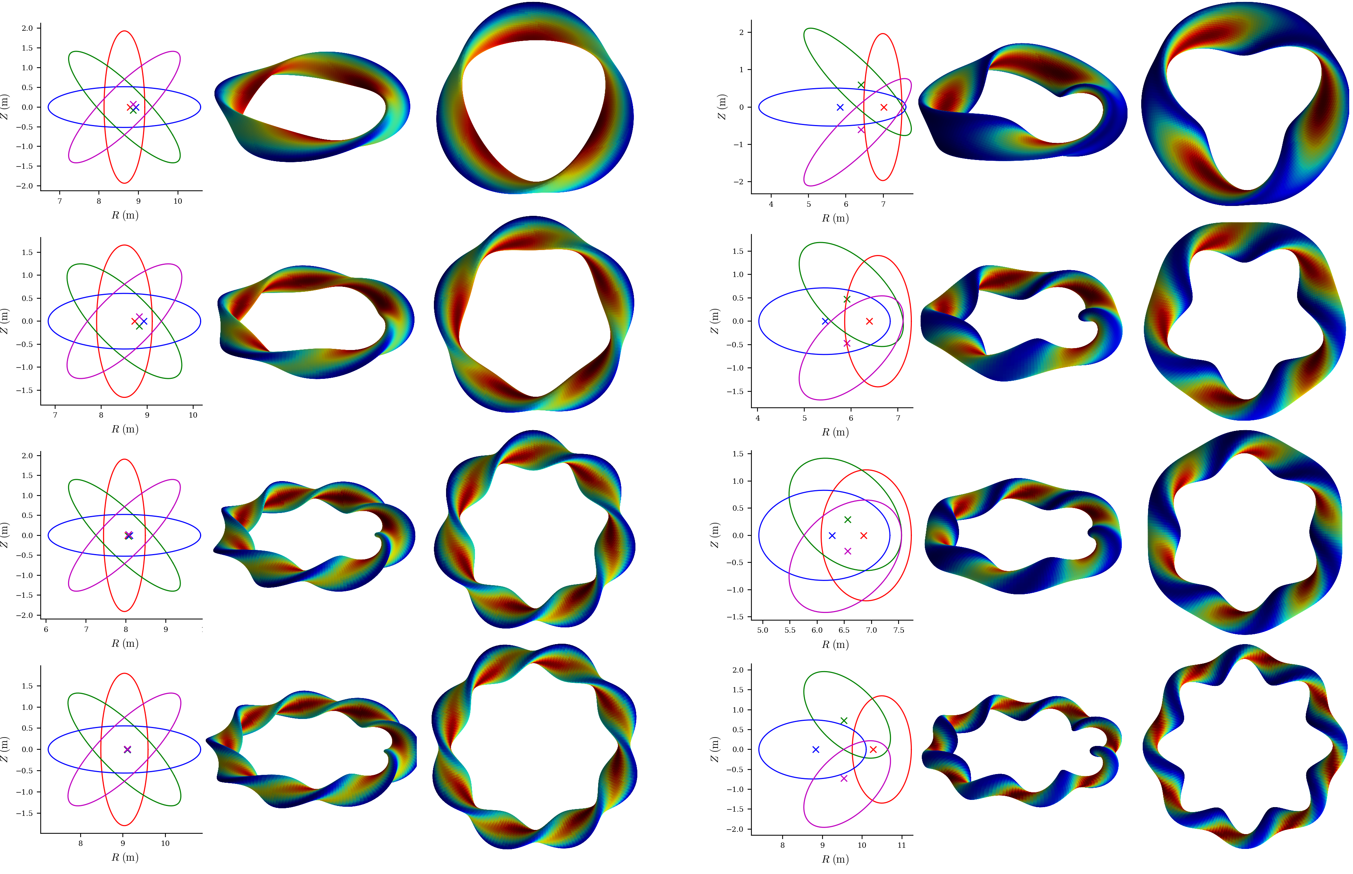
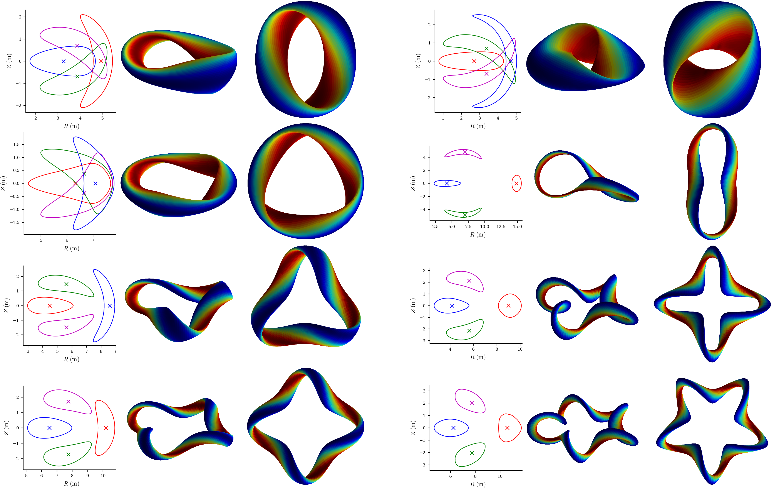
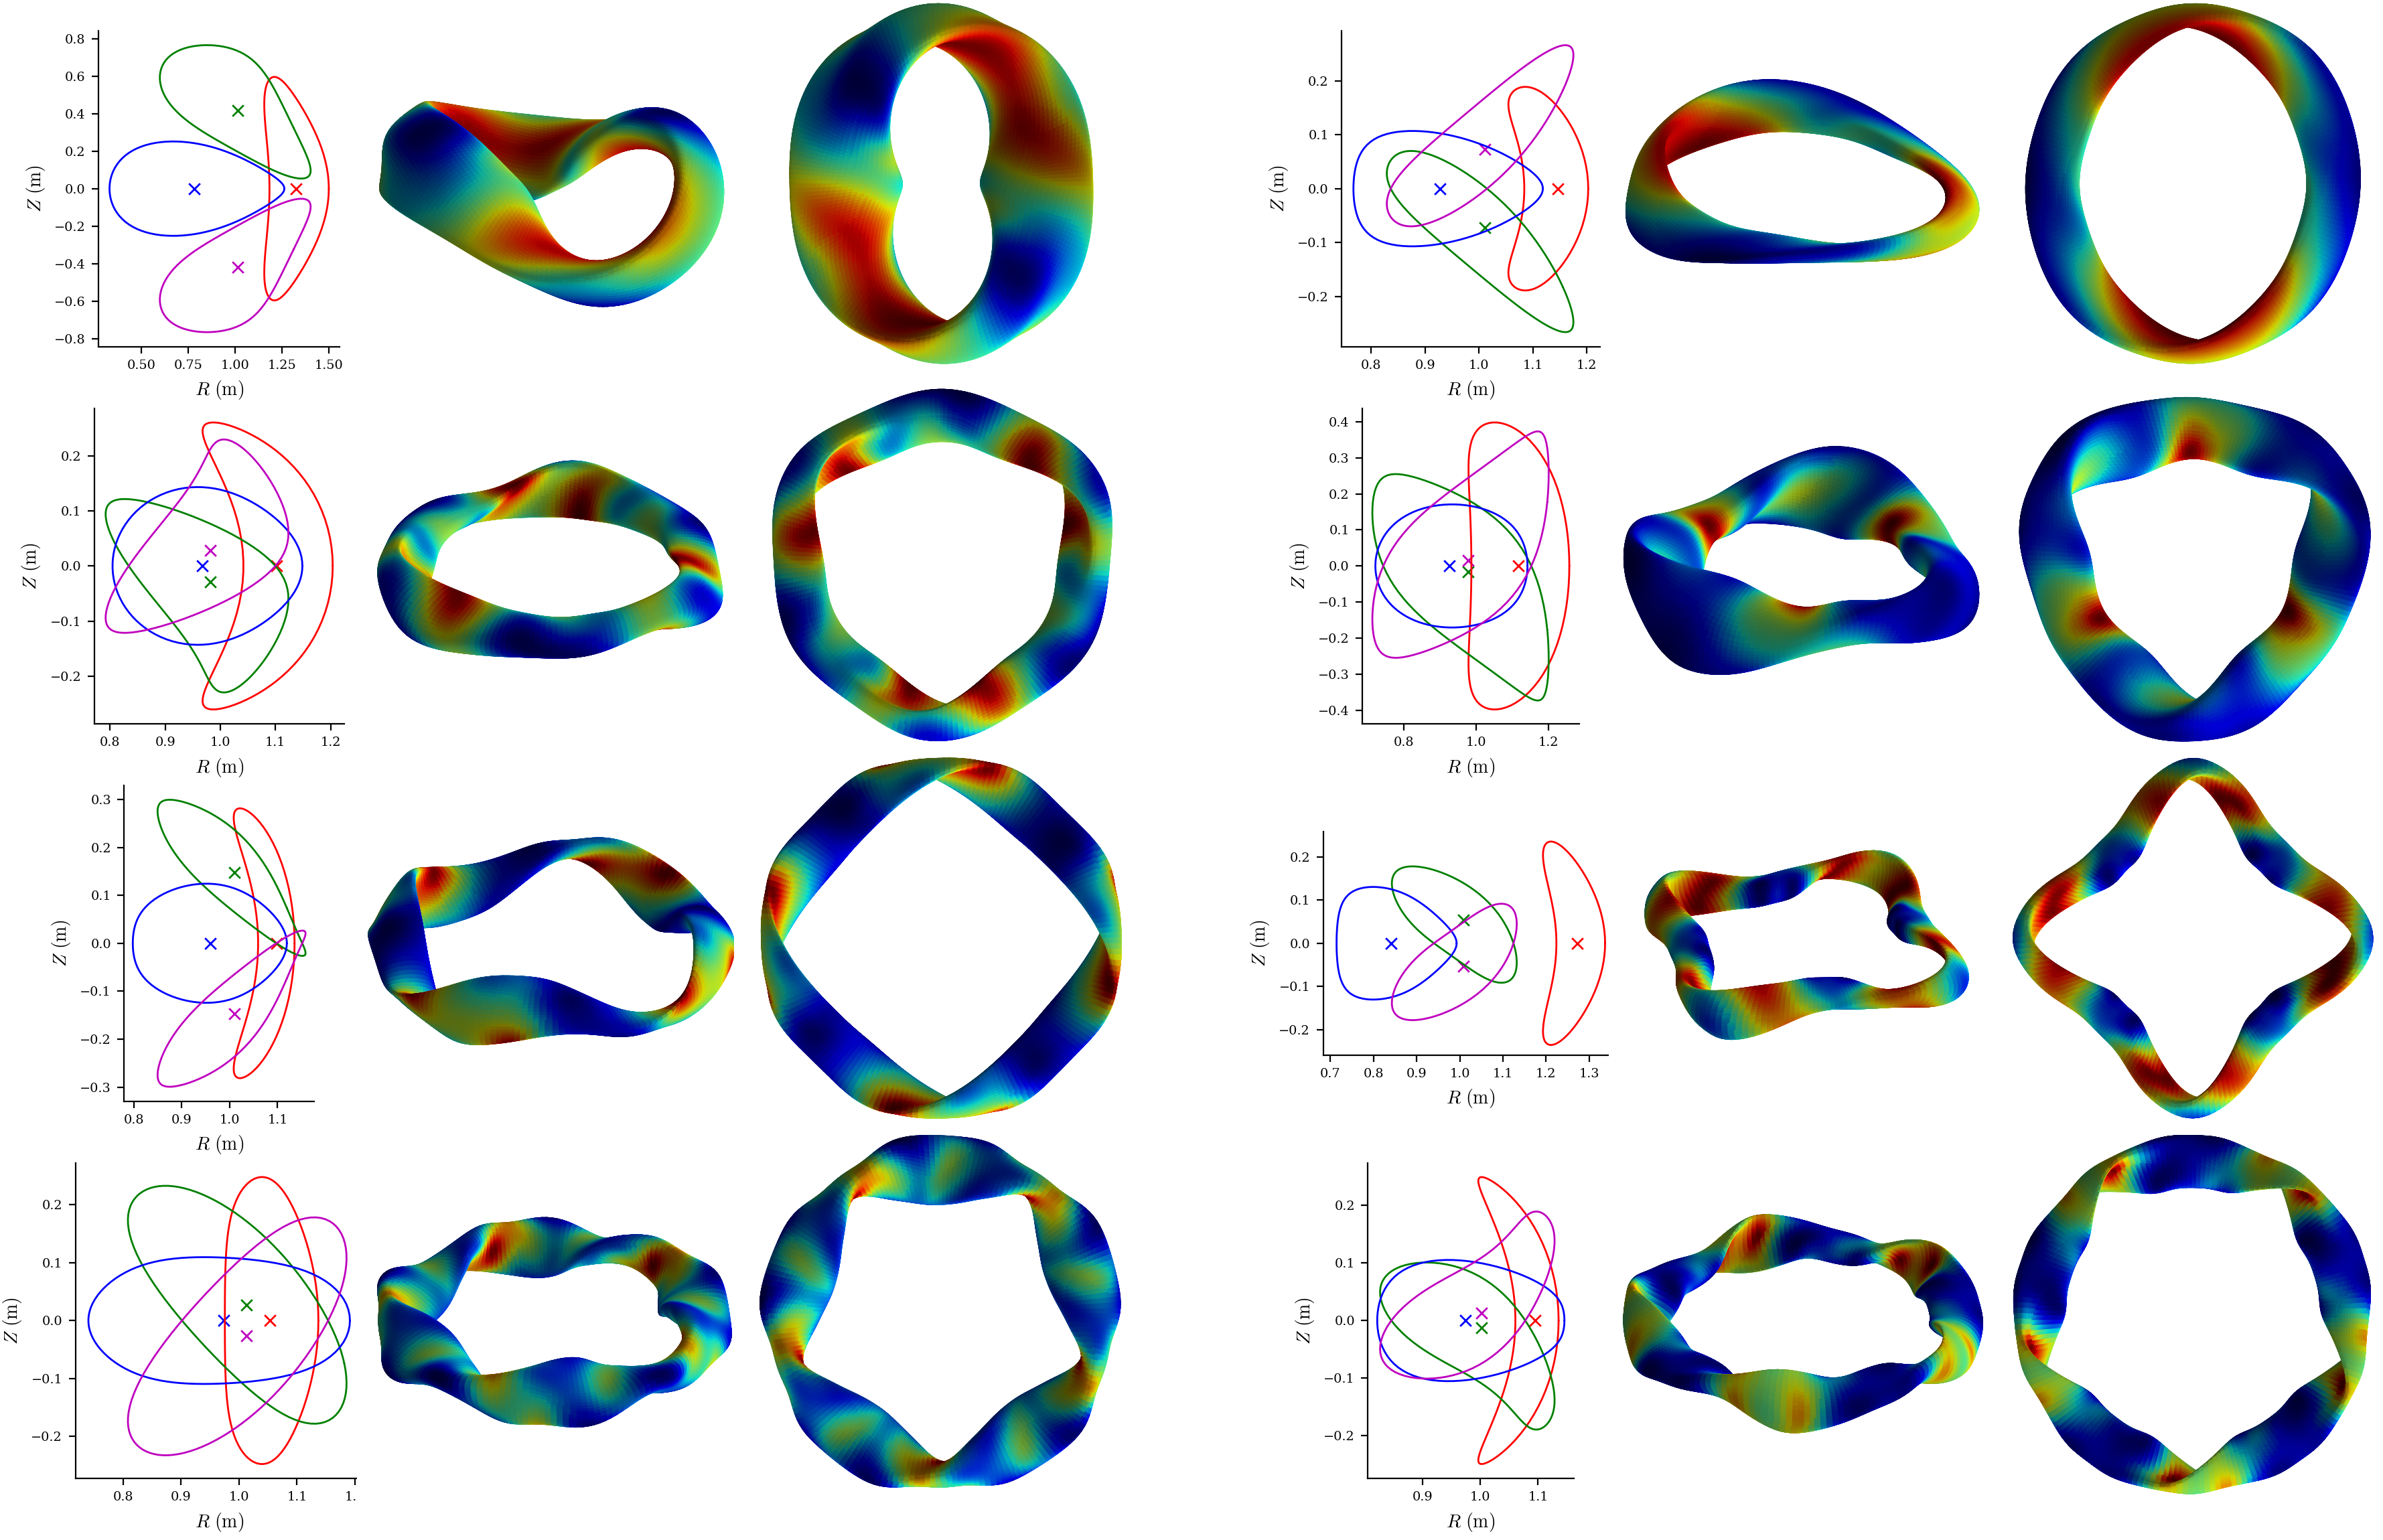
Equilibria include rotating ellipses, quasi-symmetric, and random shapes
Aspect ratio,
elongation, q = 1 / ι, β, and number of field periods are all varied.
All configurations scaled to have same gyroBohm normalizations
(Tokamak generation underway by Ralf Mackenbach)
Notes:
~/Box/work24/20241220-02-figure_of_heliiotron_equilibria$ ./20241220-02-plot_heliotron_equilibria_for_paper.py

Slide 5
Nonlinear turbulence simulations were run with GX in every equilibrium
Electrostatic, adiabatic electrons.
1 simulation in each tube with random dT/dx and dn/dx.
1 simulation in each tube with (a/T) dT/dx = 3, (a/n) dn/dx=0.9
8 minutes to get heat flux on 1 GPU
2×10⁵ nonlinear simulations took < 7000 node-hours
10⁴
Notes:
This was about 1/8 of our SciDAC GPU allocation was 53,738 node hrs, UMD GPU allocation was 40,978 node hrs.
/pscratch/sd/l/landrema/20240601-01-random_stellarator_equilibria/20240601-01-075_ntheta_scan> ./plot_gx_scan_over_1_parameter_and_configuration.py
20240902-03_plot_distribution_of_Q_from_GX_database_for_poster.py
20241218-01-plot_distribution_of_heat_fluxes_for_paper.py
20250102-10_plot_Q_vs_time_for_several_simulations.pdf

Slide 6
Turbulence simulations
R² = 0.989
Predicted heat flux
Regression
Feature importance
True heat flux
Notes:
20250102-10_plot_Q_vs_time_for_several_simulations.pdf

Slide 7
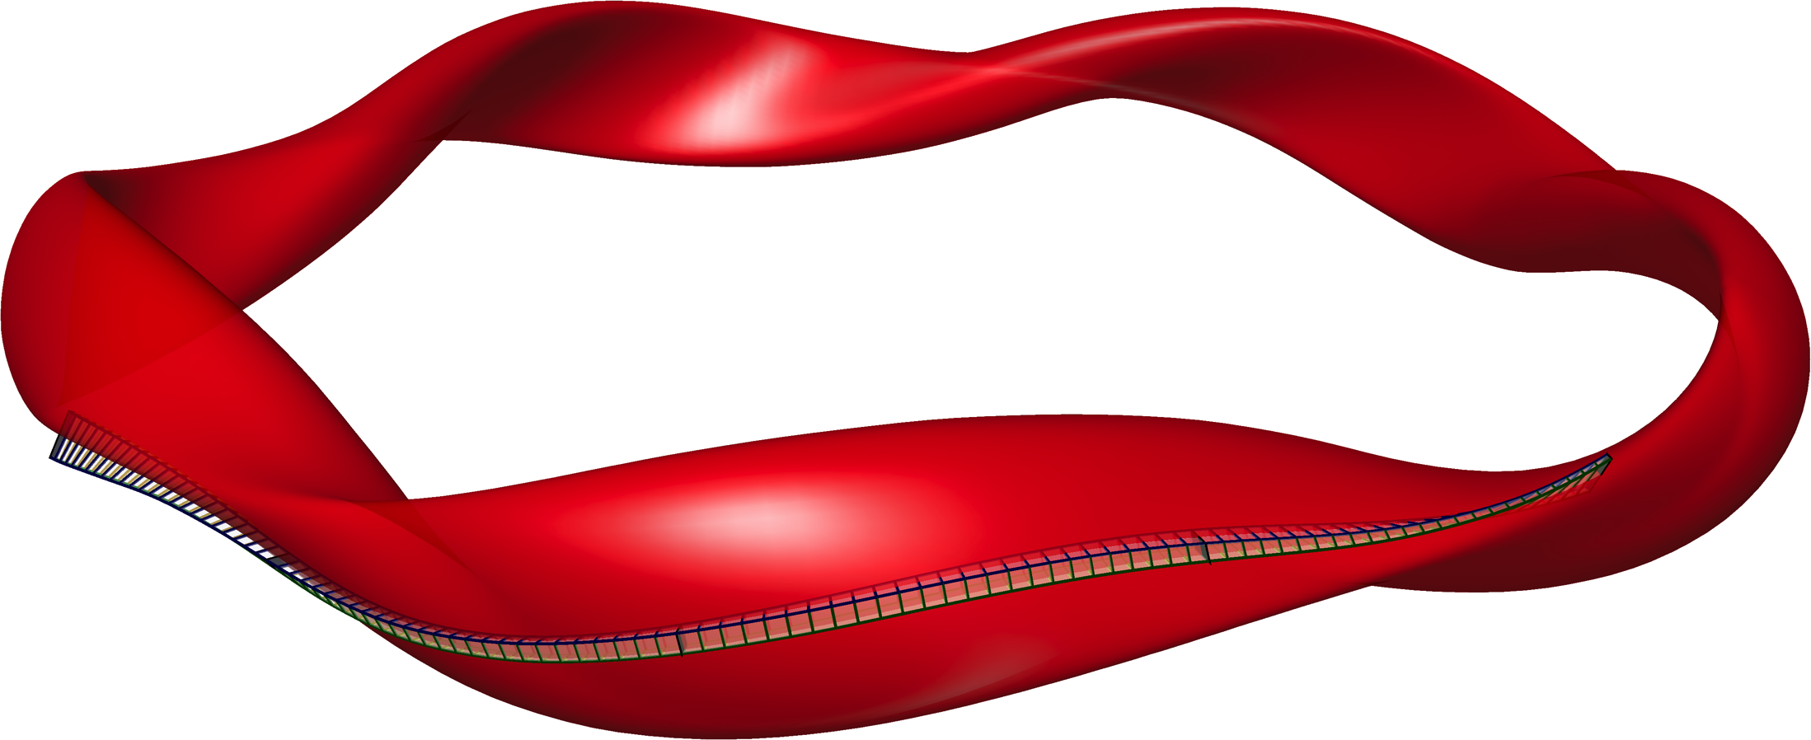
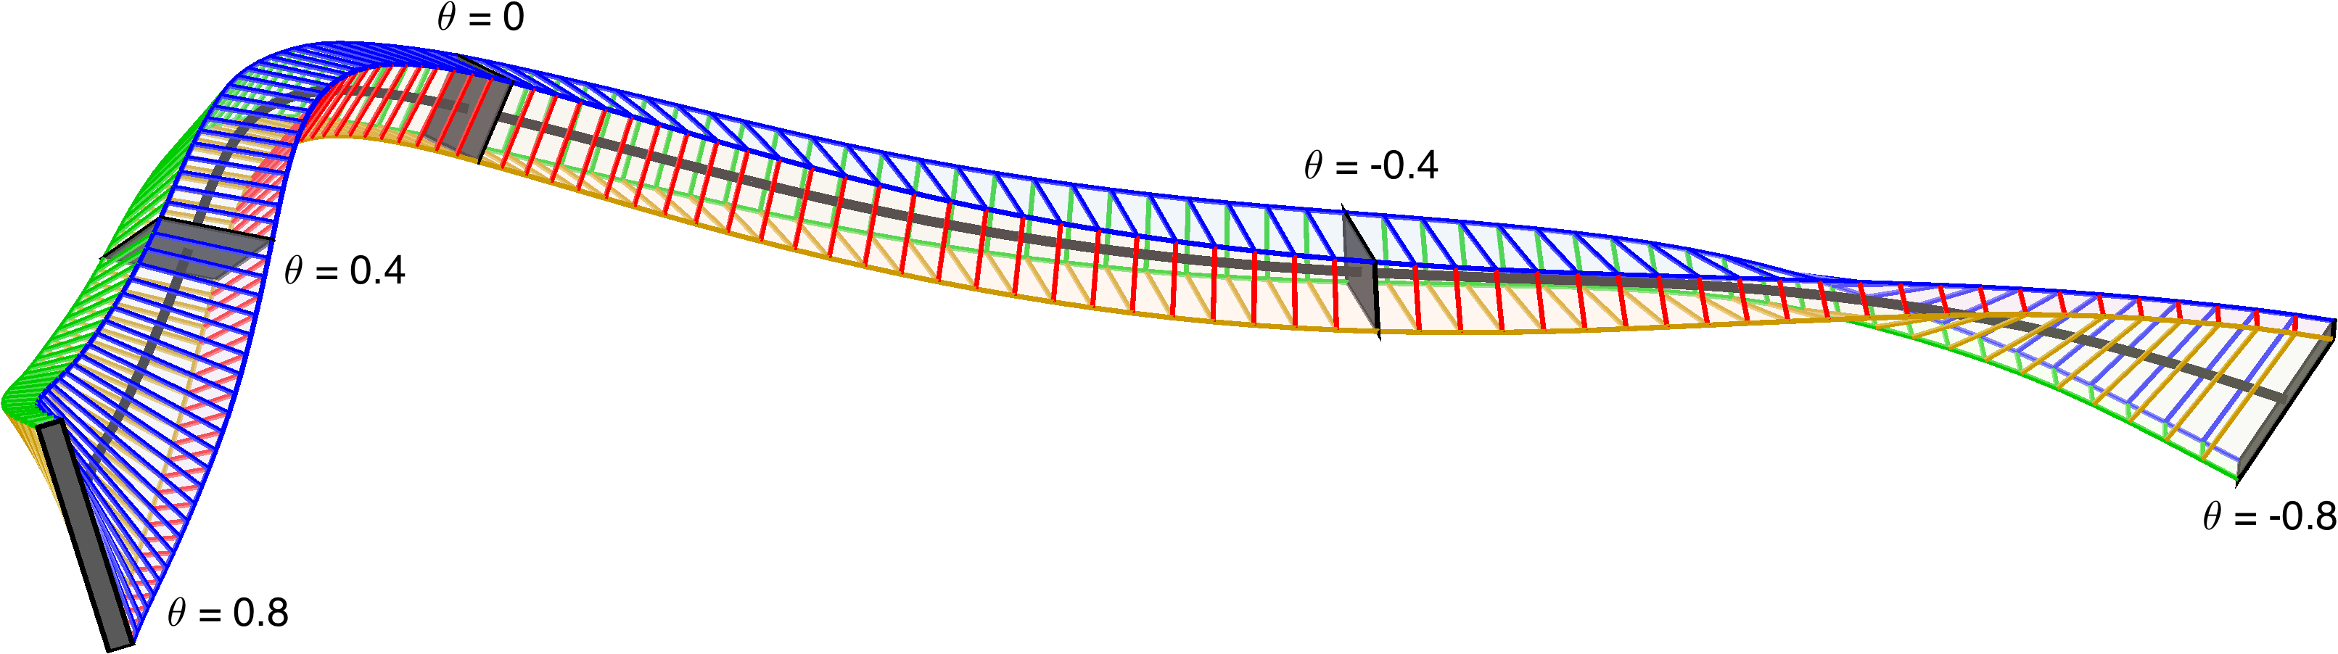






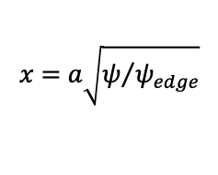

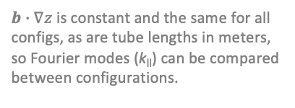

Raw feature space: 7x 1D functions that enter the turbulence simulations
$$B=B_{ref}∇x×∇y$$
$$x=a\sqrt{ψ/{ψ_{edge}}}$$
Flux tube simulation domain
$$\left|B\right|$$
$${\left|B\right|}^{−3}B×∇\left|B\right|∙∇y$$
$${\left|B\right|}^{−2}B×κ∙∇y$$
$${\left|B\right|}^{−3}B×∇\left|B\right|∙∇x$$
$$∇y∙∇y$$
$$∇x∙∇y$$
$$∇x∙∇x$$
$b∙∇z$ is constant and the same for all configs, as are tube lengths in meters, so Fourier modes (k_{ll}) can be compared between configurations.
Notes:
20250127-01-plot_random_flux_tube.py

Slide 8
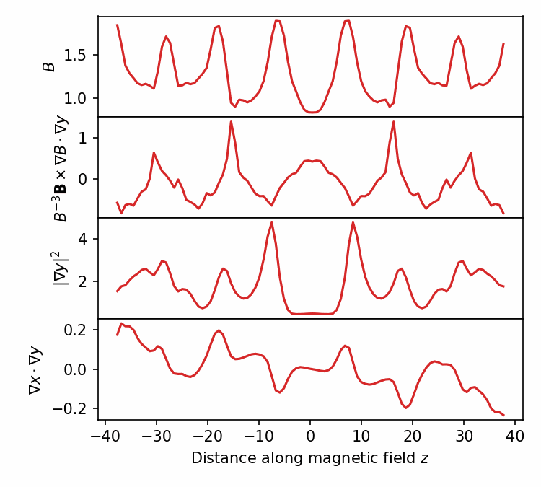
Raw features should not be directly fed to classical regression or fully-connected neural network, since model should be translation-invariant
GK equation, hence heat flux, is invariant under periodic translation of the raw features in z.
Similar to computer vision, where convolutional neural networks give approximate translation-invariance.
Notes:
20250102-01-plot_geometry_for_GX_circshift_figure.py
20250102-01-plot_geometry_for_GX_circshift_animation.py
See 20240609-01 Regressions for database of GX runs.docx
/pscratch/sd/l/landrema/20240609-01-gx_convergence/20240609-01-012_circshift
plot_gx_scan_over_1_parameter_and_configuration.py
plot_Q_vs_z_vs_circshift.py
python \
/global/homes/l/landrema/gx/gx/post_processing/plot-Q-z.py \
000001_circshift_0/gx.out.nc \
000001_circshift_12/gx.out.nc \
000001_circshift_24/gx.out.nc \
000001_circshift_36/gx.out.nc \
000001_circshift_48/gx.out.nc \
000001_circshift_61/gx.out.nc \
000001_circshift_73/gx.out.nc \
000001_circshift_85/gx.out.nc

Slide 9
Convolutional neural networks give accurate prediction of the turbulence
a/L_{T}
a/L_{n}
z-dependent geometric features
R² = 0.989
Convolutional layers x5
Predicted heat flux Q / Q_{GB}
Fully connected layers x2
by Jong Choi, ORNL
Actual heat flux Q / Q_{GB} from gyrokinetic simulation
Heat flux Q
Prediction in 0.001 sec for single network, 0.1 sec for ensemble
Notes:
pred_vs_actual_plot_pre2_20250211-01-002.pdf

Slide 10
Turbulence simulations
R² = 0.989
Predicted heat flux
Regression
Feature importance
True heat flux
Spearman correlation
Sequential feature selection
Shapley values
Testing physics-based surrogates
Notes:
20250102-10_plot_Q_vs_time_for_several_simulations.pdf

Slide 11
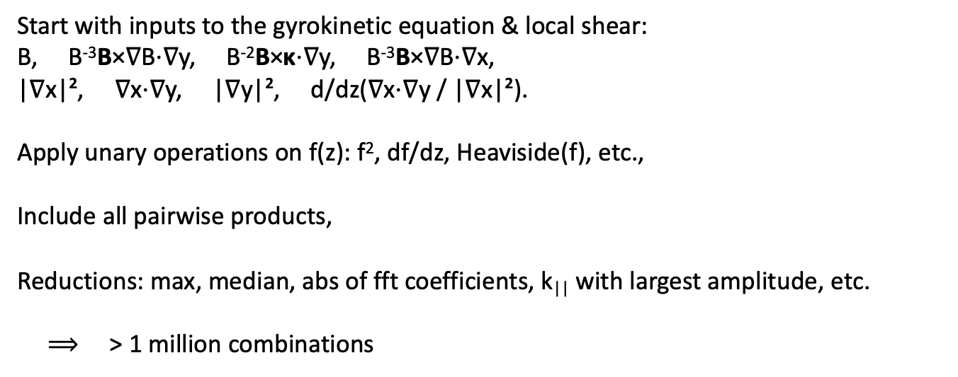
Our interpretable models use a large library of candidate features, all translation-invariant
Start with inputs to the gyrokinetic equation & local shear:
B, B⁻³B×∇B⋅∇y, B⁻²B×κ⋅∇y, B⁻³B×∇B⋅∇x,
|∇x|², ∇x⋅∇y, |∇y|², d/dz(∇x⋅∇y / |∇x|²).
Apply unary operations on f(z): f², df/dz, Heaviside(f), etc.,
Include all pairwise products,
Reductions: max, median, abs of fft coefficients, k|| with largest amplitude, etc.
$⟹$ > 1 million combinations

Slide 12
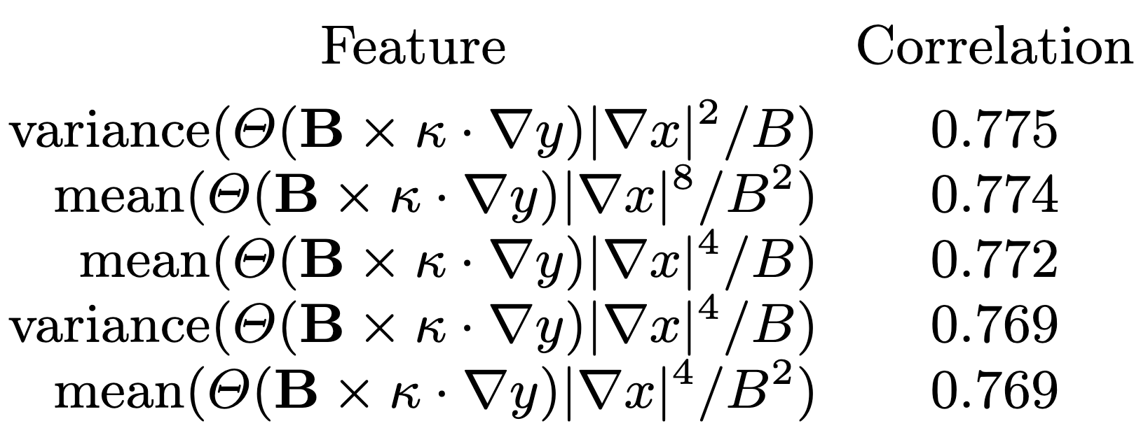
Spearman correlation is a quick tool to find the most important feature
Unlike Pearson, Spearman is invariant to any monotonic function.
Features with highest correlation to heat flux Q at fixed dT/dx & dn/dx:
Heaviside function: Where there is bad curvature,
Jacobian (maybe squared)
local temperature gradient in real space (to various powers)
|∇T| = (dT/dx) |∇x|
Extremely similar to Mynick (2010), Xanthopoulos (2014), Stroteich (2022), Goodman (2024)!
?!?! |∇x| does not appear in gyrokinetic equation for k_{x} = 0 modes!
Notes:
20250114-06-plot_W7-X_xsection_and_surface.py

Slide 13
Another method to identify most important features: forward sequential feature selection
Stiffness
Critical gradient
Using decision trees (XGBoost library), varied-gradient dataset
Notes:
20241229-07-plot_sfs_results_for_talk_simplified.py

Slide 14
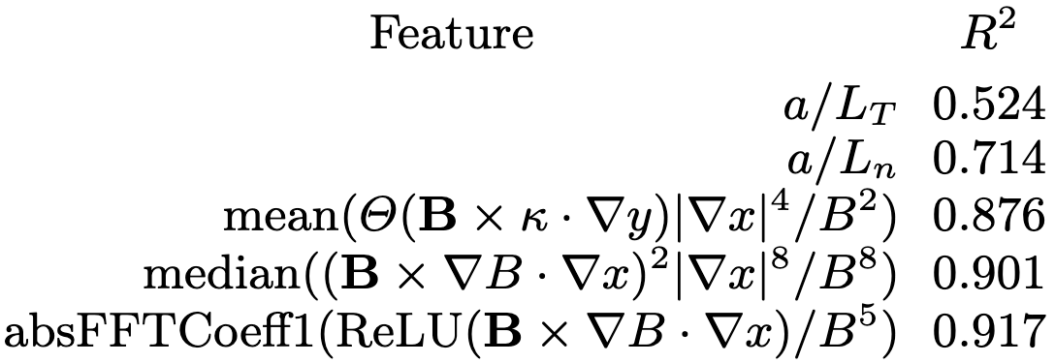
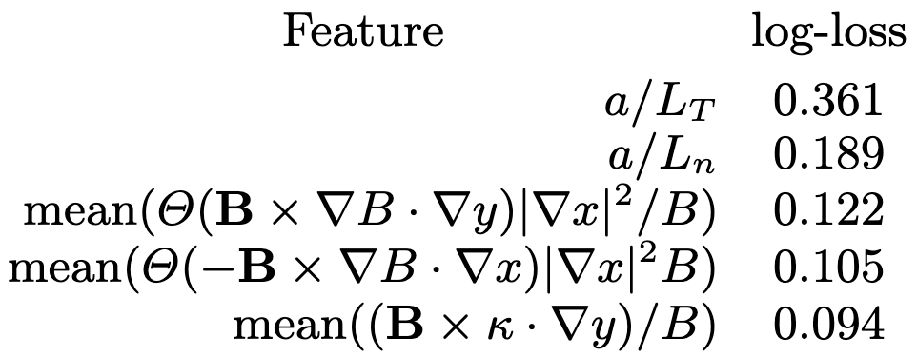
Most important features from sequential feature selection
Regression on heat flux
Classification (stability vs instability)
The 2nd most important geometric feature involves flux surface compression and radial ∇B drift
The most important geometric feature is flux surface compression where curvature is bad
The gradients are more important than any geometric feature
Xanthopoulos et al (2011), Nakata & Matsuoka (2022):
Larger geodesic curvature (= radial drift) ⇒ Stronger damping of zonal flows ⇒ higher heat flux

Slide 15
Shapley values show the sign and magnitude of each feature’s effect
a/L_{T} increases Q
a/L_{n} decreases Q
Most important geometric features:
|∇x| increases Q,
especially near bad curvature
Next geometric features:
Radial drift (geodesic curvature)
increases Q
Decreasing importance
Shapley value: contribution to predicted ln(Q)
Notes:
20240902-01-plot_shapley_values_for_GX_regression.py

Slide 16
Previously proposed proxies can be tested
Notes:
20250206-02_compare_previously_published_ITG_proxies_singleline.py

Slide 17


Summary
Interpretable ML can reveal trends and stimulate theory.
Most important feature for ITG seems to be |∇ψ| in regions of bad curvature.
Future work
From the gyrokinetic equation, understand how top features affect turbulence.
Saliency maps to understand the features learned by the neural networks.
Other interpretable methods (symbolic regression, Kolmogorov-Arnold Networks)
Kinetic electrons, magnetic fluctuations.
Optimization & profile prediction.
Paper:
arXiv:2502.11657
Dataset
doi:10.5281/zenodo.14867776

Slide 18
Extra slides

Slide 19
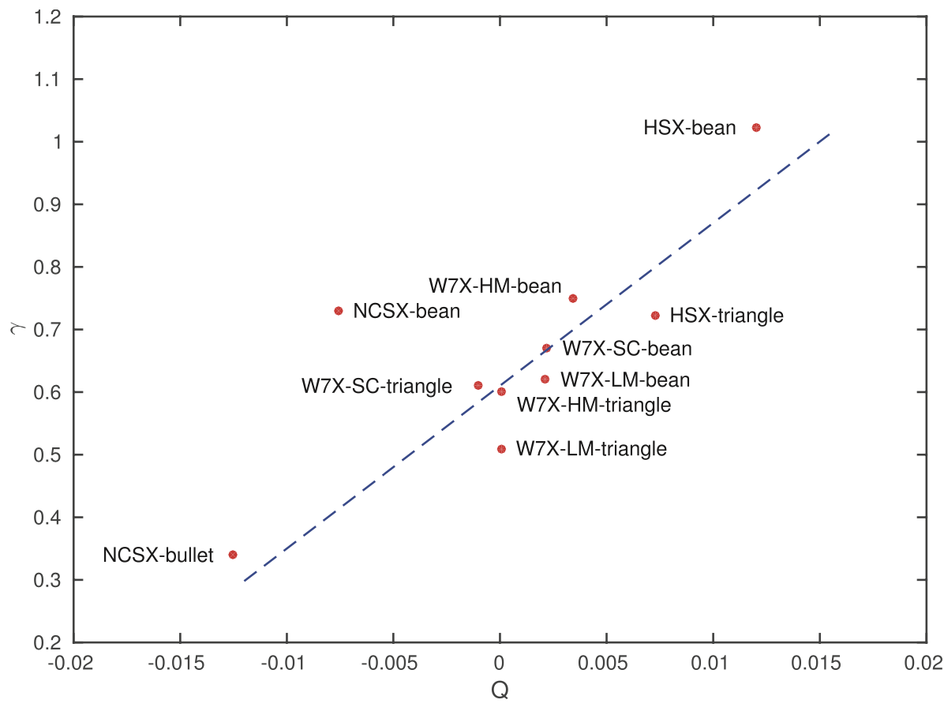
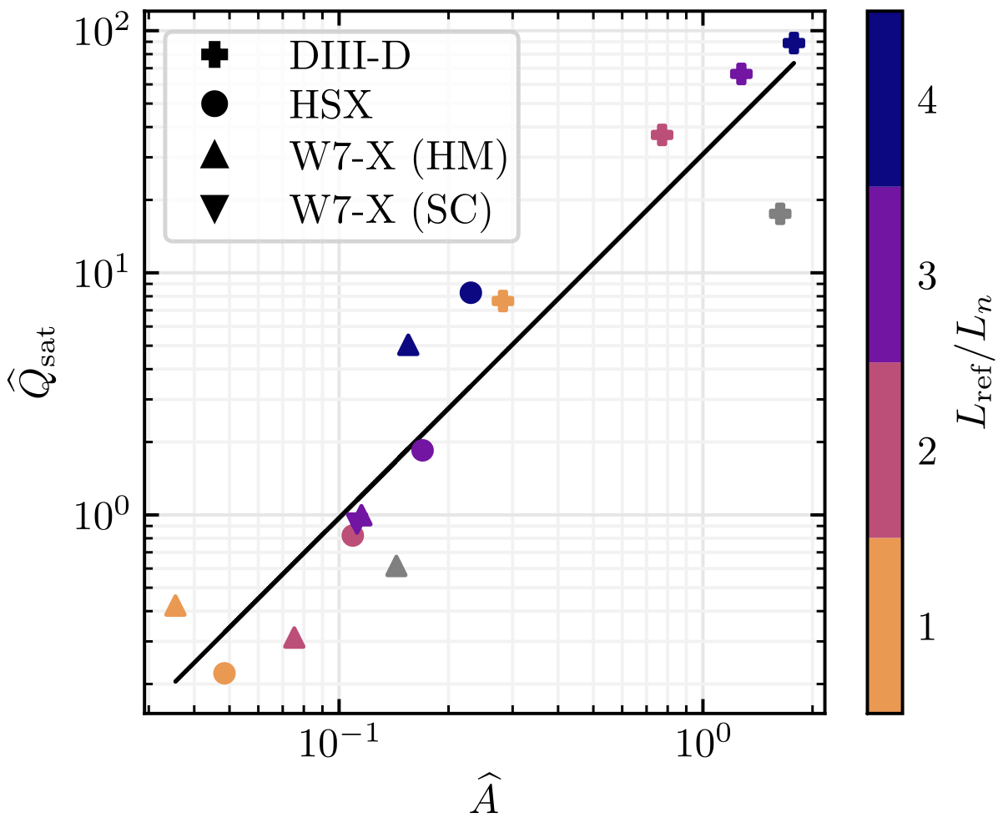
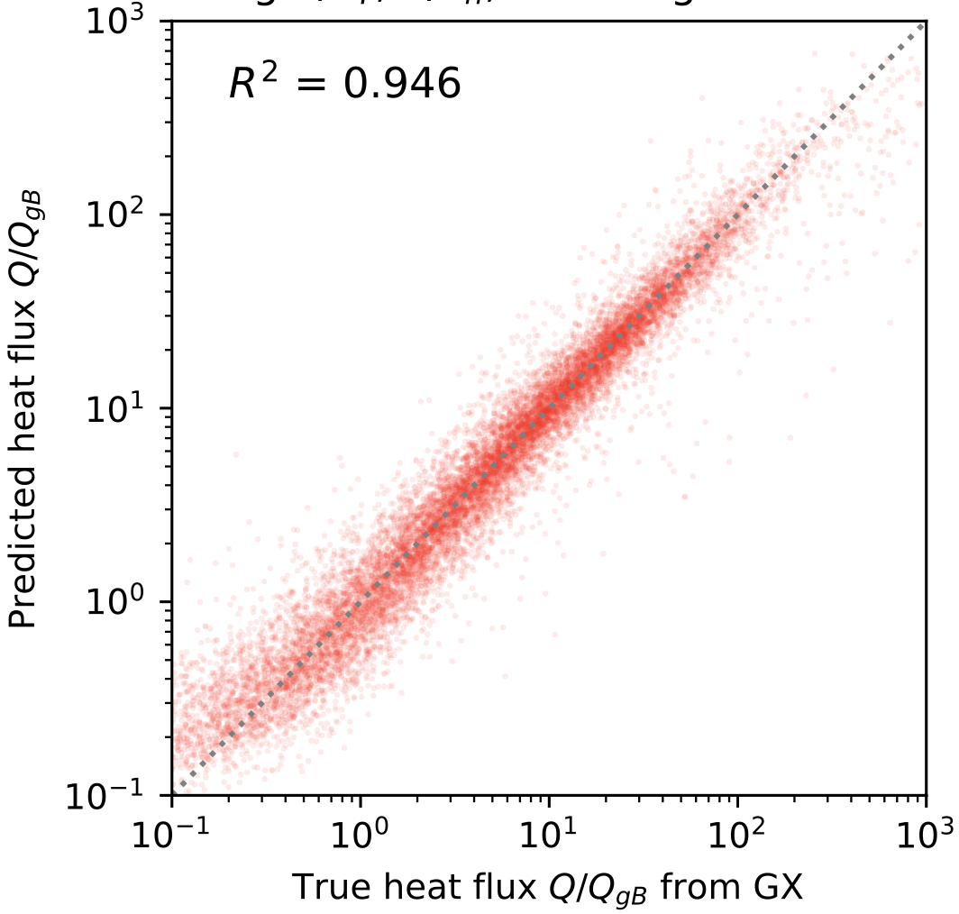
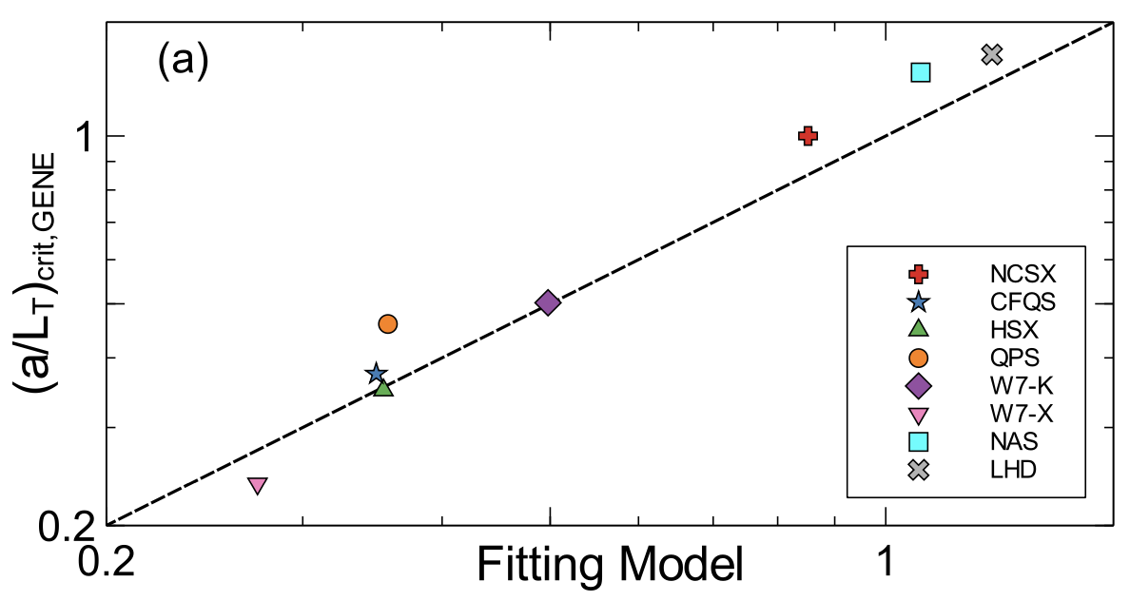
Proll (2016)
N = 10
Mackenbach (2022)
N = 15
TEM proxy
This work:
N = 100,705
Roberg-Clark (2022)
N = 8

Slide 20
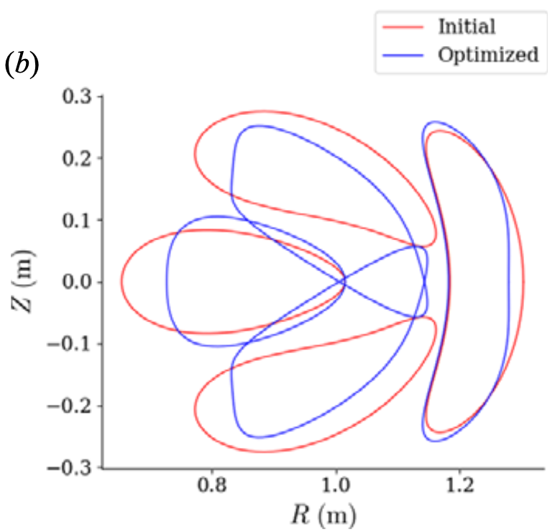
Motivations
Understanding
Optimization
Profile prediction
Kim (2024)
Mandell (2024)
Optimize geometry for maximum fusion power
Notes:
https://www.google.com/imgres?q=eureka%20understanding%20light%20bulb%20brain&imgurl=https%3A%2F%2Fpreview.redd.it%2Fhow-do-light-bulb-moments-come-about-v0-0mgno4a97tva1.jpg%3Fwidth%3D777%26format%3Dpjpg%26auto%3Dwebp%26s%3D541d28c2f1009471ab52add4a282ee4916a311fa&imgrefurl=https%3A%2F%2Fwww.reddit.com%2Fr%2Fmbti%2Fcomments%2F12xc0ef%2Fhow_do_light_bulb_moments_come_about%2F&docid=G-9kXBNk27S2YM&tbnid=9jUFrhBW814RkM&vet=12ahUKEwjdq_HN6OOKAxW7MVkFHflMNswQM3oECHAQAA..i&w=777&h=625&hcb=2&ved=2ahUKEwjdq_HN6OOKAxW7MVkFHflMNswQM3oECHAQAA

Slide 21
Turbulence simulations
R² = 0.989
Predicted heat flux
Regression
Feature importance
True heat flux
Notes:
20250102-10_plot_Q_vs_time_for_several_simulations.pdf

Slide 22
Equilibria group 1: random rotating ellipses
Nfp,
aspect ratio,
elongation,
axis torsion,
and beta are all random.
All configurations have same minor radius & toroidal flux, so same gyroBohm normalization
Notes:
~/Box/work24/20241220-02-figure_of_heliiotron_equilibria$ ./20241220-02-plot_heliotron_equilibria_for_paper.py

Slide 23
Equilibria group 2: QUASR QA & QH (Giuliani 2024)
Random pressure added for even more diversity
Notes:
~/Box/work24/20241220-01-figure_of_QUASR_equilibria$ ./20241220-01-plot_QUASR_equilibria_for_paper.py

Slide 24
Equilibria group 3: random boundary modes
RBC and ZBS boundary Fourier modes sampled from normal distributions, fit to 44 “real” stellarators
Notes:
~/Box/work24/20241117-01-figure_of_random_equilibria$ ./20241117-02-plot_random_equilibria_for_paper.py

Slide 26
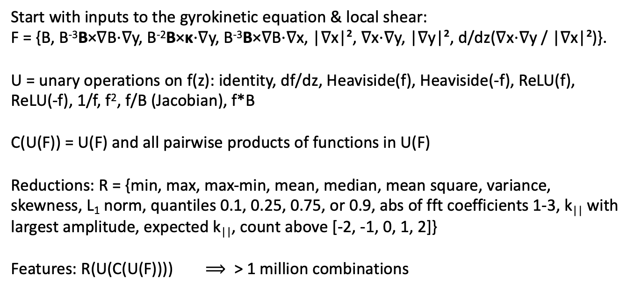
Our interpretable models use a large library of candidate features, all translation-invariant
Start with inputs to the gyrokinetic equation & local shear:
F = {B, B⁻³B×∇B⋅∇y, B⁻²B×κ⋅∇y, B⁻³B×∇B⋅∇x, |∇x|², ∇x⋅∇y, |∇y|², d/dz(∇x⋅∇y / |∇x|²)}.
U = unary operations on f(z): identity, df/dz, Heaviside(f), Heaviside(-f), ReLU(f), ReLU(-f), 1/f, f², f/B (Jacobian), f*B
C(U(F)) = U(F) and all pairwise products of functions in U(F)
Reductions: R = {min, max, max-min, mean, median, mean square, variance, skewness, L₁ norm, quantiles 0.1, 0.25, 0.75, or 0.9, abs of fft coefficients 1-3, k|| with largest amplitude, expected k||, count above [-2, -1, 0, 1, 2]}
Features: R(U(C(U(F)))) $⟹$ > 1 million combinations

Slide 27
Spearman correlation is a quick tool to find the most important feature
Spearman correlation is the regular Pearson correlation of the the sorted rank of the target with the sorted rank of the feature.
Its magnitude is invariant to any monotonic nonlinear function, e.g. corr(x, exp(x)) = 1
No regression model required.
Features with highest correlation to heat flux Q at fixed dT/dx & dn/dx:
Heaviside function: Where there is bad curvature,
Jacobian (maybe squared)
local temperature gradient in real space (to various powers)
|∇T| = (dT/dx) |∇x|
Extremely similar to Mynick (2010), Xanthopoulos (2014), Stroteich (2022), Goodman (2024)!

Slide 28
Forward sequential feature selection: ∼3 features can be almost as predictive as all features
Stiffness
Critical gradient
Notes:
20241229-02-plot_sfs_results_for_talk.py

Slide 29
Sequential feature selection allows closer fit to the data as more geometric features are included
Performance shown on 20% held-out test data
Notes:
20241224-01-plot_Q_vs_predicted_for_ML_paper.py

Slide 30
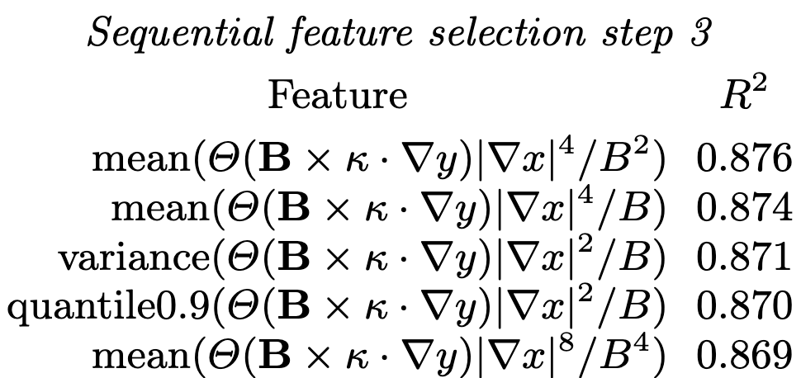
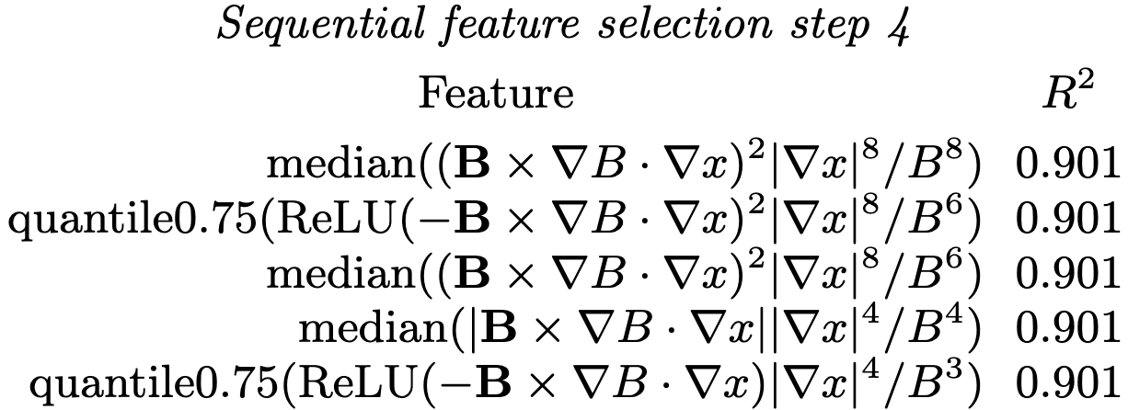
At each step, the top features are variations on a theme
Regression for the random-gradient dataset
Notes:
20241210-01-085_allConfigs_randomGradients_onlyUnstable_YlnQ_Qmin0p1_features20241227_XGB_20nodes

Slide 31
Other machine learning regression methods work also
All using a/L_{T}, a/L_{n}, and the top 10 geometric features selected via XGBoost
Notes:
20241228-01-plot_comparison_of_regression_methods.py

Slide 32
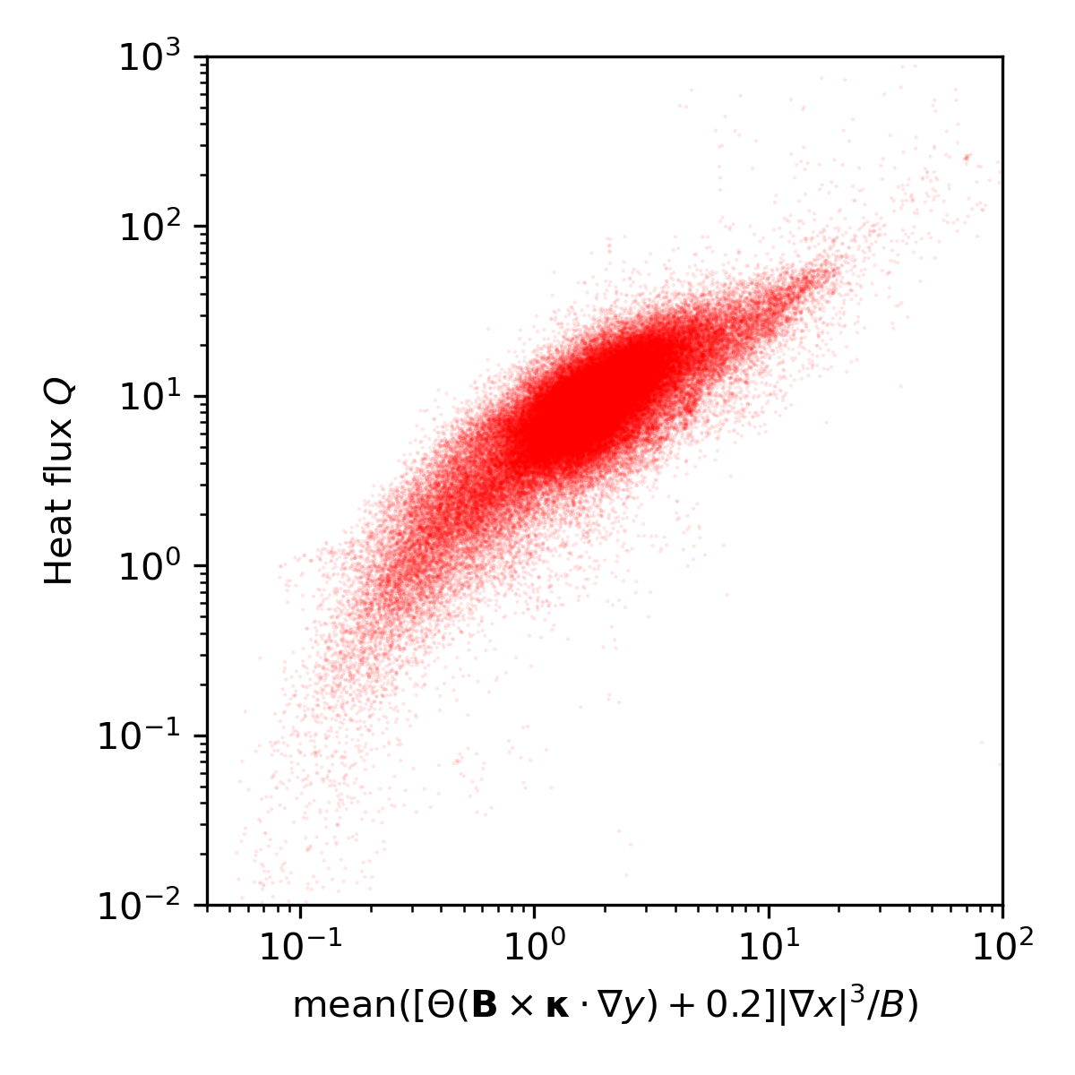
The first geometric feature can be fine-tuned for even better fit
Fixed-gradient dataset.
No regression model used here.
Feature fine-tuned for stability classifier:
Notes:
20241229-04_plot_Q_vs_optimized_single_feature_for_paper.png

Slide 33

XGBoost regression model with 1 feature
XGBoost fit
Fixed-gradient dataset
Notes:
20250128-02-plot_Q_vs_optimized_single_feature_including_xgboost.py

Slide 34
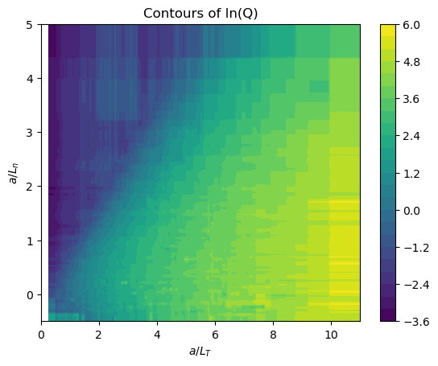
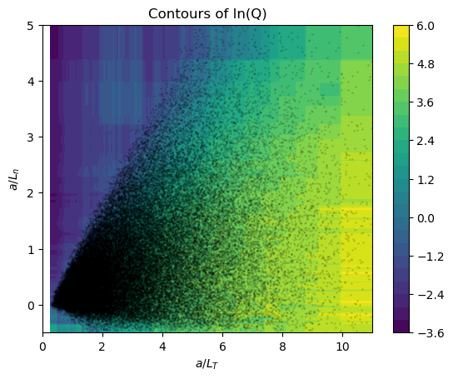
XGBoost regression model using only a/LT and a/Ln
Same plot, showing data as dots
Notes:
20241231-03_2_feature_tprim_fprim_XGB_model_visualization.ipynb

Slide 35
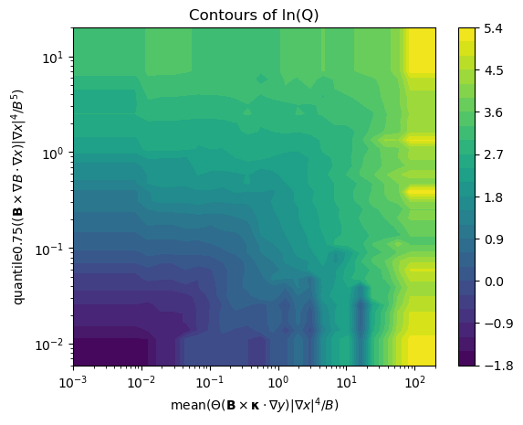
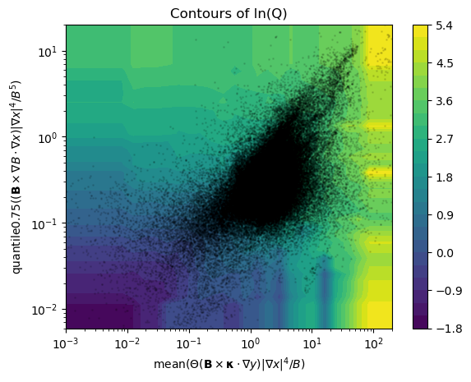
XGBoost regression model for fixed gradients using 2 features
Same plot, showing data as dots
Notes:
20241231-02_2_feature_XGB_model_visualization.ipynb

Slide 36
Turbulence simulations
R² = 0.989
Predicted heat flux
Regression
Feature importance
True heat flux
Notes:
20250102-10_plot_Q_vs_time_for_several_simulations.pdf

Slide 37
Multiple lines of evidence agree that the most important geometric feature is |∇ψ| in regions of bad curvature
Highest Spearman correlation at fixed gradients.
Consistently the first geometric feature chosen in sequential feature selection:
  In regression on the heat flux above the critical gradient
  And in the classifier for stability vs instability (i.e. determines critical gradient)
  Chosen by XGBoost, nearest-neighbors, & other algorithms.
Also the largest Shapley values
Notes:
20250114-06-plot_W7-X_xsection_and_surface.py

Slide 38
There are many extensions possible
Try larger sets of possible features
From the gyrokinetic equation, understand how these features affect turbulence.
Kinetic electrons, magnetic fluctuations.
Saliency maps to understand the features learned by the neural networks.
Symbolic regression.
Kolmogorov-Arnold Networks.
Optimization, profile prediction.
Include & test other physics-motivated features.
Data is online at doi:10.5281/zenodo.14867776, so have a go at it!

Slide 39
Paper: arXiv:2502.11657 Dataset doi:10.5281/zenodo.14867776
Turbulence simulations
R² = 0.989
Predicted heat flux
Regression
Feature importance
True heat flux
Notes:
20250102-10_plot_Q_vs_time_for_several_simulations.pdf

Slide 40
Notes:
20250321-01_compare_variants_of_ITG_proxy_grad_x_vs_grad_y.pdf

