Slide 1
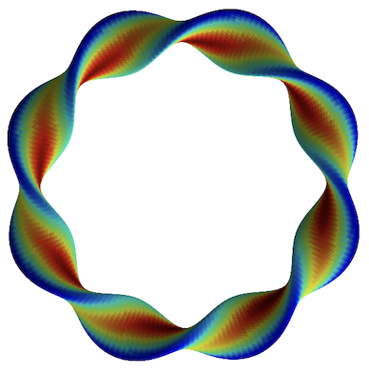
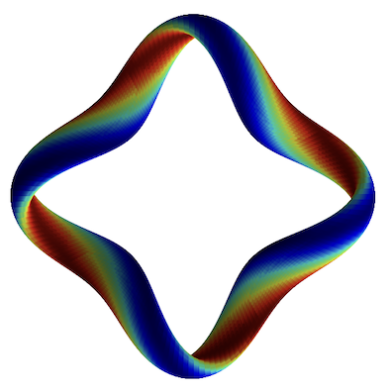
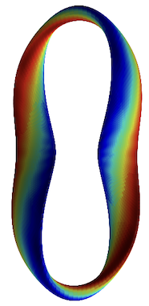
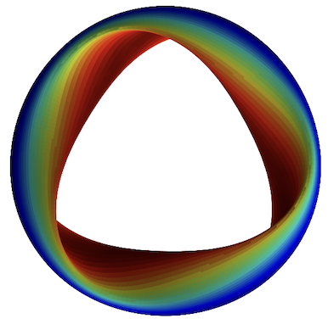
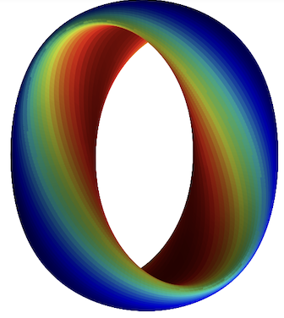
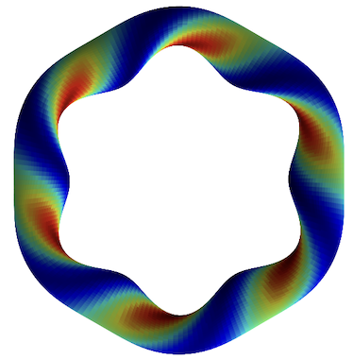
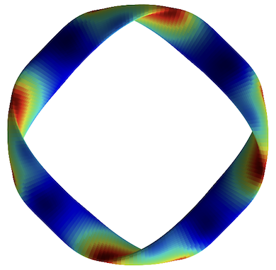
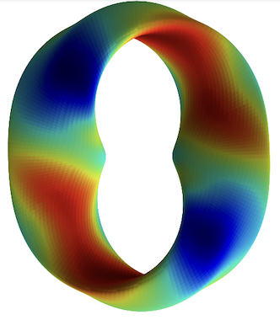
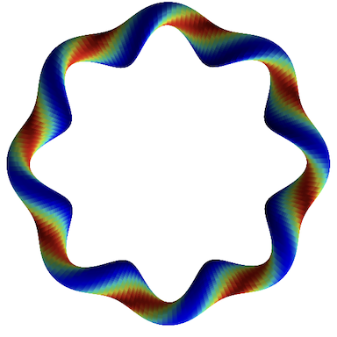
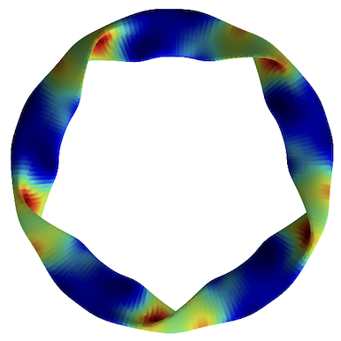
New dataset of >200,000 nonlinear gyrokinetic simulations of ITG turbulence in diverse stellarator geometries
Turbulence simulations
M Landreman, J Y Choi, C Alves, P Balaprakash, R M Churchill , R Conlin, G Roberg-Clark arXiv:2502.11657
Notes:
20250102-10_plot_Q_vs_time_for_several_simulations.pdf

Slide 2
New dataset of >200,000 nonlinear gyrokinetic simulations of ITG turbulence in diverse stellarator geometries
R² = 0.989
Turbulence simulations
Neural network
Predicted heat flux
True heat flux
M Landreman, J Y Choi, C Alves, P Balaprakash, R M Churchill , R Conlin, G Roberg-Clark arXiv:2502.11657
Notes:
20250102-10_plot_Q_vs_time_for_several_simulations.pdf

Slide 3
New dataset of >200,000 nonlinear gyrokinetic simulations of ITG turbulence in diverse stellarator geometries
R² = 0.989
Turbulence simulations
Neural network
Predicted heat flux
Interpretable machine learning
True heat flux
Bad curvature
Flux surface compression
M Landreman, J Y Choi, C Alves, P Balaprakash, R M Churchill , R Conlin, G Roberg-Clark arXiv:2502.11657
Notes:
20250102-10_plot_Q_vs_time_for_several_simulations.pdf

Slide 4
The data can also be used to test proposed turbulence cost functions
Notes:
20250206-02_compare_previously_published_ITG_proxies_singleline.py

Slide 5


Paper: arXiv:2502.11657 Dataset doi:10.5281/zenodo.14867776
R² = 0.989
Turbulence simulations
Neural network
Predicted heat flux
Interpretable machine learning
True heat flux
Bad curvature
Flux surface compression
Notes:
20250102-10_plot_Q_vs_time_for_several_simulations.pdf

