Slide 1
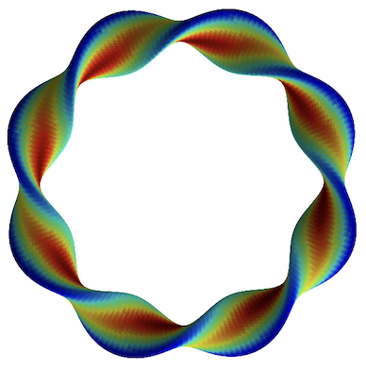
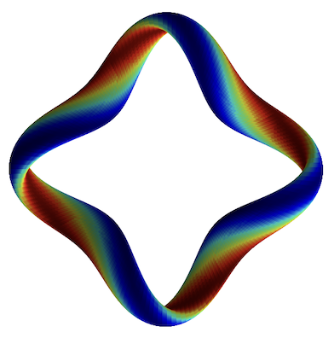
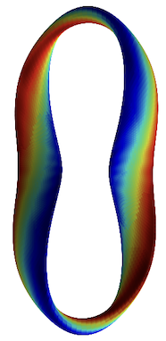
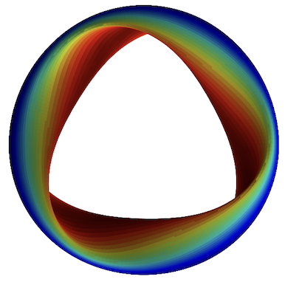
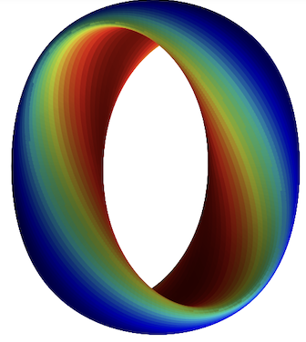
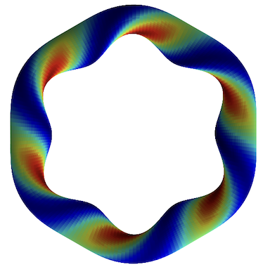
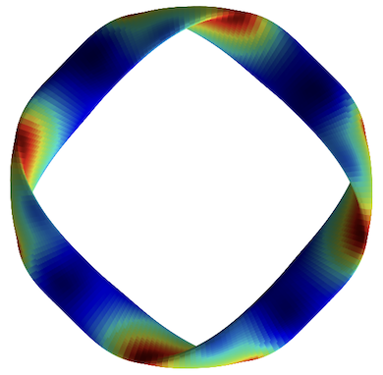
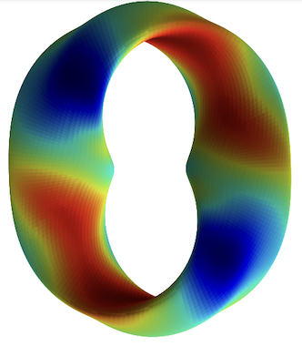
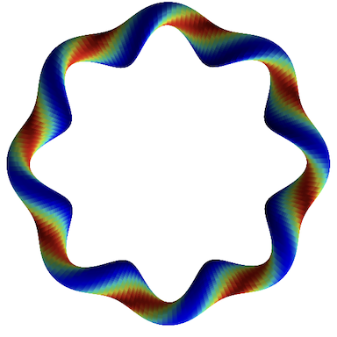
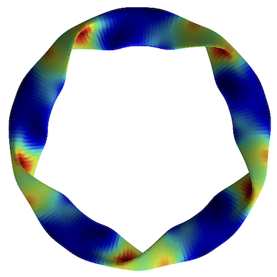
How does magnetic geometry affect ITG turbulence?
Insights from data & machine learning
Turbulence simulations
R² = 0.989
Predicted heat flux
Regression
Feature importance
True heat flux
M Landreman, J Y Choi, C Alves, P Balaprakash, R M Churchill , R Conlin, G Roberg-Clark
Thanks to many others who gave suggestions Supported by the US DOE StellFoundry SciDAC
Notes:
20250102-10_plot_Q_vs_time_for_several_simulations.pdf

Slide 2
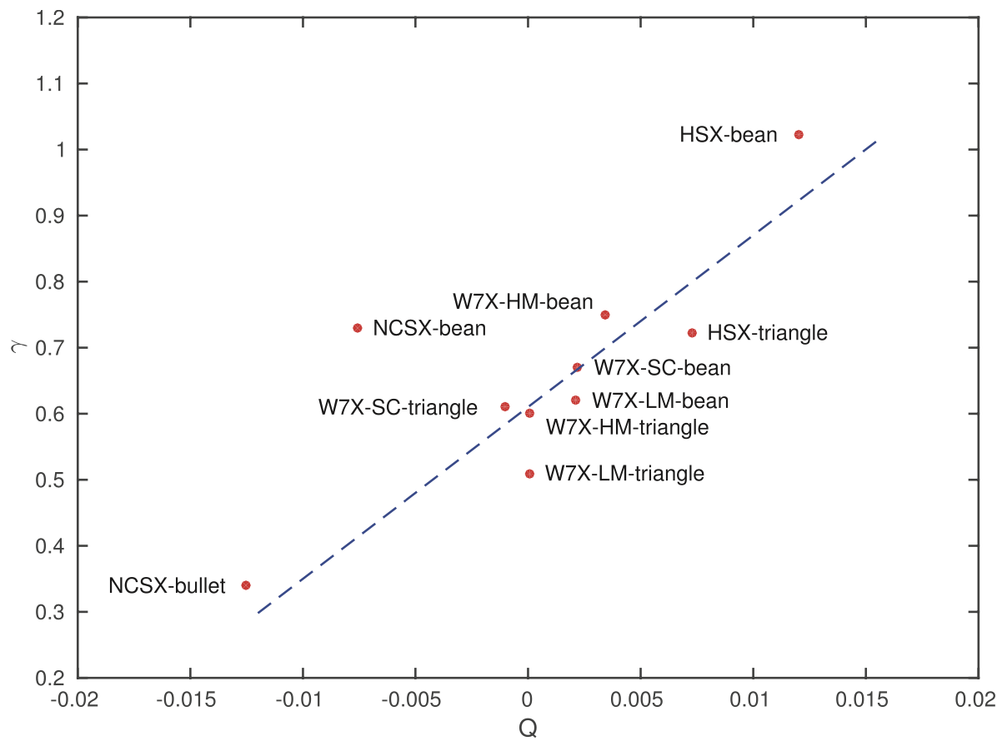
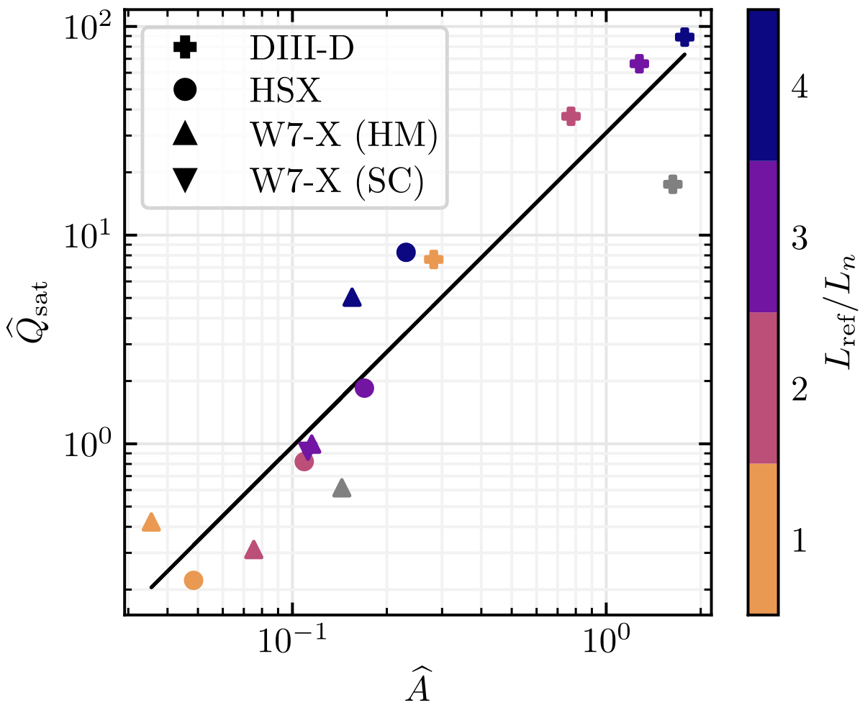
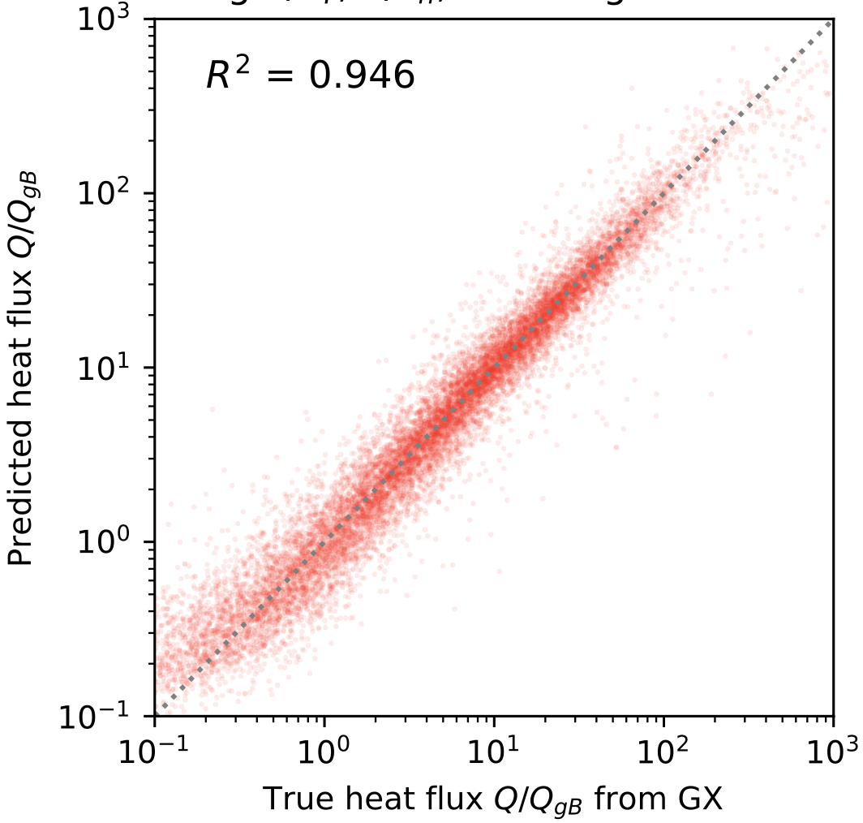
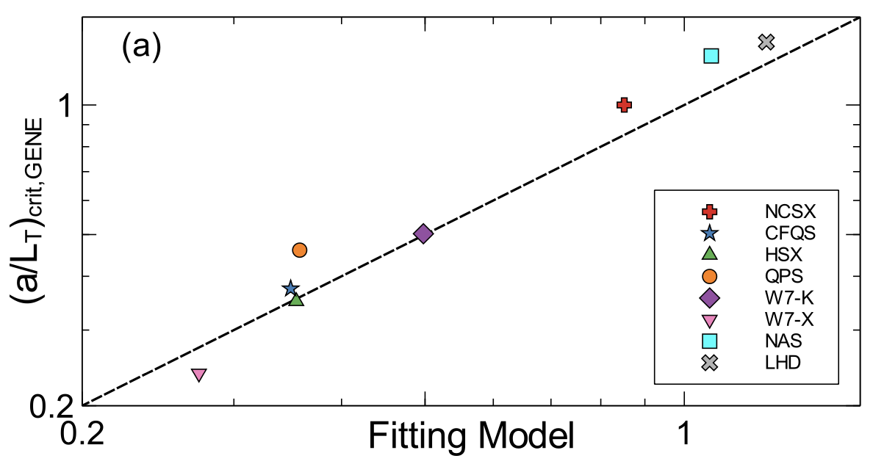
Proll (2016)
N = 10
Mackenbach (2022)
N = 15
TEM proxy
This work:
N = 100,705
Roberg-Clark (2022)
N = 8

Slide 3
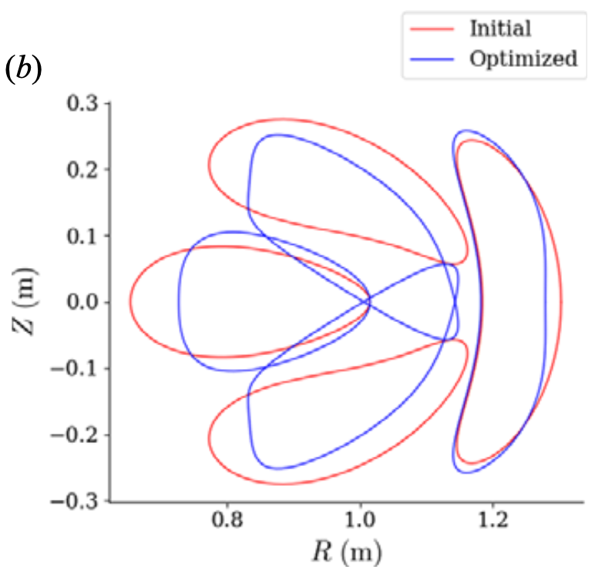

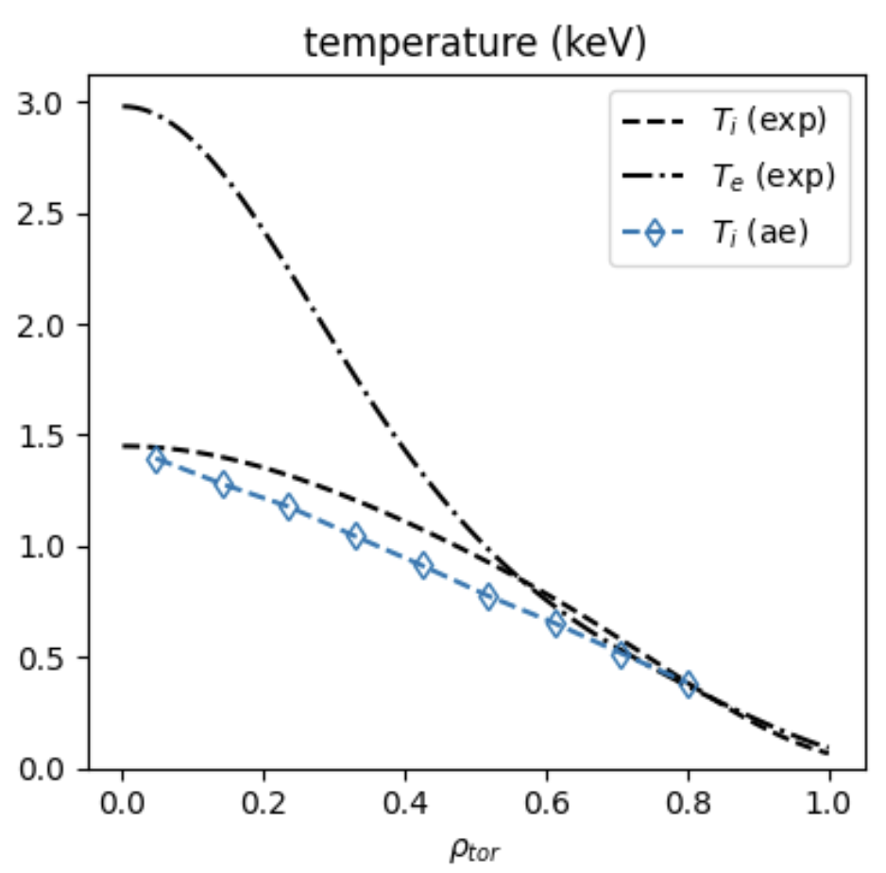
Motivations
Understanding
Optimization
Profile prediction
Kim (2024)
Mandell (2024)
Optimize geometry for maximum fusion power
Notes:
https://www.google.com/imgres?q=eureka%20understanding%20light%20bulb%20brain&imgurl=https%3A%2F%2Fpreview.redd.it%2Fhow-do-light-bulb-moments-come-about-v0-0mgno4a97tva1.jpg%3Fwidth%3D777%26format%3Dpjpg%26auto%3Dwebp%26s%3D541d28c2f1009471ab52add4a282ee4916a311fa&imgrefurl=https%3A%2F%2Fwww.reddit.com%2Fr%2Fmbti%2Fcomments%2F12xc0ef%2Fhow_do_light_bulb_moments_come_about%2F&docid=G-9kXBNk27S2YM&tbnid=9jUFrhBW814RkM&vet=12ahUKEwjdq_HN6OOKAxW7MVkFHflMNswQM3oECHAQAA..i&w=777&h=625&hcb=2&ved=2ahUKEwjdq_HN6OOKAxW7MVkFHflMNswQM3oECHAQAA

Slide 4
Turbulence simulations
R² = 0.989
Predicted heat flux
Regression
Feature importance
True heat flux
Notes:
20250102-10_plot_Q_vs_time_for_several_simulations.pdf

Slide 5
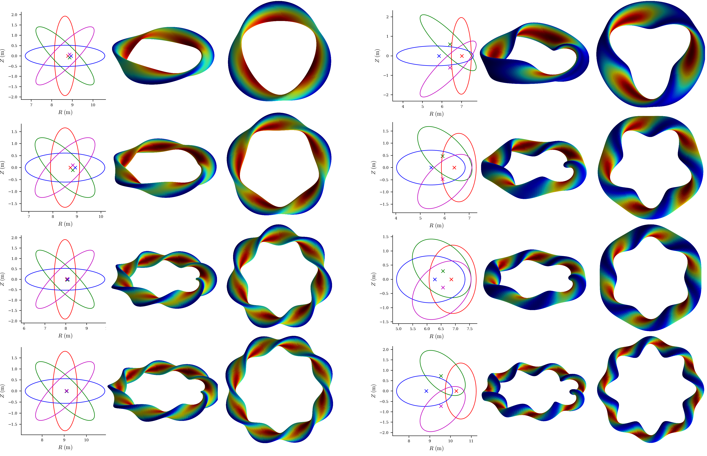
Equilibria group 1: random rotating ellipses
Nfp,
aspect ratio,
elongation,
axis torsion,
and beta are all random.
All configurations have same minor radius & toroidal flux, so same gyroBohm normalization
Notes:
~/Box/work24/20241220-02-figure_of_heliiotron_equilibria$ ./20241220-02-plot_heliotron_equilibria_for_paper.py

Slide 6
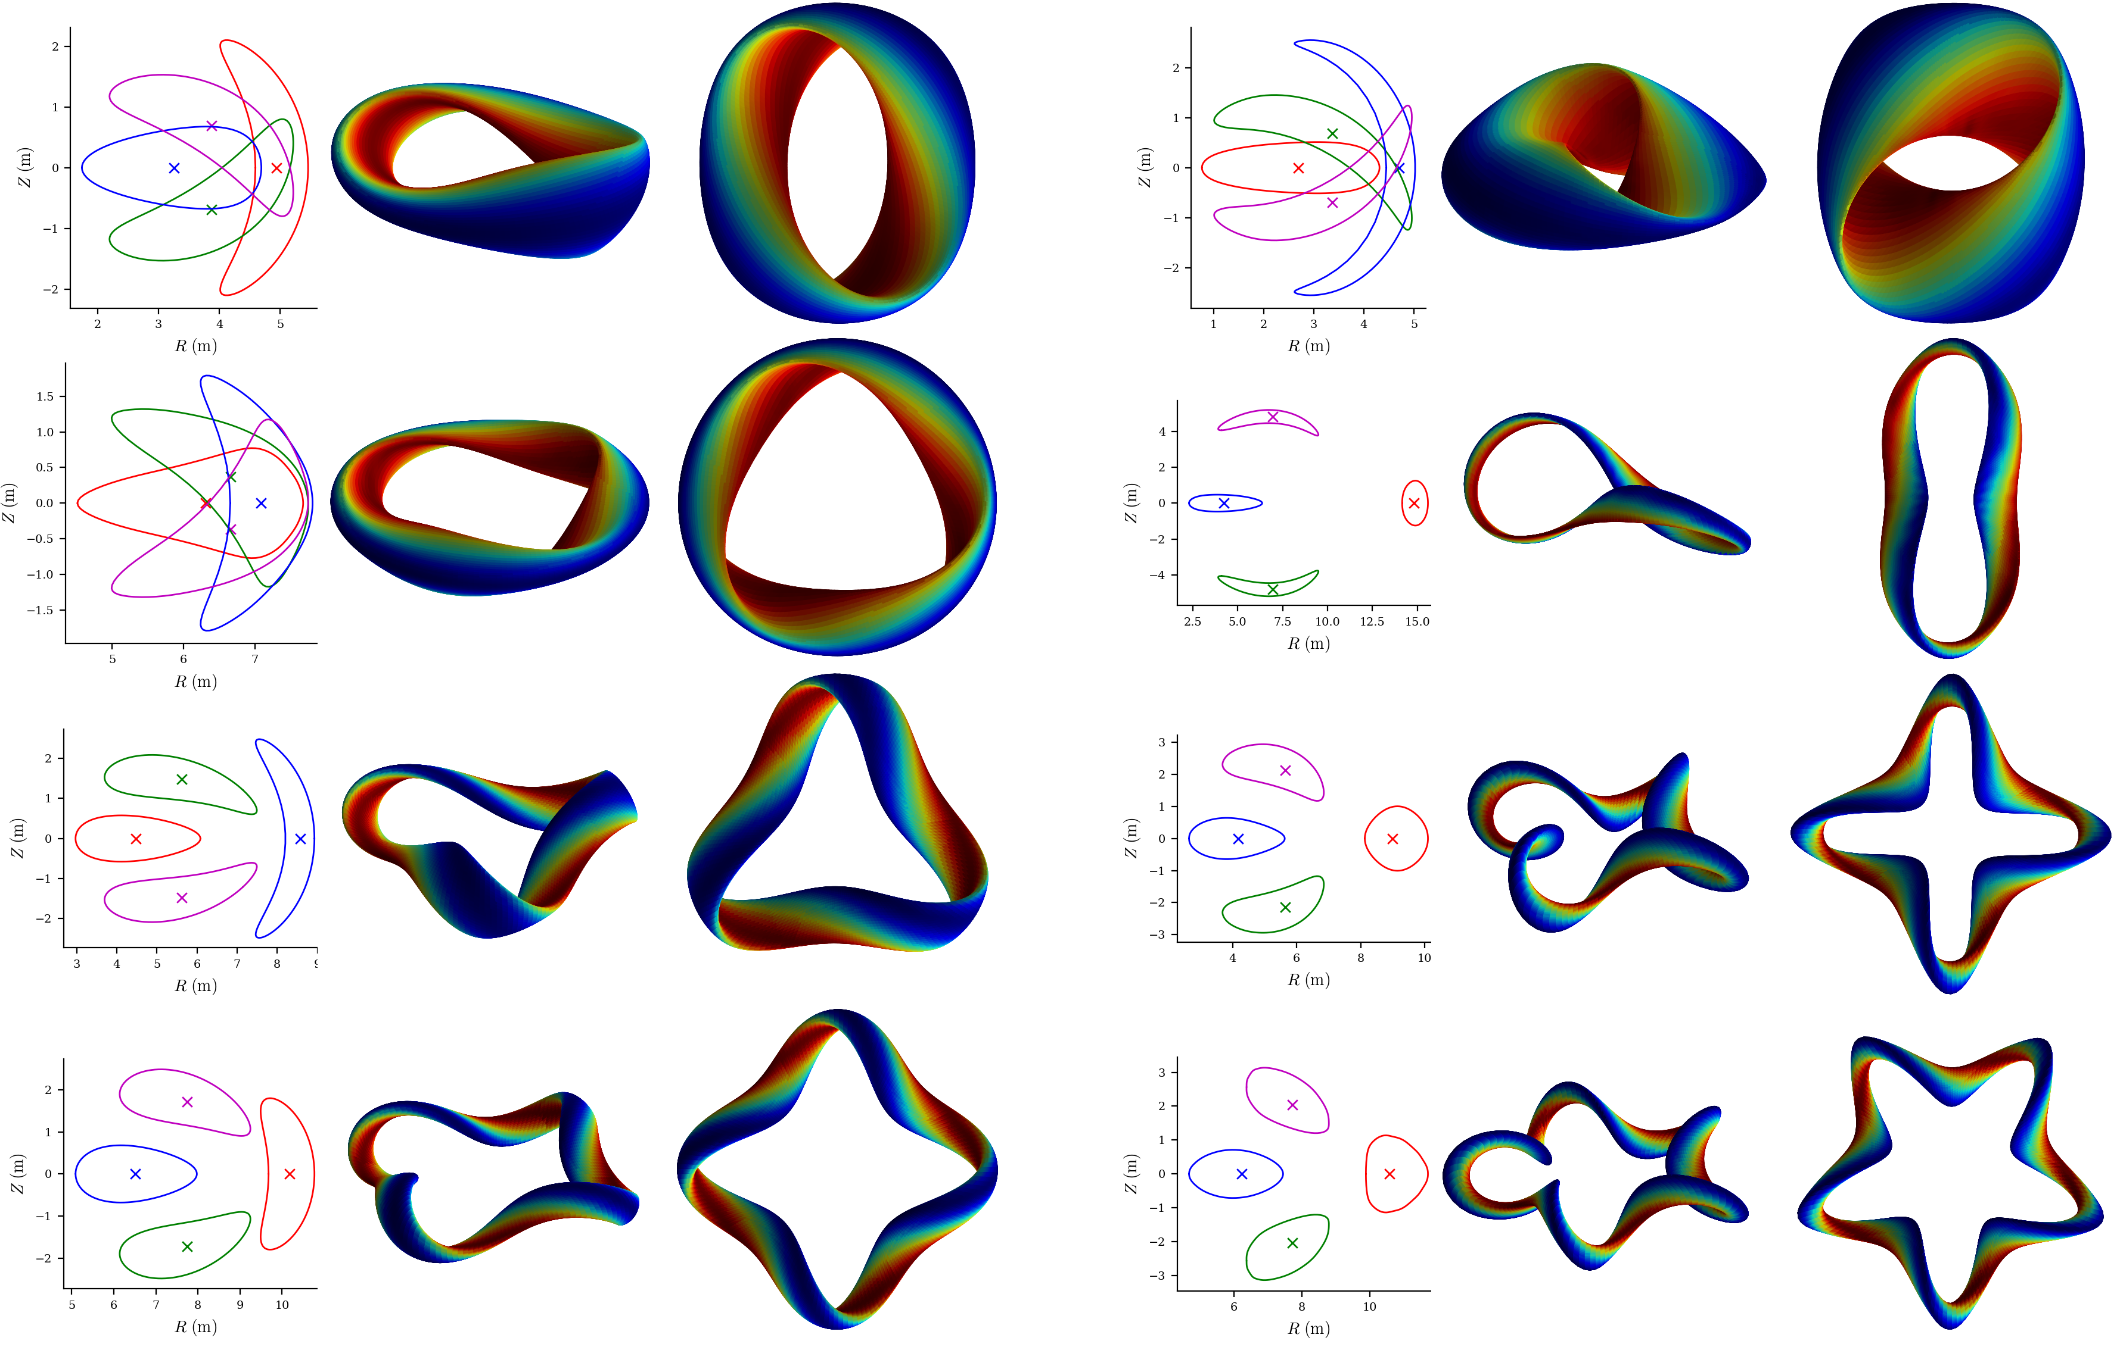
Equilibria group 2: QUASR QA & QH (Giuliani 2024)
Random pressure added for even more diversity
Notes:
~/Box/work24/20241220-01-figure_of_QUASR_equilibria$ ./20241220-01-plot_QUASR_equilibria_for_paper.py

Slide 7
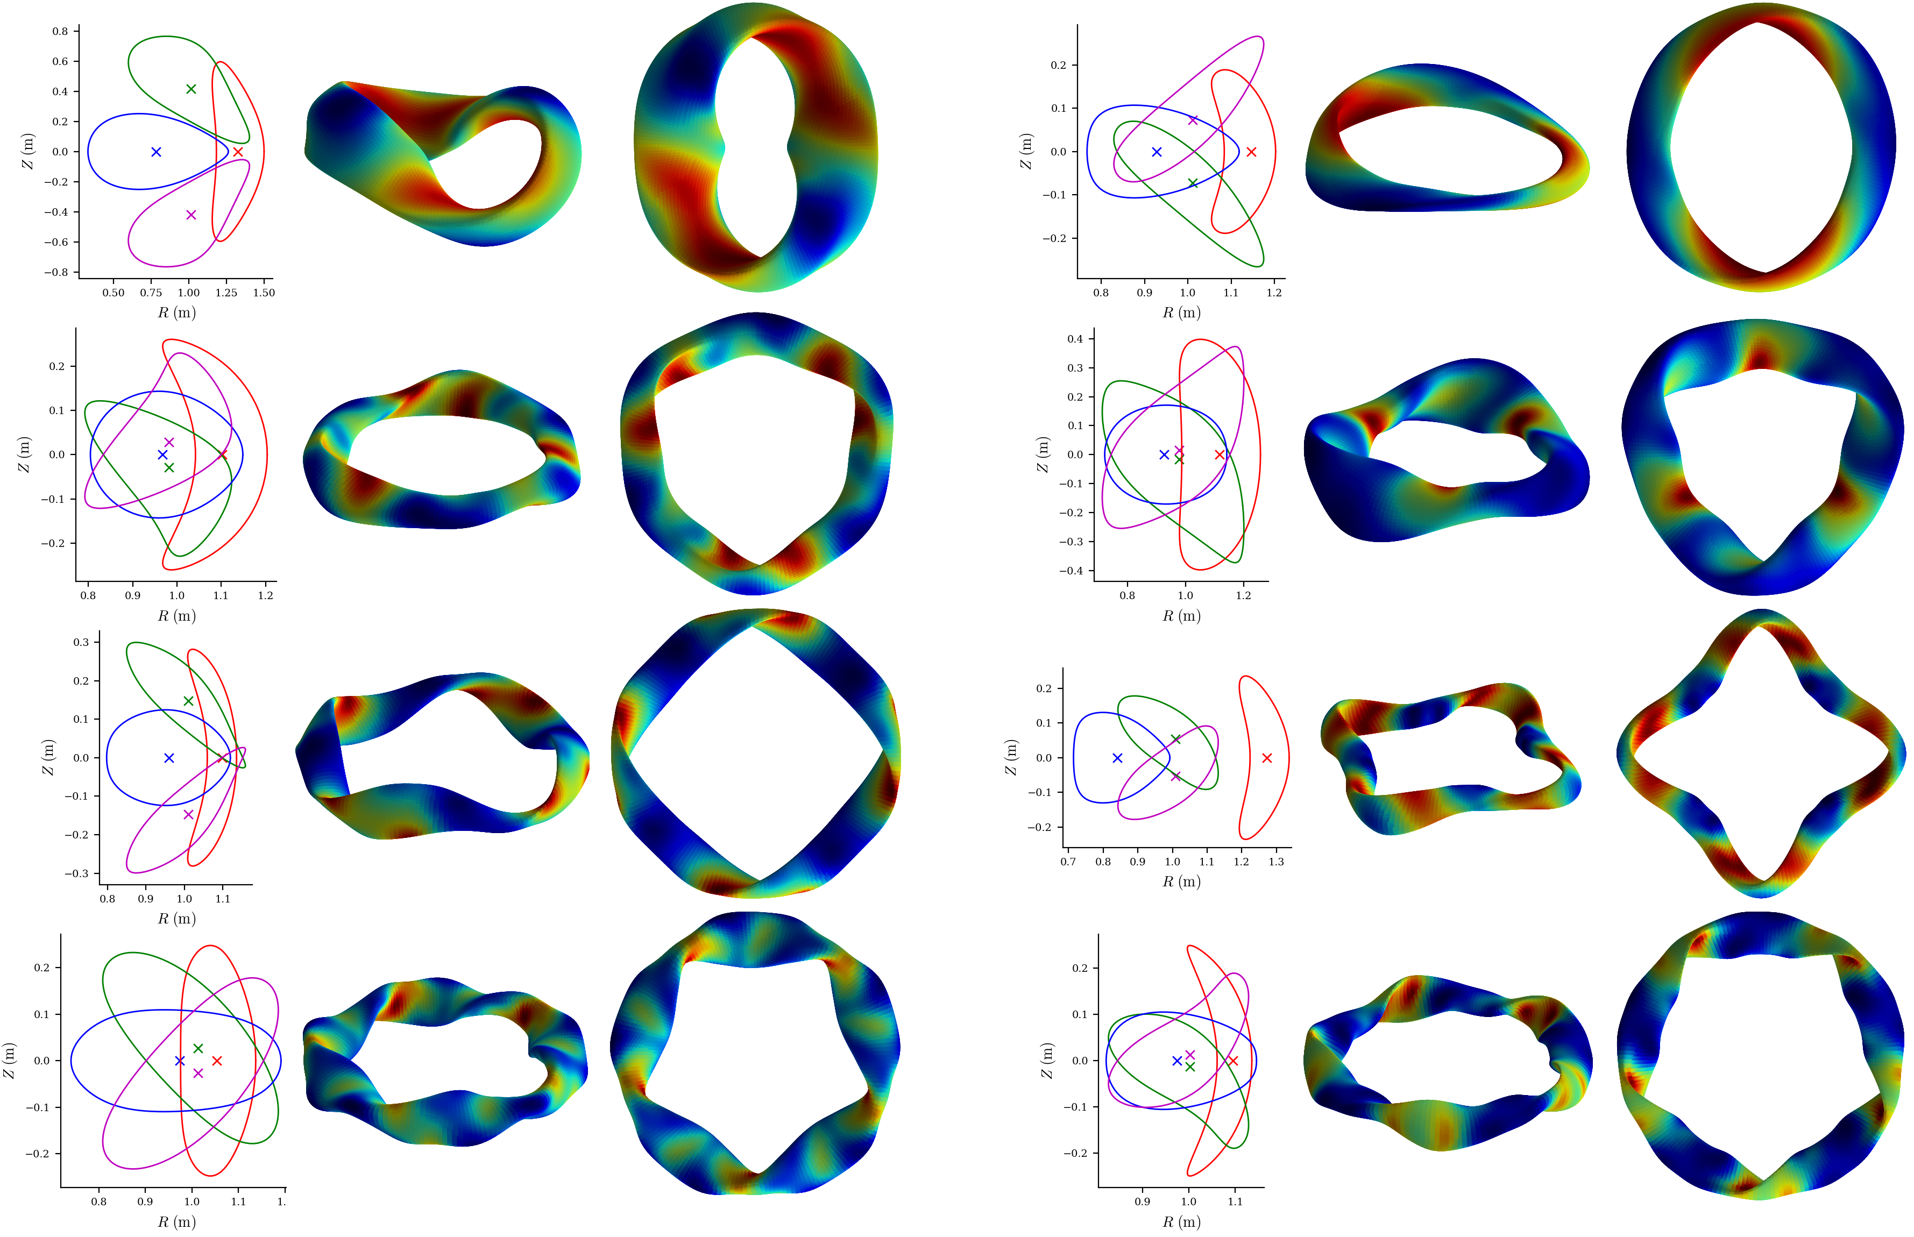
Equilibria group 3: random boundary modes
RBC and ZBS boundary Fourier modes sampled from normal distributions, fit to 44 “real” stellarators
Notes:
~/Box/work24/20241117-01-figure_of_random_equilibria$ ./20241117-02-plot_random_equilibria_for_paper.py

Slide 8
Turbulence simulations
R² = 0.989
Predicted heat flux
Regression
Feature importance
True heat flux
Notes:
20250102-10_plot_Q_vs_time_for_several_simulations.pdf

Slide 9
Nonlinear turbulence simulations were run with GX in every equilibrium
Electrostatic, adiabatic electrons.
1 simulation in each tube with random dT/dx and dn/dx.
1 simulation in each tube with (a/T) dT/dx = 3, (a/n) dn/dx=0.9
8 minutes to get heat flux on 1 GPU
2×10⁵ nonlinear simulations took < 7000 node-hours (1/8 allocation)
Don’t predict the time-dependence,
just the mean
10⁴
Notes:
This was about 1/8 of our SciDAC GPU allocation was 53,738 node hrs, UMD GPU allocation was 40,978 node hrs.
/pscratch/sd/l/landrema/20240601-01-random_stellarator_equilibria/20240601-01-075_ntheta_scan> ./plot_gx_scan_over_1_parameter_and_configuration.py
20240902-03_plot_distribution_of_Q_from_GX_database_for_poster.py
20241218-01-plot_distribution_of_heat_fluxes_for_paper.py
20250102-10_plot_Q_vs_time_for_several_simulations.pdf

Slide 10
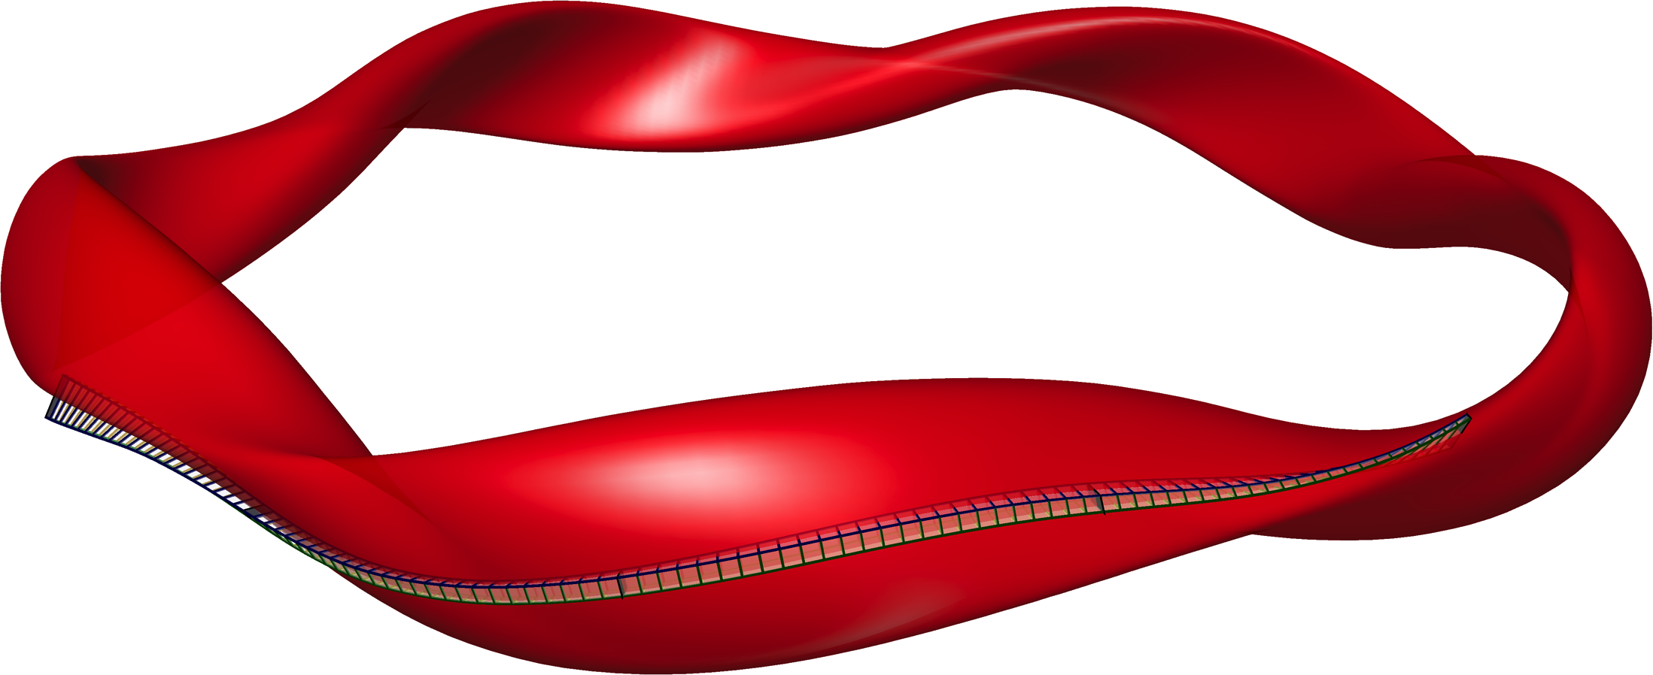
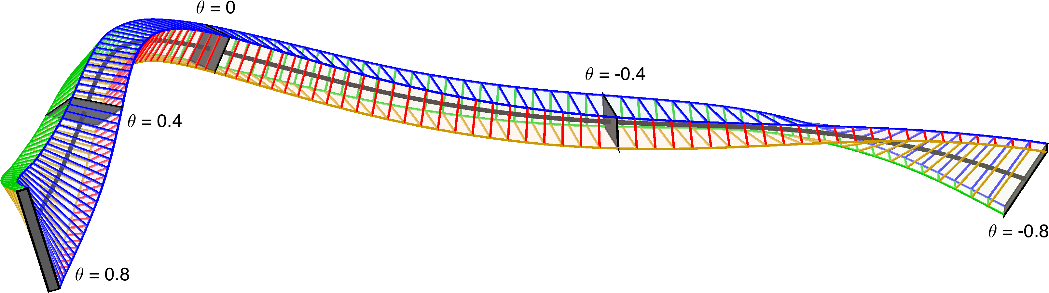






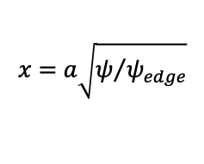

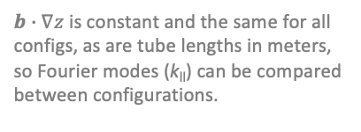

Raw feature space: 7x 1D functions that enter the turbulence simulations
$$B=B_{ref}∇x×∇y$$
$$x=a\sqrt{ψ/{ψ_{edge}}}$$
Flux tube simulation domain
$$\left|B\right|$$
$${\left|B\right|}^{−3}B×∇\left|B\right|∙∇y$$
$${\left|B\right|}^{−2}B×κ∙∇y$$
$${\left|B\right|}^{−3}B×∇\left|B\right|∙∇x$$
$$∇y∙∇y$$
$$∇x∙∇y$$
$$∇x∙∇x$$
$b∙∇z$ is constant and the same for all configs, as are tube lengths in meters, so Fourier modes (k_{ll}) can be compared between configurations.
Notes:
20250127-01-plot_random_flux_tube.py

Slide 12
Turbulence simulations
R² = 0.989
Predicted heat flux
Regression
Feature importance
True heat flux
Notes:
20250102-10_plot_Q_vs_time_for_several_simulations.pdf

Slide 13
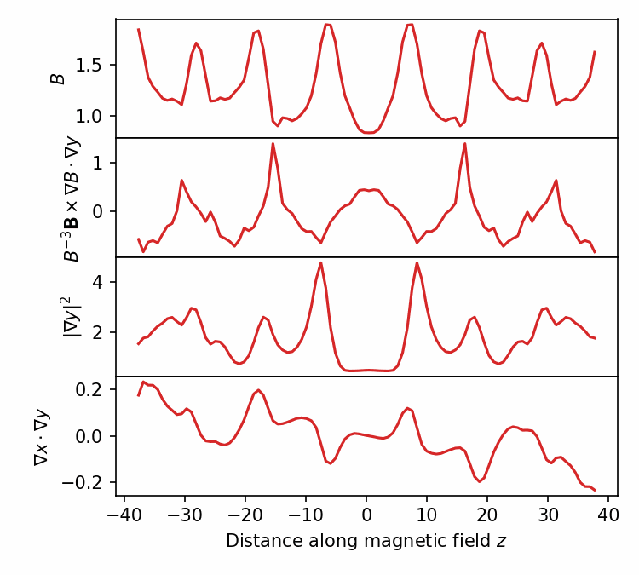
Raw features should not be directly fed to classical regression or fully-connected neural network, since model should be translation-invariant
GK equation, hence heat flux, is invariant under periodic translation of the raw features in z.
Similar to computer vision, where convolutional neural networks give approximate translation-invariance.
Notes:
20250102-01-plot_geometry_for_GX_circshift_figure.py
20250102-01-plot_geometry_for_GX_circshift_animation.py
See 20240609-01 Regressions for database of GX runs.docx
/pscratch/sd/l/landrema/20240609-01-gx_convergence/20240609-01-012_circshift
plot_gx_scan_over_1_parameter_and_configuration.py
plot_Q_vs_z_vs_circshift.py
python \
/global/homes/l/landrema/gx/gx/post_processing/plot-Q-z.py \
000001_circshift_0/gx.out.nc \
000001_circshift_12/gx.out.nc \
000001_circshift_24/gx.out.nc \
000001_circshift_36/gx.out.nc \
000001_circshift_48/gx.out.nc \
000001_circshift_61/gx.out.nc \
000001_circshift_73/gx.out.nc \
000001_circshift_85/gx.out.nc

Slide 14
Convolutional neural networks give accurate prediction of the turbulence
a/L_{T}
a/L_{n}
z-dependent geometric features
R² = 0.989
Convolutional layers x5
Predicted heat flux Q / Q_{GB}
Fully connected layers x2
by Jong Choi, ORNL
Actual heat flux Q / Q_{GB} from gyrokinetic simulation
Heat flux Q
Prediction in 0.001 sec for single network, 0.1 sec for ensemble
Notes:
pred_vs_actual_plot_pre2_20250211-01-002.pdf

Slide 15
Turbulence simulations
R² = 0.989
Predicted heat flux
Regression
Feature importance
True heat flux
Notes:
20250102-10_plot_Q_vs_time_for_several_simulations.pdf

Slide 16
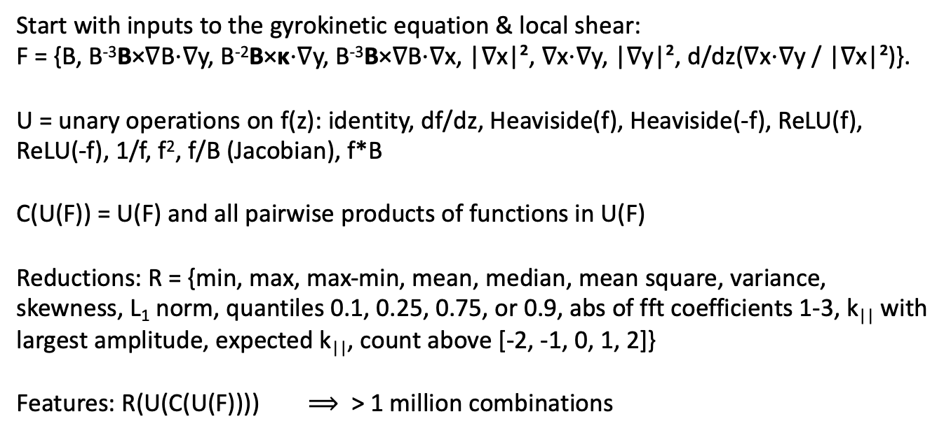
Our interpretable models use a large library of candidate features, all translation-invariant
Start with inputs to the gyrokinetic equation & local shear:
F = {B, B⁻³B×∇B⋅∇y, B⁻²B×κ⋅∇y, B⁻³B×∇B⋅∇x, |∇x|², ∇x⋅∇y, |∇y|², d/dz(∇x⋅∇y / |∇x|²)}.
U = unary operations on f(z): identity, df/dz, Heaviside(f), Heaviside(-f), ReLU(f), ReLU(-f), 1/f, f², f/B (Jacobian), f*B
C(U(F)) = U(F) and all pairwise products of functions in U(F)
Reductions: R = {min, max, max-min, mean, median, mean square, variance, skewness, L₁ norm, quantiles 0.1, 0.25, 0.75, or 0.9, abs of fft coefficients 1-3, k|| with largest amplitude, expected k||, count above [-2, -1, 0, 1, 2]}
Features: R(U(C(U(F)))) $⟹$ > 1 million combinations

Slide 17
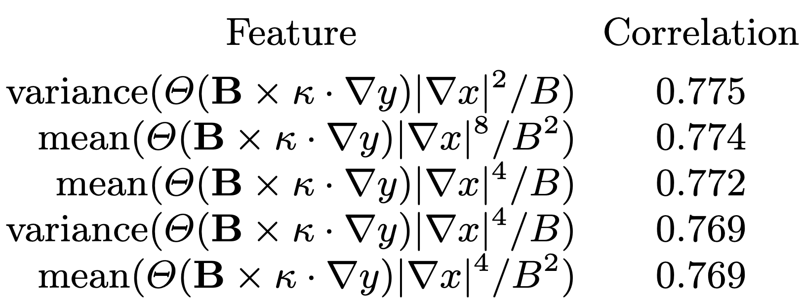
Spearman correlation is a quick tool to find the most important feature
Spearman correlation is the regular Pearson correlation of the the sorted rank of the target with the sorted rank of the feature.
Its magnitude is invariant to any monotonic nonlinear function, e.g. corr(x, exp(x)) = 1
No regression model required.
Features with highest correlation to heat flux Q at fixed dT/dx & dn/dx:
Heaviside function: Where there is bad curvature,
Jacobian (maybe squared)
local temperature gradient in real space (to various powers)
|∇T| = (dT/dx) |∇x|
Extremely similar to Mynick (2010), Xanthopoulos (2014), Stroteich (2022), Goodman (2024)!

Slide 18
Forward sequential feature selection: ∼3 features can be almost as predictive as all features
Stiffness
Critical gradient
Notes:
20241229-02-plot_sfs_results_for_talk.py

Slide 19
Sequential feature selection allows closer fit to the data as more geometric features are included
Performance shown on 20% held-out test data
Notes:
20241224-01-plot_Q_vs_predicted_for_ML_paper.py

Slide 20
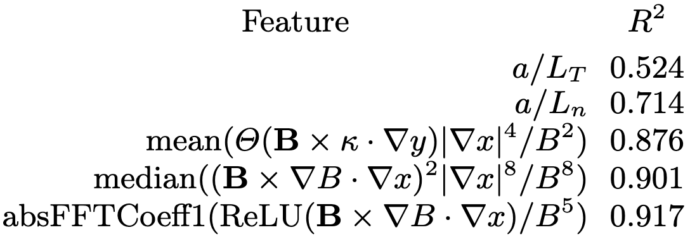
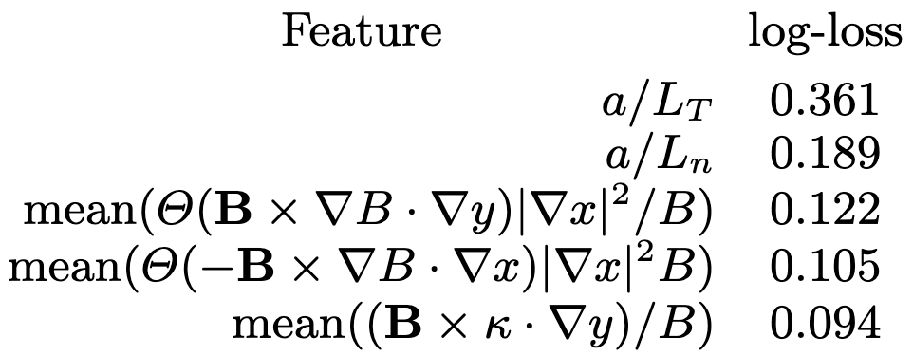
Most important features from sequential feature selection
Regression on heat flux
Classification (stability vs instability)
The 2nd most important geometric feature involves flux surface compression and radial ∇B drift
The most important geometric feature is flux surface compression where curvature is bad
The gradients are more important than any geometric feature
Xanthopoulos et al (2011), Nakata & Matsuoka (2022):
Larger geodesic curvature (= radial drift) ⇒ Stronger damping of zonal flows ⇒ higher heat flux

Slide 21
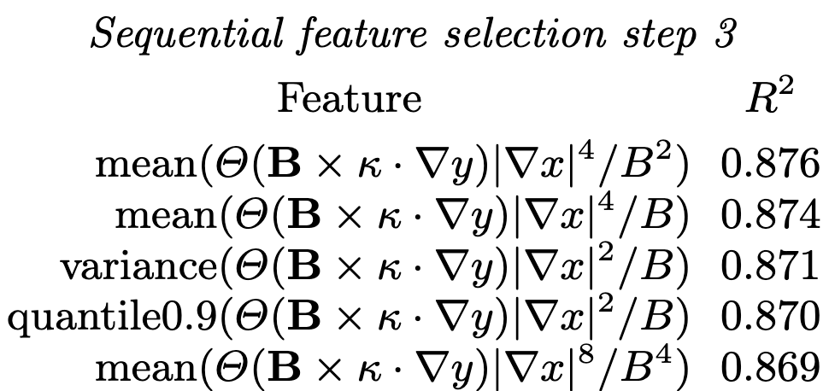
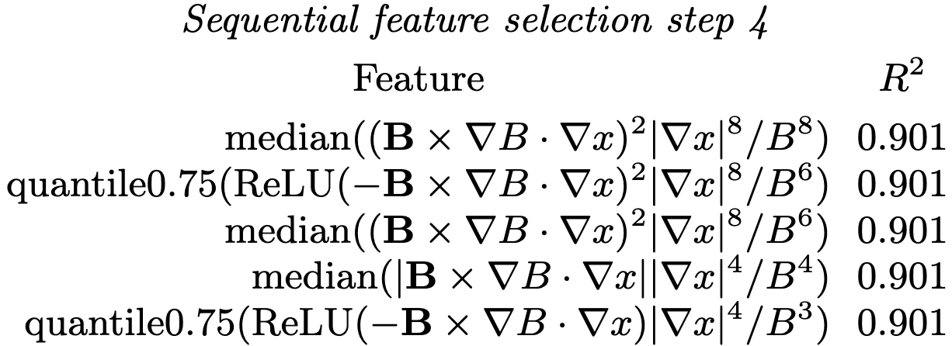
At each step, the top features are variations on a theme
Regression for the random-gradient dataset
Notes:
20241210-01-085_allConfigs_randomGradients_onlyUnstable_YlnQ_Qmin0p1_features20241227_XGB_20nodes

Slide 22
Shapley values show the sign and magnitude of each feature’s effect
a/L_{T} increases Q
a/L_{n} decreases Q
Most important geometric features:
|∇x| increases Q,
especially near bad curvature
Next geometric features:
Radial drift (geodesic curvature)
increases Q
Decreasing importance
Shapley value: contribution to predicted ln(Q)
Notes:
20240902-01-plot_shapley_values_for_GX_regression.py

Slide 23
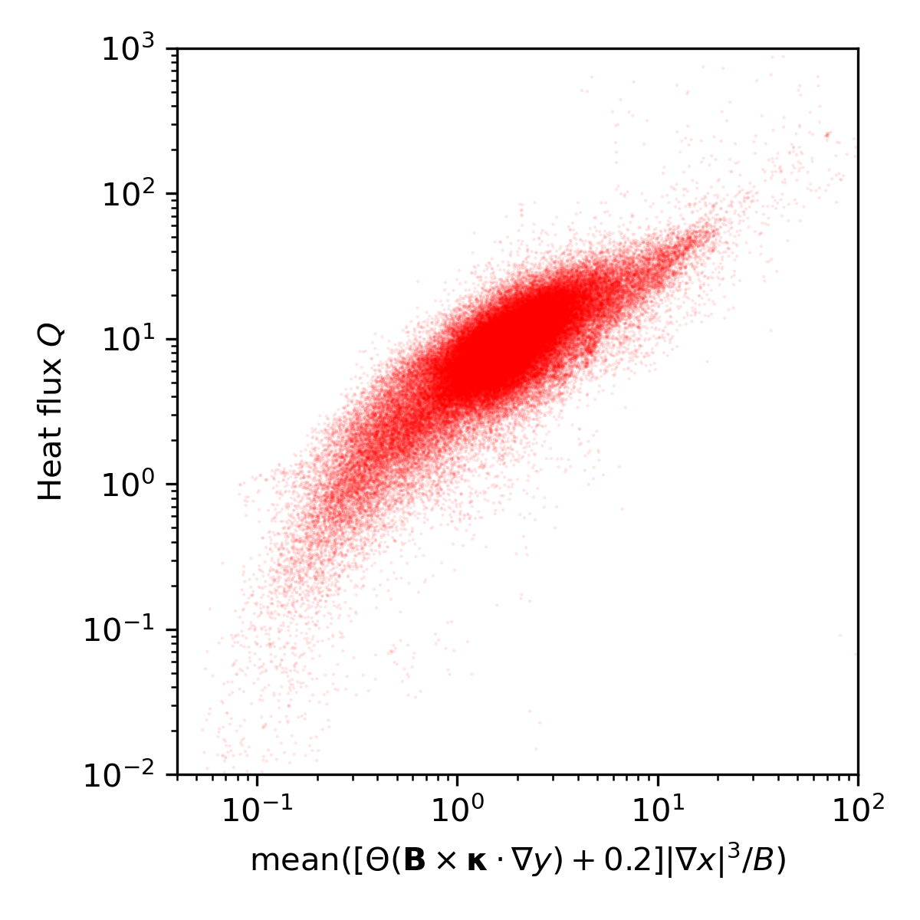
The first geometric feature can be fine-tuned for even better fit
Fixed-gradient dataset.
No regression model used here.
Feature fine-tuned for stability classifier:
Notes:
20241229-04_plot_Q_vs_optimized_single_feature_for_paper.png

Slide 24
Previously proposed proxies can be tested
Notes:
20250206-02_compare_previously_published_ITG_proxies_singleline.py

Slide 25
Multiple lines of evidence agree that the most important geometric feature is |∇ψ| in regions of bad curvature
Highest Spearman correlation at fixed gradients.
Consistently the first geometric feature chosen in sequential feature selection:
  In regression on the heat flux above the critical gradient
  And in the classifier for stability vs instability (i.e. determines critical gradient)
  Chosen by both XGBoost and nearest-neighbors.
Also the largest Shapley values
Notes:
20250114-06-plot_W7-X_xsection_and_surface.py

Slide 26
There are many extensions possible
Try larger sets of possible features
From the gyrokinetic equation, understand how these features affect turbulence.
Kinetic electrons, magnetic fluctuations.
Saliency maps to understand the features learned by the neural networks.
Symbolic regression.
Kolmogorov-Arnold Networks.
Optimization, profile prediction.
Include & test other physics-motivated features.
Data will be released on Zenodo with the paper, so have a go at it!

Slide 27
Turbulence simulations
R² = 0.989
Predicted heat flux
Regression
Feature importance
True heat flux
Notes:
20250102-10_plot_Q_vs_time_for_several_simulations.pdf

Slide 28
Extra slides

Slide 29
Other machine learning regression methods work also
All using a/L_{T}, a/L_{n}, and the top 10 geometric features selected via XGBoost
Notes:
20241228-01-plot_comparison_of_regression_methods.py

Slide 30

XGBoost regression model with 1 feature
XGBoost fit
Fixed-gradient dataset
Notes:
20250128-02-plot_Q_vs_optimized_single_feature_including_xgboost.py

Slide 31
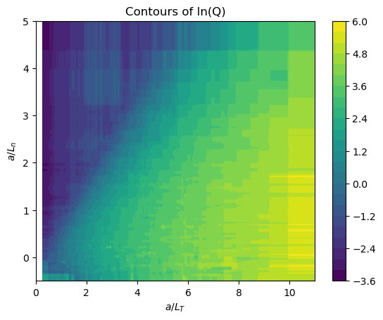
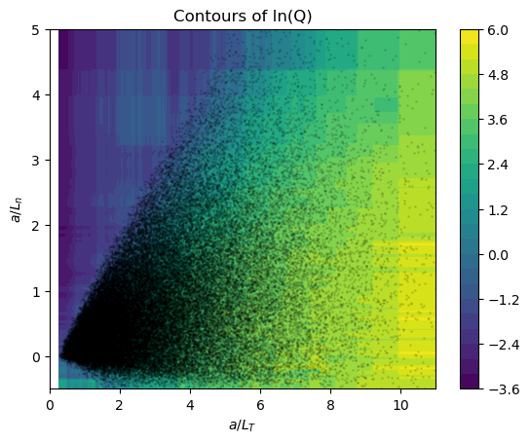
XGBoost regression model using only a/LT and a/Ln
Same plot, showing data as dots
Notes:
20241231-03_2_feature_tprim_fprim_XGB_model_visualization.ipynb

Slide 32
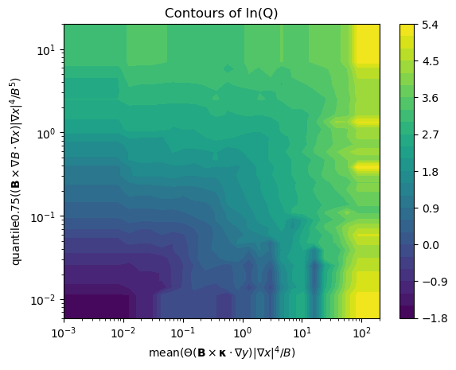
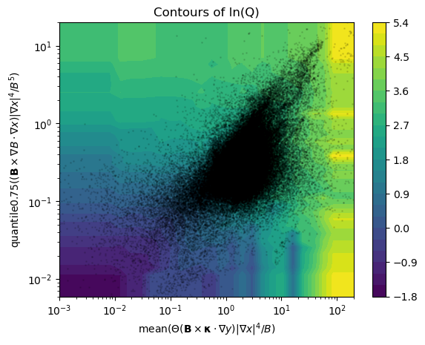
XGBoost regression model for fixed gradients using 2 features
Same plot, showing data as dots
Notes:
20241231-02_2_feature_XGB_model_visualization.ipynb

