Slide 1
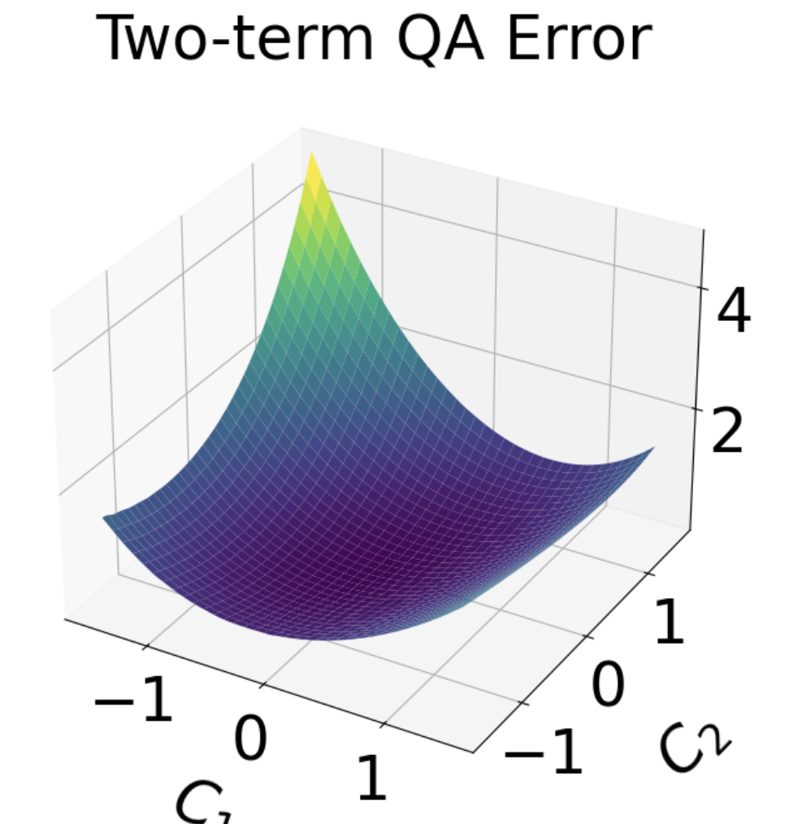
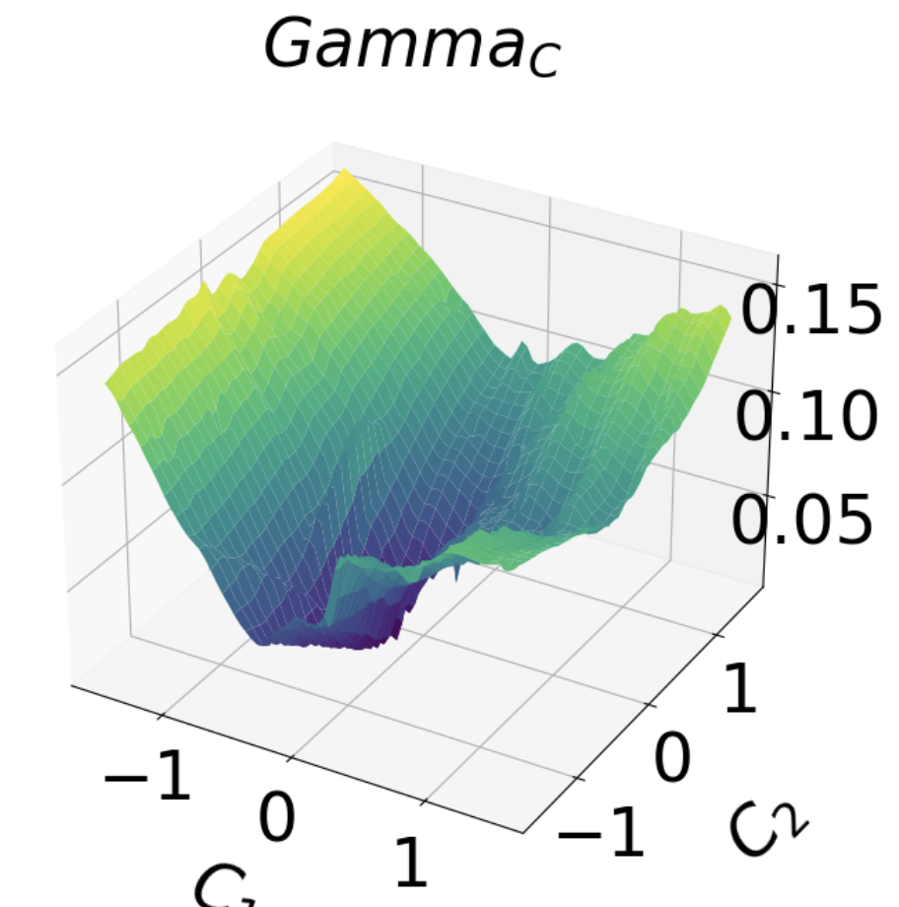
Visualizing Stellarator Objective Functions
Byoungchan Jang¹, Matt Landreman¹ 1. University of Maryland

Slide 2
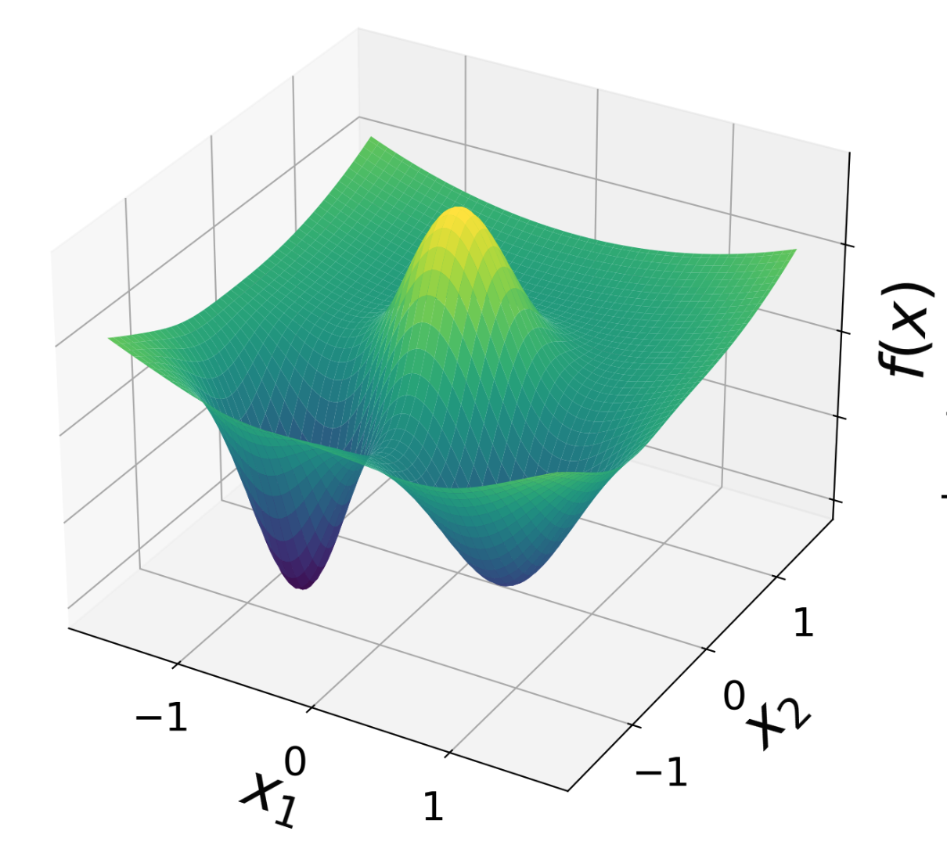
Motivation
In optimization for stellarators, the optimization algorithms(i.e. optimizers) can get stuck, and the solution depends on initial condition.
This limits us from finding all solutions from the parameter space.
To avoid local minima and ultimately to explore more of the parameter space
Need to understand the landscape of the stellarator optimization problems

Slide 3
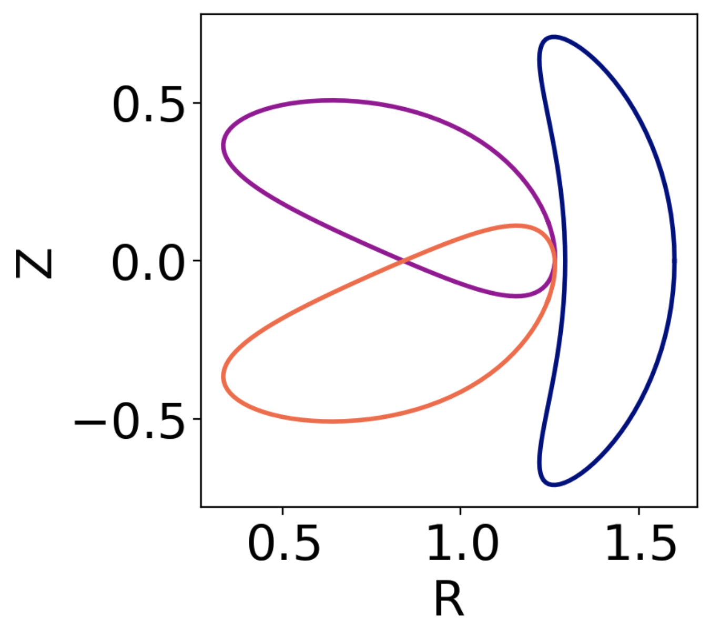
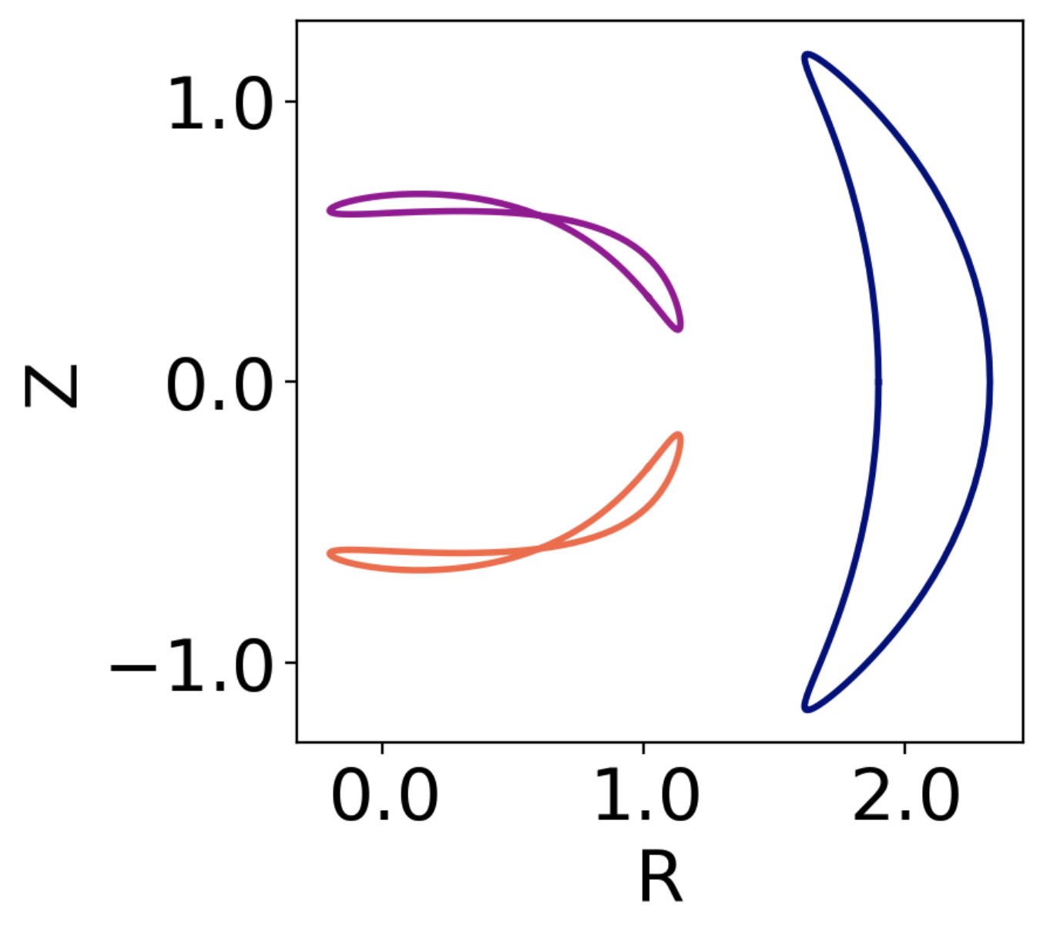





Stellarator Optimization
  Given a “objective function”
  minimize
$$f(x)$$
$$f:ℝ^{n}→ℝ,$$
  (aka “loss function”, “cost function”)
$$x$$
Parameter space:
Objective functions:
$$f$$
$$x$$
= shape of toroidal surface (25 - 121 dofs)
  Large volume of good magnetic surfaces (no islands and chaos)
  Rotational transform (i.e. inverse safety factor)
  Good confinement of particle trajectories
  Low neoclassical transport
  Low turbulent transport
  Magnetohydrodynamic (MHD) stability
  Part of the parameter space corresponds to unphysical self-intersecting shapes

Slide 4
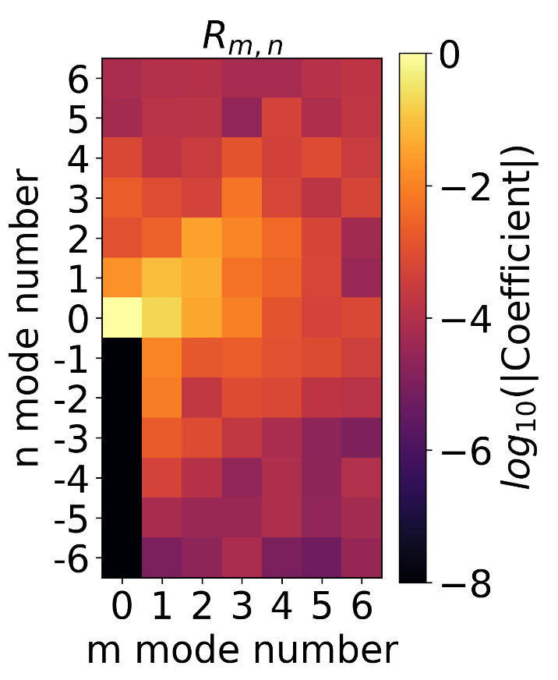
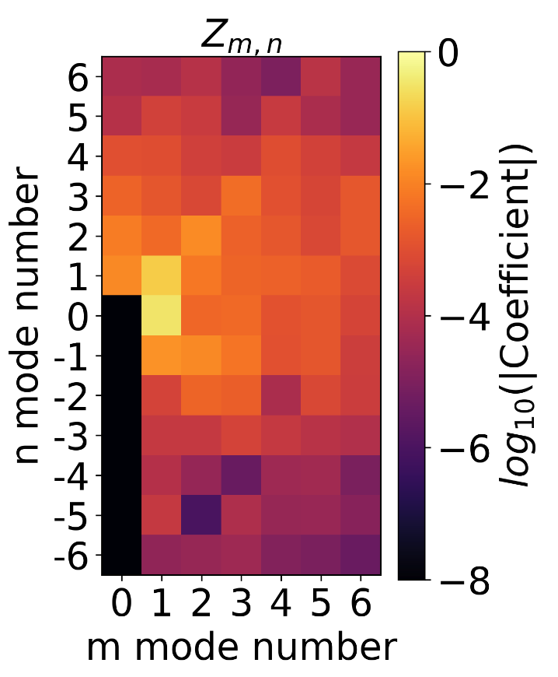
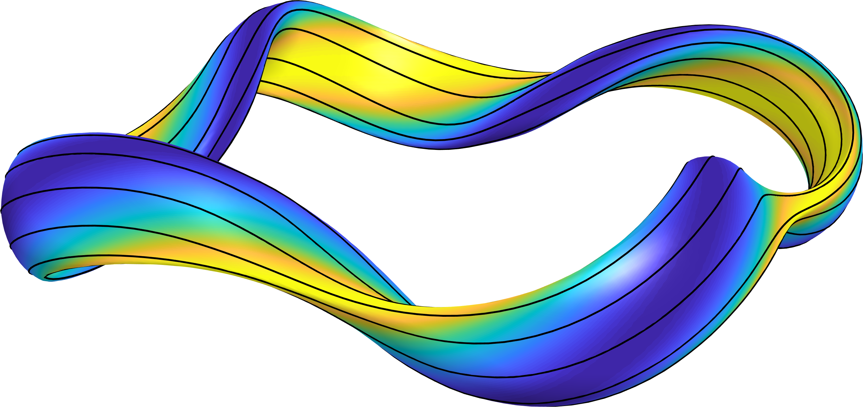
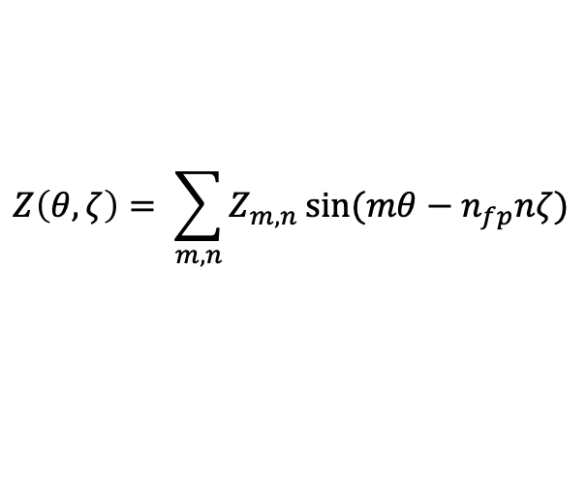
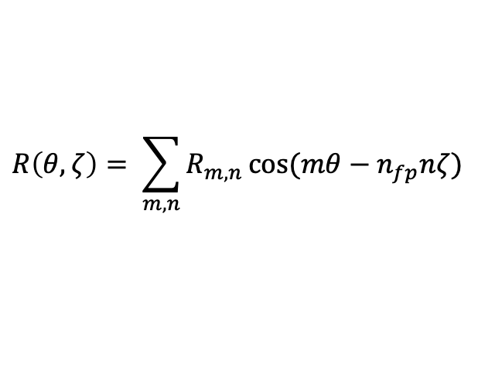


Parameter space
$$θ$$
$$ζ$$
  Parametrization of boundary surface:
$$R\left(θ, ζ\right)= \sum_{m,n}{R_{m,n}}\cos{(mθ−n_{fp}nζ)}$$
$$Z\left(θ, ζ\right)= \sum_{m,n}{Z_{m,n}}\sin{(mθ−n_{fp}nζ)}$$
$ζ$ = toroidal angle, $θ$ = poloidal angle, $n_{fp}$ = number of field periods
  Parameter space for optimization: $x= \left[R_{m,n} , Z_{m,n}\right]$

Slide 5
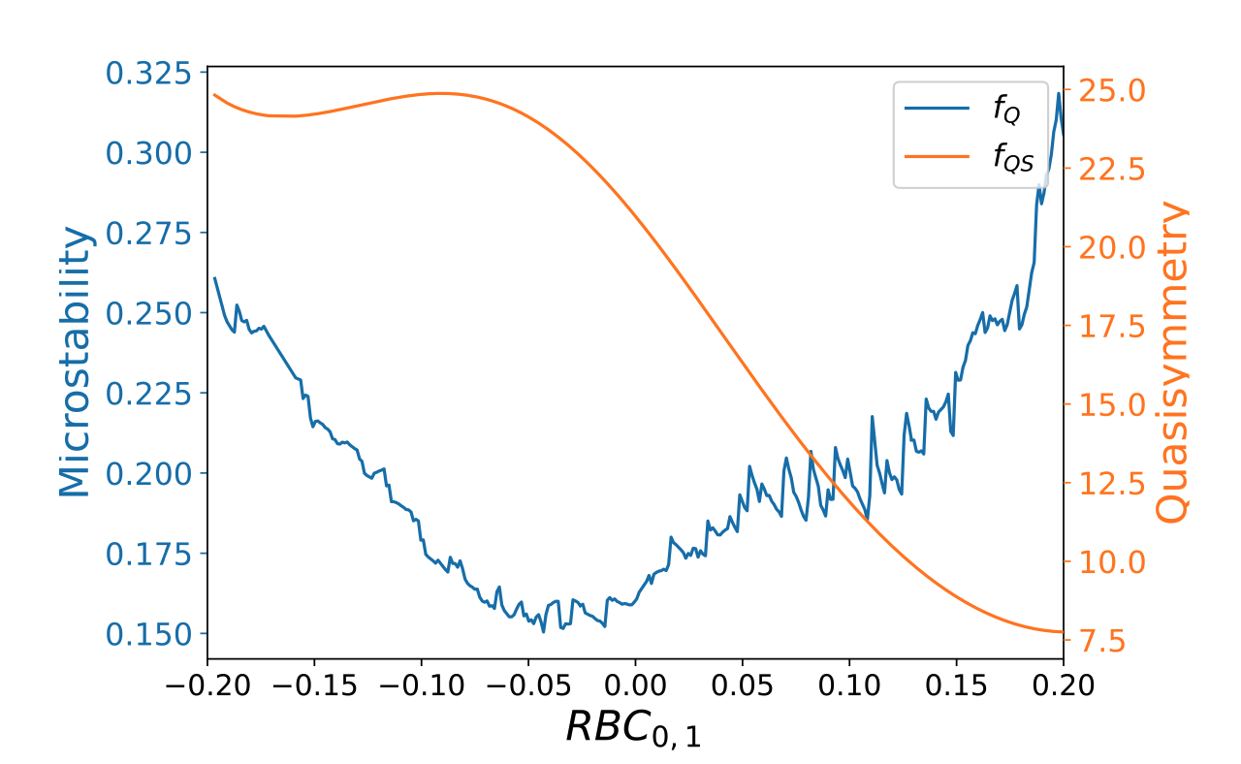
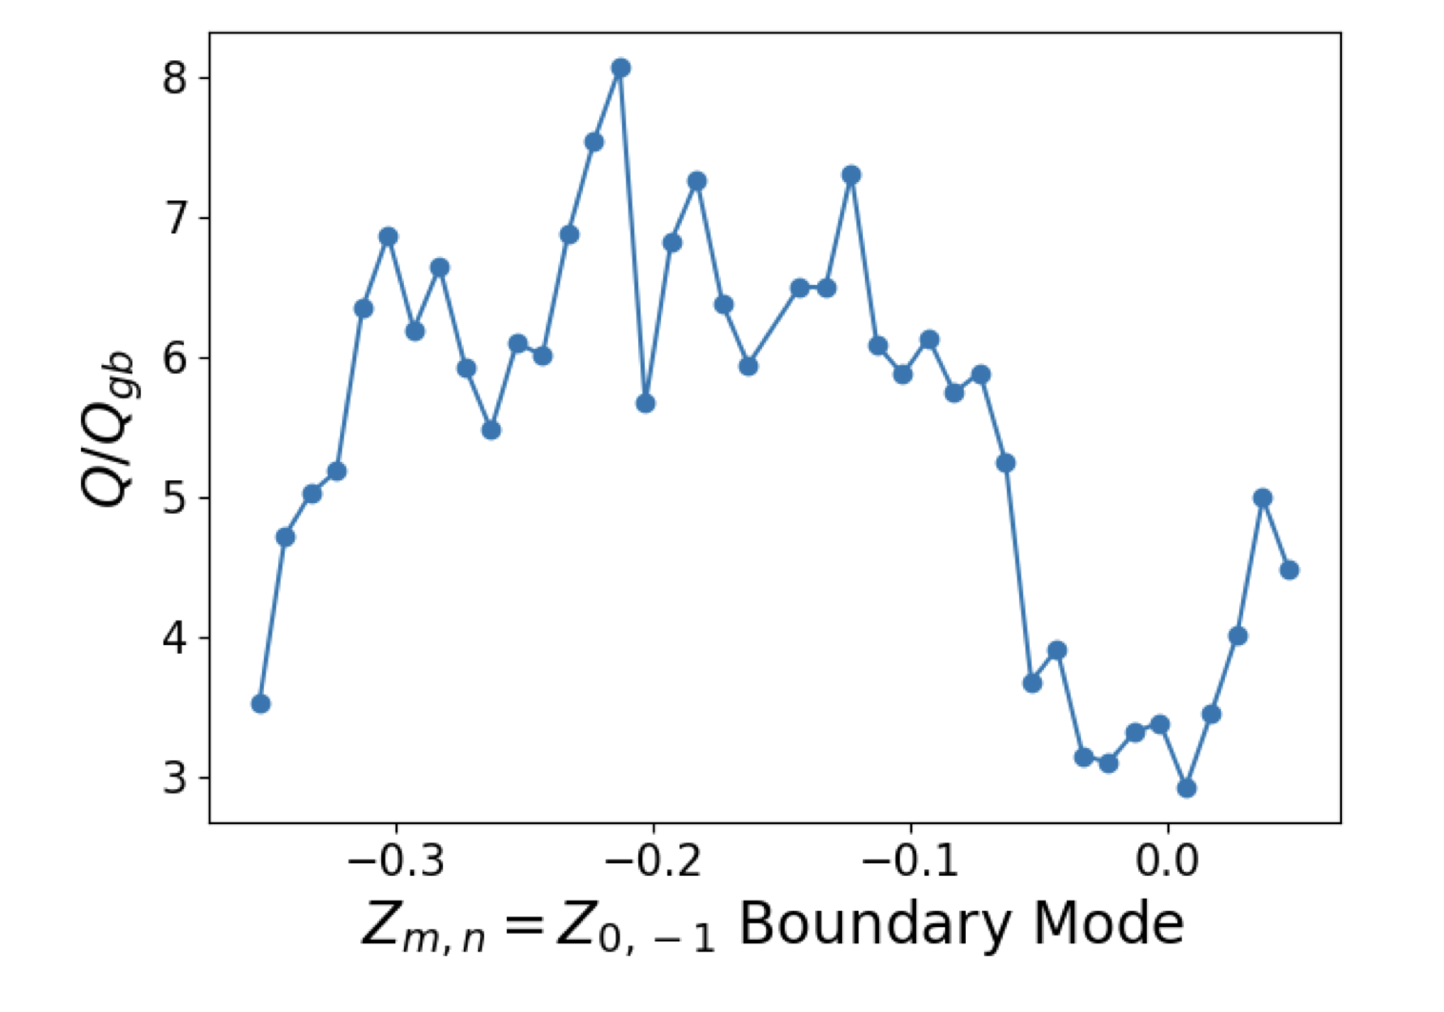
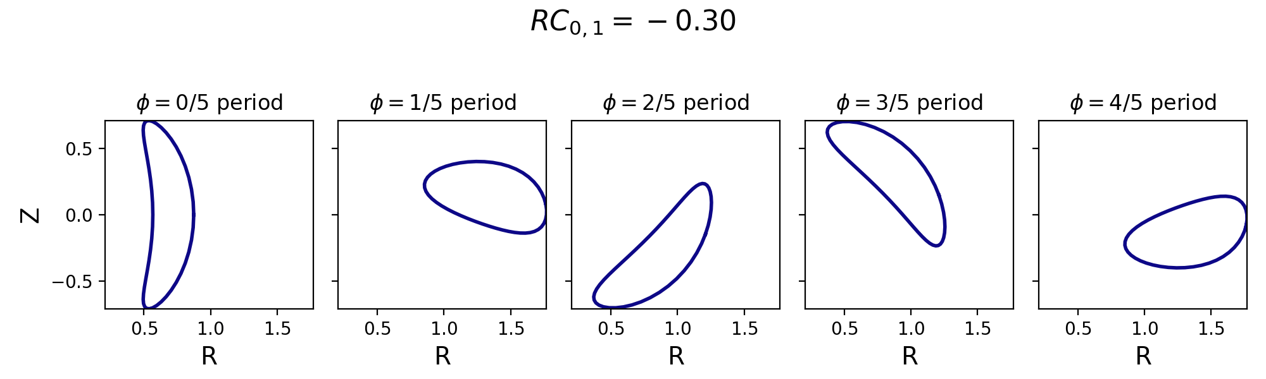


1D landscape
1D Interpolation: Changing one of the modes
$x= \left[R_{m,n} , Z_{m,n}\right]$
$$R_{0,1}∈[−0.2,0.2]$$
Jorge arXiv (2023)
Kim JPP
(2024)

Slide 6
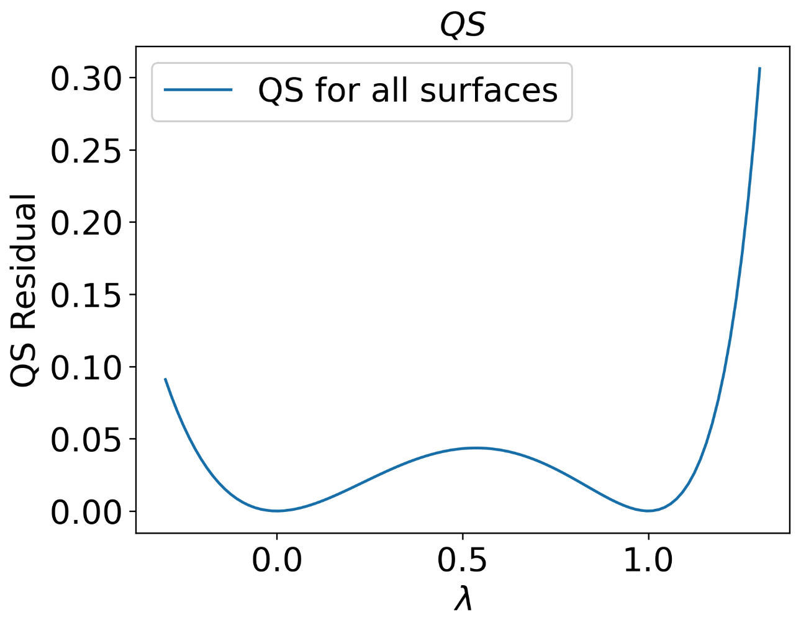
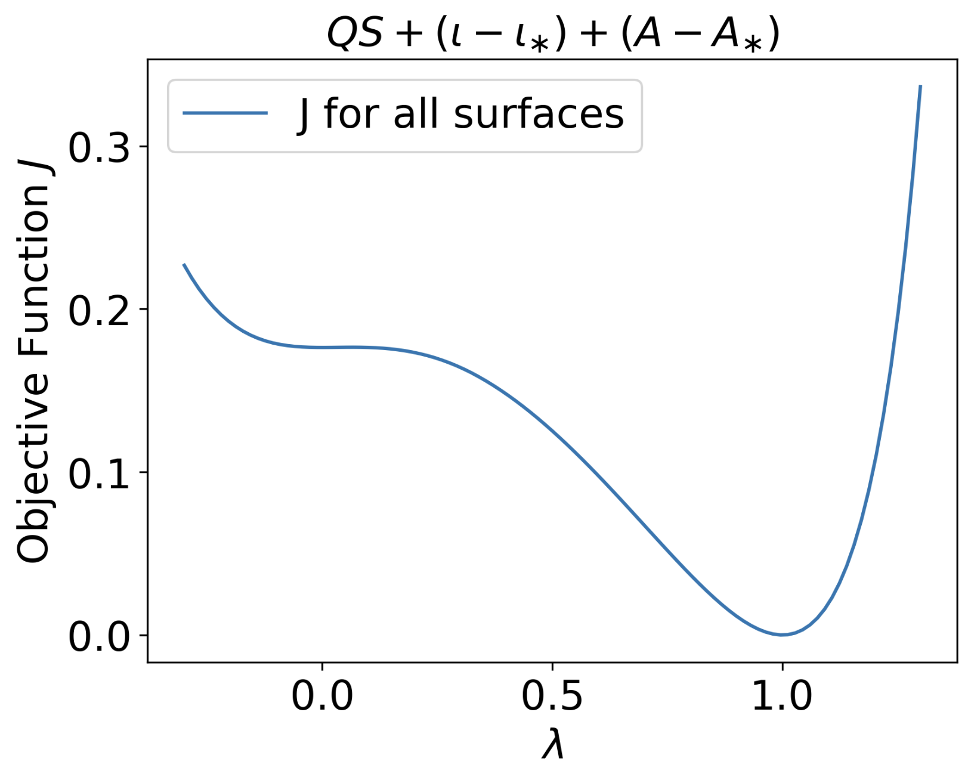
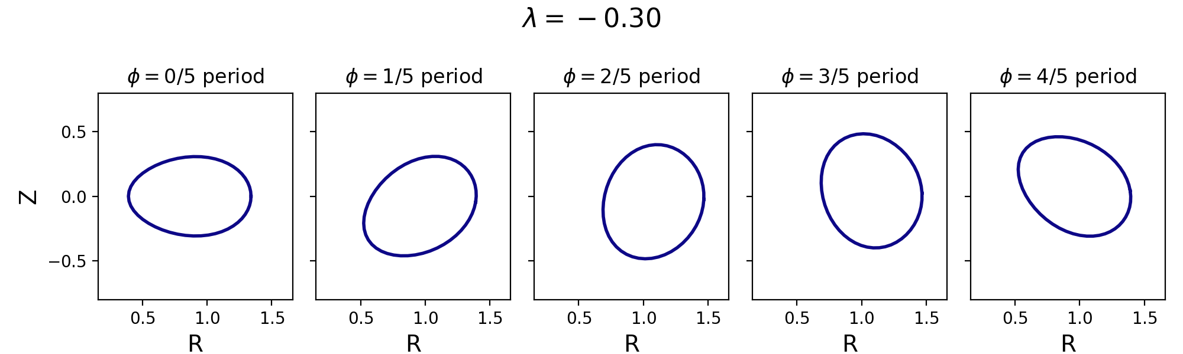

1D landscape
1D Interpolation between two configurations
$$x^{′}={(1−λ)x}_{1}+λx_{2}$$

Slide 7
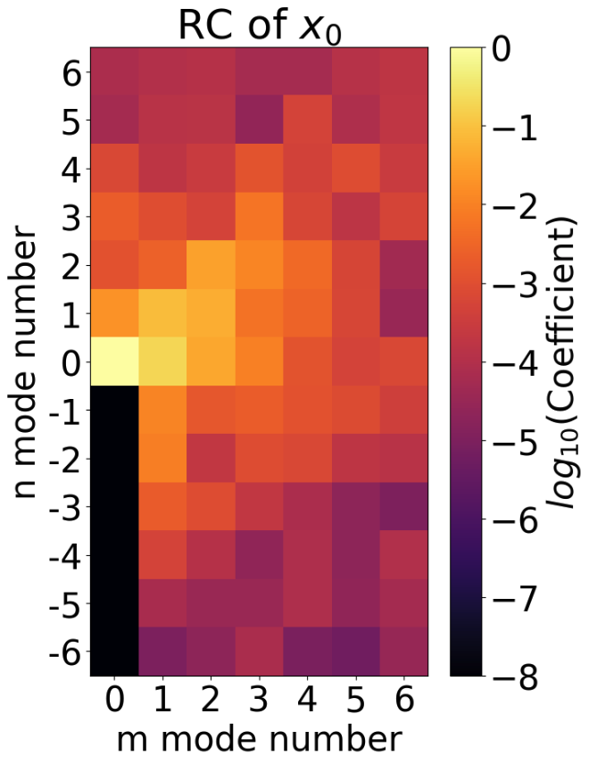
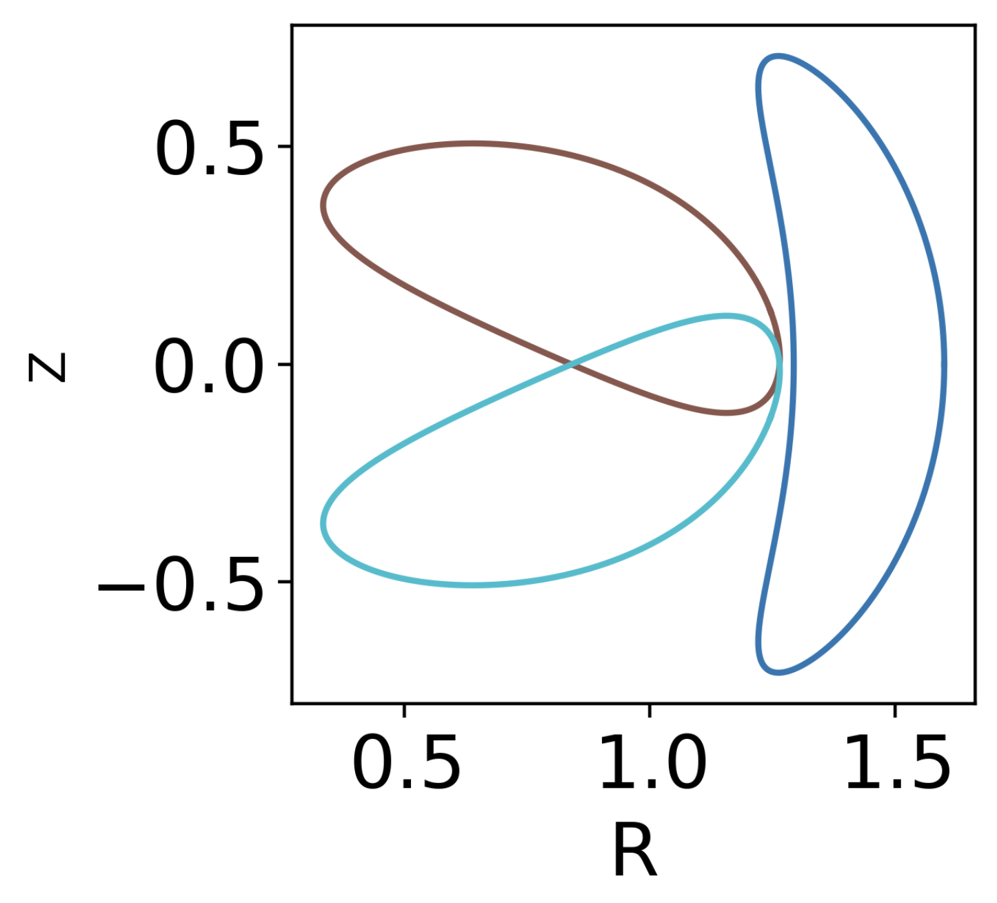
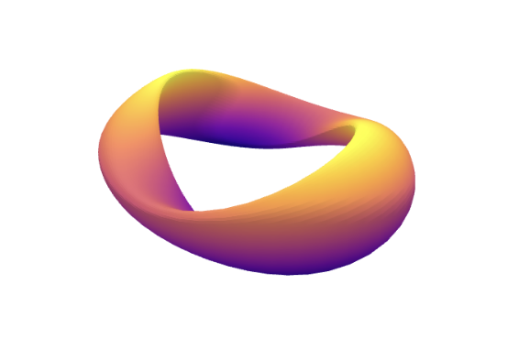

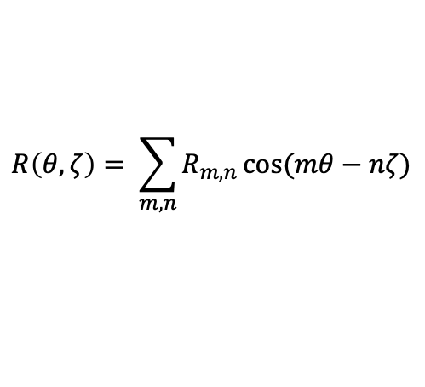

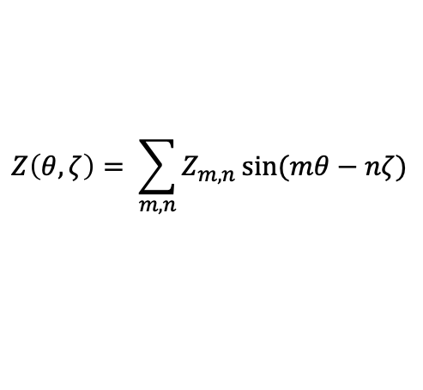
Method of Visualization
$$x^{′}=x_{0}$$
$$R\left(θ, ζ\right)= \sum_{m,n}{R_{m,n}}\cos{(mθ−nζ)}$$
$$Z\left(θ, ζ\right)= \sum_{m,n}{Z_{m,n}}\sin{(mθ−nζ)}$$
$$x_{0}$$
Array of Flattened Fourier Coefficients

Slide 8
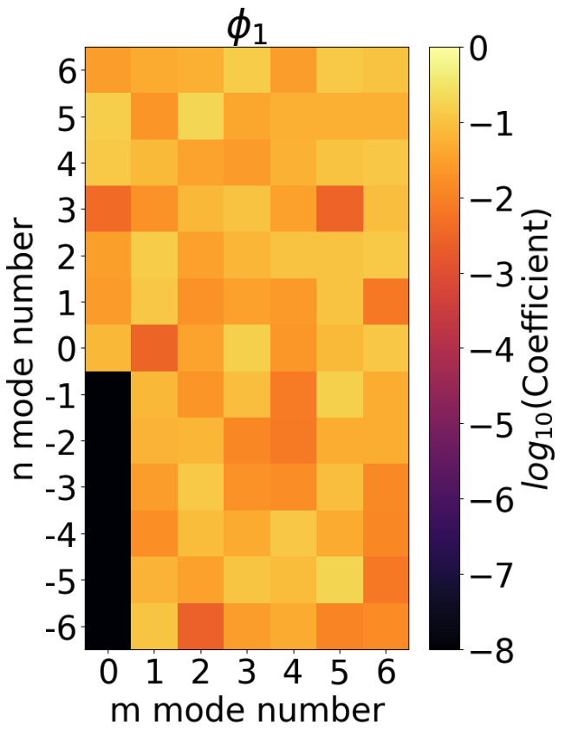
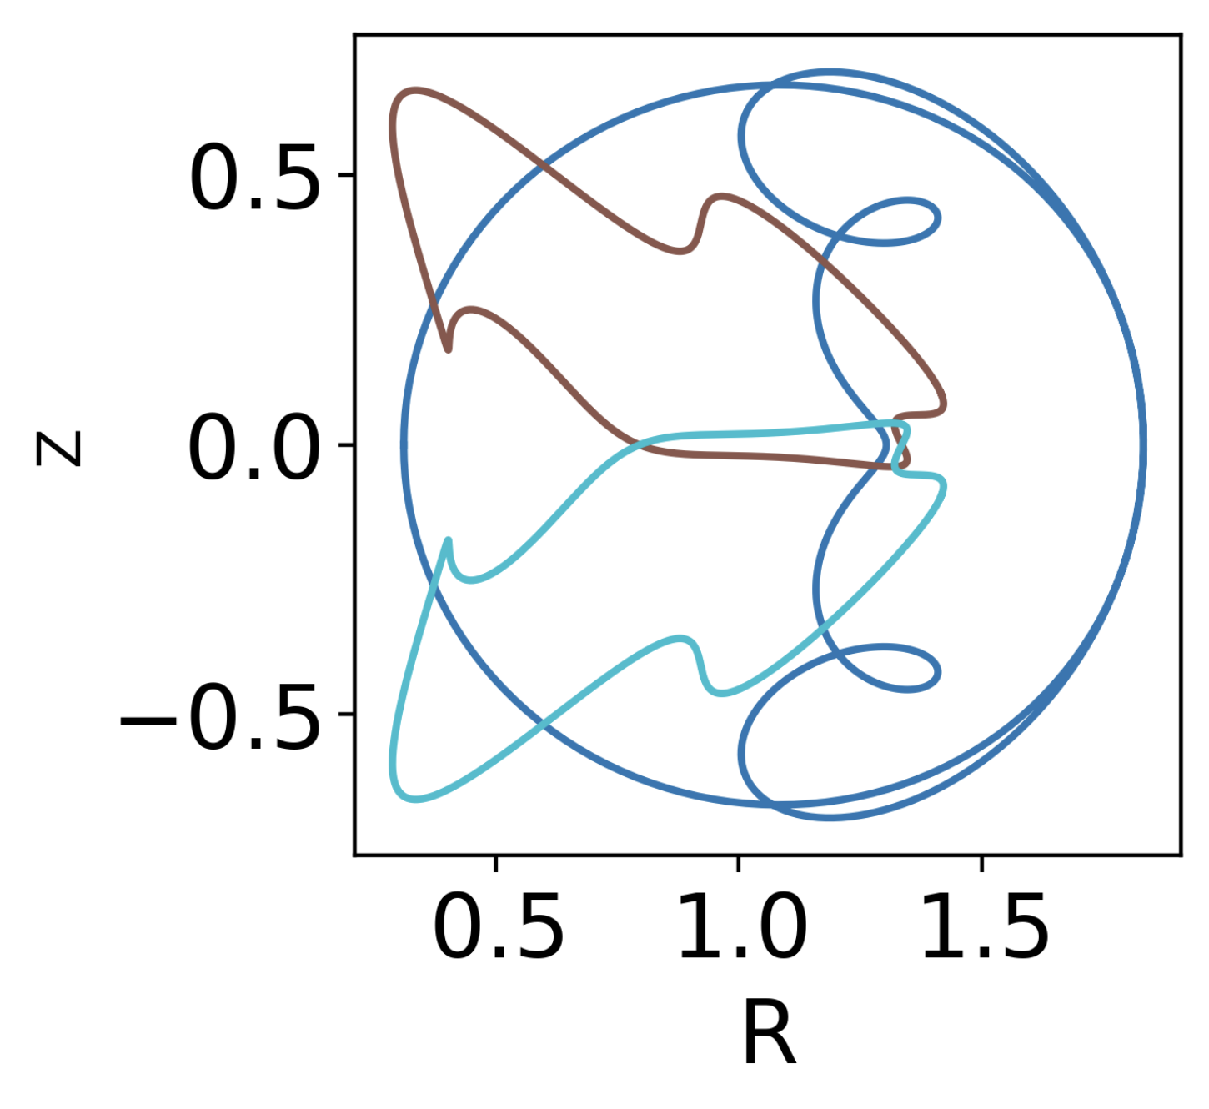
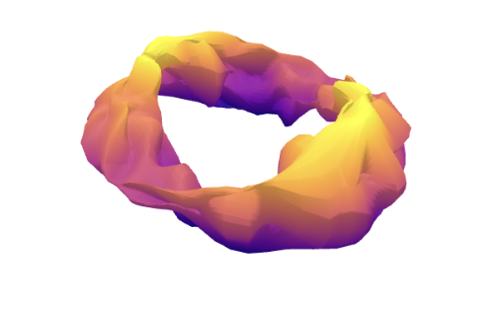


Method of Visualization
$$x^{′}=x_{0}+C1φ_{1}+C2φ_{2}$$
$$x_{0}$$
$$φ_{i}$$
Array of Flattened Fourier Coefficients
Random Sample from Gaussian Distribution

Slide 9
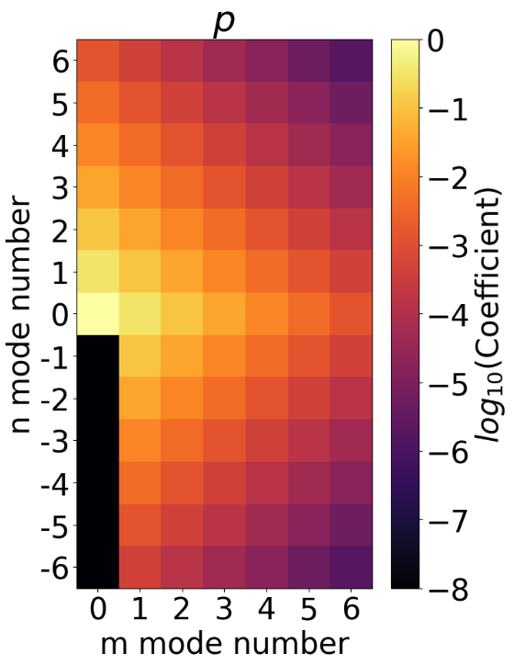
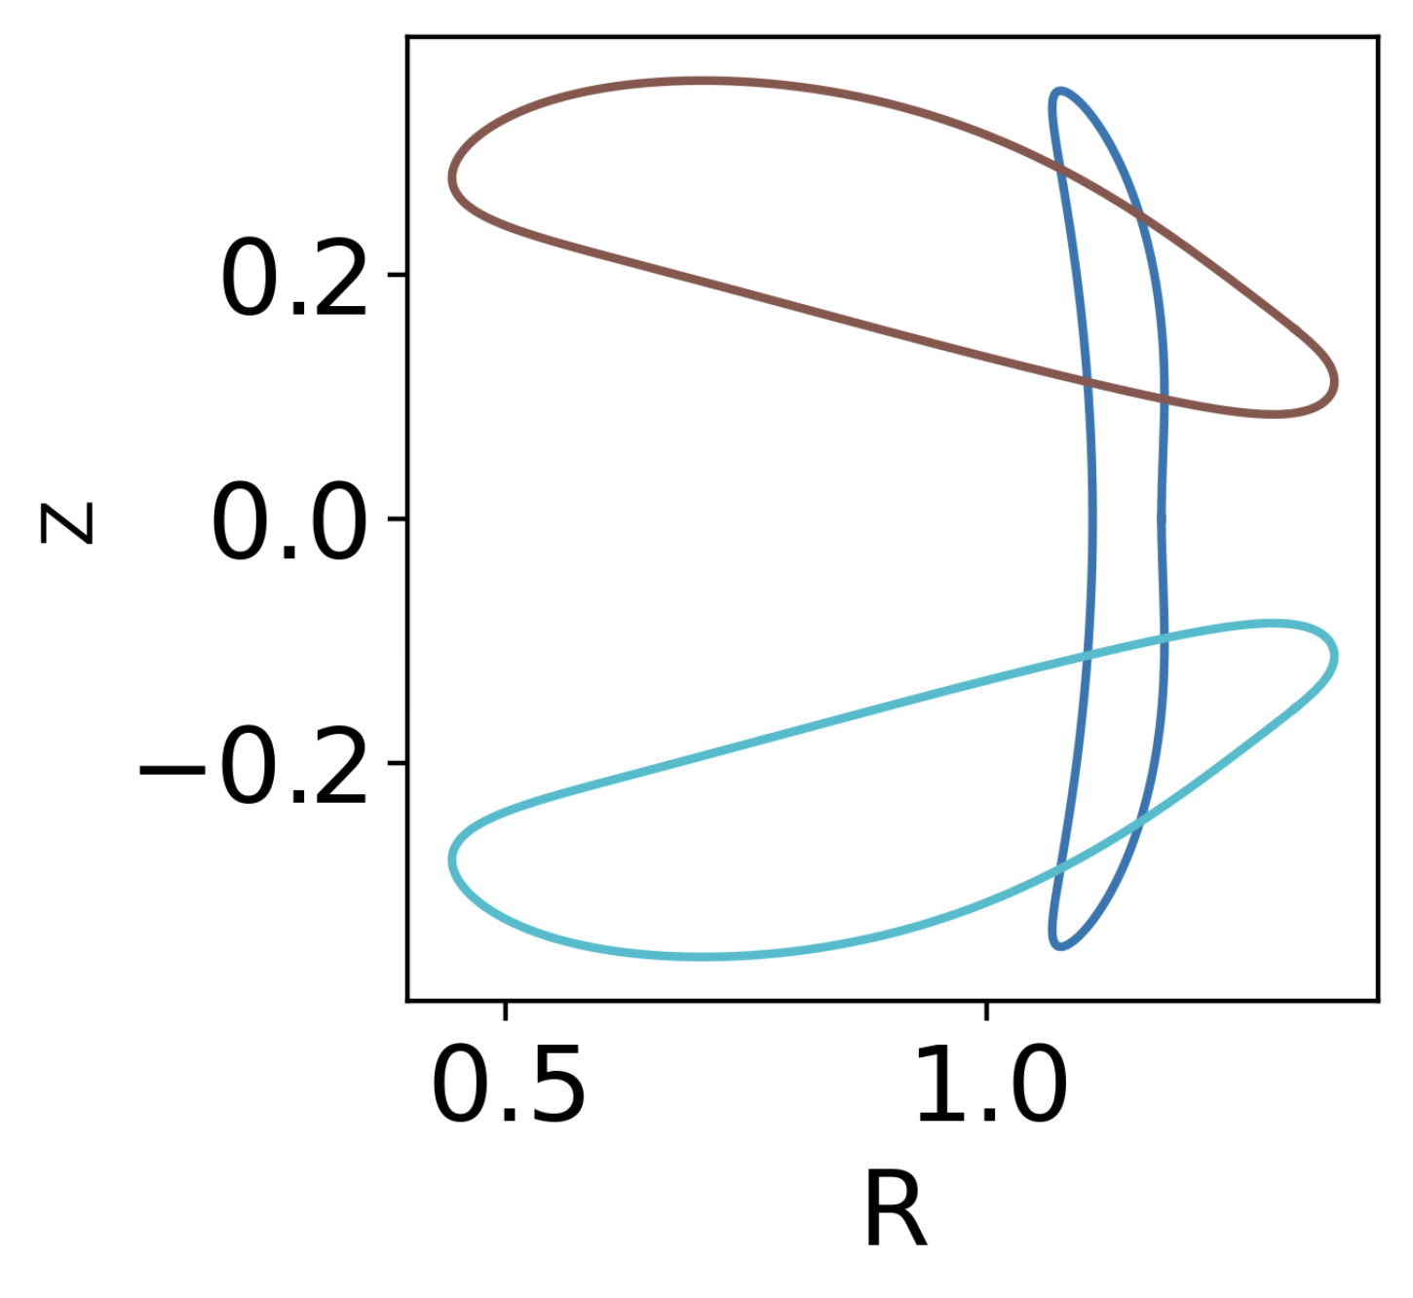
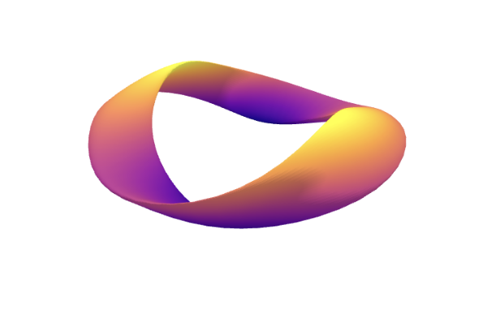



Method of Visualization
$$x^{′}=x_{0}+C1q_{1}+C2q_{2}$$
$$x_{0}$$
$$φ_{i}$$
$$p$$
Array of Flattened Fourier Coefficients
Random Sample from Gaussian Distribution
Exponential Weighting for Smooth Surfaces
$$q_{i}=p ⨀{ φ}_{i}$$

Slide 10
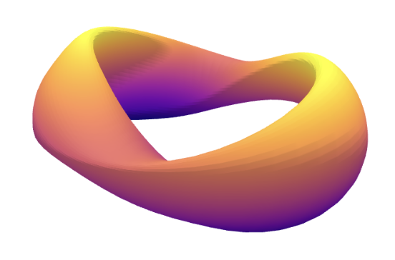
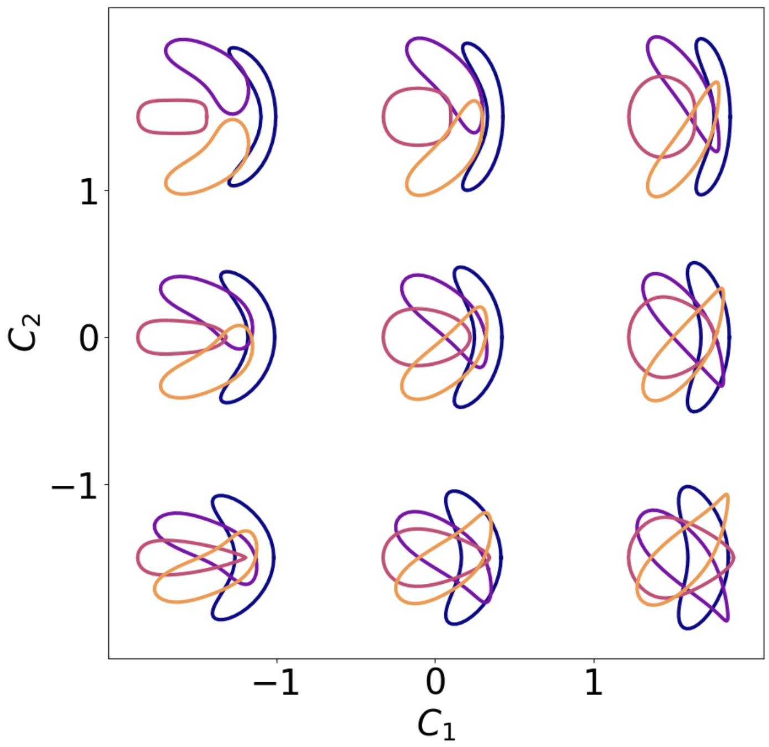

Comparing different proxies for neoclassical confinement
Two-term quasisymmetry
$ε_{eff}$: effective ripple
CFQS
$${Gamma}_{c}$$

Slide 11
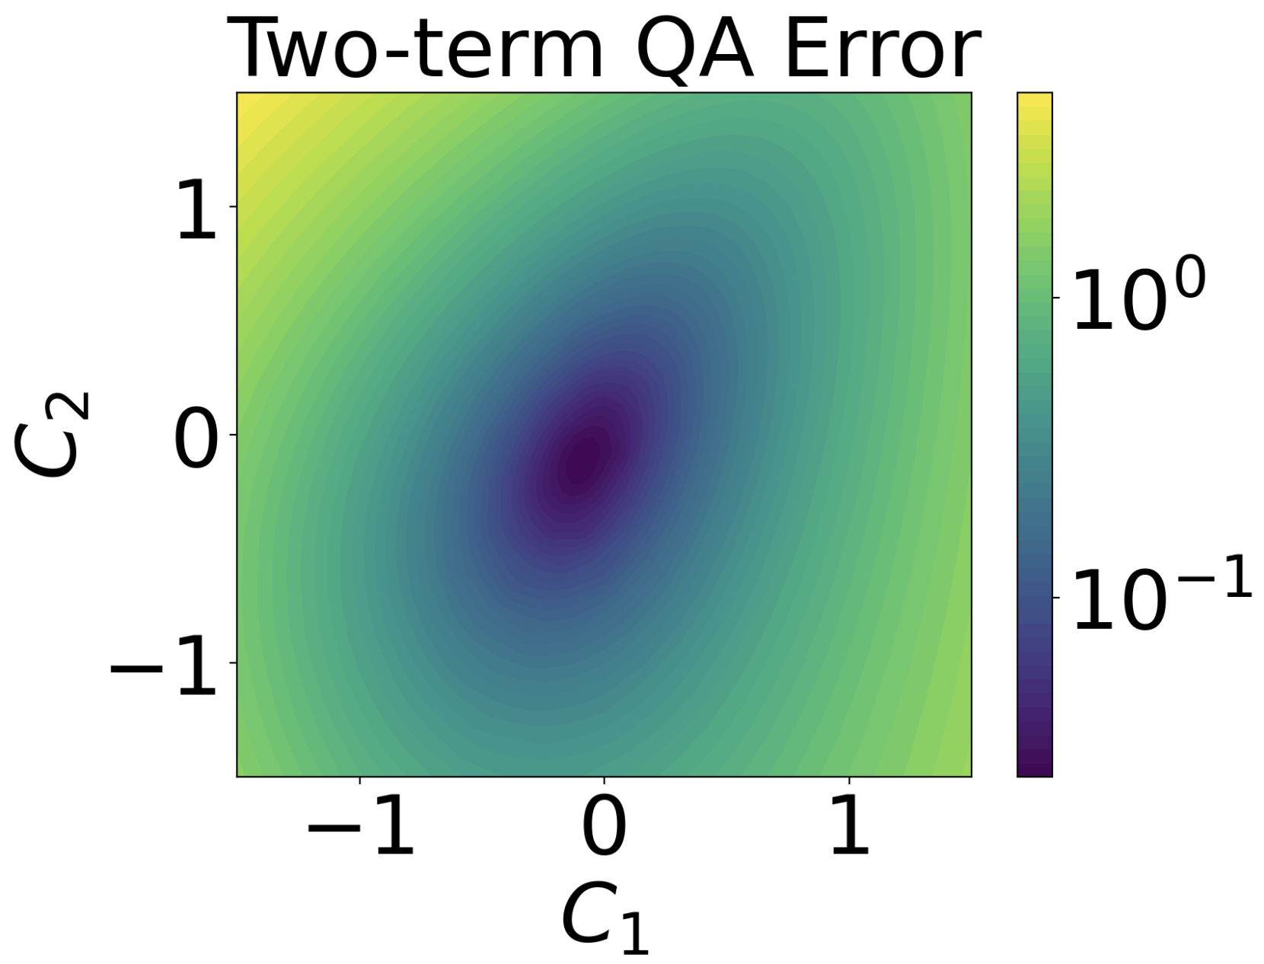
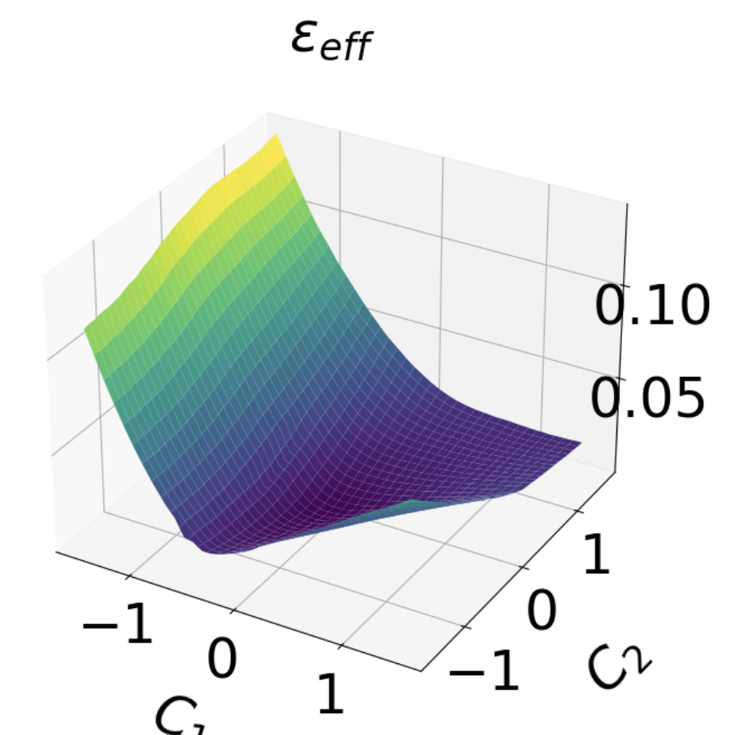
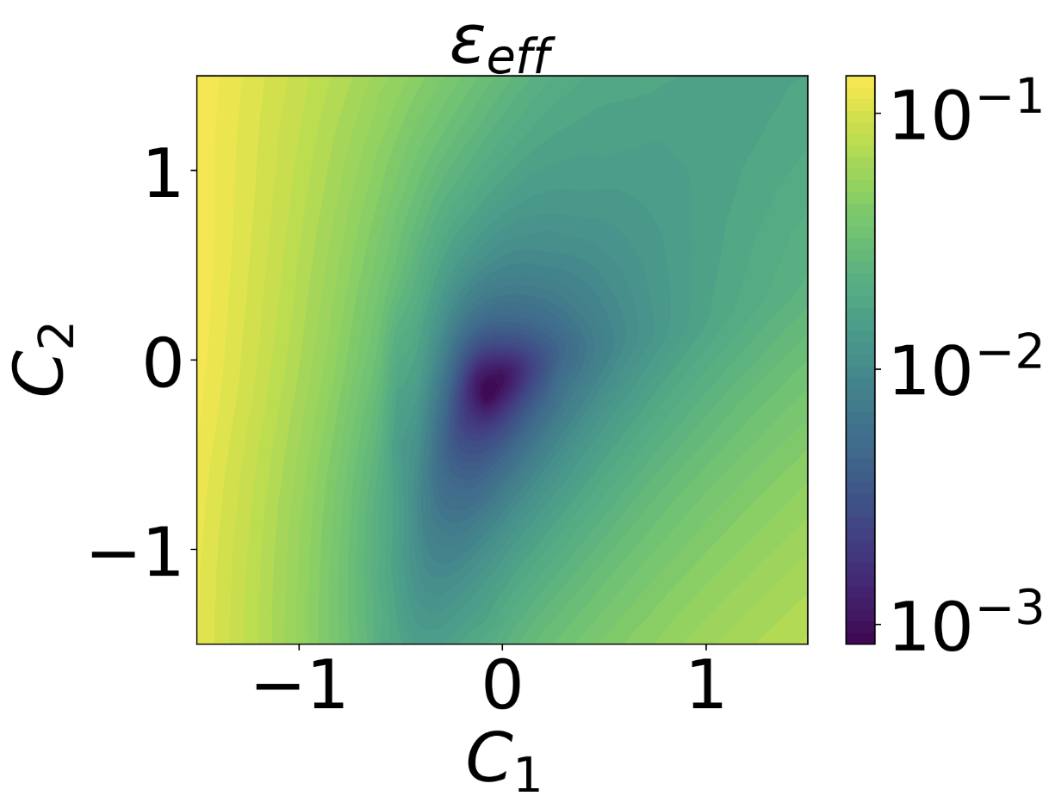
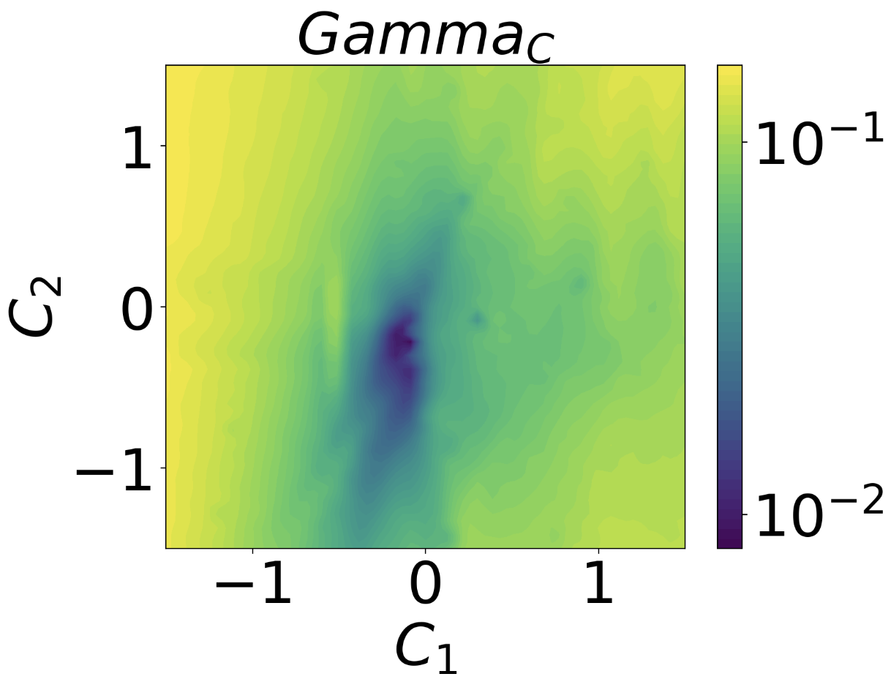
Comparing different proxies for neoclassical confinement
CFQS

Slide 12
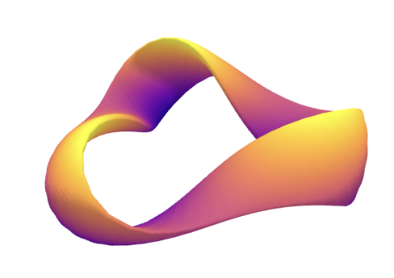
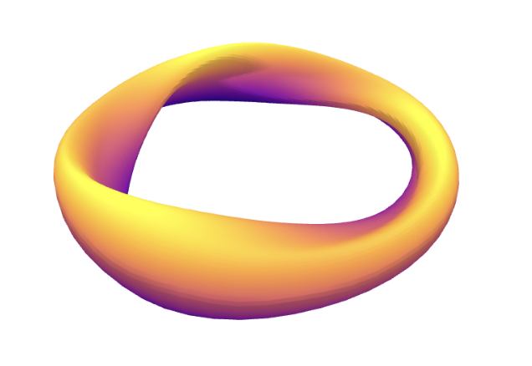
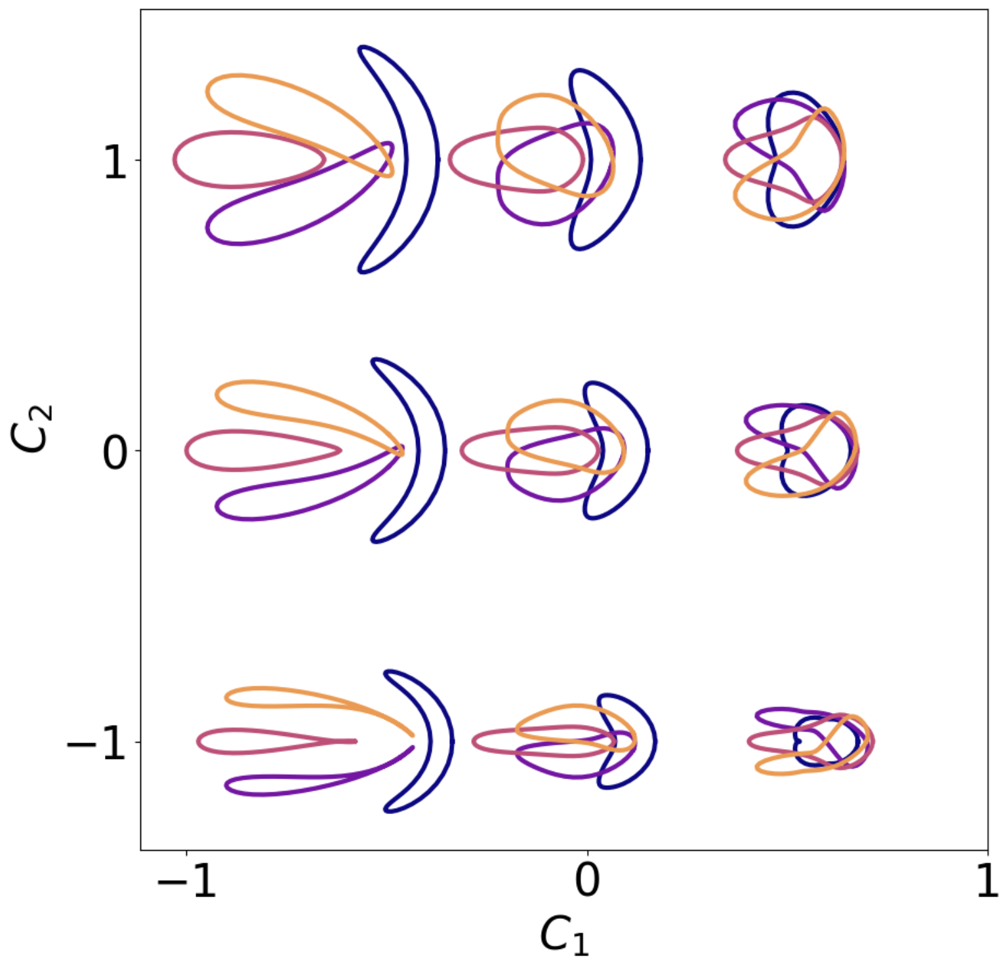

1D interpolation + 1D random direction
$$x^{′}=x_{1}+C1{(x_{2}−x}_{1})+C2q_{2}$$
Two-term quasisymmetry
$ε_{eff}$: effective ripple
$${Gamma}_{c}$$

Slide 13
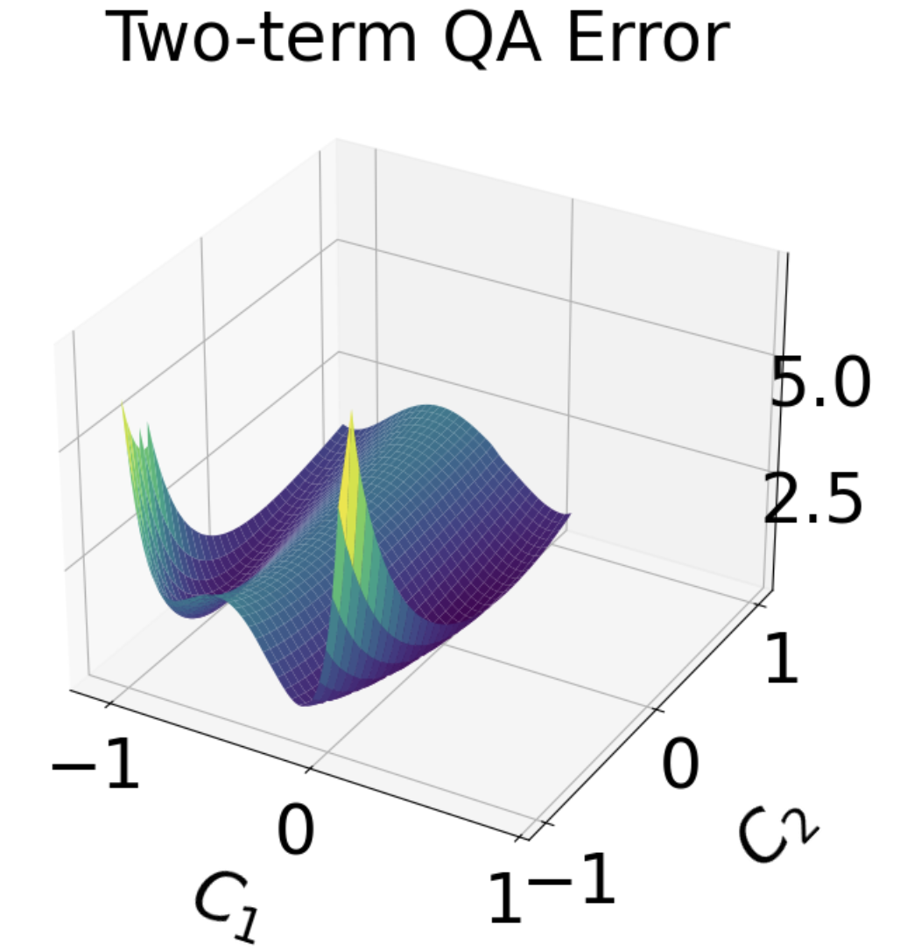
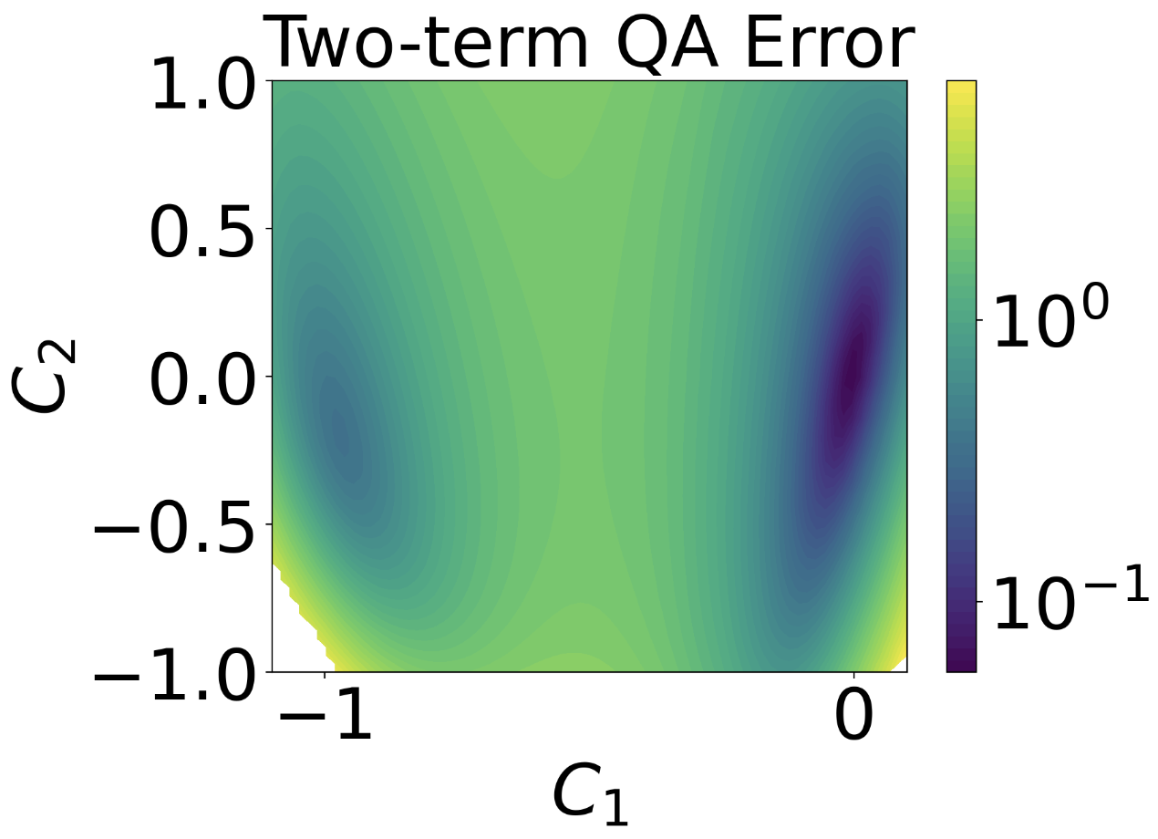
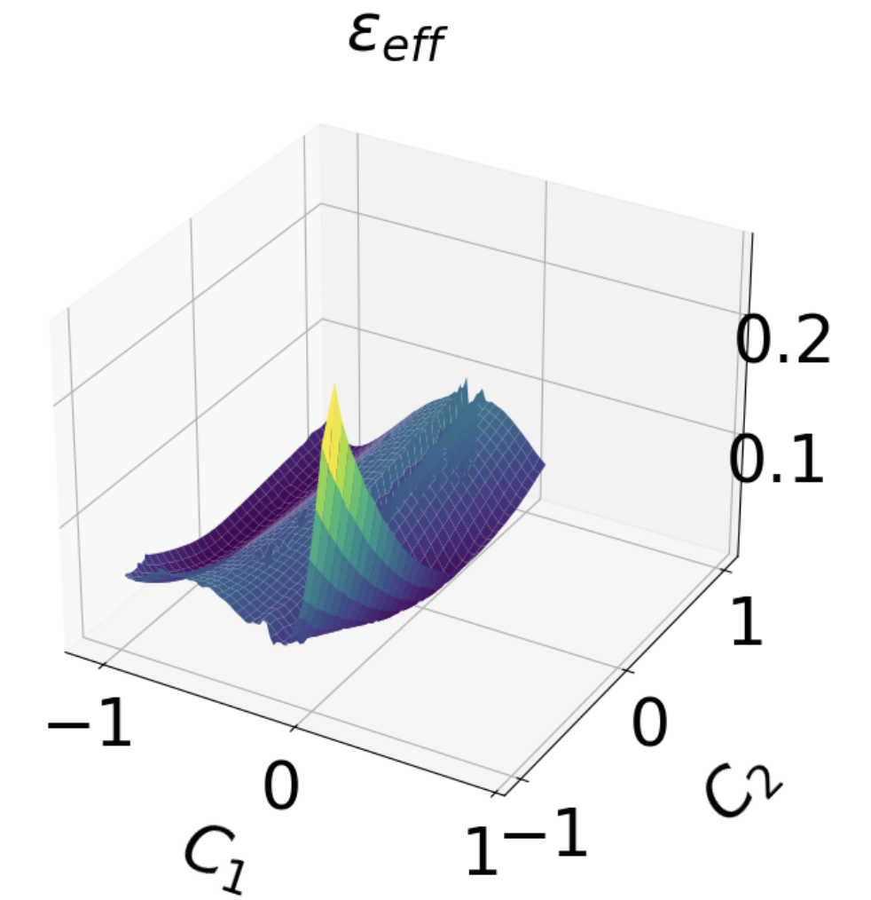
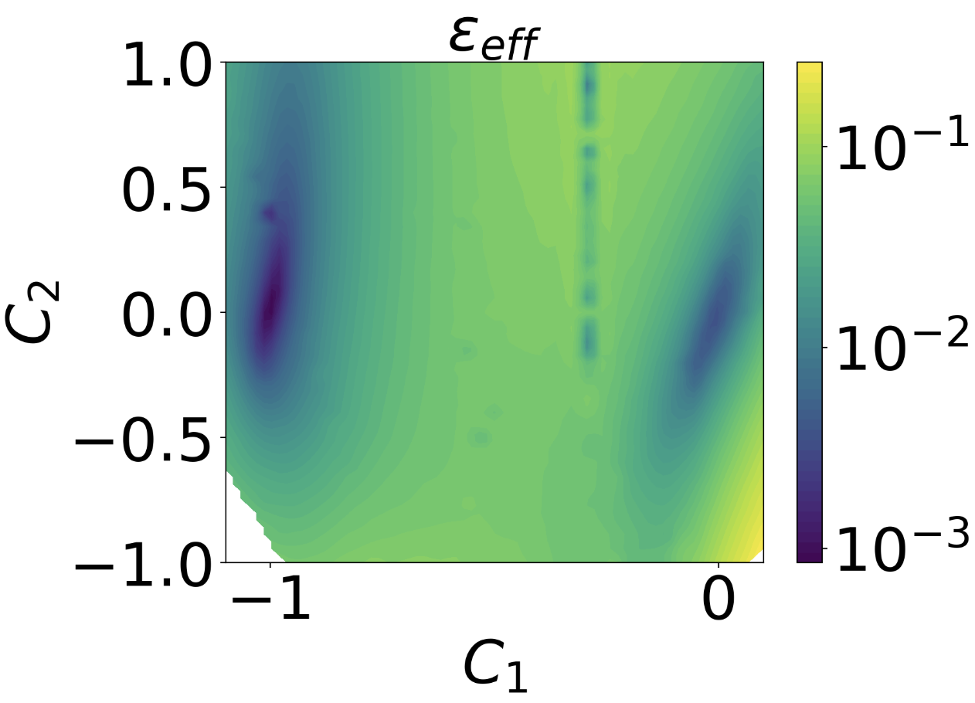
1D interpolation + 1D random direction

Slide 14
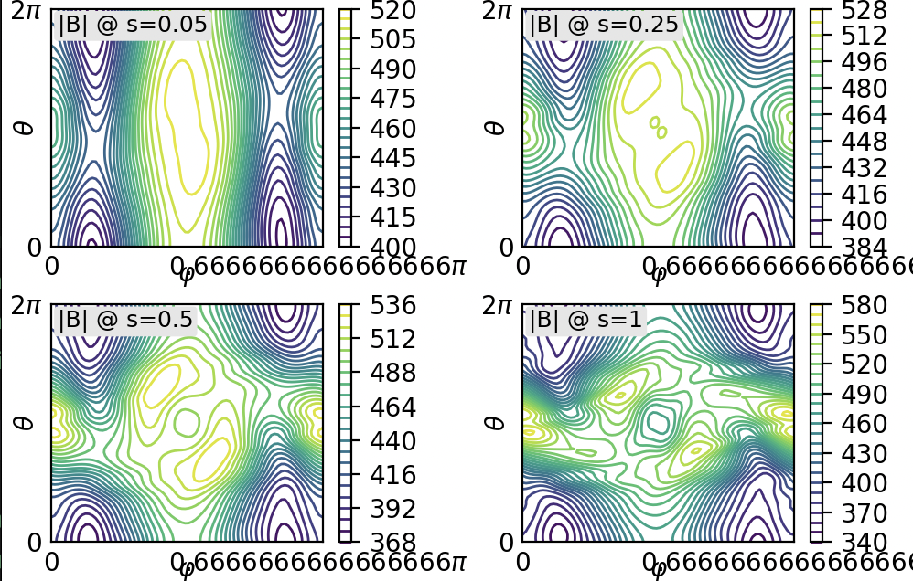
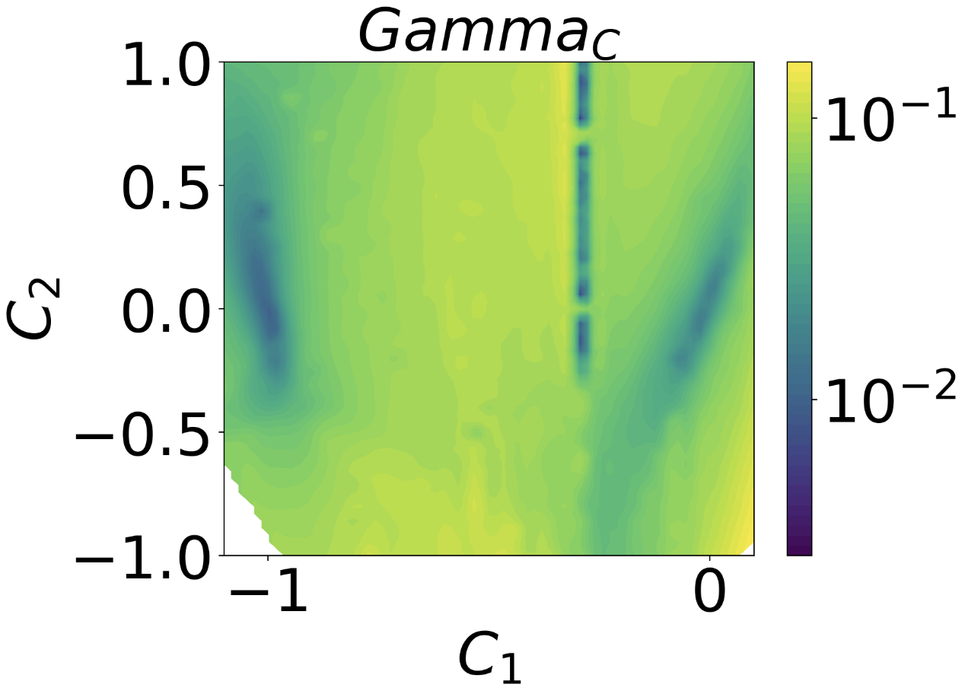
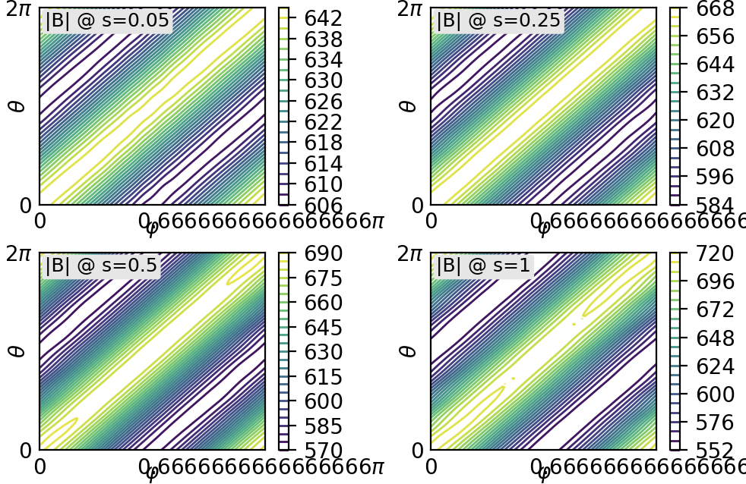
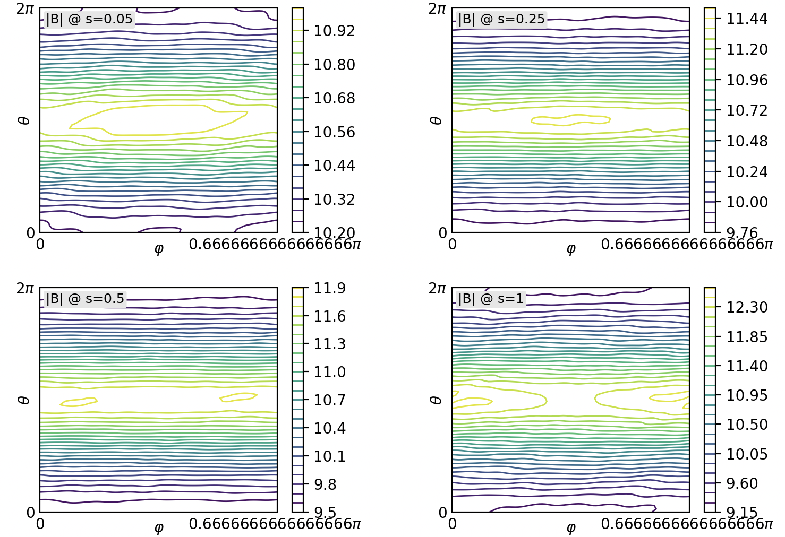
1D interpolation + 1D random direction

Slide 15
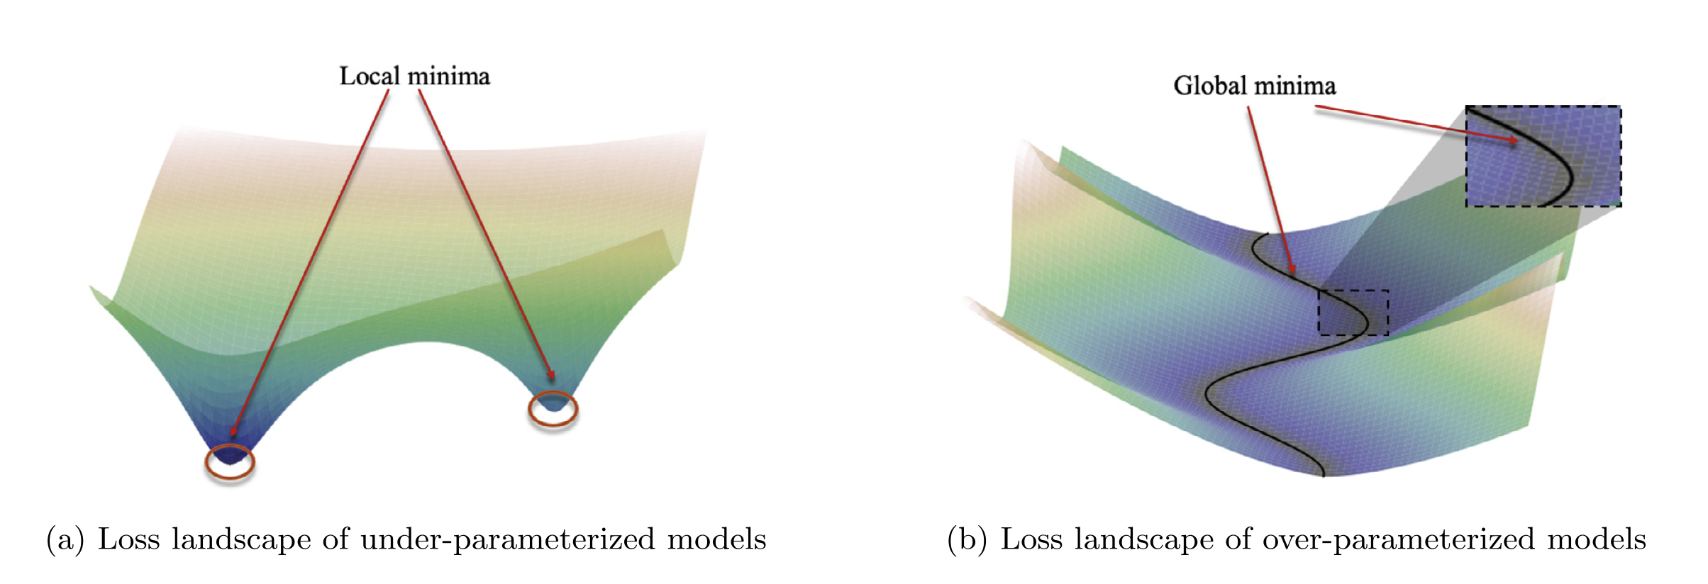
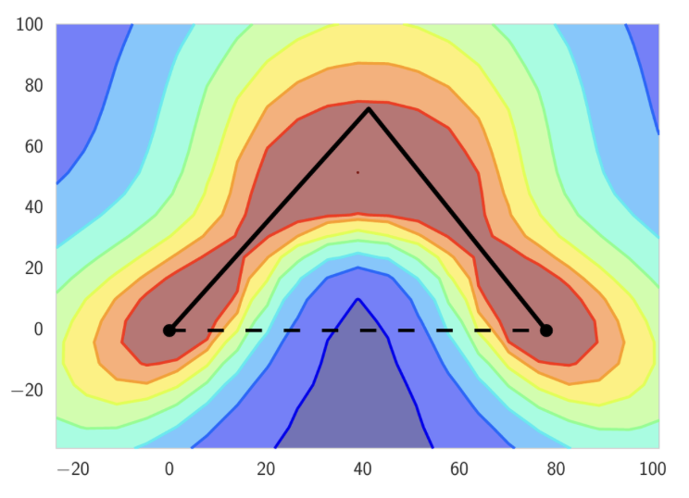
Ongoing work: Closing the gap
Liu, C., Zhu, L. and Belkin, M., 2022 Applied and Computational Harmonic Analysis.
Garipov, Timur, et al. 2018. NeurIPS
?

Slide 16

Closing thoughts
The new visualization methods can be used to explore objective functions in stellarator optimization
There seems to be a clear favorite for optimizer for certain objective functions due to its smoothness.
We can further build qualitative intuition about the stellarator objective function landscape.

Slide 17
Thank you
byoungj@umd.edu

