Slide 1

University of Maryland update
People
Research highlights
Questions for the Hidden Symmetries group & collaboration ideas
Hidden Symmetries team meeting, March 19, 2024, Princeton

Slide 2
People

Slide 3
University of Maryland stellarator personnel
(both Simons- & DOE-funded)
Departures
Patrick Kim, Rahul Gaur, Stefan Buller to Princeton.
Alan Kaptanoglu to NYU.
Arrivals
Todd Elder (split 50/50 between Maryland & IPP-Greifswald)
Rory Conlin

Slide 4
University of Maryland stellarator personnel
(both Simons- & DOE-funded)
Tom Antonsen (professor): adjoint methods, coil self-fields/forces.
Bill Dorland (professor): GX gyrokinetic code.
Todd Elder (postdoc): divertors.
John Kappel (PhD student): limits on coil-to-plasma distance.
Byoungchan Jang (PhD student): physics-informed neural networks, loss landscapes.
Siena Hurwitz (PhD student): calculating & optimizing coil I x B forces & max |B| in coil.
Alex Wiedman (undergraduate): coils for QH, near-axis expansion.
Mustafa Khan (undergraduate): finite element modeling for coil forces.
Matt Landreman (research scientist): supervising.

Slide 5
Research highlights

Slide 6
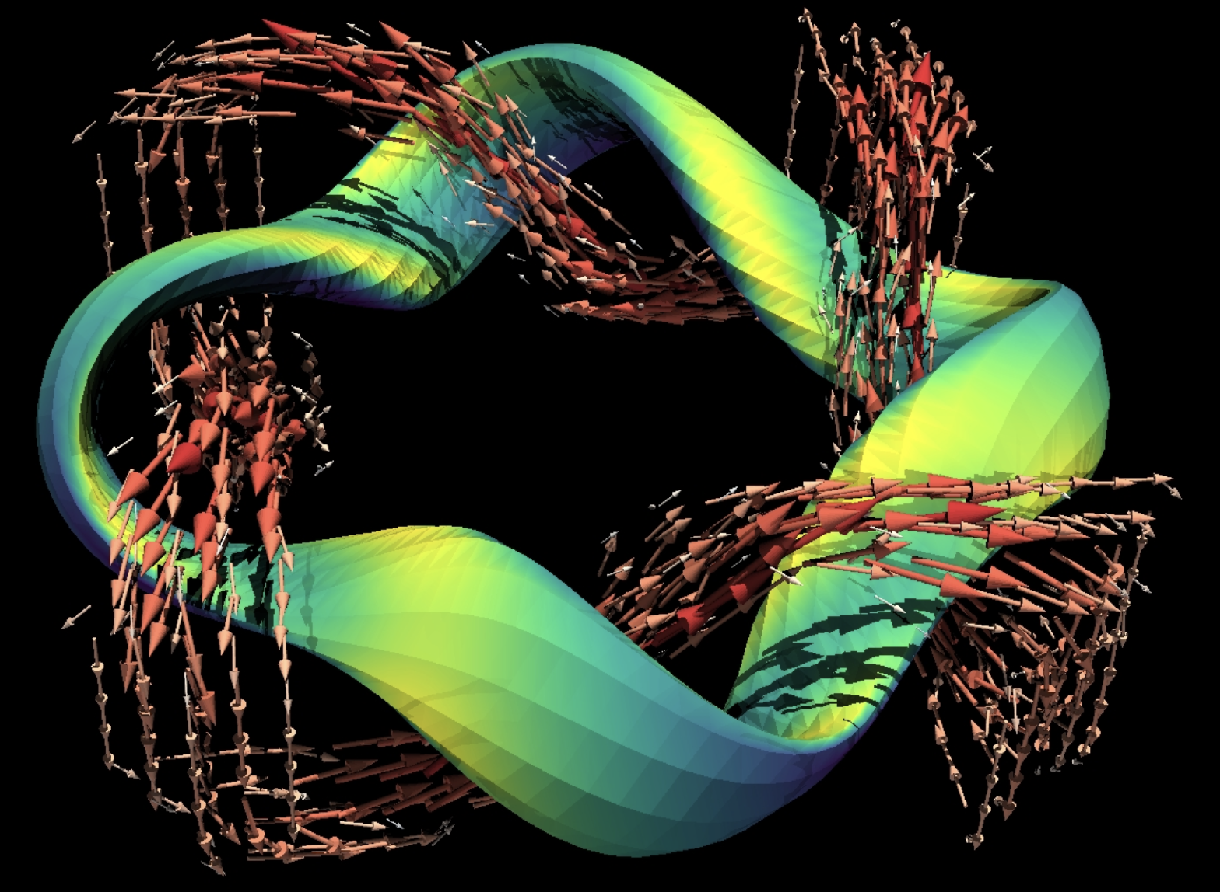
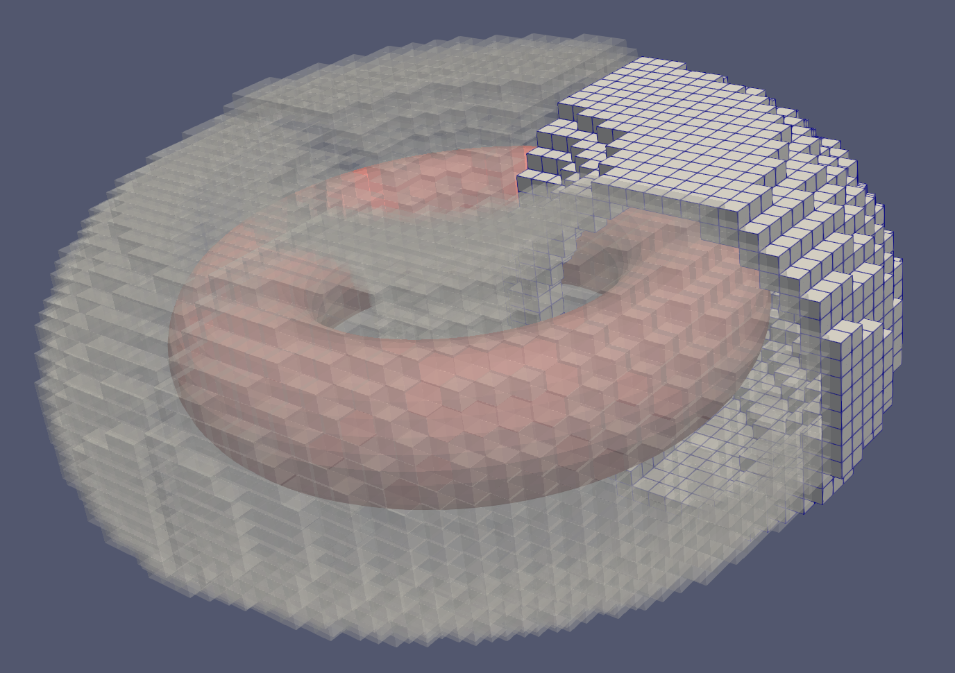
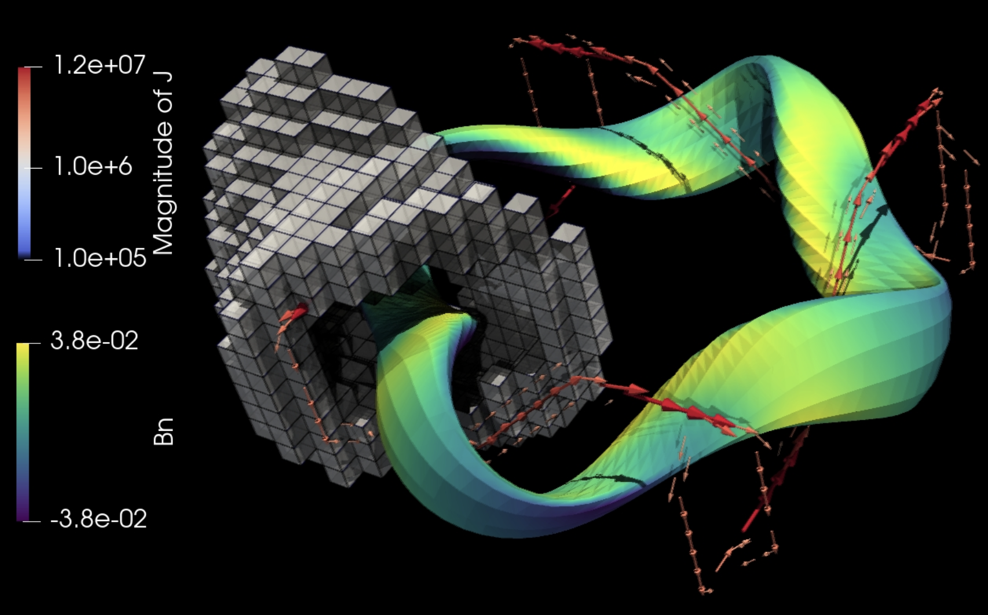
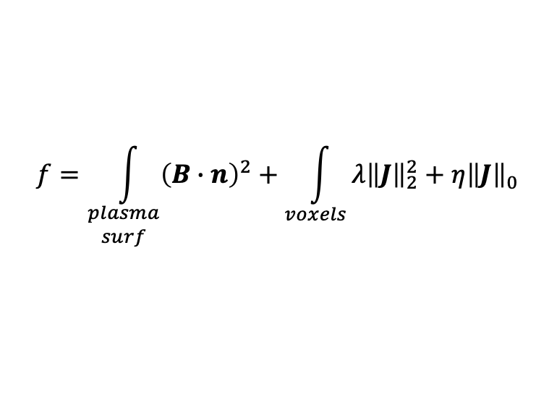
Coil topology optimization: “current voxels”
Alan Kaptanoglu, Gabriel Langlois - Computer Methods in Applied Mechanics and Engineering 418A, 115504 (2023)
Minimize objective:
$$f=\int_{\begin{aligned}plasma \\ surf\end{aligned}}{{\left(B∙n\right)}^{2}}+\int_{voxels}{λ{\left\|J\right\|}_{2}^{2}}+η{\left\|J\right\|}_{0}$$
Match target B
Regularization

Slide 7
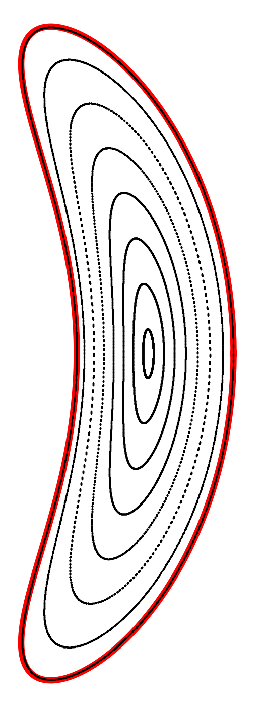
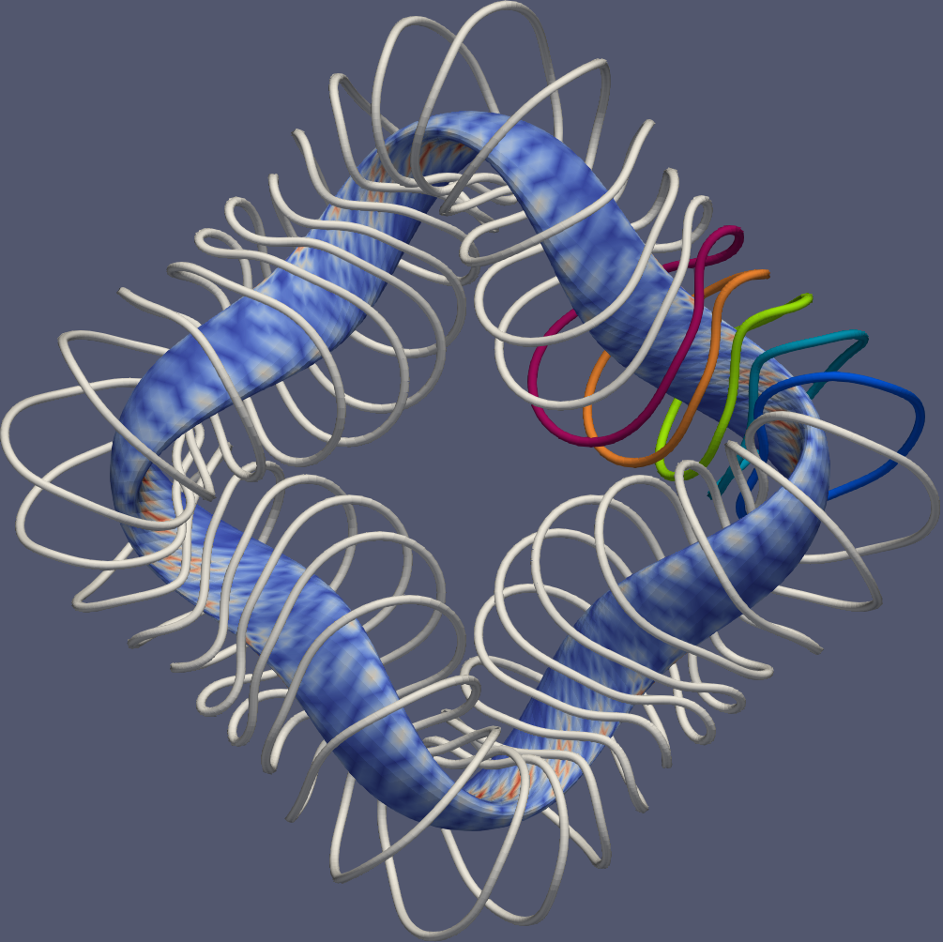
Precise quasi-helical symmetry can be produced with coils
Alex Wiedman & Stefan Buller, arXiv:2311.16386
|B| on boundary in Boozer coordinates,
with coils
[T]
θ/(2π)

Slide 8
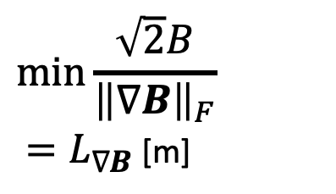
The maximum coil-to-plasma distance is the minimum scale length in B
John Kappel, Plasma Phys. Controlled Fusion 66, 025018 (2023)
Jorge nfp1 QI
B scale length
Goodman nfp1 QI
Precise QAs
$$\min_{}{\frac{\sqrt{2}B}{{\left\|∇B\right\|}_{F}}}$$
${=L}_{∇B}$ [m]
HSX with ripple
HSX without ripple
W7-X with ripple
ITER
NCSX
ROSE nfp5 QH
W7-X
CTH
Wistell-B
Ku QH
Coil-to-plasma distance from REGCOIL [m]

Slide 9
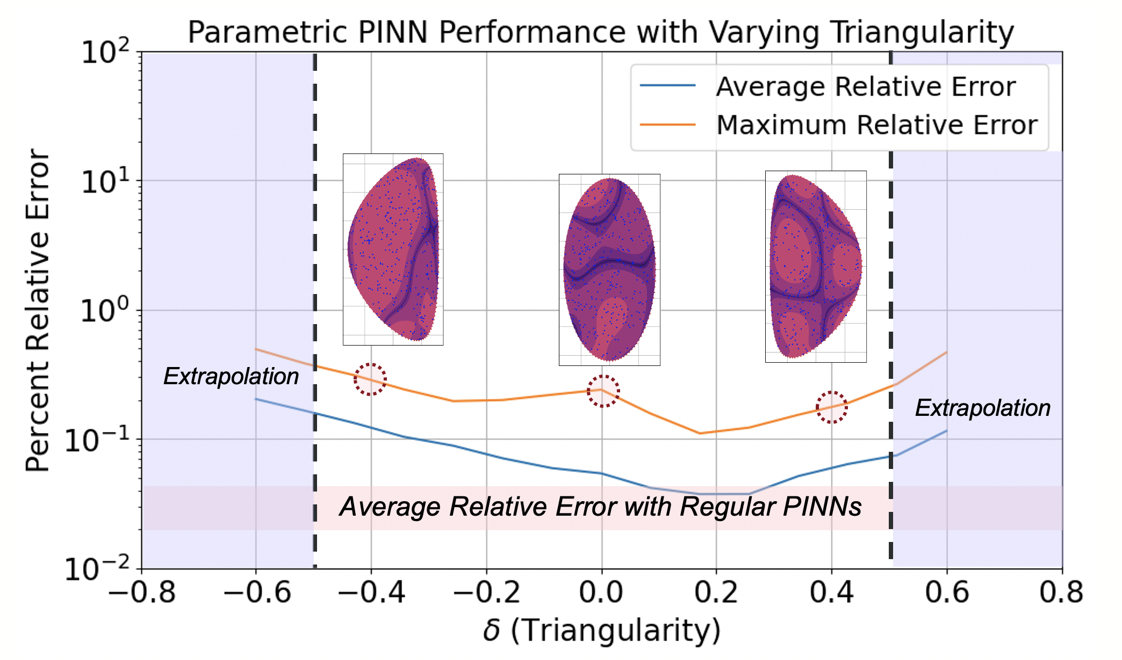
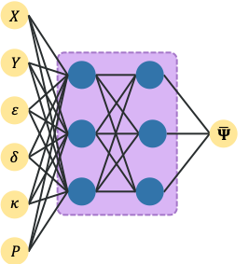
Physics-informed neural networks for MHD equilibrium
Byoungchan Jang, Alan Kaptanoglu, et al, arXiv:2311.13491 (2023), to appear in Physics of Plasmas.
R
Z

Slide 10

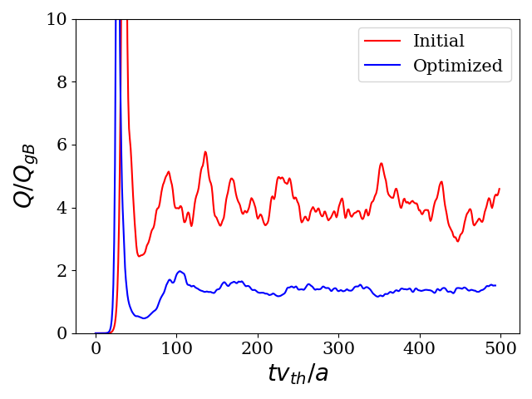
Gyrokinetic modeling & optimization for stellarators with GX, Trinity3D
See Noah Mandell talk on Wednesday – with Bill Dorland, Patrick Kim, et al
Mandell et al, arXiv:2209.06731,
Kim et al, arXiv:2310.18842,
To appear in J. Plasma Physics

Slide 11
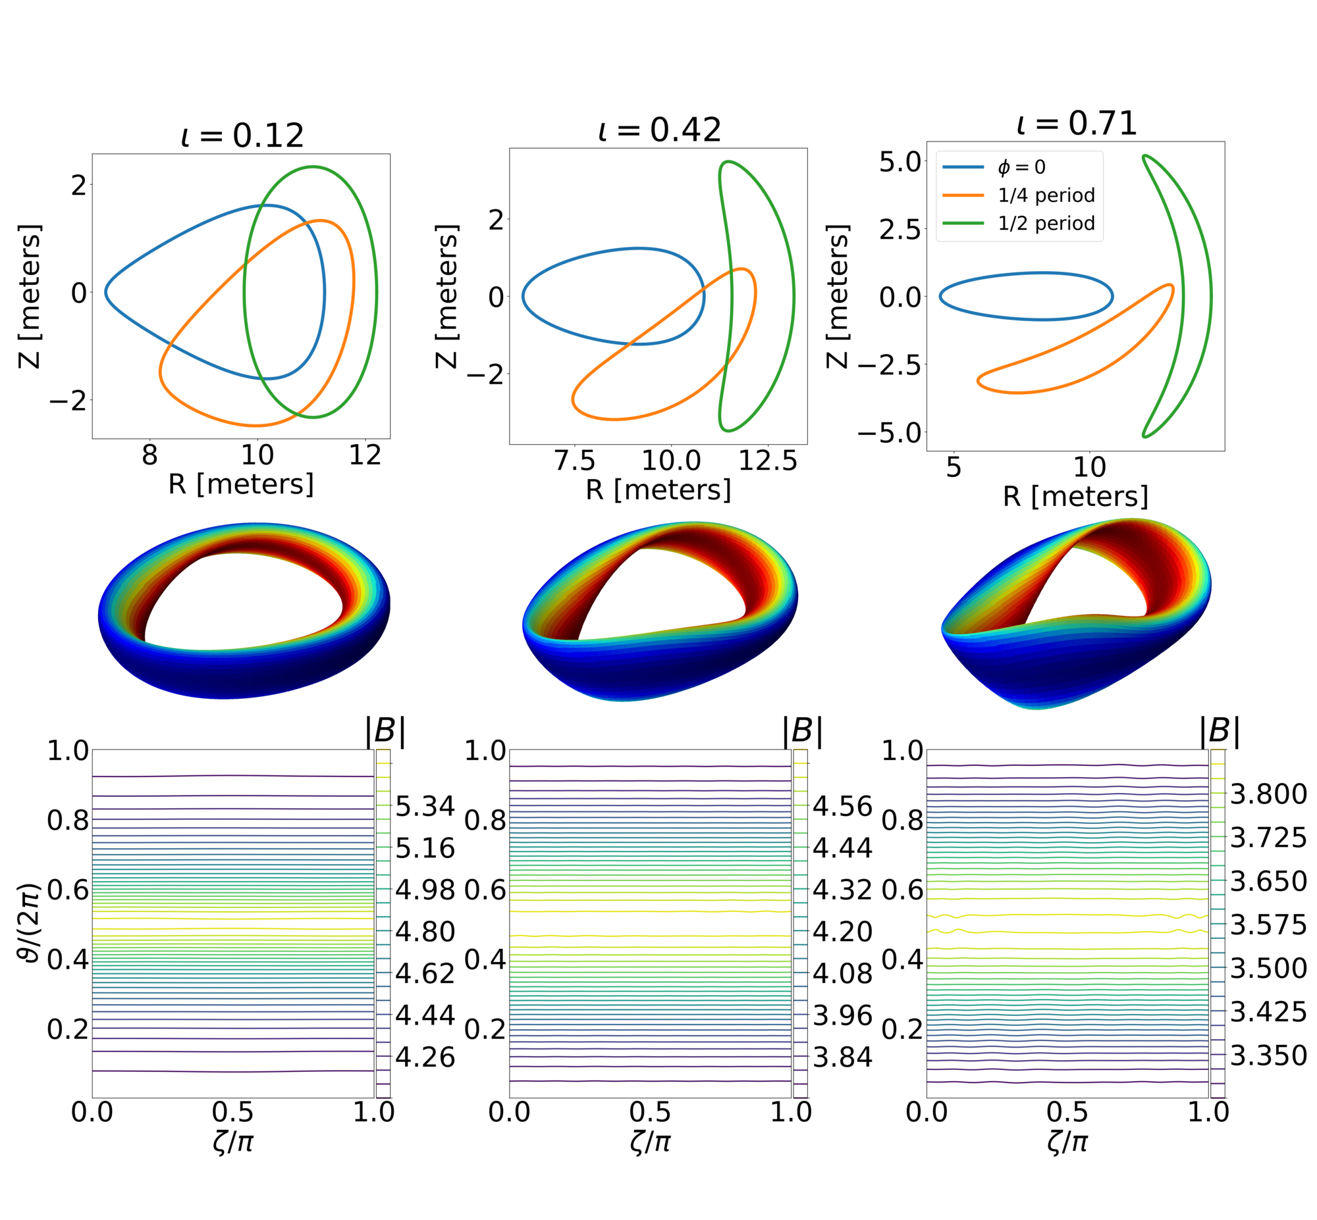
Trends with iota and shear in quasi-axisymmetric stellarators
Stefan Buller et al, arXiv:2401.09021 (2024)
ITG growth rate dips at rational ι unless you include multiple field lines per surface
# of field lines:
[T]
[T]
[T]

Slide 12
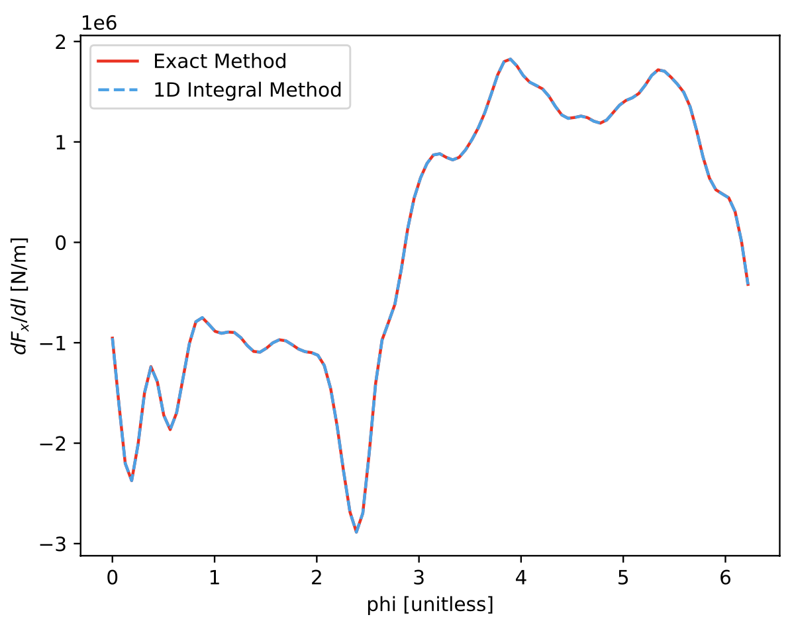
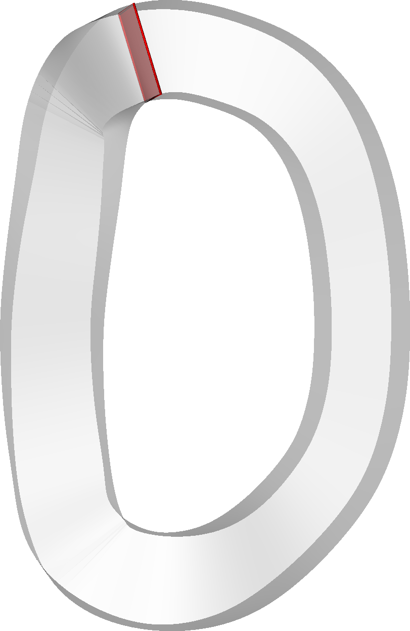
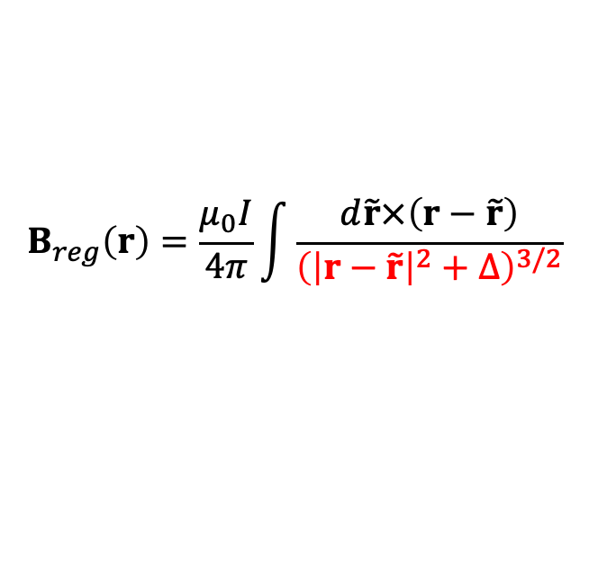
Efficient & accurate calculation of coil self-fields and self-forces
Siena Hurwitz, Tom Antonsen, arXiv:2310.09313, arXiv:2310.12087 (2023)
$$B_{reg}\left(r\right)=\frac{μ_{0}I}{4π}\int{\frac{d\tilde{r}×\left(r−\tilde{r}\right)}{{\left({\left|r−\tilde{r}\right|}^{2}+∆\right)}^{3/2}}}$$
Exact method (high fidelity)
1d integral method
(reduced model)
Self-force along HSX coil 1
|B| [Tesla]
|B| [Tesla]
HSX coil 1

Slide 13
Questions for the Hidden Symmetries group

Slide 14
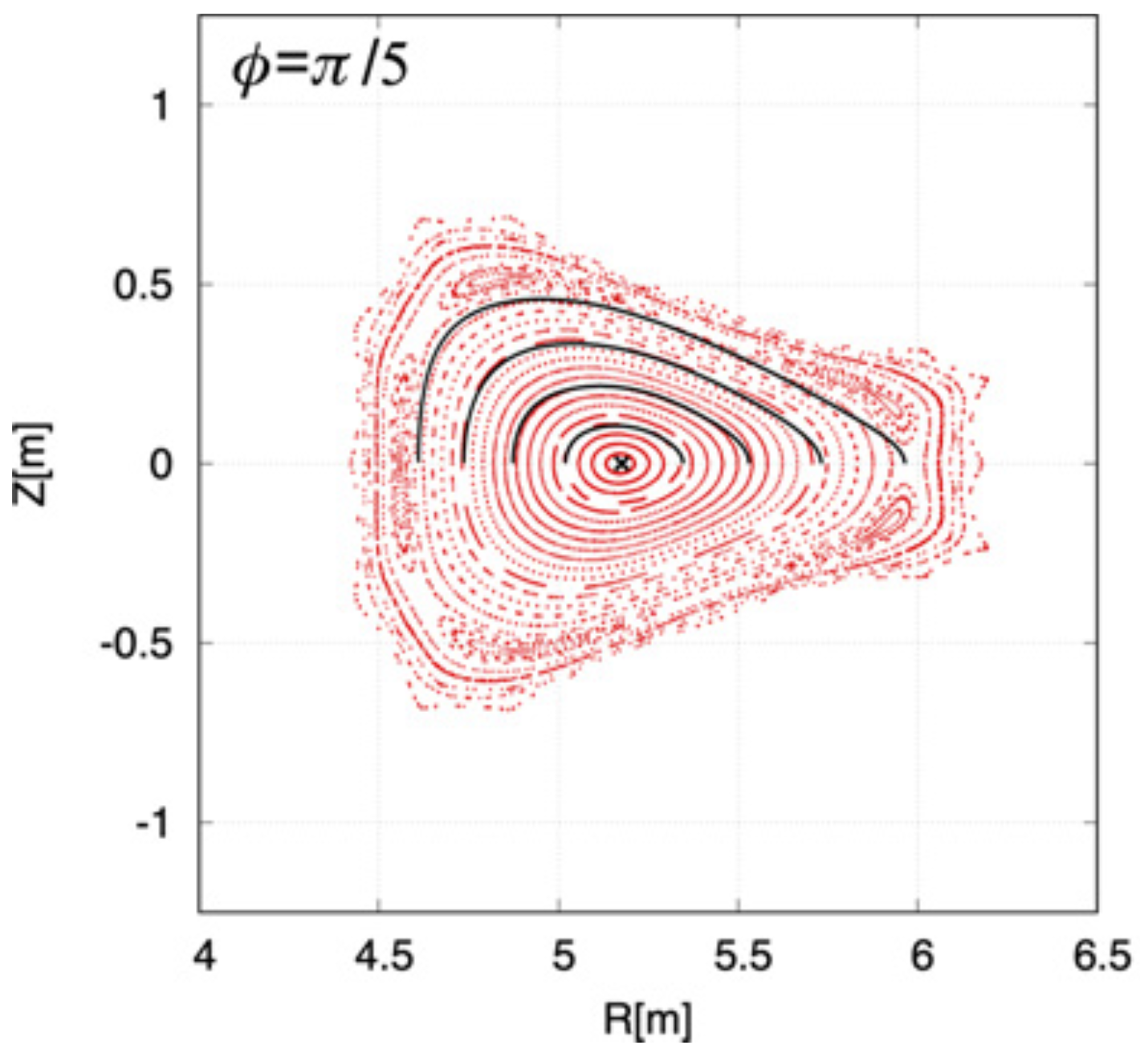
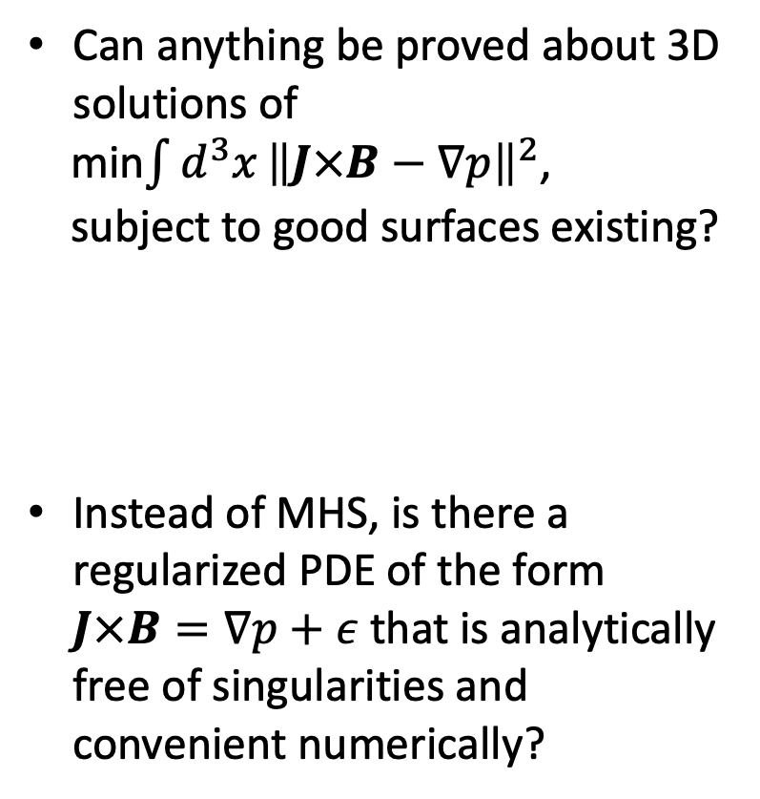
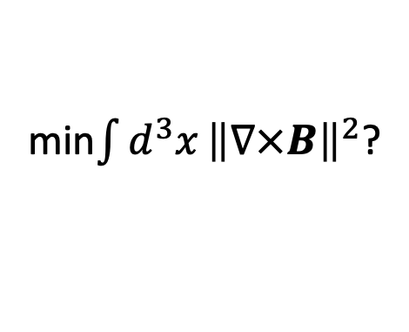
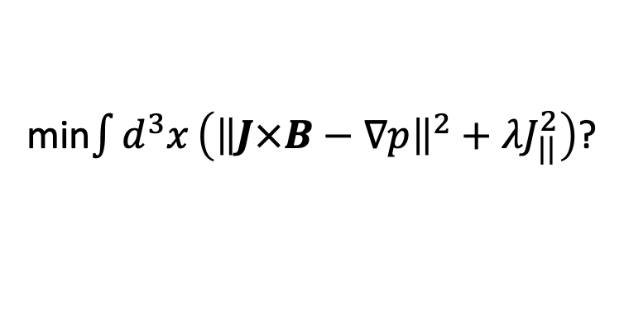
Research questions for the Hidden Symmetries group
PDEs & MHD
Can anything be proved about 3D solutions of
min$\int{d^{3}x}{\left\|J×B−∇p\right\|}^{2}$,
subject to good surfaces existing?
Instead of MHS, is there a regularized PDE of the form $J×B=∇p+ε$ that is analytically free of singularities and convenient numerically?
min$\int{d^{3}x}\left({\left\|J×B−∇p\right\|}^{2}+λJ_{||}^{2}\right)$?
min$\int{d^{3}x}{\left\|∇×B\right\|}^{2}$?
Yamaguchi (2021)

Slide 15
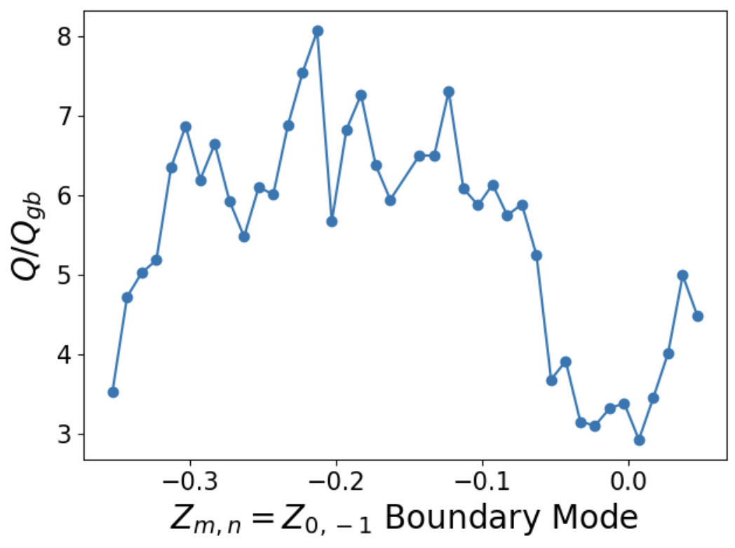
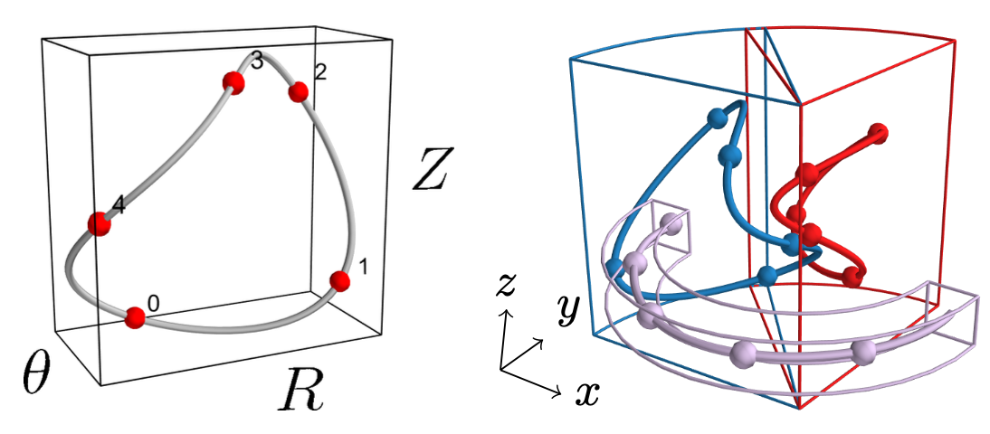
Research questions for the Hidden Symmetries group
Optimization
For expensive & non-smooth objectives (turbulence, directly following orbit losses), what are efficient algorithms for finding surrogates and optimizing?
What are effective ways to do global optimization for curve & surface shapes?
Kim et al arXiv (2023)
Giuliani arXiv (2023)

Slide 16
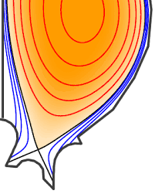
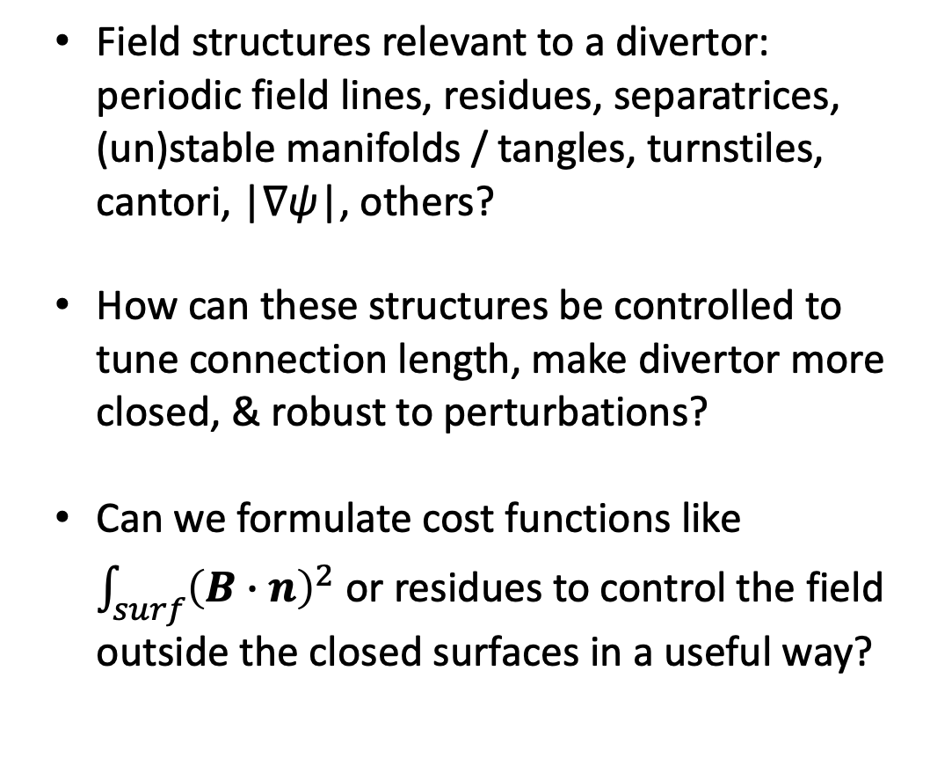
Research questions for the Hidden Symmetries group
Dynamics & Divertors
Field structures relevant to a divertor: periodic field lines, residues, separatrices, (un)stable manifolds / tangles, turnstiles, cantori, |∇ψ|, others?
How can these structures be controlled to tune connection length, make divertor more closed, & robust to perturbations?
Can we formulate cost functions like $\int_{surf}{{\left(B∙n\right)}^{2}}$ or residues to control the field outside the closed surfaces in a useful way?

