Slide 1
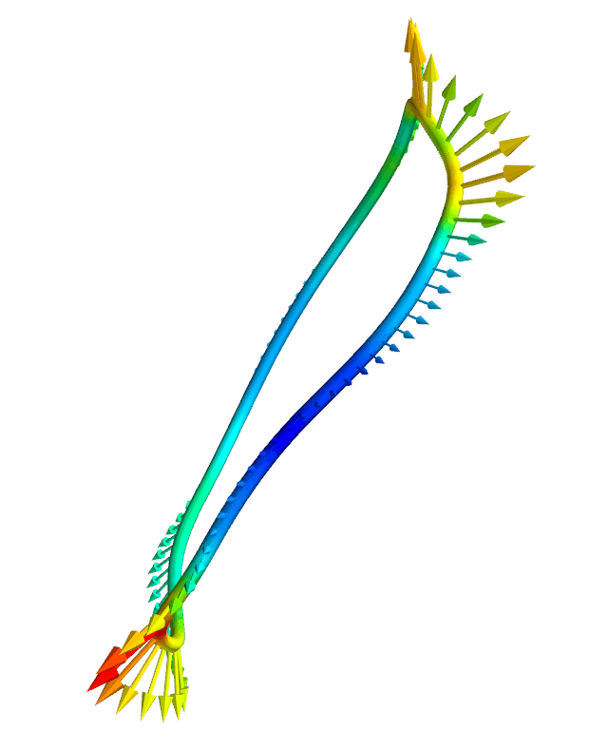
Efficient calculation of internal magnetic field & self-force for electromagnetic coils
Matt Landreman,
Siena Hurwitz,
Tom Antonsen,
University of Maryland
Notes:
~/Box/work23/20230430-02-HSX_coil_force_mayavi_animation

Slide 2
Outline
Motivation
Reducing 3D and 5D integrals to 1D
Efficient quadrature for the 1D integrals

Slide 3
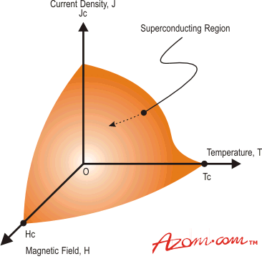
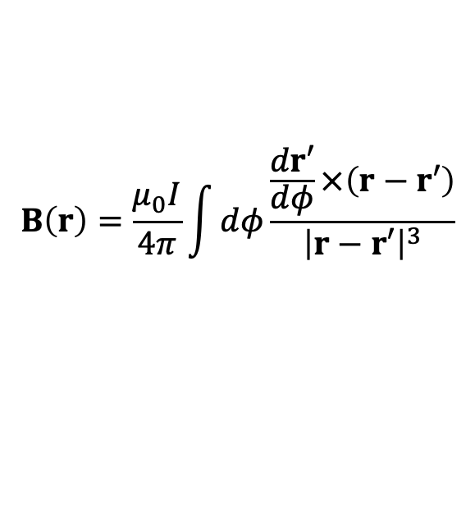
Tokamak & stellarator design requires calculations for the internal field and I x B force
Superconductor quench limits depend on local B.
Forces ∝ B². High B limited by support structure.
Coil shapes can probably be optimized for force & B.
Field and force on coil 2 due to current in coil 1 can be computed quickly: 1D filament models are ok.
azom.com
1
2
$$B\left(r\right)=\frac{μ_{0}I}{4π}\int{dφ\frac{\frac{dr′}{dφ}×\left(r−r′\right)}{{\left|r−r′\right|}^{3}}}$$
Tricky part is the self-field: singularity in Biot-Savart Law

Slide 4
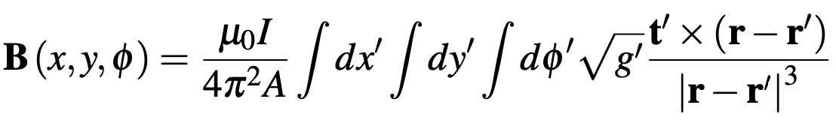
Accurate calculation of the internal field and self-force appear to require high-dimensional integrals
Field: 3D integral
Force per unit length: 5D integral
Can we simplify/approximate these integrals for fast evaluation inside an optimization loop?
Notes:
20230501-01 Equations for coil force talk.lyx

Slide 5
Simply skipping the singular point in a 1D filament calculation gives a non-converging result with signifciant error
Circular coil
Maximum |B| in the conductor [Tesla]
Force per unit length [N / m]

Slide 6
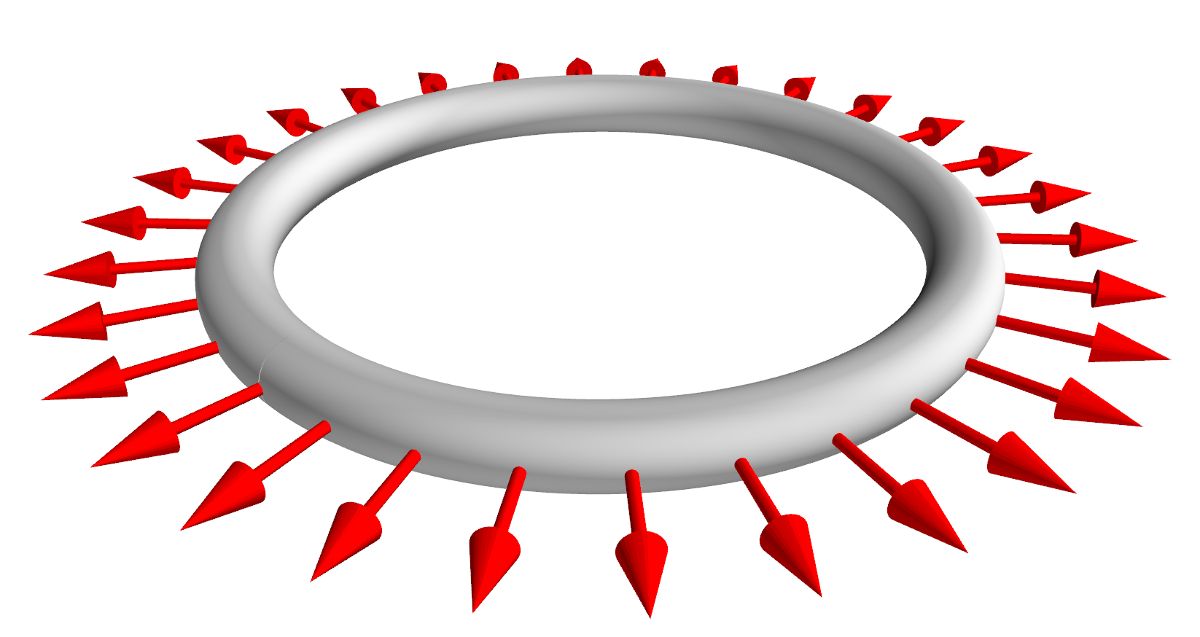
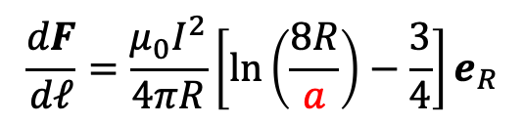



The analytic formula for a circular coil shows that the finite cross-section cannot be ignored
$$\frac{dF}{dℓ}=\frac{μ_{0}I^{2}}{4πR}\left[ln\left(\frac{8R}{a}\right)−\frac{3}{4}\right]e_{R}$$
$$R$$
$$2a$$
Diverges if minor radius $a→0$
Could a modified 1D filament model work if we supplement it with a value for a?
Notes:
20230510-01-plot_circular_coil_mayavi
20230511-05-plot_circular_coil_mayavi_with_force_arrows

Slide 7
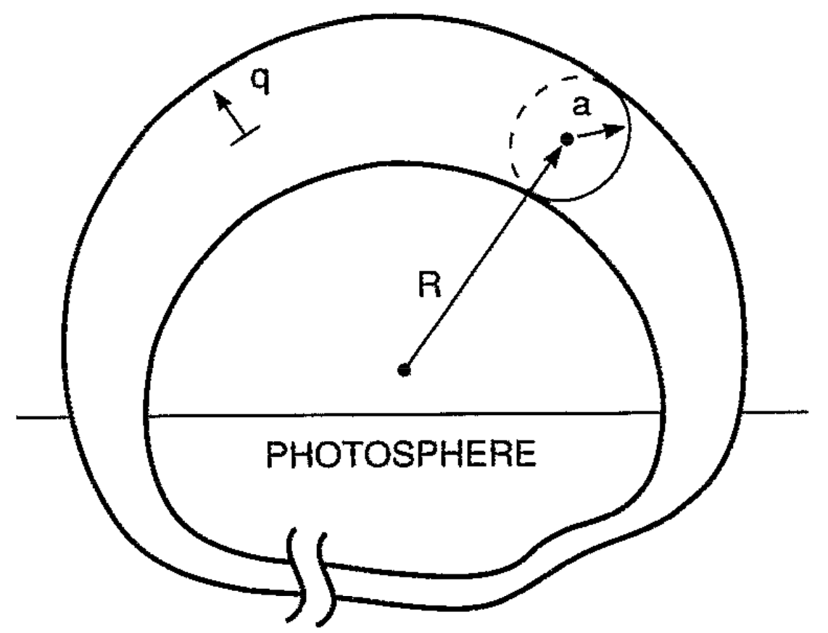
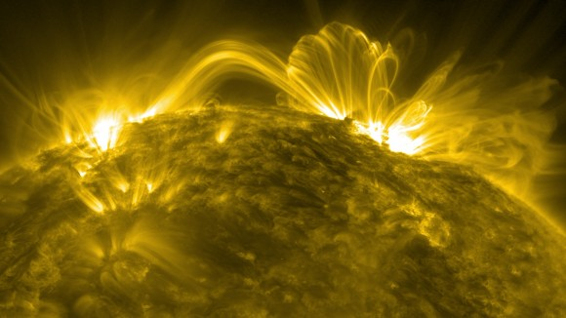
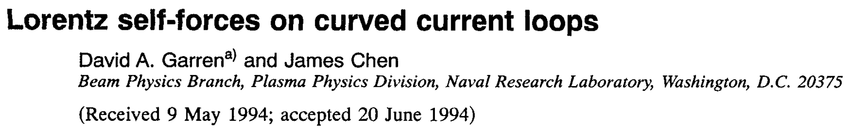
Calculations of internal field and self-force are also of interest for many other subjects, e.g. solar flares
NASA/SDO/Goddard

Slide 8
Some related work
Garren & Chen, Phys. Plasmas (1994). Looked at force but not internal field. Solution is to do a 1D integral over an incomplete loop, with a specific segment removed.
Dengler, Advanced Electromagnetics (2016). Computed self-inductance using 1D integral.
Lion, Warmer, et al Nuclear Fusion (2021). Computed B in conductor by summing analytical result for rectangular prism of J.
Robin & Volpe, Nuclear Fusion (2022). Computed force for sheet current on a winding surface.
Our contribution:
Compute both the self-force and the spatially-resolved internal field using only 1D integrals.
Integration is over a periodic domain, so quadrature can be spectrally accurate, & can re-use points/data from other coil optimization objectives.

Slide 9
Outline
Motivation
Reducing 3D and 5D integrals to 1D
Efficient quadrature for the 1D integrals

Slide 10
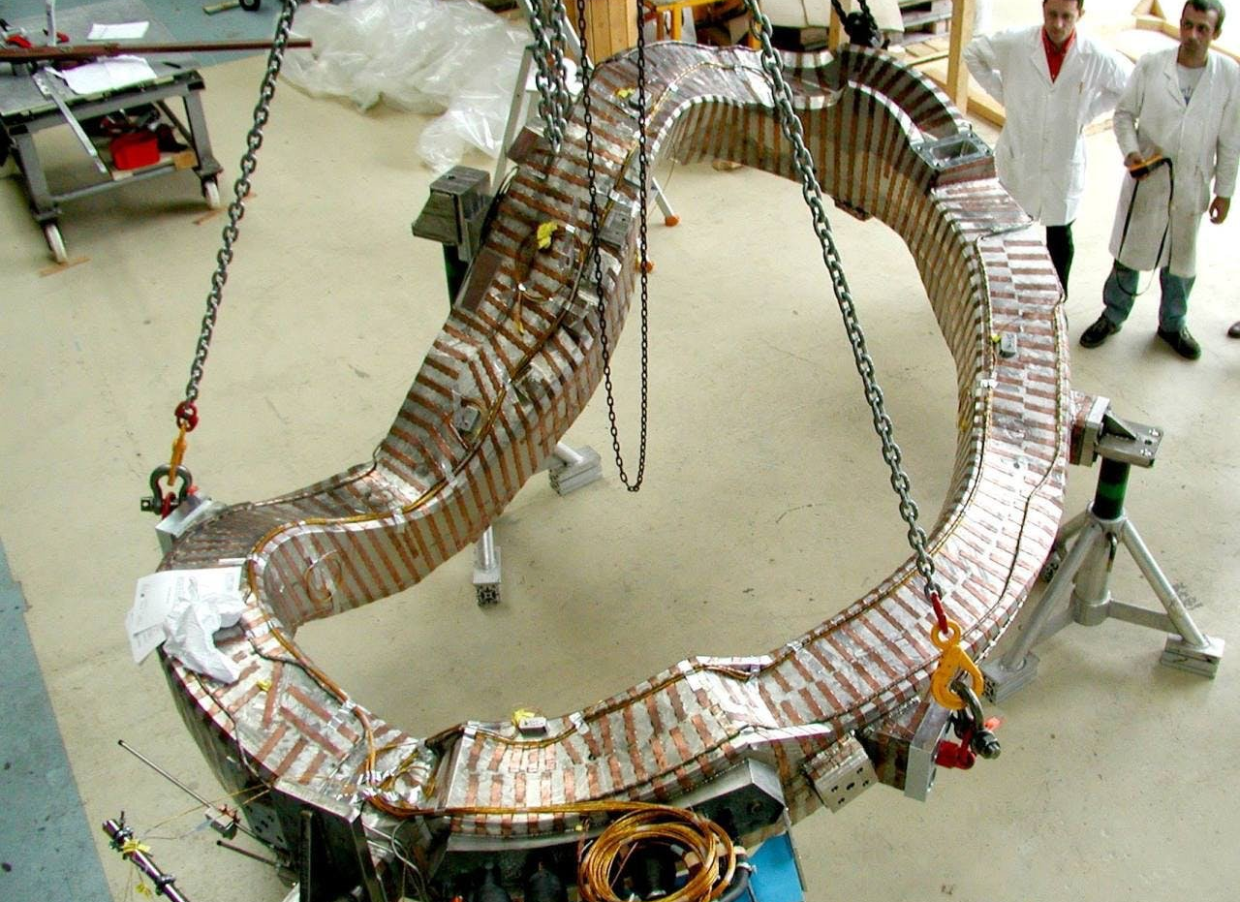
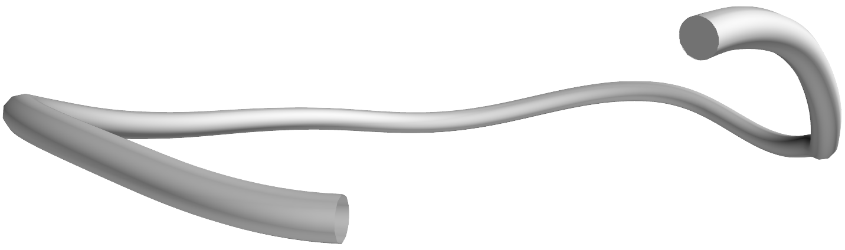
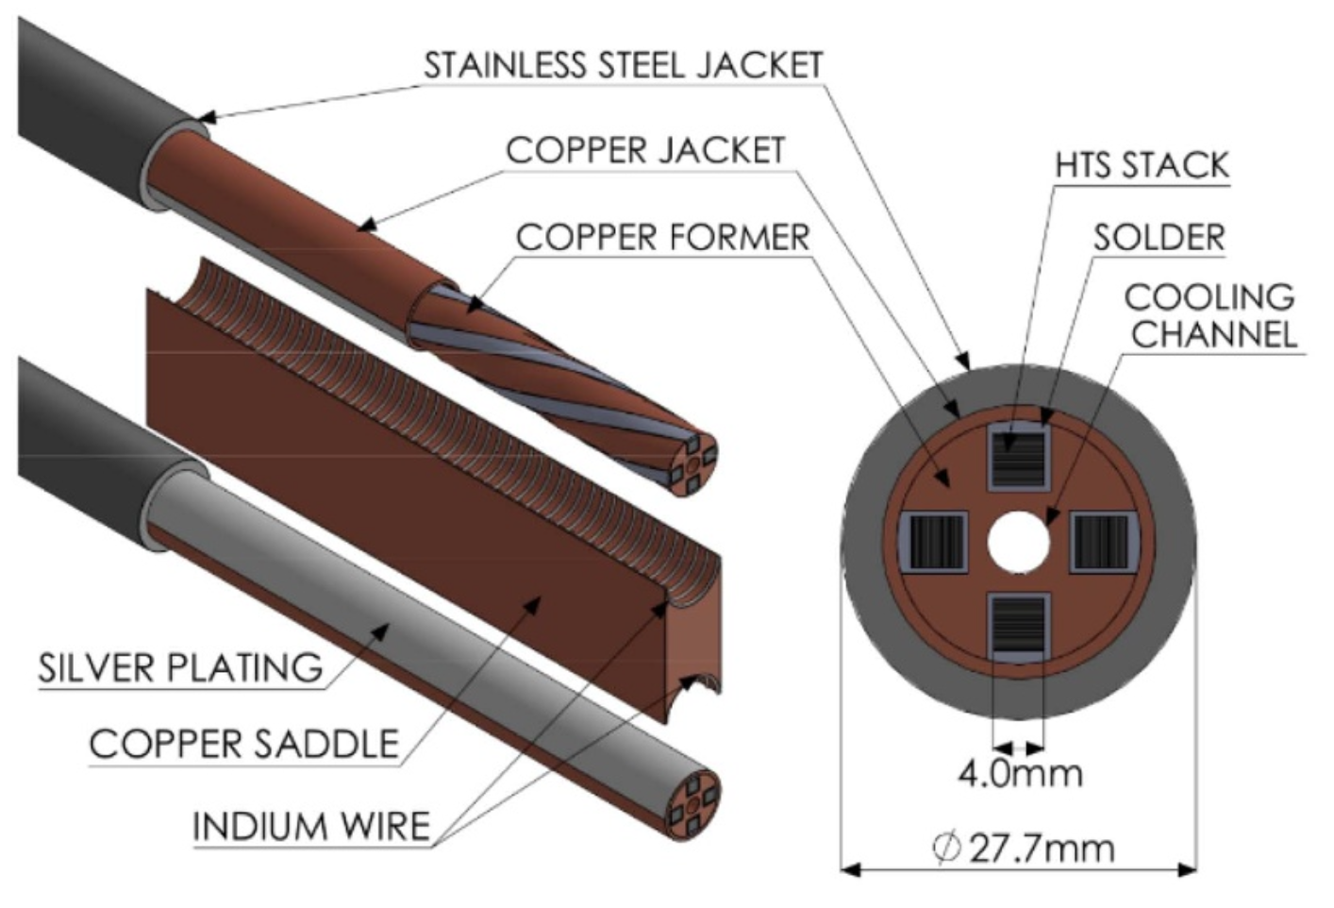

To make progress, we will consider a circular cross-section for now
Rectangular cross-section is a next step.
Some real conductors have more complicated geometry, e.g. HTS VIPER cable…
Hartwig et al 2020
Notes:
20230511-03-plot_HSX_coil_mayavi_a1cm_incomplete.png

Slide 11
Methodology for finding an accurate reduced model
Parameterize the coil volume:
Expansion parameter: a / R ≪ 1, where R ∼ scales of curve centerline.
Introduce intermediate scale b, with a ≪ b ≪ R.
Split integrals into “near part” + “far part”.
Far part defined by |r – r’| > b. Finite cross-section can be neglected.
Near part defined by |r – r’| < b. Coil centerline can be Taylor-expanded, so integrals can be done explicitly.
Identify a 1D integral that has the same near part and far part as the above “high fidelity” calculation for a / R ≪ 1.
centerline

Slide 12
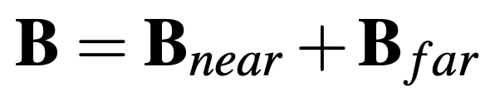
Methodology for finding an accurate reduced model
a / R ≪ 1
High fidelity 3D model
Far contribution:
|r – r’| > b
New 1D filament model
Near contribution:
|r – r’| < b

Slide 13
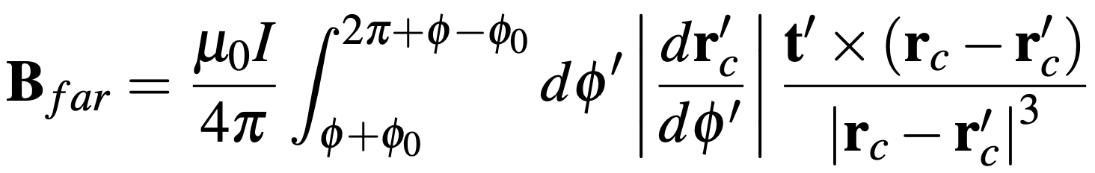

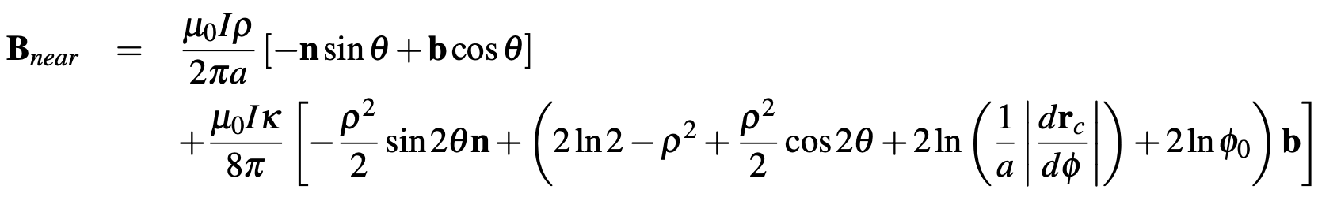
Limit of the 3D integral for the internal field for a / R ≪ 1
Intuition:
Leading order near-field is same as a straight wire. But corrections contribute to the force.

Slide 14

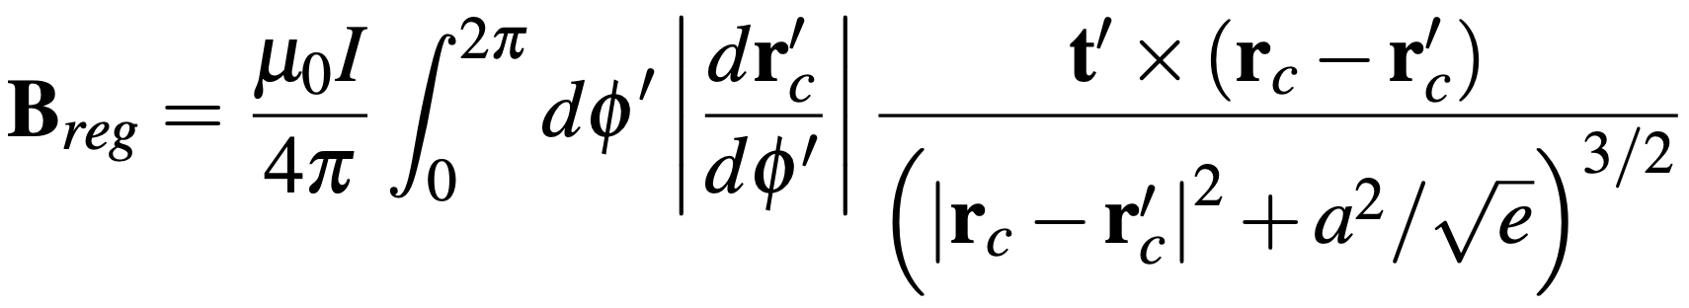
Our new 1D filament model reproduces the same limit as the original 3D integral
Intuition:
Regularization added to Biot-Savart. Makes a difference when source and evaluation points are as close as the coil radius.
Notes:
Equations from 20230501-01_Equations_for_coil_force_talk.pdf

Slide 15
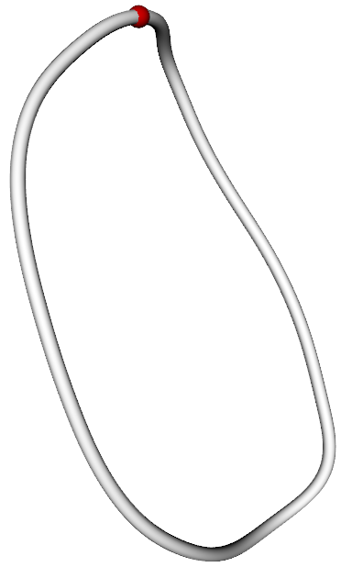
The new filament model agrees with the high-fidelity 3D integral for B in stellarator coils
HSX coil 1
|B| [T], High fidelity
|B| [T], Filament
The individual B components also agree:
B_{z} [T], High fidelity
B_{z} [T], Filament
Notes:
CoilForces.plot_high_fidelity_B_vector_for_HSX_coil_for_talk("HSX_B_a0.01_rtol0.001_atol0.001_nphi1_nn64_nb65_2023-05-11T10.06.03.780.dat")
CoilForces.plot_high_fidelity_B_vector_for_HSX_coil_for_talk("HSX_B_a0.01_rtol0.001_atol0.001_nphi2_nn30_nb31_2023-04-27T09.40.25.165.dat")
20230511-02-plot_HSX_coil_with_dot_mayavi_a1cm

Slide 16
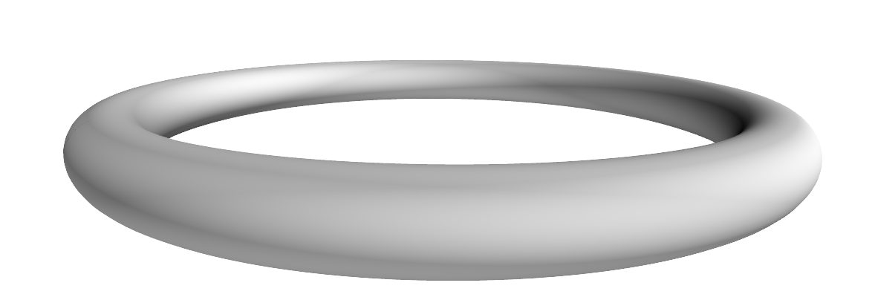
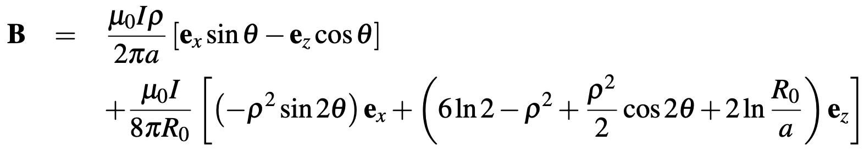
If curve centerline is a circle, the new filament model matches analytic formula for B

Slide 17
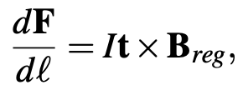
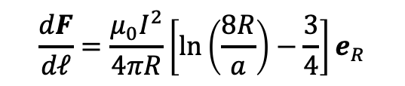
Integrating the J x B force over the conductor cross-section, our method reduces the 5D integral for the self-force to a 1D integral
If r_{c} is a circle
$$\frac{dF}{dℓ}=\frac{μ_{0}I^{2}}{4πR}\left[ln\left(\frac{8R}{a}\right)−\frac{3}{4}\right]e_{R}$$
Same as analytic result

Slide 18
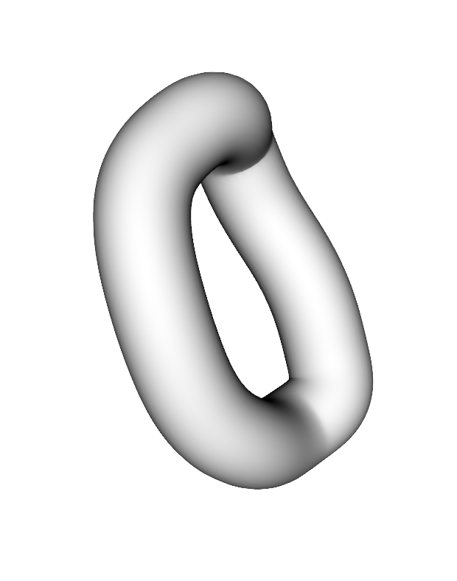
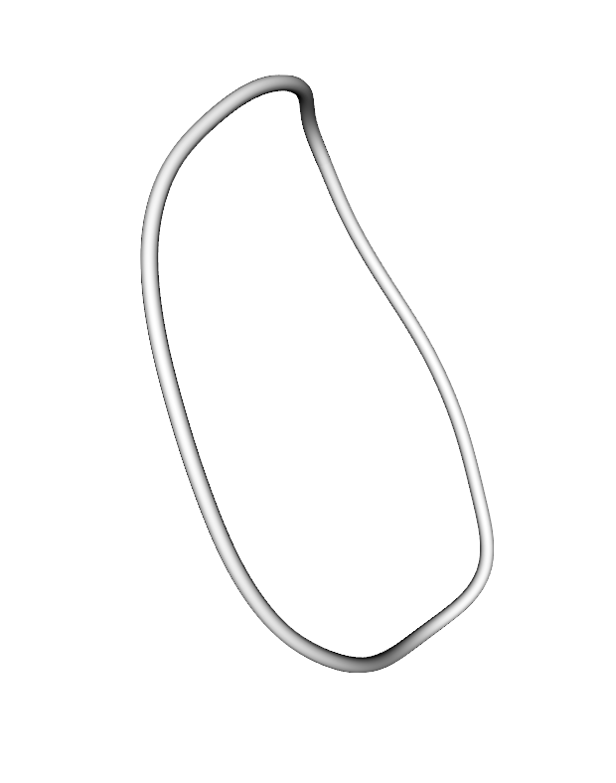



The 1D integral accurately approximates high-fidelity calculations for the self-force in stellarator coils
$dF_{x}/dℓ$ [kN / m] for HSX coil 1, @ 150 kA
High fidelity (5D integral)
1D integral
High fidelity (5D integral)
1D integral
Parameter along curve ($φ$)
Parameter along curve ($φ$)
Notes:
20230508-01-HSX_coil_force_hifi_vs_filament.pdf
Created using CoilForces.plot_hifi_force_and_1D_for_HSX_for_talk()
3D figures created using 20230508-02-plot_HSX_coil_mayavi_a1cm
And 20230508-01-plot_HSX_coil_mayavi_a10cm
The resulting png files were opened in Preview to turn the background white into transparency.

Slide 19
Outline
Motivation
Reducing 3D and 5D integrals to 1D
Efficient quadrature for the 1D integrals

Slide 20
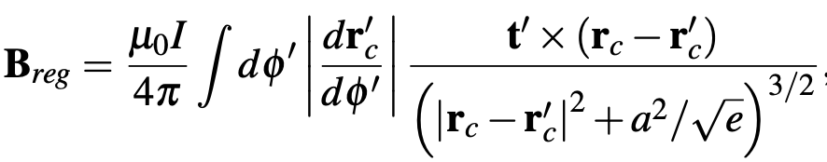
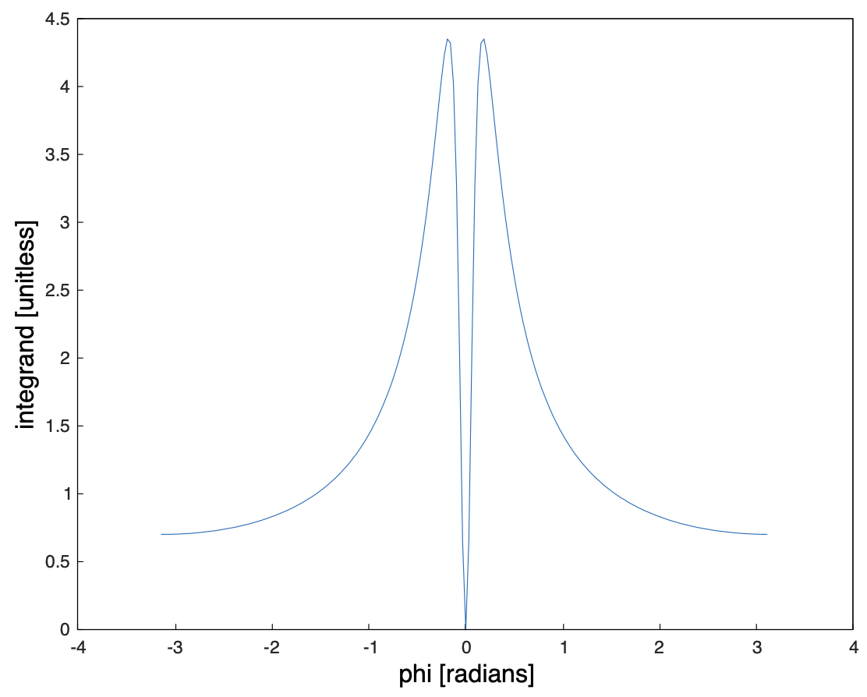
Remaining 1D integral is still tricky since integrand has fine structure
Circular coil, a/R = 0.1
A solution: subtract and add a function to the integrand with the same near-singular behavior that can be integrated analytically.
Also examining a partition-of-unity method like Malhotra et al.

Slide 21
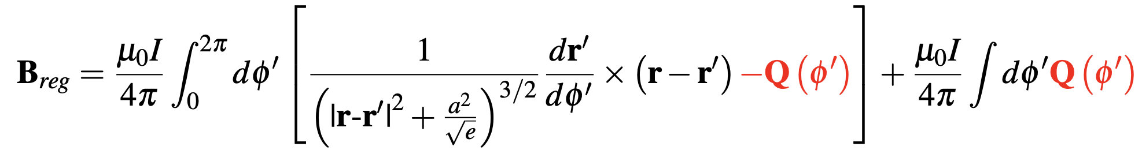
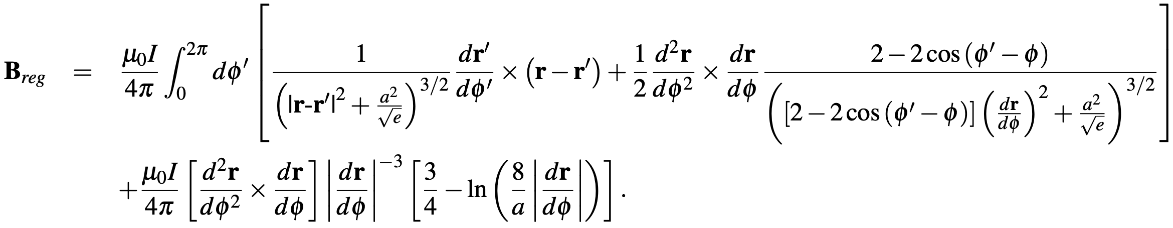
To make integrand smooth, we subtract and add a function with the same singular behavior that can be integrated analytically.
Compute Q by Taylor expansion of integrand about $φ^{′}=φ$.
Result:

Slide 22
The singularity-subtraction method allows B and the force to be evaluated with very few quadrature points.
HSX coil 1
With singularity subtraction
Without singularity subtraction
Notes:
CoilForces.plot_force_convergence_single_for_talk()
20230511-01-HSX_force_convergence_vs_nquadpoints.pdf
20230511-02-plot_HSX_coil_with_dot_mayavi_a1cm

Slide 23
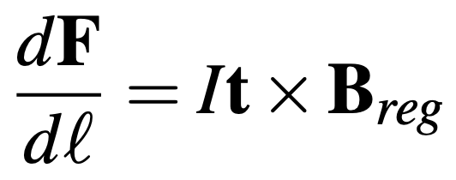
Summary of main results
Internal field:
Self-force:
Notes:
20230501-01_Equations_for_coil_force_talk.pdf

Slide 24
Conclusions & future work
To compute internal B field and self-force of a coil, the finite cross-section matters, & it is not accurate to just drop the singular point.
These quantities can be computed using just a 1D integral if formulated carefully.
New method agrees with high-fidelity finite-cross-section calculations & analytic results for a circular coil.
Next steps:
Extend to rectangular cross-section
Apply in coil optimization
Would welcome collaboration with this!

Slide 25
Extra slides

