Slide 1
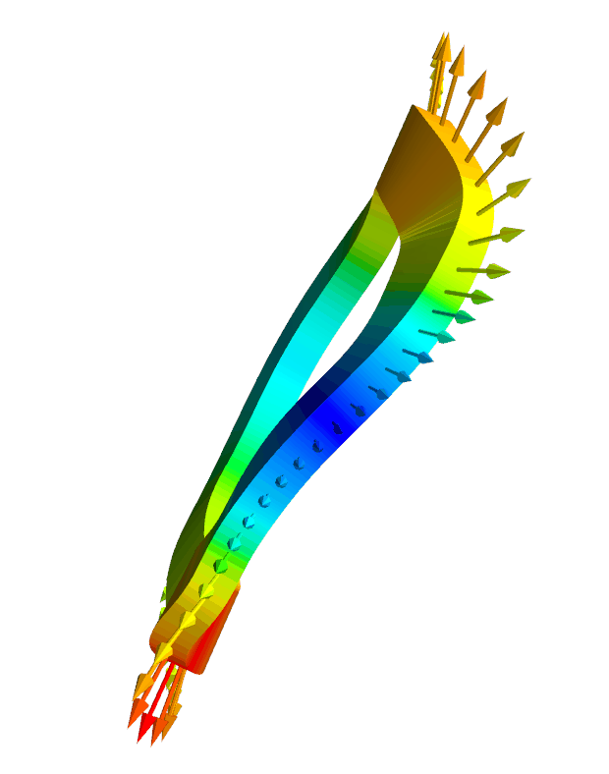
Efficient calculation of self-force, internal magnetic field,
& stored energy for electromagnetic coils
Matt Landreman,
Siena Hurwitz,
Tom Antonsen,
University of Maryland
Notes:
~/Box/work23/20230623-01-HSX_rectangular_xsection_force_animation/20230623-01-mayavi_plot_HSX_rectangular_coil_and_force.py.gif
~/Box/work23/20230430-02-HSX_coil_force_mayavi_animation for circular-xsection version

Slide 2
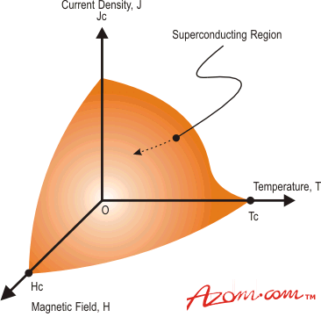
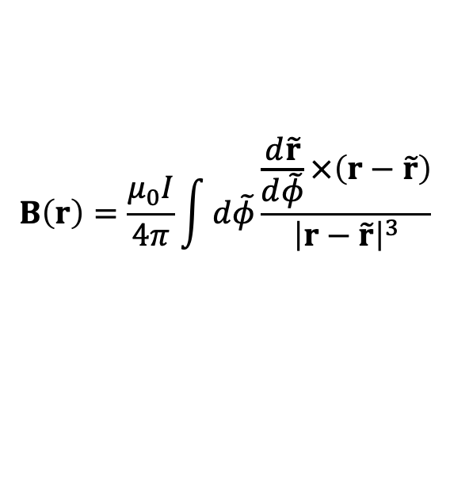
Tokamak & stellarator design requires calculations for the
I x B force, internal field, and stored energy
Forces ∝ B². High B limited by support structure.
Superconductor quench limits depend on local B.
Need to be able to dissipate stored energy W = ½LI².
Coil shapes can probably be optimized for these quantities.
Field and force on coil 2 due to current in coil 1 can be computed quickly: 1D filament models are ok.
azom.com
1
$$B\left(r\right)=\frac{μ_{0}I}{4π}\int{d\tilde{φ}\frac{\frac{d\tilde{r}}{d\tilde{φ}}×\left(r−\tilde{r}\right)}{{\left|r−\tilde{r}\right|}^{3}}}$$
2
Tricky part is the self-field: singularity in Biot-Savart Law

Slide 3
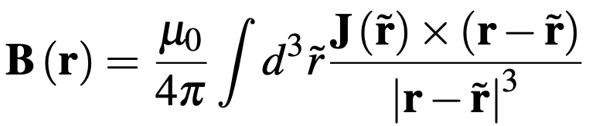
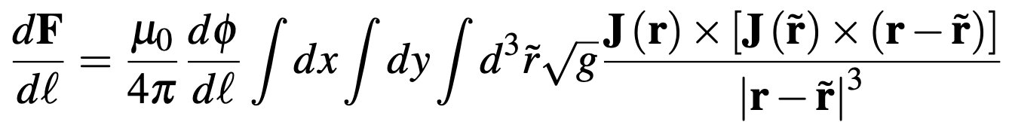
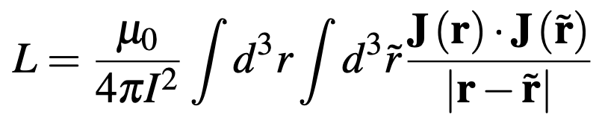
Accurate calculation of the internal field and self-force appear to require high-dimensional integrals
Field: 3D integral
Force per unit length: 5D integral
Self-inductance & stored energy: 6D integral
Can we simplify/approximate these integrals for fast evaluation inside an optimization loop?
Notes:
20230501-01 Equations for coil force talk.lyx
20230717-01 Equations for coil force talk.lyx

Slide 4
Outline
Background
Reducing 3D/5D/6D integrals to 1D/2D
Efficient quadrature for the 1D/2D integrals
Future work & conclusions

Slide 5
Simply skipping the singular point in a 1D filament calculation gives a non-converging result with signifciant error
Circular coil
Maximum |B| in the conductor [Tesla]
Force per unit length [N / m]

Slide 6
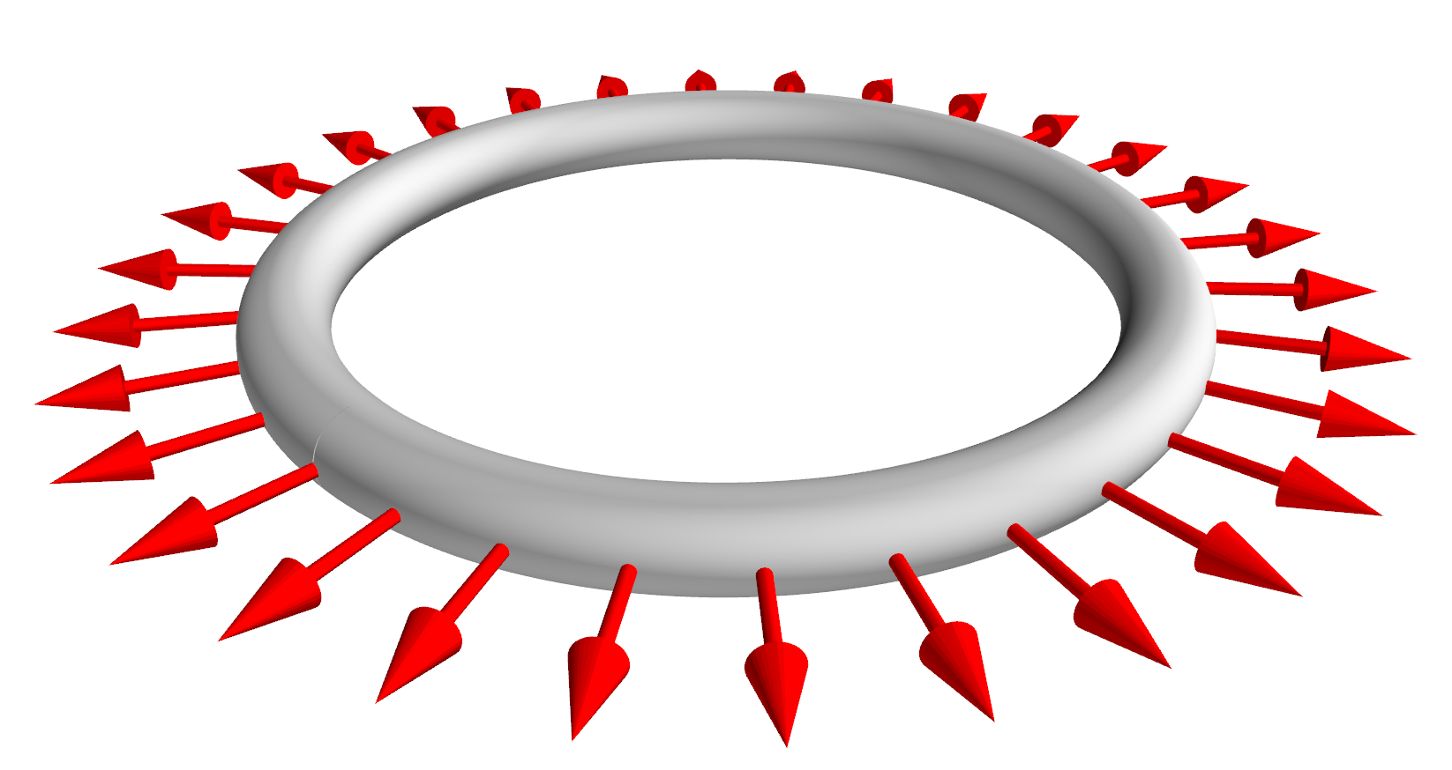
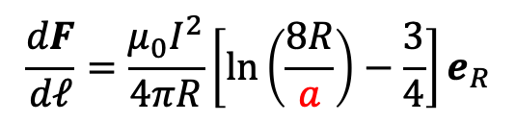



Analytic formulas for a circular coil show that the finite cross-section cannot be ignored
$$\frac{dF}{dℓ}=\frac{μ_{0}I^{2}}{4πR}\left[ln\left(\frac{8R}{a}\right)−\frac{3}{4}\right]e_{R}$$
$$R$$
$$2a$$
Diverges if minor radius $a→0$
Could a modified 1D filament model work if we supplement it with a value for a?
Notes:
20230510-01-plot_circular_coil_mayavi
20230511-05-plot_circular_coil_mayavi_with_force_arrows

Slide 7
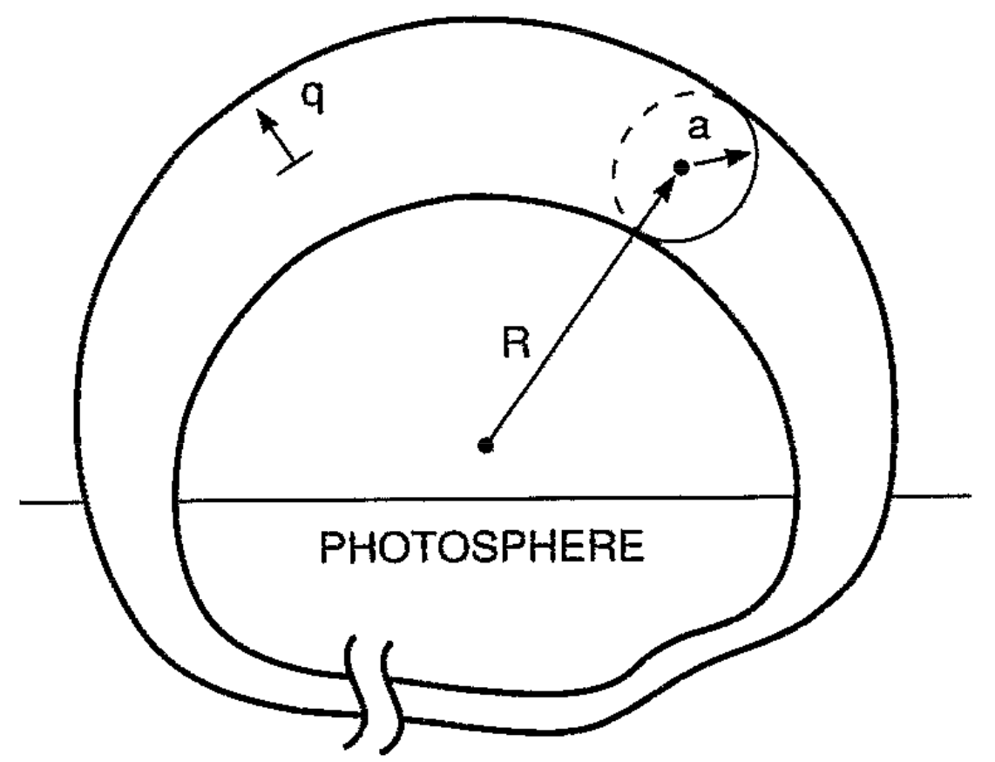
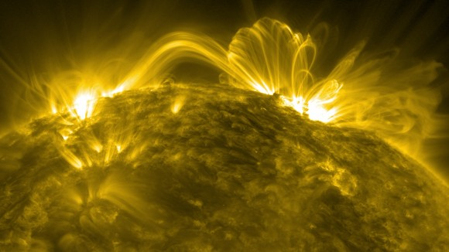
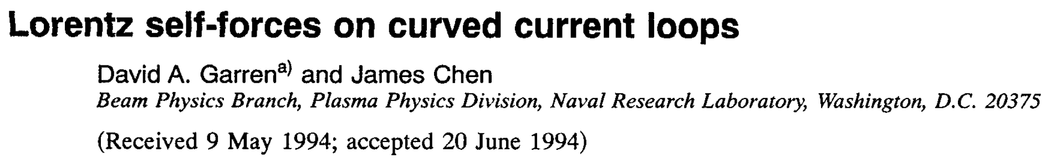
Calculations of internal field and self-force are also of interest for many other subjects, e.g. solar flares
NASA/SDO/Goddard

Slide 8
Some related work
Garren & Chen, Phys. Plasmas (1994). Looked at force but not internal field. Solution is to do a 1D integral over an incomplete loop, with a specific segment removed.
Dengler, Advanced Electromagnetics (2016). Computed self-inductance using 2D integral.
Lion, Warmer, et al Nuclear Fusion (2021). Computed B in conductor by summing analytical result for rectangular prism of J.
Robin & Volpe, Nuclear Fusion (2022). Computed force for sheet current on a winding surface.
Our contribution:
Compute self-force, stored energy / inductance, and spatially-resolved internal field using only 1D/2D integrals.
Integration is over a periodic domain, so quadrature can be spectrally accurate, & can re-use points/data from other coil optimization objectives.

Slide 9
Outline
Background
Reducing 3D/5D/6D integrals to 1D/2D
Efficient quadrature for the 1D/2D integrals
Future work & conclusions

Slide 10
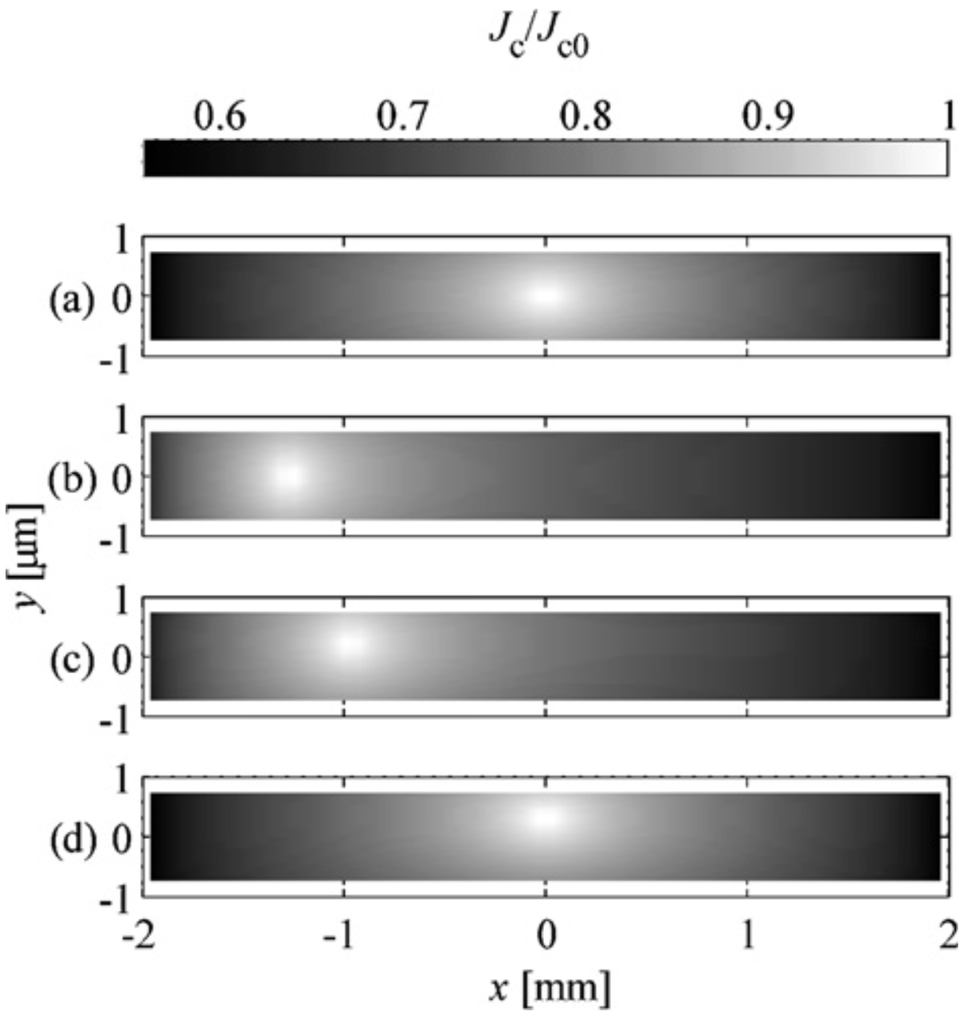
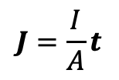
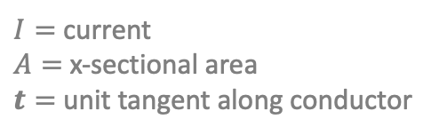
Assumption: current density J is uniform
$$J=\frac{I}{A}t$$
$I=$ current
$A=$ x-sectional area
$t=$ unit tangent along conductor
J in YBCO
Ok if multiple turns in both dimensions of the x-section.
Not necessarily accurate for superconductors, particularly HTS tapes.
Good enough for optimization?
Rostila et al, (2007)

Slide 11
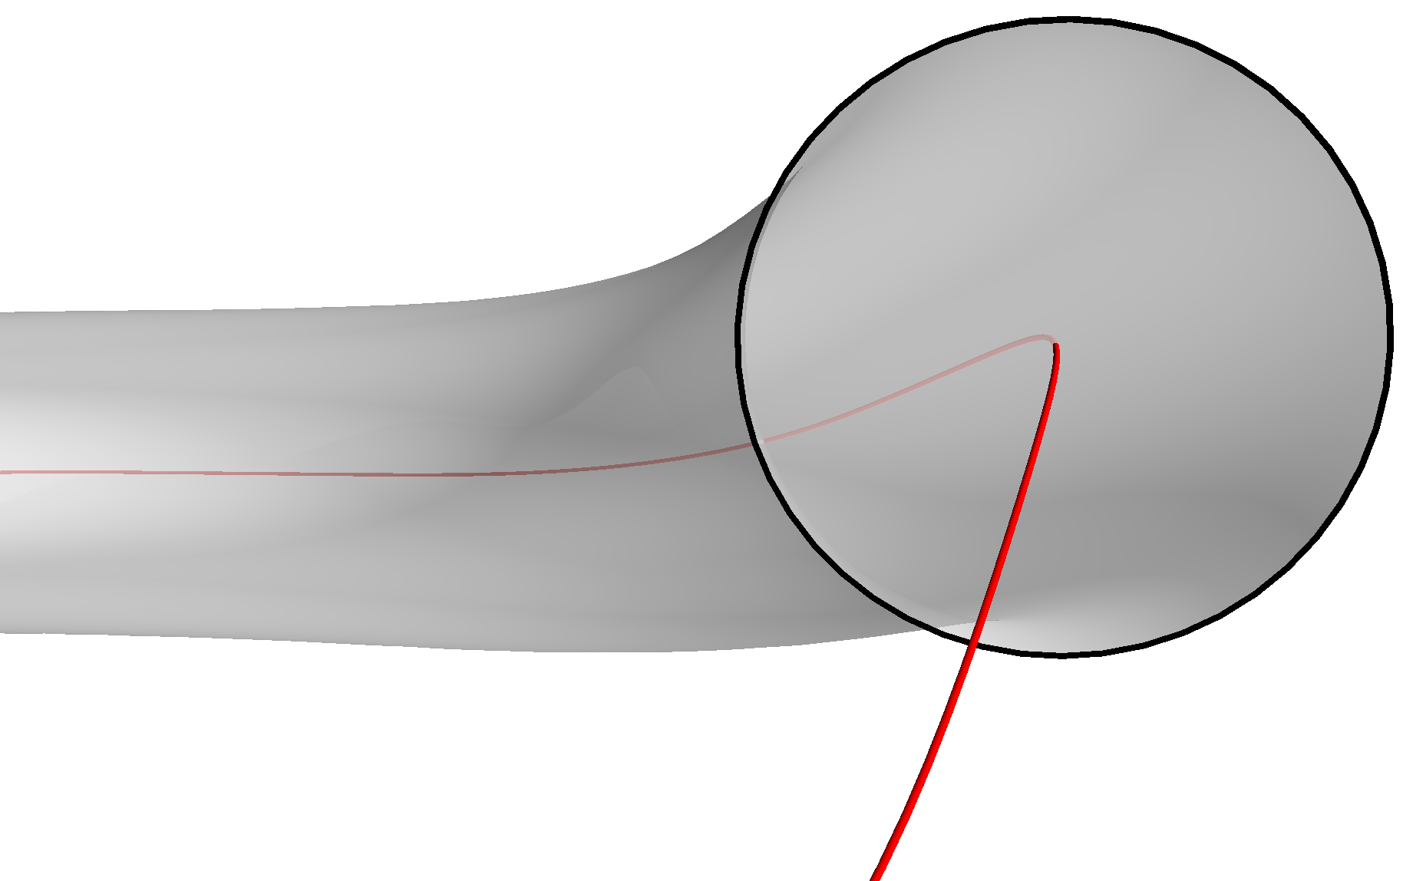
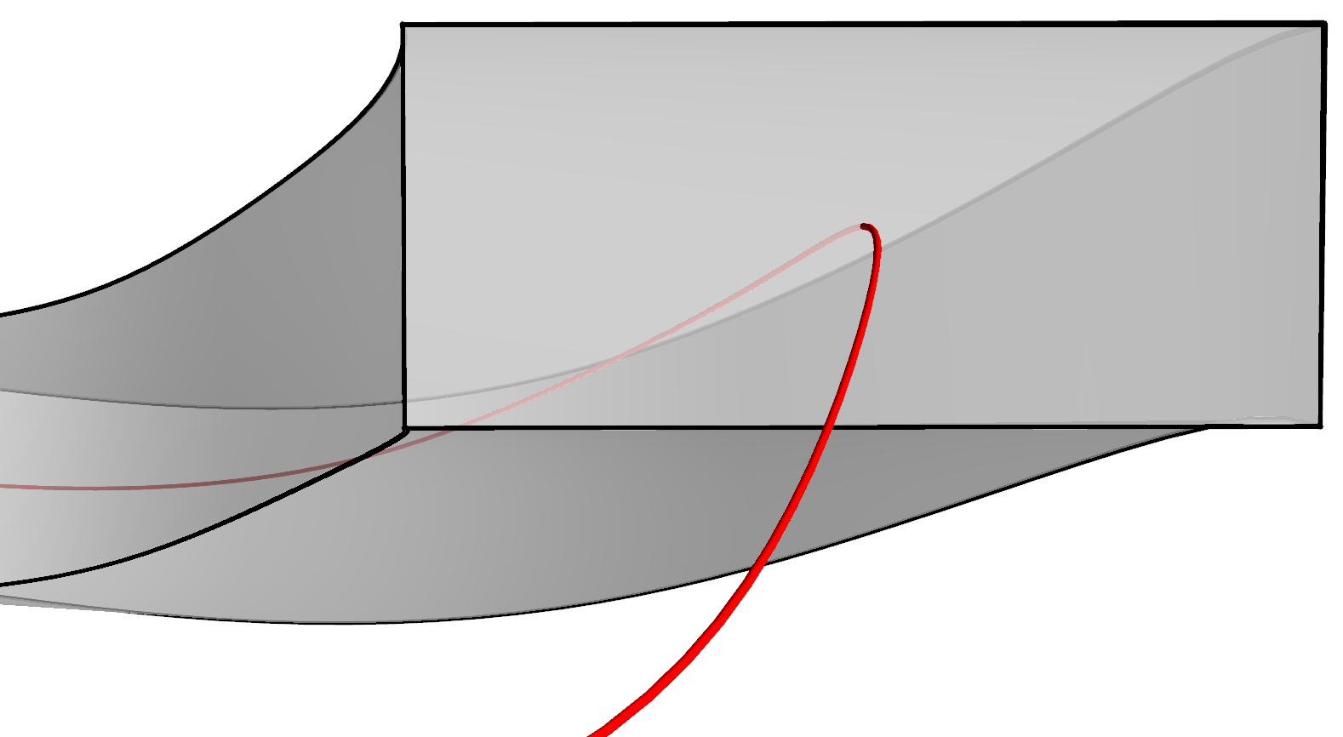
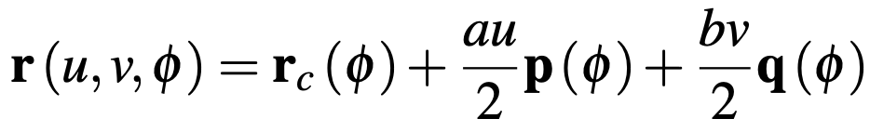
We can do the calculations for cross-sections that are either circular or rectangular
a
a
v = 1
q
b
u = -1
r_{c}
p
u = 1
ρ
n
b
v = -1
θ
r_{c}
Notes:
20230717-04-mayavi_plot_HSX_circular_xsection_coil_for_coordinate_definitions
20230707-01-mayavi_plot_HSX_rectangular_coil_for_coordinate_definitions
20230511-03-plot_HSX_coil_mayavi_a1cm_incomplete.png

Slide 12
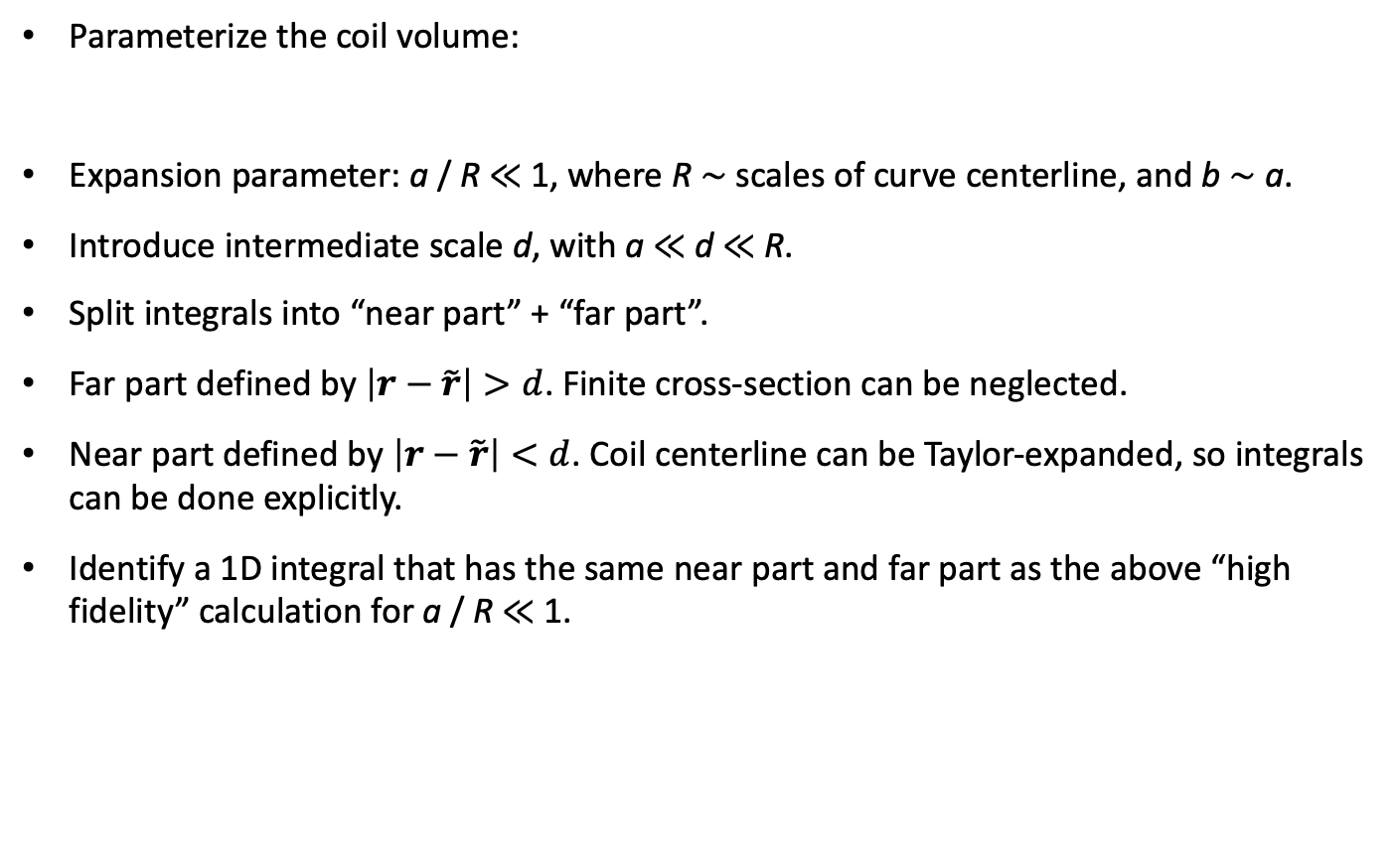
Methodology for finding an accurate reduced model
Parameterize the coil volume:
Expansion parameter: a / R ≪ 1, where R ∼ scales of curve centerline, and b ∼ a.
Introduce intermediate scale d, with a ≪ d ≪ R.
Split integrals into “near part” + “far part”.
Far part defined by $\left|r−\tilde{r}\right|>d$. Finite cross-section can be neglected.
Near part defined by $\left|r−\tilde{r}\right|<d$. Coil centerline can be Taylor-expanded, so integrals can be done explicitly.
Identify a 1D integral that has the same near part and far part as the above “high fidelity” calculation for a / R ≪ 1.
centerline

Slide 13
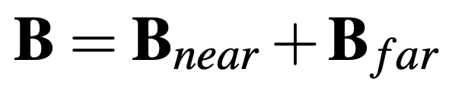
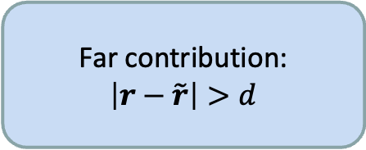
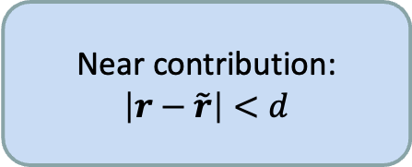
Methodology for finding an accurate reduced model
a / R ≪ 1
High fidelity 3D model
Far contribution:
$$\left|r−\tilde{r}\right|>d$$
New 1D filament model
Near contribution:
$$\left|r−\tilde{r}\right|<d$$

Slide 14
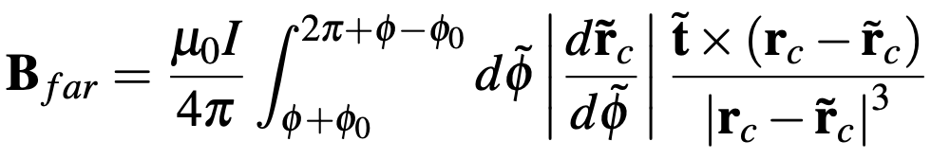

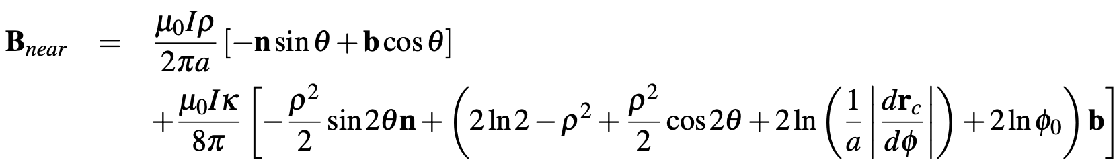
Limit of the 3D integral for the internal field for a / R ≪ 1
Intuition:
Leading order near-field is same as a straight wire. But corrections contribute to the force.

Slide 15

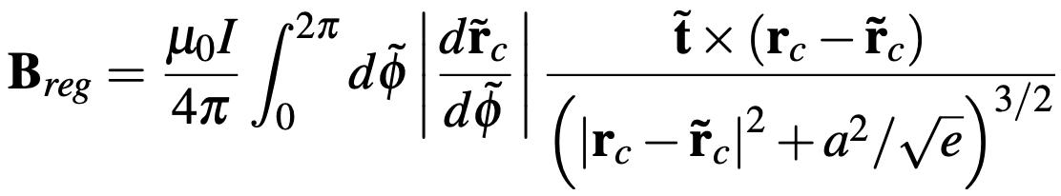
Our new 1D filament model reproduces the same limit as the original 3D integral
Intuition:
Regularization added to Biot-Savart. Makes a difference when source and evaluation points are as close as the coil radius.
Notes:
Equations from 20230501-01_Equations_for_coil_force_talk.pdf

Slide 16
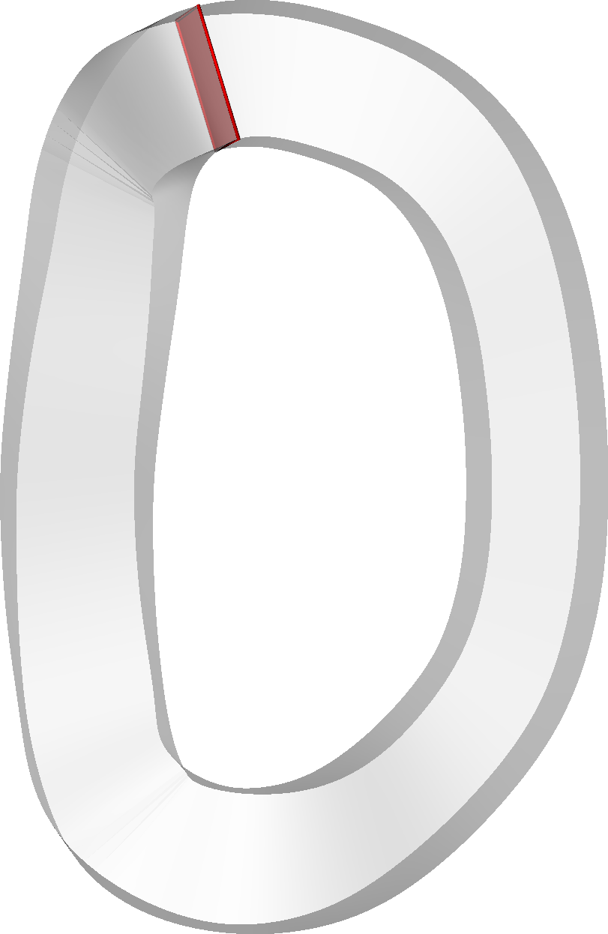
The new filament model agrees with the high-fidelity 3D integral for B in stellarator coils
The individual B components also agree:
HSX coil 1
Notes:
20230624-01-mayavi_plot_HSX_rectangular_coil_phi0_highlight.py.png
20230621-01-HSX_rectangular_xsection_B_for_paper_hifi_modB.pdf
20230621-01-HSX_rectangular_xsection_B_for_paper_hifi_Bz.pdf
20230621-01-HSX_rectangular_xsection_B_for_paper_analytic_modB.pdf
20230621-01-HSX_rectangular_xsection_B_for_paper_analytic_Bz.pdf
CoilForces.plot_high_fidelity_B_vector_for_HSX_coil_for_talk("HSX_B_a0.01_rtol0.001_atol0.001_nphi1_nn64_nb65_2023-05-11T10.06.03.780.dat")
CoilForces.plot_high_fidelity_B_vector_for_HSX_coil_for_talk("HSX_B_a0.01_rtol0.001_atol0.001_nphi2_nn30_nb31_2023-04-27T09.40.25.165.dat")
20230511-02-plot_HSX_coil_with_dot_mayavi_a1cm

Slide 17
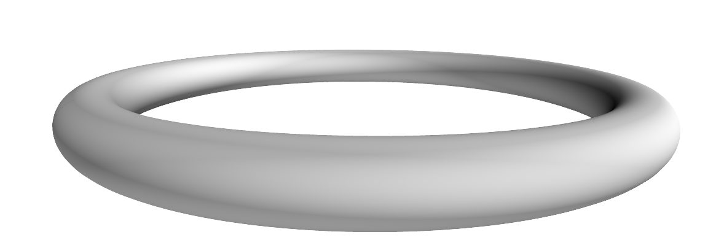
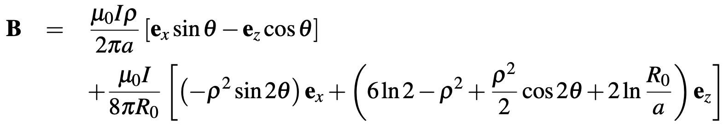
If curve centerline is a circle, the new filament model matches analytic formula for B

Slide 18
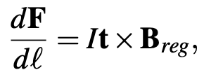

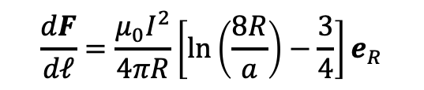
Integrating the J x B force over the conductor cross-section, our method reduces the 5D integral for the self-force to a 1D integral
If r_{c} is a circle
$$\frac{dF}{dℓ}=\frac{μ_{0}I^{2}}{4πR}\left[ln\left(\frac{8R}{a}\right)−\frac{3}{4}\right]e_{R}$$
Same as analytic result

Slide 19
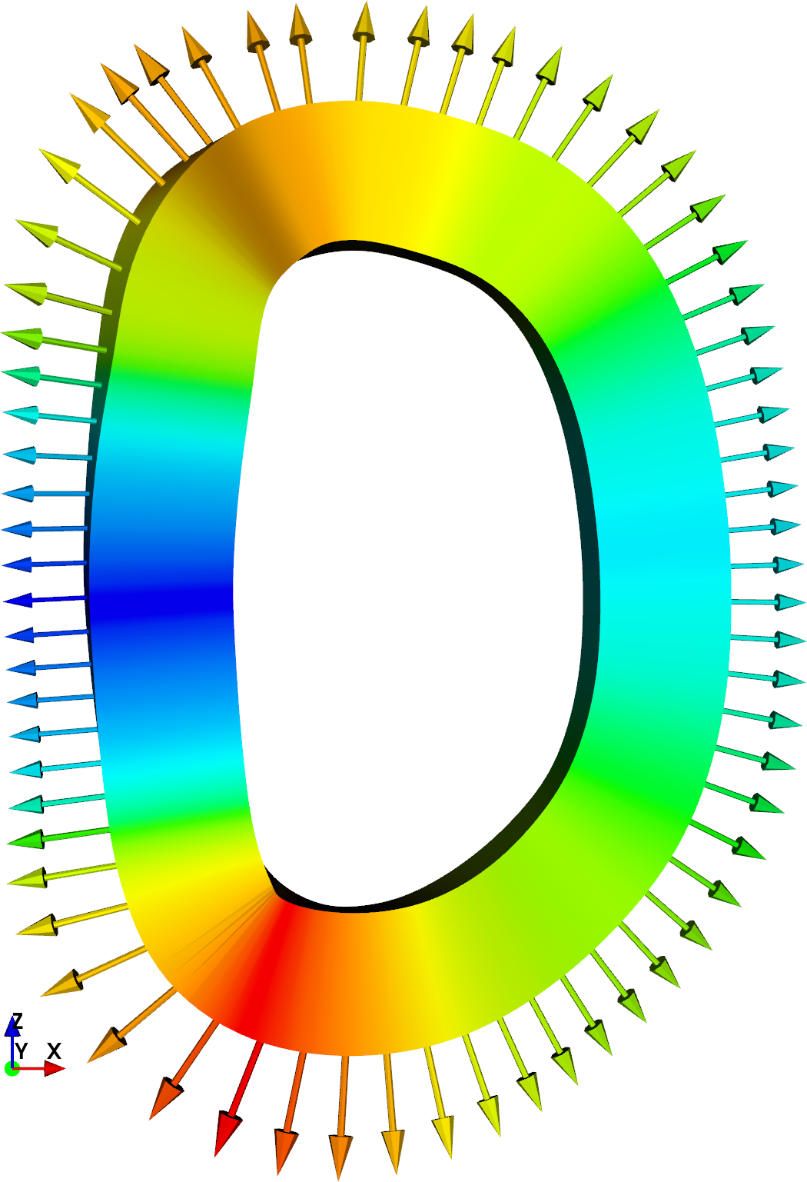
The 1D integral accurately approximates high-fidelity calculations for the self-force in stellarator coils
HSX coil 1
~ 18,000x speed-up for given precision
Notes:
20230508-01-HSX_coil_force_hifi_vs_filament.pdf
Created using CoilForces.plot_hifi_force_and_1D_for_HSX_for_talk()
3D figures created using 20230508-02-plot_HSX_coil_mayavi_a1cm
And 20230508-01-plot_HSX_coil_mayavi_a10cm
The resulting png files were opened in Preview to turn the background white into transparency.

Slide 20
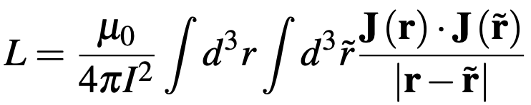
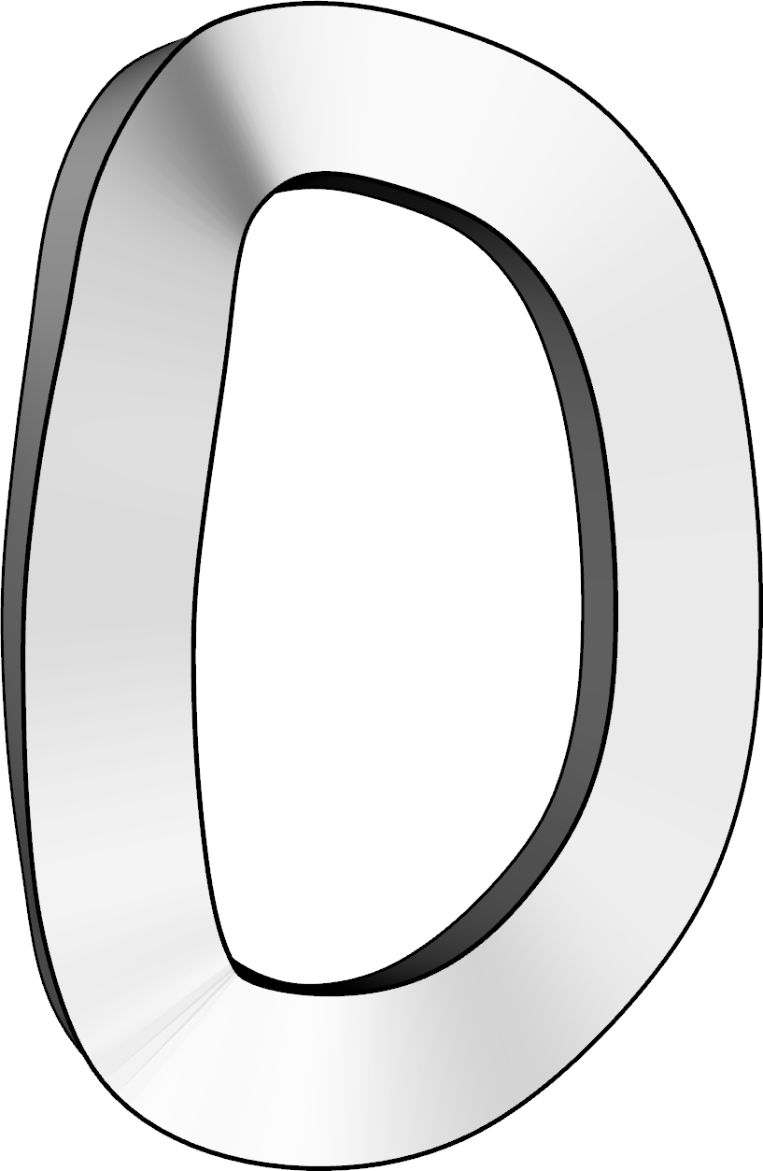
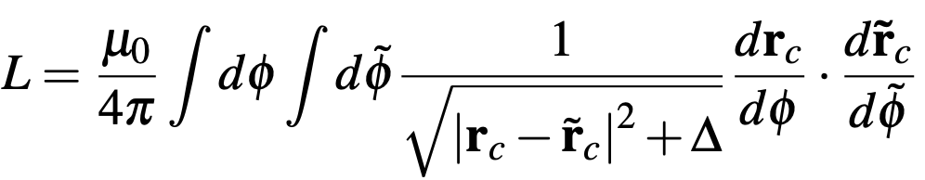

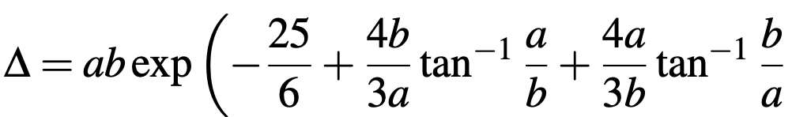
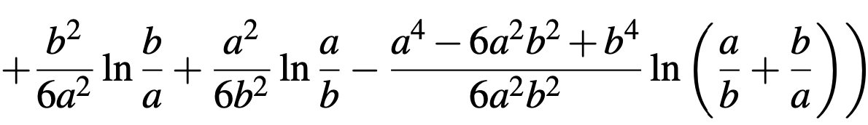
Similarly, the inductance & stored energy can be computed accurately with only a 2D integral
6D:
2D:
for circular x-section,
for rectangular x-section.
For circular centerline, matches analytic result by
Weinstein, Annalen der Physik (1884)
Notes:
20230717-01-mayavi_plot_HSX_rectangular_coil_plain_transparent.png

Slide 21
Outline
Motivation
Reducing 3D/5D/6D integrals to 1D/2D
Efficient quadrature for the 1D/2D integrals
Future work & conclusions

Slide 22
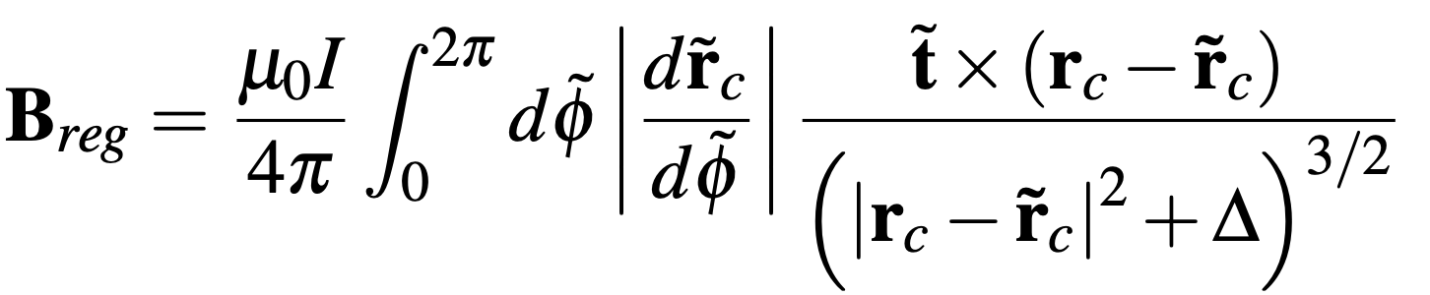
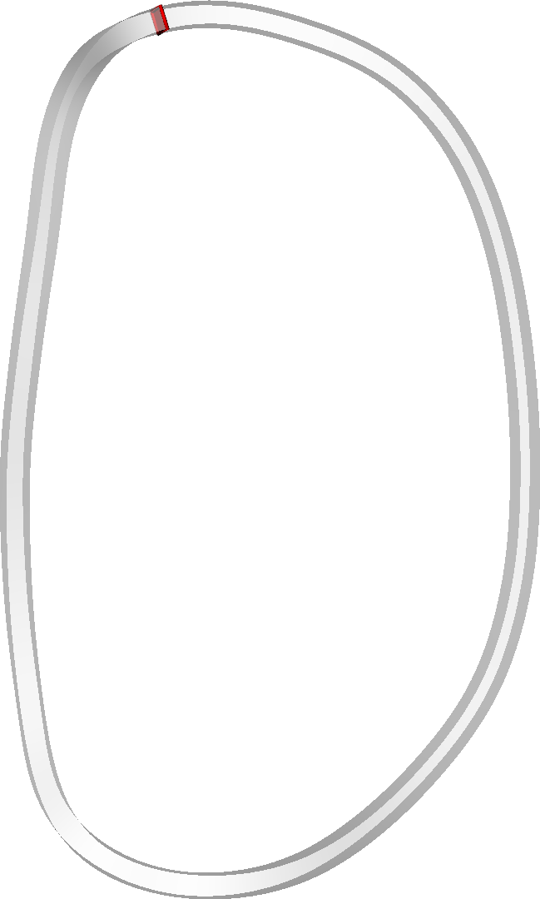
Remaining 1D integral is still tricky since integrand has fine structure
With singularity subtraction
Original
A solution: subtract and add a function to the integrand with the same near-singular behavior that can be integrated analytically.
Notes:
plot_integrand_rectangular_xsection_for_talk()
20230717-03-mayavi_plot_HSX_rectangular_coil_phi0_highlight_ab0p02.png

Slide 23
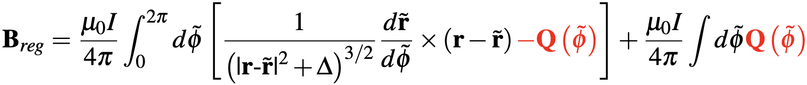
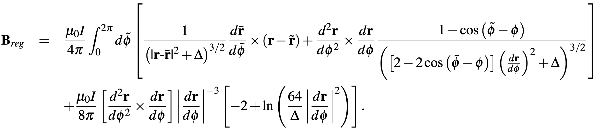
To make integrand smooth, we subtract and add a function with the same singular behavior that can be integrated analytically.
Compute Q by Taylor expansion of integrand about $\tilde{φ}=φ$.
Result:

Slide 24
The singularity-subtraction method allows B and the force to be evaluated with very few quadrature points.
HSX coil 1
Notes:
20230717-03-mayavi_plot_HSX_rectangular_coil_phi0_highlight_ab0p02
CoilForces.plot_force_convergence_single_for_talk()
20230511-01-HSX_force_convergence_vs_nquadpoints.pdf
20230511-02-plot_HSX_coil_with_dot_mayavi_a1cm

Slide 25
Outline
Motivation
Reducing 3D/5D/6D integrals to 1D/2D
Efficient quadrature for the 1D/2D integrals
Future work & conclusions

Slide 26
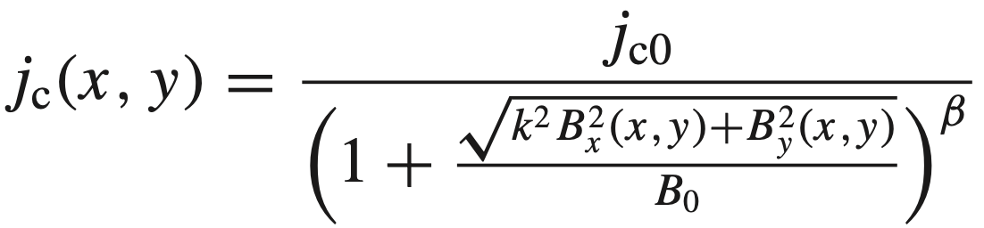
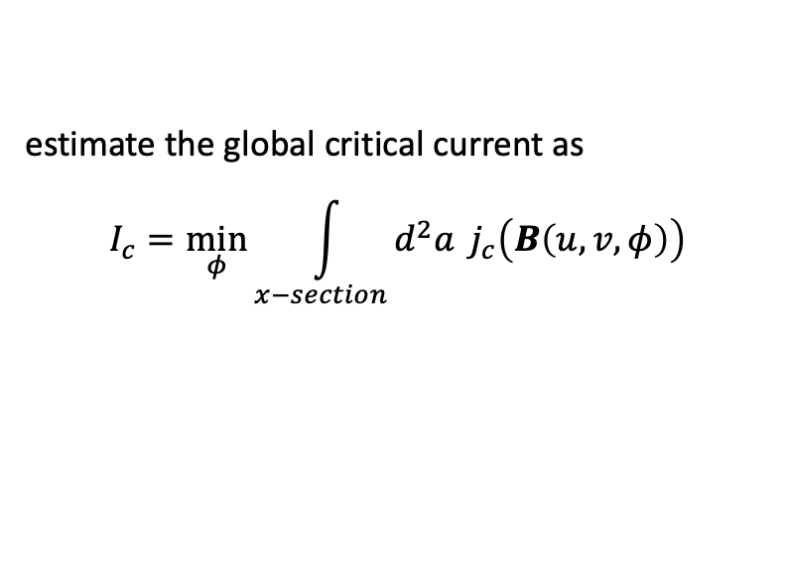
A possible reduced model for the critical current?
Given a model for how the local critical current density depends on B, e.g.
Gömöry and Klinčok (2006)
estimate the global critical current as
$$I_{c}=\min_{φ}{\int_{x−section}{d^{2}a} j_{c}\left(B\left(u,v,φ\right)\right)}$$
azom.com
Not self-consistent, but is it good enough to be useful?

Slide 27
Conclusions & future work
To compute internal B field, self-force, & stored energy of a coil, the finite cross-section matters, & it is not accurate to just drop the singular point.
These quantities can be computed using just a 1D/2D integral if formulated carefully.
New method agrees with high-fidelity finite-cross-section calculations & analytic results.
Next steps:
Apply in coil optimization
Improve applicability to superconductors
Would welcome collaboration with this!

Slide 28
Extra slides

Slide 29
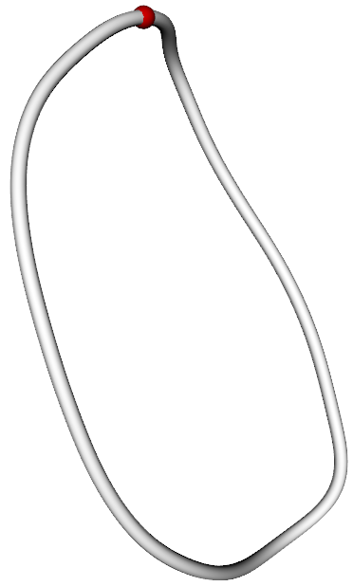
The new filament model agrees with the high-fidelity 3D integral for B in stellarator coils
HSX coil 1
|B| [T], High fidelity
|B| [T], Filament
The individual B components also agree:
B_{z} [T], High fidelity
B_{z} [T], Filament
Notes:
CoilForces.plot_high_fidelity_B_vector_for_HSX_coil_for_talk("HSX_B_a0.01_rtol0.001_atol0.001_nphi1_nn64_nb65_2023-05-11T10.06.03.780.dat")
CoilForces.plot_high_fidelity_B_vector_for_HSX_coil_for_talk("HSX_B_a0.01_rtol0.001_atol0.001_nphi2_nn30_nb31_2023-04-27T09.40.25.165.dat")
20230511-02-plot_HSX_coil_with_dot_mayavi_a1cm

Slide 30
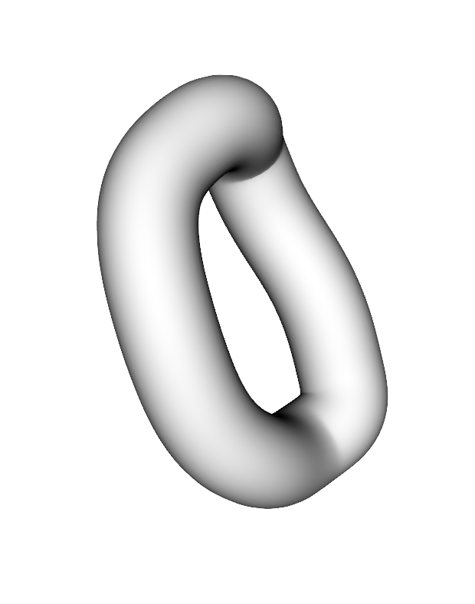
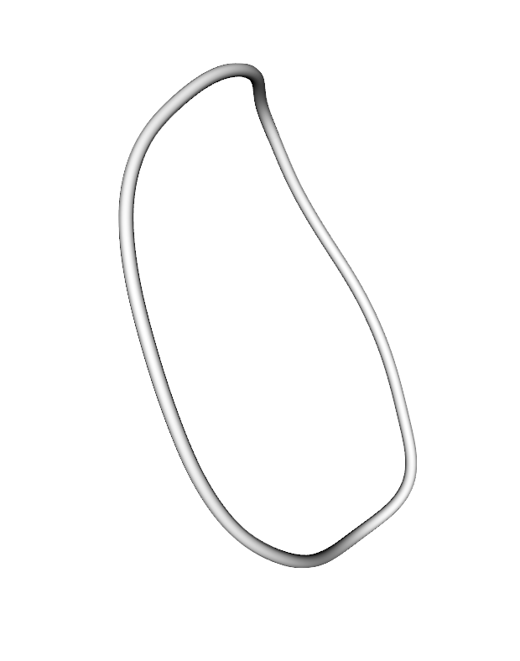



The 1D integral accurately approximates high-fidelity calculations for the self-force in stellarator coils
$dF_{x}/dℓ$ [kN / m] for HSX coil 1, @ 150 kA
High fidelity (5D integral)
1D integral
High fidelity (5D integral)
1D integral
Parameter along curve ($φ$)
Parameter along curve ($φ$)
Notes:
20230508-01-HSX_coil_force_hifi_vs_filament.pdf
Created using CoilForces.plot_hifi_force_and_1D_for_HSX_for_talk()
3D figures created using 20230508-02-plot_HSX_coil_mayavi_a1cm
And 20230508-01-plot_HSX_coil_mayavi_a10cm
The resulting png files were opened in Preview to turn the background white into transparency.

Slide 31
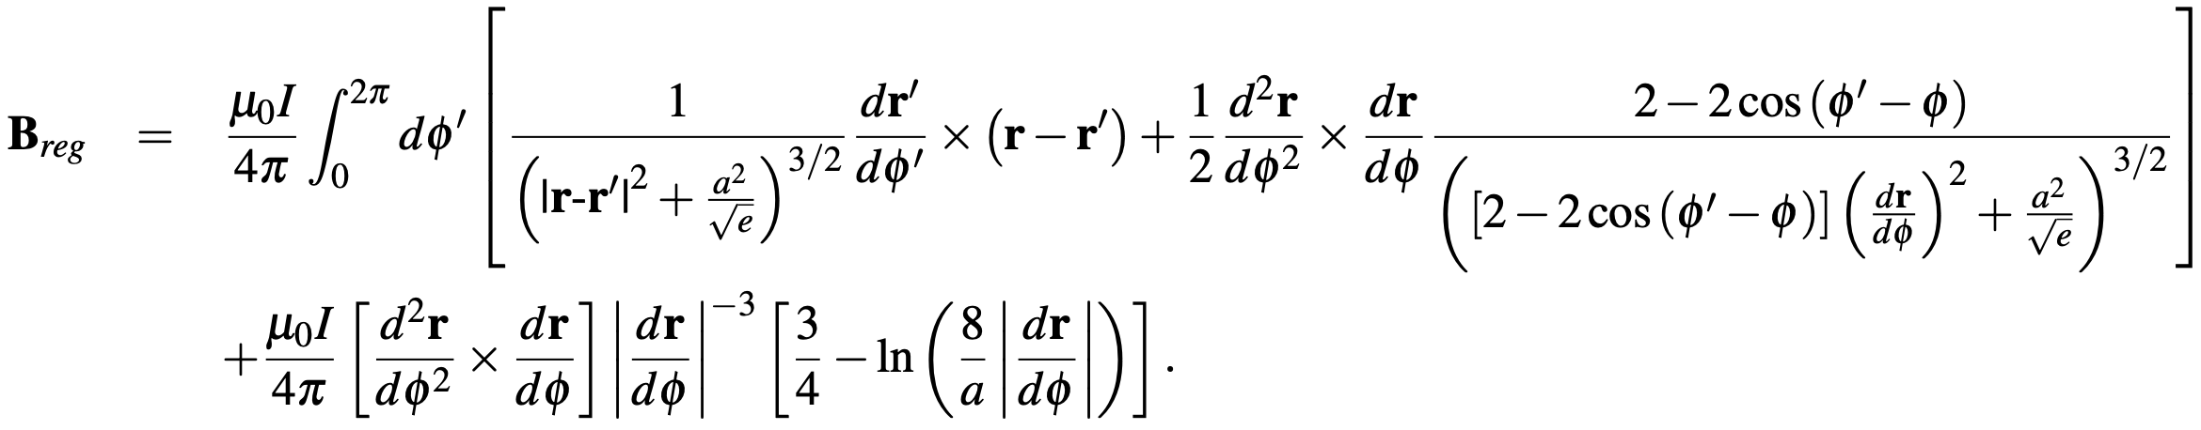
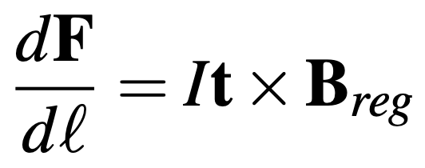
Summary of main results
Internal field:
Self-force:
Notes:
20230501-01_Equations_for_coil_force_talk.pdf

