Slide 1
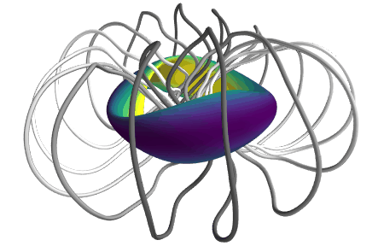
Some numerical topics in stellarator optimization
Matt Landreman, UMD, Institute for Research in Electronics & Applied Physics (IREAP)
David Bindel¹, Stefan Buller², Bill Dorland², Rogerio Jorge³, Alan Kaptanoglu², Patrick Kim², Noah Mandell⁴, Misha Padidar¹, Elizabeth Paul⁵
1 Cornell, 2 UMD, 3 IST Lisbon, 4 Princeton Plasma Physics Laboratory, 5 Columbia

Slide 2
Magnetic fields can be used to confine charged particles & plasma
Magnetic field line
Charged particle (electron or ion)
There is no confinement along the magnetic field, so bend it into a torus.

Slide 3
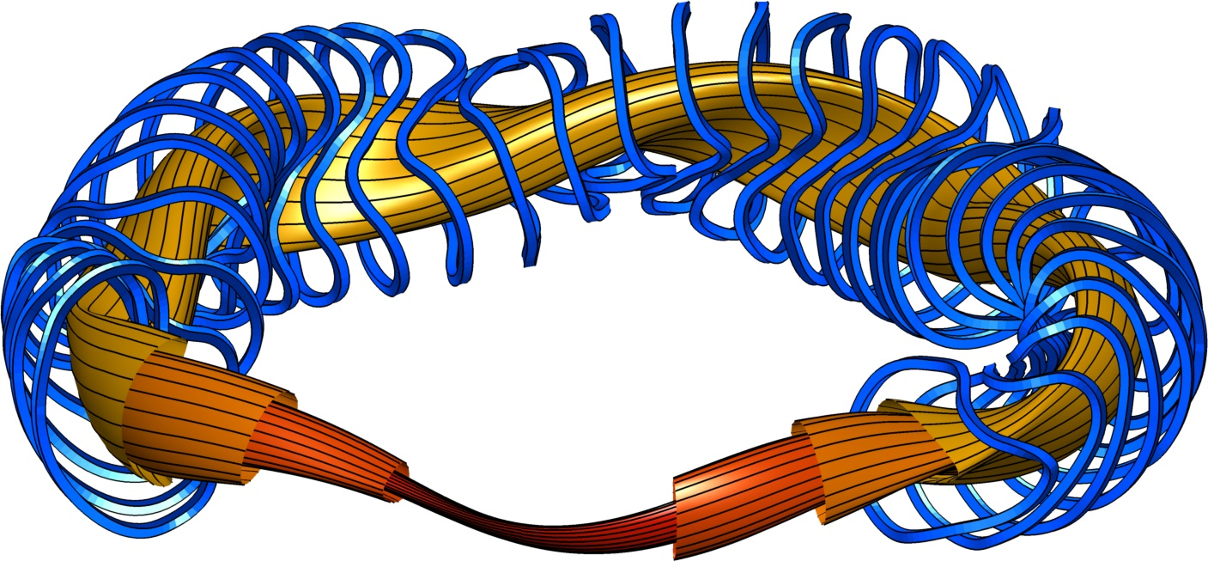
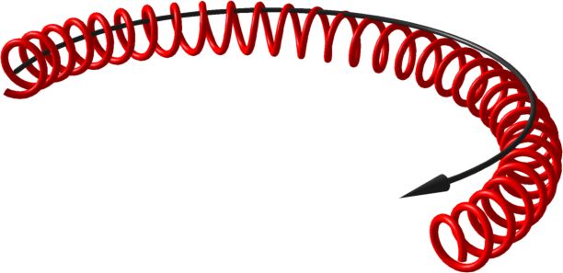
A stellarator is a configuration of magnets for confining plasma without continuous rotation symmetry
Electromagnetic coils
Magnetic field lines
Magnetic surfaces, plasma
Axisymmetry (tokamak) requires large current in plasma: hard to sustain, unstable, sometimes impossible.
Particle trajectory

Slide 4
A stellarator is a configuration of magnets for confining plasma without continuous rotation symmetry
Electromagnetic coils
Magnetic field lines
Magnetic surfaces, plasma
Applications:
Fusion energy
Particle trap for basic physics
Particle trajectory

Slide 5
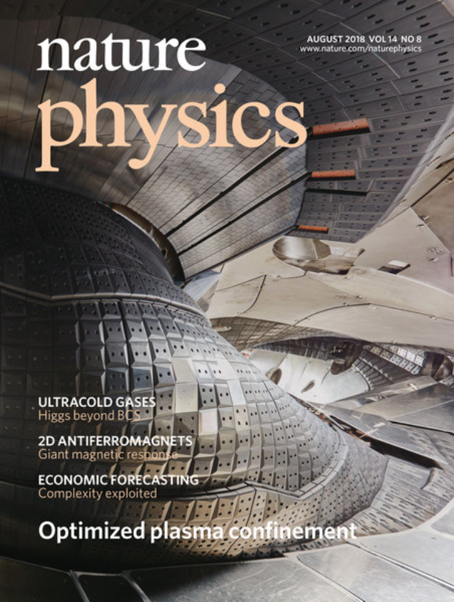
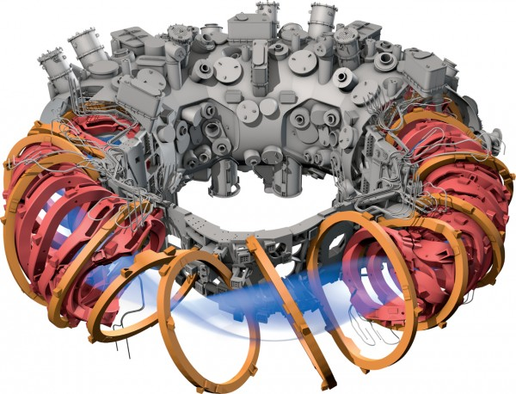
Example: W7-X (Germany)
Clery, Science (2022)

Slide 6
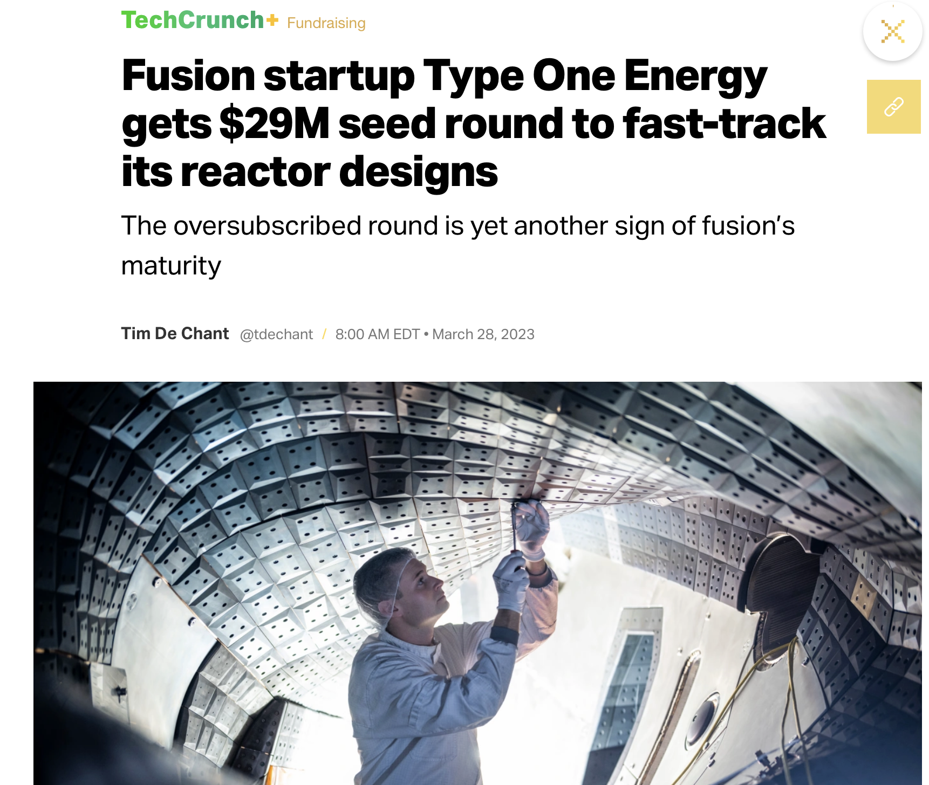

Slide 7
Stellarator plasma & coil shapes can be optimized for several objectives
Field lines lie on nested 2D toroidal surfaces, not volume-filling
Good confinement of particle trajectories
Buildable coil shapes
Any plasma current doesn’t modify B too much
Magnetohydrodynamic stability
Reduced turbulence
Electromagnetic coils
Magnetic field lines
Magnetic surfaces, plasma

Slide 8
Outline
Optimizing plasma shape, directly targeting particle confinement.
Optimizing plasma shape using a surrogate (“quasisymmetry”)
Optimizing plasma shape to reduce turbulence
Topology optimization for magnets

Slide 9
Outline
Optimizing plasma shape, directly targeting particle confinement.
Optimizing plasma shape using a surrogate (“quasisymmetry”)
Optimizing plasma shape to reduce turbulence
Topology optimization for magnets

Slide 10
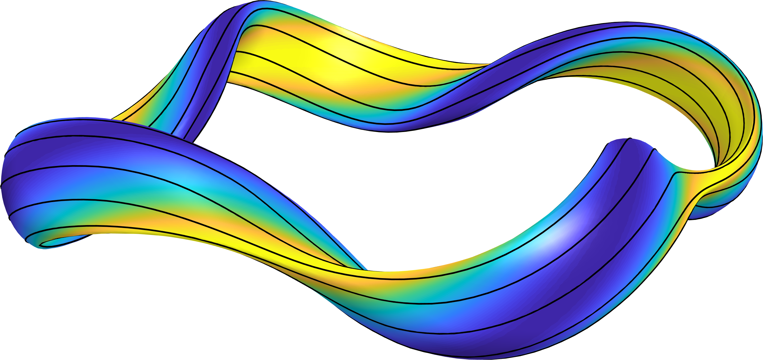
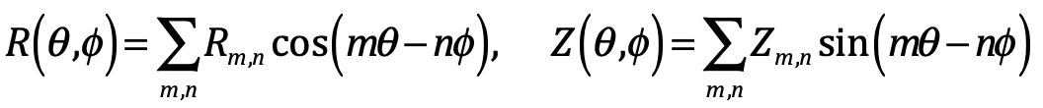

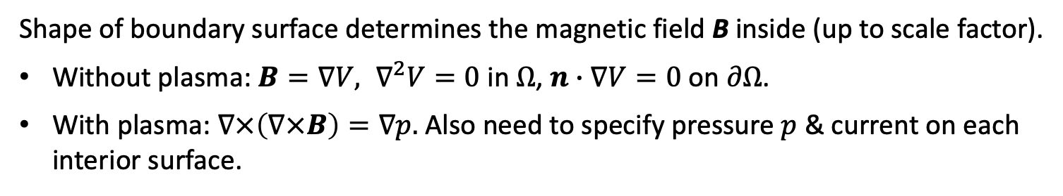
For plasma shape optimization, parameter space is usually
Fourier amplitudes of the boundary surface
$$φ$$
Room for innovation here…
Shape of boundary surface determines the magnetic field B inside (up to scale factor).
Without plasma: $B=∇V, ∇^{2}V=0$ in $Ω$, $n∙∇V=0$ on $∂Ω$.
With plasma: $∇×\left(∇×B\right)=∇p.$ Also need to specify pressure $p$ & current on each interior surface.
Notes:
m20191005_01_plotHSXForEFTCTalk.m

Slide 11
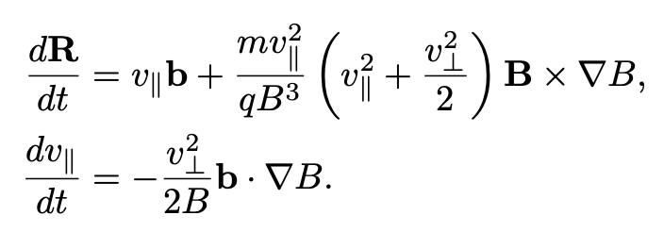
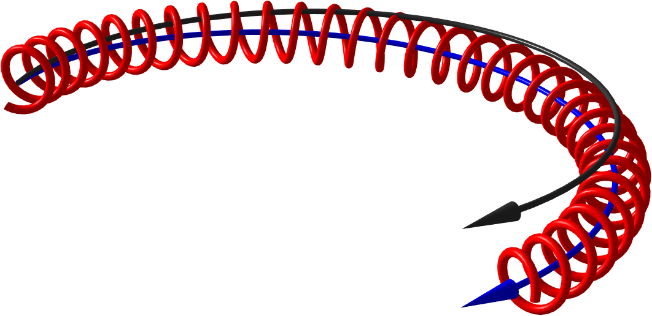
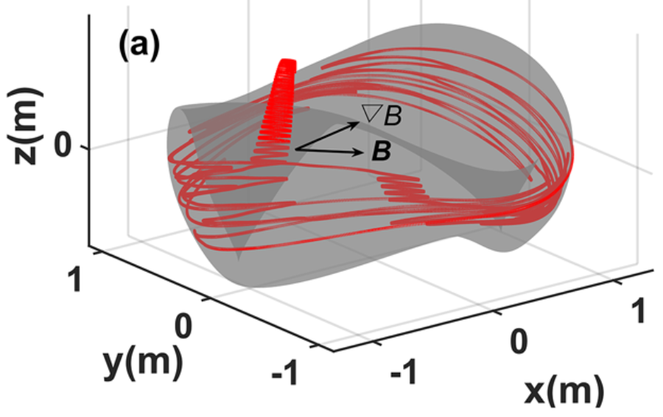
Charged particle trajectories can be simulated accurately using “guiding center” ODEs
Particle trajectory
Magnetic field line
Guiding center trajectory
Su et al (2020)

Slide 12
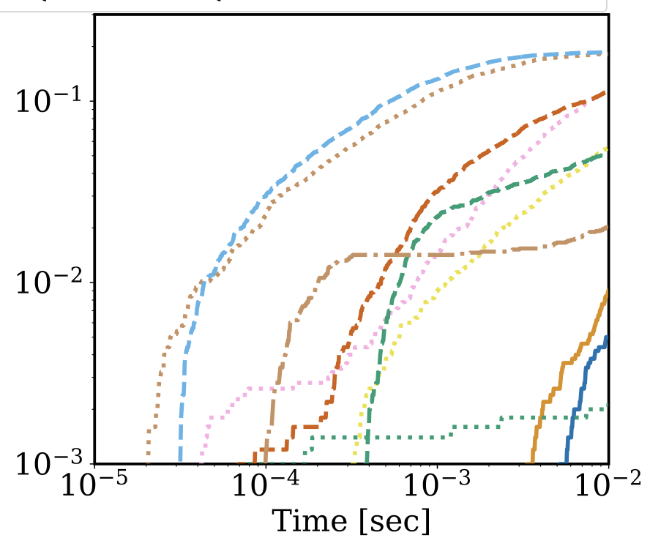
Charged particle trajectories can be simulated accurately using “guiding center” ODEs
Fraction of particles lost in various stellarators
Su et al (2020)

Slide 13
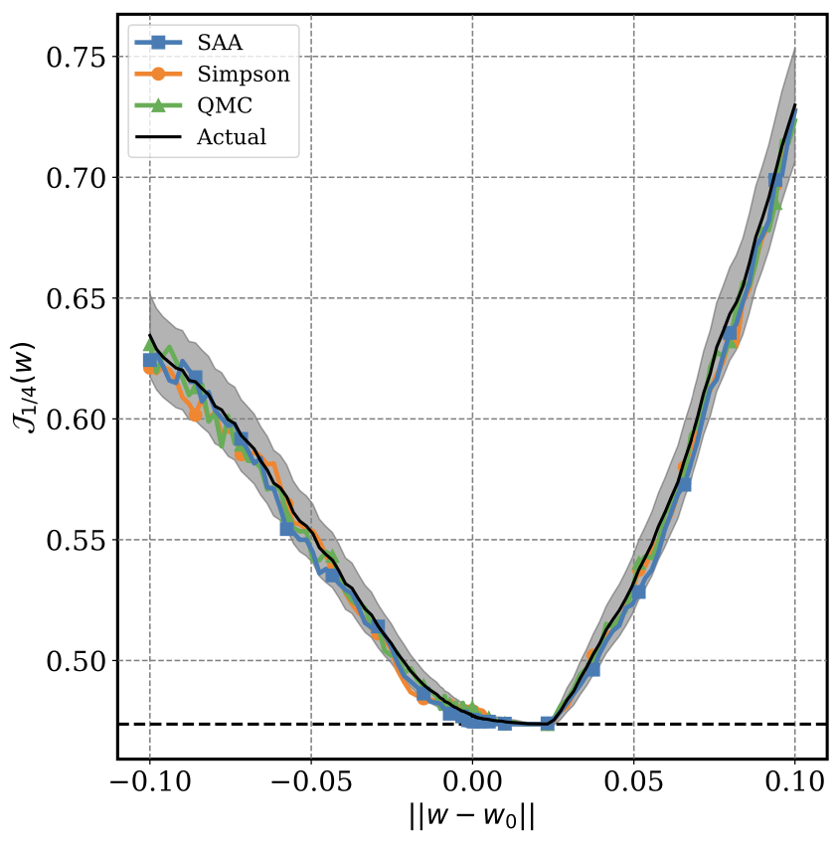
Direct optimization of particle confinement is challenging due to computational cost & noise
4096 particles
MC, 32,000 particles
Energy loss, integrating over initial conditions (objective function)
Bindel, ML, Padidar, arXiv (2023)
Line through parameter space

Slide 14
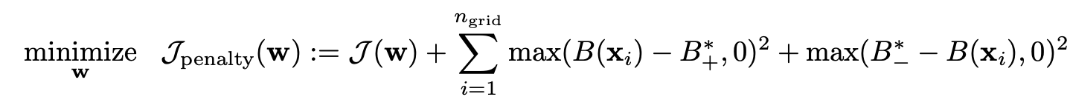
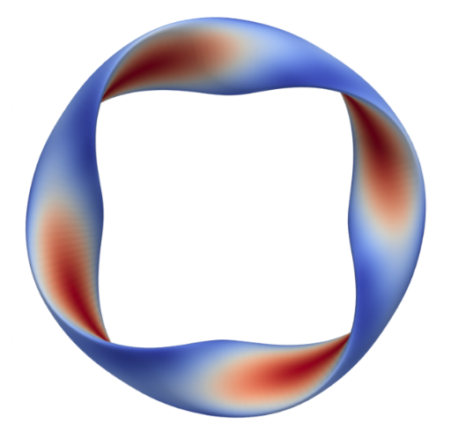
Improvement in confinement can be achieved with this direct approach
Bindel, ML, Padidar, arXiv (2023)
Energy losses
Fraction of particles lost
Other stellarator shapes
Notes:
See https://github.com/mishapadidar/alpha_particle_opt/blob/main/experiments/plot/make_loss_profile_data.py
The A and B configurations are (respectively)
nfp4_QH_cold_high_res_phase_one_mirror_1.35_aspect_7.0_iota_0.89
nfp4_QH_cold_high_res_phase_one_mirror_1.35_aspect_7.0_iota_1.043

Slide 15
Outline
Optimizing plasma shape, directly targeting particle confinement.
Optimizing plasma shape using a surrogate (“quasisymmetry”)
Optimizing plasma shape to reduce turbulence
Topology optimization for magnets

Slide 16
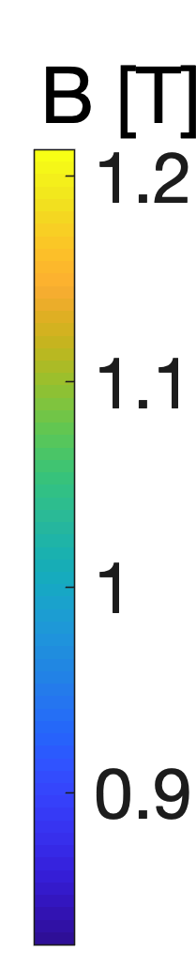
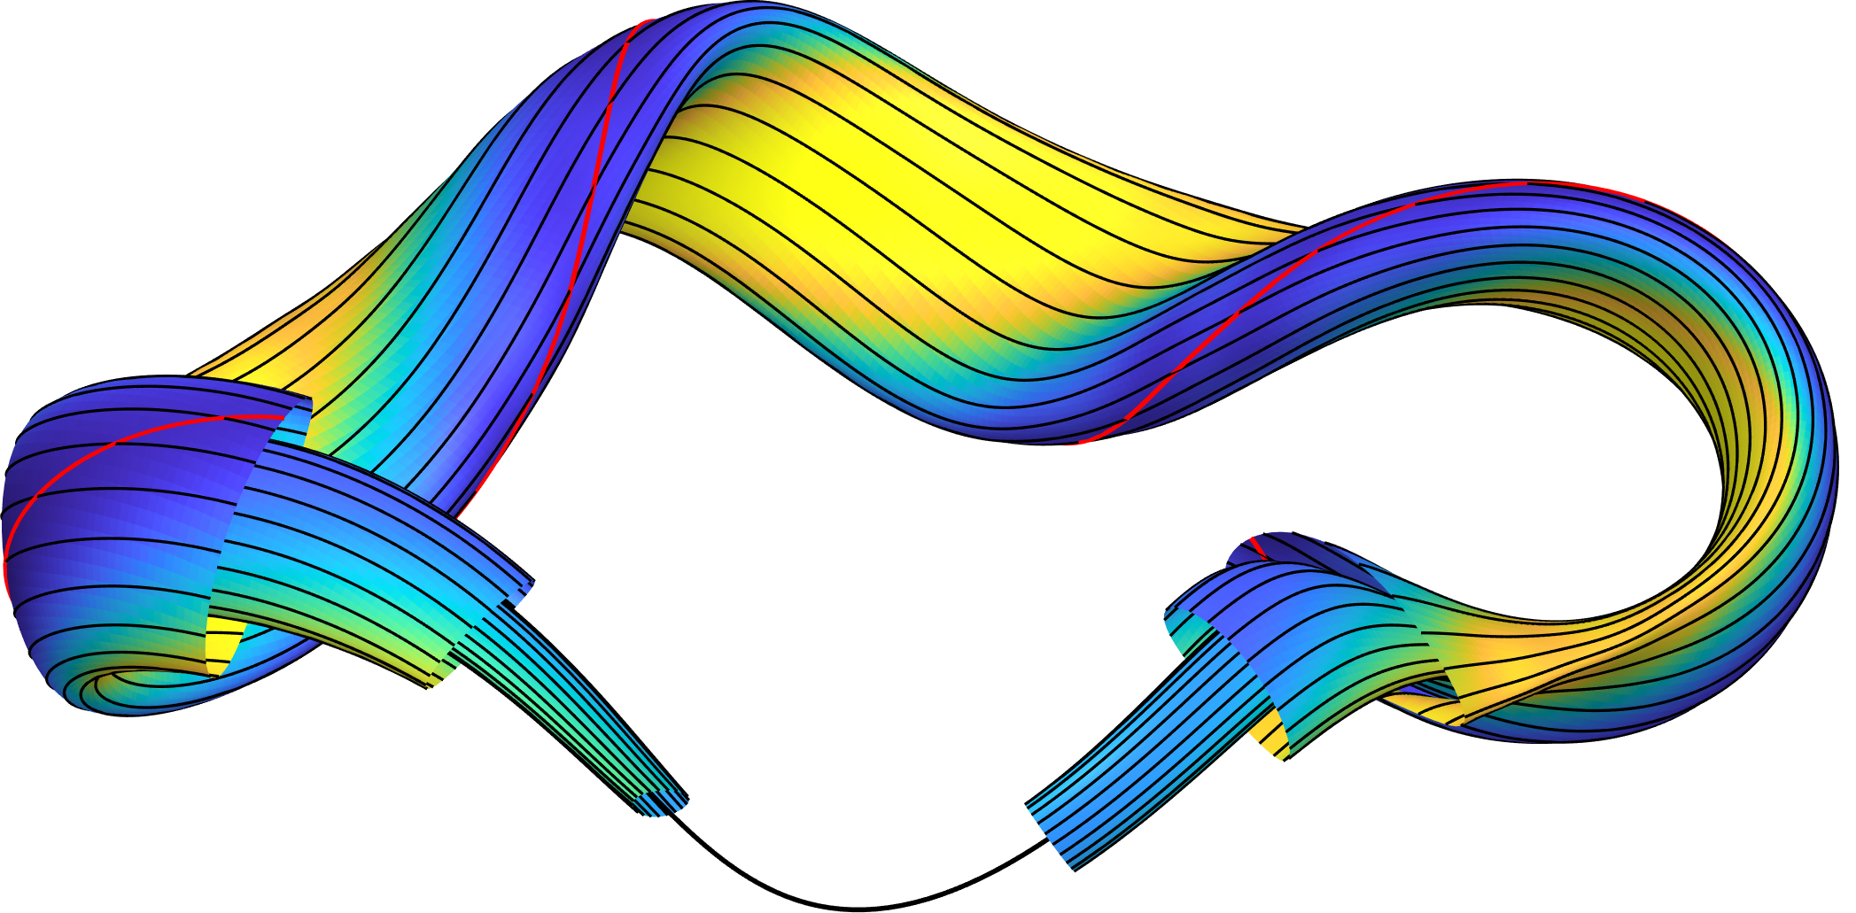
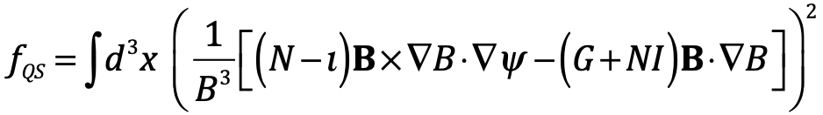
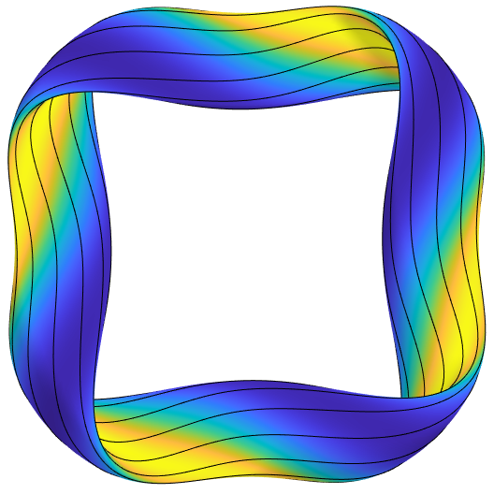

Quasisymmetry is a sufficient (though not necessary) condition for confinement, & a useful surrogate
𝜃
Magnetic field lines
B = B(s, 𝜃 − N 𝜑)
𝜑
“Boozer angles”
Constant s = normalized toroidal flux
Objective:
e.g.
N = 4
here
For quasi-axisymmetry,
N = 0.
For quasi-helical symmetry,
N is the number of field periods,
Boundary aspect ratio

Slide 17
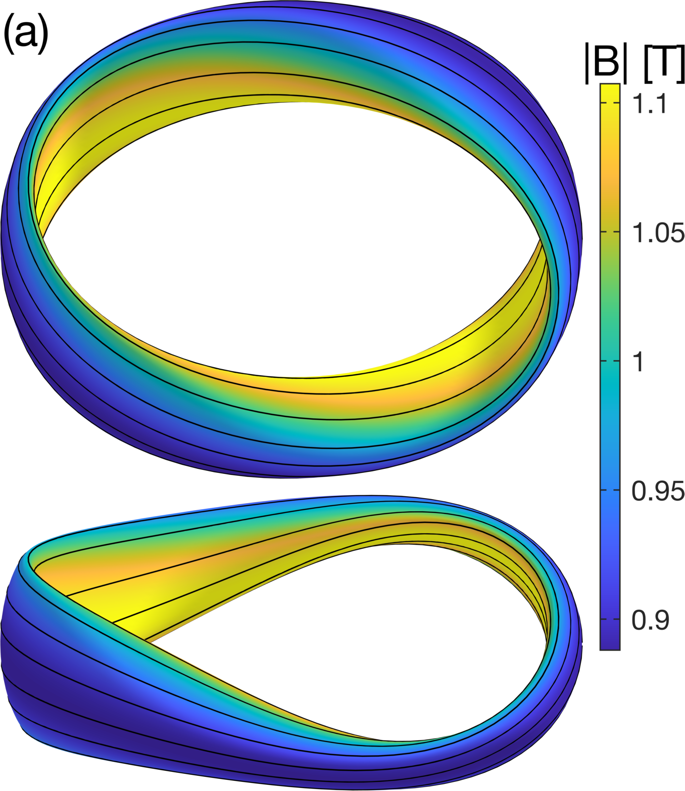
Example of quasi-axisymmetry optimization
Optimization details:
Default algorithm in scipy for nonlinear least-squares (“trust region reflective”)
Initialize with circular cross-section torus.
Gradients from finite differences or automatic differentiation.
Expand the number of Fourier modes in the parameter space in steps. 8-120 design variables.
ML & Paul, Phys Rev Lett (2022)

Slide 18
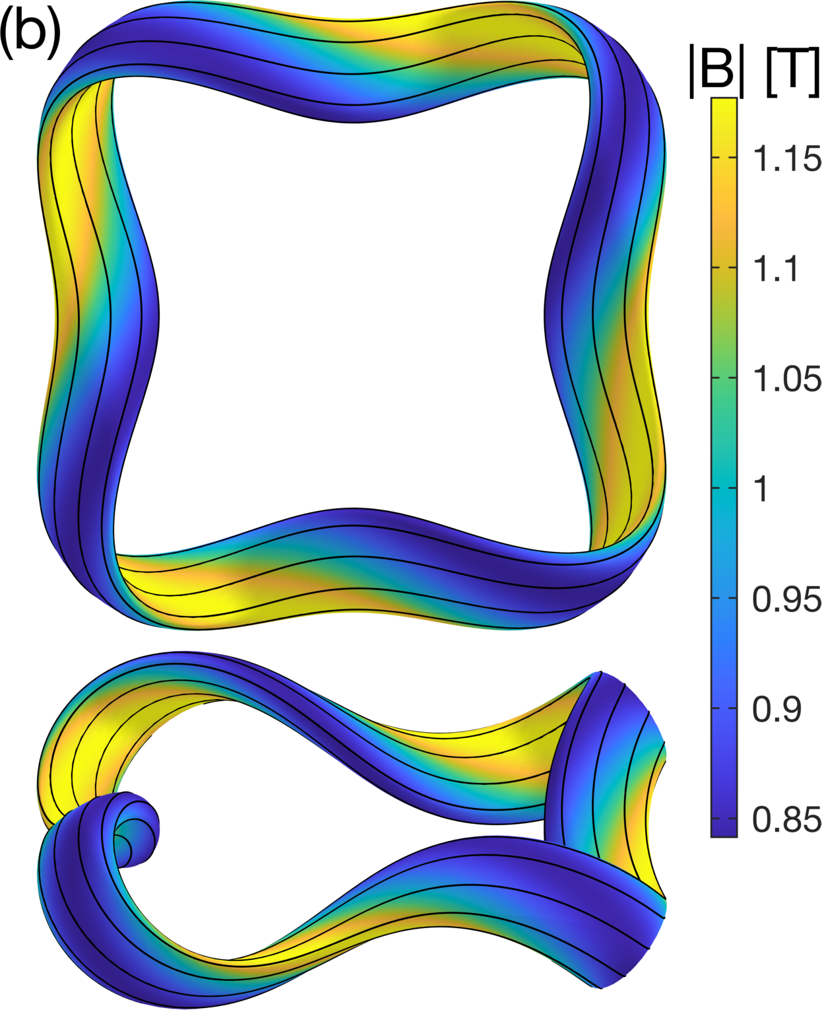
Example of quasi-helical symmetry optimization
ML & Paul, Phys Rev Lett (2022)

Slide 19
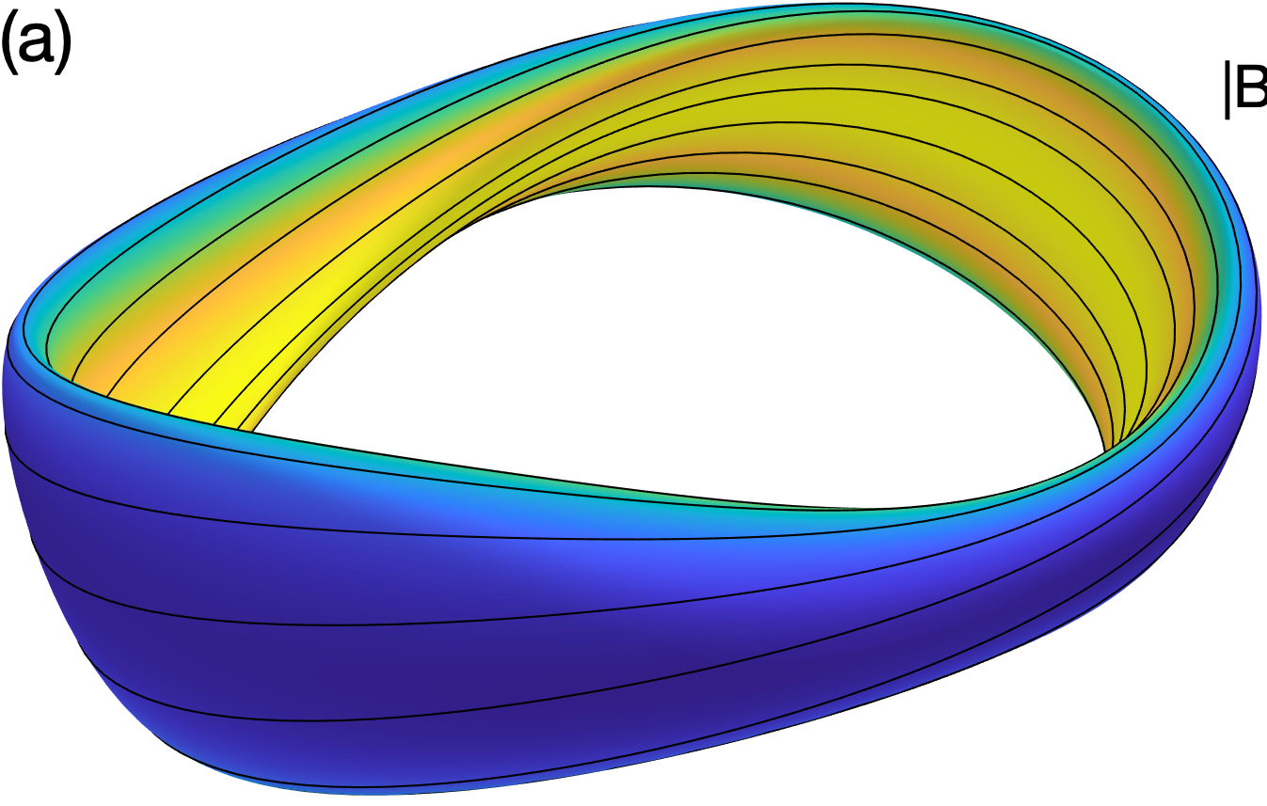
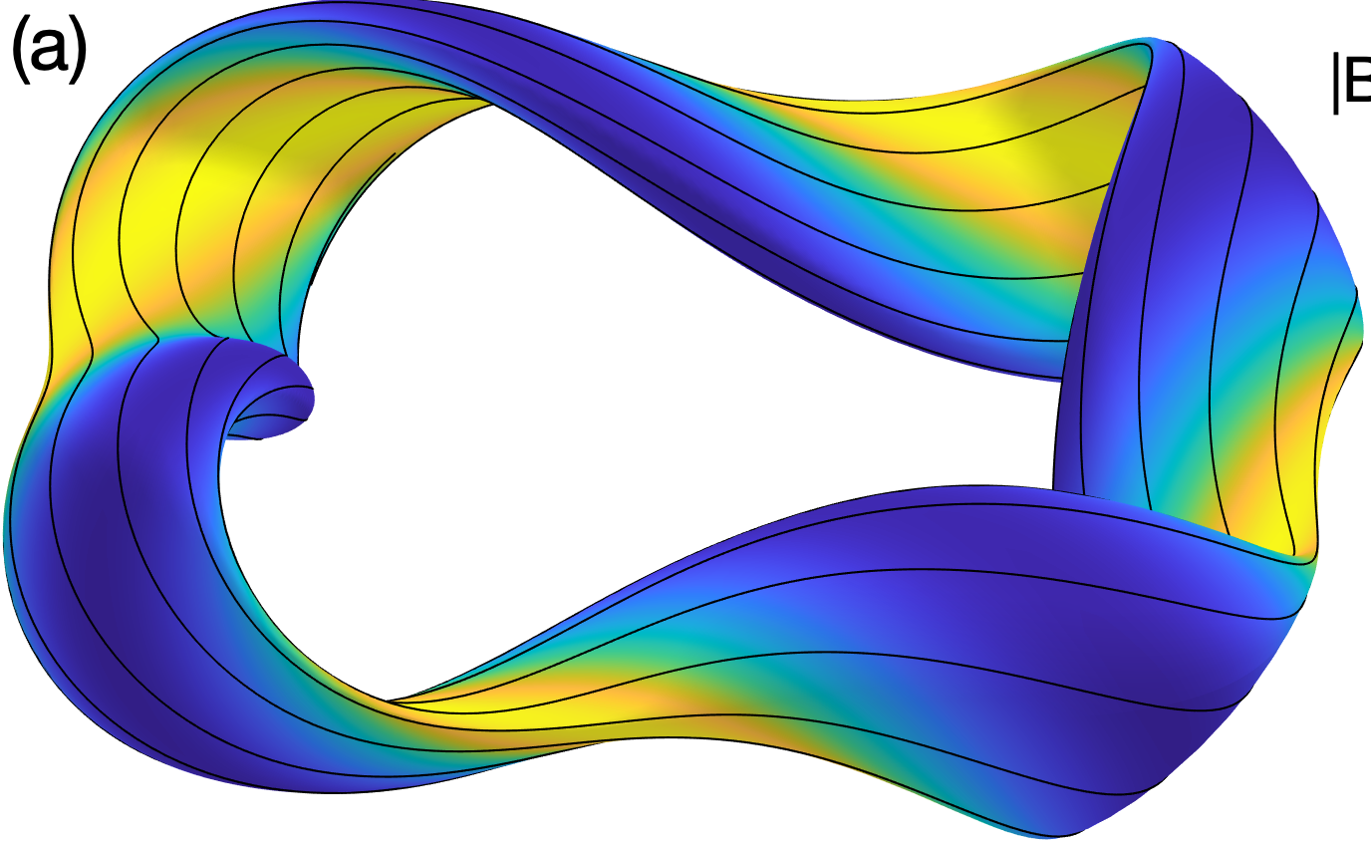
Quasisymmetry has been an effective surrogate for finding plasma shapes with good confinement, though it might be too limiting.
Trajectories of fusion-produced distribution of alpha particles followed in many magnetic configurations, all scaled to reactor size and |B|:
Since 2021
Fraction of alpha-particle energy lost before thermalization
Multi-fidelity method with quasisymmetry + direct ODE integration?

Slide 20
Outline
Optimizing plasma shape, directly targeting particle confinement.
Optimizing plasma shape using a surrogate (“quasisymmetry”)
Optimizing plasma shape to reduce turbulence
Topology optimization for magnets

Slide 21
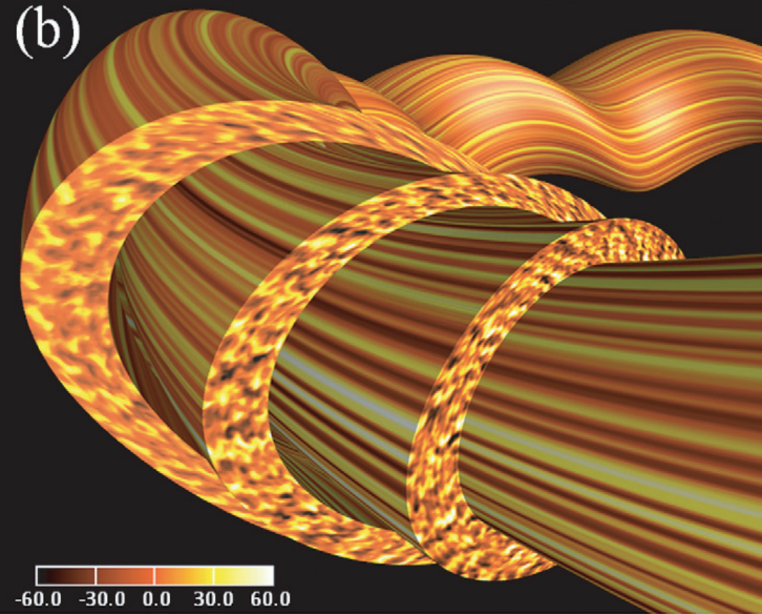
Shape optimization to reduce plasma turbulence would be valuable but is hard
Gradients of plasma density & temperature cause instabilities & turbulence.
Causes heat to leak out.
Known to depend on plasma shape.
Turbulence simulations: ~10 GPU-min to 10⁶s of CPU-hours.
5D + time
No agreed-upon surrogate like Reynolds-averaged Navier-Stokes + closure yet.
Nunami 2012
Notes:
Turbulence image from http://fusionsites.ciemat.es/gyrokineticsmadrid2014/files/2014/06/Nunami.pdf
From https://aip.scitation.org/doi/pdf/10.1063/1.4704568 Nunami et al., PoP 19, 042504 (2012)

Slide 22
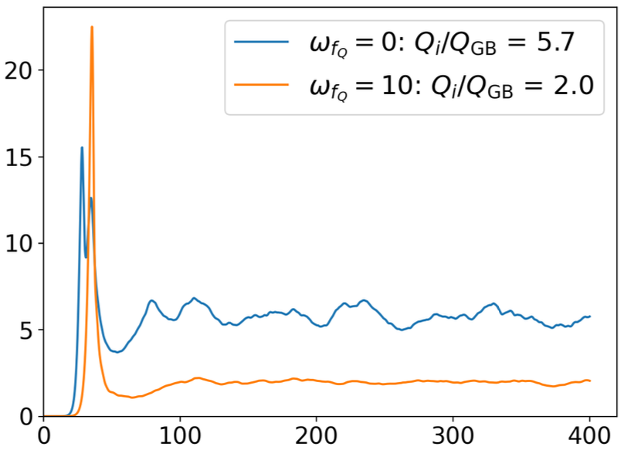
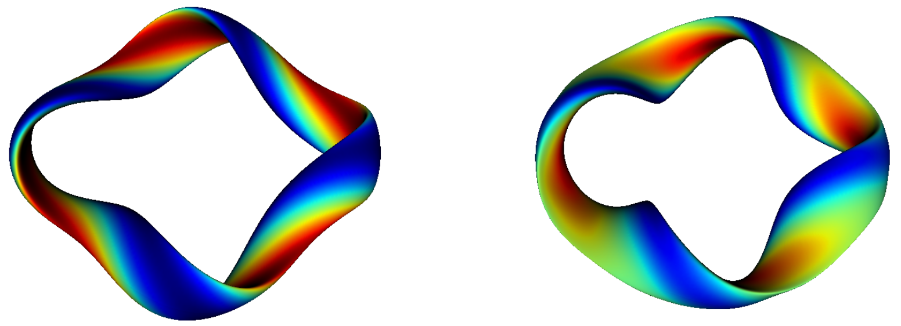
One approach to optimizing turbulence: minimize linear growth rate of instabilities
Linear growth rate gives a smooth, deterministic, non-chaotic objective
Jorge et al, arXiv (2023)
Heat flux out of the plasma
Stellarator optimized for only quasisymmetry
Stellarator also optimized for linear growth rate
Stellarator optimized for only quasisymmetry
Stellarator also optimized for linear growth rate
time
Linear phase
But linear growth rate is not a perfect predictor of the nonlinear heat flux…

Slide 23
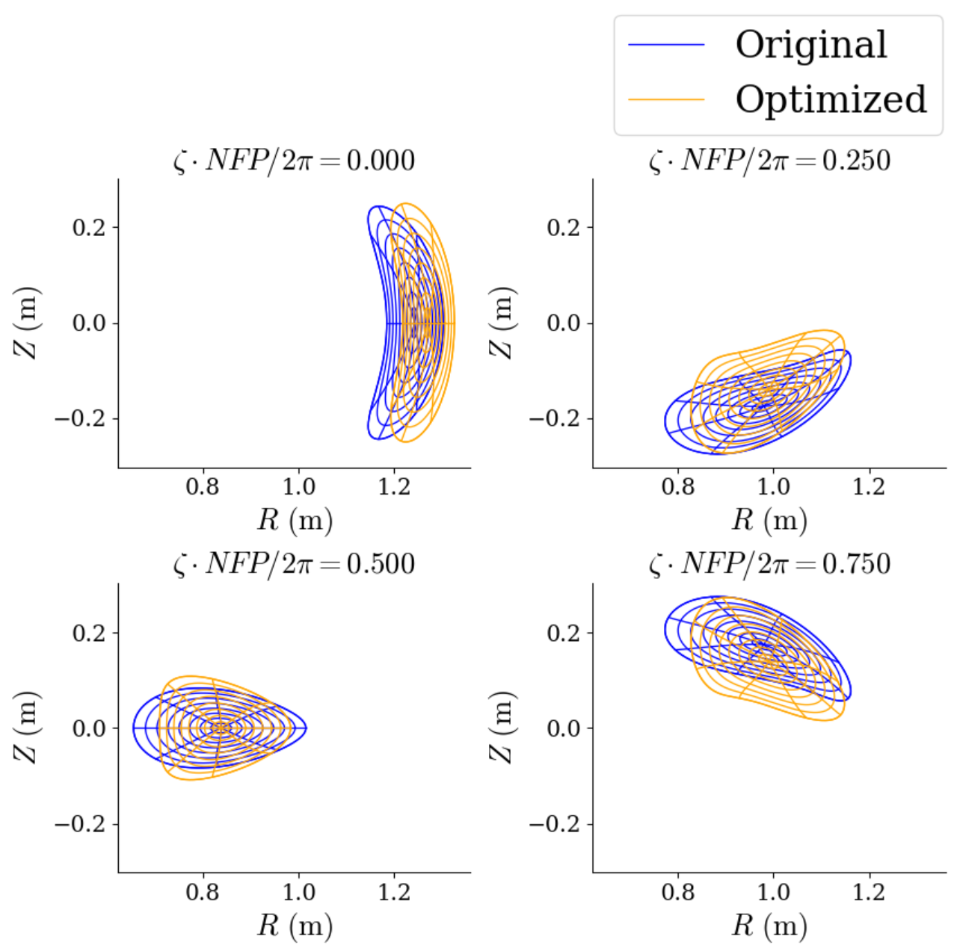
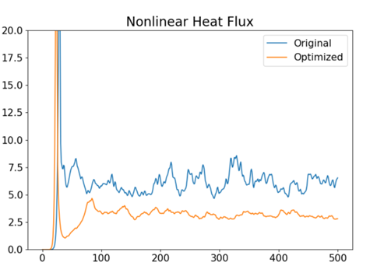
First optimizations with nonlinear turbulence calculations in the objective
By Patrick Kim (UMD undergraduate!)
Using stochastic gradient descent with momentum
time
Bayesian optimization with 20-100 design variables would be nice…

Slide 24
Outline
Optimizing plasma shape, directly targeting particle confinement.
Optimizing plasma shape using a surrogate (“quasisymmetry”)
Optimizing plasma shape to reduce turbulence
Topology optimization for magnets

Slide 25
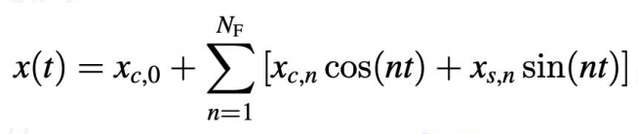
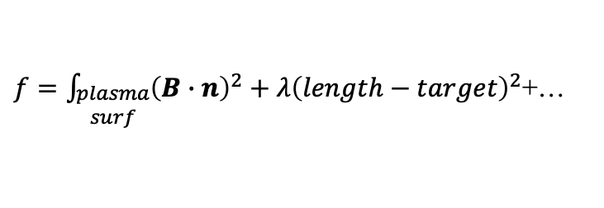
An established method for electromagnetic coil design is available, but has some limitations
Assume plasma shape has already been optimized, so target B field is known.
Coils represented as space curves.
Design variables: Fourier modes of Cartesian components.
Objective:
$f=\int_{\begin{aligned}plasma \\ surf\end{aligned}}{{\left(B∙n\right)}^{2}}+λ{\left(length−target\right)}^{2}$+…
Match target B
Regularization
Issues:
Non-convex, so there are multiple local minima. Need good initial guess.
Coil topology & number of coils are fixed by initial guess.

Slide 26
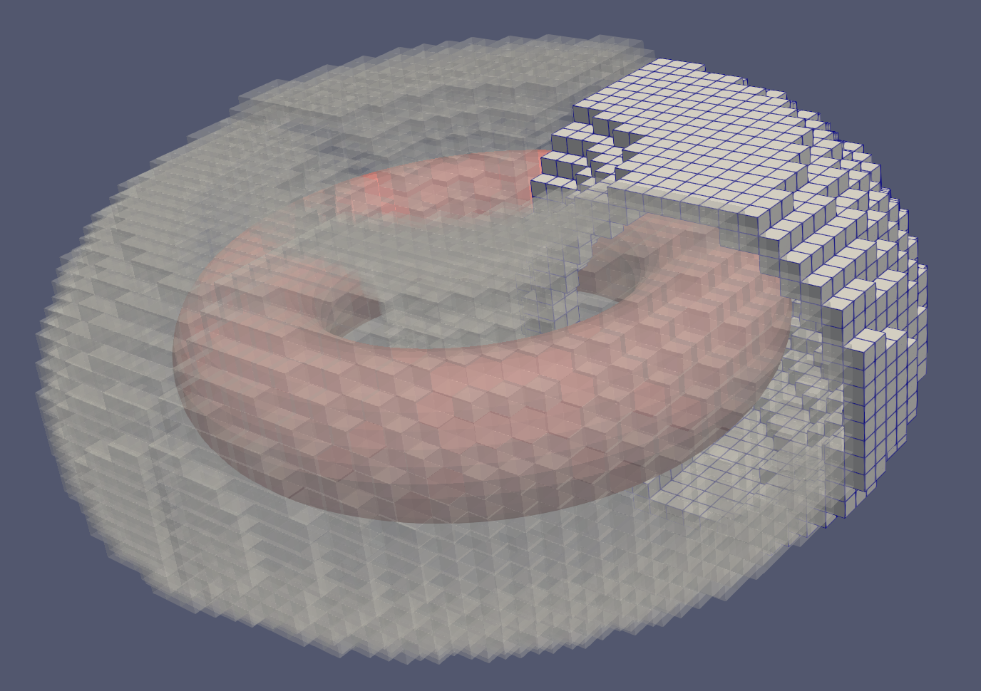
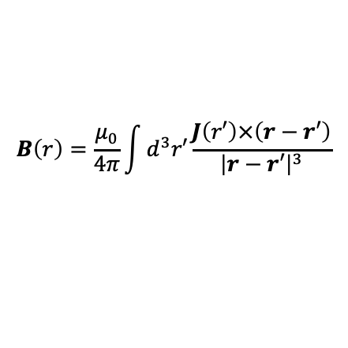
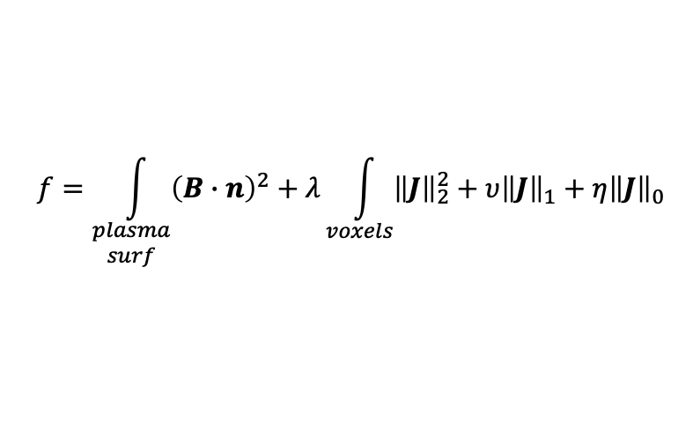
New topology optimization method for electromagnetic coils
Pre-define grid of voxels where current might flow.
Current density J in each voxel represented by basis of 11 divergence-free functions. Amplitudes are the design variables.
Current conservation at each cell face gives linear equality constraints.
Given basis functions, B can be computed by Biot-Savart Law:
Work by Alan Kaptanoglu
$$B\left(r\right)=\frac{μ_{0}}{4π}\int{d^{3}r′}\frac{J\left(r′\right)×\left(r−r′\right)}{{\left|r−r′\right|}^{3}}$$
Objective:
$$f=\int_{\begin{aligned}plasma \\ surf\end{aligned}}{{\left(B∙n\right)}^{2}}+λ\int_{voxels}{{\left\|J\right\|}_{2}^{2}}+υ{\left\|J\right\|}_{1}+η{\left\|J\right\|}_{0}$$
Without sparsity-promoting terms, problem is linear.
With l1 sparsity, problem remains convex.
With l0 sparsity, good algorithms exist.
Match target B
Regularization

Slide 27
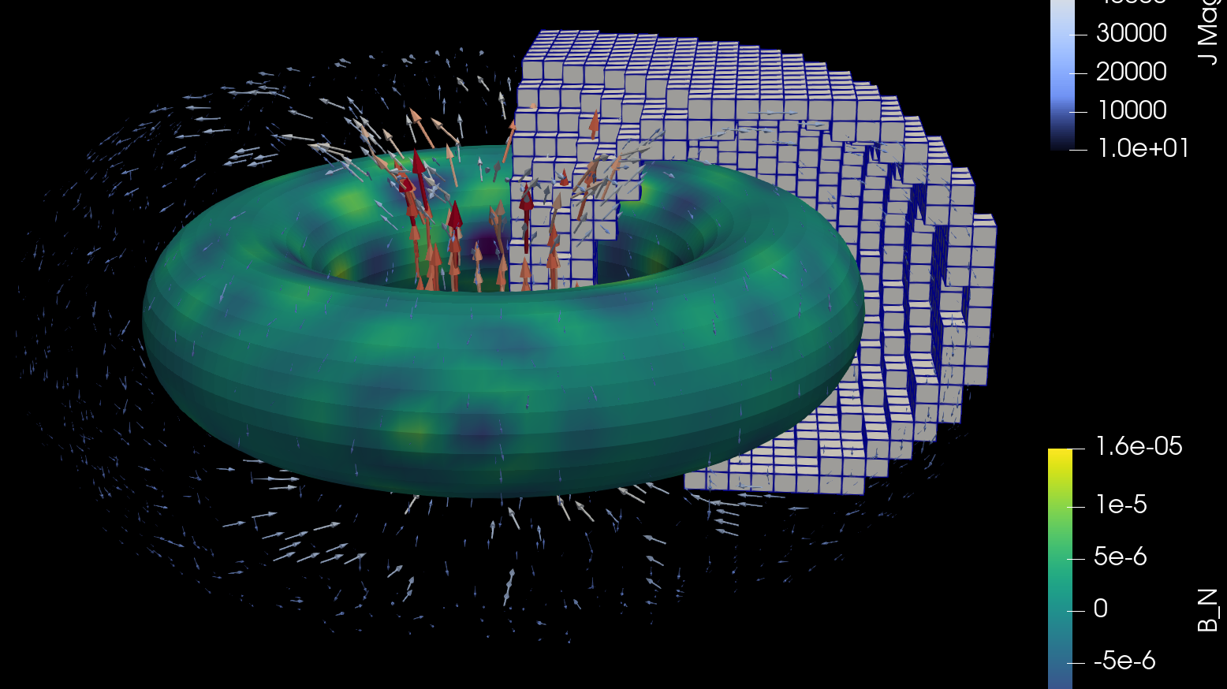
Preliminary results from electromagnet topology optimization:
In axisymmetry, expected currents are recovered

Slide 28
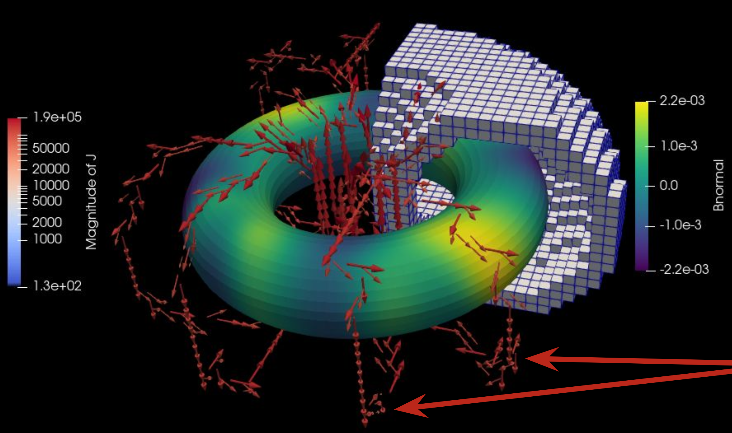
Preliminary results from electromagnet topology optimization:
With sparsity objective, currents coalesce into discrete coils

Slide 29
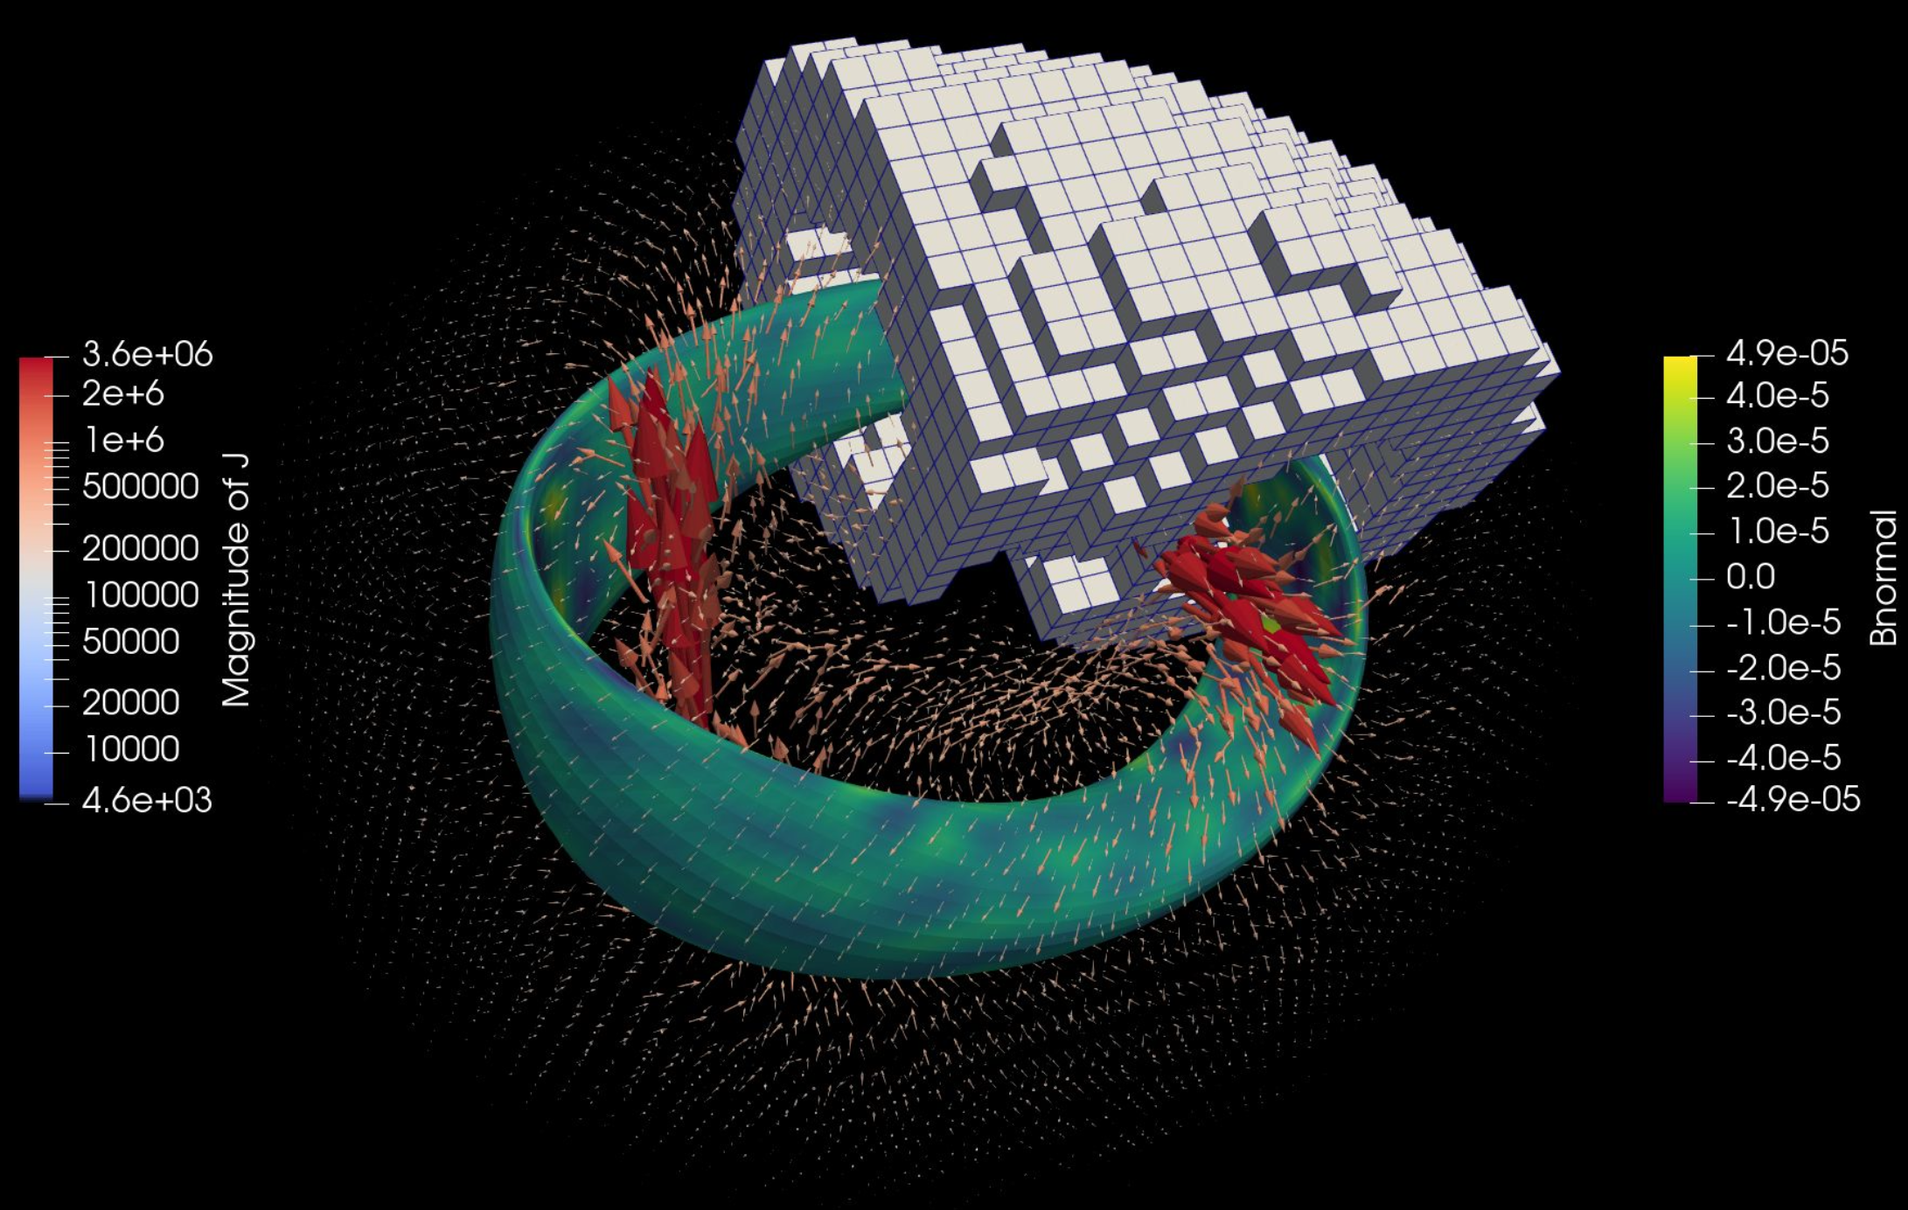
Preliminary results from electromagnet topology optimization:
Starting to look at non-axisymmetric geometries

Slide 30
Conclusions: stellarator optimization is a subject with many challenging numerical problems
This talk:
Shape optimization for confining particle trajectories, with PDE & possibly ODE solves.
Shape optimization with linear stability or nonlinear turbulence simulations in the loop.
Topology optimization for electromagnets.
Many other directions:
Other surface & curve discretizations
Multi-fidelity
Surrogates for confinement or turbulence
≥ 4D advection-dominated PDEs
Uncertainty quantification
…

Slide 31
Extra slides

Slide 32
A stellarator is a configuration of magnets for confining plasma without continuous rotation symmetry
Electromagnetic coils
Magnetic field lines
Magnetic surfaces, plasma
Applications: fusion energy, or electron-positron plasmas (astrophysics)
Shape of the plasma and of the coils is chosen by numerical optimization.

Slide 33
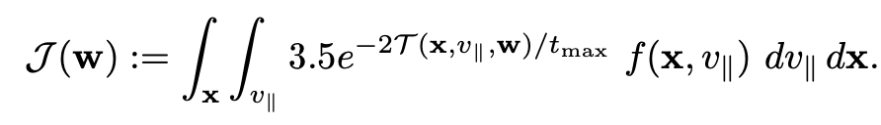
Direct optimization of particle confinement is challenging due to computational cost & noise
Objective function to measure energy loss:
Energy at loss time
1 if particle is lost, else 0
Initial condition

Slide 34
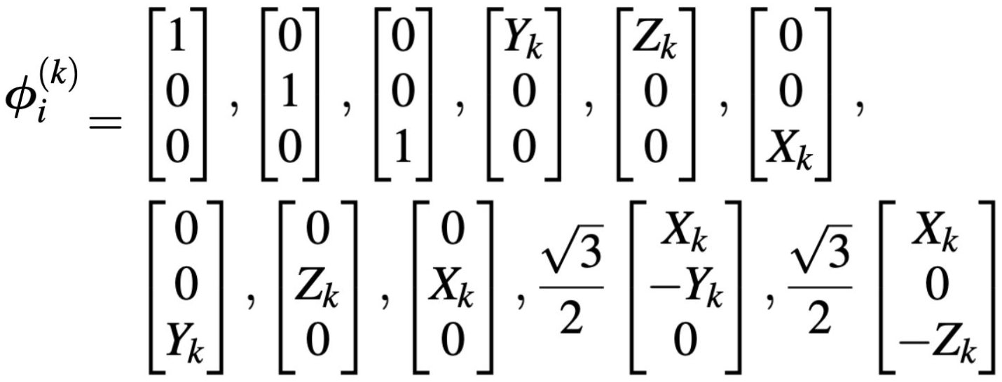
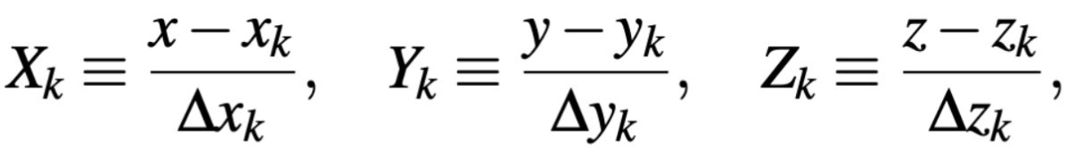
Divergence-free basis functions for current density J
where

