Slide 1
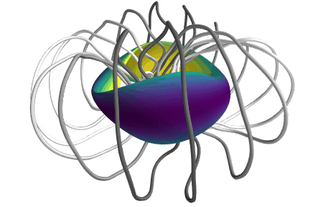
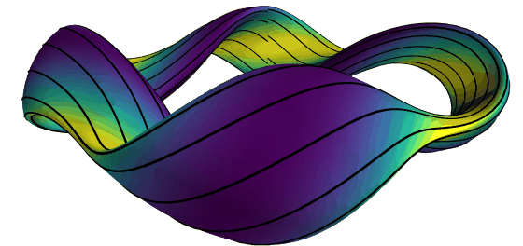
Achieving energetic particle confinement in stellarators with precise quasisymmetry
M Landremanª, A Cerfon^{b}, M Drevlak^{c}, A Giuliani^{b}, B Medasani^{d}, E J Paul^{d}, G Stadler^{b}, F Wechsung^{b}, C Zhu^{e}
ª U of Maryland, ^{b} New York U, ^{c} Max Planck Institute for Plasma Physics, ^{d} PPPL, ^{e} U of Science & Technology of China
Landreman & Paul, PRL (2022), Wechsung et al, PNAS (2022)
Notes:
~/Box Sync/work22/20220304-01-animated_gifs_for_simons_talk/20220304-01-001_simsopt_QH_beta0p05_animated_gif
~/Box Sync/work22/20220304-01-animated_gifs_for_simons_talk/20220304-01-002-preciseQAWithWellFromSimsopt_animated_gif

Slide 2
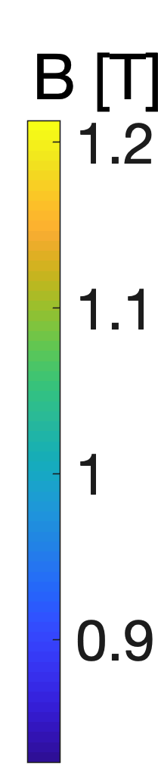
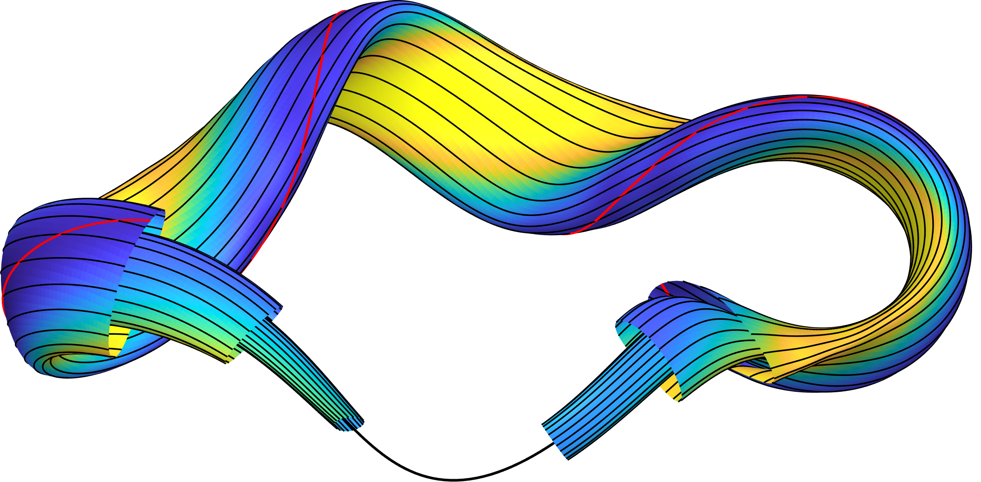
Advantages of stellarators: steady-state, no disruptions, no Greenwald density limit, no power recirculated for current drive.
But, alpha particle losses & collisional transport would be too large unless you carefully choose the geometry.
Magnetic field lines
Notes:
m20191005_01_plotHSXForEFTCTalk.m
m20191111_01_QHSIllustrationWithMagneticAxis_edited.png
m20210315_01_QHSIllustrationWithMagneticAxis_a

Slide 3
Remarkable progress in stellarator confinement in the last year
All configurations scaled to same minor radius and |B|.
See also Bader et al, Nuclear Fusion (2021).
Notes:
20220323-01-alphaLossBarChart_nr600_nphi400_nz401

Slide 4
Advantages of stellarators: steady-state, no disruptions, no Greenwald density limit, no power recirculated for current drive.
But, alpha particle losses & collisional transport would be too large unless you carefully choose the geometry.
A solution: quasisymmetry
𝜃
Magnetic field lines
B = B(s, 𝜃 − N 𝜑)
Boozer angles
𝜑
Constant s = normalized toroidal flux
Notes:
m20191005_01_plotHSXForEFTCTalk.m
m20191111_01_QHSIllustrationWithMagneticAxis_edited.png
m20210315_01_QHSIllustrationWithMagneticAxis_a

Slide 5
Goal: B = B(s, 𝜃 − N 𝜑)
Since 2021
ML & Paul,
Phys Rev Lett (2022)
Wechsung et al,
PNAS (2022)
Giuliani et al,
1-stage, arXiv (2022)
Nies & Paul
Adjoint method
Near-axis expansion
5% 𝛽, Self-consistent plasma current
Quasi-axisymmetry (QA)
N = 0
Quasi-helical symmetry (QH)
N ≠ 0
Notes:
~/Box Sync/work21/20210711-01-imperfect_symmetry_figure/20210711-01-007-imperfect_symmetry_figure_8x1
Colorbar: Box Sync/work22/20220126-01-BOnSurfacesForWechsungPreciseQACoilsPaper/20220126-01-004_BOnSurfacesForWechsungPreciseQACoilsPaper
~/Box Sync/work22/20220304-02-recent_QS_configs_for_Simons_talk

Slide 6
Optimizing stellarator geometry for precise quasisymmetry
Self-consistent bootstrap current
Conclusions

Slide 7
Optimizing stellarator geometry for precise quasisymmetry
Self-consistent bootstrap current
Conclusions

Slide 8
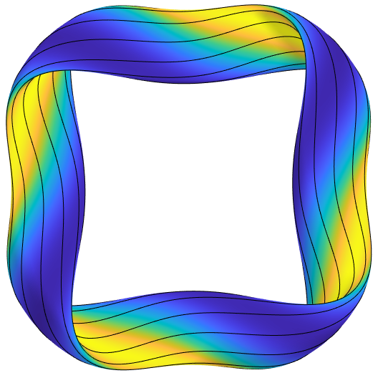
Optimization problem
2 stage approach, as for W7-X: First optimize shape of boundary surface, then coils.
Objective functions:
Boundary aspect ratio
Goal: B = B(s, 𝜃 − N 𝜑).
For quasi-axisymmetry,
N = 0.
For quasi-helical symmetry,
N is the “number of field periods”,
e.g. N = 4
here

Slide 9
Optimization problem
2 stage approach, as for W7-X: First optimize shape of boundary surface, then coils.
Objective functions:
Parameter space: R_{m,n} & Z_{m,n} defining a toroidal boundary
Codes used: SIMSOPT with VMEC
Cold start: circular cross-section torus
Vacuum fields at first, allowing precise checks
Algorithm: default for least-squares in scipy (trust region reflective)
6 steps: increasing # of modes varied & VMEC resolution
Run many optimizations, pick the best
Boundary aspect ratio

Slide 10
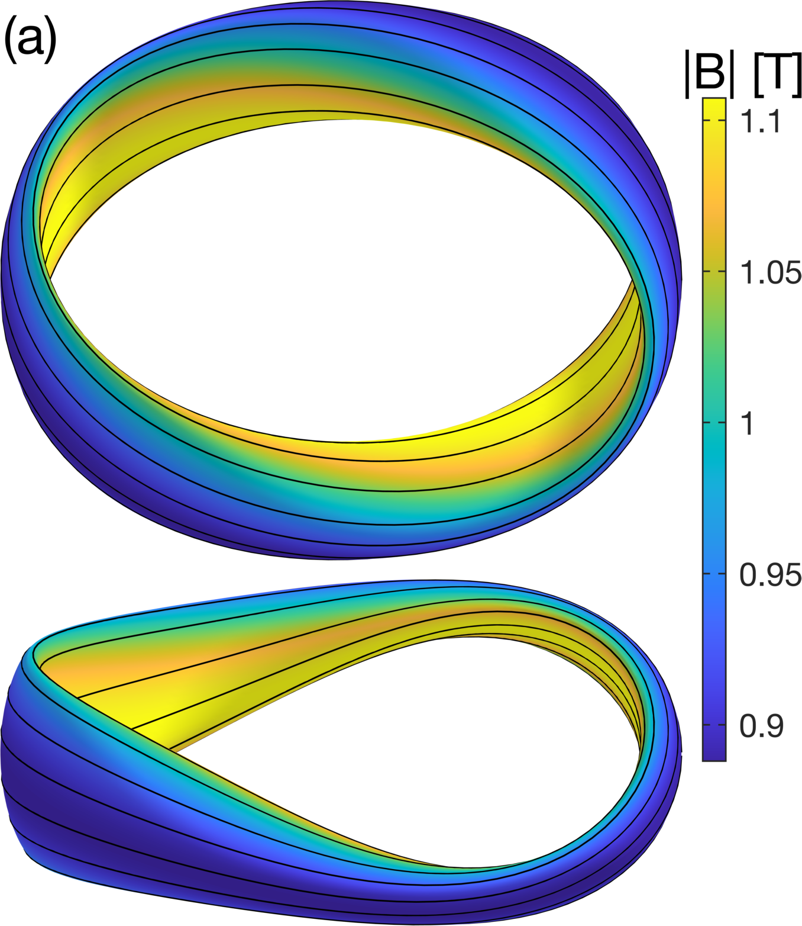
Straight |B| contours are possible for quasi-axisymmetry
aspect = 6
ML & Paul, PRL (2022).

Slide 11
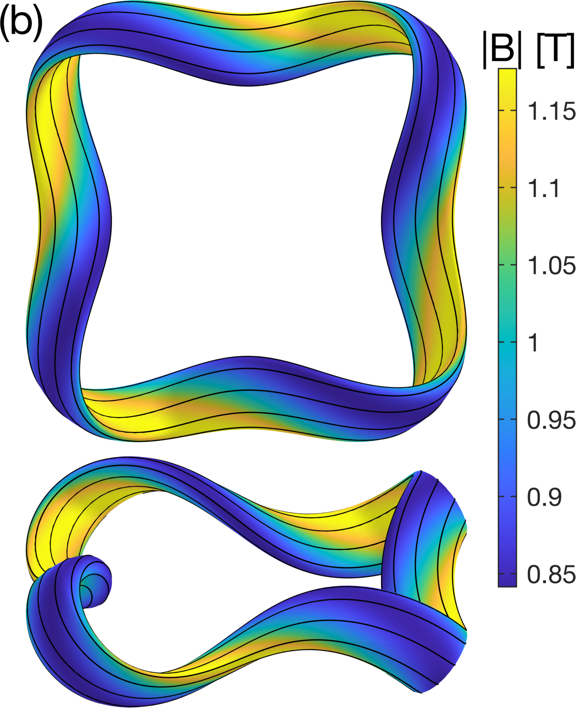
Straight |B| contours are possible for quasi-helical symmetry
aspect = 8
ML & Paul, PRL (2022).

Slide 12
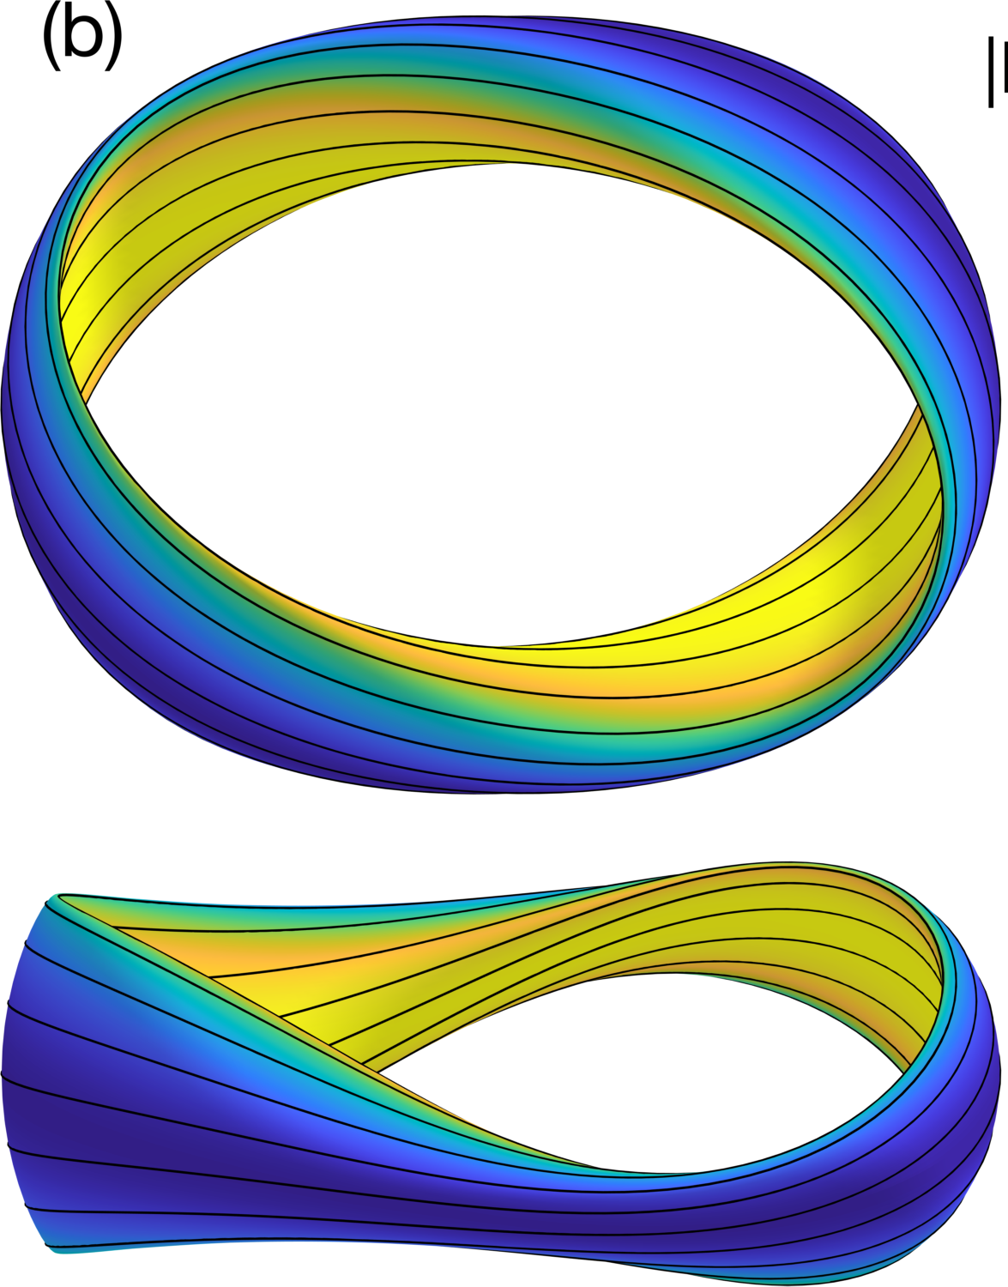
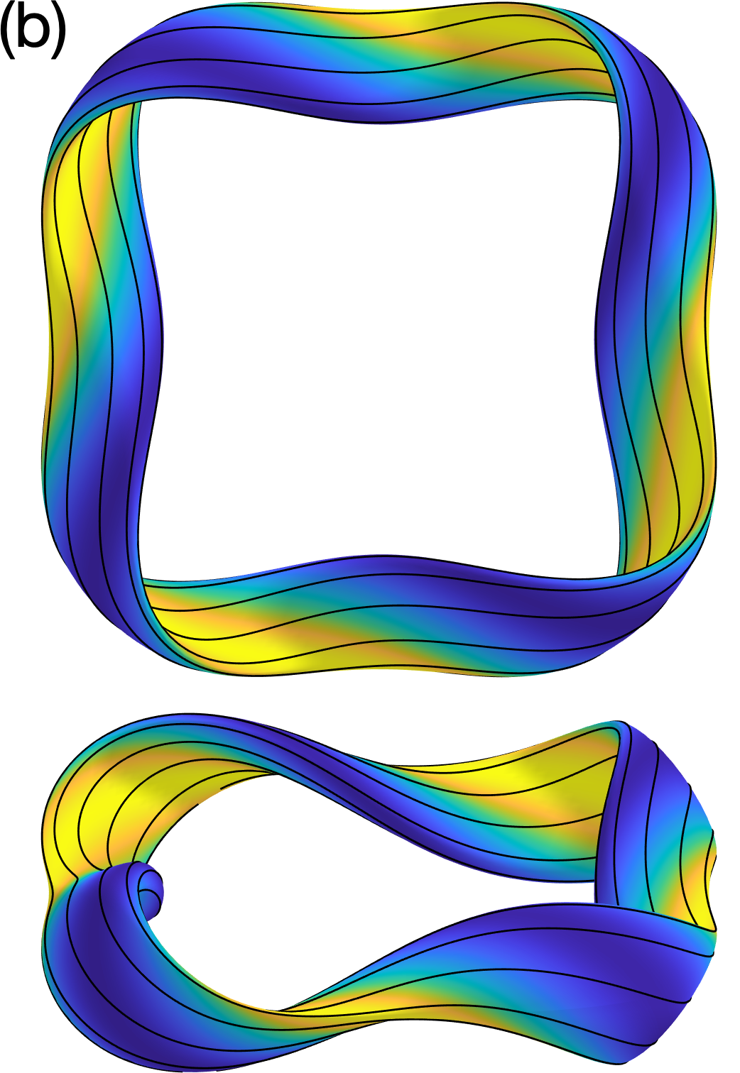
Good symmetry also exists with magnetic well
aspect = 6
QA
QH
ML & Paul, PRL (2022).
Notes:
20210730-01-precise_QA_magwell_surfaces.pdf
m20210730_01_plotPreciseQAWithWell_3D.m

Slide 13
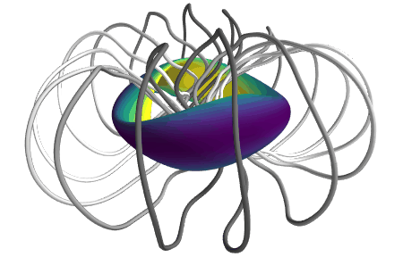
16-coil solutions have been found for the quasi-axisymmetric configurations
Without magnetic well
With magnetic well
Wechsung et al, PNAS (2022). <R> / 10 between filament centers. Haven’t looked at the QHs yet
Notes:
~/Box Sync/work21/20211103-01-simsopt_coils_from_Florian/20211103-01-precise_QA_coil_animation

Slide 14
Symmetry-breaking modes can be made extremely small
New QA configuration
Dotted = with coils
Notes:
~/Box Sync/work21/20211105-01-compareSymmetryBreakingVsRadius_withCoils
# 20210904-04-compareSymmetryBreakingVsRadius_withQHMagwell_noGeomag
20211105-01-compareSymmetryBreakingVsRadius_withCoils
Cobra:
/ptmp/mlan/20210721-01-eps_eff_for_precise_QS_configs/20210721-01-compareEpsEffAcrossConfigs.pdf

Slide 15
Quasisymmetry works: alpha particle confinement is significantly improved
All configs scaled to minor radius and |B| of ARIES-CS
Fusion alpha birth distribution
ANTS code, with collisions
Particle considered lost when s > 1
Notes:
20220323-01-alphaLossBarChart_nr600_nphi400_nz401

Slide 16
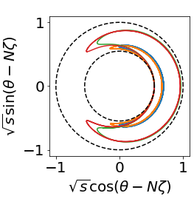
Alpha confinement in quasi-helical stellarators can be better than in a tokamak due to thinner bananas
See poster by Elizabeth Paul (session 3)
QA
QH
QH+well
QA+well
Notes:
20220323-01-alphaLossBarChart_nr600_nphi400_nz401

Slide 17
Optimizing stellarator geometry for precise quasisymmetry
Self-consistent bootstrap current
Conclusions

Slide 18
How can bootstrap current be included self-consistently in stellarator optimization?
Need self-consistency between MHD equilibrium and drift-kinetic equation.
Previous method: fixed-point iteration, only after an optimization.
Accurate drift-kinetic bootstrap calculations in stellarators are computationally expensive. Preferably not in the optimization loop.
MHD equilibrium code
VMEC: given I₀(s), determine B₀.
SFINCS: given B₀, determine I₁(s).
VMEC: given I₁(s), determine B₁.
SFINCS: given B₁, determine I₂(s).
…
Drift-kinetic code
Normalized toroidal flux s

Slide 19
New idea: exploit quasisymmetry & use analytic expressions for tokamaks
Pytte & Boozer (1981), Boozer (1983):
Bootstrap current (& other quantities) in quasisymmetry are the same as in axisymmetry, up to some substitutions:
Should be accurate for the new precisely quasisymmetric configurations.

Slide 20
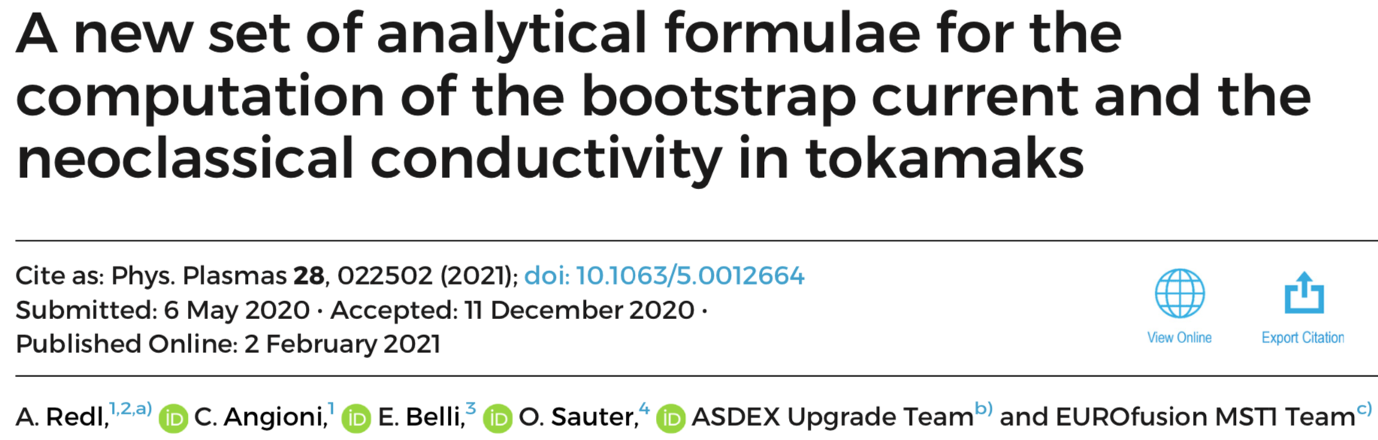
New idea: exploit quasisymmetry & use analytic expressions for tokamaks
Pytte & Boozer (1981), Boozer (1983):
Bootstrap current (& other quantities) in quasisymmetry are the same as in axisymmetry, up to some substitutions:
Should be accurate for the new precisely quasisymmetric configurations.

Slide 21
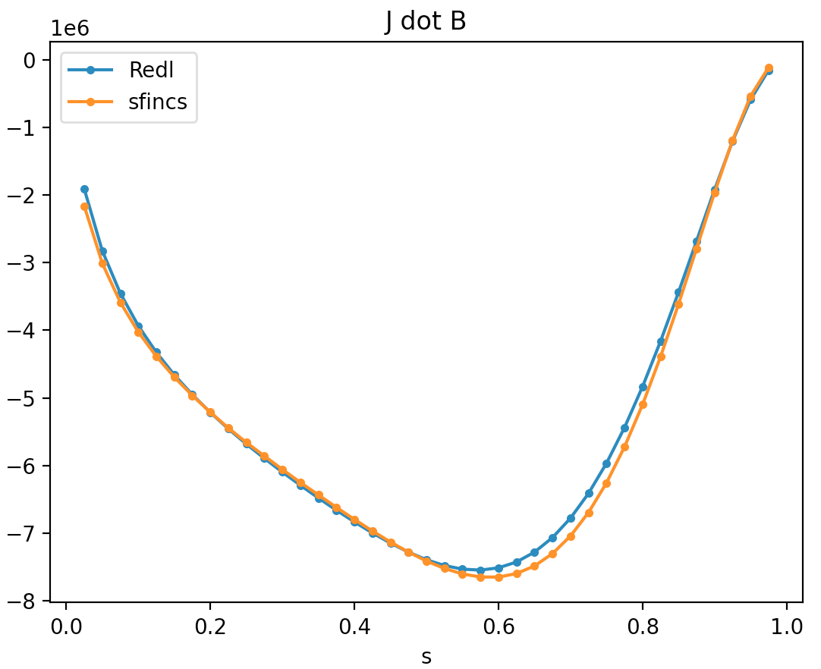
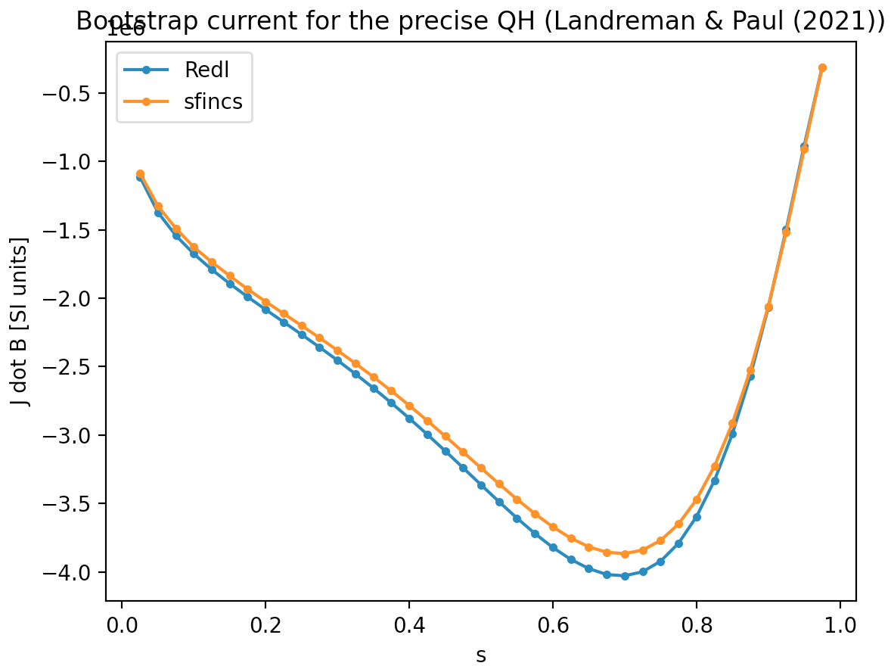
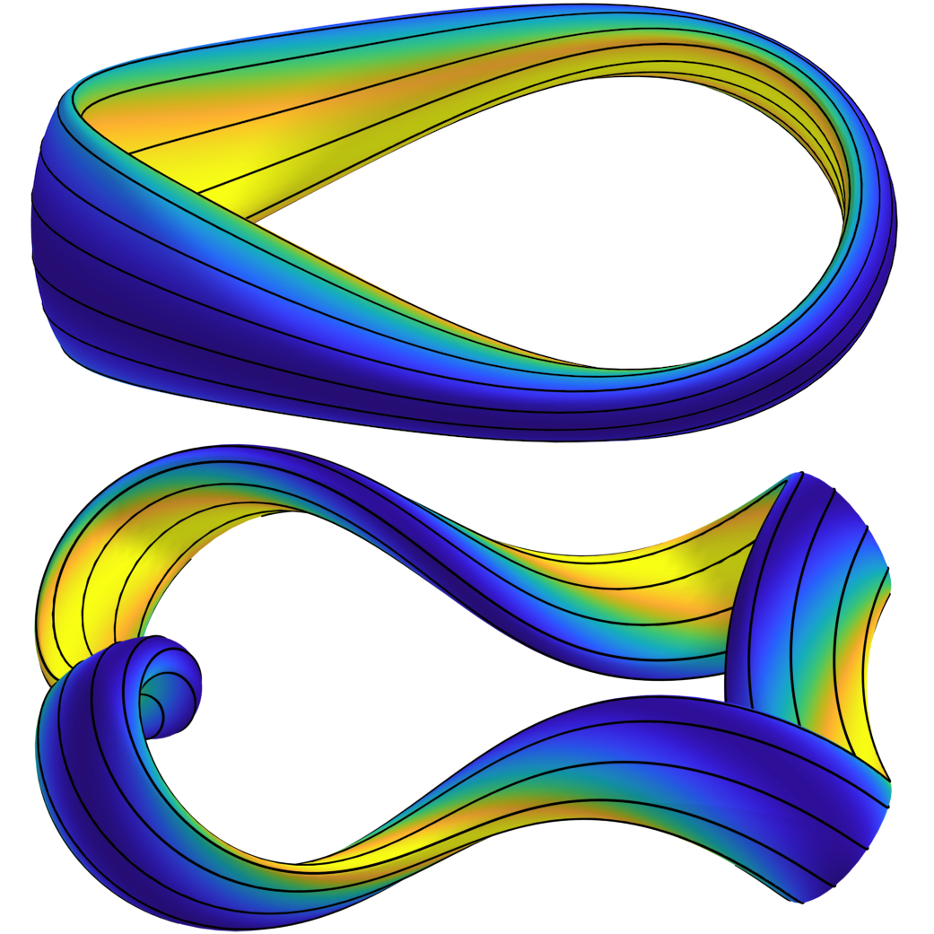
Before doing new optimizations: Redl formula is accurate in previous QA & QH stellarators
n_{e} = (1 – s⁵) 4x10²⁰ m⁻³, T_{e} = T_{i} = (1 – s) 12 keV
QA (Landreman & Paul (2021))
QH (Landreman & Paul (2021))
<J dot B> [MA T / m²]
<J dot B> [MA T / m²]
Redl analytic formula
SFINCS kinetic code
Normalized toroidal flux s
Normalized toroidal flux s
(Not self-consistent yet)
Notes:
20211225-01 Lab book - sfincs Redl benchmarks.docx

Slide 22
Optimization recipe
Objective function:
Parameter space: {R_{m,n}, Z_{m,n}, toroidal flux, current spline values}
or {R_{m,n}, Z_{m,n}, toroidal flux, iota spline values}
Cold start
Algorithm: default for least-squares in scipy (trust region reflective)
Steps: increasing # of modes varied: m and |n/nfp| up to j in step j
Boundary aspect ratio
Minor radius

Slide 23
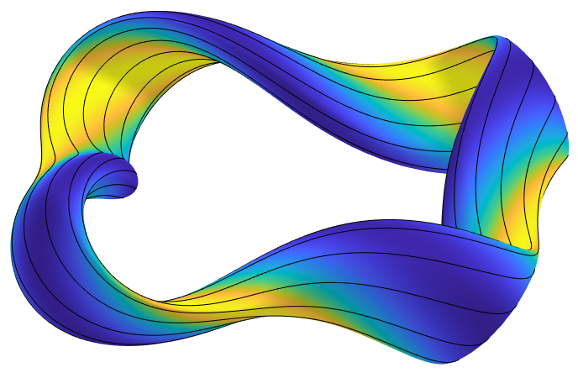
Example of optimization with self-consistent bootstrap current
n_{e0} = 2.5e20/meters³
T_{e0} = T_{i0} = 10 keV
𝛽 = 2.8%,
I_{p} = 1.3 MA
Notes:
wout_20220102-01-012_QH_A6.5_n0_2.5_T0_10_abs_step_1.00e-08_rel_step_3.16e-05_centered.nc
20220110-01-compareMethodsOfComputingJDotBForOptimizedSelfConsistentQH

Slide 24
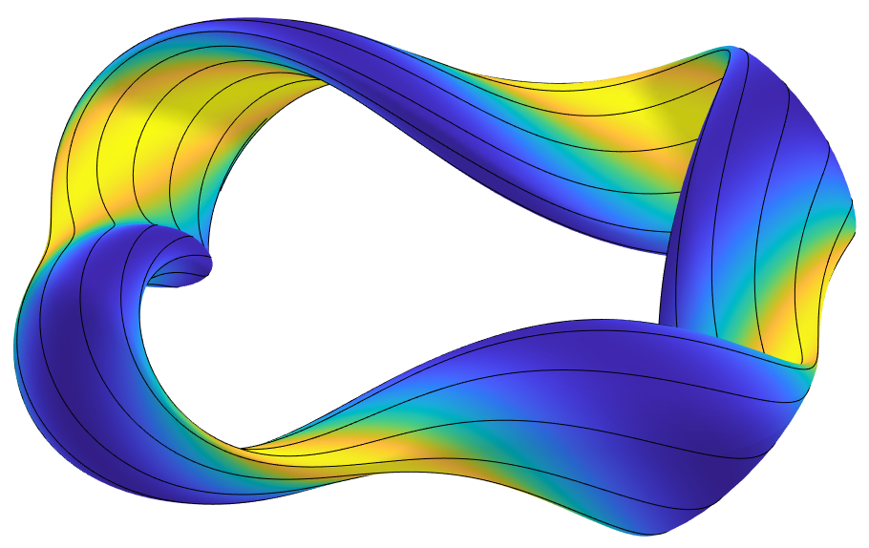
If you want perfectly self-consistent current, you can do a few fixed-point iterations at the end
No significant degradation in quasisymmetry:
Optimization with Redl current
SFINCS (kinetic bootstrap calculation)
VMEC
After SFINCS fixed-point iterations
𝛼 energy losses < 0.3%
Notes:
20220117-02-vmecSfincsConsistencyForQHBeta5
boozPlot4Surfs
boozmn_20220102-01-050_QH_nfp4_A6p5_n0_3_T0_15_beta0p05_hires_4surfs.pdf
boozmn_20220102-01-053_iteratingVmecAndSfincsForBestFrom048_003_4surfs.pdf

Slide 25
Optimizing stellarator geometry for precise quasisymmetry
Self-consistent bootstrap current
Conclusions

Slide 26
It is now possible to design stellarators with alpha confinement comparable to or better than a tokamak.
More to do: coils, surface quality, & MHD stability at high 𝛽, robustness to pressure profile, ...
𝛼 energy loss fraction:
Notes:
~/Box Sync/work22/20220304-01-animated_gifs_for_simons_talk/20220304-01-001_simsopt_QH_beta0p05_animated_gif
~/Box Sync/work22/20220304-01-animated_gifs_for_simons_talk/20220304-01-002-preciseQAWithWellFromSimsopt_animated_gif

Slide 27
Extra slides

Slide 28
The bootstrap current arises in tokamaks & stellarators when the density & temperature become significant
Ions and electrons have different trajectories. Different mean flows = electric current.
Current depends on geometry, density, & temperature.
For 𝛽 > 0, we don’t know B until we include this effect.
Computing the bootstrap current requires kinetic theory: coupled 4D advection-dominated integro-differential equations.
Need self-consistency between MHD equilibrium and kinetic equation.
How can a self-consistent bootstrap current calculation be integrated with stellarator optimization?
ion
electron

Slide 29
The symmetry also yields extremely low collisional transport for a thermal plasma
Radial neoclassical transport coefficient
Dotted = with coils
Wechsung et al, PNAS (2022)
Notes:
# 20210721-01-compareEpsEffAcrossConfigs_magwell.pdf
/ptmp/mlan/20211030-01-coils_for_precise_quasisymmetry/20211030-01-compareEpsEffAcrossConfigs_withCoils2

Slide 30
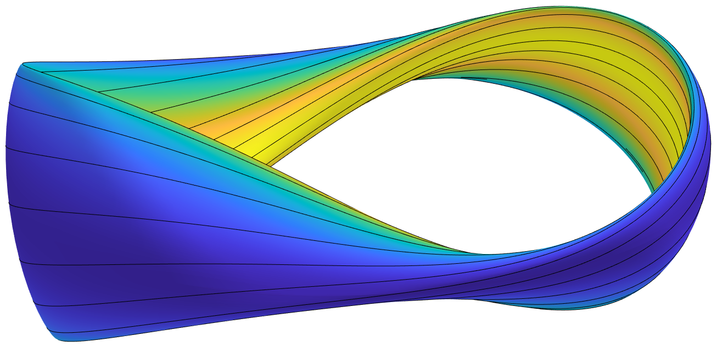
The optimization with self-consistent bootstrap current also works for quasi-axisymmetry
Symmetry is not as good as for vacuum, but sufficient for excellent confinement
SFINCS (kinetic bootstrap calculation)
VMEC
Possible islands where 𝜄 = 2/3,
𝜄 = 4/7 = 0.57?
𝛼-particle losses < 1%
Notes:
m20210604_01_plotVMECWout_withFieldlineSeamAtBottom.m with wout_20220218-01-014-005_QA_nfp2_beta0p03_iotaTarget0p7.nc
~/Box Sync/work22/boozmn_20220218-01-014-005_QA_nfp2_beta0p03_iotaTarget0p7_4surfs.pdf
20220302-01-vmecSfincsConsistencyForQA_beta3_iotaTarget0p7
20220302-02-plotIotaProfileForFiniteBetaSimsoptQA

Slide 31
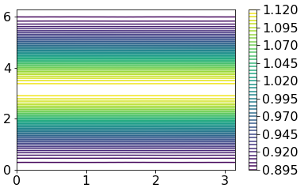
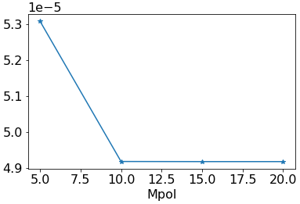
|B|in Boozer coordinates was verified by independent SPEC calculations
max |B_{m,n}| [Tesla] with n ≠ 0
Boozer poloidal angle
Boozer toroidal angle
(Ntor = Mpol, Lrad = Mpol + 4)
By Elizabeth Paul

Slide 32
To reach reactor-relevant 5% beta in QH without crossing iota=1, a constraint on iota can be included
Crossing iota=1, the worst resonance, is probably unacceptable.
n_{e0} = 3e20/meters³, T_{e0} = T_{i0} = 15 keV
𝛽 = 0
𝛽 = 5%
Notes:
20220117-03-plotIotaProfilesForFiniteBetaSimsoptQHs_withoutBest

Slide 33
To reach reactor-relevant 5% beta in QH without crossing iota=1, a constraint on iota can be included
Crossing iota=1, the worst resonance, is probably unacceptable.
Solution: Add barrier term in objective
𝛽 = 0
𝛽 = 5% with 𝜄 barrier
𝛽 = 5%
Quasisymmetry & bootstrap consistency remain good:
Normalized toroidal flux s
Notes:
20220117-01-plotIotaProfilesForFiniteBetaSimsoptQHs
boozPlot4Surfs
boozmn_20220102-01-050_QH_nfp4_A6p5_n0_3_T0_15_beta0p05_hires_4surfs.pdf
20220116-01-compareMethodsOfComputingJDotBForOptimizedSelfConsistentQH_beta5 with config=1
20220302-02-plotIotaProfileForFiniteBetaSimsoptQA

Slide 34
Why do the configurations with best quasisymmetry not have the best trajectory confinement?
QA
Fraction of
alpha energy lost
QA + magnetic well
QH
Lost trajectories in the new QA look like this:
Notes:
# 20210721-02-compareSimpleResultsAcrossConfigs_topFew.pdf
20210719-01-117_beams3d_new_QA_aScaling_losses.pdf
20220106-01-plot_ANTS_config_comparison_topFew.pdf

Slide 35
2 types of quasisymmetry
Contours of B = |B|:
Notes:
~/Box Sync/work21/20211115-01-illustration_of_QA_QH_for_talk

Slide 36
Previous quasisymmetric configurations
(a) Zarnstorff et al (2001)
(b) Najambadi et al (2008)
(c) Garabedian (2008)
(d) Liu et al (2018)
(e) Henneberg et al (2019)
(f) Nuhrenberg & Zille (1988)
(g) Anderson et al (1995)
(h) Bader et al (2020)
We want
B = B(r, 𝜃 − N 𝜑)
Is there an optimization recipe that can give consistently straight |B| contours?

Slide 37
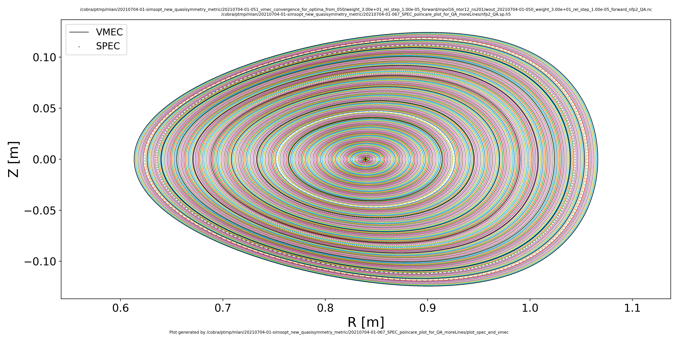
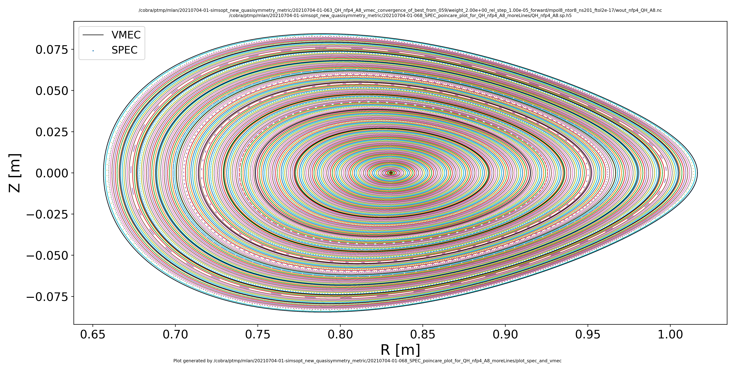
The new configurations have small magnetic shear
VMEC
...... SPEC
New QA
New QH

Slide 38
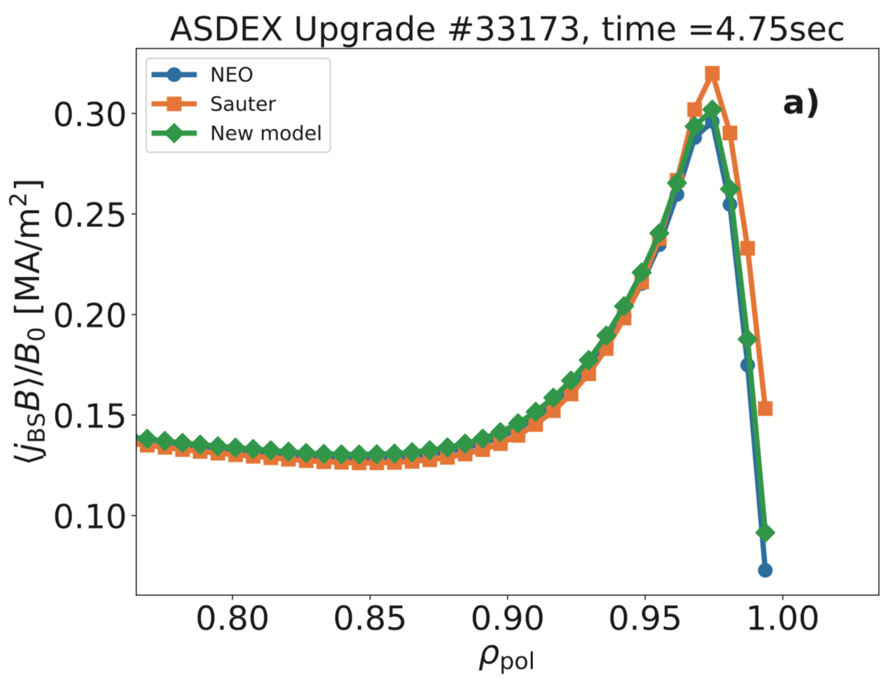
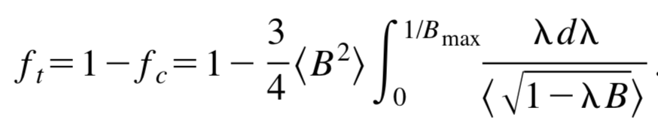
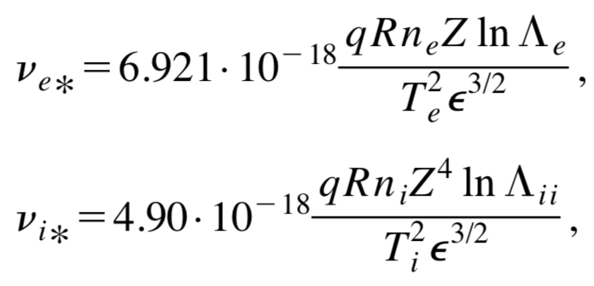
New idea: exploit quasisymmetry & use analytic expressions for tokamaks
Redl (2021)
Geometry enters through
Bootstrap current
NEO = kinetic calculation
Flux surface label (minor radius)

Slide 39
The symmetry yields extremely good confinement of collisionless trajectories
All configurations scaled to ARIES-CS minor radius (1.7 m) and |B| (5.7 T).
5000 alpha particles initialized isotropically at s=0.3.
SIMPLE code: Albert et al, JCP (2020).
Wistell-A
New QA with coils
New QA+well with coils
New QH, New QH+well
Notes:
/ptmp/mlan/20211030-01-coils_for_precise_quasisymmetry/20211030-01-compareSimpleResultsAcrossConfigs_withCoils2
# 20210721-02-compareSimpleResultsAcrossConfigs_magwell.pdf

Slide 41
Previous quasisymmetric configurations (s=0.5)
Notes:
~/Box Sync/work21/20210711-01-imperfect_symmetry_figure/20210711-01-005_B_along_fieldlines_previous_configs_s0.5.pdf

Slide 42
Previous quasisymmetric configurations (s=1)
Notes:
~/Box Sync/work21/20210711-01-imperfect_symmetry_figure/20210711-01-005_B_along_fieldlines_previous_configs_s1.pdf

Slide 43
|B| along a field line for new QA
Notes:
~/Box Sync/work21/20210720-03-plot_B_along_field_line_for_precise_QA

Slide 44
|B| along a field line for new QH
Notes:
~/Box Sync/work21/20210720-04-plot_B_along_field_line_for_precise_QH

Slide 45
|B| along a field line for new QA with magnetic well
Notes:
~/Box Sync/work21/20210801-01-plot_B_along_field_line_for_precise_QA_magwell

Slide 46
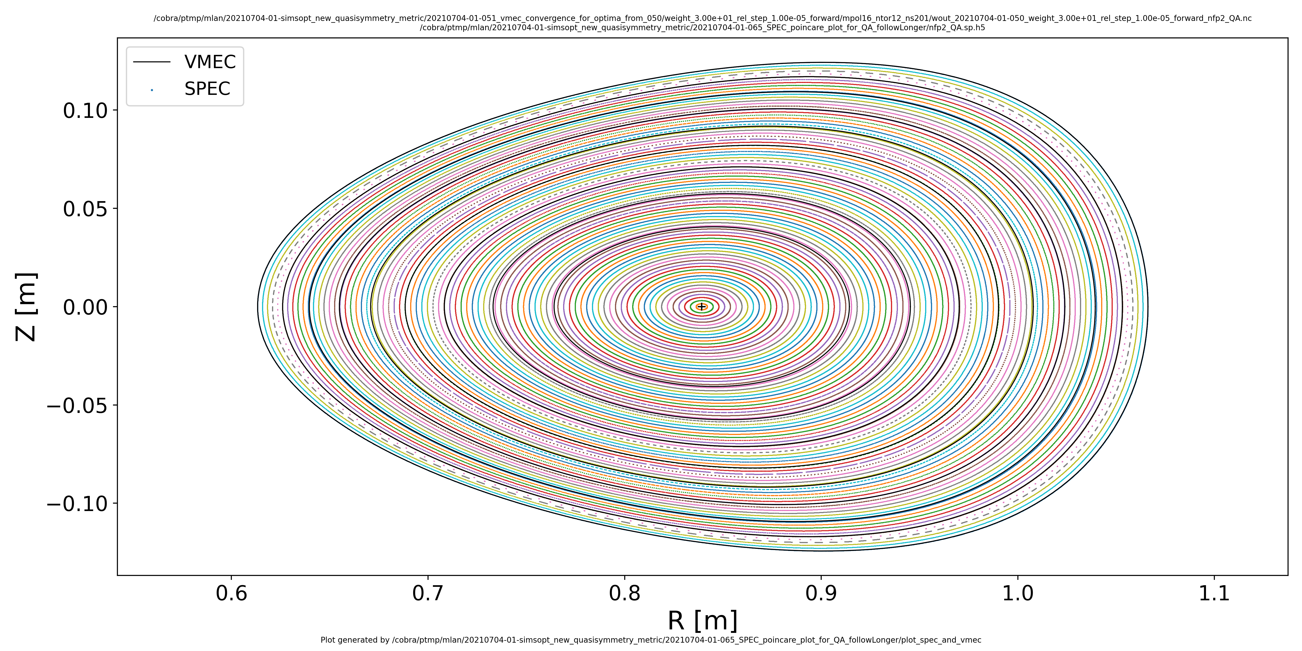
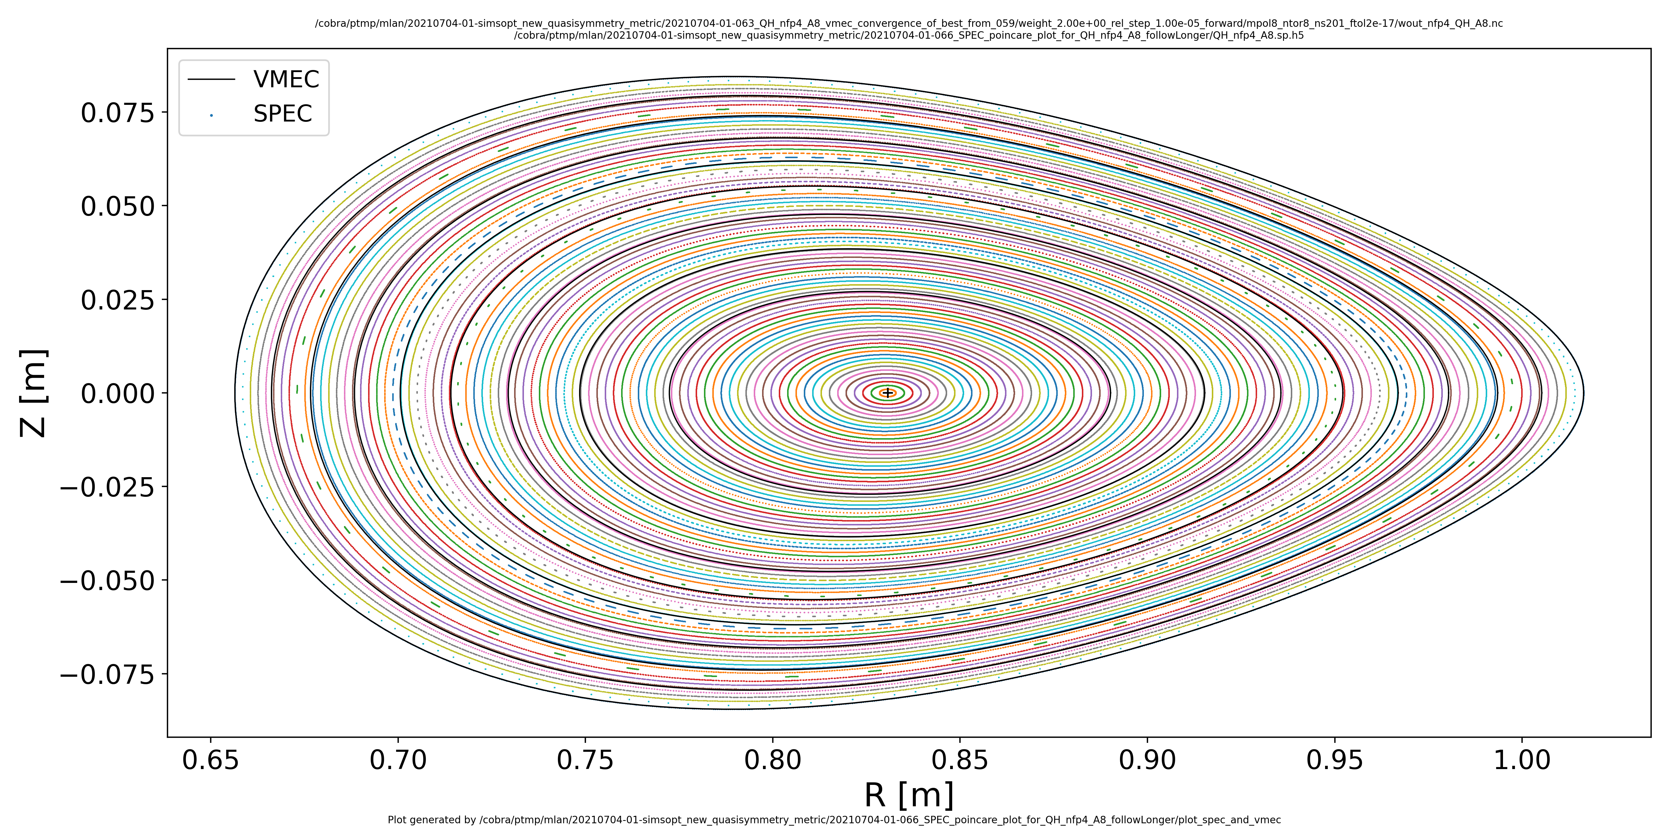
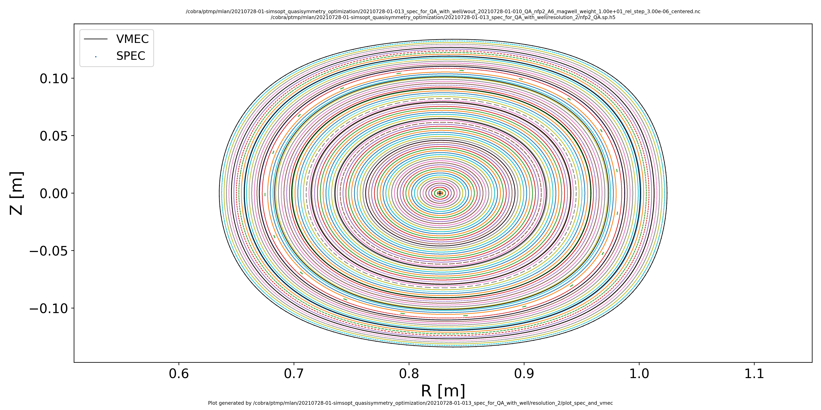
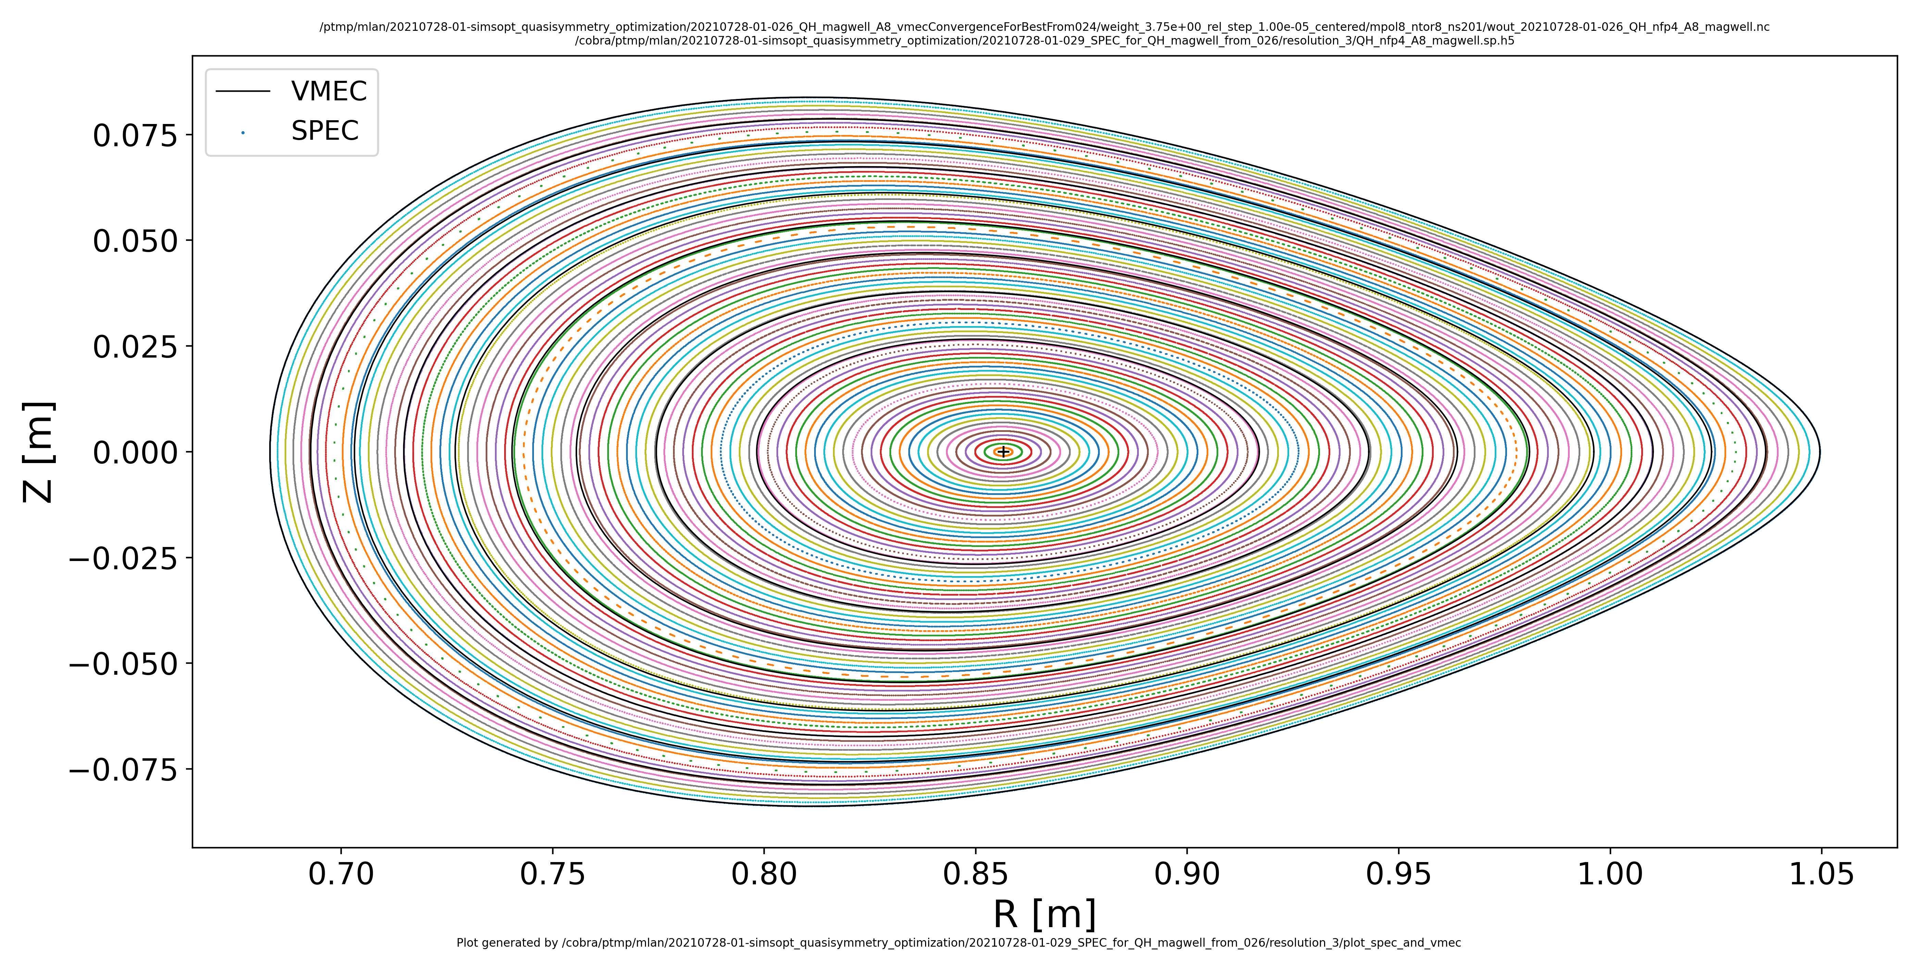
SPEC confirms the new QA/QH configurations have good surfaces
VMEC
...... SPEC
New QA
New QH
New
QA+well
New QH+well
Notes:
20210704-01-065_new_QA_plot_spec_and_vmec.png
20210704-01-064_new_QH_plot_spec_and_vmec.png
20210728-01-013_new_QA_magwell_plot_spec_and_vmec.png
20210728-01-029_new_QH_magwell_plot_spec_and_vmec.png

Slide 47
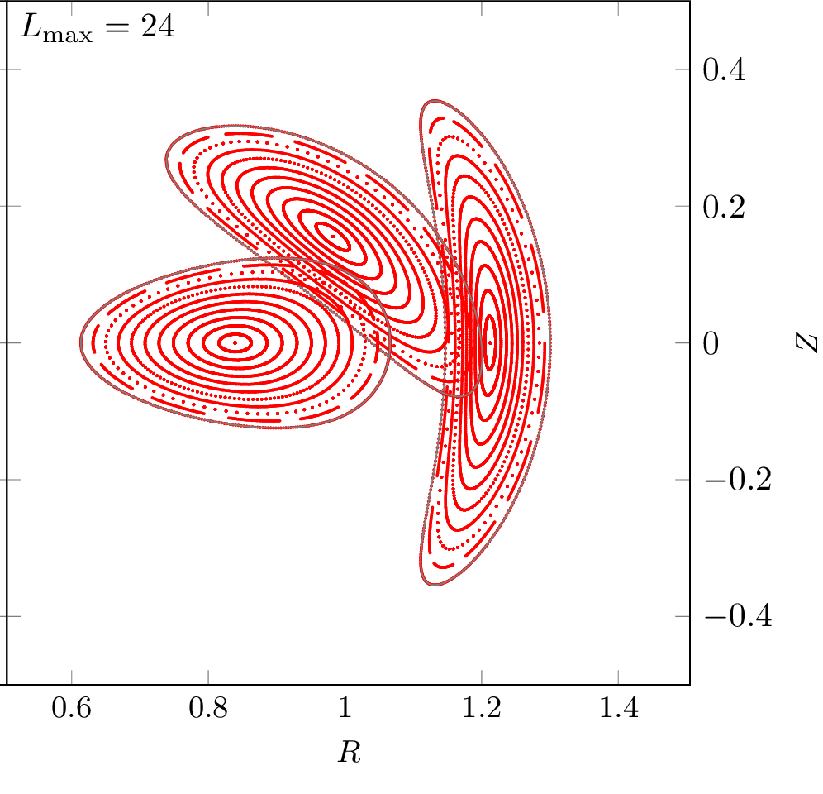
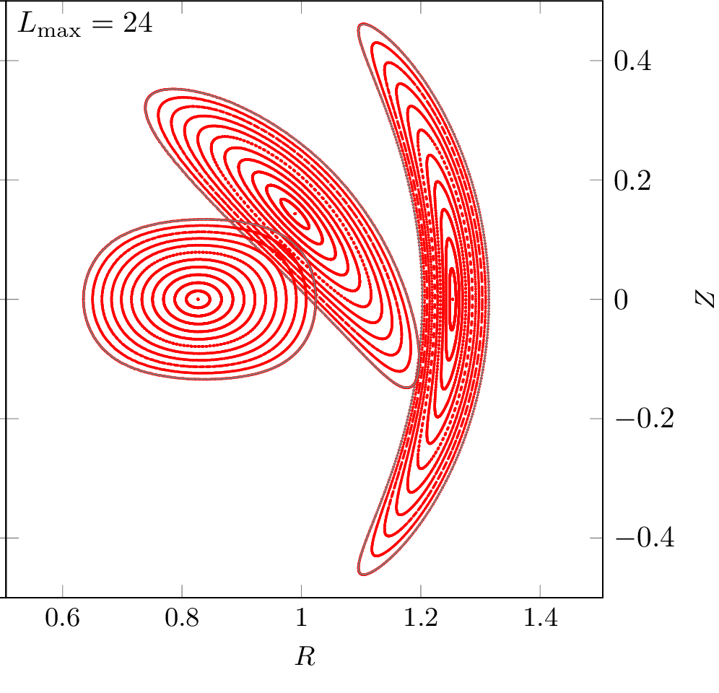
Good flux surface exist with coils
New QA
New QA+well

Slide 48
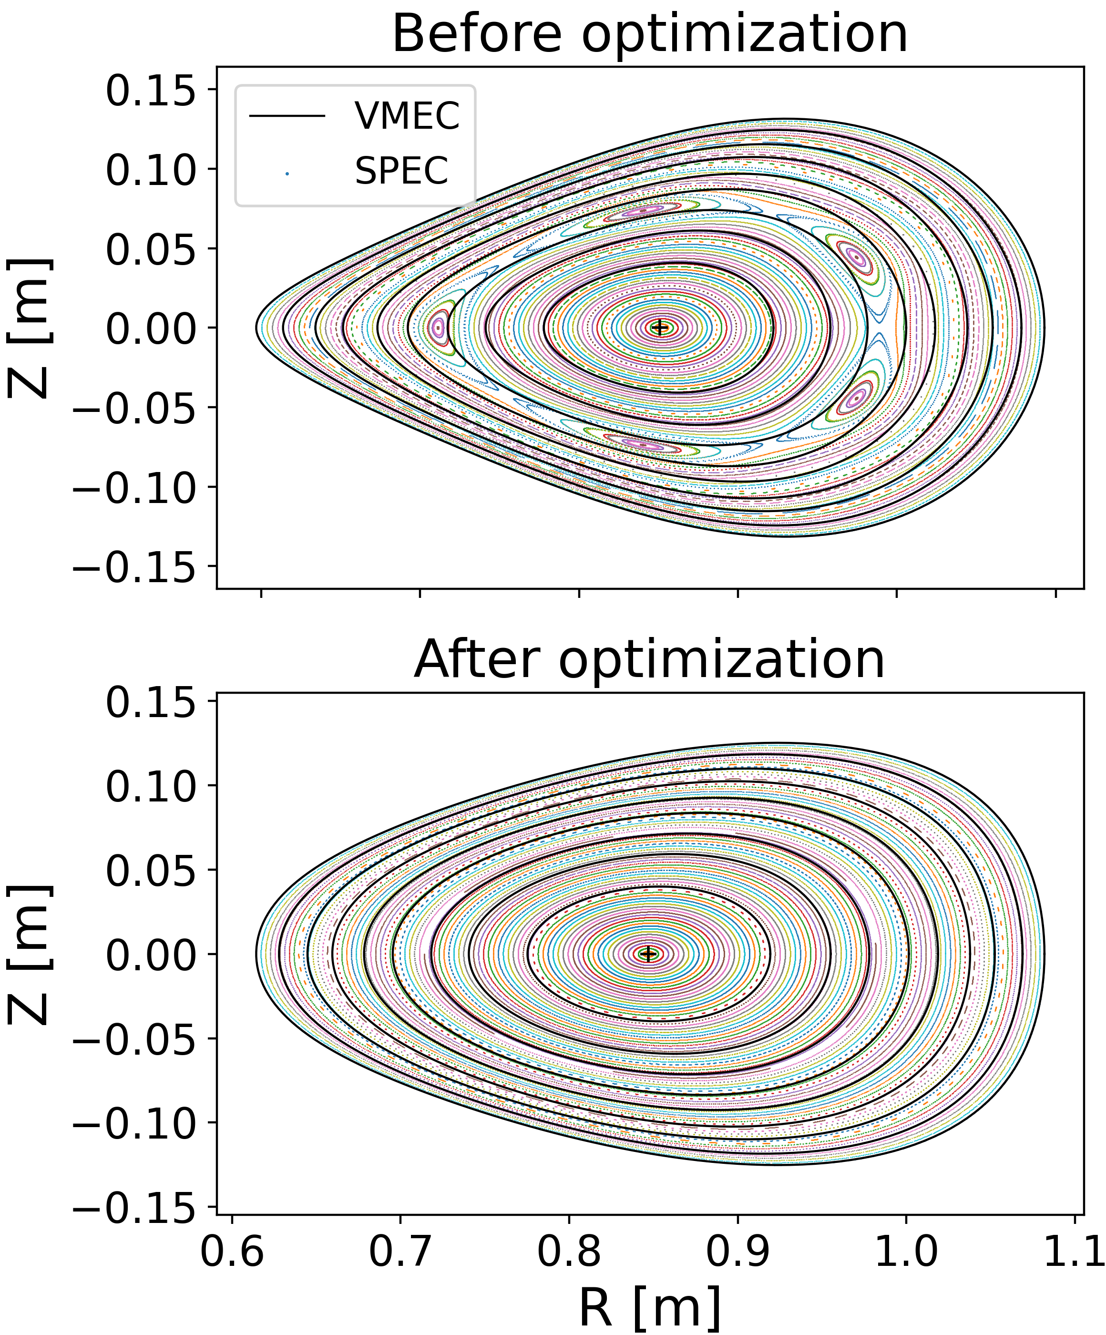
Future directions
Eliminate islands at high 𝛽 (plasma pressure & current)
Coils & MHD stability for the high 𝛽 configurations
Quasi-isodynamic (|B| contours close poloidally)
Understand trade-offs using multi-objective optimization
Robustness to uncertainty in the pressure profile
Interact with systems codes & reactor studies
Combined coil + confinement (1-stage) optimization
Optimization of turbulence & divertor
...... SPEC
Before optimization
After optimization
ML, Medasani & Zhu (2021)

