Slide 1
Second Order Transients
Part 1: circuits excited by initial conditions
ENEE 205

Slide 2
2nd-order circuits excited by initial conditions
ALGORITHM:
Get circuit.
Find natural initial conditions for energy storage elements.
    (draw circuit for t<0 if needed).
Find needed initial conditions for the circuit quantity to be calculated.
    (draw circuit at t=0₊ if needed).
Add a source to the circuit so that you recover the original circuit when you set the source to zero!
Find transfer function of desired output in terms of source (draw circuit for t>0 .)
Find characteristic equation by setting denominator of transfer function to zero. Determine damping case. Obtain general homogeneous solution.
Plug in initial conditions to the general homogeneous solution to get specific solution. (The particular solution is zero.)

Slide 3
  RLC series circuit excited by initial conditions – demonstrating Steps 4-5 to see the 3 cases
Suggestion: If you have a series connection, solve for capacitor voltage first; If you have a parallel connection, solve for inductor current first.

Slide 4
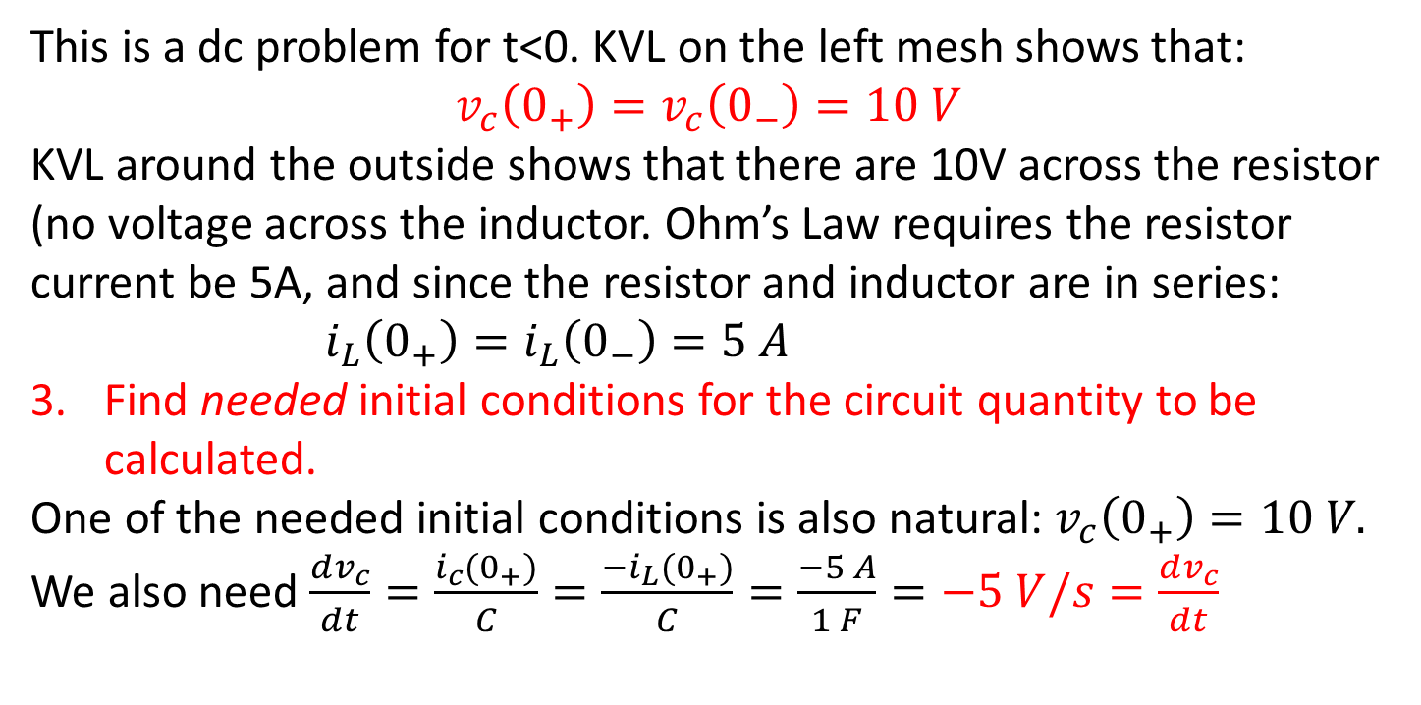
Critically-damped RLC series circuit
i_{c}
Find natural initial conditions for energy storage elements.
This is a dc problem for t<0. KVL on the left mesh shows that:
$$v_{c}\left(0_{+}\right)=v_{c}\left(0_{−}\right)=10 V$$
KVL around the outside shows that there are 10V across the resistor (no voltage across the inductor. Ohm’s Law requires the resistor current be 5A, and since the resistor and inductor are in series: $i_{L}\left(0_{+}\right)=i_{L}\left(0_{−}\right)=5 A$
Find needed initial conditions for the circuit quantity to be calculated.
One of the needed initial conditions is also natural: $v_{c}\left(0_{+}\right)=10 V.$
We also need $\frac{dv_{c}}{dt}=\frac{i_{c}(0_{+})}{C}=\frac{{−i}_{L}(0_{+})}{C}=\frac{−5 A}{1 F}=−5 V/s=\frac{dv_{c}}{dt}$
Capacitor terminal relationship
L and C are in series for t>0

Slide 5
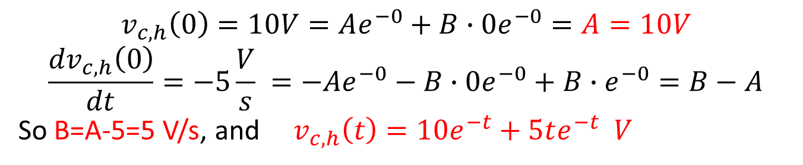
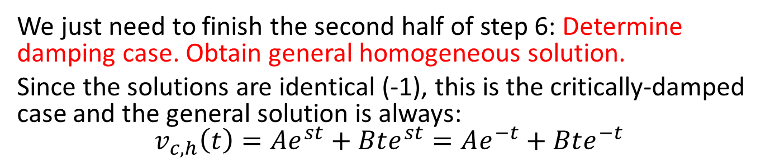
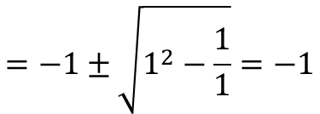
Critically-damped case
Steps 4 – 6 previously gave us:
$$=−1±\sqrt{1^{2}−\frac{1}{1}}=−1$$
We just need to finish the second half of step 6: Determine damping case. Obtain general homogeneous solution.
Since the solutions are identical (-1), this is the critically-damped case and the general solution is always:
$$v_{c,h}\left(t\right)=Ae^{st}+Bte^{st}=Ae^{−t}+Bte^{−t}$$
Plug in initial conditions to the general homogeneous solution to get specific solution.
=0
$$v_{c,h}\left(0\right)=10V=Ae^{−0}+B∙0e^{−0}=A=10V$$
$$\frac{{dv}_{c,h}\left(0\right)}{dt}=−5\frac{V}{s} =−Ae^{−0}−B∙0e^{−0}+B∙e^{−0}=B−A$$
So B=A-5=5 V/s, and $v_{c,h}\left(t\right)=10e^{−t}+5te^{−t} V$
=0

Slide 6
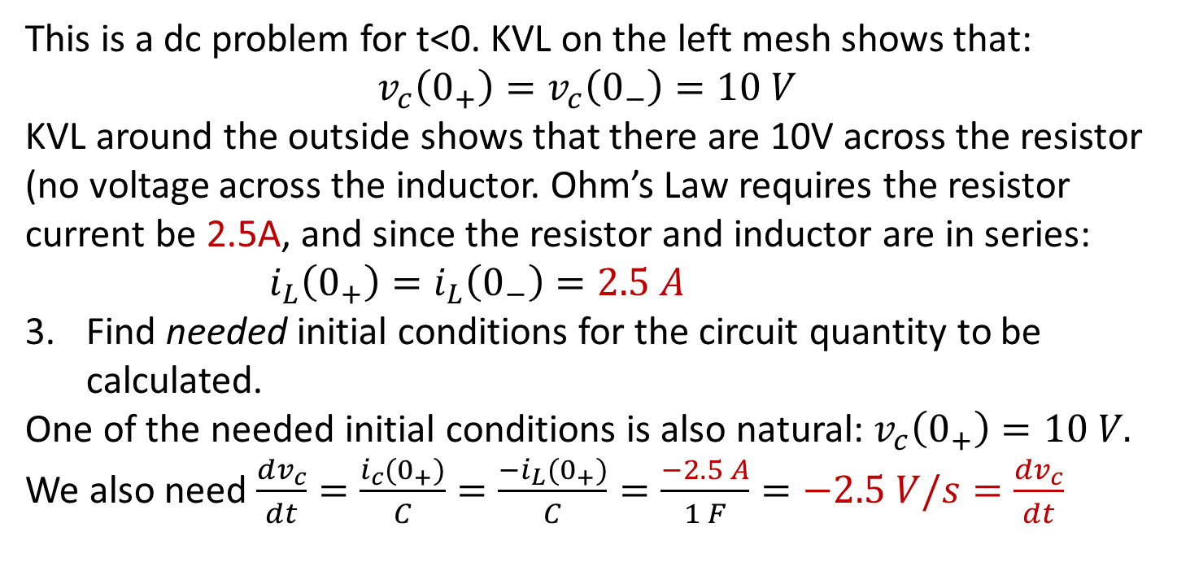
Overdamped RLC series circuit
i_{L}
Find natural initial conditions for energy storage elements.
(Very similar to last case!)
i_{c}
This is a dc problem for t<0. KVL on the left mesh shows that:
$$v_{c}\left(0_{+}\right)=v_{c}\left(0_{−}\right)=10 V$$
KVL around the outside shows that there are 10V across the resistor (no voltage across the inductor. Ohm’s Law requires the resistor current be 2.5A, and since the resistor and inductor are in series: $i_{L}\left(0_{+}\right)=i_{L}\left(0_{−}\right)=2.5 A$
Find needed initial conditions for the circuit quantity to be calculated.
One of the needed initial conditions is also natural: $v_{c}\left(0_{+}\right)=10 V.$
We also need $\frac{dv_{c}}{dt}=\frac{i_{c}(0_{+})}{C}=\frac{{−i}_{L}(0_{+})}{C}=\frac{−2.5 A}{1 F}=−2.5 V/s=\frac{dv_{c}}{dt}$
Capacitor terminal relationship
L and C are in series for t>0

Slide 7
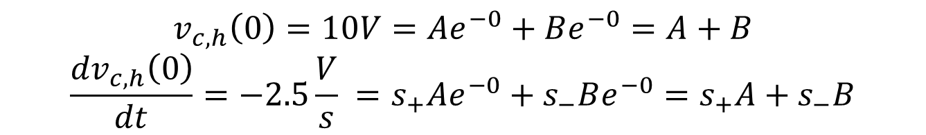
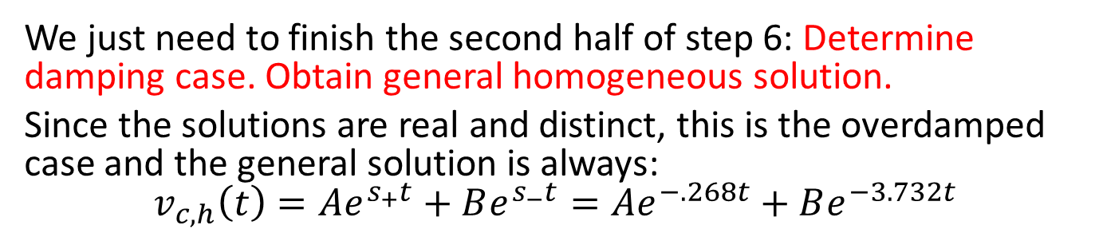
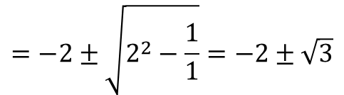
Overdamped case
Steps 4 – 6 previously gave us:
$$=−2±\sqrt{2^{2}−\frac{1}{1}}=−2±\sqrt{3}$$
We just need to finish the second half of step 6: Determine damping case. Obtain general homogeneous solution.
Since the solutions are real and distinct, this is the overdamped case and the general solution is always:
$$v_{c,h}\left(t\right)=Ae^{s_{+}t}+Be^{s_{−}t}=Ae^{−.268t}+Be^{−3.732t}$$
Plug in initial conditions to the general homogeneous solution to get specific solution.
$$v_{c,h}\left(0\right)=10V=Ae^{−0}+Be^{−0}=A+B$$
$$\frac{{dv}_{c,h}\left(0\right)}{dt}=−2.5\frac{V}{s} =s_{+}Ae^{−0}+s_{−}Be^{−0}=s_{+}A+s_{−}B$$

Slide 8
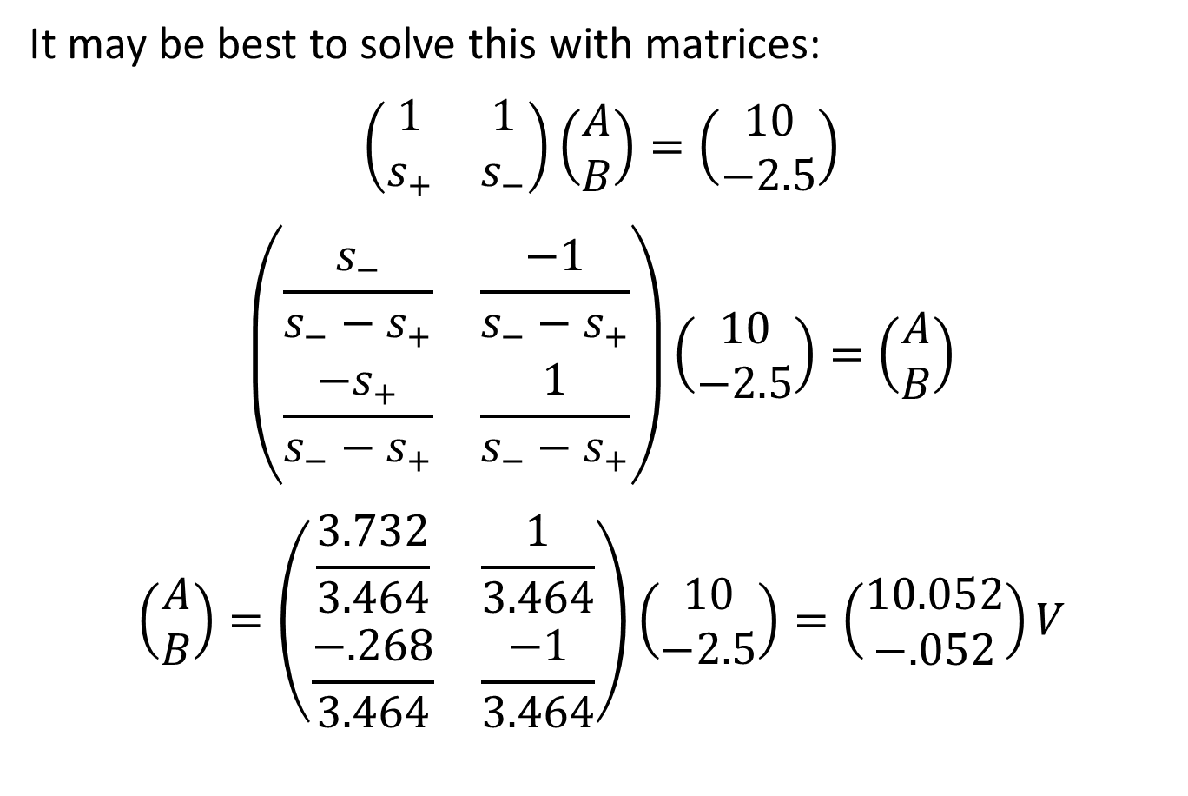
Overdamped case
It may be best to solve this with matrices:
$$\left(\begin{matrix}1 & 1 \\ s_{+} & s_{−}\end{matrix}\right)\left(\begin{matrix}A \\ B\end{matrix}\right)=\left(\begin{matrix}10 \\ −2.5\end{matrix}\right)$$
$$\left(\begin{matrix}\frac{s_{−}}{s_{−}−s_{+}} & \frac{−1}{s_{−}−s_{+}} \\ \frac{{−s}_{+}}{s_{−}−s_{+}} & \frac{1}{s_{−}−s_{+}}\end{matrix}\right)\left(\begin{matrix}10 \\ −2.5\end{matrix}\right)=\left(\begin{matrix}A \\ B\end{matrix}\right)$$
$$\left(\begin{matrix}A \\ B\end{matrix}\right)=\left(\begin{matrix}\frac{3.732}{3.464} & \frac{1}{3.464} \\ \frac{−.268}{3.464} & \frac{−1}{3.464}\end{matrix}\right)\left(\begin{matrix}10 \\ −2.5\end{matrix}\right)=\left(\begin{matrix}10.052 \\ −.052\end{matrix}\right)V$$

Slide 9
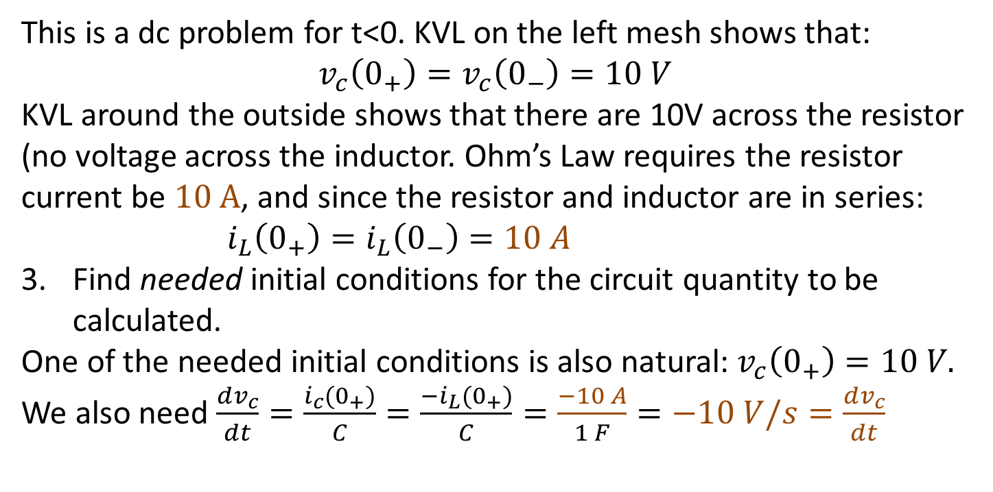
Underdamped RLC series circuit
Find natural initial conditions for energy storage elements.
(Very similar to last two cases!)
i_{c}
This is a dc problem for t<0. KVL on the left mesh shows that:
$$v_{c}\left(0_{+}\right)=v_{c}\left(0_{−}\right)=10 V$$
KVL around the outside shows that there are 10V across the resistor (no voltage across the inductor. Ohm’s Law requires the resistor current be 10 A, and since the resistor and inductor are in series: $i_{L}\left(0_{+}\right)=i_{L}\left(0_{−}\right)=10 A$
Find needed initial conditions for the circuit quantity to be calculated.
One of the needed initial conditions is also natural: $v_{c}\left(0_{+}\right)=10 V.$
We also need $\frac{dv_{c}}{dt}=\frac{i_{c}(0_{+})}{C}=\frac{{−i}_{L}(0_{+})}{C}=\frac{−10 A}{1 F}=−10 V/s=\frac{dv_{c}}{dt}$
Capacitor terminal relationship
L and C are in series for t>0

Slide 10
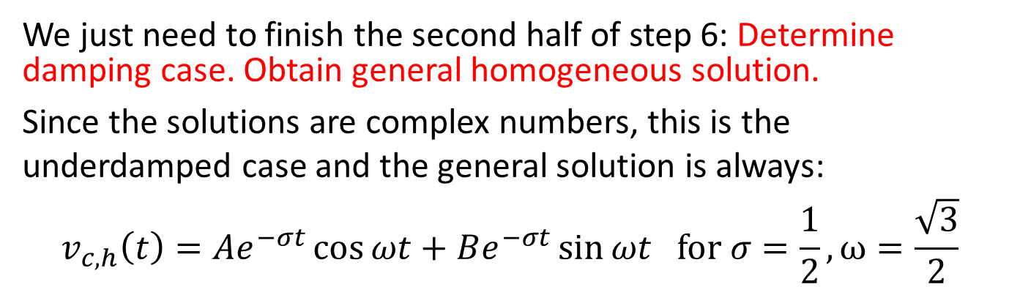
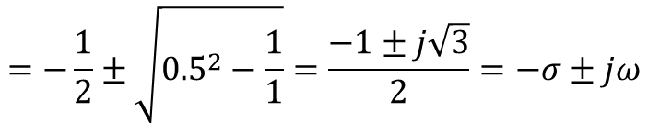
Underdamped case
Steps 4 – 6 previously gave us:
$$=−\frac{1}{2}±\sqrt{{0.5}^{2}−\frac{1}{1}}=\frac{−1±j\sqrt{3}}{2}=−σ±jω$$
We just need to finish the second half of step 6: Determine damping case. Obtain general homogeneous solution.
Since the solutions are complex numbers, this is the underdamped case and the general solution is always:
$$v_{c,h}\left(t\right)=Ae^{−σt}\cos{ωt}+Be^{−σt}\sin{ωt for σ=\frac{1}{2}}, ω=\frac{\sqrt{3}}{2}$$
Plug in initial conditions to the general homogeneous solution to get specific solution.
$$v_{c,h}\left(0\right)=10V=Ae^{−0}cos⁡(0)+Be^{−0}sin⁡(0)=A=10V$$

Slide 11
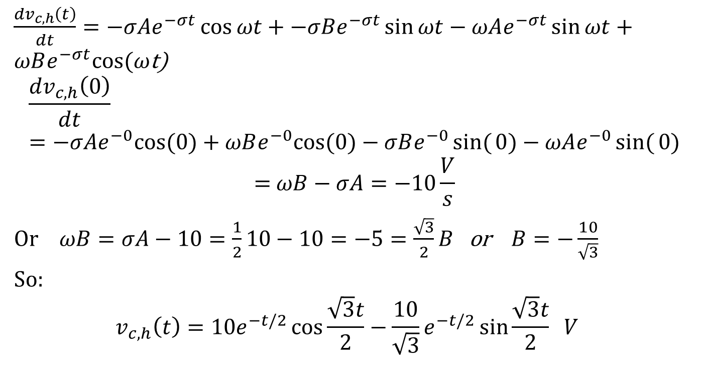
Underdamped case
$\frac{{dv}_{c,h}\left(t\right)}{dt}=−σAe^{−σt}\cos{ωt}+−σBe^{−σt}\sin{ωt−ωAe^{−σt}\sin{ωt}}+ωBe^{−σt}cos⁡(ω$t)
$$\frac{{dv}_{c,h}\left(0\right)}{dt} =−σAe^{−0}cos⁡(0)+ωBe^{−0}cos⁡(0\text{)}−σBe^{−0}sin({0)−ωAe^{−0}sin({0)}}$$
$$\text{=} ωB−σA=−10\frac{V}{s}$$
Or $ωB=σA−10=\frac{1}{2}10−10=−5=\frac{\sqrt{3}}{2}B$ or $B=−\frac{10}{\sqrt{3}}$
So:
$$v_{c,h}\left(t\right)=10e^{−t/2}\cos{\frac{\sqrt{3}t}{2}}−\frac{10}{\sqrt{3}}e^{−t/2}\sin{\frac{\sqrt{3}t}{2} V }$$
=0
=0

Slide 12
Second Order Transients
Part 2: circuits excited by sources
ENEE 205

Slide 13
2nd-order circuits excited by sources
ALGORITHM:
Get circuit.
Find natural initial conditions for energy storage elements.
    (draw circuit for t<0 if needed).
Find needed initial conditions for the circuit quantity to be calculated.
    (draw circuit at t=0₊ if needed).
Find transfer function of desired output in terms of source (draw circuit for t>0 .)
Find characteristic equation by setting denominator of transfer function to zero. Determine damping case. Obtain general homogeneous solution.
Find the particular solution by inserting s=jω into transfer function and solving.
Plug in initial condition to COMPLETE solution (general homogeneous plus particular) to get specific solution

Slide 14
  RLC parallel circuit excited by a source – demonstrating Step 4 to see the 3 cases
Suggestion: If you have a series connection, solve for capacitor voltage first; If you have a parallel connection, solve for inductor current first.

Slide 15

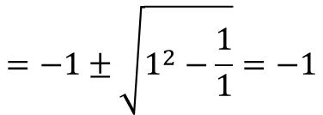
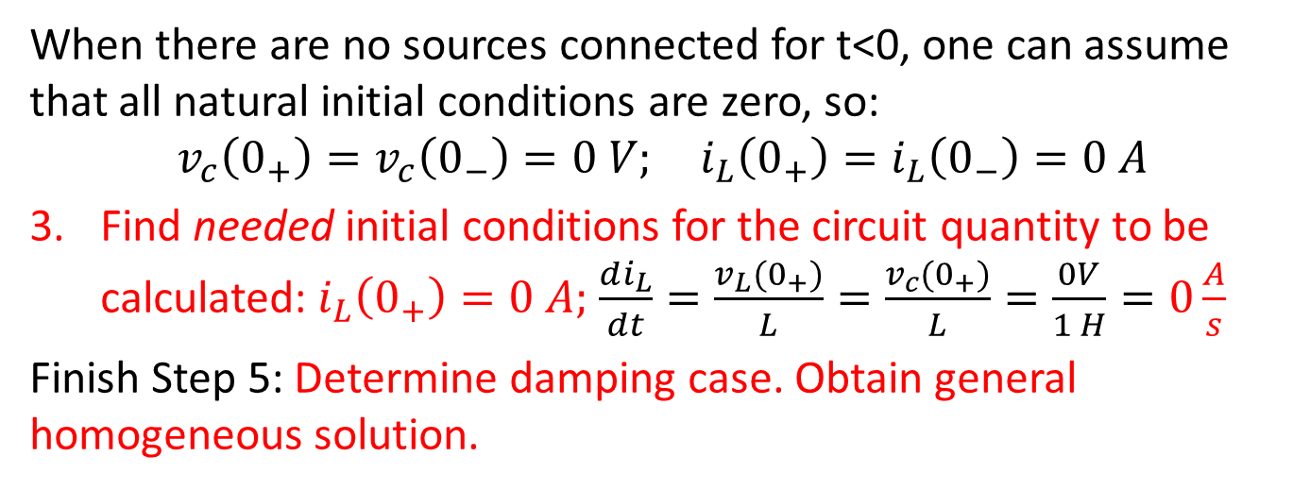
Critically damped RLC parallel circuit
Find natural initial conditions for energy storage elements.
When there are no sources connected for t<0, one can assume that all natural initial conditions are zero, so:
$$v_{c}\left(0_{+}\right)=v_{c}\left(0_{−}\right)=0 V; i_{L}\left(0_{+}\right)=i_{L}\left(0_{−}\right)=0 A$$
Find needed initial conditions for the circuit quantity to be calculated: $i_{L}\left(0_{+}\right)=0 A;$ $\frac{di_{L}}{dt}=\frac{v_{L}(0_{+})}{L}=\frac{v_{c}(0_{+})}{L}=\frac{0V}{1 H}=0\frac{A}{s}$
Finish Step 5: Determine damping case. Obtain general homogeneous solution.
$$=−1±\sqrt{1^{2}−\frac{1}{1}}=−1$$
Since the solutions are identical (-1), this is the critically-damped case and the general solution is always:
$$i_{L,h}\left(t\right)=Ae^{st}+Bte^{st}=Ae^{−t}+Bte^{−t}$$

Slide 16
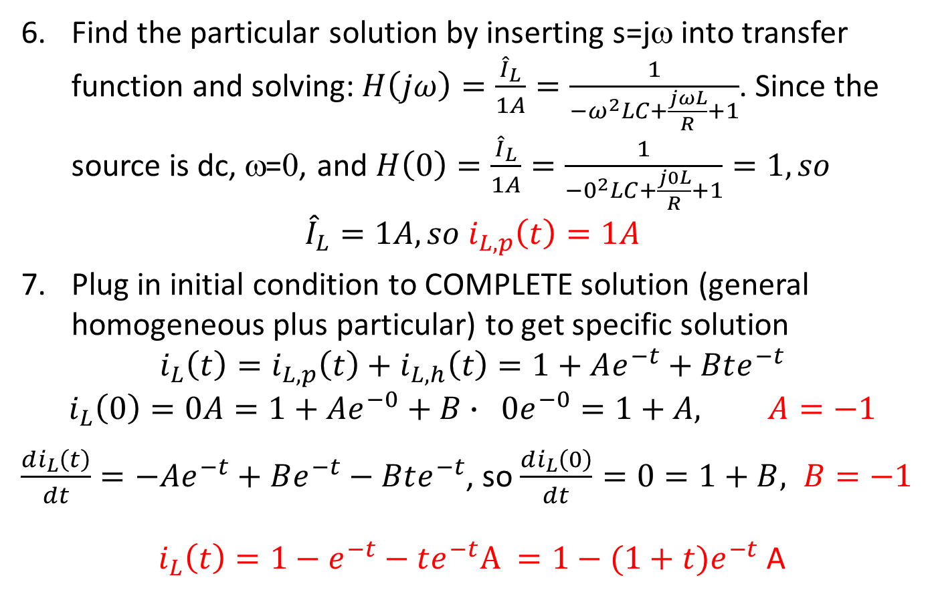
Critically-damped parallel RLC
Find the particular solution by inserting s=jω into transfer function and solving: $H\left(jω\right)=\frac{{\hat{I}}_{L}}{1A}=\frac{1}{−ω^{2}LC+\frac{jωL}{R}+1}$. Since the source is dc, ω=0, and $H\left(0\right)=\frac{{\hat{I}}_{L}}{1A}=\frac{1}{−0^{2}LC+\frac{j0L}{R}+1}=1, so$
$${\hat{I}}_{L}=1A, so i_{L,p}\left(t\right)=1A$$
Plug in initial condition to COMPLETE solution (general homogeneous plus particular) to get specific solution
$$i_{L}\left(t\right)=i_{L,p}\left(t\right)+i_{L,h}\left(t\right)=1+Ae^{−t}+Bte^{−t}$$
$$i_{L}\left(0\right)=0A=1+Ae^{−0}+B∙ 0e^{−0}=1+A, A=−1$$
$\frac{di_{L}\left(t\right)}{dt}=−Ae^{−t}+Be^{−t}−Bte^{−t}$, so $\frac{di_{L}\left(0\right)}{dt}=0=1+B, B=−1$
$i_{L}\left(t\right)=1−e^{−t}−te^{−t}A =1−(1+t)e^{−t}$ A

Slide 17
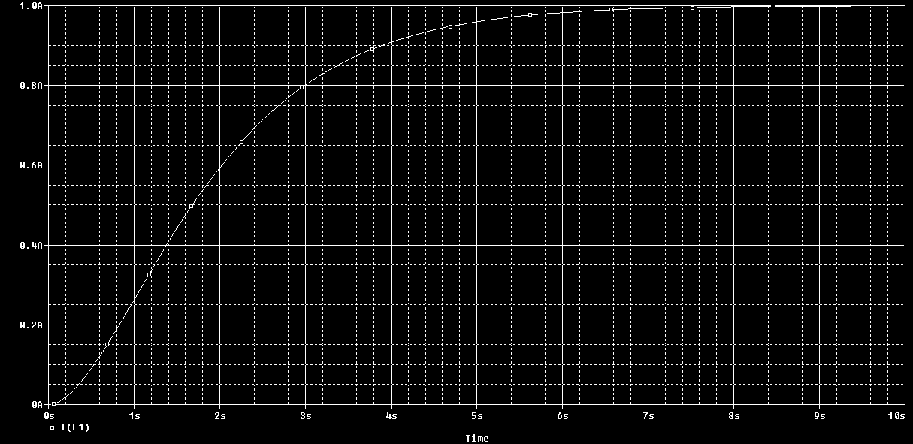
Critically-damped simulation

Slide 18

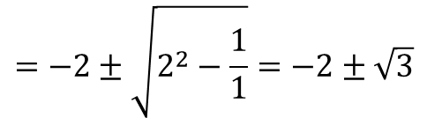
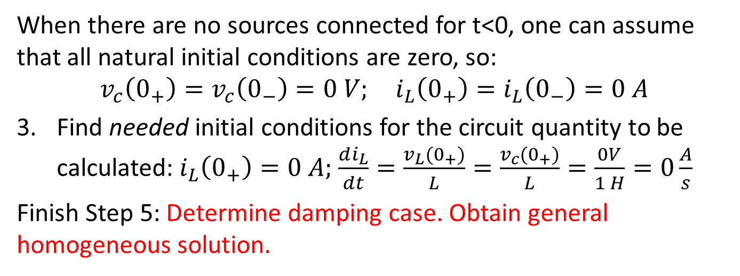
Overdamped RLC parallel circuit
Find natural initial conditions for energy storage elements.
When there are no sources connected for t<0, one can assume that all natural initial conditions are zero, so:
$$v_{c}\left(0_{+}\right)=v_{c}\left(0_{−}\right)=0 V; i_{L}\left(0_{+}\right)=i_{L}\left(0_{−}\right)=0 A$$
Find needed initial conditions for the circuit quantity to be calculated: $i_{L}\left(0_{+}\right)=0 A;$ $\frac{di_{L}}{dt}=\frac{v_{L}(0_{+})}{L}=\frac{v_{c}(0_{+})}{L}=\frac{0V}{1 H}=0\frac{A}{s}$
Finish Step 5: Determine damping case. Obtain general homogeneous solution.
$$=−2±\sqrt{2^{2}−\frac{1}{1}}=−2±\sqrt{3}$$
Since the solutions are real and distinct, this is the overdamped case and the general solution is always:
$$i_{L,h}\left(t\right)=Ae^{s_{+}t}+Be^{s_{−}t}=Ae^{−.268t}+Be^{−3.732t}$$

Slide 19
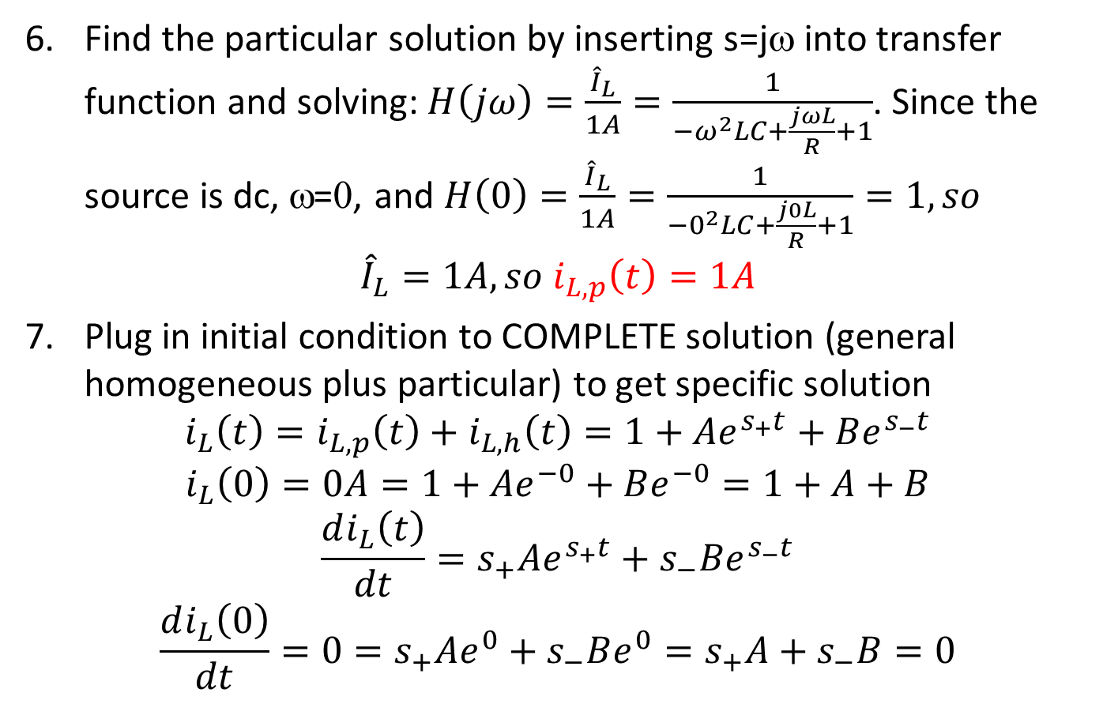
Overdamped parallel RLC
Find the particular solution by inserting s=jω into transfer function and solving: $H\left(jω\right)=\frac{{\hat{I}}_{L}}{1A}=\frac{1}{−ω^{2}LC+\frac{jωL}{R}+1}$. Since the source is dc, ω=0, and $H\left(0\right)=\frac{{\hat{I}}_{L}}{1A}=\frac{1}{−0^{2}LC+\frac{j0L}{R}+1}=1, so$
$${\hat{I}}_{L}=1A, so i_{L,p}\left(t\right)=1A$$
Plug in initial condition to COMPLETE solution (general homogeneous plus particular) to get specific solution
$$i_{L}\left(t\right)=i_{L,p}\left(t\right)+i_{L,h}\left(t\right)=1+Ae^{s_{+}t}+Be^{s_{−}t}$$
$$i_{L}\left(0\right)=0A=1+Ae^{−0}+Be^{−0}=1+A+B$$
$$\frac{di_{L}\left(t\right)}{dt}=s_{+}Ae^{s_{+}t}+s_{−}Be^{s_{−}t}$$
$$\frac{di_{L}\left(0\right)}{dt}={0=s}_{+}Ae^{0}+s_{−}Be^{0}=s_{+}A+s_{−}B=0$$

Slide 20
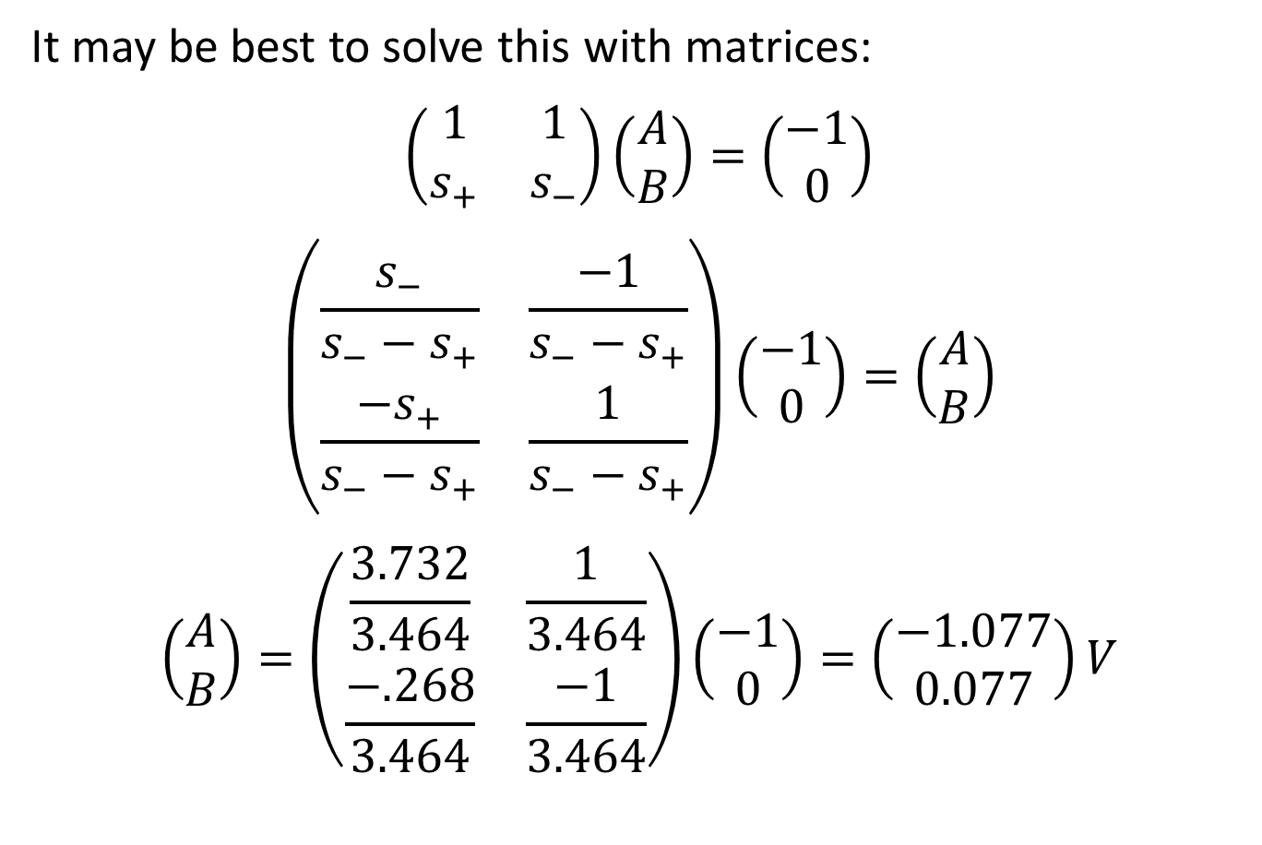
Overdamped parallel RLC case
It may be best to solve this with matrices:
$$\left(\begin{matrix}1 & 1 \\ s_{+} & s_{−}\end{matrix}\right)\left(\begin{matrix}A \\ B\end{matrix}\right)=\left(\begin{matrix}−1 \\ 0\end{matrix}\right)$$
$$\left(\begin{matrix}\frac{s_{−}}{s_{−}−s_{+}} & \frac{−1}{s_{−}−s_{+}} \\ \frac{{−s}_{+}}{s_{−}−s_{+}} & \frac{1}{s_{−}−s_{+}}\end{matrix}\right)\left(\begin{matrix}−1 \\ 0\end{matrix}\right)=\left(\begin{matrix}A \\ B\end{matrix}\right)$$
$$\left(\begin{matrix}A \\ B\end{matrix}\right)=\left(\begin{matrix}\frac{3.732}{3.464} & \frac{1}{3.464} \\ \frac{−.268}{3.464} & \frac{−1}{3.464}\end{matrix}\right)\left(\begin{matrix}−1 \\ 0\end{matrix}\right)=\left(\begin{matrix}−1.077 \\ 0.077\end{matrix}\right)V$$

Slide 21
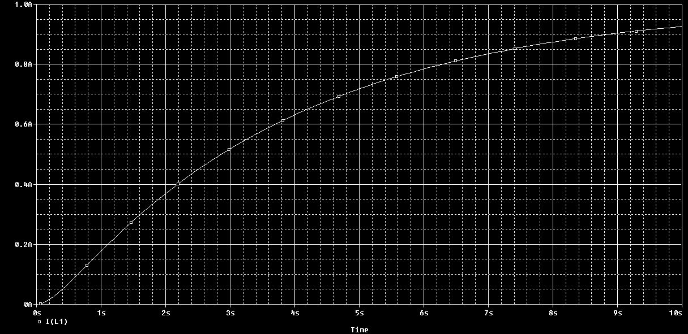
Overdamped simulation

Slide 22
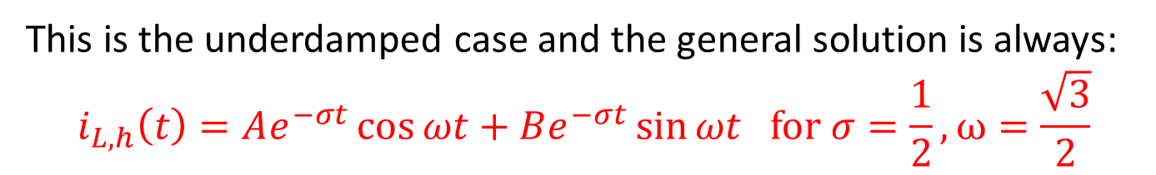
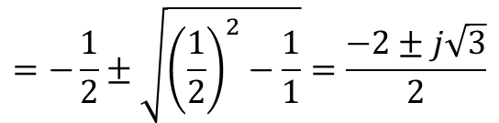
Underdamped RLC parallel circuit
Find natural initial conditions for energy storage elements.
When there are no sources connected for t<0, one can assume that all natural initial conditions are zero, so:
$$v_{c}\left(0_{+}\right)=v_{c}\left(0_{−}\right)=0 V; i_{L}\left(0_{+}\right)=i_{L}\left(0_{−}\right)=0 A$$
Find needed initial conditions for the circuit quantity to be calculated: $i_{L}\left(0_{+}\right)=0 A;$ $\frac{di_{L}}{dt}=\frac{v_{L}(0_{+})}{L}=\frac{v_{c}(0_{+})}{L}=\frac{0V}{1 H}=0\frac{A}{s}$
Finish Step 5: Determine damping case. Obtain general homogeneous solution.
$$=−\frac{1}{2}±\sqrt{{\left(\frac{1}{2}\right)}^{2}−\frac{1}{1}}=\frac{−2±j\sqrt{3}}{2}$$
This is the underdamped case and the general solution is always:
$$i_{L,h}\left(t\right)=Ae^{−σt}\cos{ωt}+Be^{−σt}\sin{ωt for σ=\frac{1}{2}}, ω=\frac{\sqrt{3}}{2}$$

Slide 23
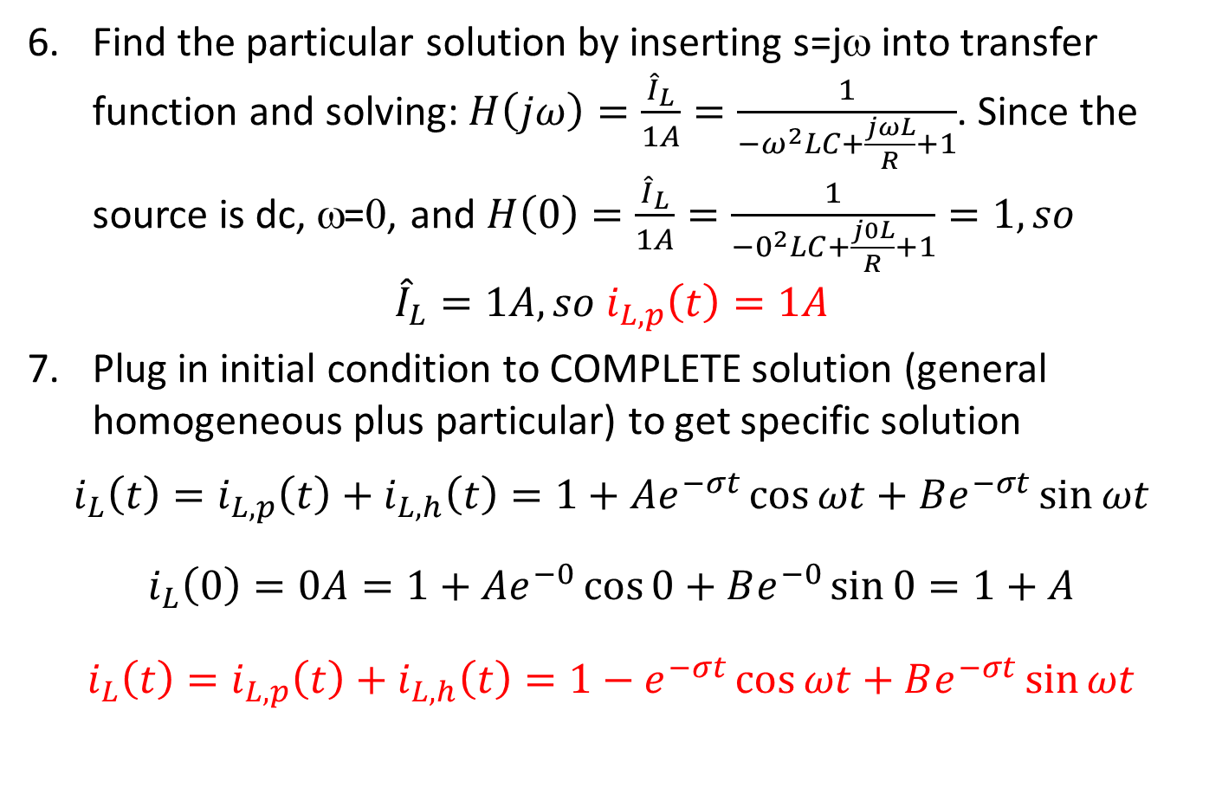
Underdamped parallel RLC
Find the particular solution by inserting s=jω into transfer function and solving: $H\left(jω\right)=\frac{{\hat{I}}_{L}}{1A}=\frac{1}{−ω^{2}LC+\frac{jωL}{R}+1}$. Since the source is dc, ω=0, and $H\left(0\right)=\frac{{\hat{I}}_{L}}{1A}=\frac{1}{−0^{2}LC+\frac{j0L}{R}+1}=1, so$
$${\hat{I}}_{L}=1A, so i_{L,p}\left(t\right)=1A$$
Plug in initial condition to COMPLETE solution (general homogeneous plus particular) to get specific solution
$$i_{L}\left(t\right)=i_{L,p}\left(t\right)+i_{L,h}\left(t\right)=1+Ae^{−σt}\cos{ωt}+Be^{−σt}\sin{ωt}$$
$$i_{L}\left(0\right)=0A=1+Ae^{−0}\cos{0}+Be^{−0}\sin{0}=1+A$$
$$i_{L}\left(t\right)=i_{L,p}\left(t\right)+i_{L,h}\left(t\right)=1−e^{−σt}\cos{ωt}+Be^{−σt}\sin{ωt}$$

Slide 24
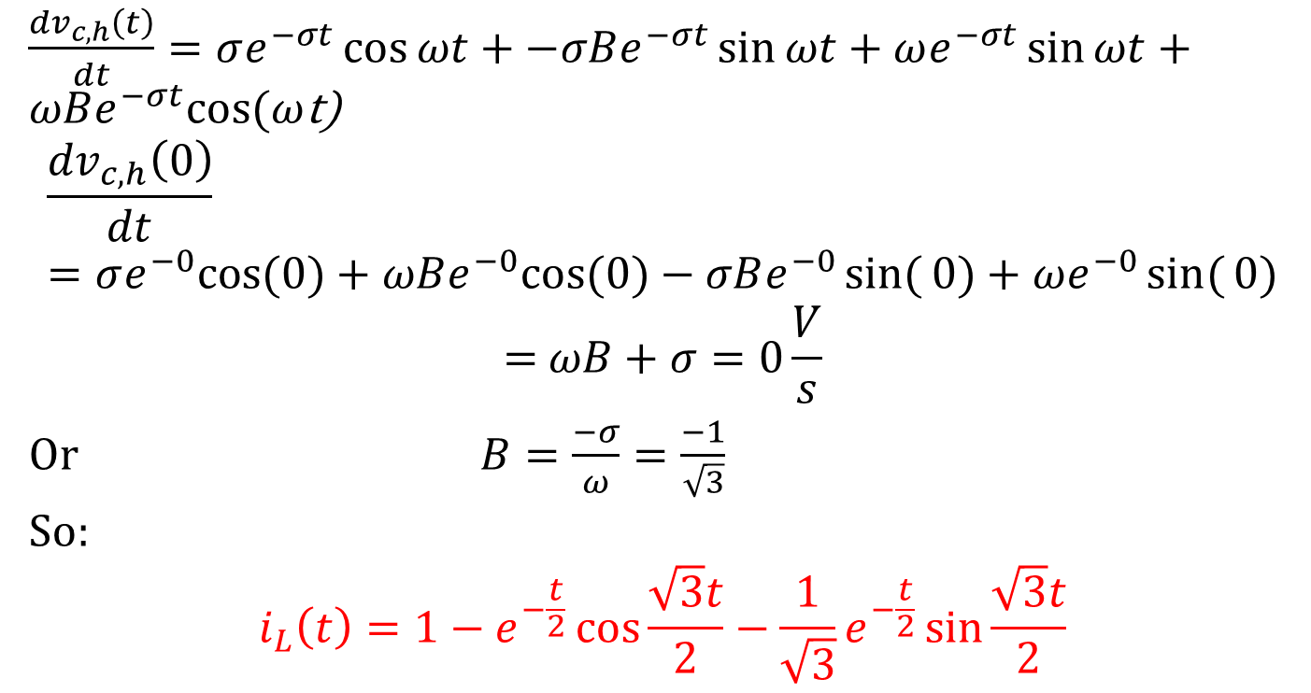
Underdamped parallel RLC case
$\frac{{dv}_{c,h}\left(t\right)}{dt}=σe^{−σt}\cos{ωt}+−σBe^{−σt}\sin{ωt+ωe^{−σt}\sin{ωt}}+ωBe^{−σt}cos⁡(ω$t)
$$\frac{{dv}_{c,h}\left(0\right)}{dt} =σe^{−0}cos⁡(0)+ωBe^{−0}cos⁡(0\text{)}−σBe^{−0}sin({0)+ωe^{−0}sin({0)}}$$
$$\text{=} ωB+σ=0\frac{V}{s}$$
Or $B=\frac{−σ}{ω}=\frac{−1}{\sqrt{3}}$
So:
$$i_{L}\left(t\right)=1−e^{−\frac{t}{2}}\cos{\frac{\sqrt{3}t}{2}}−\frac{1}{\sqrt{3}}e^{−\frac{t}{2}}\sin{\frac{\sqrt{3}t}{2}}$$
=0
=0

Slide 25
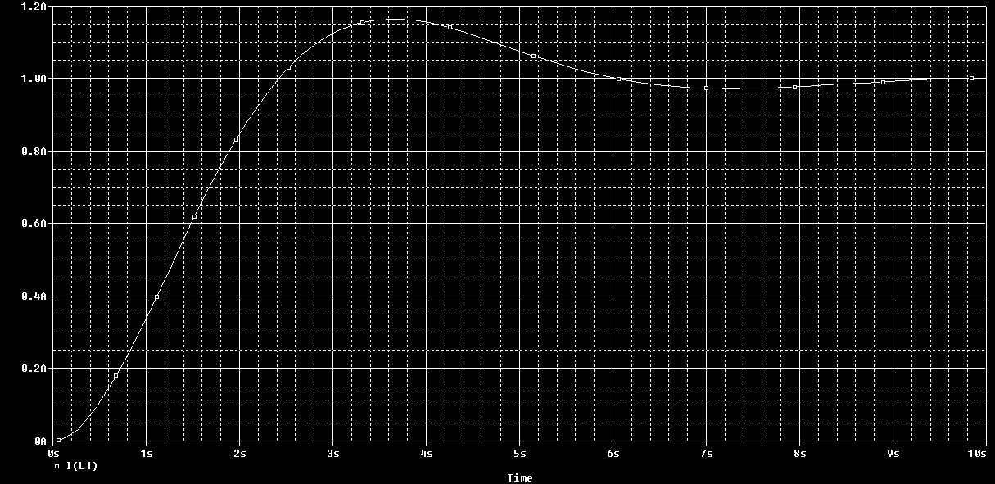
Underdamped simulation
Overshoot

Slide 26
Transients
Part 3: Needed Initial Conditions
ENEE 205

Slide 27
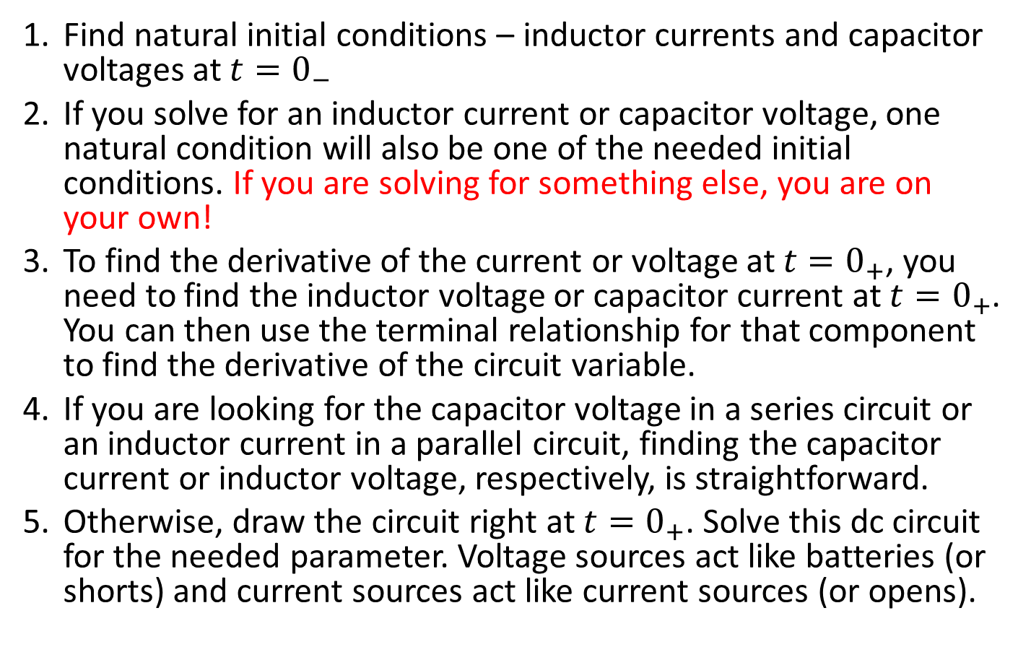
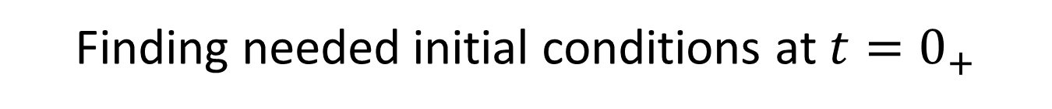
  Finding needed initial conditions at $t=0_{+}$
Find natural initial conditions – inductor currents and capacitor voltages at $t=0_{−}$
If you solve for an inductor current or capacitor voltage, one natural condition will also be one of the needed initial conditions. If you are solving for something else, you are on your own!
To find the derivative of the current or voltage at $t=0_{+}$, you need to find the inductor voltage or capacitor current at $t=0_{+}$. You can then use the terminal relationship for that component to find the derivative of the circuit variable.
If you are looking for the capacitor voltage in a series circuit or an inductor current in a parallel circuit, finding the capacitor current or inductor voltage, respectively, is straightforward.
Otherwise, draw the circuit right at $t=0_{+}$. Solve this dc circuit for the needed parameter. Voltage sources act like batteries (or shorts) and current sources act like current sources (or opens).

Slide 28
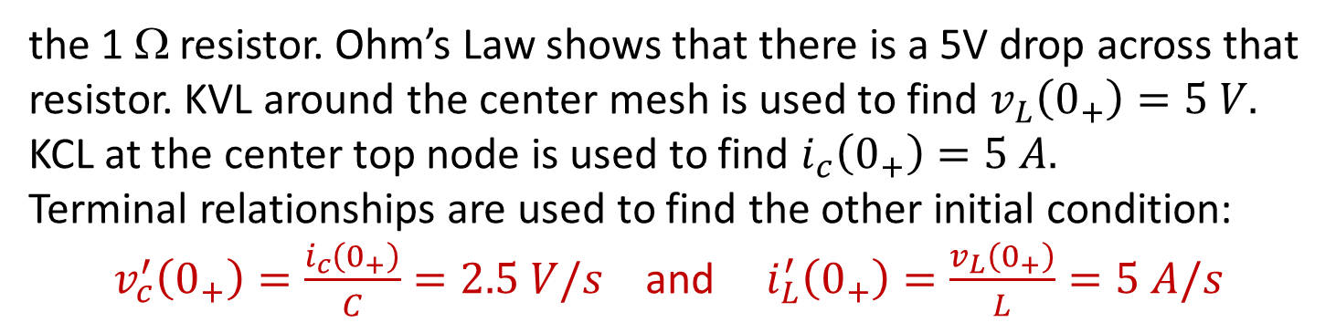
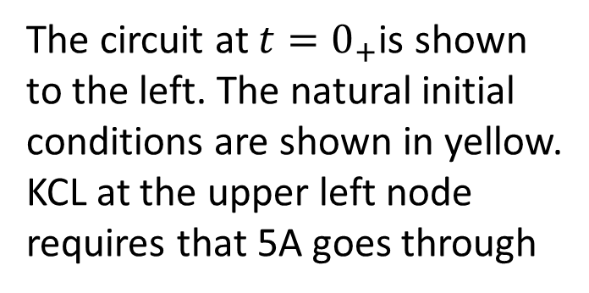
Initial condition example
For t<0, there are no sources connected to the circuit, so:
$$v_{c}\left(0_{+}\right)=v_{c}\left(0_{−}\right)=0 V; i_{L}\left(0_{+}\right)=i_{L}\left(0_{−}\right)=0 A$$
1 Ω
5 A
0.5 Ω
The circuit at $t=0_{+}$is shown to the left. The natural initial conditions are shown in yellow.
KCL at the upper left node requires that 5A goes through
+
5 V
-
+ 5 V -
+ 0 V -
+
0 V
-
0 A
5 A
0 A
5 A
the 1 Ω resistor. Ohm’s Law shows that there is a 5V drop across that resistor. KVL around the center mesh is used to find $v_{L}\left(0_{+}\right)=5 V.$
KCL at the center top node is used to find $i_{c}\left(0_{+}\right)=5 A.$
Terminal relationships are used to find the other initial condition:
$v_{c}^{′}\left(0_{+}\right)=\frac{i_{c}\left(0_{+}\right)}{C}=2.5 V/s$ and $i_{L}^{′}\left(0_{+}\right)=\frac{v_{L}\left(0_{+}\right)}{L}=5 A/s$

Slide 29
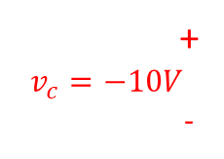

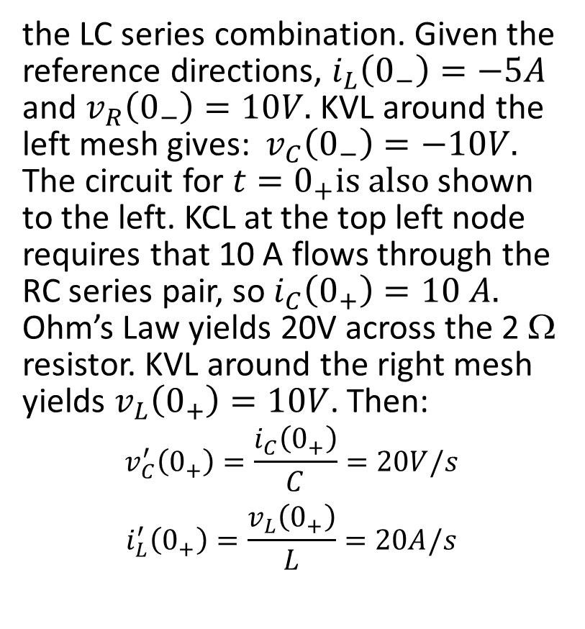


Initial condition example
For t<0, the circuit is shown to the left. It is a steady-state, dc problem, so the capacitor has infinite impedance and the inductor has zero impedance. Thus, all 5A goes through
+ V_{R} -
t<0
the LC series combination. Given the reference directions, $i_{L}\left(0_{−}\right)=−5A$ and $v_{R}\left(0_{−}\right)=10V.$ KVL around the left mesh gives: $v_{C}\left(0_{−}\right)=−10V.$
The circuit for $t=0_{+}is also$shown to the left. KCL at the top left node requires that 10 A flows through the RC series pair, so $i_{C}\left(0_{+}\right)=10 A.$
Ohm’s Law yields 20V across the 2 Ω resistor. KVL around the right mesh yields $v_{L}\left(0_{+}\right)=10V$. Then:
$$v_{C}^{′}\left(0_{+}\right)=\frac{i_{C}\left(0_{+}\right)}{C}=20V/s$$
$$i_{L}^{′}\left(0_{+}\right)=\frac{v_{L}\left(0_{+}\right)}{L}=20A/s$$
+
V_{L}
-
2Ω
+
V_{c}
-
5A
i_{L}
$$t=0_{+}$$
+ V_{R} =20V -
5A
+
V_{L}
-
+
$$v_{c}=−10V$$
-
$$i_{L}=−5A$$
$$10A$$

Slide 30
Second Order Transients
Part 4: Example Problems
ENEE 205

Slide 31
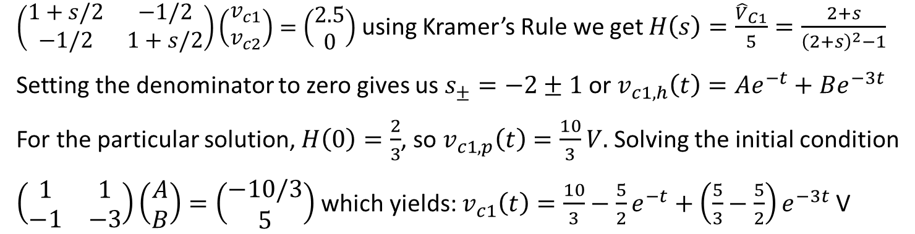
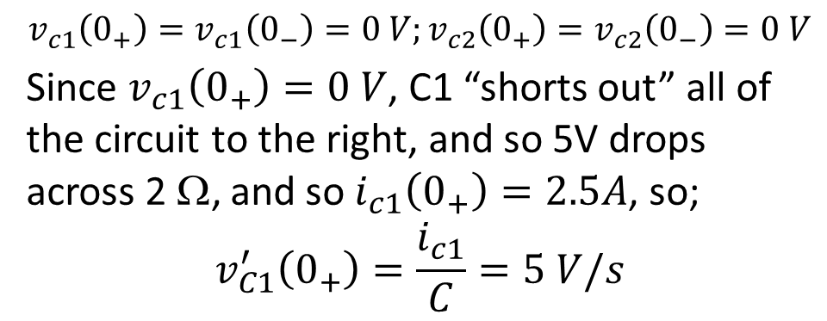
  A TWO-CAPACITOR CIRCUIT EXAMPLE
$$v_{c1}\left(0_{+}\right)=v_{c1}\left(0_{−}\right)=0 V;v_{c2}\left(0_{+}\right)=v_{c2}\left(0_{−}\right)=0 V$$
Since $v_{c1}\left(0_{+}\right)=0 V$, C1 “shorts out” all of the circuit to the right, and so 5V drops across 2 Ω, and so $i_{c1}\left(0_{+}\right)=2.5A$, so;
$$v_{C1}^{′}\left(0_{+}\right)=\frac{i_{c1}}{C}=5 V/s$$
t
=
0
2
Ω
+
+
V_{c2}
-
0
.
5
V
V
5
F
2
Ω
c1
0
.
-
5
F
2
Ω
0.5
+
V_{c1}
-
+
V_{c2}
-
2.5 A
0.5
0.5s
0.5s
0.5
We use nodal analysis to find the transfer function:
$\left(\begin{matrix}1+s/2 & −1/2 \\ −1/2 & 1+s/2\end{matrix}\right)\left(\begin{matrix}v_{c1} \\ v_{c2}\end{matrix}\right)=\left(\begin{matrix}2.5 \\ 0\end{matrix}\right)$ using Kramer’s Rule we get $H\left(s\right)=\frac{{\hat{V}}_{C1}}{5}=\frac{2+s}{{\left(2+s\right)}^{2}−1}$
Setting the denominator to zero gives us $s_{±}=−2±1$ or $v_{c1,h}\left(t\right)=Ae^{−t}+Be^{−3t}$
For the particular solution, $H\left(0\right)=\frac{2}{3}$, so $v_{c1,p}\left(t\right)=\frac{10}{3}V.$ Solving the initial condition
$\left(\begin{matrix}1 & 1 \\ −1 & −3\end{matrix}\right)\left(\begin{matrix}A \\ B\end{matrix}\right)=\left(\begin{matrix}−10/3 \\ 5\end{matrix}\right)$ which yields: $v_{c1}\left(t\right)=\frac{10}{3}−\frac{5}{2}e^{−t}+\left(\frac{5}{3}−\frac{5}{2}\right)e^{−3t}$ V

Slide 32
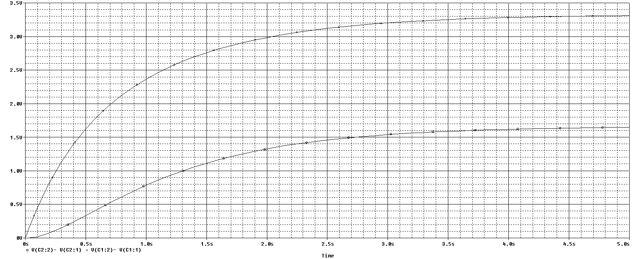


Two capacitor simulation
$$v_{c1}$$
$$v_{c2}$$

Slide 33
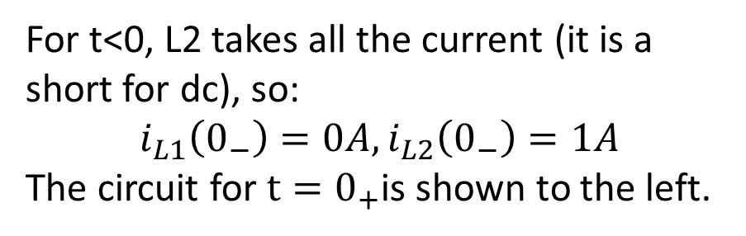



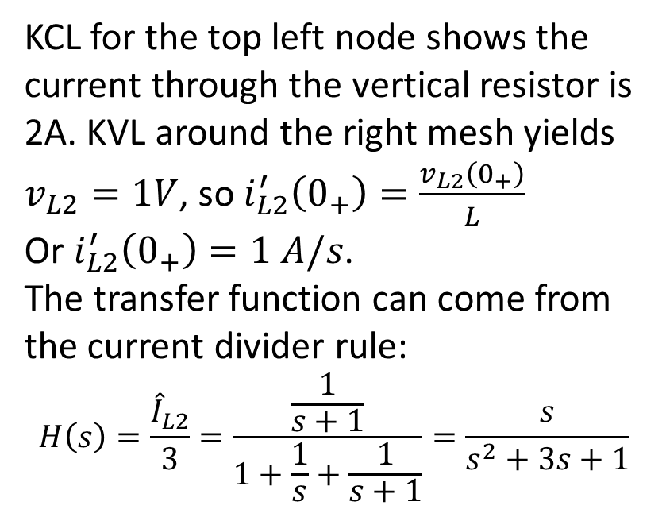
  TWO-INDUCTOR EXAMPLE - Solve for i_{L2} for t>0
For t<0, L2 takes all the current (it is a short for dc), so:
$$i_{L1}\left(0_{−}\right)=0A, i_{L2}\left(0_{−}\right)=1A$$
The circuit for $t=0_{+}$is shown to the left.
$t=0_{+}$
KCL for the top left node shows the current through the vertical resistor is 2A. KVL around the right mesh yields $v_{L2}=1V$, so $i_{L2}^{′}\left(0_{+}\right)=\frac{v_{L2}\left(0_{+}\right)}{L}$
Or $i_{L2}^{′}\left(0_{+}\right)=1 A/s$.
The transfer function can come from the current divider rule:
$$H\left(s\right)=\frac{{\hat{I}}_{L2}}{3}=\frac{\frac{1}{s+1}}{1+\frac{1}{s}+\frac{1}{s+1}}=\frac{s}{s^{2}+3s+1}$$
+
2V
-
+
V_{L2}
-
+ 1V -
3A
2A
0A
1A
$t>0$
3A
1
1/s
1/(s+1)
$${\hat{I}}_{L2}$$

Slide 34
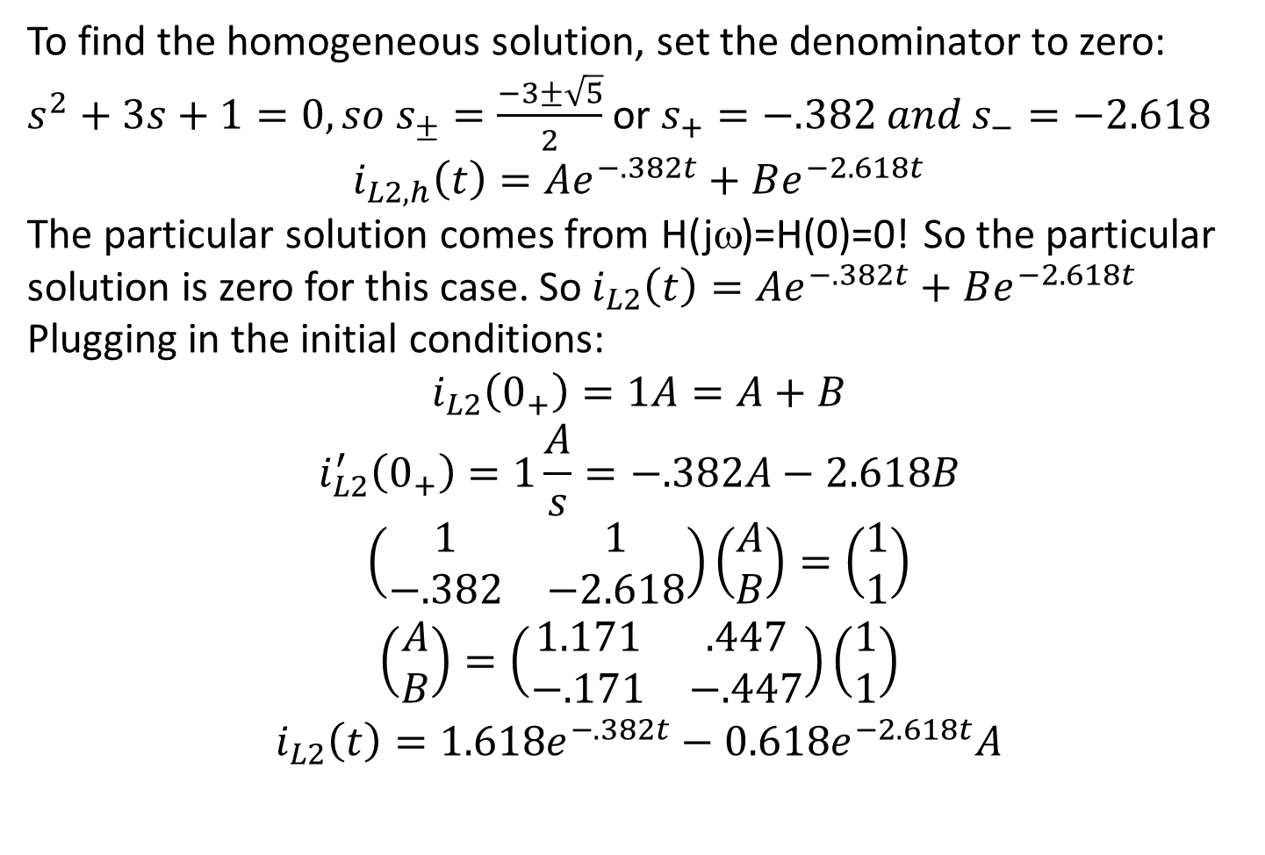
  Solve for i_{L2} for t>0
To find the homogeneous solution, set the denominator to zero:
$s^{2}+3s+1=0, so s_{±}=\frac{−3±\sqrt{5}}{2}$ or $s_{+}=−.382 and s_{−}=−2.618$
$$i_{L2,h}\left(t\right)=Ae^{−.382t}+Be^{−2.618t}$$
The particular solution comes from H(jω)=H(0)=0! So the particular solution is zero for this case. So $i_{L2}\left(t\right)=Ae^{−.382t}+Be^{−2.618t}$
Plugging in the initial conditions:
$$i_{L2}\left(0_{+}\right)=1A=A+B$$
$$i_{L2}^{′}\left(0_{+}\right)=1\frac{A}{s}=−.382A−2.618B$$
$$\left(\begin{matrix}1 & 1 \\ −.382 & −2.618\end{matrix}\right)\left(\begin{matrix}A \\ B\end{matrix}\right)=\left(\begin{matrix}1 \\ 1\end{matrix}\right)$$
$$\left(\begin{matrix}A \\ B\end{matrix}\right)=\left(\begin{matrix}1.171 & .447 \\ −.171 & −.447\end{matrix}\right)\left(\begin{matrix}1 \\ 1\end{matrix}\right)$$
$$i_{L2}\left(t\right)=1.618e^{−.382t}−0.618e^{−2.618t}A$$

Slide 35
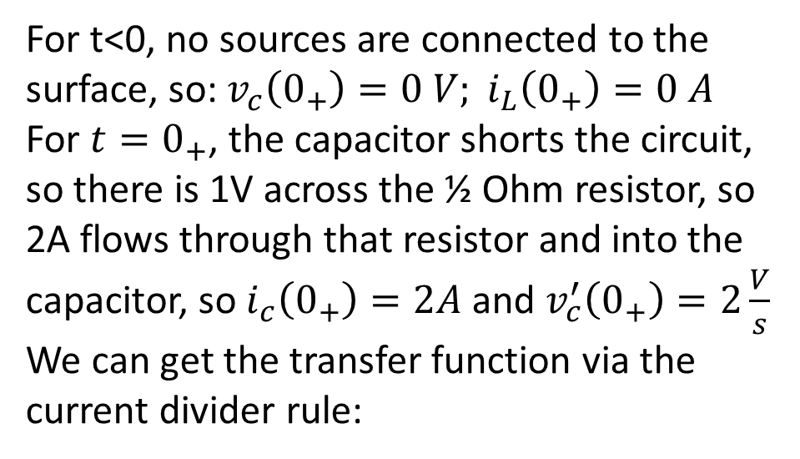
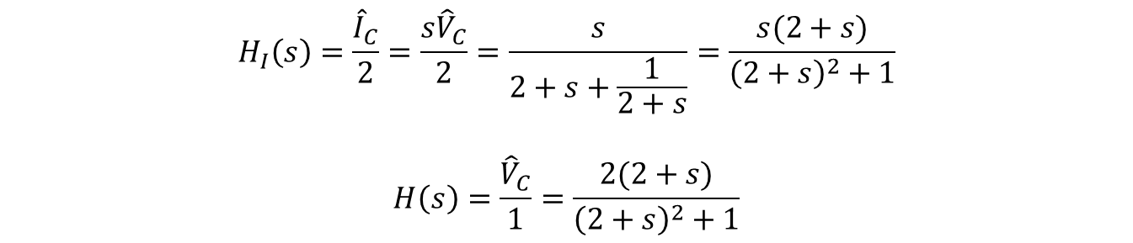


2nd-order Sinusoidal source example
For t<0, no sources are connected to the surface, so:$v_{c}\left(0_{+}\right)=0 V; i_{L}\left(0_{+}\right)=0 A$
For $t=0_{+}$, the capacitor shorts the circuit, so there is 1V across the ½ Ohm resistor, so 2A flows through that resistor and into the capacitor, so $i_{c}\left(0_{+}\right)=2A$ and $v_{c}^{′}\left(0_{+}\right)=2\frac{V}{s}$
We can get the transfer function via the current divider rule:
2A
2
s
$$\frac{1}{2+s}$$
$${\hat{I}}_{C}$$
$$H_{I}\left(s\right)=\frac{{\hat{I}}_{C}}{2}=\frac{s{\hat{V}}_{C}}{2}=\frac{s}{2+s+\frac{1}{2+s}}=\frac{s(2+s)}{{\left(2+s\right)}^{2}+1}$$
$$H\left(s\right)=\frac{{\hat{V}}_{C}}{1}=\frac{2(2+s)}{{\left(2+s\right)}^{2}+1}$$

Slide 36
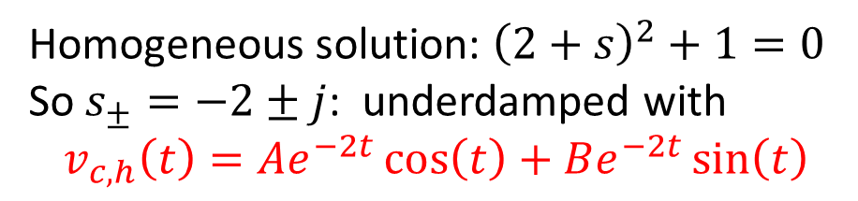
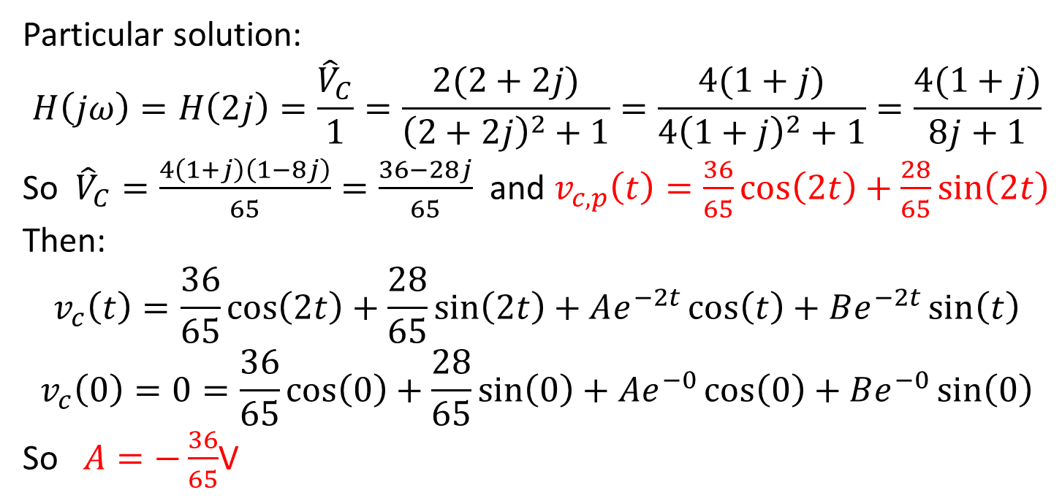
2nd-order Sinusoidal source example
Homogeneous solution: ${\left(2+s\right)}^{2}+1=0$
So $s_{±}=−2±j$: underdamped with
$$v_{c,h}\left(t\right)=Ae^{−2t}\cos\left(t\right)+Be^{−2t}\sin\left(t\right)$$
Particular solution:
$$H\left(jω\right)=H\left(2j\right)=\frac{{\hat{V}}_{C}}{1}=\frac{2(2+2j)}{{\left(2+2j\right)}^{2}+1}=\frac{4(1+j)}{4{\left(1+j\right)}^{2}+1}=\frac{4(1+j)}{8j+1}$$
So ${\hat{V}}_{C}=\frac{4\left(1+j\right)\left(1−8j\right)}{65}=\frac{36−28j}{65}$ and $v_{c,p}\left(t\right)=\frac{36}{65}\cos\left(2t\right)+\frac{28}{65}\sin\left(2t\right)$
Then:
$$v_{c}\left(t\right)=\frac{36}{65}\cos\left(2t\right)+\frac{28}{65}\sin\left(2t\right)+Ae^{−2t}\cos\left(t\right)+Be^{−2t}\sin\left(t\right)$$
$$v_{c}\left(0\right)=0=\frac{36}{65}\cos\left(0\right)+\frac{28}{65}\sin\left(0\right)+Ae^{−0}\cos\left(0\right)+Be^{−0}\sin\left(0\right)$$
So $A=−\frac{36}{65}$V

Slide 37
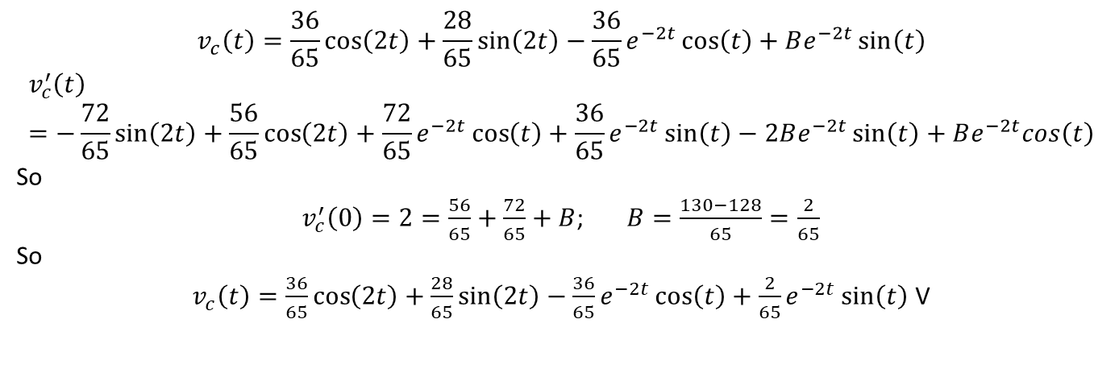
2nd-order Sinusoidal source example
$$v_{c}\left(t\right)=\frac{36}{65}\cos\left(2t\right)+\frac{28}{65}\sin\left(2t\right)−\frac{36}{65}e^{−2t}\cos\left(t\right)+Be^{−2t}\sin\left(t\right)$$
$$v_{c}^{′}\left(t\right)=−\frac{72}{65}\sin\left(2t\right)+\frac{56}{65}\cos\left(2t\right)+\frac{72}{65}e^{−2t}\cos\left(t\right)+\frac{36}{65}e^{−2t}\sin\left(t\right)−2Be^{−2t}\sin\left(t\right)+Be^{−2t}cos\left(t\right)$$
So
$v_{c}^{′}\left(0\right)=2=\frac{56}{65}+\frac{72}{65}+B$; $B=\frac{130−128}{65}=\frac{2}{65}$
So
$v_{c}\left(t\right)=\frac{36}{65}\cos\left(2t\right)+\frac{28}{65}\sin\left(2t\right)−\frac{36}{65}e^{−2t}\cos\left(t\right)+\frac{2}{65}e^{−2t}\sin\left(t\right)$ V

Slide 38
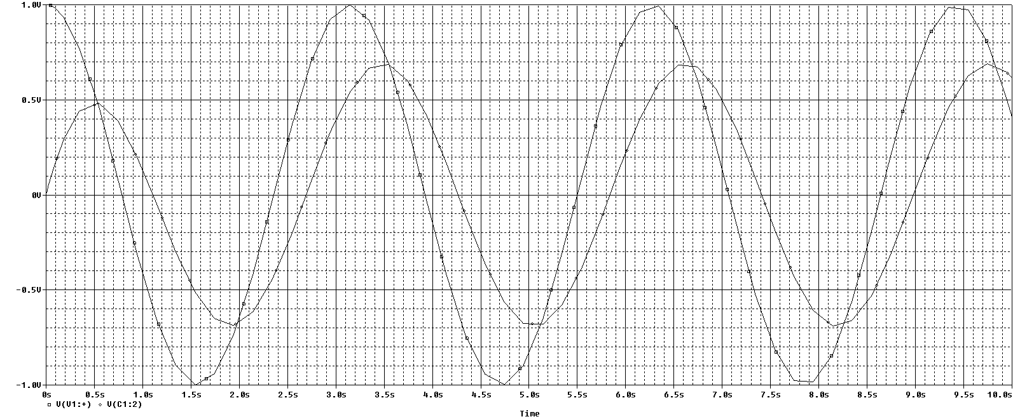
Sinusoid input simulation
Source
Voltage
Capacitor
Voltage

