Slide 1
Nodal Analysis Part 1: Derivation of the method
ENEE 205

Slide 2
Nodal Analysis equations
Definitions:
Ground – a node that we to agree to use as a reference of “zero” voltage; a node that we define to be at “zero volts.”
Node Potential – the voltage difference between a node in a circuit and the reference ground node.
Approach:
Write KCLs for all nodes except ground.
Write currents through the passive components in terms of admittances and node potentials.
Organize KLCs in matrix form where the only unknowns are node potentials.
Write general algorithm to find matrix elements to bypass KCL evaluation in general.

Slide 3
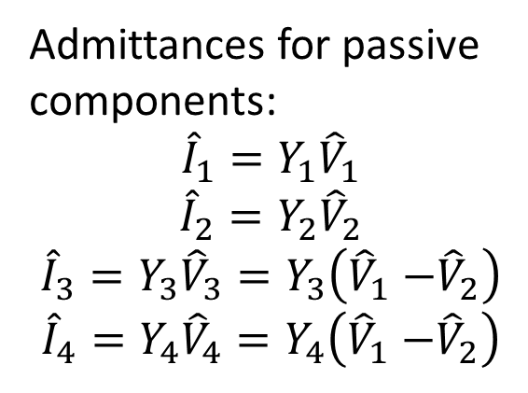
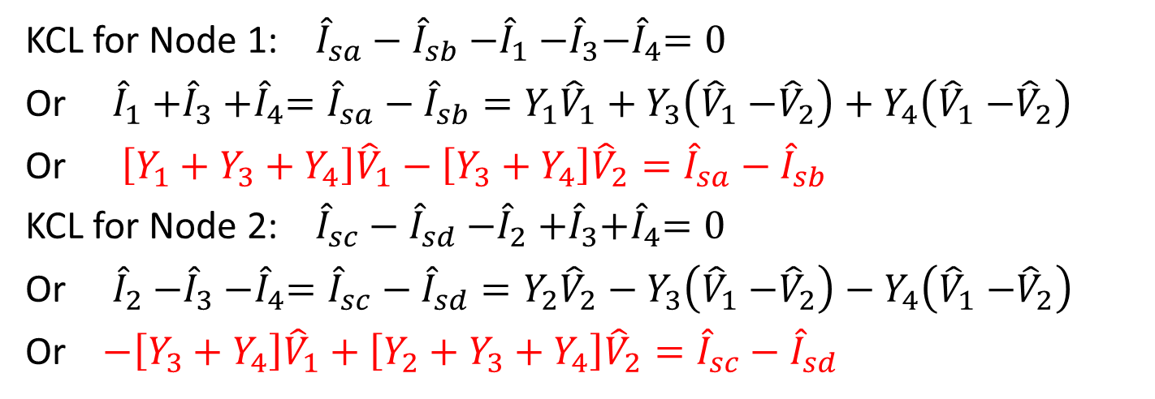
“Derivation” of Nodal Analysis Technique
Admittances for passive components:
$${\hat{I}}_{1}=Y_{1}{\hat{V}}_{1}$$
$${\hat{I}}_{2}=Y_{2}{\hat{V}}_{2}$$
$${\hat{I}}_{3}=Y_{3}{\hat{V}}_{3}=Y_{3}\left({\hat{V}}_{1}{−\hat{V}}_{2}\right)$$
$${\hat{I}}_{4}=Y_{4}{\hat{V}}_{4}=Y_{4}\left({\hat{V}}_{1}{−\hat{V}}_{2}\right)$$
i₄
i₃
+ V₃ -
i₂
+
V₁
-
i₁
+
V₂
-
KCL for Node 1: ${\hat{I}}_{sa}−{\hat{I}}_{sb}{−\hat{I}}_{1}{−\hat{I}}_{3}{−\hat{I}}_{4}=0$
Or ${\hat{I}}_{1}{+\hat{I}}_{3}{+\hat{I}}_{4}={\hat{I}}_{sa}−{\hat{I}}_{sb}=Y_{1}{\hat{V}}_{1}+Y_{3}\left({\hat{V}}_{1}{−\hat{V}}_{2}\right)+Y_{4}\left({\hat{V}}_{1}{−\hat{V}}_{2}\right)$
Or $\left[Y_{1}+Y_{3}+Y_{4}\right]{\hat{V}}_{1}−\left[Y_{3}+Y_{4}\right]{\hat{V}}_{2}={\hat{I}}_{sa}−{\hat{I}}_{sb}$
KCL for Node 2: ${\hat{I}}_{sc}−{\hat{I}}_{sd}{−\hat{I}}_{2}{+\hat{I}}_{3}{+\hat{I}}_{4}=0$
Or ${\hat{I}}_{2}{−\hat{I}}_{3}{−\hat{I}}_{4}={\hat{I}}_{sc}−{\hat{I}}_{sd}=Y_{2}{\hat{V}}_{2}−Y_{3}\left({\hat{V}}_{1}{−\hat{V}}_{2}\right)−Y_{4}\left({\hat{V}}_{1}{−\hat{V}}_{2}\right)$
Or $−\left[Y_{3}+Y_{4}\right]{\hat{V}}_{1}+\left[Y_{2}+Y_{3}+Y_{4}\right]{\hat{V}}_{2}={\hat{I}}_{sc}−{\hat{I}}_{sd}$

Slide 4
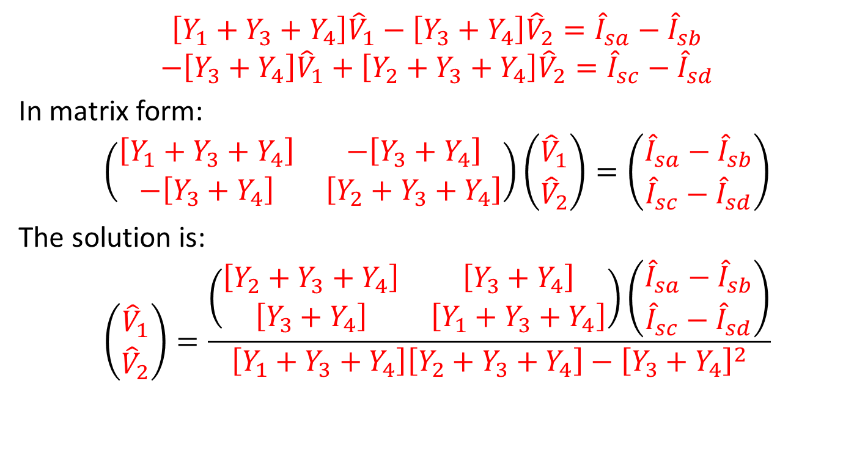
“Derivation” continued
$$\left[Y_{1}+Y_{3}+Y_{4}\right]{\hat{V}}_{1}−\left[Y_{3}+Y_{4}\right]{\hat{V}}_{2}={\hat{I}}_{sa}−{\hat{I}}_{sb}$$
$$−\left[Y_{3}+Y_{4}\right]{\hat{V}}_{1}+\left[Y_{2}+Y_{3}+Y_{4}\right]{\hat{V}}_{2}={\hat{I}}_{sc}−{\hat{I}}_{sd}$$
In matrix form:
$$\left(\begin{matrix}\left[Y_{1}+Y_{3}+Y_{4}\right] & −\left[Y_{3}+Y_{4}\right] \\ −\left[Y_{3}+Y_{4}\right] & \left[Y_{2}+Y_{3}+Y_{4}\right]\end{matrix}\right)\left(\begin{matrix}{\hat{V}}_{1} \\ {\hat{V}}_{2}\end{matrix}\right)=\left(\begin{matrix}{\hat{I}}_{sa}−{\hat{I}}_{sb} \\ {\hat{I}}_{sc}−{\hat{I}}_{sd}\end{matrix}\right)$$
The solution is:
$$\left(\begin{matrix}{\hat{V}}_{1} \\ {\hat{V}}_{2}\end{matrix}\right)=\frac{\left(\begin{matrix}\left[Y_{2}+Y_{3}+Y_{4}\right] & \left[Y_{3}+Y_{4}\right] \\ \left[Y_{3}+Y_{4}\right] & \left[Y_{1}+Y_{3}+Y_{4}\right]\end{matrix}\right)\left(\begin{matrix}{\hat{I}}_{sa}−{\hat{I}}_{sb} \\ {\hat{I}}_{sc}−{\hat{I}}_{sd}\end{matrix}\right)}{\left[Y_{1}+Y_{3}+Y_{4}\right]\left[Y_{2}+Y_{3}+Y_{4}\right]−{\left[Y_{3}+Y_{4}\right]}^{2}}$$

Slide 5
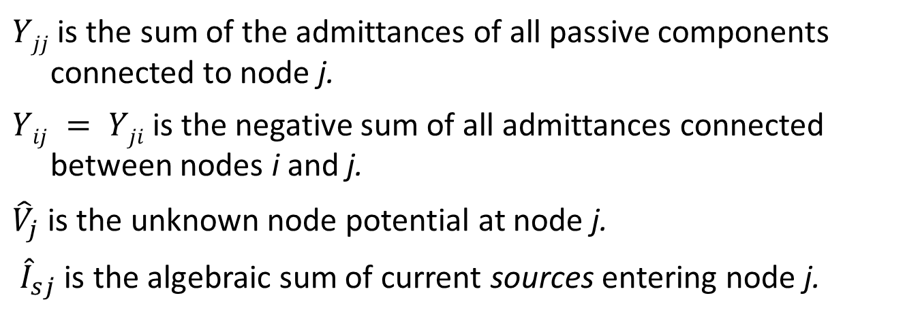
Nodal Analysis MATRIX (basic – n+1 nodes)
$Yjj$ is the sum of the admittances of all passive components connected to node j.
$Yij = Yji$is the negative sum of all admittances connected between nodes i and j.
${\hat{V}}_{j}$ is the unknown node potential at node j.
${\hat{I}}_{sj}$ is the algebraic sum of current sources entering node j.

Slide 6
Nodal Analysis algorithm (BASIC)
Step 0 get circuit.
Step 1 convert circuit to phasor form – use admittances.
Step 2 assign ground; label other nodes.
Step 3 fill out admittance matrix equation.
Step 4 solve matrix equation for unknown node potentials.
Step 5 use node potentials to find any and all currents and voltages in the circuit.

Slide 7
Nodal analysis example
Step 0. get circuit→
1 Ω
1 Ω
0.5 Ω
3cos(2t) A
1 F
0.5 H
4cos(2t+45°) A
1
1
Ω
2
Step 1. Convert to phasors and admittances
Ω
Ω
3 A
2j
Ω
-j
Ω
4e^{j45°} A

Slide 8
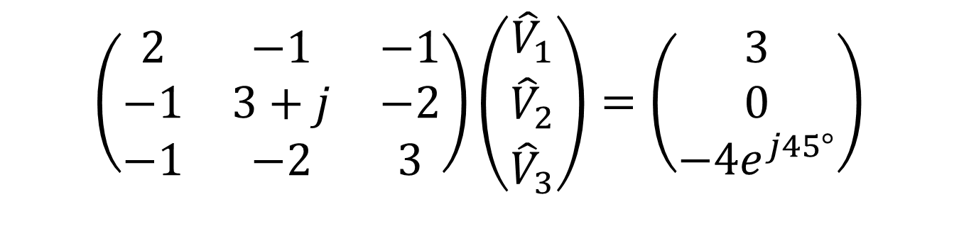
Step 2. Assign ground and nodes
Node 1
Node 3
1
Ω
1
Ω
2
Ω
Node 2
3 A
2j
Ω
-j
Ω
4e^{j45°} A
Step 3. Fill out matrix using prescription
$$\left(\begin{matrix}2 & −1 & −1 \\ −1 & 3+j & −2 \\ −1 & −2 & 3\end{matrix}\right)\left(\begin{matrix}{\hat{V}}_{1} \\ {\hat{V}}_{2} \\ {\hat{V}}_{3}\end{matrix}\right)=\left(\begin{matrix}3 \\ 0 \\ −4e^{j45°}\end{matrix}\right)$$

Slide 9
Nodal Analysis Part 2: Elimination of trivial nodes
ENEE 205

Slide 10






Mandatory Elimination of trivial nodes
Not allowed!
$$\frac{Y_{1}Y_{2}}{Y_{1}{+Y}_{2}}$$
+
$$I_{2}$$
$$Y_{1}V_{2}$$
$$Y_{1}$$
$$I_{1}$$
-
$$V_{1}+V_{2}$$

Slide 11
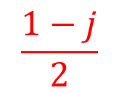
Example with trivial nodes
1
Ω
-j
Ω
1
Ω
2
Ω
2j
Ω
3 A
2j
Ω
-j
Ω
4e^{j45°} A
+
2 V
-
$$\frac{1−j}{2}$$
Ω
Combined resistor and inductor in series
Converted non-ideal voltage source into current source
1
Ω
2
Ω
N2
N3
N1
3 A
2j
Ω
-j
Ω
4e^{j45°} A
4j A
2j
Ω

Slide 12
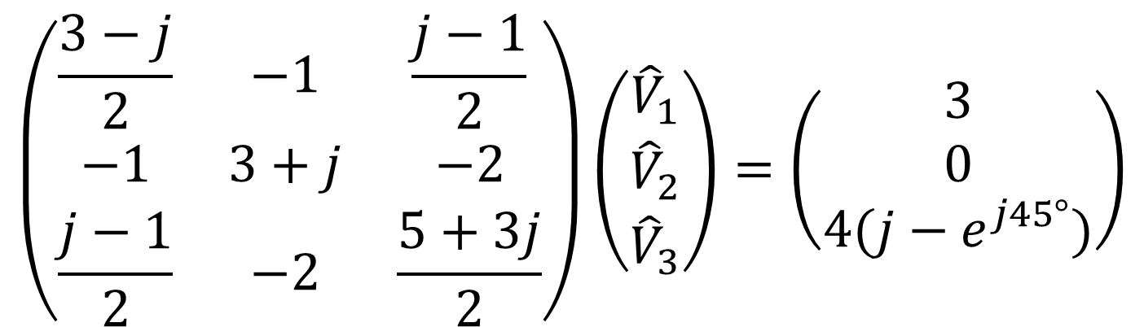
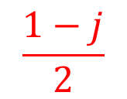
$$\frac{1−j}{2}$$
Ω
1
Ω
2
Ω
N2
N3
N1
3 A
2j
Ω
-j
Ω
4e^{j45°} A
4j A
2j
Ω
$$\left(\begin{matrix}\frac{3−j}{2} & −1 & \frac{j−1}{2} \\ −1 & 3+j & −2 \\ \frac{j−1}{2} & −2 & \frac{5+3j}{2}\end{matrix}\right)\left(\begin{matrix}{\hat{V}}_{1} \\ {\hat{V}}_{2} \\ {\hat{V}}_{3}\end{matrix}\right)=\left(\begin{matrix}3 \\ 0 \\ 4(j−e^{j45°})\end{matrix}\right)$$

Slide 13
Nodal Analysis Part 3: Circuits with ideal independent voltage sources
ENEE 205

Slide 14
Inclusion of ideal voltage sources algorithm
Step 0 get circuit.
Step 1 convert circuit to phasor form – use admittances.
Step 2 assign ground; label other nodes.
Step 3 fill out admittance matrix equation - pretend for the moment that ideal voltage sources are actually current sources of unknown phasor.
Step 4 eliminate unknown(s) in source current column vector by eliminating one row in matrix equation.
Step 5 eliminate one column in matrix equation by eliminating one unknown node potential using ideal voltage source.
Step 6 solve matrix equation for unknown node potentials.
Step 7 use node potentials to find any and all currents and voltages in the circuit

Slide 15
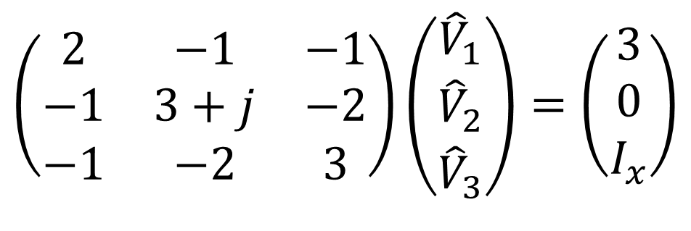


Example 1 with ideal voltage source
Step 0 get circuit.
Step 1 convert circuit to phasor form – use admittances.
Step 2 assign ground; label other nodes.
N1
N3
1
Ω
1
Ω
2
Ω
N2
3 A
2j
Ω
-j
Ω
4 V
+
-
$$I_{x}$$
Step 3 fill out matrix equation - pretend for the moment that ideal voltage sources are actually current sources of unknown phasor.
$$\left(\begin{matrix}2 & −1 & −1 \\ −1 & 3+j & −2 \\ −1 & −2 & 3\end{matrix}\right)\left(\begin{matrix}{\hat{V}}_{1} \\ {\hat{V}}_{2} \\ {\hat{V}}_{3}\end{matrix}\right)=\left(\begin{matrix}3 \\ 0 \\ I_{x}\end{matrix}\right)$$
Note that ${\hat{V}}_{3}$ = 4V, so it is NOT an unknown!

Slide 16
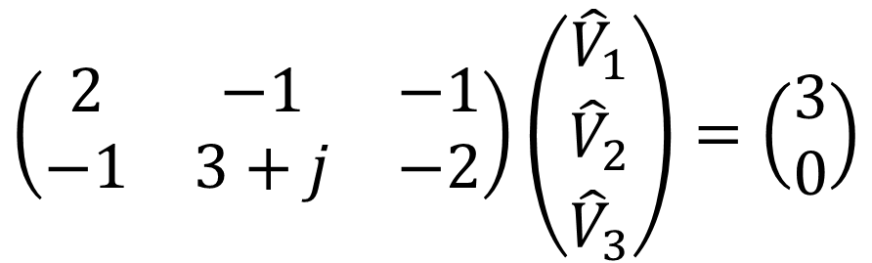
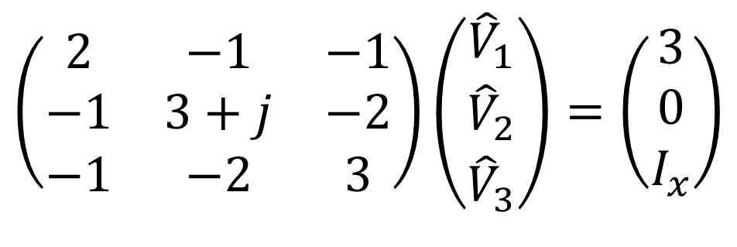
$$\left(\begin{matrix}2 & −1 & −1 \\ −1 & 3+j & −2 \\ −1 & −2 & 3\end{matrix}\right)\left(\begin{matrix}{\hat{V}}_{1} \\ {\hat{V}}_{2} \\ {\hat{V}}_{3}\end{matrix}\right)=\left(\begin{matrix}3 \\ 0 \\ I_{x}\end{matrix}\right)$$
Step 4 eliminate unknown(s) in source current column vector by eliminating one row in matrix equation.
$$\left(\begin{matrix}2 & −1 & −1 \\ −1 & 3+j & −2\end{matrix}\right)\left(\begin{matrix}{\hat{V}}_{1} \\ {\hat{V}}_{2} \\ {\hat{V}}_{3}\end{matrix}\right)=\left(\begin{matrix}3 \\ 0\end{matrix}\right)$$

Slide 17
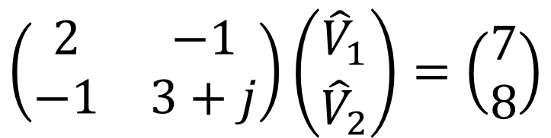
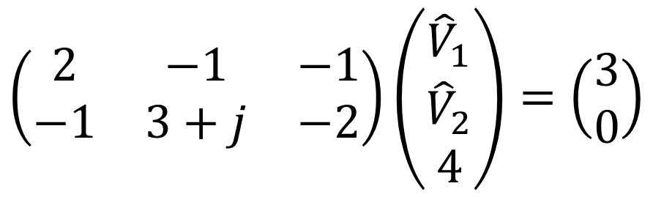
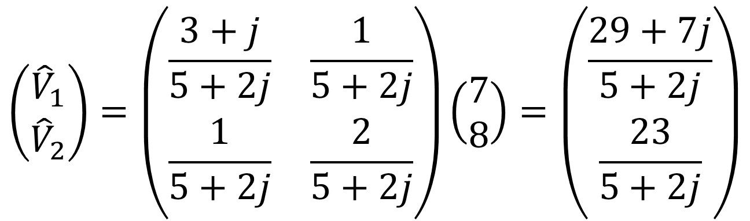
$$\left(\begin{matrix}2 & −1 & −1 \\ −1 & 3+j & −2\end{matrix}\right)\left(\begin{matrix}{\hat{V}}_{1} \\ {\hat{V}}_{2} \\ 4\end{matrix}\right)=\left(\begin{matrix}3 \\ 0\end{matrix}\right)$$
Step 5 eliminate one column in matrix equation by eliminating one unknown node potential using ideal voltage source.
$$\left(\begin{matrix}2 & −1 \\ −1 & 3+j\end{matrix}\right)\left(\begin{matrix}{\hat{V}}_{1} \\ {\hat{V}}_{2}\end{matrix}\right)=\left(\begin{matrix}7 \\ 8\end{matrix}\right)$$
Step 6 solve matrix equation for unknown node potentials.
$$\left(\begin{matrix}{\hat{V}}_{1} \\ {\hat{V}}_{2}\end{matrix}\right)=\left(\begin{matrix}\frac{3+j}{5+2j} & \frac{1}{5+2j} \\ \frac{1}{5+2j} & \frac{2}{5+2j}\end{matrix}\right)\left(\begin{matrix}7 \\ 8\end{matrix}\right)=\left(\begin{matrix}\frac{29+7j}{5+2j} \\ \frac{23}{5+2j}\end{matrix}\right)$$

Slide 18
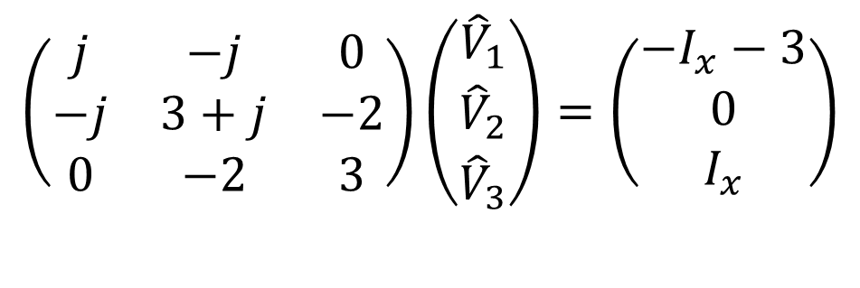
Example 2 with ideal voltage source
Step 0 get circuit.
Step 1 convert circuit to phasor form – use admittances.
Step 2 assign ground; label other nodes (swap ground and N1 for last example).
1
1
Ω
2
N3
Ω
Ω
N2
3 A
2j
Ω
-j
Ω
4 V
+
-
N1
$$I_{x}$$
Step 3 fill out matrix equation - pretend for the moment that ideal voltage sources are actually current sources of unknown phasor.
$$\left(\begin{matrix}j & −j & 0 \\ −j & 3+j & −2 \\ 0 & −2 & 3\end{matrix}\right)\left(\begin{matrix}{\hat{V}}_{1} \\ {\hat{V}}_{2} \\ {\hat{V}}_{3}\end{matrix}\right)=\left(\begin{matrix}−I_{x}−3 \\ 0 \\ I_{x}\end{matrix}\right)$$
Note that ${\hat{V}}_{3}$-${\hat{V}}_{1}$ = 4V, so there is one less unknown!

Slide 19
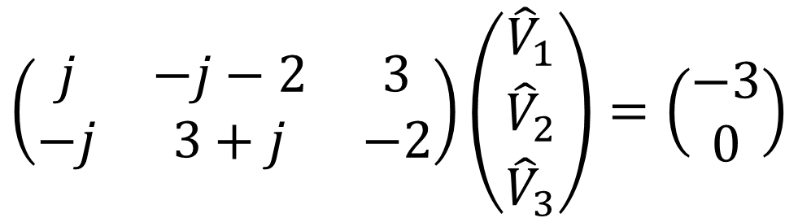
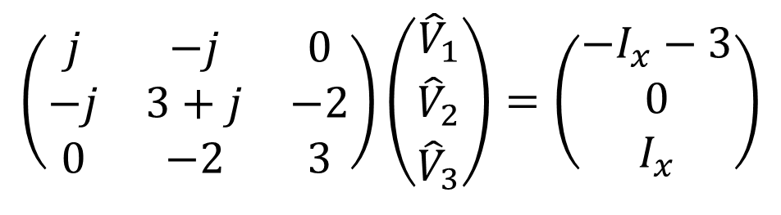
$$\left(\begin{matrix}j & −j & 0 \\ −j & 3+j & −2 \\ 0 & −2 & 3\end{matrix}\right)\left(\begin{matrix}{\hat{V}}_{1} \\ {\hat{V}}_{2} \\ {\hat{V}}_{3}\end{matrix}\right)=\left(\begin{matrix}−I_{x}−3 \\ 0 \\ I_{x}\end{matrix}\right)$$
Step 4 eliminate unknown(s) in source current column vector by eliminating one row in matrix equation (add lines 1 and 3).
$$\left(\begin{matrix}j & −j−2 & 3 \\ −j & 3+j & −2\end{matrix}\right)\left(\begin{matrix}{\hat{V}}_{1} \\ {\hat{V}}_{2} \\ {\hat{V}}_{3}\end{matrix}\right)=\left(\begin{matrix}−3 \\ 0\end{matrix}\right)$$

Slide 20
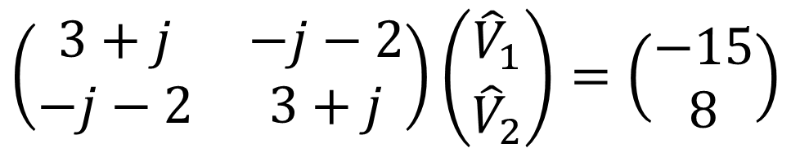
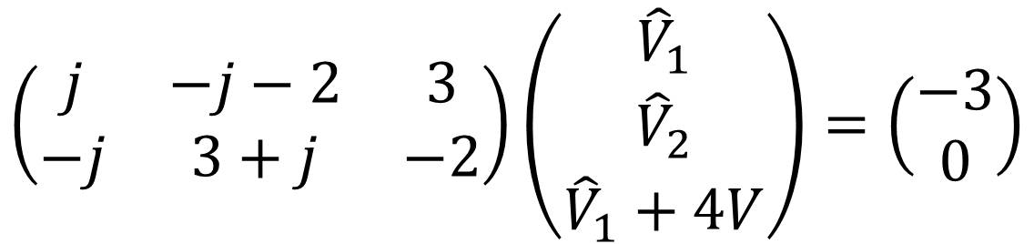
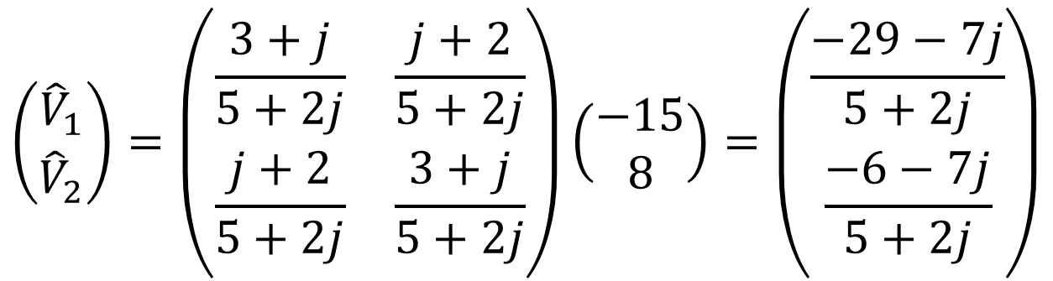
Add columns 1 & 3
$$\left(\begin{matrix}j & −j−2 & 3 \\ −j & 3+j & −2\end{matrix}\right)\left(\begin{matrix}{\hat{V}}_{1} \\ {\hat{V}}_{2} \\ {\hat{V}}_{1}+4V\end{matrix}\right)=\left(\begin{matrix}−3 \\ 0\end{matrix}\right)$$
Also, multiply column 3 by 4V and move to RHS
Step 5 eliminate one column in matrix equation by eliminating one unknown node potential using ideal voltage source.
$$\left(\begin{matrix}3+j & −j−2 \\ −j−2 & 3+j\end{matrix}\right)\left(\begin{matrix}{\hat{V}}_{1} \\ {\hat{V}}_{2}\end{matrix}\right)=\left(\begin{matrix}−15 \\ 8\end{matrix}\right)$$
Step 6 solve matrix equation for unknown node potentials.
$$\left(\begin{matrix}{\hat{V}}_{1} \\ {\hat{V}}_{2}\end{matrix}\right)=\left(\begin{matrix}\frac{3+j}{5+2j} & \frac{j+2}{5+2j} \\ \frac{j+2}{5+2j} & \frac{3+j}{5+2j}\end{matrix}\right)\left(\begin{matrix}−15 \\ 8\end{matrix}\right)=\left(\begin{matrix}\frac{−29−7j}{5+2j} \\ \frac{−6−7j}{5+2j}\end{matrix}\right)$$

Slide 21
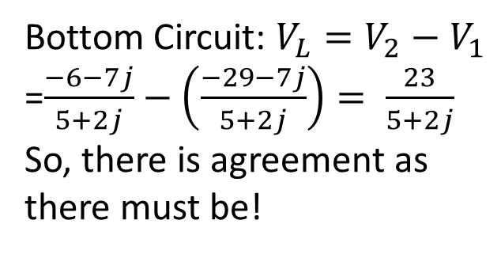
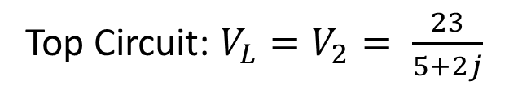
Compare answers – Calculate voltage across inductor
N1
N3
1
Ω
1
Ω
2
Ω
Top Circuit: $V_{L}=V_{2}= \frac{23}{5+2j}$
N2
+
V_{L}
-
3 A
2j
Ω
-j
Ω
4 V
+
-
1
Ω
N3
Bottom Circuit: $V_{L}=V_{2}−V_{1}$
=$\frac{−6−7j}{5+2j}−\left(\frac{−29−7j}{5+2j}\right)= \frac{23}{5+2j}$
So, there is agreement as there must be!
1
Ω
2
Ω
N2
+
V_{L}
-
3 A
2j
Ω
-j
Ω
4 V
+
-
N1

Slide 22
Nodal Analysis Part 4: Circuits with dependent sources
ENEE 205

Slide 23
Inclusion of dependent sources algorithm
Step 0 get circuit.
Step 1 convert circuit to phasor form – use admittances.
Step 2 assign ground; label other nodes.
Step 3 fill out admittance matrix equation - pretend for the moment that dependent sources are actually independent sources.
Step 4 write dependent source dependencies either in terms of known values (if possible) or in terms of unknown node potentials (if not.)
Step 5 move all expressions containing unknown node potentials in the source column vector to the appropriate place in the admittance matrix.
Step 6 solve matrix equation for unknown node potentials.
Step 7 use node potentials to find any and all currents and voltages in the circuit.

Slide 24
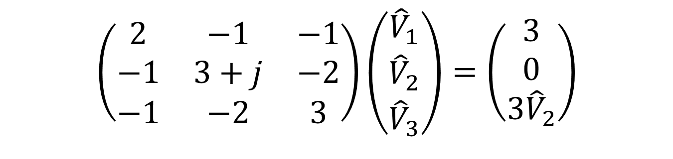

Example with a dependent source
Step 0 get circuit.
Step 1 convert circuit to phasor form – use admittances.
Step 2 assign ground; label other nodes.
Step 3 fill out admittance matrix equation - pretend for the moment that dependent sources are actually independent sources.
N1
N3
1
Ω
1
Ω
2
Ω
N2
+
V_{L}
-
3 A
2j
Ω
-j
Ω
$$3{\hat{V}}_{2}$$
$$\left(\begin{matrix}2 & −1 & −1 \\ −1 & 3+j & −2 \\ −1 & −2 & 3\end{matrix}\right)\left(\begin{matrix}{\hat{V}}_{1} \\ {\hat{V}}_{2} \\ {\hat{V}}_{3}\end{matrix}\right)=\left(\begin{matrix}3 \\ 0 \\ 3{\hat{V}}_{2}\end{matrix}\right)$$

Slide 25
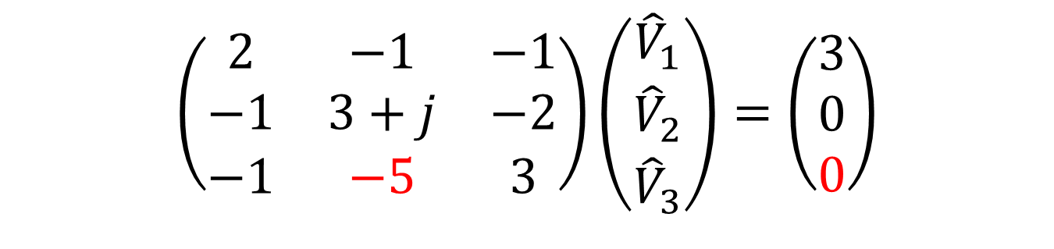
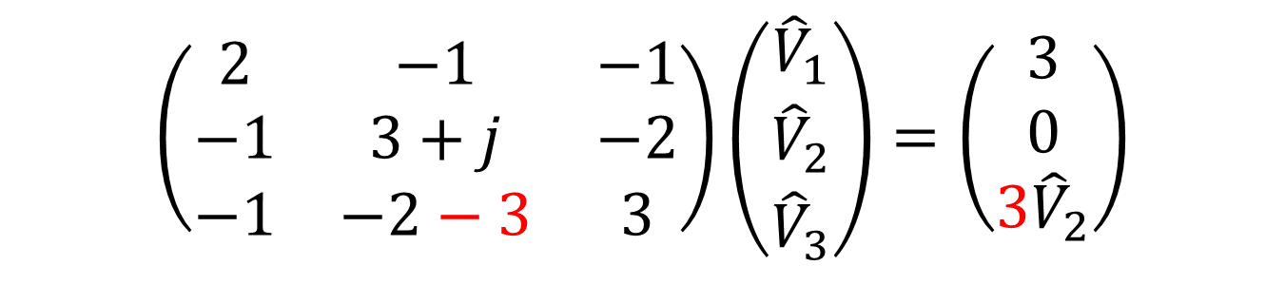
Step 4 write dependent source dependencies either in terms of known values (if possible) or in terms of unknown node potentials (if not.)
$$\left(\begin{matrix}2 & −1 & −1 \\ −1 & 3+j & −2 \\ −1 & −2−3 & 3\end{matrix}\right)\left(\begin{matrix}{\hat{V}}_{1} \\ {\hat{V}}_{2} \\ {\hat{V}}_{3}\end{matrix}\right)=\left(\begin{matrix}3 \\ 0 \\ 3{\hat{V}}_{2}\end{matrix}\right)$$
Step 5 move all expressions containing unknown node potentials in the source column vector to the appropriate place in the admittance matrix.
$$\left(\begin{matrix}2 & −1 & −1 \\ −1 & 3+j & −2 \\ −1 & −5 & 3\end{matrix}\right)\left(\begin{matrix}{\hat{V}}_{1} \\ {\hat{V}}_{2} \\ {\hat{V}}_{3}\end{matrix}\right)=\left(\begin{matrix}3 \\ 0 \\ 0\end{matrix}\right)$$

Slide 26
Nodal Analysis Part 5: The Probing method
ENEE 205

Slide 27
The probing method algorithm
Basic Idea:
When you want to find the Thevenin Equivalent source at a pair of terminals,
Add a probing current or voltage source across the terminal pair.
Calculate the relationship at the terminals between phasor voltage and current for the circuit using some technique (like node or mesh analysis).
Find the equivalent non-ideal source parameters (that give the same relation between voltage and current when the “probing” source is attached to the equivalent non-ideal source).
There are four different possible cases: when the non-ideal source is a current or voltage source and when the “probing” source is a voltage or current source.
This technique can be used for any Thevenin / Norton problem, but is particularly useful when the original circuit has dependent sources.

Slide 28
Probing method variations

Slide 29
Probing method example

Slide 30
z₁
AV₃
z₂
-
+
+
V₃
-
+
I_{p}
V_{s1}
-
GV₃
Convert non-ideal voltage source to non-ideal current source.
Y₂
+
V₃
-
Y₁V_{s1}
Y₁
Y₁AV₃
GV₃
I_{p}

Slide 31
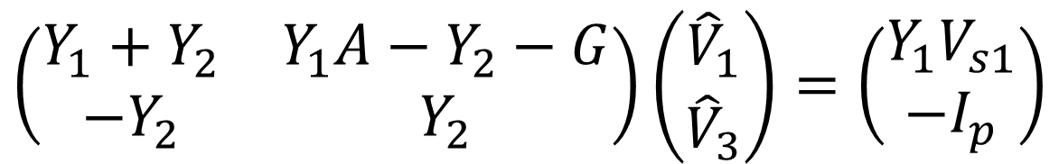
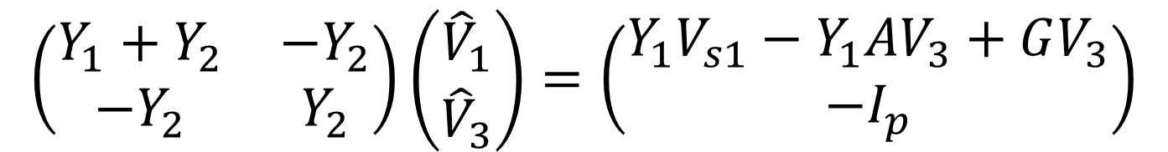
Y₂
N1
+
V₃
-
Y₁V_{s1}
Y₁
Y₁AV₃
GV₃
I_{p}
$$\left(\begin{matrix}Y_{1}+Y_{2} & −Y_{2} \\ −Y_{2} & Y_{2}\end{matrix}\right)\left(\begin{matrix}{\hat{V}}_{1} \\ {\hat{V}}_{3}\end{matrix}\right)=\left(\begin{matrix}Y_{1}V_{s1}−Y_{1}{AV}_{3}+GV_{3} \\ −I_{p}\end{matrix}\right)$$
$$\left(\begin{matrix}Y_{1}+Y_{2} & Y_{1}A−Y_{2}−G \\ −Y_{2} & Y_{2}\end{matrix}\right)\left(\begin{matrix}{\hat{V}}_{1} \\ {\hat{V}}_{3}\end{matrix}\right)=\left(\begin{matrix}Y_{1}V_{s1} \\ −I_{p}\end{matrix}\right)$$

Slide 32
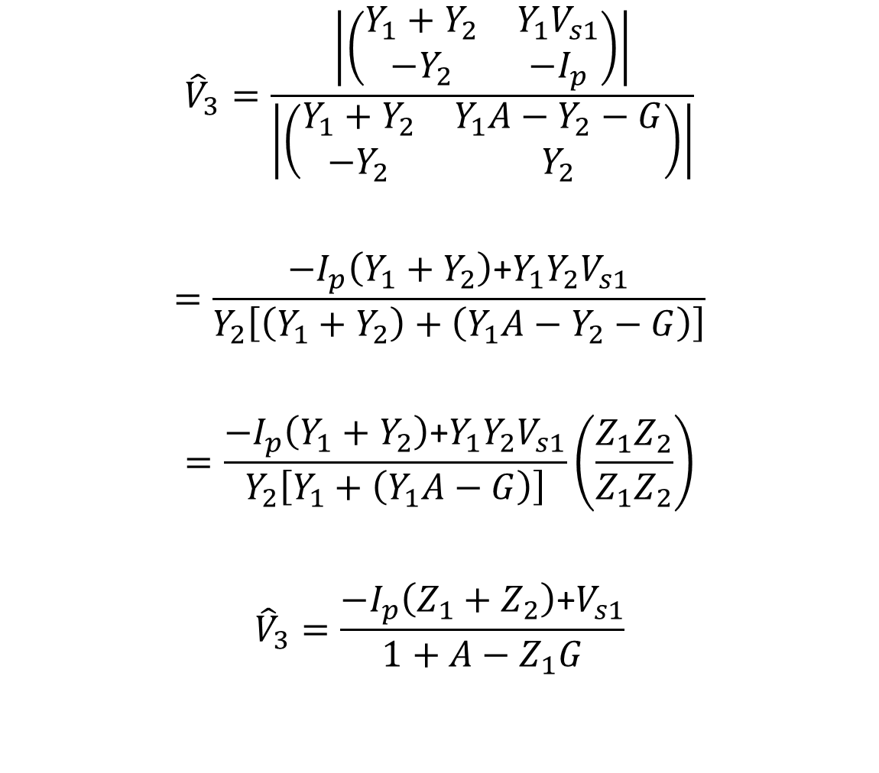
Use Kramer’s Rule to solve for V₃
$${\hat{V}}_{3}=\frac{\left|\left(\begin{matrix}Y_{1}+Y_{2} & Y_{1}V_{s1} \\ −Y_{2} & −I_{p}\end{matrix}\right)\right|}{\left|\left(\begin{matrix}Y_{1}+Y_{2} & Y_{1}A−Y_{2}−G \\ −Y_{2} & Y_{2}\end{matrix}\right)\right|}$$
$$=\frac{−I_{p}\left(Y_{1}+Y_{2}\right)\text{+}Y_{1}Y_{2}V_{s1}}{Y_{2}\left[\left(Y_{1}+Y_{2}\right)+\left(Y_{1}A−Y_{2}−G\right)\right]}$$
$$=\frac{−I_{p}\left(Y_{1}+Y_{2}\right)\text{+}Y_{1}Y_{2}V_{s1}}{Y_{2}\left[Y_{1}+\left(Y_{1}A−G\right)\right]}\left(\frac{Z_{1}Z_{2}}{Z_{1}Z_{2}}\right)$$
$${\hat{V}}_{3}=\frac{−I_{p}\left(Z_{1}+Z_{2}\right)\text{+}V_{s1}}{1+A−Z_{1}G}$$

Slide 33
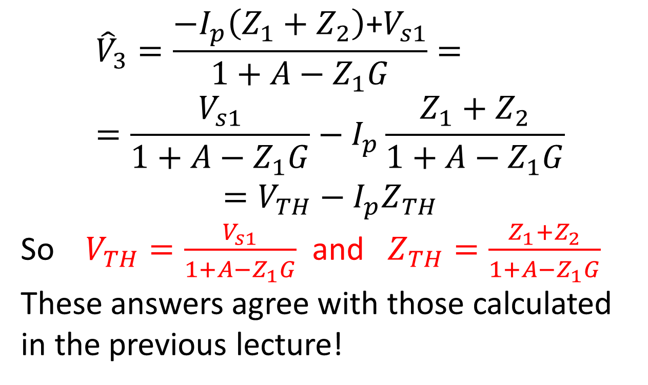
Read off Thevenin’s quantities
$${\hat{V}}_{3}=\frac{−I_{p}\left(Z_{1}+Z_{2}\right)\text{+}V_{s1}}{1+A−Z_{1}G}==\frac{V_{s1}}{1+A−Z_{1}G}−I_{p}\frac{Z_{1}+Z_{2}}{1+A−Z_{1}G}$$
$$=V_{TH}−I_{p}Z_{TH}$$
So $V_{TH}=\frac{V_{s1}}{1+A−Z_{1}G}$ and $Z_{TH}=\frac{Z_{1}+Z_{2}}{1+A−Z_{1}G}$
These answers agree with those calculated in the previous lecture!

