Slide 1
Thevenin’s Theorem Part 1: Non-ideal independent voltage and current sources
ENEE 205

Slide 2
Non-ideal sources
For ideal sources, output voltage (current) is independent of current through (voltage across) the source. In reality, the output does depend on what is connected to it! We call real world sources non-ideal.
Non-ideal sources are modeled by combining an ideal source with a passive component. The non-ideal source is comprised of the two branches together.

Slide 3
Equivalent transformations of non-ideal sources
A non-ideal voltage source can be converted into a non-ideal current source (and vice-versa) by applying the following three rules:
Zin = 1/Yin (it is the same passive component)
Vs / Is = Zin
The current direction for the current source points from the terminal with the negative voltage polarity to the terminal with the positive voltage polarity for the equivalent non-ideal voltage source.

Slide 4
Example transformations
A
9 Ω
A
(1+j) Ω
1 A
9 Ω
(2-j2)A
(1+j) Ω
9 V
B
- 4 V +
B

Slide 5
Thevenin’s Theorem Part 2: D-to-A Converter
ENEE 205

Slide 6
A 3-bit D-to-A converter (revisited)
Three conversions of non-ideal voltage sources to non-ideal current sources.
Recall in the last module we found: $i_{out}=\frac{{4B}_{2}+{2B}_{1}+B_{0}}{24R}$

Slide 7
Solution by alternating non-ideal voltage and current sources
R
R
R
b₂/2R
b₁/2R
b₀/2R
2R
R
2R
2R
2R
i_{out}
2R in parallel with 2R
R
R
R
b₂/2R
b₁/2R
b₀/2R
R
R
2R
2R
i_{out}

Slide 8
R
R
R
b₂/2R
b₁/2R
b₀/2R
R
2R
2R
R
i_{out}
R
R
R
R
b₂/2R
b₁/2R
R
2R
- b₀/2+
2R
i_{out}
R
R
2R
b₂/2R
b₁/2R
- b₀/2+
R
2R
2R
i_{out}

Slide 9
R
R
2R
b₂/2R
b₁/2R
- b₀/2+
R
2R
2R
i_{out}
R
R
b₁/2R
b₂/2R
b₀/4R
R
2R
2R
2R
i_{out}
R
R
2R in parallel with 2R
2 Current sources in parallel
b₂/2R
R
(2b₁+b₀)/4R
R
2R
i_{out}

Slide 10
R
R
b₂/2R
R
(2b₁+b₀)/4R
R
2R
i_{out}
R
R
R
b₂/2R
- (2b₁+b₀)/4 +
R
2R
i_{out}
R
2R
b₂/2R
- (2b₁+b₀)/4 +
R
2R
i_{out}

Slide 11
R
b₂/2R
R
2R
(2b₁+b₀)/8R
2R
i_{out}
R
Summary of this example:
i_{out}= (4b₂+2b₁+b₀)/24R which is the same as before (but easier to evaluate?)
We have replaced a complicated circuit (3 batteries and 7 resistors) with a single non-ideal voltage source!
R
(4b₂+2b₁+b₀)/8R
R
i_{out}
2R
+
(4b₂+2b₁+b₀)/8
-
R
i_{out}

Slide 12
Thevenin’s Theorem Part 3: Theorem proof and algorithm
ENEE 205

Slide 13
Proof of Thevenin’s Theorem
Thevenin’s Theorem: Any linear, active circuit (with sources) can be replaced at a given pair of terminals with a non-ideal voltage source (under SSS conditions).
Norton’s Theorem: Any linear, active circuit (with sources) can be replaced at a given pair of terminals with a non-ideal current source (under SSS conditions).

Slide 14
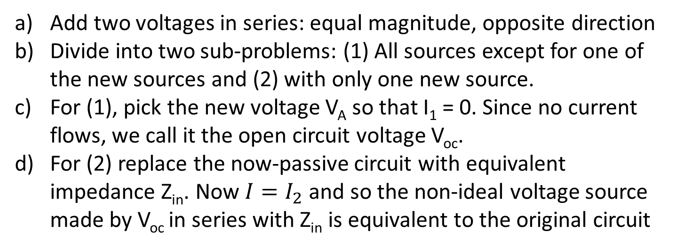

Proof via superposition
$$I=I_{1}+I_{2}$$
Add two voltages in series: equal magnitude, opposite direction
Divide into two sub-problems: (1) All sources except for one of the new sources and (2) with only one new source.
For (1), pick the new voltage V_{A} so that I₁ = 0. Since no current flows, we call it the open circuit voltage V_{oc}.
For (2) replace the now-passive circuit with equivalent impedance Z_{in}. Now $I=I_{2}$ and so the non-ideal voltage source made by V_{oc} in series with Z_{in} is equivalent to the original circuit

Slide 15
Thevenin AND NORTON algorithms
THEVENIN ALGORITHM
Get circuit
Find open circuit voltage
Set sources to zero and find input impedance
Draw Thevenin equivalent source
NORTON ALGORITHM
Get circuit
Find short circuit current
Set sources to zero and find input admittance
Draw Norton equivalent source
Practically speaking, one can find any two of Voc, Isc, or Zin and then use Zin=Voc/Isc if needed to get the equivalent non-ideal source.
Often you will be able to convert back and forth between non-ideal voltage and current sources as an alternate way to get the Thevenin or Norton equivalent source.

Slide 16
Thevenin’s Theorem Part 4: Examples without dependent sources
ENEE 205

Slide 17
Example 1 – Find the Thevenin Equivalent NI Voltage Source at A-B
8 Ω
8 Ω
A
Set independent sources to zero (voltage to short, current to open). The circuit has two 8 Ω resistors in parallel; that 4 Ω combination is in series with an 8 Ω resistor and that 12 Ω combination is in parallel with 12 Ω, so Zin = 6 Ω.
5 V
8 Ω
1 A
12 Ω
B
8 Ω
8 Ω
A
8 Ω
12 Ω
B

Slide 18


Let’s use superposition to find V_{oc}
8 Ω
8 Ω
A
+
$$V_{oc}^{A}$$
-
8 Ω
1 A
12 Ω
B
A
+
$$V_{oc}^{A}=6V$$
-
1 A
6Ω
B

Slide 19
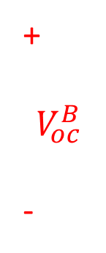

Second sub-problem
8 Ω
8 Ω
A
+
$$V_{oc}^{B}$$
-
5 V
8 Ω
12 Ω
B
8 Ω
A
+
$$V_{oc}^{B}$$
-
5/8 A
4 Ω
12 Ω
B

Slide 20
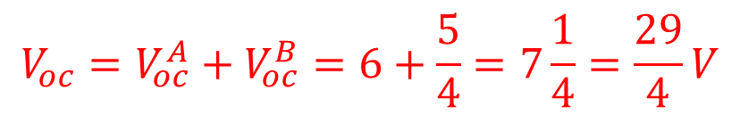

Final steps
4 Ω
8 Ω
A
+
$$V_{oc}^{B}=\frac{5}{4}V$$
-
5/2 V
12 Ω
B
$${V_{oc}=V}_{oc}^{A}+V_{oc}^{B}=6+\frac{5}{4}=7\frac{1}{4}=\frac{29}{4}V$$
6 Ω
A
←Thevenin Equivalent non-ideal voltage source at terminals A-B
29/4 V
B

Slide 21
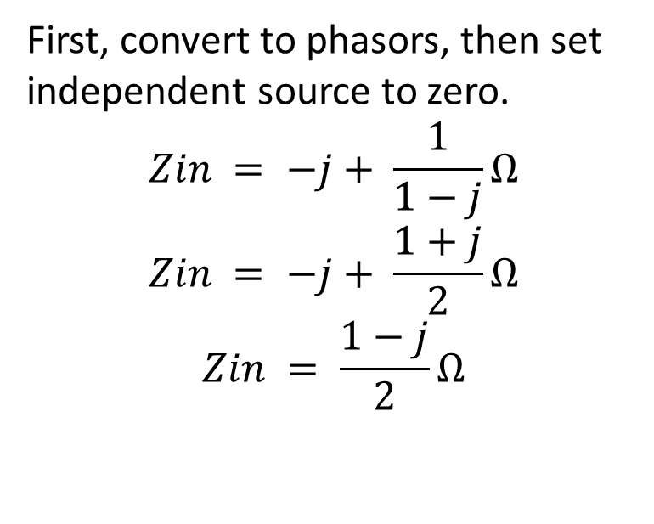
Example 2 - Find the Norton Equivalent NI Current Source at A-B
First, convert to phasors, then set independent source to zero.
$$Zin = −j+ \frac{1}{1−j}Ω$$
$$Zin = −j+ \frac{1+j}{2}Ω$$
$$Zin = \frac{1−j}{2}Ω$$
A
1 Ω
½ F
+
½ H
5cos(2t) V
-
B
A
A
1 Ω
1 Ω
-j Ω
-j Ω
5 V
+
j Ω
j Ω
-
B
B

Slide 22

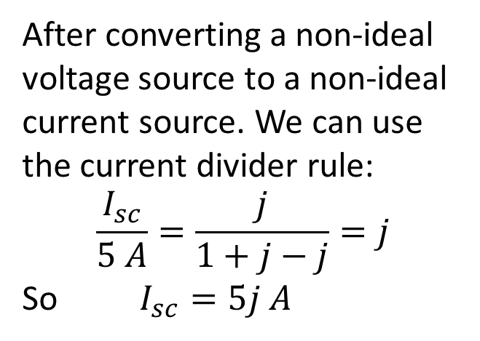
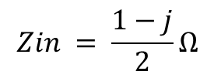
Find the short circuit current
After converting a non-ideal voltage source to a non-ideal current source. We can use the current divider rule:
$$\frac{I_{sc}}{5 A}=\frac{j}{1+j−j}=j$$
So $I_{sc}=5j A$
1 Ω
-j Ω
5 V
+
j Ω
-
I_{sc}
A
-j Ω
5 A
1 Ω
j Ω
I_{sc}
$$Zin = \frac{1−j}{2}Ω$$
$$I_{sc}=5j A$$
B

Slide 23
Thevenin’s Theorem Part 5: Example with dependent sources
ENEE 205

Slide 24
Thevenin and Norton example with dependent sources
One can no longer set all sources to zero to find the input impedance.
One can no longer convert back and forth between non-ideal voltage and current sources as an alternate way to get the Thevenin or Norton equivalent source (still may be partially useful).
So, you must find both Voc and Isc and use Zin=Voc/Isc!
(Later we will learn another technique called the probing method.)
NOTE: the Thevenin equivalent source is a non-ideal INDEPENDENT source. Dependent sources will “disappear,” but their effect will be seen both in Voc and Zin, which may now have a negative resistance.

Slide 25
Find the Thevenin Equivalent Circuit
z₁
AV₃
z₂
-
+
A
+
V₃
-
+
V_{s1}
-
GV₃
B

Slide 26
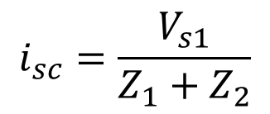
Find short circuit current
z₁
0=
AV₃
z₂
-
+
+
V₃
-
+
V_{s1}
-
0=
GV₃
0=
i_{sc}
z₁
z₂
$$i_{sc}=\frac{V_{s1}}{Z_{1}+Z_{2}}$$
+
V_{s1}
-
i_{sc}

Slide 27
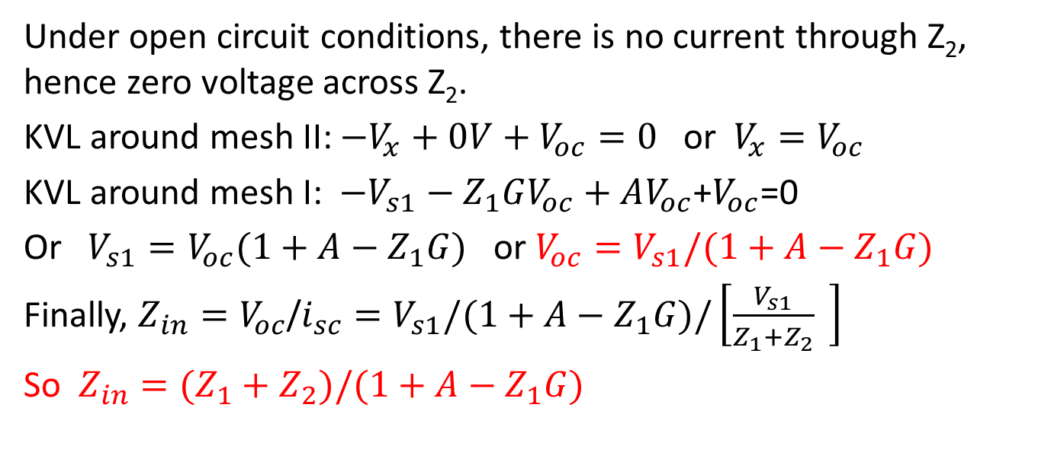
Find open circuit voltage
z₁
AV_{oc}
z₂
-
A
+
- 0 V +
+
V_{oc}
-
- Z₁GV_{oc} +
+
V_{x}
-
+
V_{s1}
-
I
GV_{oc}
II
B
Under open circuit conditions, there is no current through Z₂, hence zero voltage across Z₂.
KVL around mesh II: $−V_{x}+0V+V_{oc}=0$ or $V_{x}=V_{oc}$
KVL around mesh I: $−V_{s1}−Z_{1}GV_{oc}+AV_{oc}$+$V_{oc}$=0
Or $V_{s1}=V_{oc}(1+A−Z_{1}G)$ or $V_{oc}=V_{s1}/(1+A−Z_{1}G)$
Finally, $Z_{in}=V_{oc}$/$i_{sc}=V_{s1}/(1+A−Z_{1}G)/\left[\frac{V_{s1}}{Z_{1}+Z_{2}} \right]$
So $Z_{in}=(Z_{1}+Z_{2})/(1+A−Z_{1}G)$

