Slide 1
Sinusoidal steady state problems PART 1: The basic assumptions and consequences
ENEE 205

Slide 2
Sinusoidal Steady State (SSS) assumptions and consequences
SINUSOIDAL ASSUMPTIONS
Any and all voltage sources and current sources in a circuit have a sinusoidal time dependence, i.e. they have the form: v(t) = V_{o}cos (ωt+φ_{v}) or i(t) = I_{o}cos(ωt+φ_{I})
If there is more than one source, they all have the same angular frequency ω.
STEADY STATE ASSUMPTION
The circuit was assembled so far in the past that all transient effects – driven by initial conditions - have “died out” exponentially. (We will revisit this later.)
SSS CONSEQUENCES
Under SSS conditions, All voltages and currents in a circuit have a sinusoidal time dependence!

Slide 3
SSS Phase/amplitude relations for RESISTORS
Due to SSS conditions, we can assume that:
v_{R}(t)=V_{m}cos(ωt+φ_{v})
i_{R}(t)=I_{m}cos(ωt+φ_{i})
Ohms Law then tells us that:
v_{R}(t)=V_{m}cos(ωt+φ_{v})=Ri_{R}(t)=RI_{m}cos(ωt+φ_{i})
The only way this can be true for all times is if
V_{m}=RI_{m} or V_{m}/I_{m} =R and φ_{v} = φ_{i}
So, the voltage and current are in phase and the ratio of the voltage magnitude to the current magnitude is the resistance R.

Slide 4
SSS Phase/amplitude relations for CAPACITORS
Due to SSS conditions, we can assume that:
v_{C}(t)=V_{m}cos(ωt+φ_{v})
i_{C}(t)=I_{m}cos(ωt+φ_{i})
The terminal relation for a capacitor tells us that:
i_{c}(t)= I_{m}cos(ωt+φ_{i})=Cdv_{c}/dt=-ωCV_{m}sin(ωt+φ_{v})
Or I_{m}cos(ωt+φ_{i})=ωCV_{m}cos(ωt+φ_{v}+90°)*
The only way this can be true for all times is if
I_{m}=ωCV_{m} or V_{m}/I_{m} = 1/ωC and φ_{v} = φ_{i}-90°
So, the voltage lags the current by 90° and the ratio of the voltage magnitude to the current magnitude is 1/ωC.
*cos(Α+Β)=cos(A)cos(B)-sin(A)sin(B)
So cos(A+90⁰) =-sin(A) and cos(A-90⁰) =+sin(A)

Slide 5
SSS Phase/amplitude relations for INDUCTORS
Due to SSS conditions, we can assume that:
v_{L}(t)=V_{m}cos(ωt+φ_{v})
i_{L}(t)=I_{m}cos(ωt+φ_{i})
The terminal relation for an inductor tells us that:
v_{L}(t)= V_{m}cos(ωt+φ_{v})=Ldi_{L}/dt=-ωLI_{m}sin(ωt+φ_{i})
Or V_{m}cos(ωt+φ_{V})=ωLI_{m}cos(ωt+φ_{i}+90°)*
The only way this can be true for all times is if
V_{m}=ωLI_{m} or V_{m}/I_{m} = ωL and φ_{v} = φ_{i}+90°
So, the voltage leads the current by 90° and the ratio of the voltage magnitude to the current magnitude is ωL.
*cos(Α−Β)=cos(A)cos(B)+sin(A)sin(B)
So cos(A+90⁰) =-sin(A) and cos(A-90⁰) =+sin(A)

Slide 6
Summary of amplitude and phase relations
Component | Vmax / Imax (Vm/Im) | Vphase – Iphase (φ_{V}-φ_{I})
Resistor | R | 0
Capacitor | 1/(ωC) | -90°
Inductor | ωL | 90°

Slide 7
Sinusoidal steady state Part 2: Complex Number Discussion
ENEE 205

Slide 8
Complex Numbers
So, j² = -1, j³ = -j, and j⁴ = +1.
A general complex number can be written in Cartesian Form:
Z = X + j Y, where X and Y are real numbers.
We say Re { Z } = X (the real part of Z is X)
Euler’s Equation states (use Taylor Series expansion to prove):
exp( j φ ) = cos (φ) + j sin (φ)
From this we can write a complex number in exponential-polar form:
Z = Z_{m} exp( j φ)
We can convert from Cartesian (Z= X + j Y) to Exponential-Polar forms by
X = Z_{m}cos(φ) and Y = Z_{m}sin(φ) or Z_{m} = (X² + Y²)^{1/2} and φ = arctan(Y/X)

Slide 9
COMPLEX NUMBER practice
Let’s say your complex number in Cartesian form is
Z = 3 +4j
Then in exponential form:
|Z| = (3² + 4²)^{1/2} = 5 and φ = tan⁻¹(4/3) = 53.13°
Z = 5e^{j53.13°}
Let’s say your complex number in exponential form is
Z = 13e^{j22.62°}
Then in Cartesian form:
Z = 13 cos(22.62°) +j 13 sin(22.62°) = 12 + 5j.

Slide 10
Sinusoidal steady state Part 3: Phasors
ENEE 205

Slide 11
Phasors
We will use Euler’s Equation to simplify Terminal Relationships under SSS conditions:
Since any SSS voltage in a circuit can be written as:
V(t) = V_{m} cos(ωt + φ_{v})
= V_{m} Re { exp[j(ωt + φ_{v})] }
= Re {V_{m} exp[j(ωt + φ_{v})] }
= Re {V_{m} exp(jφ_{v}) exp(jωt) }
We define a PHASOR for any VOLTAGE or, likewise, any CURRENT in a circuit to be:
Given a phasor, we can find the corresponding time dependence by (the frequency is implicit):

Slide 12
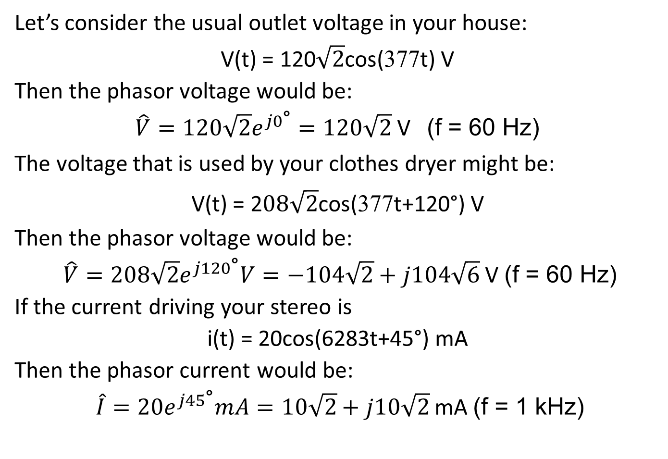
Phasor practice
Let’s consider the usual outlet voltage in your house:
V(t) = 120$\sqrt{2}$cos(377t) V
Then the phasor voltage would be:
$\hat{V}=120\sqrt{2}e^{j0\text{°}}=120\sqrt{2}$ V (f = 60 Hz)
The voltage that is used by your clothes dryer might be:
V(t) = 2$08\sqrt{2}$cos(377t+120°) V
Then the phasor voltage would be:
$\hat{V}=208\sqrt{2}e^{j120\text{°}}V=−104\sqrt{2}+j104\sqrt{6}$ V (f = 60 Hz)
If the current driving your stereo is
i(t) = 20cos(6283t+45°) mA
Then the phasor current would be:
$\hat{I}=20e^{j45\text{°}}mA=10\sqrt{2}+j10\sqrt{2}$ mA (f = 1 kHz)

Slide 13
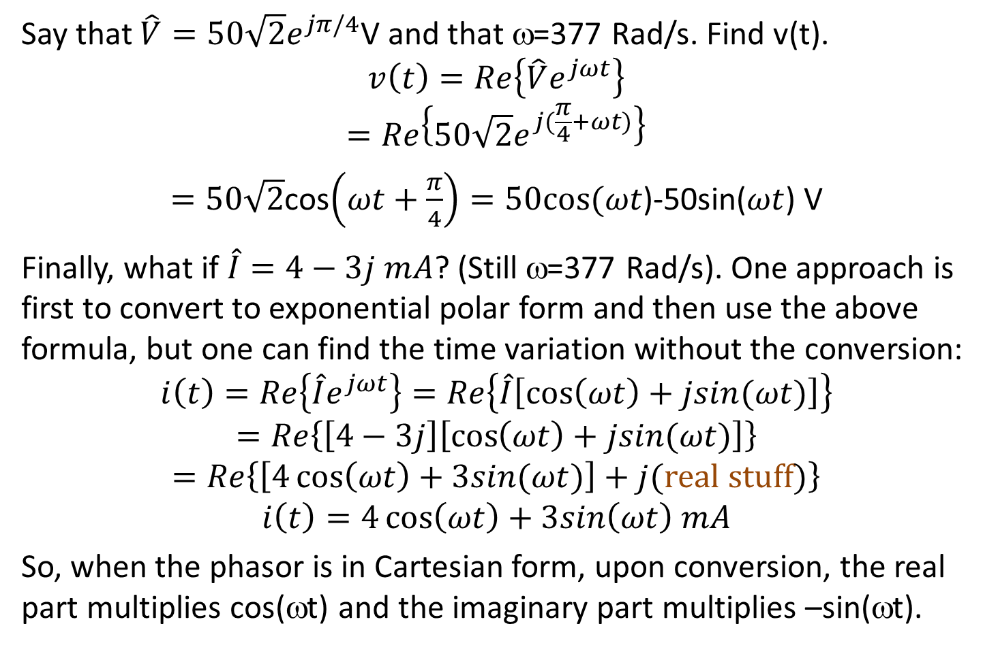
More phasor practice
Say that $\hat{V}=50\sqrt{2}e^{jπ/4}$V and that ω=377 Rad/s. Find v(t).
$$v\left(t\right)=Re\left\{\hat{V}e^{jωt}\right\}$$
$$=Re\left\{50\sqrt{2}e^{j(\frac{π}{4}+ωt)}\right\}$$
$=50\sqrt{2}$cos$\left(ωt+\frac{π}{4}\right)=50cos⁡(ωt$)-50sin($ωt$) V
Finally, what if $\hat{I}=4−3j mA$? (Still ω=377 Rad/s). One approach is first to convert to exponential polar form and then use the above formula, but one can find the time variation without the conversion:
$$i\left(t\right)=Re\left\{\hat{I}e^{jωt}\right\}=Re\left\{\hat{I}\left[\cos\left(ωt\right)+jsin(ωt)\right]\right\}$$
$$=Re\left\{\left[4−3j\right]\left[\cos\left(ωt\right)+jsin(ωt)\right]\right\}$$
$$=Re\left\{\left[4\cos\left(ωt\right)+3sin(ωt)\right]+j(\text{real} \text{stuff})\right\}$$
$$i\left(t\right)=4\cos\left(ωt\right)+3sin\left(ωt\right) mA$$
So, when the phasor is in Cartesian form, upon conversion, the real part multiplies cos(ωt) and the imaginary part multiplies –sin(ωt).

Slide 14
Sinusoidal steady state Part 4: Impedance and Admittance
ENEE 205

Slide 15

Impedance and Admittance
The IMPEDANCE of any passive component is the ratio of the phasor voltage across the passive component to the phasor current entering the component (under SSS conditions, using the passive sign convention). The units are Ohms.
The ADMITTANCE of any passive component is the ratio of the phasor current entering the component to the phasor voltage across the passive component. So Y = 1/Z and the units are Mhos.
These quantities essentially represent the Sinusoidal Steady State equivalent of the terminal relationships.

Slide 16
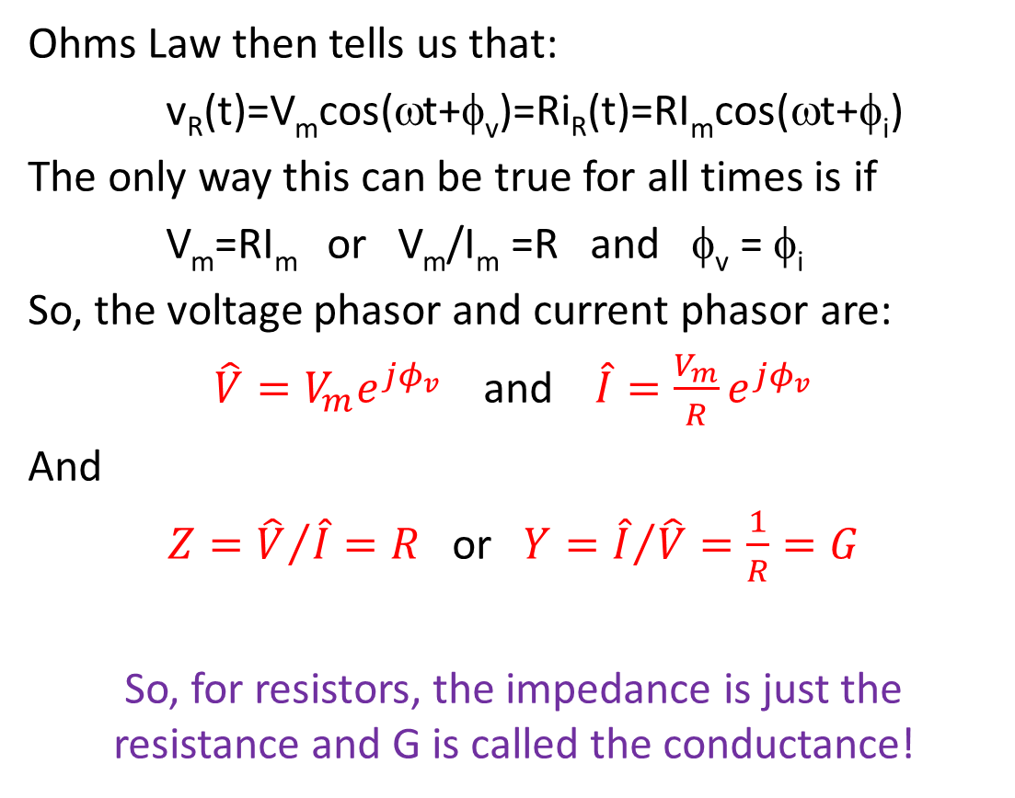
Impedance and admittance for Resistors
Ohms Law then tells us that:
v_{R}(t)=V_{m}cos(ωt+φ_{v})=Ri_{R}(t)=RI_{m}cos(ωt+φ_{i})
The only way this can be true for all times is if
V_{m}=RI_{m} or V_{m}/I_{m} =R and φ_{v} = φ_{i}
So, the voltage phasor and current phasor are:
$\hat{V}=V_{m}e^{jφ_{v}}$ and $\hat{I}=\frac{V_{m}}{R}e^{jφ_{v}}$
And
$Z={\hat{V}}/{\hat{I}}=R$ or $Y={\hat{I}}/{\hat{V}}=\frac{1}{R}=G$
So, for resistors, the impedance is just the resistance and G is called the conductance!

Slide 17
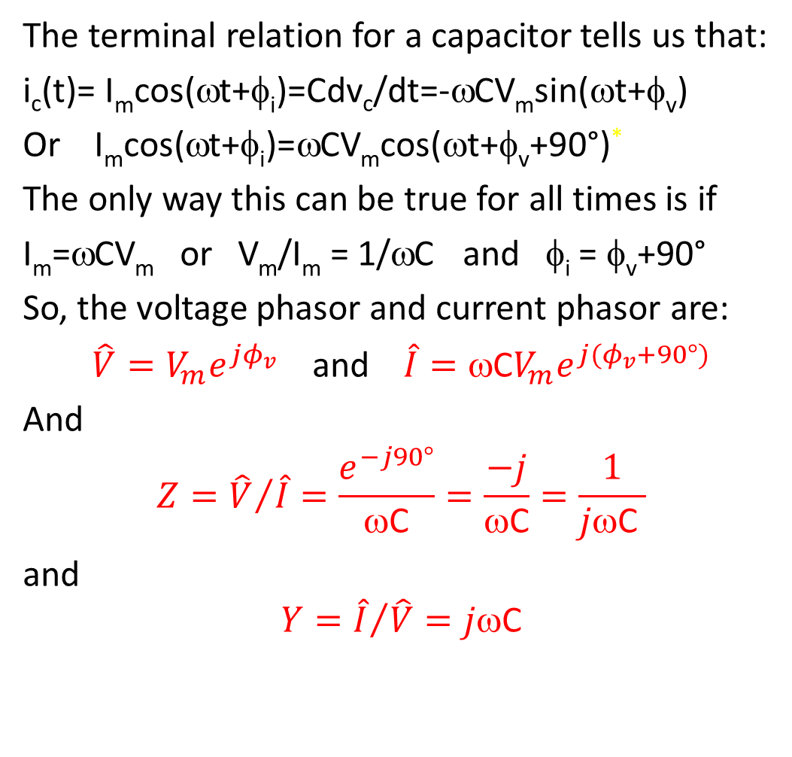
Impedance and admittance for Capacitors
The terminal relation for a capacitor tells us that:
i_{c}(t)= I_{m}cos(ωt+φ_{i})=Cdv_{c}/dt=-ωCV_{m}sin(ωt+φ_{v})
Or I_{m}cos(ωt+φ_{i})=ωCV_{m}cos(ωt+φ_{v}+90°)*
The only way this can be true for all times is if
I_{m}=ωCV_{m} or V_{m}/I_{m} = 1/ωC and φ_{i} = φ_{v}+90°
So, the voltage phasor and current phasor are:
$\hat{V}=V_{m}e^{jφ_{v}}$ and $\hat{I}={\text{w}\text{C}V}_{m}e^{j{(φ}_{v}+90°)}$
And
$$Z={\hat{V}}/{\hat{I}}=\frac{e^{−j90°}}{\text{w}\text{C}}=\frac{−j}{\text{w}\text{C}}=\frac{1}{j\text{w}\text{C} }$$
and
$$Y={\hat{I}}/{\hat{V}}=j\text{w}\text{C}$$

Slide 18
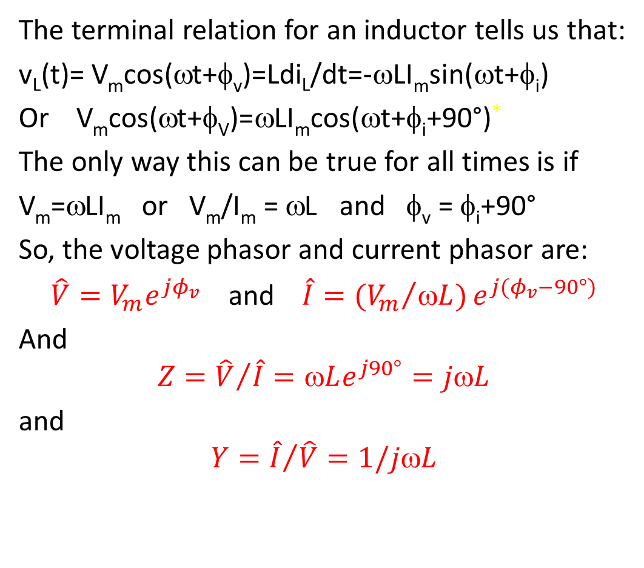
Impedance and admittance for Inductors
The terminal relation for an inductor tells us that:
v_{L}(t)= V_{m}cos(ωt+φ_{v})=Ldi_{L}/dt=-ωLI_{m}sin(ωt+φ_{i})
Or V_{m}cos(ωt+φ_{V})=ωLI_{m}cos(ωt+φ_{i}+90°)*
The only way this can be true for all times is if
V_{m}=ωLI_{m} or V_{m}/I_{m} = ωL and φ_{v} = φ_{i}+90°
So, the voltage phasor and current phasor are:
$\hat{V}=V_{m}e^{jφ_{v}}$ and $\hat{I}={{{(V}_{m}}/{\text{w}L)}e}^{j{(φ}_{v}−90°)}$
And
$$Z={\hat{V}}/{\hat{I}}=\text{w}Le^{j90°}=j\text{w}L$$
and
$$Y={\hat{I}}/{\hat{V}}=1/j\text{w}L$$

Slide 19
Summary of impedances and admittances
Component | Vmax / Imax (Vm/Im) | Vphase – Iphase (φ_{V}-φ_{I}) | Impedance (Ω) | Admittance (1/Ω)
Resistor | R | 0 | R = R e ^{j0} | G = 1/R
Capacitor | 1/(ωC) | -90° | 1/(jωC) = e ^{-j90°}/(ωC) | jωC
Inductor | ωL | 90° | jωL = e ^{j90°} ωL | 1/(jωL)

Slide 20
Sinusoidal steady state Part 5: Simplifying circuits – combining passive components connected by trivial nodes or meshes
ENEE 205

Slide 21
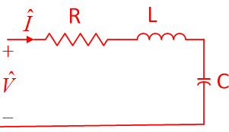
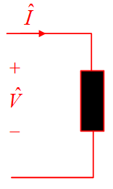
Simplifying passive circuits
Whenever one has some passive network that connects to the rest of the circuit via two terminals, a generalized definition of impedance can be used to replace the passive network with a single passive branch.
The impedance is defined to be the phasor voltage across those two terminals divided by the phasor current entering the terminal denoted the positive reference for voltage.
General techniques for simplifying passive circuits is the subject of the next module; on the following slides we will look only at two simple, but very useful, configurations.

Slide 22
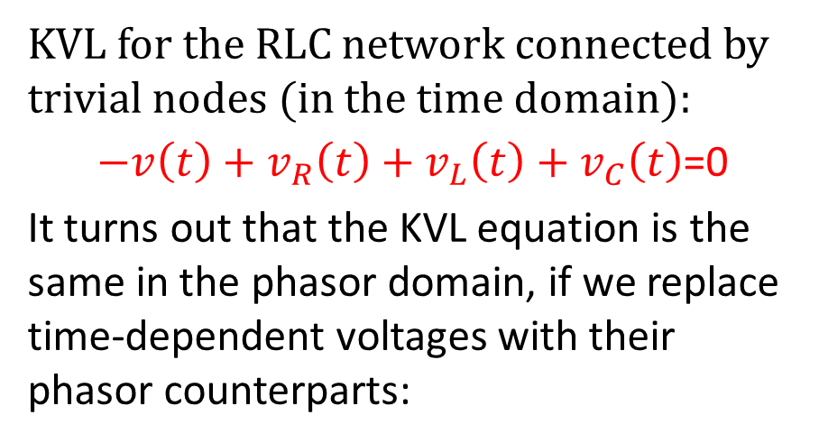
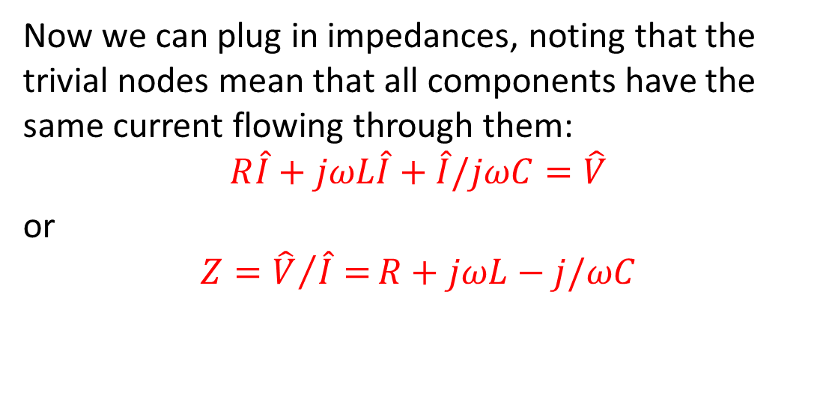

Series RLC branch impedance
KVL for the RLC network connected by trivial nodes (in the time domain):
$−v\left(t\right)+v_{R}\left(t\right)+v_{L}\left(t\right)+v_{C}\left(t\right)$=0
It turns out that the KVL equation is the same in the phasor domain, if we replace time-dependent voltages with their phasor counterparts:
+ v_{R} -
+ v_{L} -
+
v_{C}
-
$${\hat{V}}_{R}+{\hat{V}}_{L}+{\hat{V}}_{C}=\hat{V}$$
Now we can plug in impedances, noting that the trivial nodes mean that all components have the same current flowing through them:
$$R\hat{I}+jωL\hat{I}+\hat{I}/jωC=\hat{V}$$
or
$$Z={\hat{V}}/{\hat{I}=}R+jωL−j/ωC$$

Slide 23
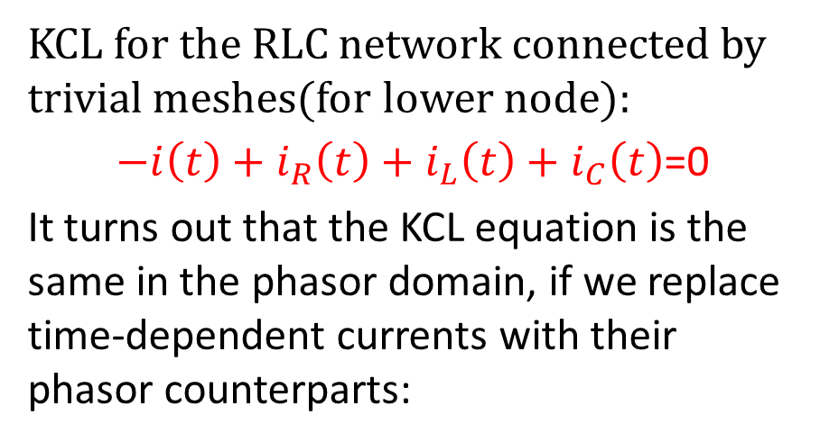
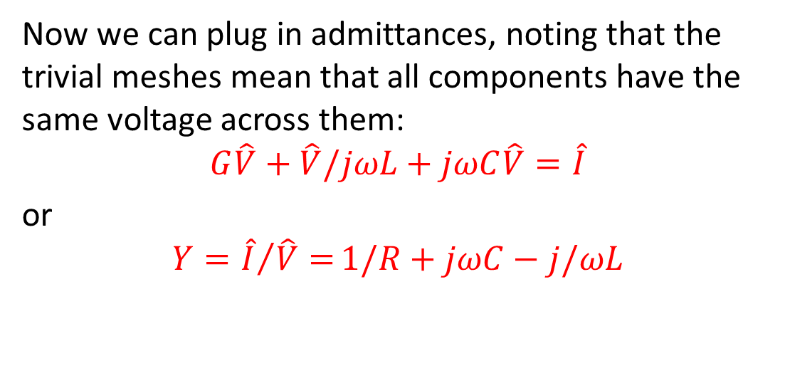

parallel RLC branch admittance
KCL for the RLC network connected by trivial meshes(for lower node):
$−i\left(t\right)+i_{R}\left(t\right)+i_{L}\left(t\right)+i_{C}\left(t\right)$=0
It turns out that the KCL equation is the same in the phasor domain, if we replace time-dependent currents with their phasor counterparts:
i_{R}
i_{L}
i_{C}
$${\hat{I}}_{R}+{\hat{I}}_{L}+{\hat{I}}_{C}=\hat{I}$$
Now we can plug in admittances, noting that the trivial meshes mean that all components have the same voltage across them:
$$G\hat{V}+\hat{V}/jωL+jωC\hat{V}=\hat{I}$$
or
$$Y={\hat{I}}/{\hat{V}=}1/R+jωC−j/ωL$$

Slide 24
Sinusoidal steady state Part 6: What’s in the box problems
ENEE 205

Slide 25
Definitions
Z=R+jX; R=resistance X=reactance
Y=G+jB; G=conductance B=susceptance
Z=1/Y=R+jX=1/(G+jB)=(G-jB)/(G²+B²)
So:
R = G/(G²+B²) and X = -B/(G²+B²)
Or
Y=1/Z=G+jB=1/(R+jX)=(R-jX)/(R²+X²)
So
G = R/(R²+X²) and B = -X/(R²+X²)

Slide 26
What’s in the box?
When a voltage source:
v(t) =10 cos(1,000,000t) V
is connected to mystery the box shown on the right, the current flowing into the box is measured to be:
i(t) = 200 cos(1,000,000t-20°) mA.
If the box contains a series combination of two passive components, what are the values of the components in the box? DRAW a picture of the circuit and label the component values clearly!

Slide 27
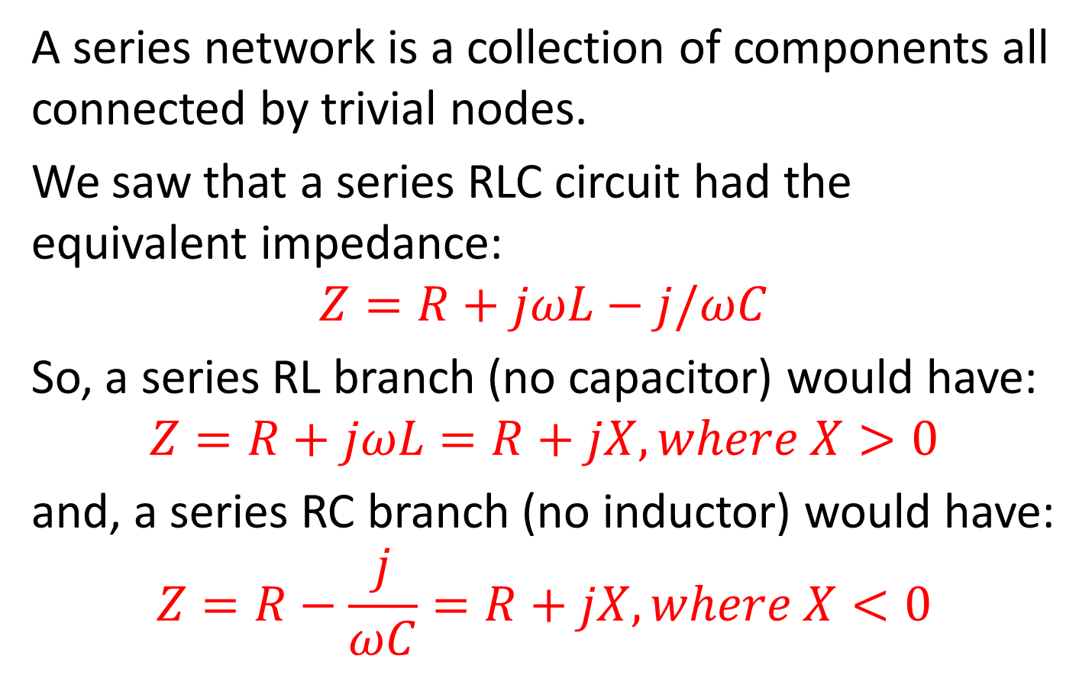
Series RL and RC circuits
A series network is a collection of components all connected by trivial nodes.
We saw that a series RLC circuit had the equivalent impedance:
$$Z=R+jωL−j/ωC$$
So, a series RL branch (no capacitor) would have:
$$Z=R+jωL=R+jX, where X>0$$
and, a series RC branch (no inductor) would have:
$$Z=R−\frac{j}{ωC}=R+jX, where X<0$$

Slide 28
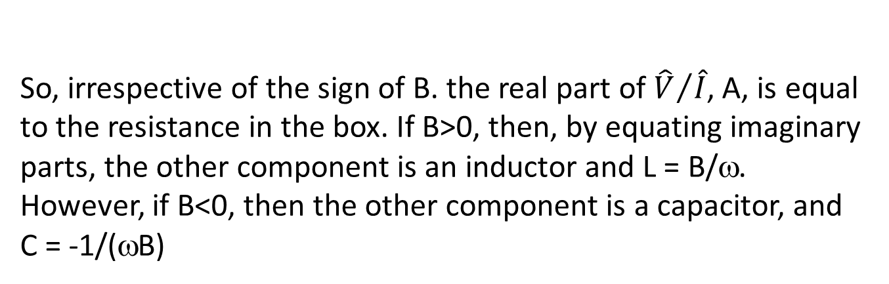
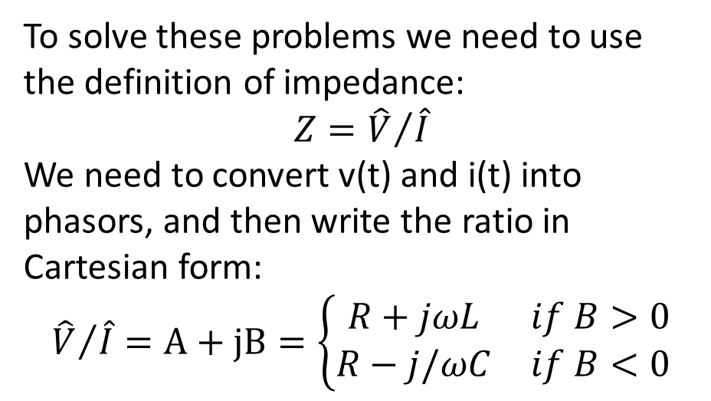
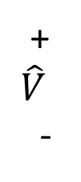

Solving “What’s in the box problems”
To solve these problems we need to use the definition of impedance:
$$Z={\hat{V}}/{\hat{I}}$$
We need to convert v(t) and i(t) into phasors, and then write the ratio in Cartesian form:
$${\hat{V}}/{\hat{I}}=A+jB=\left\{\begin{matrix}R+jωL & if B>0 \\ R−j/ωC & if B<0\end{matrix}\right.$$
$$\hat{I}$$
+
$$\hat{V}$$
-
So, irrespective of the sign of B. the real part of ${\hat{V}}/{\hat{I}}$, A, is equal to the resistance in the box. If B>0, then, by equating imaginary parts, the other component is an inductor and L = B/ω. However, if B<0, then the other component is a capacitor, and
C = -1/(ωB)

Slide 29

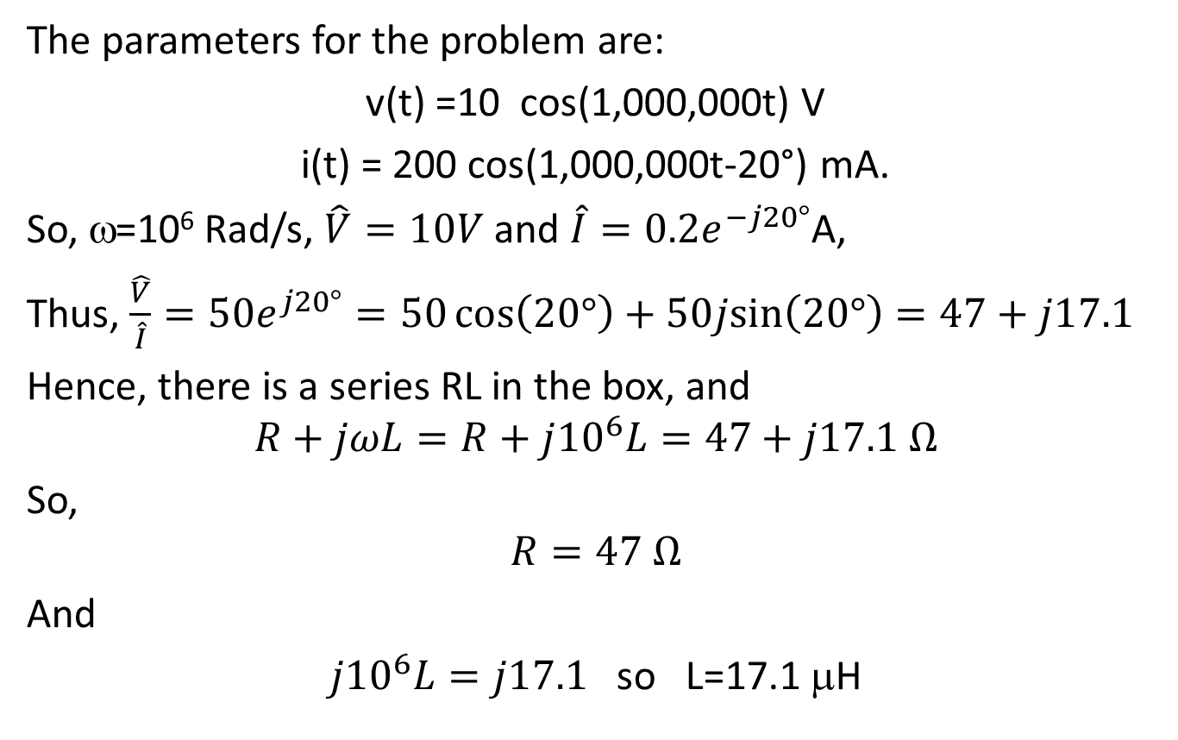
Solving our “What’s in the box problem”
The parameters for the problem are:
v(t) =10 cos(1,000,000t) V
i(t) = 200 cos(1,000,000t-20°) mA.
So, ω=10⁶ Rad/s, $\hat{V}=10V$ and $\hat{I}=0.2e^{−j20°}$A,
Thus, $\frac{\hat{V}}{\hat{I}}=50e^{j20°}=50\cos\left(20°\right)+50j\text{sin}\left(20°\right)=47+j17.1$
Hence, there is a series RL in the box, and
$$R+jωL=R+j{10}^{6}L=47+j17.1 Ω$$
So,
$$R=47 Ω$$
And
${j10}^{6}L=j17.1$ so L=17.1 μH

Slide 30

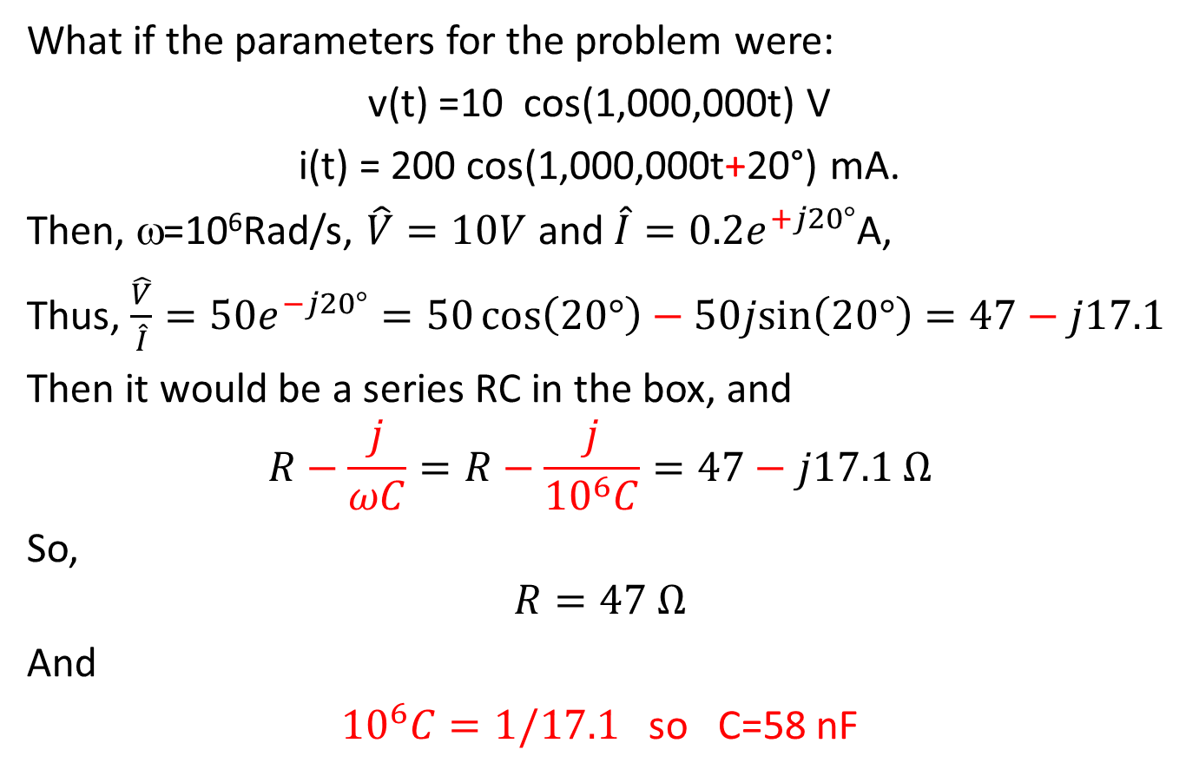
Solving a different “What’s in the box?”
What if the parameters for the problem were:
v(t) =10 cos(1,000,000t) V
i(t) = 200 cos(1,000,000t+20°) mA.
Then, ω=10⁶Rad/s, $\hat{V}=10V$ and $\hat{I}=0.2e^{+j20°}$A,
Thus, $\frac{\hat{V}}{\hat{I}}=50e^{−j20°}=50\cos\left(20°\right)−50j\text{sin}\left(20°\right)=47−j17.1$
Then it would be a series RC in the box, and
$$R−\frac{j}{ωC}=R−\frac{j}{{10}^{6}C}=47−j17.1 Ω$$
So,
$$R=47 Ω$$
And
${10}^{6}C=1/17.1$ so C=58 nF

Slide 31
Sinusoidal steady state Part 7: Finding the complete set of algebraic equations needed to solve a Sinusoidal Steady-State problem.
ENEE 205

Slide 32
Algorithm for solving complete sets of sinusoidal steady state equations
Step 0 Obtain circuit
Step 1 Convert to “phasor” domain: write impedances/ admittances and phasor values on circuit drawing - combine passive components if applicable.
Step 2 Label nodes and meshes (Find B, N, M)
Step 3 Assign reference directions
Step 4 Write B KLs
Step 4a Write N-1 KCLs
Step 4b Write M KVLs
Step 5 Plug admittances into KCLs OR plug impedances into KVLs (follow instructor’s directions)
Step 6 Solve B algebraic equations!
Step 7 Box Answer!

Slide 33
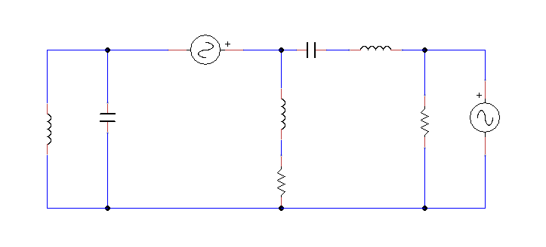
Step 0 - Obtain circuit
4cos(2t) V
0.5 F
3 H
3 F
2 H
3 Ω
3sin(2t) V
0.1 H
4 Ω

Slide 34
Step 1 – convert to phasors
4 V
-j Ω
6j Ω
0.2j Ω
-j/6 Ω
4j Ω
3 Ω
-3j V
4 Ω

Slide 35
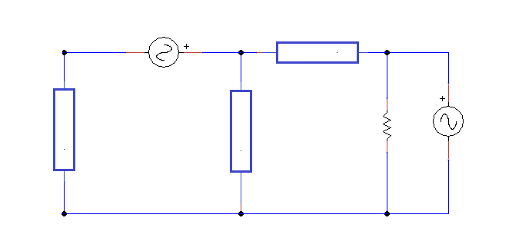
Step 1b – simplify if possible
4 V
5j Ω
-3j V
-j Ω
4(1+j) Ω
3 Ω

Slide 36
Step 2 - Label nodes and meshes
4 V
5j Ω
C
A
B
I
II
III
-3j V
-j Ω
4(1+j) Ω
3 Ω
D

Slide 37
Step 3 – Assign Reference Directions
i₁
- 4 V +
+ V₂ -
C
A
B
i₂
+
V₃
-
+
V₄
-
5j Ω
+
V₅
-
3 Ω
-3j V
-j Ω
4(1+j) Ω
I
II
III
i₃
i₄
i₅
i₆
D

Slide 38
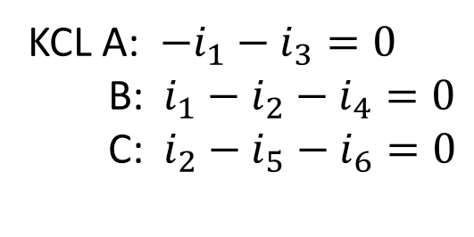
Step 4a – Write N-1 KCLs
i₁
- 4 V +
+ V₂ -
C
A
B
i₂
+
V₃
-
+
V₄
-
5j Ω
+
V₅
-
3 Ω
-3j V
-j Ω
4(1+j) Ω
I
II
III
i₃
i₄
i₅
i₆
D
KCL A: $−i_{1}−i_{3}=0$
B: $i_{1}−i_{2}−i_{4}=0$
C: $i_{2}−i_{5}−i_{6}=0$

Slide 39
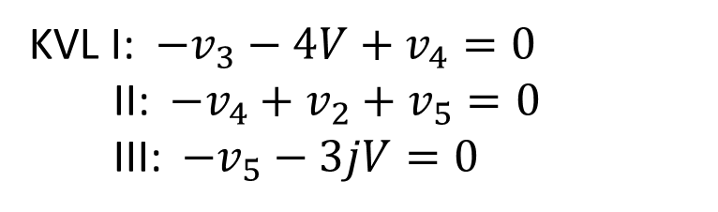
Step 4b – Write M KVLs
i₁
- 4 V +
+ V₂ -
C
A
B
i₂
+
V₃
-
+
V₄
-
5j Ω
+
V₅
-
3 Ω
-3j V
-j Ω
4(1+j) Ω
I
II
III
i₃
i₄
i₅
i₆
D
KVL I: $−v_{3}−4V+v_{4}=0$
II: ${−v}_{4}+v_{2}+v_{5}=0$
III: $−v_{5}−3jV=0$

Slide 40
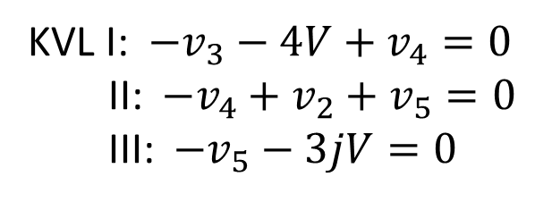
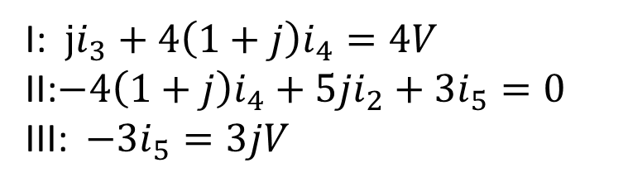
Step 5 – Plug Impedance/Admittance into KLs
i₁
- 4 V +
+ V₂ -
C
A
B
i₂
+
V₃
-
+
V₄
-
5j Ω
+
V₅
-
3 Ω
-3j V
-j Ω
4(1+j) Ω
I
II
III
i₃
i₄
i₅
i₆
D
KVL I: $−v_{3}−4V+v_{4}=0$
II: ${−v}_{4}+v_{2}+v_{5}=0$
III: $−v_{5}−3jV=0$
I: $ji_{3}+4\left(1+j\right)i_{4}=4V$
II:$−4\left(1+j\right)i_{4}+{5ji}_{2}+{3i}_{5}=0$
III: $−{3i}_{5}=3jV$

Slide 41
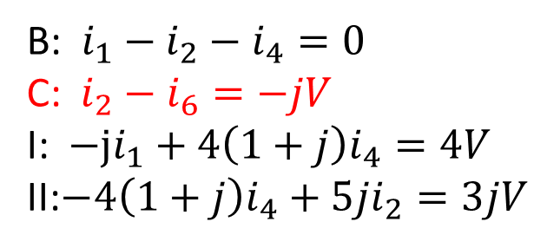
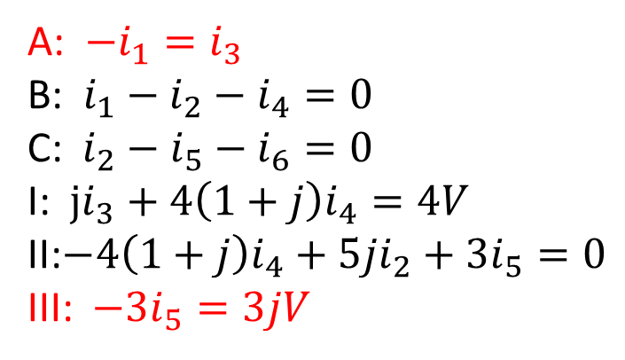
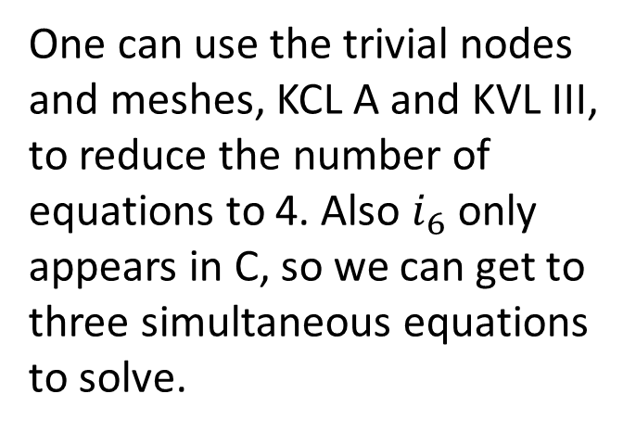
Step 6 – Solve equations
One can use the trivial nodes and meshes, KCL A and KVL III, to reduce the number of equations to 4. Also $i_{6}$ only appears in C, so we can get to three simultaneous equations to solve.
A: $−i_{1}=i_{3}$
B: $i_{1}−i_{2}−i_{4}=0$
C: $i_{2}−i_{5}−i_{6}=0$
I: $ji_{3}+4\left(1+j\right)i_{4}=4V$
II:$−4\left(1+j\right)i_{4}+{5ji}_{2}+{3i}_{5}=0$
III: $−{3i}_{5}=3jV$
B: $i_{1}−i_{2}−i_{4}=0$
C: $i_{2}−i_{6}=−jV$
I: $−ji_{1}+4\left(1+j\right)i_{4}=4V$
II:$−4\left(1+j\right)i_{4}+{5ji}_{2}=3jV$

Slide 42
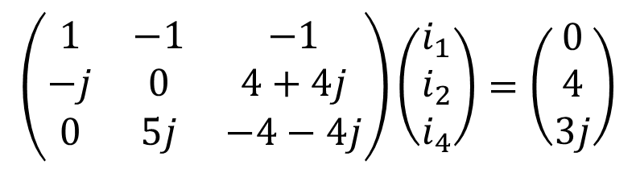
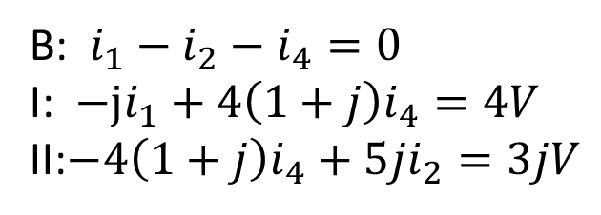
Solving equations, part 2
B: $i_{1}−i_{2}−i_{4}=0$
I: $−ji_{1}+4\left(1+j\right)i_{4}=4V$
II:$−4\left(1+j\right)i_{4}+{5ji}_{2}=3jV$
The three equations can be written in matrix form
$$\left(\begin{matrix}1 & −1 & −1 \\ −j & 0 & 4+4j \\ 0 & 5j & −4−4j\end{matrix}\right)\left(\begin{matrix}i_{1} \\ i_{2} \\ i_{4}\end{matrix}\right)=\left(\begin{matrix}0 \\ 4 \\ 3j\end{matrix}\right)$$
The matrix then can be solved numerically (e.g. with MATLAB), or by matrix inversion, Gaussian elimination. Kramer’s Rule, etc.

Slide 43
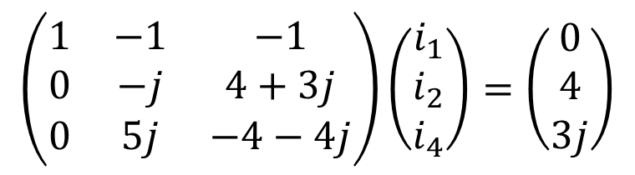
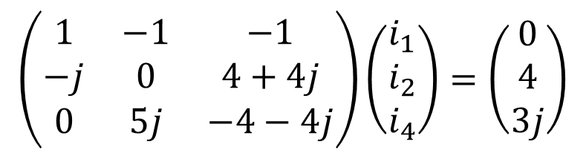
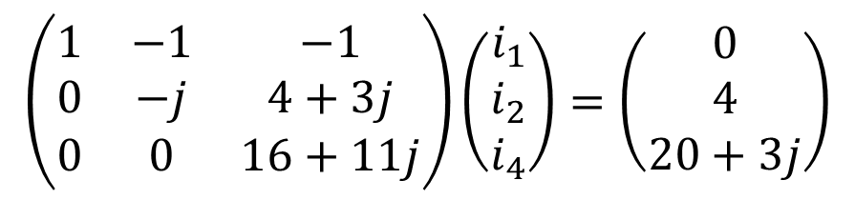
Gaussian elimination
$$\left(\begin{matrix}1 & −1 & −1 \\ −j & 0 & 4+4j \\ 0 & 5j & −4−4j\end{matrix}\right)\left(\begin{matrix}i_{1} \\ i_{2} \\ i_{4}\end{matrix}\right)=\left(\begin{matrix}0 \\ 4 \\ 3j\end{matrix}\right)$$
$$\left(\begin{matrix}1 & −1 & −1 \\ 0 & −j & 4+3j \\ 0 & 5j & −4−4j\end{matrix}\right)\left(\begin{matrix}i_{1} \\ i_{2} \\ i_{4}\end{matrix}\right)=\left(\begin{matrix}0 \\ 4 \\ 3j\end{matrix}\right)$$
$$\left(\begin{matrix}1 & −1 & −1 \\ 0 & −j & 4+3j \\ 0 & 0 & 16+11j\end{matrix}\right)\left(\begin{matrix}i_{1} \\ i_{2} \\ i_{4}\end{matrix}\right)=\left(\begin{matrix}0 \\ 4 \\ 20+3j\end{matrix}\right)$$

Slide 44
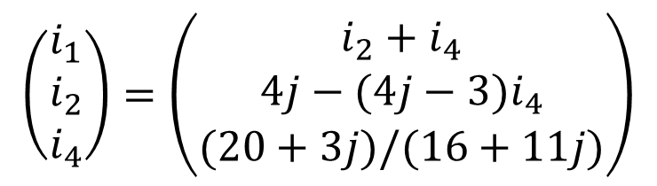
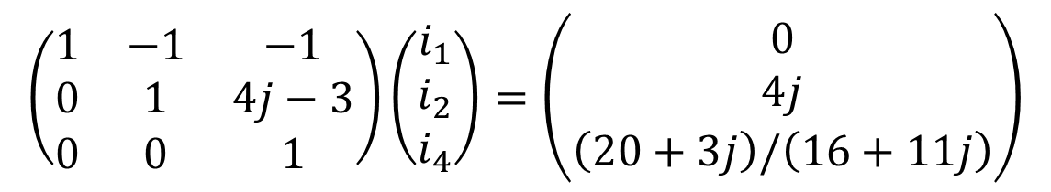
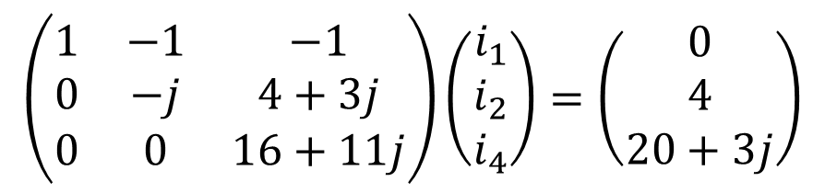

Gaussian elimination, part 2
$$\left(\begin{matrix}1 & −1 & −1 \\ 0 & −j & 4+3j \\ 0 & 0 & 16+11j\end{matrix}\right)\left(\begin{matrix}i_{1} \\ i_{2} \\ i_{4}\end{matrix}\right)=\left(\begin{matrix}0 \\ 4 \\ 20+3j\end{matrix}\right)$$
$$\left(\begin{matrix}1 & −1 & −1 \\ 0 & 1 & 4j−3 \\ 0 & 0 & 1\end{matrix}\right)\left(\begin{matrix}i_{1} \\ i_{2} \\ i_{4}\end{matrix}\right)=\left(\begin{matrix}0 \\ 4j \\ \left(20+3j\right)/\left(16+11j\right)\end{matrix}\right)$$
$$\left(\begin{matrix}i_{1} \\ i_{2} \\ i_{4}\end{matrix}\right)=\left(\begin{matrix}i_{2}+i_{4} \\ 4j−(4j−3)i_{4} \\ (20+3j)/(16+11j)\end{matrix}\right)$$
Calculate $i_{4}$ first and then backfill to get $i_{2}$ and then $i_{1}$.

Slide 45
Sinusoidal steady state Part 8: RMS voltage and current, average power, and the power factor
ENEE 205

Slide 46
Root-mean-square (RMS) voltages and currents
For sinusoidal steady-state, the average value of a voltage or current is zero, so we characterize voltages/currents by their RMS values instead:

Slide 47
Average power dissipated in a branch
Where T is the period

Slide 48
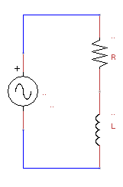
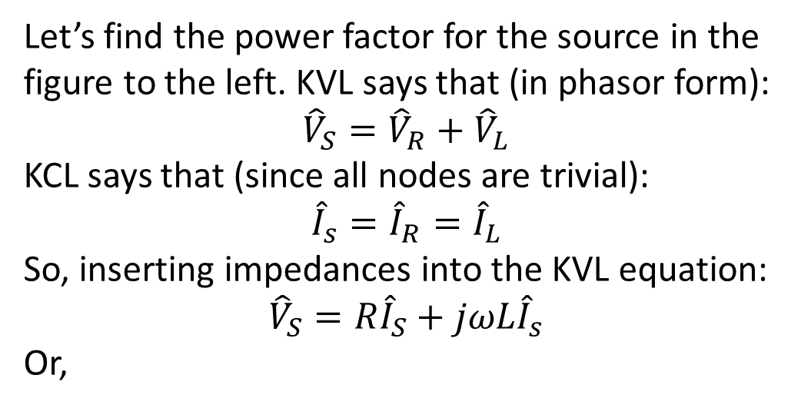
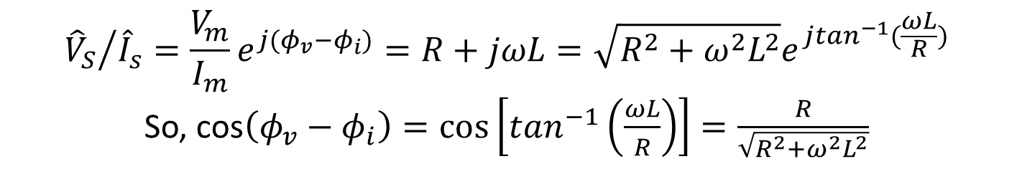
Power factor correction example
i_{R}
Let’s find the power factor for the source in the figure to the left. KVL says that (in phasor form):
$${\hat{V}}_{S}={\hat{V}}_{R}+{\hat{V}}_{L}$$
KCL says that (since all nodes are trivial):
$${\hat{I}}_{s}={\hat{I}}_{R}={\hat{I}}_{L}$$
So, inserting impedances into the KVL equation:
$${\hat{V}}_{S}={R\hat{I}}_{S}+{jωL\hat{I}}_{s}$$
Or,
i_{S}
+
v_{R}
-
+
v_{S}
-
i_{L}
+
v_{L}
-
$${{\hat{V}}_{S}}/{{\hat{I}}_{s}=\frac{V_{m}}{I_{m}}e^{j(φ_{v}−φ_{i})}=R+jωL=\sqrt{R^{2}+ω^{2}L^{2}}e^{j\tan^{−1}(\frac{ωL}{R})}}$$
So, cos$\left(φ_{v}−φ_{i}\right)=\cos\left[\tan^{−1}\left(\frac{ωL}{R}\right)\right]=\frac{R}{\sqrt{R^{2}+ω^{2}L^{2}}}$

Slide 49
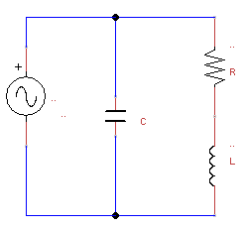
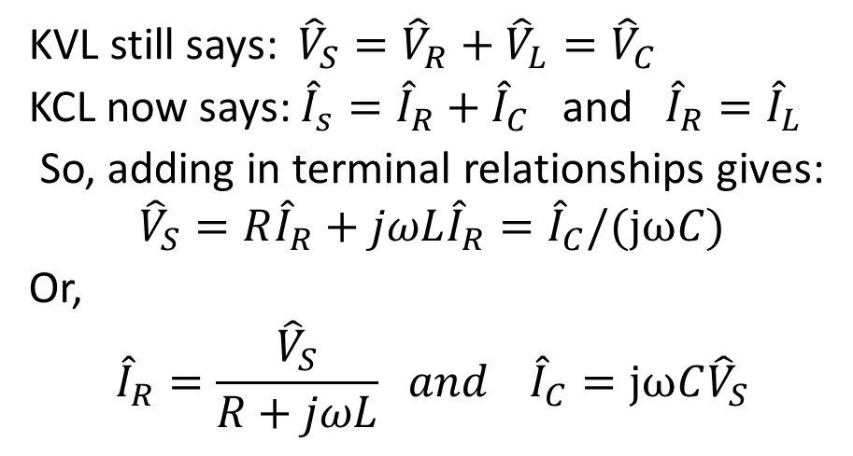
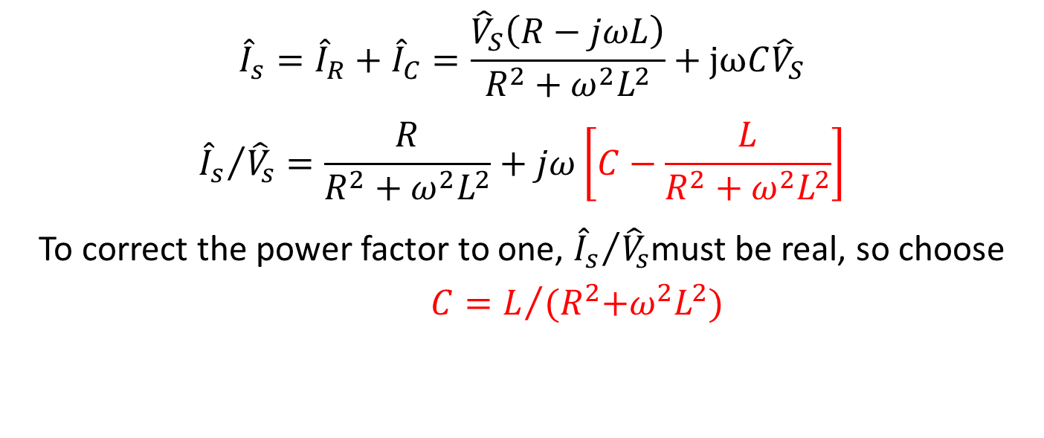
Use a capacitor to correct the power factor!
KVL still says: ${\hat{V}}_{S}={\hat{V}}_{R}+{\hat{V}}_{L}={\hat{V}}_{C}$
KCL now says: ${\hat{I}}_{s}={\hat{I}}_{R}+{\hat{I}}_{C}$ and ${\hat{I}}_{R}={\hat{I}}_{L}$
So, adding in terminal relationships gives:
$${\hat{V}}_{S}={R\hat{I}}_{R}+{jωL\hat{I}}_{R}={\hat{I}}_{C}/(jωC)$$
Or,
$${\hat{I}}_{R}=\frac{{\hat{V}}_{S}}{R+jωL} and {\hat{I}}_{C}=jωC{\hat{V}}_{S}$$
i_{S}
i_{C}
+
v_{R}
-
i_{R}
+
v_{S}
-
+
v_{c}
-
i_{L}
+
v_{L}
-
$${\hat{I}}_{s}={\hat{I}}_{R}+{\hat{I}}_{C}=\frac{{\hat{V}}_{S}\left(R−jωL\right)}{R^{2}+ω^{2}L^{2}}+jωC{\hat{V}}_{S}$$
$${{\hat{I}}_{s}}/{{\hat{V}}_{s}}=\frac{R}{R^{2}+ω^{2}L^{2}}+jω\left[C−\frac{L}{R^{2}+ω^{2}L^{2}}\right]$$
To correct the power factor to one, ${{\hat{I}}_{s}}/{{\hat{V}}_{s}}$must be real, so choose $C=L/{{(R}^{2}+ω^{2}L^{2})}$

Slide 50
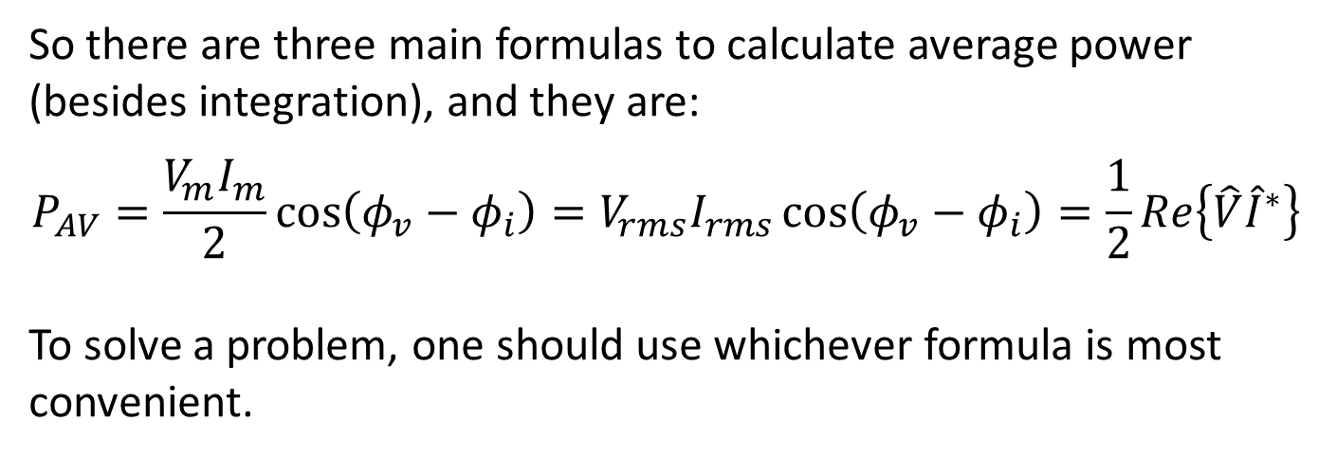
Average power summary
So there are three main formulas to calculate average power (besides integration), and they are:
$$P_{AV}=\frac{V_{m}I_{m}}{2}\cos\left(φ_{v}−φ_{i}\right)=V_{rms}I_{rms}\cos\left(φ_{v}−φ_{i}\right)=\frac{1}{2}Re\left\{\hat{V}{\hat{I}}^{∗}\right\}$$
To solve a problem, one should use whichever formula is most convenient.
component | φ_{v}-φ_{I} | cos(φ_{v}-φ_{I}) | Average power
Resistor R | 0 | 1 | V_{rms} I_{rms}
Capacitor C | -90 | 0 | 0
Inductor L | 90 | 0 | 0
RL branch | Arctan(ωL/R) | R/((ωL)²+R²)^{1/2} | V_{rms} I_{rms}R/((ωL)²+R²)^{1/2}

Slide 51
Sinusoidal steady state Part 9: SSS Op-amp problems and transfer functions
ENEE 205

Slide 52
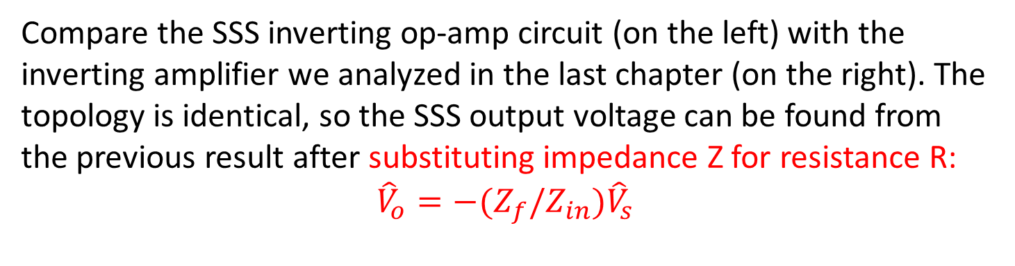
Sinusoidal steady state op-amp circuits
I_{in}
+ R_{in}I_{in} -
+ R_{f}I_{f} -
I_{f}
Node A
I₋
II
I
v_{d}
I₊
Compare the SSS inverting op-amp circuit (on the left) with the inverting amplifier we analyzed in the last chapter (on the right). The topology is identical, so the SSS output voltage can be found from the previous result after substituting impedance Z for resistance R:
$${\hat{V}}_{o}=−(Z_{f}/Z_{in}{)\hat{V}}_{s}$$

Slide 53
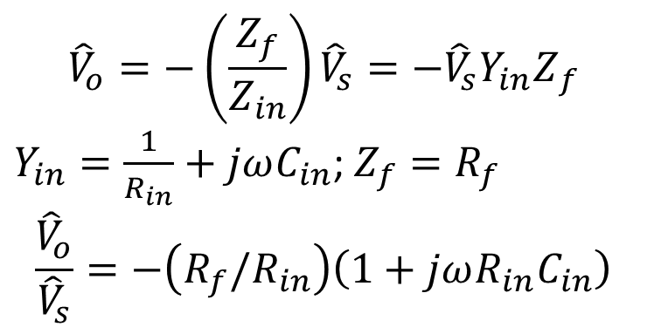
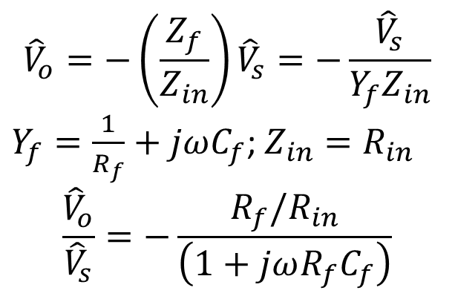
Op-amp circuit Examples
$${\hat{V}}_{o}=−\left(\frac{Z_{f}}{Z_{in}}\right){\hat{V}}_{s}=−\frac{{\hat{V}}_{s}}{{Y_{f}Z}_{in}}$$
$Y_{f}=\frac{1}{R_{f}}+jωC_{f}$; $Z_{in}=R_{in}$
$$\frac{{\hat{V}}_{o}}{{\hat{V}}_{s}}=−\frac{R_{f}/R_{in}}{\left(1+jωR_{f}C_{f}\right)}$$
$${\hat{V}}_{o}=−\left(\frac{Z_{f}}{Z_{in}}\right){\hat{V}}_{s}=−{{{\hat{V}}_{s}Y}_{in}Z}_{f}$$
$Y_{in}=\frac{1}{R_{in}}+jωC_{in}$; $Z_{f}=R_{f}$
$$\frac{{\hat{V}}_{o}}{{\hat{V}}_{s}}=−\left(R_{f}/R_{in}\right)\left(1+jωR_{in}C_{in}\right)$$

Slide 54
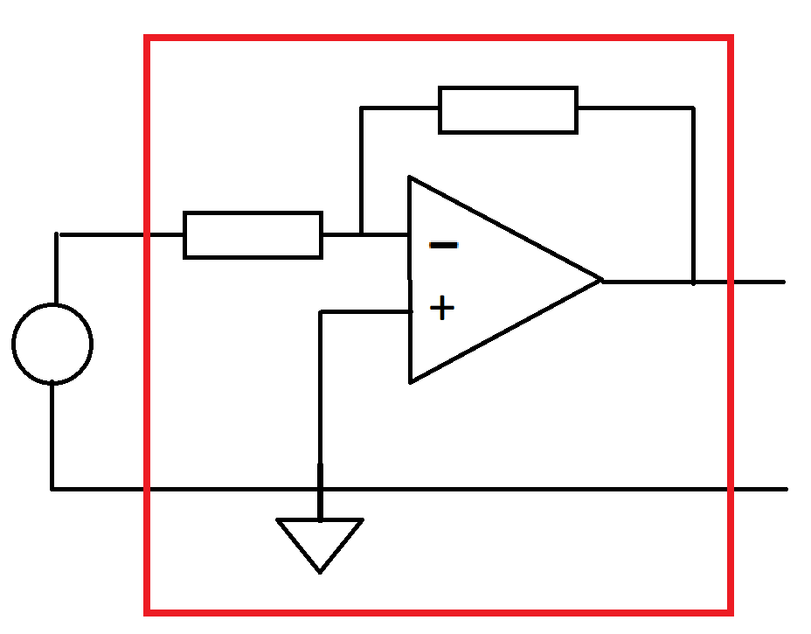
Transfer functions
For op-amp circuits, we are usually looking for the output voltage in terms of the input voltage(s), and when there is a single input, that brings us to the idea of a transfer function.
The box labeled H(s) represents the circuit that connects the input to the output. We use s as a shorthand for jω. (This will be more useful later)
Transfer functions will facilitate the solution of many problems in this class and others. Here, they will be useful for circuits with multiple op-amps and for transient analysis (at the end of the course).
Z_{in}
Z_{f}
+
V_{s}
-
H(s)
+
V_{o}
-

Slide 55
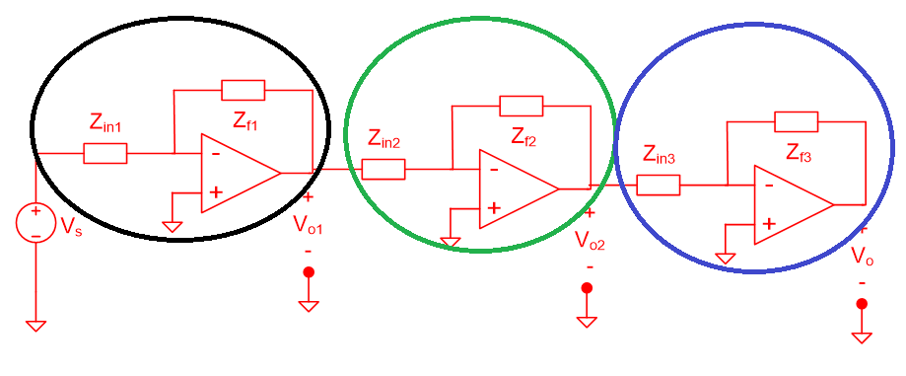
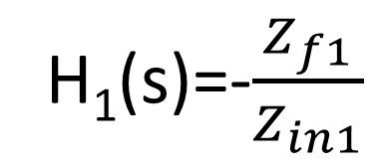
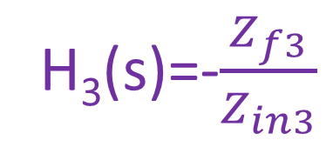
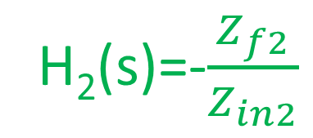
Multiple op-amp transfer function example
Z_{in1}
The ovals indicate what’s in the H(s) box:
Z_{f1}
+
V_{s}
-
+
V_{o1}
-
H₁(s)
H₁(s)=-$\frac{Z_{f1}}{Z_{in1}}$
H₂(s)=-$\frac{Z_{f2}}{Z_{in2}}$
H₃(s)=-$\frac{Z_{f3}}{Z_{in3}}$

Slide 56
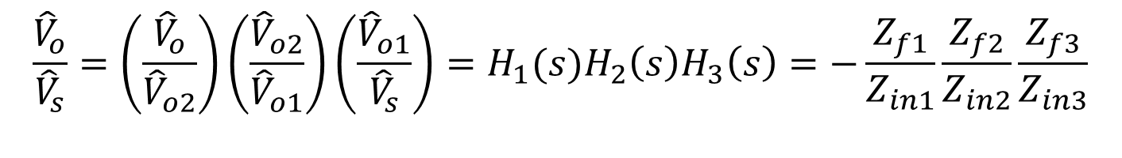
Cascading op-amp circuits
$$\frac{{\hat{V}}_{o}}{{\hat{V}}_{s}}=\left(\frac{{\hat{V}}_{o}}{{\hat{V}}_{o2}}\right)\left(\frac{{\hat{V}}_{o2}}{{\hat{V}}_{o1}}\right)\left(\frac{{\hat{V}}_{o1}}{{\hat{V}}_{s}}\right)=H_{1}(s)H_{2}\left(s\right)H_{3}\left(s\right)=−\frac{Z_{f1}}{Z_{in1}}\frac{Z_{f2}}{Z_{in2}}\frac{Z_{f3}}{Z_{in3}}$$

