Slide 1
Kirchhoff’s Laws Part 1: Circuit topologies and definitions
ENEE 205

Slide 2
Circuit topologies/definitions - NODES
Nodes – “points” where two or more component terminals are connected together or the collection of wires that connect two or more component terminals together . We denote the number of nodes in a circuit as “N.”
Trivial node – a node which connects exactly two components.
Non-trivial node – a node with more than two connected components
For the circuit to the right, there are
5 nodes : Nodes A – Node E
Trivial nodes (2): Nodes A, C
Non-trivial nodes (3): B (3 connections), D (3 connections), and E (4 connections),
Note: reference are currents shown in the figure.

Slide 3
Circuit topologies/definitions - MESHES
Loops– closed paths in a circuit, or, the list of components encountered when one moves along a closed path (path must not pass through a point more than once).
Mesh – a loop that does not completely enclose any components. We denote the number of meshes in a circuit as “M.”
Trivial mesh– a mesh which contains exactly two components.
Non-trivial mesh– a mesh that contains more than two components.
For the circuit to the right, there are 3 meshes
Trivial meshes (1): mesh 3
Non-trivial meshes (2): mesh 1 (3 components), and mesh 2 (4 components)

Slide 4
Circuit topologies/definitions - Branches
Branch– a general term for any two-terminal component, whether active or passive, We denote the number of branches in a circuit as “B.”
It turns out that the there is a relationship between B, N, and M: B = M + N -1
Because of this equation, meshes are more
useful than loops – we will determine Kirchhoff’s
Equations on meshes and nodes, but not
generally on loops that are not meshes.
For the example to the right, there are
5 nodes , 3 meshes, and 7 branches
However, there are 6 loops!

Slide 5
Kirchhoff’s laws Part 2: Kirchhoff’s Current Law (KCL) and Kirchhoff’s Voltage Law (KVL)
ENEE 205

Slide 6
Kirchhoff’s current law (KCL)
Kirchhoff’s laws come from laws of physics.
PHYSICAL LAW: NET CHARGE CAN NOT BE CREATED OR DESTROYED
Consequence: If the net charge in some volume is increasing or decreasing, current must be entering or leaving that volume, respectively.
Consequence: If there is no net change in charge in a volume, the sum of all currents entering and leaving the volume must be zero.
In circuit theory, our “volumes” are ones that contain nodes, and nodes have no net charge, so we get Kirchhoff’s Current Law (KCL):
The algebraic sum of currents entering a node equals zero.

Slide 7
KCL - continued
“Algebraic” means that if a current is entering a node, we put a plus sign in front of the reference current in KCL for that node. However, if a reference current is pointed away from a node, we place a minus sign in front of the reference current.
Note: One can write N KCL equations for any circuit, but only N-1 equations are linearly independent.
Note: remember that the reference current does not indicate the direction of current, it only tells us how to interpret a positive or negative current:
A positive value indicates that the actual current IS in the direction of the reference current, while a negative result tells us that the actual current is flowing in the opposite direction.

Slide 8
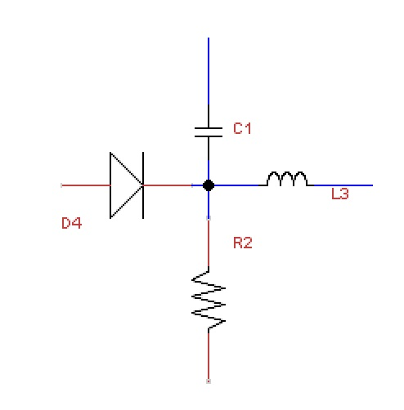
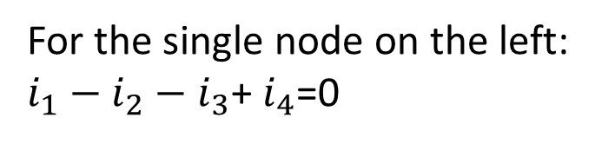
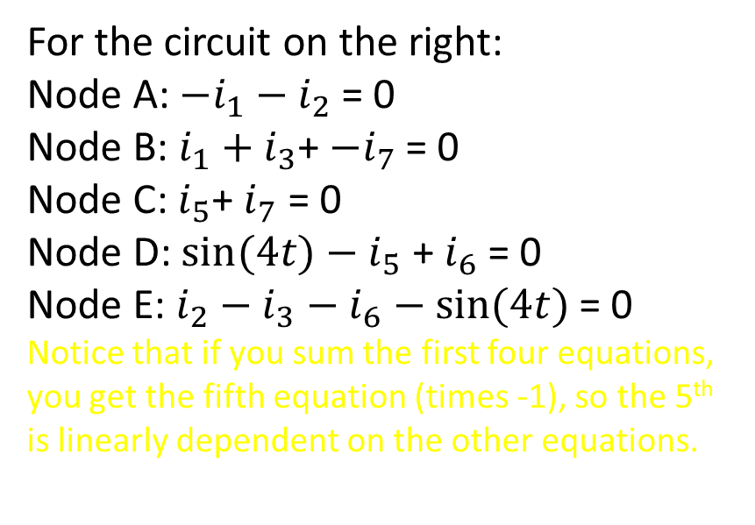
KCL examples
i₁
i₄
i₃
For the single node on the left:
$i_{1}−$ $i_{2}$ $−$ $i_{3}$+ $i_{4}$=0
i₂
Node E
For the circuit on the right:
Node A: $−i_{1}−$ $i_{2}$ = 0
Node B: $i_{1}+i_{3}$+ ${−i}_{7}$ = 0
Node C: $i_{5}$+ $i_{7}$ = 0
Node D: $sin⁡(4t)−$ $i_{5}$ + $i_{6}$ = 0
Node E: $i_{2}$ $−$ $i_{3}$ $−$ $i_{6}−sin⁡(4t)$ = 0
Notice that if you sum the first four equations, you get the fifth equation (times -1), so the 5th is linearly dependent on the other equations.
Node A
Node D
Node B
Node C

Slide 9
Kirchhoff’s voltage law (KvL)
PHYSICAL LAW: A (QUASI-) STATIC ELECTRIC FIELD IS A CONSERVATIVE FIELD
Consequence: The voltage difference from point “A” to point “B” does not depend on the path.
Consequence: The net voltage change around a closed path equals zero.
In circuit theory, our paths are around loops and meshes, so we get Kirchhoff’s Voltage Law (KVL):
The algebraic sum of voltage drops around a mesh or loop equals zero.

Slide 10
KVL, continued
“Algebraic” means that if , while traversing a loop, one “enters” a positive terminal (for a reference voltage) and then leaves the negative terminal, that constitutes a voltage drop and that reference voltage is written in KVL with a plus sign. Otherwise, it is a voltage rise, and the reference voltage is written in the KVL equation with a minus sign.
Notes: We always traverse the meshes in a “clockwise” manner.
There are only M linearly independent KVL equations, so we normally only write them for meshes.

Slide 11
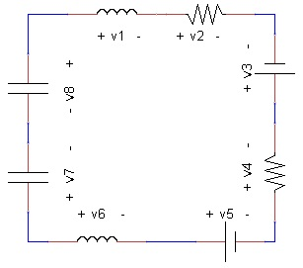
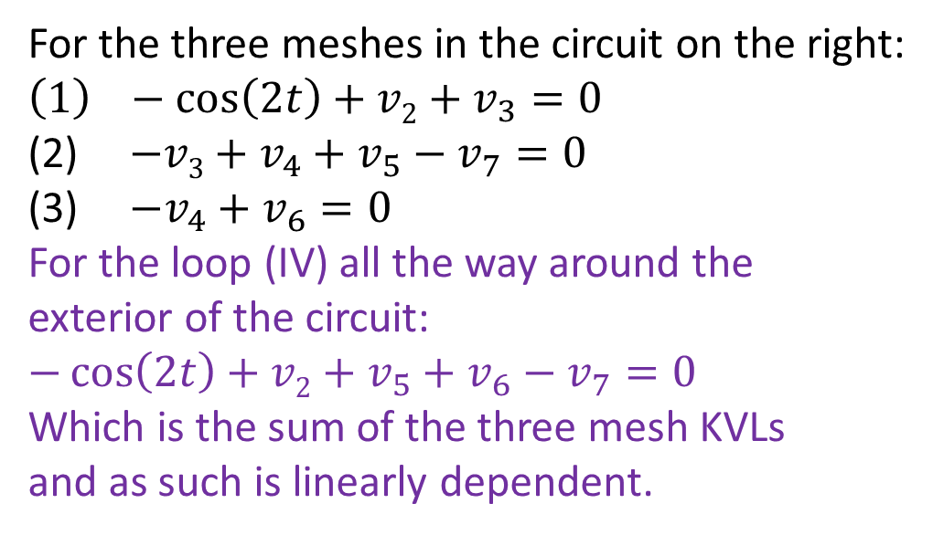
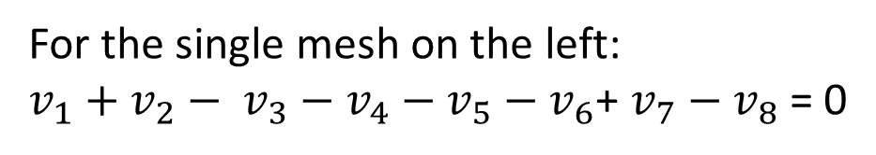
KVL examples
For the single mesh on the left:
$v_{1}+$ $v_{2}− v_{3}$ $−$ $v_{4}$ $−$ $v_{5}$ $−$ $v_{6}$+ $v_{7}$ $−$ $v_{8}$ = 0
IV
For the three meshes in the circuit on the right:
$$\left(1\right) −\cos\left(2t\right)+v2+v_{3}=0$$
(2) $−v3+v_{4}+v_{5}−v_{7}=0$
(3) $−v_{4}+v_{6}=0$
For the loop (IV) all the way around the
exterior of the circuit:
$$−\cos\left(2t\right)+v2+v_{5}+v_{6}−v_{7}=0$$
Which is the sum of the three mesh KVLs
and as such is linearly dependent.
+ v₆ -
+ v₂ -
+
V₅
-
+
V₃
-
+ v₇ -

Slide 12
Kirchhoff’s laws Part 3: The complete set of first-order differential equations needed to find all voltages and currents in a circuit
ENEE 205

Slide 13
Unique circuit solutions
It can be shown (but we won’t) that we can always generate the number of equations that we need to uniquely solve any circuit problem for all voltage and currents for all components.
When the circuit only has two-terminal components (i.e. no op-amps), if there are B branches (components), we need 2B equations. Terminal relationships, plus expressions for dependent and independent sources, give us half of those equations. The other half come from N-1 KCLs and M KVLs.
For circuits with op-amps, we need to use the three consequences of the ideal op-amp assumptions, plus terminal relationships, KCLs and KVLs to come up with the required number of equations to solve uniquely for all voltages and currents in the op-amp circuit.

Slide 14
Algorithm to find the complete set of 1st order differential equations (with no op-amps):
Step 0 Obtain circuit
Step 1 Label nodes and meshes (Find B, N, M)
Step 2 Assign reference directions
Step 3 Write B KLs
Step 3a Write N-1 KCLs
Step 3b Write M KVLs
Step 4 Write one Terminal Relationship (TR) for each passive component - plus one equation for each dependent source
Step 5 Plug TRs into KLs
Step 6 Write one (symbolic) Initial Condition (IC) for each energy storage element
Step 7 Box Answer!

Slide 15
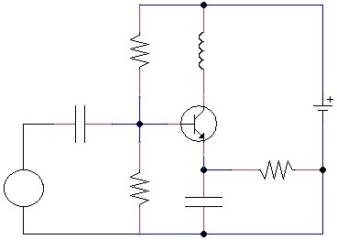
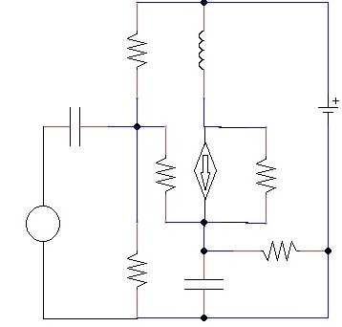
Step 0 Obtain circuit
Here is a simple transistor circuit:
Here is the model of the simple transistor circuit with a current-controlled current source:

Slide 16
Step 1 Label nodes and meshes (Find B, N, M)
C
B = 11
N = 6
M = 6
II
III
B
D
A
V
I
E
VI
IV
F

Slide 17
Step 2 Assign reference directions
C
-
V₃
+
-
V₄
+
i₅
II
III
i₃
i₄
+
V₅
-
i₁₁
B
D
A
+
V₂
-
i₂=βi₇
+ V₁₁ -
-
V₈
+
i₁
+
V₇
-
i₆
V
+
V₁
-
i₇
i₈
I
E
i₉
+ V₉ -
-
V₆
+
VI
-
V₁₀
+
IV
i₁₀
F

Slide 18
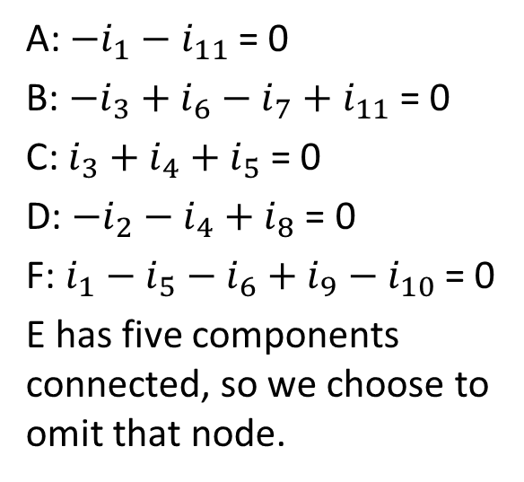
Step 3a Write N-1 KCLs
A: $−i_{1}−$ $i_{11}$ = 0
B: $−i_{3}+i_{6}−i_{7}+i_{11}$ = 0
C:$i_{3}+i_{4}+i_{5}$ = 0
D: $−i_{2}−i_{4}+i_{8}$ = 0
F: $i_{1}−i_{5}−i_{6}+i_{9}−i_{10}$ = 0
E has five components connected, so we choose to omit that node.
C
-
V₃
+
-
V₄
+
i₅
II
III
i₃
i₄
+
V₅
-
i₁₁
B
D
A
+
V₂
-
i₂=βi₇
+ V₁₁ -
-
V₈
+
i₁
+
V₇
-
i₆
V
+
V₁
-
i₇
i₈
I
-
V₆
+
E
i₉
+ V₉ -
VI
-
V₁₀
+
IV
i₁₀
F

Slide 19
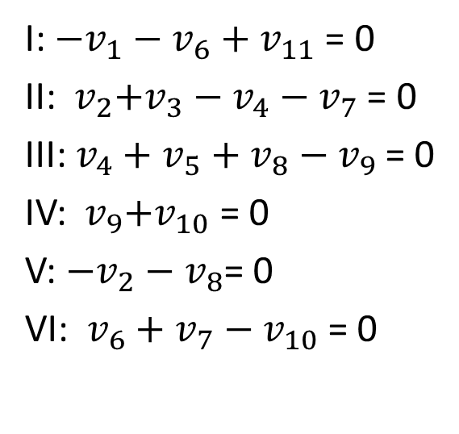
Step 3b Write M KVLs
I: $−v_{1}−v_{6}+$ $v_{11}$ = 0
II:${ v}_{2}{+v}_{3}−v_{4}−v_{7}$ = 0
III:$v_{4}+v_{5}+v_{8}−v_{9}$ = 0
IV:${ v}_{9}+v_{10}$ = 0
V: $−v_{2}−v_{8}$= 0
VI: $v_{6}+v_{7}$ $−{ v}_{10}$= 0
C
-
V₃
+
-
V₄
+
i₅
II
III
i₃
i₄
+
V₅
-
i₁₁
B
D
A
+
V₂
-
i₂=βi₇
+ V₁₁ -
-
V₈
+
i₁
+
V₇
-
i₆
V
+
V₁
-
i₇
i₈
I
-
V₆
+
E
i₉
+ V₉ -
VI
-
V₁₀
+
IV
i₁₀
F

Slide 20
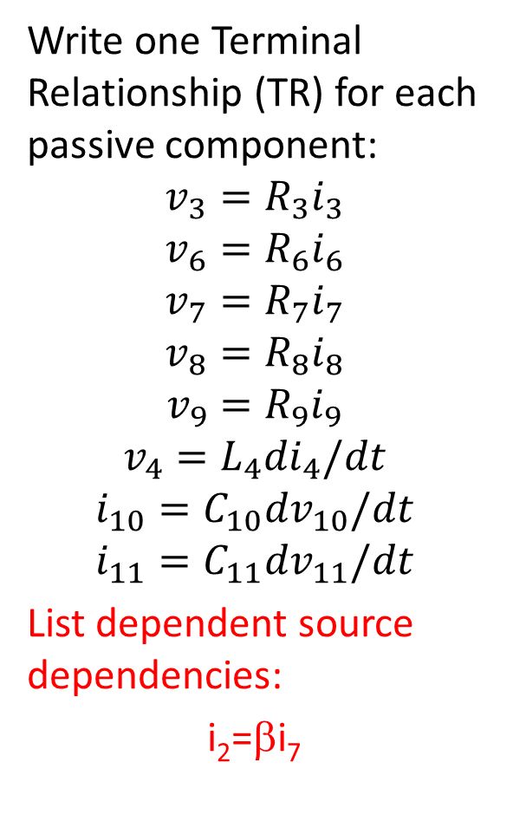
Step 4 Terminal Relationships:
Write one Terminal Relationship (TR) for each passive component:
$$v_{3}=R_{3}i_{3}$$
$$v_{6}=R_{6}i_{6}$$
$$v_{7}=R_{7}i_{7}$$
$$v_{8}=R_{8}i_{8}$$
$$v_{9}=R_{9}i_{9}$$
$$v_{4}=L_{4}{di}_{4}/dt$$
$$i_{10}=C_{10}{dv}_{10}/dt$$
$$i_{11}=C_{11}{dv}_{11}/dt$$
List dependent source dependencies:
i₂=βi₇
C
-
V₃
+
R₃
-
V₄
+
L₄
i₅
II
III
C₁₁
i₄
+
V₅
-
i₃
i₁₁
B
D
A
R₇
+
V₂
-
i₂=βi₇
R₈
+ V₁₁ -
+
V₇
-
-
V₈
+
i₁
i₆
V
+
V₁
-
i₇
i₈
I
-
V₆
+
E
i₉
+ V₉ -
VI
R₉
-
V₁₀
+
R₆
IV
C₁₀
i₁₀
F

Slide 21
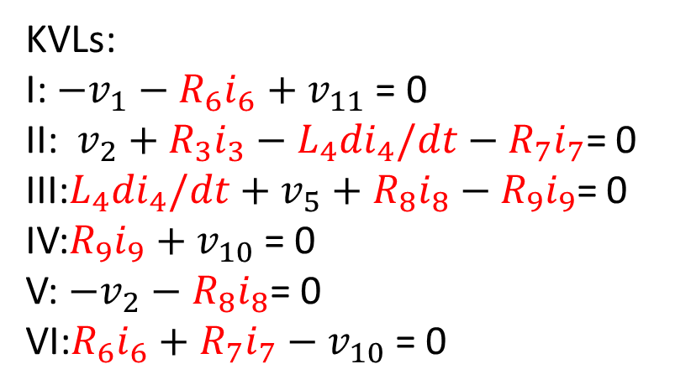
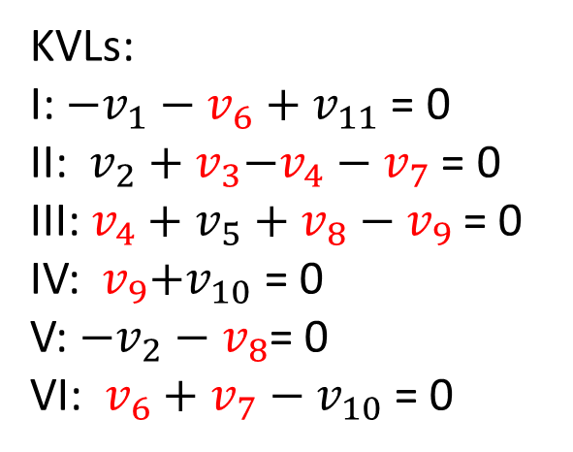
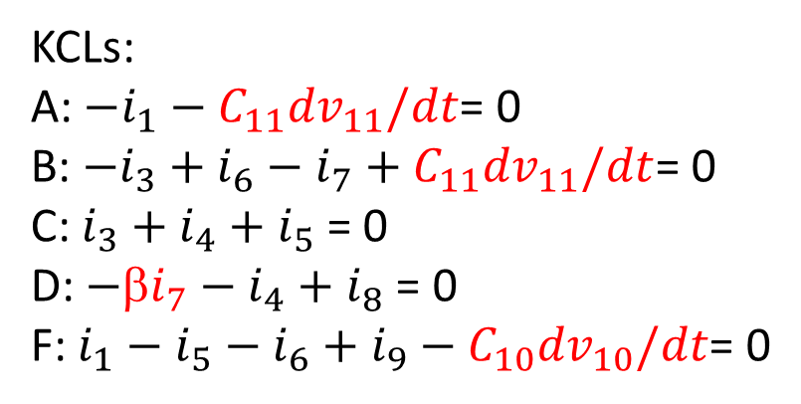
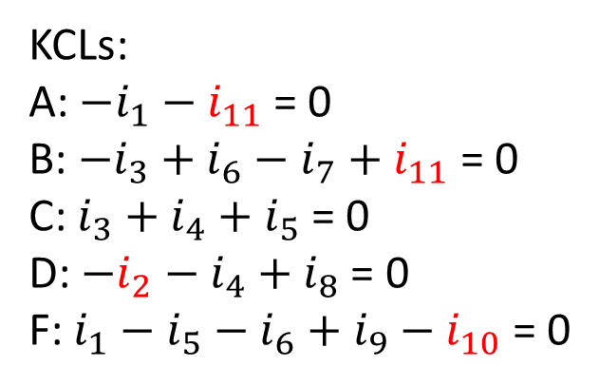
Step 5 Plug TRs into KLs
KCLs:
A: $−i_{1}−$ $i_{11}$ = 0
B: $−i_{3}+i_{6}−i_{7}+i_{11}$ = 0
C:$i_{3}+i_{4}+i_{5}$ = 0
D: $−i_{2}−i_{4}+i_{8}$ = 0
F: $i_{1}−i_{5}−i_{6}+i_{9}−i_{10}$ = 0
KCLs:
A: $−i_{1}−C_{11}{dv}_{11}/dt$= 0
B: $−i_{3}+i_{6}−i_{7}+C_{11}{dv}_{11}/dt$= 0
C:$i_{3}+i_{4}+i_{5}$ = 0
D: $−\text{β}i_{7}−i_{4}+i_{8}$ = 0
F: $i_{1}−i_{5}−i_{6}+i_{9}−C_{10}{dv}_{10}/dt$= 0
KVLs:
I: $−v_{1}−v_{6}+$ $v_{11}$ = 0
II:${ v}_{2}{ + v}_{3}−v_{4}−v_{7}$ = 0
III:$v_{4}+v_{5}+v_{8}−v_{9}$ = 0
IV:${ v}_{9}+v_{10}$ = 0
V: $−v_{2}−v_{8}$= 0
VI: $v_{6}+v_{7}$ $−{ v}_{10}$= 0
KVLs:
I: $−v_{1}−R_{6}i_{6}+$ $v_{11}$ = 0
II:${ v}_{2}{ + R}_{3}i_{3}−L_{4}{di}_{4}/dt−R_{7}i_{7}$= 0
III:$L_{4}{di}_{4}/dt+v_{5}+R_{8}i_{8}−R_{9}i_{9}$= 0
IV:$R_{9}i_{9}+v_{10}$ = 0
V: $−v_{2}−R_{8}i_{8}$= 0
VI:$R_{6}i_{6}+R_{7}i_{7}−{ v}_{10}$= 0

Slide 22
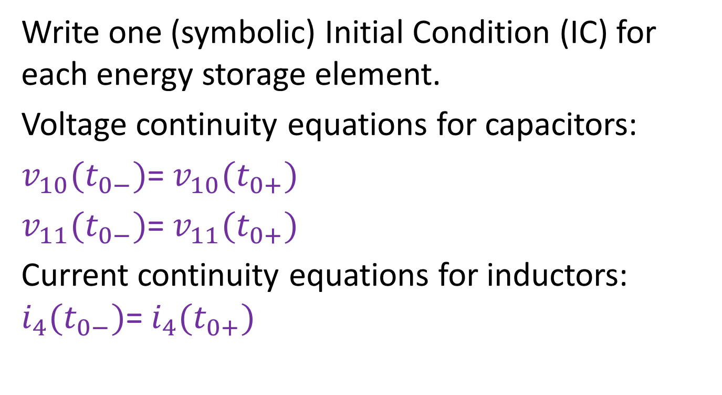
Step 6 List all initial conditions
Write one (symbolic) Initial Condition (IC) for each energy storage element.
Voltage continuity equations for capacitors:
$v_{10}(t_{0−})$= $v_{10}(t_{0+})$
$v_{11}(t_{0−})$= $v_{11}(t_{0+})$
Current continuity equations for inductors: $i_{4}(t_{0−})$= $i_{4}(t_{0+})$

Slide 23

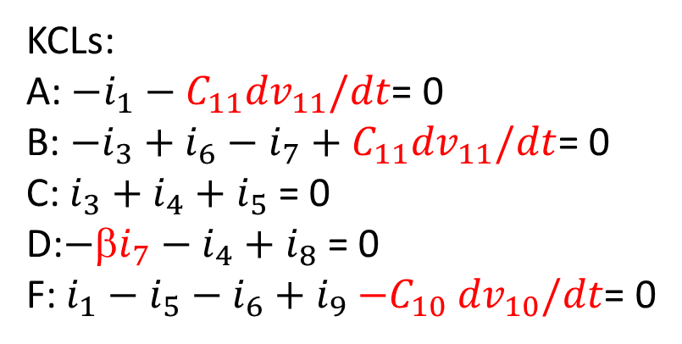
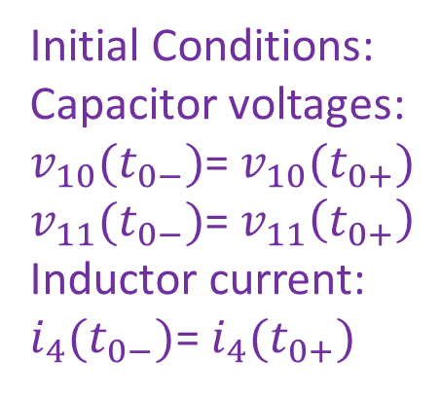
Step 7: Box your answer
KCLs:
A: $−i_{1}−C_{11}{dv}_{11}/dt$= 0
B: $−i_{3}+i_{6}−i_{7}+C_{11}{dv}_{11}/dt$= 0
C:$i_{3}+i_{4}+i_{5}$ = 0
D:$−\text{β}i_{7}−i_{4}+i_{8}$ = 0
F: $i_{1}−i_{5}−i_{6}+i_{9}{−C}_{10}{dv}_{10}/dt$= 0
Initial Conditions:
Capacitor voltages:
$v_{10}(t_{0−})$= $v_{10}(t_{0+})$
$v_{11}(t_{0−})$= $v_{11}\left(t_{0+}\right)$
Inductor current:
$i_{4}(t_{0−})$= $i_{4}(t_{0+})$
KVLs:
I: $−v_{1}−R_{6}i_{6}+$ $v_{11}$ = 0
II:${ v}_{2}{ + R}_{3}i_{3}−L_{4}{di}_{4}/dt−R_{7}i_{7}$= 0
III:$L_{4}{di}_{4}/dt+v_{5}+R_{8}i_{8}−R_{9}i_{9}$= 0
IV:$R_{9}i_{9}+v_{10}$ = 0
V: $−v_{2}−R_{8}i_{8}$= 0
VI:$R_{6}i_{6}+R_{7}i_{7}−{ v}_{10}$= 0

Slide 24
Solution techniques
Note that our algorithm gives B equations that need to be solved simultaneously. If B is a large number (11 in the last example), that can be a difficult task. If there are trivial nodes or meshes, we can reduce the number of equations we need to solve simultaneously. Two components connected by a trivial node are said to be “in series” and they always have the same current through them, so we can eliminate one equation for each trivial node. Two components connected in a trivial mesh are said to be “in parallel” and they always have the same voltage across them, so we can eliminate one equation for each trivial mesh.
If the circuit contains only sources and resistors, the equations will be algebraic (no derivatives), and we can write the equations in matrix form, and then solve the matrix equation using software like MATLAB, or techniques like Kramer’s rule, Gaussian elimination or direct matrix inversion (e.g. for 2x2 matrices)

Slide 25
Kirchhoff’s laws: Part 4: Examples with DC sources
ENEE 205

Slide 26
Example DirECt Current (DC) circuits
We will see later in the course that if a circuit has only batteries as sources (or constant (DC) current sources), some time after the circuit is assembled, the inductors will act like short circuits (simple wires) and capacitors will act like open circuits (no connection).
So all that is left are batteries and resistors. There may be other components (like diodes or motors), but those other components will act like resistors or will draw a constant current or require a constant voltage (and thus act like sources).
In the next few slides we will solve a few of these DC circuits

Slide 27
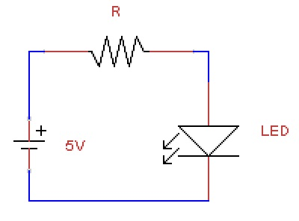
A Simple LED circuit
Node A
i_{R}
+ V_{R} -
i_{D}=30 mA
Consider the circuit shown to the right. We want to light the LED properly. The data sheet says that a blue LED needs 30 mA to be bright and the voltage drop is 3.3 V
+
3.3V
-
I
The design requires only selecting the proper value of the resistance. The circuit is simple enough that we don’t need to follow the algorithm.
KVL for mesh I: -5 V + V_{R} + 3.3 V = 0 or V_{R} = 1.7 V
KCL for Node A: i_{R} – i_{D} = 0 or i_{R} = i_{D} = 30 mA
Ohm’s Law: R = V_{R}/i_{R} = 1.7 V / 30 mA = 56.67 Ω
Standard resistances are 56 Ω and 62 Ω. So pick one of those for your circuit. (There is a precision 56.7 Ω resistor, but that is not necessary and they are much more expensive!)

Slide 28
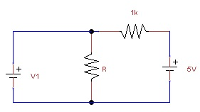
Charging a Battery
Consider the circuit shown to the right. It could be used as a simple battery charger. (The 5V source will charge the V₁ battery.)
Let’s say that V₁ is normally a 3.3V battery when fully charged. When discharged, the voltage is typically less than 1 V. We need to design the circuit (i.e. find the value of resistance R) so that the battery charges until it reaches 3.3V. That means that the current going into V₁ must go to zero
Let’s use the general algorithm to find the complete set of algebraic equations, and then we’ll simplify and solve.

Slide 29
Step 1 Label nodes and meshes (Find B, N, M)
B = 4
N = 3
M = 2
A
B
I
II
C

Slide 30
Step 2 Assign reference directions
A
i₃
B
+
V₂
-
i₂
- V₃ +
i₄
i₁
I
II
C

Slide 31
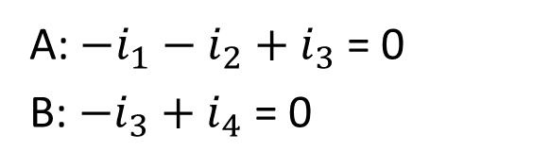
Step 3a Write two KCLs
A: $−i_{1}−$ $i_{2}$ $+$ $i_{3}$ = 0
B: $−i_{3}+i_{4}$ = 0
A
i₃
B
+
V₂
-
i₂
- V₃ +
i₄
i₁
I
II
C

Slide 32
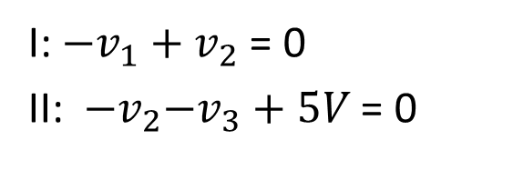
Step 3b Write two KVLs
I: $−v_{1}+$ $v_{2}$ = 0
II:${ −v}_{2}{−v}_{3}+5V$ = 0
A
i₃
B
+
V₂
-
i₂
- V₃ +
i₄
i₁
I
II
C

Slide 33
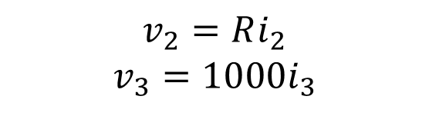
Step 4 Terminal Relationships:
$$v_{2}=Ri_{2}$$
$$v_{3}=1000i_{3}$$
A
i₃
B
+
V₂
-
i₂
- V₃ +
i₄
i₁
I
II
C

Slide 34
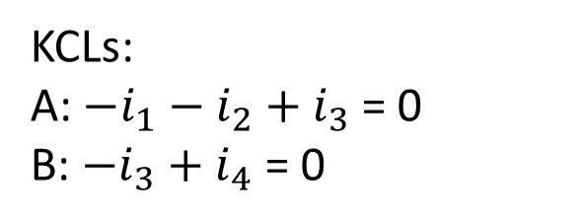
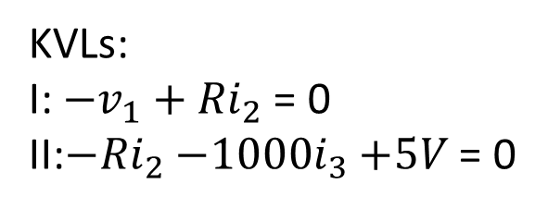
Step 5 Plug TRs into KLs
KCLs:
A: $−i_{1}−$ $i_{2}$ $+$ $i_{3}$ = 0
B: $−i_{3}+i_{4}$ = 0
KVLs:
I: $−v_{1}+$ ${Ri}_{2}$ = 0
II:$−{Ri}_{2}{−1000i}_{3}+5V$ = 0
A
i₃
B
+
V₂
-
i₂
- V₃ +
i₄
i₁
I
II
C

Slide 35
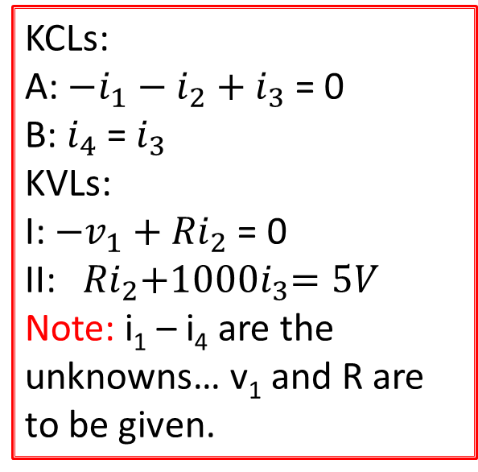
Step 6 List all initial conditions
There are no inductors or capacitors, so there are no initial conditions needed )or available).
Step 7: Box your answer
KCLs:
A: $−i_{1}−$ $i_{2}$ $+$ $i_{3}$ = 0
B: $i_{4}$ = $i_{3}$
KVLs:
I: $−v_{1}+$ ${Ri}_{2}$ = 0
II:${Ri}_{2}{+1000i}_{3}=5V$
Note: i₁ – i₄ are the unknowns… v₁ and R are to be given.

Slide 36
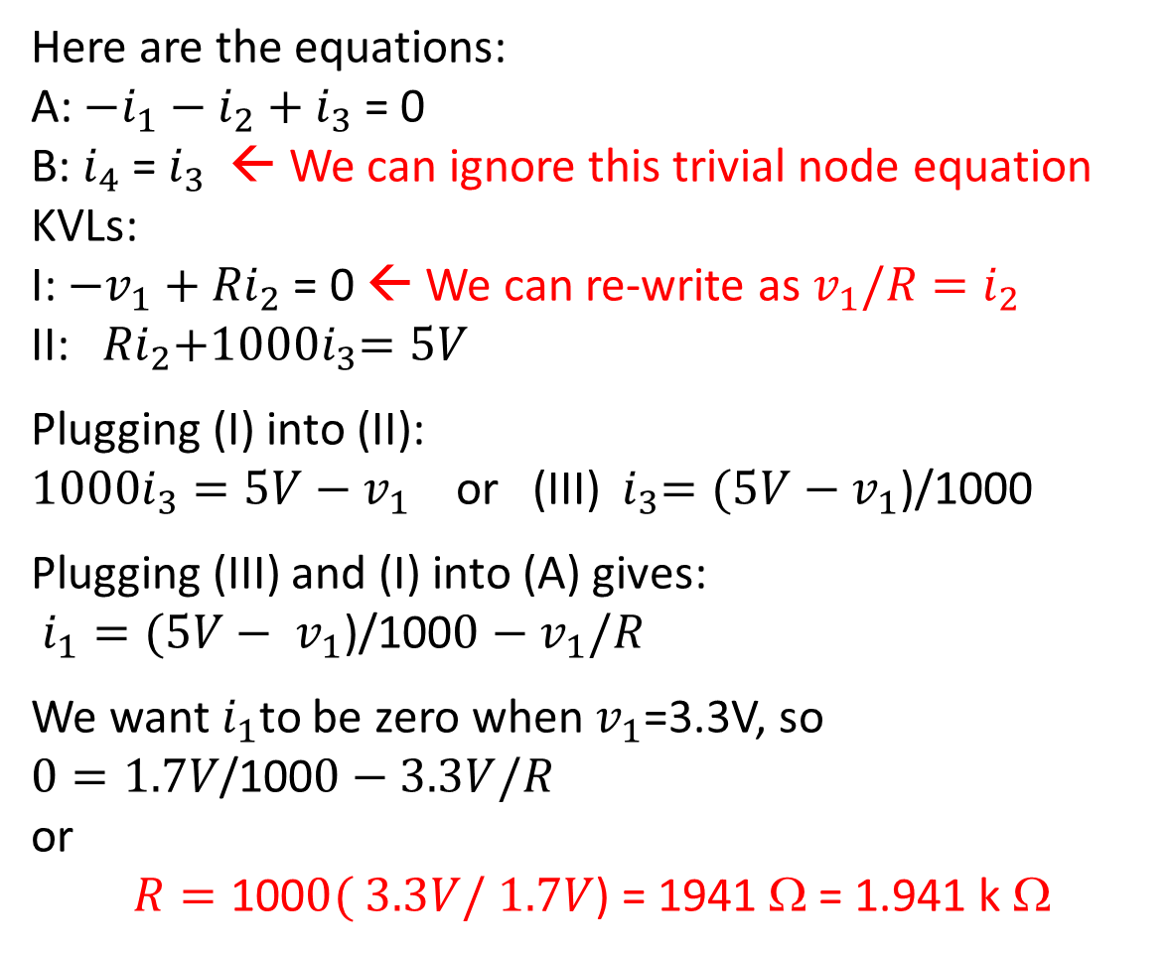
Simplify and solve
Here are the equations:
A: $−i_{1}−$ $i_{2}$ $+$ $i_{3}$ = 0
B: $i_{4}$ = $i_{3}$ ← We can ignore this trivial node equation
KVLs:
I: $−v_{1}+$ ${Ri}_{2}$ = 0 ← We can re-write as $v_{1}/{R=i}_{2}$
II:${Ri}_{2}{+1000i}_{3}=5V$
Plugging (I) into (II):
${1000i}_{3}=5V−$ $v_{1}$ or (III) ${ i}_{3}=(5V−$ $v_{1}$)/1000
Plugging (III) and (I) into (A) gives:
$i_{1}=(5V− v_{1}\text{)/100}0−$ $v_{1}/R$
We want $i_{1}$to be zero when $v_{1}$=3.3V, so
$0=1.7V\text{/100}0−$ $3.3V/R$
or
$R=\text{100}0($ $3.3V/$ $1.7V$) = 1941 Ω = 1.941 k Ω

Slide 37
Kirchhoff’s laws Part 5: Circuits with op-amps
ENEE 205

Slide 38
Solving circuits with op-amps
We could come up with an algorithm for finding the complete set of equations needed to solve for all voltages and current in a circuit with op-amps. It would involve much of the past algorithm, plus using the consequences of the three ideal op-amp assumptions.
However, for most op-amp circuits, the goal will be to find a single equation for the output voltage in terms of the input voltage(s).
Thus, an algorithm that accomplishes that goal typically requires only two KVL equations and one or two KCL equations, plus terminal relations and ideal op-amp consequences.
Three op-amp circuits are analyzed in the following slides.

Slide 39
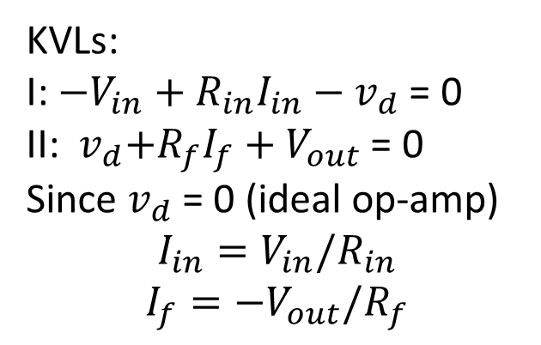
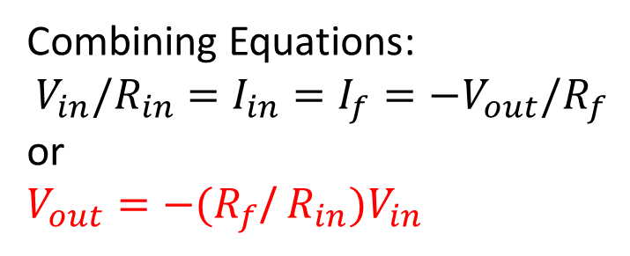
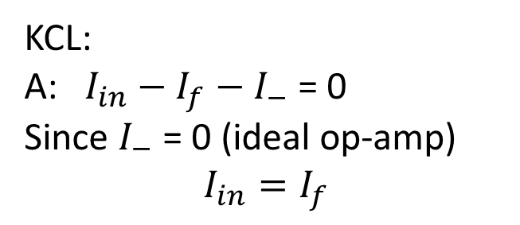
Inverting amplifier
KVLs:
I: $−V_{in}+R_{in}I_{in}−$ $v_{d}$ = 0
II:${ v}_{d}{+R}_{f}I_{f}+V_{out}$ = 0
Since $v_{d}$ = 0 (ideal op-amp)
$$I_{in}=V_{in}/R_{in}$$
$$I_{f}={−V}_{out}/R_{f}$$
I_{in}
+ R_{in}I_{in} -
+ R_{f}I_{f} -
I_{f}
Node A
KCL:
A: $I_{in}−I_{f}−$ $I_{−}$ = 0
Since $I_{−}$ = 0 (ideal op-amp)
$$I_{in}=I_{f}$$
I₋
II
I
v_{d}
I₊
Combining Equations:
$${V_{in}/R_{in}=I}_{in}=I_{f}={−V}_{out}/R_{f}$$
or
$V_{out}=−(R_{f}$/ $R_{in})V_{in}$

Slide 40
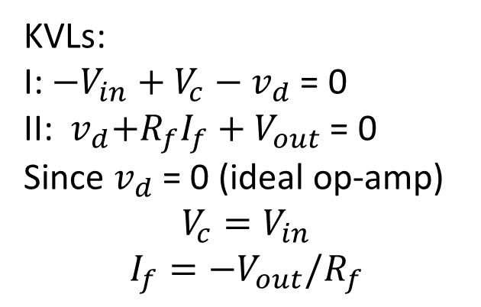
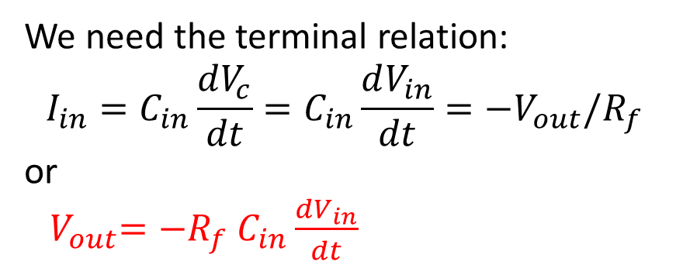
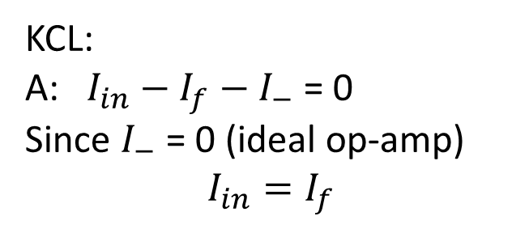
Differentiating (Inverting) amplifier
KVLs:
I: $−V_{in}+V_{c}−$ $v_{d}$ = 0
II:${ v}_{d}{+R}_{f}I_{f}+V_{out}$ = 0
Since $v_{d}$ = 0 (ideal op-amp)
$$V_{c}=V_{in}$$
$$I_{f}={−V}_{out}/R_{f}$$
I_{in}
+ V_{c} -
+ R_{f}I_{f} -
I_{f}
Node A
I₋
II
I
v_{d}
KCL:
A: $I_{in}−I_{f}−$ $I_{−}$ = 0
Since $I_{−}$ = 0 (ideal op-amp)
$$I_{in}=I_{f}$$
I₊
We need the terminal relation:
$$I_{in}=C_{in}\frac{dV_{c}}{dt}=C_{in}\frac{dV_{in}}{dt}={−V}_{out}/R_{f}$$
or
${ V}_{out}=−R_{f}$ $C_{in}\frac{dV_{in}}{dt}$

Slide 41
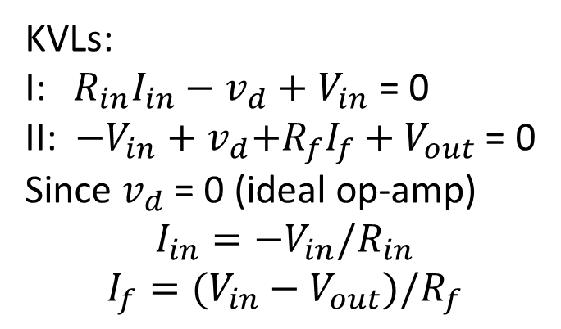
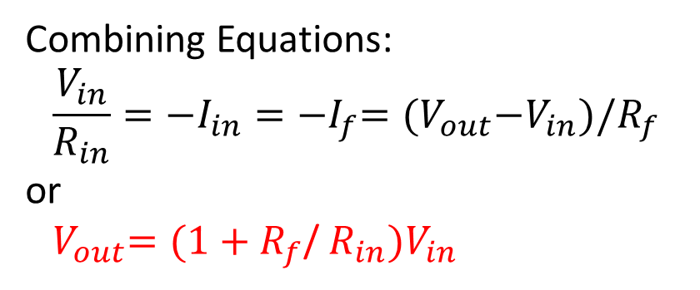
NON-Inverting amplifier
KVLs:
I: $R_{in}I_{in}−$ $v_{d}$ $+$ $V_{in}$ = 0
II:${ −V_{in}+v}_{d}{+R}_{f}I_{f}+V_{out}$ = 0
Since $v_{d}$ = 0 (ideal op-amp)
$$I_{in}={−V}_{in}/R_{in}$$
$$I_{f}={(V_{in}−V}_{out})/R_{f}$$
I_{in}
+ R_{in}I_{in} -
+ R_{f}I_{f} -
I_{f}
Node A
I₋
II
v_{d}
I
KCL:
A: $I_{in}−I_{f}−$ $I_{−}$ = 0
Since $I_{−}$ = 0 (ideal op-amp)
$$I_{in}=I_{f}$$
I₊
Combining Equations:
$${\frac{V_{in}}{R_{in}}=−I}_{in}={−I}_{f}={(V}_{out}−V_{in})/R_{f}$$
or
${ V}_{out}=(1+R_{f}$/ $R_{in})V_{in}$

