Slide 1
The Min-Max Multi-Depot Vehicle Routing Problem: Three-Stage Heuristic and Computational Results
X. Wang, B. Golden, and E. Wasil
POMS -May 4, 2013

Slide 2
Overview
Introduction
Literature review
Heuristic for solving the Min-Max MDVRP
Computational results
Conclusions

Slide 3
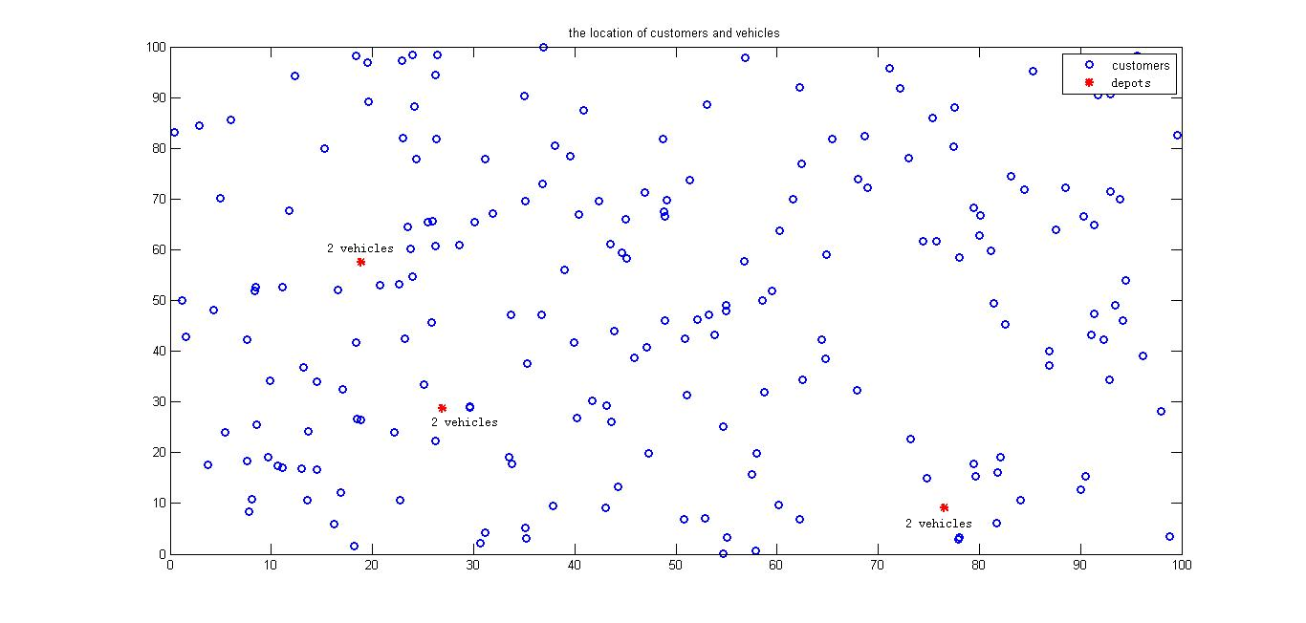
Introduction
The Min-Max Multi-Depot Vehicle Routing Problem

Slide 4
Introduction
In the Multi-Depot VRP, the objective is to minimize the total distance traveled by all vehicles
In the Min-Max MDVRP, the objective is to minimize the maximum distance traveled by the vehicles

Slide 5
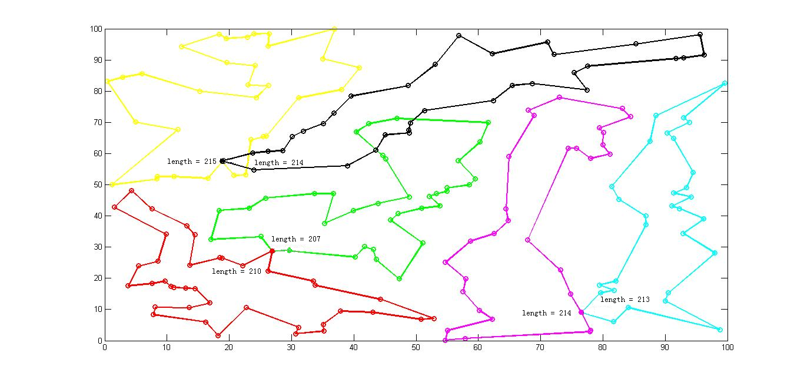
Introduction
The min-max objective function

Slide 6
Introduction Why is the min-max objective important?
Applications
Disaster relief efforts
Serve all victims as soon as possible
Computer networks
Minimize maximum latency between a server and a client
Workload balance
Balance amount of work among drivers or across time horizon

Slide 7
Literature Review
Carlsson et al. (2007) proposed an LP-based balancing approach to solve the Min-Max MDVRP
Assignment of customers to vehicles by LP
TSP solved by Concorde
These steps are repeated and the best feasible solution is returned

Slide 8
Solving the Min-Max MDVRP
We develop a heuristic (denoted by MD)
MD has three phases
Initialization
Local search
Perturbation

Slide 9
Phase 1: Initialization
Assign customers evenly to vehicles
Solve a TSP on each route using the Lin-Kernighan heuristic

Slide 10
Phase 2: Local Search
Step 1. From the maximal route, identify the customer to remove (savings estimation)
Customer to remove
Savings estimation

Slide 11
Phase 2: Local Search
Step 2. Identify the route to insert the removed customer (cost estimation)
Step 3. Try inserting the customer in the cheapest way
Successful – go back to Step 1
Unsuccessful – try moving another customer
Step 4. Stop if we have tried to move every customer on the maximal route

Slide 12
Phase 3: Perturbation
Perturb the locations of the depots

Slide 13
Phase 3: Perturbation
Solve the new problem
Set the depots back the their original positions
Solve the problem and update the solution
Repeat the process

Slide 14
Computational Results
20 test problems
10 – 500 customers
3 – 20 depots
Problems have uniform and non-uniform customer locations
MD used an Intel Pentium CPU with 2.20 GHz processor
Code for LB required a 32-bit machine (Intel Core i5 with 2.40 GHz processor)

Slide 15
Computational Results
Problem MM8 (3 depots, 200 customers, 2 vehicles)

Slide 16
Computational Results
Problem MM8 (3 depots, 200 customers, 2 vehicles)

Slide 17
Computational Results Uniform Customer Locations
MD outperforms the LB-based heuristic by 10.7% on average
Identifier | LB |  | MD |  | Improvement (%)
 | Objective | Time (s) | Objective | Time (s)
MM2 | 149.225 | 38.2 | 131.431 | 2.80 | 11.92
MM3 | 265.349 | 61.4 | 236.174 | 8.20 | 10.99
MM7 | 222.071 | 14.5 | 189.016 | 0.74 | 14.88
MM8 | 242.730 | 73.2 | 215.269 | 12.56 | 11.31
MM10 | 197.594 | 32.9 | 197.869 | 1.33 | -0.14
MM11 | 119.658 | 78.5 | 111.067 | 0.65 | 7.18
MM12 | 114.826 | 37.9 | 81.300 | 0.86 | 29.20
MM13 | 138.823 | 35.8 | 125.268 | 2.55 | 9.76
MM14 | 146.492 | 35.5 | 134.476 | 3.67 | 8.20
MM15 | 110.963 | 41.0 | 100.074 | 1.80 | 9.81
MM16 | 115.744 | 60.2 | 104.125 | 3.92 | 10.04
MM18 | 439.606 | 68.4 | 415.777 | 91.00 | 5.42

Slide 18
Computational Results Non-uniform Customer Locations
MD outperforms the LB-based heuristic by 16.2% on average
Identifier | LB |  | MD |  | Improvement (%)
 | Objective | Time (s) | Objective | Time (s)
MM4 | 569.453 | 43.9 | 488.254 | 57.7 | 14.26
MM5 | 398.970 | 40.2 | 330.195 | 7.7 | 17.24
MM9 | 183.157 | 36.8 | 153.286 | 38.1 | 16.31
MM17 | 325.708 | 56.8 | 253.765 | 84.4 | 22.09
MM19 | 474.935 | 68.4 | 395.606 | 155.8 | 16.70
MM20 | 385.297 | 92.1 | 344.309 | 74.2 | 10.64

Slide 19
Computational Results
On all 20 problems, the running time for MD (596s) is much less than LB (943s)
Times for MD are between 0.65s and 156s with most times under 13s
Times for LB are between 6s and 92s

Slide 20
Computational Results
Contribution from improvement procedures

Slide 21
Conclusions
On the 20 test problems, MD outperforms the LB-based heuristic by 11.27% on average
In future work, we hope to apply MD to solve a real-world problem
We want to extend our heuristic to solve min-max problems with service times

