Slide 1
Long-Range Triage: Assessing Patient Risk From a Distance
David Anderson, Mangla Gulati, Bruce Golden, Ed Wasil, et al.
University of Maryland
College Park & Baltimore, MD

Slide 2
Internal Medicine
Broad range of diseases
Patients often transferred to/from ICU
Treated at UMMC by hospitalists

Slide 3
Inter-Hospital Transfer (IHT)
Some patients too severe for smaller hospitals
UMMC often accepts these patients
IHT patients tend to be higher acuity

Slide 4
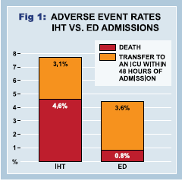
Higher Severity
These patients put a strain on hospital resources
ICU space
Nurse time
Uncertainty in referring hospital’s assessment
Poor documentation
Incomplete/inaccurate information

Slide 5
Objective Risk Assessment
Better patient severity information needed
Referring hospitals not always trusted
Ideal tool is:
Objective
Easy to understand
Based on commonly used patient data
Quick to compute

Slide 6
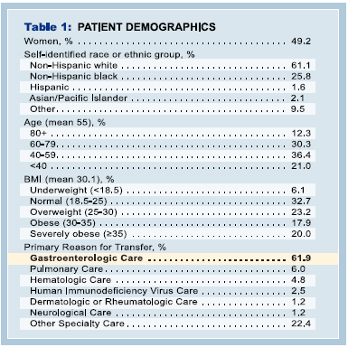
Patient Demographics

Slide 7
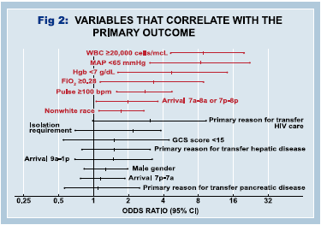
Individual Factors

Slide 8
Initial HALT Tool

Slide 9
Description of HALT
Feature | Description
Hypotension | Measured by mean arterial pressure. Considered low if < 65 mmHg.
Anemia | Measured by hemoglobin. Considered low if < 7 g/dL.
Leukocytosis | Measured by white blood cell count. Considered high if > 20,000 cells/mL.
Tachycardia | Measured by pulse. Considered high if > 100 beats per minute.

Slide 10
Methods
Binary Cutoff Model
Simple, intuitive
Logistic Regression
Easy to interpret, better power
Naïve Bayes
Slightly better results, more complicated
Combination of logistic regression and Naïve Bayes

Slide 11
Results
 | Predicted0 | 1
Observed 0 | .807 | .048
1 | .110 | .034
 | Predicted0 | 1
Observed 0 | .807 | .038
1 | .113 | .042
HALT Binary Cutoff
Logistic Regression
 | Predicted0 | 1
Observed 0 | .781 | .033
1 | .139 | .047
 | Predicted0 | 1
Observed 0 | .813 | .038
1 | .108 | .042
Naïve Bayes Classifier
Combination Tool

Slide 12
Results
Tool | True + | True - | False + | False - | Sensitivity | Specificity
Max | 27 | 450 | 80 | 19 | 0.587 | 0.849
Logistic Regression | 24 | 465 | 65 | 22 | 0.522 | 0.877
Naïve Bayes | 24 | 468 | 62 | 22 | 0.522 | 0.883
HALT | 39 | 935 | 128 | 56 | 0.411 | 0.88
HLT | 37 | 946 | 117 | 58 | 0.39 | 0.89
ALT | 35 | 947 | 116 | 60 | 0.368 | 0.891
LT | 33 | 958 | 105 | 62 | 0.347 | 0.901
HAL | 29 | 1010 | 53 | 66 | 0.305 | 0.95
HAT | 25 | 962 | 101 | 70 | 0.263 | 0.905

Slide 13
ROC
ROC plots for Naïve Bayes (Red) and Logistic Regression (Blue)

Slide 14
False Positives vs. False Negatives
Model | Cost 1:1 | Cost 3:1 | Cost 5:1 | Cost 10:1 | Cost 20:1 | Cost 50:1 | Cost 100:1
Combination | 0.172 | 0.238 | 0.304 | 0.469 | 0.799 | 1.788 | 3.438
Naïve Bayes | 0.146 | 0.222 | 0.299 | 0.49 | 0.872 | 2.017 | 3.927
Logistic Regression | 0.151 | 0.227 | 0.304 | 0.495 | 0.877 | 2.023 | 3.932
HALT | 0.159 | 0.256 | 0.352 | 0.594 | 1.078 | 2.529 | 4.947
HLT | 0.151 | 0.251 | 0.352 | 0.602 | 1.103 | 2.605 | 5.11
HAL | 0.103 | 0.217 | 0.331 | 0.616 | 1.186 | 2.896 | 5.745
ALT | 0.152 | 0.256 | 0.359 | 0.618 | 1.136 | 2.691 | 5.282
LT | 0.144 | 0.251 | 0.358 | 0.626 | 1.162 | 2.768 | 5.445
HAT | 0.148 | 0.269 | 0.39 | 0.692 | 1.296 | 3.11 | 6.132

Slide 15
Including Age
 | Actual 0 | Actual 1
Extended Logit 0 | 434 | 19
Extended Logit 1 | 59 | 22
The sensitivity of the model increases from 52.2% to 53.7%, while the specificity increases from 87.7% to 88.0%. This translates to a decrease in “cost” of between 3.3% (1:1 ratio) and 6.7% (100:1 ratio).

Slide 16
Prospective Study
Currently collecting data for a prospective study
34 patients treated so far
6 classified as High Risk
4 Discharged Home
1 Died
1 Transferred to a Skilled Nursing Facility
28 classified as Low Risk
26 discharged home
1 ICU stay – colonoscopy perforated bowel
1 transfer back to referring hospital

Slide 17
Conclusions
Simple, objective measures can be used to accurately predict risk
This research will lead to a useful tool in helping to make admission decisions and predict resource usage

Slide 18
Future Work
We hope to implement the HALT tool as a standard part of the IHT process
Better information about incoming patients
Better resource management and utilization

Slide 19
Questions?
danderson@rhsmith.umd.edu

