Slide 1
Vacuum Electronics Theory,
Modeling & Simulation
Thomas M. Antonsen Jr.
Institute for Research in Electronics and Applied Physics
Departments of ECE and Physics
University of Maryland
March 3, 2022

Slide 2
Acknowledgements
People
NRL
Simon Cooke
Alexander Vlasov
Igor Chernyavskiy
Baruch Levush
LEIDOS
David Chernin
John Petillo
Agencies
NRL
ONR
DoE
AFOSR
AFRL

Slide 3
Outline
Part I
Role of Simulation
Classification of code types
Part II
Geometry Based Codes, FDTD-PIC
Part III
Reduced Description Design Codes

Slide 4
Why is Modeling and Simulation Important?
• Understanding of basic physical processes
• Understanding and diagnosing particular experiments
• Designing improved experiments
• Optimizing designs for “ first pass success”

Slide 5
AREAS of PROGRESS
Improved Physics Models
Find better (compact) descriptions of what’s going on inside a VE device.
More Efficient Algorithms
Solve the governing equations with fewer operations and/or less memory usage.
New Computing Architectures
Restructure your code to take advantage of new hardware.

Slide 6

Apology: I am not really a computer expert.
Computation

Slide 7
Classification of Vacuum
Electronics Design Codes
Geometry Based Codes
Commercial CEM - to characterize EM properties of structure
Full PIC - first principles description, but time consuming
3D Beam Optics - gun and depressed collector
Thermal/Mechanical - heat and stress
Reduced Description Codes
1D- 2.5D Parametric - simple beam model, scope parameters, study trade-offs
2.5D Hybrid PIC - fields in beam tunnel represented more accurately, expectation of quantitative accuracy

Slide 8
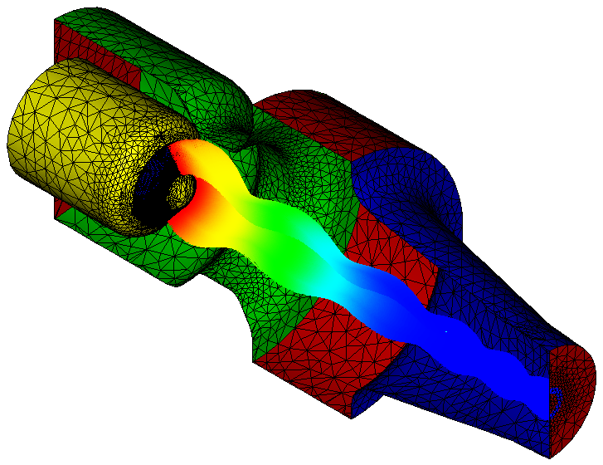
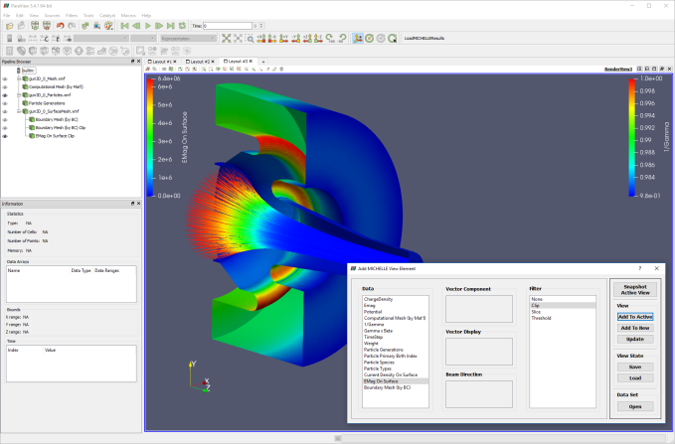
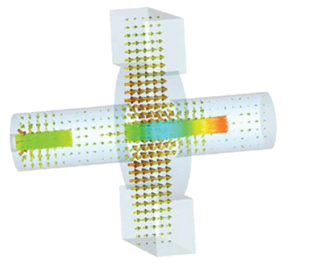
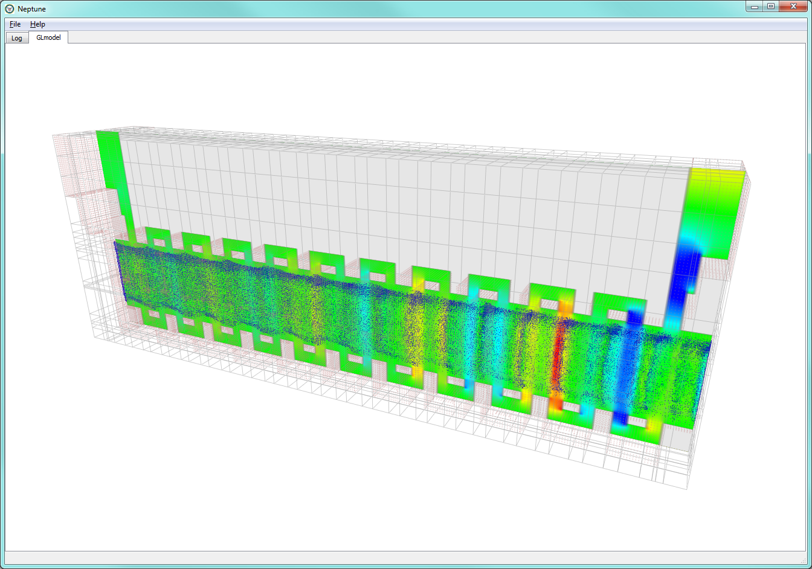
3D Geometry Based Codes
  Electrostatic Fields & Particles (Gun codes)
    MICHELLE (Leidos)
    Beam Optics Analyzer (CCR)
    Electron Optics Simulator (UESTC)
    Opera (Cobham)
  Magnetostatics
    Maxwell (ANSYS)
  Electromagetic Fields (Frequency domain)
    HFSS (ANSYS)
    Analyst (NI / AWR)
    HFCS (UESTC)
  Electromagnetic Fields & Particles (Time domain)
    VSim (Tech-X)
    CST Microwave/Particle Studio (CST)
    ICEPIC (AFRL)
    Neptune (NRL)
    MAGIC (Orbital ATK)
    KARAT

Slide 9
Classification of Vacuum
Electronics Design Codes
Geometry Based Codes
Commercial CEM - to characterize EM properties of structure
Full PIC - first principles description, but time consuming
3D Beam Optics - gun and depressed collector
Thermal/Mechanical - heat and stress
Reduced Description Codes
1D- 2.5D Parametric - simple beam model, scope parameters, study trade-offs
2.5D Hybrid PIC - fields in beam tunnel represented more accurately, expectation of quantitative accuracy

Slide 10
Computational Electromagnetics Codes (CEM)
Frequency Domain: Assumes time harmonic fields
Typically unstructured mesh
Driven solutions
Scattering matrices
Antennas
Eigenmode solution
Normal modes of structures
Dispersion curves periodic structures
Time Domain: Fields evolve in time
Typically structured mesh
Finite difference time domain (FDTD)
Frequency domain data extracted by Fourier Transform

Slide 11
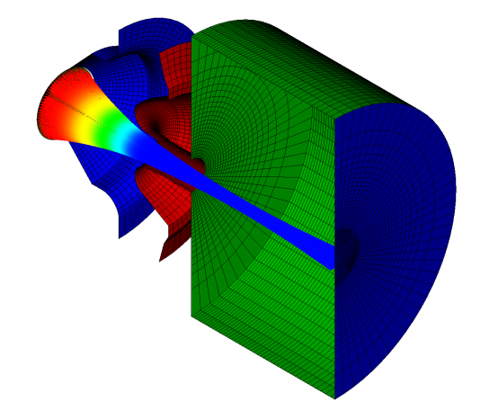
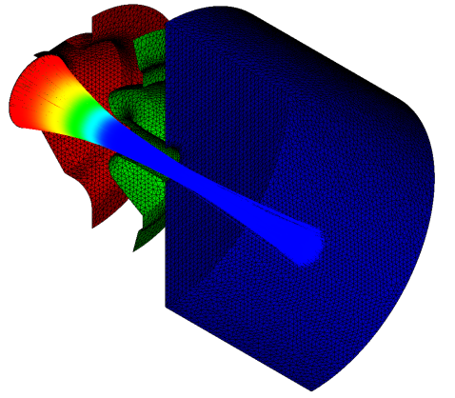
Mesh Types (S. Cooke)
Structured: logical ordering
Unstructured: no specific ordering
  Pros:
Structured mesh elements generally smoothly evolve from one to another
    Higher accuracy → lower numerical noise
Logical ordering of data makes…
    Particle tracking easier/faster
    Data more compact – allowing larger meshes
  Cons:
Meshing is usually a manual process, and can be time consuming
Some geometries can be intractable to mesh
  Cons:
Unstructured mesh elements have no distinct pattern or smooth connectivity
    Higher numerical noise → lower accuracy
Non-Logical ordering of data makes… Particle tracking more complex
Data is accessed through linked lists, and not as compact or computationally efficient
  Pros:
Meshing is a much more automated process, with less manual interaction. Trade user time for computer time.
Can mesh just about any geometry
(5)
(1,2)
(2,2)
(3)
(4)
2
(0,2)
(1,1)
(7)
(10)
(2,1)
(2)
(9)
(0,1)
1
(0,0)
(1,0)
(6)
(1)
1
(2,0)
(0)
(8)
0
2
0

Slide 12
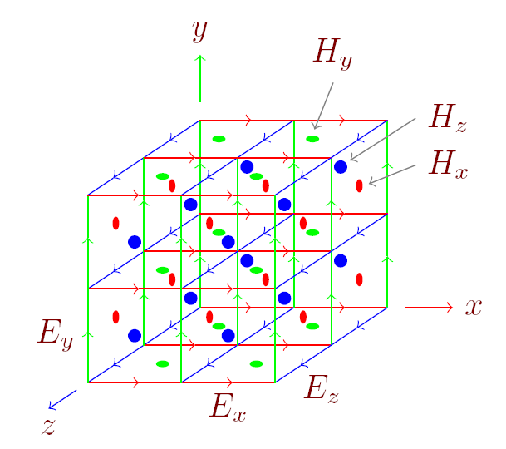
Finite Difference Time Domain (FDTD)
  The Cartesian “Yee” Grid
Express Maxwell’s Equations in discrete form
Store electric fields on the edges of the grid cells
Store magnetic fields on the faces of the grid cells

Slide 13

Eliminating stepped boundaries in structured meshes
  Traditional “Stair-step” algorithm
    Each cell is either metal or vacuum
    Leads to poor simulation accuracy
  Dey-Mittra “Cut-cell” algorithm
    Use fractions of edge lengths and face areas that lie in the vacuum to correct the geometry
vacuum
vacuum
metal
metal
$20×20×20$ grid

Slide 14


Discrete Cut-Cell Dielectric Model, S.Cooke
ε₁
(1) Identify edges cut
by the interface
ε₂
ε₁
ε₁
ε₂
ε₂
ε₁
ε₂
ε₁
(2) Compute effective permittivity
for each cut cell edge
(4) Resulting matrix is
symmetric with sparse
off-diagonal components
ε₂
(3) Compute symmetric matrix
elements to couple adjacent edges
14

Slide 15

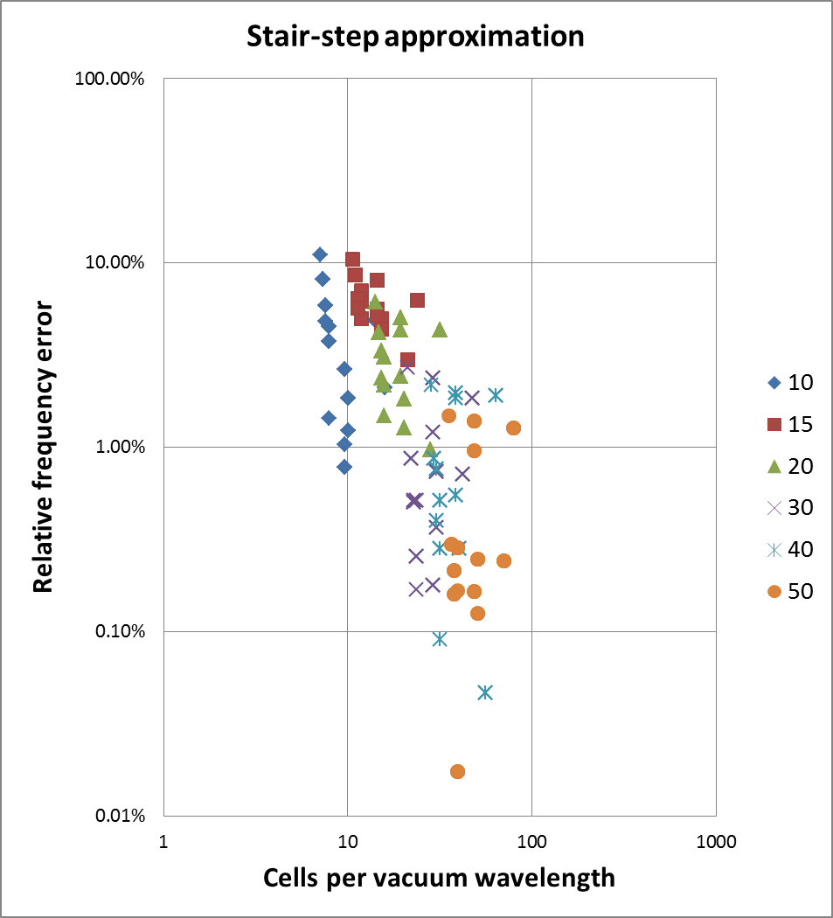
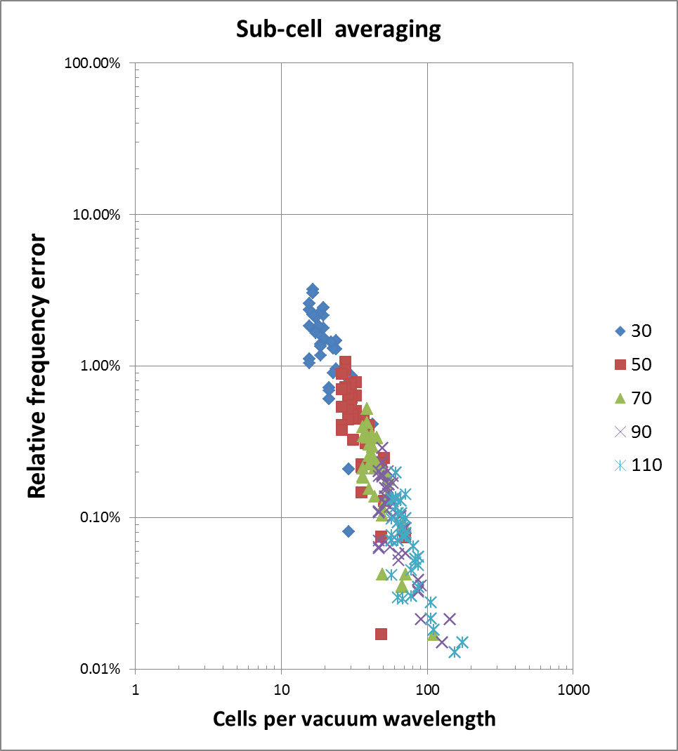
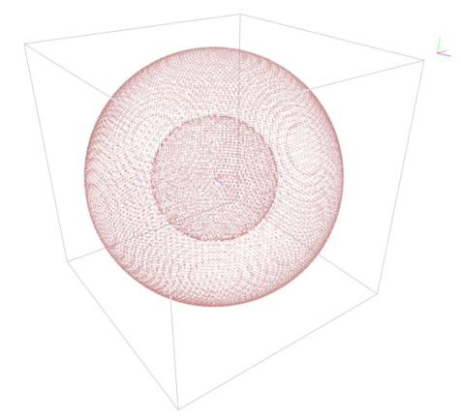



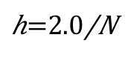
Convergence wrt grid size (Cooke) Eigenmode calculation
Stair-step approximation
Sub-cell averaging
O(h²)
Error
Error
0.1%
0.1%
# of cells
# of cells

Slide 16
CEM calculation of FW Fields
2p
Symbols CEM
Lines - model

Slide 17
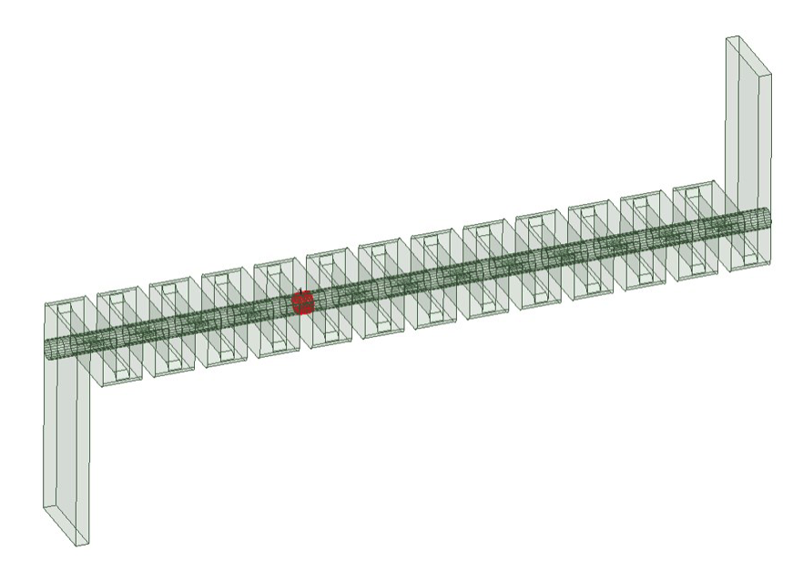
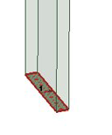
Impedance and Scattering Matrices
Gaps
Ports
Output
Folded waveguide
29 x 29
Z_{ij}
Output
Input
I_{G1}
I_{G2}
I_{Gn}

Slide 18
Classification of Vacuum
Electronics Design Codes
Geometry Based Codes
Commercial CEM - to characterize EM properties of structure
Full PIC - first principles description, but time consuming
3D Beam Optics - gun and depressed collector
Thermal/Mechanical - heat and stress
Reduced Description Codes
1D- 2.5D Parametric - simple beam model, scope parameters, study trade-offs
2.5D Hybrid PIC - fields in beam tunnel represented more accurately, expectation of quantitative accuracy

Slide 19
First Principles Basic Physics Model

Slide 20
Particle in Cell (PIC) Algorithm

Slide 21
Interpolation
Gather – Scatter #1 Gather
E_{x}
Fields are interpolated from edges of a cube to location of a particle in the cube.
E_{y}
E_{y}
E_{x}

Slide 22
Interpolation
Gather Scatter: #2 Scatter
E_{x}
Each Component of J needs to be calculated on the edge associated with the corresponding component of E.
J needs to be evaluated at the half time step. The velocity is known at the half time step, position is known at the time step.
v
E_{y}
E_{y}
E_{x}

Slide 23
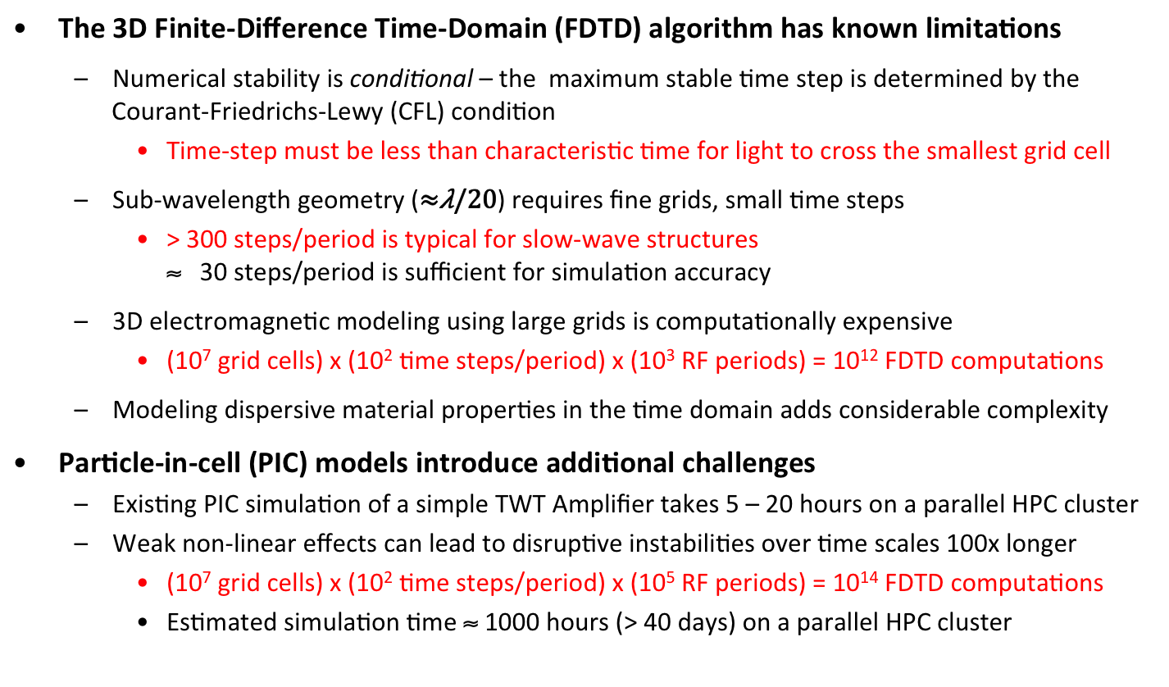
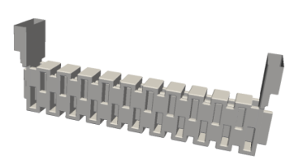
Challenges in PIC Simulations of Vacuum Electronic Devices

Slide 24
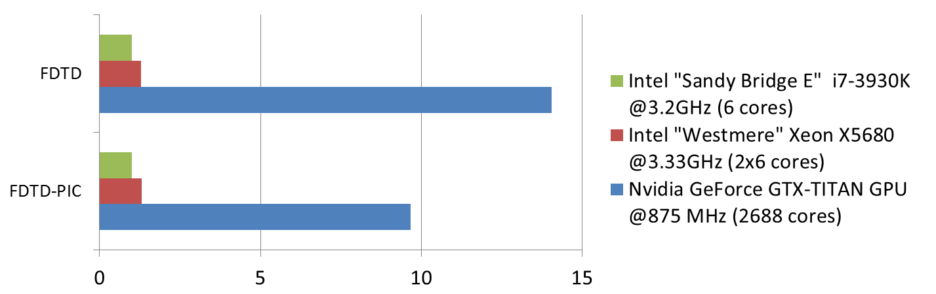
GPU Accelerated PIC Simulations
  FDTD algorithm for electromagnetics
  (explicit time step)
NRL Code Neptune was created to target GPU simulation
Based on existing algorithms – adapted for the GPU architecture
  Boris algorithm for particle time step, with charge-conserving current deposition
NEPTUNE
CPU
13.7M cells, 1M particles
Conformal representation of metal surfaces
(accurate geometry discretization)
GPU
CPU
GPU
Simulation speed (normalized to 6-core “Sandy Bridge” CPU)

Slide 25
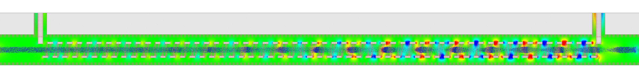
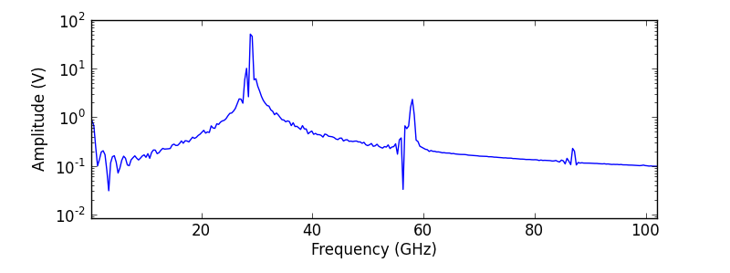
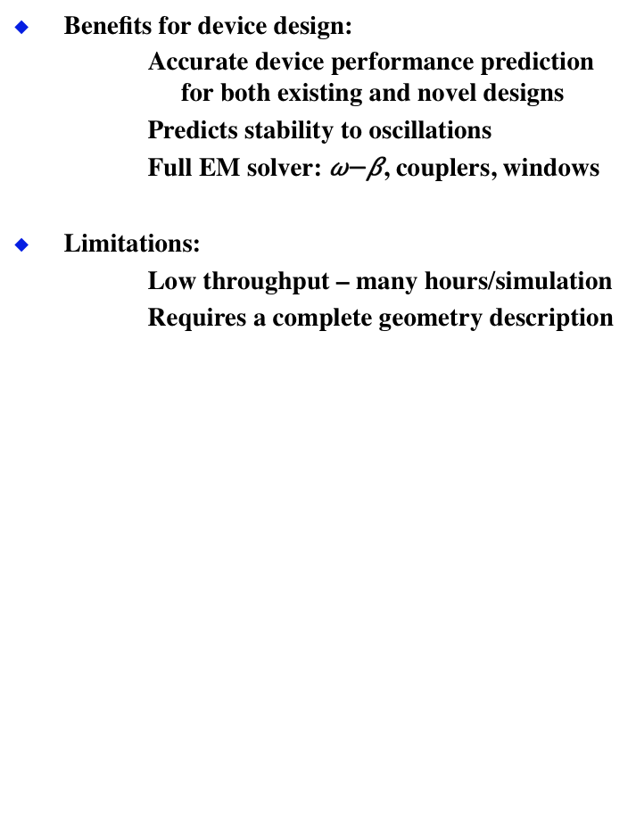
Electromagnetic PIC Simulation (S. Cooke)
Direct discretization of interaction physics based on detailed 3D device geometry
    Finite-Difference Time-Domain (FDTD) model for electromagnetic fields
    Full-spectrum of RF field
    Detailed beam model using a large collection of macro-particles to capture the spatial and energy/momentum distribution
    Fully self-consistent beam-wave interaction
Benefits for device design:
    Accurate device performance prediction for both existing and novel designs
    Predicts stability to oscillations
    Full EM solver: , couplers, windows
Limitations:
    Low throughput – many hours/simulation
    Requires a complete geometry description
minutes
Single-stage Helix TWT amplifier
(Neptune 3D EM-PIC simulation)
Electron Energy
Time

Slide 26
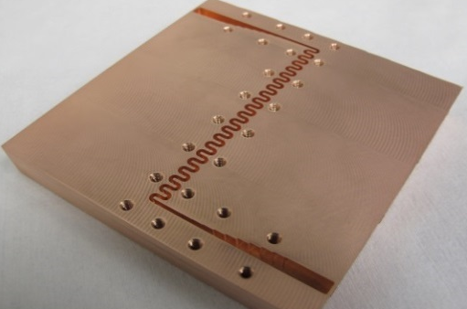
Neptune Simulations of NRL G-Band SW TWT
NRL 220 GHz Serpentine TWT amplifier (simulations performed using measured dimensions)
Small Signal Gain
Transfer curves
Data 11.7kV
11.9kV
Neptune 11.7kV
11.7kV
K. T. Nguyen et al., “Design Methodology and Experimental Verification of Serpentine/Folded-Waveguide TWTs”
IEEE T-ED Special Issue on Vacuum Electronics, 2014
Good Agreement between Neptune predictions and measurements

Slide 27
Classification of Vacuum
Electronics Design Codes
Geometry Based Codes
Commercial CEM - to characterize EM properties of structure and static magnetic fields
Full PIC - first principles (but structure deficient)*
3D Beam Optics - gun and depressed collector
Thermal/Mechanical - heat and stress
Reduced Description Codes
1D- 2.5D Parametric - to scope parameters, sensitivity
2.5D Hybrid PIC - fields in beam tunnel represented in modes
Many codes used, codes talk to each other, some codes are duplicative

Slide 28
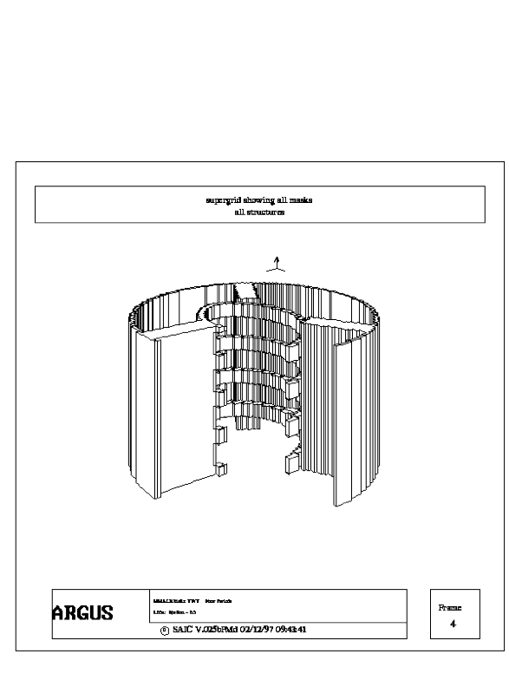
CHRISTINE: a Multifrequency Parametric Simulation Code for Traveling Wave Tube Amplifiers
TMA and Baruch Levush NRL/FR/6840-97-9845 (1997)
IEEE TRANSACTIONS ON PLASMA SCIENCE, VOL. 26, NO. 3, JUNE 1998
Particles: Energy and time of flight vs z
found
in separate calculation
Space charge, disks
Helix
Structure Impedance
Structure wave number
Also: Internal Sheath Helix Model

Slide 29
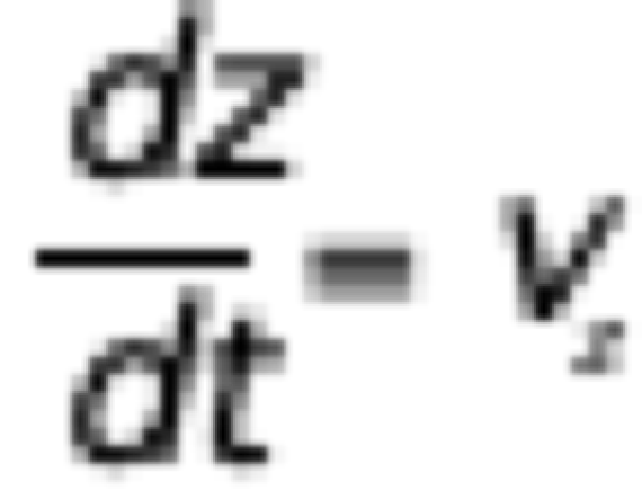
Time Domain Simulation
Standard PIC
time
Trajectories
Positions interpolated to a grid in z
Signal and
particles injected
t+dt
Fields advanced in time domain
t
Carrier and its harmonics must be resolved
System state specified
0
z
L

Slide 30


Frequency & Slow - Time Domain Hybrid Simulation
4. Slow time or iterative update
If counter propagating waves present, iterative convergence
time
3. Forward propagating waves integrated with particles
Trajectories
2. Group of particles entering in one period are advanced together
Signal
Period T=2π/ω
1. Fields are assumed to be time periodic.
0
z
z+dz
L

Slide 31
Sheath Helix Model TMA and Baruch Levush NRL/FR/6840-97-9845 (1997)
IEEE TRANSACTIONS ON PLASMA SCIENCE, VOL. 26, NO. 3, JUNE 1998
Helical tape is modeled as a cylinder with anisotropic conductivity.
Perfect conductor along helical path.
Perfect insulator transverse to path.
Wall
Beam
Current density profile
Sheath helix
Structure mode
Space Charge
Correction

Slide 32
Basic Calculations
Phase
Space

Slide 33
Multi Frequency – “Steady State”
t_{i}(z)
Particles launched with entrance times covering one period
Periodic time dependent signal
Each frequency component evolves in z
z
Integrations completed in one pass

Slide 34
Multi-Frequency Simulations
Intermodulation
16 QAM digital signal
Traveling-Wave Tube Devices with Nonlinear Dielectric Elements,
Thomas M. Antonsen, Jr., and Baruch Levush,
IEEE TRANSACTIONS ON PLASMA SCIENCE, VOL. 26, NO. 3, JUNE 1998
From Frequency-Domain Physics-Based Simulation to Time-Domain Modeling of Traveling-Wave Tube Amplifiers for High Data-Rate Communication Applications
Pedro N. Safier, Vasily Dronov, Thomas M. Antonsen, Jr., Joe X. Qiu, Bruce G. Danly, and Baruch Levush,
IEEE TRANSACTIONS ON MICROWAVE THEORY AND TECHNIQUES, VOL. 54, NO. 10, OCTOBER 2006

Slide 35
Beam Models and Self fields
Christine 1D
z
Charge disks
Representation of a bunched beam
Christine 3D (2 ½ D)
Charge rings
A Three-Dimensional Multifrequency Large Signal Model for Helix Traveling Wave Tubes, David Chernin, Thomas M. Antonsen, Jr., Baruch Levush, and David R. Whaley
IEEE TRANSACTIONS ON ELECTRON DEVICES, VOL. 48, NO. 1, JANUARY 2001

Slide 36
Self Fields - Comparison with Experiment
Charge and current density deposited on a grid in r at each z.
Longitudinal self fields
Intercepted current
More elaborate models
Transverse self fields
Experimental and simulated drive curves of C-Band DVT TWT: (a) logarithmic drive curve, (b) linear drive curve, and (c) intercept current variation with
input drive power. Beam voltage = 4.8 kV, current = 146 mA, operating frequency = 4.75 GHz.

Slide 37
An Improved Representation of AC Space-Charge Fields in Steady-State Simulation Codes for Linear-Beam Tubes
D. Dialetis, D. Chernin, T. M. Antonsen, Jr., and B. Levush
IEEE TRANSACTIONS ON ELECTRON DEVICES, VOL. 54, NO. 4, APRIL 2007
Wall
Helix
Dielectric
Beam
In CEM code insert current
In interaction code
Structure mode
Space Charge
Correction

Slide 38
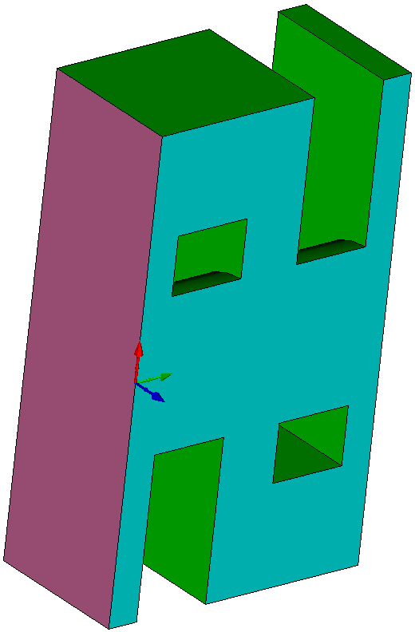
Devices with Gaps – Christine and TESLA
Klystrons
Coupled Cavity
A.P.Kuznetsov et al. UDC621.385.6
Radiophysics and Quantum Electronics, Vol. 47, Nos. 5–6, 2004
Beam
Folded Waveguide
General Approach
Separate domains
Beam tunnel
Structure
CL
38

Slide 39
Parametric Treatment of Structures with Gaps
Particles: Energy and time of flight
Space charge
Coupled Cavity, Folded WG

Slide 40
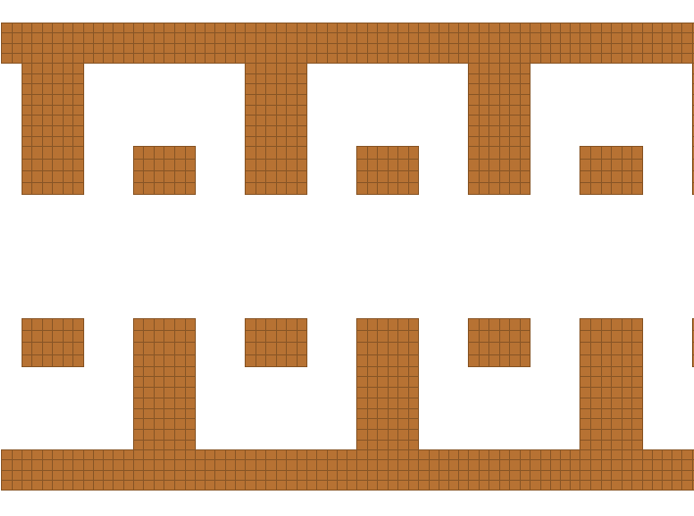
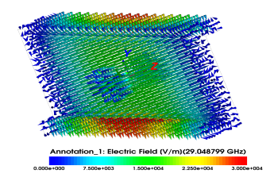
Parametric Approach: CHRISTINE-FW
Circuit model:
  Dispersion and impedance:
“Transmission Line Model for Folded Waveguide Circuits”, T.M. Antonsen, Jr., et al., IEEE Trans. on Electron Devices, 60 (9), 2013.
Comparison of model dispersion and impedance with CEM calculations

Slide 41
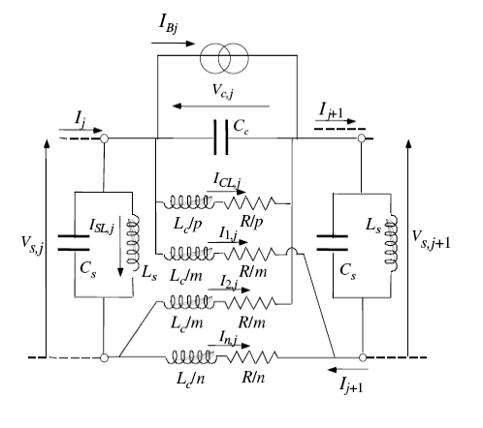
Hybrid Model - TESLA
RF Input
RF Output
TESLA
Gun
Collector
Structure fields pre- calculated, fit to circuit model, couple through gaps
CL
Full solution of beam tunnel fields and electron motion.
Dispersion and Impedance fit to circuit model
Steps
Compute dispersion and impedance using CEM.
Fit to circuit model: Curnow , FW or other
3. Import to TESLA
Goal: eliminate circuit model
41

Slide 42
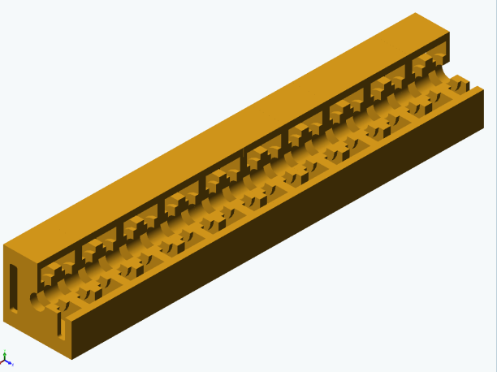
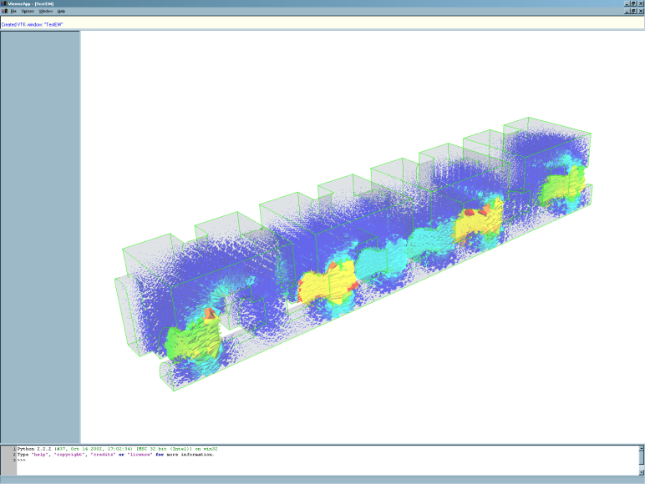
Separation of domains in large-signal model:
separation of domains:
introduce simulation boundary dividing the whole device into two domains:
  (1) beam-tunnel and (2) external circuit
use distinct representation of the fields in each domain
couple the two domains on the boundary between them
simulation boundary
Beam-tunnel
e⁻-beam
External circuit
Domain 1: beam-tunnel
Domain 2: external slow-wave structure
Beam tunnel fields: Sum over local cross-section eigenmodes provides full solution of Maxwell’s Equations
sum over temporal harmonics
Physical fields represented by Electromagnetic Modes of an arbitrary slow-wave structure
local cross-section eigenmodes
The field representation used inside the beam-tunnel is complete in describing beam-wave interaction. Keep this approach in our future model!
Geometry-driven
large-signal modeling

Slide 43
Impedance and Scattering Matrices
Gaps
Ports
Output
Folded waveguide
29 x 29
Z_{ij}
Output
Input
I_{G1}
I_{G2}
I_{Gn}

Slide 44
Stitching Together Structure and Beam Tunnel Fields Z-Matrix
Step 1
In a CEM code or circuit model,
place annular current source in each gap. One by one, compute voltage on each gap in response to each source
Also include input and output ports
Can be done with CEM code or circuit model
Gaps
Ports

Slide 45
Run Two Concurrent Beam Tunnel Simulations
Iteration
Impose tangential electric field based on current values of gap voltages V_{G}
Solve beam tunnel twice: with (1) and without (2) beam
Compute effective gap currents
Repeat until converged.

Slide 46
Impedance Matrix Characterization
Gaps
Ports
Output
Folded waveguide
B.Levush et. al. “A 1.8 kW Broad Band Ka-band TWT Power Booster”,
IVEC 2014.
29 x 29
Z_{ij}
Output
Input
I_{G1}
I_{G2}
I_{Gn}
Implemented Christine

Slide 47
New Directions
Calculation and Application of Impedance Matrices for Vacuum Electronic Devices, Jabotinski et al., IEEE TRANSACTIONS ON ELECTRON DEVICES, VOL. 66, NO. 5, MAY 2019
Numerical Determination of Vacuum Electronic Device Stability, Chernyavskiy et al., IEEE TRANSACTIONS ON PLASMA SCIENCE, VOL. 48, NO. 12, DECEMBER 2020.
Structure Optimization, Adjoint Equations for Beam-Wave Interaction and Optimization of TWT Design, Vlasov et al., to be published, IEEE Trans. Plasma Sci.

Slide 48
Thank You
Questions ?

Slide 49
History (continued)
• Gyro devices
• Mode competition

Slide 50
History (cont.)
• Free electron lasers

Slide 51
3D – Geometry Based Codes (S. Cooke)
  Magnetostatics
  Static magnetic fields for a given set of coils or permanent magnets
  Electromagetic Fields (Frequency domain)
  Eigenmodes of structures
  Structure Port Scattering Matrices
  Electrostatic Fields & Particles (Gun codes)
  Steady state charge flow guns, transport channels, depressed collectors
  Electromagnetic Fields & Particles (Time domain)
  Time dependent charged particle motion and field evolution

Slide 52
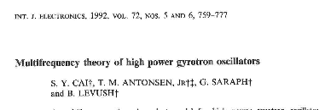
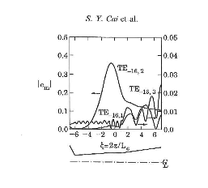

MAryland
GYrotron
Code
Maggie
Improved by M. Botton and A. Vlasov

Slide 53
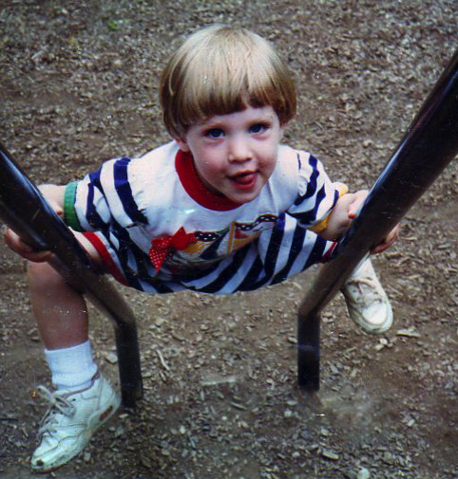
CHRISTINE: a Multifrequency Parametric Simulation
Code for Traveling Wave Tube Amplifiers
Naval Research Laboratory
Washington DC
spectrum
Christine
Phase
space
Further developed by Dave Chernin 3D, CCTWT, FW

Slide 54

A sweet of codes

Slide 55
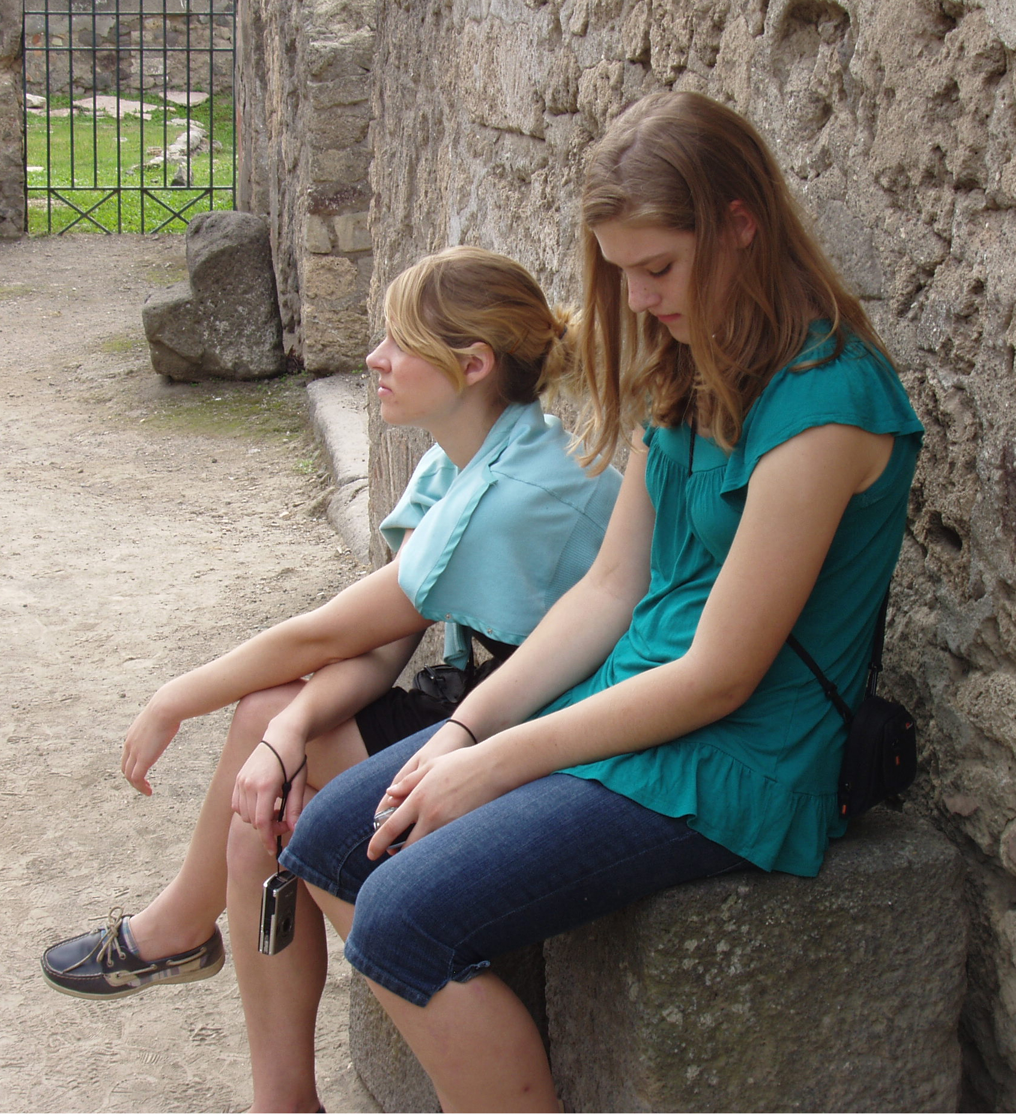
Codes Mature
MAGY ➔ TESLA
I. Chernyavskiy, A. Vlasov
Christine
Helix ➔ CCTWT,
FW, Klystron
D. Chernin

