Slide 1
Adjoint Methods in Charged Particle Dynamics or
When the solution to your problem is not your problem.
Thomas M. Antonsen Jr.
Department of Electrical and Computer Engineering
Department of Physics
Institute for Research in Electronics and Applied Physics
University of Maryland, College Park

Slide 2
Example
Jackson, Classical Electrodynamics
Problems 1.12 and 1.13
A charge q is placed at an arbitrary point, x_{o}, relative to two grounded, conducting electrodes.
q
q₂
q₁
x₀
B₁
B₂
What is the charge q₁ on the surface of electrode 1?
Repeat for different x₀

Slide 3
Solution – Green’s Reciprocation Theorem
Prob #1
Your Problem
BC:
Prob #2
Adjoint (Not your) Problem
BC:
Green’s
Theorem
0
0
When the dust settles:

Slide 4
George Green 1793-1841
Physics Today Dec. 2003
Born in Nottingham (Home of Robin Hood)
Father was a baker
At age 8 enrolled in Robert Goodacre’s Academy
Left after 18 months (extent of formal education pre age 40)
Worked in bakery for 5 years
Sent by father to town mill to learn to be a miller

Slide 5
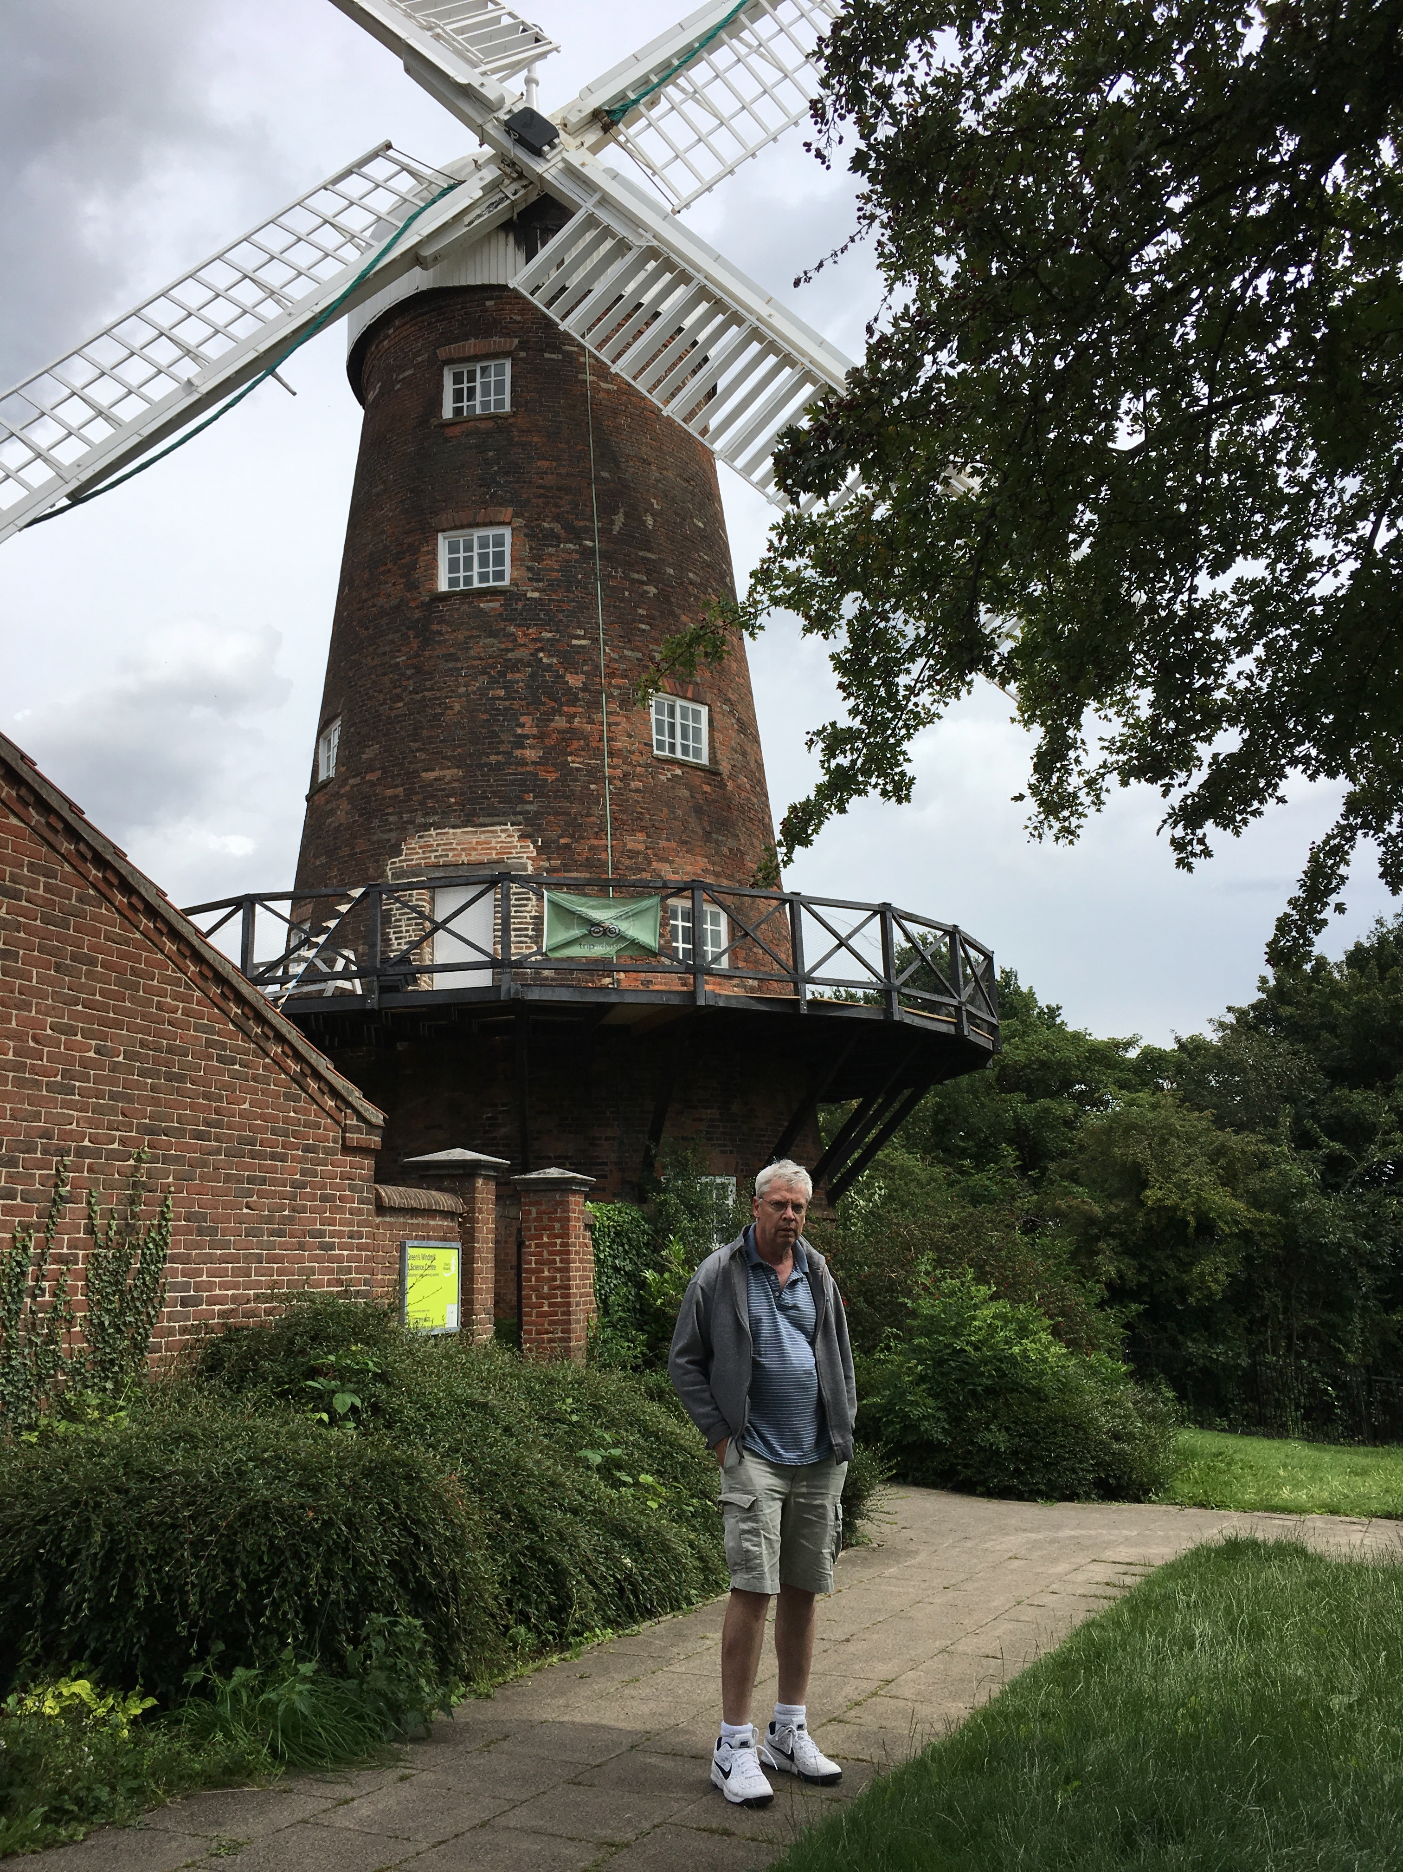
Fell in love with Jane, the miller’s daughter.
Green’s father forbade marriage.
Had 7 children with Jane.
Self published work in 1828
With help, entered Cambridge 1833, graduated 1837.
Theory of Elasticity, refraction, evanescence
“Discovered” by Lord Kelvin in 1840.
Died of influenza, 1841
Green’s Mill: still functions

Slide 6
Features of Problems Suited to an Adjoint Approach
Many computations need to be repeated.
(many different locations of charge, q)
Only a limited amount of information about the solution is required.
(only want to know charge on electrode #1)

Slide 7
Relation to Reciprocity
Example:
- Antenna sending and receiving radiation patterns are equal due to time reversal symmetry of ME.
- Direct calculation of receiving pattern requires many simulations
- Instead, calculate sending pattern and invoke reciprocity
V
V
Receiving
Sending

Slide 8
Other Examples of Reciprocity
Electrostatics Symmetry of the Capacitance Matrix
Electromagnetics Symmetry of the Inductance Matrix
Symmetry of Scattering Matrix
Collisional Transport: Onsager Symmetry of off-diagonal elements of transport matrices.
Temperature gradient ➔ Electric current
Electric field ➔ Heat flux
Neoclassical Tokamak Transport
Pressure gradient ➔ Bootstrap Current
Toroidal E-field ➔ Ware particle flux

Slide 9
Adjoint Methods in Engineering

Slide 10
Courtesy, Elizabeth Paul
Optimize shape
to minimize drag.
Result is also aesthetically appealing.
Super Computer

Slide 11
1985 Volvo 240 DL
Oops, coding error.

Slide 12
Adjoint Approach in Plasma and Beam Physics
Neoclassical Transport, F. Hinton, and R. Hazeltine, Rev. Mod Phys, 48 (2) , 1976
Calculation of beam driven currents in magnetized plasmas, S. Hirshman, PoF, 23, 1238 (1980).
Calculation of RF current drive in magnetic confinement plasma configurations, TMA and K. Chu PoF 25, (1982)
Calculation of RF induced transport in magnetic confinement plasmas, TMA and K. Yoshioka, PoF 29, (1986), Nucl. Fusion, 26 (1986).
Shot noise on gyrotron beams, TMA, W. Manheimer and A. Fliflet, PoP (2001).

Slide 13
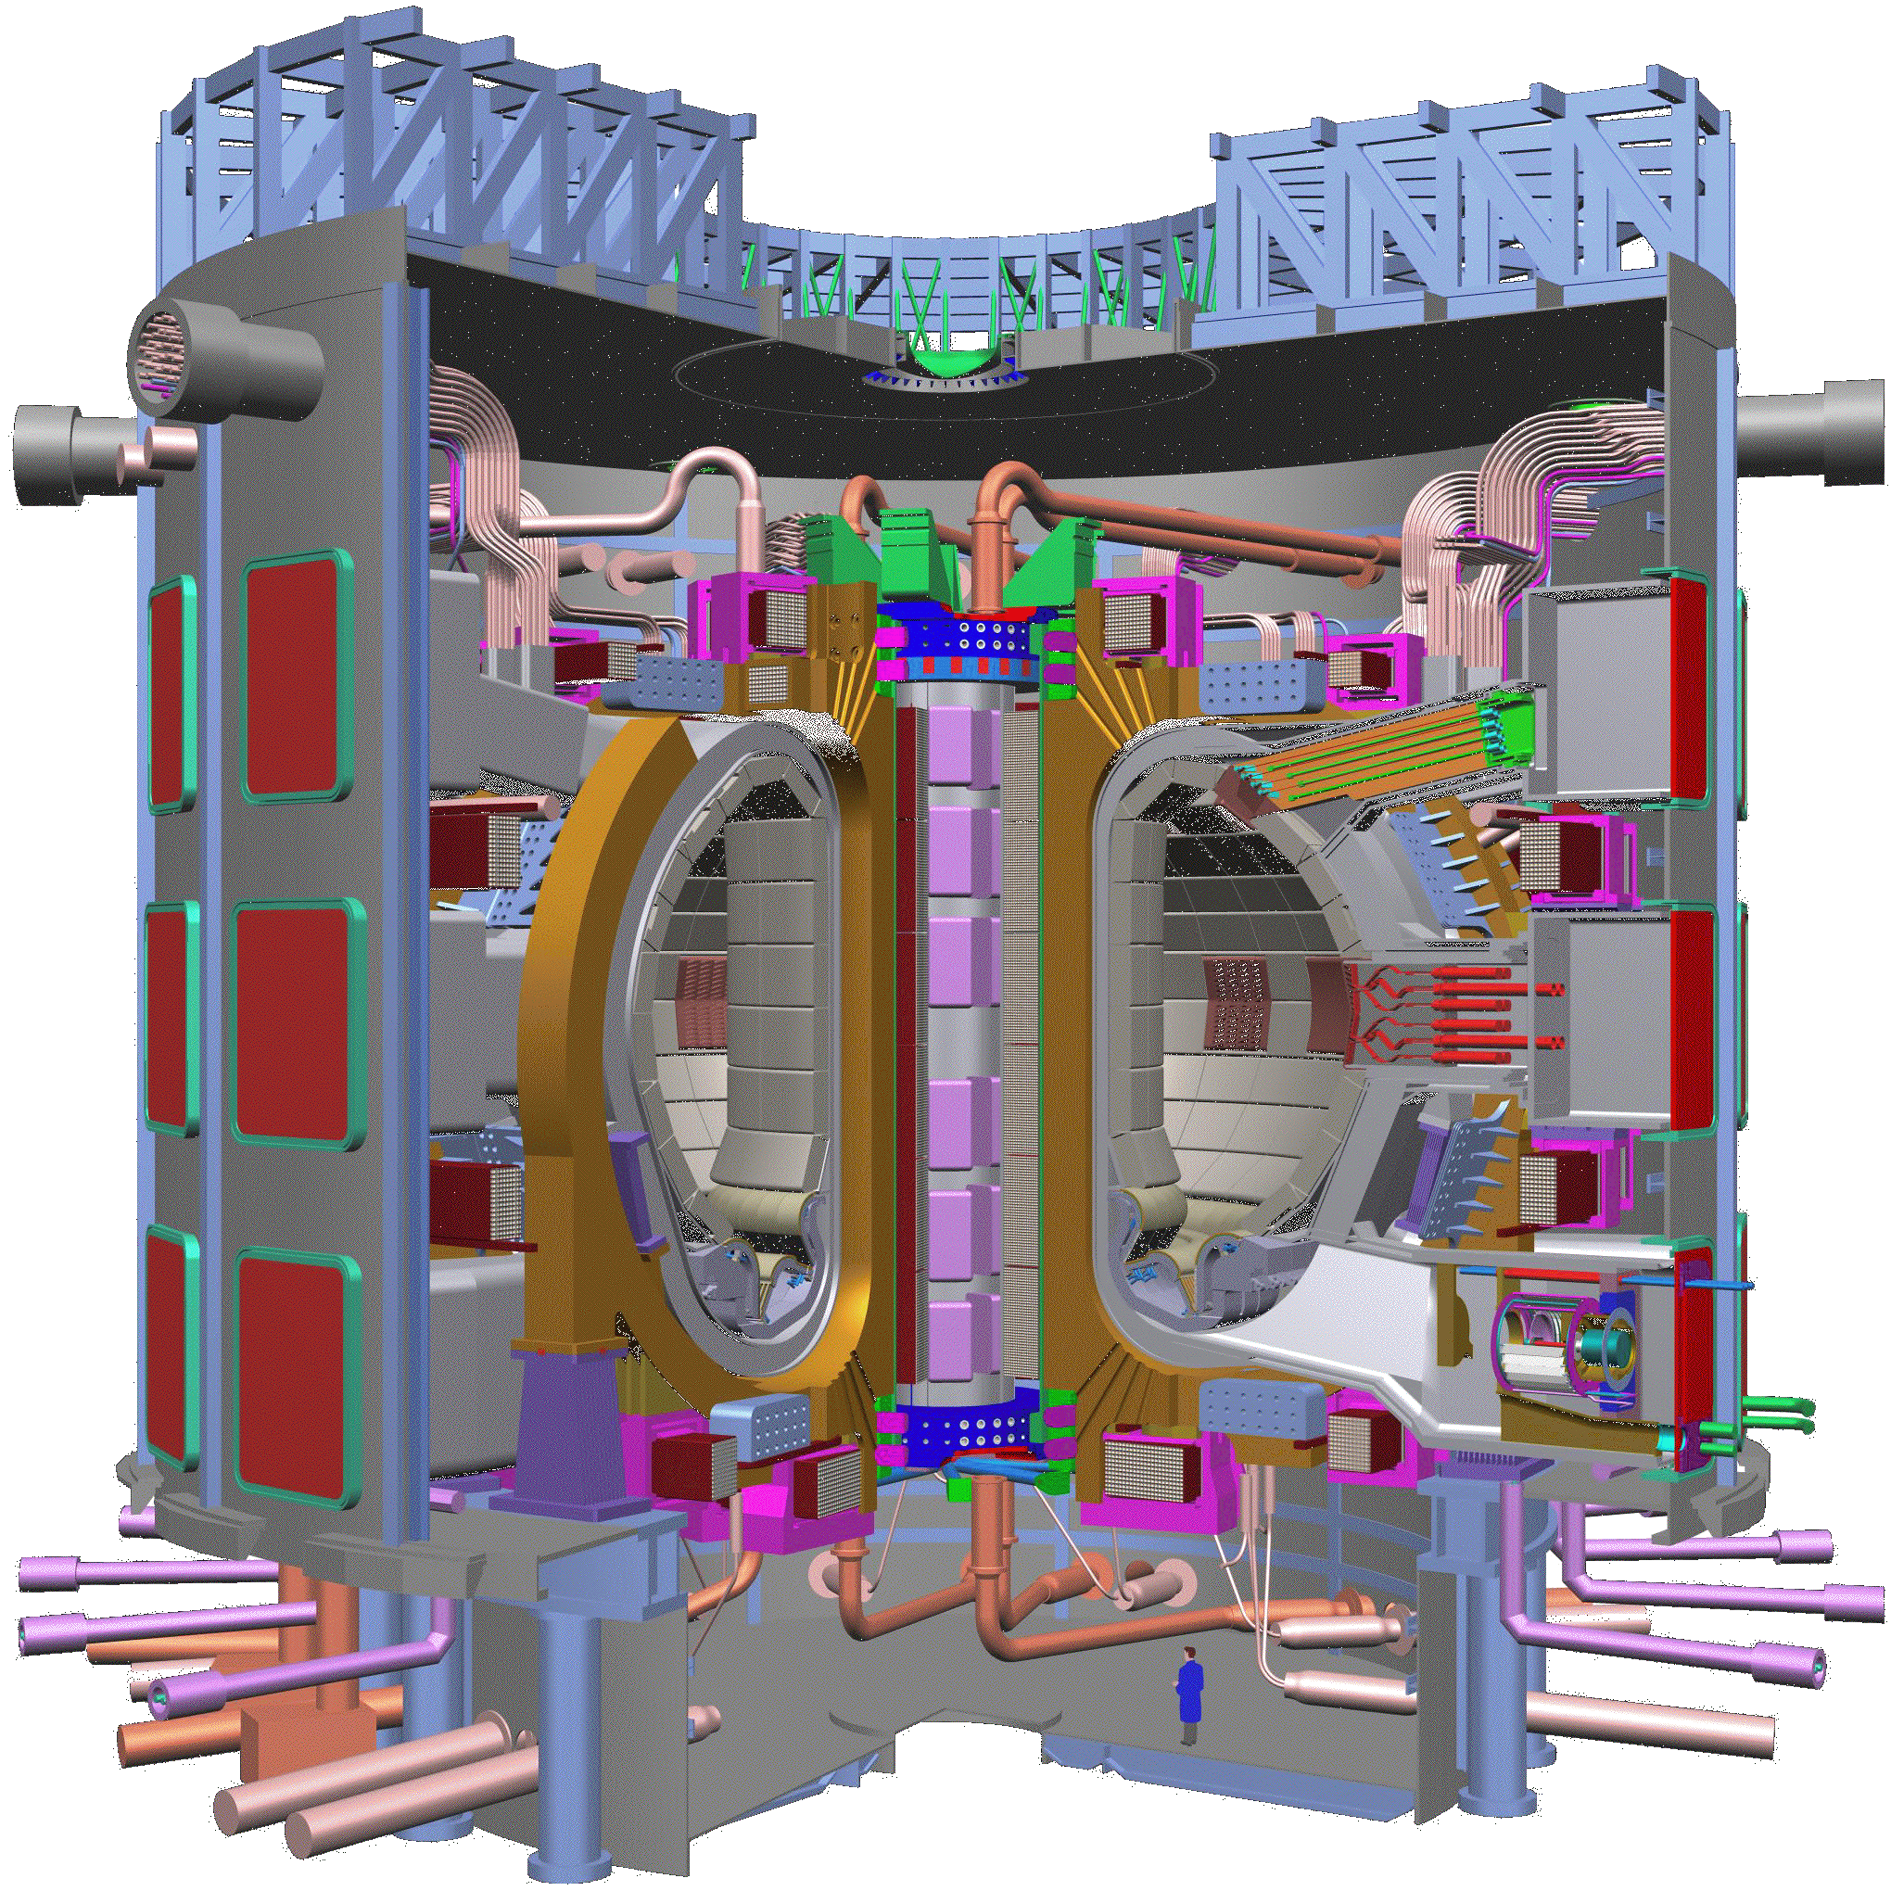
RF Current Drive in Fusion Plasmas
Magnetic Confinement: ITER
US-EU-Russia-Japan-India Collaboration
Will be built in Cardarache France
Completion 2016??
http://www.iter.org/
Poloidal magnetic field
a person
Injecting RF waves can drive a toroidal current. N. Fisch PRL (1978)
Toroidal current

Slide 14
RF Current Drive Efficiency
Original Langevin Treatment: Nat Fisch, PRL (1978)
RF pushes particles in velocity space.
Collisions relax distribution back to equilibrium.
What is the current generated per unit power dissipated? J/P_{D}
= RF induced velocity space particle flux
ψ inversely proportional to collision rate

Slide 15
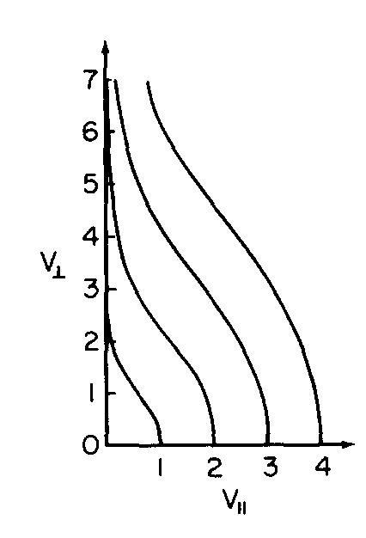
RF Current Drive Efficiency
RF pushes particles in velocity space.
Collisions relax distribution back to equilibrium.
electron velocity space
N. Fisch: Current generated in parallel direction even if push is in perpendicular direction

Slide 16
Adjoint Approach: S. Hirshman, PoF, 23, 1238 (1980),
TMA and KR Chu, PoF 25, (1982)
For a Homogeneous Plasma, we want to solve steady state kinetic equation
Problem #1
Linearized collision operator
RF induced velocity space flux
Then find parallel current
Problem #2
Adjoint problem: Spitzer-Harm
Distribution function driven by a DC electric field.
Parallel current

Slide 17
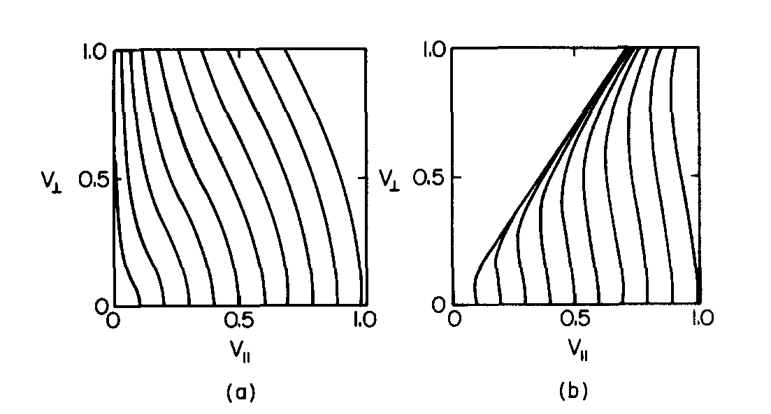
Toroidal Geometry Makes a Difference, TMA and KR Chu, PoF 25, (1982)
streaming
Inside
Outside
Magnetically trapped particles

Slide 18
Recent Adjoint Approaches
Beam optics sensitivity function, TMA, D. Chernin, J. Petillo, Phys. Plasmas 26, 013109 (2019); doi: 10.1063/1.5079629
Stellarator Optimization and Sensitivity, E. Paul, M. Landreman, TMA, J. Plasma Phys. (2019), vol. 85, 905850207, J. Plasma Phys. (2021), vol. 87, 905870214
Optimization of Flat to Round Transformers in Particle Accelerators, L. Dovlatyan, B. Beaudoin, S. Bernal, I. Haber, D. Sutter and TMA, Phys Rev Accel and Beams V25, 044002 (2022).
Adjoint Equations for Beam-Wave Interaction and Optimization of TWT Design, A. Vlasov, TMA, D. Chernin and I. Chernyavskiy, IEEE Trans. Plasma Sci. V. March (2022).
Give a child a hammer and everything becomes a nail.

Slide 19
Global Beam Sensitivity Function for Electron Guns
Goal
Derive and Calculate a function that gives the variation of specific beam parameters to
- variations in electrode potential/position
- variations in magnet current/position
Can be used to
- establish manufacturing tolerances
- optimize gun designs
Should be embedded in gun code (e.g. Michelle)

Slide 20
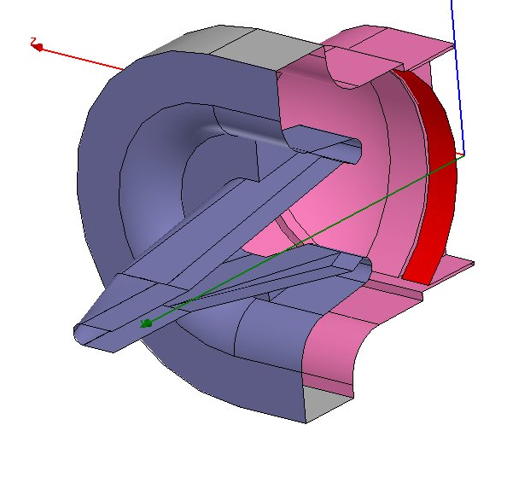
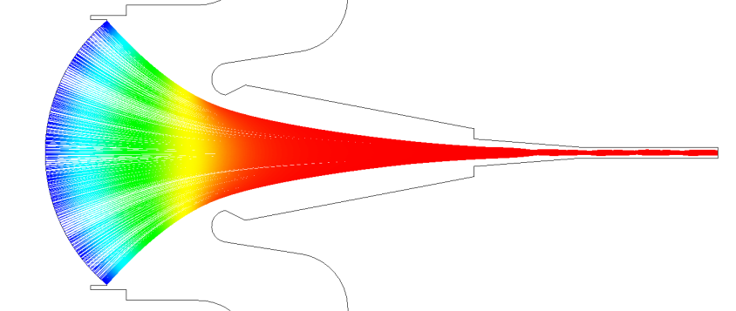
Thermionic Cathode Electron Gun
– HV
Solid Model of Electrodes
1 cm
Emitter
Focus
Electrode
Ground
Beam is compressed
Cut away view of trajectories
Matching
Section
Emitter
Focus
Electrode
Anode
What shape to make electrodes?

Slide 21
A
Michelle: Petillo, J; Eppley, K; Panagos, D; et al., IEEE TPS 30, 1238-1264 (2002).
K
Code (Michelle) solves the following equations:
Equations of motion for N particles j=1,N
Start with vacuum fields
Iterates until converged
Accumulates a charge density
Solves Poisson Equation

Slide 22
Sensitivity Function
Basic question: How do small changes in position or potential of anode affect the properties of the beam leaving the gun?
A
K
Beam leaves here
C
Conventional approach: trial and error. Do many simulations with different anode potentials or positions select the best based on some metric measured at the exit.

Slide 23
It will be shown …
Problem #1
Wall displacement changes potential on unperturbed surface.
A
K
Leads to change in RMS beam radius
C
Problem #2
A
Calculate and record change in normal E.
K
Reverse and perturb electron coordinates
C
Electrons run backwards
Sensitivity function
Is the sensitivity function

Slide 24
Hamilton’s Equations H(p,q,t)
Conserve Symplectic Area
perturbed orbit #1
perturbed orbit #2
Area conserved for any choice of 1 and 2

Slide 25
Reference Solution + Two Linearized Solutions
Two Linearized Solutions
true
adjoint
Reference Solution
Perturbation
subject to different BC’s
Can show
Generalized Green Theorem

Slide 26
Generalized Green’s Theorem
Problem #1 (true problem) Unperturbed trajectories at cathode, Perturbed potential on boundary.
Problem #2 (adjoint problem) Perturbed trajectories at exit, Unperturbed potential on boundary.
Sensitivity Function

Slide 27
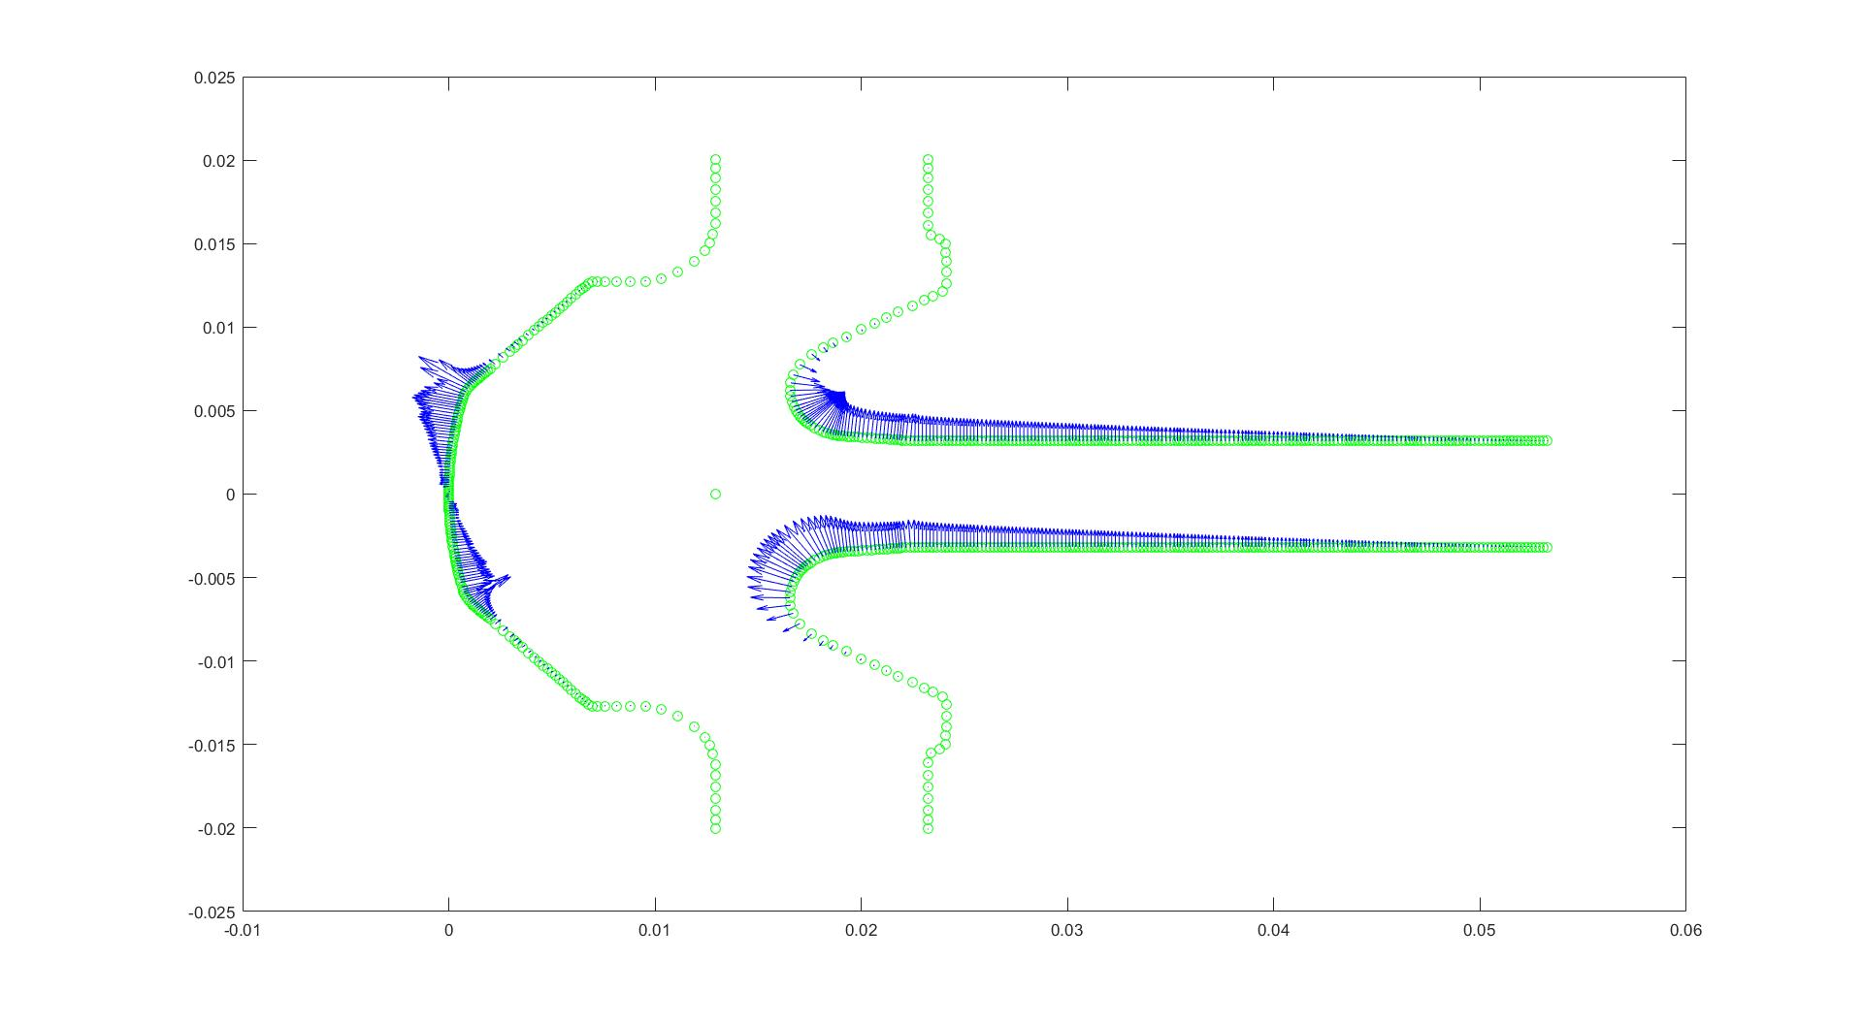
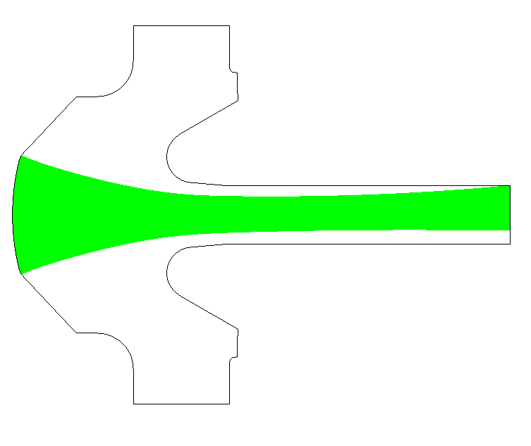
Vertical Displacement of the Beam
Vector plot of the ‘sensitivity’ or Green’s function
‘Direct’ MICHELLE Simulation with
Perturbed Anode Voltages
$$−∇δ\hat{Φ}$$
$$δx$$
Predicted displacement / Calculated displacement = 0.9969

Slide 28
Numerical Accuracy
Problem #1 (true problem) Change anode voltage, find change in RMS radius.
Problem #2 (adjoint problem) Perturbed trajectories at exit, Unperturbed potential on boundary.

Slide 29

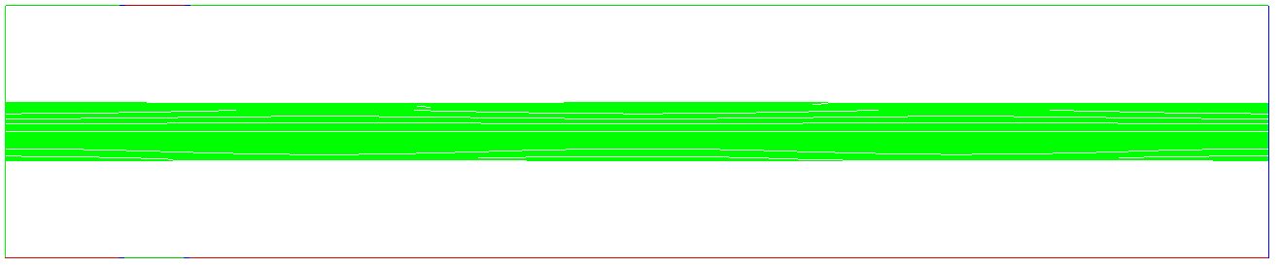
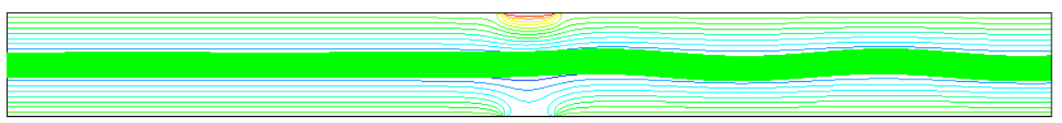
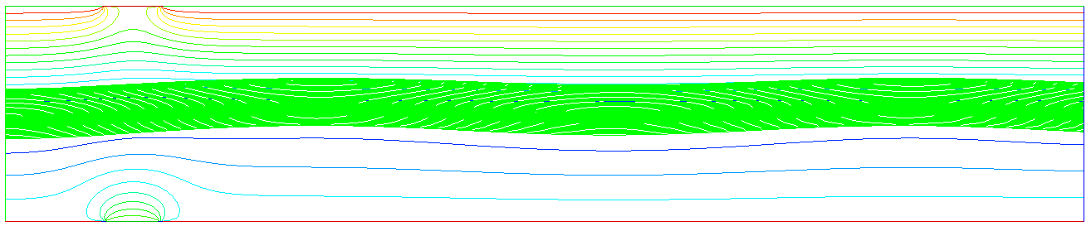
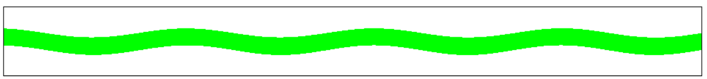
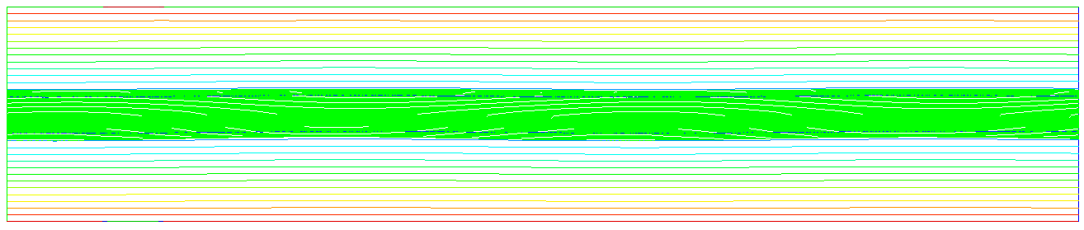
AO 2.4-4: John Petillo, Serguei Ovtchinnikov, Aaron Jensen (Leidos), Philipp Borchard (Dymenso)
Kyle Kuhn, Heather Shannon, Brain Beaudoin TMA. (U. Maryland)
Application: 2D parallel plate sheet beam
Forward Case: Grounded Inserts top and bottom
Direct Perturbation Case: Electrode inserts on top and bottom set to ΔV
ΔV tested from 1 – 10,000 V
V=0
ΔV=0
V=0
Neumann
Electrode Inserts
Forward Case
Neumann
ΔV=2000 V
Direct Perturbed Case
Perturbed Δp_{x} = λ∗p_{z0}
Or Perturbed Δx = λ∗H
Reverse-Beam Adjoint Method Case

Slide 30
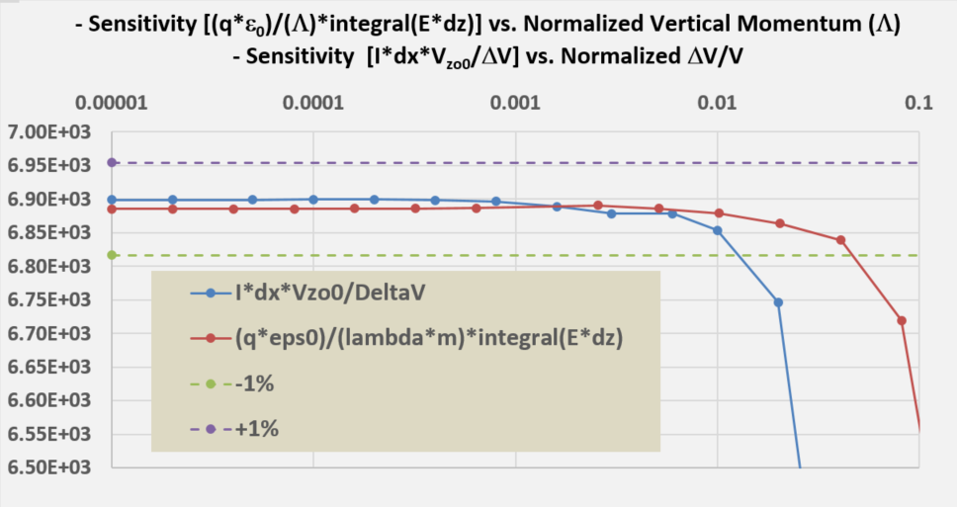
Mean Displacement: 2D parallel plate sheet beam
- Manufacturing sensitivity to beam centering offset
Results of direct vs. adjoint methods agree to within 0.20%.
Verification: Hamiltonian Approach
Excellent first successful Adjoint method to beam transport in a magnetic field.
Results:
  As the perturbed-case voltage values became small enough it easily entered the linear regime.
  There is very a broad range of both Λ and ΔV where the results are all in a linear regime.
Adjoint method predicted the deflection sensitivity to within 0.2%

Slide 31
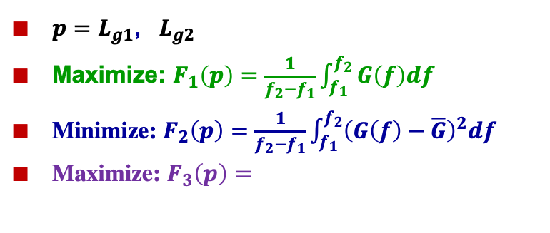

AO 2.4-2 – Optimization of TWT Design by Using Adjoint Approach
A. Vlasov, T. M. Antonsen Jr., D. Chernin, I. Chernyavskiy
Optimization of Small Signal Gain
Distance between gaps (two sections).
3 different goal functions
2 optimization parameters
$p=L_{g1}$, $L_{g2}$
Maximize: $F_{1}\left(p\right)=\frac{1}{f_{2}−f_{1}}\int_{f_{1}}^{f_{2}}{G\left(f\right)df}$
Minimize: $F_{2}\left(p\right)=\frac{1}{f_{2}−f_{1}}\int_{f_{1}}^{f_{2}}{{\left(G\left(f\right)−\overline{G}\right)}^{2}df}$
Maximize: $F_{3}\left(p\right)=$
$$Γ_{p}≡\frac{〈g〉}{σ_{g}^{p}}$$

Slide 32
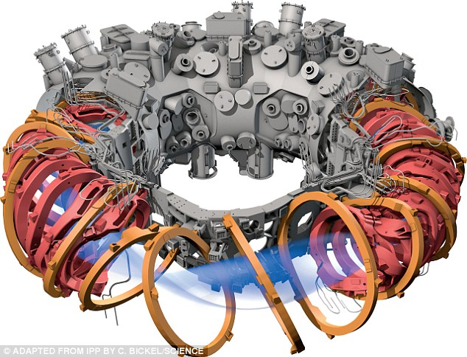
3D MHD Equilibria
Vacuum Vessel
Coils
Plasma
Wendelstein 7-X
Max Planck Institute for Plasma Physics (IPP)
Greifswald, Germany Completed 2015

Slide 33
Optimization of Stellarator Equilibria
Figures of Merit (FoM) - Examples
Plasma Beta, Rotational Transform, Quasi-symmetry
FoMs depend on boundary or coil shapes
Shape Gradient Sensitivity Functions
gradient based optimization
establish tolerances
C. Othmer, J. Math. Industry 4, 6 (2014). DRAG
Landreman and Paul, 2018 Nucl. Fusion 58 076023,
E. Paul, M. Landreman, TMA, J. Plasma Phys. (2019), vol. 85, 905850207,
J. Plasma Phys. (2021), vol. 87, 905870214
Rotational transform

Slide 34
Adjoint Symmetry Simplifies Calculations
Adjoint Approach to gradient calculation
> 500 X Speed – Up over direct calculation
Uses VMEC & DIAGNO
Hirshman and Whitman, 1983 Phys. Fluids 25 3553
H.J. Gardner 1990 Nucl. Fusion 30 1417
Different Figures of Merit Possible
Plasma pressure – beta
Rotational transform
Toroidal current
Neoclassical radial transport -1/ν regime
Energetic particle drifts
Quasi-symmetry
Others
Surface shape sensitivity
Coil location sensitivity

Slide 35
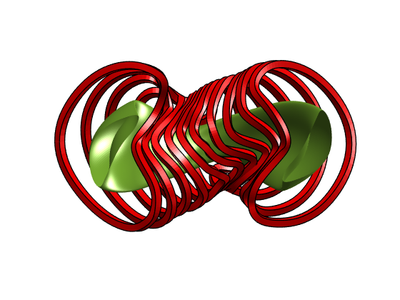
3D MHD Toroidal Equilibrium
In plasma
Assume good flux surfaces in plasma
Coils
In vacuum
Poloidal flux
coil current
Toroidal Flux
Rotational transform

Slide 36
Linear Perturbations to Equilibrium
Generalized Forces:
Changes in current/shape/location of coils
Added pressure tensor
Change in poloidal flux profile
Generalized responses:
Changes in vacuum fields
Changes in magnetic field
Changes in toroidal current profile

Slide 37
Generalized Forces and Responses
Responses
Vacuum fields
Plasma displacement
Toroidal current profile
Forces:
Coil currents
Pressure tensor
Rotational transform
More generically,
for two different perturbations
Onsager Symmetry Gives

Slide 38
Onsager Symmetry for 3D MHD Equilibria
Self-adjoint MHD Force Operator
True
Adjoint
Pressure - Displacement
Rotational transform –Toroidal current
Surface displacement

Slide 39
Specify BC’s & Constraints
Make this appear to be change in FoM
True
Adjoint
Pressure - Displacement
Rotational transform –Toroidal current
Sensitivity function
Surface displacement

Slide 40
Specify BC’s & Constraints
Make this appear to be change in FoM
True
Adjoint
Pressure - Displacement
Sensitivity function
Surface displacement

Slide 42
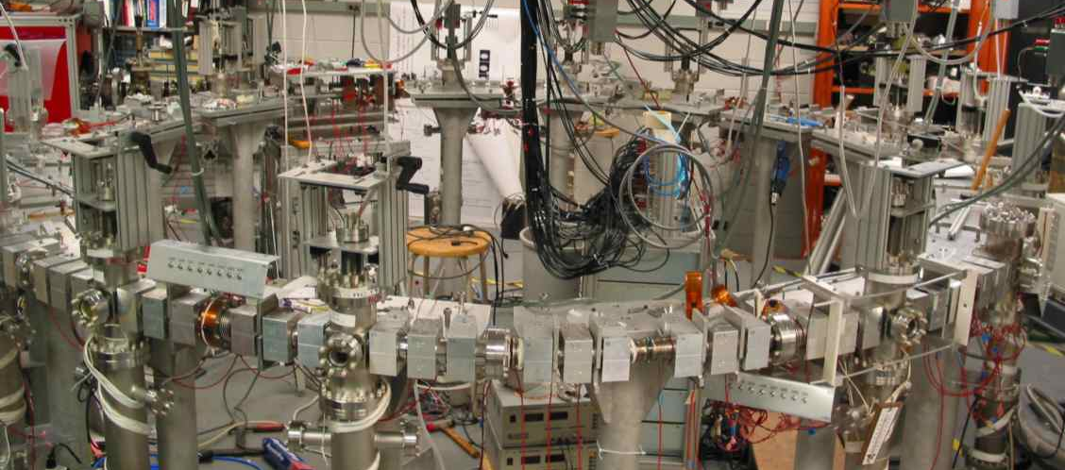
Optimization of Focusing Magnets in Accelerator Lattices
The University of Maryland Electron Ring
UMER is a fully functional electron storage ring

Slide 43
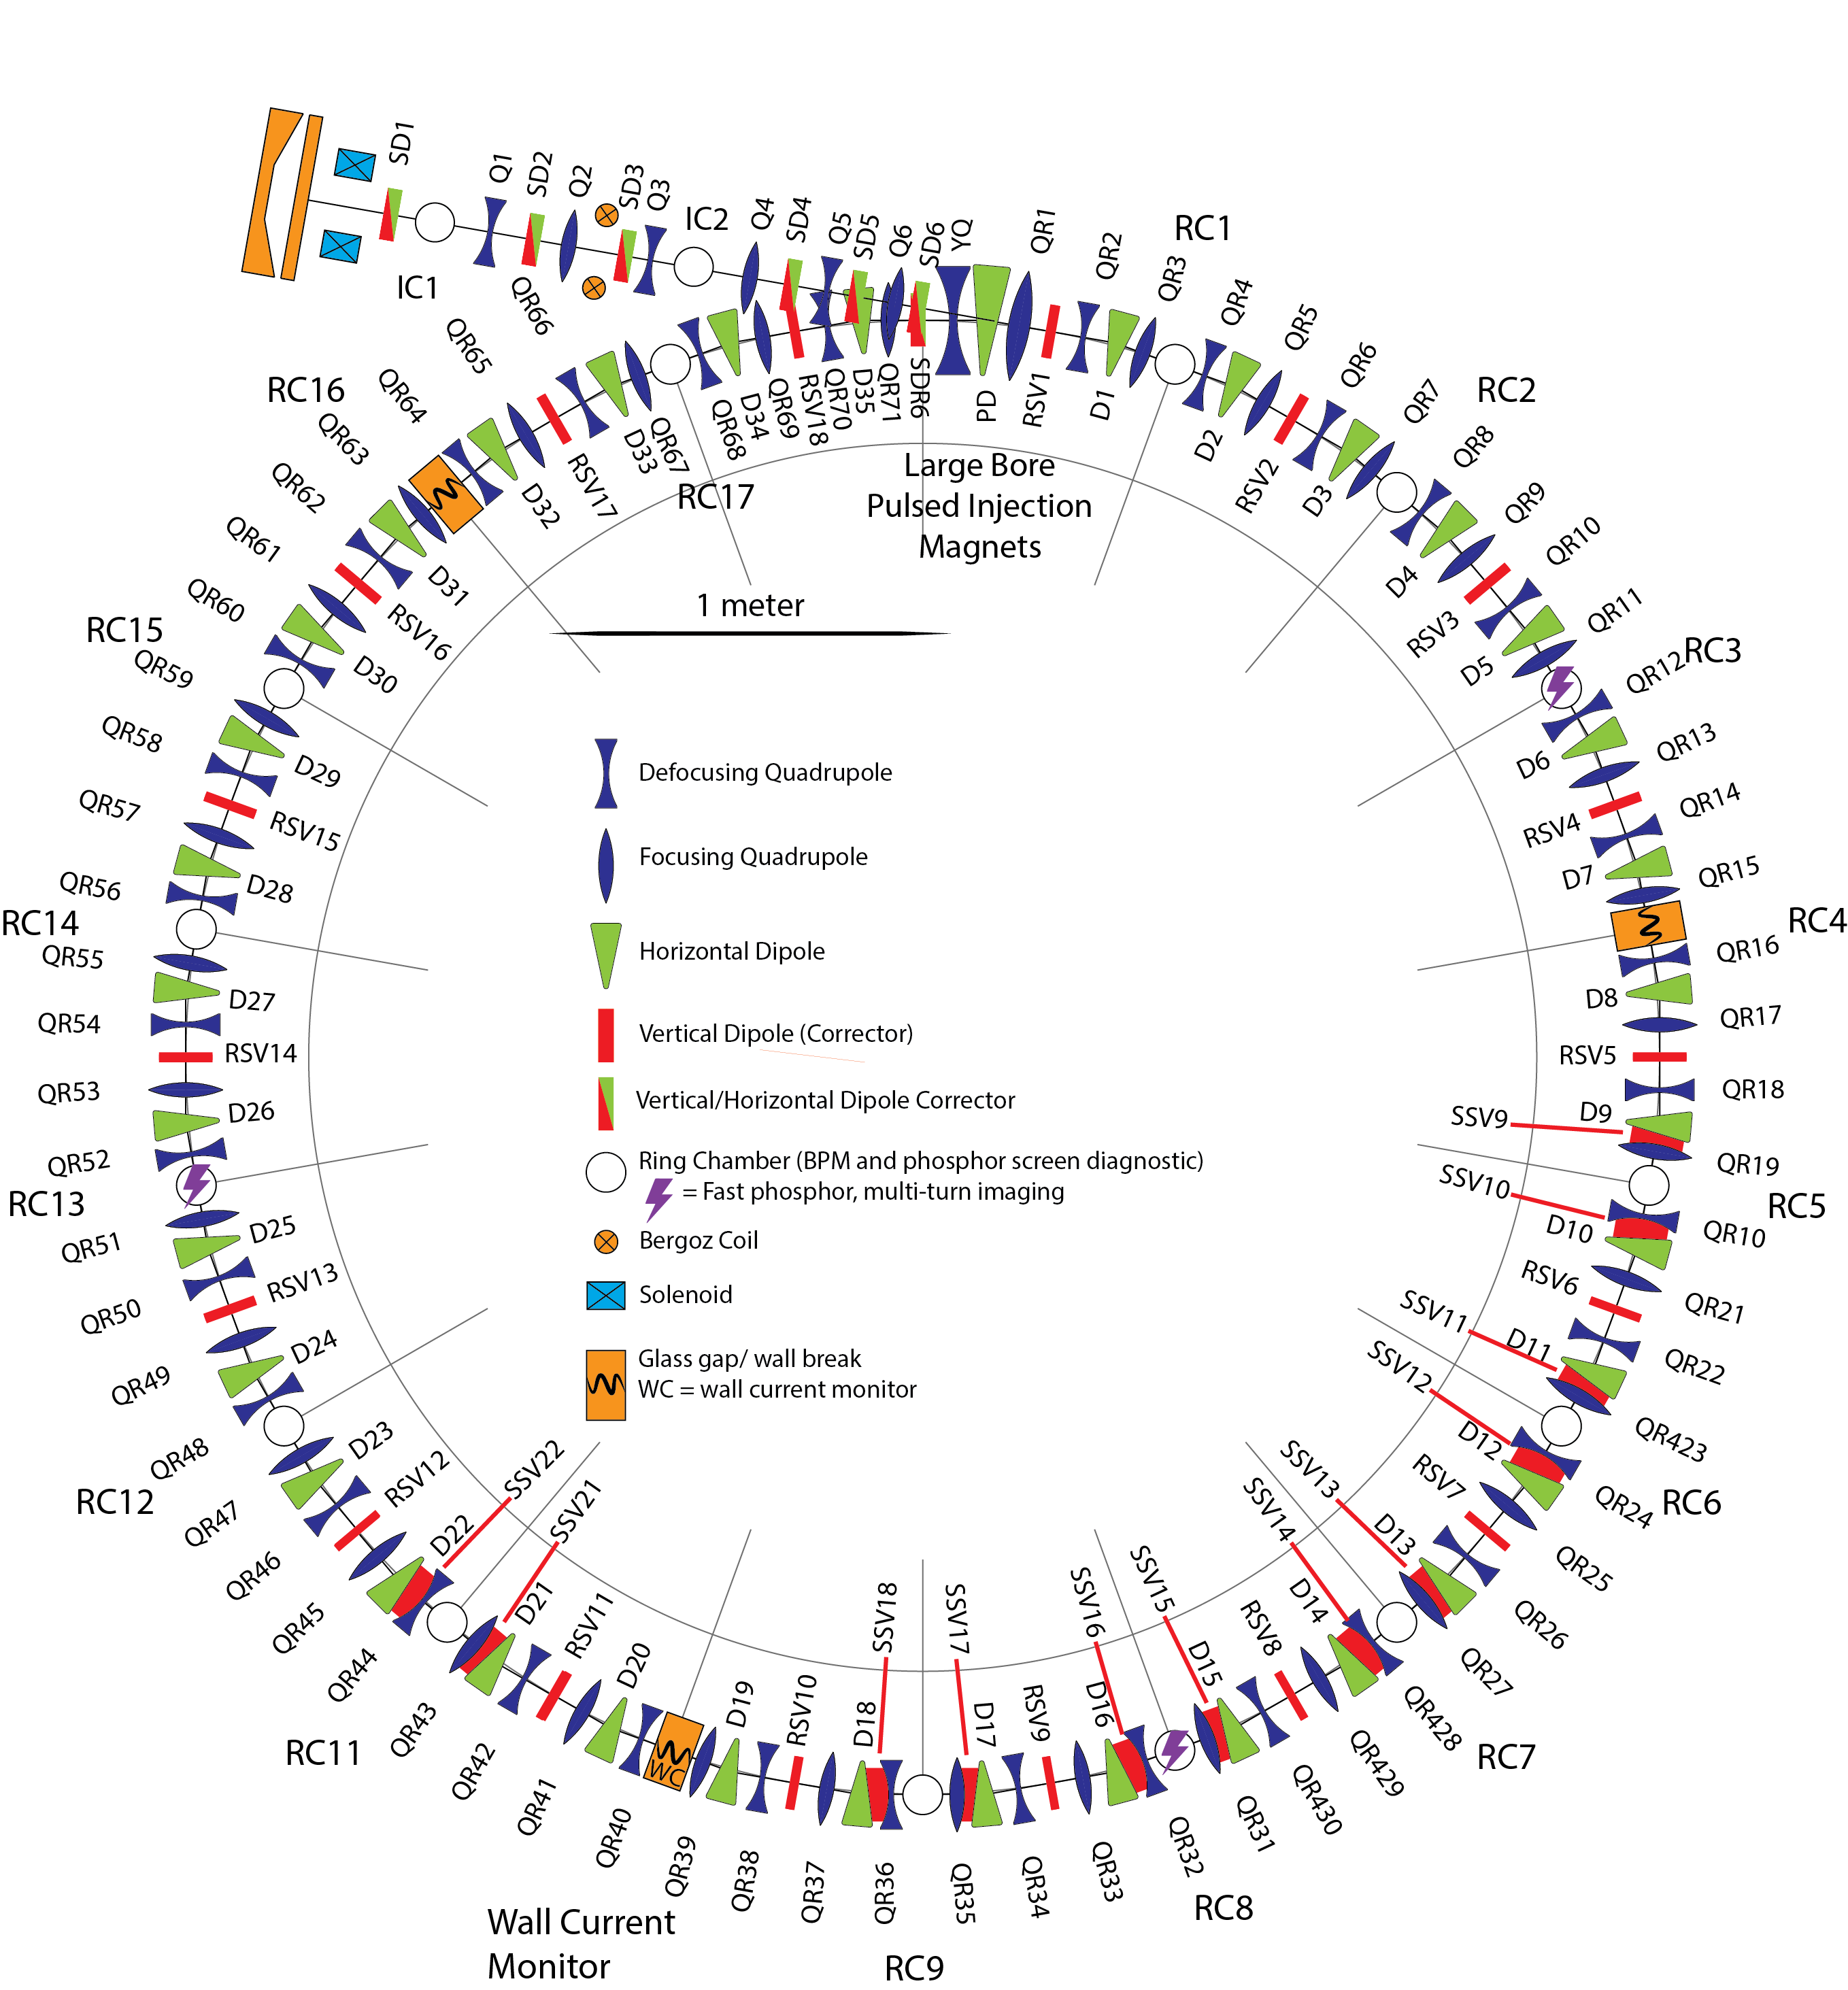
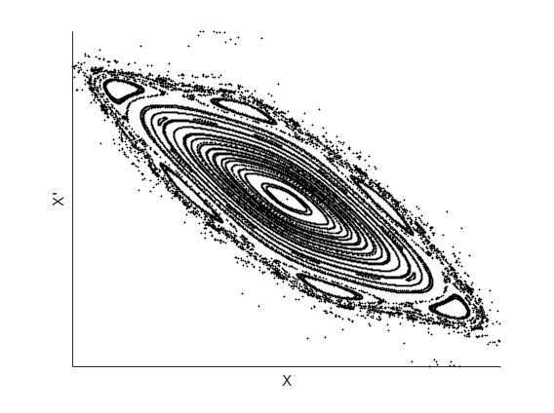
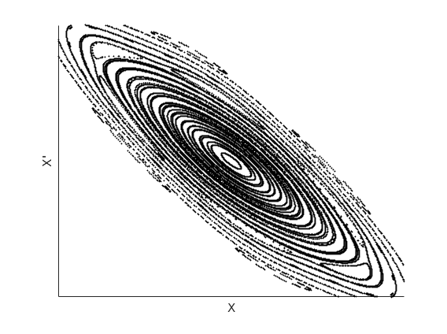
UMER Systems and Layout
167 Magnets, power supplies &
controls.
x’=dx/ds
Transverse Phase space
x
x’=dx/ds
Want to avoid trajectories outside here
x

Slide 44
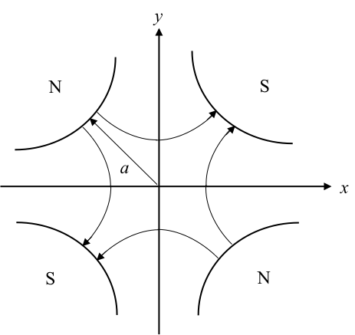
Focusing Basics
Quadrupole Magnetic Field
Focusing in x-direction
Defocusing in y-direction
qv – out of page
32 Quadrupole
magnets
Field strength increases linearly with distance from the axis

Slide 45
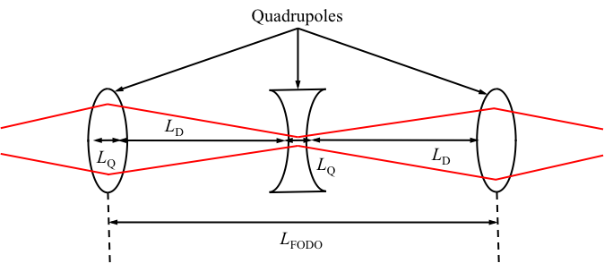
FODO Lattice
Alternate focusing and defocusing orientations
32 Quadrupole
magnets
Qualitative explanation: beam passes through focusing quad when it is big (strong fields). Passes through defocusing quad when it is small (weak fields). Net effect is focusing.
Beam distribution depends on many parameters How to optimize?

Slide 46
Optimization of Flat to Round Transformers Using Adjoint Techniques*
L. Dovlatyan, B. Beaudoin, S. Bernal, I. Haber, D. Sutter and T. M. Antonsen Jr , Phys Rev Accel and Beams V25, 044002 (2022).
Flat Beam
Round Beam
Flat to Round and Round to Flat transformers are proposed for cooling of hadron beams. Ya. Derbenev, Adapting optics for high-energy electron cooling, Tech. Rep. UM-HE-98-04-A (1998).
Cylindrical hadron beam cools via collisions when co-propagated with electron beam.

Slide 47
Steps
1. Derive system of moment equations (include self fields)
2. Linearize (to compute parameter gradient)
3. Find adjoint system
4. Decide on Figures of Merit
5. Optimize by Gradient Descent
Flat Beam
Round Beam

Slide 48
Moment Equations
Symbols –PIC
Lines – Moment Eqs.
Depend on magnet parameters

Slide 49
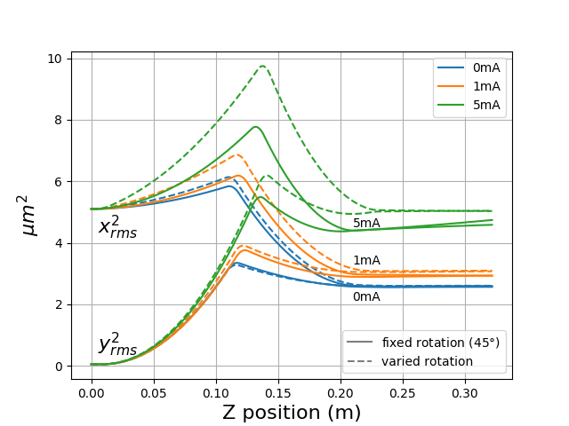
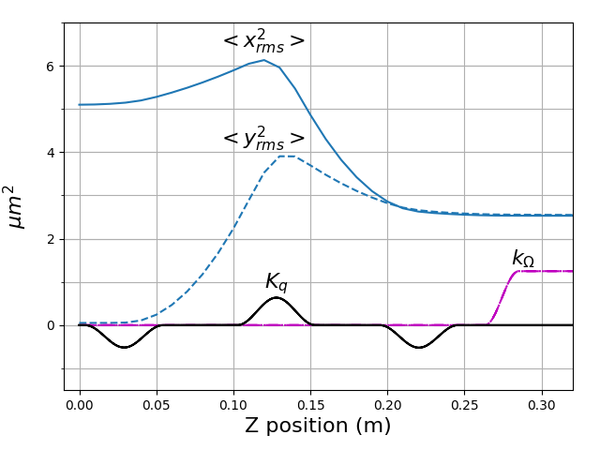
More Optimization
Continuous magnetic field profiles
Variable magnet orientations

Slide 50
Circular Accelerators-Periodicity
Solve Eqs. of motion and self fields
Particles return to initial plane.
Need to maintain periodicity of distribution, not individual orbits
Big problems:
Do periodic distributions exist? Most likely no.
How to relaunch particles to optimize?
Start here with 4D particle coordinates
Particles + Periodicity = Problems

Slide 51
Conclusion
Adjoint methods are a powerful way to evaluate parameter dependences in many systems involving charged particle dynamics.
Thank you.

Slide 52
Moment Equations
Transverse phase space:
The second order moments are averages of the 4 by 4 elements of the Sigma matrix.
Moments: Q, P, E, L
Angular momentum

Slide 53
Linearized System
Linear perturbation due to true change in parameters
Base case
Adjoint system
Sensitivity functions
Change in magnet parameters

Slide 54
Figure of Merit and Gradient
Constant radius, Round
Radial force balance, Rigid rotation

Slide 55
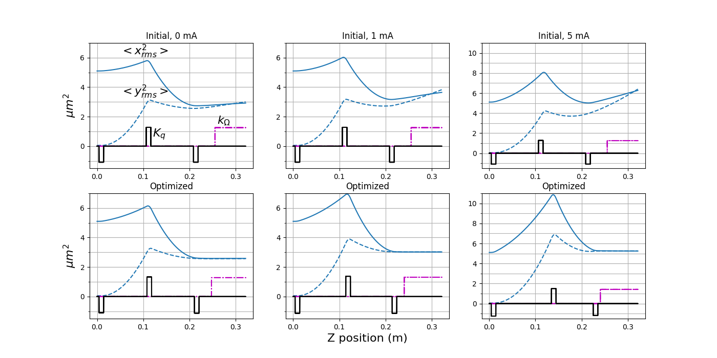
Optimization – Space Charge Compensation

Slide 56
Next Step – Circular Accelerators
Beam Particles
Solve Moment Eqs.
Z=Z_{i}
Z=Z_{f}
Periodicity: Enforce
Optimize: Minimize
Figure of Merit F(X,a)
a = parameter list
Constrained Optimization
by Multiple Relaxation
Adjoint with a Chaser !

Slide 57
Next Step – Circular Accelerators
Beam Particles
Z=Z_{i}
Z=Z_{f}
Solve Moment Eqs.
Periodicity: Minimize
Minimize
Figure of Merit F(X,a)
This is the tricky term

Slide 58
The Tricky Term
This is the tricky term
Requires evaluating and inverting large matrices

Slide 59
Constrained Optimization by Multiple Relaxation
or
Adjoint with a Chaser !
The equilibrium
The chaser
Parameter evolution
Only first derivatives required (6)

Slide 60
How is it Supposed to Work
So that “a” evolves “slowly”.
X tends to local equilibrium
The chaser tends to a slightly different equilibrium
Allow a to change:
The X equilibrium changes

Slide 61
Constrained Optimization by Multiple Relaxation
or
Adjoint with a Chaser !
The equilibrium
The chaser
Parameter evolution
Only first derivatives required (4)

Slide 62
Moment Eqs. – Circular Accelerators
Beam Particles
Z=Z_{i}
Z=Z_{f}
Solve Moment Eqs.
Periodicity: Minimize
Solve Adjoint Eqs.
Figure of Merit F(X,a)
Can be evaluated with 6 solutions of adjoint Eqs.

Slide 63
Conclusion
Adjoint method allows for optimization of Round to Flat and Flat to Round transformers.
Periodic lattices may (?) be handled by “Adjoint with a Chaser”. We are currently testing using moment equations
Formalism extended to treat particle description - done
“Adjoint with a Chaser” may be extended to Stellarator optimization, with a side of ALPO©️.

Slide 64
Conclusion: Next Steps
Add Magnetic field
sensitivity function
Change in magnetization current
Add time dependence
Implement in an optimization routine

Slide 65
Basic Formulation – Linear Algebra
We wish to solve :
for many B’s.
And then evaluate for each B:
D(B) is the answer.
Instead solve for y once:
Then:

Slide 66
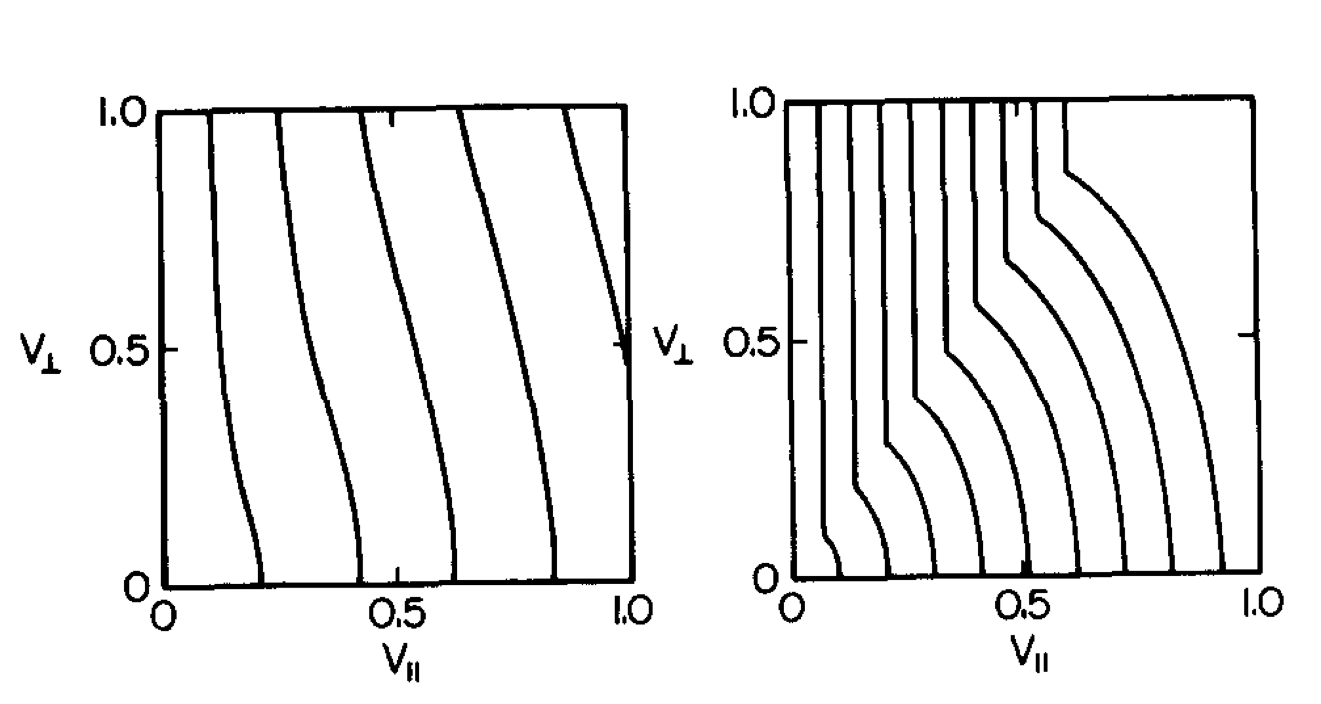
Radial Flux driven by RF

Slide 67
RF Induced Transport
Perturbed neoclassical DF
TMA and K. Yoshioka, PoF 29, (1986)
Response to a radial gradient
Fluctuation induced radial flux

Slide 68
Jacobian Matrix – M(t)
2Nx2N
2N Eiegenvectors and Eigenvalues of M
Solutions come in N pairs-
Eigenvectors from different pairs orthogonal

Slide 69
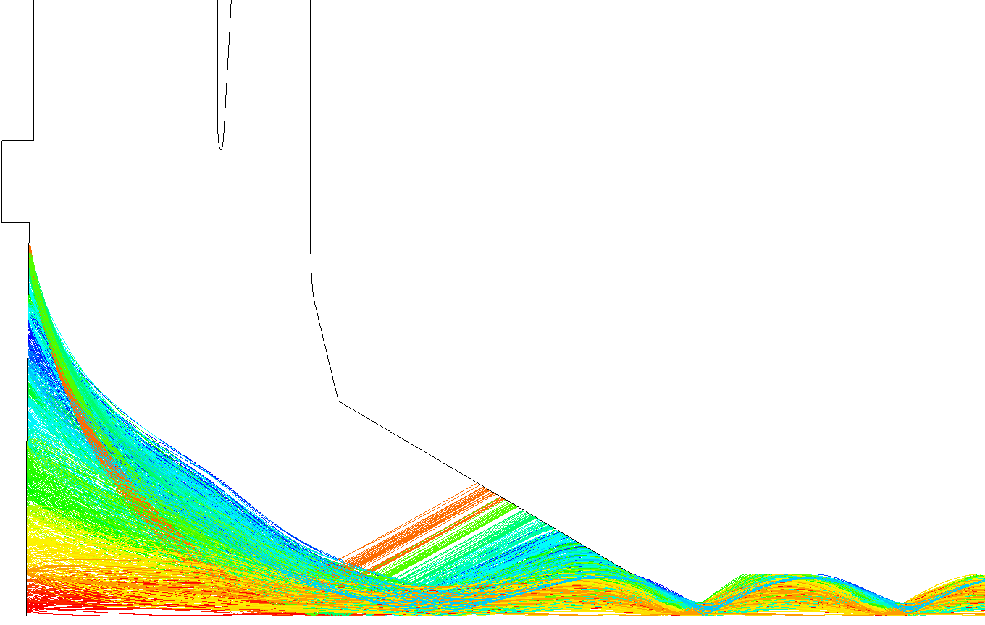
Beamstick: Gun Baseline Geometry
Particle Trajectories at Actual Voltages
V_{k} = -25.1 kV
V_{ma} = -20.2 kV
I_{k} = 39.8 mA
I_{t} = 16.7 mA
Transmission = 42%
10X
Approved for public release; Distribution unlimited

Slide 70
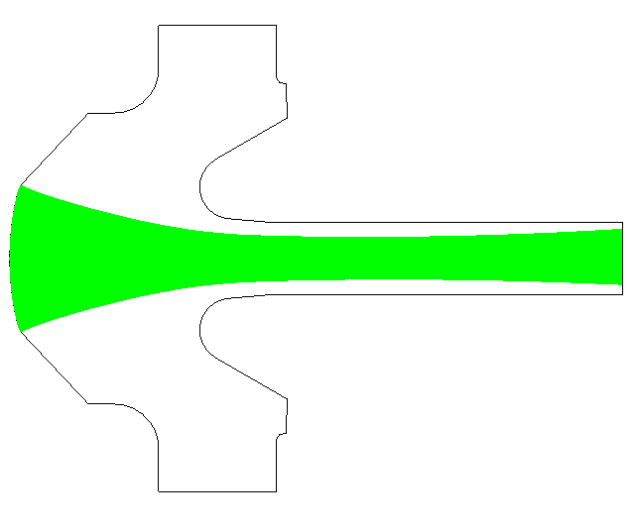

Theoretical Study of Statistical Variations
Example of the Adjoint Method in Action
Problem: Compute the displacement of the beam in a sheet beam gun due to a small change in anode potential or a small displacement of the anode:
MICHELLE Simulations of Sheet Beam Gun
‘Perfect’ case:
Beam centroid at gun exit is on axis
‘Perturbed’ case:
Beam centroid at gun exit is displaced
$$δx$$
The adjoint method gives us a way to compute the displacement of the beam without re-running MICHELLE:
$δx$= Beam centroid displacement at gun exit
δΦ = Small change or error in anode or other electrode potential
$−n∙∇\hat{Φ}$= Sensitivity (Green’s) function

Slide 71
A
K
Code (Michelle) solves the following equations:
Hamilton’s Equations for N particles j=1,N
Accumulates a charge density
Iterates until converged
Solves Poisson Equation

Slide 72
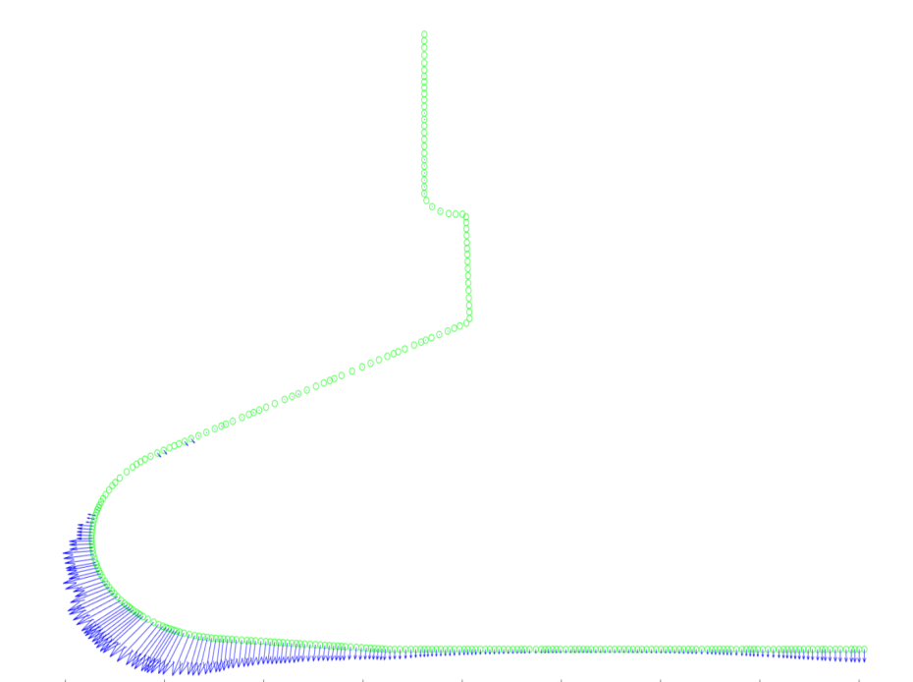
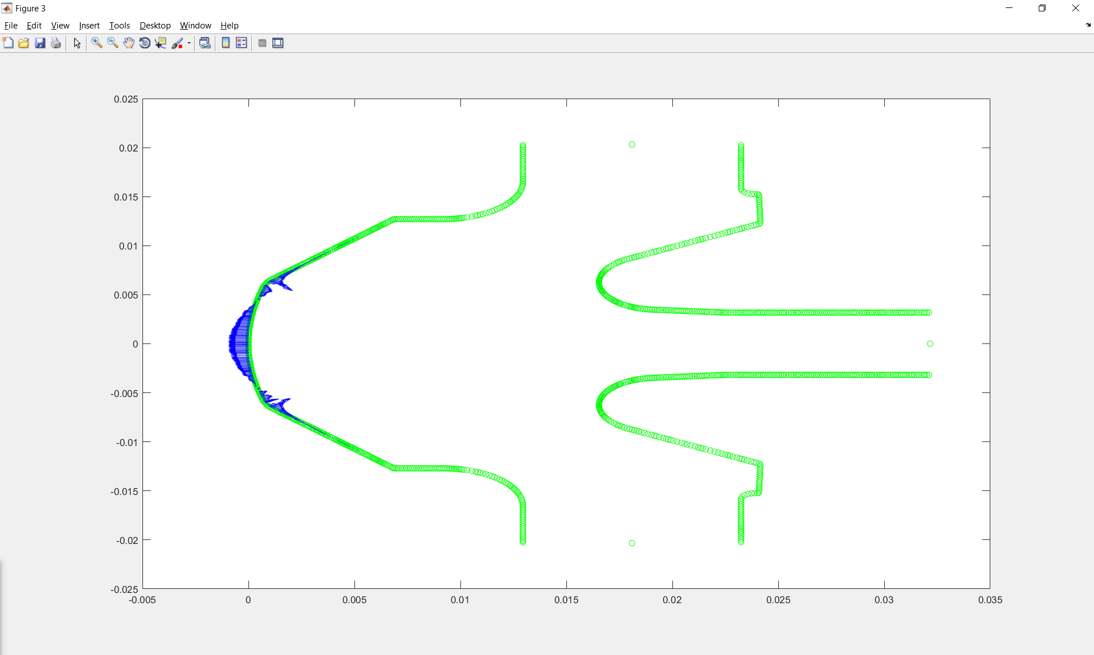
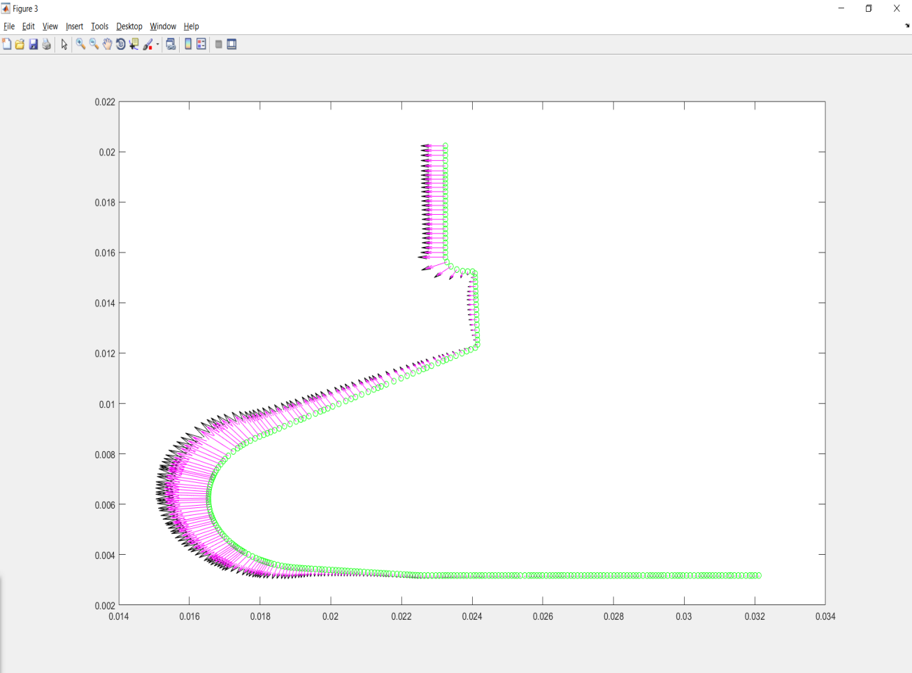
RMS radius sensitivity
Cathode E-normal has the largest “sensitivity”
Anode E-normal sensitivity
Anode normal AK-Gap values

Slide 73
Adjoint Equations
Base case
Linear perturbation due to change in parameters
Adjoint system
Arbitrary Changes in focusing magnets
Can show
Adjoint sensitivity

Slide 74
Change in Figure of Merit
Figure of Merit
Can show
Adjoint sensitivity
Arbitrary Changes in focusing magnets

Slide 75
Focusing Basics
Quadrupole Magnetic Field
Focusing in x-direction
Defocusing in y-direction
qv – out of page
32 Quadrupole
magnets
Field strength increases linearly with distance from the axis

Slide 76
FODO Lattice
Alternate focusing and defocusing orientations
32 Quadrupole
magnets
Qualitative explanation: beam passes through focusing quad when it is big (strong fields). Passes through defocusing quad when it is small (weak fields). Net effect is focusing.
Beam distribution depends on many parameters How to optimize?

Slide 77
Circular Accelerators-Periodicity
Need to maintain periodicity of distribution, not individual orbits
z=0, z=L
Pick adjoint coordinate perturbations to realize desired FoM
Sensitivity to changes in magnet parameters
Too hard!

Slide 78
Effective Area – Antenna Gain
I
V
V
Receiving
Sending
Power received
Power per unit solid angle
Incident intensity
Effective area
gain

