Slide 1

Adjoint Methods in Plasma Physics and Charged Particle Dynamics or
When the solution to your problem is not your problem.
Thomas M. Antonsen Jr.
Department of Electrical and Computer Engineering
Department of Physics
Institute for Research in Electronics and Applied Physics
University of Maryland, College Park

Slide 2
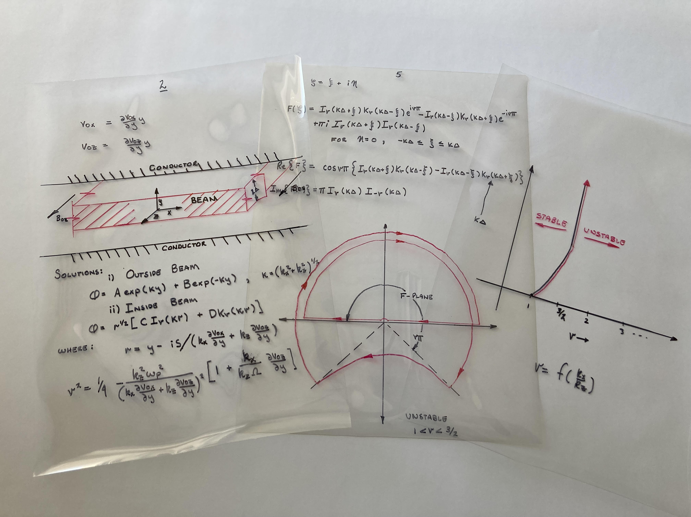
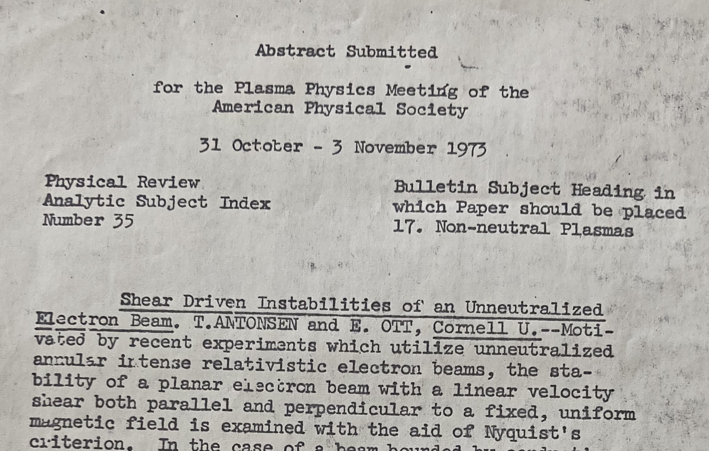
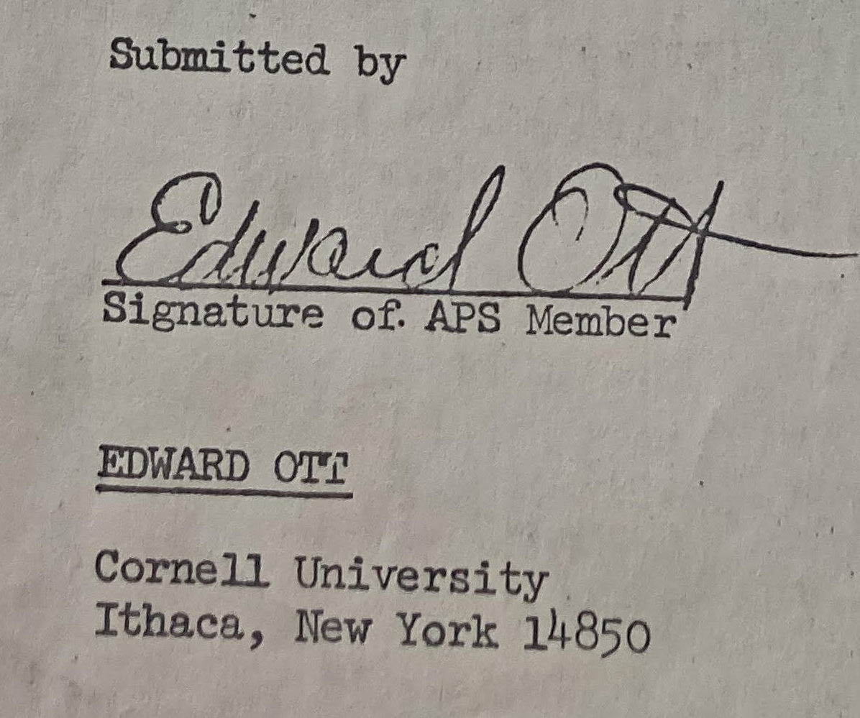
First, Some Nostalgia – TMA-DPP 50th
These are called transparencies
Submitted by my advisor

Slide 3
Adjoint Method: What it does
Efficiently finds the dependence of system performance on parameters by solving a system problem different from the one proposed. - Adjoint Problem
Requires identification of a Metric or Figure of Merit (FoM)
    F(a) a list of parameters
or
d F(a)/d a
- Solution of adjoint problem gives F or dF/d a
Useful for:
Optimization
Sensitivity Studies

Slide 4


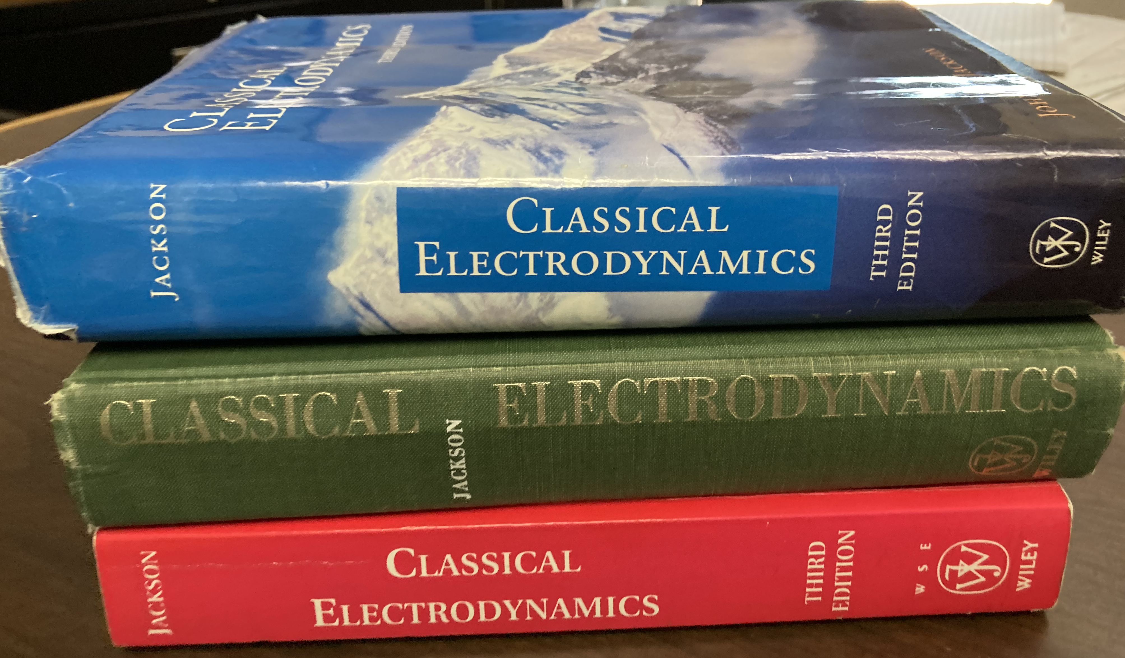
Basic Adjoint Example (More Nostalgia)
Jackson, Classical Electrodynamics Problems 1.12 and 1.13
A charge q is placed at an arbitrary point, x_{o}, relative to two grounded, conducting electrodes.
q
q₂
q₁
x₀
B₁
B₂
What is the charge q₁ on the surface of electrode 1?
Now Repeat for different x₀
q₁ Figure of Merit
x₀ Parameters

Slide 5
Direct Solution
Prob #1
Your Problem
Solve
BCs:
answer
Repeated for each x₀
* Must first find potential throughout space.
* Then evaluate E-field on surface of B₁.
* If x₀ changes everything must be redone.
q
q₂
q₁
x₀
B₁
B₂

Slide 6
Adjoint Solution – Green’s Reciprocation Theorem
Prob #2
Adjoint Problem
(Not your problem)
BCs:
Solve
Done once !
Apply Green’s
Theorem
0
0
When the dust settles:
Answer

Slide 7
George Green 1793-1841
Physics Today Dec. 2003
Born in Nottingham (Home of Robin Hood)
Father was a baker
At age 8 enrolled in Robert Goodacre’s Academy
Left after 18 months (extent of formal education pre age 40)
Worked in bakery for 5 years
Sent by father to town mill to learn to be a miller

Slide 8
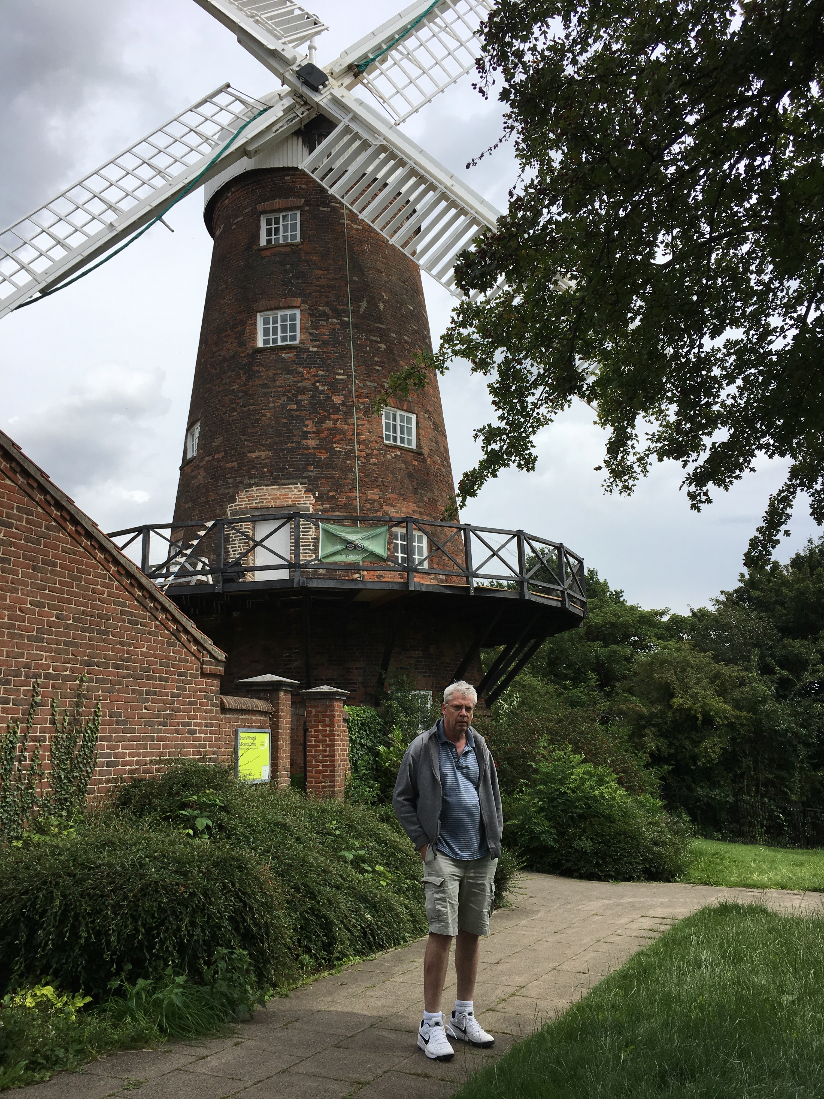
Fell in love with Jane, the miller’s daughter.
Green’s father forbade marriage.
Green had 7 children with Jane.
Took up mathematics.
Self published work in 1828
With help, entered Cambridge 1833, graduated 1837.
Theory of elasticity, refraction, evanescence
“Discovered” by Lord Kelvin in 1840.
Died of influenza, 1841
Green’s Mill: still functions

Slide 9
Features of Problems Suited to an Adjoint Approach
Many computations need to be repeated.
(many different locations of charge, q)
Only a limited amount of information about the solution is required.
(only want to know charge on electrode #1)
Trick is to find the right combination of conditions on problem 2 to solve problem 1.
q
q₂
q₁
x₀
B₁
B₂

Slide 10
Adjoint Methods in Science and Engineering

Slide 11
Courtesy, Elizabeth Paul
Optimize shape
via steepest descent to minimize drag.
Result is also aesthetically appealing.
Super Computer

Slide 12
1985 Volvo 240 DL
Oops, coding error ? Possible local minimum?

Slide 13
Relation to Reciprocity
Example:
- Antenna sending and receiving radiation patterns are equal due to time reversal symmetry of Maxwell’s Equations.
- Direct calculation of receiving pattern requires many simulations
- Instead, calculate sending pattern and invoke reciprocity
V
V
Receiving
Sending

Slide 14
Other Examples of Reciprocity
Collisional Transport: Onsager Symmetry of off-diagonal elements of transport matrices.
Temperature gradient ➔ Electric current
Electric field ➔ Heat flux
Neoclassical Tokamak Transport
Pressure gradient ➔ Bootstrap Current
Toroidal E-field ➔ Ware particle flux
F. Hinton, and R. Hazeltine, Rev. Mod Phys, 48 (2) , 1976

Slide 15
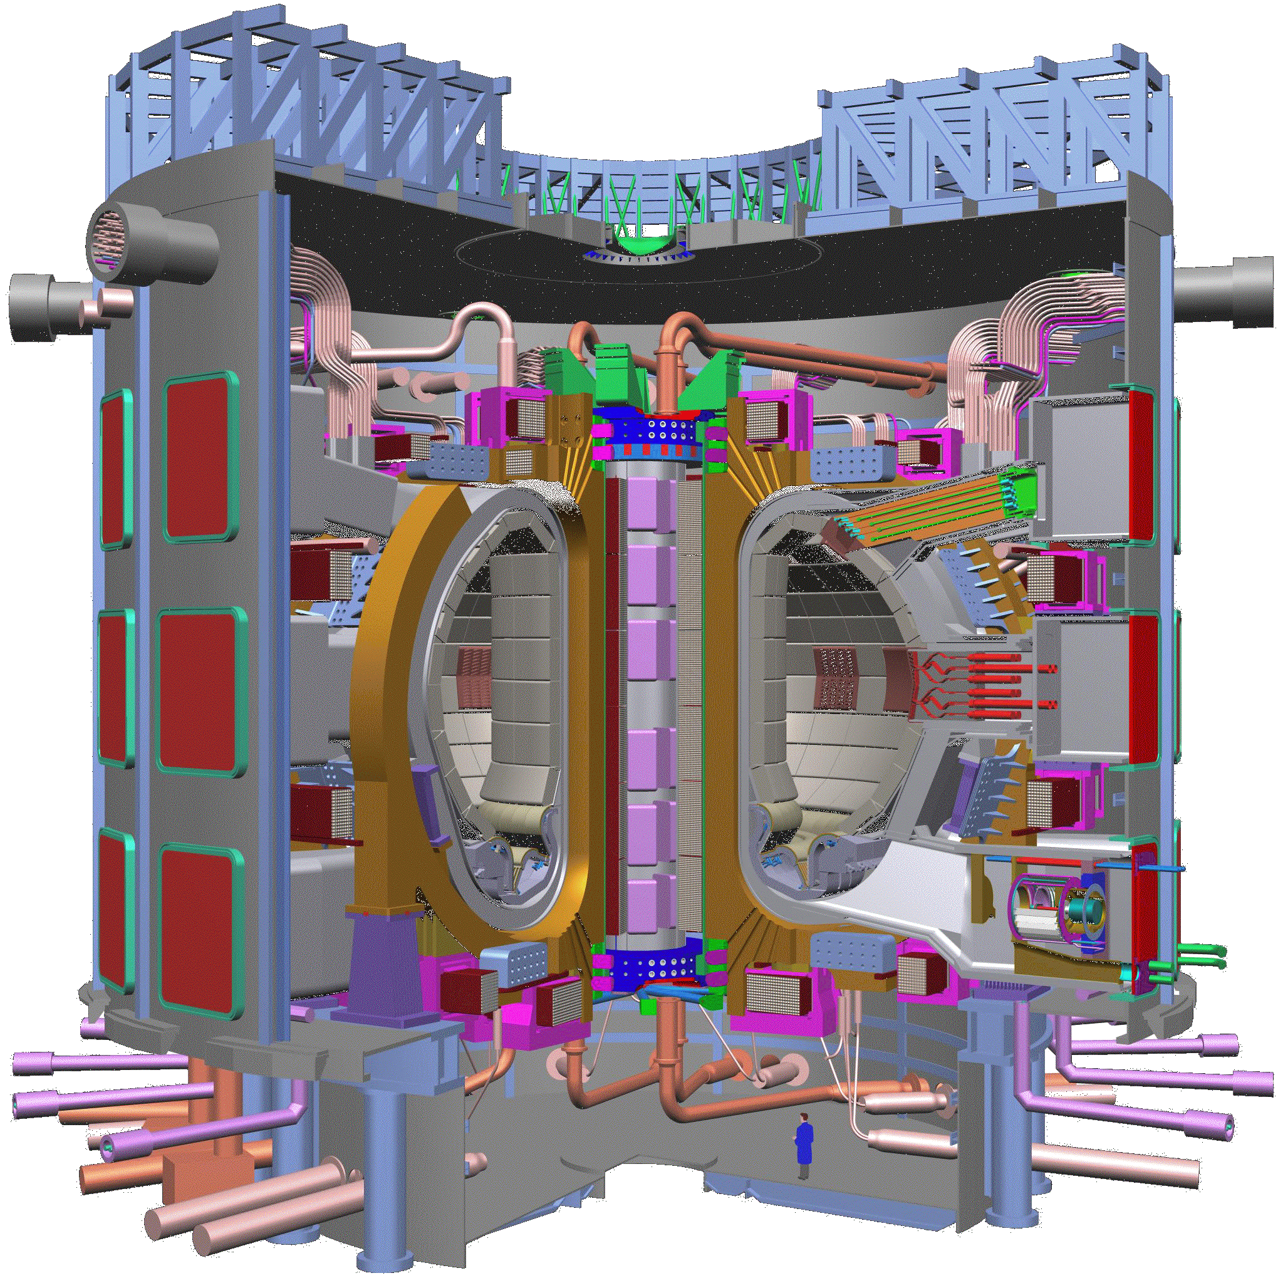
RF Current Drive in Fusion Plasmas
Magnetic Confinement: ITER
US-EU-Russia-Japan-India Collaboration
Will be built in Cardarache France
Completion 2016??
http://www.iter.org/
Poloidal magnetic field
a person
Injecting RF waves can drive a toroidal current. N. Fisch PRL (1978)
Toroidal current

Slide 16
RF Current Drive Efficiency
Original Langevin Treatment: Nat Fisch, PRL (1978)
RF pushes particles in velocity space.
Collisions relax distribution back to equilibrium.
What is the current generated per unit power dissipated? J/P_{D}
= RF induced velocity space particle flux
- energy
ψ sensitivity function, inversely proportional to collision rate

Slide 17
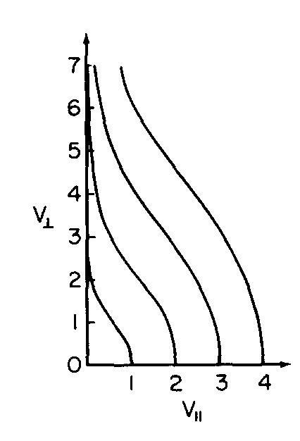
RF Current Drive Efficiency
RF pushes particles in velocity space.
Collisions relax distribution back to equilibrium.
electron velocity space
N. Fisch: Current generated in parallel direction even if push is in perpendicular direction
antisymmetric in v||

Slide 18
S. Hirshman, PoF, 23, 1238 (1980),
TMA and KR Chu, PoF 25, (1982),
M. Taguchi, J. Phys. Soc. Jpn (1982)
Adjoint Approach:
For a Homogeneous Plasma, we want to solve steady state kinetic equation
Problem #1
Linearized collision operator
RF induced velocity space flux - parameters
Then find parallel current FoM
Adjoint problem: Spitzer-Harm
Distribution function driven by a DC electric field.
Problem #2
Parallel current

Slide 19
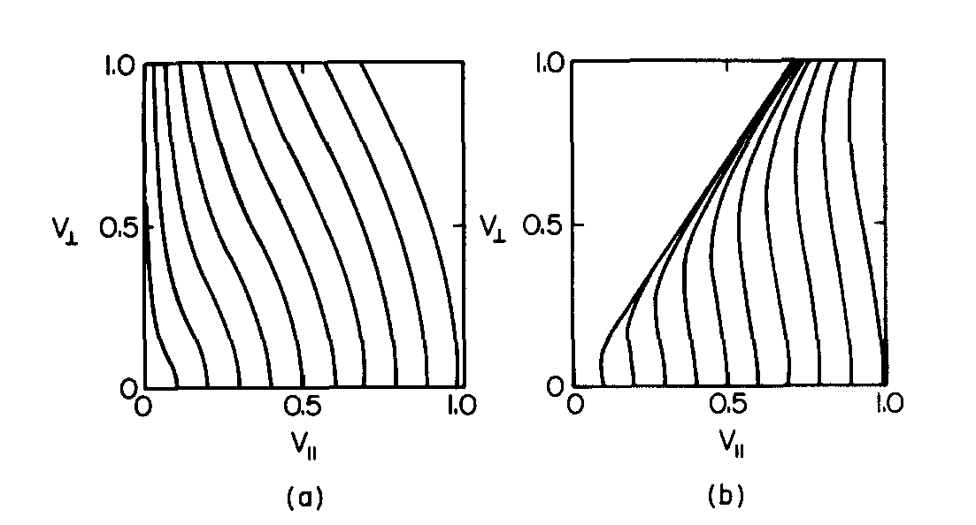
Toroidal Geometry Makes a Difference,
Streaming
TMA and KR Chu, PoF 25, (1982),
M. Taguchi, J. Phys. Soc. Jpn (1982)
Inside
Outside
Magnetically trapped particles
Toroidal effects
Ohkawa, T., 1976, General Atomic Company Report No. A1384
Parks, P. B., and F. B. Marcus, 1981, Nucl. Fusion 21, 1207
TMA, B. Hui, IEEE Trans Plasma Sci., 1986

Slide 20
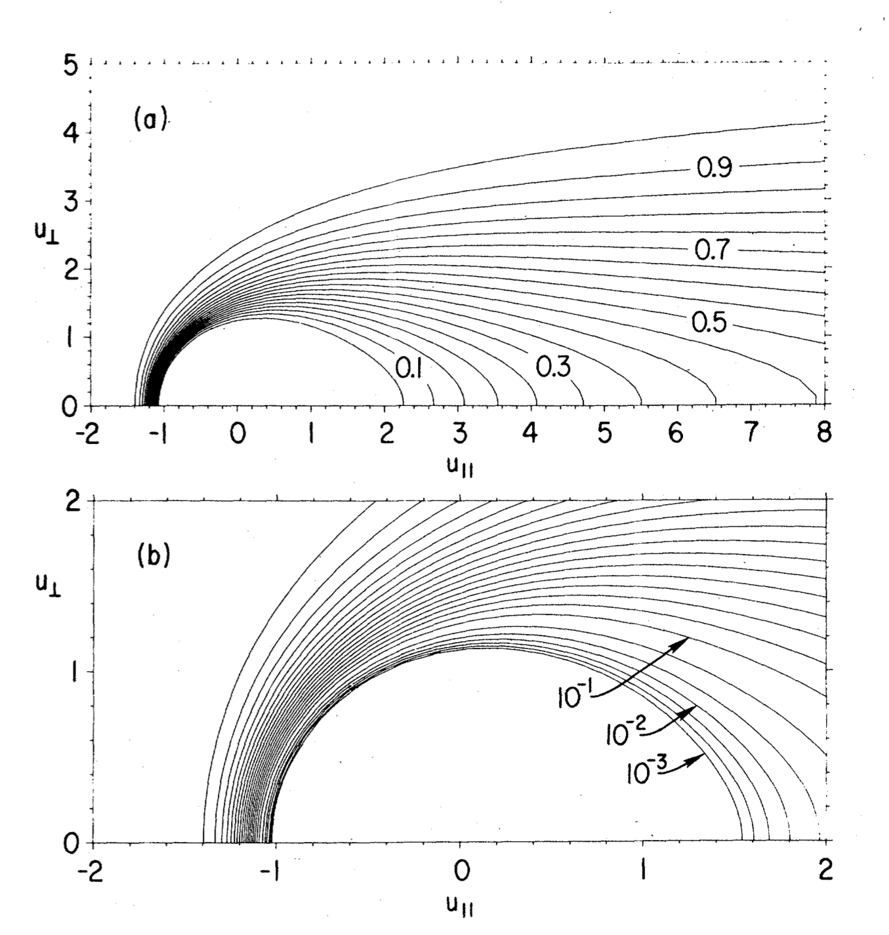
Extensions to Energetic Particles– Fisch and Karney
Probability of runaway
Energetic Particles lead to dynamic distribution functions
no RF
Probability of runaway (no RF)
Runaway rate with RF
Energy flow to stored poloidal field
w/ RF
Fisch, N. J., 1985a, Phys. Fluids 28, 245.
Fisch, N. J., and C. F. F. Karney, 1985b, Phys. Fluids 28, 3107.
Karney, C. F. F., and N. J. Fisch, 1986, Phys. Fluids 29, 180.
Fisch, Reviews of Modern Physics, Vol. 59, No. 1, January 1987
u - normalized to Dreicer velocity

Slide 21
Recent Adjoint Approaches
Shot noise on gyrotron beams, TMA, W. Manheimer and A. Fliflet, PoP (2001).
Beam optics sensitivity function, TMA, D. Chernin, J. Petillo, Phys. Plasmas 26, 013109 (2019);
Stellarator Optimization and Sensitivity, E. Paul, M. Landreman, TMA, J. Plasma Phys. (2019), vol. 85, 905850207, J. Plasma Phys. (2021), vol. 87, 905870214
Optimization of Flat to Round Transformers in Particle Accelerators, L. Dovlatyan, B. Beaudoin, S. Bernal, I. Haber, D. Sutter and TMA, Phys Rev Accel and Beams V25, 044002 (2022).
Adjoint Equations for Beam-Wave Interaction and Optimization of TWT Design, A. Vlasov, TMA, D. Chernin and I. Chernyavskiy, IEEE Trans. Plasma Sci. V. March (2022).
Give a child a hammer and everything becomes a nail.

Slide 22
Signal to Noise Ratio in Klystrons & Gyro-Klystrons
TMA, W. Manheimer and A. Fliflet, PoP (2001).
electron beam
power
in
power
out
Signal to noise ratio determined by ratio of injected signal power in Cavity 1 to fluctuating beam power due to discrete electronic charge.
fluctuating current
cathode
Cavity 1
Cavity 2
Shot noise: If arrival times in cavity 1 are independent and identically distributed, fluctuations are a white noise process.
But, this is wrong: electrons become correlated on transit from cathode to Cavity 1. Significantly reduces noise level.

Slide 23
Shielding Cloud
Method of dressed test particles
Direct calculation: Problem 1
For an ensemble (N>>1) of initial conditions at the cathode of test electrons, calculate the shielding cloud and total current fluctuation that excites the relevant mode in the cavity. Must be done for each test charge
shielding cloud
v
test charge
Adjoint approach: Problem 2
For a given cavity mode profile, integrate the kinetic equation (once) backward in time to find the sensitivity function at the cathode, average over initial ensemble of test electrons.
Shielding cloud is potentially unstable for Gyro-Klystrons (must taper guiding magnetic field)

Slide 24
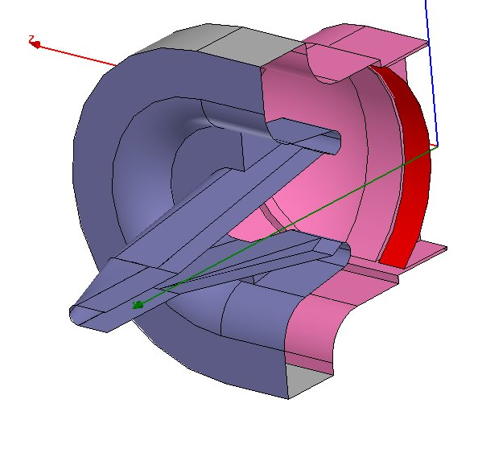
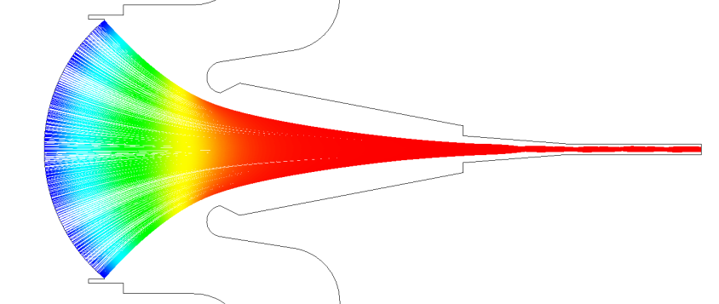
Global Beam Sensitivity Function for Electron Guns
TMA, D. Chernin, J. Petillo, Phys. Plasmas 26, 013109 (2019).
Thermionic Cathode Electron Gun
Goal
Evaluate a function that gives the variation of specific beam FoMs to variations in electrode potential/position
Can be used to
- establish manufacturing tolerances
- optimize gun designs
Should be embedded in gun code (e.g. Michelle)
– HV
Solid Model of Electrodes
1 cm
Emitter
Focus
Electrode
Ground
Beam is compressed
emitter
Beam leaves here
What shape to make electrodes?

Slide 25
Particle in Cell (PIC) Code Michelle
Code solves the Steady state equations of motion for N particles j=1, N in self consistent fields
Start with vacuum fields
Solve for trajectories
Anode
Emitter
exit
Accumulate a charge density on grid
CL
Particle Trajectories
Solve Poisson Equation
Iterates until converged
Petillo, J; Eppley, K; Panagos, D; et al., IEEE TPS 30, 1238-1264 (2002).

Slide 26
Beam Sensitivity Function
Basic question: How do small changes in position or potential of anode affect the properties of the beam leaving the gun?
Anode
Beam characterized by FoM, function of particle coordinates
Emitter
Beam leaves here
CL
Conventional Approach: Solve directly (Problem 1)
Do many simulations with different anode potentials, positions
Select the best based on Figure of Merit (FoM) measured at the exit.
Example RMS size

Slide 27
We need an adjoint problem
a) Wall displacement changes potential on unperturbed surface.
A
Problem #1
Direct
K
b) Leads to change in Figure of Merit F, function of electron coordinates.
C
A
b) Calculate and record change in normal E.
Problem #2
Adjoint
K
a) Perturb electron coordinates in a prescribed way based on FoM, then reverse momenta and send back
C
Electrons run backwards
Sensitivity function
Is the sensitivity function

Slide 28
Why does it work? Hamilton’s Equations Conserve Symplectic Area
H(p,q,t)
2023 John Dawson Award for Excellence in Plasma Physics Research
Philip Morrison, Hong Qin, and Eric Sonnendrücker
“For establishing and shaping the field of structure-preserving geometric algorithms for plasma physics.”
perturbed orbit #1
perturbed orbit #2
Reference trajectory in 6N dimensional phase space
Area conserved for any choice of 1 and 2

Slide 29
Reference Solution + Two Linearized Solutions
Two Linearized Solutions
true – changes in anode
adjoint – we pick
Subject to different BC’s
Reference Solution
Perturbation
Can show difference in symplectic area entering and leaving is given by surface integral of perturbed fields
Conservation of Symplectic Area meets Green’s Theorem !

Slide 30
What is the change in a generic figure of merit?
Generalized Green’s Theorem
Problem #2 Perturbed trajectories at exit proportional to grad-F
Sensitivity Function

Slide 31
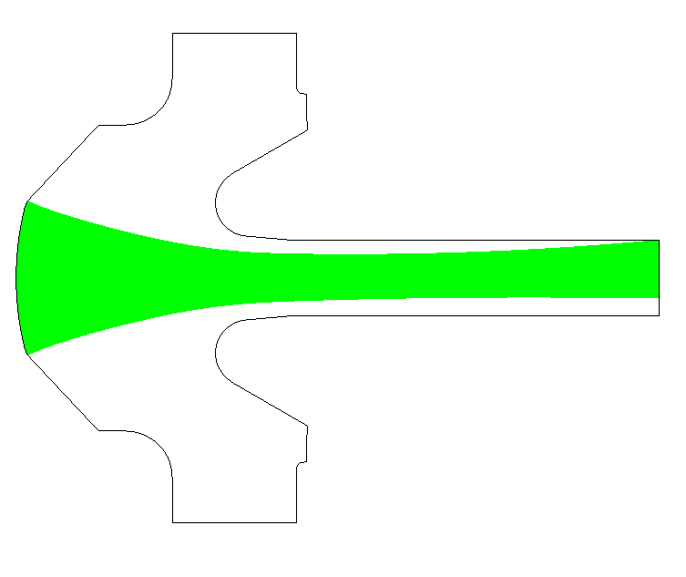
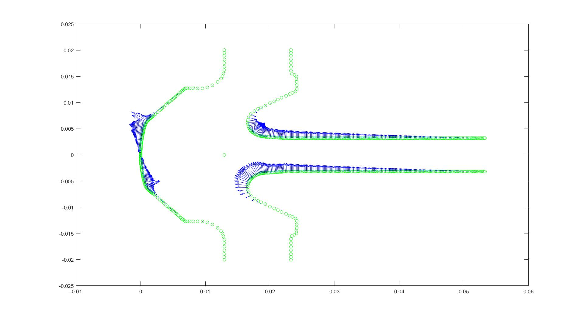
Vertical Displacement of the Beam
Vector plot of the ‘sensitivity’ or Green’s function
‘Direct’ MICHELLE Simulation with
Perturbed Anode Voltages
sensitivity arrows
Predicted displacement / Calculated displacement = 0.9969
Currently being updated to include B-field:
John Petillo, Serguei Ovtchinnikov, Aaron Jensen (Leidos), Philipp Borchard (Dymenso)
Kyle Kuhn, Heather Shannon, Brain Beaudoin TMA. (U. Maryland) ONR STTR

Slide 32
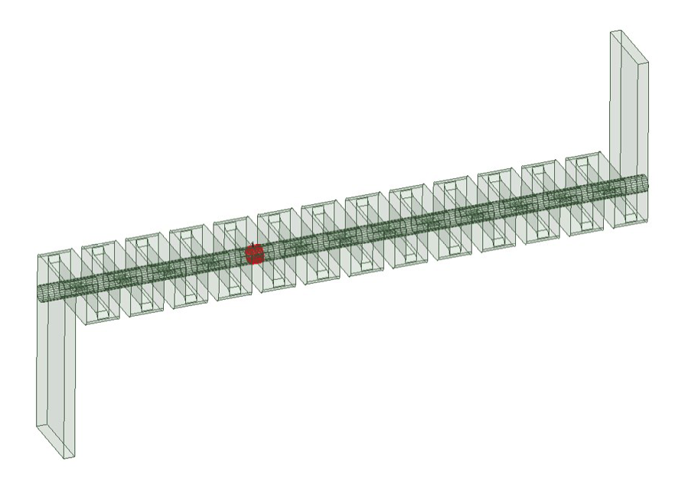
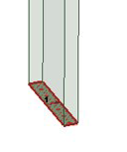
Optimization of TWT Design Using Adjoint Approach
A. Vlasov, TMA, D. Chernin, I. Chernyavskiy, IEEE Trans Plasma Science 2023.
Output
Folded waveguide
Beam
Optimizing gap spacings
Input
Optimization of Small Signal Gain

Slide 33
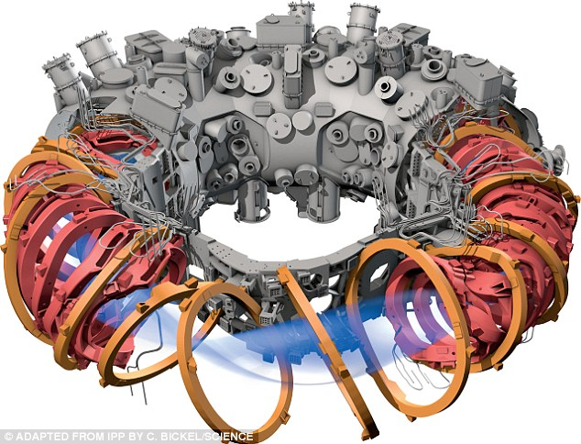
3D MHD Equilibria
Coils
Plasma
Wendelstein 7-X
Max Planck Institute for Plasma Physics (IPP)
Greifswald, Germany Completed 2015

Slide 34
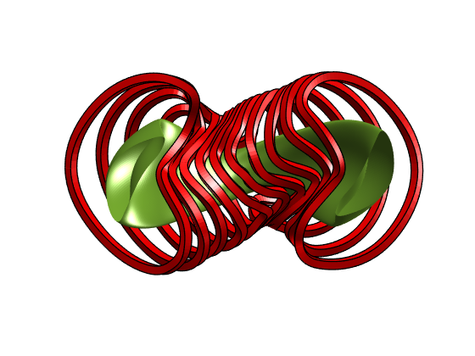
3D MHD Toroidal Equilibrium
In plasma
Coils
Basic Question: How do changes in coil currents or shapes affect equilibrium?
Alternatively, how do changes in the shape of the outermost flux surface affect equilibrium?

Slide 35
Adjoint Equations for Stellarator Equilibria
DRAG
Shape Gradient Sensitivity Functions
2021 APS Marshall N. Rosenbluth Outstanding Doctoral Thesis Award
"Adjoint methods for stellarator shape optimization and sensitivity analysis" UMD 2020
Currently Assistant Prof. Columbia
Elizabeth Paul
Outer flux surface
Landreman and Paul, (2018) Nucl. Fusion 58 076023,
TMA , E. Paul, M. Landreman, J. Plasma Phys. (2019),
E. Paul, M. Landreman, TMA, J. Plasma Phys. (2021),
R. Nies, E. Paul, S. Hudson, and A. Bhattacharjee, J. Plasma Phys. (2022), vol. 88, 905880106
Colors show sensitivity of rotational transform to displacement of outer flux surface

Slide 36
Linear Perturbations to Equilibrium
Similar to MHD stability -
- field line displacement
Changes in magnetic field
Added pressure tensor
Changes in current/shape of coils
or Shape of outer flux surface
Generalized responses:
Changes in current/shape/location of coil
Changes in vacuum fields
Changes in magnetic field

Slide 37
Generalized Forces and Responses
Responses
Vacuum fields
Plasma displacement
Toroidal current profile
Forces:
Coil currents
Pressure tensor
Rotational transform
More generically,
for two different perturbations
Self-Adjoint Symmetry Gives

Slide 38
Example Adjoint Relation
Adjoint added pressure tensor
Adjoint sensitivity function
Make this appear to be change in FoM
True interior displacement
True outer flux surface displacement

Slide 39
Surface and Coil Sensitivity
Adjoint Approach to gradient calculation
> 500 X Speed – Up over direct calculation
Uses VMEC & DIAGNO
Hirshman and Whitman, 1983 Phys. Fluids 25 3553
H.J. Gardner 1990 Nucl. Fusion 30 1417
Different Figures of Merit Possible
Plasma pressure – beta
Rotational transform
Toroidal current
Neoclassical radial transport -1/ν regime
Energetic particle drifts
Quasi-symmetry
Surface shape sensitivity
Coil location sensitivity

Slide 40
initial
final
initial
Optimized for “Quasi-symmetry” on axis
( good particle confinement)
final

Slide 41
Challenges
Sensitivity function
Make this appear to be change in FoM
Surface displacement
Limited number of FoMs can be put in this form.
Formulation must be compatible with 3D - Equilibrium codes
Minimize Energy
VMEC - S. P. Hirshman and J. C. Whitson, (1983).
SPEC - S. R. Hudson, R. L. Dewar, G. Dennis, M. J. Hole, M. McGann, G. von Nessi, and S. Lazerson, (2012).
Solve Force Balance
DESC – D. W. Dudt, E. Kolemen, (2020), D.W. Dudt , R. Conlin1, D. Panici and E. Kolemen, (2023)
Includes automatic differentiation to compute FoM gradient Program takes code, breaks into primitive operations and computes derivatives

Slide 42
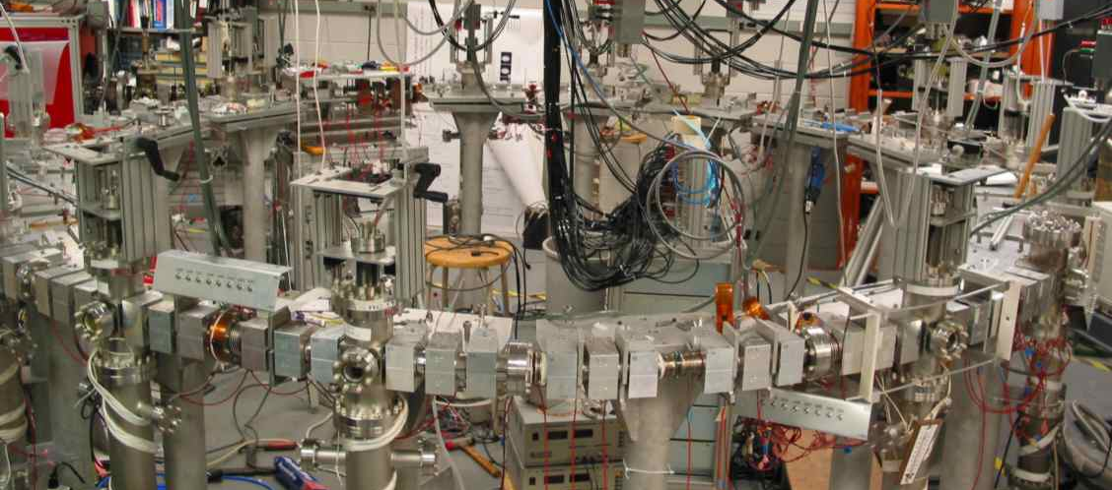
Optimization of Focusing Magnets in Accelerator Lattices
The University of Maryland Electron Ring
UMER is a fully functional electron storage ring

Slide 43
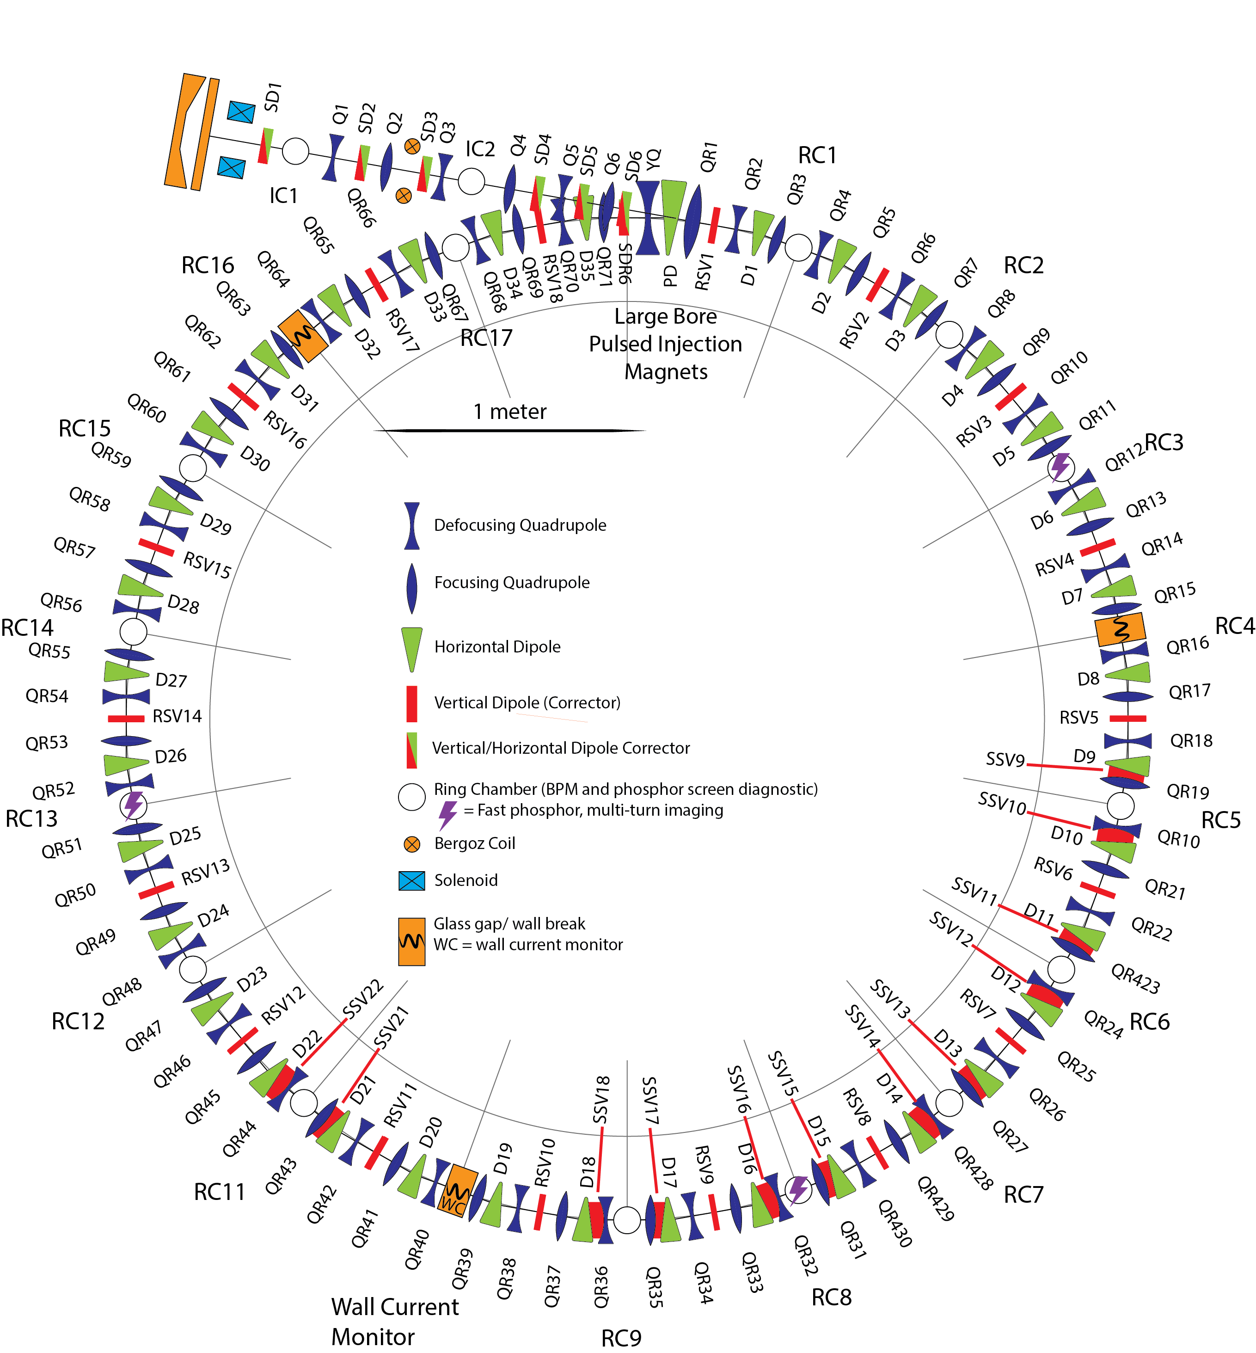
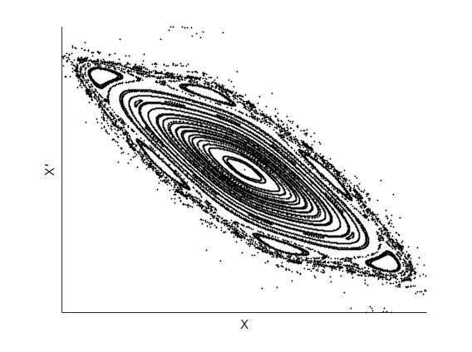
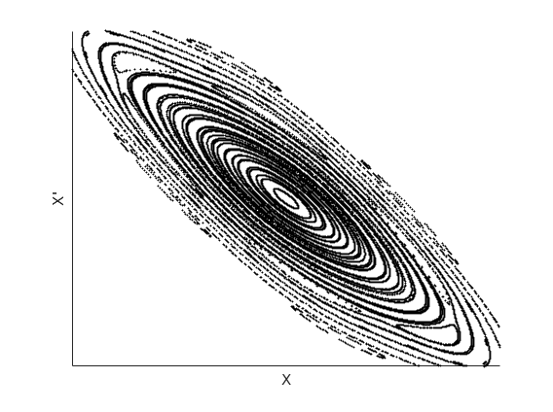
UMER Systems and Layout
167 Magnets, power supplies &
controls.
x’=dx/ds
Transverse Phase space
x
x’=dx/ds
Want to avoid trajectories outside here
x

Slide 44
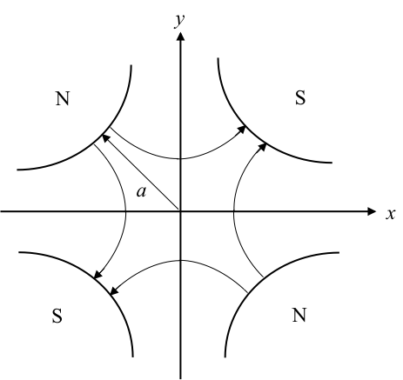
Focusing Basics
Quadrupole Magnetic Field
Focusing in x-direction
Defocusing in y-direction
qv – out of page
32 Quadrupole
magnets
Field strength increases linearly with distance from the axis

Slide 45
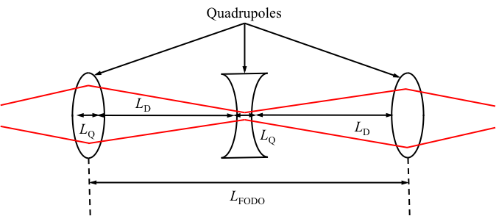
FODO Lattice
Alternate focusing and defocusing orientations
32 Quadrupole
magnets
Qualitative explanation: beam passes through focusing quad when it is big (strong fields). Passes through defocusing quad when it is small (weak fields). Net effect is focusing.
Beam distribution depends on many parameters How to optimize?
Can we become Lords of the Ring?

Slide 46
Optimization of Flat to Round Transformers Using Adjoint Techniques
L. Dovlatyan, B. Beaudoin, S. Bernal, I. Haber, D. Sutter and T. M. A. Phys. Rev. Acc. Beams (2022).
Locations and strengths of magnets optimized to produce round beam in solenoid
Flat Beam
Round Beam
Flat to Round and Round to Flat transformers are proposed for cooling of hadron beams. Ya. Derbenev, Adapting optics for high-energy electron cooling, Tech. Rep. UM-HE-98-04-A (1998).
Cylindrical hadron beam cools via collisions when co-propagated with electron beam. Optimized when beams overlap and transverse energy is minimum.

Slide 47
Circular Accelerators-Periodicity
Solve Eqs. of motion and self fields
Particles return to initial plane.
Need to maintain periodicity of distribution, not individual orbits
Big problems:
Do periodic distributions exist? Most likely no.
How to relaunch particles to optimize?
Start here with 4D particle coordinates
Constrained Optimization
“Adjoint with a Chaser”

Slide 48
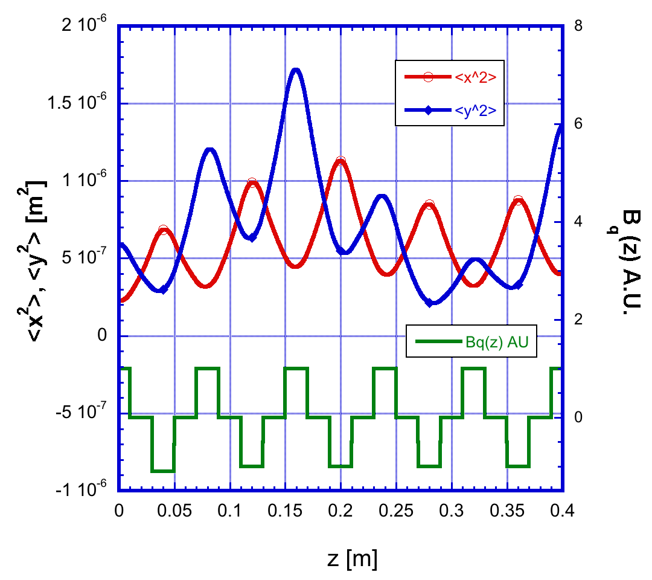
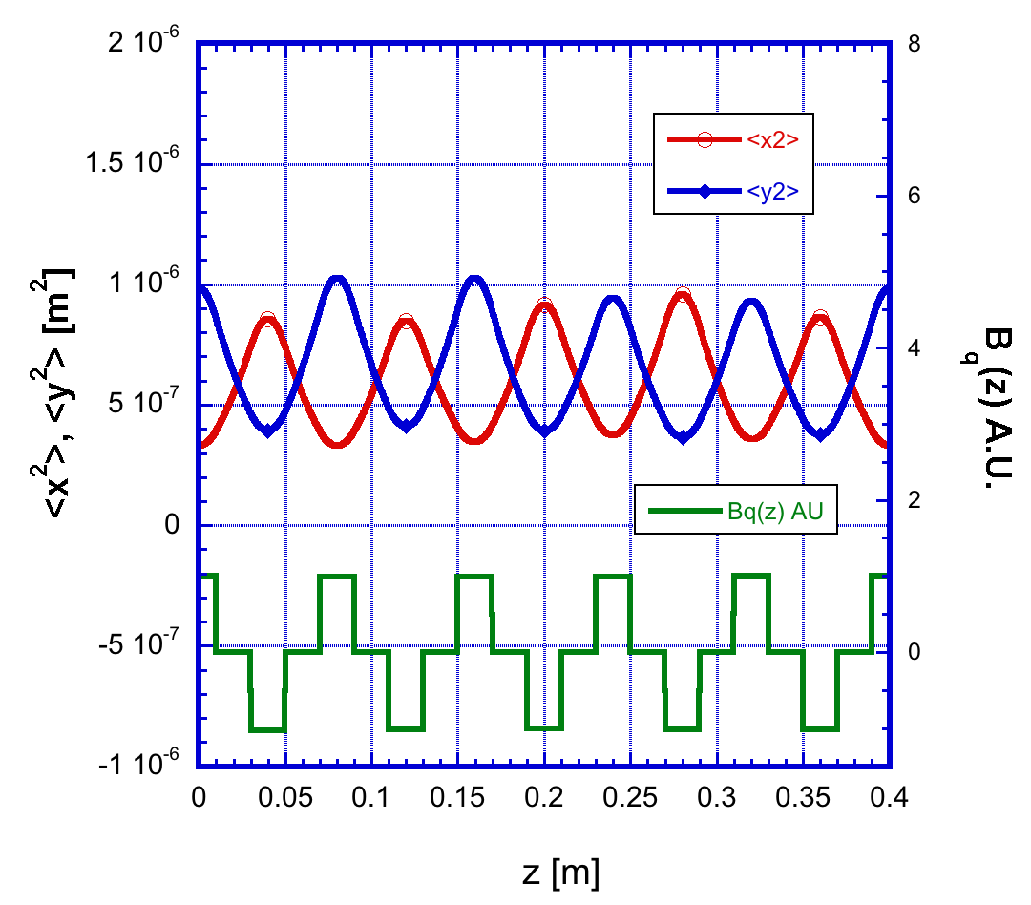
Test Problem – 10 Quadrupole lattice
Initial
Final
Transverse moments
Quadrupole strengths
Beam not in equilibrium
Large beam waist excursion
Beam moments become periodic
Excursions minimized (FoM)

Slide 49
Conclusion
Adjoint methods are a powerful way to evaluate parameter dependences in many systems involving charged particle dynamics.
Issue: coding complexity
Adjoint vs Automatic differentiation?
Thank you.
Acknowledge: ONR, DoE, AFOSR, Simons Foundation
Fuel Efficiency 1985 Volvo 240 DL

