Slide 1
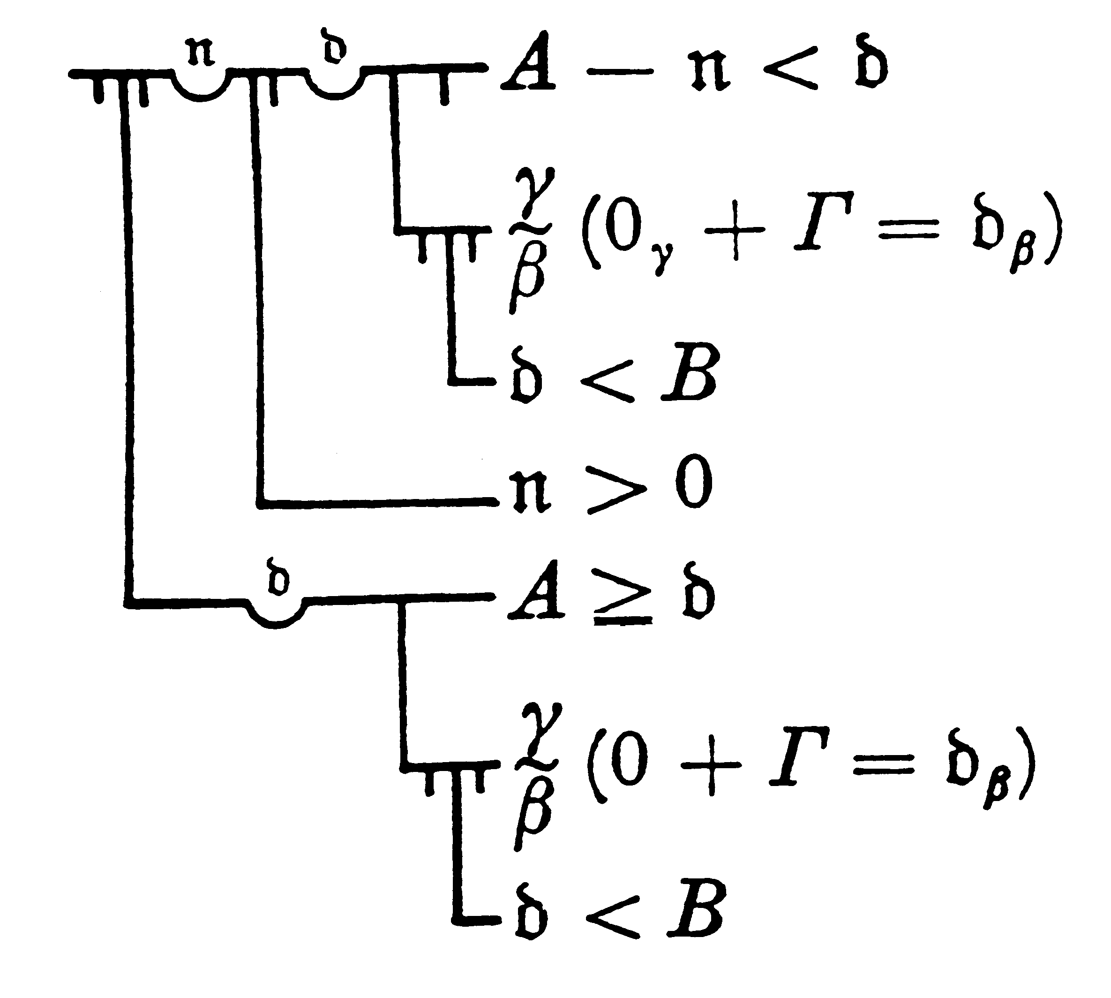
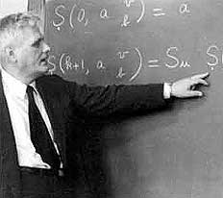
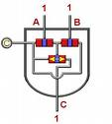
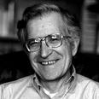
'I' Before 'E’ (especially after ‘C’) in Semantics:
Church, Chomsky, & Constrained Composition
Paul M. Pietroski
University of Maryland
Dept. of Linguistics, Dept. of Philosophy
http://www.terpconnect.umd.edu/~pietro

Slide 2

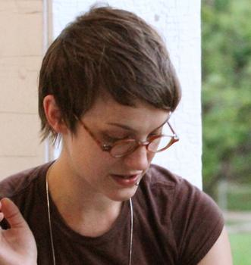
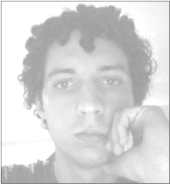
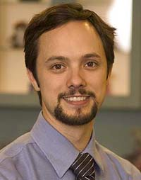
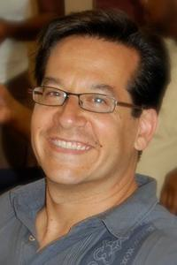
Tim
Hunter
A W
l e
e l
x l
i w
s o
o
d
Darko
Odic
J
e
f
f
L
i
d
z
Justin Halberda

Slide 3
Plan
Warm up on the I-language/E-language distinction
Examples of why focusing on I-languages matters in semantics
  semantic composition: & and ∃ in logical forms
  (which logical concepts get expressed via grammatical combination?)
  lexical meaning: ‘Most’ and its relation to human concepts
  (which logical concepts are used to encode word meanings?)

Slide 4
Plan
Warm up on the I-language/E-language distinction
Examples of why focusing on I-languages matters in semantics
  semantic composition: & and ∃ in logical forms
  (which logical concepts get expressed via grammatical combination?)
‘brown cow’ BROWN(x) & COW(x)
‘Fido chased Bessie into a barn’ ∃e[CHASED(e, FIDO, BESSIE) &
∃x[INTO(e, x) & BARN(x)]}

Slide 5
Lots of Ampersands
(not extensionally equivalent)
P & Q purely propositional
Fx &^{M} Gx purely monadic
Rx₁x₂ &^{DF} Sx₁x₂ purely dyadic, with fixed order
...
Rx₁x₂ &^{PA} Tx₃x₄x₁x₅ polyadic, with any order
Rx₁x₂ &^{PA} Tx₃x₄x₅x₆
‘brown cow’ BROWN(x) & COW(x)
‘Fido chased Bessie into a barn’ ∃e[CHASED(e, FIDO, BESSIE) &
∃x[INTO(e, x) & BARN(x)]}

Slide 6
Plan
Warm up on the I-language/E-language distinction
Examples of why focusing on I-languages matters in semantics
  semantic composition: & and ∃ in logical forms
  (which logical concepts get expressed via grammatical combination?
  lexical meaning: ‘Most’ and its relation to human concepts
  (which logical concepts are used to encode word meanings?)
MOST{DOTS(x), BLUE(x)}
#{x:DOT(x) & BLUE(x)} > #{x:DOT(x)}/2
#{x:DOT(x) & BLUE(x)} > #{x:DOT(x) & ∼BLUE(x)}
#{x:DOT(x) & BLUE(x)} > #{x:DOT(x)} – #{x:DOT(x) & BLUE(x)}
extensionally
equivalent

Slide 7
Many Conceptions of Human Language(s)
complexes of “dispositions to verbal behavior”
strings of a corpus (perhaps elicited, perhaps not)
something a radical interpreter ascribes to a speaker
a set of expressions
a biologically implementable procedure that generates
expressions, which may be characterizable only in terms of the procedure that generates them

Slide 8
‘I’ Before ‘E’
Church, reconstructing Frege...
function-in-intension vs. function-in-extension
--a procedure that pairs inputs with outputs in a certain way
--a set of ordered pairs (with no <x,y> and <x, z> where y ≠ z)

Slide 9
‘I’ Before ‘E’
function in Intension implementable procedure
that pairs inputs with outputs
function in Extension set of input-output pairs
|x – 1| ⁺√(x² – 2x + 1)
{…(-2, 3), (-1, -2), (0, 1), (1, 0), (2, 1), …}
λx . |x – 1| ≠ λx . ⁺√(x² – 2x + 1) distinct procedures
λx . |x – 1| = λx . ⁺√(x² – 2x + 1) same set
Extension[λx . |x – 1|] = Extension[λx . ⁺√(x² – 2x + 1)]

Slide 10
‘I’ Before ‘E’
Church: function-in-intension vs. function-in-extension
Chomsky: I-language vs. E-language
--an implementable procedure that generates expressions: π-λ DS-SS-PF DS-SS-PF-LF PHON-SEM
(a) ‘generate’ as in ‘These axioms generate the natural numbers’
(b) procedure...a LEXICON plus a COMBINATORICS
(c) open question how such procedures are used in events of comprehension/production/thinking/judging-acceptability

Slide 11
‘I’ Before ‘E’
Church: function-in-intension vs. function-in-extension
Chomsky: I-language vs. E-language
--an implementable procedure that generates expressions: π-λ DS-SS-PF DS-SS-PF-LF PHON-SEM
--other notions of language, e.g. sets of <PHON, SEM> pairs

Slide 12
In a Longer Version of the Talk...
Church’s Invention of the Lambda Calculus
  takes the I-perspective to be fundamental
Lewis, “Languages and Language”
  takes the E-perspective to be fundamental
  languages as sets of “ordered pairs of strings and meanings.”
  mixes the question of what languages are with questions about
  our (pre-theoretic) concept of a language
Two Perspectives on Marr’s LevelOne/LevelTwo distinction
  distinct targets of inquiry
  a suggested discovery procedure for getting a Level Two theory
Notes:
SLIDES 17-21 OPTIONAL

Slide 13
Plan
✔ Warm up on the I-language/E-language distinction
Examples of why focusing on I-languages matters in semantics
  semantic composition: & and ∃ in logical forms
  (which logical concepts get expressed via grammatical combination?)
  lexical meaning: ‘Most’ and its relation to human concepts
  (which logical concepts are used to encode word meanings?)

Slide 14
Event Variables
(1) Fido chased Bessie.
Chased(Fido, Bessie)
(2) Fido chased Bessie into a barn.
(3) Fido chased Bessie today.
(4) Fido chased Bessie into a barn today.
(5) Today, Fido chased Bessie into a barn.
(4) ⬅➔ (5)
 
(3) (2)
 
(1)

Slide 15
Event Variables
Fido chased Bessie.
∃e{Chased(e, Fido, Bessie)}
Fido chased Bessie into a barn.
∃e{Chased(e, Fido, Bessie) & Into-a-Barn(e)}
∃e{Chased(e, Fido, Bessie) & ∃x[Into(e, x) & Barn(x)]}
Fido chased Bessie today.
∃e{Chased(e, Fido, Bessie) & Today(e)}
∃e{Before(e, now) & Chase(e, Fido, Bessie) & OnDayOf(e, now)}
Chris saw Fido chase Bessie from the barn. (ambiguous)
∃e{Before(e, now) & ∃e’[See(e, Chris, e’) &
Chase(e’, Fido, Bessie) & From(e/e’, the barn)]}

Slide 16
Event Variables
Fido chased Bessie.
∃e{Chased(e, Fido, Bessie)}
Fido chased Bessie into a barn.
∃e{Chased(e, Fido, Bessie) & Into-a-Barn(e)}
∃e{Chased(e, Fido, Bessie) & ∃x[Into(e, x) & Barn(x)]}
Fido chased Bessie today.
∃e{Chased(e, Fido, Bessie) & Today(e)}
∃e{Before(e, now) & Chase(e, Fido, Bessie) & OnDayOf(e, now)}
Assumption: linguistic expressions really do have Logical Forms
expressions express (or are instructions for how to assemble) mental representations that exhibit certain forms and certain constituents

Slide 17
Events and Potential Decompositions
Fido chased Bessie.
∃e{Before(e, now) & Chase(e, Fido, Bessie)}
Agent(e, Fido) & Chase(e, Bessie)
Agent(e, Fido) & Chase(e) & Patient(e, Bessie)
Bessie was chased.
∃e{Before(e, now) & ∃x[Chase(e, x, Bessie)]}
Chase(e, Bessie)
There was a chase.
∃e{Before(e, now) & ∃x∃x’[Chase(e, x, x’)]
Chase(e)

Slide 18
Events and Potential Decompositions
Fido chased Bessie.
∃e{Before(e, now) & Chase(e, Fido, Bessie)}
Agent(e, Fido) & Chase(e, Bessie)
Agent(e, Fido) & Chase(e) & Patient(e, Bessie)
Bessie was chased by Fido.
∃e{Before(e, now) & ∃x[Chase(e, x, Bessie)]} & Agent(e, Fido)}
Chase(e, Bessie)
There was a chase of Bessie.
∃e{Before(e, now) & ∃x∃x’[Chase(e, x, x’)]} & Patient(e, Bessie)
Chase(e)

Slide 19
Event Variables, but at least Agents separated
Fido chased Bessie.
∃e{Before(e, now) & Agent(e, Fido) & ChaseOf(e, Bessie)}
For today, remain neutral about Chase(e) & Patient(e, Bessie)
any further decomposition

Slide 20
Event Variables, but at least Agents separated
Fido chased Bessie.
∃e{Before(e, now) & Agent(e, Fido) & ChaseOf(e, Bessie)}
Bessie kicked Fido.
∃e{Before(e, now) & Agent(e, Bessie) & KickOf(e, Fido)}

Slide 21
Event Variables but no SupraDyadic Predicates
Fido chased Bessie.
∃e{Before(e, now) & Agent(e, Fido) & ChaseOf(e, Bessie)}
Bessie kicked Fido.
∃e{Before(e, now) & Agent(e, Bessie) & KickOf(e, Fido)}
Bessie kicked Fido the ball
∃e{Before(e, now) & Agent(e, Bessie) & KickOfTo(e, the ball, Fido)}
To(e, Fido) & KickOf(e, the ball)

Slide 22
Event Variables but no SupraDyadic Predicates
Fido chased Bessie.
∃e{Before(e, now) & Agent(e, Fido) & ChaseOf(e, Bessie)}
Bessie kicked Fido.
∃e{Before(e, now) & Agent(e, Bessie) & KickOf(e, Fido)}
Bessie kicked Fido the ball
∃e{Before(e, now) & Agent(e, Bessie) & KickOfTo(e, the ball, Fido)}
To(e, Fido) & KickOf(e, the ball)
Bessie gave Fido the ball
∃e{Before(e, now) & Agent(e, Bessie) & GiveOfTo(e, the ball, Fido)}
To(e, Fido) & GiveOf(e, the ball)

Slide 23
Event Variables but no SupraDyadic Predicates
Fido chased Bessie.
∃e{Before(e, now) & Agent(e, Fido) & ChaseOf(e, Bessie)}
Fido gleefully chased Bessie into a barn today.
∃e{Before(e, now) & Agent(e, Fido)
& Gleeful(e)
& ChaseOf(e, Bessie)
& ∃x[Into(e, x) & Barn(x)]
& OnDayOf(e, now)
}
Another Talk
(Several Papers)
This is indicative...
Logical Forms
do not include triadic concepts

Slide 24
Event Variables but no SupraDyadic Predicates
Fido chased Bessie.
∃e{Before(e, now) & Agent(e, Fido) & ChaseOf(e, Bessie)}
Fido gleefully chased Bessie into a barn today.
∃e{Before(e, now) & Agent(e, Fido)
& Gleeful(e)
& ChaseOf(e, Bessie)
& ∃x[Into(e, x) & Barn(x)]
& OnDayOf(e, now)
}
Another Talk
(Several Papers)
This is indicative...
Logical Forms
do not include triadic concepts

Slide 25
Lots of Conjoiners
P & Q purely propositional
Fx &^{M} Gx purely monadic
??? ???
Rx₁x₂ &^{DF} Sx₁x₂ purely dyadic, with fixed order
Rx₁x₂ &^{DA} Sx₂x₁ purely dyadic, any order
Rx₁x₂ &^{PF} Tx₁x₂x₃x₄ polyadic, with fixed order
Rx₁x₂ &^{PA} Tx₃x₄x₁x₅ polyadic, any order
Rx₁x₂ &^{PA} Tx₃x₄x₅x₆ the number of variables in the
conjunction can exceed
the number in either conjunct
NOT EXTENSIONALLY
EQUIVALENT

Slide 26
Lots of Conjoiners, Semantics
If π and π* are propositions, then
TRUE(π & π*) iff TRUE(π) and TRUE(π*)
If π and π* are monadic predicates, then for each entity x:
SATISFIES[(π &^{M} π*), x] iff APPLIES[π, x] and APPLIES[π*, x]
If π and π* are dyadic predicates, then for each ordered pair o:
SATISFIES[(π &^{DA} π*), o] iff APPLIES[π, o] and APPLIES[π*, o]
If π and π* are predicates, then for each sequence σ:
SATISFIES[σ, (π &^{PA} π*)] iff SATISFIES[σ, π] and SATISFIES[σ, π*]

Slide 27
Lots of Conjoiners
P & Q purely propositional
Fx &^{M} Gx purely monadic
??? ???
Rx₁x₂ &^{DF} Sx₁x₂ purely dyadic, with fixed order
Rx₁x₂ &^{DA} Sx₂x₁ purely dyadic, any order
Rx₁x₂ &^{PF} Tx₁x₂x₃x₄ polyadic, with fixed order
Rx₁x₂ &^{PA} Tx₃x₄x₁x₅ polyadic, any order
Rx₁x₂ &^{PA} Tx₃x₄x₅x₆ the number of variables in the
conjunction can exceed
the number in either conjunct

Slide 28
Lots of Conjoiners
P & Q purely propositional
Fx &^{M} Gx purely monadic
Brown(_)^Cow(_) a monad can join with a monad
Into(_,_)^Barn(_) a dyad can join with a monad (order fixed)
Rx₁x₂ &^{DF} Sx₁x₂ purely dyadic, with fixed order
Rx₁x₂ &^{DA} Sx₂x₁ purely dyadic, any order
Rx₁x₂ &^{PF} Tx₁x₂x₃x₄ polyadic, with fixed order
Rx₁x₂ &^{PA} Tx₃x₄x₁x₅ polyadic, any order
Rx₁x₂ &^{PA} Tx₃x₄x₅x₆ the number of variables in the
conjunction can exceed
the number in either conjunct

Slide 29
A Restricted Conjoiner and Closer, allowing for a smidgen of dyadicity
If M is a monadic predicate and D is a dyadic predicate,
then for each ordered pair <e, x>:
the conjunction D^M applies to <e, x> iff
D applies to <e, x> and M applies to x
∃[D^M] applies to e iff
for some x: D^M applies to <e, x>
for some x: D applies to <e, x> and M applies to x

Slide 30
A Restricted Conjoiner and Closer, allowing for a smidgen of dyadicity
If M is a monadic predicate and D is a dyadic predicate,
then for each ordered pair <e, x>:
the conjunction D^M applies to <e, x> iff
D applies to <e, x> and M applies to x
∃[Into(_, _)^Barn(_)] applies to e iff
for some x: Into(_, _)^Barn(_) applies to <e, x>
for some x: Into(_, _) applies to <e, x> and Barn(_) applies to x

Slide 31
Fido chase Bessie into a barn
∃e{Agent(e, Fido) & ChaseOf(e, Bessie) & ∃x[Into(e, x) & Barn(x)]}
∃[Into(_, _)^Barn(_)]
No Freedom
(1) the “internal” slot of any dyadic conjunct
must target the slot of the other conjunct
(2) a dyadic conjunct triggers ∃-closure,
which must target the slot of a monadic concept
∃x[Into(e, y) & Barn(x)]
∃e[Into(e, x) & Barn(x)]

Slide 32
Fido chase Bessie into a barn
∃e{Agent(e, Fido) & ChaseOf(e, Bessie) & ∃x[Into(e, x) & Barn(x)]}
∃[Into(_, _)^Barn(_)]
∃[Agent(_, _)^Bessie(_)]
(1) the “internal” slot of any dyadic conjunct
must target the slot of the other conjunct
(2) a dyadic conjunct triggers ∃-closure,
which must target the slot of a monadic concept

Slide 33
Fido chase Bessie into a barn
∃e{Agent(e, Fido) & ChaseOf(e, Bessie) & ∃x[Into(e, x) & Barn(x)]}
∃[Into(_, _)^Barn(_)]
∃[ChaseOf(_, _)^Bessie(_)]
(1) the “internal” slot of any dyadic conjunct
must target the slot of the other conjunct
(2) a dyadic conjunct triggers ∃-closure,
which must target the slot of a monadic concept

Slide 34
Fido chase Bessie into a barn
∃e{Agent(e, Fido) & ChaseOf(e, Bessie) & ∃x[Into(e, x) & Barn(x)]}
∃ {
∃[Agent(_, _)^Fido(_)]^
∃[ChaseOf(_, _)^Bessie(_)]^
∃[Into(_, _)^Barn(_)]
}
(1) the “internal” slot of any dyadic conjunct
must target the slot of the other conjunct
(2) a dyadic conjunct triggers ∃-closure,
which must target the slot of a monadic concept

Slide 35
Lots of Conjoiners
P & Q purely propositional
Fx &^{M} Gx purely monadic
Brown(_)^Cow(_) a monad can join with a monad
Into(_,_)^Barn(_) a dyad can join with a monad (order fixed)
Rx₁x₂ &^{DF} Sx₁x₂ purely dyadic, with fixed order
Rx₁x₂ &^{DA} Sx₂x₁ purely dyadic, any order
Rx₁x₂ &^{PF} Tx₁x₂x₃x₄ polyadic, with fixed order
Rx₁x₂ &^{PA} Tx₃x₄x₁x₅ polyadic, any order
Rx₁x₂ &^{PA} Tx₃x₄x₅x₆ the number of variables in the
conjunction can exceed
the number in either conjunct

Slide 36
A Restricted Conjoiner and Closer, allowing for a little dyadicity
a monad can join with...
Brown(_)^Cow(_) ...another monad to form a monad
∃[Into(_, _)^Barn(_)] ...or with a dyad to form a monad (via fixed closure)
Appeal to more permissive operations must be justified on empirical grounds that include accounting for the limited way in which polyadicity is manifested in human languages

Slide 37
Plan
✔ Warm up on the I-language/E-language distinction
Examples of why focusing on I-languages matters in semantics
  ✔ semantic composition: & and ∃ in logical forms
  (which logical concepts get expressed via grammatical combination?)
  lexical meaning: ‘Most’ and its relation to human concepts
  (which logical concepts are used to encode word meanings?)

Slide 38
Lots of Possible Analyses
MOST{DOTS(x), BLUE(x)}
Cardinality Comparison
#{x:DOT(x) & BLUE(x)} > #{x:DOT(x)}/2
#{x:DOT(x) & BLUE(x)} > #{x:DOT(x) & ∼BLUE(x)}
#{x:DOT(x) & BLUE(x)} > #{x:DOT(x)} – #{x:DOT(x) & BLUE(x)}

Slide 39
Hume’s Principle
#{x:T(x)} = #{x:H(x)}
iff
{x:T(x)} OneToOne {x:H(x)}
____________________________________________
#{x:T(x)} > #{x:H(x)}
iff
{x:T(x)} OneToOnePlus {x:H(x)}
α OneToOnePlus β iff for some α*,
α* is a proper subset of α, and α* OneToOne β
(and it’s not the case that β OneToOne α)

Slide 40
Lots of Possible Analyses
MOST{DOTS(x), BLUE(x)}
No Cardinality Comparison
1-TO-1-PLUS[{x:DOT(x) & BLUE(x)}, {x:DOT(x) & ∼BLUE(x)}]
Cardinality Comparison
#{x:DOT(x) & BLUE(x)} > #{x:DOT(x)}/2
#{x:DOT(x) & BLUE(x)} > #{x:DOT(x) & ∼BLUE(x)}
#{x:DOT(x) & BLUE(x)} > #{x:DOT(x)} – #{x:DOT(x) & BLUE(x)}

Slide 41
Some Relevant Facts
many animals are good cardinality-estimators, by dint of a much studied “ANS” system (Dehaene, Gallistel/Gelman, etc.)
appeal to subtraction operations is not crazy (Gallistel & King)
infants can do one-to-one comparison (see Wynn)
Frege’s derived his axioms for arithmetic from Hume’s Principle, definitions, and a consistent fragment of his logic
Lots of references and discussion in…
The Meaning of 'Most’. Mind and Language (2009).
Interface Transparency and the Psychosemantics of ‘most’. Natural Language Semantics (2011 ).

Slide 42
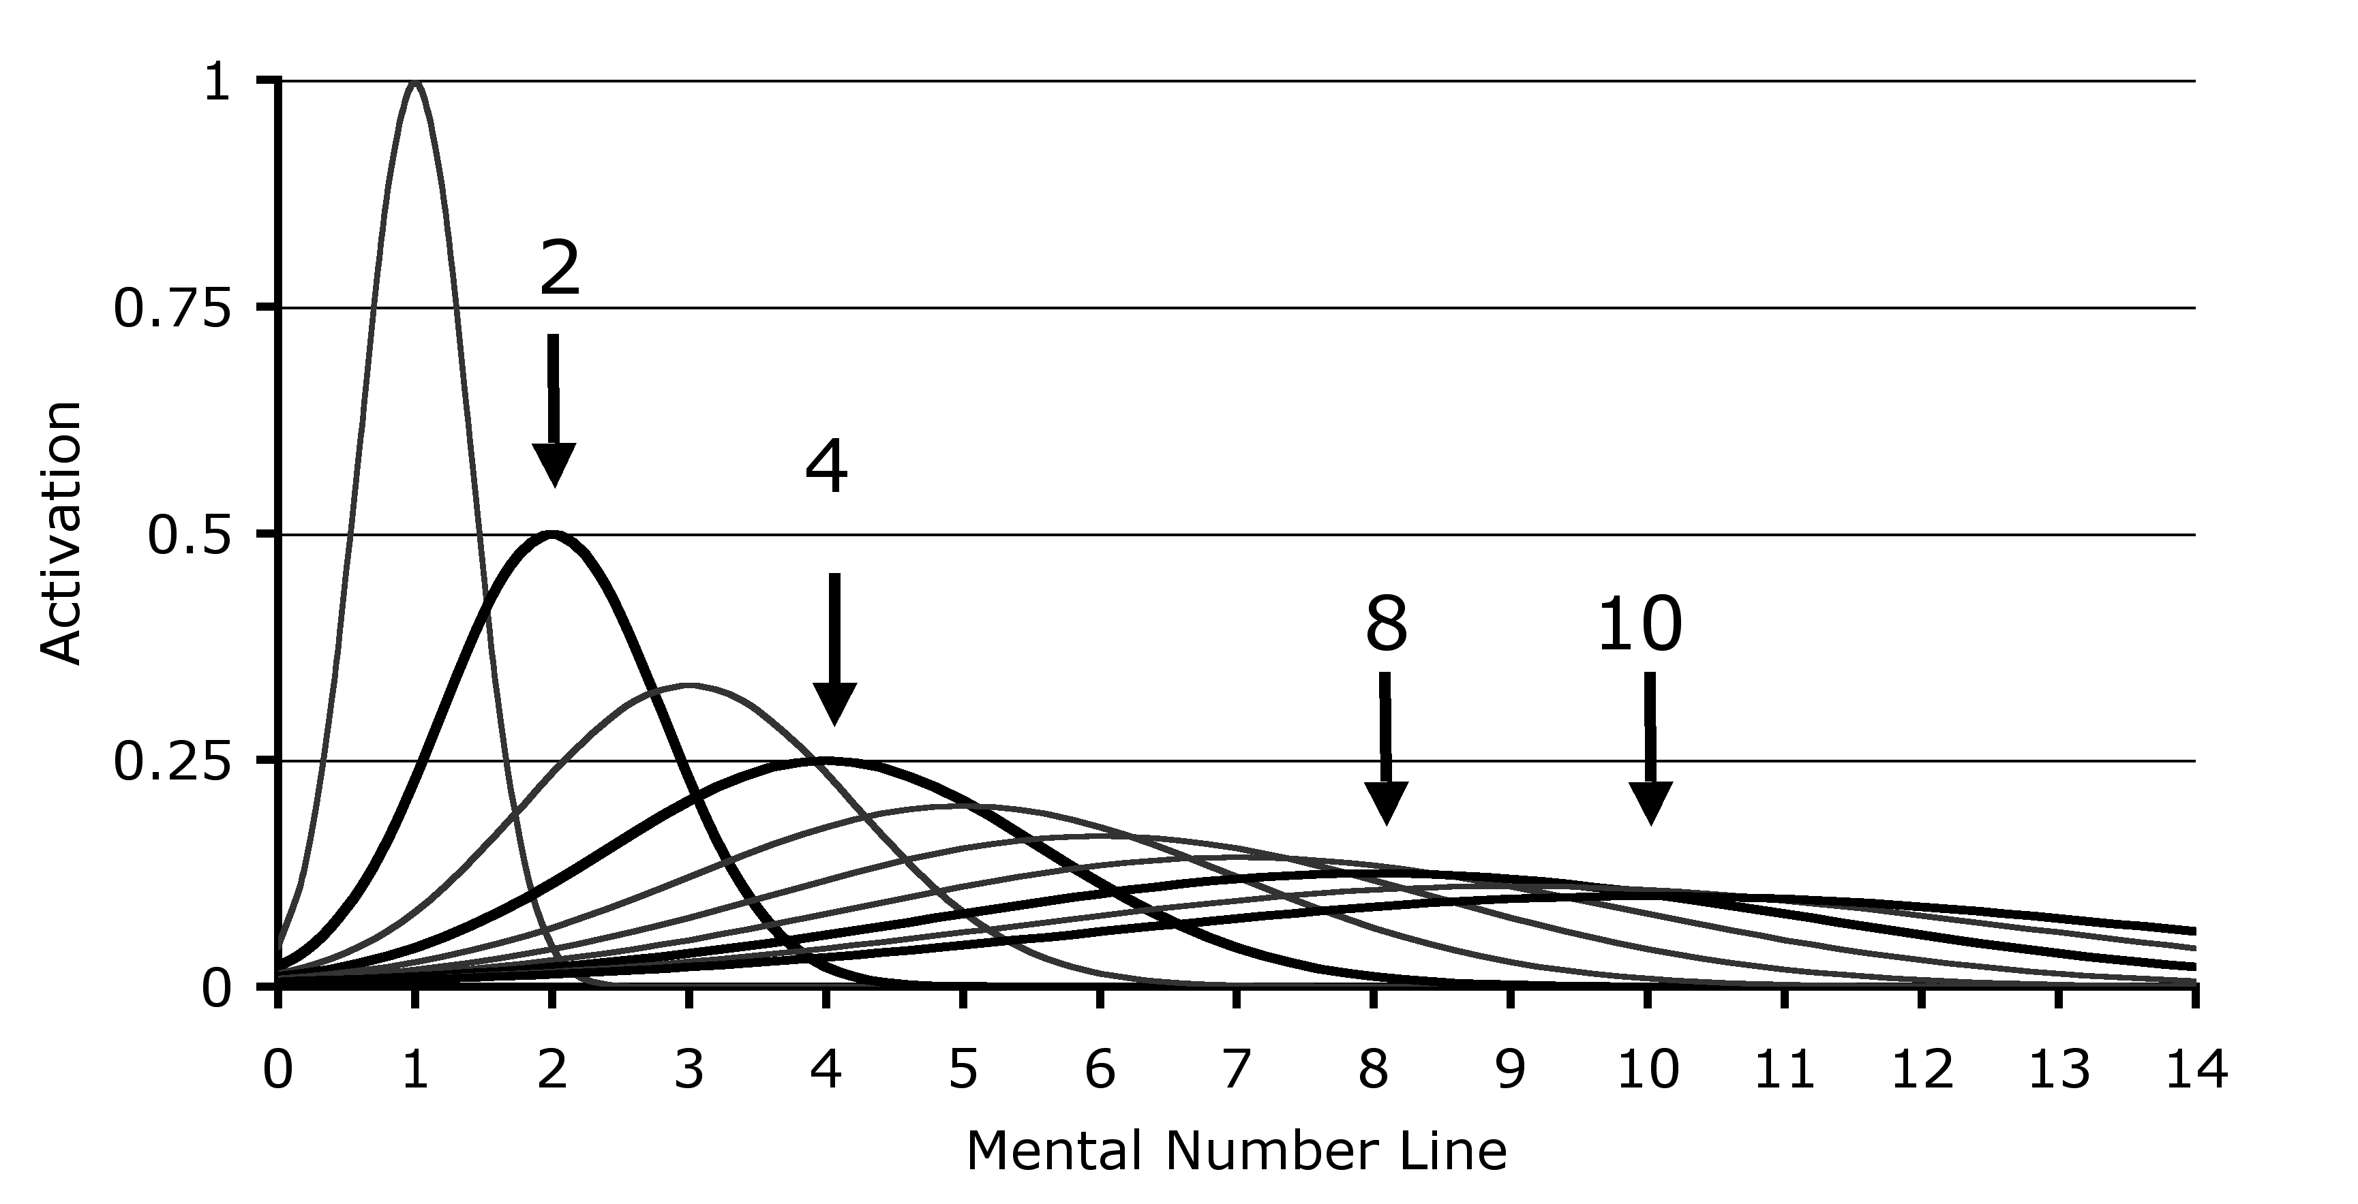
a model of the “Approximate Number System (ANS)”
(key feature: ratio-dependence of discriminability)
distinguishing 8 dots from 4 (or 16 from 8)
is easier than
distinguishing 10 dots from 8 (or 20 from 10)

Slide 43
a model of the “Approximate Number System (ANS)”
(key feature: ratio-dependence of discriminability)
correlatively, as the number of dots rises, “acuity” for estimating of cardinality decreases--but still in a ratio-dependent way, with wider “normal spreads” centered on right answers

Slide 44
Lots of Possible Analyses, but perhaps... a way of testing how ‘most’ is understood
MOST{DOTS(x), BLUE(x)}
No Cardinality Comparison
1-TO-1-PLUS[{x:DOT(x) & BLUE(x)}, {x:DOT(x) & ∼BLUE(x)}]
Cardinality Comparison
#{x:DOT(x) & BLUE(x)} > #{x:DOT(x)}/2
#{x:DOT(x) & BLUE(x)} > #{x:DOT(x) & ∼BLUE(x)}
#{x:DOT(x) & BLUE(x)} > #{x:DOT(x)} – #{x:DOT(x) & BLUE(x)}
So it would be nice if we could get evidence about which computations speakers perform when evaluating ‘Most of the dots are blue’

Slide 45
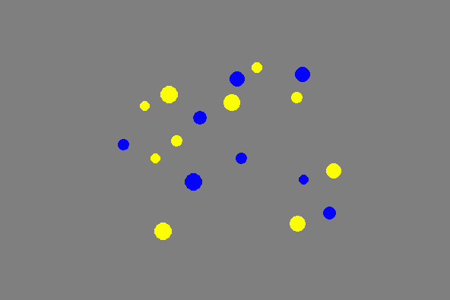
Notes:
4 to 5

Slide 46
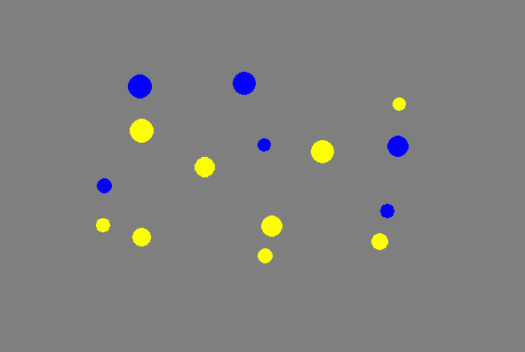
Notes:
1 to 2 SUPER EASY

Slide 47
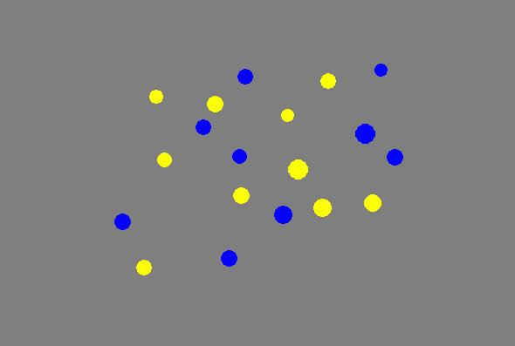
Notes:
9 tp 10

Slide 48
4:5 (blue:yellow)
“scattered random”
Notes:
4 to 5

Slide 49
1:2 (blue:yellow)
“scattered random”
Notes:
1 to 2 SUPER EASY

Slide 50
9:10 (blue:yellow)
“scattered random”
Notes:
9 tp 10

Slide 51
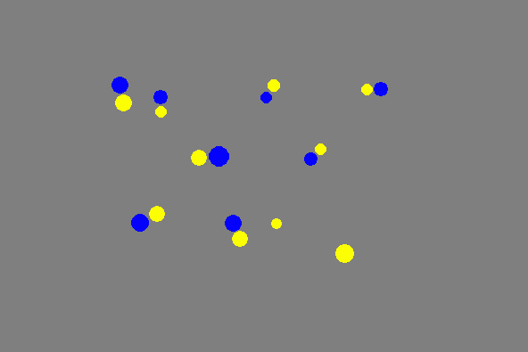
4:5 (blue:yellow)
“scattered pairs”
yellow loners

Slide 52
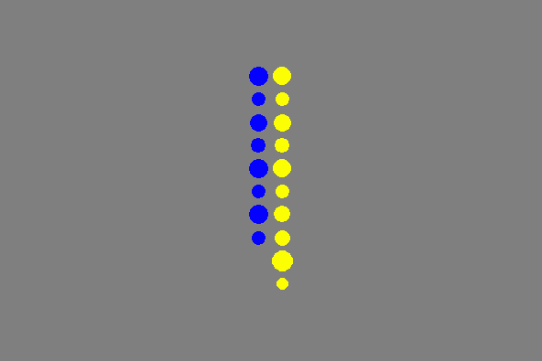
4:5 (blue:yellow)
“sorted columns”
yellow loners

Slide 53
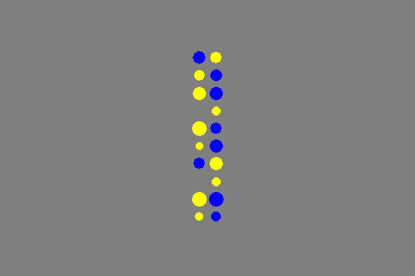
4:5 (blue:yellow)
“mixed columns”
yellow loners
Notes:
4 to 5

Slide 54
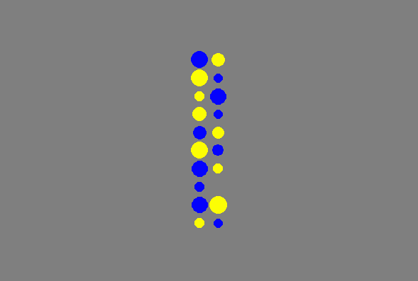
5:4 (blue:yellow)
“mixed columns”
one blue loner
Notes:
9 to 10

Slide 55
4:5 (blue:yellow)

Slide 56
Basic Design
12 naive adults, 360 trials for each participant
4 trial types: scattered random, scattered pairs (with loners)
mixed columns, sorted columns
5-17 dots of each color on each trial
trials varied by ratio (from 1:2 to 9:10) and type
each “dot scene” displayed for 200ms
target sentence: Are most of the dots yellow?
answer ‘yes’ or ‘no’ by pressing buttons on a keyboard
correct answer randomized
relevant controls for area (pixels) vs. number, yada yada…

Slide 57
better performance on easier ratios: p < .001

Slide 58
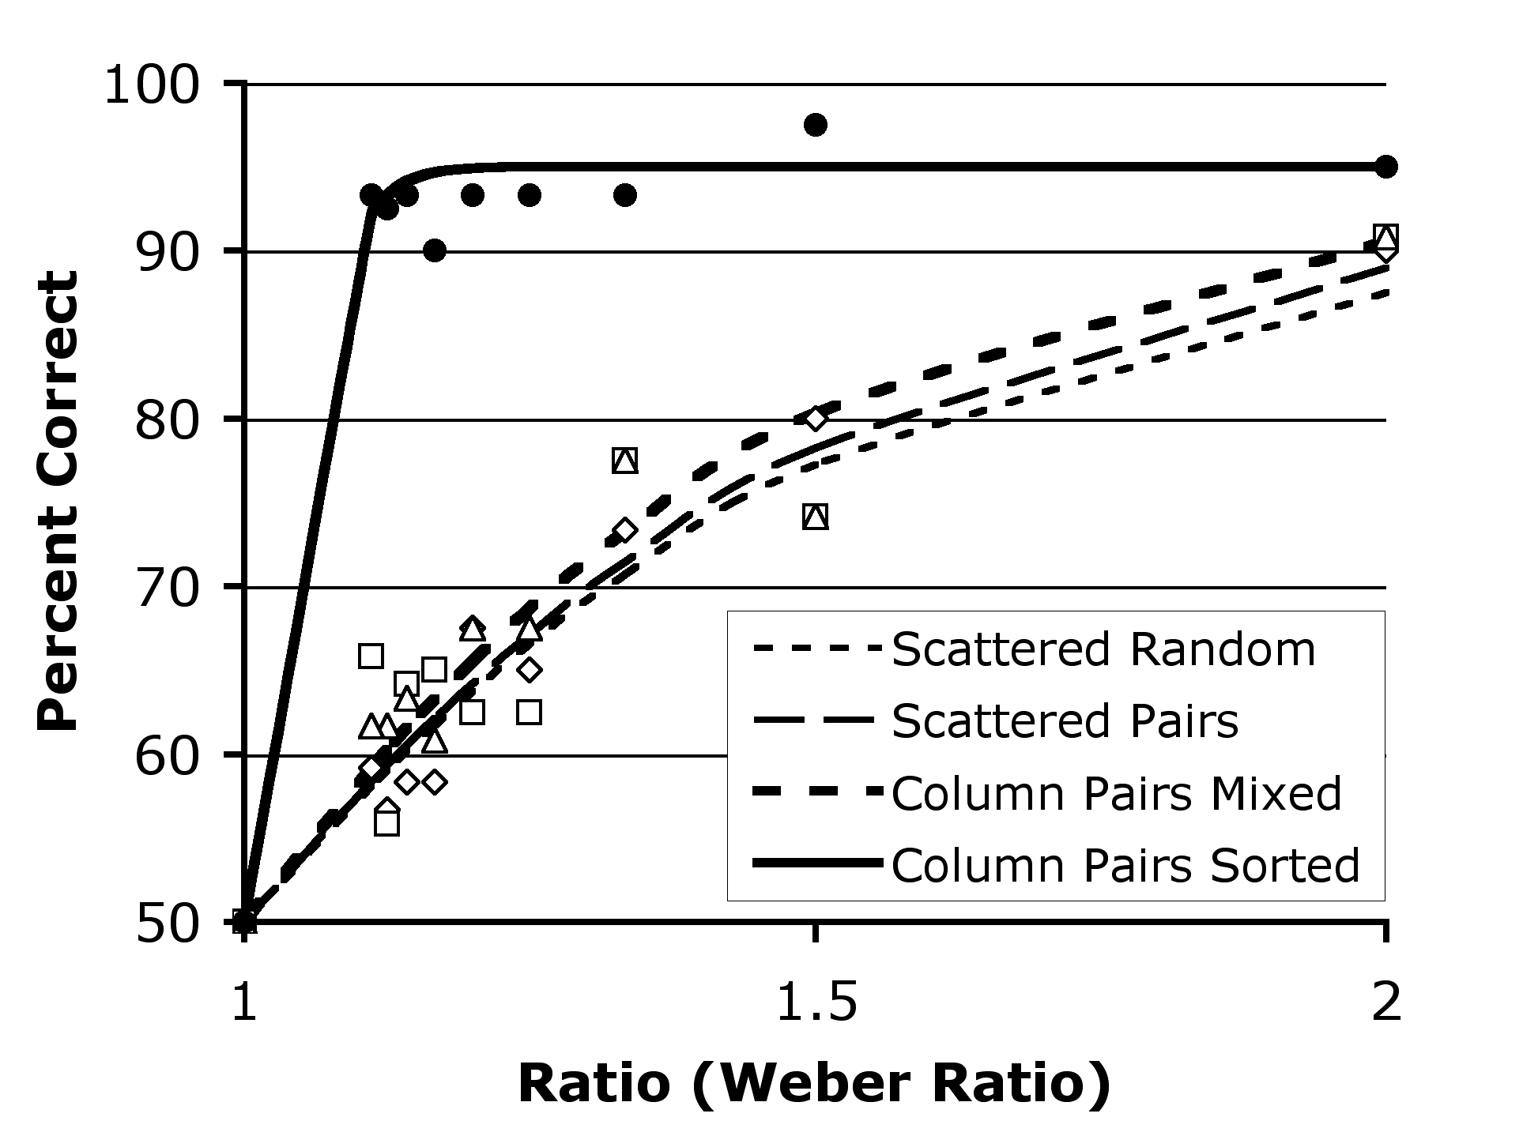
fits for Sorted-Columns trials to an independent model for detecting the longer of two line segments
fits for trials
(apart from Sorted-Columns)
to a standard psychophysical model for predicting ANS-driven performance

Slide 60
ANS
ANS
4:5 (blue:yellow)
ANS
Line
Length

Slide 61
Follow-Up Study
Could it be that speakers understand
‘Most of the dots are blue?’
as a 1-To-1-Plus question…
but our task made it too hard to use
a 1-To-1-Plus verification strategy?
Probably not, since people did even better
when asked to deploy the components of a 1-to-1-Plus strategy
(on trials where that would be a good strategy to use)

Slide 62
4:5 (blue:yellow)
“scattered pairs”
Identify-the-Loners Task

Slide 63
better performance on components of a 1-to-1-plus task

Slide 64
Side Point Worth Noting…

Slide 65
Lots of Possible Analyses, but perhaps... a way of testing how ‘most’ is understood
MOST{DOTS(x), BLUE(x)}
No Cardinality Comparison
1-TO-1-PLUS[{x:DOT(x) & BLUE(x)}, {x:DOT(x) & ∼BLUE(x)}]
Cardinality Comparison
#{x:DOT(x) & BLUE(x)} > #{x:DOT(x)}/2
#{x:DOT(x) & BLUE(x)} > #{x:DOT(x) & ∼BLUE(x)}
#{x:DOT(x) & BLUE(x)} > #{x:DOT(x)} – #{x:DOT(x) & BLUE(x)}
So it would be nice if we could get evidence about which computations speakers perform when evaluating ‘Most of the dots are blue’

Slide 66

Lots of Possible Analyses, but perhaps... a way of testing how ‘most’ is understood
MOST{DOTS(x), BLUE(x)}
Cardinality Comparison
#{x:DOT(x) & BLUE(x)} > #{x:DOT(x)}/2 Martin Hackl
#{x:DOT(x) & BLUE(x)} > #{x:DOT(x) & ∼BLUE(x)}
#{x:DOT(x) & BLUE(x)} > #{x:DOT(x)} – #{x:DOT(x) & BLUE(x)}
if there are only two colors to worry about, blue and red, the non-blues can be identified with the reds

Slide 67
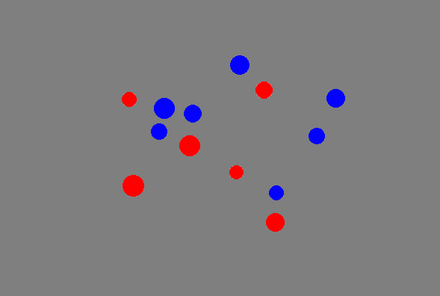

Slide 68
Lots of Possible Analyses, but perhaps... a way of testing how ‘most’ is understood
‘Most of the dots are blue’
#{x:Dot(x) & Blue(x)} > #{x:Dot(x) & ~Blue(x)}
#{x:Dot(x) & Blue(x)} > #{x:Dot(x)} − #{x:Dot(x) & Blue(x)}
if there are only 2 colors to worry about, blue and red, the non-blues can be identified reds
the visual system can (and will) “select”
the dots, the blue dots, and the red dots;
so the ANS can estimate these three cardinalities
but adding more colors will make it harder (and with 5 colors, impossible) for the visual system to make enough “selections” for the ANS to operate on

Slide 69
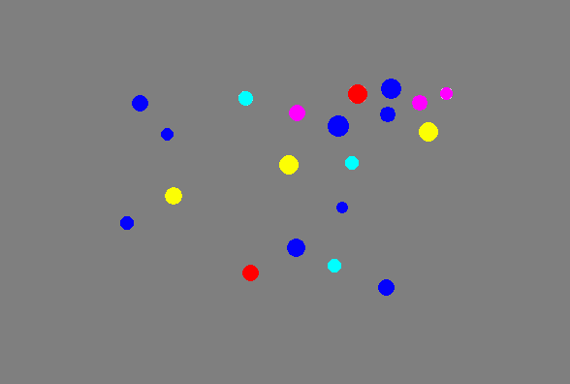

Slide 71
Lots of Possible Analyses, but perhaps... a way of testing how ‘most’ is understood
‘Most of the dots are blue’
#{x:Dot(x) & Blue(x)} > #{x:Dot(x) & ~Blue(x)}
#{x:Dot(x) & Blue(x)} > #{x:Dot(x)} − #{x:Dot(x) & Blue(x)}
adding alternative colors will make it harder (and eventually impossible) for the visual system to make enough “selections” for the ANS to operate on
so given the first proposal (with negation), verification should get harder as the number of colors increases
but the second proposal (with subtraction) predicts relative indifference to the number of alternative colors

Slide 72
better performance on easier ratios: p < .001

Slide 73
no effect of number of colors

Slide 74
fit to psychophysical model of ANS-driven performance
r²
.9480
.9586
.9813
.9625

Slide 75
Lots of Possible Analyses, but perhaps... a way of testing how ‘most’ is understood
‘Most of the dots are blue’
#{x:Dot(x) & Blue(x)} > #{x:Dot(x) & ~Blue(x)}
#{x:Dot(x) & Blue(x)} > #{x:Dot(x)} − #{x:Dot(x) & Blue(x)}
adding alternative colors will make it harder (and eventually impossible) for the visual system to make enough “selections” for the ANS to operate on
so given the first proposal (with negation), verification should get harder as the number of colors increases
but the second proposal (with subtraction) predicts relative indifference to the number of alternative colors

Slide 76
Plan
✔ Warm up on the I-language/E-language distinction
Examples of why focusing on I-languages matters in semantics
  ✔ semantic composition: & and ∃ in logical forms
  (which logical concepts get expressed via grammatical combination?)
  ✔ lexical meaning: ‘Most’ and its relation to human concepts
  (which logical concepts are used to encode word meanings?)
  time permitting, a coda on the Mass/Count distinction
Notes:
SLIDE 90 for thanks

Slide 77
Coda: Mass ‘Most’
‘Most of the dots are blue’
#{x:Dot(x) & Blue(x)} > #{x:Dot(x)} − #{x:Dot(x) & Blue(x)}
determiner/adjectival flexibility (for another day)
I saw the most dots
I saw at most three dots
mass/count flexibility
Most of the dots/blobs are blue
Most of the goo/blob is blue

Slide 78
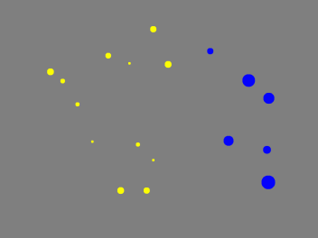

Slide 79


Slide 80
Coda: Mass ‘Most’
‘Most of the dots are blue’
#{x:Dot(x) & Blue(x)} > #{x:Dot(x)} − #{x:Dot(x) & Blue(x)}
mass/count flexibility
Most of the dots (blobs) are blue
Most of the goo (blob) is blue
are mass nouns disguised count nouns?
#{x:GooUnits(x) & BlueUnits(x)} >
#{x:GooUnits(x)} − #{x:GooUnits(x) & BlueUnits(x)}

Slide 81


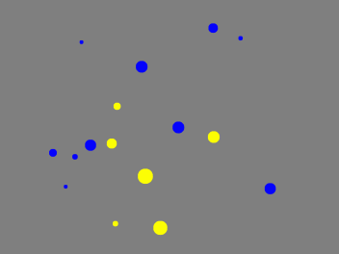
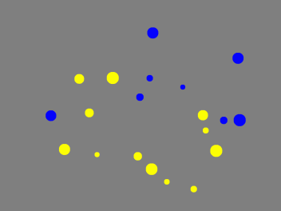

Slide 82
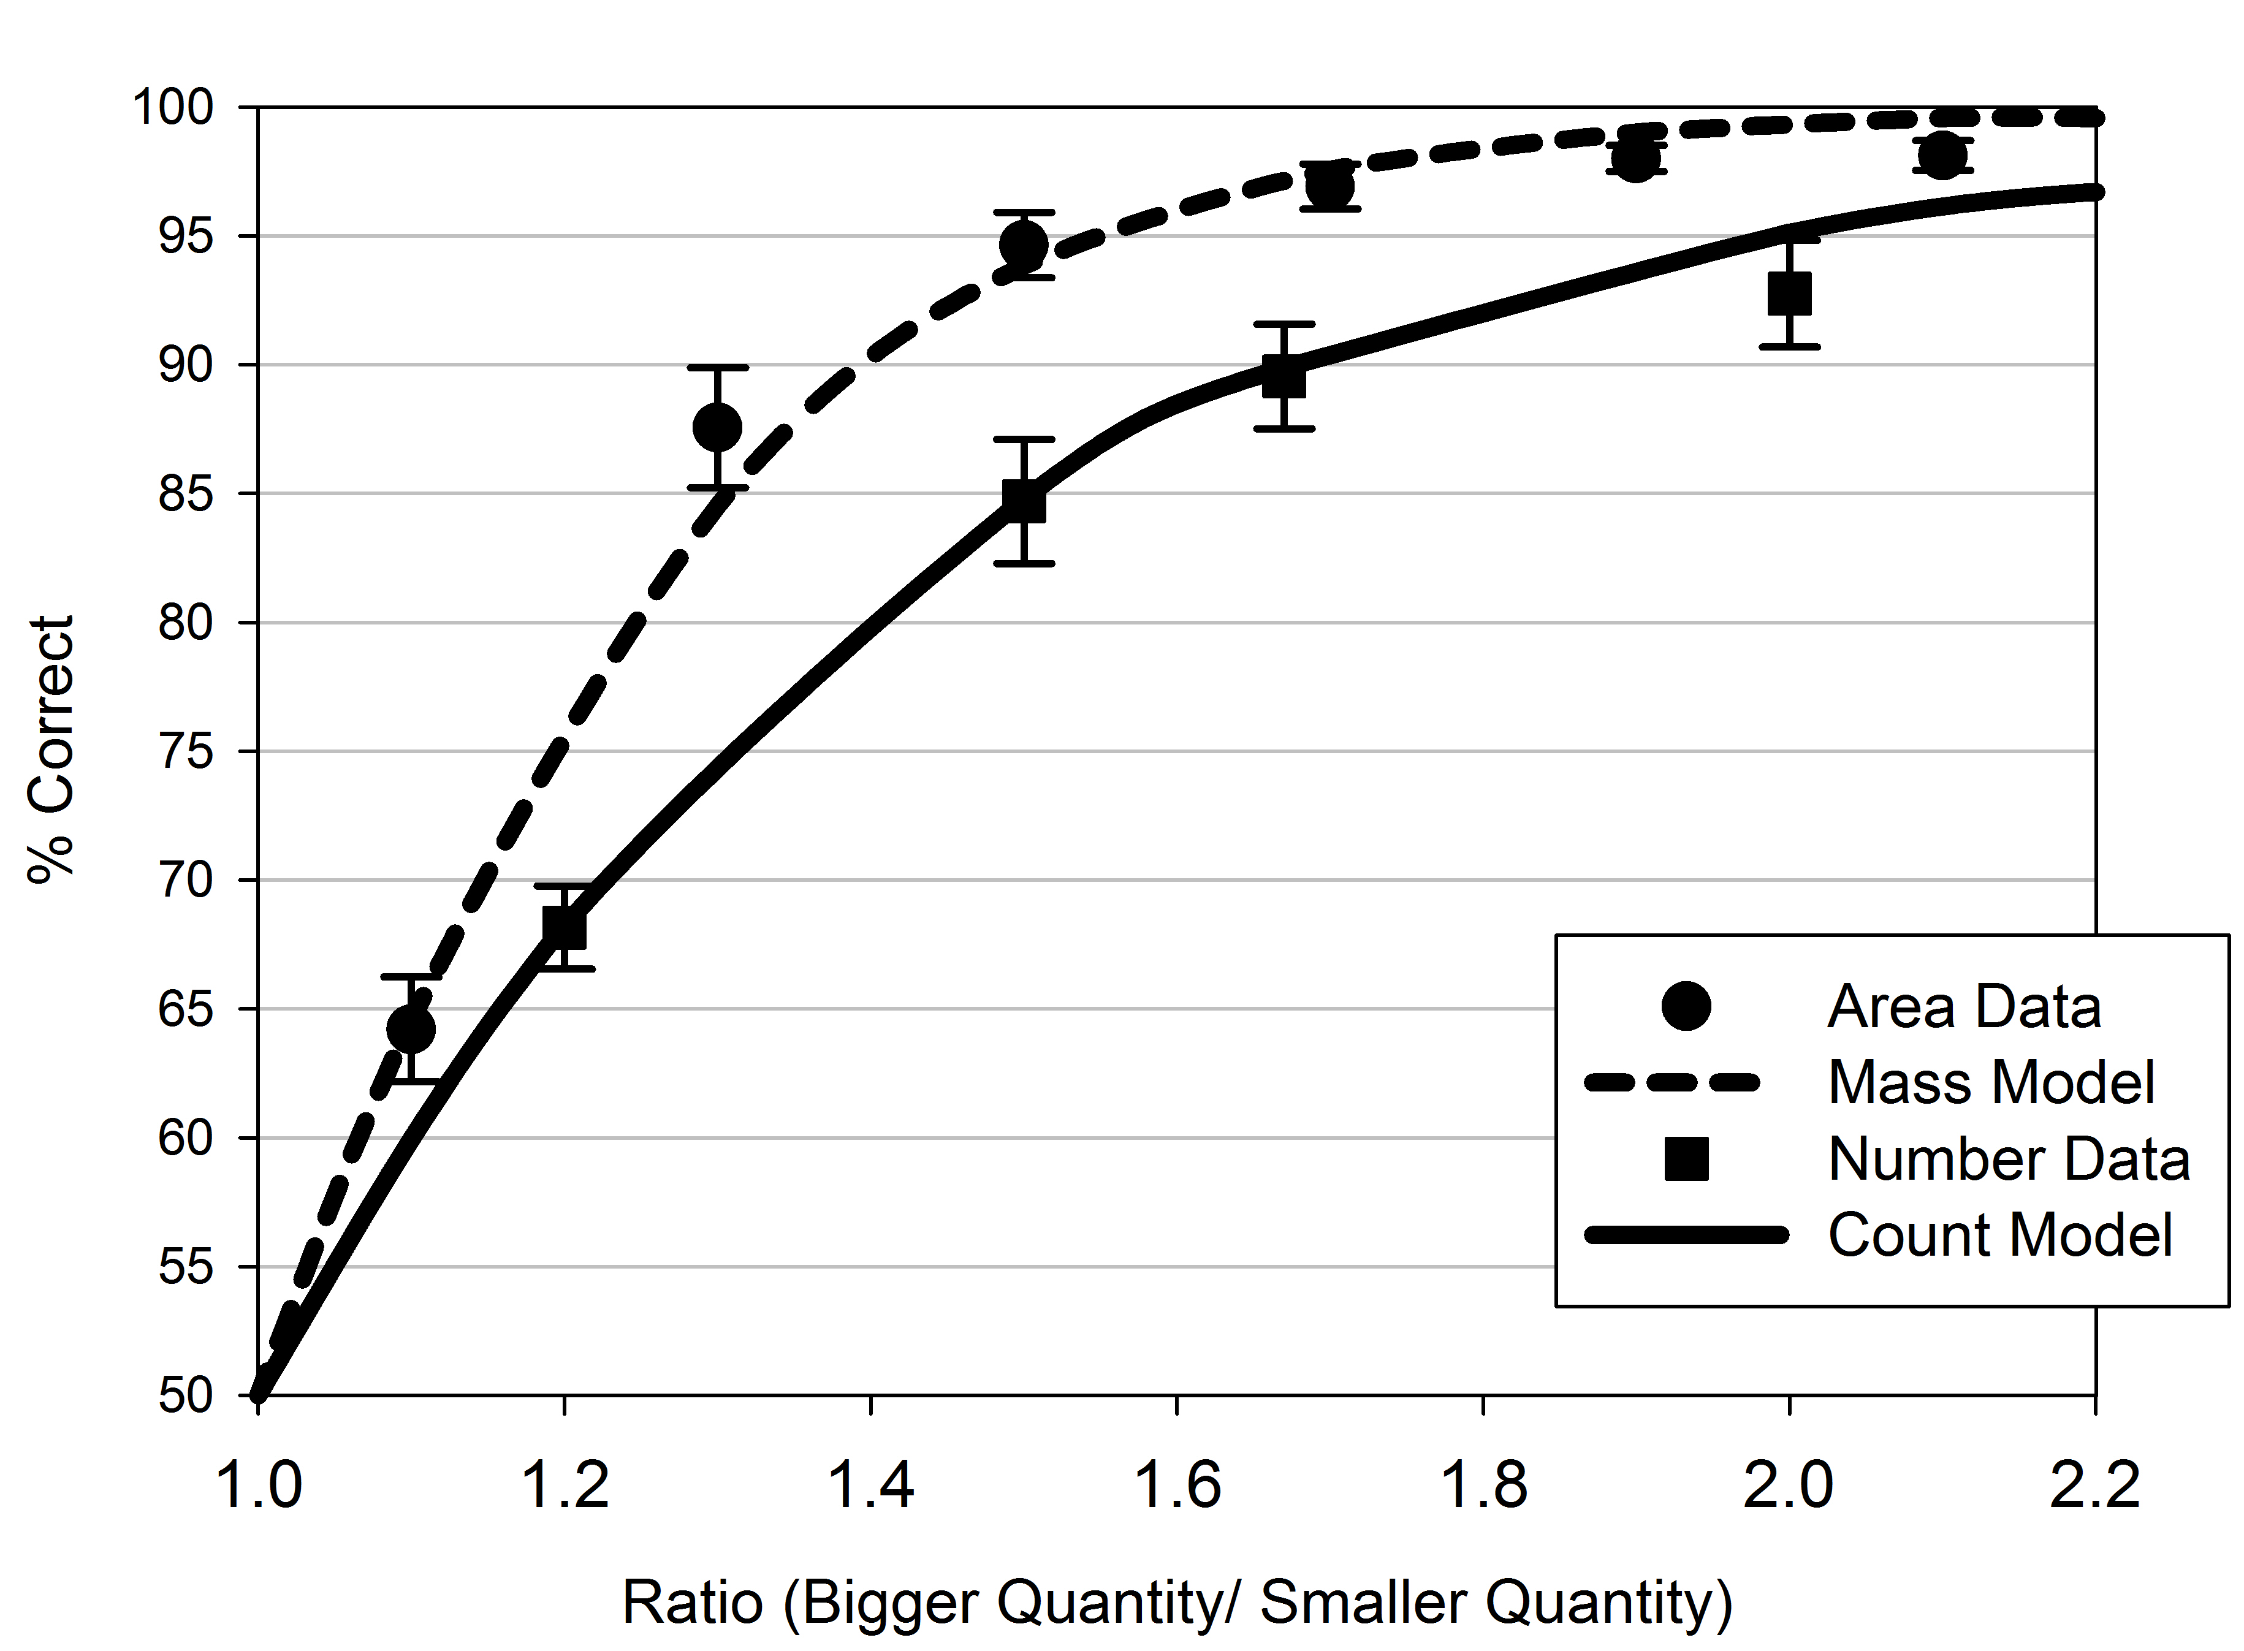
discriminability is BETTER for ‘goo’ (than for ‘dots’)
w = .18
r² = .97
w = .27
r² = .97

Slide 83
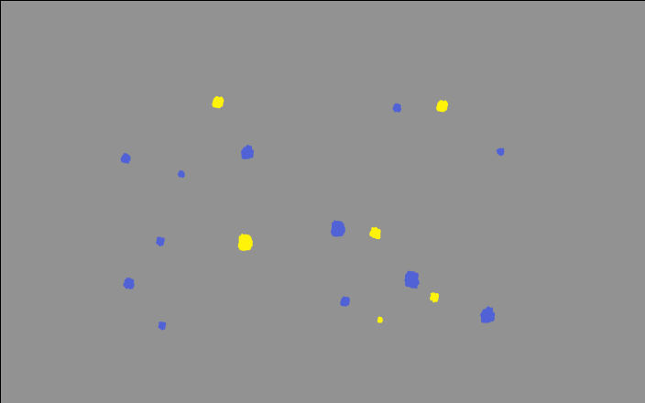
Are more of the blobs blue or yellow?
If more the blobs are blue, press ‘F’. If more of the blobs are yellow, press ‘J’.
Is more of the blob blue or yellow?
If more the blob is blue, press ‘F’. If more of the blob is yellow, press ‘J’.

Slide 84
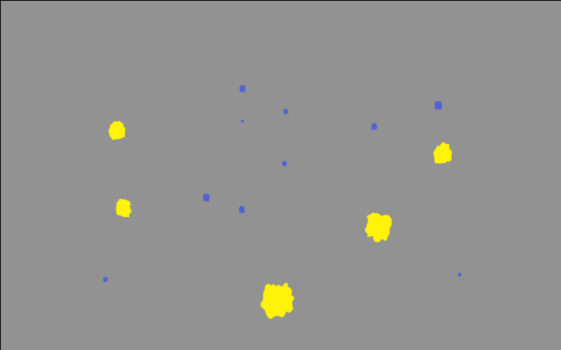

Slide 85
Performance is better (on the same stimuli)
when the question is posed with a mass noun
w = .20
r² = .99
w = .29
r² = .98

Slide 86
discriminability is BETTER for ‘goo’ (than for ‘dots’)
w = .18
r² = .97
w = .27
r² = .97

Slide 87
Coda: Mass ‘Most’
‘Most of the dots are blue’
#{x:Dot(x) & Blue(x)} > #{x:Dot(x)} − #{x:Dot(x) & Blue(x)}
mass/count flexibility
Most of the dots (blobs) are blue
Most of the goo (blob) is blue
are mass nouns disguised count nouns?
#{x:GooUnits(x) & BlueUnits(x)} >
#{x:GooUnits(x)} − #{x:GooUnits(x) & BlueUnits(x)}
SEEMS NOT...
and that matters

Slide 88
Plan
Warm up on the I-language/E-language distinction
Examples of why focusing on I-languages matters in semantics
  semantic composition: & and ∃ in logical forms
  (which logical concepts get expressed via grammatical combination?)
  lexical meaning: ‘Most’ and its relation to human concepts
  (which logical concepts are used to encode word meanings?)

Slide 89
THANKS

Slide 90
Tim
Hunter
A W
l e
e l
x l
i w
s o
o
d
Darko
Odic
J
e
f
f
L
i
d
z
Justin Halberda

Slide 91
Church (1941) on Lambdas
1: a function is a “rule of correspondence”
2: underdetermined when “two functions shall be considered the same”
2-3: functions in extension, functions in intension
In the calculus of λ-conversion and the calculus of restricted λ-K-conversion, as developed below, it is possible, if desired, to interpret the expressions of the calculus as denoting functions in extension. However, in the caluclus of λ-δ-conversion, where the notion of identity of functions is introduced into the system by the symbol δ, it is necessary, in order to preserve the finitary character of the transformation rules, so to formulate these rules that an interpretation by functions in extension becomes impossible.
The expressions which appear in the calculus of λ-δ-conversion are interpretable as denoting functions in intension of an appropriate kind.

Slide 92
Lewis, “Languages and Language”
“What is a language? Something which assigns meanings to certain strings of types of sounds or marks. It could therefore be a function, a set of ordered pairs of strings and meanings.”
“What is language? A social phenomenon which is part of the natural history of human beings; a sphere of human action ...”
Later on, in replies to objections...
“We may define a class of objects called grammars... A grammar uniquely determines the language it generates. But a language does not uniquely determine the grammar that generates it...”
Notes:
SLIDES 17-21 OPTIONAL

Slide 93
Lewis, “Languages and Language”
“I know of no promising way to make objective sense of the assertion that a grammar Γ is used by a population P, whereas another grammar Γ’, which generates the same language as Γ, is not. I have tried to say how there are facts about P which objectively select the languages used by P. I am not sure there are facts about P which objectively select privileged grammars for those languages...a convention of truthfulness and trust in Γ will also be a convention of truthfulness and trust in Γ’ whenever Γ and Γ’ generate the same language.”
“I think it makes sense to say that languages might be used by populations even if there were no internally represented grammars. I can tentatively agree that £ is used by P if and only if everyone in P possesses an internal representation of a grammar for £, if that is offered as a scientific hypothesis. But I cannot accept it as any sort of analysis of “£ is used by P”, since the analysandum clearly could be true although the analysans was false.”
Notes:
SKIP ON

Slide 94
Two Perspectives on Marr’s Levels
Level One: what function (input-output mapping) is computed?
Level Two: how (i.e., by what algorithm) is it being computed?
First Perspective (Quine, Davidson, Lewis)
at least initially, theorists use generative/computational vocabulary to describe sets of input-ouput pairs with no implications for Level Two, which gets addressed later, optionally, and via different methods
Second Perspective (Church, Chomsky, Gallistel)
given computational vocabulary, theorists are always offering Level Two hypotheses, but with a fallback position: any proposal is almost certainly wrong in the details; but one hopes to find a better Level Two hypothesis that is roughly equivalent in extension

Slide 95
Two Perspectives on Marr’s Levels
Level One: what function (input-output mapping) is computed?
Level Two: how (i.e., by what algorithm) is it being computed?
First Perspective (Quine, Davidson, Lewis)
--takes a set of I-O pairs to be a reasonable if limited target of inquiry
--implies that thinkers can “have the same language” by generating the “same expressions” in very different ways
Second Perspective (Church, Chomsky, Gallistel)
-- takes the computational system itself to be the target of inquiry, with the algorithmic level of abstraction as primary
-- Level One is not a real level of abstraction across different systems; it is simply part of one useful discovery procedure

Slide 97
Maybe: Word Meanings Combine Simply, but Some are Introduced via Operations
Fido chased Bessie into a barn
∃ { ∃[Before(_, _)^Now(_)]^
∃[Agent(_, _)^Fido(_)]^
∃[ChaseOf(_, _)^Bessie(_)]^
∃[Into(_, _)^Barn(_)]
}
Most of the dots are blue
#{x:Dot(x) & Blue(x)} >
#{x:Dot(x)} − #{x:Dot(x) & Blue(x)}
MOST(Restrictor, Scope) iff
#[R(_)^S(_)] >
#R(_) − #[R(_)^S(_)]

Slide 98
Maybe: Word Meanings Combine Simply, but Some are Introduced via Operations
Fido chased Bessie into a barn
∃ { ∃[Before(_, _)^Now(_)]^
∃[Agent(_, _)^Fido(_)]^
∃[ChaseOf(_, _)^Bessie(_)]^
∃[Into(_, _)^Barn(_)]
}
Most of the dots are blue
#{x:Dot(x) & Blue(x)} >
#{x:Dot(x)} − #{x:Dot(x) & Blue(x)}
MOST(<Restrictor, Scope>) iff
#[R(_)^S(_)] >
#R(_) − #[R(_)^S(_)]

Slide 99
Maybe: Word Meanings Combine Simply, but
Some are Introduced via Basic Operations
Fido chased Bessie into a barn Most of the dots are blue
∃ { ∃[Before(_, _)^Now(_)]^ ∃ { MOST(_)^
∃[Agent(_, _)^Fido(_)]^ ∃[Restrictor(_, _)^TheDots(_)]^
∃[ChaseOf(_, _)^Bessie(_)]^ ∃[Scope(_, _)^Blue(_)]
∃[Into(_, _)^Barn(_)] }
} MOST(<Restrictor, Scope>) iff
#[R(_)^S(_)] >
#R(_) − #[R(_)^S(_)]

Slide 100
Maybe: Word Meanings Combine Simply, but
Some are Introduced via Basic Operations
Fido chased Bessie into a barn Most of the blob is blue
∃ { ∃[Before(_, _)^Now(_)]^ ∃ { MOST(_)^
∃[Agent(_, _)^Fido(_)]^ ∃[Restrictor(_, _)^TheBlob(_)]^
∃[ChaseOf(_, _)^Bessie(_)]^ ∃[Scope(_, _)^Blue(_)]
∃[Into(_, _)^Barn(_)] }
} ^{-count}MOST(<Restrictor, Scope>) iff
[R(_)^S(_)] >
R(_) − ν[R(_)^S(_)]

Slide 101
Maybe: Word Meanings Combine Simply, but
Some are Introduced via Basic Operations
Fido chased Bessie into a barn Most of the blobs are blue
∃ { ∃[Before(_, _)^Now(_)]^ ∃ { MOST(_)^
∃[Agent(_, _)^Fido(_)]^ ∃[Restrictor(_, _)^TheBlobs(_)]^
∃[ChaseOf(_, _)^Bessie(_)]^ ∃[Scope(_, _)^Blue(_)]
∃[Into(_, _)^Barn(_)] }
} ^{+count}MOST(<Restrictor, Scope>) iff
#[R(_)^S(_)] >
#R(_) − [#R(_)^S(_)]

Slide 102
Maybe: Word Meanings Combine Simply, but
Some are Introduced via Basic Operations
Fido chased Bessie into a barn Most of the blobs are blue
∃ { ∃[Before(_, _)^Now(_)]^ ∃ { MOST(_)^
∃[Agent(_, _)^Fido(_)]^ ∃[Restrictor(_, _)^TheBlobs(_)]^
∃[ChaseOf(_, _)^Bessie(_)]^ ∃[Scope(_, _)^Blue(_)]
∃[Into(_, _)^Barn(_)] }
} ^{+count}MOST(<Restrictor, Scope>) iff
#{x:DOT(x) & BLUE(x)} >
#{x:DOT(x) − BLUE(x)}

Slide 103
Maybe: Word Meanings Combine Simply, but
Some are Introduced via Basic Operations
Fido chased Bessie into a barn Most of the blobs are blue
∃ { ∃[Before(_, _)^Now(_)]^ ∃ { MOST(_)^
∃[Agent(_, _)^Fido(_)]^ ∃[Restrictor(_, _)^TheBlobs(_)]^
∃[ChaseOf(_, _)^Bessie(_)]^ ∃[Scope(_, _)^Blue(_)]
∃[Into(_, _)^Barn(_)] }
} ^{+/-count}MOST(<Restrictor, Scope>) iff
[R(_)^S(_)] >
R(_) − [R(_)^S(_)]

Slide 104
What is it for words to mean what they do? In the essays collected here, I explore the idea that we would have an answer to this question if we knew how to construct a theory satisfying two demands: it would provide an interpretation of all utterances, actual and potential, of a speaker or group of speakers; and it would be verifiable without knowledge of the detailed propositional attitudes of the speaker. The first condition acknowledges the holistic nature of linguistic understanding. The second condition aims to prevent smuggling into the foundations of the theory concepts too closely allied to the concept of meaning. A theory that does not satisfy both conditions cannot be said to answer our opening question in a philosophically instructive way (Davidson [1984], p. xiii).

